Slide 1


Electro-Optic Sampling Beam Positioning Monitor for Relativistic Electron Beams
North American Particle Accelerator Conference 2025
August 12, 2025
Elena L. Ros¹, Michael L. Litos¹, Alexander Knetsch², Brendan O’ Shea², Claire Hansel¹, Daniel Matteo³, Gerdard Andonian³, Mark Hogan², Robert Ariniello², Shutang Meng¹, Tara Hodgetts³, Valentina Lee¹
[1] (CU Boulder, Physics), [2] (SLAC National Accelerator Laboratory), [3] RadiaBeam Technologies
Notes:
Done

Slide 2
Our Research is Funded By…
U.S. Department of Energy, Office of Science, Office of High Energy Physics, under Award Number DE-SC001796.
National Science Foundation under Award Number PHY-1806053
and Faculty Early Career Development Program Award Number
PHY-2047083.

Slide 3
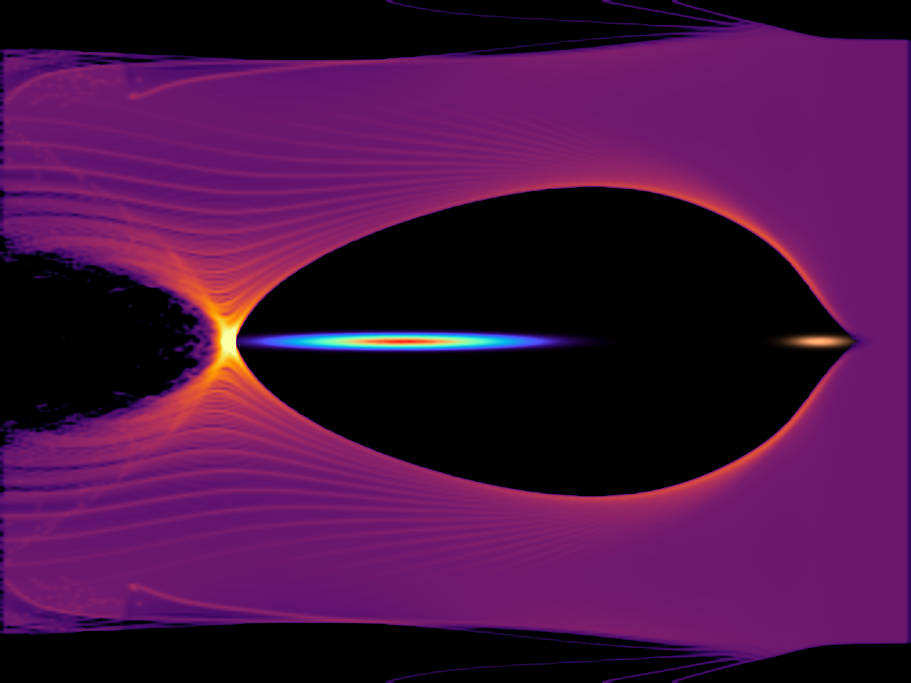
Motivation
PWFA Simulation
Independent transverse and longitudinal measurement of drive and witness beam for Plasma Wakefield Acceleration (PWFA).
Require precise transverse alignment for emittance preservation.
Require precise longitudinal separation to minimize energy spread and maximize efficiency.
Non-destructive shot by shot measurement
z
Witness Beam
Drive Beam

Slide 4
Background: EO Sampling
EO Spatial Encoding Scheme
e⁻ beam
γ
e⁻ beam
γ
e⁻ beam
γ
e⁻ beam
γ
e⁻ beam
γ
k
Laser
k
k
Laser
k
Laser
EO Crystal
EO Crystal
EO Crystal
Laser
EO Crystal
EO Crystal
k
Laser
Temporal information mapped to transverse profile of laser¹.
Rotated Polarization

Slide 5
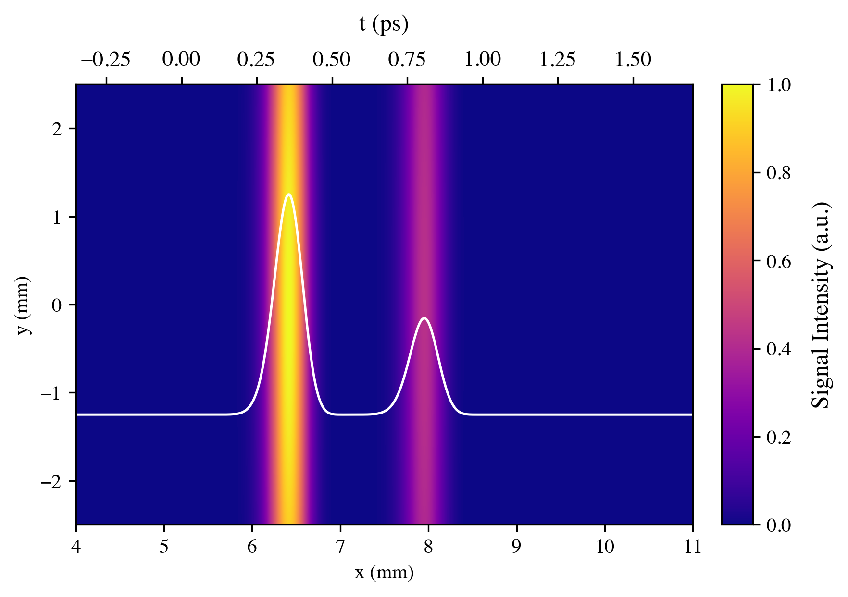
Background: EO Sampling
Image on camera
e⁻ beam
k
γ
Laser
Drive
Witness
Polarizer
Horizontally polarized
Polarizer
Vertically Polarized
CMOS Camera

Slide 6
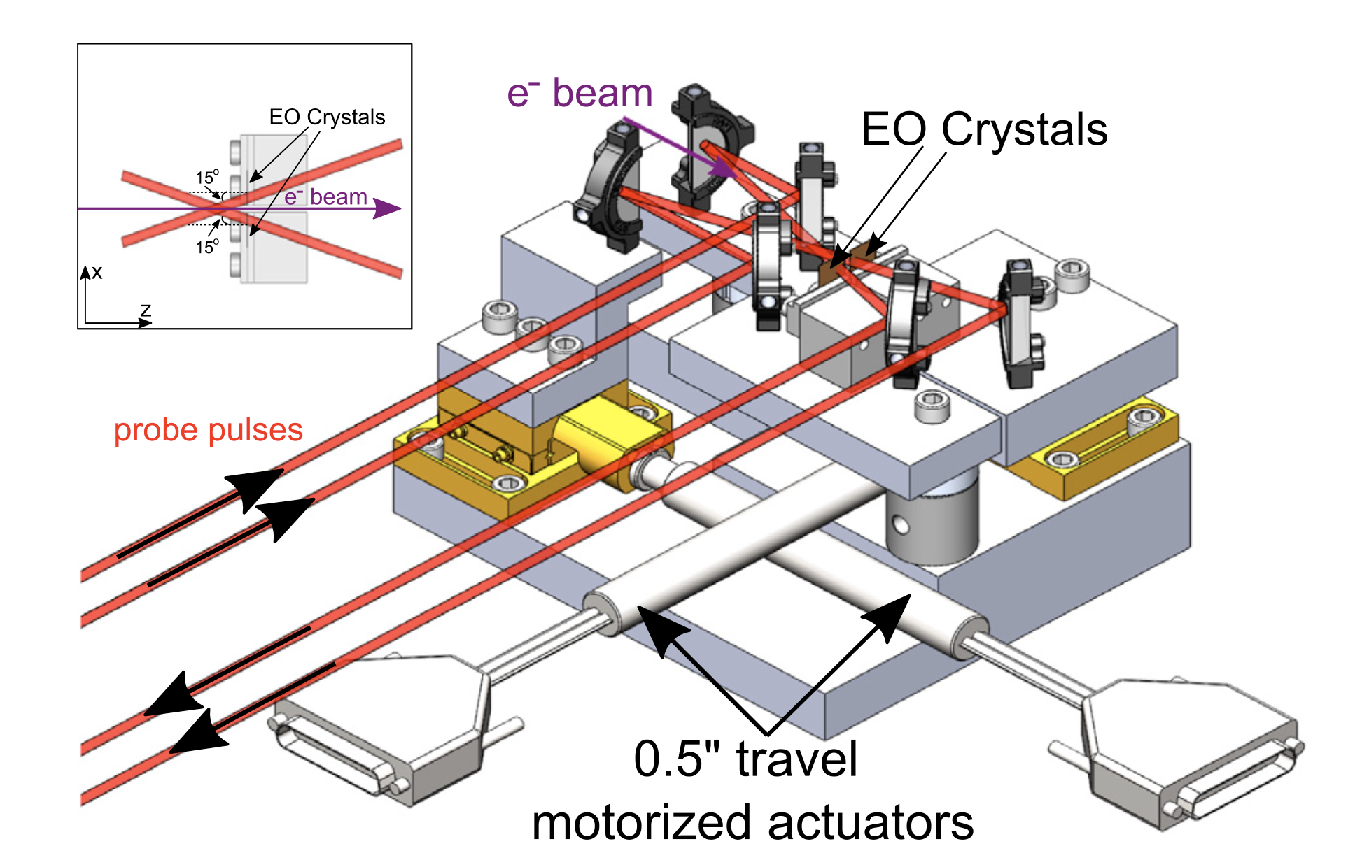
Electro Optic Sampling Beam Position Monitor
EOS BPM Mk.1
EO Crystal
e⁻ beam
EO Crystal
Leverages correlation between strength of phase retardation and location of e⁻ beam with respect to crystal².
Laser

Slide 7
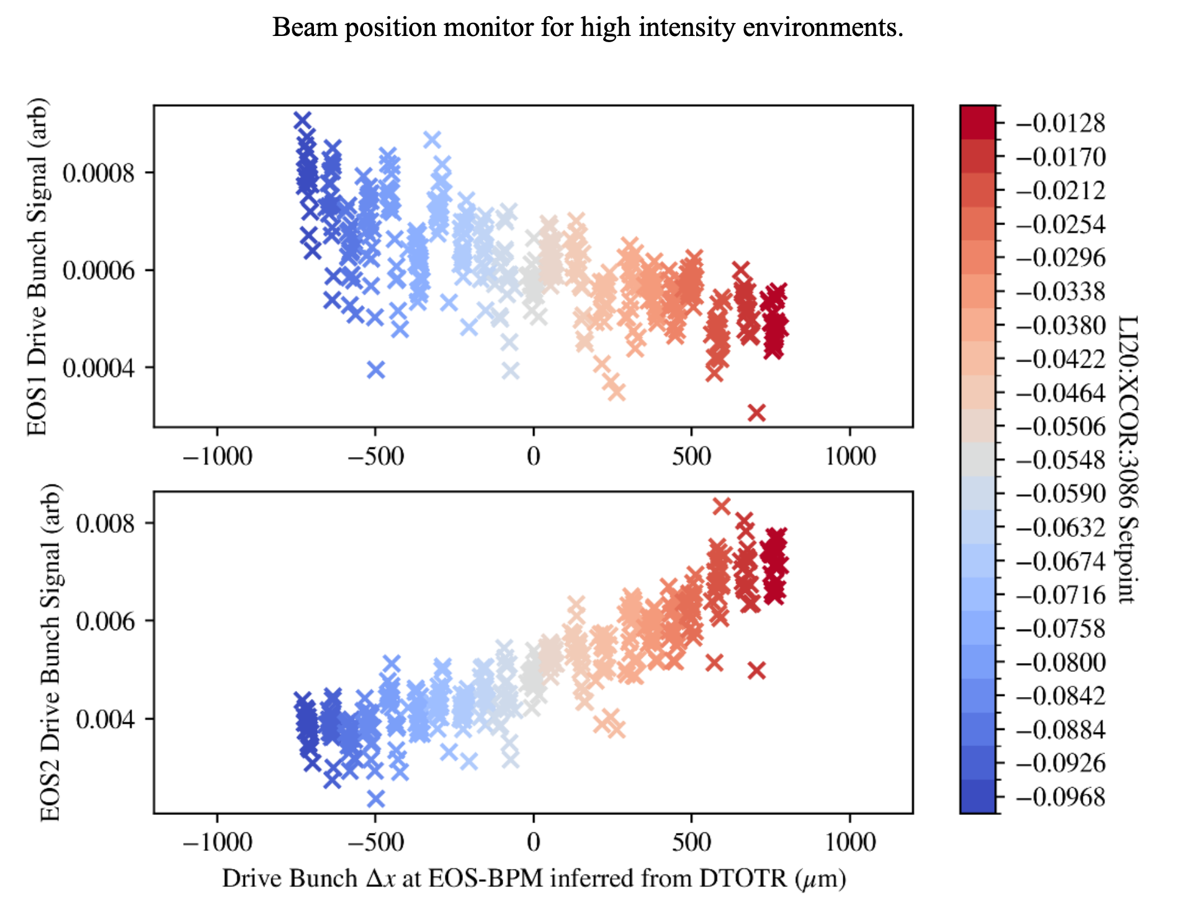
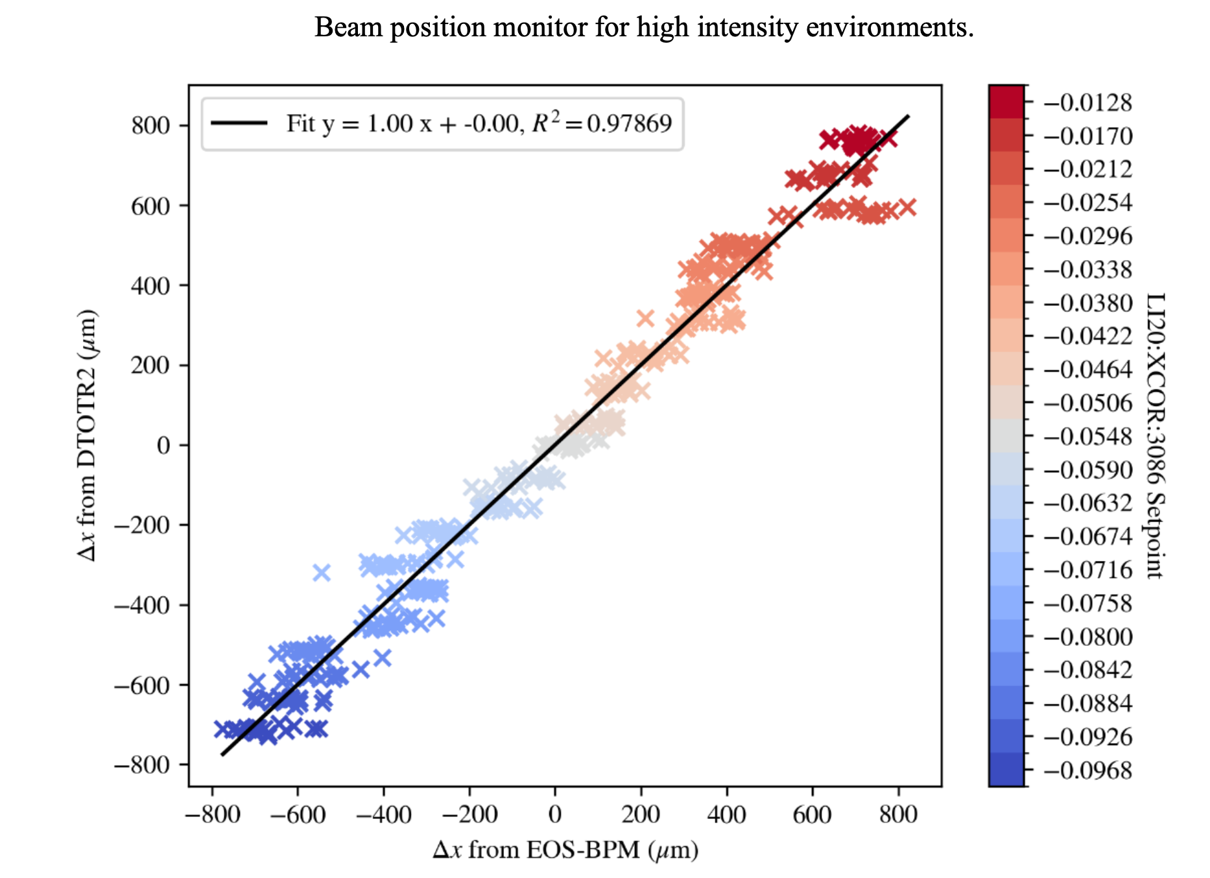
EOS BPM Mk1. / Experimental Data
Beam position monitor for high intensity environments
EOS1 Drive Bunch Signal (arb)
Δx from DTOTR2 (μm)
EOS2 Drive Bunch Signal (arb)
Δx from EOS-BPM (μm)
Drive Bunch Δx at EOS-BPM inferred from DTOTR (μm)

Slide 8
EOS BPM Mk.2 Design
EO Crystal
Axicon creates circular donut
4 crystals around e⁻ beam axis
More complete azimuthal coverage allows for position measurement in x and y.
Increase in total signal leads to better temporal and transverse resolution.
k
e⁻ beam
k
4 Crystal Design
Tilted Pulse Front
5º angle of incidence (θ)
3 ps temporal window
θ
4 10mm x 10mm 100μm thick GaP wafers
Axicon

Slide 9
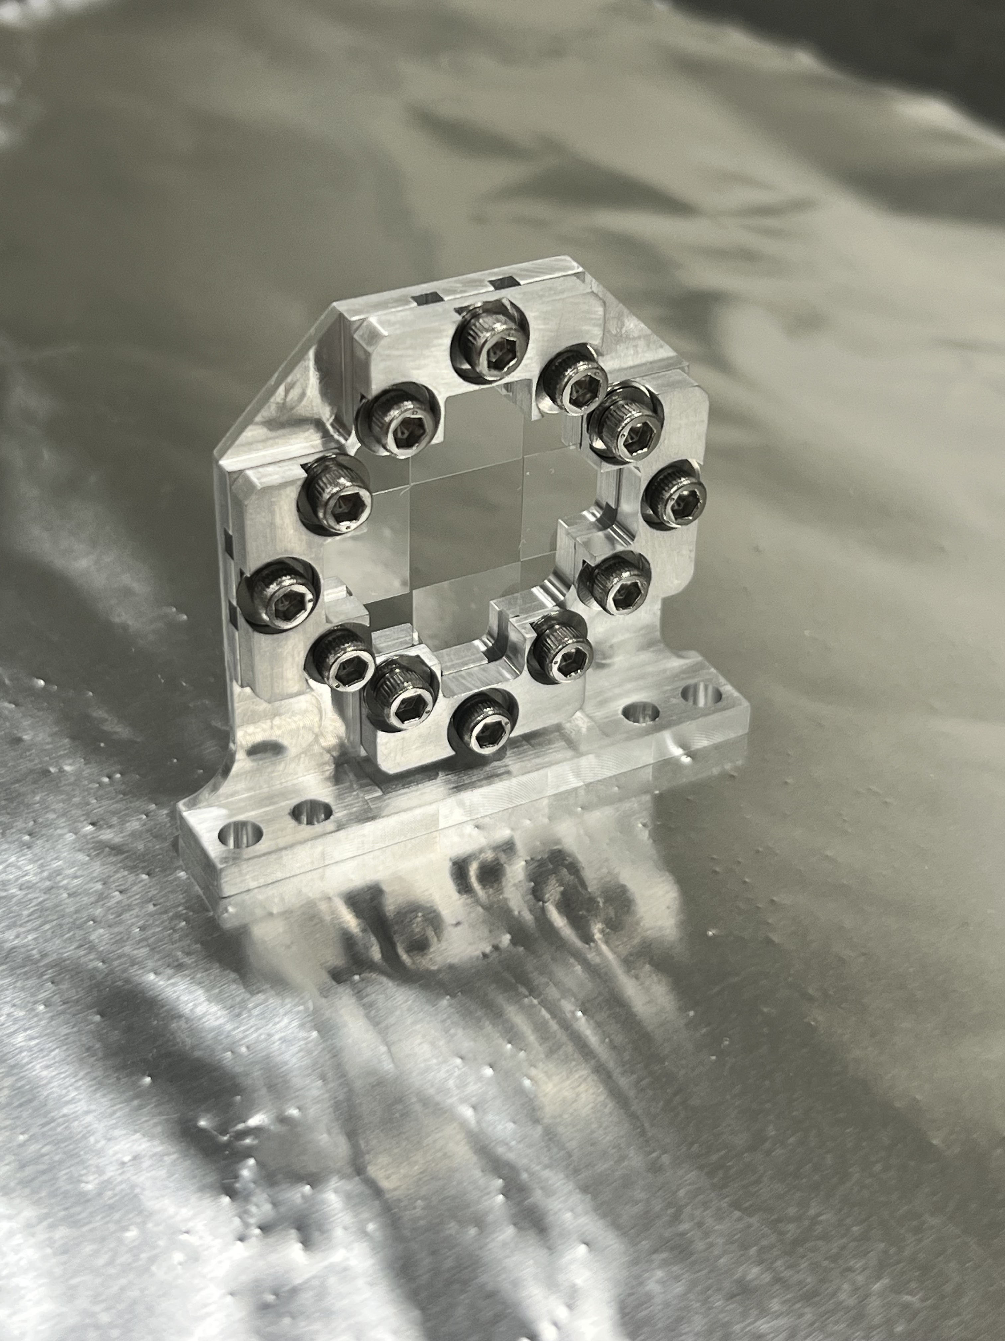
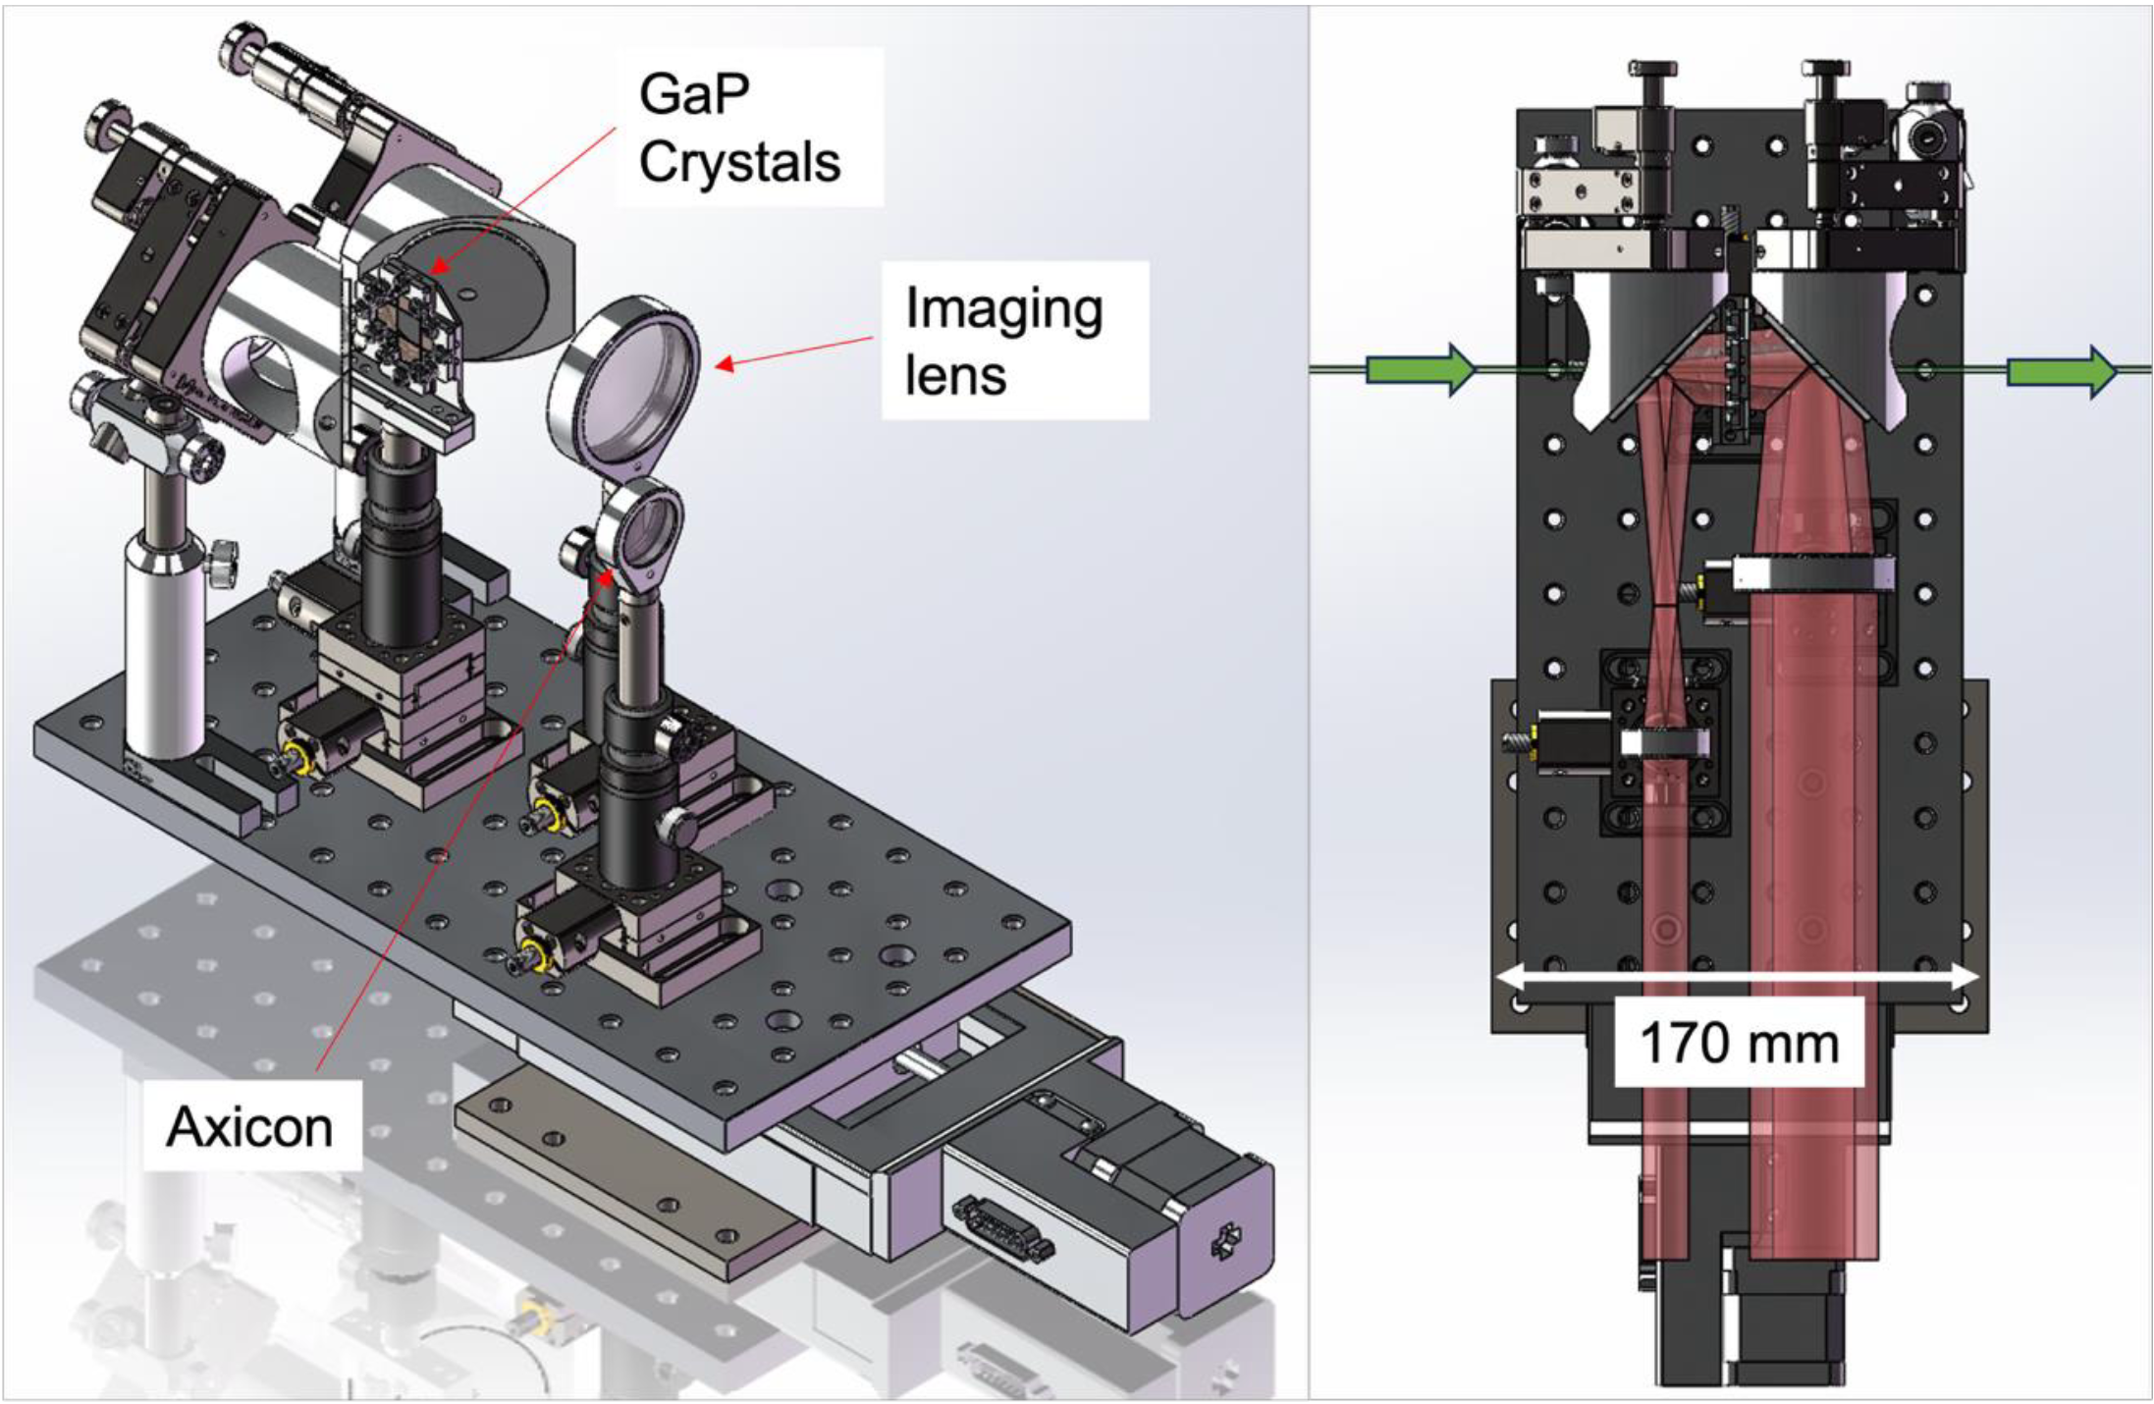
CAD Model/Pictures
e⁻ beam
Mounted 100μm Glass Wafers in EOS BPM Mk.2 Crystal Holder

Slide 10
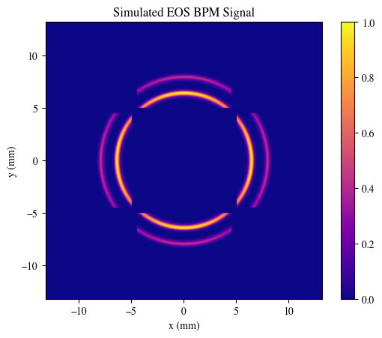
EOS BPM Mk.2 Simulation
Parameter | Value | Unit
Laser Wavelength | 800 | nm
Laser Angle | 5 | degree
Drive Beam Charge | 1000 | pC
Witness Beam Charge | 800 | pC
Time Delay btw. Beams | 450/135 | fs/μm
Transverse Beam Offset Drive | ~10 | μm
Transverse Beam Offset Witness | ~10 | μm
Bunch Length (Both) | 50/15 | fs/μm
GaP Wafer Thickness | 100 | μm
t
Witness
Drive

Slide 11
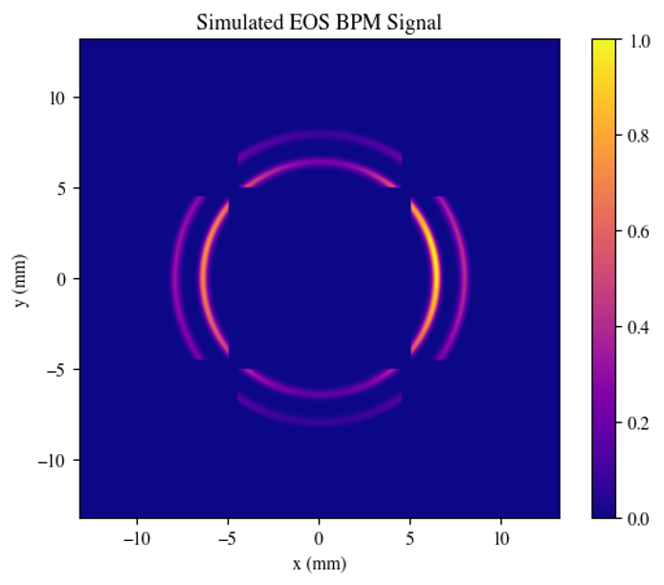


EOS BPM Analysis
Intensity on Camera
$$I\left(α,r\right)=A_{1}{Sin}^{2}\left(\frac{A_{2}}{r}\sqrt{1+3\cos^{2}\left(α \right)}\right)$$
r
α
Temporal window
$$t=\frac{{(r−r}_{i}) sin θ}{c\cos^{2}{θ}}$$
e⁻beam
θ is laser angle of incidence

Slide 12




EOS BPM Analysis with Rotated Crystals
Crystal rotated 90º
Intensity on Camera
$$I\left(α,r\right)=A_{1}{Sin}^{2}\left(\frac{A_{2}}{r}\sqrt{1+3\cos^{2}\left(α \right)}\right)$$
α₁
$$I_{r}\left(α,r\right)=A_{1}{Sin}^{2}\left(\frac{A_{2}}{r}\sqrt{1+3\sin^{2}\left(α \right)}\right)$$
α
α₁ = α +π/2
Temporal window
$$t=\frac{{(r−r}_{i}) sin θ}{c\cos^{2}{θ}}$$
e⁻beam
θ is laser angle of incidence
Crystal rotated 90º

Slide 13
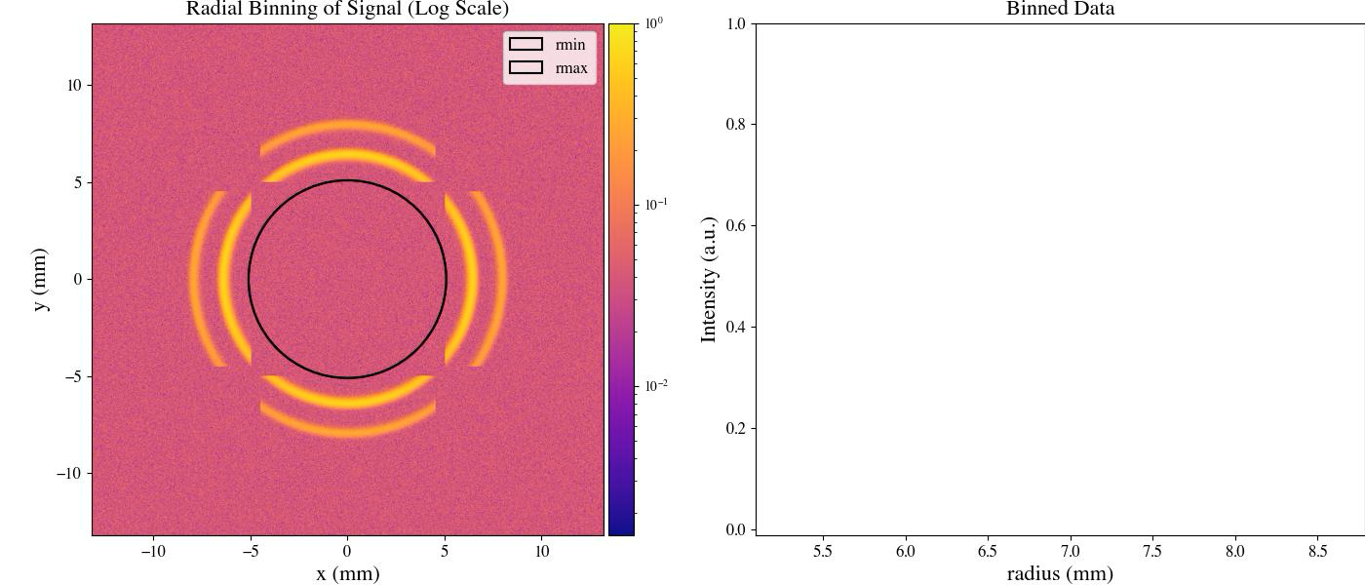
EOS BPM Mk.2 Time of Arrival Analysis

Slide 14
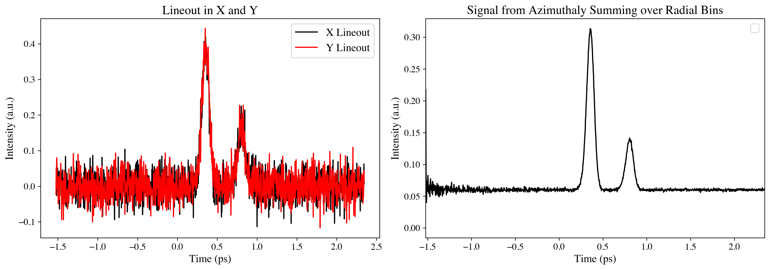
EOS BPM Mk.2 Time of Arrival
SNR Drive Beam: 2.20
SNR Witness Beam: 0.92
SNR Drive Beam: 73.1
SNR Witness Beam: 50.4

Slide 15
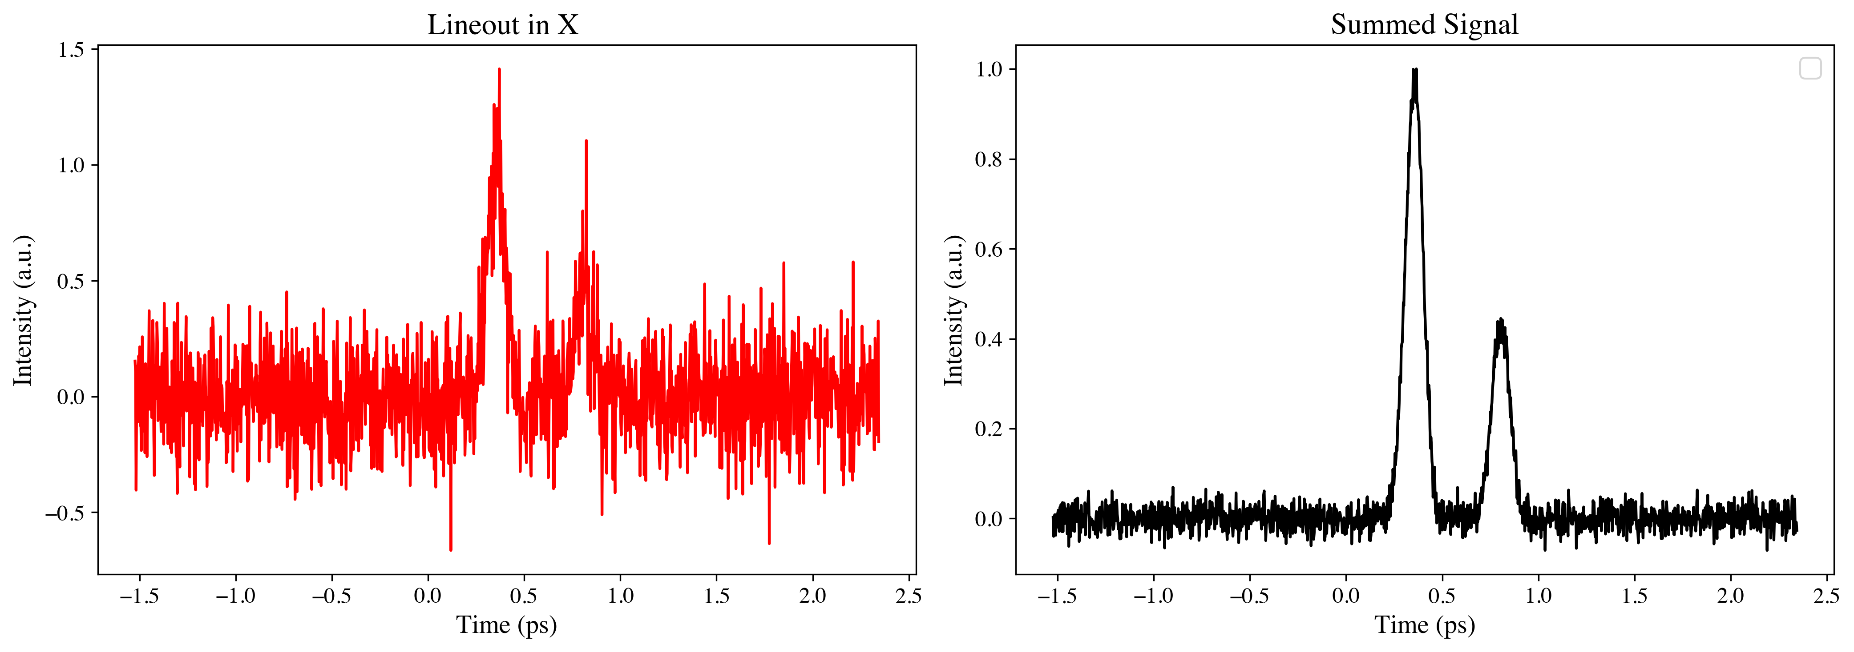
Time of Arrival with 1 crystal
SNR Drive Beam: 1.58
SNR Witness Beam: 0.74
SNR Drive Beam: 11.8
SNR Witness Beam: 4.9

Slide 16
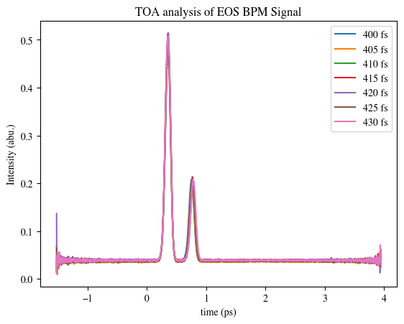
Study of Longitudinal Separation Resolution
Actual Bunch Separation | Fit
400 fs | 397 fs
405 fs | 402
410 fs | 407
415 fs | 412
420 fs | 418
425 fs | 422
430 fs | 428
~ 3 fs resolution with 15 % noise

Slide 17
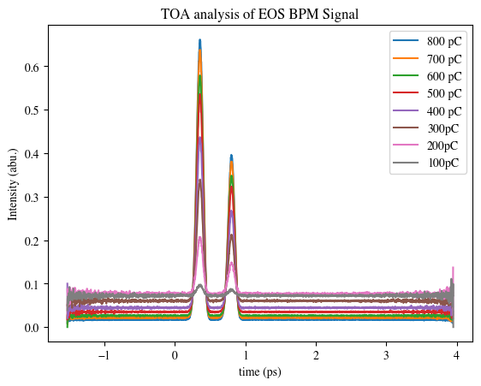
Study of Low Charge Bunches
Actual: 450 fs
Lineout SNR
Azimuthal Summing SNR
Bunch Charge (pC) | Fit (fs) | Drive | Witness | Drive | Witness
800 | 447 | 19 | 12 | 450 | 350
700 | 447 | 14 | 9 | 300 | 230
600 | 447 | 11 | 7 | 260 | 200
500 | 447 | 7 | 4 | 190 | 150
400 | 448 | 5 | 3 | 120 | 100
300 | 448 | 3 | 2 | 80 | 70
200 | 450 | 1 | 1 | 50 | 50
100 | 440 | 0.5 | 0.1 | 35 | 35
5% noise at 800pC

Slide 18
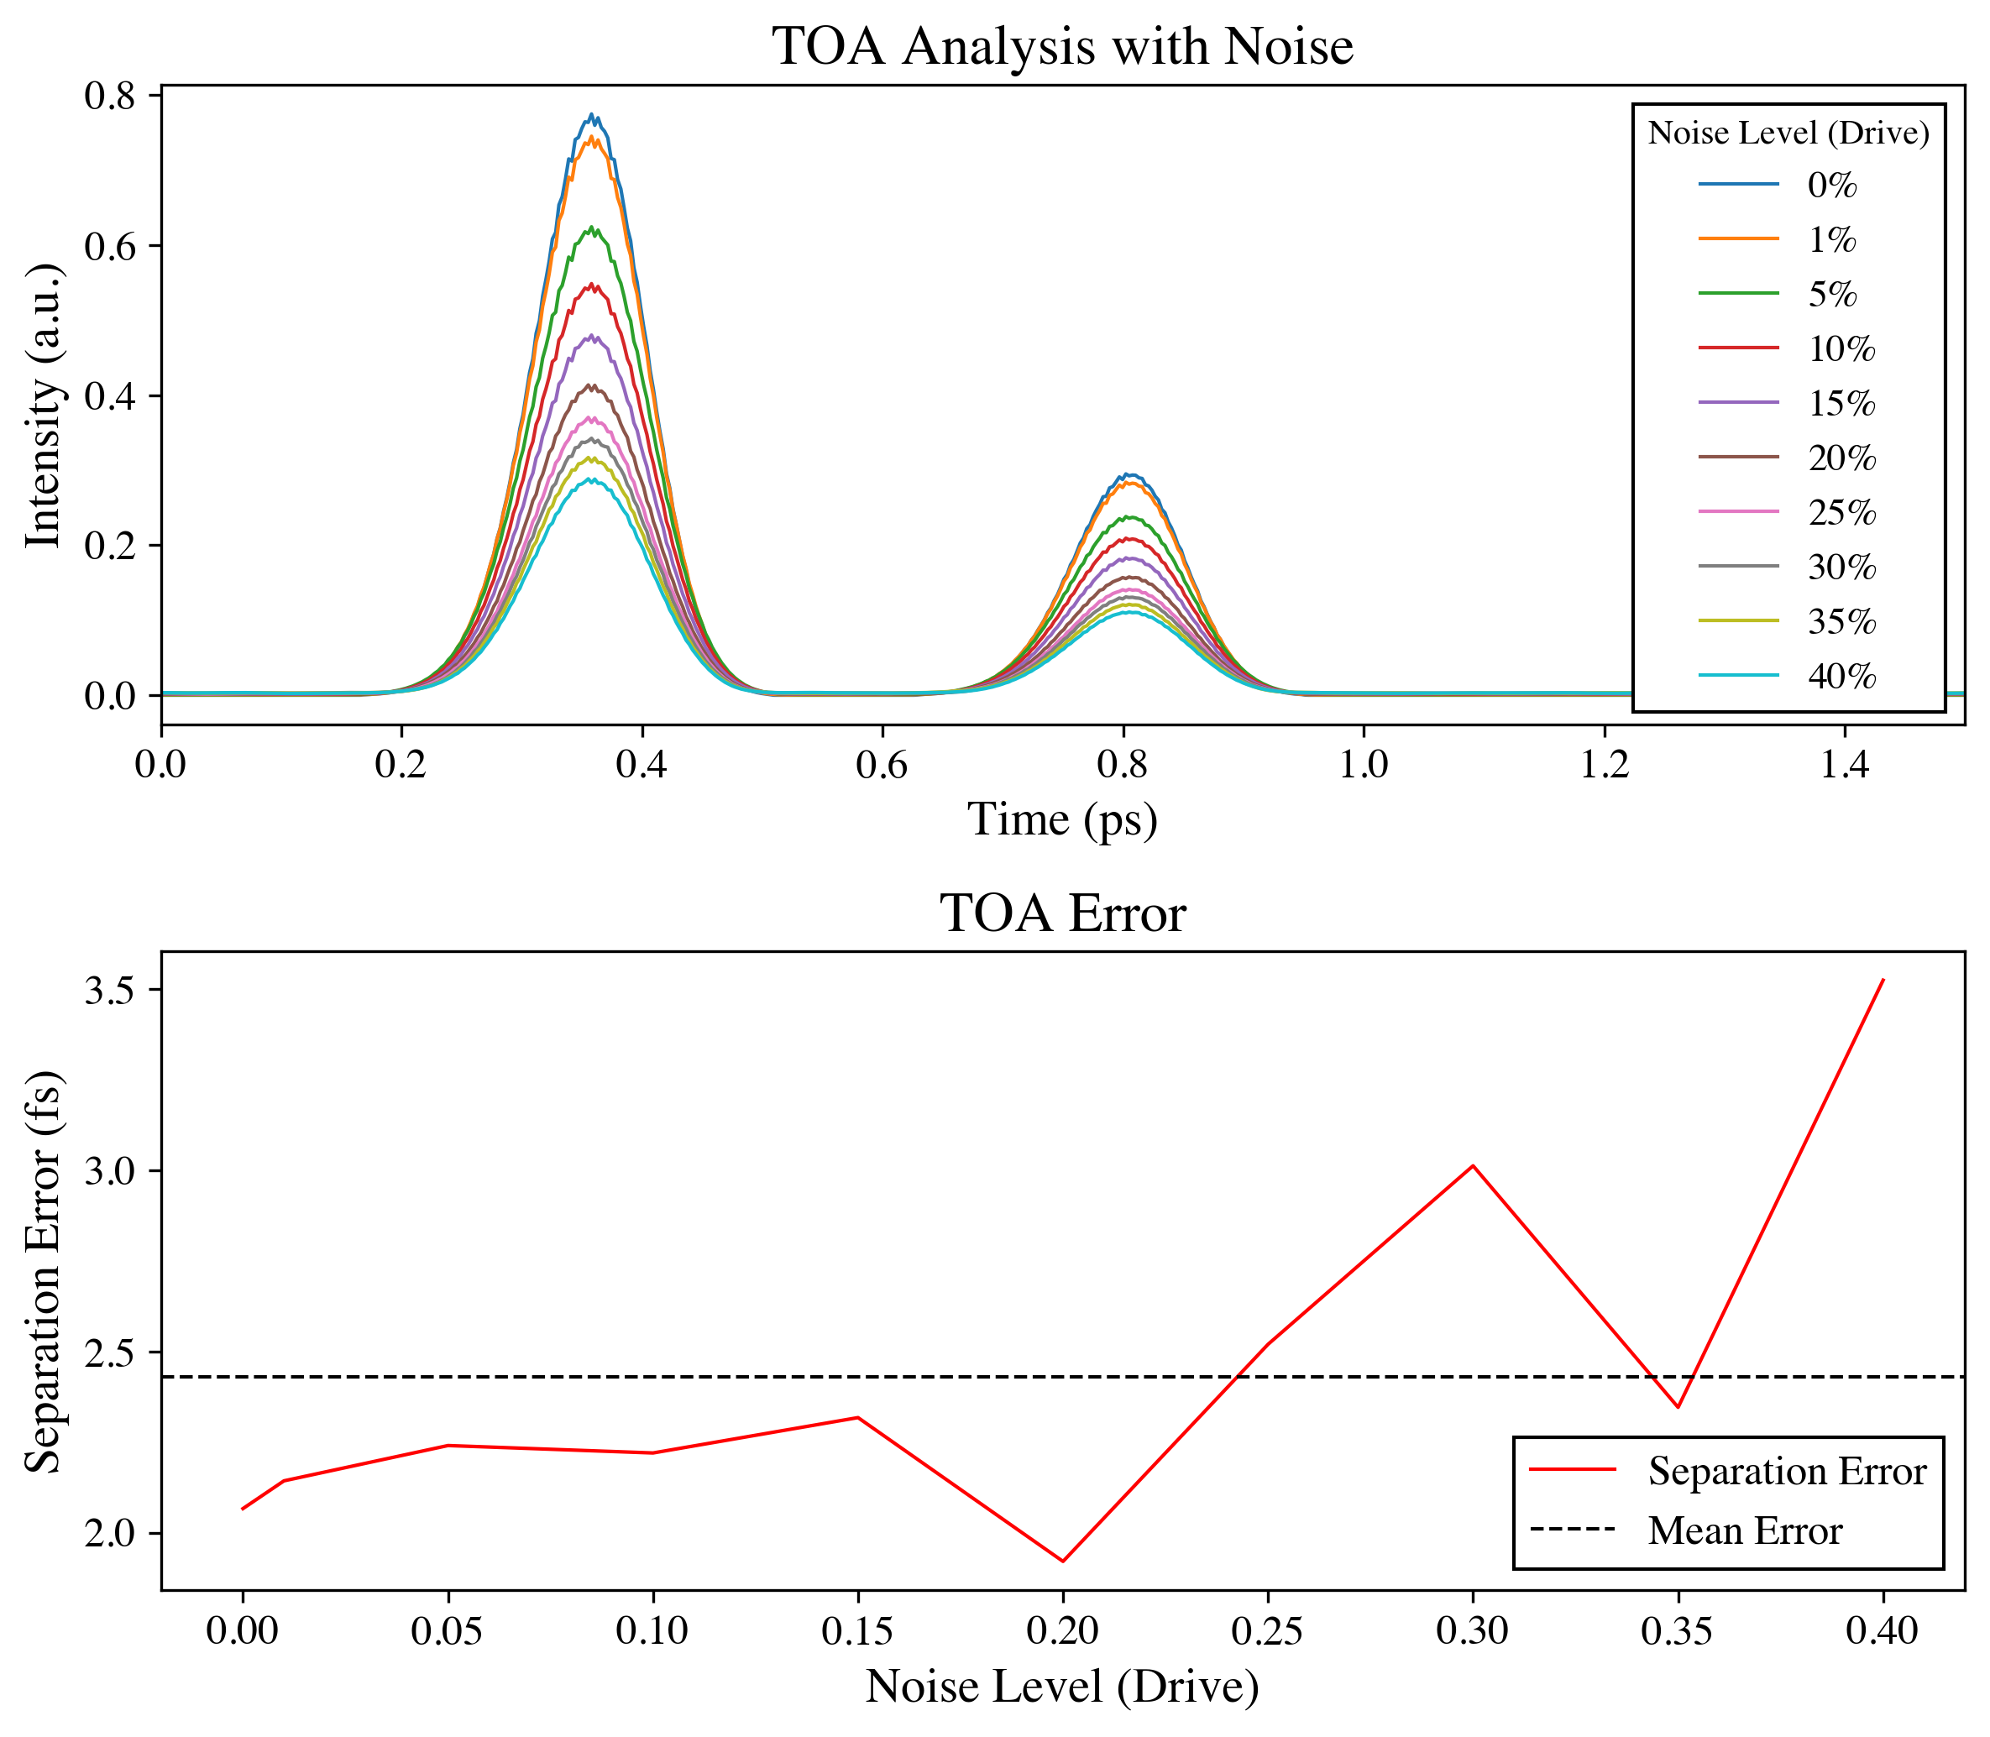
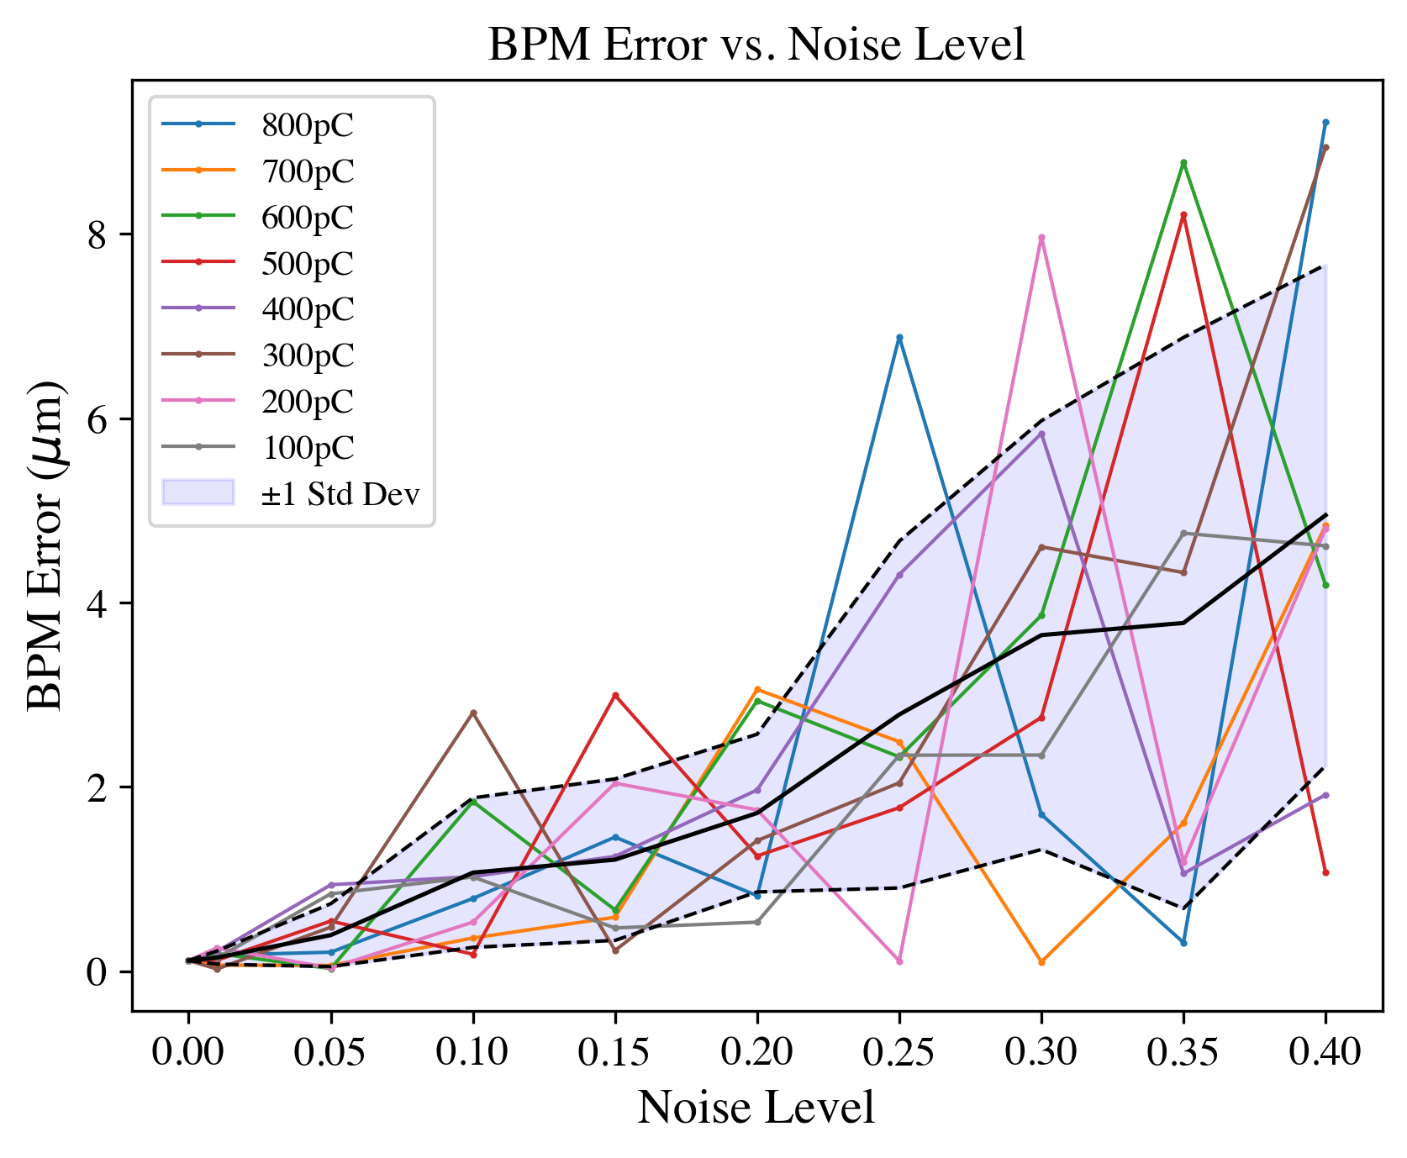
EOS BPM Mk.2 BPM and TOA Results
3 fs TOA resolution
<5 μm transverse resolution

Slide 19
Summary
Novel ultra-fast optical device for measuring beam centroid location with fs/μm level precision.
  Required for emittance preservation of PWFA.
  Required to minimize energy spread and maximize efficiency.
Expected Resolution:
  Longitudinal: ~ 3fs/1μm for signals with up to 40% noise.
  Transverse: < 5μm for signals with up to 40% noise.
Future Work:
  Install and commission EOS BPM Mk.2 at FACET-II next run.
  Explore the utility of EOS BPM to diagnose tilted beams.

Slide 20
References
[1] A. L. Cavalieri et al., “Clocking Femtosecond X Rays,” Phys. Rev. Lett., vol. 94, no. 11, Mar. 2005, doi: 10.1103/physrevlett.94.114801.
[2] K. Hunt-Stone, R. Ariniello, C. Doss, V. Lee, and M. Litos, “Electro-optic sampling beam position monitor for relativistic electron beams,” Nuclear Instruments and Methods in Physics Research Section A: Accelerators, Spectrometers, Detectors and Associated Equipment, vol. 999, p. 165210, May 2021, doi: 10.1016/j.nima.2021.165210.
[3] S. Casalbuoni, H. Schlarb, B. Schmidt, P. Schmüser, B. Steffen, and A. Winter, “Numerical studies on the electro-optic detection of femtosecond electron bunches,” Phys. Rev. ST Accel. Beams, vol. 11, no. 7, Jul. 2008, doi: 10.1103/physrevstab.11.072802.
[4] B. Steffen et al., “Electro-optic time profile monitors for femtosecond electron bunches at the soft x-ray free-electron laser FLASH,” Phys. Rev. ST Accel. Beams, vol. 12, no. 3, Mar. 2009, doi: 10.1103/physrevstab.12.032802.

Slide 21
Questions

Slide 22
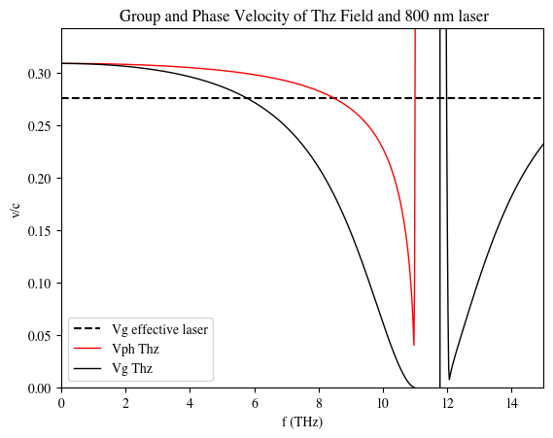
Signal Ringing for Short Bunches
Shorter electron bunches correspond to higher THz frequencies. For GaP the cutoff is ~ 10 THz due to the phase velocity mismatch.
This is better than ZnTe, but there is also the trade off, of lower signal.
The phase mismatch can cause ringing in the signal -> worse TOA resolution.
For FACET-II 100 μm GaP is optimal.

Slide 23
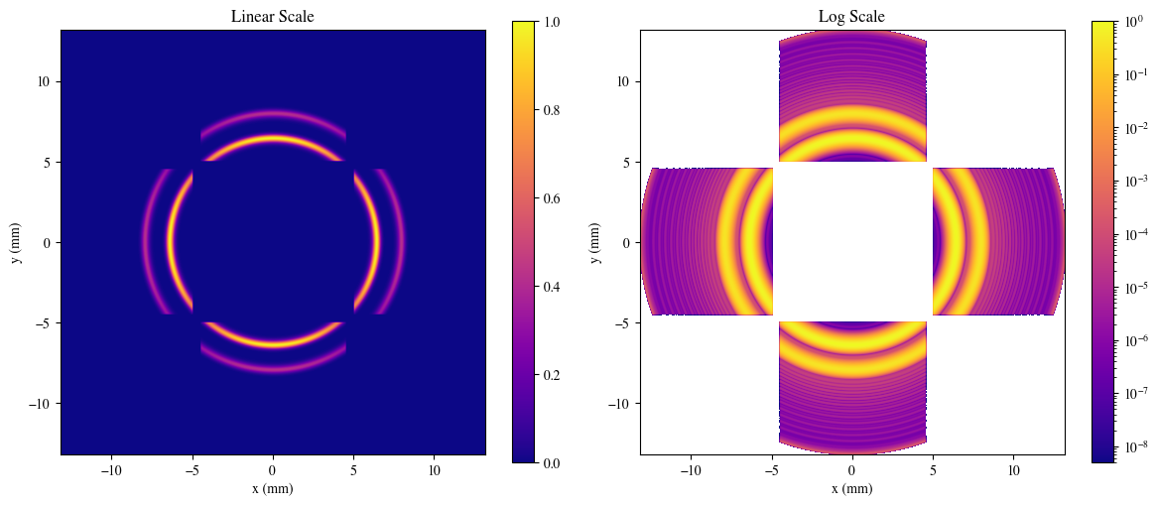
Example of Ringing

Slide 24
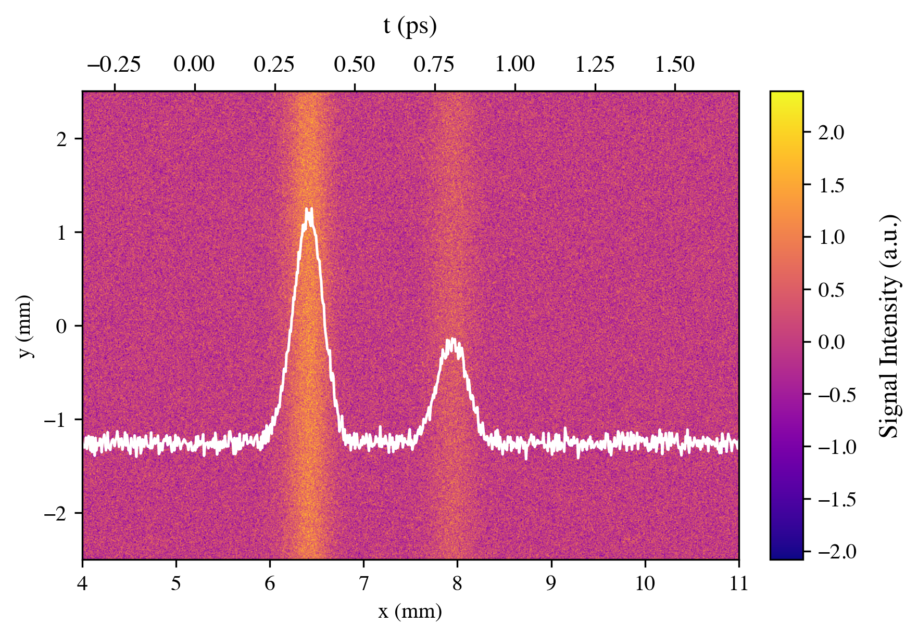
Single Crystal Signal

Slide 25

Phase Retardation of Crystal
EO Crystal
Signal from Phase Retardation
α
$$I\left(α,r\right)=A_{1}{Sin}^{2}\left(\frac{A_{2}}{r}\sqrt{1+3\cos^{2}\left(α \right)}\right)$$
e⁻beam

Slide 26


Phase Retardation of Rotated Crystal Orientation
I_{r}
EO Crystal
α_{r}
Signal from Phase Retardation
α
$$I\left(α,r\right)=A_{1}{Sin}^{2}\left(\frac{A_{2}}{r}\sqrt{1+3\cos^{2}\left(α \right)}\right)$$
I
I
$$I_{r}\left(α,r\right)=A_{1}{Sin}^{2}\left(\frac{A_{2}}{r}\sqrt{1+3\sin^{2}\left(α \right)}\right)$$
I_{r}
e⁻beam
$$α=α_{r}+\frac{π}{2}$$
EO Crystal rotated 90º

Slide 27


BPM Analysis
Region I
Region II
Region I
α₂
r₂
r₁
α₁
$$I\left(α_{1},r_{2}\right)=A_{1}{Sin}^{2}\left(\frac{A_{2}}{r_{1}}\sqrt{1+3\cos^{2}\left(α_{1}\right)}\right)$$
$$I\left(α_{2},r_{2}\right)=A_{1}{Sin}^{2}\left(\frac{A_{2}}{r_{2}}\sqrt{1+3\sin^{2}\left(α_{1}\right)}\right)$$

