Slide 1

Experimental Progress of Passive Plasma Lens at FACET-II
PWFA Meeting
Jul 23, 2025
Presenter: Shutang Meng¹
Erik Adli², Robert Ariniello³, Gevy Cao², Sebastien Corde⁴, Christopher Doss⁵, Keegan Downham³ , Thamine Dalichaouch⁶ , Claudio Emma³, Spencer Gessner³, Claire Hansel¹, Mark Hogan³, C. Joshi⁶, Alexander Knetsch³, Valentina Lee¹, Michael Litos¹, Nathan Majernik³, Ken Marsh⁶, Brendan O'Shea³, Elena Ros¹, Doug Storey³, Chaojie Zhang⁶
¹CU Boulder, ²University of Oslo , ³SLAC, ⁴Ecole Polytechnique, ⁵LBNL, ⁶UCLA
Notes:
Done

Slide 2
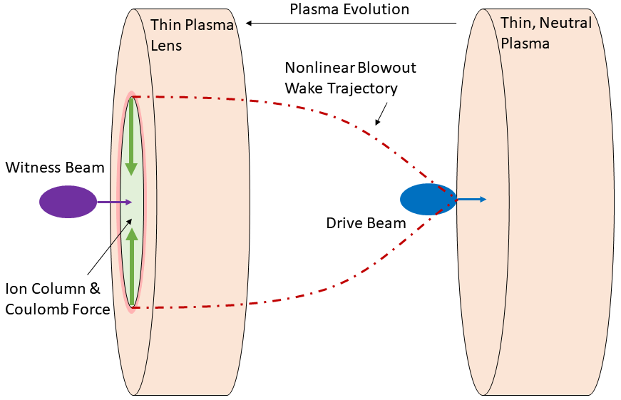
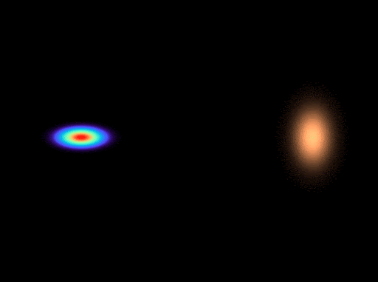
Thin, Underdense, Passive Plasma Lens (TUPPL)
Thin – PWFA much shorter than one betatron period
Underdense – Nonlinear blowout regime
Passive – No reliance on externally driven current
Plasma Lens – Transverse focusing impulse with negligible energy change

Slide 3
Attractive Features of TUPPL
Extremely strong focusing
Orders of magnitude beyond electromagnets, PMQs, APL.
Axisymmetric focusing
Single lens can achieve symmetric focus in x & y
Ultra-compact
Plasma lens itself: ~500 µm
Gas jet & laser hardware: ~1 cm footprint along beam line
Rapidly and easily tunable
Strength scales with density → gas pressure
Strength scales with length → laser energy / focus/height above gas jet
Self-aligning
Central axis of blowout determined by electron beam

Slide 4
The Importance of Strong Focusing
Matching into plasma stages
Necessary to prevent chromatic emittance growth
Quadrupole magnets not strong enough
Divergence control coming out of plasma stages
Prevent chromatic emittance growth in vacuum from high divergence
Match injected beams exiting plasma to magnets / undulators
Collider final focus
Axisymmetric – can reduce length
Ultra compact and strong – can provide tightest focus
Serve as proxy for collider FF in strong focusing studies (Oide effect)
Other
SFQED – increase chi: nonlinear quantum param.
ICS – increase brightness by reducing source size
HEDP – increase energy density on target

Slide 5
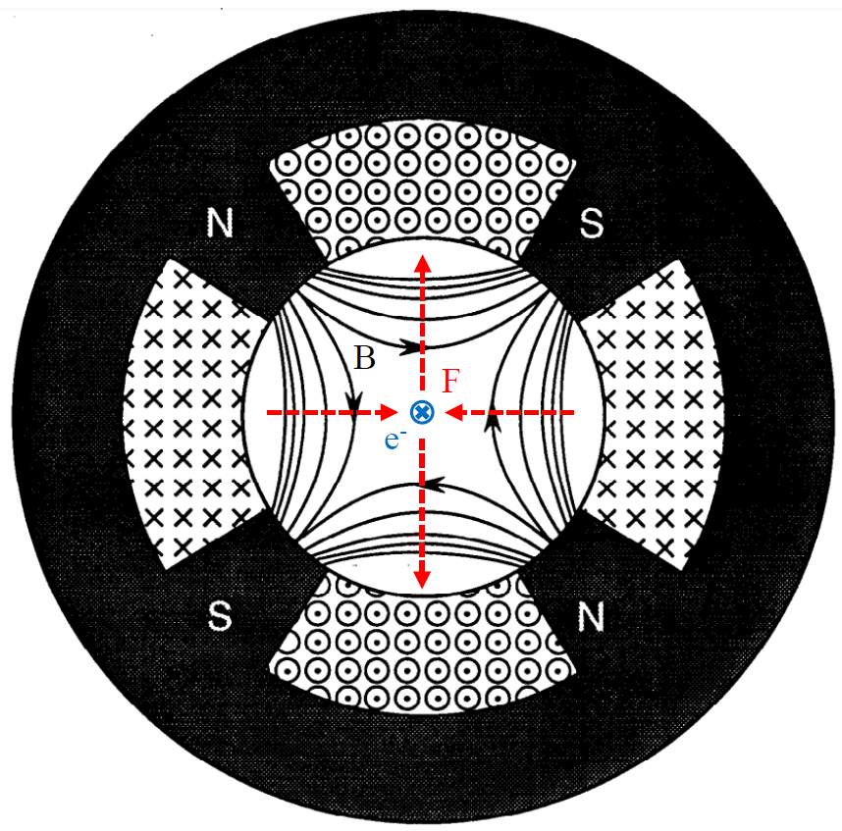

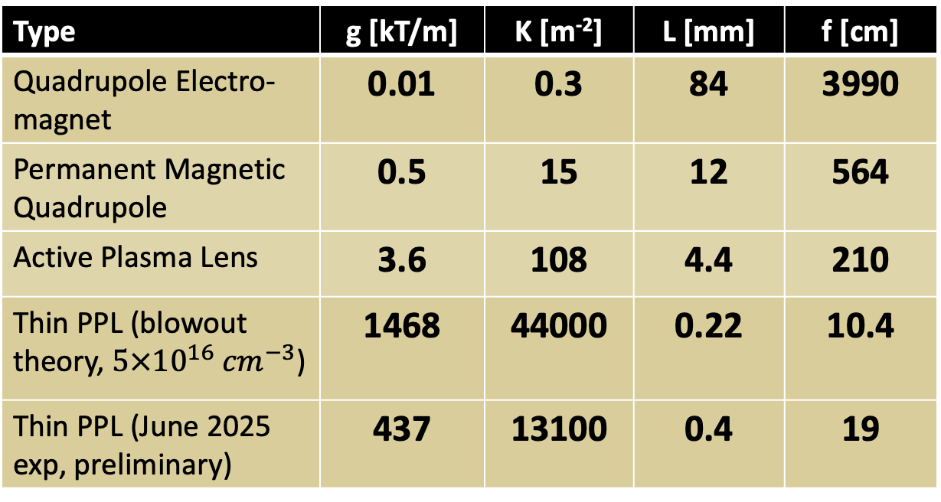
Comparison to other focusing optics
PPL focusing strength is orders of magnitude stronger than magnets of equivalent phase advance (normalized length).
Phase advance (normalized length):
$$∆ψ=\sqrt{K}L=0.0458$$
Quadruple Magnet
Type | g [kT/m] | K [m⁻²] | L [mm] | f [cm]
Quadrupole Electro-magnet | 0.01 | 0.3 | 84 | 3990
Permanent Magnetic Quadrupole | 0.5 | 15 | 12 | 564
Active Plasma Lens | 3.6 | 108 | 4.4 | 210
Thin PPL (blowout theory, $5×{10}^{16} {cm}^{−3}$) | 1468 | 44000 | 0.22 | 10.4
Thin PPL (June 2025 exp, preliminary) | 437 | 13100 | 0.4 | 19
Adapted from Taylor, SLAC-PUB-5621 (1991)

Slide 6
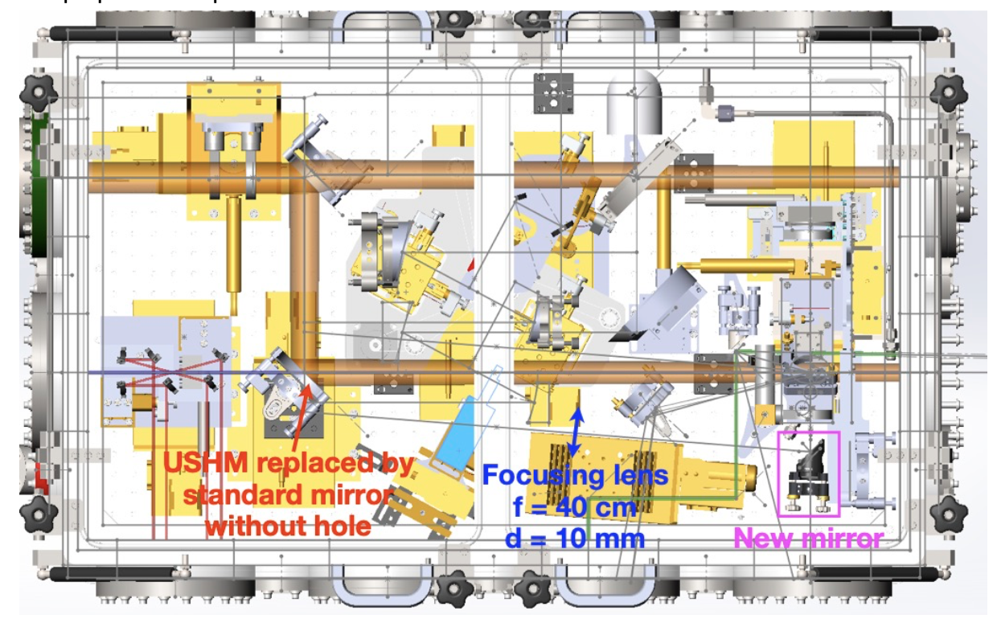
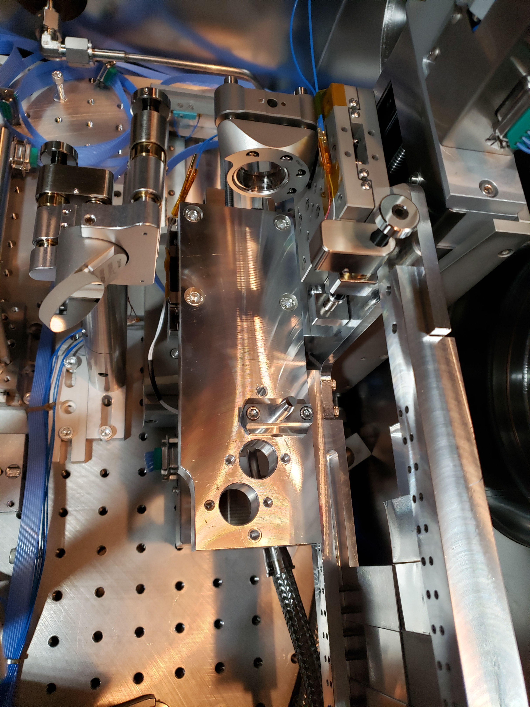
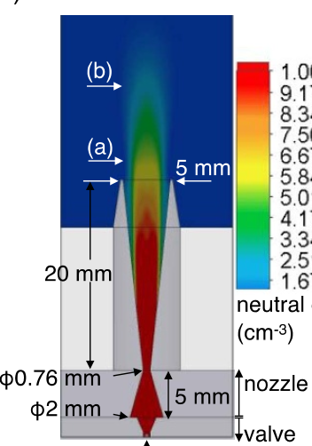
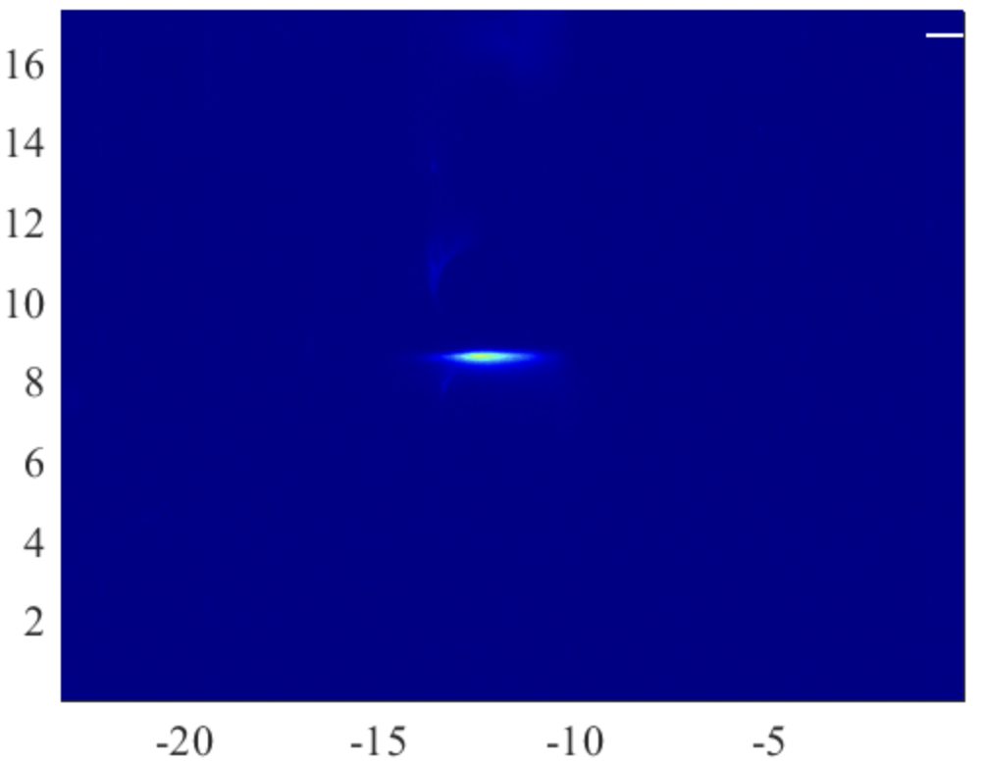

Experimental Setup
Chaojie Zhang et al 2021 Plasma Phys. Control. Fusion 63 095011
Laser, 3 mJ
5mm $D_{exit}$; 50 psi
E-beam
Top view
E-beam
Limitation: Gas jet “true” backing pressure

Slide 7
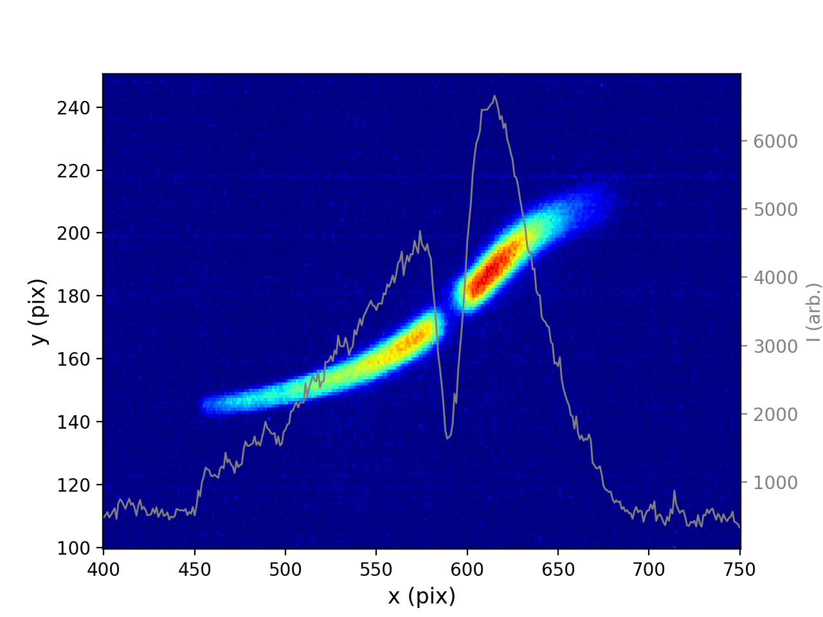
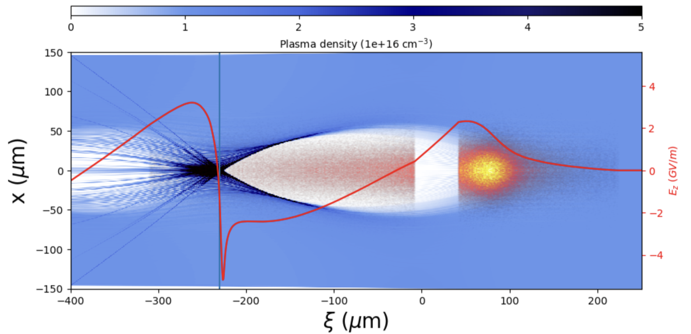
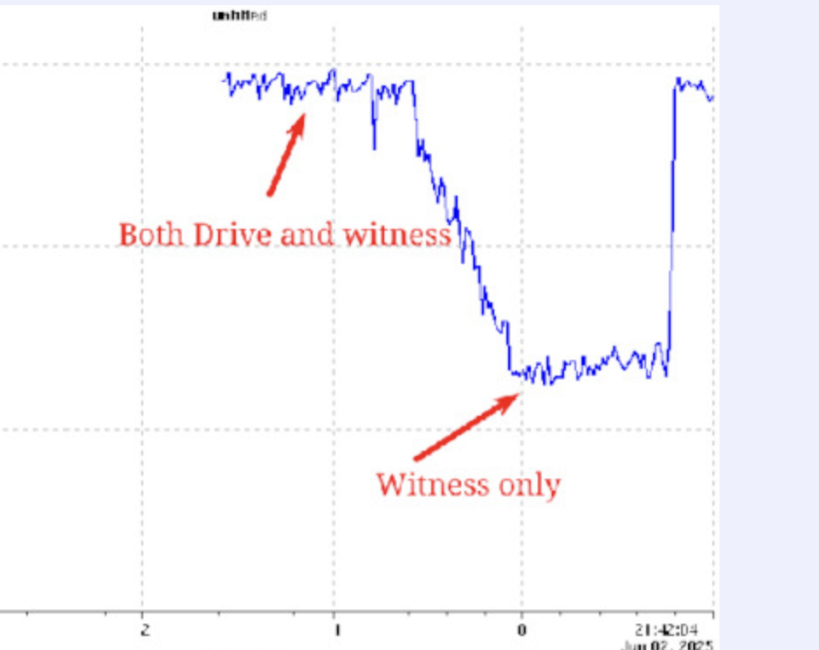
Electron bunch Characterization
Requirement:
Long, linearly chirped witness bunch to probe transverse wakefield at multiple longitudinal locations.
TCAV measurement
Example PIC sim
Charge measurement:
Witness: 650 pC
Driver: 780 pC

Slide 8
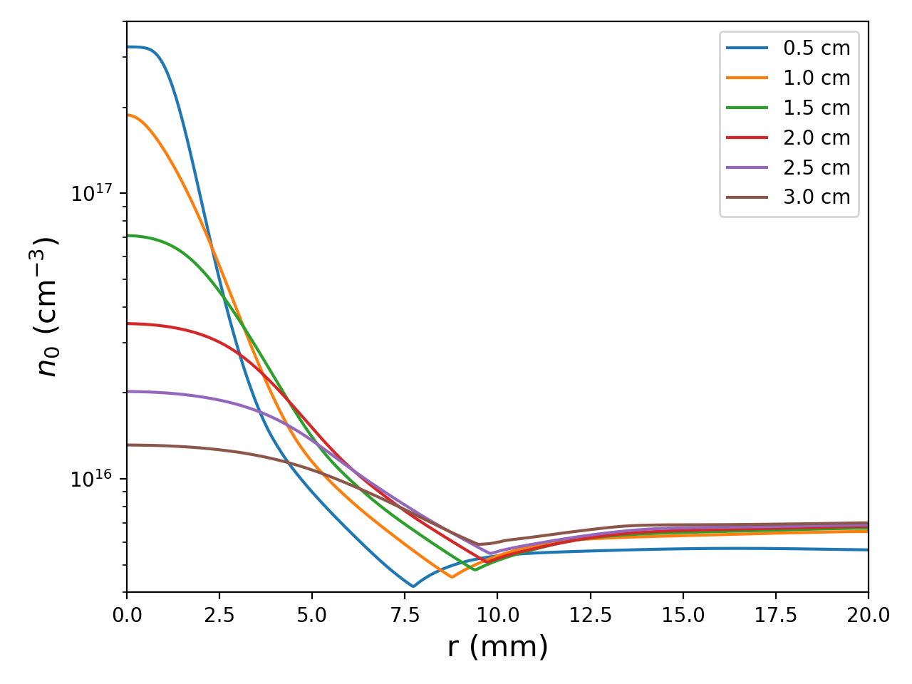
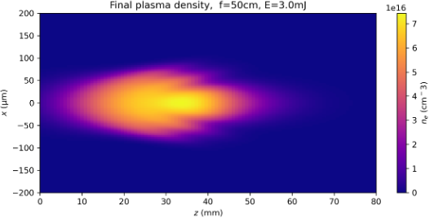
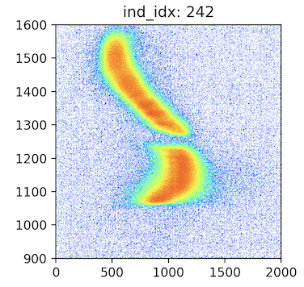
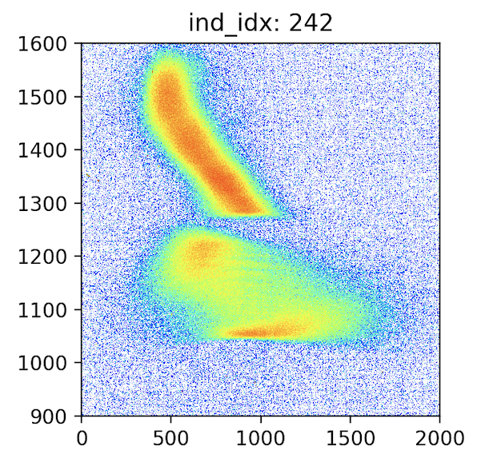
Plasma Characterization
Simulation (Fluid + optical)
Split-step Fourier code
Radial neutral density profile
Fluent simulation
Max width: 132 um
Need to rely on plasma expansion to reach plasma length ~ 500 um.
assume 1e17
No interaction
with interaction
Plasma length measurement ~ 400 um
Scan laser height and observe divergence of the witness beam
Optimize laser timing and height location
Manual 2D scan to find maximum interactions
Working point (WP) 1: gas jet at 1.5 cm below e-beam; laser fired 3 ns before e-beam arrival.
WP2: gas jet at 1 cm below e-beam; laser fired 20 ns before e-beam arrival.

Slide 9
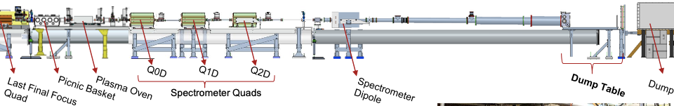
FACET-II Electron Imaging Spectrometer
Plasma Lens
Beam Direction
OTR Screen
Quadrupole magnet triplet and spectrometer dipole magnet
Disperses in y, images in x
Image plane at OTR screen near dump, energy setpoint at 10 GeV
Object plane scanned from the gas jet location to gas jet + 50 cm
M12 scan at the gas jet location

Slide 10
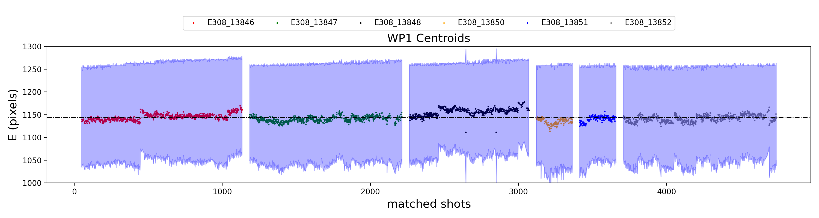
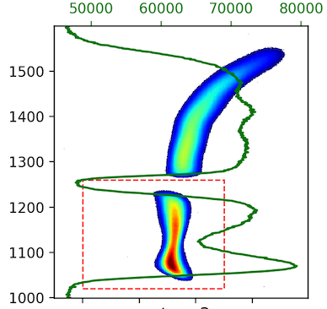
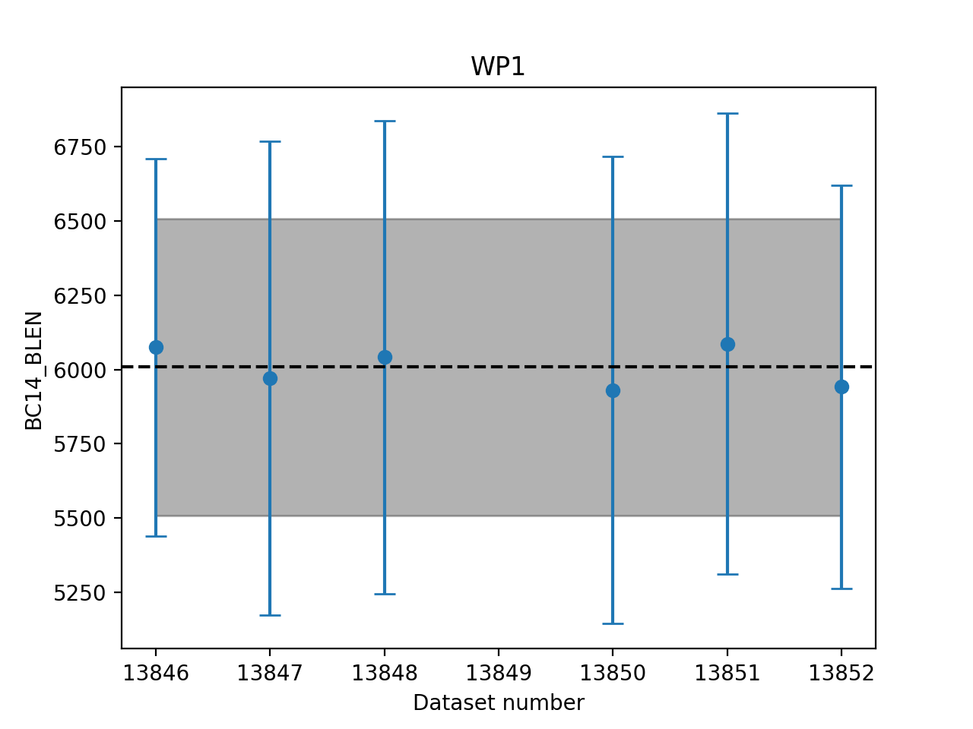
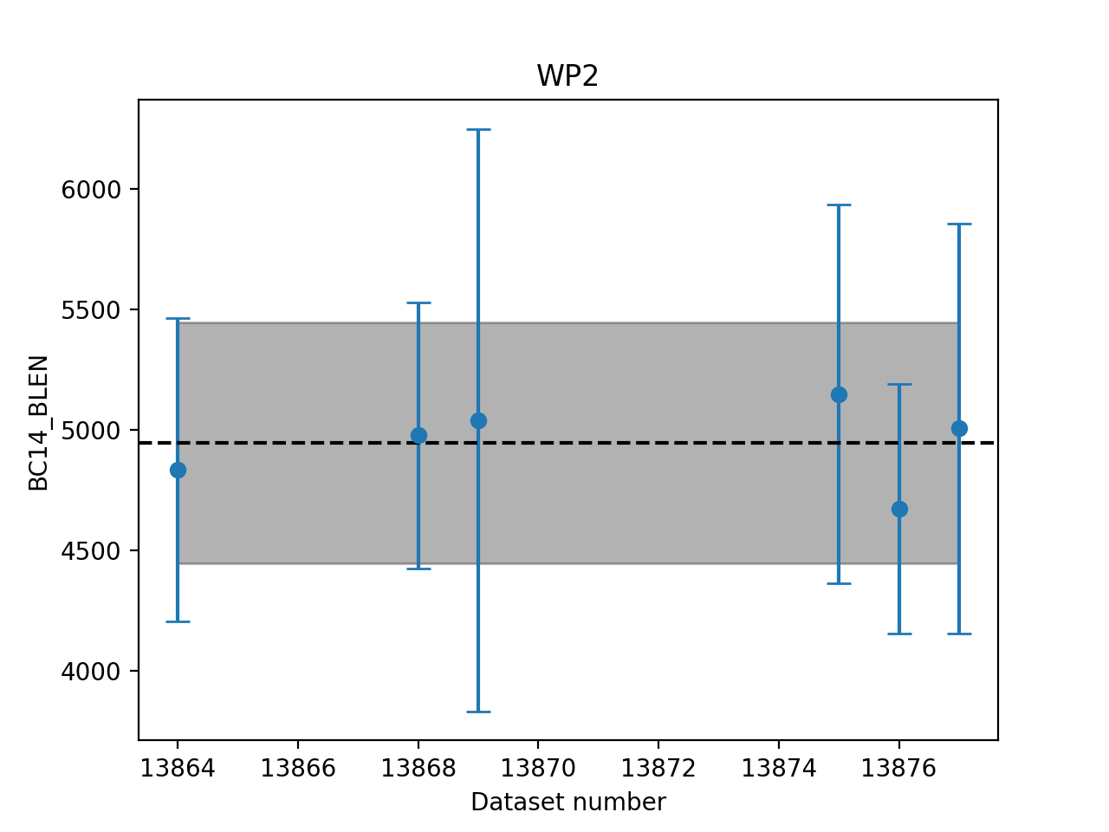
Image adjustments and data filtering
Energy centroids jitter; align by the valley location between driver and witness
Filter by BC14 bunch length; still good statistics after filtering.

Slide 11
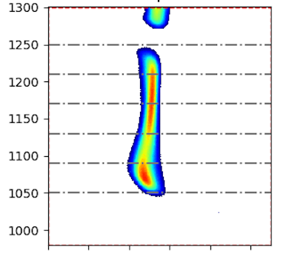
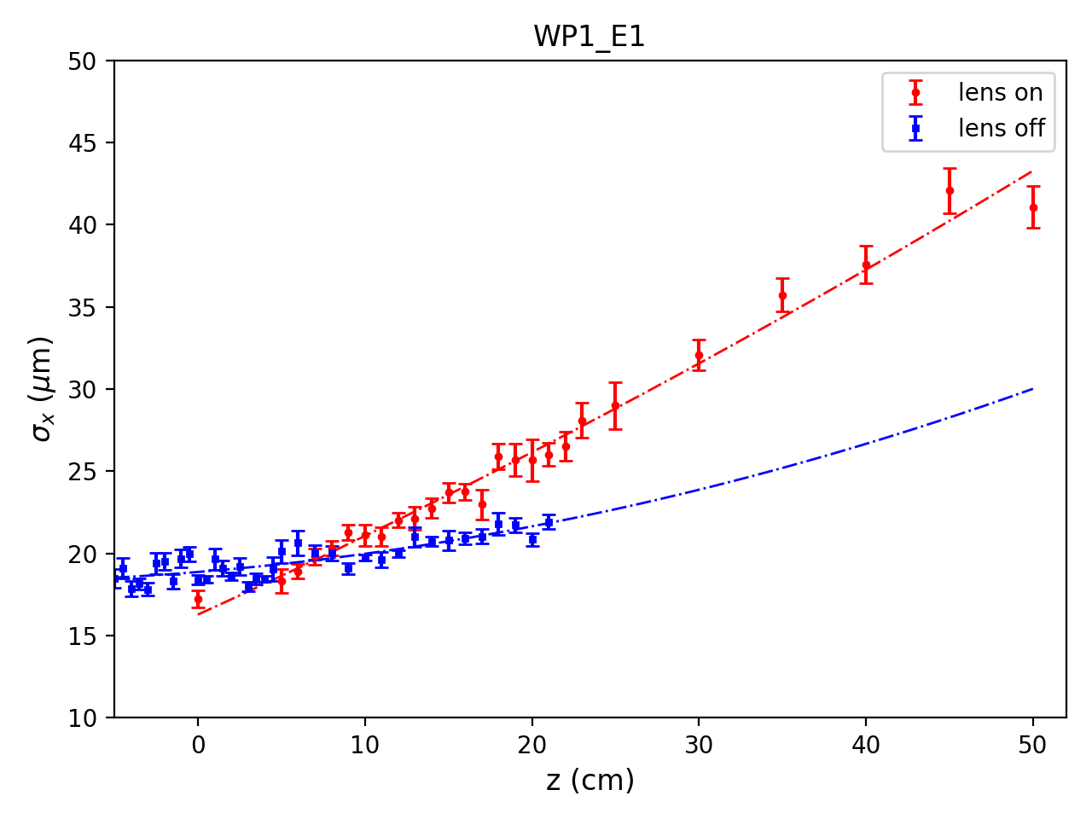
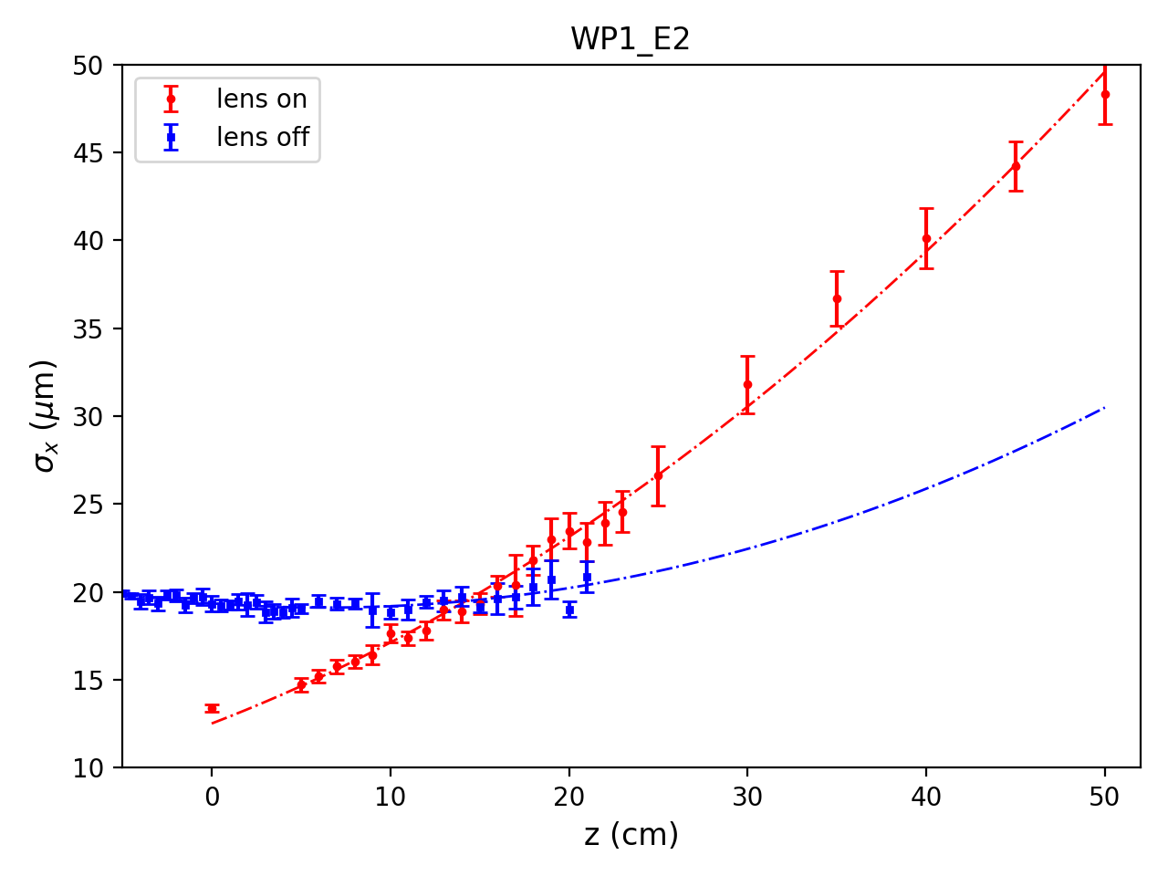
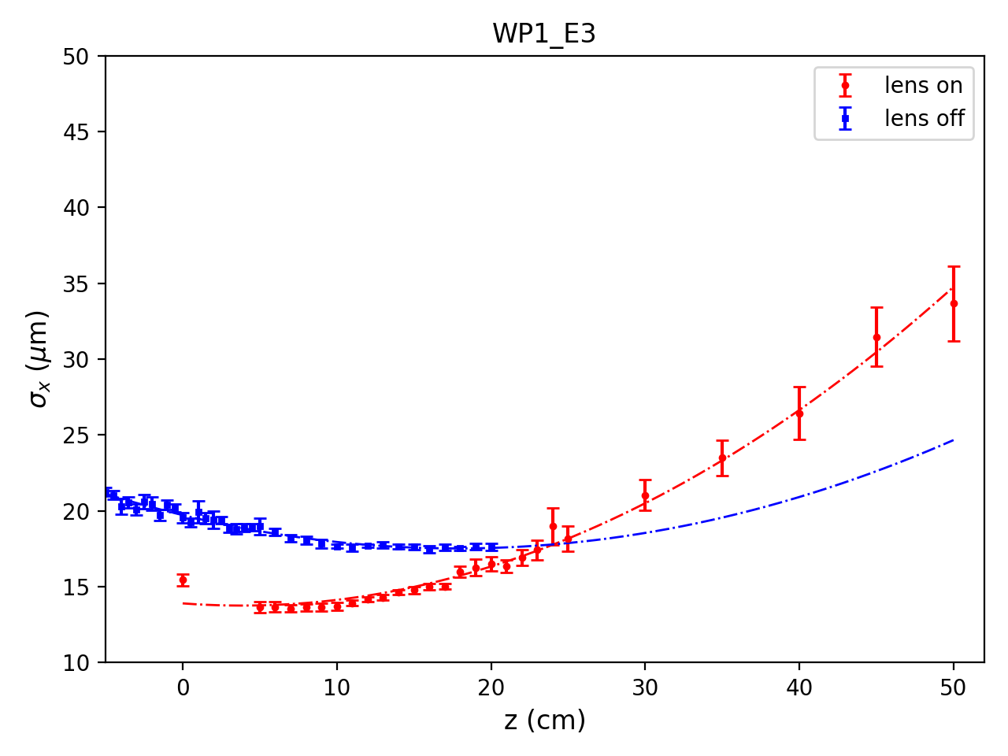
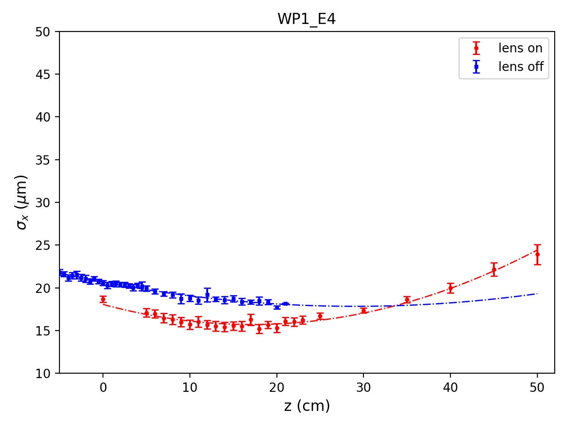
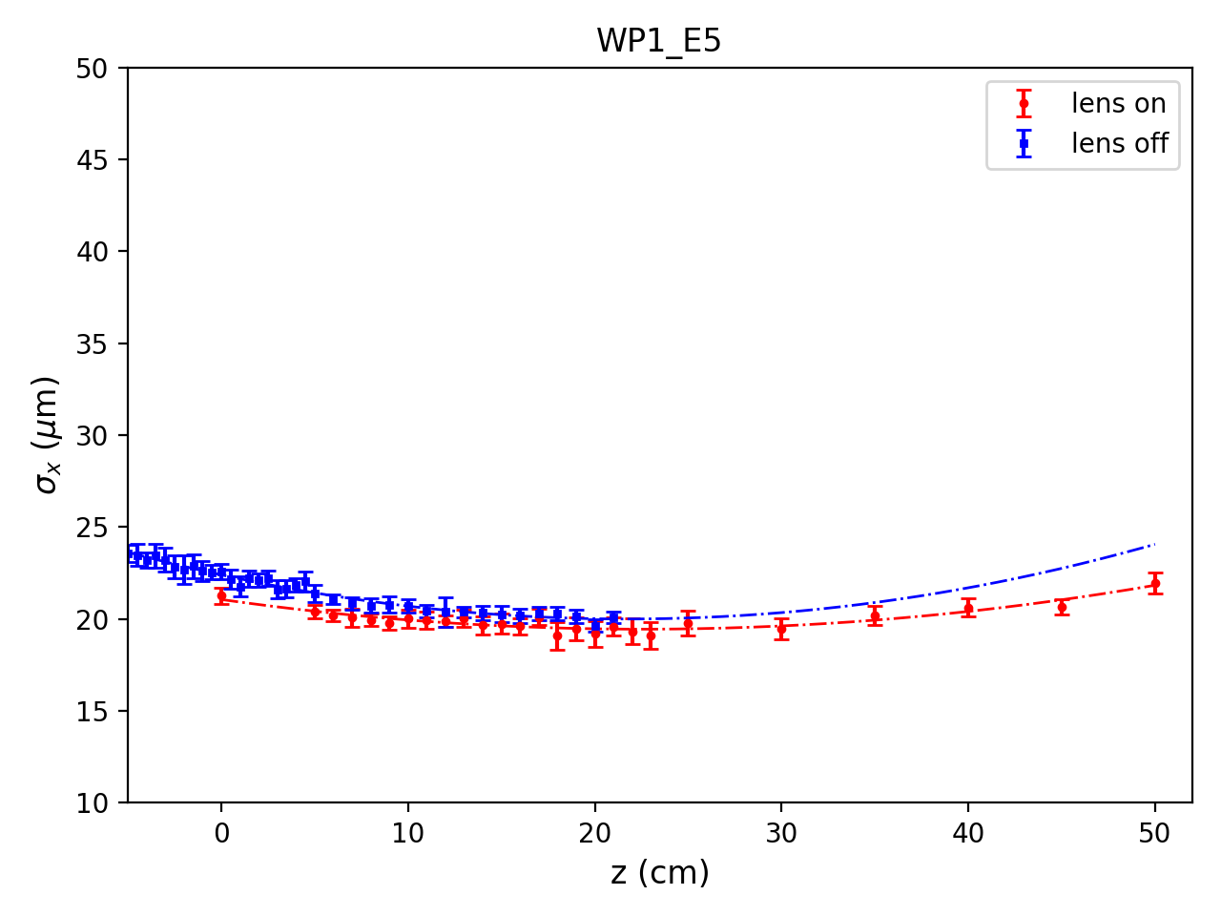
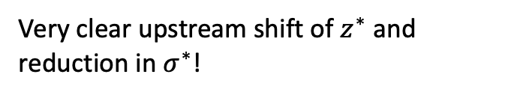
Evidence of passive plasma lensing
Object plane scan with no chromaticity correction
E1 → E5 with increasing energy
E1
E2
5 energy slices
Very clear upstream shift of $z^{∗}$ and reduction in $σ^{∗}$!
E3
E4
E5

Slide 12
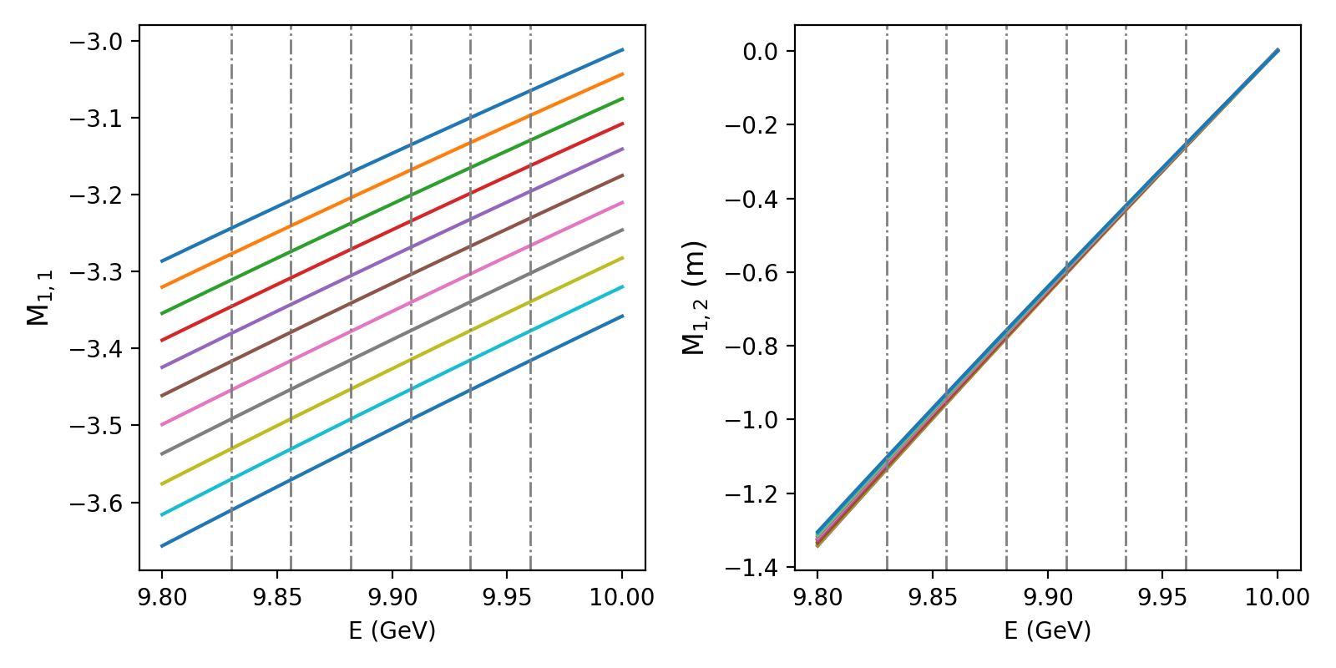
Spectrometer chromaticity
Example: object plane scan from gas jet location to gas jet + 50 cm.

Slide 13
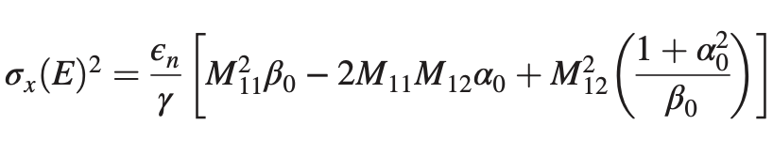
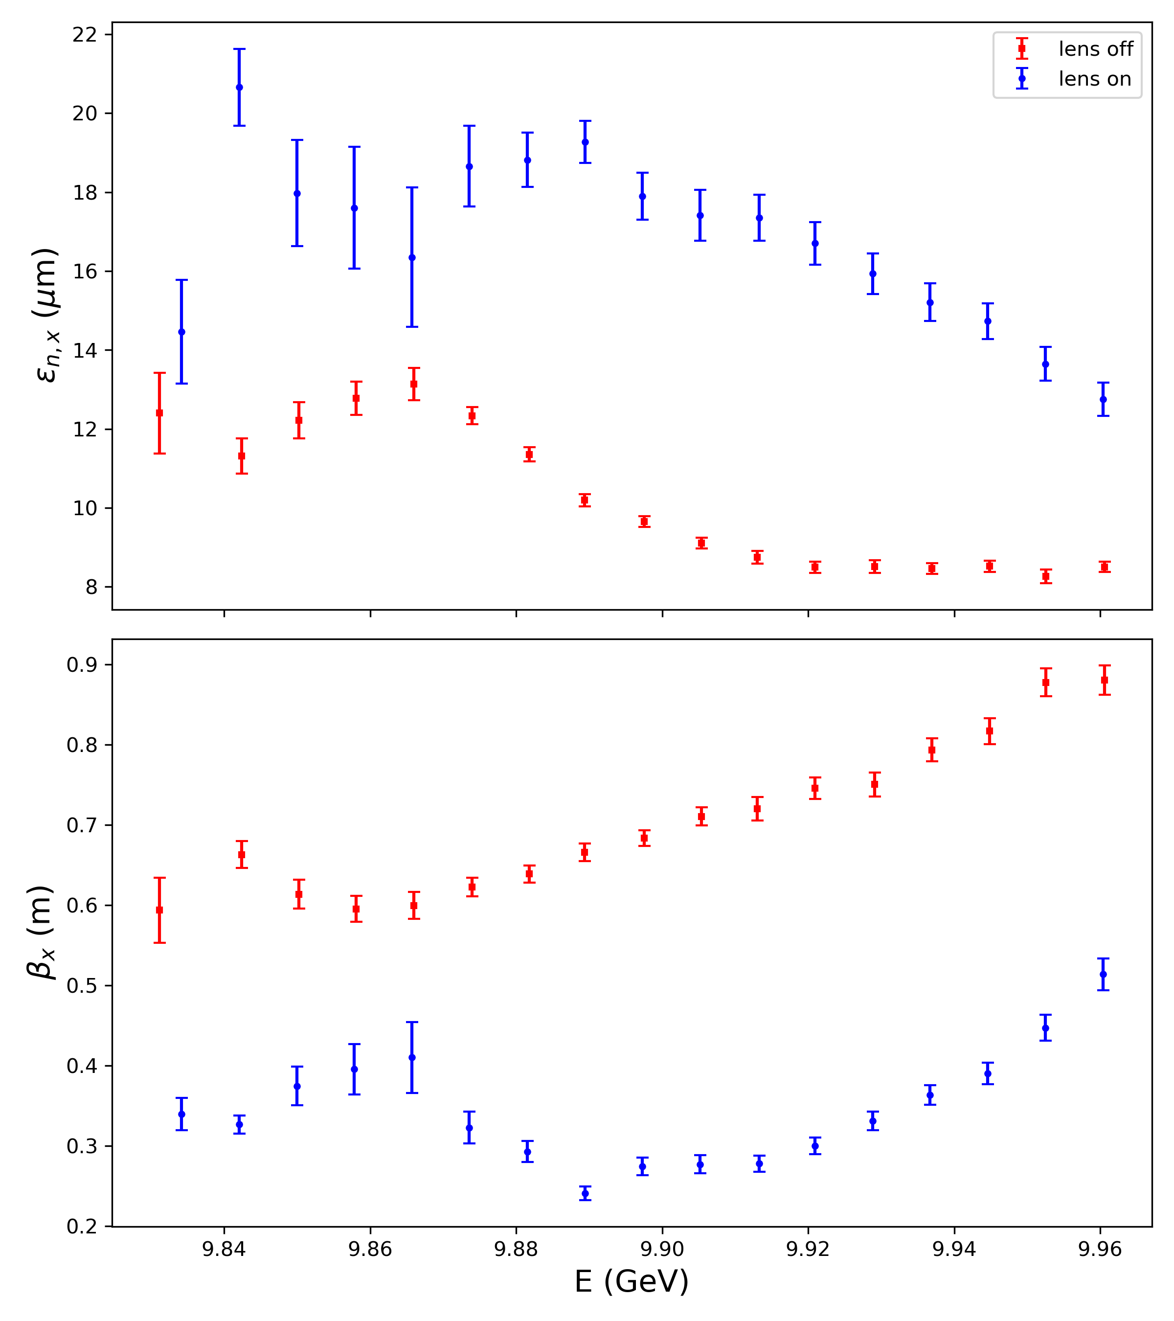
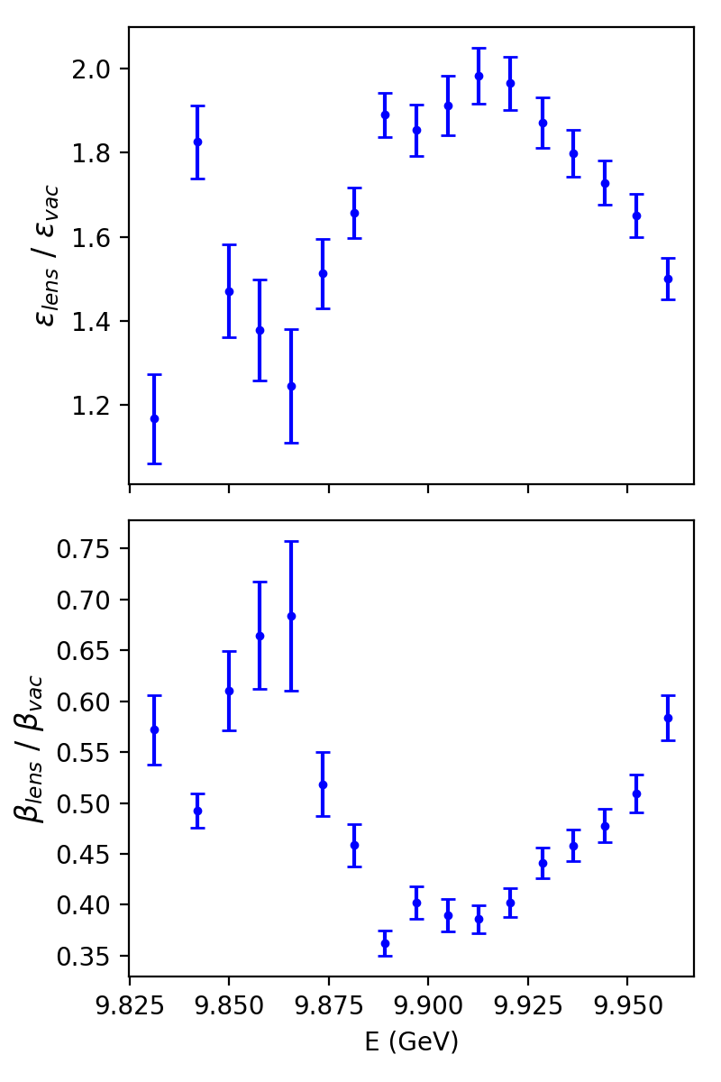
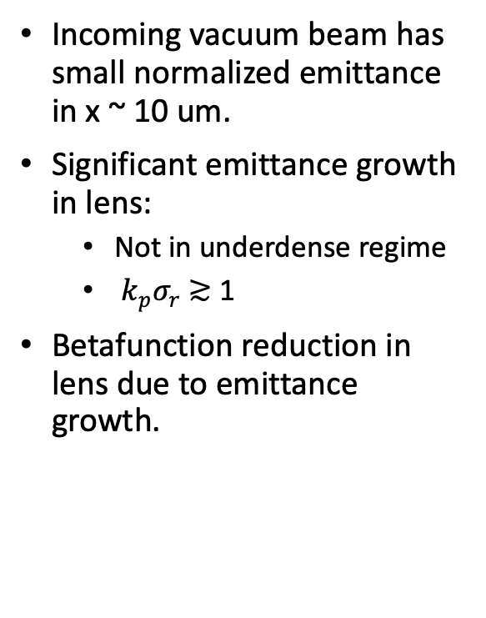
Emittance measurement of the witness bunch
Preliminary results
Use 20 energy slices, each about 10 MeV.
Object plane location: PPL exit.
(a) Absolute value comparison
(b) Ratio comparison
Incoming vacuum beam has small normalized emittance in x ~ 10 um.
Significant emittance growth in lens:
Not in underdense regime
$k_{p}σ_{r}$ ≳ 1
Betafunction reduction in lens due to emittance growth.

Slide 14
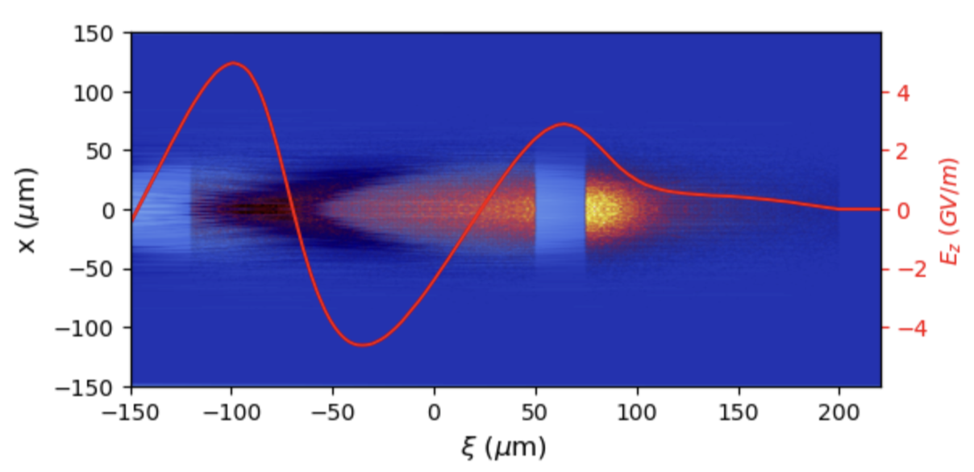
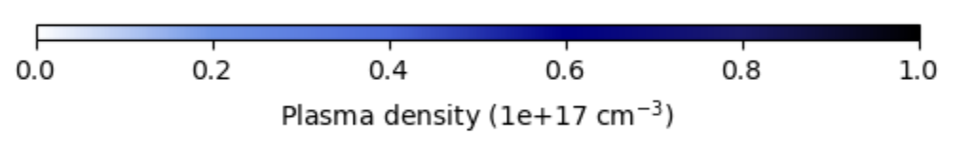
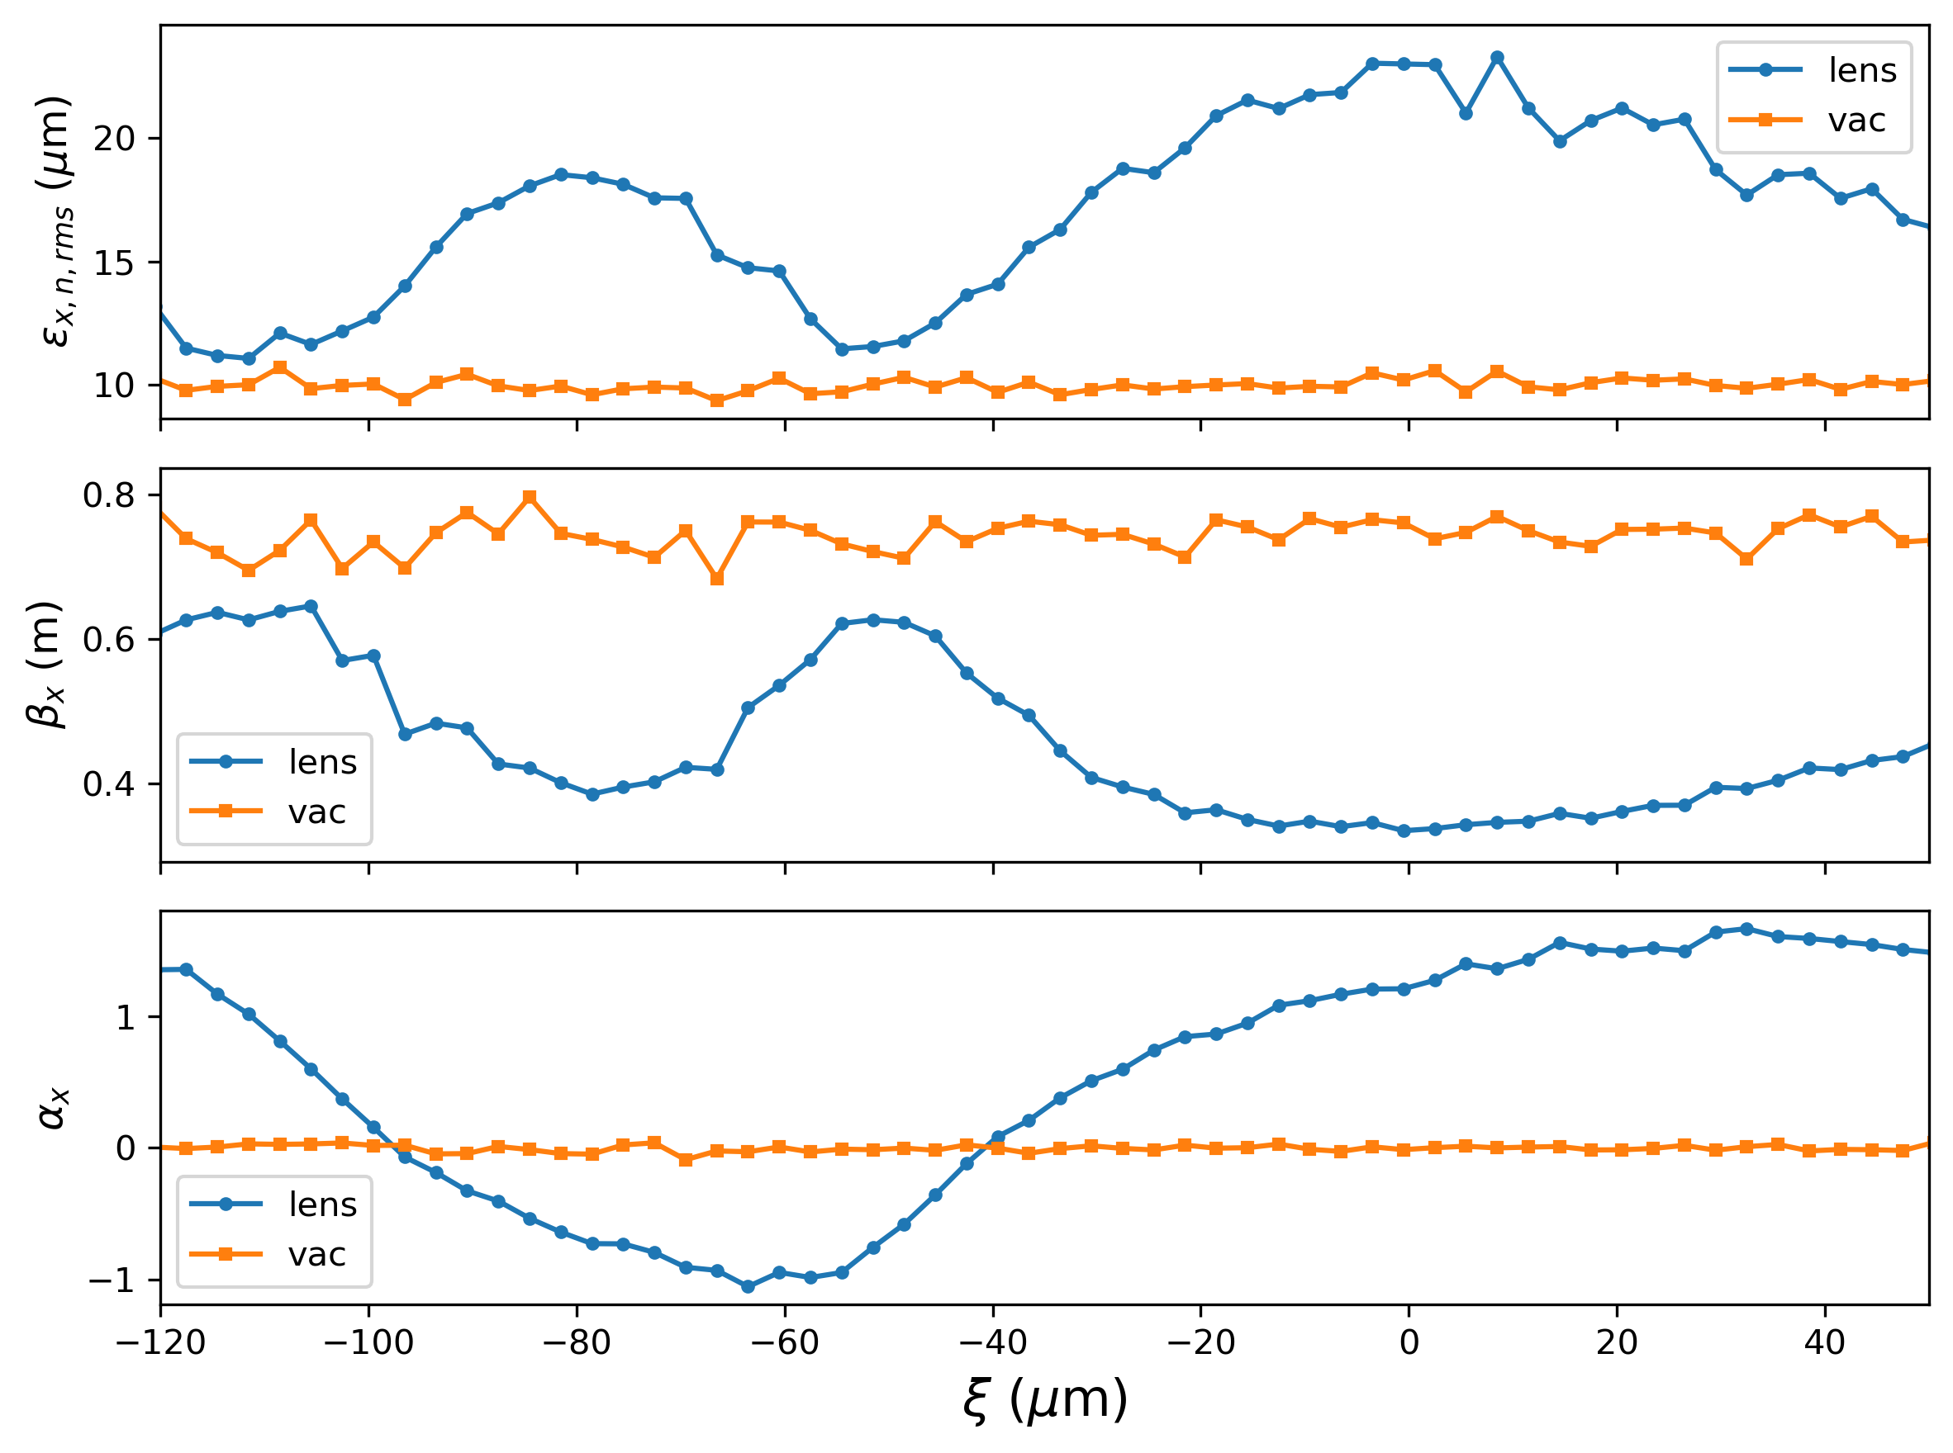
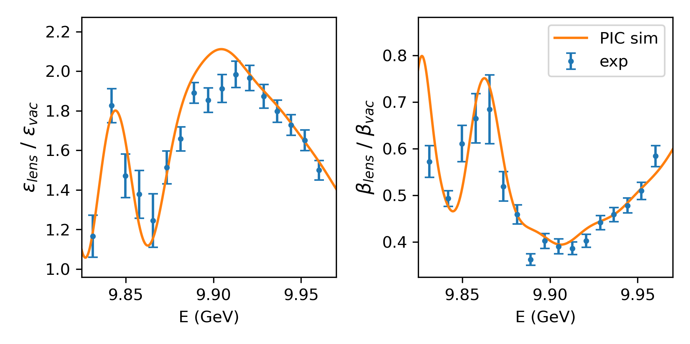

Preliminary PIC simulation studies
Simulation parameters:
Gaussian transverse profile with 20 um spot size and 75 cm beta that match x-plane measurement.
Current profile from BMAD simulation generated by Claudio, similar to TCAV measurement.
Plasma density ~ $5×{10}^{16} {cm}^{−3}$; plasma length ~ 400 um.
Witness beam samples three regions: first wake, defocusing region, front of the second wake.
Simulation value scaled by 6%
Good agreement!
150 um

Slide 15
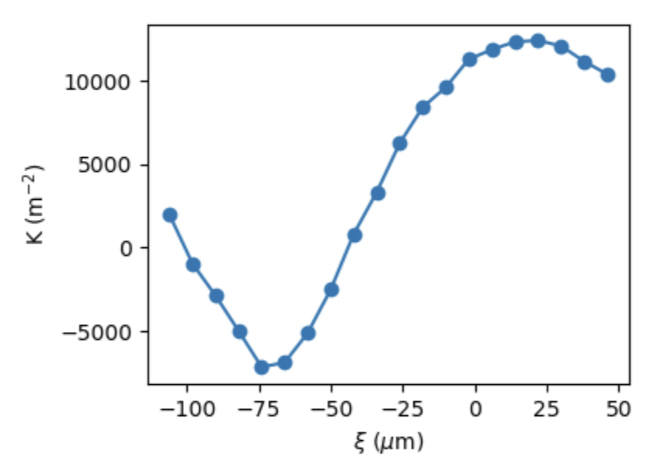
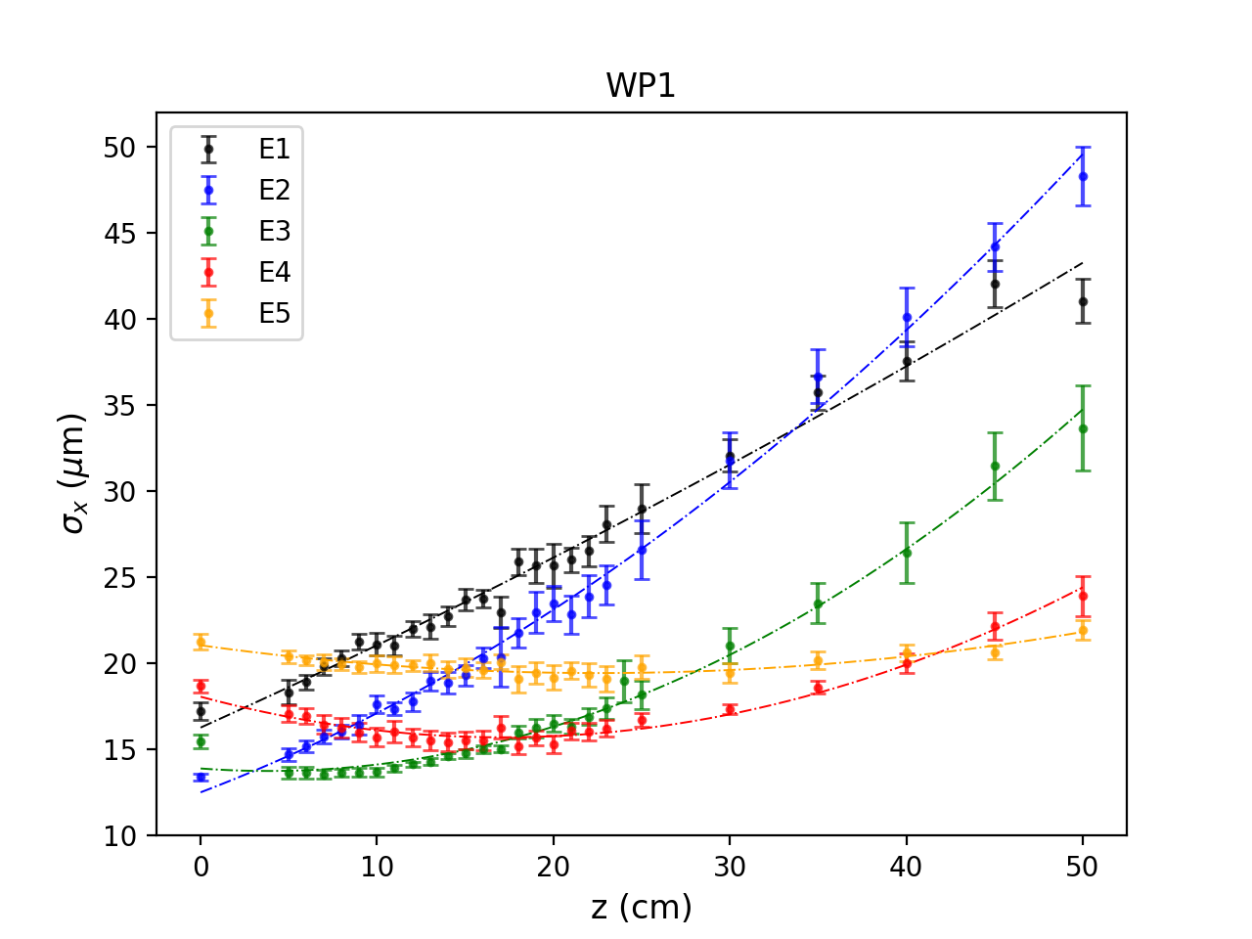
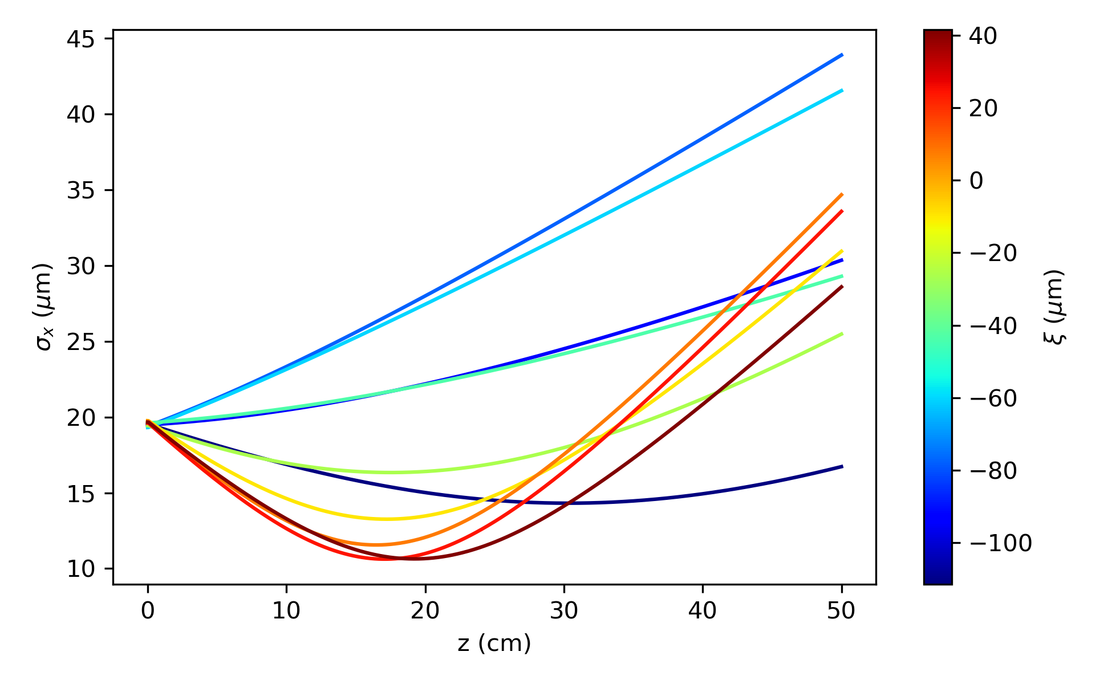


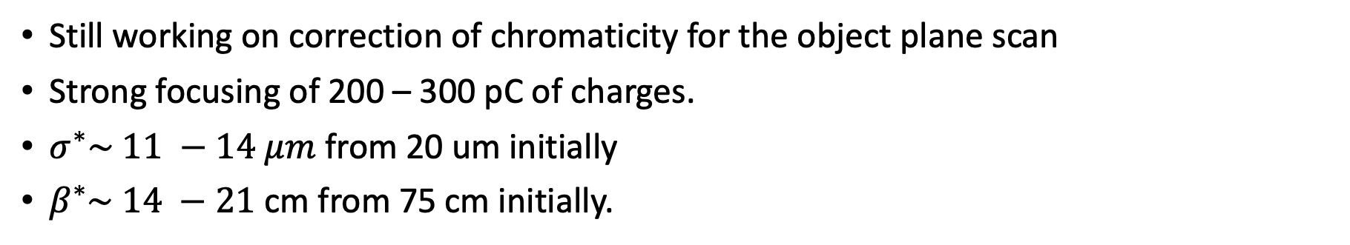
Beam size evolution in vacuum
Still working on correction of chromaticity for the object plane scan
Strong focusing of 200 – 300 pC of charges.
$σ^{∗}\sim 11 −14 μm$ from 20 um initially
$β^{∗}\sim 14 −21$ cm from 75 cm initially.
PIC simulation
No chromatic correction
$σ^{∗}\sim 11$ um
$β^{∗}\sim$ 14 cm
$σ^{∗}\sim 14$ um
$β^{∗}\sim$ 21 cm
First wake

Slide 16
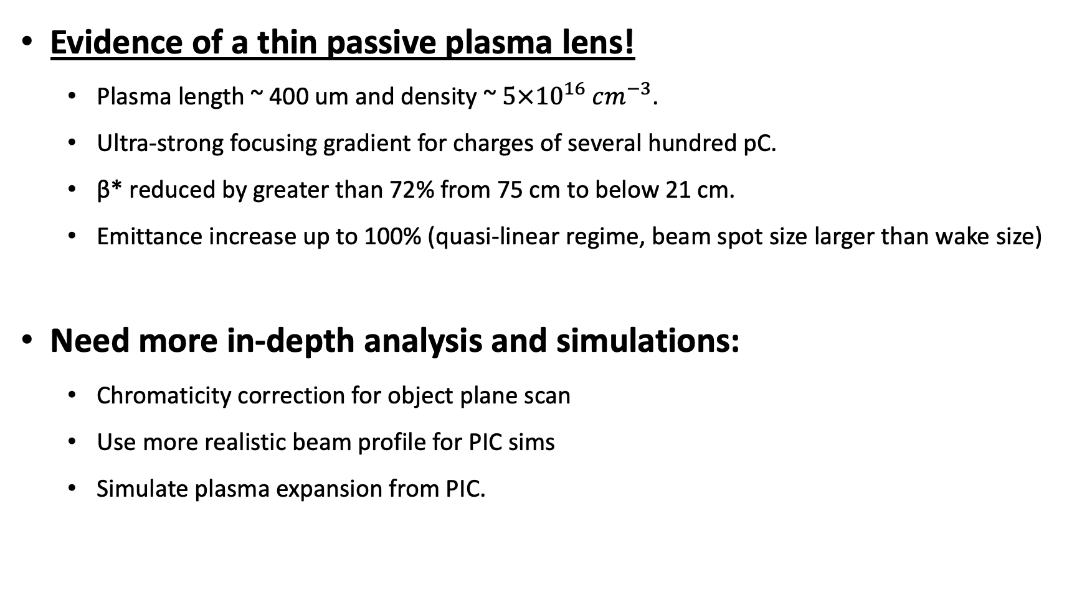
June 2025 Experimental Summary
Evidence of a thin passive plasma lens!
Plasma length ~ 400 um and density ~ $5×{10}^{16} {cm}^{−3}$.
Ultra-strong focusing gradient for charges of several hundred pC.
β* reduced by greater than 72% from 75 cm to below 21 cm.
Emittance increase up to 100% (quasi-linear regime, beam spot size larger than wake size)
Need more in-depth analysis and simulations:
Chromaticity correction for object plane scan
Use more realistic beam profile for PIC sims
Simulate plasma expansion from PIC.

Slide 17
Outlook for next runs
Improve setup:
Better characterization of the gas jet:
Know the actual backing pressure
Be able to tune gas jet pressure remotely
Transverse propagation of ionization laser with 10 mJ:
Plasma length controlled by laser focus: short and tunable
Can go to longer plasma length without relying on plasma expansion
Higher quality incoming e-beam
Easier to reach underdense regime
Allow operation at higher plasma density
Broader parameter scans:
Better statistics on M12 scan
Vary density with gas jet pressure
Vary length with laser properties

Slide 18
Thank you for your attention!
Notes:
Done

