Slide 1


Electro-Optic Sampling Beam Positioning Monitor for Relativistic Electron Beams
North American Particle Accelerator Conference 2025
August 12, 2025
Elena L. Ros¹, Michael L. Litos¹, Alexander Knetsch², Brendan O’ Shea², Claire Hansel¹, Daniel Matteo³, Gerdard Andonian³, Mark Hogan², Robert Ariniello², Shutang Meng¹, Tara Hodgetts³, Valentina Lee¹
[1] (CU Boulder, Physics), [2] (SLAC National Accelerator Laboratory), [3] RadiaBeam Technologies
Notes:
Done

Slide 2
Our Research is Funded By…
U.S. Department of Energy, Office of Science, Office of High Energy Physics, under Award Number DE-SC001796.
National Science Foundation under Award Number PHY-1806053
and Faculty Early Career Development Program Award Number
PHY-2047083.

Slide 3
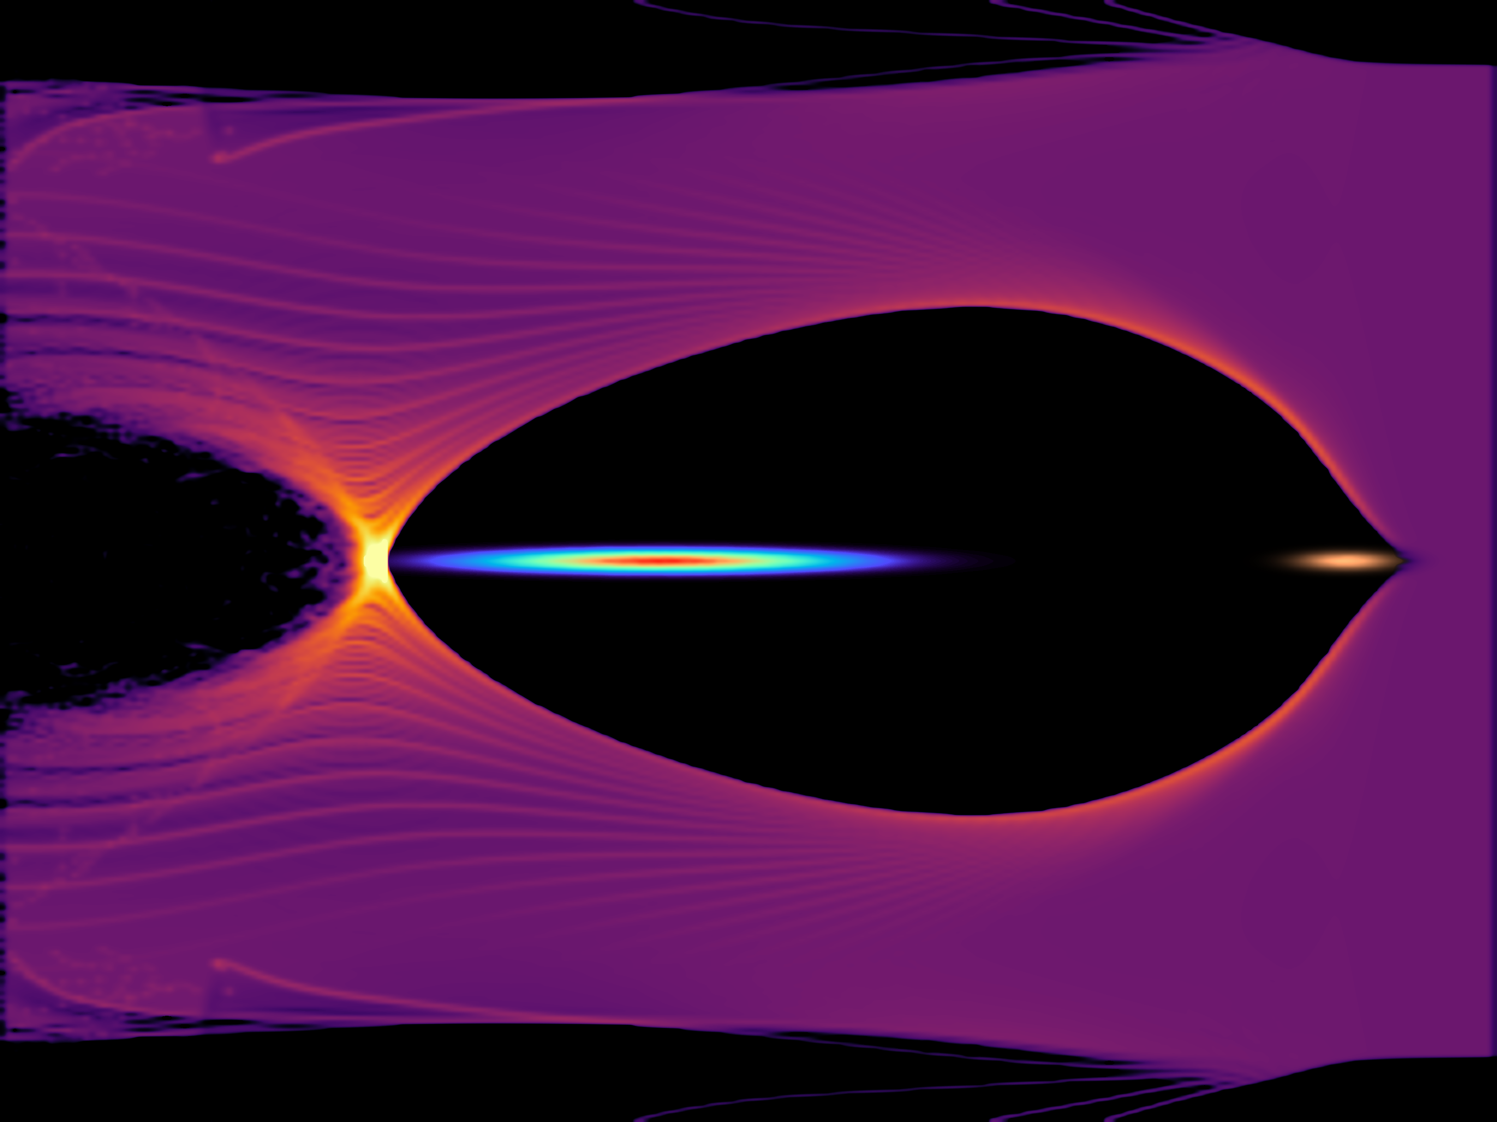
Motivation
PWFA Simulation
Independent transverse and longitudinal measurement of drive and witness beam for Plasma Wakefield Acceleration (PWFA).
Require precise transverse alignment for emittance preservation.
Require precise longitudinal separation to minimize energy spread and maximize efficiency.
Non-destructive shot by shot measurement
z
Witness Beam
Drive Beam

Slide 4
Background: EO Sampling
EO Spatial Encoding Scheme
e⁻ beam
γ
e⁻ beam
γ
e⁻ beam
γ
e⁻ beam
γ
e⁻ beam
γ
k
Laser
k
k
Laser
k
Laser
EO Crystal
EO Crystal
EO Crystal
Laser
EO Crystal
EO Crystal
k
Laser
Temporal information mapped to transverse profile of laser¹.
Rotated Polarization

Slide 5
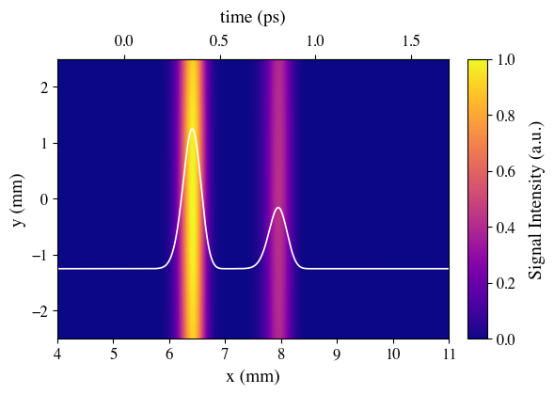
Background: EO Sampling
Image on camera
e⁻ beam
k
γ
Laser
Drive
Witness
Polarizer
Horizontally polarized
Polarizer
Vertically Polarized
CMOS Camera

Slide 6
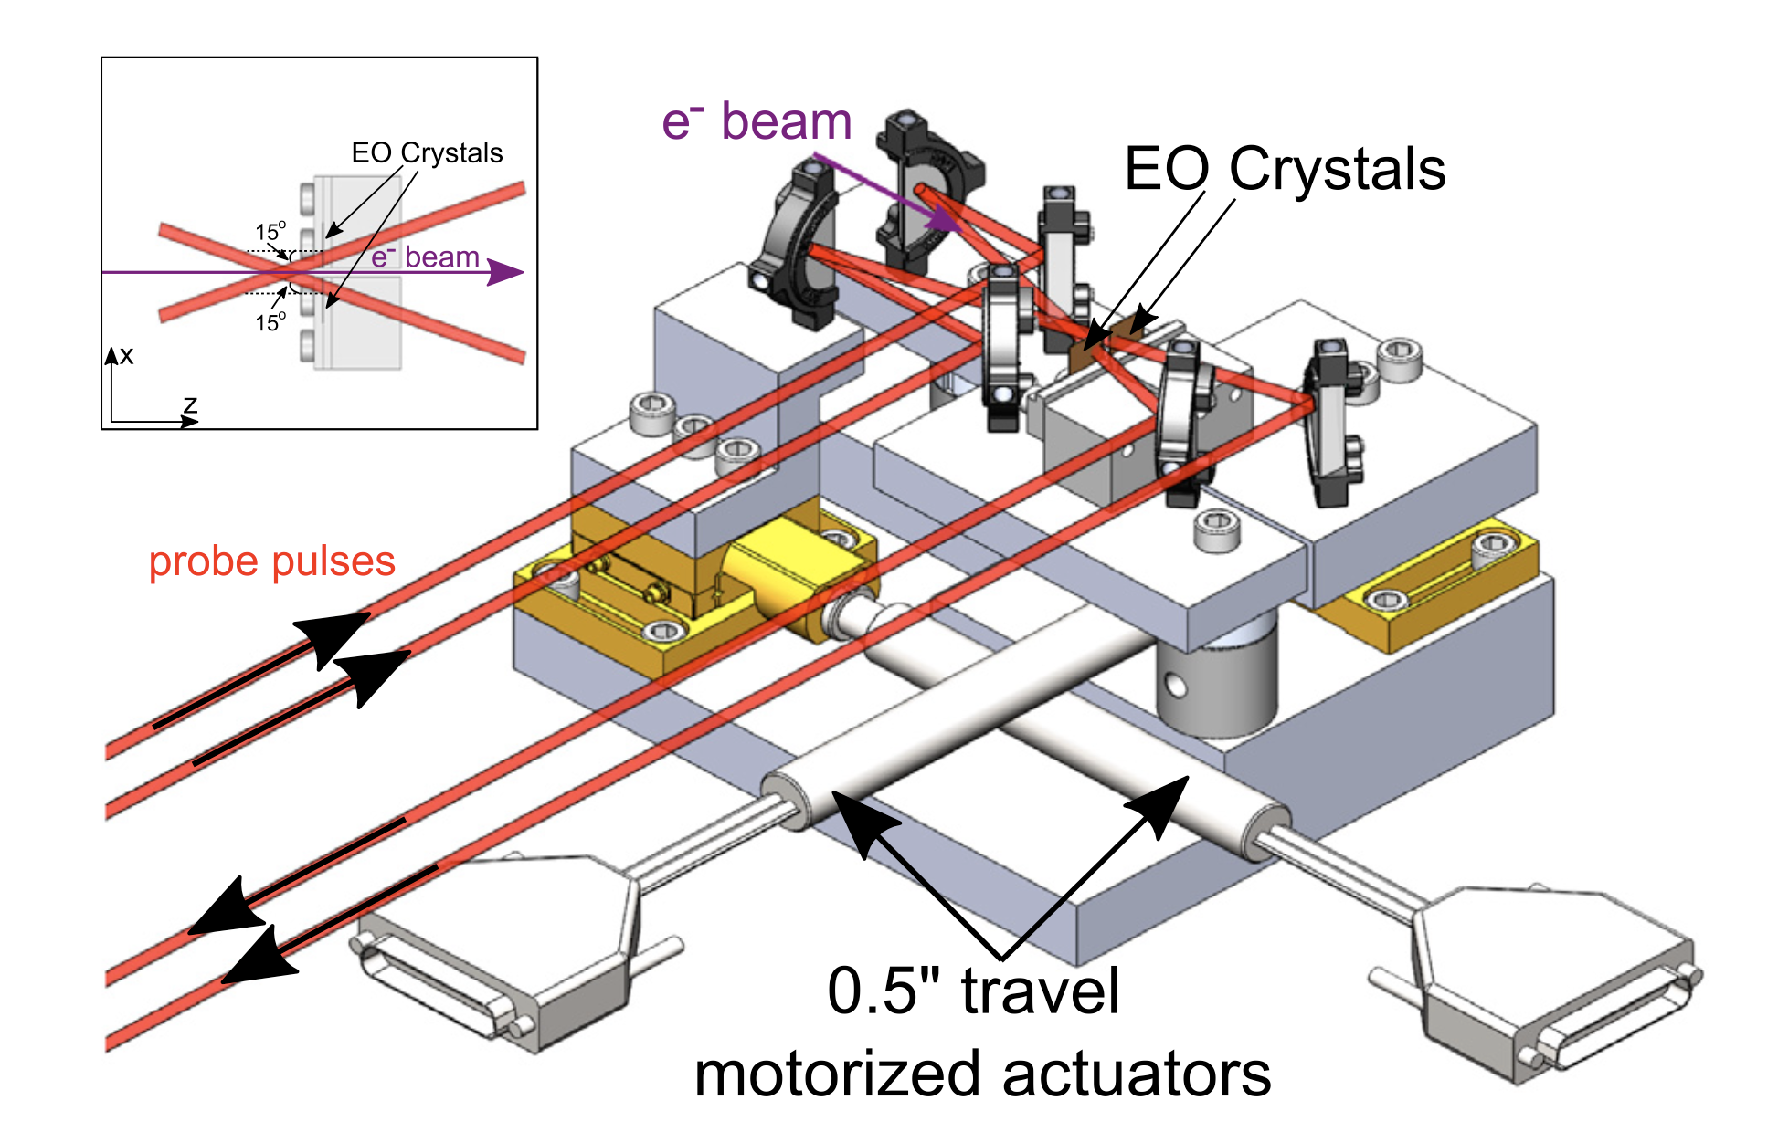
Electro Optic Sampling Beam Position Monitor
EOS BPM Mk.1
EO Crystal
e⁻ beam
EO Crystal
Leverages correlation between strength of phase retardation and location of e⁻ beam with respect to crystal².
Laser

Slide 7
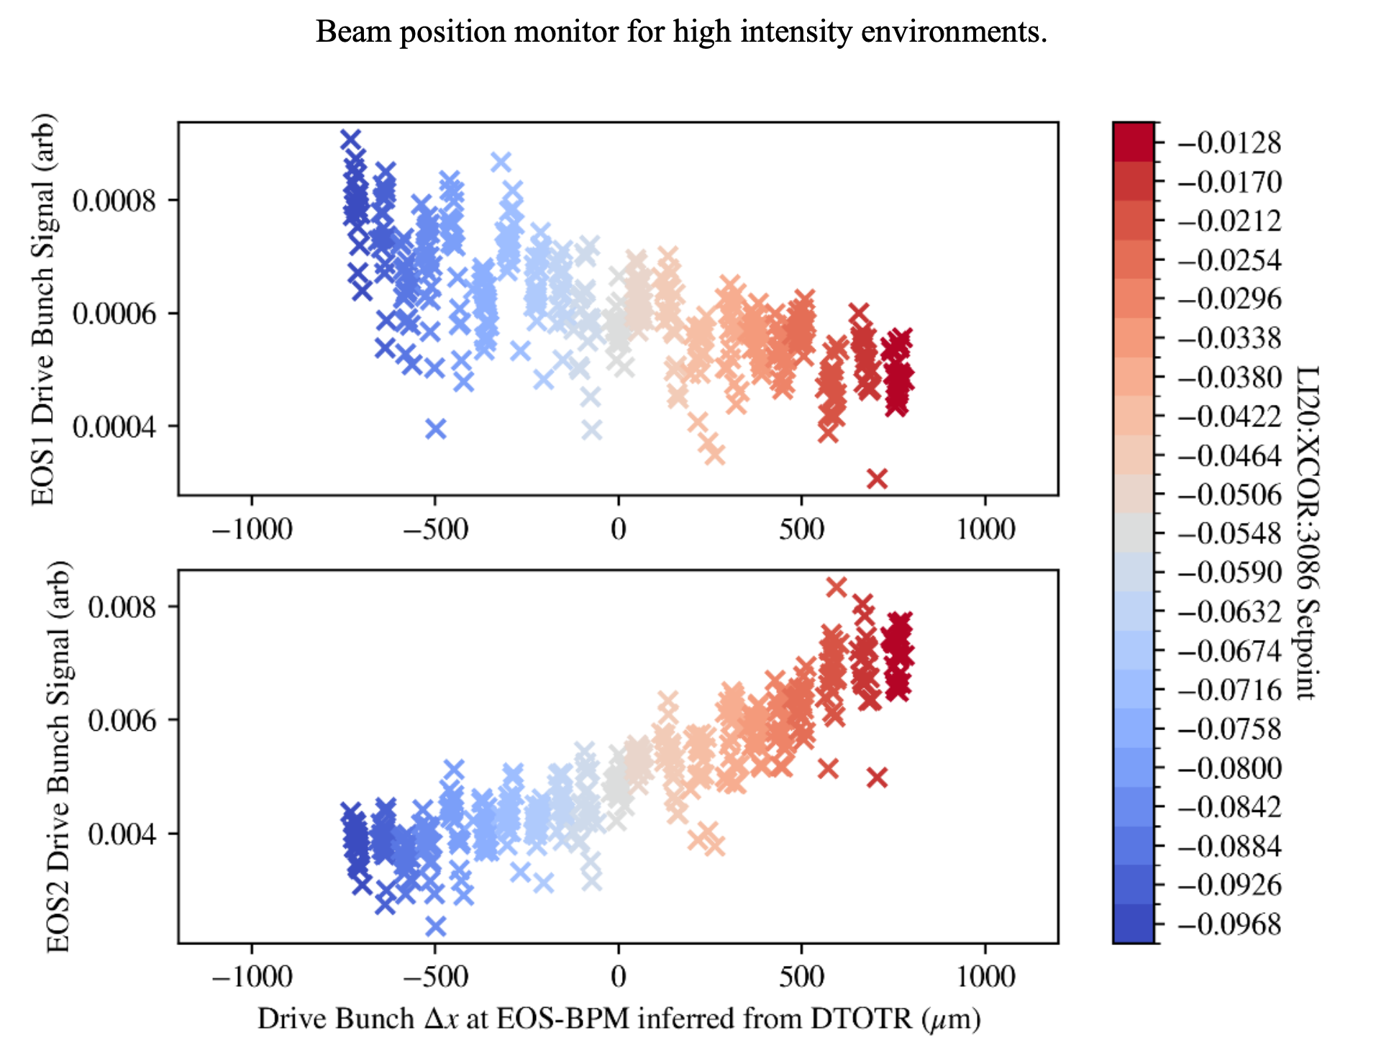
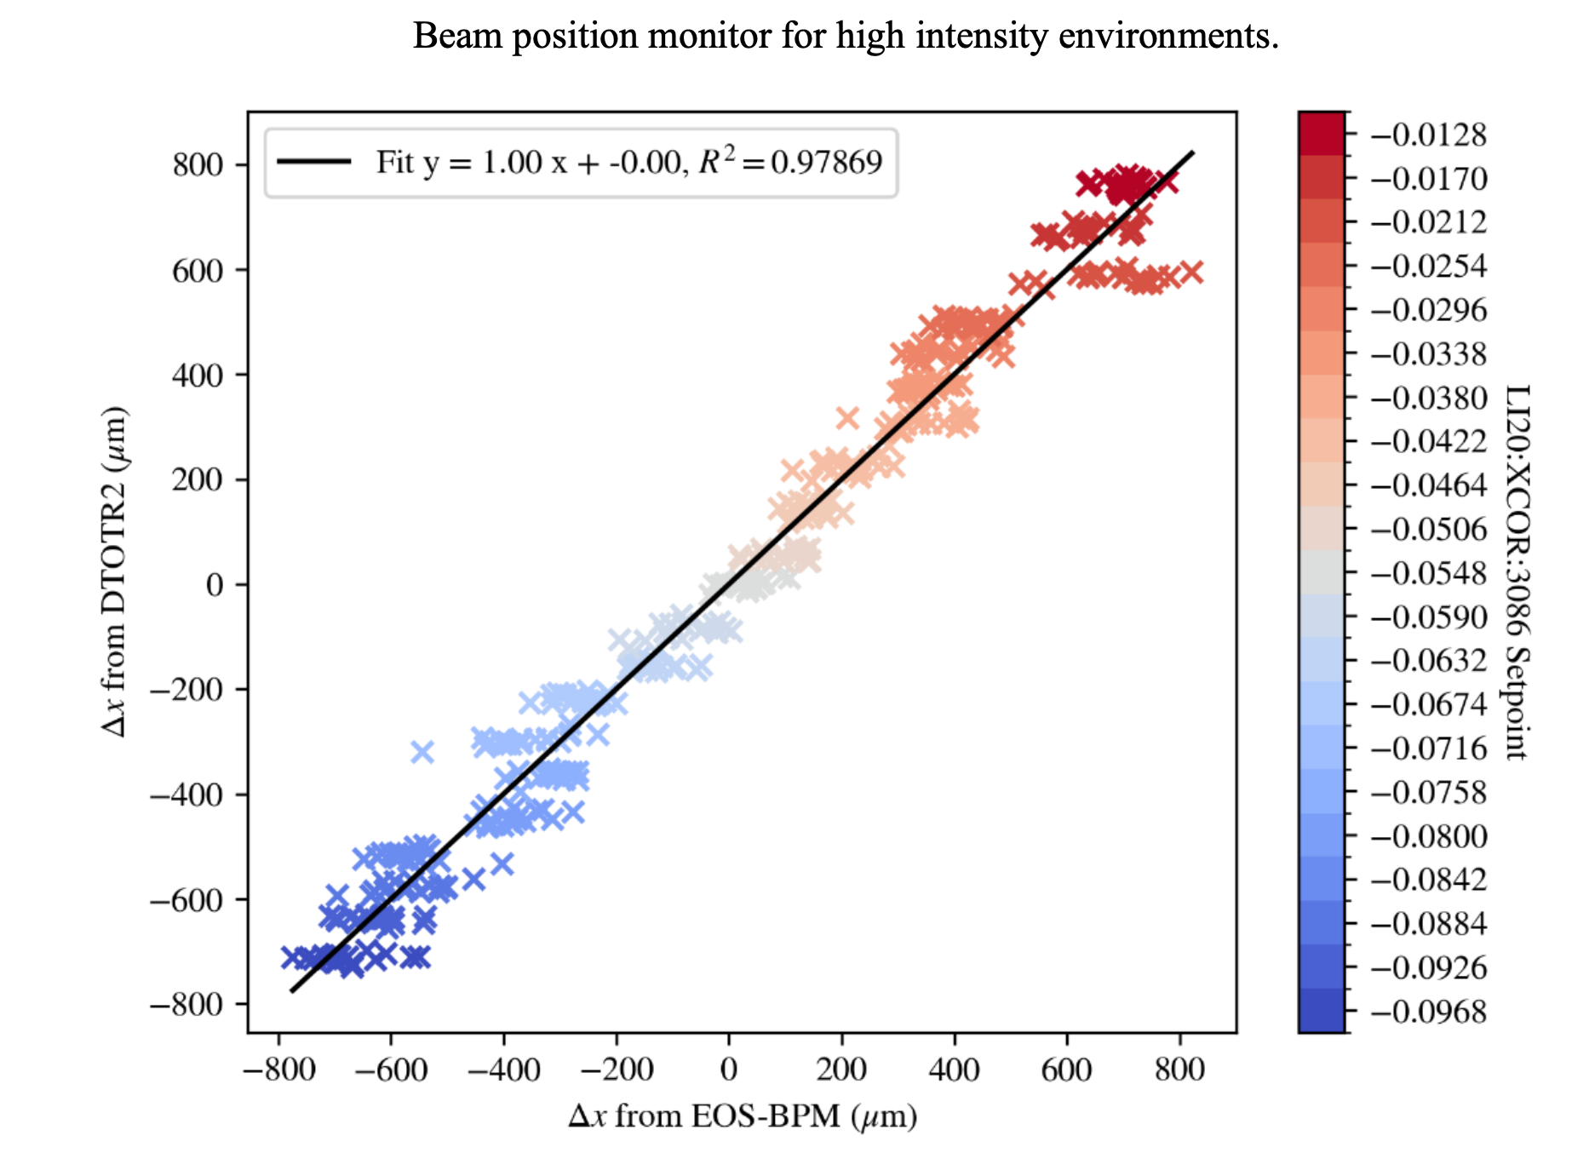
EOS BPM Mk1. / Experimental Data
Beam position monitor for high intensity environments
EOS1 Drive Bunch Signal (arb)
Δx from DTOTR2 (μm)
EOS2 Drive Bunch Signal (arb)
Δx from EOS-BPM (μm)
Drive Bunch Δx at EOS-BPM inferred from DTOTR (μm)

Slide 8
EOS BPM Mk.2 Design
EO Crystal
Axicon creates circular donut
4 crystals around e⁻ beam axis
More complete azimuthal coverage allows for position measurement in x and y.
Increase in total signal leads to better temporal and transverse resolution.
k
e⁻ beam
k
4 Crystal Design
Tilted Pulse Front
5º angle of incidence (θ)
3 ps temporal window
θ
4 10mm x 10mm 100μm thick GaP wafers
Axicon

Slide 9
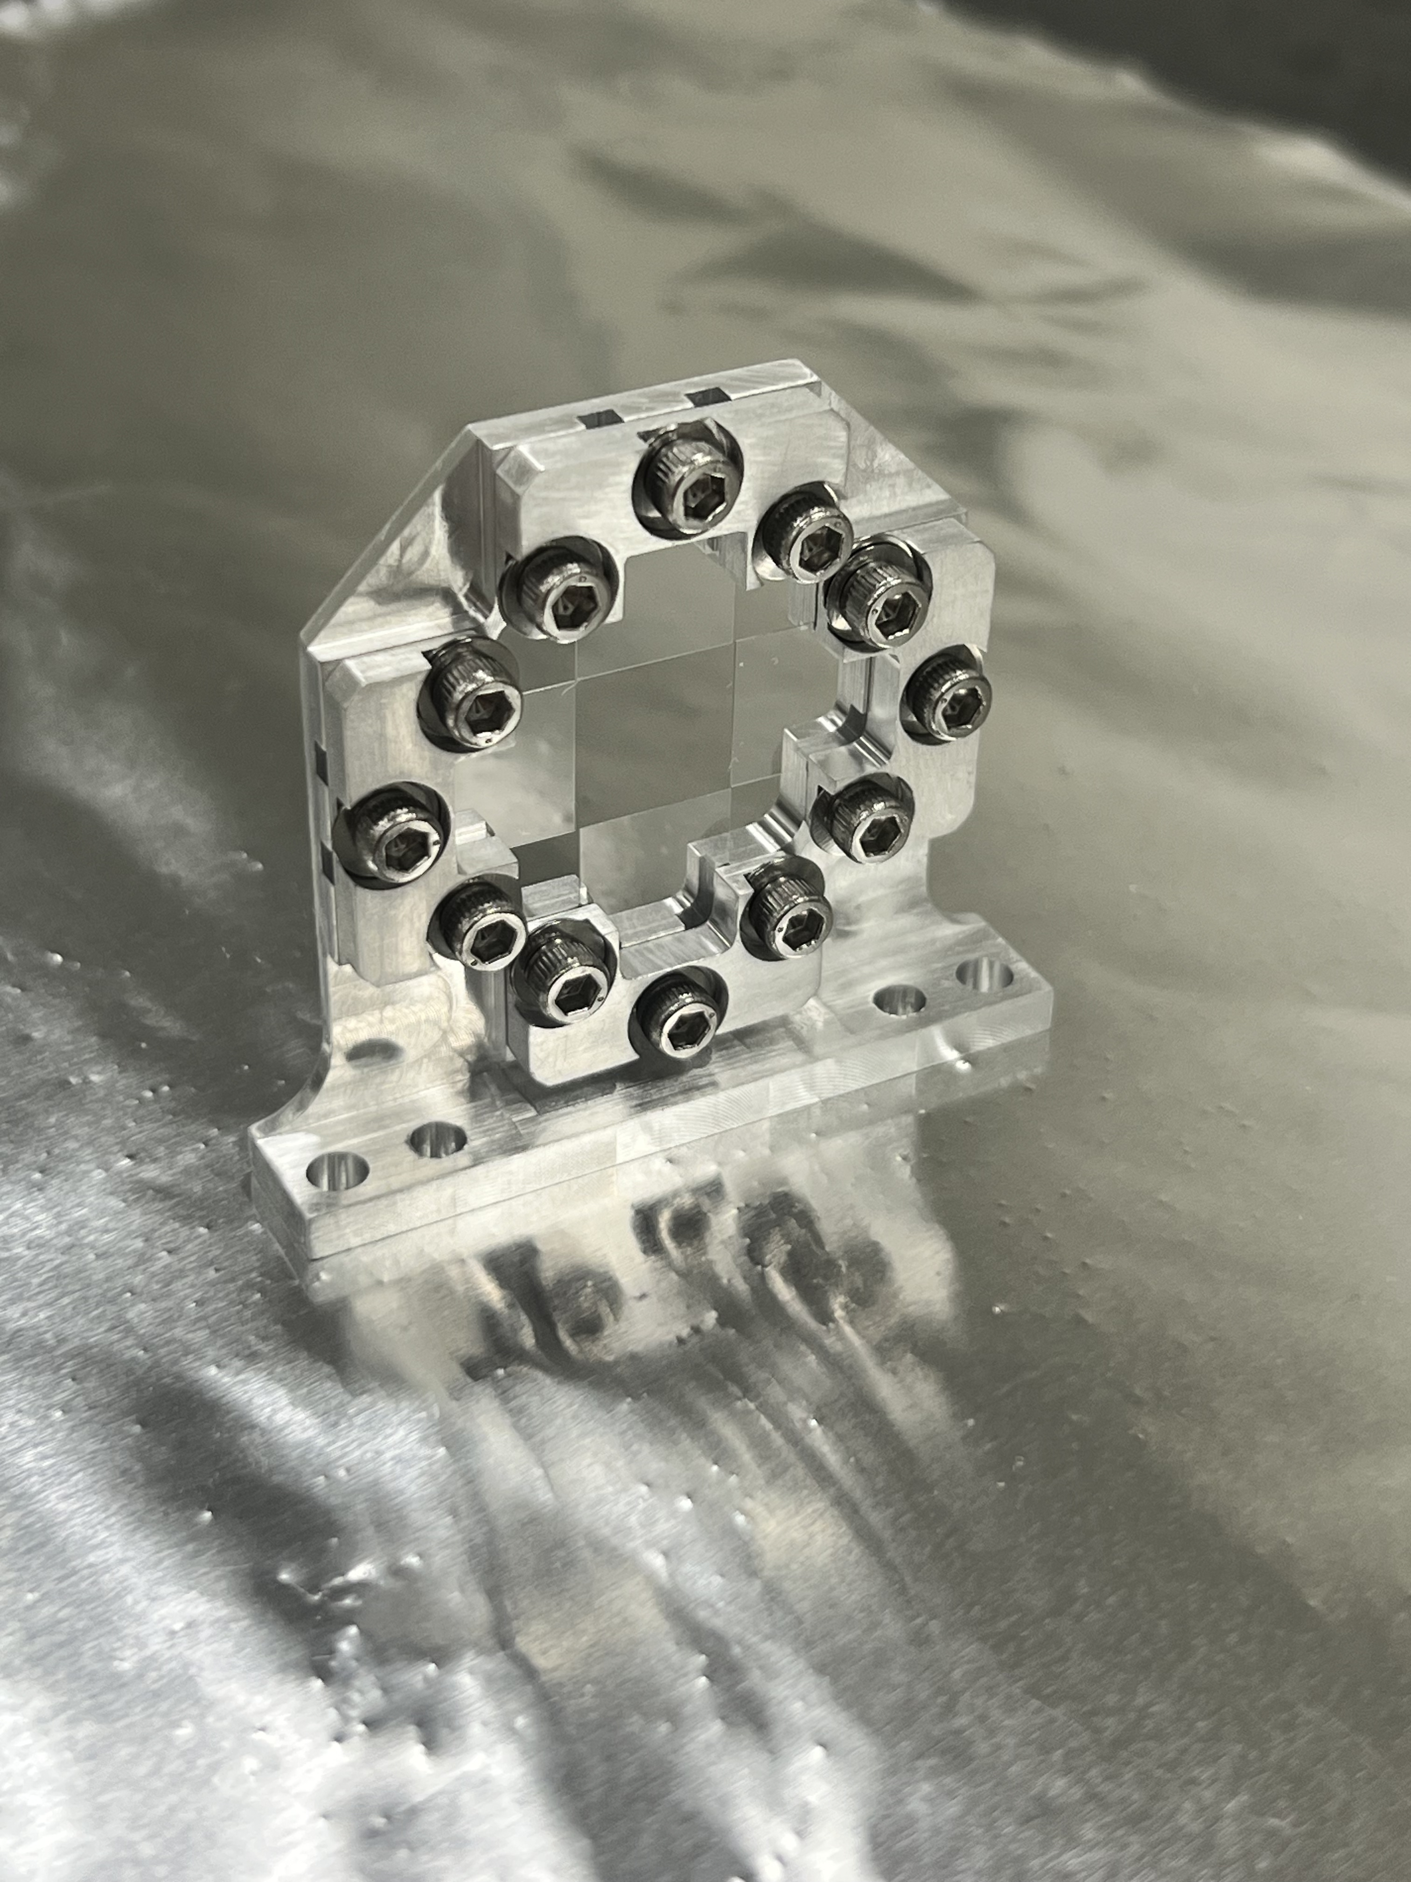
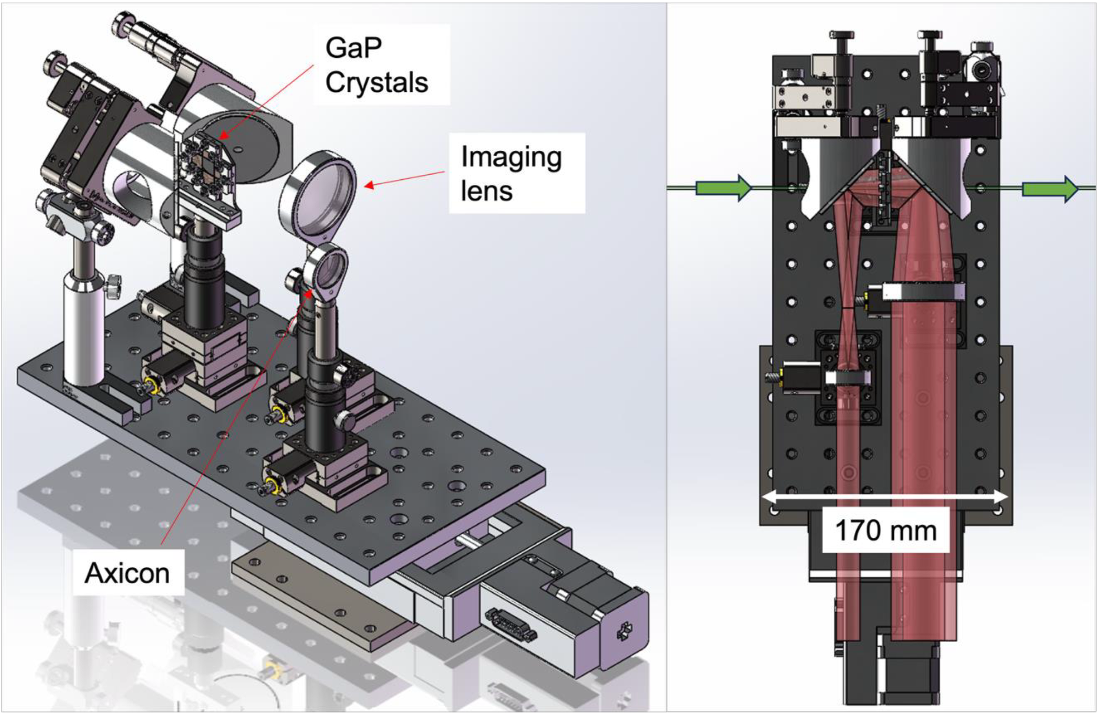
CAD Model/Pictures Inside Picnic Basket
e⁻ beam
This design fits on the delay stage currently installed for EOS in the picnic basket.
Mounted 100μm Glass Wafers in EOS BPM Mk.2 Crystal Holder

Slide 10
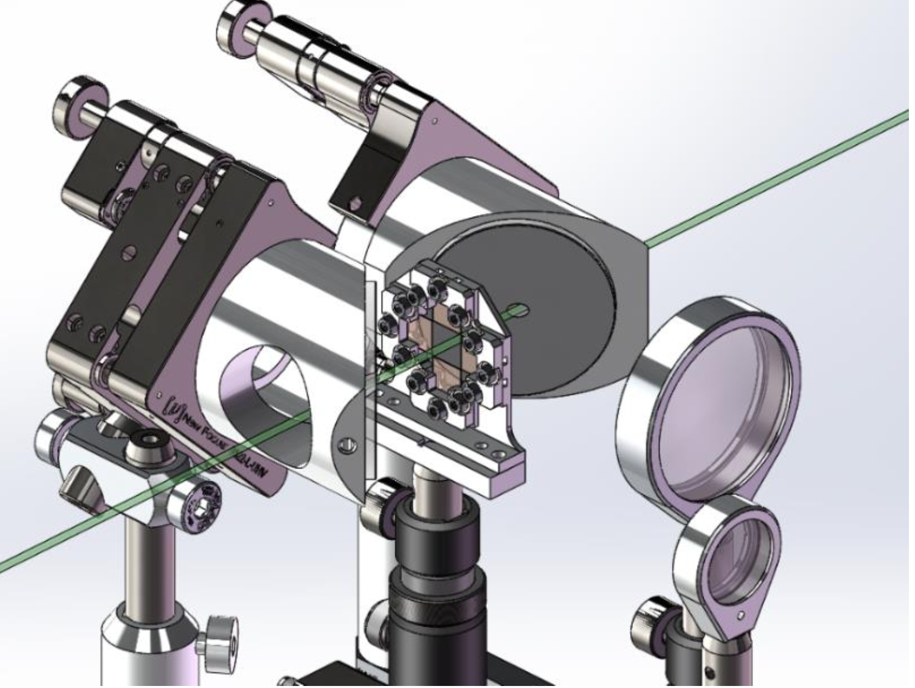
Limiting Aperture
Mirrors have 4 mm hole diameter and are 6.7 mm thick.
If this is too tight for some applications we would be able to swap out the breadboard on the stage for a different configuration for those experiments.
- Crystal minimum aperture is 1 cm

Slide 11
Outside of Picnic Basket
Picnic Basket
Lens 3
Plan to install EOS 2 camera to look at either the “negative” signal or unfiltered laser
“negative” signal: overall more signal to use
unfiltered laser: better background correction
Lens 2
Lens 4¹
Lens 4²
x 1.5
Lens 5¹
Polarizer (H)
Lens 1
EOS Cam 1
Polarizer (V)
Lens 5²
Polarizer (H)
Waveplate
EOS Cam 2

Slide 12
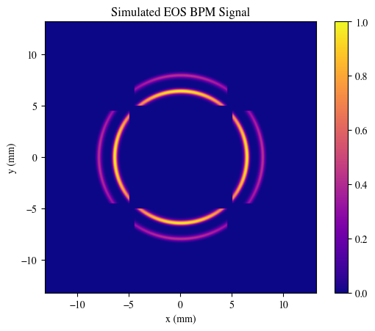
EOS BPM Mk.2 Simulation
Parameter | Value | Unit
Laser Wavelength | 800 | nm
Laser Angle | 5 | degree
Drive Beam Charge | 1000 | pC
Witness Beam Charge | 800 | pC
Time Delay btw. Beams | 450/135 | fs/μm
Transverse Beam Offset Drive | ~10 | μm
Transverse Beam Offset Witness | ~10 | μm
Bunch Length (Both) | 50/15 | fs/μm
GaP Wafer Thickness | 100 | μm
t
Witness
Drive

Slide 13
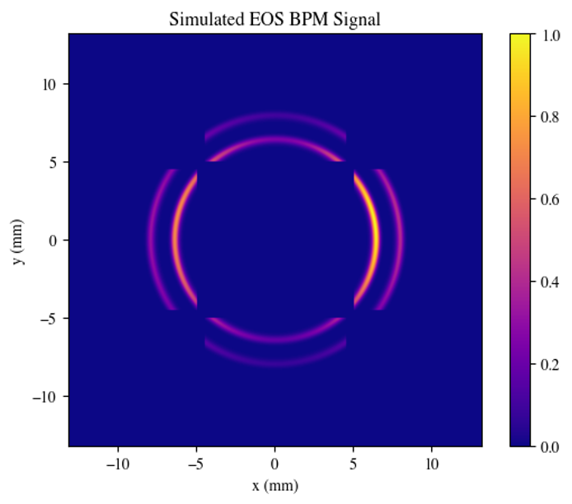


EOS BPM Analysis
Intensity on Camera
$$I\left(α,r\right)=A_{1}{Sin}^{2}\left(\frac{A_{2}}{r}\sqrt{1+3\cos^{2}\left(α \right)}\right)$$
r
α
Temporal window
$$t=\frac{{(r−r}_{i}) sin θ}{c\cos^{2}{θ}}$$
e⁻beam
θ is laser angle of incidence

Slide 14




EOS BPM Analysis with Rotated Crystals
Crystal rotated 90º
Intensity on Camera
$$I\left(α,r\right)=A_{1}{Sin}^{2}\left(\frac{A_{2}}{r}\sqrt{1+3\cos^{2}\left(α \right)}\right)$$
α₁
$$I_{r}\left(α,r\right)=A_{1}{Sin}^{2}\left(\frac{A_{2}}{r}\sqrt{1+3\sin^{2}\left(α \right)}\right)$$
α
α₁ = α +π/2
Temporal window
$$t=\frac{{(r−r}_{i}) sin θ}{c\cos^{2}{θ}}$$
e⁻beam
θ is laser angle of incidence
Crystal rotated 90º

Slide 15
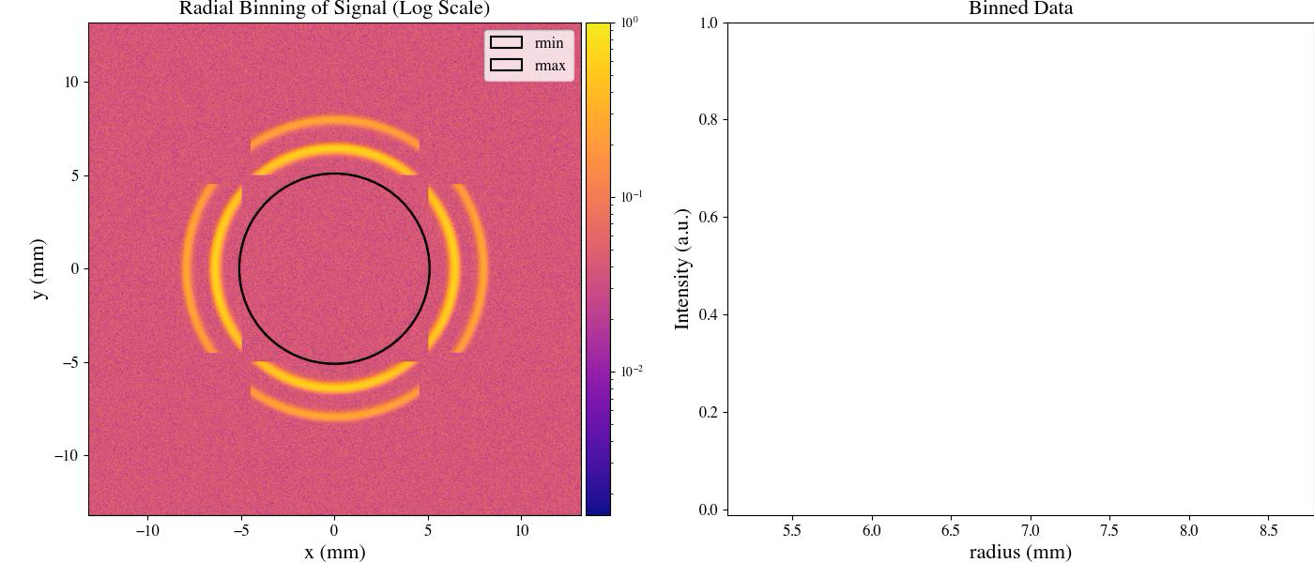
EOS BPM Mk.2 Time of Arrival Analysis

Slide 16
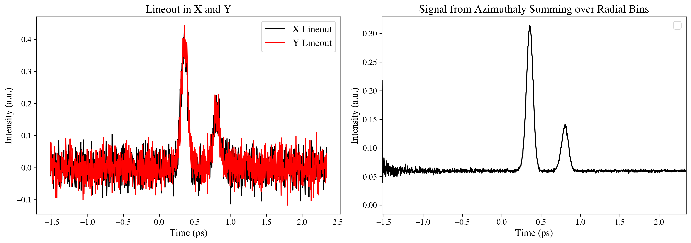
EOS BPM Mk.2 Time of Arrival
SNR Drive Beam: 2.20
SNR Witness Beam: 0.92
SNR Drive Beam: 73.1
SNR Witness Beam: 50.4

Slide 17
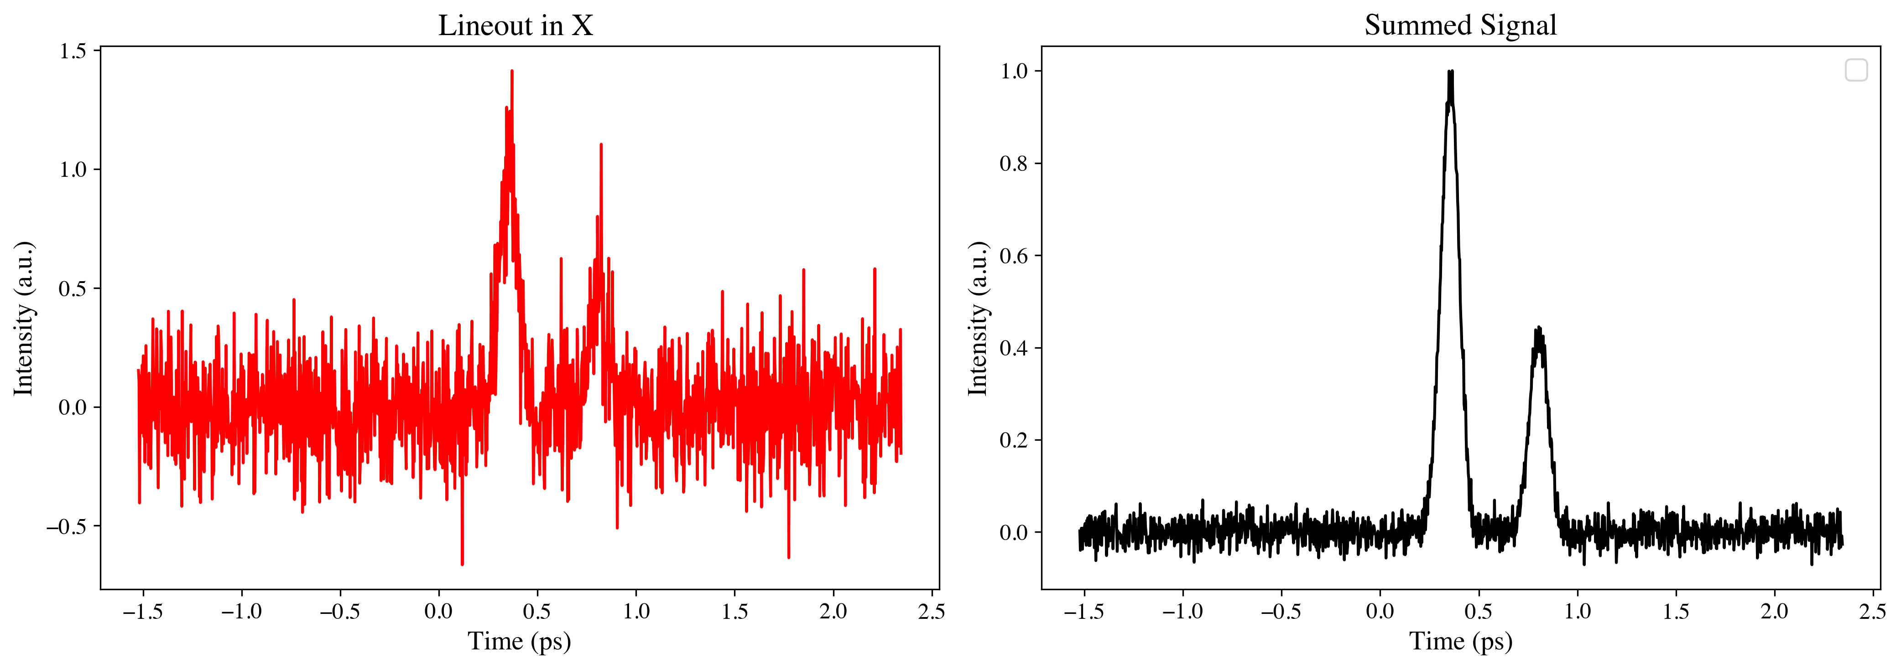
Time of Arrival with 1 crystal
SNR Drive Beam: 1.58
SNR Witness Beam: 0.74
SNR Drive Beam: 11.8
SNR Witness Beam: 4.9

Slide 18
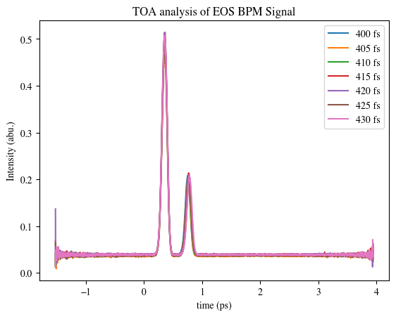
Study of Longitudinal Separation Resolution
Actual Bunch Separation | Fit
400 fs | 397 fs
405 fs | 402
410 fs | 407
415 fs | 412
420 fs | 418
425 fs | 422
430 fs | 428
~ 3 fs resolution with 15 % noise

Slide 19
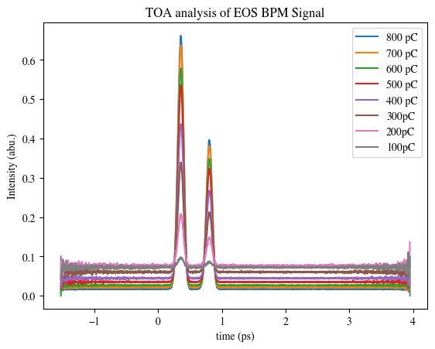
Study of Low Charge Bunches
Actual: 450 fs
Lineout SNR
Azimuthal Summing SNR
Bunch Charge (pC) | Fit (fs) | Drive | Witness | Drive | Witness
800 | 447 | 19 | 12 | 450 | 350
700 | 447 | 14 | 9 | 300 | 230
600 | 447 | 11 | 7 | 260 | 200
500 | 447 | 7 | 4 | 190 | 150
400 | 448 | 5 | 3 | 120 | 100
300 | 448 | 3 | 2 | 80 | 70
200 | 450 | 1 | 1 | 50 | 50
100 | 440 | 0.5 | 0.1 | 35 | 35
5% noise at 800pC

Slide 20
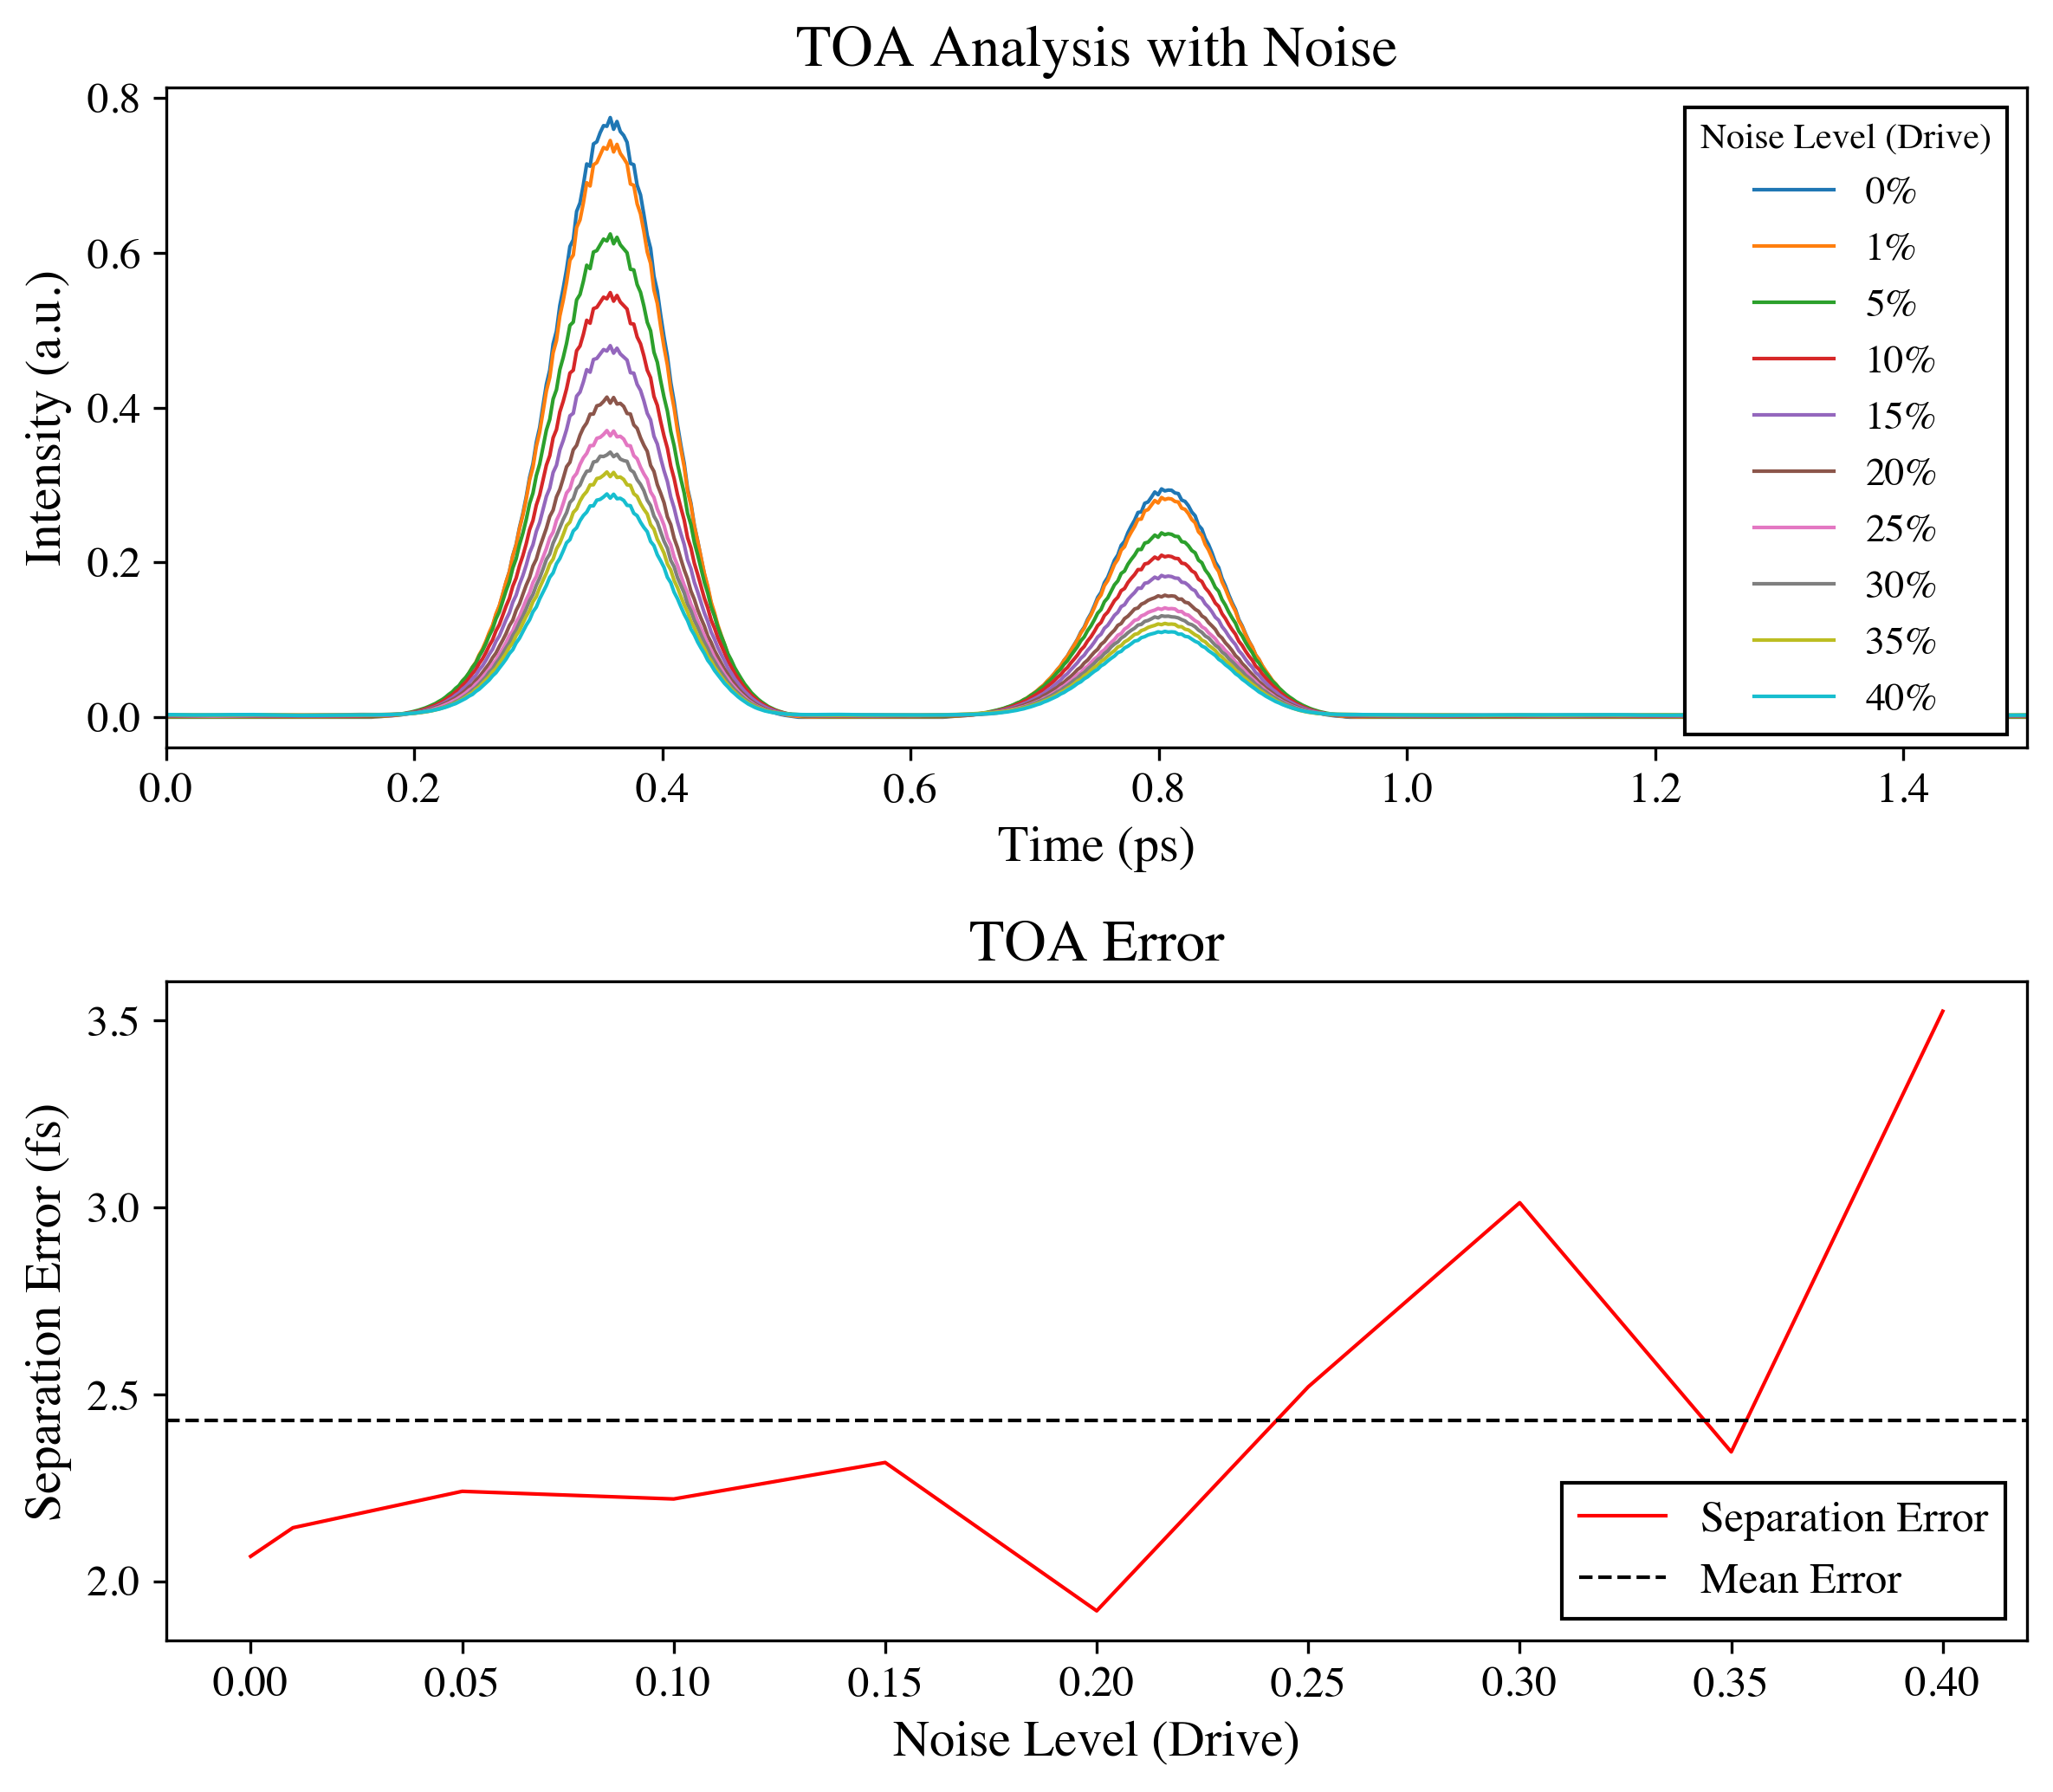
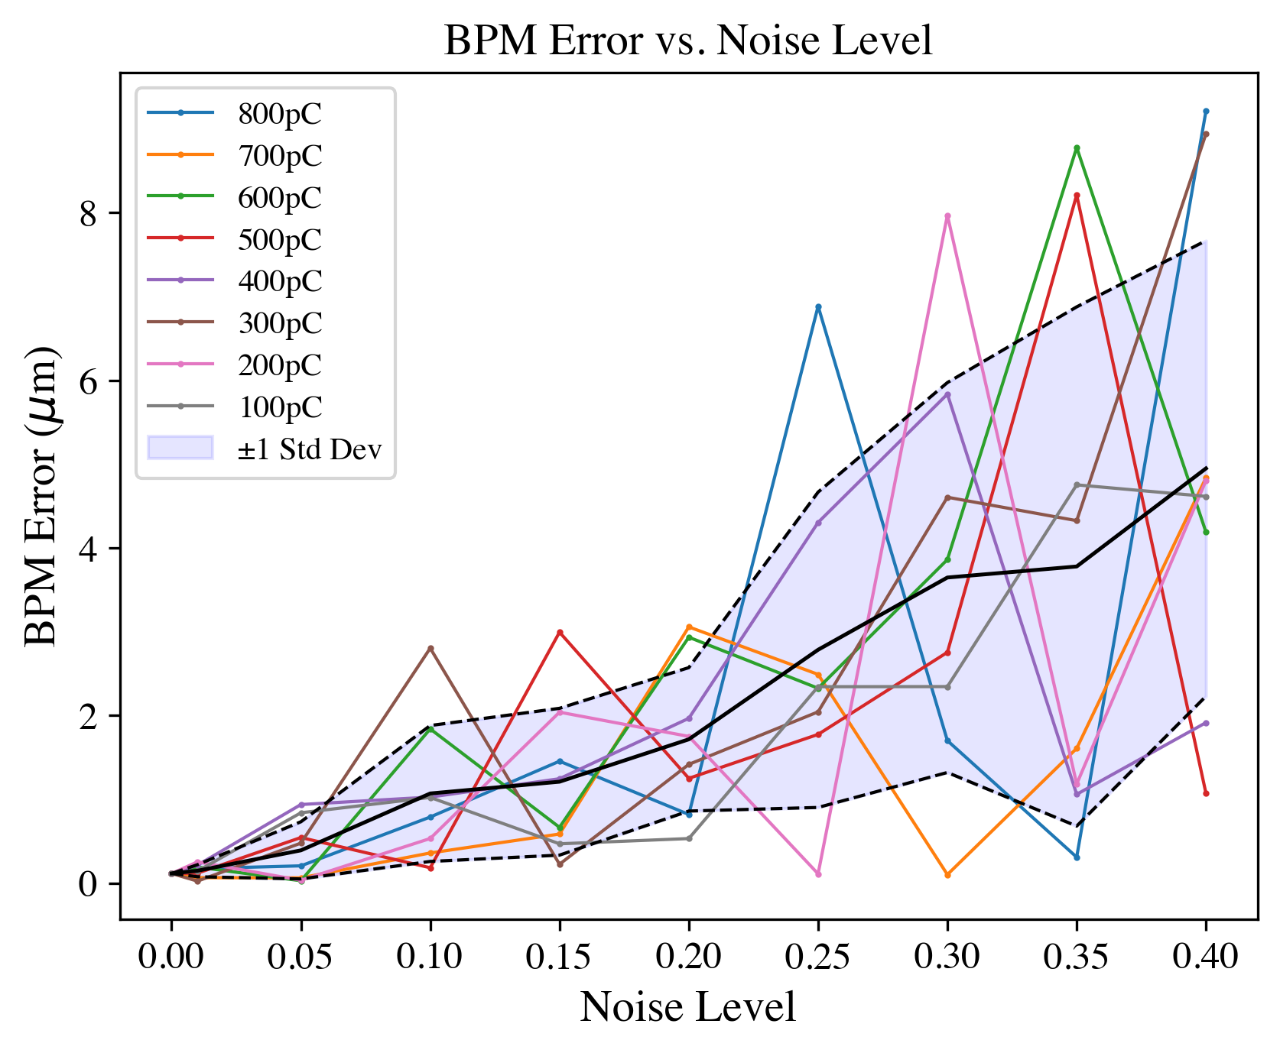
EOS BPM Mk.2 BPM and TOA Results
3 fs TOA resolution
<5 μm transverse resolution

Slide 21
Future Outlook
E300/E301: More precise drive-witness beam alignment for emittance preservation and separation for optimal beam loading for PWFA experiments.
E302: Shot-by-shot measurement of the witness offset for hosing studies in PWFA.
E306: Shot-by-shot measurement of witness offset for ion channel laser (ICL) studies.
E308: Witness-drive offset measurement to quantify kick from plasma lens
E320: Improved TOA measurement for laser and e-beam for strong-field QED studies.
E388: Improved drive-witness separation measurement for PWFA chirp studies.

Slide 22
Summary
Novel ultra-fast optical device for measuring beam centroid location with fs/μm level precision.
  Required for emittance preservation of PWFA.
  Required to minimize energy spread and maximize efficiency.
Expected Resolution:
  Longitudinal: ~ 3fs/1μm for signals with up to 40% noise.
  Transverse: < 5μm for signals with up to 40% noise.
Future Work:
  Install and commission EOS BPM Mk.2 at FACET-II next run.
  Explore the utility of EOS BPM to diagnose tilted beams.

Slide 23
References
[1] A. L. Cavalieri et al., “Clocking Femtosecond X Rays,” Phys. Rev. Lett., vol. 94, no. 11, Mar. 2005, doi: 10.1103/physrevlett.94.114801.
[2] K. Hunt-Stone, R. Ariniello, C. Doss, V. Lee, and M. Litos, “Electro-optic sampling beam position monitor for relativistic electron beams,” Nuclear Instruments and Methods in Physics Research Section A: Accelerators, Spectrometers, Detectors and Associated Equipment, vol. 999, p. 165210, May 2021, doi: 10.1016/j.nima.2021.165210.
[3] S. Casalbuoni, H. Schlarb, B. Schmidt, P. Schmüser, B. Steffen, and A. Winter, “Numerical studies on the electro-optic detection of femtosecond electron bunches,” Phys. Rev. ST Accel. Beams, vol. 11, no. 7, Jul. 2008, doi: 10.1103/physrevstab.11.072802.
[4] B. Steffen et al., “Electro-optic time profile monitors for femtosecond electron bunches at the soft x-ray free-electron laser FLASH,” Phys. Rev. ST Accel. Beams, vol. 12, no. 3, Mar. 2009, doi: 10.1103/physrevstab.12.032802.

Slide 24
Questions

Slide 25
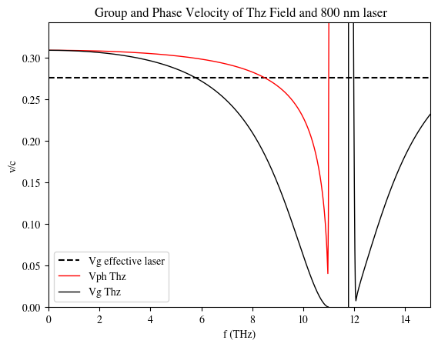
Signal Ringing for Short Bunches
Shorter electron bunches correspond to higher THz frequencies. For GaP the cutoff is ~ 10 THz due to the phase velocity mismatch.
This is better than ZnTe, but there is also the trade off, of lower signal.
The phase mismatch can cause ringing in the signal -> worse TOA resolution.
For FACET-II 100 μm GaP is optimal.

Slide 26
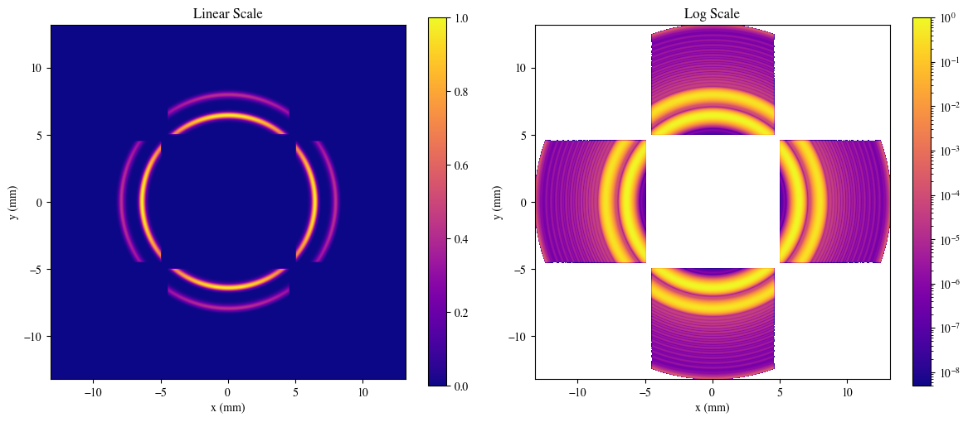
Example of Ringing

Slide 27
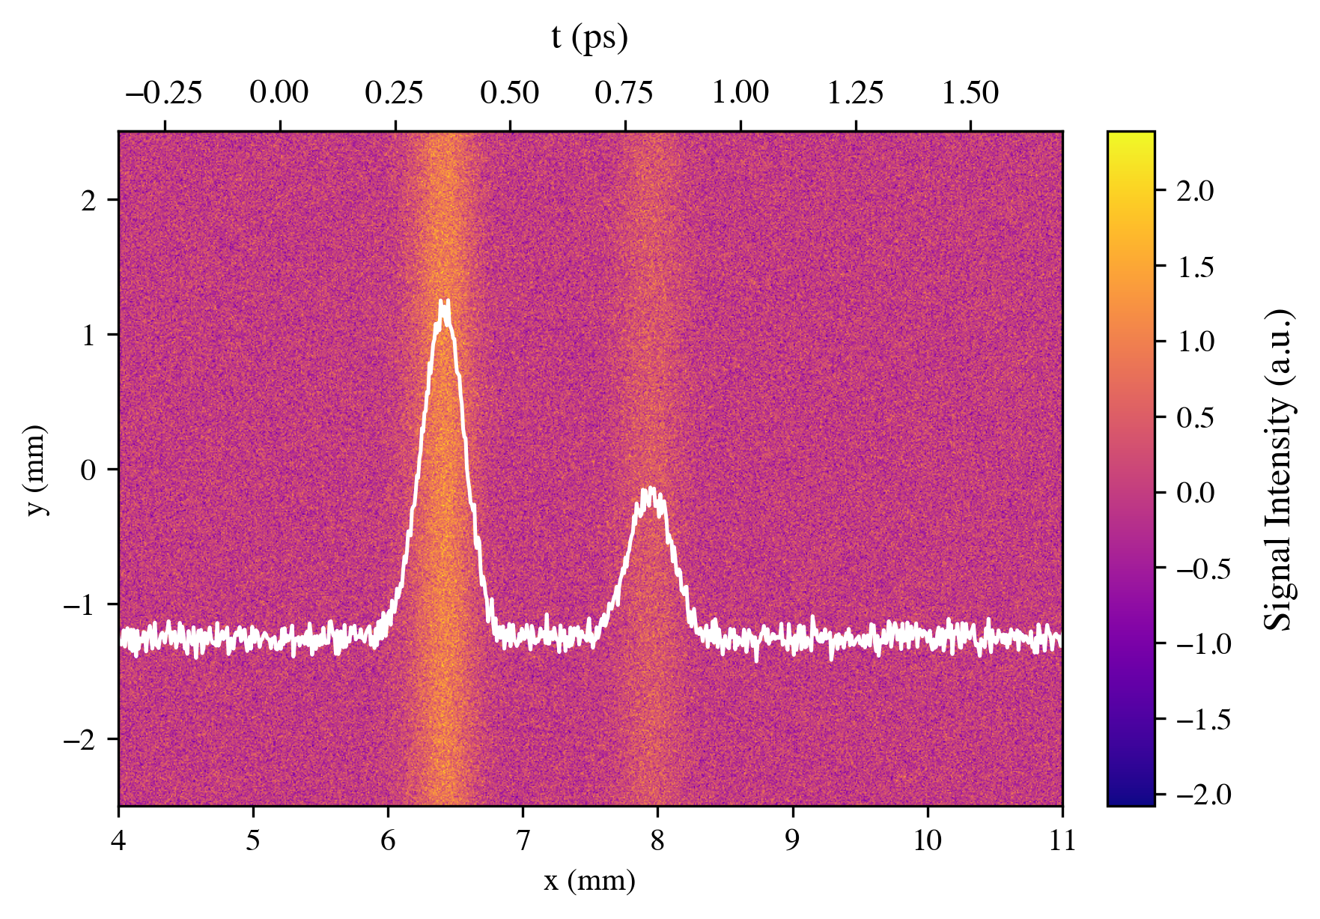
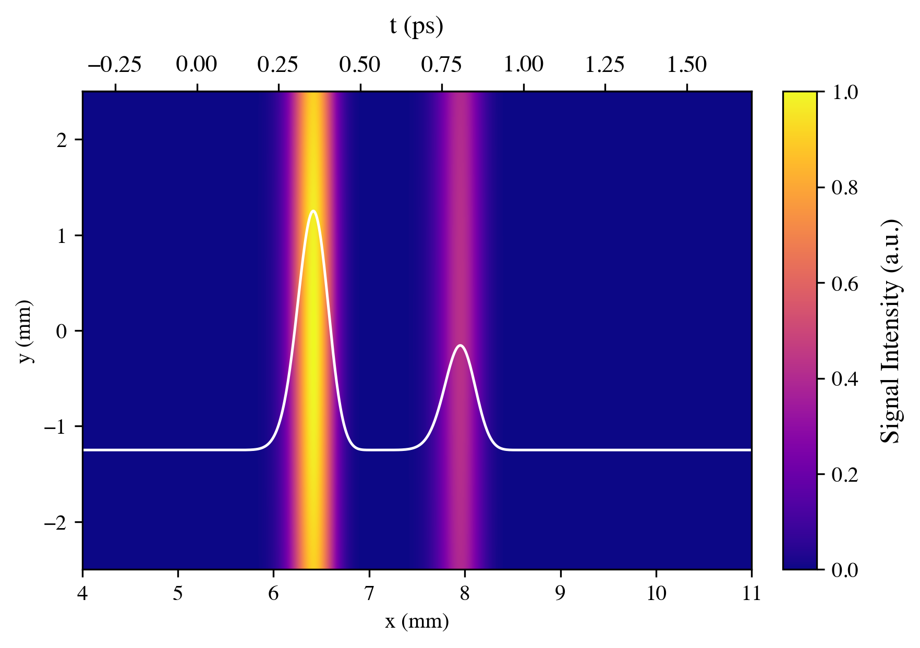
Single Crystal Signal

Slide 28

Phase Retardation of Crystal
EO Crystal
Signal from Phase Retardation
α
$$I\left(α,r\right)=A_{1}{Sin}^{2}\left(\frac{A_{2}}{r}\sqrt{1+3\cos^{2}\left(α \right)}\right)$$
e⁻beam

Slide 29


Phase Retardation of Rotated Crystal Orientation
I_{r}
EO Crystal
α_{r}
Signal from Phase Retardation
α
$$I\left(α,r\right)=A_{1}{Sin}^{2}\left(\frac{A_{2}}{r}\sqrt{1+3\cos^{2}\left(α \right)}\right)$$
I
I
$$I_{r}\left(α,r\right)=A_{1}{Sin}^{2}\left(\frac{A_{2}}{r}\sqrt{1+3\sin^{2}\left(α \right)}\right)$$
I_{r}
e⁻beam
$$α=α_{r}+\frac{π}{2}$$
EO Crystal rotated 90º

Slide 30


BPM Analysis
Region I
Region II
Region I
α₂
r₂
r₁
α₁
$$I\left(α_{1},r_{2}\right)=A_{1}{Sin}^{2}\left(\frac{A_{2}}{r_{1}}\sqrt{1+3\cos^{2}\left(α_{1}\right)}\right)$$
$$I\left(α_{2},r_{2}\right)=A_{1}{Sin}^{2}\left(\frac{A_{2}}{r_{2}}\sqrt{1+3\sin^{2}\left(α_{1}\right)}\right)$$

