Slide 1

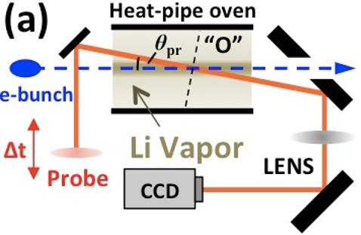
Lifetime of 10Hz, 10 GeV Beam Driven Wakes in H2, Ar and Li at the FACET-II Facility
Jason Brooks, Rafal Zgadzaj, Timothy Araujo, Robert Ariniello, Michael Downer
E-224 publications: Zgadzaj et al., “Dissipation of electron-beam-driven plasma wakes,” Nature Commun. 11, 4753 (2020).
Khudyakov et al., "Ion dynamics driven by strongly nonlinear plasma wake," PPCF 64, 045003 (2022).
Chang et al., "Faraday rotation study of plasma bubbles in GeV wakefield accelerators," PoP 28, 123105 (2021).
Silva et al., “Stable positron acceleration in thin, warm, hollow plasma channels,“ PRL 127, 104801 (2021)
Experiment Goal: observe, analyze, understand post-wake plasma recovery and its potential bearing on accelerator repetition rates

Slide 2

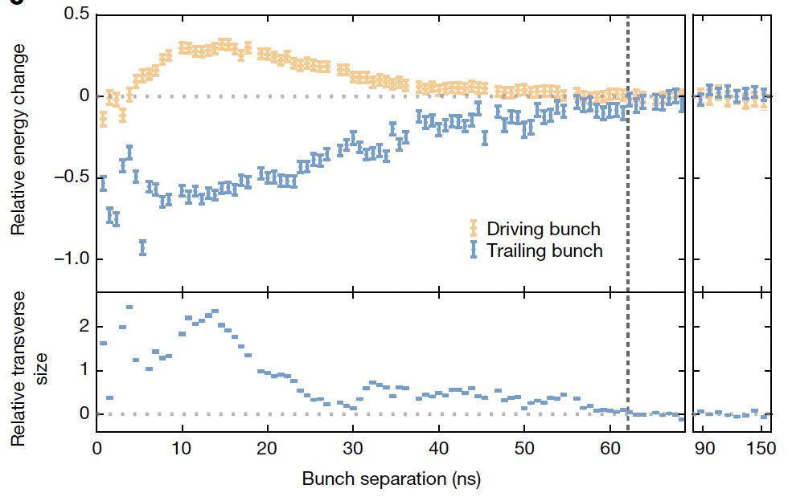
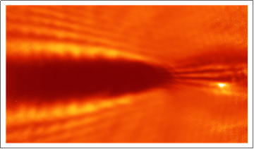
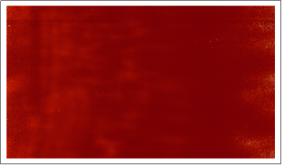
A recent DESY experiment reported
~60 ns plasma recovery time (lower limit)
D’Arcy et al. “Recovery time of a plasma-wakefield accelerator.” Nature 603, 58 (2022).
FlashForward parameters:
• drive bunch: 1 GeV, 0.5 nC
FACET-II parameters:
• plasma: 1.75 x 10¹⁶ cm⁻³ Ar
• drive bunch: 10 GeV, 2 nC
• plasma: 5 x 10¹⁶ cm⁻³ Li
• probe: secondary PWFA driver
at 1 ns < ∆t ≤ 150 ns + trailing
witness bunch
• optical probe at
1 ns < ∆t < ms
• Previous experiment observations:
• “recovery” measured after
single shots only. No account
of cumulative plasma heating.
10 Hz heated Li oven tens ˚C within minutes
“Hail Mary” E-224 result (Zgadaj, 2020):
0.3 ns
10 µs
FACET-II is uniquely positioned to resolve current
orders-of-magnitude uncertainty in plasma recovery time
Notes:
Plasma based accelerators and light sources - need to know rep rate for operation comparable to match conventional equivalents (luminosity and brilliance)
Meter scale beam driven plasma targets are more sensitive than e.g. gas jets because there’s no rapid laminar flow
Gas jets also carry complications/limitations at high rep rate
How rapidly does a stationary, meter scale plasma recover, and is recovery time dependent on rep rate, beam energy and/or charge?
J/m heating; developing probes to measure [R. Zgadzaj et al., Nat Commun 11, 4753 (2020)]
Similar study in H2 performed in R.Pompili et al., Commun Phys 7, 241(2024).

Slide 3
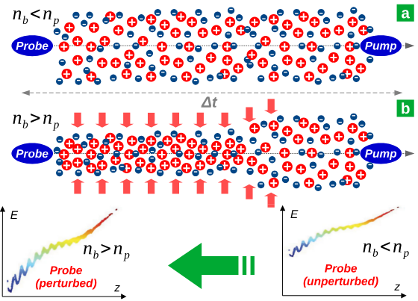
Another recent experiment reported ~0.7 ns plasma recovery time in H₂
R.Pompili et al., “Recovery of hydrogen plasma at the sub-nanosecond timescale in a plasma-wakefield accelerator” Commun Phys 7, 241(2024).
SPARC_LAB parameters:
• Drive bunch: 0.084 GeV, 0.5 nC, 167 fs duration
• Gas species: H₂ in 3 cm capillary
• Probe: trailing 0.084 GeV bunch
• Stated findings: Pump probe recovery at <0.7ns
Notes:
Plasma based accelerators and light sources - need to know rep rate for operation comparable to match conventional equivalents (luminosity and brilliance)
Meter scale beam driven plasma targets are more sensitive than e.g. gas jets because there’s no rapid laminar flow
Gas jets also carry complications/limitations at high rep rate
How rapidly does a stationary, meter scale plasma recover, and is recovery time dependent on rep rate, beam energy and/or charge?
J/m heating; developing probes to measure [R. Zgadzaj et al., Nat Commun 11, 4753 (2020)]
Similar study in H2 performed in R.Pompili et al., Commun Phys 7, 241(2024).

Slide 4
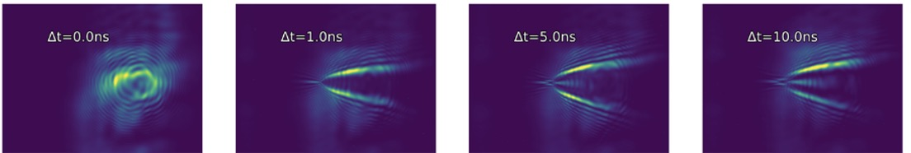
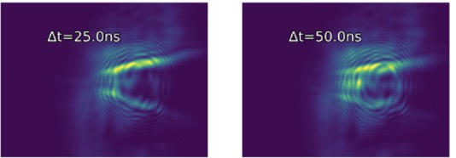
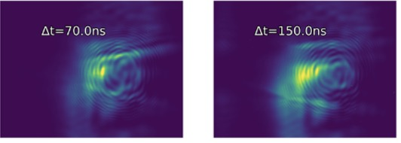
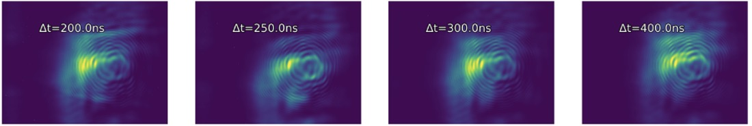
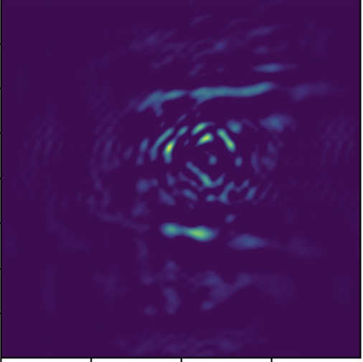
Shallow angle shadowgraph results in 1 Torr Ar plasma
DESY accelerator parameters:
+Z
f=750 mm
1:1 imaging
• drive bunch: 1 GeV, 0.5 nC -> 10 GeV, 1 nC
Θ=17 mrad
P1
CCD
• plasma: 1.75 x 10¹⁶ cm⁻³ Ar -> 3x10^16 Ar
Ar plasma
Obj plane
2
∆t < 0
1 ns
5 ns
10 ns
25 ns
50 ns
+Z
0
-Z
r [mm]
P1
In-focus slice
-2
Expanding plasma
2
70 ns
150 ns
200 ns
250 ns
300 ns
400 ns
250 ns
0
r [mm]
-2
• expanding plasma observed out to ∆t ~ 300 ns (~4x longer than DESY results)
-- similar results obtained in 3 Torr Ar
background-subtracted,
spatially-filtered
Notes:
Repeating every 60 ns can lead to cumulative heating

Slide 5
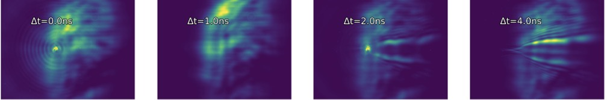
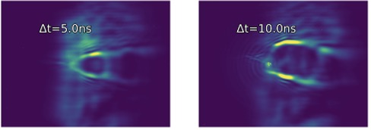
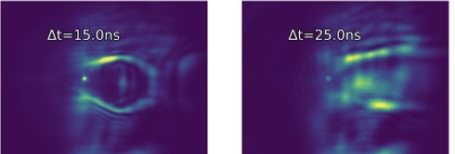
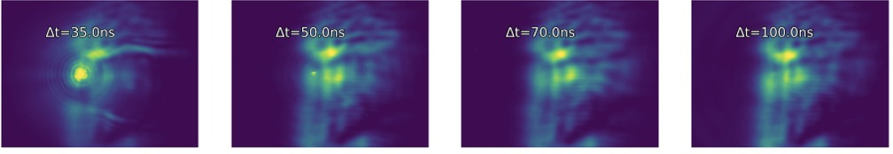
We observed 5-6x faster ion wake evolution in H₂ plasma
3 Torr H₂ plasma, e-beam-ionized (June 16-17, 2024 run)
2
∆t < 0
1 ns
2 ns
4 ns
5 ns
10 ns
r [mm]
0
-2
2
15 ns
25 ns
35 ns
50 ns
70 ns
100 ns
0
r [mm]
-2
• Plasma structures no longer discernible for ∆t ≥ 70 ns
original probe profile
• Faster evolution consistent with ion motion governing plasma dynamics for ∆t ≳ 0.3 ns *
* Zgadzaj et al., Nature Commun. 11, 4753 (2020).

Slide 6
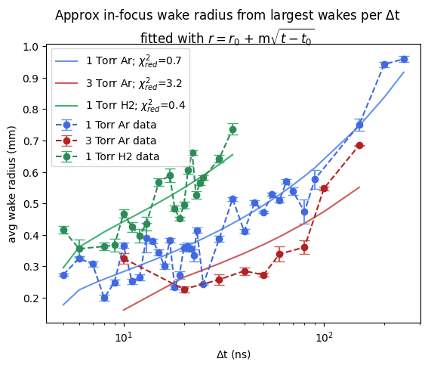
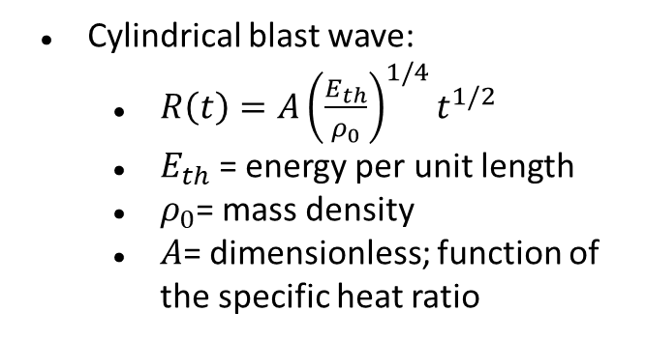
Ion wake radius vs time
1.0
1 Torr Ar fit
3 Torr Ar fit
0.8
3 Torr H2 fit
Cylindrical blast wave:
$R\left(t\right)=A{\left(\frac{E_{th}}{ρ_{0}}\right)}^{1/4}t^{1/2}$
$E_{th}$= energy per unit length
$ρ_{0}$= mass density
$A$= dimensionless; function of the specific heat ratio
0.6
3
Average wake radius (mm)
0.4
0.2
10¹
10²
time delay ∆t after e-bunch (ns)
Notes:
.

Slide 7
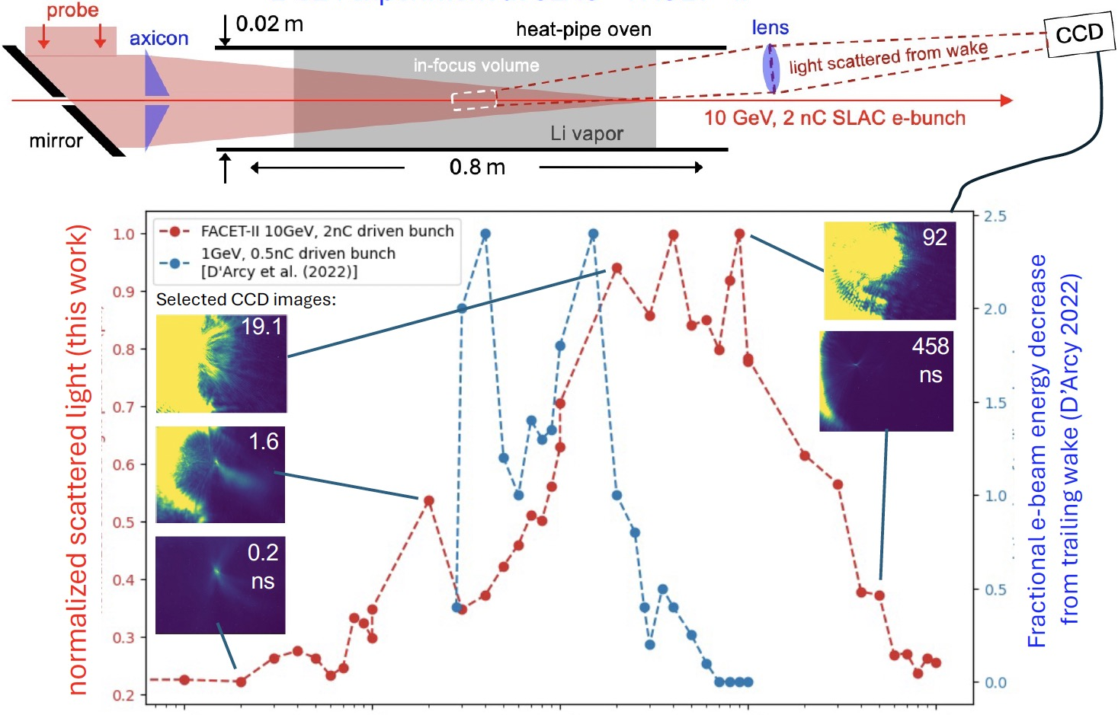

Scattered light from probe persists up to ~1us in Li oven
Θ$\sim$5 mrad
CCD
Obj plane
f=750 mm
1:1 imaging
10⁻¹
10⁰
10¹
10²
10³
time delay ∆t after e-bunch (ns)
Notes:
Plot in red shows sum of all pixels measured by scattered light from 6 mrad probe in Li with blue showing relative size of trailing e bunch measured in [D’Arcy et al. 2022]
Different beam energies, charge, gas species ( blue line Ar plasma with e density ~10¹⁷ cm⁻³; red line Li density ~5 x 10¹⁶ cm⁻³)

Slide 8
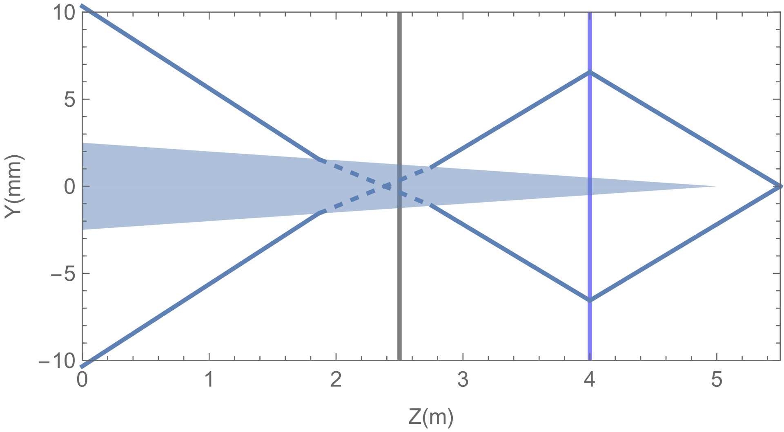
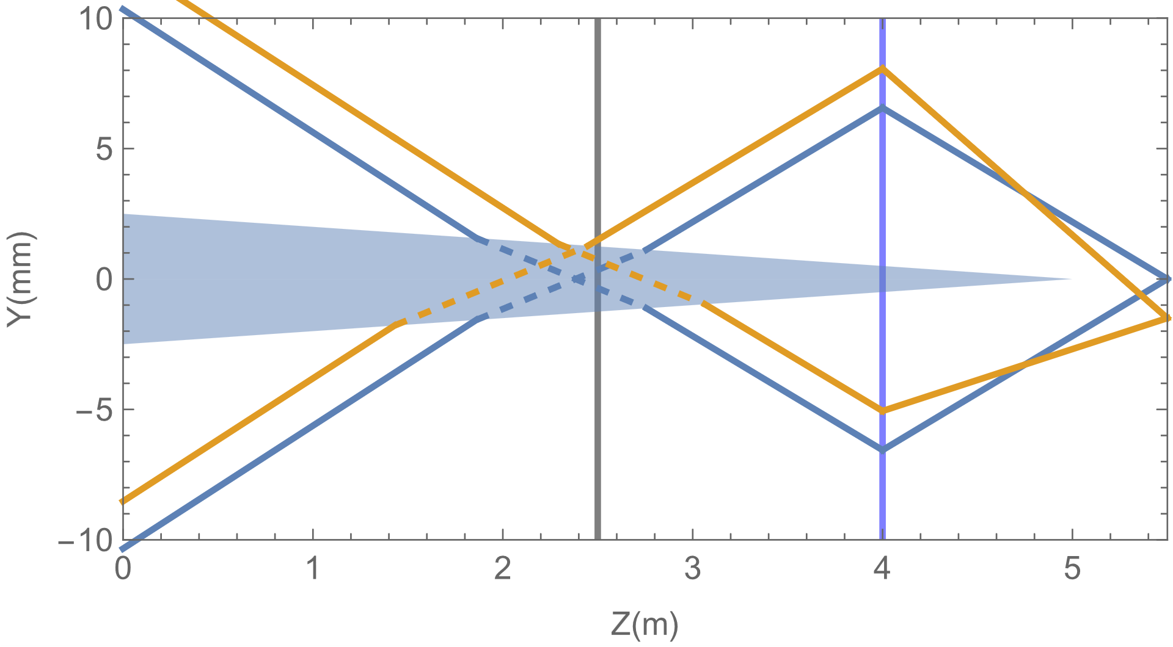
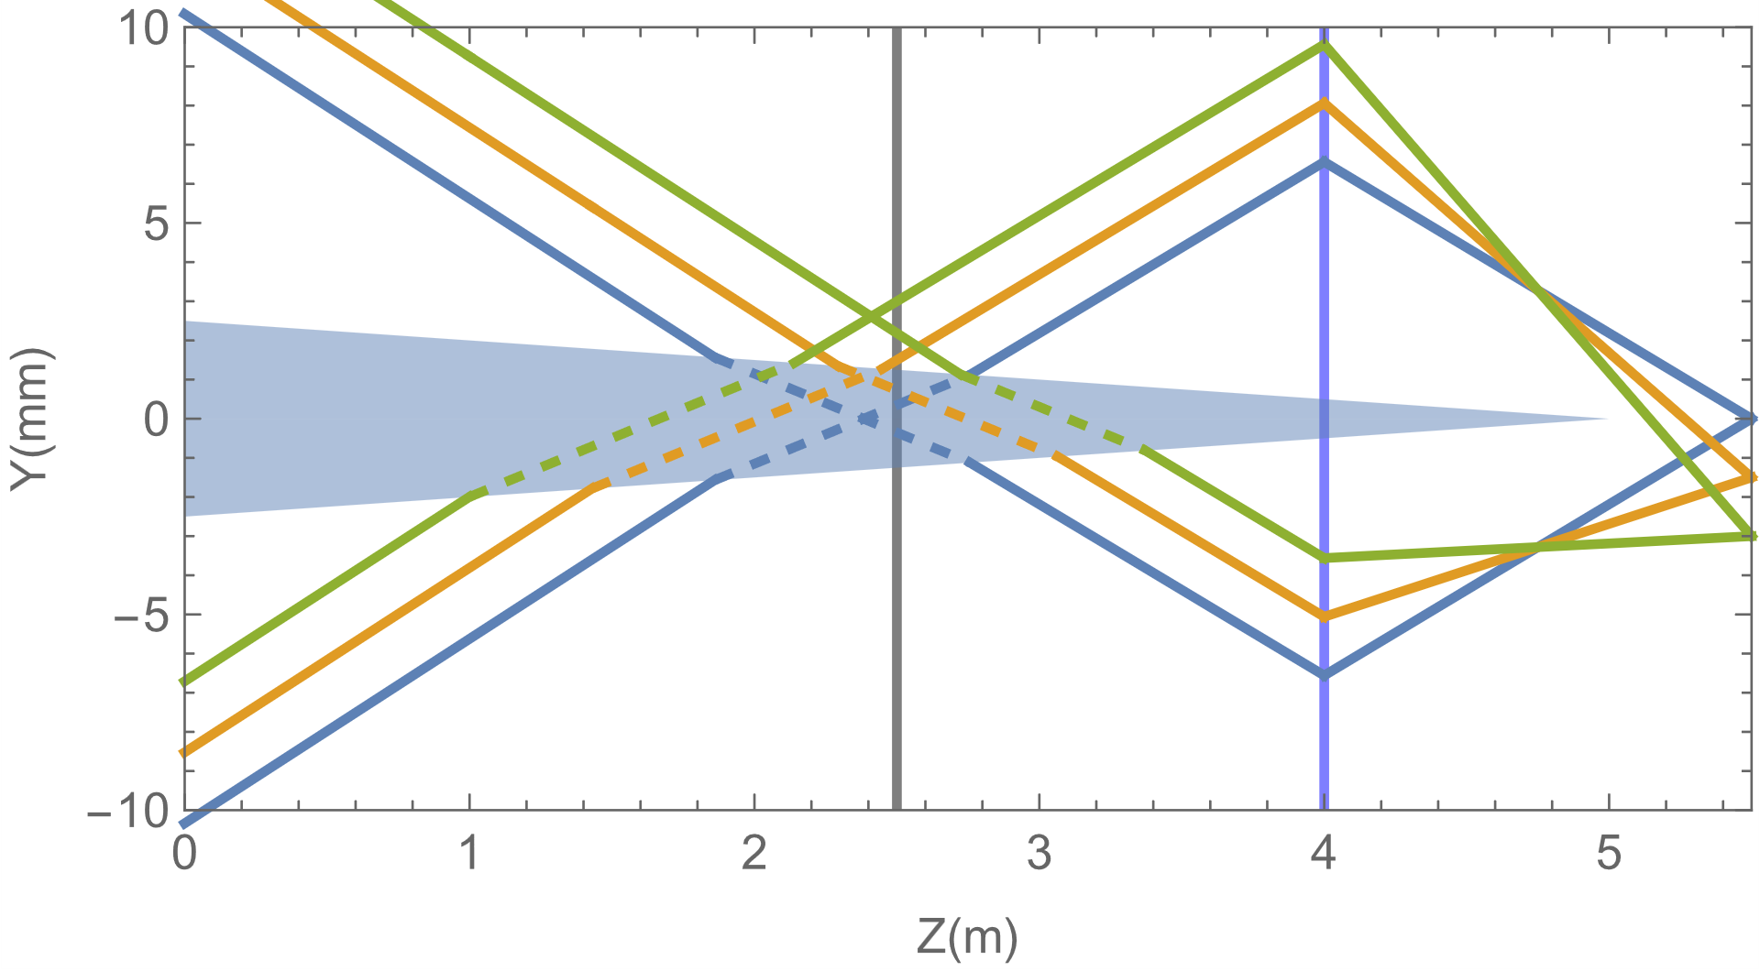


Bessel interferometry
Plasma
Vacuum
Interferometry used to improve sensitivity to us+ effects
New approach: repurpose Bessel beam as an interferometer
Longitudinal variations -> shift in Bessel rings
$$J_{0}{\left(kθr+b\right)}^{2}\sim cos(k(2θ)r+2b−\frac{π}{2})$$
Head erosion
angle
Ar plasma
ΔOPD
Transverse Bessel probe intensity asymptotic form
Obj plane
Thin lens
$$J_{0}{\left(kθr+b\right)}^{2}\sim cos(k(2θ)r+2b−\frac{π}{2})$$
angle
ΔOPD

Slide 9
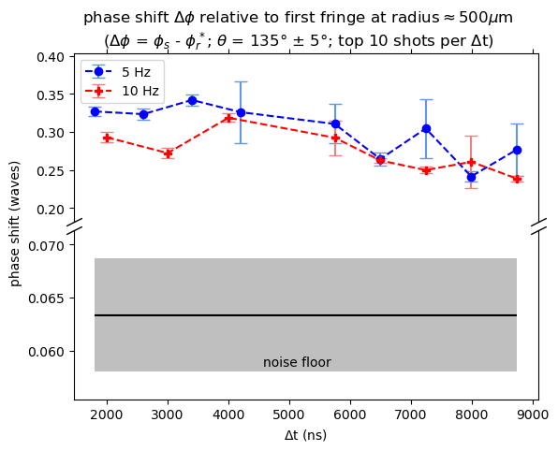
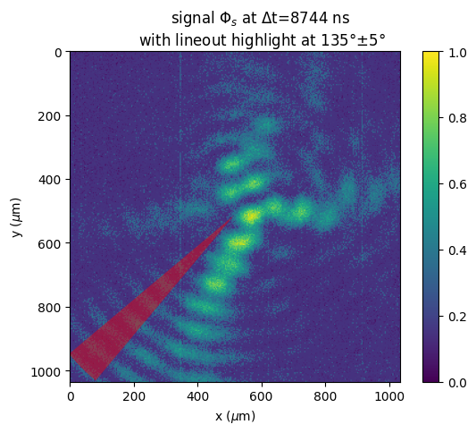
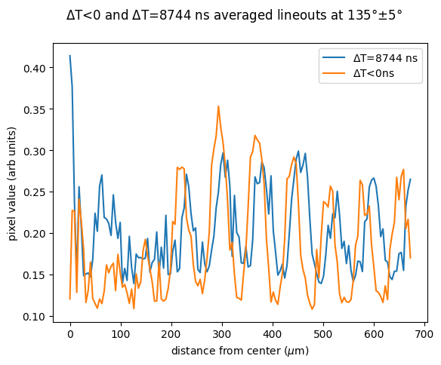

Bessel Interferometry reveals slow signal decay out to ∆t > 10 µs in 1 Torr Ar
1 Torr Ar, ~10 µs max time delay
0.35
Δt<0ns
Δt$\sim$10μs
0.25
Phase shift (waves)
Slow decay out to 10’s of µs
0.07
Δt<0 average phase shift
10 deg averaging cone
0.06
averaging
cone
2
3
4
5
6
7
8
9
∆t (µs)

Slide 10


Summary of main results
plasma
species
$$τ_{recovery}$$
Probe method
Wake excitation conditions
...$7×{10}^{−4}$ µs
H₂
recovery of probe e- properties
0.084 GeV, 0.5 nC drive bunch¹
...0.06 µs
Ar
recovery of wake-accelerated e- properties
1 GeV, 0.5 nC drive bunch²
...0.3 µs
Ar
grazing-incidence shadowgraphy
10 GeV, 2 nC drive bunch³
...0.07 µs
H₂
“
“
...1 µs
Li
near-forward light scatter
“
...>10 µs
Ar
Bessel-beam interferometry
“
¹R.Pompili et al., “Recovery of hydrogen plasma at the sub-nanosecond timescale in a plasma-wakefield accelerator” Commun Phys 7, 241(2024).
²D’Arcy et al. “Recovery time of a plasma-wakefield accelerator.” Nature 603, 58 (2022).
³This work
Requirements for an impactful study
• Calibrate optical methods for conditions of Ref. 1,2: e.g. 10 GeV, sub-nC excitation of Ar, H₂
This will require laser pre-ionization of Ar
⇒
independent probe laser needed for ∆t ~ µs
⇒
measure vessel heating at 10 and 30 Hz
• Address cumulative plasma heating question

Slide 11
Thank you!
Thanks to Mark Hogan, Brendan O’Shea, Robert Ariniello and all of the FACET-II staff for their help with this experiment
Thanks to NSF for supporting this project (award number 2308921)

Slide 12
Backups

Slide 13
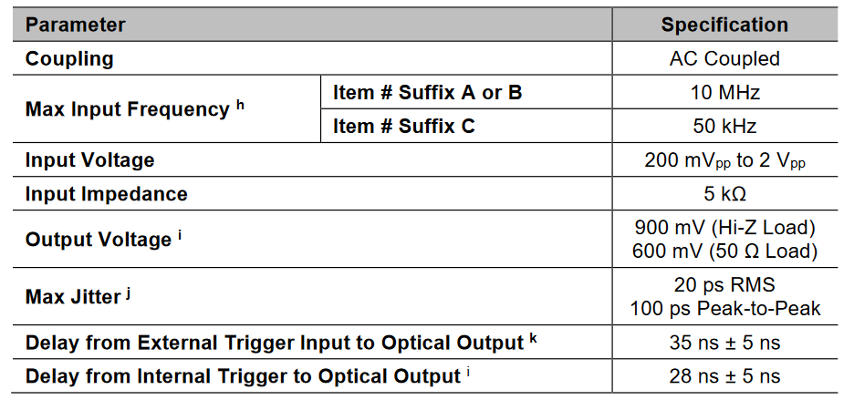
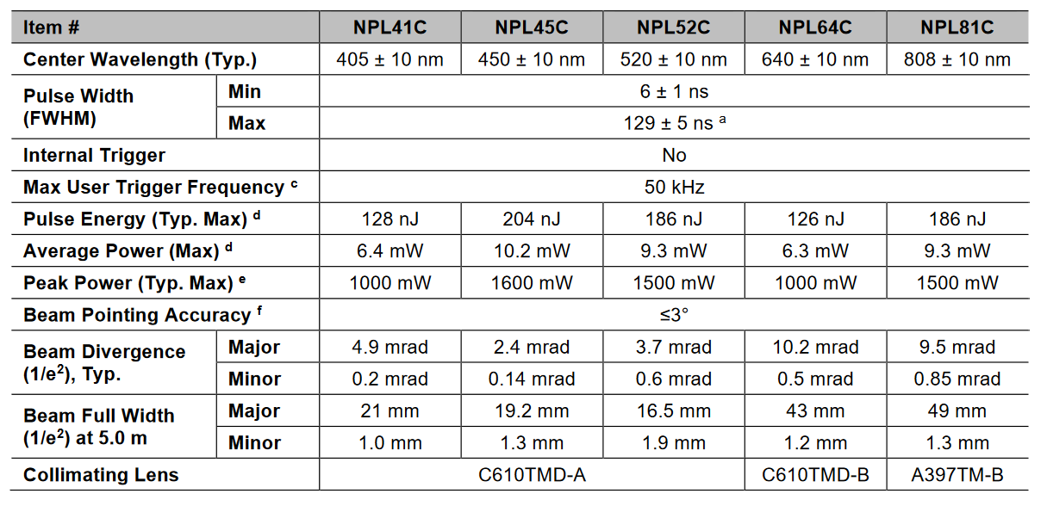
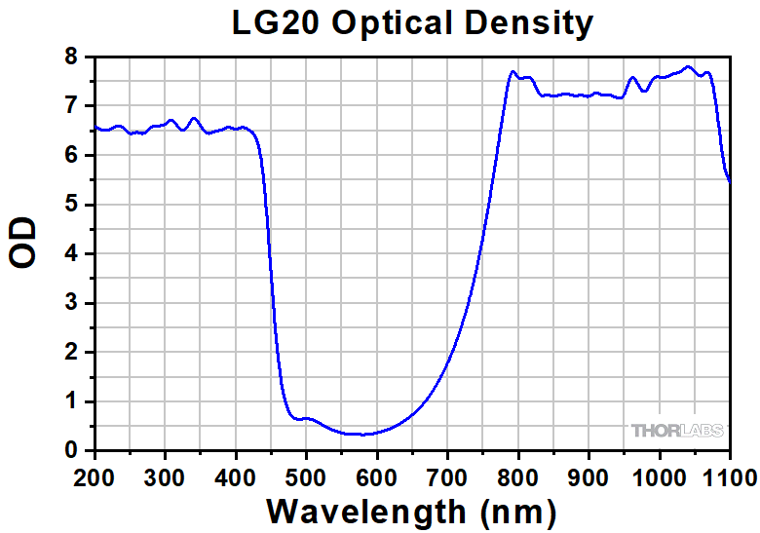
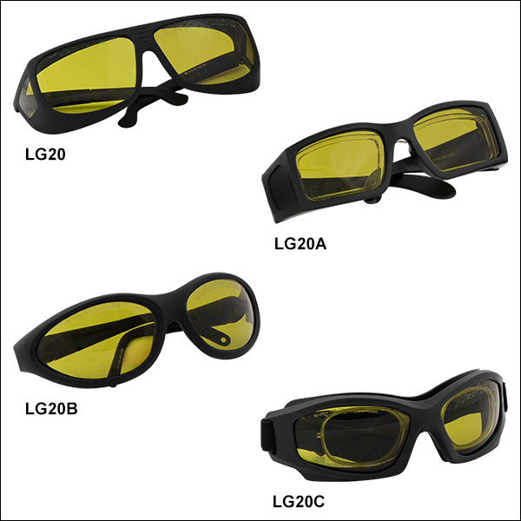
THORLABS - Nanosecond Pulsed Laser Diode System, 6 - 129 ns Adjustable Pulse Width
Laser can be interlocked
$2,998.80
$1,986.71
$2,168.78
$1,874.25
$1,820.70
Goggles that could function for 450nm and 800nm
45% Light transmission

Slide 14
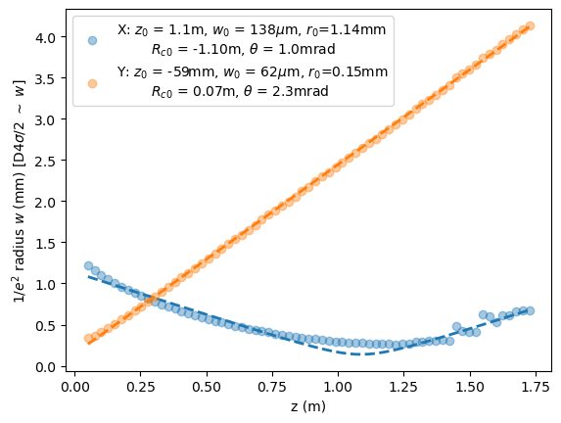
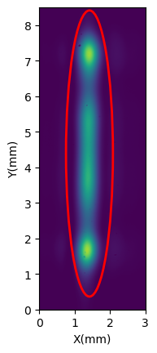
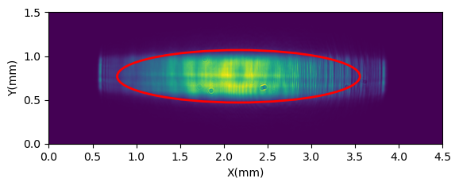
Diode intensity and phase
zL + 1.75m
Profile at laser output (zL)

Slide 15
Beam expander design
L1, L2
L3
L4
d1
d2
d3
d4
Pinhole
Pinhole
Y/Z view
X/Z view
d1: 273.6432 mm (0mm defined to be laser output)
d2: 215.1291 mm
d3: 489.4393 mm
d4: 491.9747 mm
Total distance: ~1500 mm
L1:Thorlabs LJ1277L1-A (250 mm fl in y)
L2: LA1484-A-ML (spherical; 300 mm fl)
L3: LJ1144L2-A (500 mm fl in y)
L4: LJ1516L1-A(1000 mm fl in x)

Slide 16
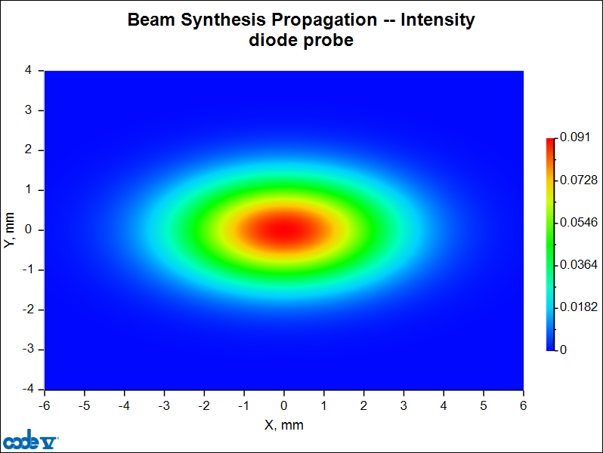
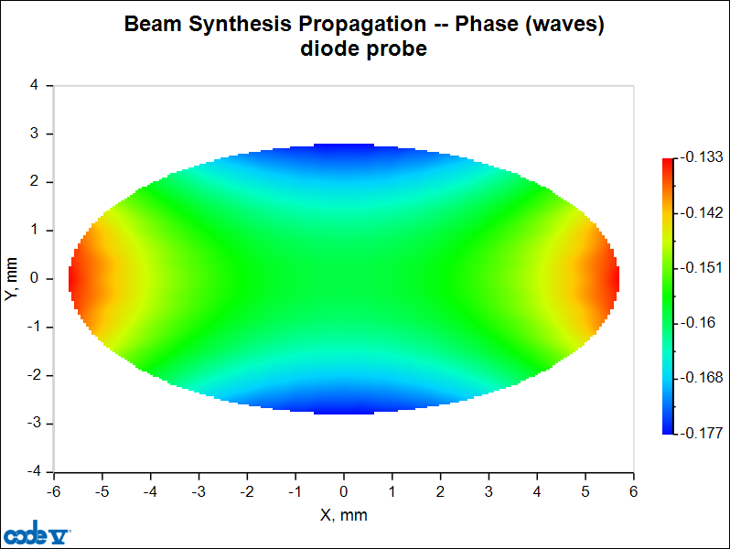
Output shape
w_{x}(e⁻²) radius: 3.77 mm
w_{y}(e⁻²) radius: 1.85 mm
<=lambda/10 variation in phase across 1/e^2 area

Slide 17
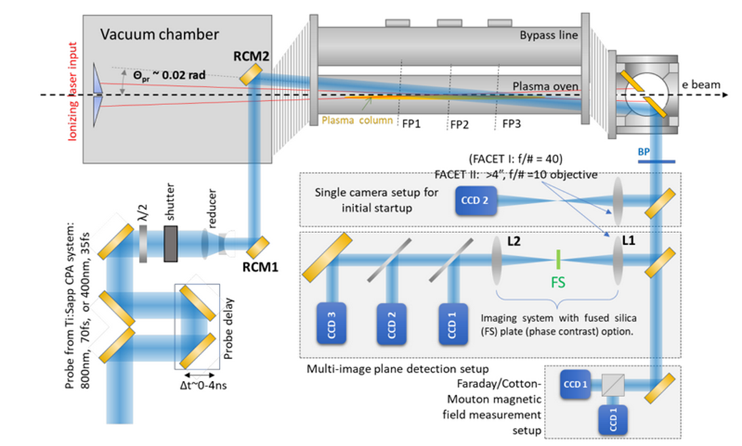
Proposed E-324 interferometric probe setup
Ar gas
e-beam
ionizing
laser
• dedicated E-324 probe
• high-beam quality & stability
+ independent wavelength
for improved bkgd. subtraction
• enables study of laser-preionized
Ar, H₂ plasmas
• interferometric shadowgraphy
enables sensitive plasma probing
at multi-µs ∆t.
Thorlabs
6 ns-pulsed laser diode
< $2 K
450 nm
0.2 µJ/pulse

Slide 18

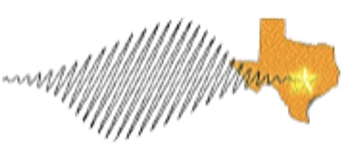
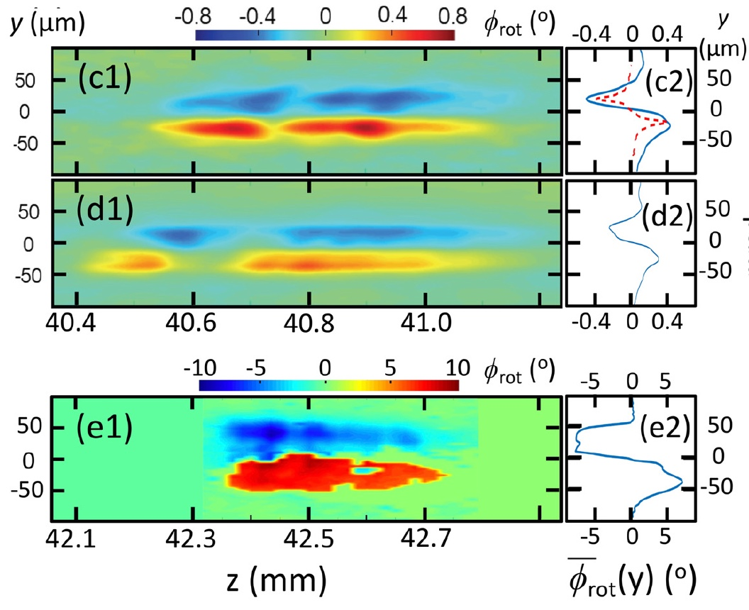
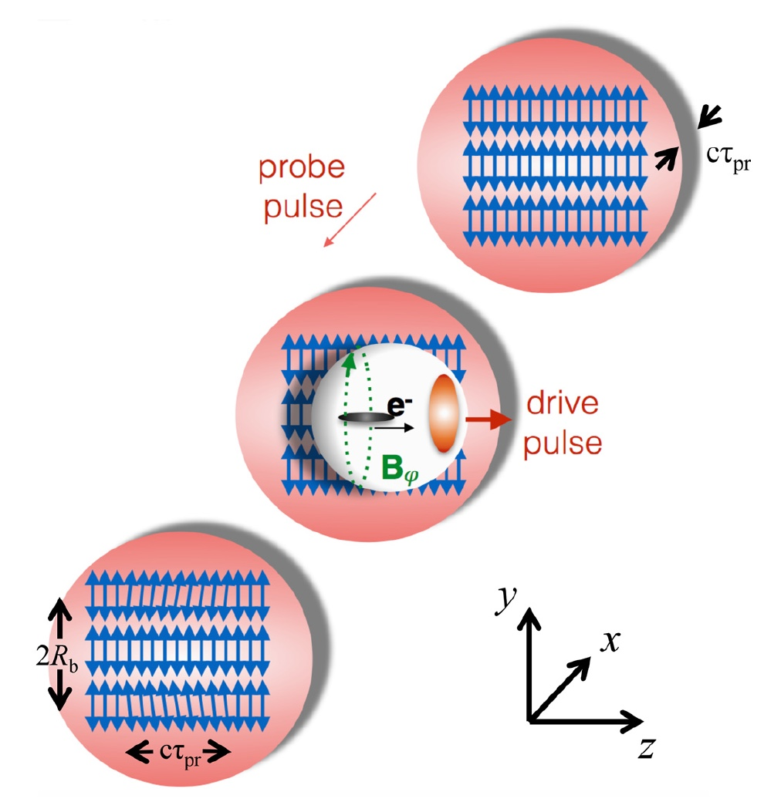
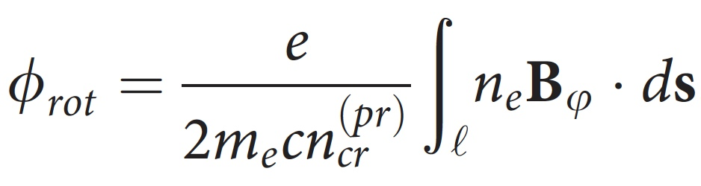
2026: Faraday rotation to image plasma bubbles in low-n_{e} plasma
n_{e} ≈ 10¹⁷ cm⁻³:
⁽¹⁾ Chang et al., “Faraday rotation study of plasma bubbles in GeV wakefield accelerators,” Phys. Plasmas 28, 123105 (2021)
n_{e} > 10¹⁹ cm⁻³:
⁽²⁾ Kaluza et al., Phys. Rev. Lett. 105, 115002 (2010);
⁽³⁾ Buck et al., Nat. Phys. 7, 453 (2011).
Texas Petawatt
Faraday “streaks” of magnetized plasma bubble walls
in n_{e} ≈ 10¹⁷ cm⁻³ plasma
𝜏_{pr} = 2 ps
𝜏_{pr} = 1-2 ps
𝜆_{pr} = 1 µm
𝜏_{pr} = 2 ps
n_{e} ≈ 10¹⁷ cm⁻³
plasma
Texas PW
drive pulse
𝜏_{pr} = 1 ps
large B_{𝜑} and l
compensate
small n_{e}/n_{cr}^{(pr)}
At FACET-II, the drive bunch will magnetize the front end of the bubble.

Slide 19
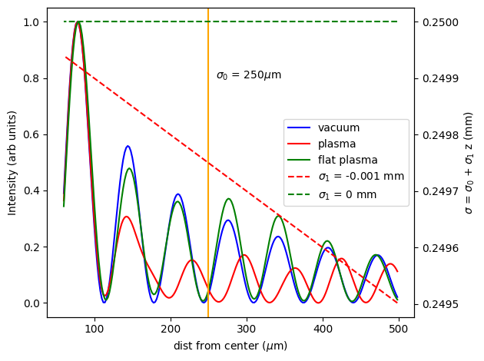
(right) Comparison with flat plasma, plasma with 1mrad tilt and no plasma (Code V simulation)
(below) FACET-II Bessel data

Slide 20
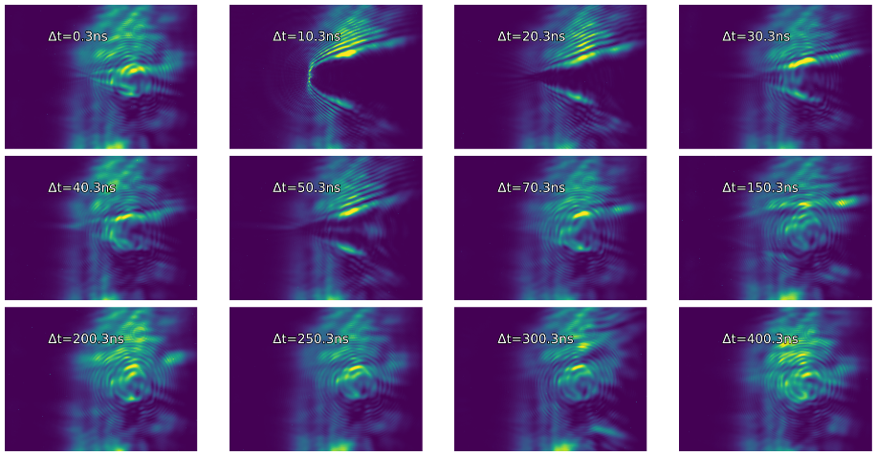
Probing Ar wakes at 3 Torr with 17 mrad probe
Probe from 0 ns to 400 ns
Probe fully recovered at ~T0 + 200 ns

Slide 21
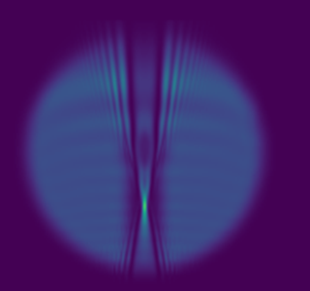
Multiple object plane shallow angle probing
In focus element
P1
P2
P3
Probe
plasma
P1
P2
P3
Simulated probe beam passing through plasma using Code V
Reconstructed plasma profile via Gerchberg-saxton [Optics Letters 38, 5157 (2013).]

Slide 22
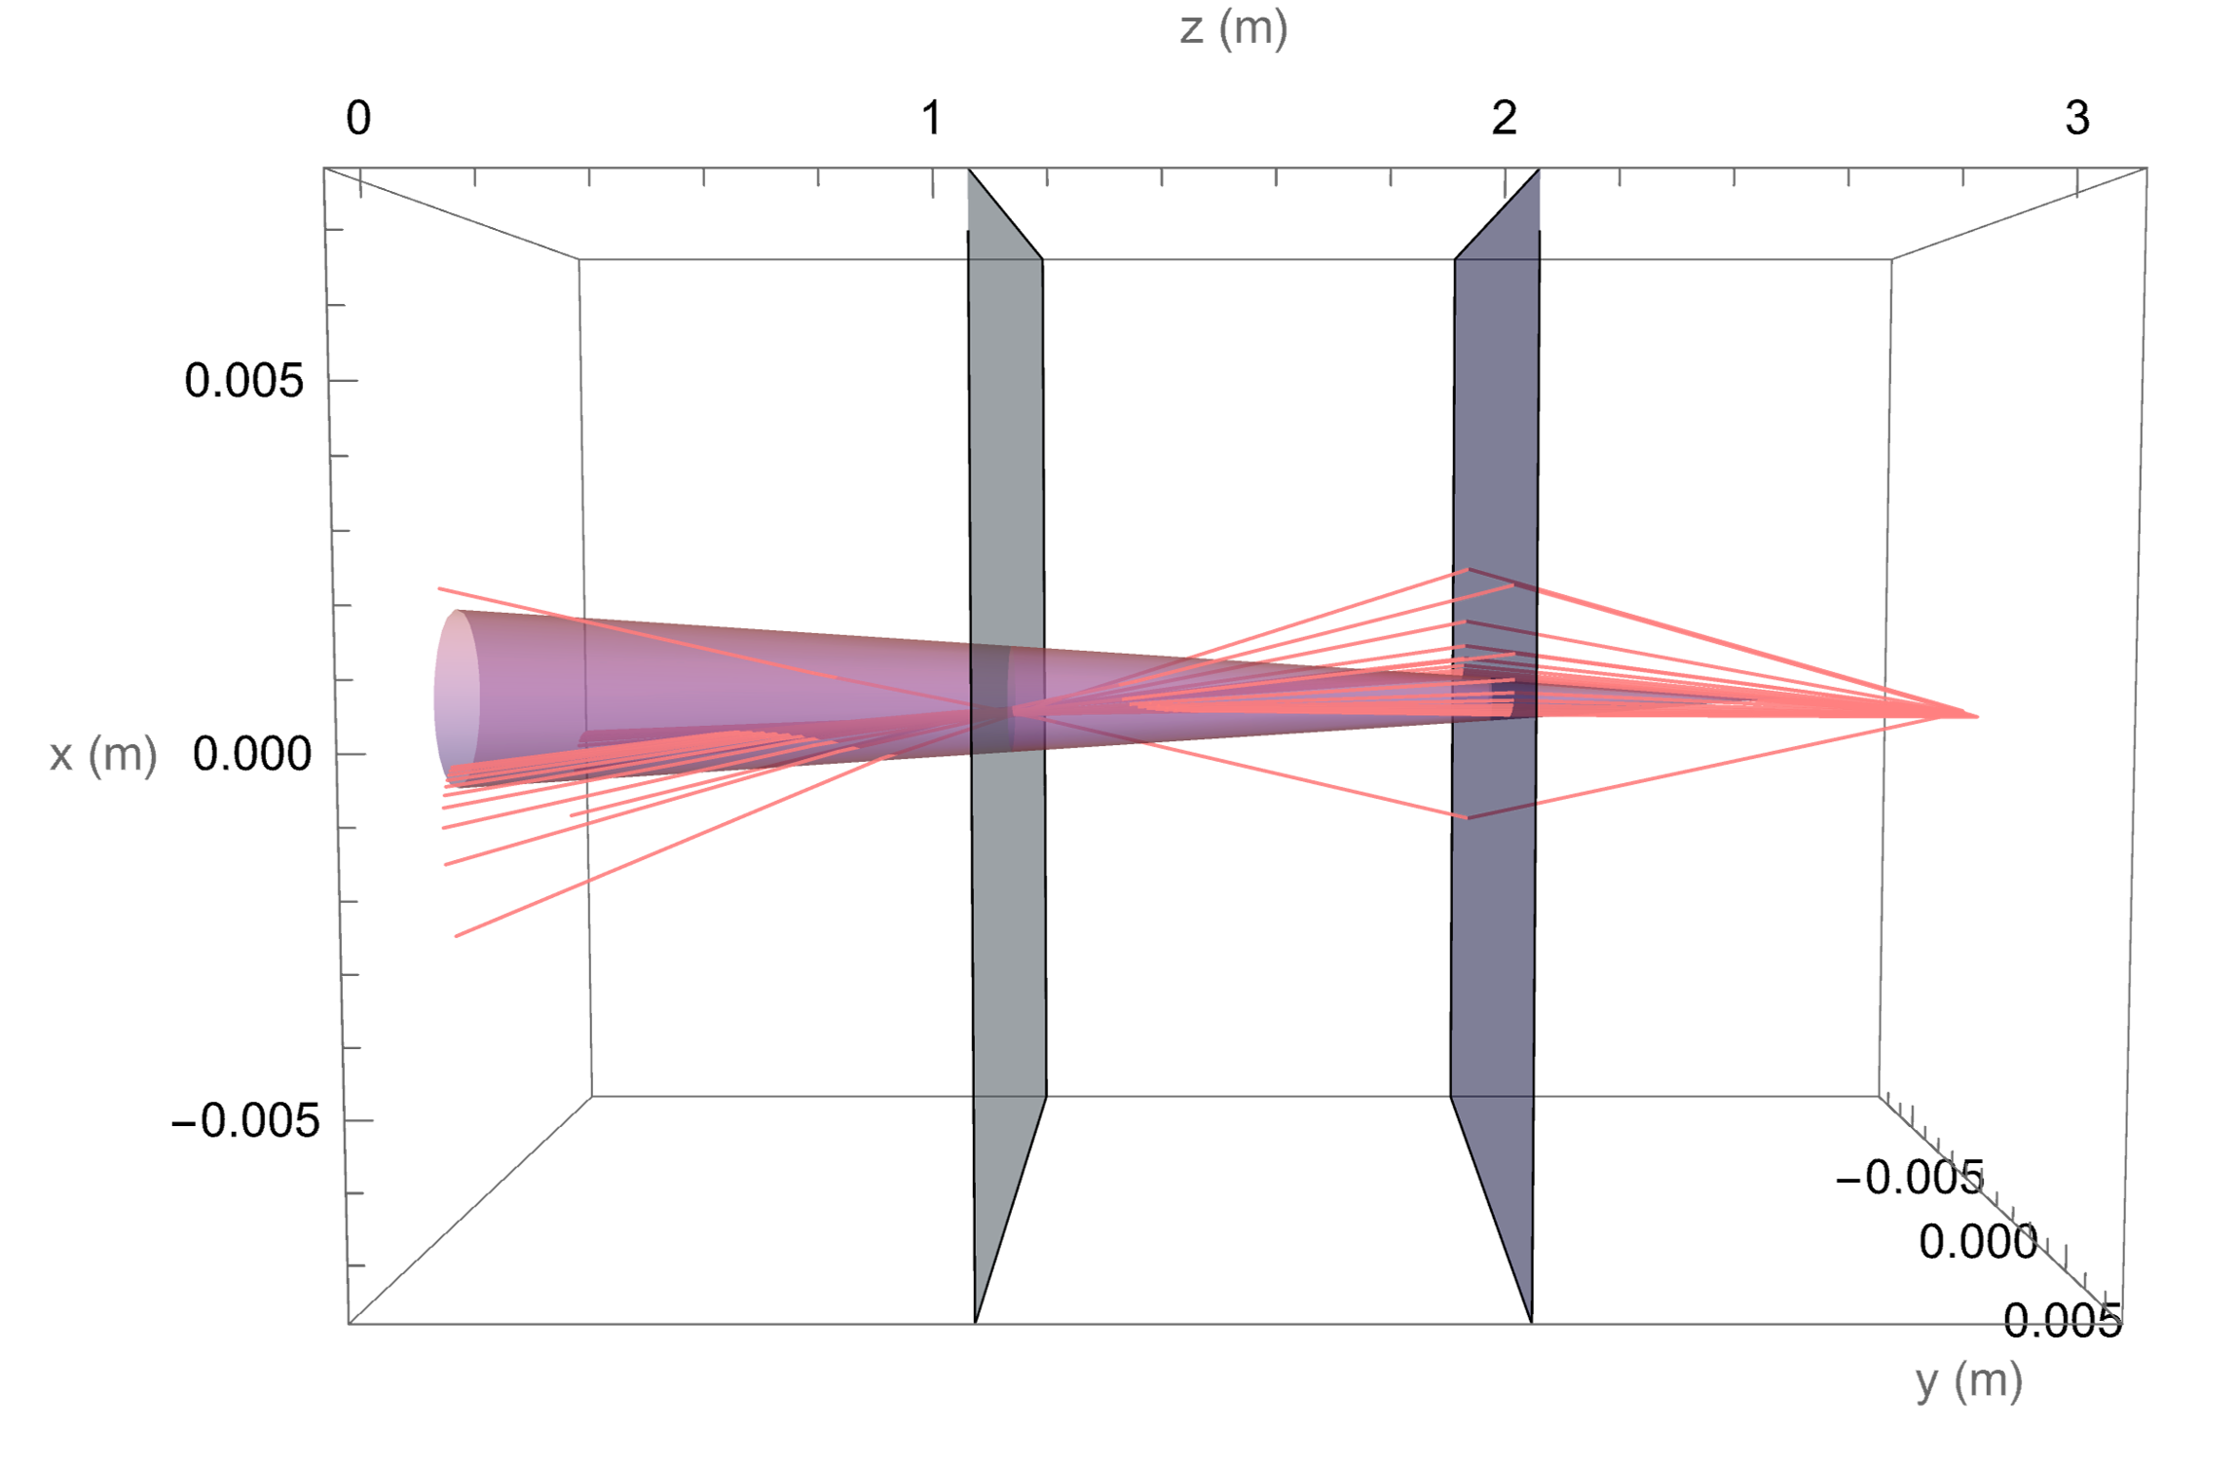
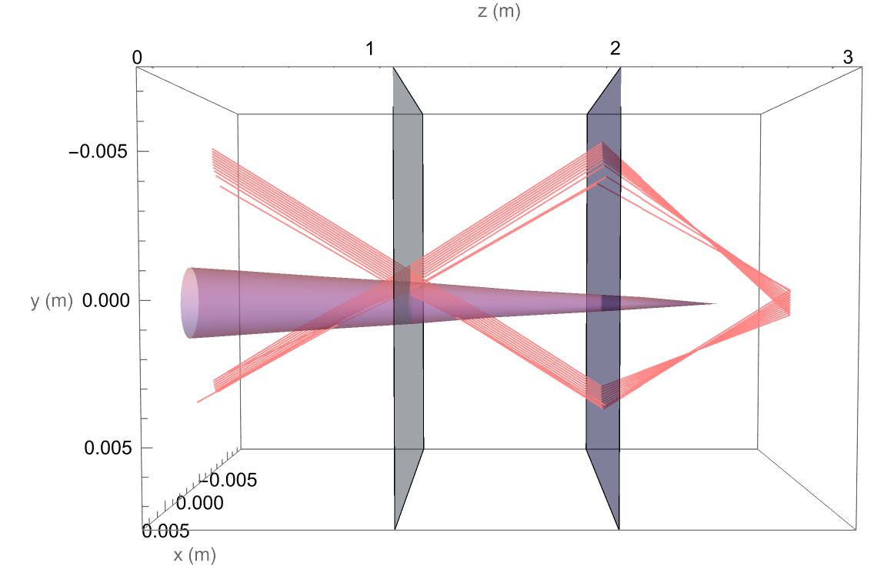
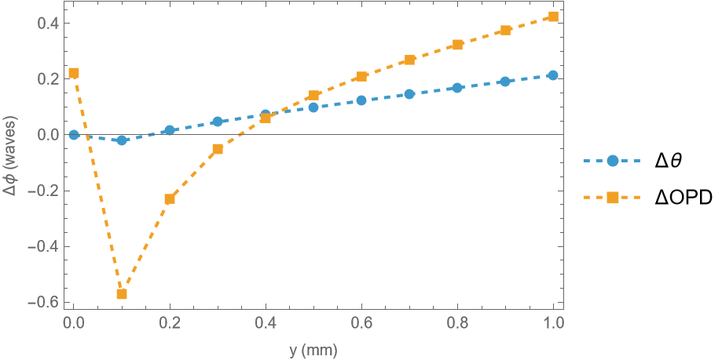
Phase shift: off axis
Object plane
Plano-convex lens;
f=500mm
Plasma offset: X₀=250μm, Y₀=500μm
Image plane phase at X=0

Slide 23
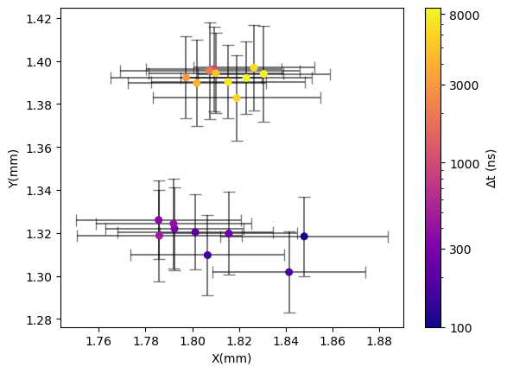
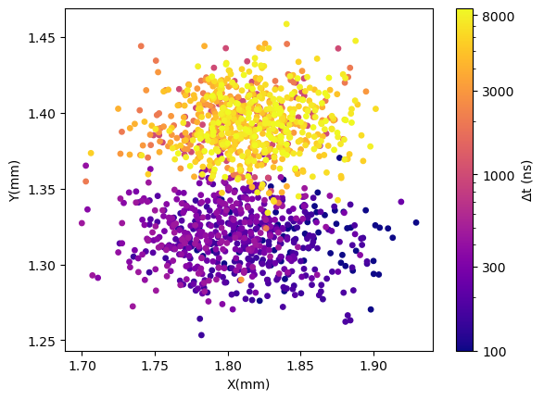
Ax pointing throughout data collection

