Slide 1
FACET-II Long-term Planning
Andrew Sutherland
On behalf of the E310 Collaboration
25 July 2025

Slide 2
Questions
What are the high-level scientific goals?
What are your target (high-impact) publications and time frame?
What data do you have and what analysis has been done?
What data and analysis is missing to reach that high-impact publication?
What went well? What could go better? How does this run compare to the last?
Notes:
(* Quick overview, I don‘t want to talk much about this slide *)

Slide 3
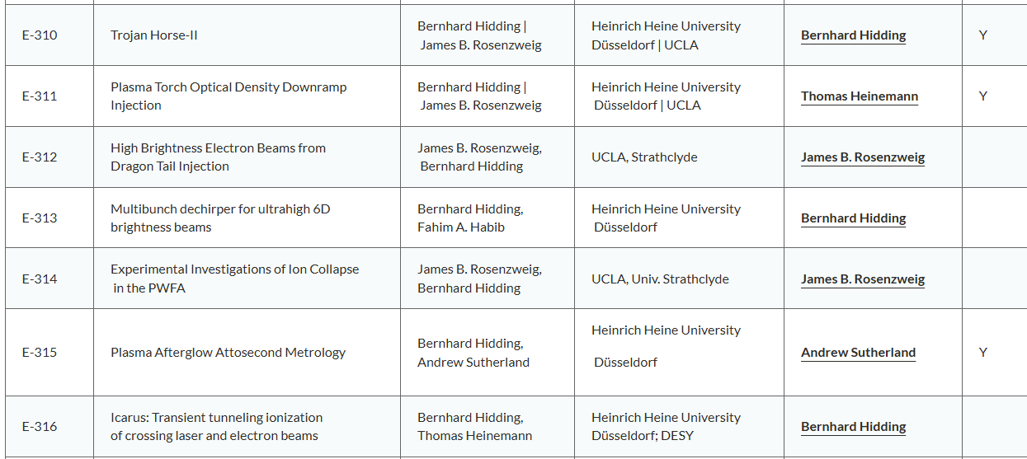
E31x Experiments

Slide 4
E310 Scientific goal summaries
Experiment | Main Objectives
E310 | Realise plasma-photocathode: a) In a plasma channel wide enough to host blowout. b) 90° and collinear injection geometry c) Higher energy, lower energy spread d) Enhanced stability e) Ultrashort crisp bunches f) Ultralow emittance and ultrahigh brightness, and metrology
E311 | Investigate thin filament bunchlet injection
E313 | Production of tunable multi-bunches Production of bunches suitable for HEP, QED and XFEL
E315 | Passive plasma interaction monitor: Improved spatiotemporal synchronisation E beam metrology (e.g. bunch length)
E316 | ICARUS: synchronization, current monitor etc.

Slide 5
Key components for E310, E311, E315
  Stable electron beam > 5 kA. Need strong wake to trap cold electrons from rest.
  Two-component gas with low (LIT) and high ionization threshold (HIT) component. LIT supports wake, HIT used for plasma photocathode laser etc. LIT/HIT combination H₂/He (as at FACET) or He/He⁺ or Ar/Ar⁺…
  Preionizer laser to generate wide plasma channel with selective ionization capability (e.g. only LIT, not HIT)
  Spatiotemporally synchronized (injector) laser pulse for Trojan Horse and Plasma Torch in 90° or collinear geometry at “Injection Line”
  Ionizer at PB (E-315/E-308), and downstream of PB (E-310, E-311 etc.)

Slide 6
Shift summaries
June 2024 – E310-1: Ionisation of mixed gases
  Goal: Testing selective ionisation in mixed He/H2 gas
    A) self-ionisation only
    B) with H2 preionised (axilens)
  Measured
    plasma emission in afterglow cameras, IPOTR,
    beam deceleration in electron spectrometer
  Outcome
    Beam self-ionises pure H2 but not pure He
    Evidence that both species are ionised in mixture
      Wakefield is driven in self-ionised H2
    Some accelerated charge in axilens ionised H2 case
      Evidence of correlation between Afterglow and Deceleration

Slide 7
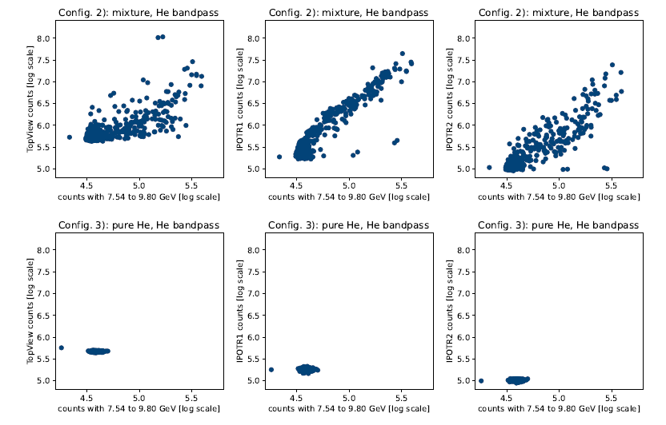
E310 Data – Self-ionisation
He/H2 Mixture:
He plasma emissions observed and correlates with driver deceleration
He only Mixture:
He plasma emissions not observed
E. Hartmann MSc Thesis HHU 2024

Slide 8
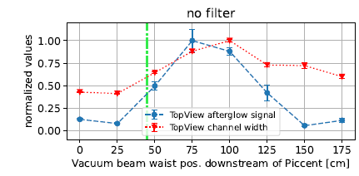
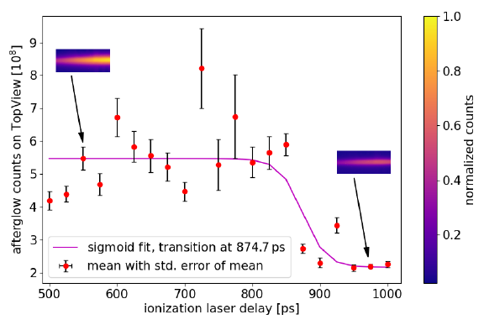
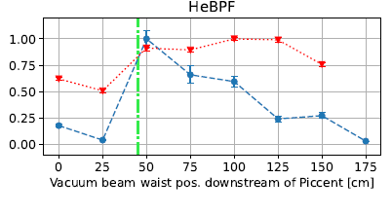
E310 Data – Axilens ionisation
Enhanced Afterglow:
Coarse timing synchronisation between main laser and electron beam
Beam Metrology:
Detectable changes in bunch properties
E. Hartmann MSc Thesis HHU 2024

Slide 9
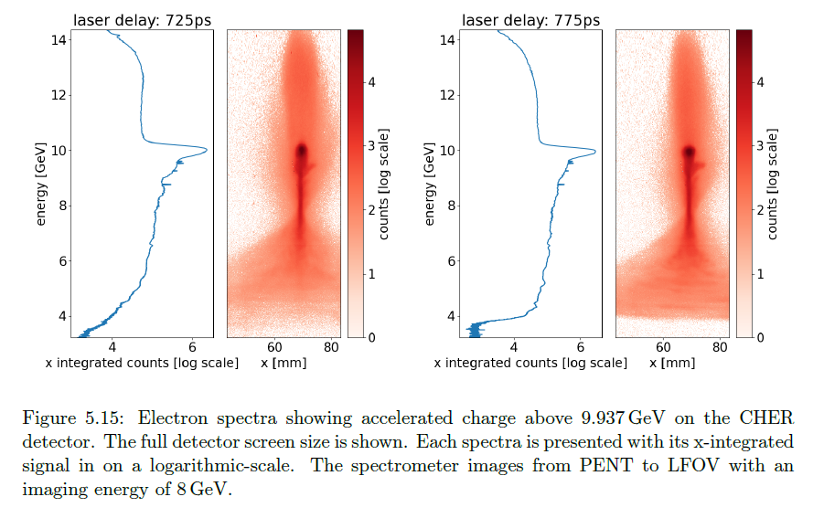
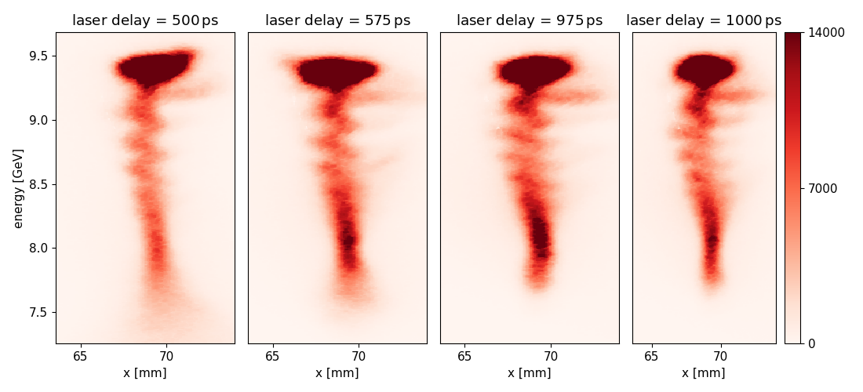
E310 Data – Axilens ionisation
He/H2 Mixture:
Evidence of accelerated charge from driver tail (8/300 shots)
Plan: Test of betatron oscillation with new UCLA Compton spectrometer
E. Hartmann MSc Thesis HHU 2024

Slide 10
Proposed targets development matrix
 | Near term ~<1 year | Mid-term ~1-2 years | Long-term >2 years | Exploit for e.g. HEP, XFEL & Light sources, QED studies
Driver Beam | A(ny) beam | 5-10 kA | Matched to plasma source Drives stable blowout
Witness Beam | A bunch | >2GeV <1% E spread High 5D brightness | >10 Gev, <100 nmrad FEL compatible High 6D brightness
Pre-ionisation | Vacuum verification of E31x optic Use default plasma channel at FACET (e.g. tandem lens) | Plasma generation Driver depletion | >200 um wide, >50cm long, ~1e17 ccm Witness extraction
Injection | Rework of probe laser Commissioning of compact injector in “Injection Line” | “Trojan Horse chamber” | Dechirper
Diagnostics | Afterglow (E315, E316..) Compton Spectrometer etc. | Emittance Charge Energy (spread) | Longitudinal phase space ~100 nmrad emittance
Help Motivate FACET-III

Slide 11
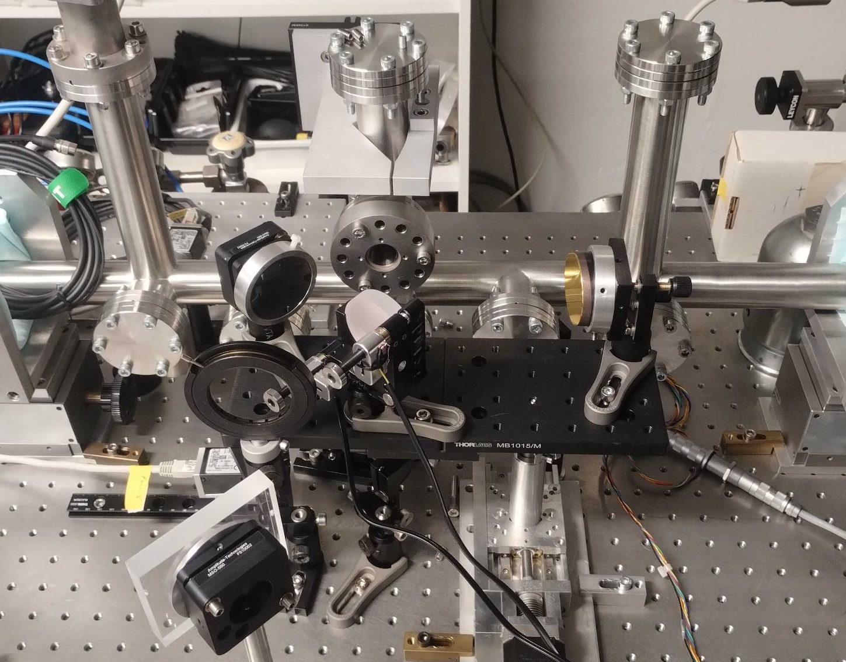
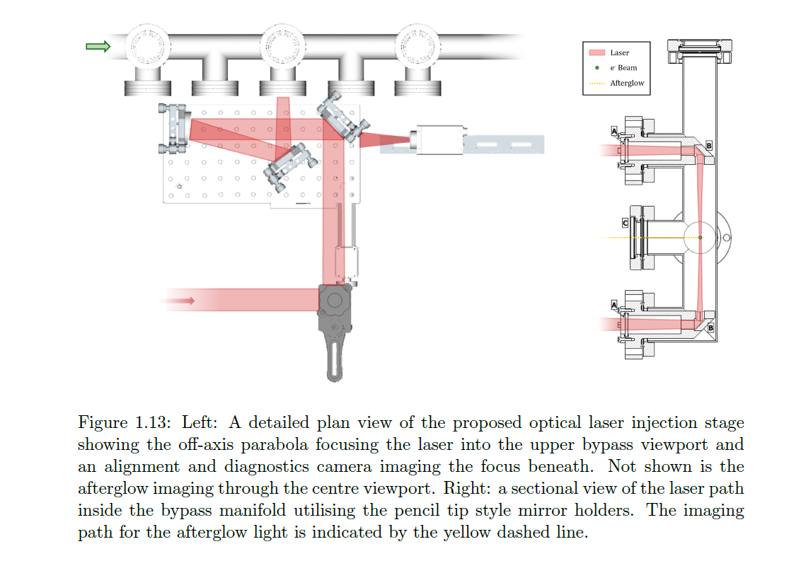
Compact Injector
“Injection Line” w/ injection line arm:
designed and tested; integration into new probe begins next week

Slide 12
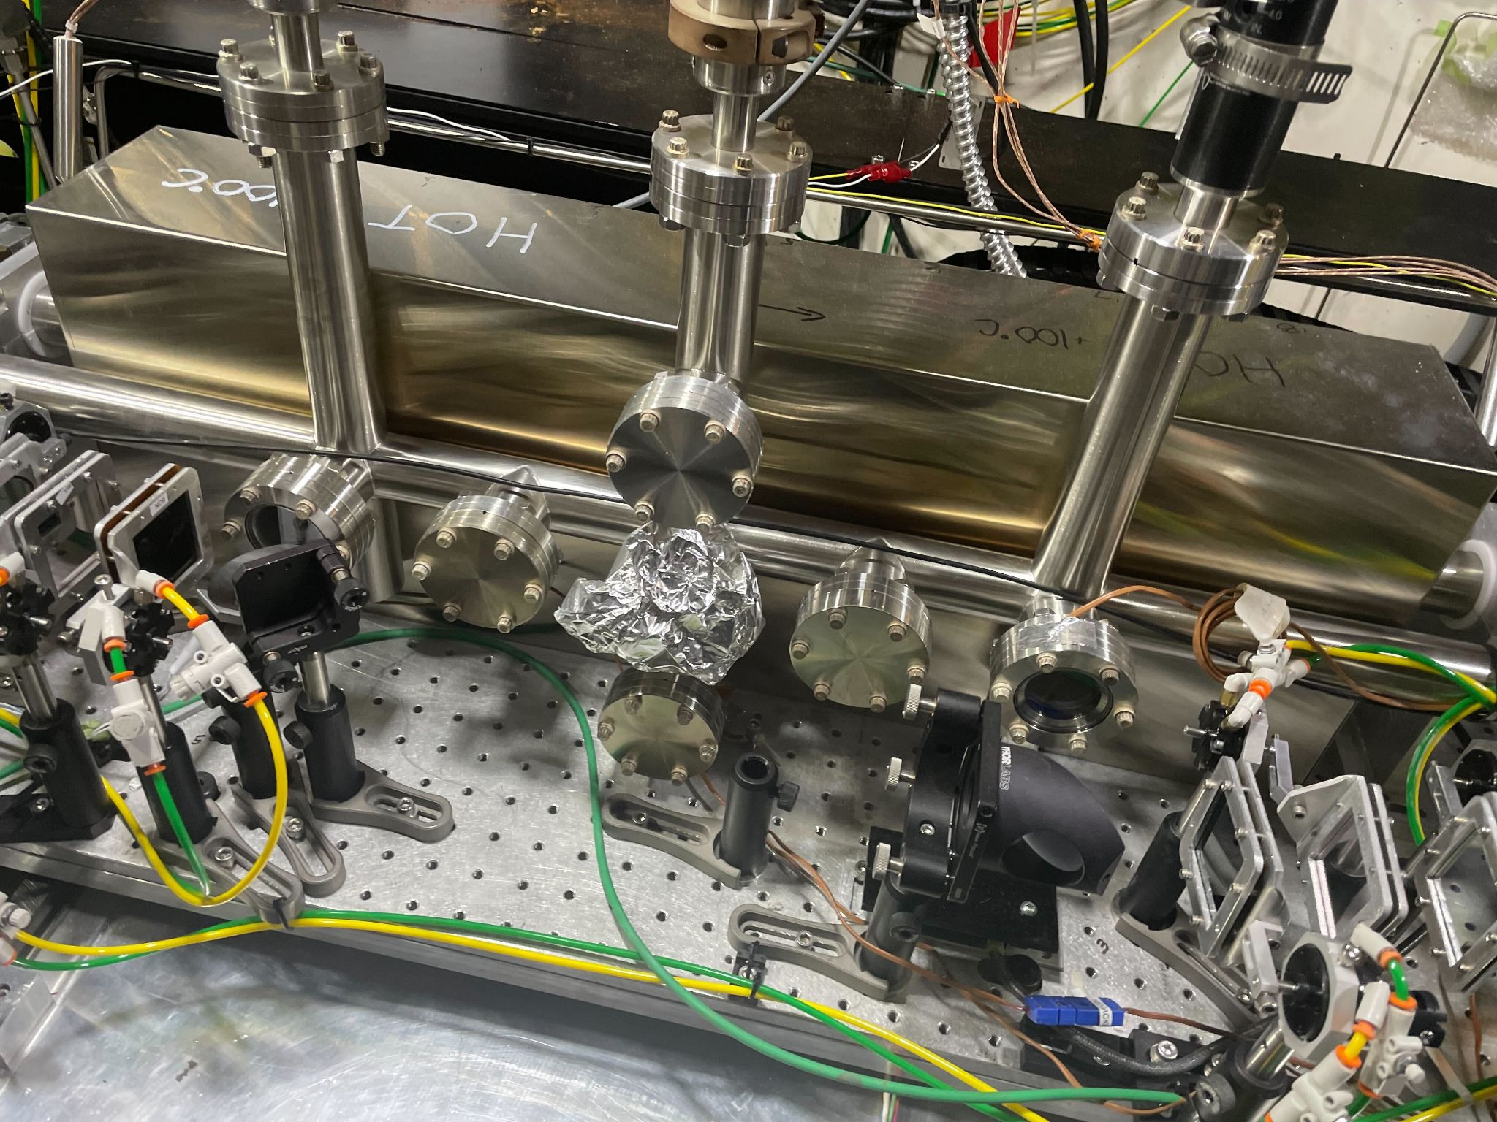
Injector Line limitations
Focusing optics in air (no lesson learned at FACET-I?)
Limited tunability: pointing, alignment, intensity, half inch mirrors..…
Limited diagnostics (just one window..)
No localized gas target
….

Slide 13
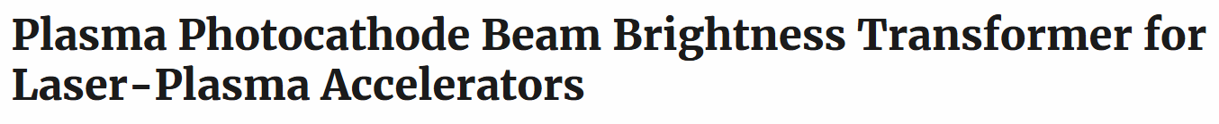

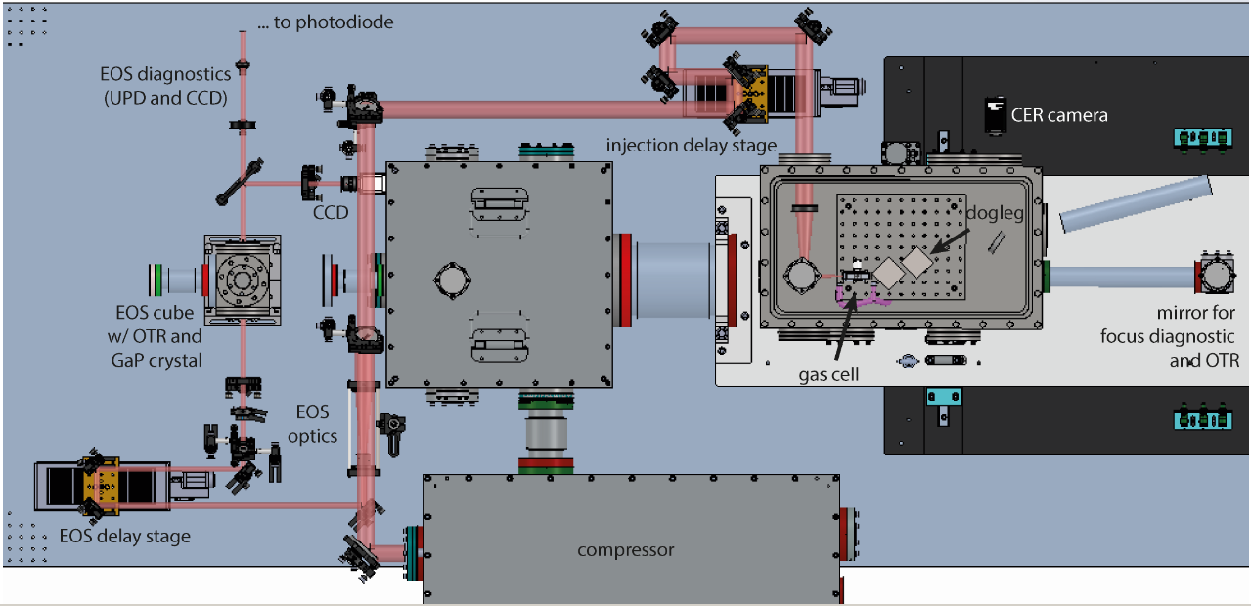
Original Trojan Horse E210 Chamber
Designed and procured from 2014 SBIR
Then became multi-purpose PB

Slide 14
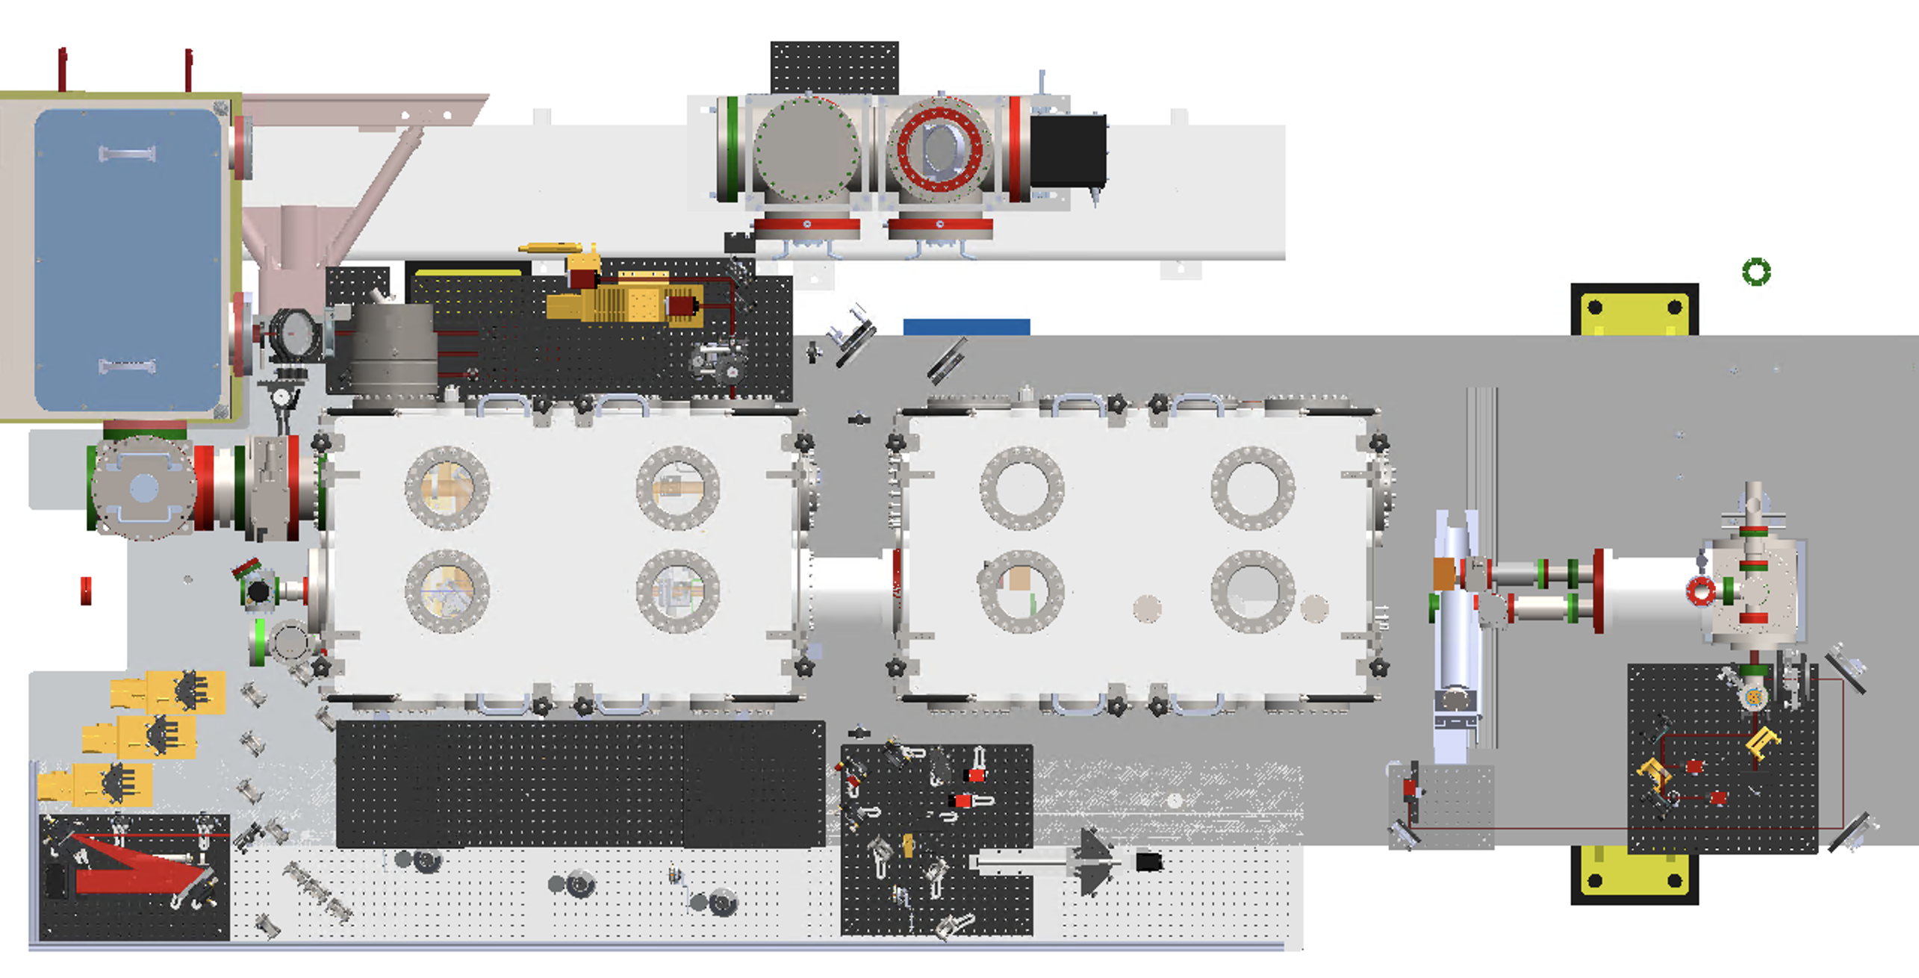
New Trojan Horse Chamber?

Slide 15
New Trojan Horse Chamber?
Focusing in vacuum (lessons learned from FACET-I)
Flexibility and tunability: key for optimizing injection and ultimately pinning down high brightness beams, larger (holed) optics, advanced plasma photocathodes…
360° observation & diagnostics (side view, top view, filters, beam profile monitors, afterglow monitors…
Defined gas target with defined ramps
Extraction and transport of beams with emittance preservation
Multiple plasma (photo)cathodes (required for E313)
E315 and E316 for witness
….

Slide 16
Joint efforts
Preionization & gas targets
“Trojan Horse“ chamber
Diagnostics (nm-rad level emittance, brightness, 6D phase space)
Exploitation (chicane beam gymnastics, radiation source… )

Slide 17
End

Slide 18
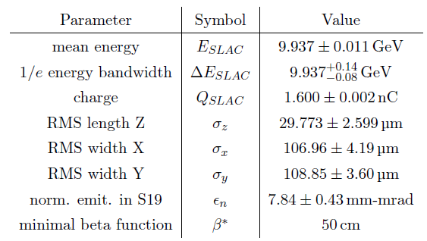
Beam conditions June 2024 shift

Slide 19
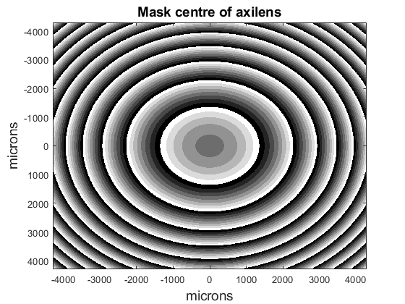
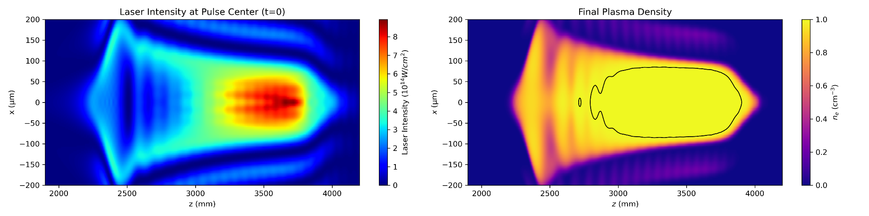
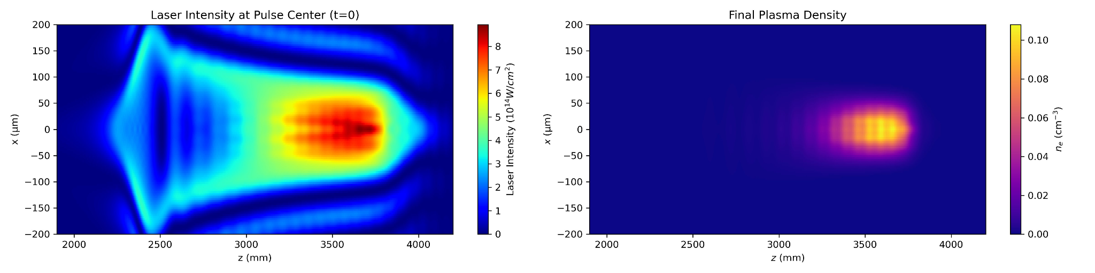
Plasma source for E31x
  Optics designed with U Colorado code (M. Litos et al., link to E-301) to design optimum optics for plasma channel generation (Adam Hewitt)
  Produced by NILT
  E.g. w/ 212 mJ, 55 fs FWHM, 20 mm top-hat intensity profile in H2/He:
  Big fat H2 plasma in 3.6e16 cm⁻³, λ_{p}~175 µm
  H2 plasma
  (little) He plasma

Slide 20
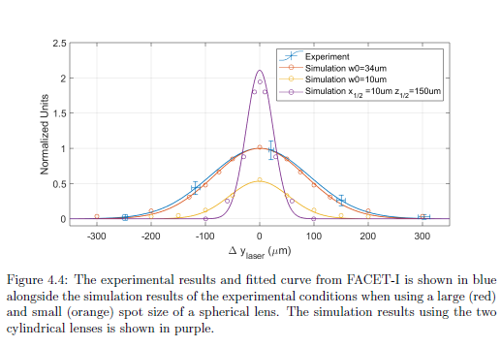
Afterglow enhancement

Slide 21
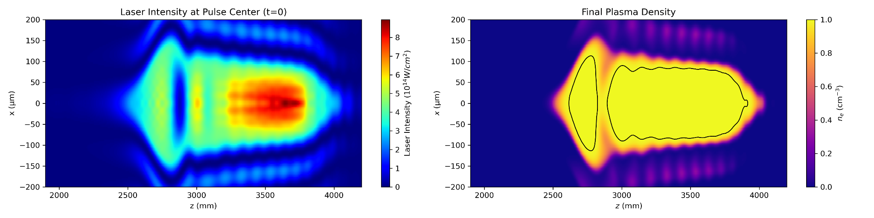
Plasma source for E31x
  First plasma blob not fully ionized, not useful.
  H2 plasma
  Can get rid of this part by using central masks:
  (little) He plasma

Slide 22
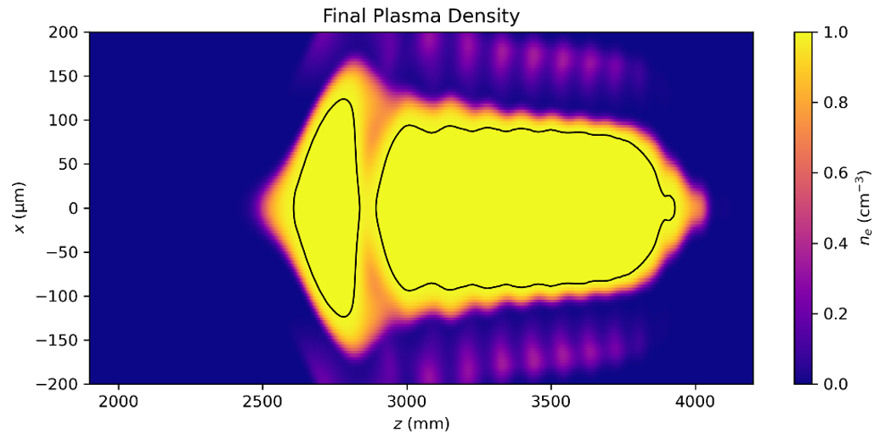
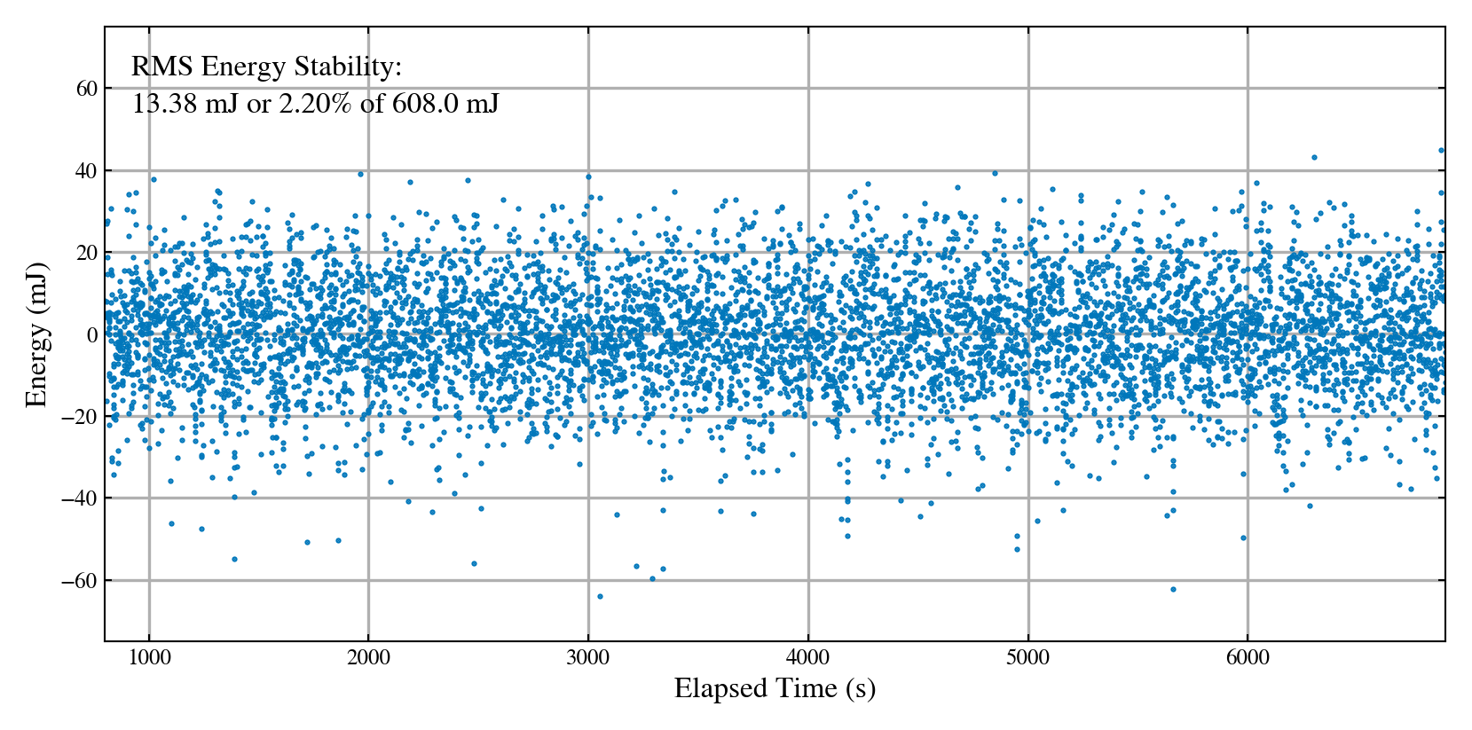
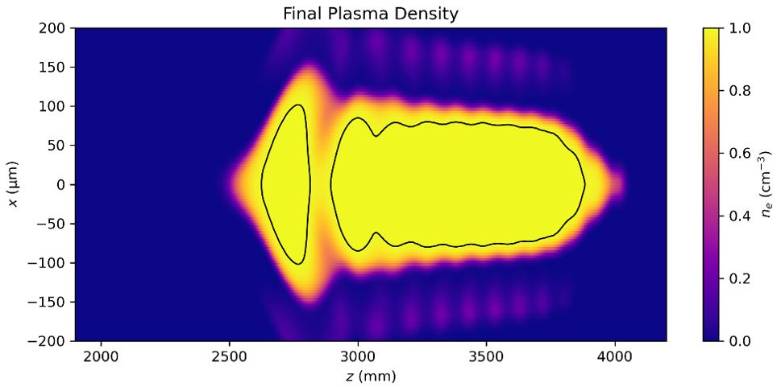

Plasma source for E31x
  Is preionization laser energy jitter critical?
  +10%
  -10%
  Maximum variance 60 mJ, so ~10% at 600 mJ
  No, plasma robust. There is a bit more He in the hot spot region, but no significant problem for acc. or injection
  Testing required, using FACET-II railcam and afterglow

Slide 23
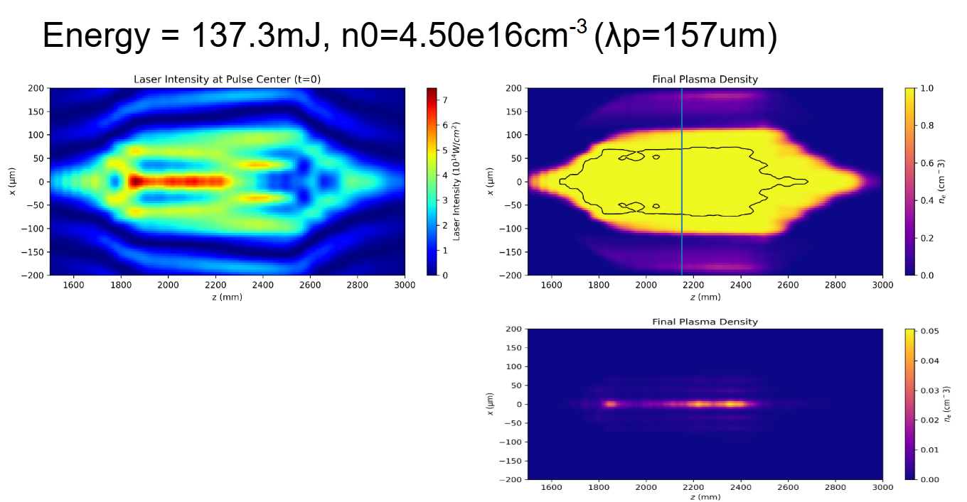
Back up tandem lens in argon

Slide 25
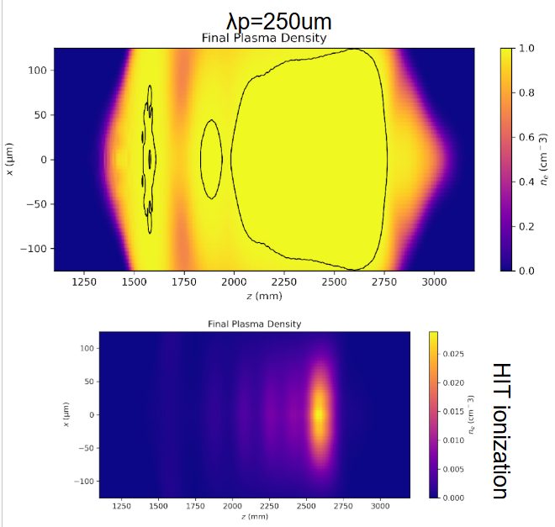
Our axilens profile

Slide 26
E310 Paper

Slide 27
E311

Slide 28
E313

Slide 29
E315 + 316

