Slide 1


PCA and similar for compression
Fred Poitevin - 06/27/2025
https://lcls-mlcv.github.io/

Slide 2

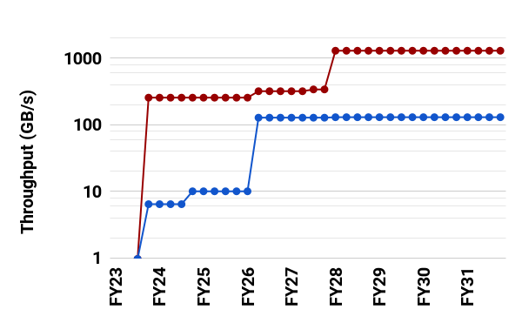
LCLS Data Throughput
1 TB/s
Detector Output
250 GB/s
Throughtput (GB/s)
Processed Data
LCLS-II Upgrade: greater data velocity, volume, and complexity
Data Rates: 120 Hz to 1 MHz (10000x)
Raw Data Volumes: 2 GB/s to 200 GB/s (100x)
Recorded Data Volumes: 2 GB/s to 20 GB/s (10x)
Computational Requirements: 80% ~1 PF, 20% ~1 ExaFLOP
Fast Feedback: real-time analysis (sec/min) is essential to the users’ ability to make informed decisions during experiments.

Slide 3
2025 - the year of the LCLS Digital Twin
sample states
Sample
Instrument
Controls
filter
image
encoder
image
feature
Training
Model
of the Sample
Simulation
reconstructed
https://lcls-mlcv.github.io/
Notes:
Digital twins, surrogate models

Slide 4
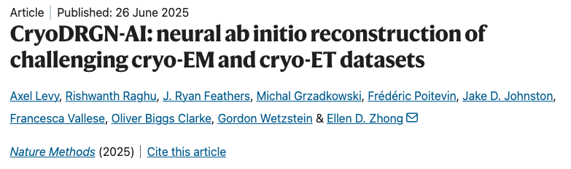
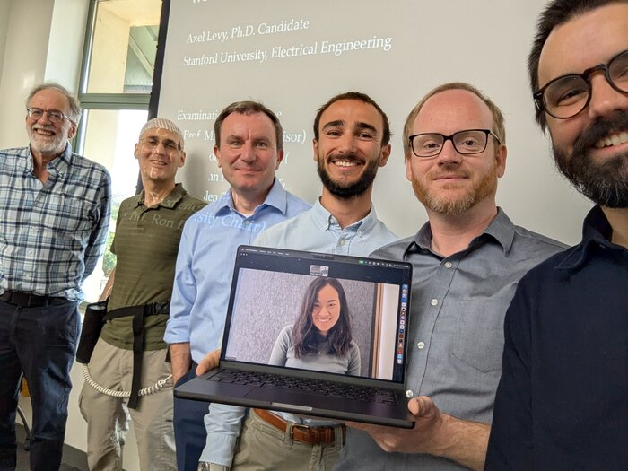
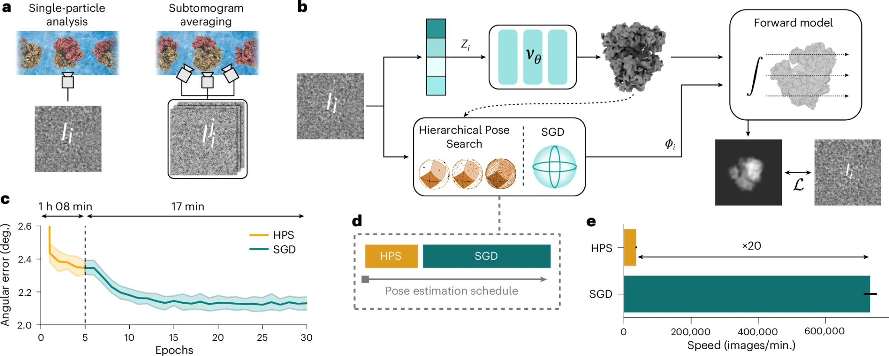

Slide 5





2025 - the year of the LCLS Digital Twin
Sample
Data Reduction Pipeline
Instrument
Controls
filter
image
image
encoder
image
feature
Training
Model
of the Sample
Simulation
reconstructed
https://lcls-mlcv.github.io/

Slide 6
2025 - the year of the LCLS Digital Twin
Sample
Instrument
Controls
filter
image
encoder
encoder
image
feature
Steering
Latent space
Model
of the Sample
Simulation
Model
of the Sample
reconstructed
https://lcls-mlcv.github.io/

Slide 7
Roadmap to compression, exploration and visualization
lossless
lossy
Time to establish baselines and benchmarks.
Start with simple, fast and efficient methods - and build from there.
res.red.
dim.red.
quant.
feature selection
feature reduction
linear
non-linear
PCA
LDA,...
UMAP,...
NN

Slide 8
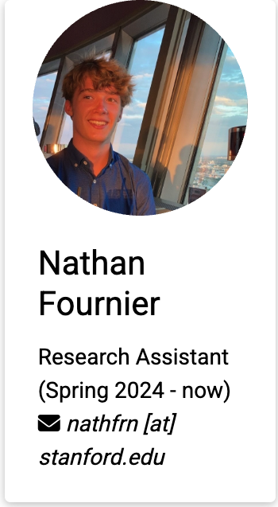
Roadmap to compression, exploration and visualization
Remember:
~ 10⁴-10⁶ frames per second (n)
~ 10⁶-10⁷ pixels per frame (p)
rank unknown (r)
Scikit-learn won’t help…
PCA
O(p³)
SVD
O(pn²)
Update by batch (s)
to become n-independent
iPCA
O((r + s).p)
Still r-limited…
Build q independent sub-detectors
PyPCA
O((r + s).p / q)
Empirically, on 40GB GPU, for 2Mpixel detector: r_{max} ~ 750 q

Slide 9
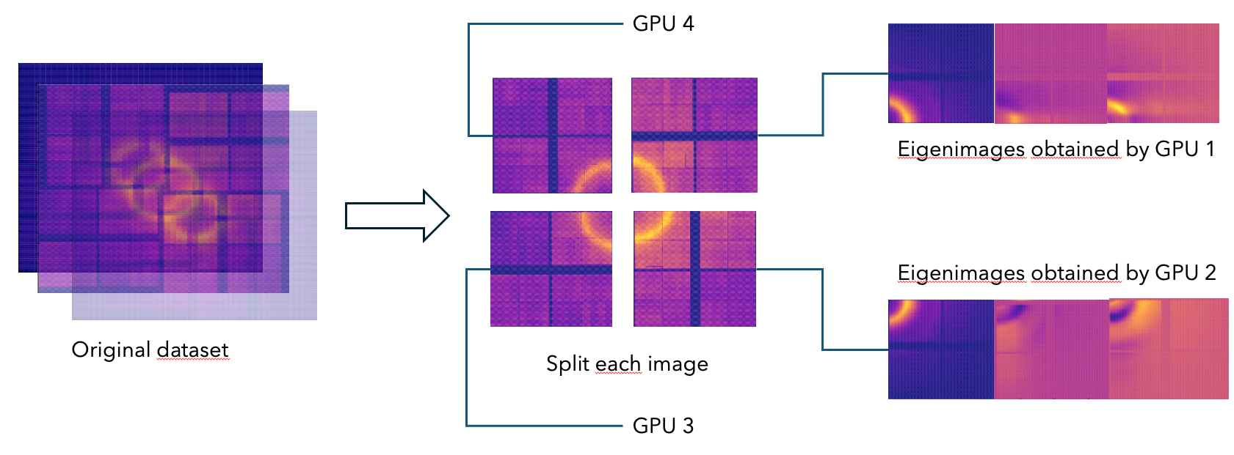
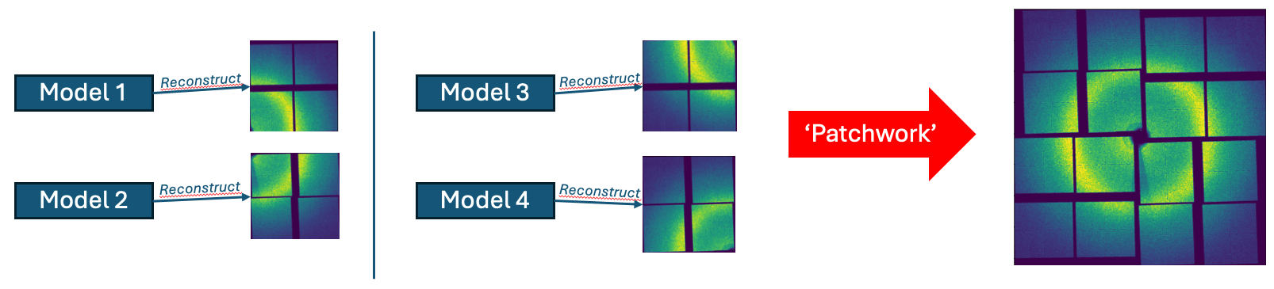
PyPCA: Parallelized pytorch-based Incremental PCA

Slide 10
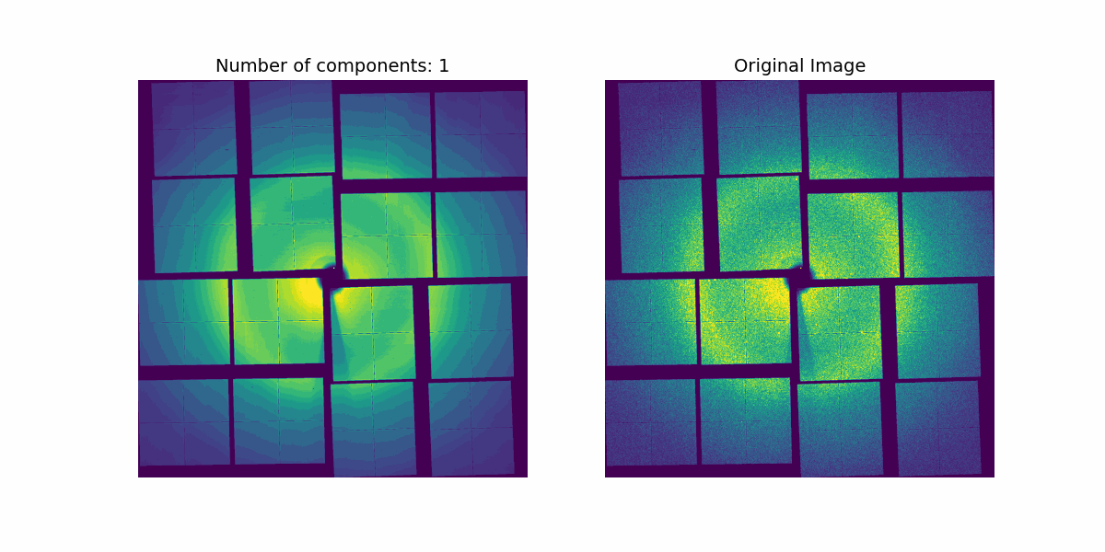
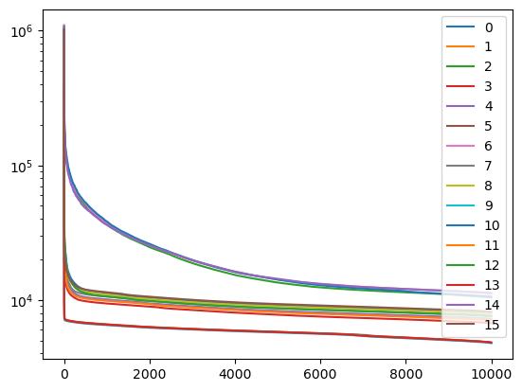
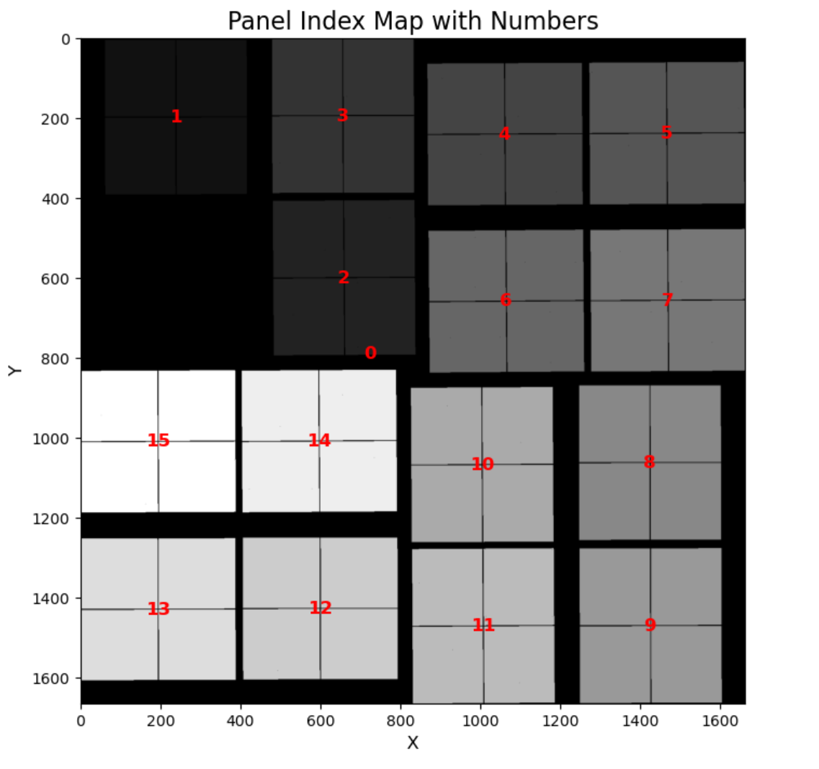
PyPCA: Parallelized pytorch-based Incremental PCA

Slide 11
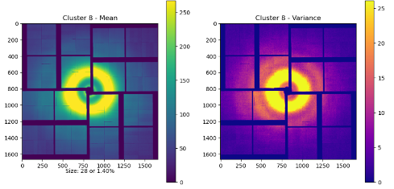
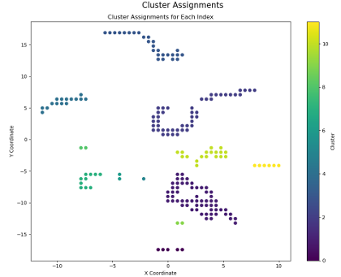
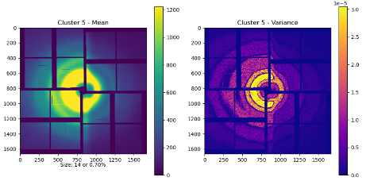
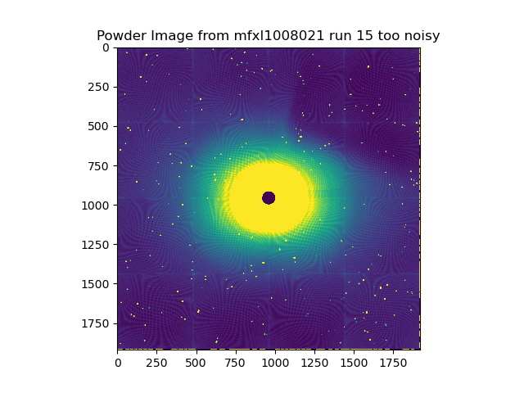
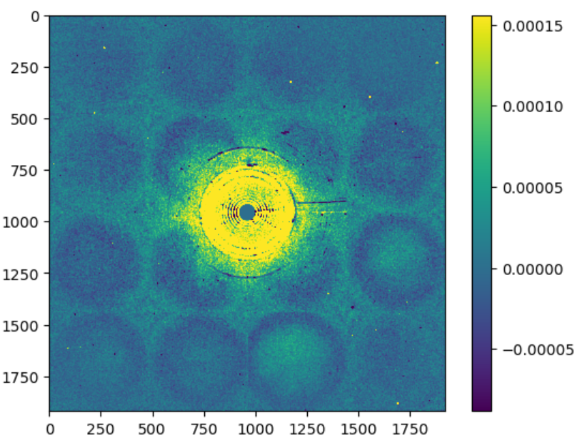
What can we do with this?
- Data exploration
- Featurization

Slide 12
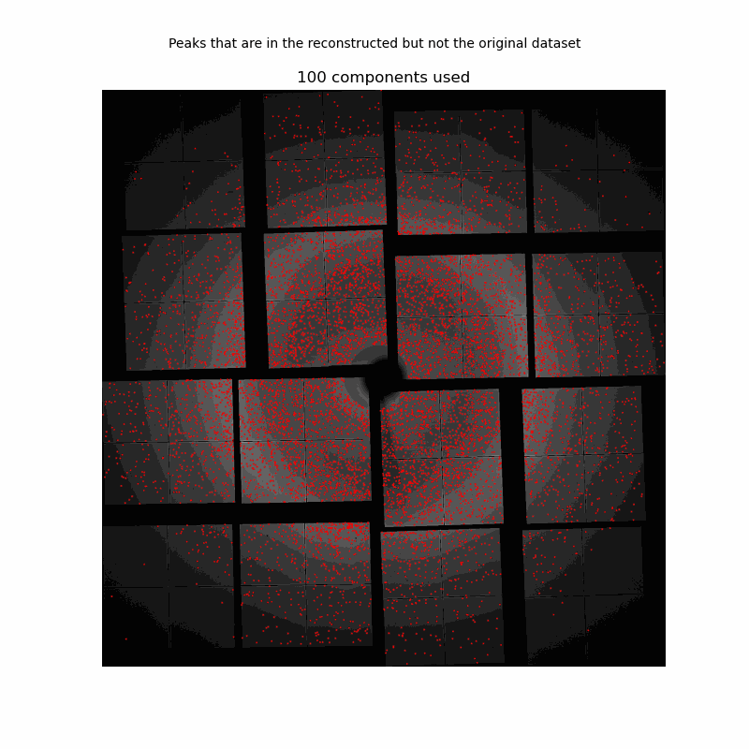
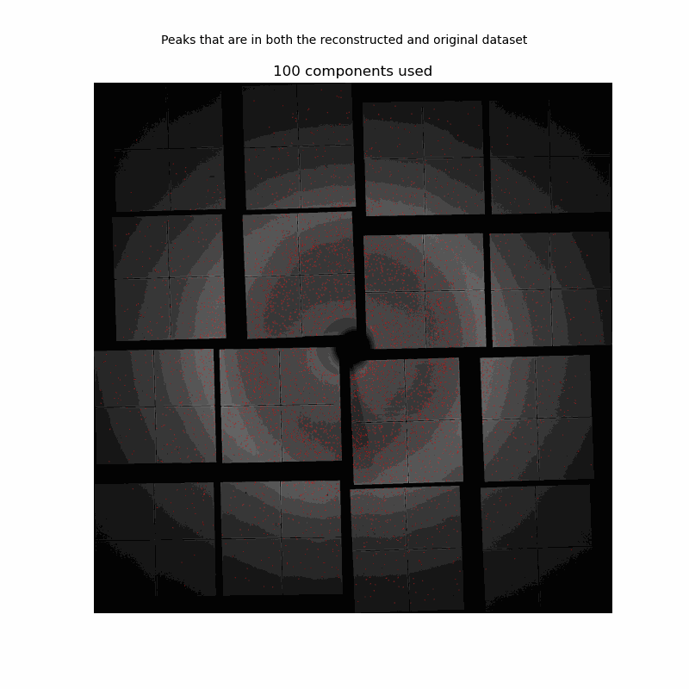
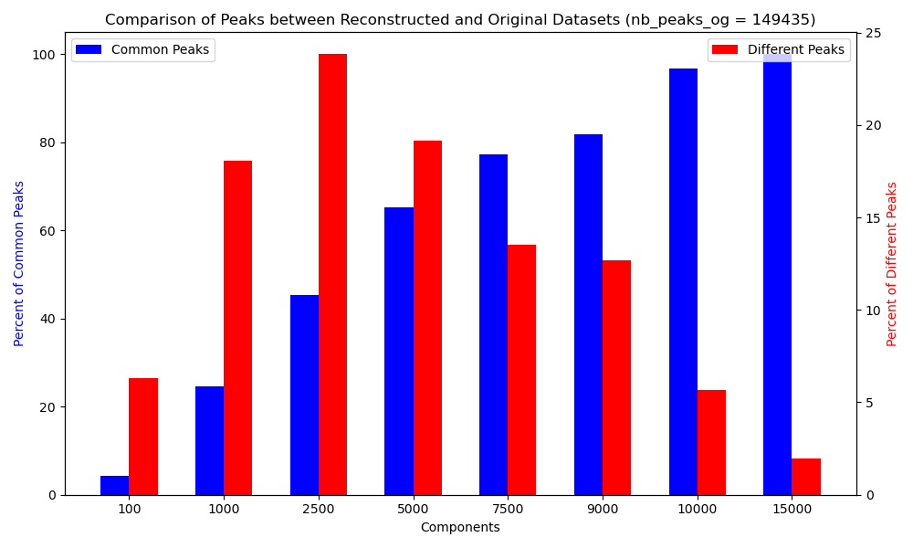
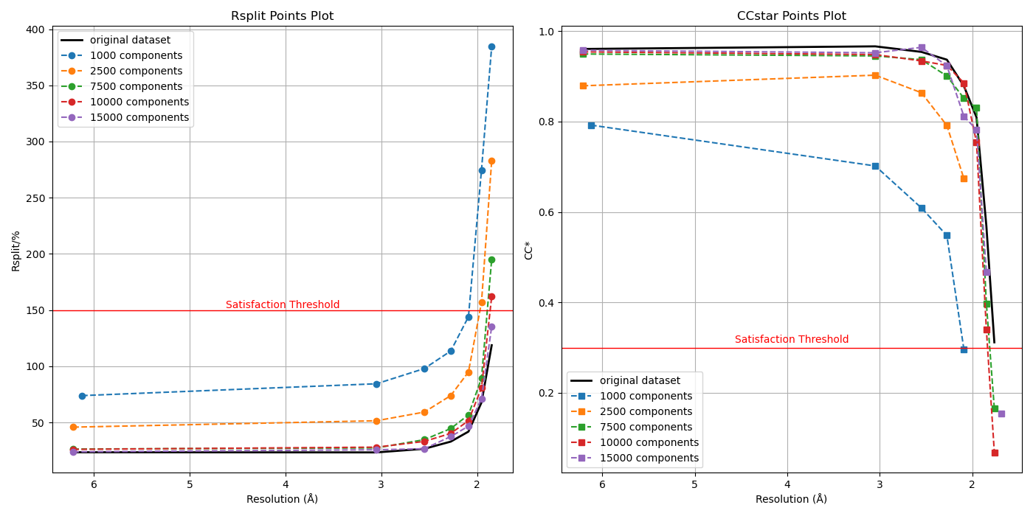
What can we do with this?
- Denoising

Slide 13
What can we do with this?
- Steering
Opportunities for on-chip inference informing controls:
- veto-ing
- alignment
- tuning (speed, power)
Opportunities for on-chip inference informing analysis: - background-inferred metadata (Temperature, …)
- cleaner signal simplifies algorithms. Speed-up.
- cleaner signal is easier to simulate. Helps Digital Twinning!
Laser Delivery
Beam Delivery
=
+
image
background
signal
Sample Delivery

Slide 14


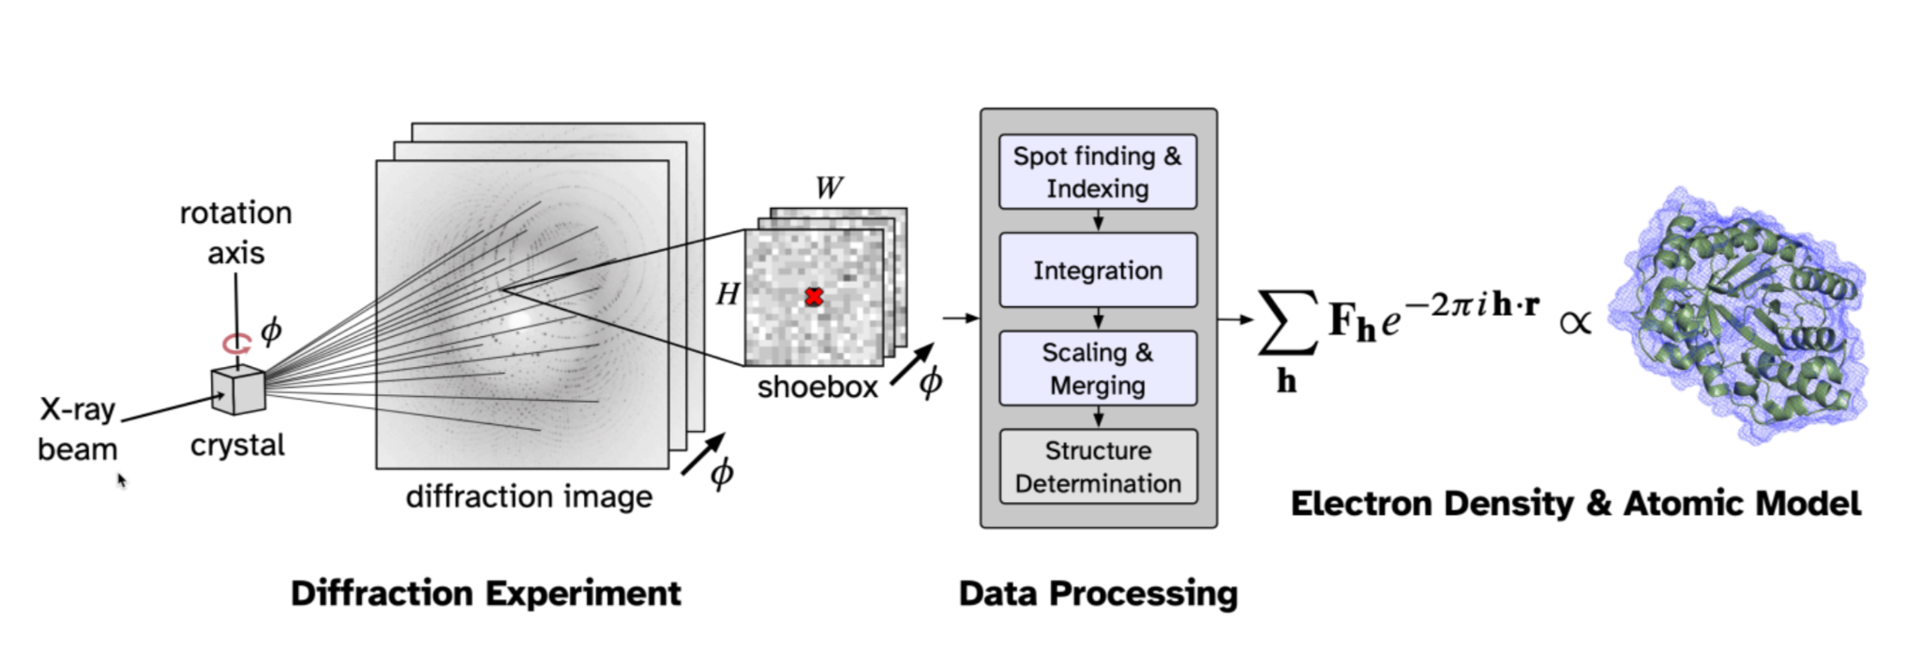
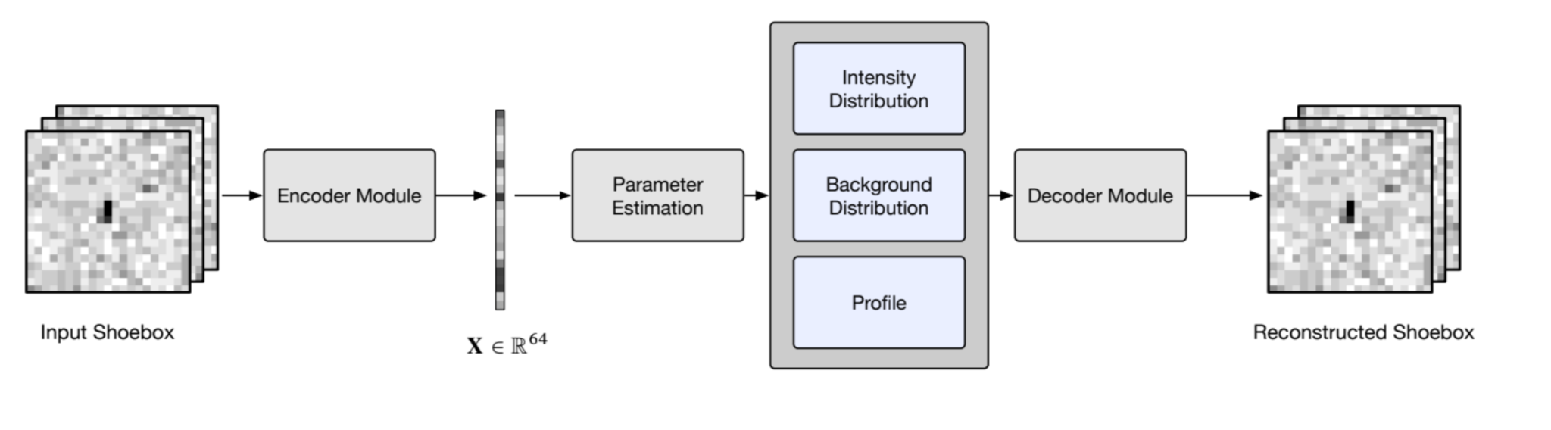

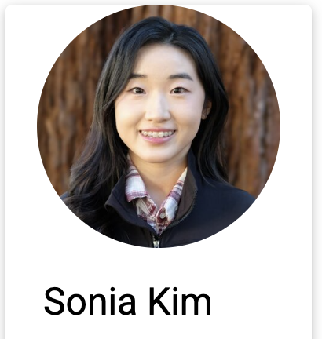
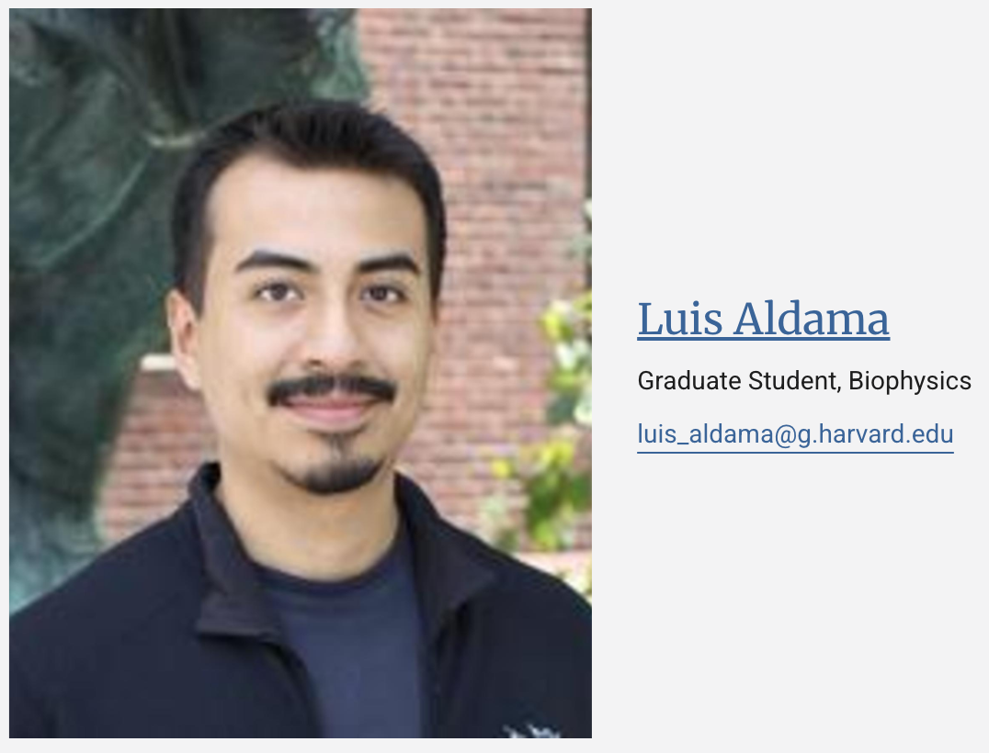
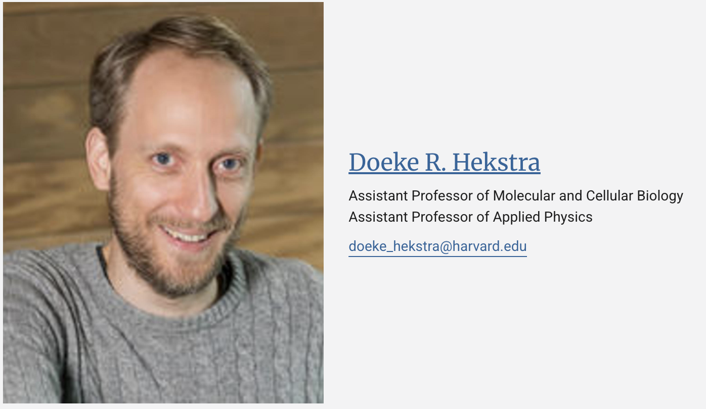
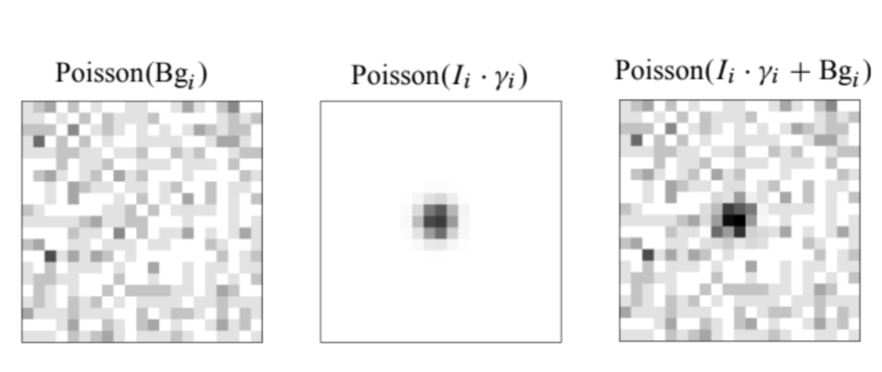
What can we do with this?
- End-to-end analysis for X-ray Crystallography

Slide 15
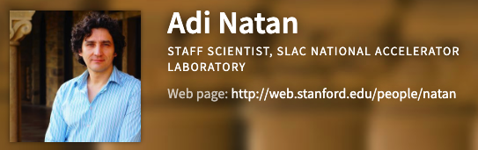



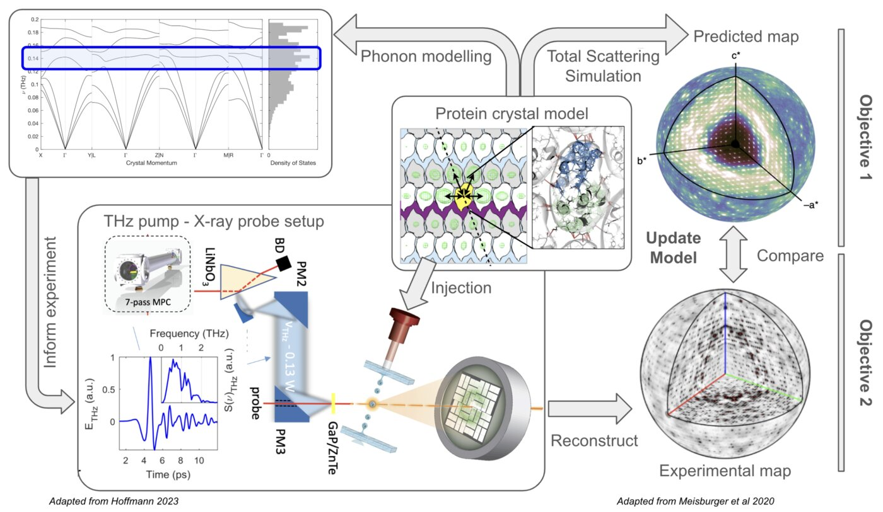

What can we do with this?
- End-to-end analysis for X-ray Crystallography
Background subtraction becomes critical when signal is diffuse

Slide 16
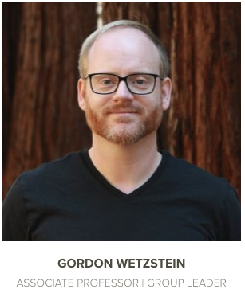

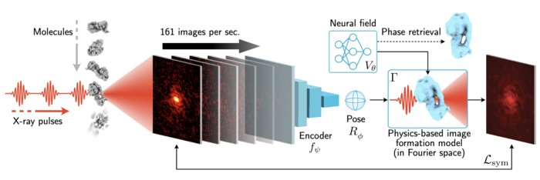

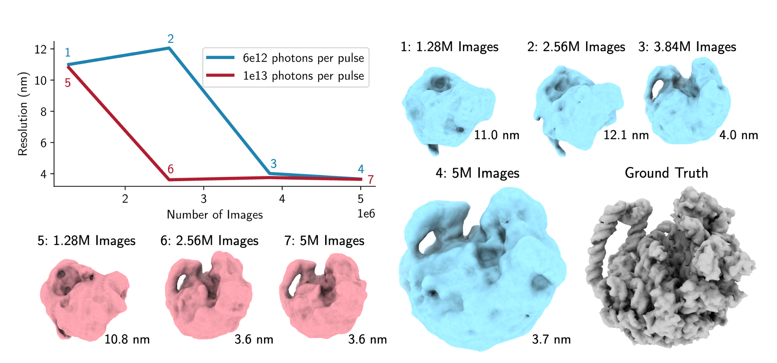
What can we do with this?
- End-to-end analysis for X-ray Single Particle Imaging
End goal:
Reconstruct on the fly - ultimate data reduction.

Slide 17
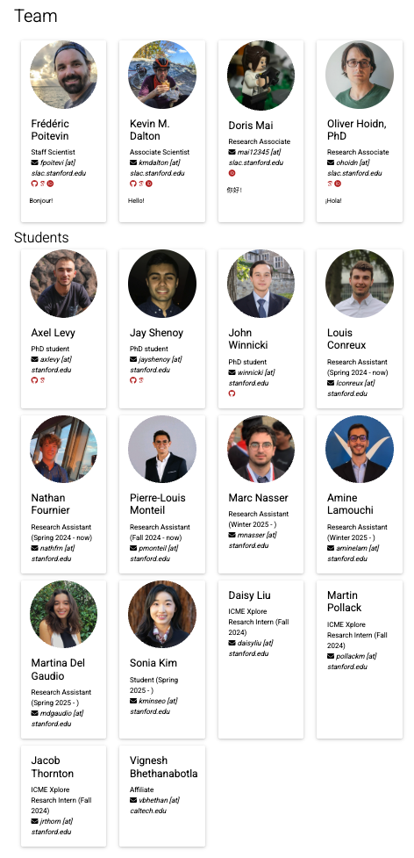
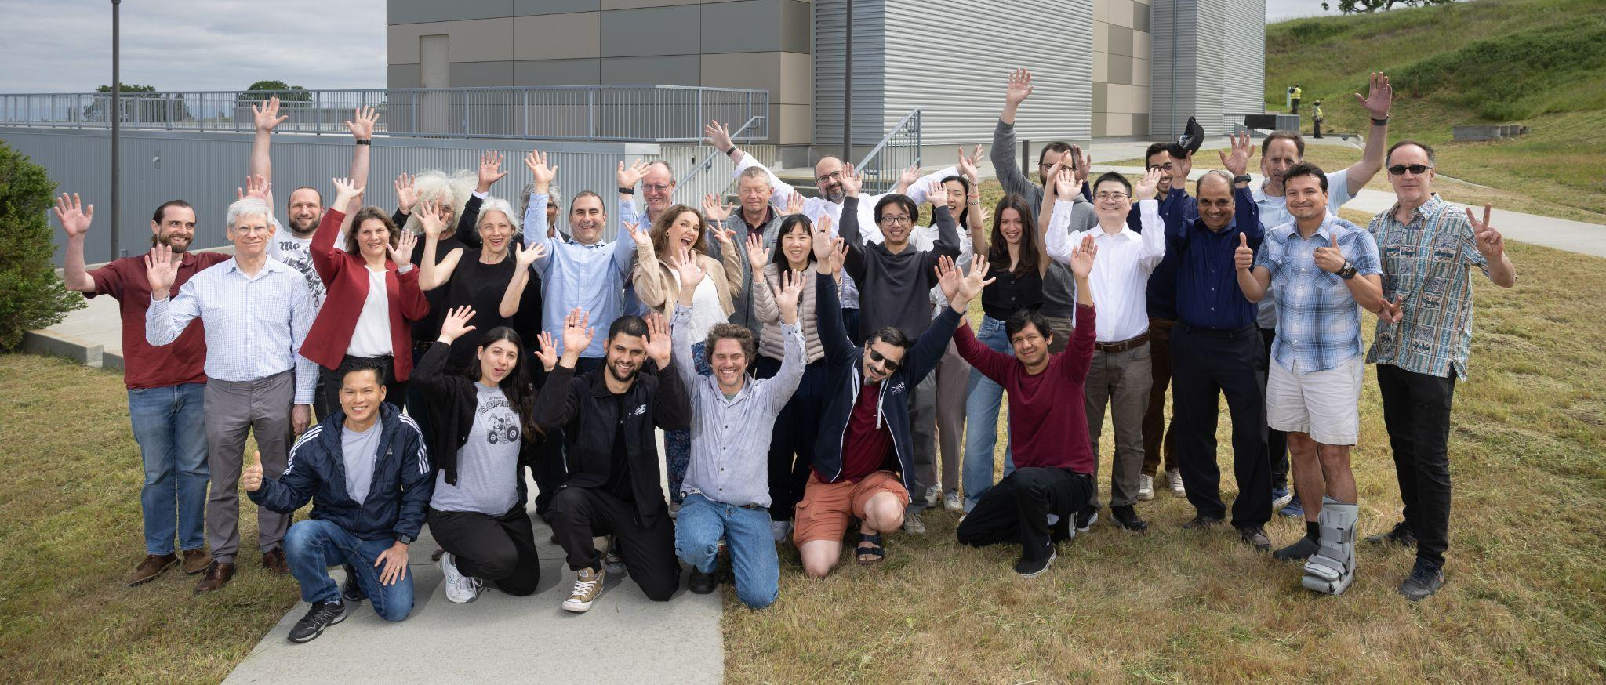





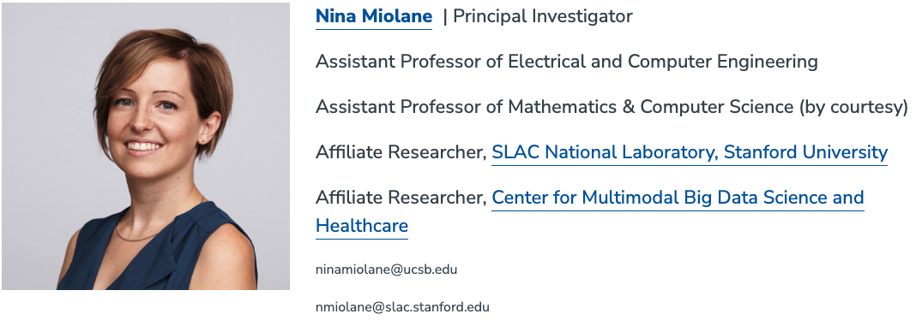
Thank you!

Slide 19
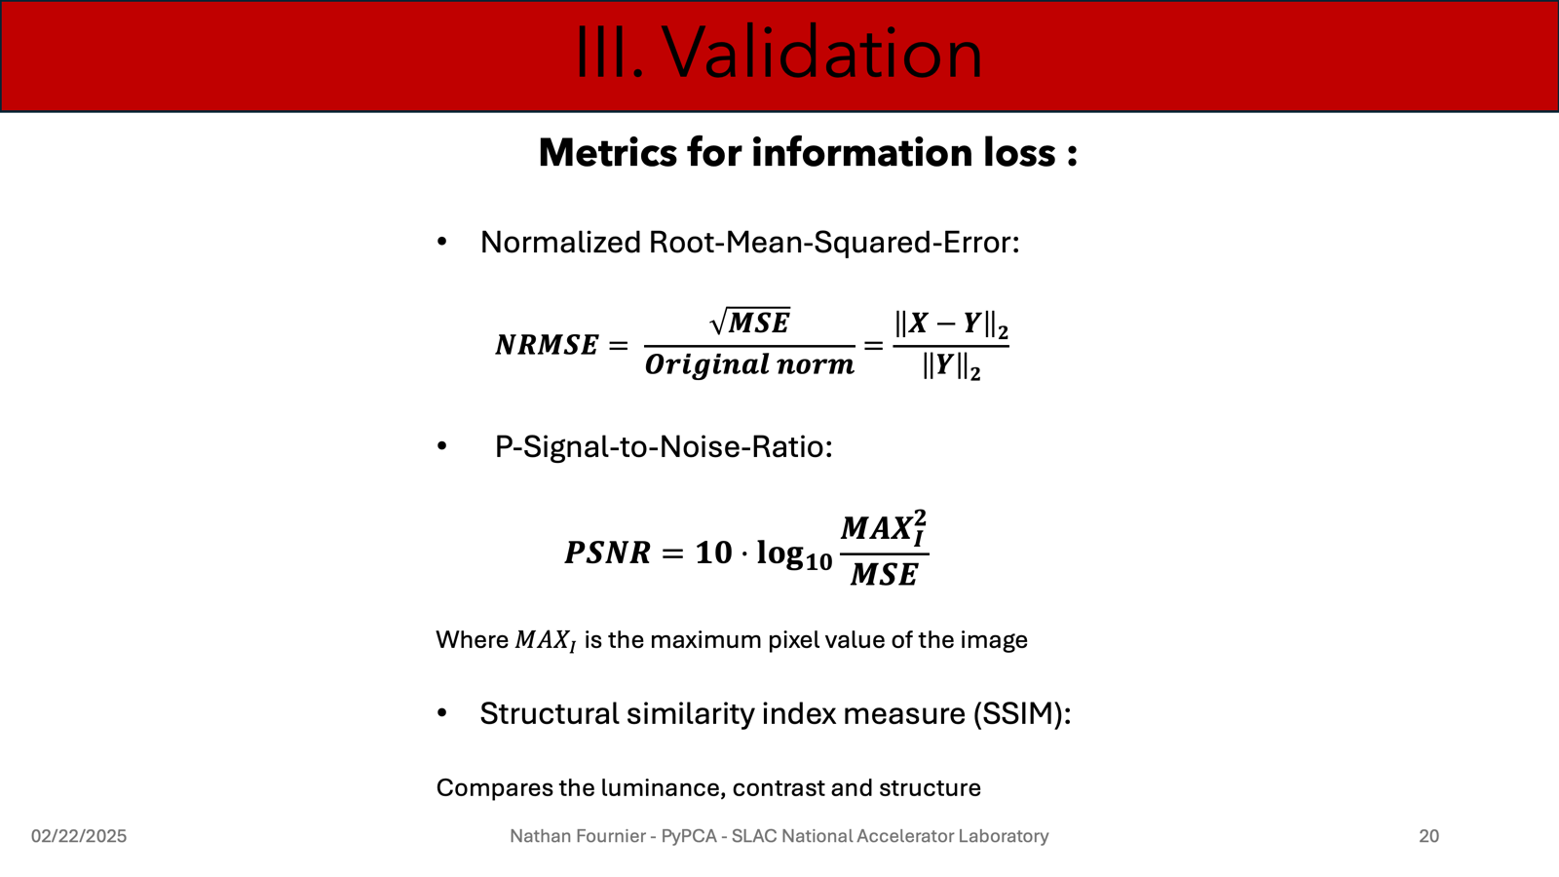

Slide 20
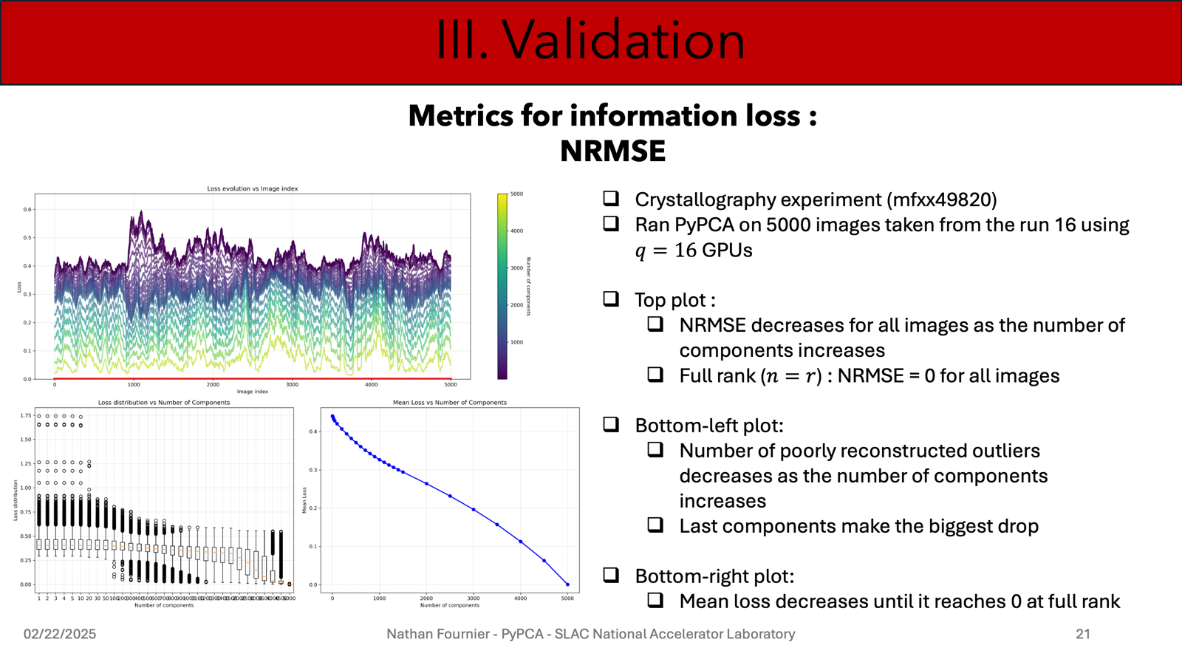

Slide 21
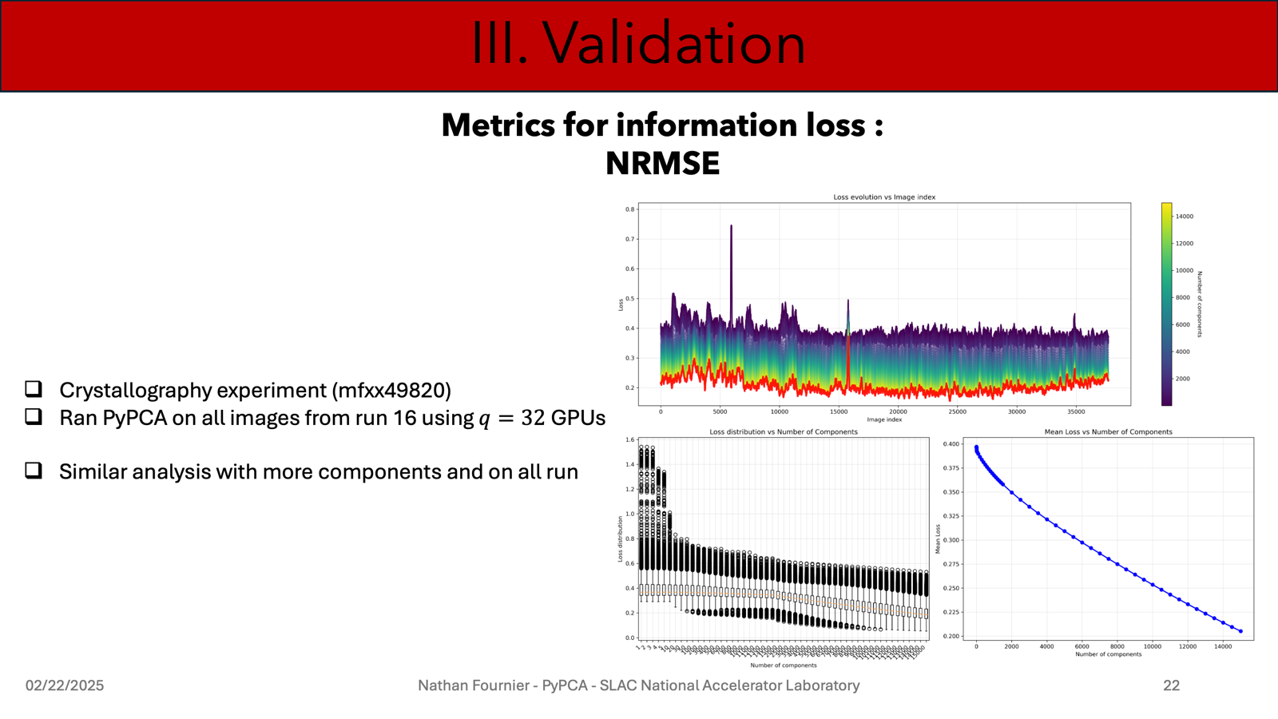

Slide 22
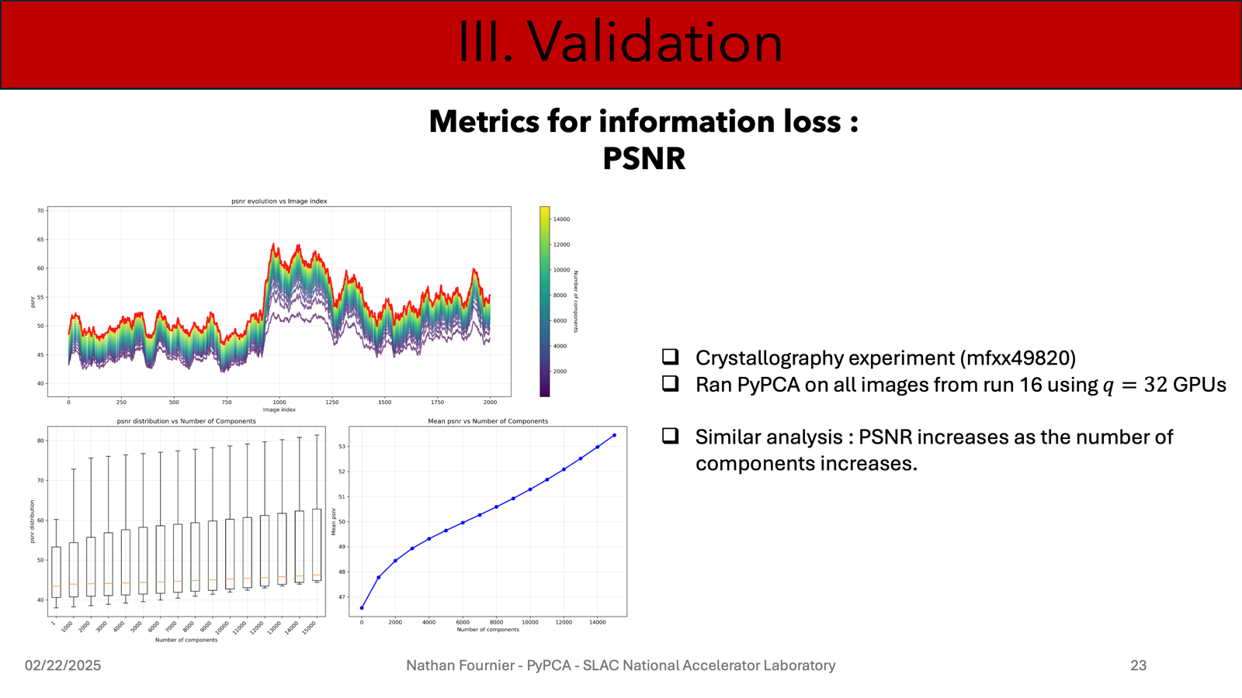

Slide 23
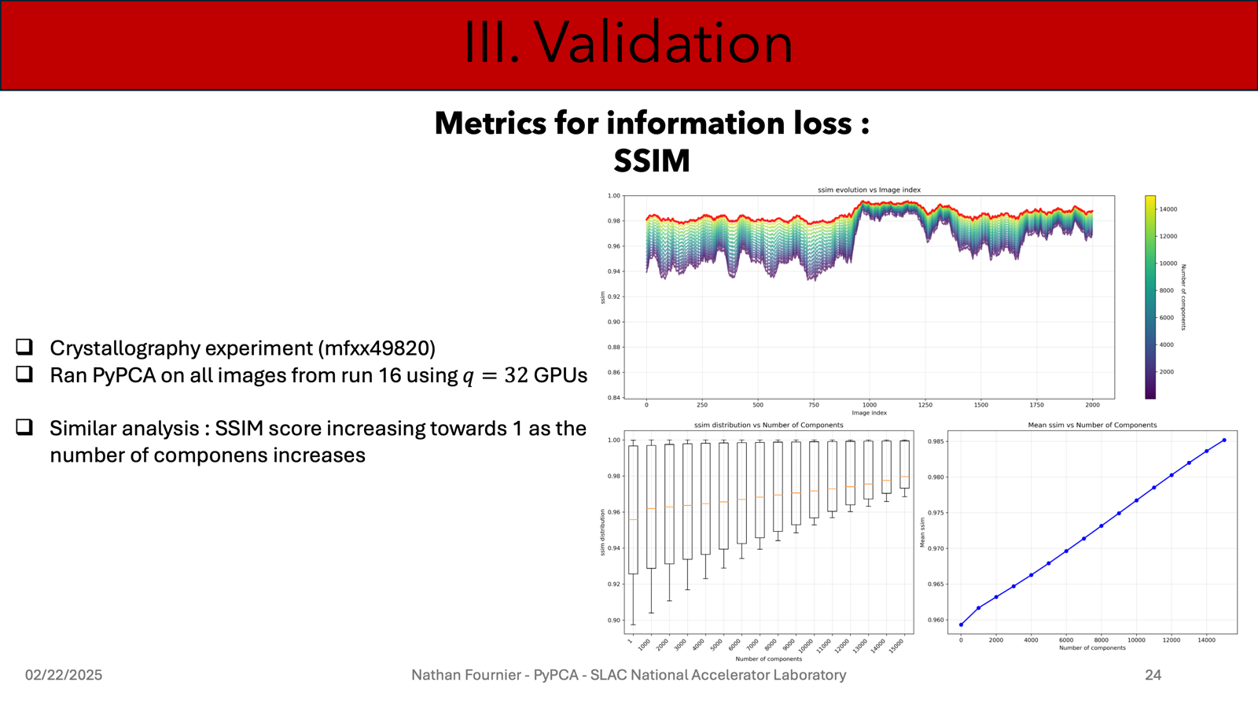

Slide 24
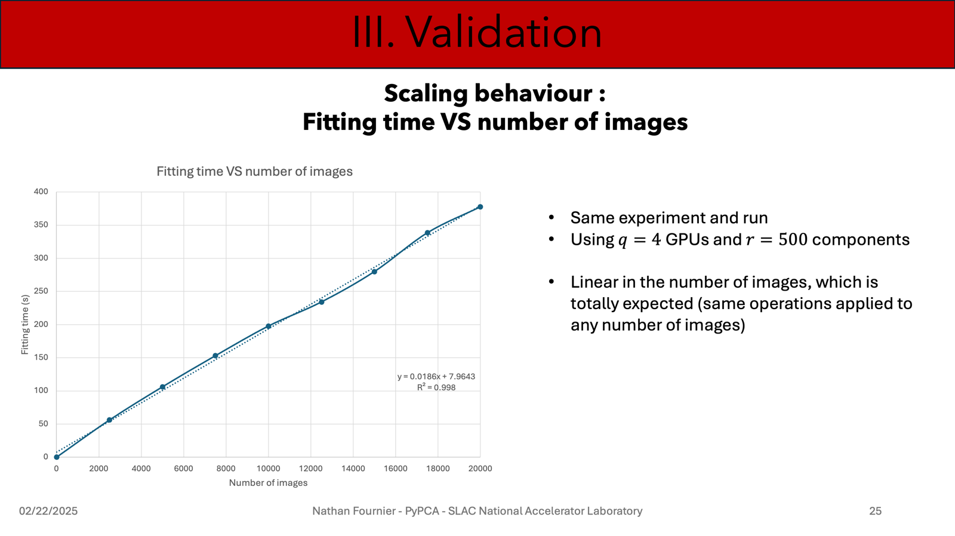

Slide 25
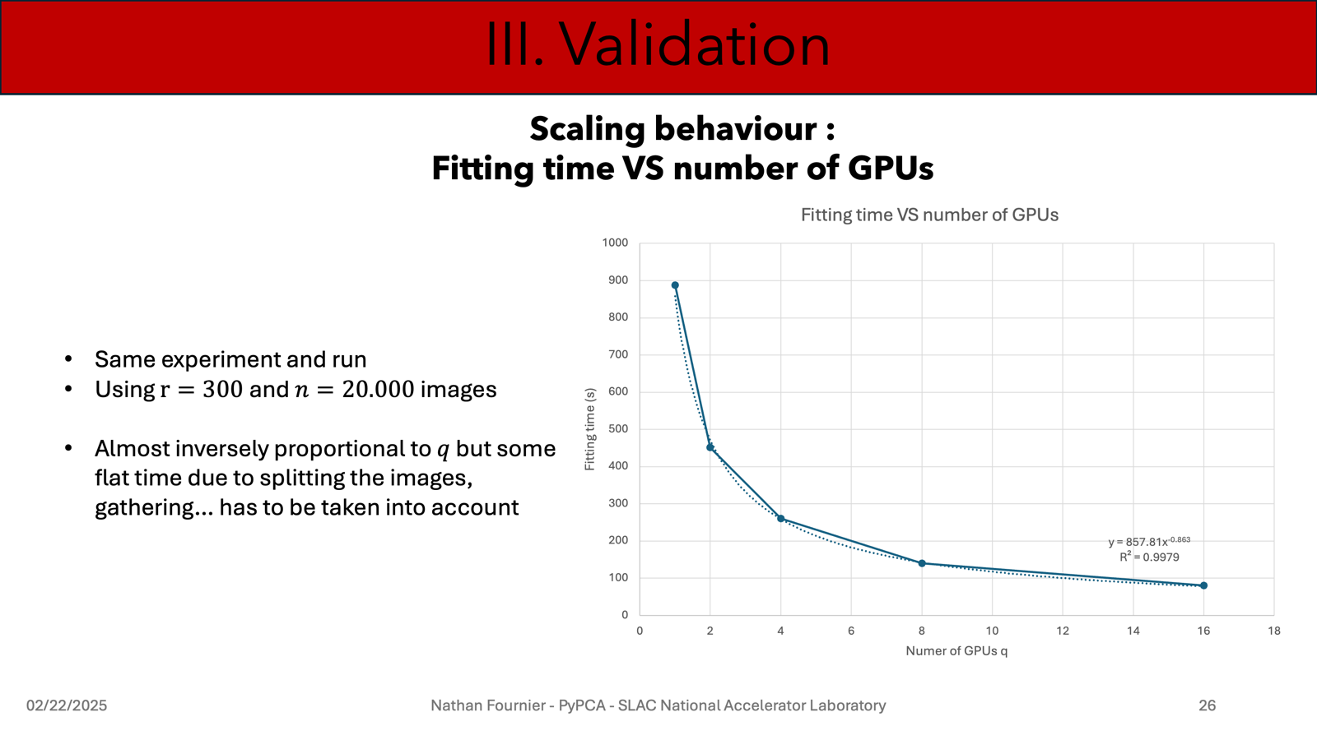

Slide 26
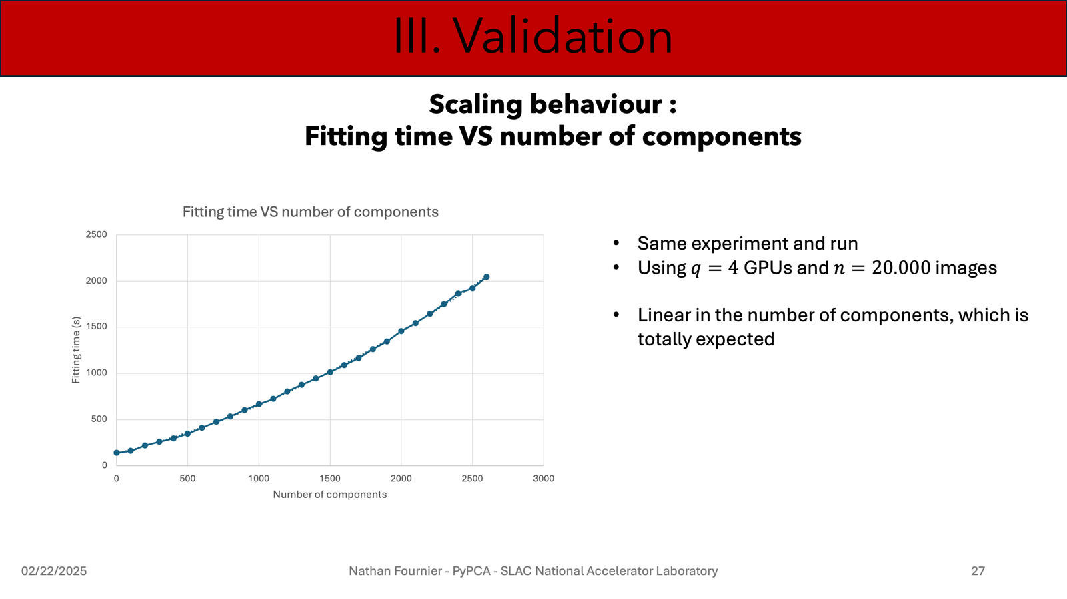

Slide 27
