Slide 1
Federated AI/ML and Compression for Experimental Light Source and Neutron Data
ORNL Team
R. Archibald, G. Cage, M. Doucet, L. Drane, W. Heller, S. Hitefield, P. Laiu, A. Malviya-Thakur, M. McDonnell, & S. Schotthöfer
SLAC Team
R. Coffee.
AUREIS mini-workshop for Intelligent Sensing, June 27, 2024

Slide 2
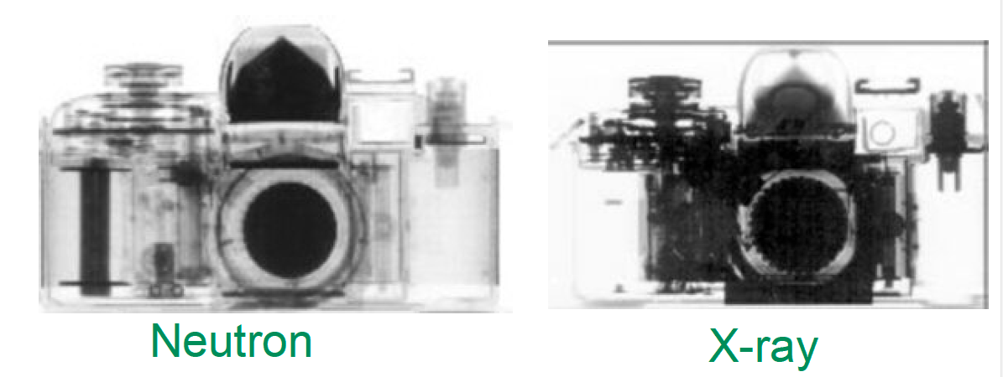
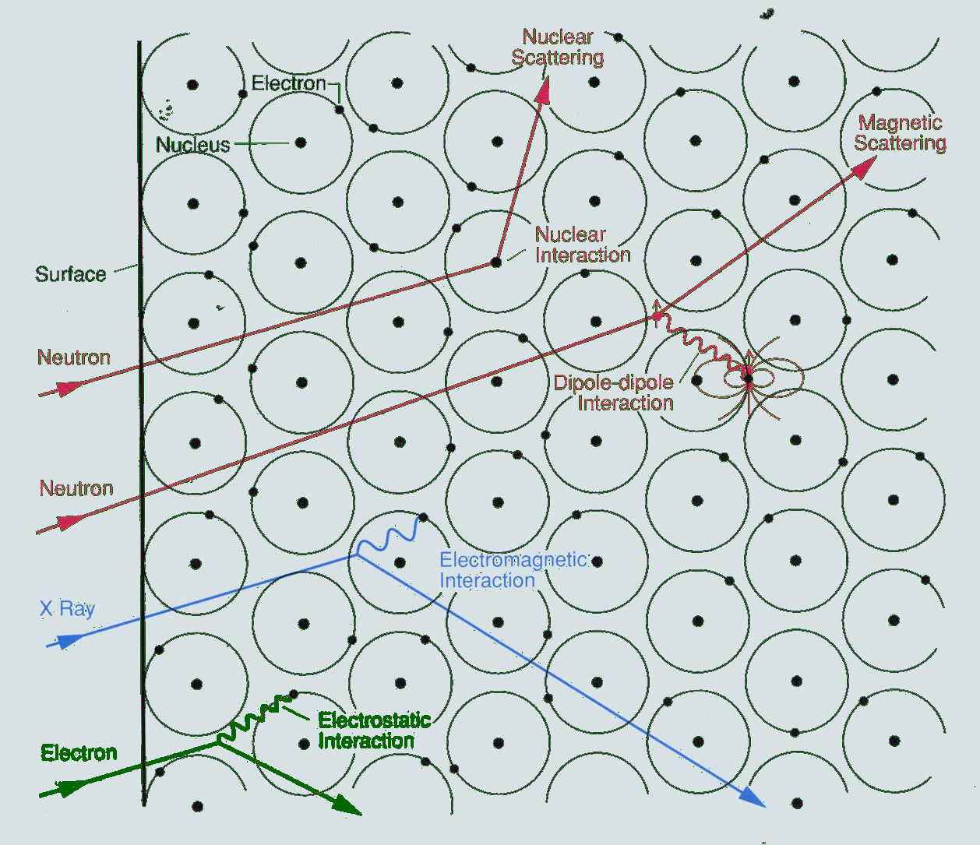
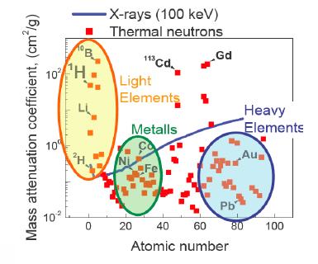
Experimental Science at DOE Facilities
Why Neutrons, X-Rays or Electrons?
Neutrons
X-Rays
Penetrate metals without absorbing
Highly sensitive to water and hydrocarbons
High contrast to light elements
Sensitivity to magnetism
Measure dynamics and structure
R. Pynn, ‘Neutron Scattering’, LANL
Notes:
$\mathbf{d} = F(S,R) = S_{\{\Phi\}}( \mathbf{Q}, \omega) \ast R( \mathbf{Q}, \omega)$

Slide 3








DOE Landscape Experimental Facility Landscape
Electron Sources
X-Ray Light Sources
Six SAS Instruments
Five SAS Instruments
Neutron Scattering Facilities
Twelve SAS Instruments
Two SAS Instruments
One SAS Instruments

Slide 4
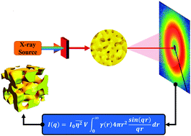
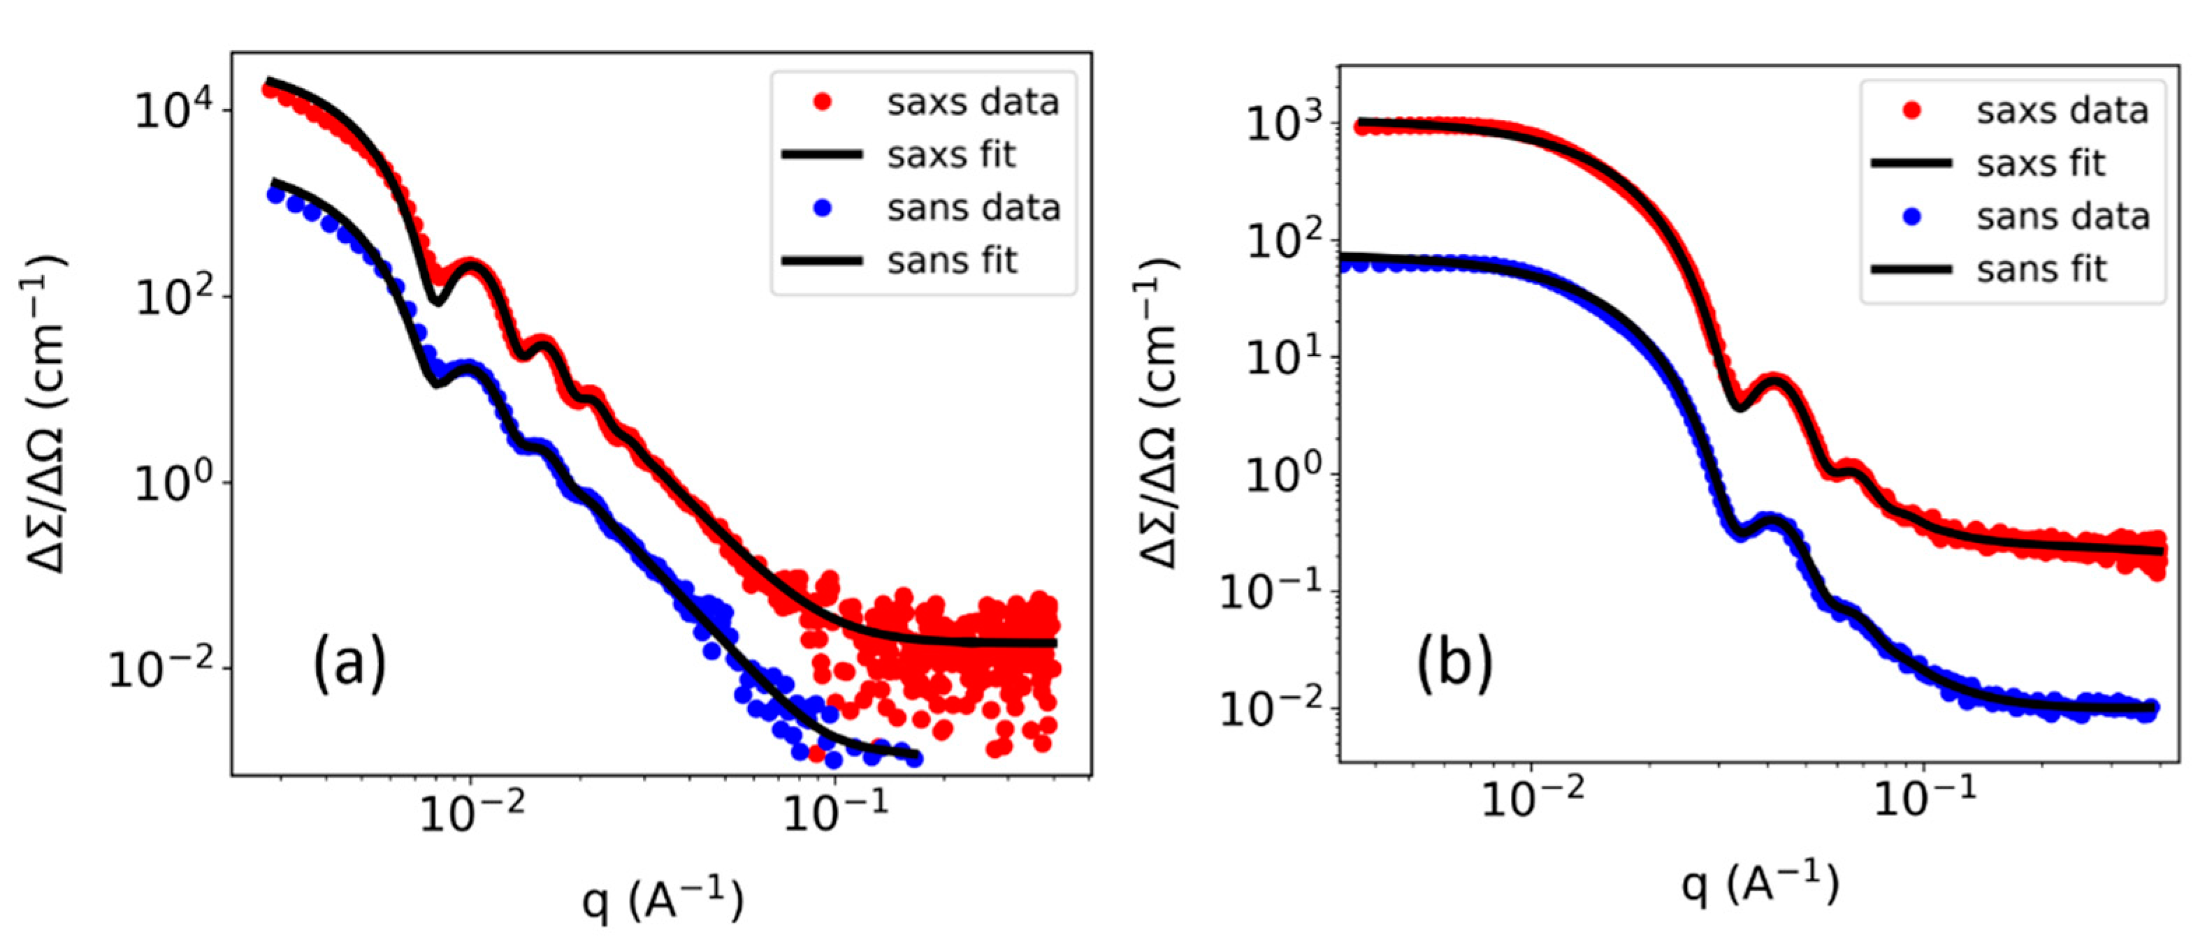
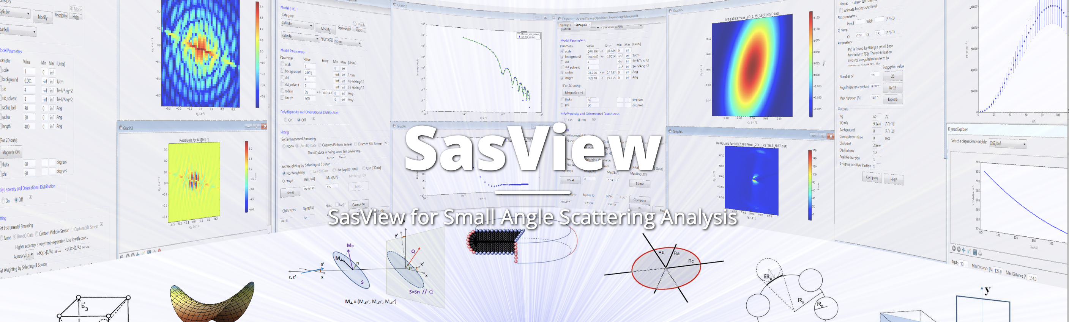
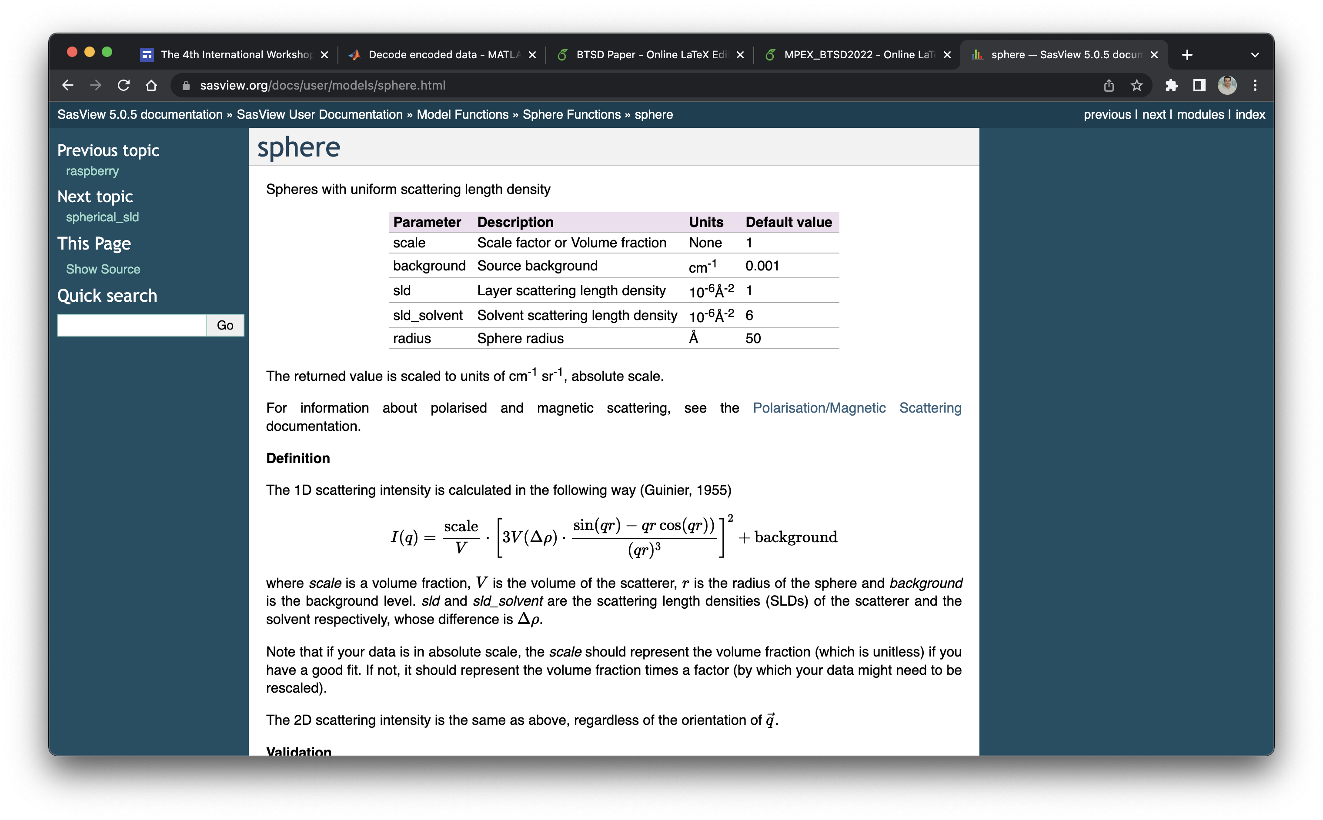

Small Angle Scattering (SAS)
source
p = distance distribution function
R = Instrument Resolution function
$$I∝p∗R$$
SAS Model for distance distribution function

Slide 5

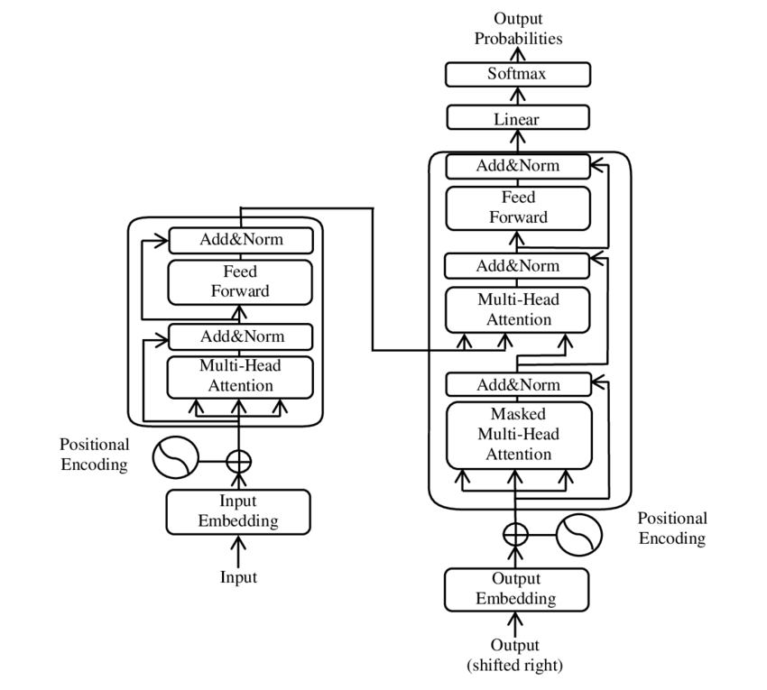
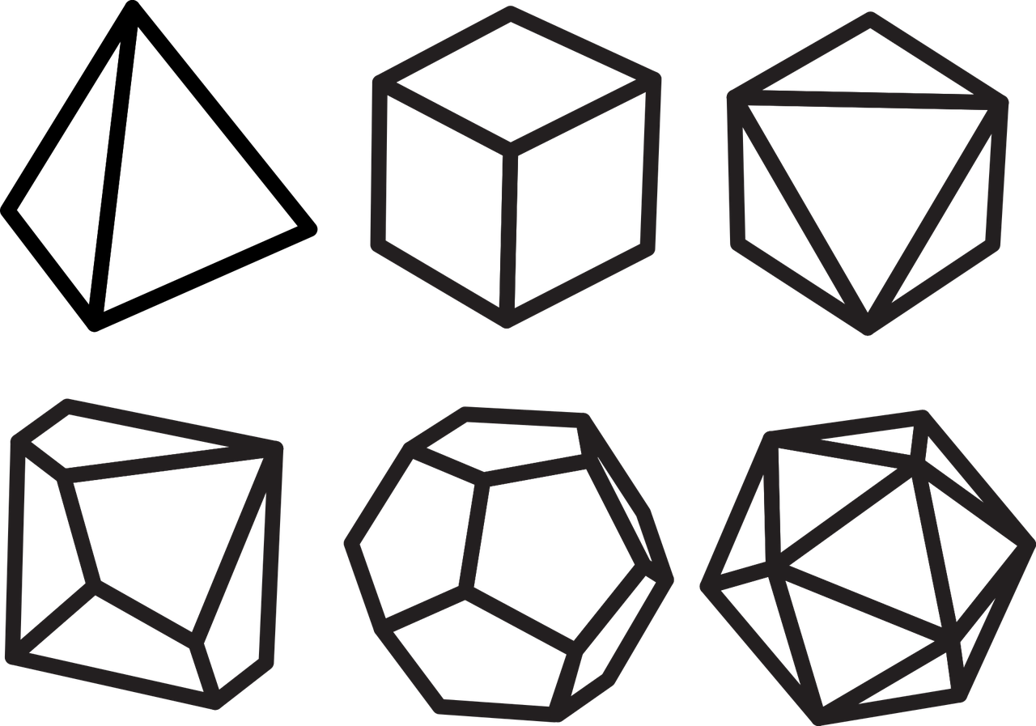
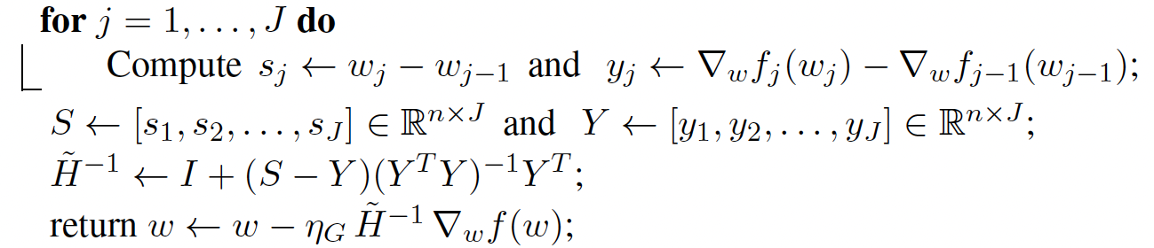











FedAvg Update
Location A
Model $≡ w_{A}$
Data
$$w_{A}$$
Single Location
Location B
$${\tilde{w}}_{A}$$
Central Hub
$$w_{B}$$
$${\tilde{w}}_{B}$$
$$w_{C}$$
Model $≡ w_{B}$
Data
$${\tilde{w}}_{C}$$
Model $≡ ρ$
Data
Location C
Gold Standard Federated Learning Comparison
Model $≡ w_{C}$
Data

Slide 6
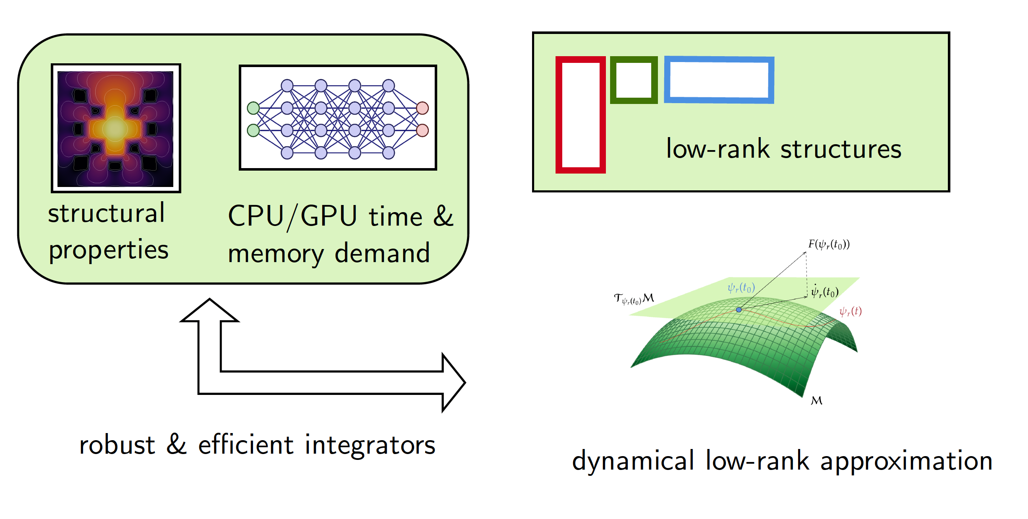
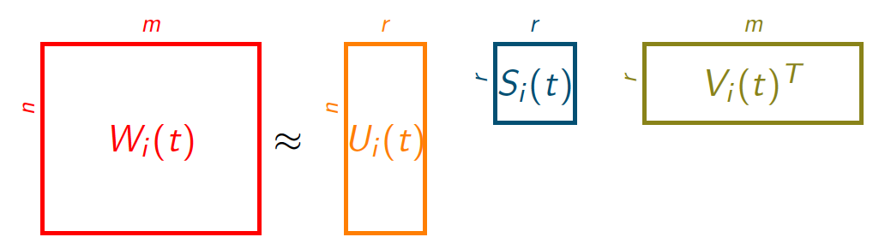
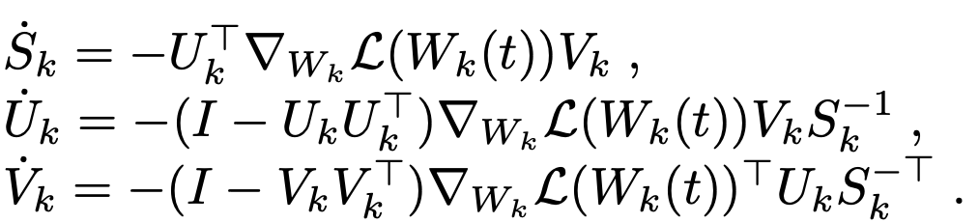
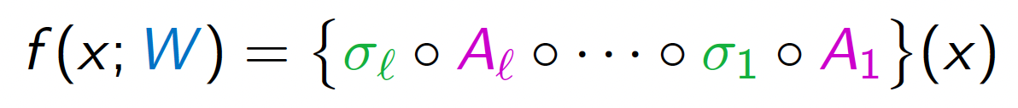
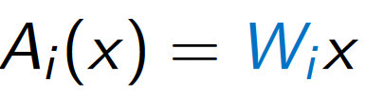
Dynamical Low-Rank Approximation for Neural Networks
*Research and code from Steffen Schotthöfer at ORNL

Slide 7
Accelerated Update
Location A
Model $≡ w_{A}$
Data
$$w_{A}$$
Single Location
Location B
$${\tilde{w}}_{A}$$
Central Hub
$$w_{B}$$
$${\tilde{w}}_{B}$$
$$w_{C}$$
Model $≡ w_{B}$
Data
$${\tilde{w}}_{C}$$
Model $≡ ρ$
Data
Location C
Gold Standard Federated Learning Comparison
Model $≡ w_{C}$
Data

Slide 8
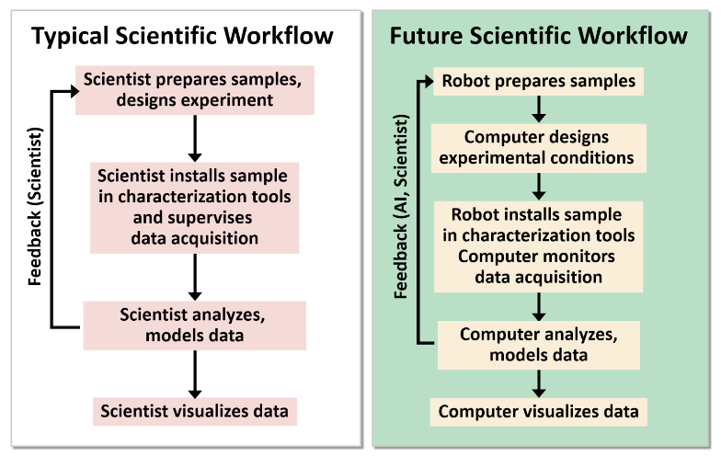
Federated Learning + INTERSECT + Laboratory of the Future

Slide 9
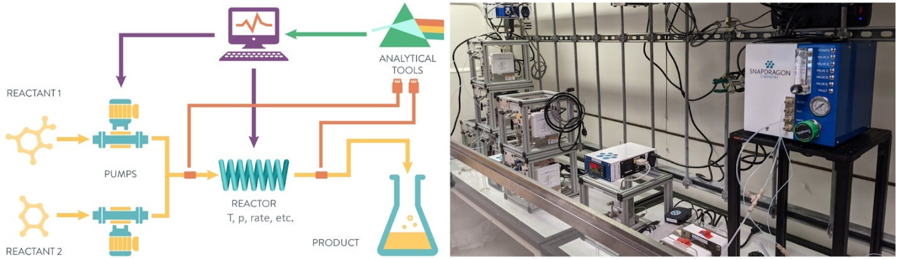
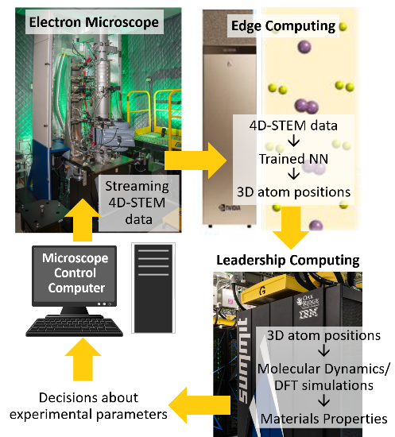
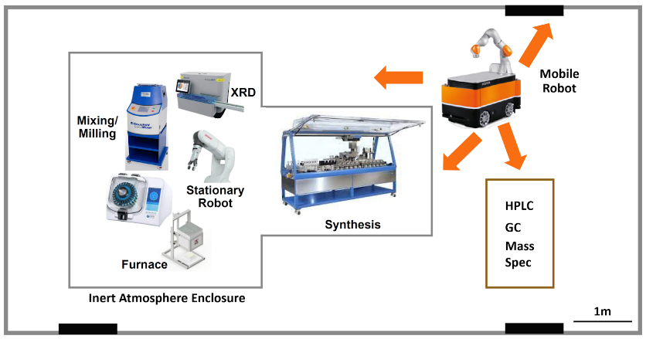
Federated Learning + INTERSECT + Laboratory of the Future
Autonomous Chemistry
Autonomous Spectroscopy

Slide 10
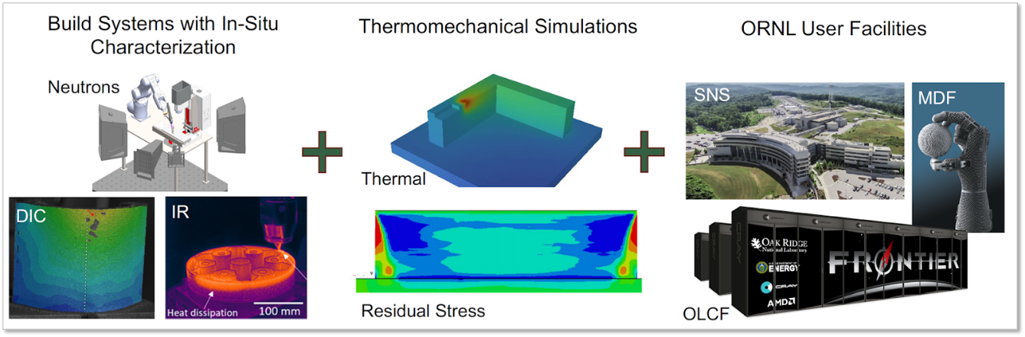
Federated Learning + INTERSECT + Laboratory of the Future
Systems of Systems Science

Slide 11






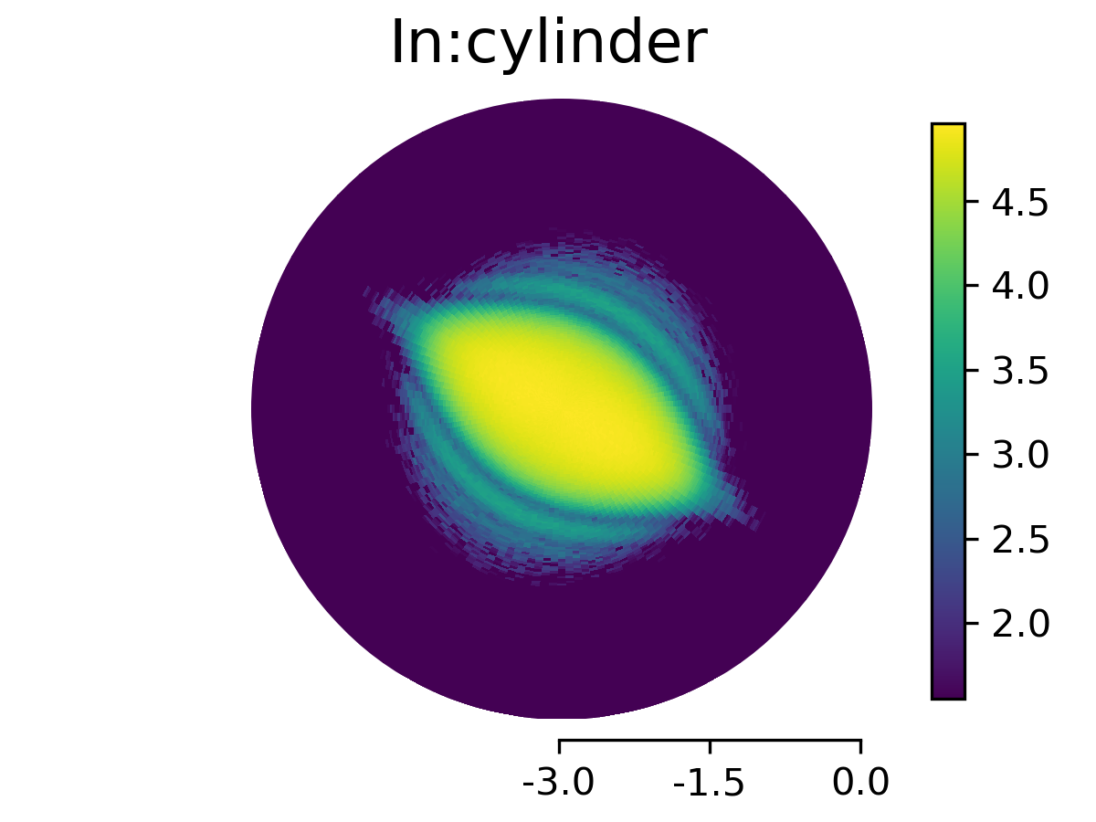
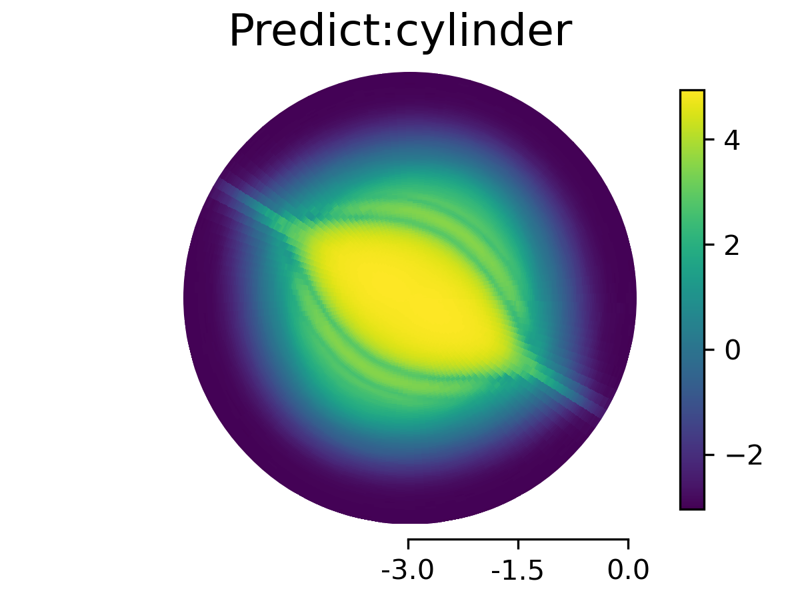
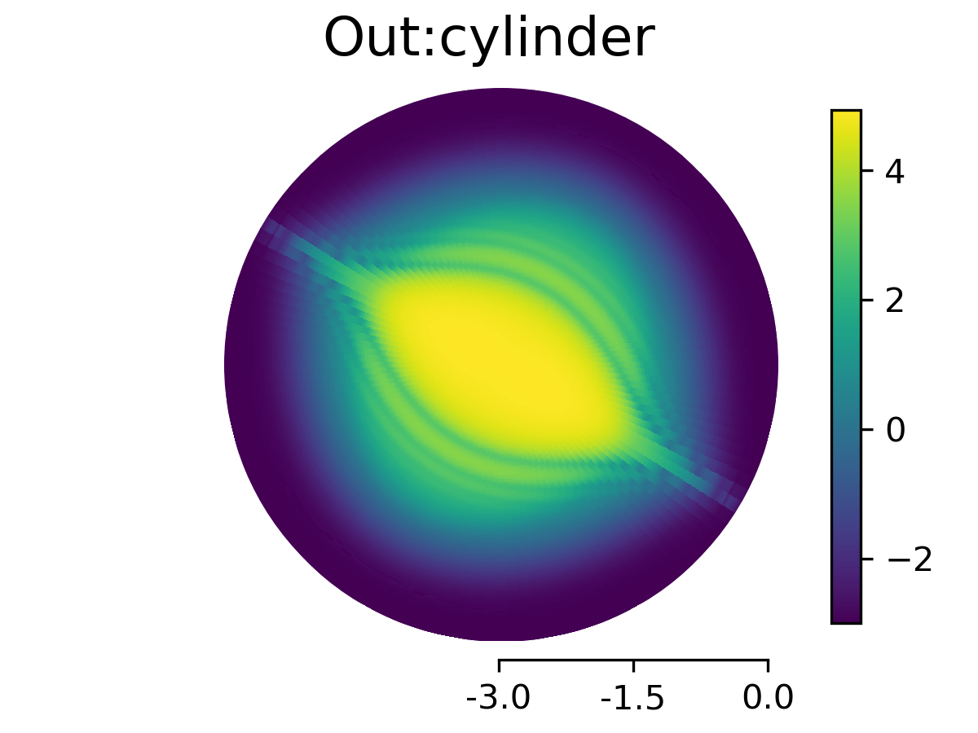

Federated Learning for Experimental Facilities (IBM/ORNL/RedHat/SLAC)
secure science
Neutrons
X-Ray
Ground
Truth
Measurement
Sim Input
Predicted
Output
Ground
Truth
secure science
secure science
Electrons
Federated Learning across different facilities and security domains increase the accuracy in reconstruction, model classification, and decompression rate. Using SasView we build-in community based physical knowledge.

Slide 12
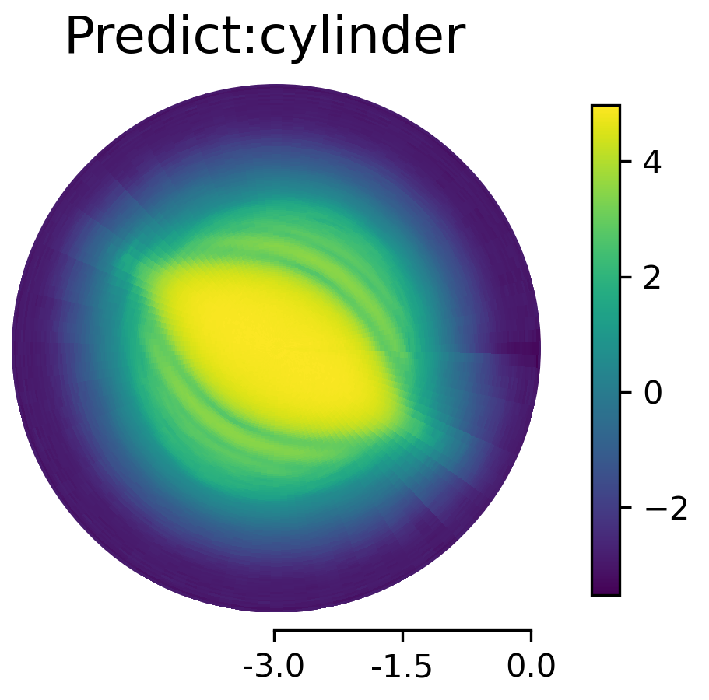
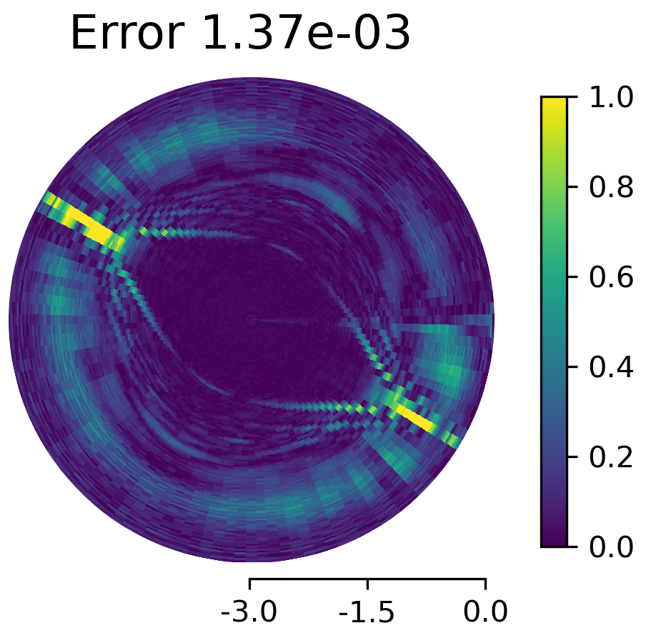
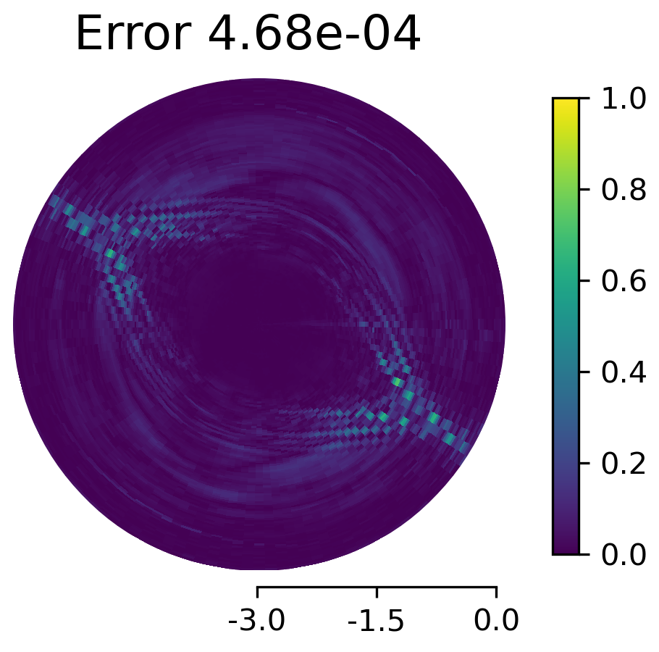
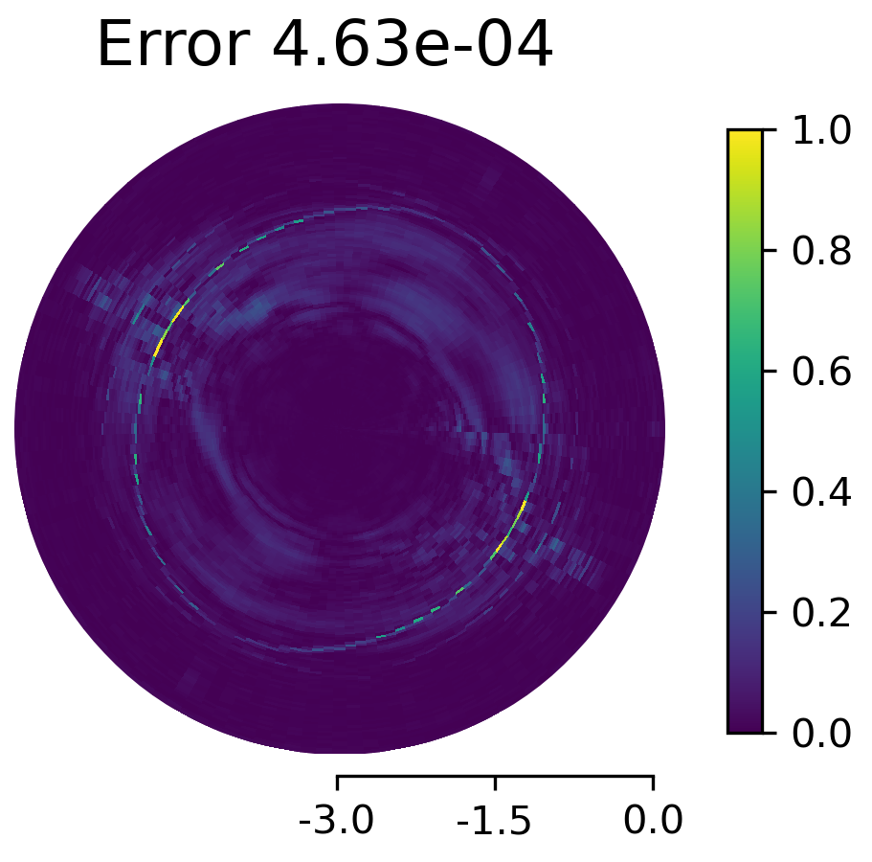
ML Opt. Single Fac
ML Opt. Fed Learn
ML Opt. Uni. Server
ML Data

Slide 13
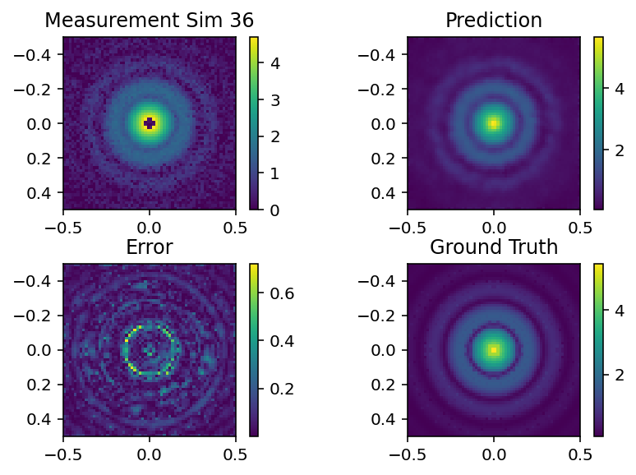
Inpainting Beam Stop

Slide 14
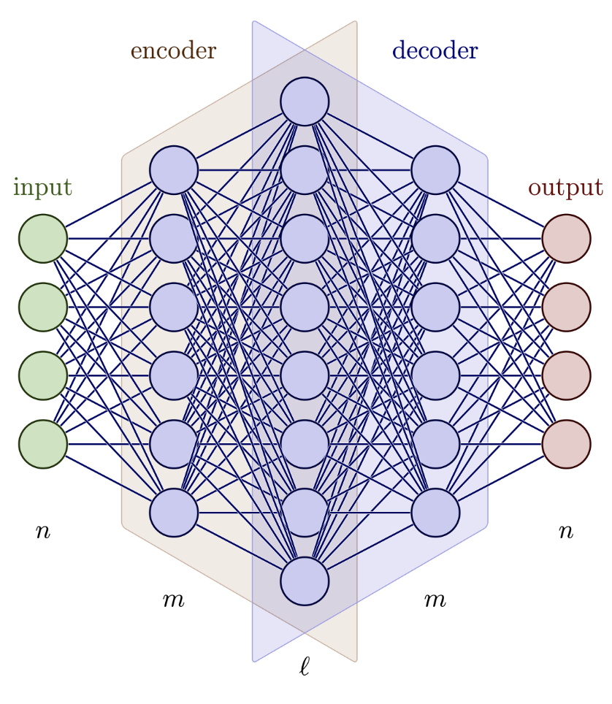
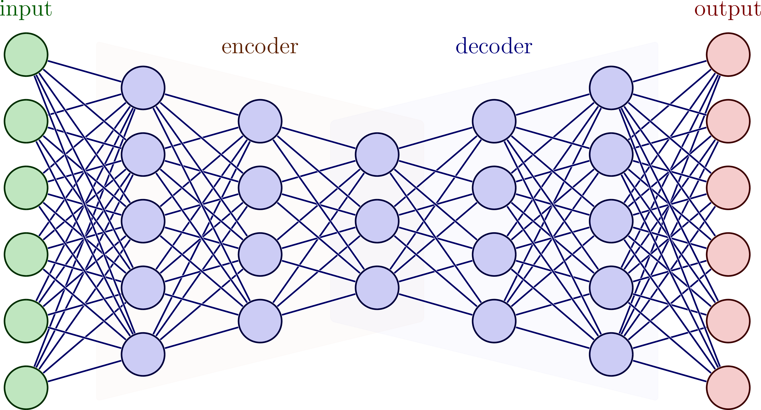
High Dimensional Sparse Autoencoders

Slide 15
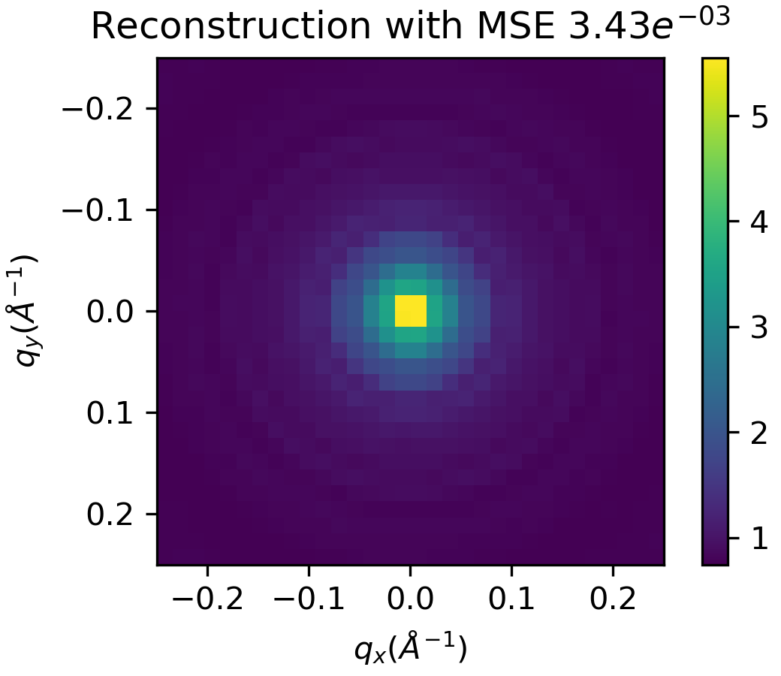
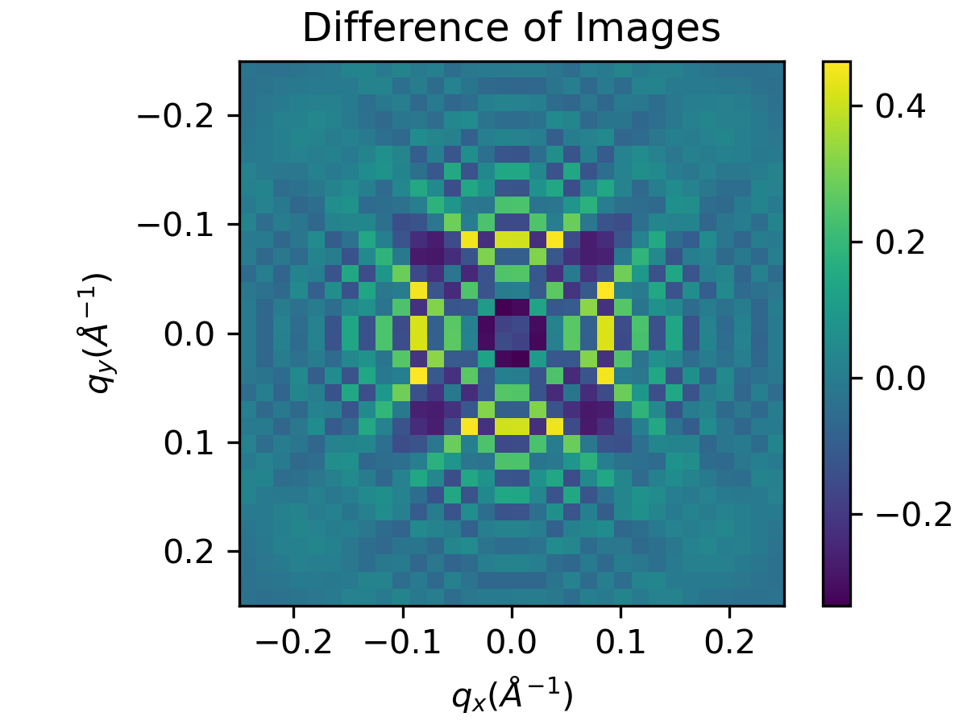
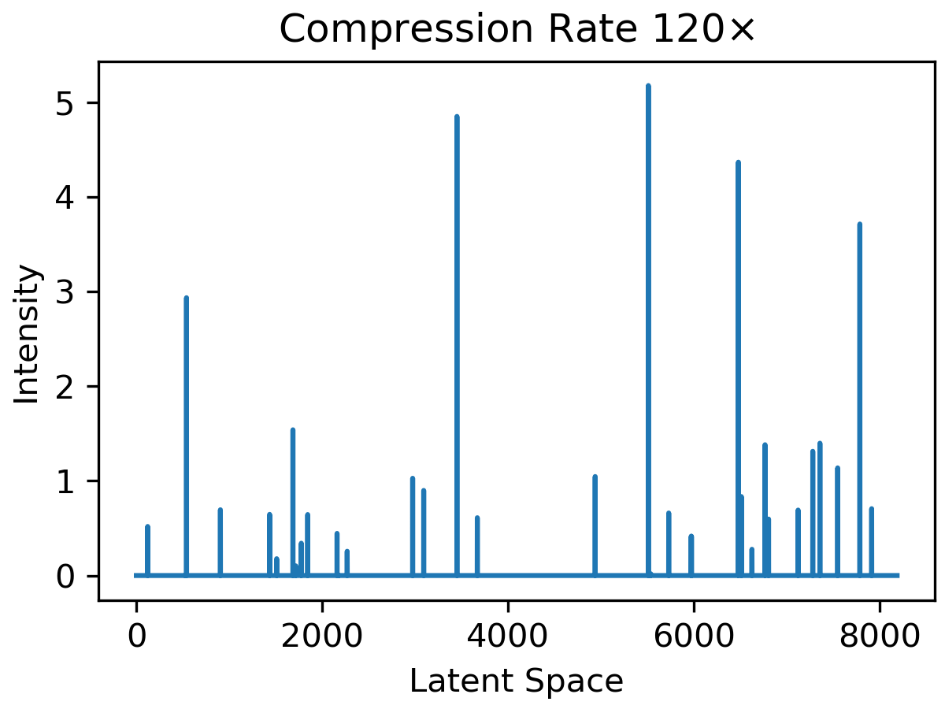
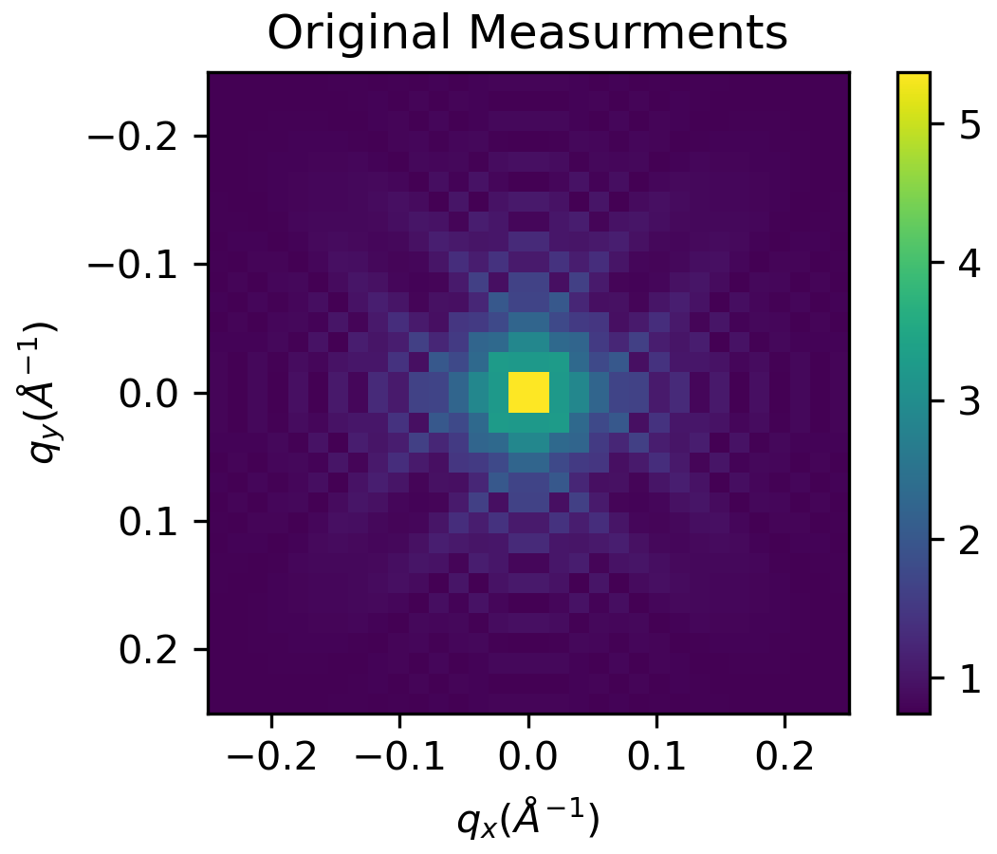

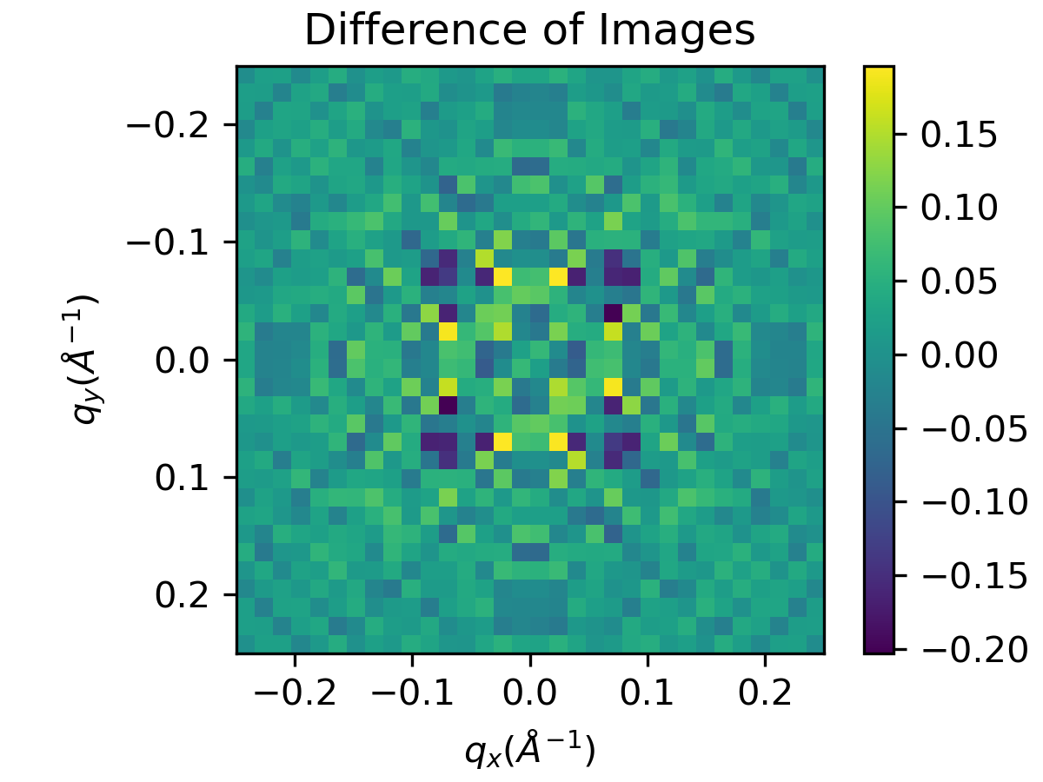
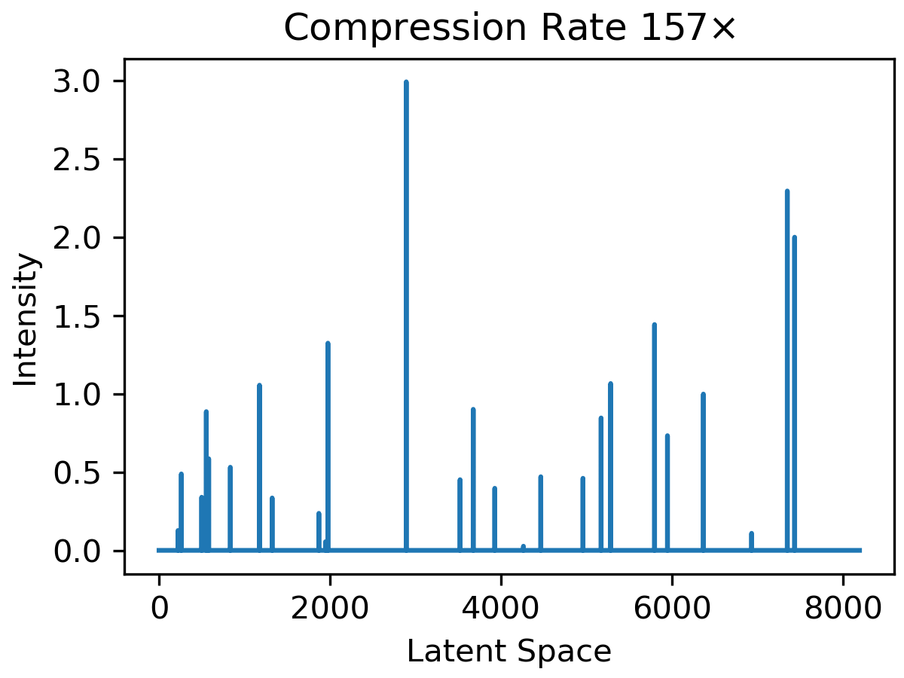
High Dimensional Sparse Autoencoders

Slide 16
Thanks!
Questions???
Acknowledgments
DOE Funding from ASCR & BES
ORNL Funding from LDRD

