Slide 1
X-ray diffuse scattering:
Small differences on a constant background
Tim van Driel – LCLS/SLAC National Accelerator Laboratory
6/27 - 2025

Slide 2
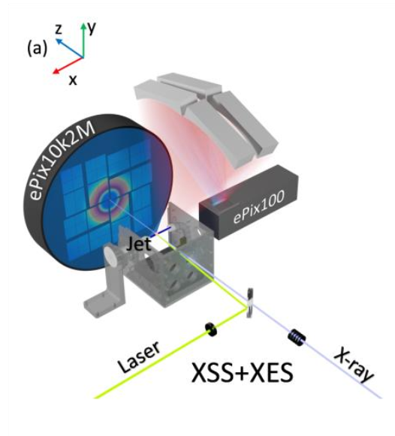
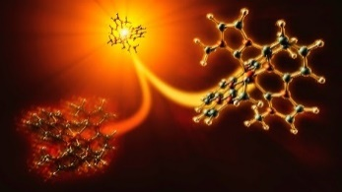
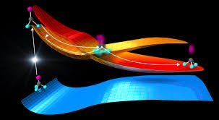
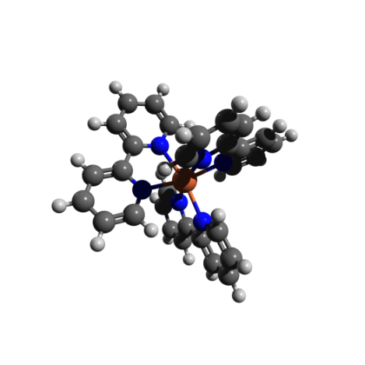
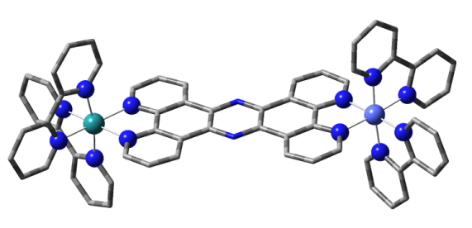
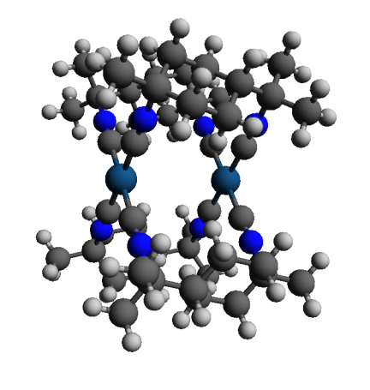
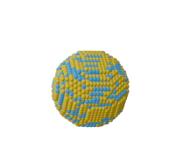

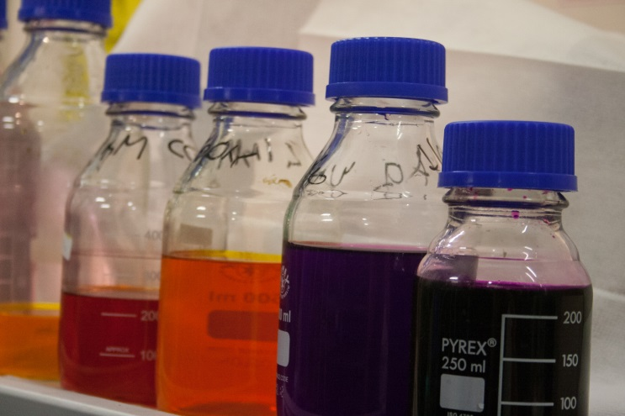
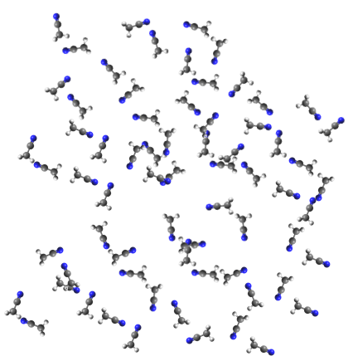
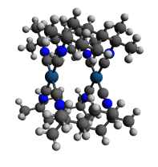
Ultrafast solution phase Chemistry
Photocatalyst
Photosensitizer
CT catalyst
Nanoparticles
Water 55M
Sample 10mM
Large Background!
0
time
Notes:
Todays talk
Spend time introducing Large scale x-ray facilities in general

Slide 3
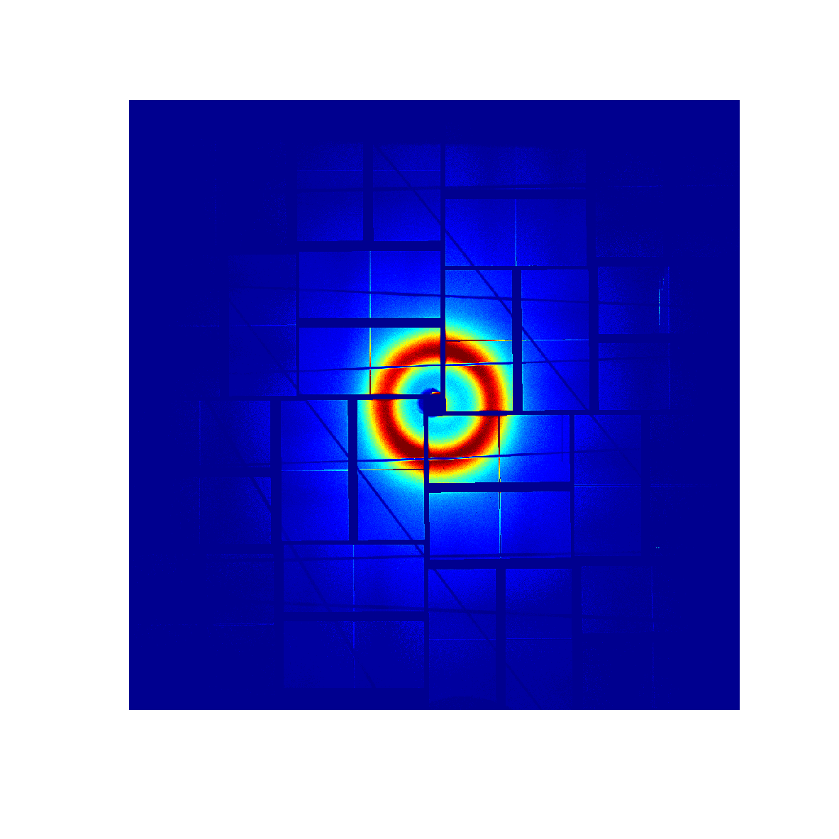
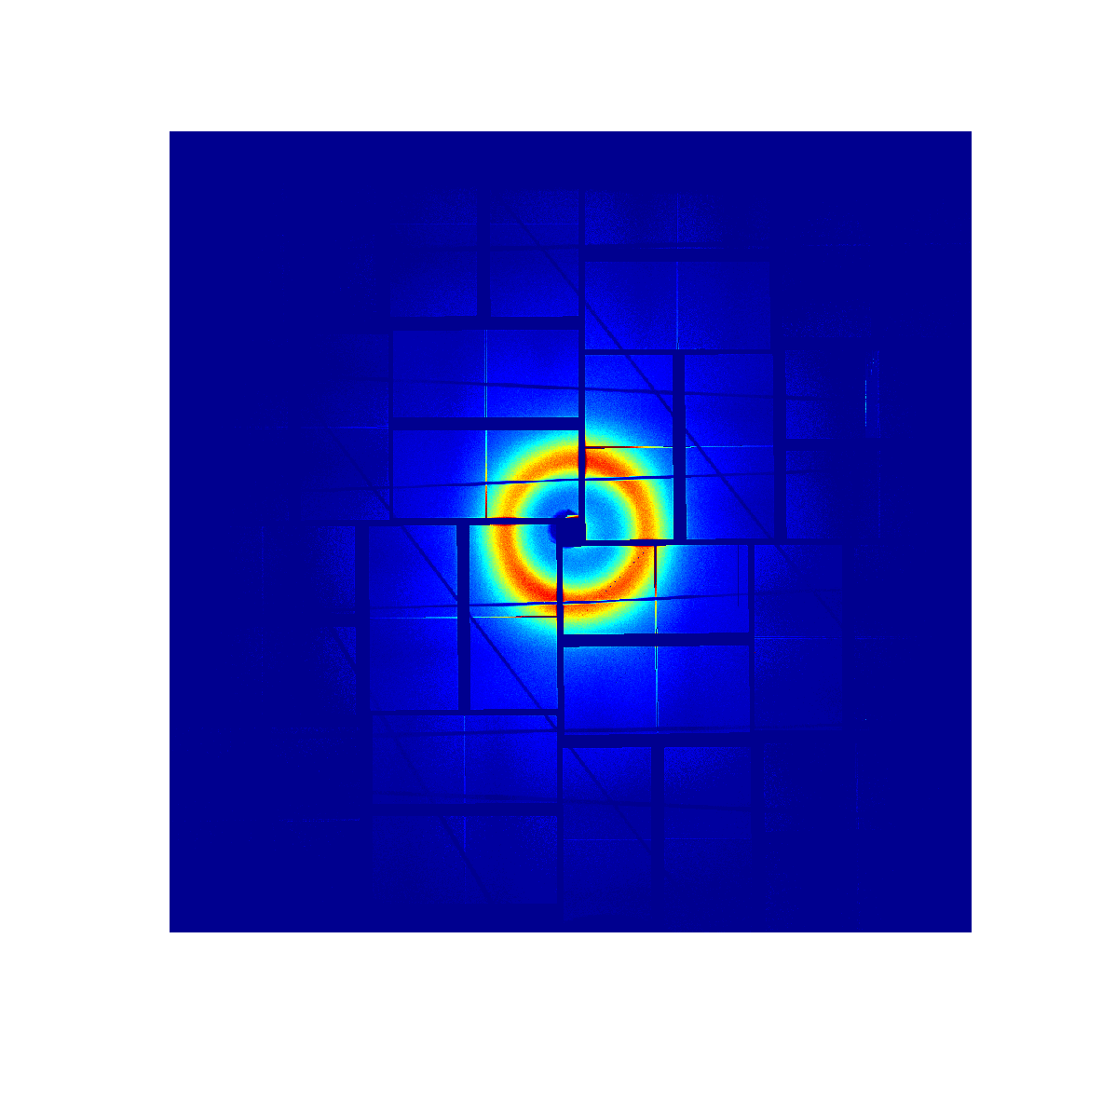

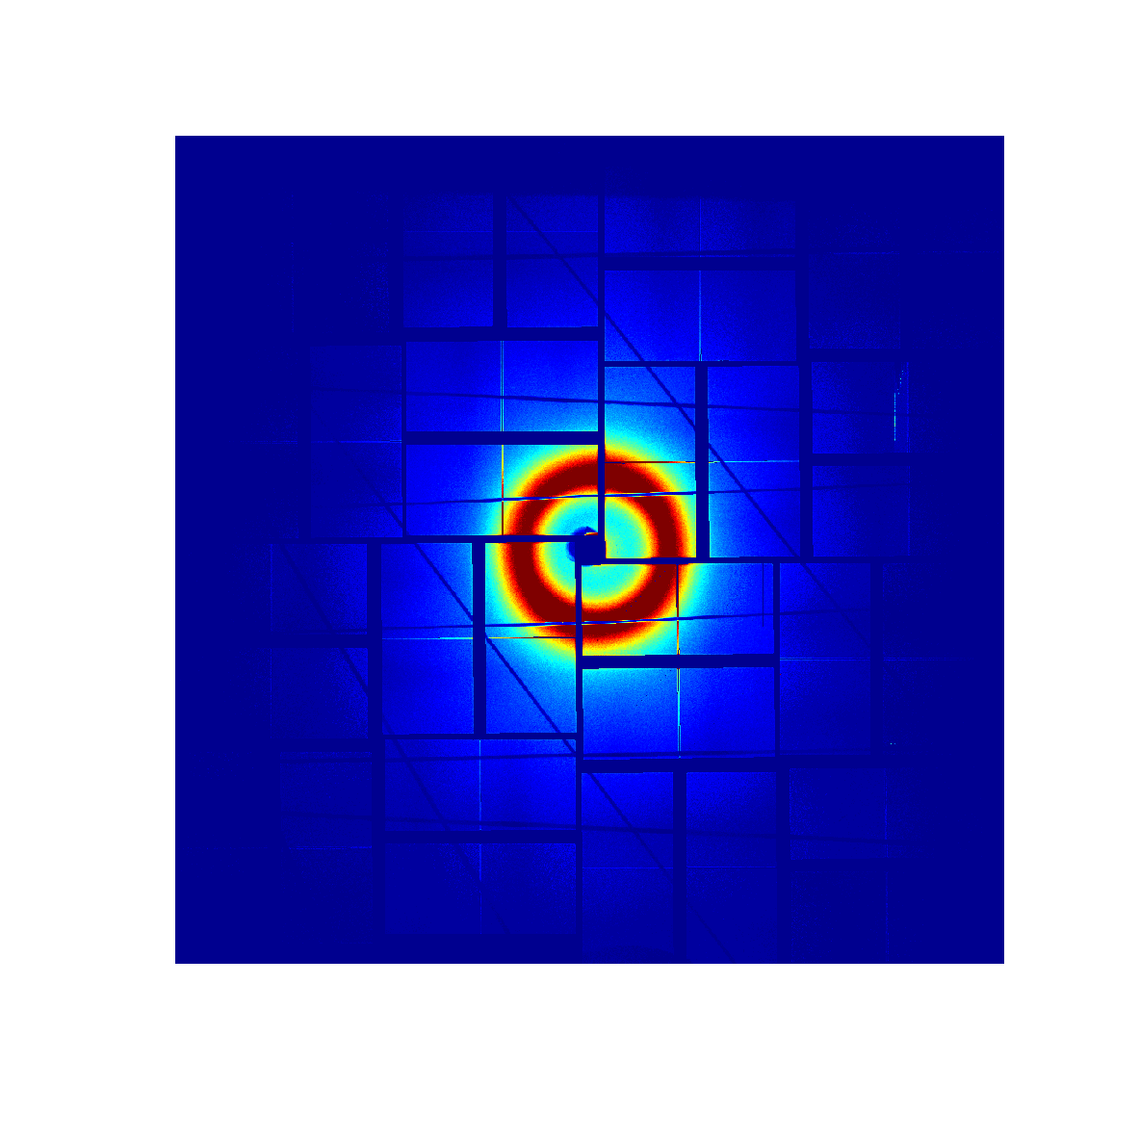
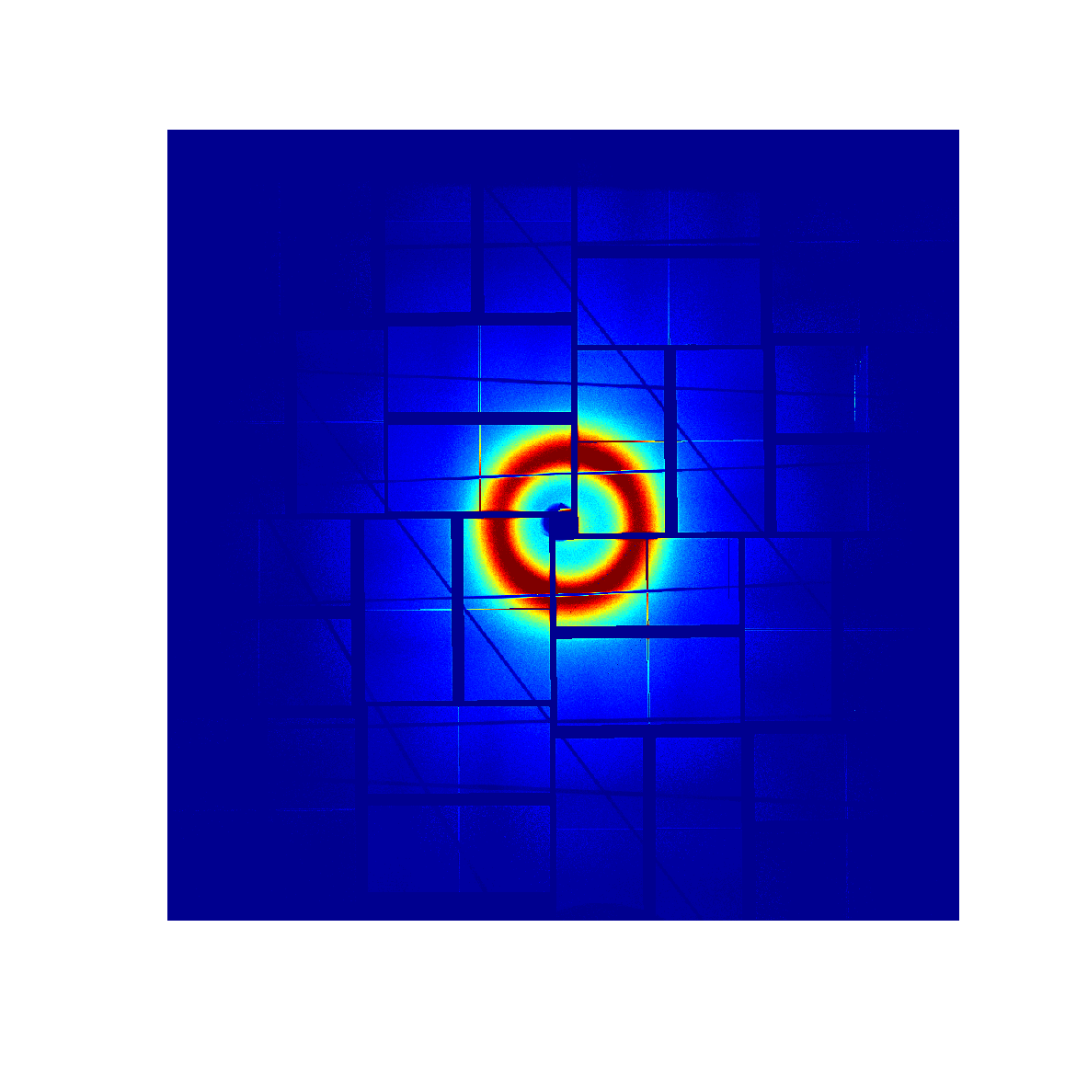
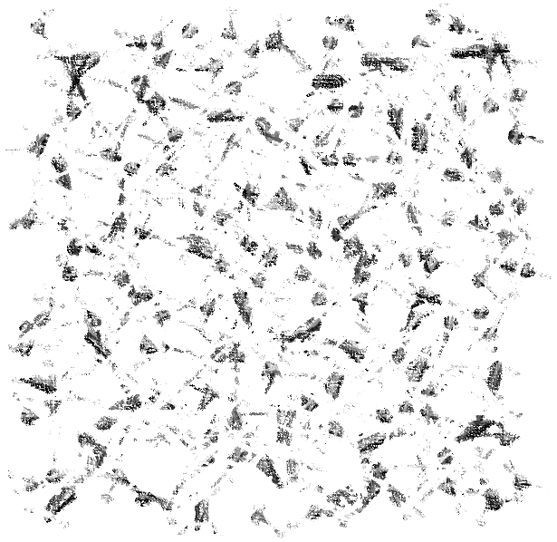
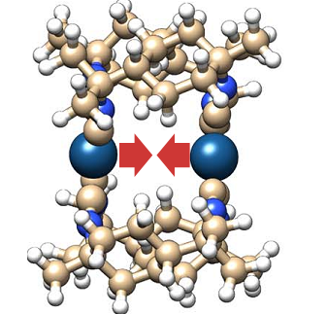
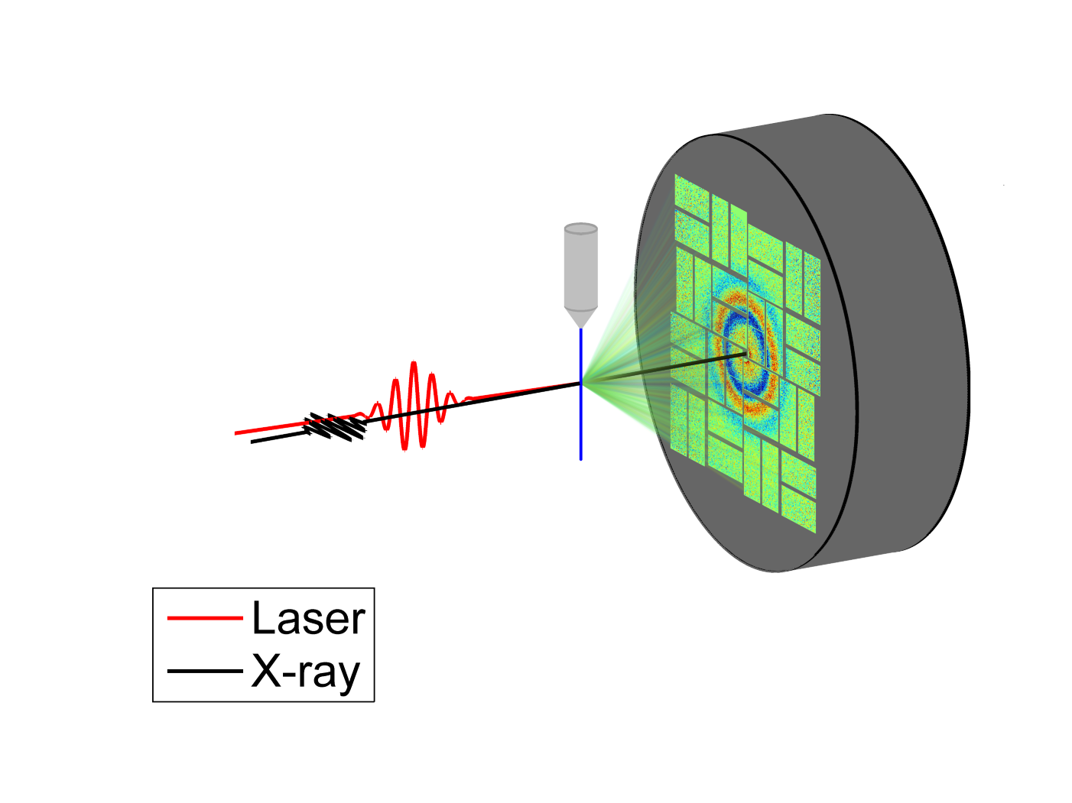
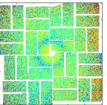
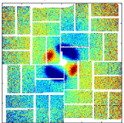
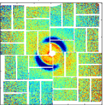
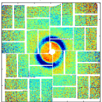
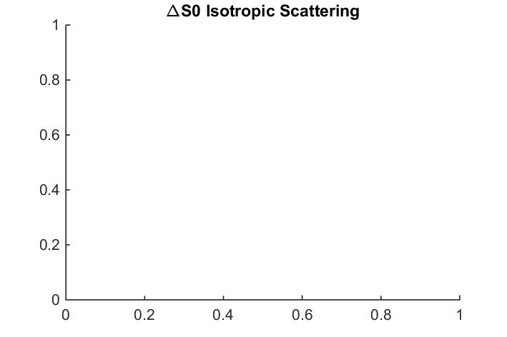
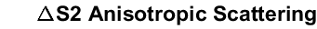
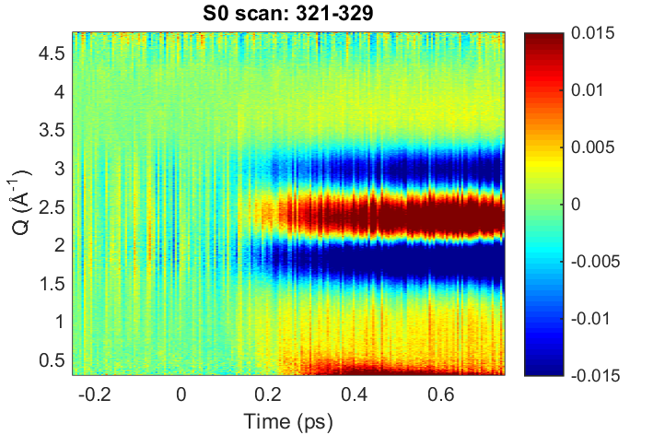
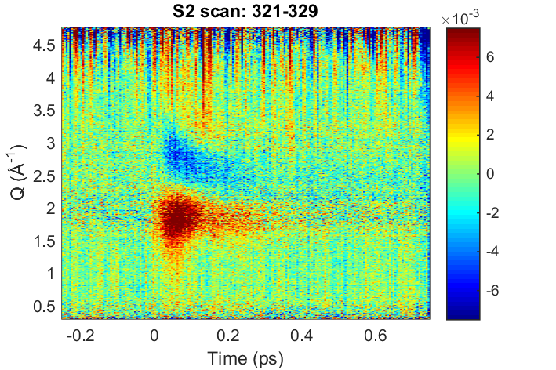
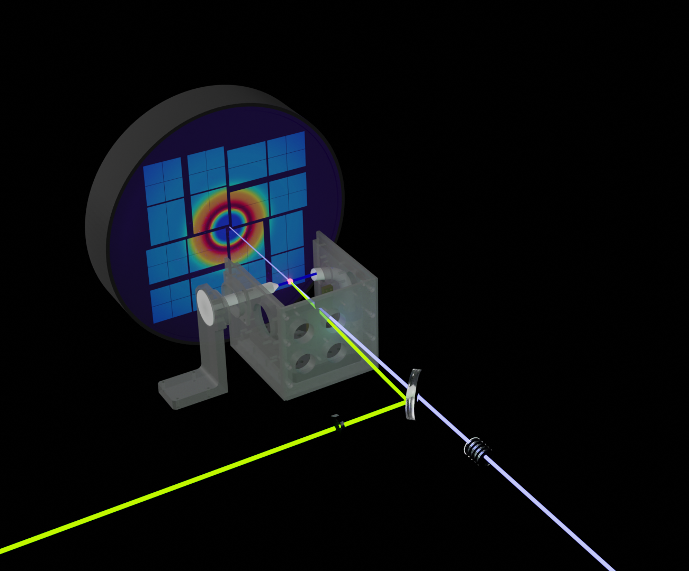
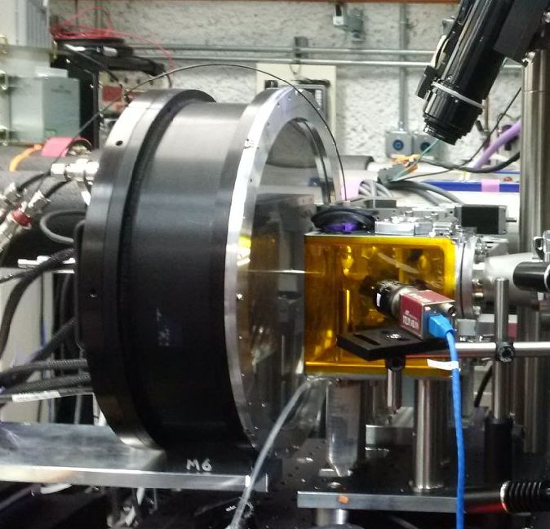
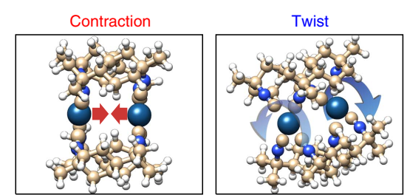
Laser Pump / X-ray Probe
100,000s Raw images
…
Mask, correct (non-linear,solid angle, polarization,abs)
AverageDiff(t)
LASER
delay(t)
Reduction(q,t,S_{n})
XFEL
Pump
Interpretation
Solution Scattering setup
Tim van Driel - timbvd@slac.stanford.edu

Slide 4
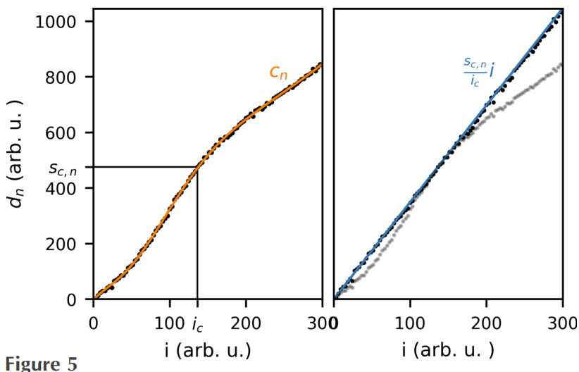
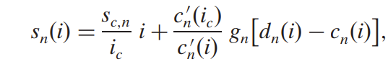
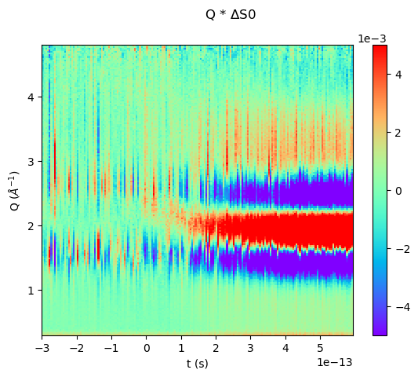
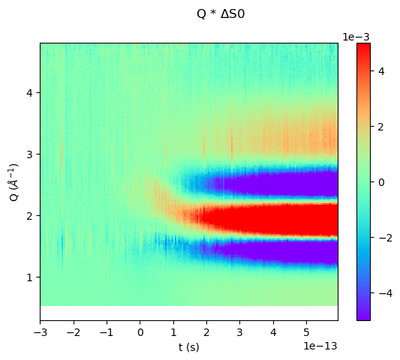
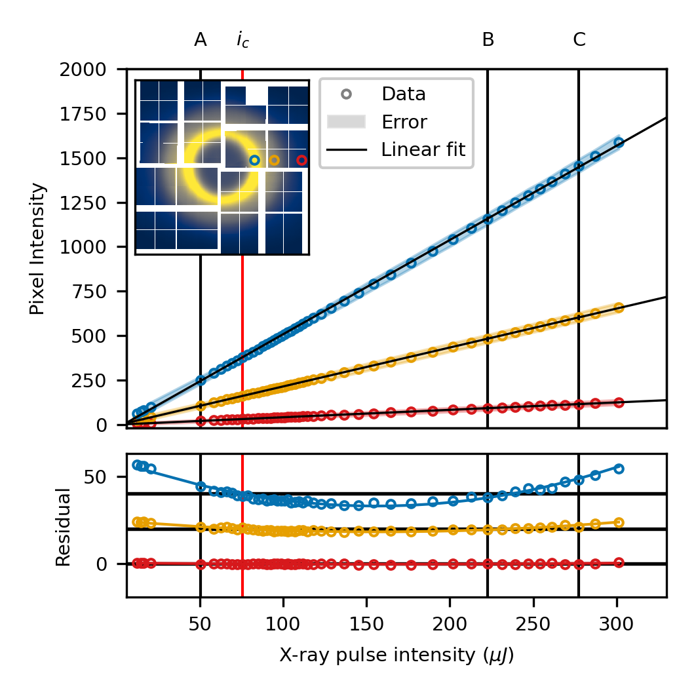
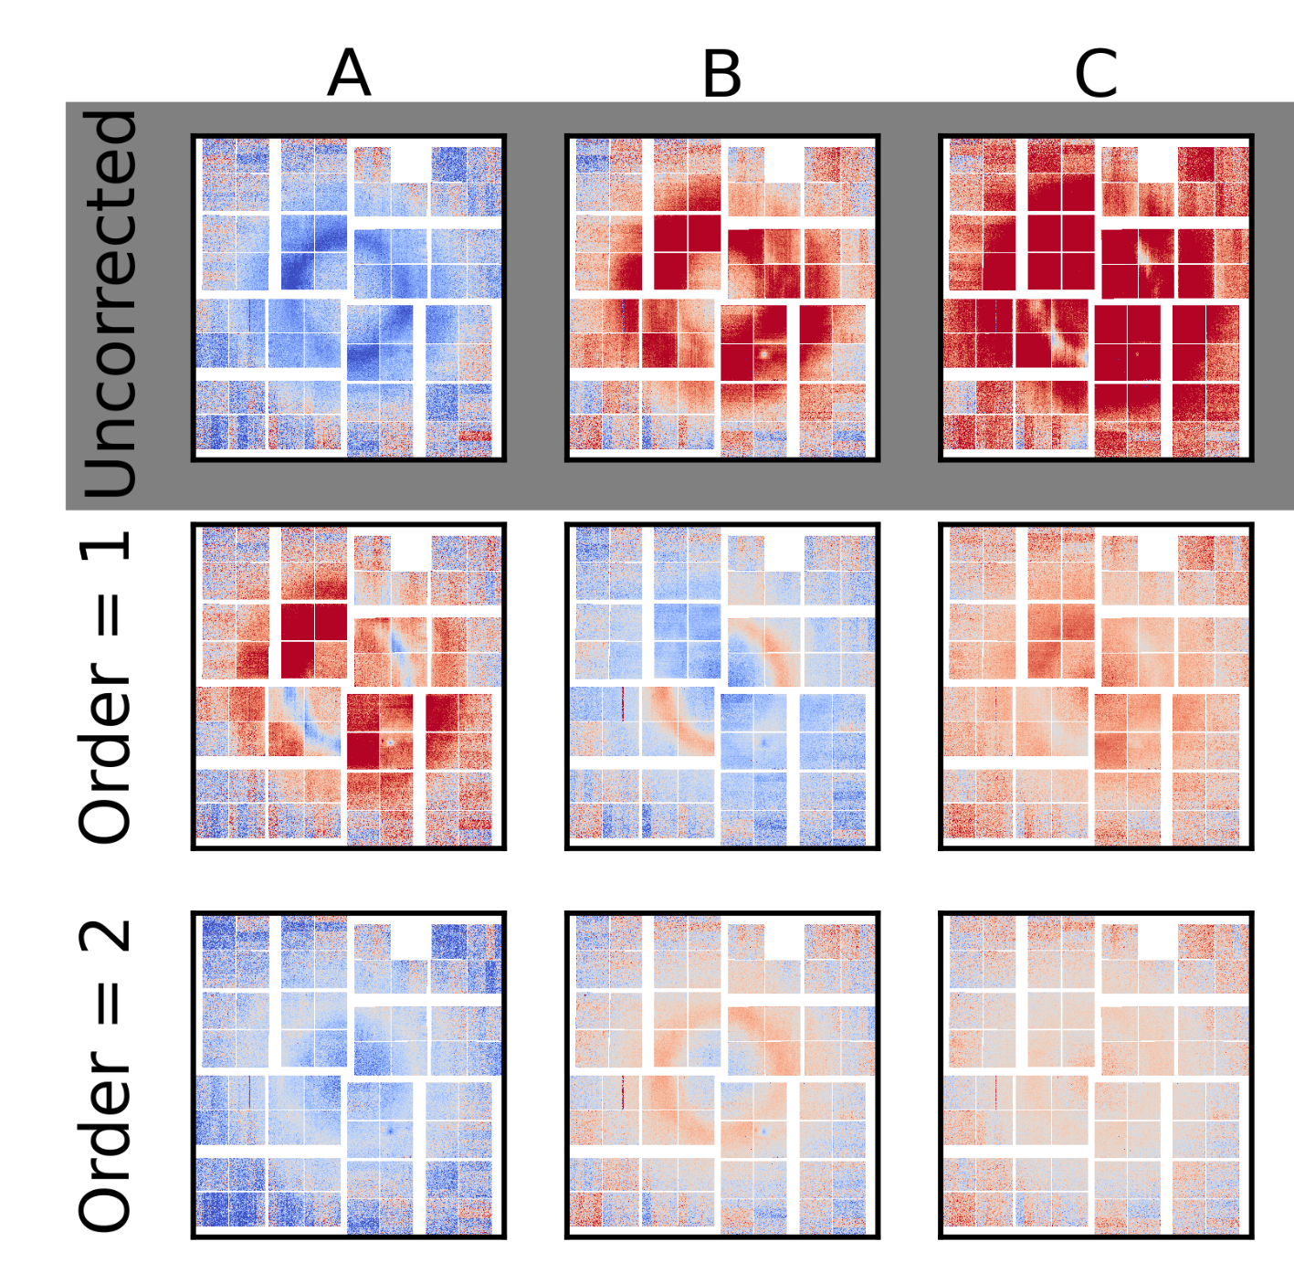

Detector Corrections
Q x ΔS
Q x ΔS
(Mixed Gain and Corr.)
Q (Å⁻¹)
Calibrate Pixels
Visualize nonlinearity
Q (Å⁻¹)
Delay (100fs)
Delay (100fs)
van Driel et al. J. Sync Rad, 22. 2015
van Driel et al. J. Sync Rad, 27(3). 2020
M. Haubro, T. van Driel et al. J. Sync Rad, 32(2). 2025

Slide 5
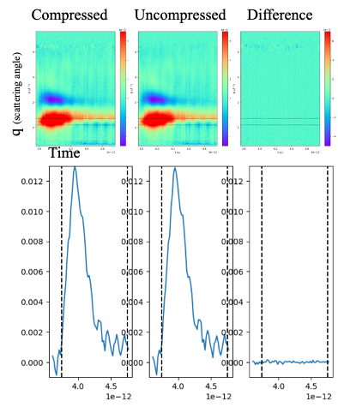
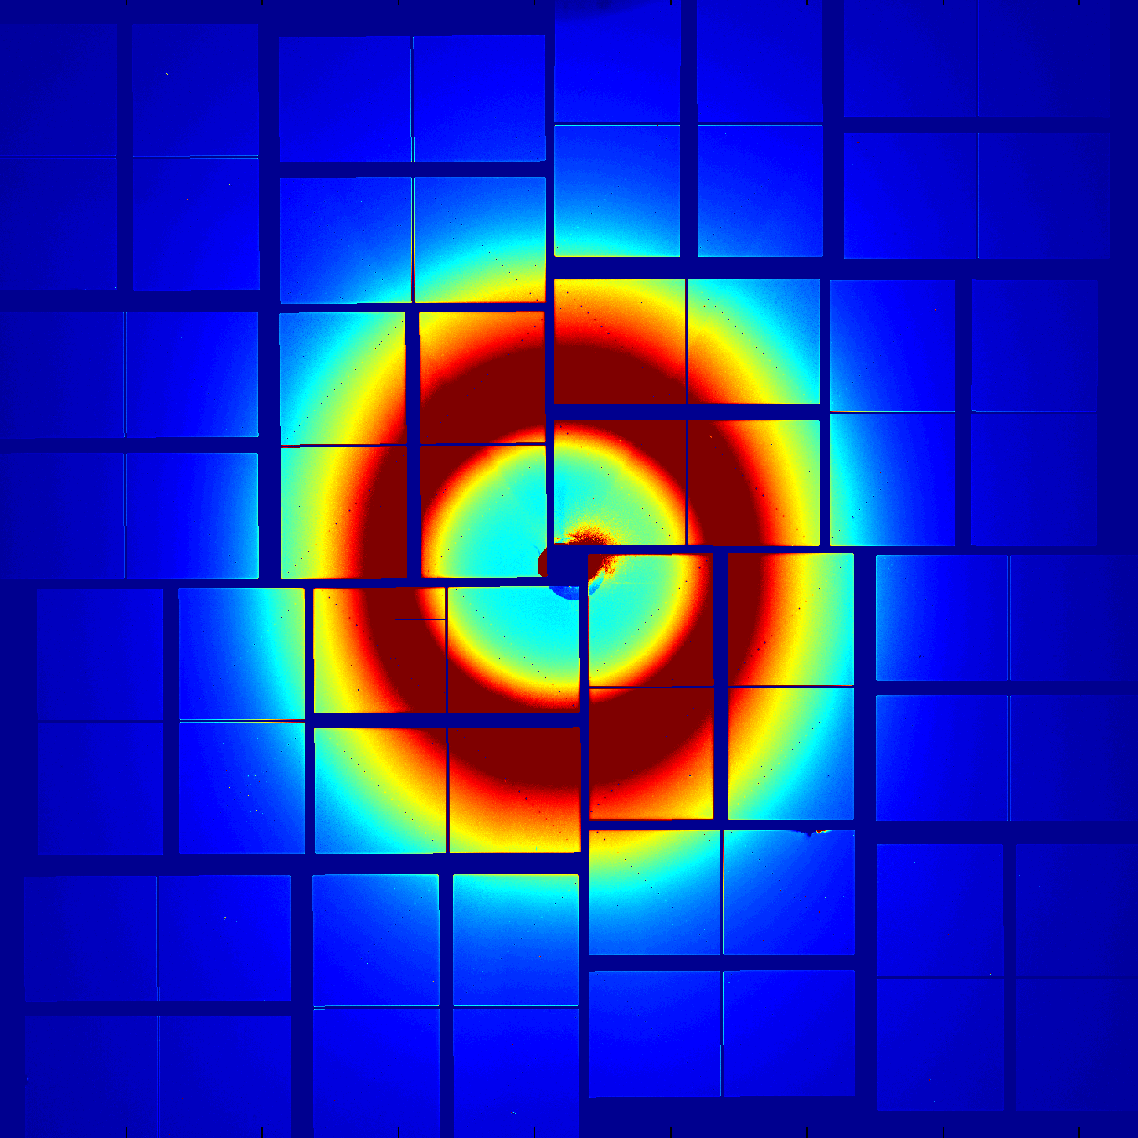
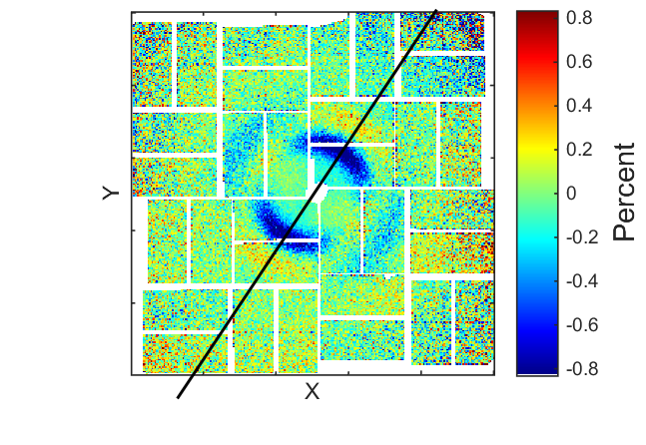
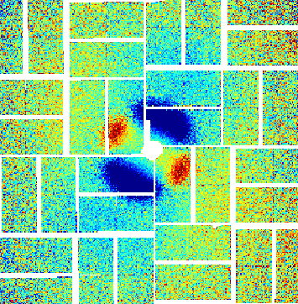
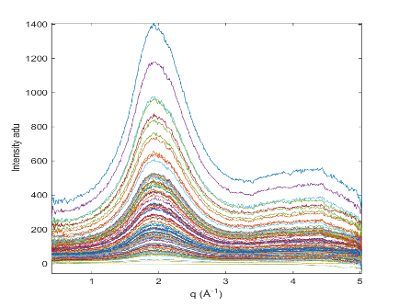
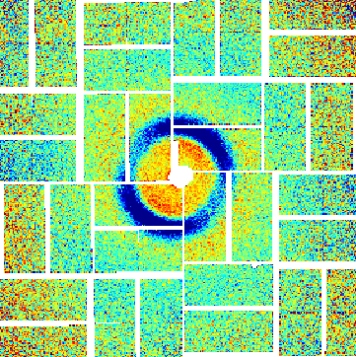

Reduction schemes
LZ compression
Angular integration
Event binning

Slide 6
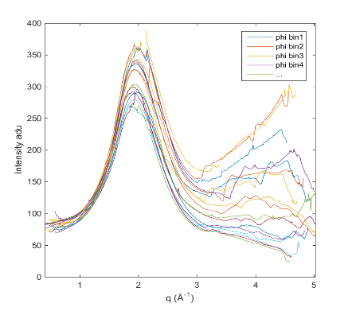
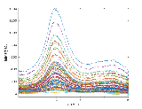
Pixel Binning – “smalldata” angular integration
2.3Mpix x n events
n events x b pixel-bins
500bins x 20 slices x n events
~ 200 times reduction

Slide 7
Event binning – “cube” bin according to scan
Event Binning
”Cube”
Delay ->
2.3Mpix x n events
2.3Mpix x b event-Bins
50.000 events => 500 bins
100 times reduction

Slide 8
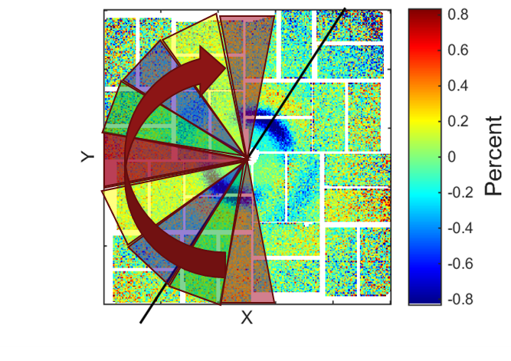
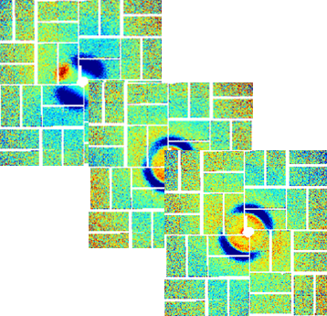
Challenges
LZ compression
Angular integration
Event binning
Must correct for pixel-to-pixel variations in bins,
has independent events.
Masks
Pedestal
Geometric Corrections
Experiemental Corrections (absorption)
Detector geometry
Commonmode correction
Gain Correction
Non-linear detector fluctuations in 2D
Experimental geometry (detector distance)
Must correct for event-to-event variations in bins,
has independent pixels.
Common mode correction
For timebinning – Timetool calibration
Non-linear corrections/ correlated behaviour
Filtering
Outlier rejection
Choice of binning
Choice of how to average/weight/construct differences
Compression may be limited
Error needs to be validated for the specific usecase
A more general approach
Less experiment specific

Slide 9
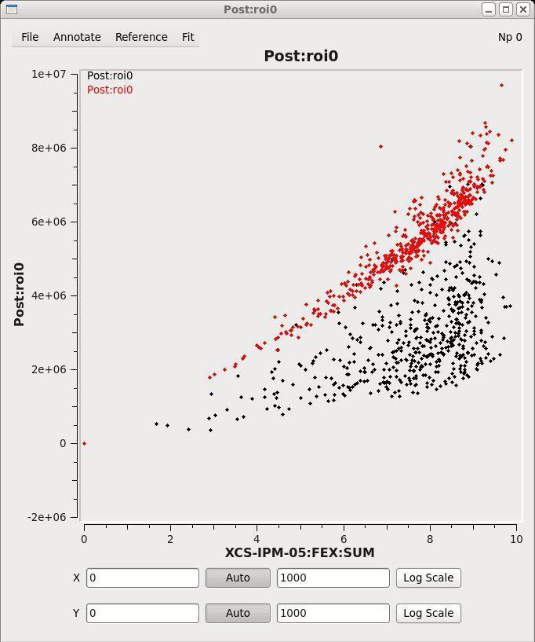
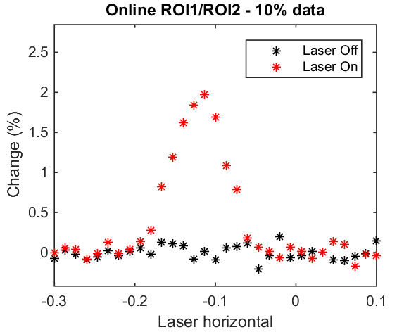
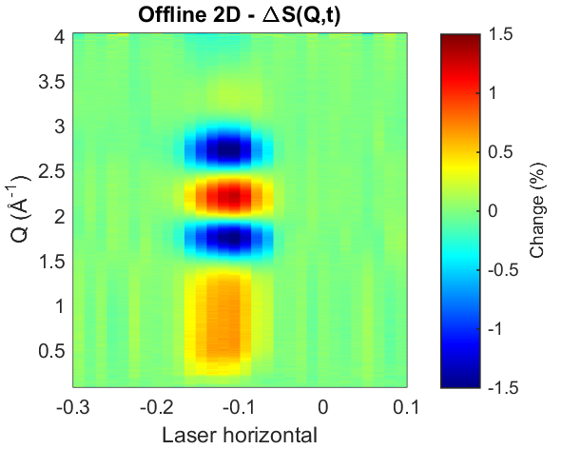
Other Challenges: Realtime feedback - ROIs
Simple analysis
ROI vs I0
Corner ROI as I0
Correlation plots
ROI1
ROI2
Simple analysis
Binned ROI1/ROI2
Full smalldata analysis
Overlap Scans

Slide 10
Discussion /conclusion
X-ray diffuse scattering at XFELS
Not sparse
High dynamic range
Tiny difference signals
Tiny signals makes it hard to validate the signal without full analysis
Tiny signal makes the detector performance demanding across large dynamic range
Benefits
The intensity distribution is similar for each frame due to the solvent
We can use this to compute the nonlinear correction
We could possibly develop a purpose built compression pipeline ;)
Data pipeline is simple, just addition and multiplication on independent frames
Many experiments with well developed procedures
Many internal references (dropped x-rays, dropped lasers, varying intensity)
Prior knowledge about solvent heating
Key to develop flexible pipelines that can be easily reconfigured/validated/monitored
Along with robust calibrations and procedures
Could be developed for standard config like the diffuse scattering at the liquid jet endstation
Many experiments
Large data rates
Sensitive to the pipeline

