Slide 1
Real-time GPU/FPGA Data Reduction at LCLS-II
Christopher O’Grady (work of many, including TID)
SLAC National Accelerator Laboratory
June 27, 2025

Slide 2

Data System Overview
DAQ
Data Reduction Pipeline
Fast Feedback Layer
Offline
Timing
(input)
PM
Software Trigger
Nodes
Offline
10-100 PB
PGP
PGP
Data
Cache
PGP
PGP
IB
IB
Ethernet
Ethernet
PGP
PGP
NVRAM
Lustre
BLD
PGP
DTI
PGP
Online Monitoring
Nodes
Fast Feedback Analysis Farm
DAQ Readout Nodes
DRP (compressor)
Nodes
Offline Analysis Farm
Control
250 GB/s - 1 TB/s
10 GB/s – 1000 GB/s
Hutch
Experimental Hall
HPC (SLAC, NERSC, LCF)

Slide 3
In Production: 33kHz FPGA Data Reduction
Currently using Matt Weaver’s simple threshold for 6GHz 60000-sample digitizers
Used in production for 16 channels at 33kHz shot rate
Save a programmable rate of un-reduced data
must be coordinated across detectors!
Maintaining correct thresholds has been problematic but doable
Complexities subtracting off “baseline” in FPGA:
Every 4th sample digitized by different DAC, so different baseline
Early samples of waveform used to compute/subtract baseline
Some scaling used to preserve precision of subtraction

Slide 4
2027: 35kHz 4Mpixel EpixUHR Area Detector
4Mpixel 35kHz epixUHR detector:
288 data fiber pairs (reduced by 4x using LR4 transceivers)
~250GB/s
Will be deployed at 120Hz in summer 2026. 35kHz in 2027 with LCLS-II-HE
CPUs not practical (too many nodes: ~250), FPGAs too inflexible: use GPU (“world standard”: nvidia/cuda)
36 C1100 commercial FPGA boards, 9 to 36 GPUs
Goal is to reduce data by 10x (and compute software trigger input data)
Saving to disk: GPU Direct Storage as recommended by WEKA filesystem team
16MPixel (1TB/s, 1000 fiber pairs) in 2029 (and several 4Mpixel cameras). 100kHz eventually?

Slide 5
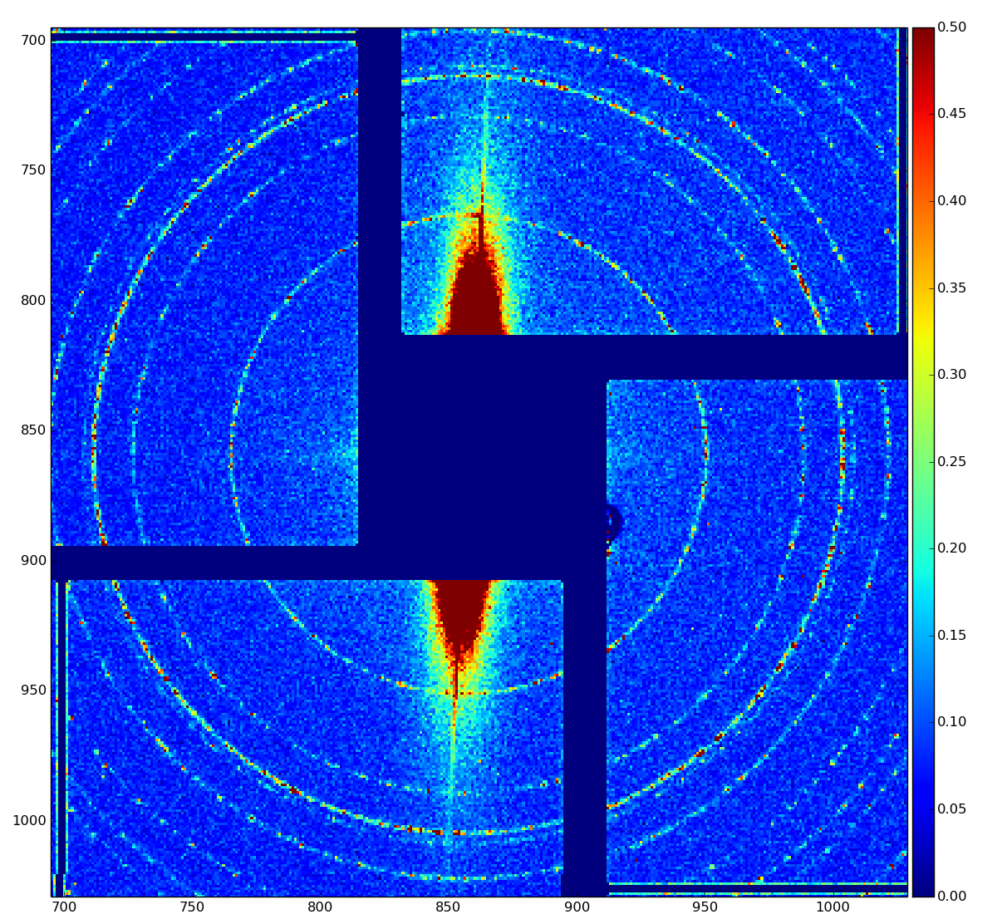
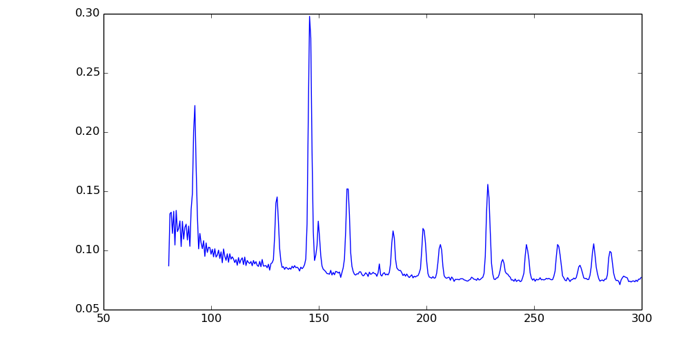
Reduction Algorithms We Are Trying to Implement
Easy:
Region Of Interest (ROI)
Zero suppression (with Thresholding)
Medium difficulty:
Software triggering (often without detector corrections)
Compression (e.g. “SZ” compression from Argonne: https://szcompressor.org/)
can fixup incorrect calibration in some cases?
Hard:
Summing (e.g. angular integration, image binning, average image vs. pump-probe time (“cube”), projections). Requires good calibrations!
Peak Finding. Requires good calibration!

Slide 6
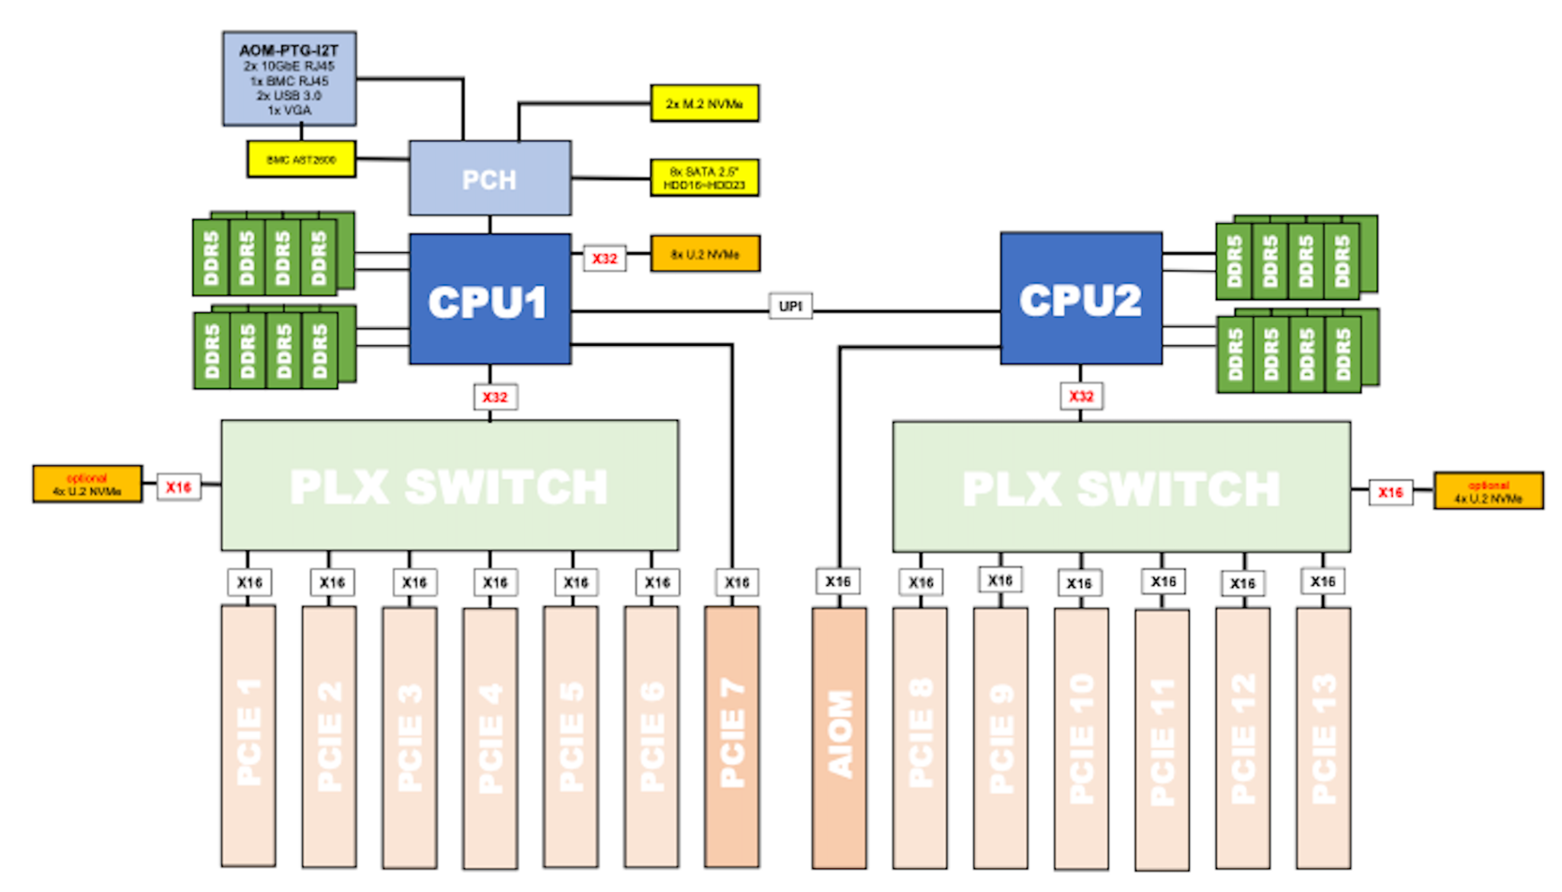
GPU Data Reduction Status
Ric Claus starting to run GPU DAQ this week
SYS-521GE supermicro with pcie5
We will choose between 1 and 5 C1100 FPGA boards per GPU, depending on algorithm performance

Slide 7
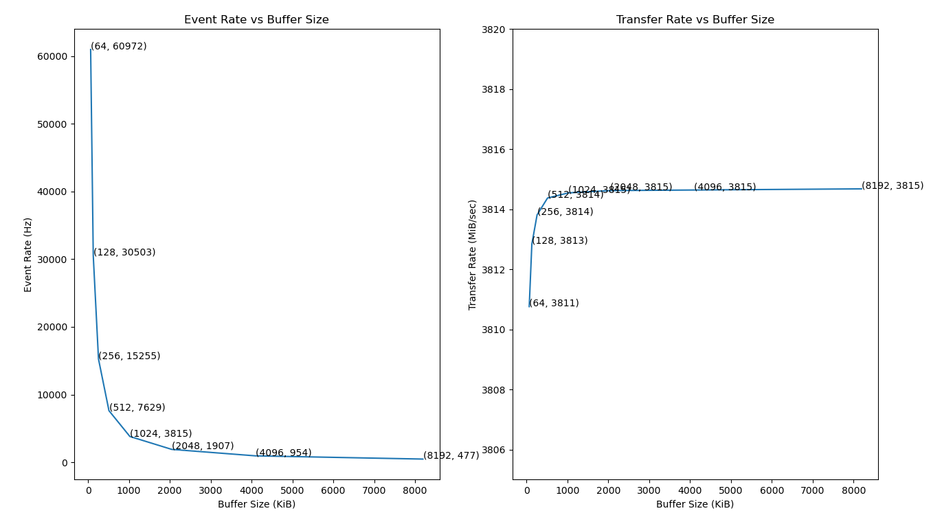
FPGA to GPU Data Transfer Measurements
Outstanding help from TID engineering (Herbst/Ruckman/Lorelli/Mishra)
4GB/s and 60kHz with older pcie3 and A5000 GPU
Expect our goal (10GB/s and 35kHz) per FPGA to be easily achievable with pcie5 and modern GPU

Slide 8
GPU Reduction Algorithm Throughput Measurements
Goal is 50GB/s to reduce GPU count. 10GB/s may be acceptable (250 GPUs for 16Mpixel epixUHR)
Algorithm | Processing Rate | Data Details (384*504 panel, SAXS/WAXS data)
cuSZ | 91GB/s | 1 GPU stream
LC-GPU | 60GB/s | 4 GPU streams
pyFAI Angular Integration | 1.7GB/s | 1 GPU stream
Sparse Matrix (spmv) Angular Integration | 6.6GB/s | 1 GPU stream

Slide 9
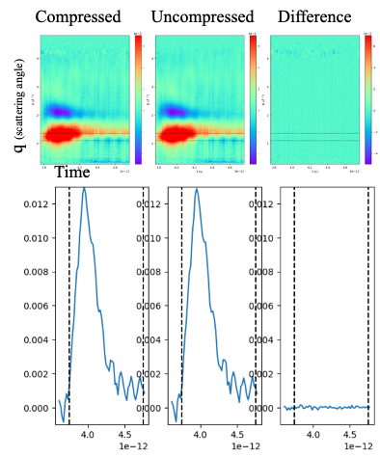
Algorithm Validation
Validation is difficult!
Stefano Marchesini doing most of this
need to go through full physics analysis with/without reduction
need a wide variety of experiments (or “worst case”)
Have done crystallography, high/low intensity saxs/waxs
Need more work on XPCS (although sparkpix should help with that?)
We are not expert in the physics fields
should probably offload algorithm validation to scientists

Slide 10
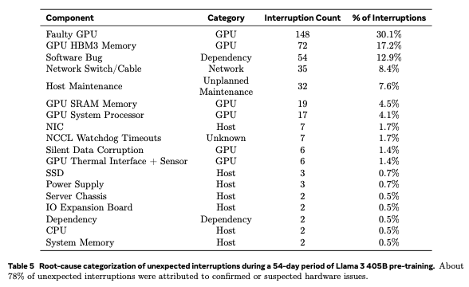
Reliability
From the company “Meta” (https://arxiv.org/pdf/2407.21783):
419 unexpected job interruptions in 54 days for 16K GPUs implies ~1 failure every 10 days for 250GPUs used for 16MPixel 35kHz epixUHR detector
Risk mitigation approach: quickly turn off failing panels?
Our timing-system firmware and optical links are not reliable enough

Slide 11
Summary
Deadline: 2027 for 4Mpixel 35kHz epixUHR in XPP
LCLS experiments change frequently which makes real-time data reduction difficult: using mostly GPUs, and some FPGA, with CPU for simpler detectors
Getting sufficient throughput through GPUs is challenging for some algorithms
Scale of 16Mpixel 35kHz epixUHR is unlike anything we have ever seen in DAQ. Risks are very significant.
Validation that reduction does not affect physics is difficult

