Slide 1
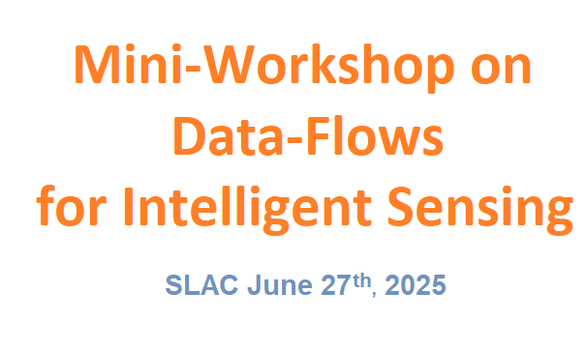










Adaptive UltRa-fast Energy-efficient Intelligent Sensing technologies
A. Dragone – SLAC National Accelerator Laboratory
May 25 -26 2023

Slide 2
Welcome and thank you.
What is AUREIS?
Adaptive UltRa-fast Energy-efficient Intelligent Sensing technologies
It is one of the 8 projects within the new DOE Microelectronics Energy Efficiency Research Center for Advanced Technologies (MEERCAT)
Project Name | Lead Laboratory | Lead PI
Adaptive UltRa-fast Energy-efficient Intelligent Sensing technologies (AUREIS) | SLAC National Accelerator Laboratory | Dragone, Angelo
BIA: A Co-Design Methodology to Transform Materials and Computer Architecture Research for Energy Efficiency | Argonne National Laboratory (ANL) | Taylor, Valerie
Democratization of Co-design for Energy-Efficient Heterogeneous Computing: DeCoDe | Pacific Northwest National Laboratory (PNNL) | Ang, James
El-Pho: Electro-Photonic Integrated Platform for Near-Sensor Processing in Extreme Environments | Brookhaven National Laboratory (BNL) | Deptuch, Grzegorz
Enabling Science for Transformative Energy-Efficient Microelectronics (ESTEEM) | SLAC National Accelerator Laboratory | McIntyre, Paul
Nanoscale hybrids: a new paradigm for energy-efficient optoelectronics | Lawrence Berkeley National Laboratory (LBNL) | Garcia-Sciveres, Maurice
Nano-Scale Research Center for Heterogeneous Integration Platforms (NSR-CHIP) | Sandia National Laboratories | Nelson, Jeffrey
Self-Assembly of Tunable Molecular Memristors with Long Range Order for Resilient and Energy-Efficient Neuromorphic Computing | Pacific Northwest National Laboratory (PNNL) | Johnson, Grant
Goal: Revolutionize energy-efficient microelectronics by advancing integrated innovations across materials, devices, information-carrying modalities, and systems architectures. Exploring transformative solutions that seamlessly bridge sensing, edge processing, artificial intelligence, and high-performance computing.

Slide 3
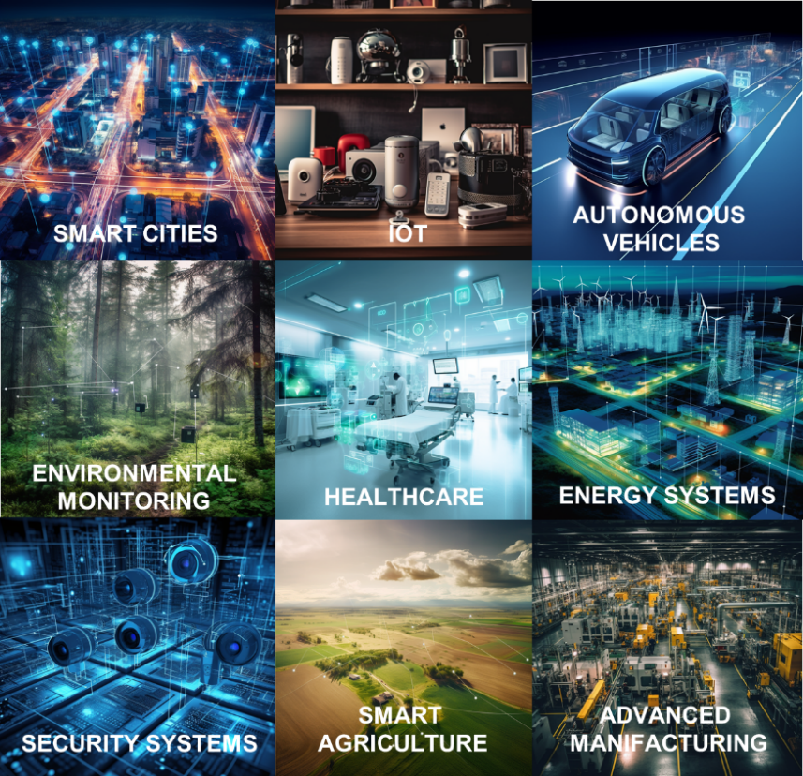
A World Shaped by Sensing
Sensing technologies are reshaping our world, driving efficiencies and enabling innovation in multiple sectors
Exponential growth and demand for unprecedented functionality, acquisition speed, and response latency create an extreme deluge of data requiring exponential increases in data movement, computational power, and storage.

Slide 4
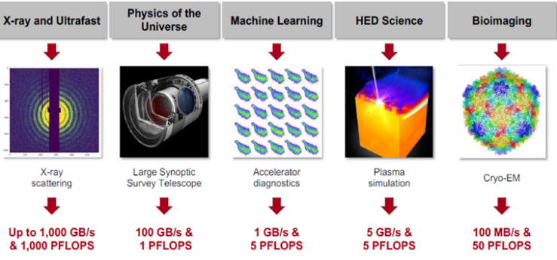
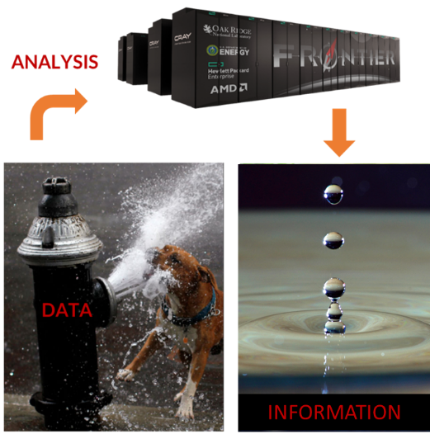
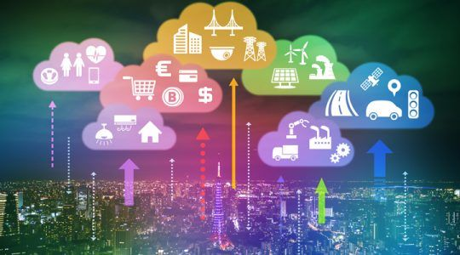
The Data Deluge Problem in SLAC Scientific Mission and its Scale
SLAC Mission
Detectors = Network of high precision independent sensing units densely distributed with local and exascale computing
e.g., just one 16Mpix MHz detector for LCLS would generate 40 Terabytes/s. Equivalent to ~1.2 Zettabytes/year
e.g., just one detector at HL LHC can produce up to 10 PB/s data (same rate as average internet traffic in all of North America) which, if unprocessed, would produce ~200 Zettabytes/year
In Science:
IoT = Network of lower-precision independent sensing units widely distributed with Cloud computing
> 30 billion connected devices generating ~100 Zettabytes/year
In Society:

Slide 5
Adaptive UltRa-fast Energy-efficient Intelligent Sensing technologies (AUREIS)
AUREIS aims to develop the underpinning microelectronics technologies for ultrafast, energy-efficient, dense networks of sensors, large-area imagers, and future detectors, solving the extreme data deluge problem by:
Reimagining network of sensors as data-driven adaptive intelligent architectures
Introducing optimally distributed computing at the data source (edge)
Leveraging meshed hierarchical interconnections
Optimizing and benchmarking energy and information extraction efficiency
Application example: X-ray detector systems for ultrafast, ultra-bright, high-energy multi-probe Light Sources that are also compatible with high energies in extreme environments, as with inertial and magnetic fusion devices, ensuring broad applicability in other scientific and industrial fields.

Slide 6
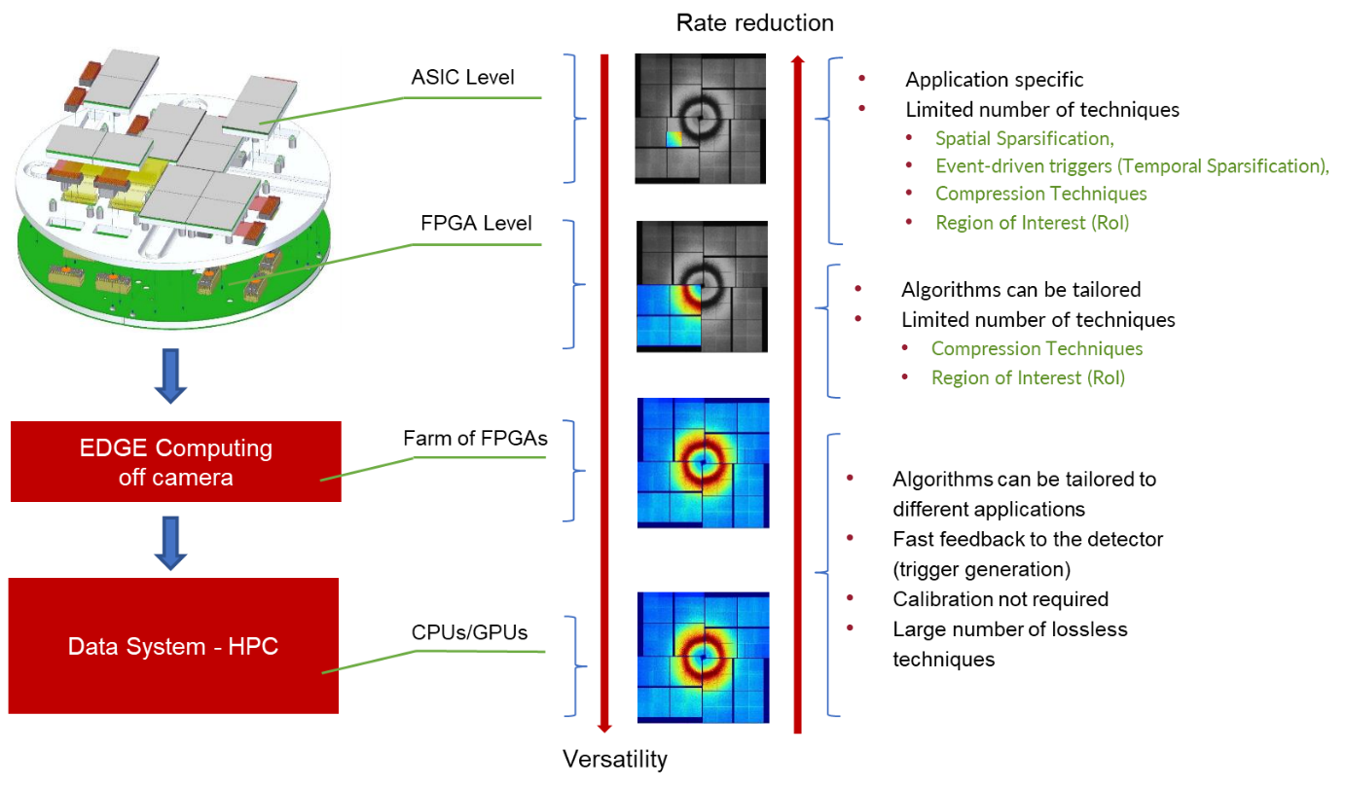
Real-Time Information extraction and detectors
Distributing computing to extract information as data move through the network in the most efficient way.
To maximize results:
we need to move away from hardware-driven architectures
Designed for worst-case signal characteristics
Mismatch between acquisition and information rate
Over-designed and thus energy inefficient

Slide 7






AUREIS Research Thrusts
Thrust 1 – Hardware/resource-aware ML/AI-based workflows for dynamic real-time experiment operation.
Reformulate few existing AI/ML workflows in a resource-aware fashion to operate on heterogeneous distributed computing architecture and demonstrate we can maximize energy and information extraction simultaneously allowing for autonomous performance.
Thrust 2 - Energy-efficient distributed network organization and AI-based edge computing architecture trainable across architectures -- analog and digital -- for optimized information extraction.
Study suitable distributed edge computing architectures within the sensor network and its characteristic (analog vs digital and/or combinations) allowing for robust, energy-efficient, and information extraction (benchmarking).
Thrust 3 - Ultra-high-rate trainable front-end ASIC architectures with adaptive analog interfaces.
Study adaptive analog front-end ASIC architectures that can be trained within the AI/ML workflows (end-to-end training), thus optimally mapping to a feature space more amenable to data acquisition with integrated auto-calibration and information extraction.
Thrust 4 - Integration of dense multi-tile sensor planes with inter-tile communication.
Co-design cycle for Information and Energy Efficiency (IEE)
Study true event-driven readout architectures with dynamic arbitration methods applied to meshed hierarchical interconnections between arrays of sensor nodes can optimally share relevant but reduced information, allowing for additional information and energy efficiency.
Thrust 5 - Wide bandgap material-based sensor for efficiency over a wide range of energies.
Study sensors materials for resiliency against extreme conditions, i.e., irradiation and high and extreme temperature fluctuations, critical for a broad range of harsh environments, e.g., fission and fusion reactor regimes, industry, and aerospace.

Slide 8
Goals
during the workshop:
Learn and discuss with scientists about their data analysis pipeline
The core computational elements in their analysis
Benefits of executing part of them in real-time to allow experimental steering
Introduce potential adaptive functionalities allowing for autonomous data-driven acquisition based on experimental goals, and discuss the potential advantages
after the workshop and during the project:
Summarize the findings in a joint position paper
Select a couple of workflows to rethink for real-time implementation during the course of the project.
Identifying a subset of computational elements representative of the majority of workflows.
Identifying a subset of the most promising adaptive functionalities
This will then inform the studies on hardware architectures
beyond the project:
Create a community interested in leveraging the project result to develop a new generation of intelligent detectors for your applications

Slide 9
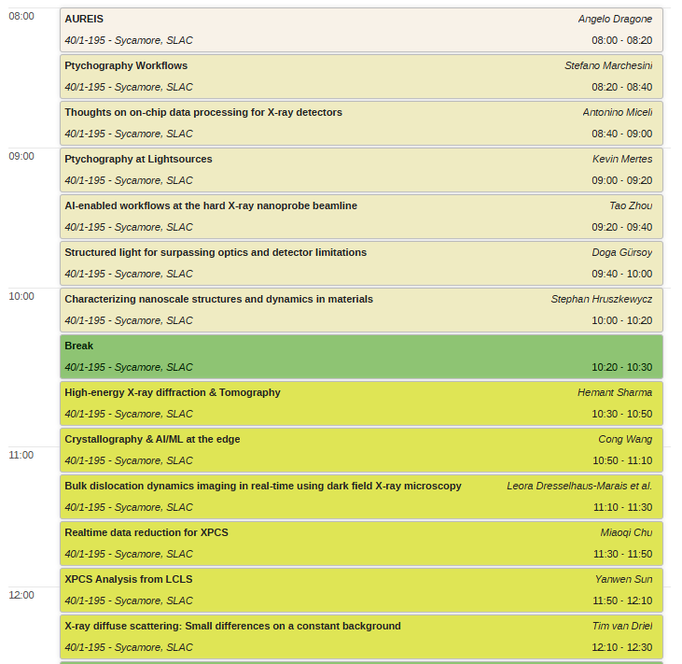
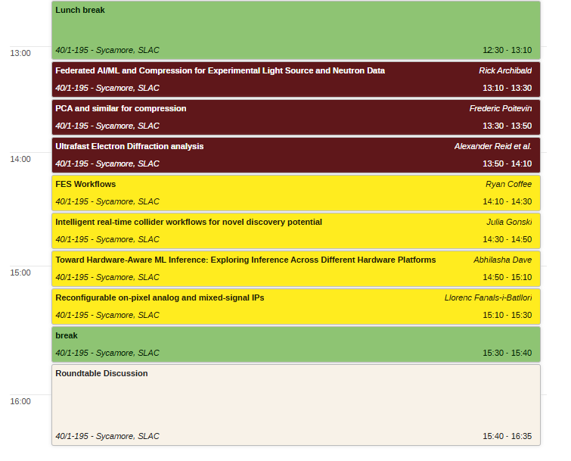
Program for the day

Slide 10
AUREIS participants
A. Dragone, SLAC National Accelerator Laboratory (PI),
A. Arbabian, Stanford University (Co-PI),
G. Carini, Brookhaven National Laboratory (Co-PI),
S. Chowdhury, Stanford University (Co-PI),
R. Coffee, SLAC National Accelerator Laboratory (Co-PI),
G. Deptuch, Brookhaven National Laboratory (Co-PI),
A. Gleason, SLAC National Accelerator Laboratory (Co-PI),
M. Gokhale, Lawrence Livermore National Laboratory (Co-PI),
C. Grace, Lawrence Berkeley National Laboratory (Co-PI),
D. Gorni, Brookhaven National Laboratory (Co-PI),
R. Herbst, SLAC National Accelerator Laboratory (Co-PI),
J. Hoff, Fermilab National Accelerator Laboratory (Co-PI),
M. Kling, SLAC National Accelerator Laboratory (Co-PI),
A. Miceli, Argonne National Laboratory (Co-PI),
B. Murmann, University of Hawaii, Manoa (Co-PI),
A. Quinn, Fermilab National Accelerator Laboratory (Co-PI),
L. Rota, SLAC National Accelerator Laboratory (Co-PI),
D. Senesky, Stanford University (Co-PI),
S. Shankar, SLAC National Accelerator Laboratory (Co-PI),
J. Thayer, SLAC National Accelerator Laboratory (Co-PI),
L. Voss, SLAC National Accelerator Laboratory (Co-PI)
D. Doering, SLAC National Accelerator Laboratory (SKP),
L. Fanals-i-Batllori, SLAC National Accelerator Laboratory (SKP),
M. Hammer, Argonne National Laboratory (SKP),
P. C. Huang, SLAC National Accelerator Laboratory (SKP),
J. Johnson, Lawrence Berkeley National Laboratory (SKP),
C. Kenney, SLAC National Accelerator Laboratory (SKP),
A. Pena Perez, SLAC National Accelerator Laboratory (SKP),
H. Shi, Argonne National Laboratory (SKP),
J. Gonski, SLAC National Accelerator Laboratory (C),
J. Hastings, SLAC National Accelerator Laboratory (C),
A. Mehta, SLAC National Accelerator Laboratory (C),
T. Zhou, Argonne National Laboratory (C),

