Slide 1
LESA for HEP, photon science, fusion energy, and security
Chris Kenney
Sept 5, 2025

Slide 2
Photon Science - LCLS
XFELs are pulsed synchronous sources
Sealed sources and most x-ray tubes are continuous
synchrotrons are essentially continuous or tend to have a fixed bunch spacing in practice
XFEL beam time is over subscribed
A pulsed, ps-level, synchronous radiation source would be generally useful for instrumentation development
GeV electrons aren’t x-rays but one can pretend

Slide 3
LESA -> poor scientist’s LCLS
Set of thin foils along electron beam
Generate bremsstrahlung
Generate fluorescence photons
Can select fluorescence photon energy by picking the right element
Can use filters to modify the spectrum
Can modulate photon generation via foil thickness or bunch charge

Slide 4
LESA -> poor scientist’s LCLS
Can create a set of photon pulses with predetermined temporal separation by varying the foil spacing and DUT geometry
1 mm =~ 3 ps – trivial foil set assembly
Allows sampling from ~1ns down to sub-ps spacings
5 micron foils with 100 micron spacing could generate a set of 100, 100-fs long pulses within a cm

Slide 5
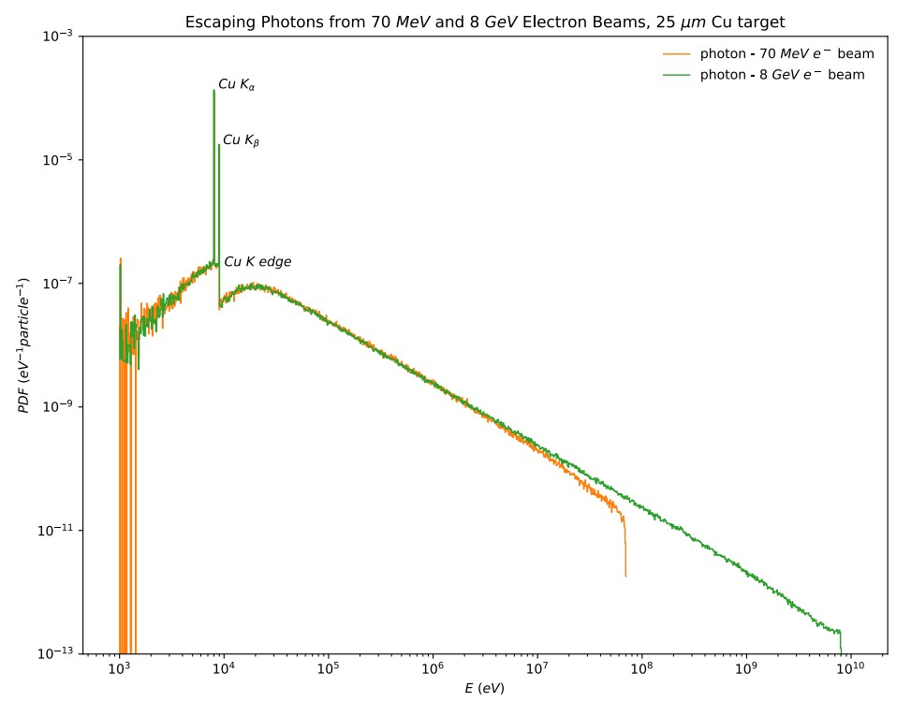
LESA -> poor scientist’s LCLS

Slide 6
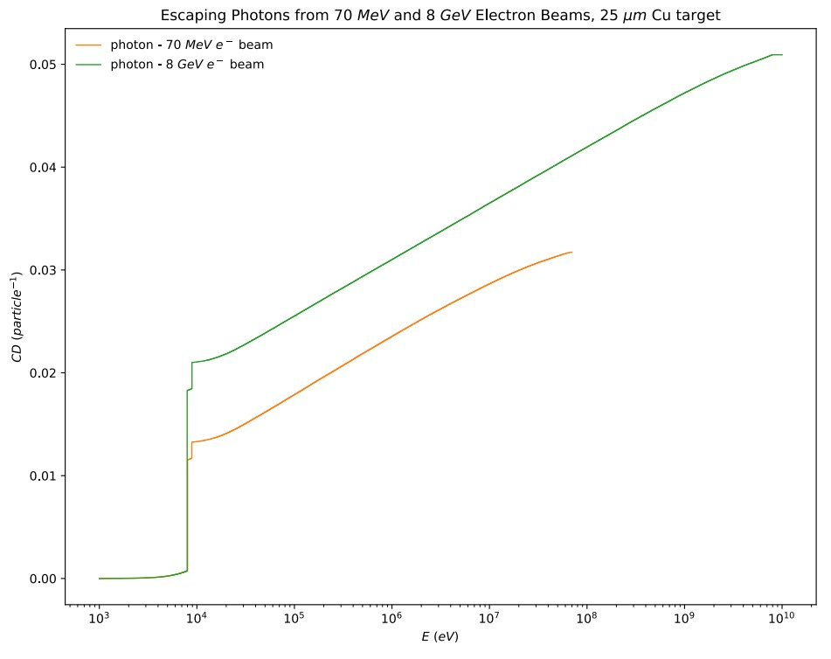
LESA -> poor scientist’s LCLS
1-2 percent electron-to-x-ray generation ratio
So, 20 pC would produce about 1x10^6 fluorescence x-rays per foil into 4Pi

Slide 7
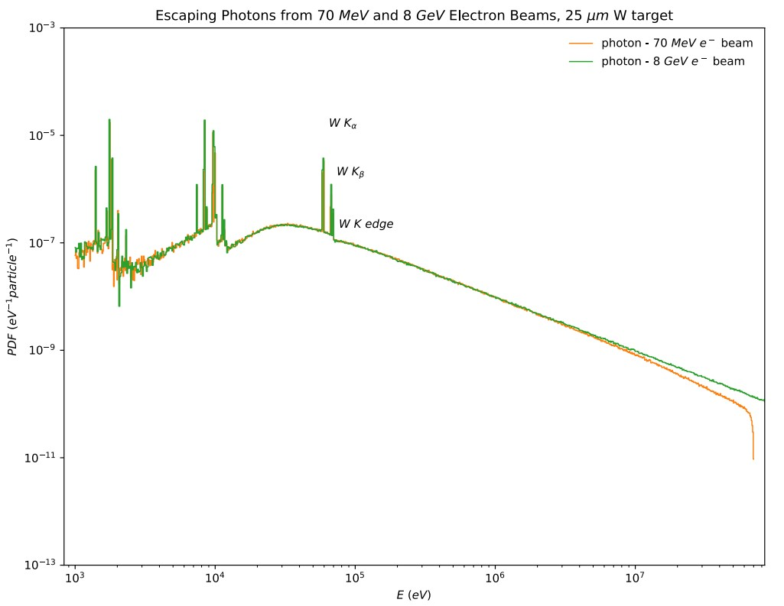
LESA -> poor scientist’s LCLS
Can span energies from carbon to uranium
Would need vacuum for soft x-rays

Slide 8
Photon Science
Momentum Spectrometers
Photon-molecule collisions
Reconstruct original molecular state by recording trajectories of electrons and ions in magnetic fields – typical energies 10s-100s of eV
Currently at 100 ps resolution
In future would benefit from 10ps
Bunch lengths ~5 ps
Bunch charge of a few to 1,000s of electrons
Or high bunch charge and convert to photons using Ti foil
Rep rate 1 kHz to 1 MHz

Slide 9
Photon Science
X-ray Photo-Correlation Spectroscopy
Speckle patterns
Time resolved
Sparse
Can mimic speckles of 1, 2, 3, 4 and 5 photons by having 5 foils with K-lines that are multiples of the photon energy of interest
Bunch charge 10-100 pC
Rep rate 1 MHz

Slide 10
HEP
Irradiations
Ideally with the ability to bias or operate devices during exposures
~ Mrad per hour silicon equivalent
Sled/trolley (remotely controlled) for timed insertion of devices
Sensors, ASICs, materials
Damage tolerance characterization
Damage physics studies

Slide 11
HEP
Timing
Currently have 6.25 ps TDC ASICs
Will couple to LGAD arrays
Few electrons / bunch
Bunch lengths ~1 ps
a MIP deposits a somewhat random amount of ionization signal in semiconductors
An x-ray generates a well-known signal with much less uncertainty than a MIP
-> High bunch charge

Slide 12
Fusion
Fast Spectroscopy
Measure x-ray spectrum as target evolves
Desire 4 to 32 images with 1-5 ps exposures
Bunch lengths ~1 ps
Bunch charge as high as feasible
Rep rate 1-1,000 Hz

Slide 13
Fusion
Fast Radiography
Record x-ray absorption image with short exposure
Bunch lengths ~5 ps
Bunch charge as high as feasible
Rep rate 1-1,000 Hz

Slide 14
Security
Emilio will cover in more detail
But one project needs to image 50-70 keV photons that arrive in ~ps long pulses
Using LESA with foils could mimic the planned source.
Possibly in combination with novel x-ray optics
Radiation damage studies
Radiovoltaics

