Slide 1
Timing Solutions at LCLS
Matt Weaver, SLAC Technology Innovation Directorate
Sept 4, 2025

Slide 2
LCLS Overview
LINAC Coherent Light Source
120 Hz pulsed
normal conducting (NC) accelerator
476 MHz accelerating RF
~37 MHz
low charge bunches
Inj
X-Ray
Expts
~1MHz continuous wave
super conducting (SC) accelerator
1300 MHz accelerating RF
LESA
Expts

Slide 3
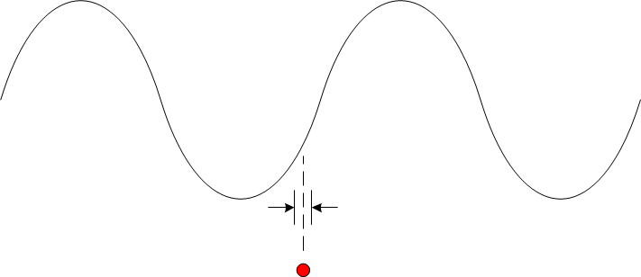
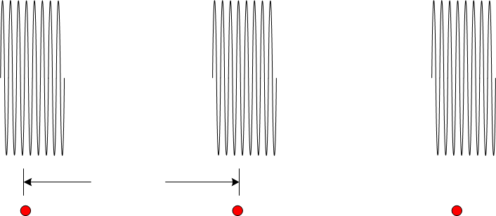
LCLS-II Timing System Overview
Precision Timing System
f_{RF} = 1300MHz
Provide 1300MHz reference to synchronize RF and Laser systems.
Jitter and stability to a small fraction
of 1300MHz period
e⁻
f_{Beam} = 929kHz
Event Timing System
Provide trigger and acquisition commands to beam control and diagnostics systems.
Jitter and stability to a small fraction
of 929kHz period
0.93MHz Max LCLS Injection
e⁻
37MHz LESA Injection

Slide 4
LCLS-II Timing System Functions
LCLSII-2.7-PR-0345-R0 (Timing System)
  Provide for beam synchronous triggers at up to the full pulse rate (0.929 MHz=1300/1400)
  Control beam generation in a wide variety of bunch patterns
  Option to synchronize to power-line
  Globally distribute “beam meta data”
  Compatibility with LCLS-I
  Orchestrate beam synchronous acquisition (BSA), diagnostic buffers, and snapshots
  Label each pulse with global pulseID for correlation across sensors or even acquisition systems (beamline data with experiment data, for example)
  Use dedicated hardware and communications [maintain availability]
  Maintain User Interface [consistency with LCLS-I + new features]

Slide 5
Requirements
Timing Attribute | Value
Phase Reference (Linac RF) | 1300 MHz
Clock (Gun RF = Linac RF/7) | 185.71 MHz
Nominal Beam Rate (Clock/200) | 0.92857 MHz
Fiducial Resync Freq (Clock/2600) | 0.07143 MHz
Fiducial (Power Line Phase) | 360 Hz
Stability - Standard (fiber) | 0.4 ns
Stability – Phase reference line (PRL) | 1 fs/sec, 1 ps/day
Jitter – Standard (fiber) | 40 ps
Jitter – PRL (50Hz to 5kHz) | 0.005º or 10.7 fs
Event Timing
Precision Timing
Event Timing
Precision Timing

Slide 6
Timing System Usage
Ways in which devices use the timing system:
Local (asynchronous) clocking + Event Timing to trigger
  Beamline diagnostics
Clocking derived from Event Timing + Event Timing to trigger
  Experiment 6GS/s digitizers
Local oscillator locked to Precision Timing + Event Timing to trigger
  LLRF, Laser Systems (Injection and Experiment)

Slide 7
Timing System Overview
Precision Timing
Distributes a low jitter RF reference at
1300 MHz or 2600 MHz
Rigid Cu Coax (LINAC)
RF over Fiber (Expt)
Event Timing
Broadcasts synchronous data at 929kHz
One-directional fiber distribution
One challenge to both of these systems is the long distance
and uncontrolled environment over which they distribute.

Slide 8
Precision Timing: Commercial RF Over Fiber Systems
We employ commercial systems from two manufacturers for transporting precision timing over distances. They utilize fiber ovens and electronic phase shifters to achieve compensation and introduce little additive jitter (~fs).
I-tech Libera3 RFoF
  Up to about 1km
Cycle RFoF
  Uncompensated – 5km
  Compensated – 5km
    Still working out implementation of fast thermal drift
    External feedback and phase shifters still needed

Slide 9
Event Timing Distribution Across the Facility
Timing Pattern Generator
AF
TPG
Active fanout
Drift corrected links (2 ps granularity)
AF
Sector 2
F
Passive fanout
Same path as LCLS-I
AF
Sector 20
AF
Bldg 5
F
F
F
F
F
F
F
F
F
F
F
F
F
F
F
F
F
F
F
F
F
F
F
F
F
F
F
F
F
F
F
F
F
F
F
F
F
F
F
F
F
F
F
F
F
F
F
F
F
F
F
F
F
F
F
F
F
F
F
F
F
F
Sector 17
Sector 11
Sector 20
Sector 26
Sector 14
Sector 23
Sector 29
Bldg 136
Bldg 105
Bldg 106
Bldg 911
Bldg 912
Sector 0
Bldg 913
Bldg 921
Bldg 950
Sector 1
Sector 2
Sector 3
Sector 5
Sector 8
EndStationA
Notes:
Highlight what we are doing – adding additional passives to the sectors where new devices are (show design maturity and extension of existing system) adding leaves to the tree (point to where passives are going)

Slide 10
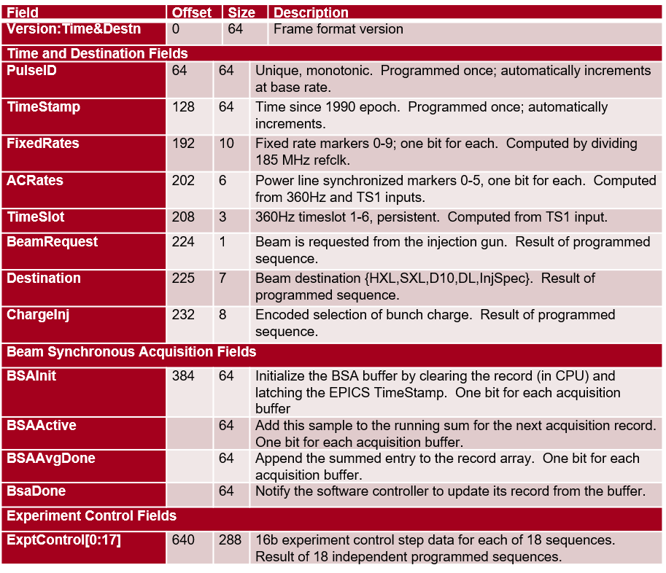
Software/Firmware – Event Timing Data
Information received by all timing receivers in the facility.
Allows synchronous acquisition across all devices.
Allows pulse-by-pulse correlated analysis of all diagnostics.
Notes:
Update the table and indicate what needs to be added.

Slide 11
DASEL– Event Timing Data
(from Ben Reese)
The 56 bit PulseID (0.93 MHz) is concatenated with an 8-bit bunch count (37 MHz)
for unique bunch identification.
On each triggered event, the bunch ID, timestamp, and other accelerator meta-data
are recorded that indicate delivery.
37 MHz Clocking is derived from the Event Timing + jitter cleaners
Local fast control distributes Timing Messages and Readout Requests.
Notes:
Update the table and indicate what needs to be added.

Slide 12
Performance Summary
System | Jitter | Drift | Comment
Phase Reference Line | 10 fs | 1 ps/day | Cu rigid-line in controlled environment.
RFoF | 20 – 50 fs | Up to 10 ps | Long haul environment limiting drift compensation
Event Timing | 40 ps | 40-100 ps
Event Timing + Jitter Cleaner | 5 ps | 40-100 ps | Can benefit from external feedback

Slide 13
Summary
A complete timing system for laser, RF synchronization as well as synchronous control and acquisition services was developed for the LCLS-II project.
The experimental systems have extended this timing system for fast acquisition systems respecting resource limitations.
The hardware is ATCA based, but many modules have been ported to PCI-e platforms and embedded FPGAs as well.

