Slide 1
LESA Facility Overview
T. Markiewicz/SLAC
LESA Test Beam Workshop
2025-09-04

Slide 2
LESA = Linac to End Station A
LESA (formerly known as DASEL, S30XL,…)
Motivation
Bring beam from the LCLS-II Superconducting CW accelerator to ESA for HEP Experiments and Test Beams
General Idea:
Kick beam to new transport line and connect to A-Line
LESA Kicker is AFTER those used for photon science
Kick out ~550ns of “whatever beam there is” between the 929kHz (1100ns) bunches that go to undulators

Slide 3
What will LESA deliver to Users
High Availability
  LESA will be able to operate in parallel with the LCLS-II BES funded photon science program
Bunch Rate and Bunch Charge
  Maximum Beam Power at ESA of 100-200 W
  User determined beam rate up to 37.1 MHz (27 ns)
  User determined # e/bunch subject to overall power limit
  Primary beam energy determined by LCLS-II
  Secondary beam of lower energy and bunch charge
Picosecond level bunch timing
as used in LCLS-II “pump-probe” experiments

Slide 4
Boundary Conditions
Primary beam energy set by LCLS-II
  Nominally 8 GeV after “HE Upgrade” in 2027
Operation for HEP must not adversely affect photon science program.

Slide 5
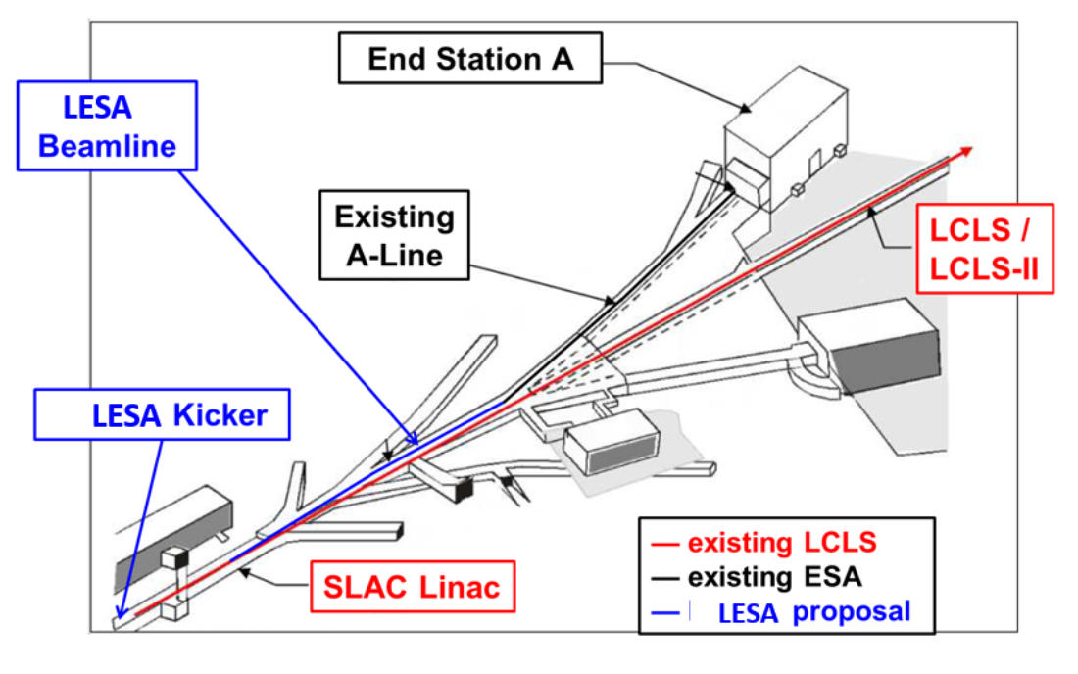
Relies of new beamline and A-Line last used in 2018

Slide 6
Beam to Users
Non-Interference with LCLS-II (beam loading) limits current in LESA to 25nA -> 200W at 8 GeV
  Final safety systems will limit beam power to 400W
  ESA dump rated for 3kW
  This beam useable for radiation studies
    ~400 Mrad/hr (per T506 at ESTB, 2016)
    ~20 times more than during ESTB times
It is assumed that most users will want “single electrons”
  Make these by degrading the beam with a thin (now 500um) or thick (now 6mm copper) target and using the A-Line 24-degree bend and the momentum slit

Slide 7
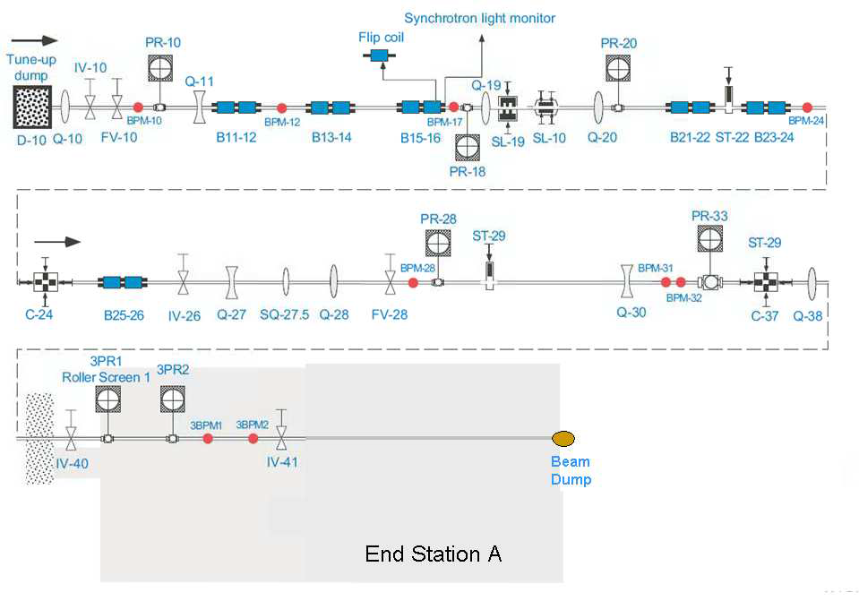
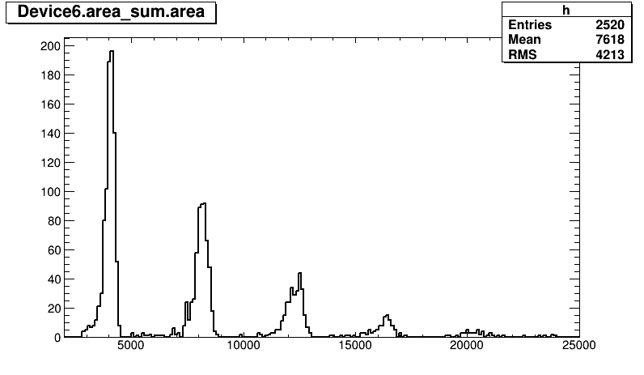
A-Line Produces Secondary Beams for the End Station
PR-10 Spoiler
SL-10 defines momentum
1 e⁻
2 e⁻
3 e⁻
Collimators C-24 and C-37 define beam spot
4 e⁻
5 e⁻
6 e⁻
ESTB Results shown by Carsten
3 kW beam dump

Slide 8
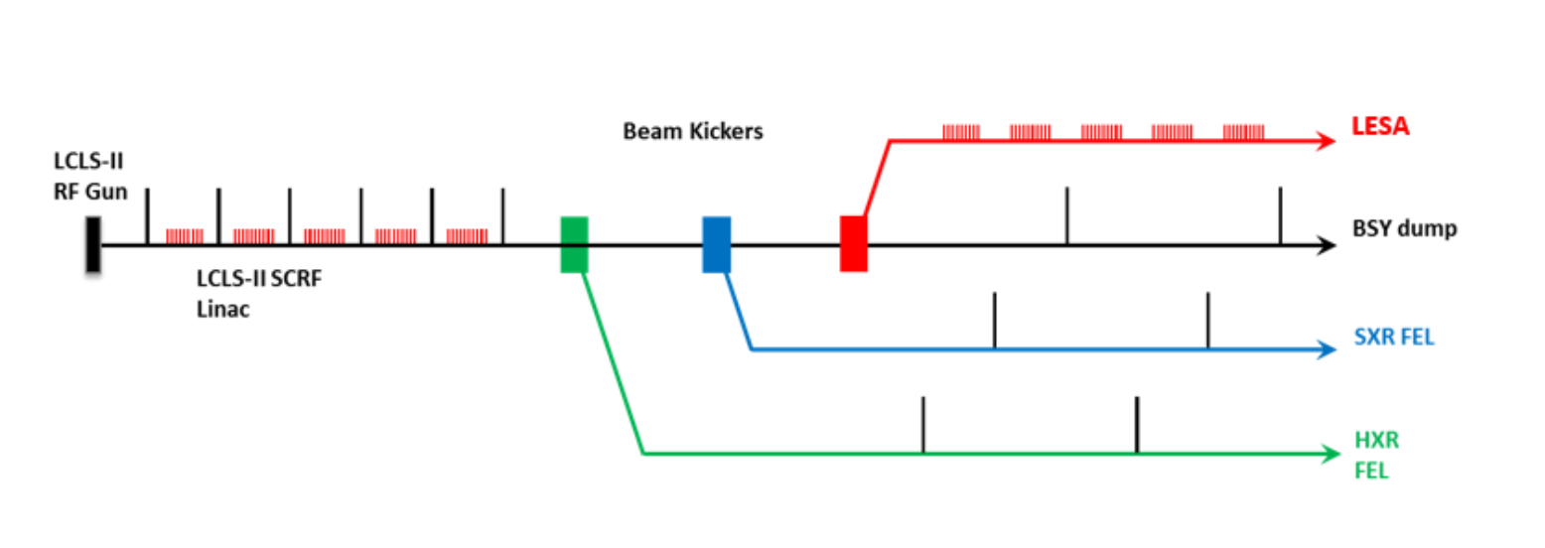
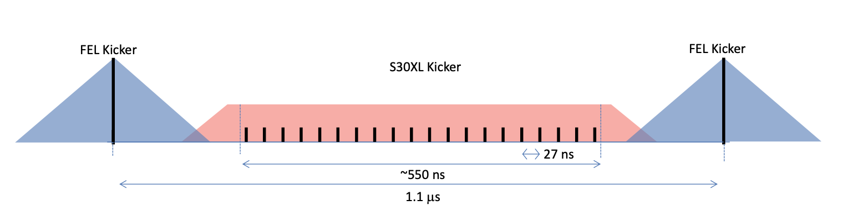
Beam Path and Time Structure

Slide 9
Timeline
Period | Actions, Milestones, Plans
2016-2019 | Concept developed & presented to SLAC and DOE
2020-2024 | Funding & Construction of new beamline in 2 phases COVID and LCLS-II installation
June 20, 2024 | LCLS-II 60pC bunches at 10 Hz to temporary Phase A dump
2024-2025 | Finish LESA and recommission A-Line (last use 2018) ”Interleaved Operation” w/ LCLS-II Continuous kicker operation for LDMX Hodoscope
Nov-Dec 2025 | 10 Hz Electrons to ESA
2026 | LCLS-II OFF to install Cryomodules for 8 GeV LESA finishes work to allow 929kHz electron beam to ESA New LESA Profile Monitors, Clean up ESA
2027 | 8 GeV beam Certify ACM-BCS system New devoted 37 MHz LESA laser Test beam operations

Slide 10
Non-Laser Sources of Electrons for LESA: Dark Current
In 2016, dark current was thought to be the source of electrons for LESA.
  These electrons are emitted by 185.7MHz gun RF every 5.4ns.
In April 2025 dark current was measured in LESA by LDMX
  ~2 pA or 5 e- per kicker pulse spread over 100 buckets (see Lauren Tompkins talk)
Dark current levels are sensitive to injector configuration and can change
Dark Current electrons will be present along with those produced by lasers

Slide 11
Existing Laser Source for Electrons
LCLS II Laser (“Interleaved Mode”):
  LCLS-II will usually be able to send “extra” pulses to LESA
    LESA kicker fires in phase with the 929kHz pattern
    Currently 10 Hz: 2.4W at 60pC/bunch @ 4 GeV
    Maximum rate 250 Hz: 200W at 100pC @ 8 GeV
  Do not need “devoted” beam time
    can run parasitically to LCLS-II
    LCLS-II sets the bunch charge
  This is mode we will use November-December 2025 to show that A-Line is operational

Slide 12
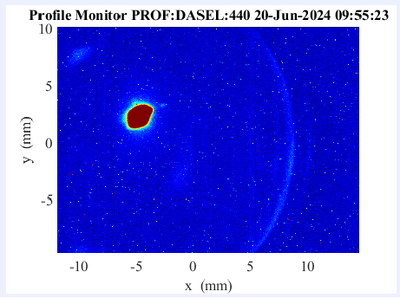
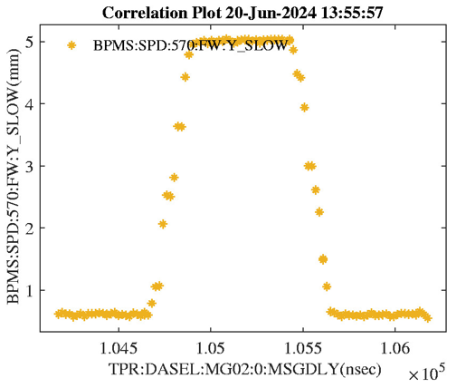
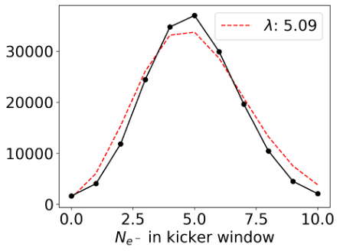
June 20, 2024
First Beam in LESA with LCLS-II bunches and Dark Current
LESA Profile Monitor
LESA BPM as function of kicker delay, showing flat top and rise time of LESA kicker
LDMX Hodoscope Measurement of Dark Current in ~100 5.4ns buckets

Slide 13
Future Laser Sources of Electrons for LESA: Part 1
XLEAP Laser: Transition Path to 10^6 Hz
    LCLS-II has a second short pulse independent laser for its XLEAP program that pulses cathode on top of the broader main laser pulse
      Exists and is optically plumbed into the gun
      Not used all the time & is available for LESA tests
    It can be timed to the center of our kicker flattop
    Rate and charge can be set by LESA (subject to RP limits) up to 929kHz
    Technical capability to use XLEAP this way is under development

Slide 14
Future Laser Sources of Electrons for LESA: Part 2
LESA Laser: Transition to 37.1 MHz Laser
    New laser running at 5th harmonic of Gun HV RF
      37.1 MHz
      27.1 ns period
    Fill kicker pulse with 18-20 buckets of charge
    At 929kHz, 100W -> 4200 e- before spoiler -> 1-2 e- at ESA
    Conceptual design exists but new hardware and system design work needed
    Potential applications to pileup studies in high-rate environments
    ”Pulse Picking” at laser will allow customizable pattern of bunches

Slide 15
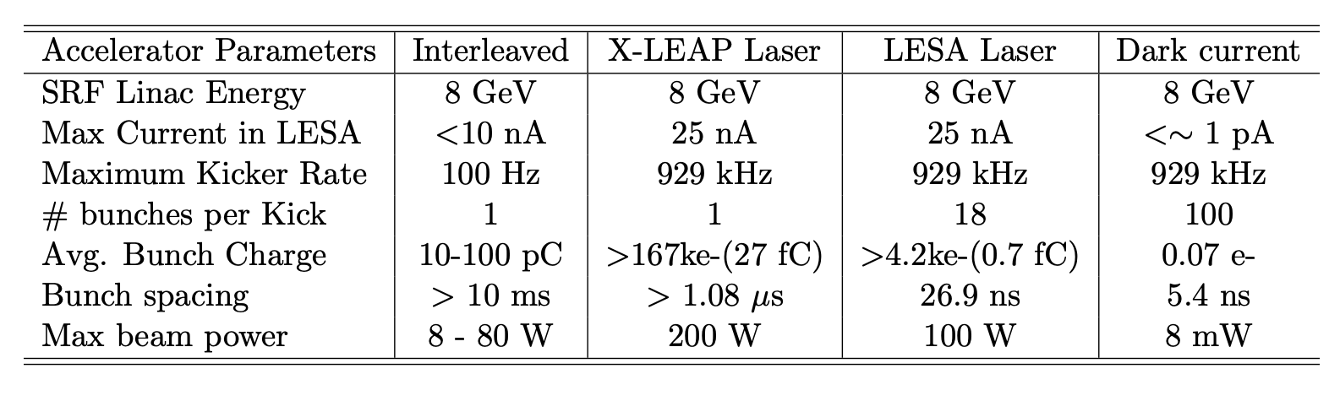
Summary of Beam Modes at LESA

Slide 16
LESA Bunch Length
LCLS-II is designed to deliver very short high current bunches
  10 um -> 33 fs long in the accelerator
Low current configuration and A-line dispersion will distort LCLS-II bunches
  Expect 1-10ps
Field measurements and optimization will be required

Slide 17
LESA Status
LESA
  Need to connect to A-line & leak check
  Need to commission one temporary profile monitor
A-Line
  Vacuum high but coming down after Q38 replacement
  No water leaks on magnets
  Power for quads and bend trims in place and tested
  Power for dipoles ready to test after RP paperwork issues resolved
  Collimation system works
  Profile monitors need cameras installed & checkout
  1990-era MicroVax based Control system works (replacement planned)
System
  Legacy PPS/BCS needs certification and connection to the LCLS-II accelerator
  Radiation Safety Committee scheduled 9/15/25
  Approvals: BAS and USI in process
  Run beam ~November-December 2025

Slide 18
2026 Work Plan
Install 2 new LCLS-II style Profile Monitors in LESA
  Being shipped from Korea this week
Install ACM Receivers and Tone Generators into rack & checkout
  These have been assembled and are RFI
Install PLC system to tie ACMs to BCS
Develop Timing and MPS to allow use of existing 929 kHz XLEAP laser
Design, build, install and test 37 MHz laser
Mount two existing 8cm aperture quads in ESA to shape beam for LDMX
Remove existing dipoles & wigglers from ESA

Slide 19
2027 Plan
Certify ACM system in 2027 to allow 929 kHz kicker operation
Begin test beam operations
Commission 37MHz Laser
Upgrade control system to EPICS running LCLS-II

Slide 20
Backup

Slide 21
Source of Electrons: Summary
Dark Current from the electron gun by the HV RF system
Lasers
  Existing laser feeding FEL undulators
    FEL program sets charge per bunch
    Currently the main source of electrons for LESA
      10 Hz (60pC, 4 GeV, 2.4W)
  Existing short pulse “XLEAP” laser
    Maximum rate 928 kHz
    Could be used when XLEAP not running
    LESA can set the rate and charge subject to RP limits
  Planned 37.1MHz laser for the LDMX science program
    Early equipment funding authorized
    Delicate job to fuse a 3rd laser beam onto the cathode

Slide 22
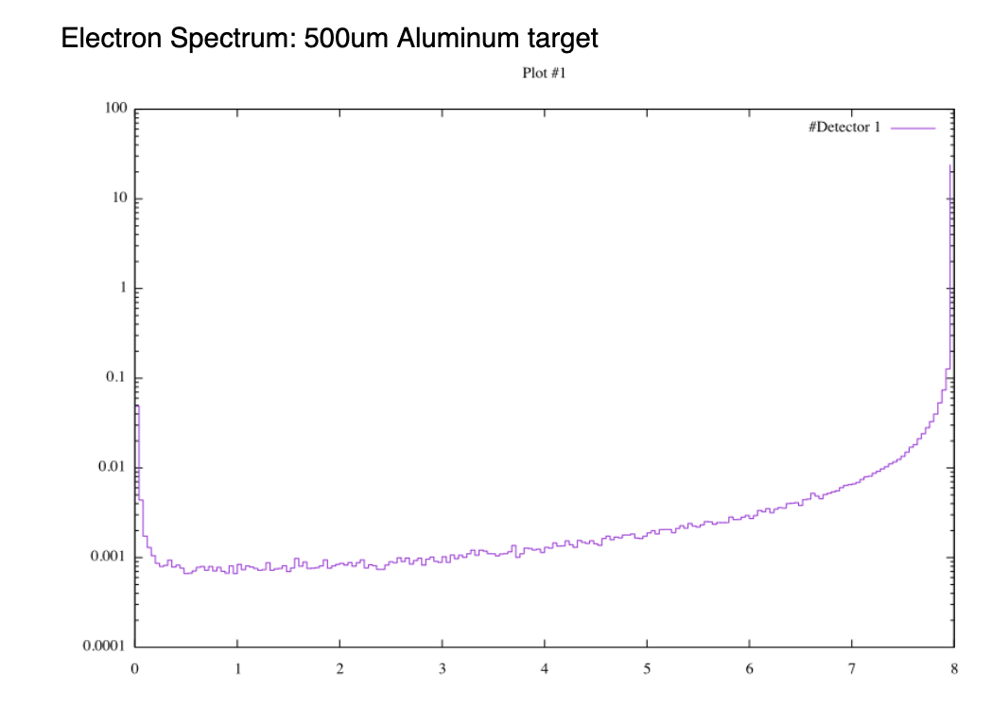
Spoiled 8-GeV Electron Spectrum (FLUKA)

Slide 23
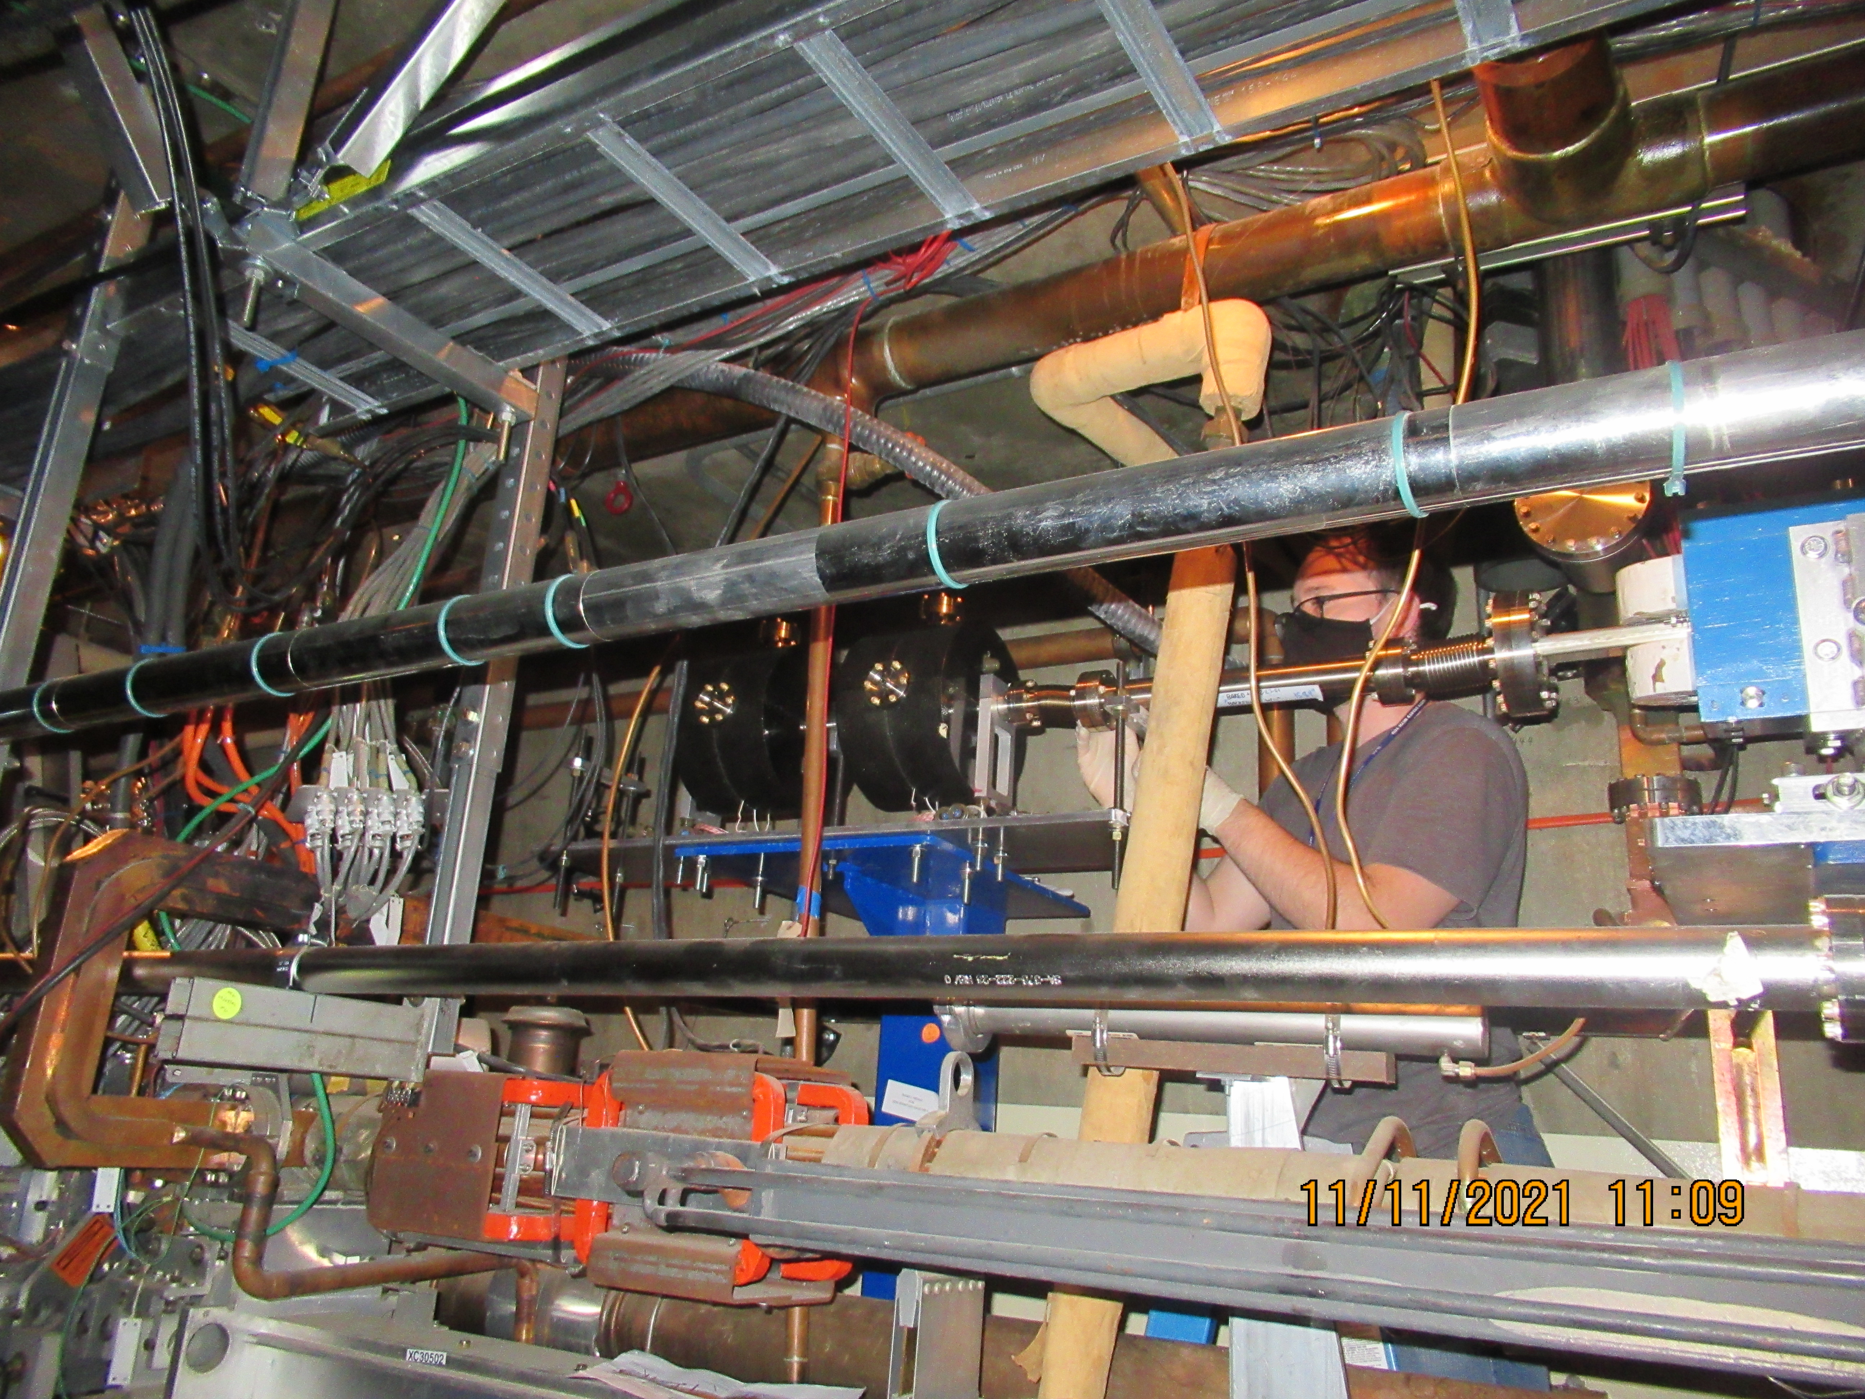
ACM = Average Current Monitor
BCS = Beam Containment System
ACM is the “accredited” BCS device that tells RP (Radiation Physics) that LESA beam power is < maximum allowed
  2 devices each with 2 readout chains
  Given low LESA charge, needed new readout
Until these are “certified” RP assumes an accident can deliver full LCLS-II beam power to ESA
  LCLS-II power limited by one ACM pair in Sector 0
2026 Work plan
  Load rack with tone generators and receivers
  PLCs to trip BCS if ACMs indicate fault
2027 Work Plan
  Certify operation of ACMs and BCS
All LESA operations to date allowed via an “Unreviewed Safety Issue (USI)” exemption based on an “unaccredited” 10 Hz hardware rate limit on the kicker

Slide 24
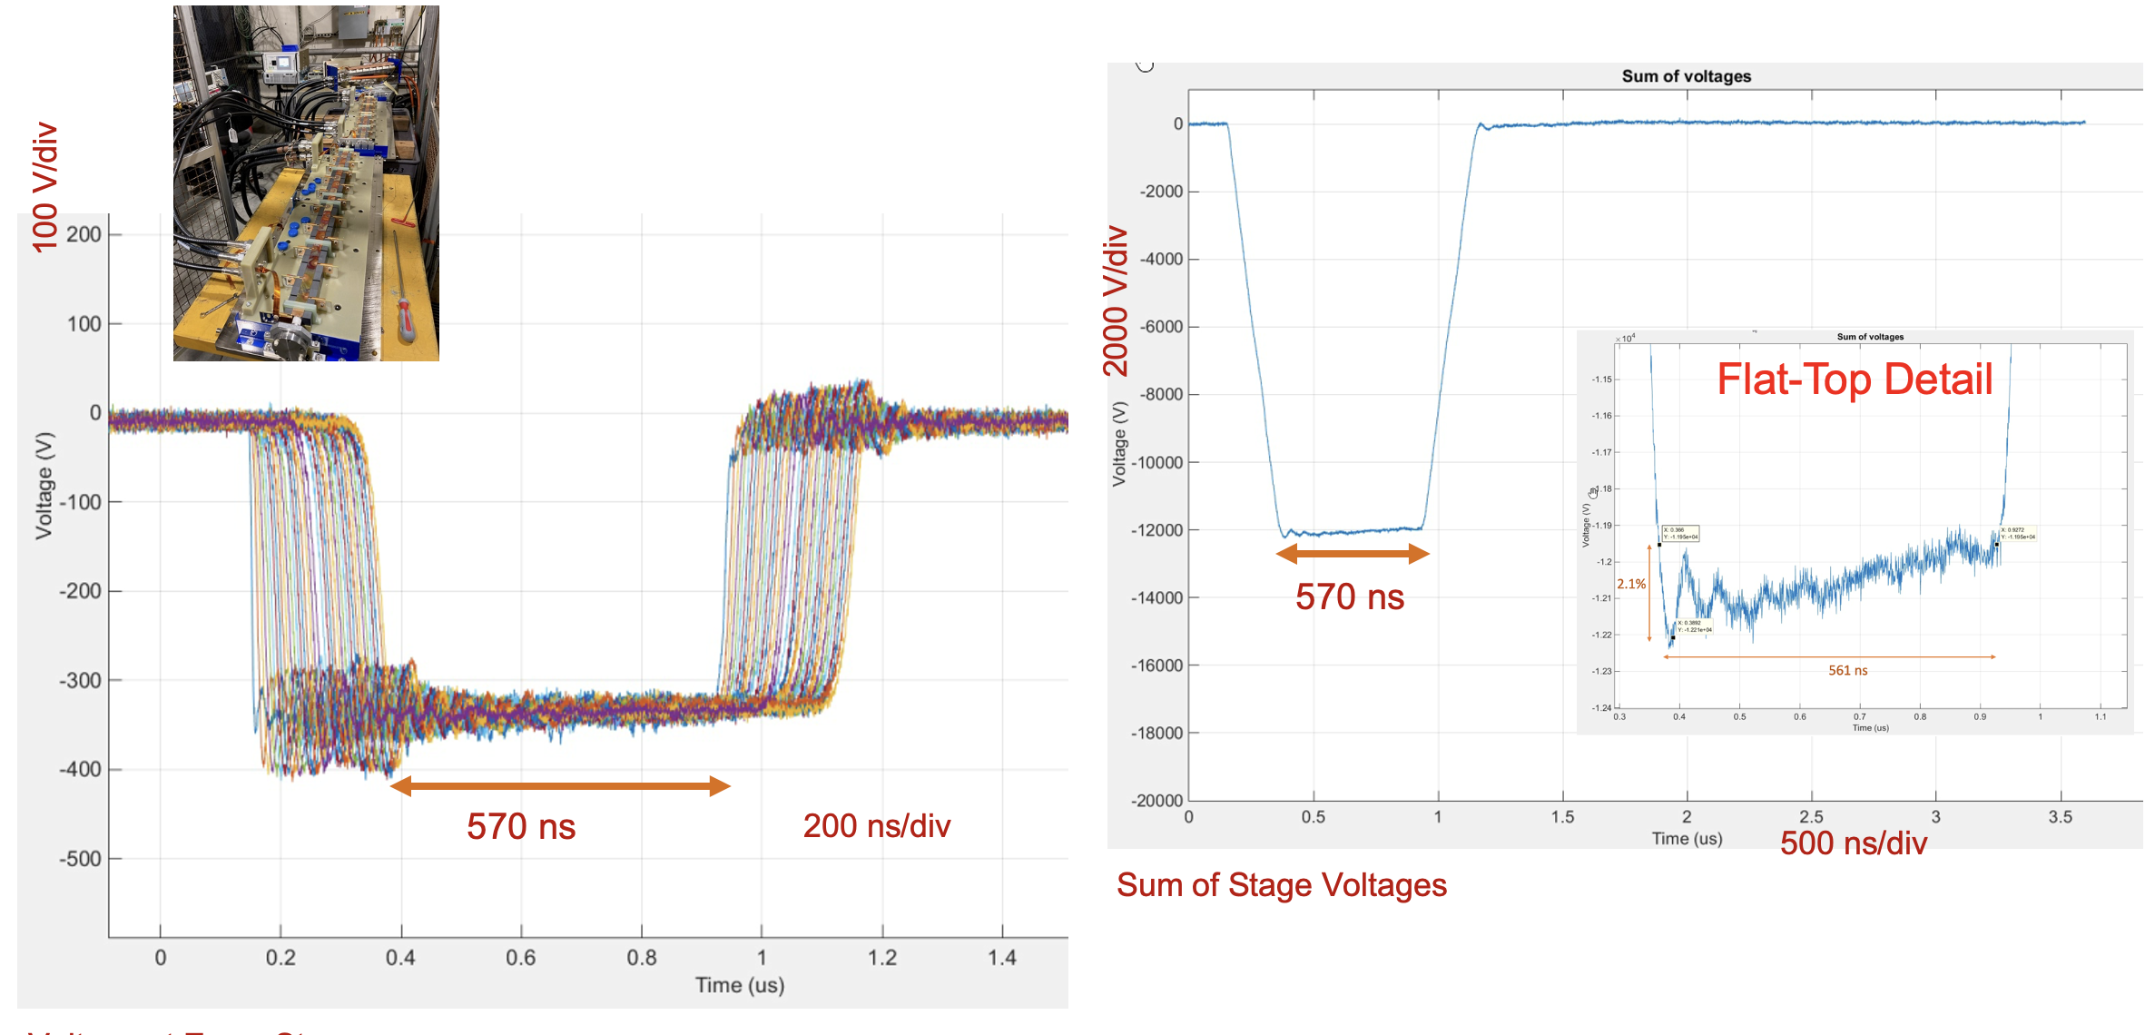
LESA Kicker: Tony Beukers

Slide 25
Numerology
System | Frequency | Period | Harmonic
Accelerating RF | 1.3 GHz | 76.9 ps | 1
Electron Gun RF | 185.7 Mhz | 5.385 ns | 7
LCLS-II Laser RF | 46.4 Mhz | 21.5 ns | 4
Pockel Cell | 0.929 MHz | 1.08 us | 50
LESA Laser | 37.1 Mhz | 27.1 ns | 5
XLEAP Laser | 0.929 MHz | 1.08 us (variable)
200 5.4 ns Gun buckets between LCLS-II pulses locations

Slide 26
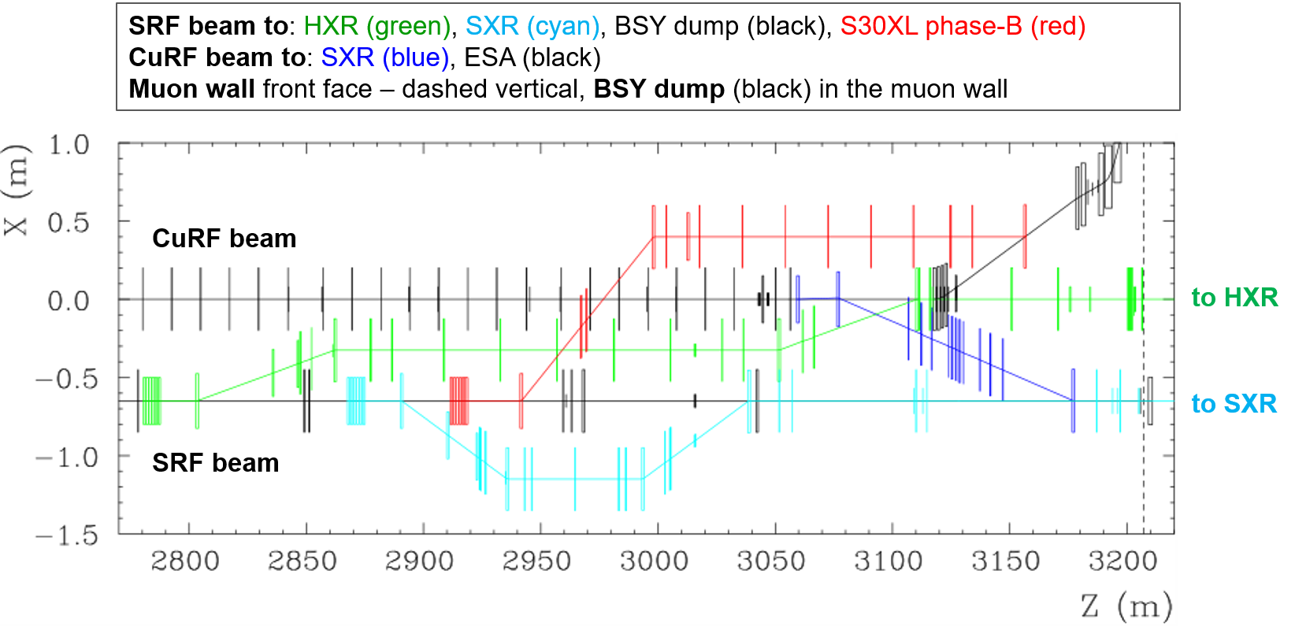
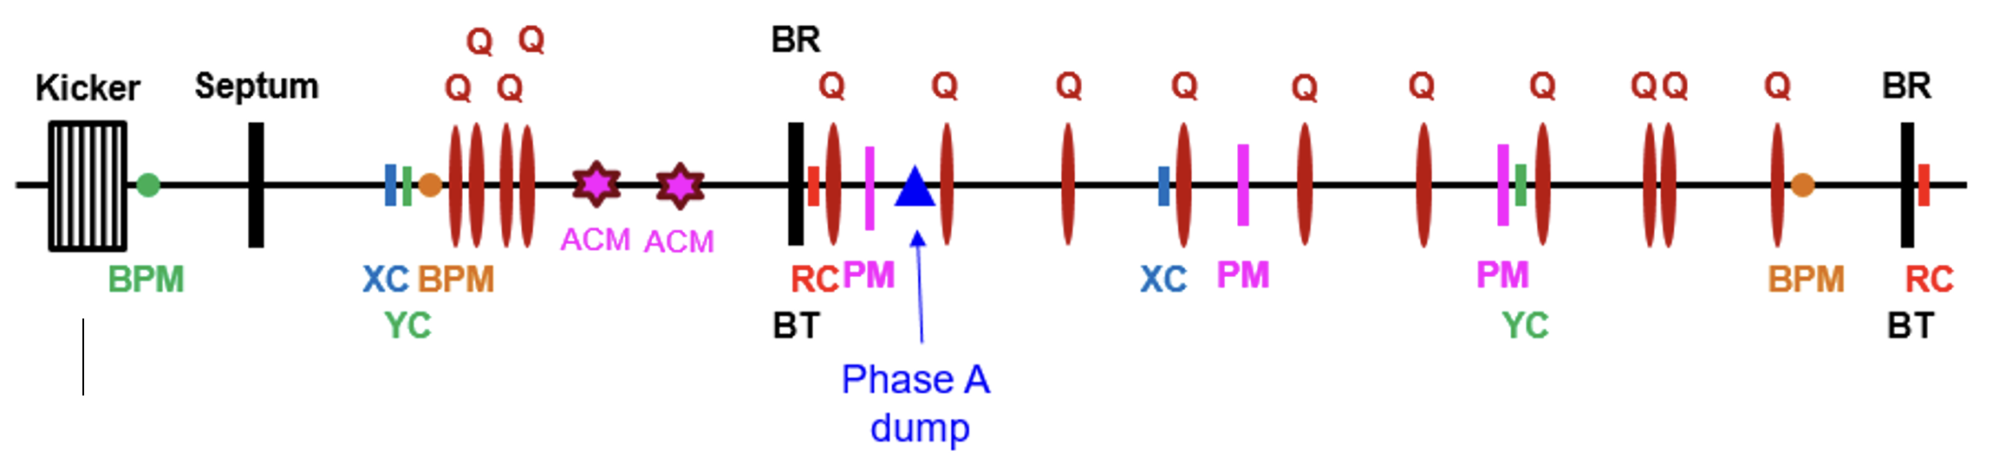
Beamline Elements: Can transport 4 and 8 GeV beam

