Slide 1
Test Beams for SiC-LGADs
Carl Haber
On behalf of the NC State - LBNL- BNL Collaboration

Slide 2
Why SiC-LGADs?
Fast timing is critical for future colliders - pile-up at hadron colliders, PID by TOF at Higgs Factories
Wide band gap materials are interesting candidates for LGAD b/c
Potential for enhanced radiation hardness
Lower mass due to high temperature operation- cooling not required
Intrinsically fast (2x silicon)
Supported by growing industrial base for SiC and GaN
LGAD operation in SiC has been recently demonstrated by our collaboration and there is a growing international R&D community (ie DRD3 WG6 etc)
Indicated as a priority research direction by DOE BRN study and ICFA roadmap

Slide 3
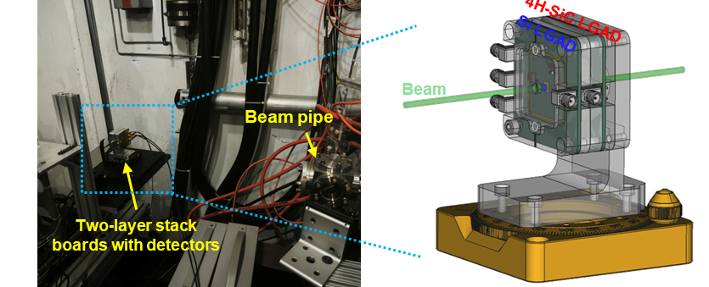
Experience at the NLCT Facility ESB Test Beam
In the past few months we have performed two test beam runs at the SLAC ESB area, 40 MeV electron beam, low rate operation, off axis
Suitable for studies of timing resolution, but energy too low for position resolution studies
Typical data point required a full day of running
Brought our own, self triggered DAQ
Devices operated at ~1000 V, underwent SLAC safety review re: cables, connectors

Slide 4
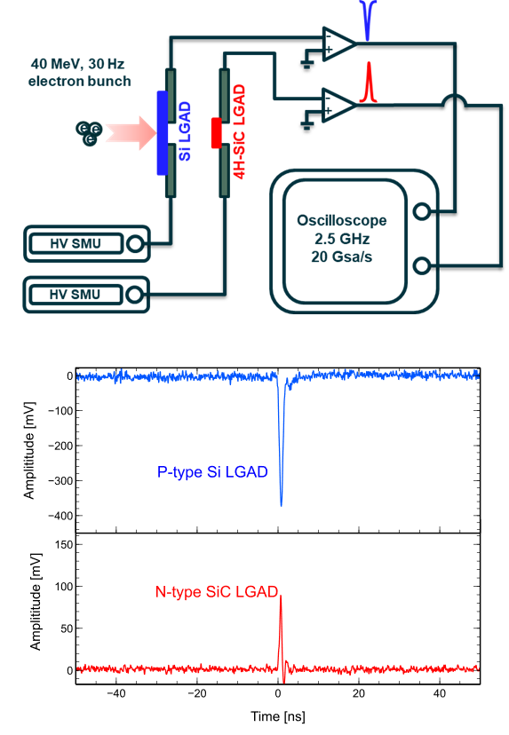
Program going forward
Measure position resolution
Explore device parameter space
Doping
Field control
Segmentation
AC coupling
New WBG electronics
Study irradiated devices and devices with possibly enhanced radiation hardness

Slide 5
Requested Beam Parameters
What beam parameters do you want, e.g.:
Bunch charge
Beam energy
Bunch spacing/time structure
Pulse timing precision
How much beam time do you need?
What facility-supported instrumentation do you need?
What support do you need, for example:
Readout (of what?)
Computing
Radiation physics support for non-standard requests (e.g. detector irradiation)

Slide 6
Requested Beam Parameters
Beam energy - (need to understand the expected charge signal)
Beam charge - (single particles per bunch)
Bunch spacing/time structure - interesting question, how much could we handle?
Pulse timing precision - SiC LGAD ultimate time resolution could be ~10 ps (??) so if we had a 1-5 ps reference perhaps that would be interesting???
Question about photon backgrounds. WBG materials are UV sensitive (but “solar” blind)

Slide 7
How Much Beam Time Do We Want?
At low rate it takes us a day to collect statistics on a single setting
Perhaps 3-4 day runs
Perhaps 1-2 x per year
Higher rate running could be interesting for the future but we would need to think this through

Slide 8
What facility-supported instrumentation do you need?
Precision tracking telescope - pixel scale, ~ several micron resolution
How to read data into a coherent record with our own DAQ
Remote mechanical positioning for scans and steering

Slide 9
What support do you need, for example:
Readout (of what?) - want to understand how to link our data with telescope and possible timing reference system, spectrometer?
Computing - none
Radiation physics support for non-standard requests (e.g. detector irradiation)
Our irradiated devices will already have been released by other site EHS
EHS and Radiation Survey - in our past experience it has not been possible to get our devices cleared by Radiation Safety at the end of a run period. Instead we have to leave all our gear behind and arrange for other transport another day. Considering that an electron beam, at these rates, should not activate materials can this be addressed more efficiently?

