Slide 1
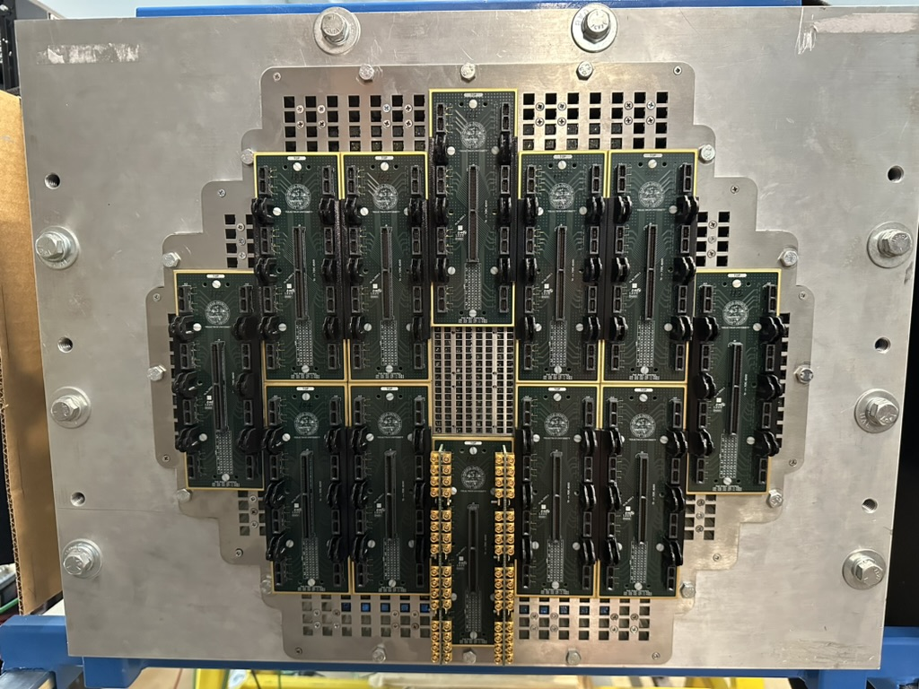
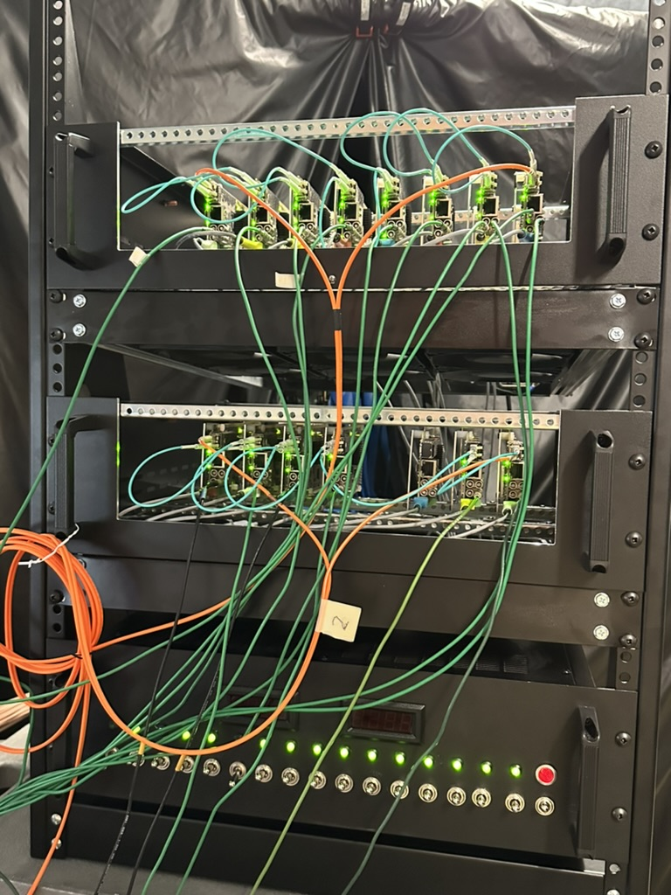
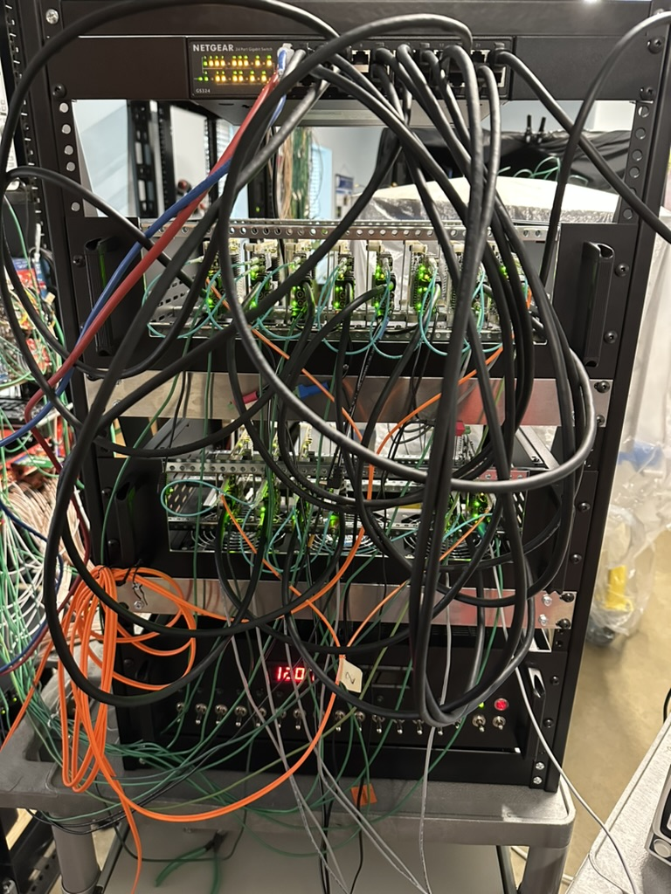
TTU Status Update
CERN beam tests are at H8
  Period 1 in Aug 13-20
  Period 2 in Sept 24-Oct 8
Welcome SLAC colleagues and students. Consider this an invitation to participate in test beam and data analysis work
HG-DREAM is coming together nicely. The ship date is July 7
Crystal ECAL
SiPMs
Optical
Ethernet

Slide 2
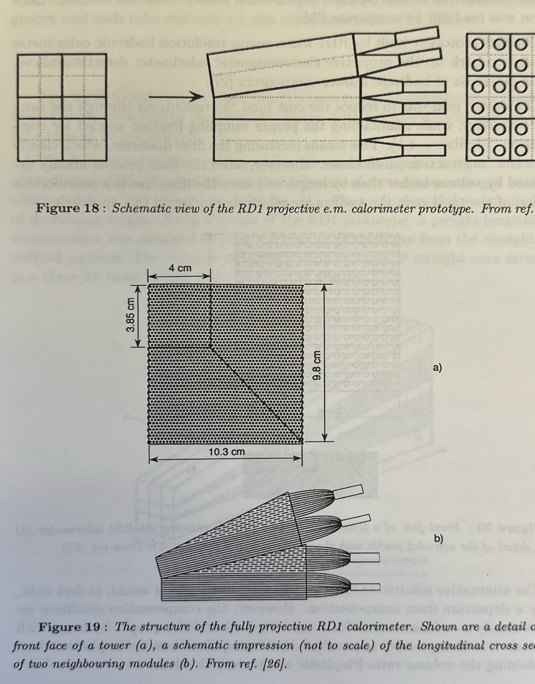
Projective Fiber Calorimeter

