Slide 1

Microbunching at FACET
Sergei Kladov
3rd year PhD student, will be working here for 20 months

Slide 2
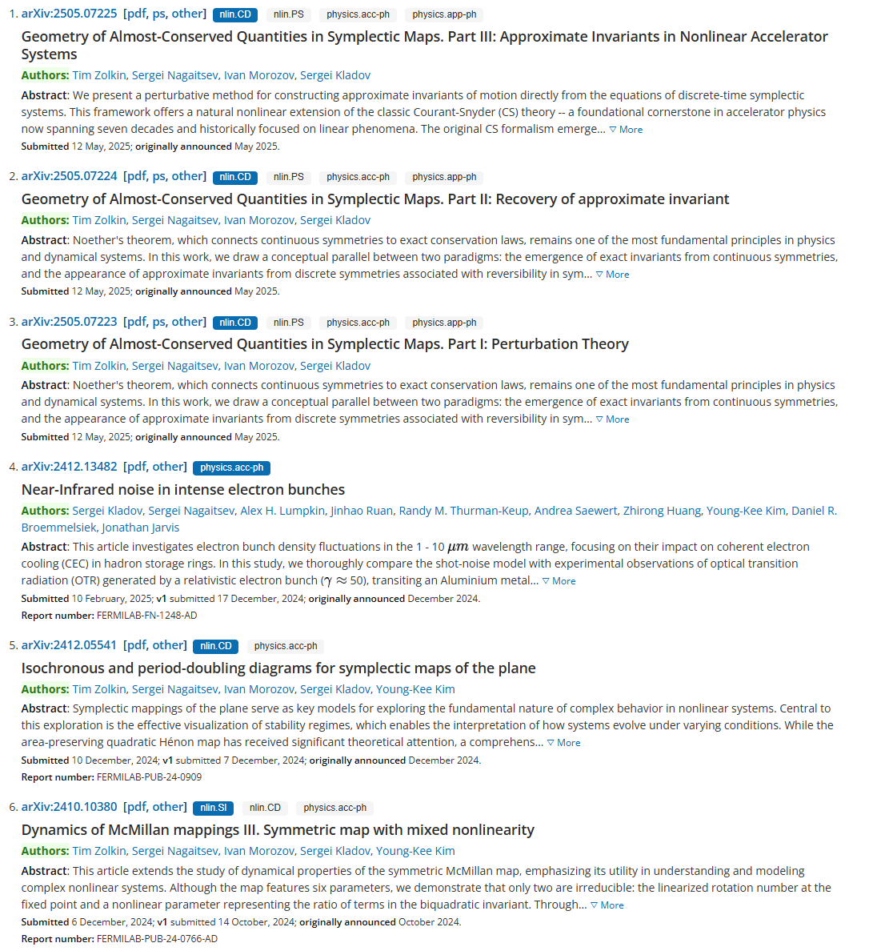
Introduction
Two “main” projects:
Intra Beam Scattering (IBS)
Noise in Electron Beams (NEB)
Recently submitted a number of papers on dynamical systems
Before that was working on developing code and techniques for that
Now the plan is to repeat the same procedures for other maps – will take much less time (hopefully)
Answering to referees
Published
Published
Sergei Kladov Microbunching at FACET 05/20/25
1/12

Slide 3
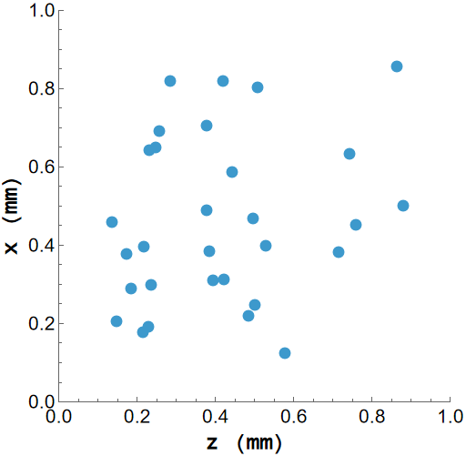

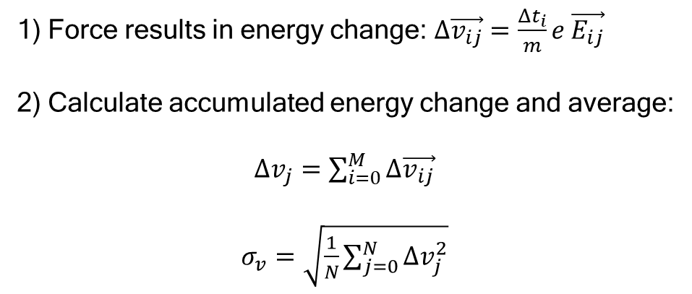

Intra Beam Scattering
Distribution at $t=t_{1}$
1) Force results in energy change: $Δ\vec{v_{ij}}=\frac{Δt_{i}}{m}e \vec{E_{ij}}$
2) Calculate accumulated energy change and average:
$Δv_{j}=\sum_{i=0}^{M}{Δ\vec{v_{ij}}}$
$σ_{v}=\sqrt{\frac{1}{N}\sum_{j=0}^{N}{Δv_{j}^{2}}}$
$$\vec{F}$$
We subtract $E_{0}$ from the field – only interested in modulations
Sergei Kladov Microbunching at FACET 05/20/25
2/12

Slide 4
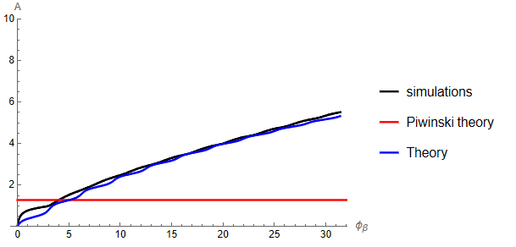
Intra Beam Scattering
Squared spread growth speed: $A\left(t\right)\sim \frac{1}{t}σ^{2}\left(t\right)$
Our simple simulation saturates to some value
This saturation is supported by new Gennady’s derivation
time
Random walk results in the constant growth speed of squared spread
Sergei Kladov Microbunching at FACET 05/20/25
3/12

Slide 5
Noise in Electron Beams

Slide 6
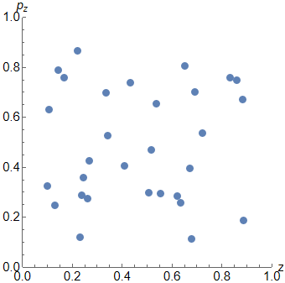
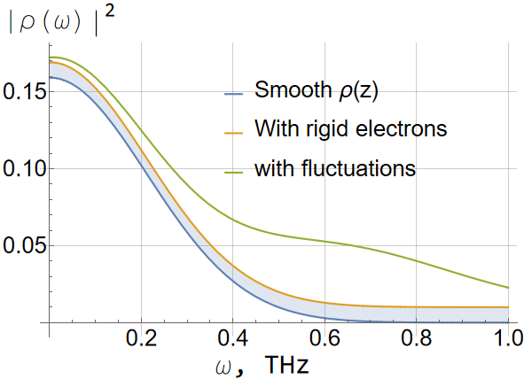
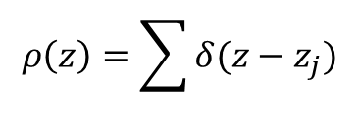
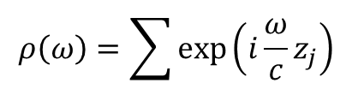
What is microbunching
Phase space of particles
Spectrum of the distribution
Interested in the region where the spectrum from the smooth function is 0
If particles are grouped together, the spectral power will be elevated
$$ρ\left(z\right)=\sum{δ(z−z_{j})}$$
$$ρ\left(ω\right)=\sum{\exp\left(i\frac{ω}{c}z_{j}\right)}$$
Sergei Kladov Microbunching at FACET 05/20/25
4/12

Slide 7
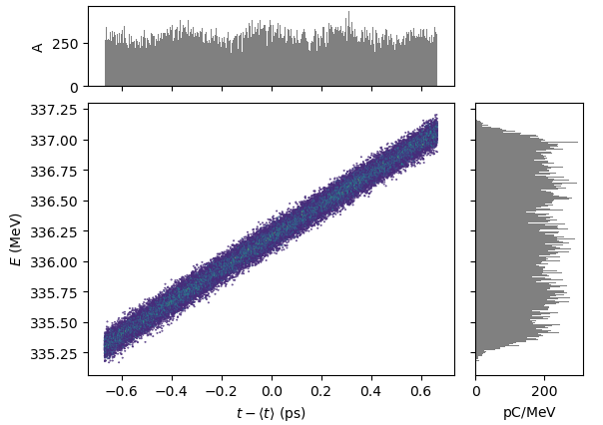
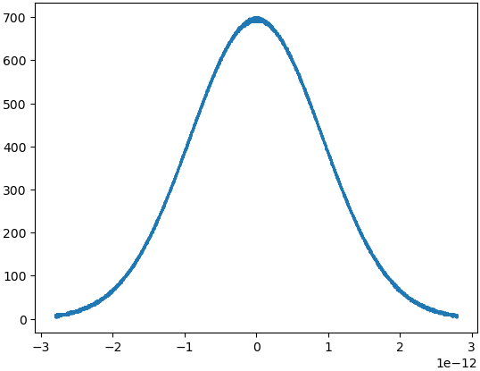
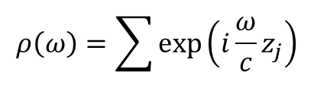

What we are doing
$$ρ\left(ω\right)=\sum{\exp\left(i\frac{ω}{c}z_{j}\right)}$$
All we need are these coordinates
Correlated noise – for gain calculation
$$ρ(z)$$
Just a little noisy distribution
t (s)
Usual simulations:
Care about the general properties of the bunch:
  All 1st and 2nd moments
Microbunching simulations:
Care about microscopic structure within the bunch:
  Tail of the Fourier of the distribution
Sergei Kladov Microbunching at FACET 05/20/25
5/12

Slide 8
Challenges
t-based when the energy is low (ASTRA, Impact-t)
z-based when the energy is high (Impact-z, BMAD)
Need to choose hyperparameters more carefully:
  Number of bins for collective effect calculations
  Number of particles to have enough statistics of small modulations
Need to consider additional effects:
  Space charge or CSR can have little effect on the bunch second moments, but large effect on microbunching structure
  Turn on/off for comparing with theory/experiment
Number of bins illustration
Sergei Kladov Microbunching at FACET 05/20/25
6/12

Slide 9
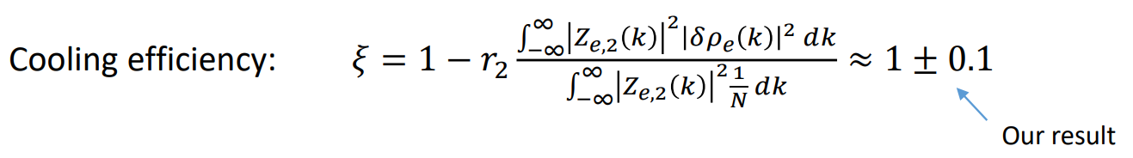
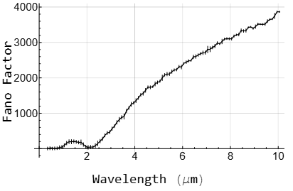

Applications
Application-defined function
Bunch spectrum
Main concern
Interferes with the wake signal from ions in Coherent Electron Cooling – loose efficiency
Interferes with seeding lasers in linacs and interacts with CSR – Reduces monochromaticity and coherence
Without microbunching
$$N ρ{\left(λ\right)}^{2}$$
FAST simulation results
Graph is for a 10 times more compressed bunch. Does not correspond to the main result
Sergei Kladov Microbunching at FACET 05/20/25
7/12

Slide 10

Experimental setup
OTR source
Parabolic mirror
If the bunch is coherent, what about the fields produced with transition radiation?
How is coherence preserved throughout the measurement system?
How does the bunch transverse size affect the coherence?
beam
Flat mirror system
What exactly do we measure?
Overall power conservation
Photodiode
Coherence conservation
filter
Parabolic mirror
Sergei Kladov Microbunching at FACET 05/20/25
8/12

Slide 11
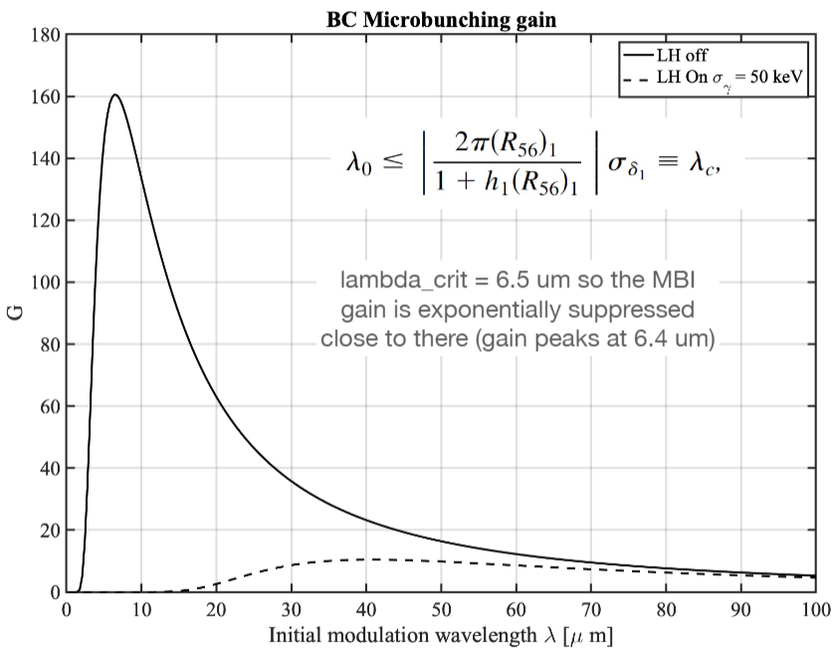


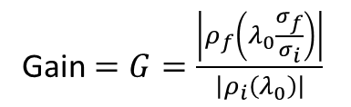
Theoretical treatment. Gain factors
Spectral density
Account for bunch compression
Gain $=G=\frac{\left|ρ_{f}\left(λ_{0}\frac{σ_{f}}{σ_{i}}\right)\right|}{\left|ρ_{i}\left(λ_{0}\right)\right|}$
Initial modulation wavelength
Gain from SC:
Gain from CSR:
SC + SCR? + Wakefields?
BC11
Sergei Kladov Microbunching at FACET 05/20/25
9/12

Slide 12
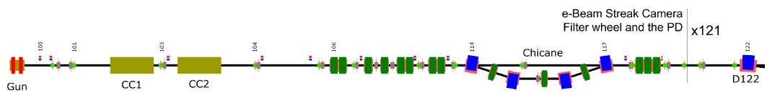
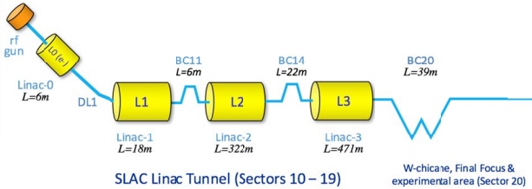
FAST vs FACET
FAST sims:
Used ASTRA for the photoemission and gun section simulation, and ImpactX for the high-energy section
No wakefields, no dogleg, tilted square bends in chicane
FAST
FACET
R51, R52 terms
Laser heater
End of simulations for now
Sergei Kladov Microbunching at FACET 05/20/25
10/12

Slide 13
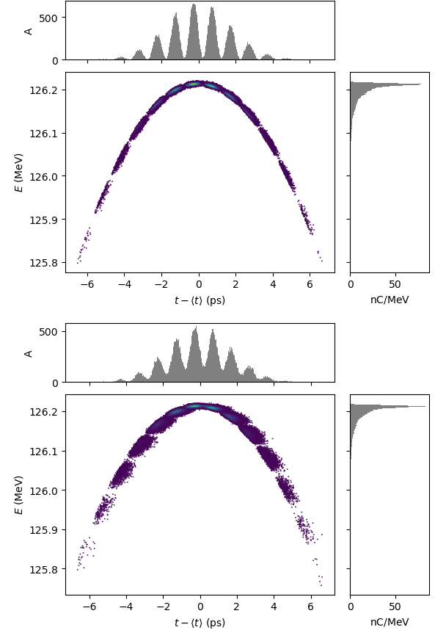
Microbunching damping
Before dogleg
R51 sources:
  Chromatism (sextupoles, not achromatic dipole systems)
  Collective effects
Energy spread
These lead to microbunch overlapping
After dogleg
Turned off wakefields, CSR, SC
Started after BX10 (injection dipoles)
Substituted the bunch with 6D Gaussian (before L1)
Checked that the chicane is from square dipoles, not sector magnets
Sergei Kladov Microbunching at FACET 05/20/25
11/12

Slide 14
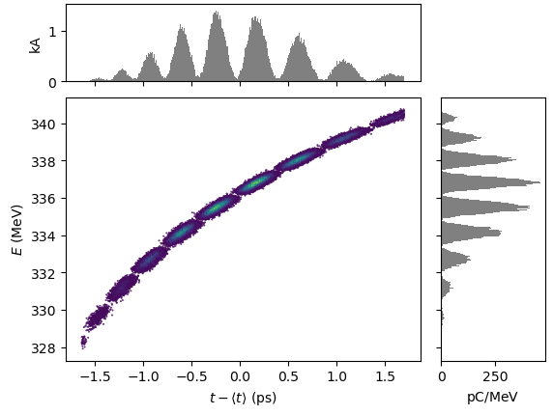
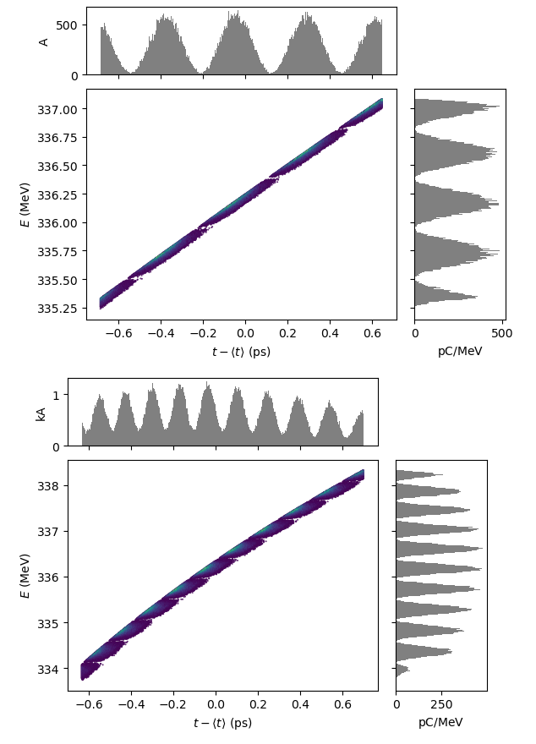

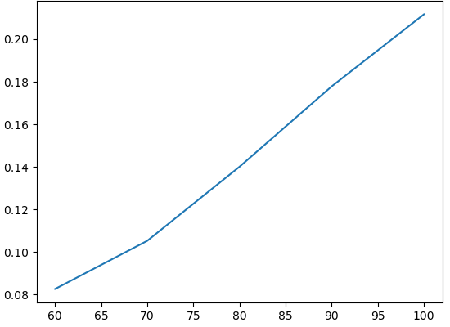




Is it correct now?
BC11END
BC11BEG
Still have gain reduction in “plain” case
Transverse size affects longitudinal dynamics (R51 term still persists)
$300$ um
$100$ um
Without SC
BC11END
Without SC
$100$ um
Gain factor
Theory
$λ_{0}$ (um)
Sergei Kladov Microbunching at FACET 05/20/25
12/12

Slide 15

Thank you!
Questions?
One more slide later..

Slide 16
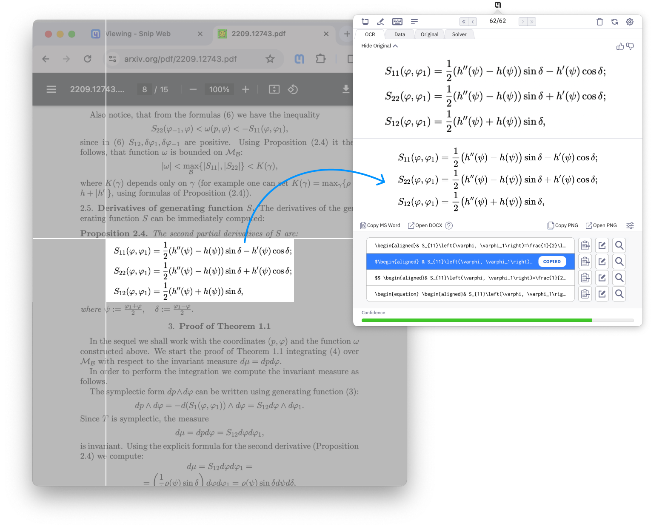
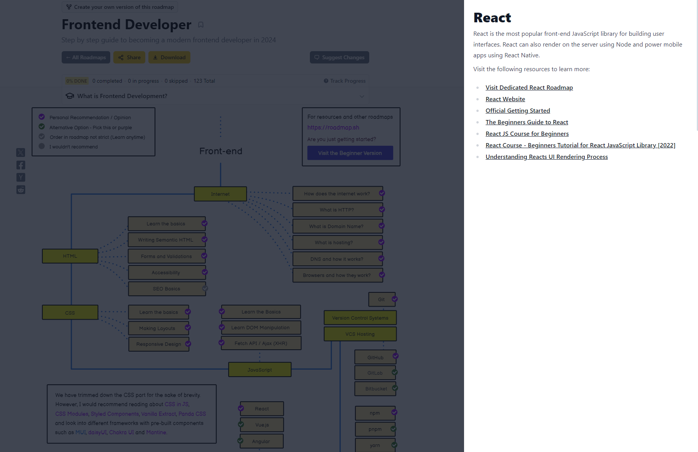
Final slide
Contact me for:
Dynamical systems (nonlinear maps)
BMAD and ImpactT on S3DF for FACET lattice (if for some reason you don’t want to contact Nathan and Eric)
Other general discussions
Useful resources:
https://mathpix.com/snipping-tool (screenshot to LaTex)
https://sci-hub.ru (almost all articles)
https://unpaywall.org (some articles)
http://bookszlibb74ugqojhzhg2a63w5i2atv5bqarulgczawnbmsb6s6qead.onion/ (books)
https://roadmap.sh/frontend (great programming roadmaps)
Sergei Kladov Microbunching at FACET 05/20/25
2/2

