Slide 1

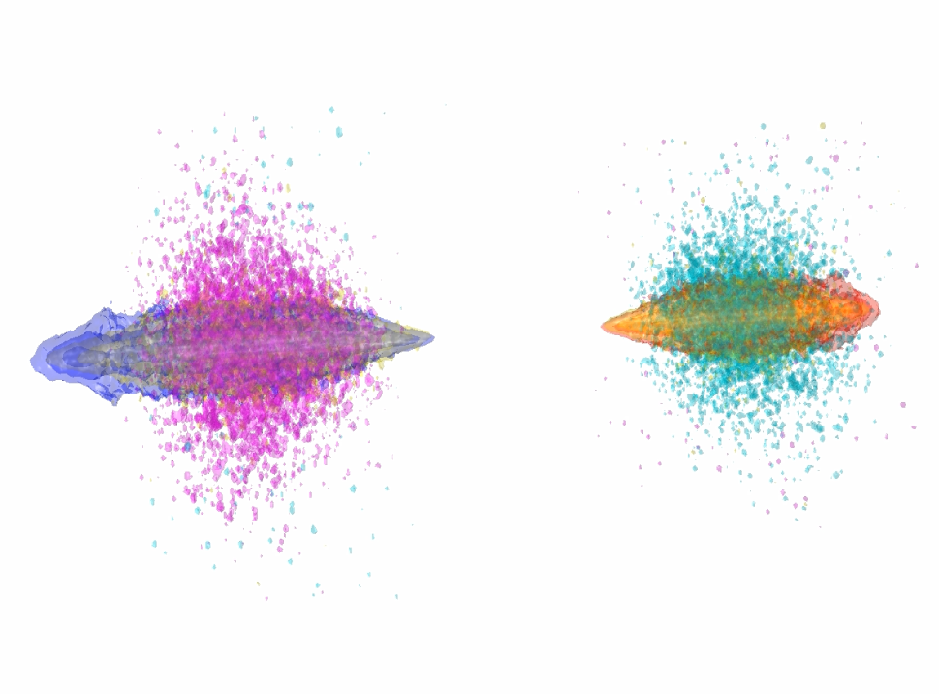
Beam-Beam Interaction Point
Alexander Pukhov & Tom Wilson
Heinrich-Heine-University Dusseldorf
John Farmer
CERN & MPI Physics

Slide 2
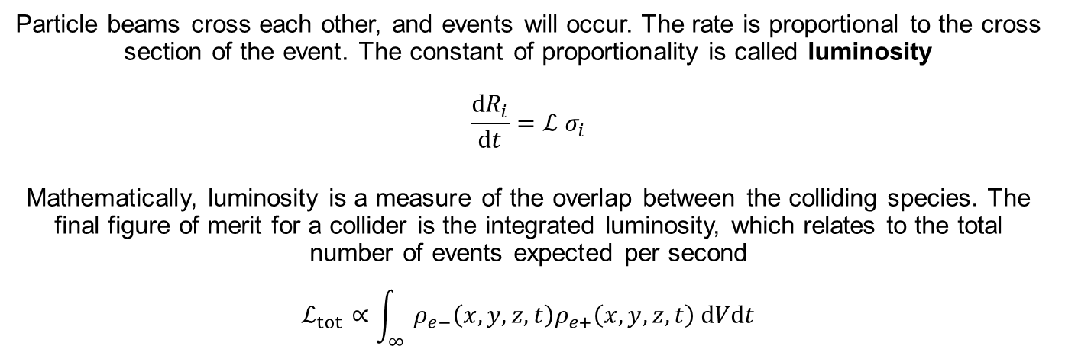
Particle colliders
e⁻
e⁺
Particle beams cross each other, and events will occur. The rate is proportional to the cross section of the event. The constant of proportionality is called luminosity
$$\frac{dR_{i}}{dt}=ℒ σ_{i}$$
Mathematically, luminosity is a measure of the overlap between the colliding species. The final figure of merit for a collider is the integrated luminosity, which relates to the total number of events expected per second
$$ℒ_{tot}∝\int_{∞}{ρ_{e−}\left(x,y,z,t\right)ρ_{e+}\left(x,y,z,t\right) dVdt}$$

Slide 3
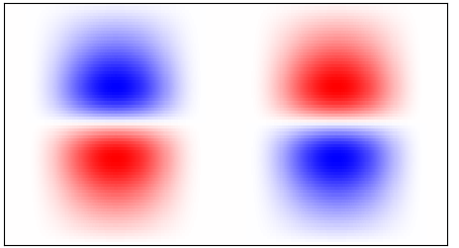
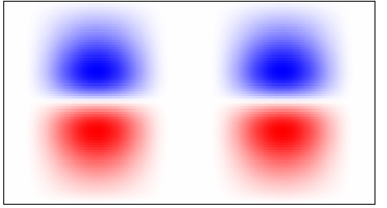
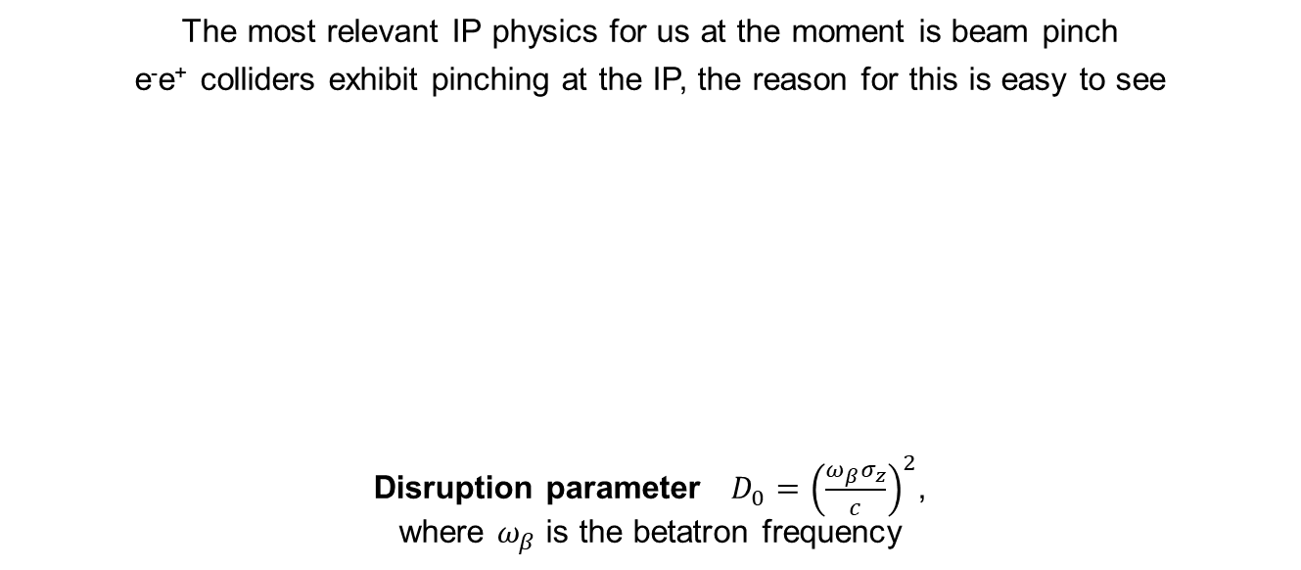
Pinch & disruption
The most relevant IP physics for us at the moment is beam pinch
e⁻e⁺ colliders exhibit pinching at the IP, the reason for this is easy to see
Disruption parameter $D_{0}={\left(\frac{ω_{β}σ_{z}}{c}\right)}^{2}$,
where $ω_{β}$ is the betatron frequency
E_{y}
B_{z}
e⁻
e⁺
e⁻
e⁺

Slide 4
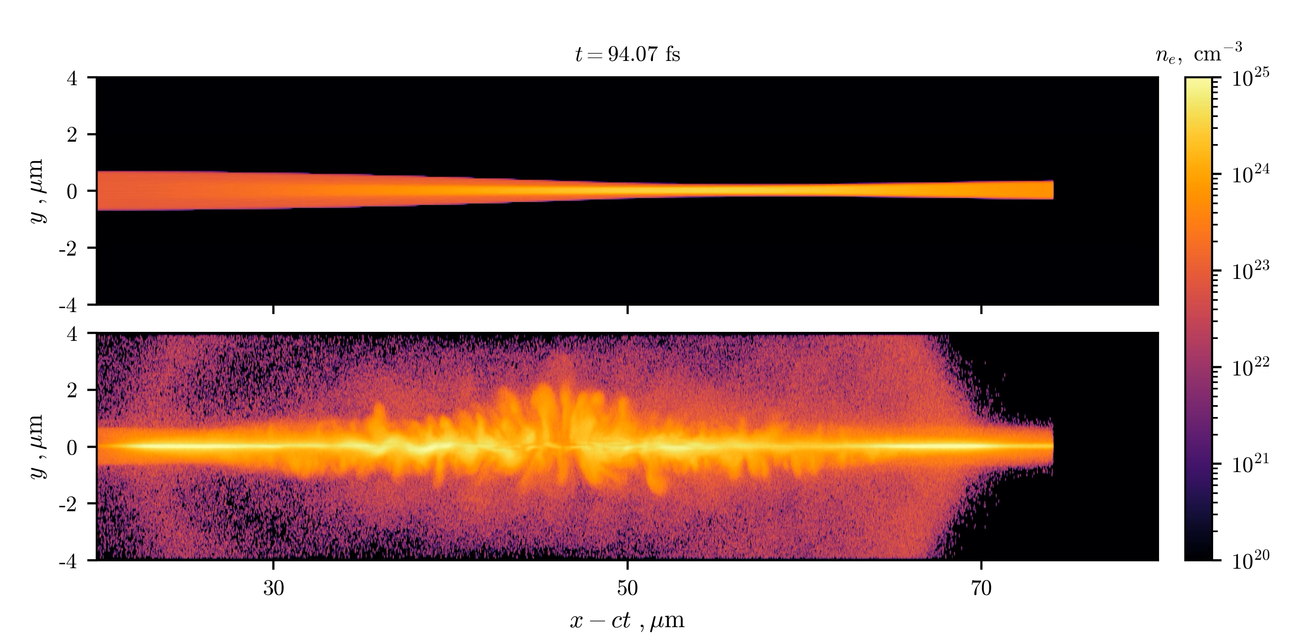
Beamstrahlung-enhanced disruption
Collision of two cylindrical beams (Movie)
QED off
QED on
A. Samsonov et al., NJP 23, 103040 (2021)

Slide 5
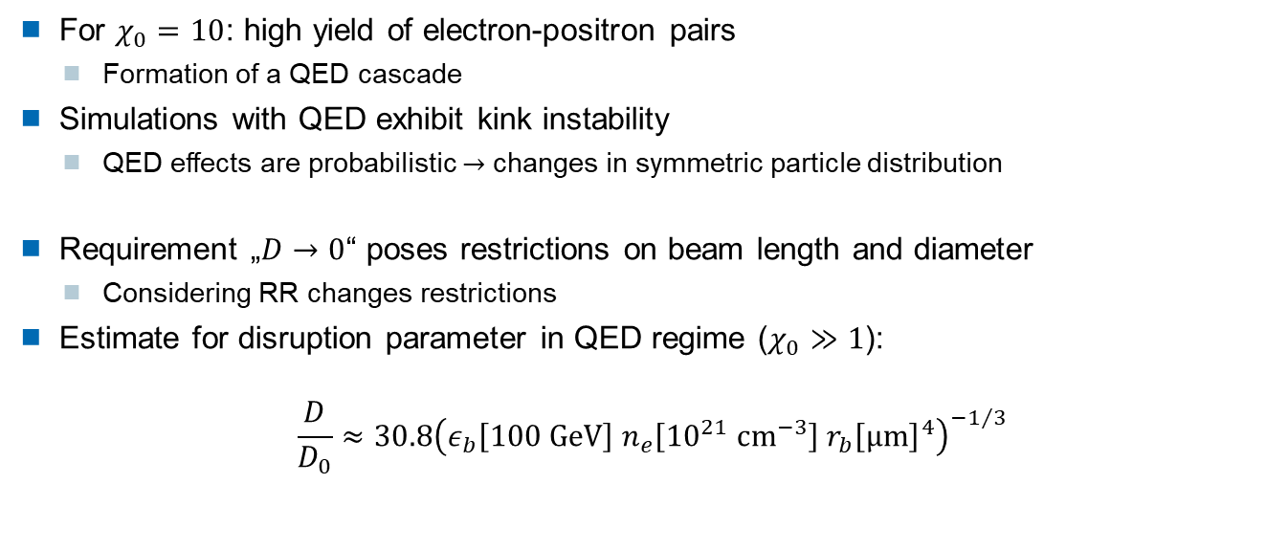
Beamstrahlung-enhanced disruption
Results
For $χ_{0}=10$: high yield of electron-positron pairs
  Formation of a QED cascade
Simulations with QED exhibit kink instability
  QED effects are probabilistic $→$ changes in symmetric particle distribution
Requirement „$D→0$“ poses restrictions on beam length and diameter
  Considering RR changes restrictions
Estimate for disruption parameter in QED regime ($χ_{0}≫1$):
$$\frac{D}{D_{0}}≈30.8{\left(ε_{b}\left[100 GeV\right]{ n}_{e}\left[{10}^{21} cm^{−3}\right] r_{b}{\left[μm\right]}^{4}\right)}^{−1/3}$$
A. Samsonov et al., NJP 23, 103040 (2021)

Slide 6
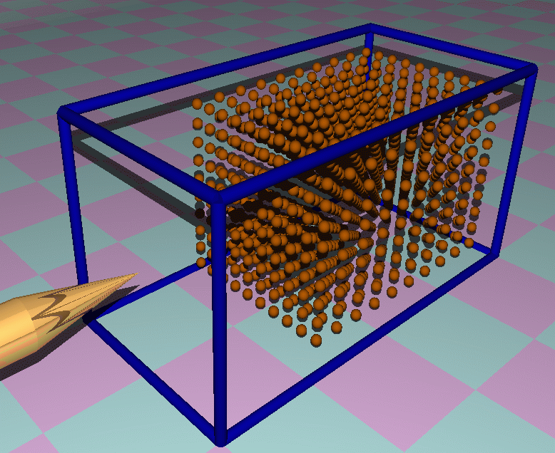
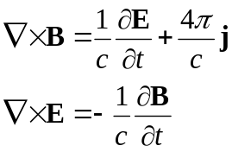
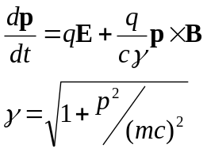
Virtual Laser Plasma Lab
A. Pukhov, J. Plasma Phys. 61, 425 (1999); CERN Yellow Reports (2016)
Plasma or neutral gas
Gas of an arbitrary element can be used.
Fields
Advanced physics & numerics
Inelastic processes
Radiation damping
QED effects
hybrid hydro model
quasi-static approximation
Galilean boost
Particles

Slide 7
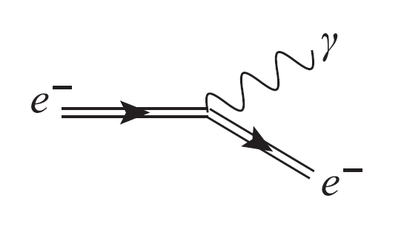
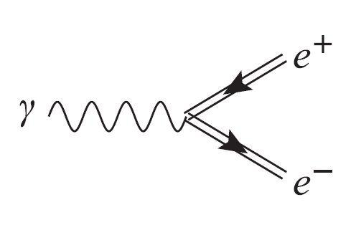
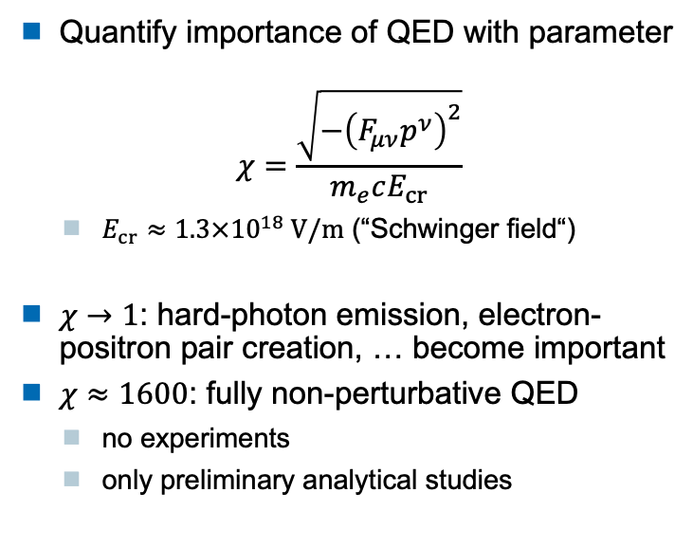
Quantum electrodynamics (QED)
Quantify importance of QED with parameter
$$χ=\frac{\sqrt{−{\left(F_{μν}p^{ν}\right)}^{2}}}{m_{e}cE_{cr}}$$
  $E_{cr}≈1.3×{10}^{18} V/m$ (“Schwinger field“)
$χ→1$: hard-photon emission, electron-positron pair creation, … become important
$χ≈1600$: fully non-perturbative QED
  no experiments
  only preliminary analytical studies
Photon emission
Pair production
V. Ritus, Ann. Phys. 69, 555 (1972)
V. Yakimenko et al., PRL 122, 190404 (2019)

Slide 8
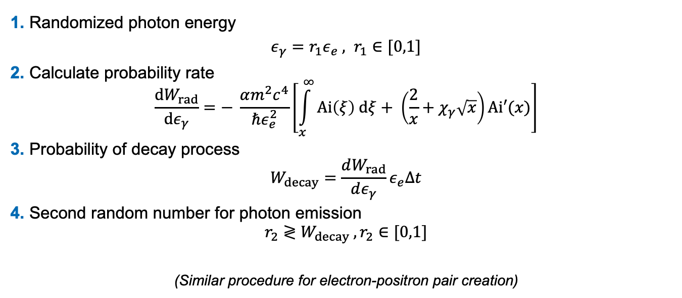
Modeling QED effects
Monte-Carlo QED loop (Photon emission)
1. Randomized photon energy
$ε_{γ}=r_{1}ε_{e} , r_{1}∈[0,1]$
2. Calculate probability rate
$$\frac{dW_{rad}}{dε_{γ}}=− \frac{αm^{2}c^{4}}{ℏε_{e}^{2}}\left[\int_{x}^{∞}{Ai\left(ξ\right) dξ+ \left(\frac{2}{x}+χ_{γ}\sqrt{x}\right)Ai′(x)}\right]$$
3. Probability of decay process
$$W_{decay}=\frac{dW_{rad}}{dε_{γ}}ε_{e}Δt$$
4. Second random number for photon emission
$$r_{2}≷W_{decay} , r_{2}∈[0,1]$$
(Similar procedure for electron-positron pair creation)
N. Elkina, PRAB 14, 054401 (2011)

Slide 9
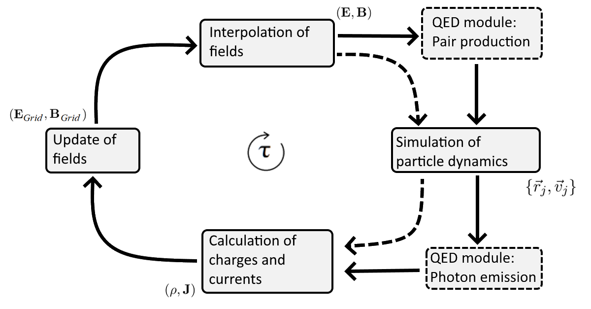
Modeling QED effects in VLPL
Modified PIC cycle

Slide 10
Maxwell Solvers in VLPL
Full EM solvers
Special solvers
Yee
RIP
iRIP
GEM
Quasi-static
Static
Universal
Isotropic
Overdense plasmas
No numerical Cerenkov
LWFA
Implicit RIP
high transverse resolution
Galilean boost
for LWFA
Beam-driven
PWFA
Beam-beam
IP

Slide 11
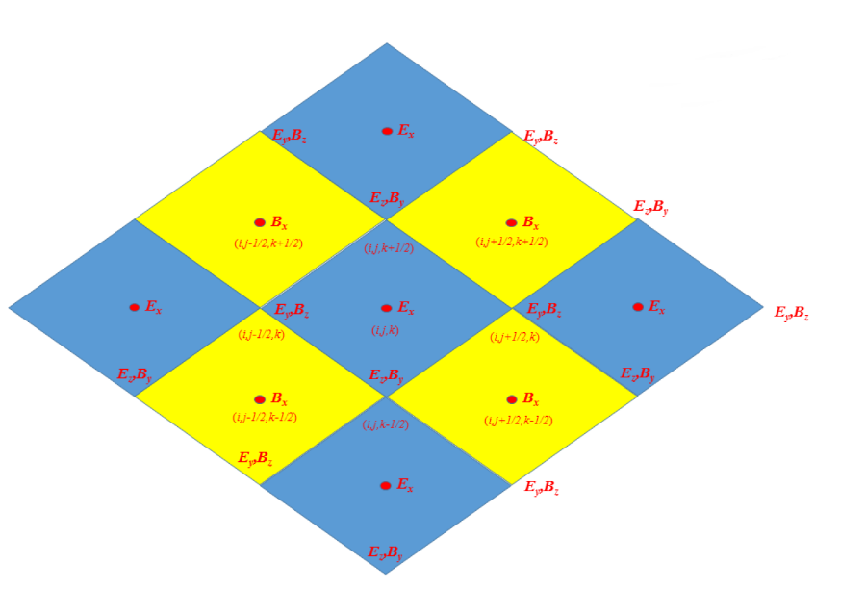
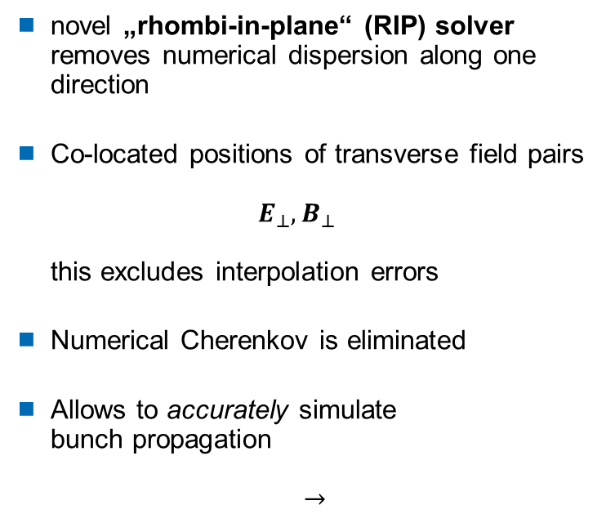
Removing Numerical Cherenkov Instability
A. Pukhov, J. Comp. Phys. 418, 109622 (2020)
novel „rhombi-in-plane“ (RIP) solver
removes numerical dispersion along one direction
Co-located positions of transverse field pairs
$E_{⊥},B_{⊥}$
this excludes interpolation errors
Numerical Cherenkov is eliminated
Allows to accurately simulate
bunch propagation
$$→$$

Slide 12
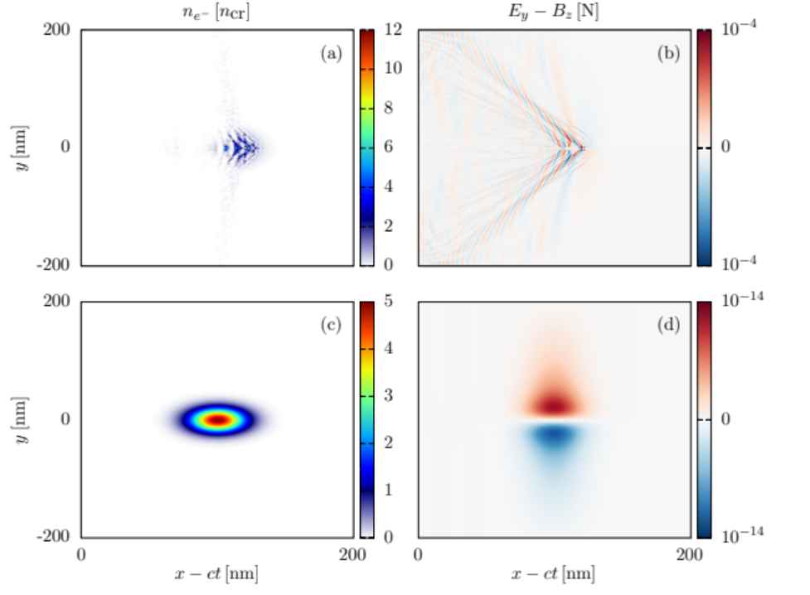
VLPL vs Yee solvers
Ultra-relativistic electron bunch moving in vacuum
M. Filipovic et al., PRAB 25, 054405 (2022)
Yee solver:
full NCI
VLPL solver:
stable

Slide 13
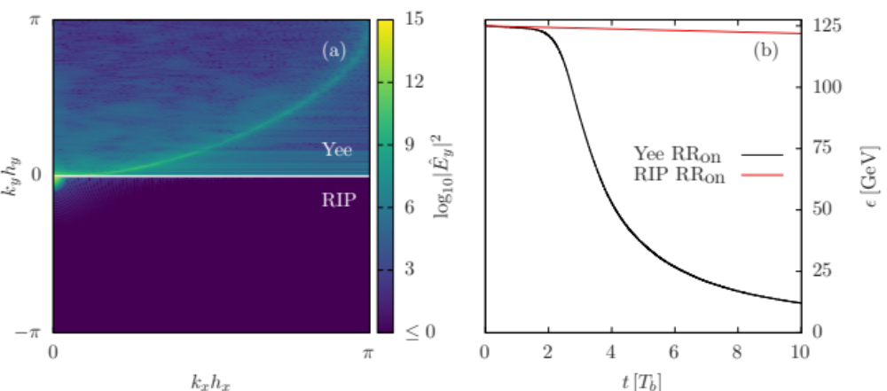
VLPL vs Yee solver
Fourier transform
Radiative energy loss
Yee solver:
full NCI
VLPL solver:
stable
Radiative losses using the Yee solver
NCI effectively suppressed for the RIP solver
M. Filipovic et al., PRAB 25, 054405 (2022)

Slide 14
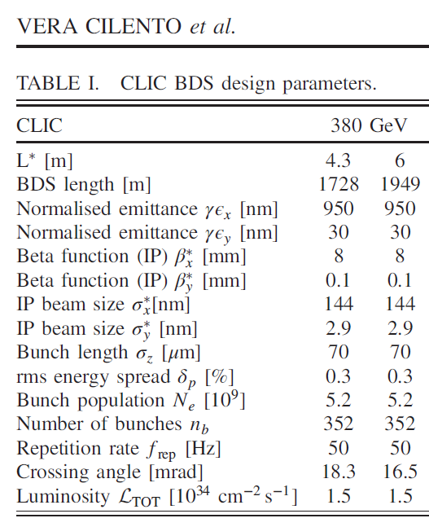
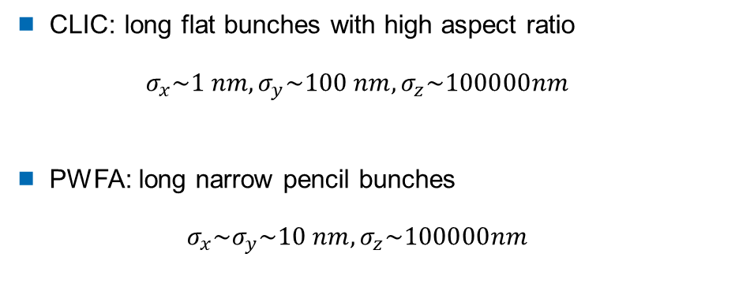
Typical CLIC and PWFA bunches
Phys. Rev. Accel. Beams 24, 071001
CLIC: long flat bunches with high aspect ratio
$σ_{x}\sim 1 nm,σ_{y}\sim 100 nm,σ_{z}\sim 100000nm$
PWFA: long narrow pencil bunches
$σ_{x}\sim σ_{y}\sim 10 nm,σ_{z}\sim 100000nm$
It is extremely challenging to simulate these bunch with full EM PIC codes

Slide 15
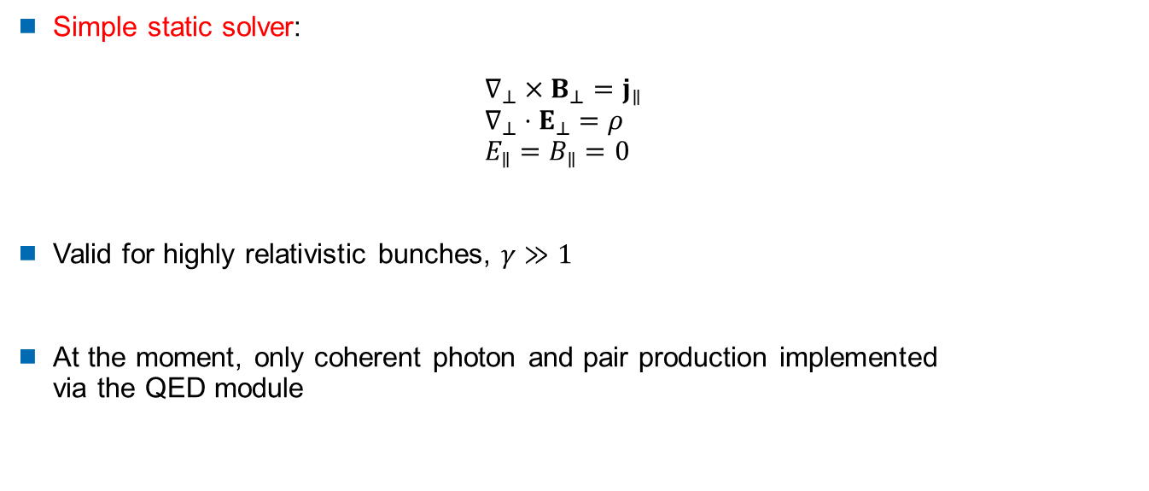
Beam-Beam IP Simulations
Simple static solver:
$∇_{⊥}×B_{⊥}=j_{∥}$
$∇_{⊥}⋅E_{⊥}=ρ$
$E_{∥}=B_{∥}=0$
Valid for highly relativistic bunches, $γ≫1$
At the moment, only coherent photon and pair production implemented
via the QED module

Slide 16
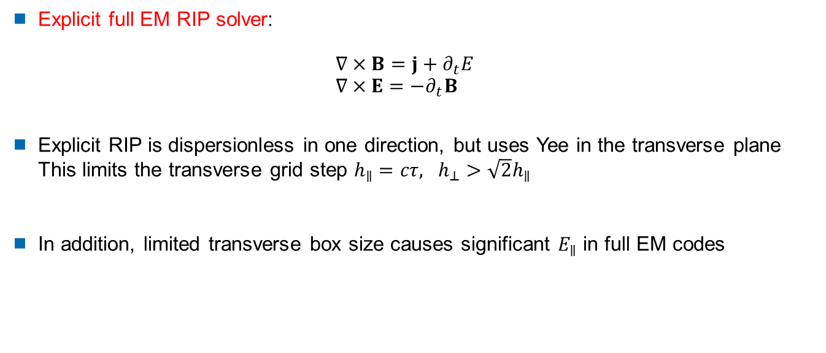
Beam-Beam IP Simulations
Explicit full EM RIP solver:
$∇×B=j+∂_{t}E$
$∇×E=−∂_{t}B$
Explicit RIP is dispersionless in one direction, but uses Yee in the transverse plane
This limits the transverse grid step $h_{∥}=cτ, h_{⊥}>\sqrt{2}h_{∥}$
In addition, limited transverse box size causes significant $E_{∥}$ in full EM codes

Slide 17
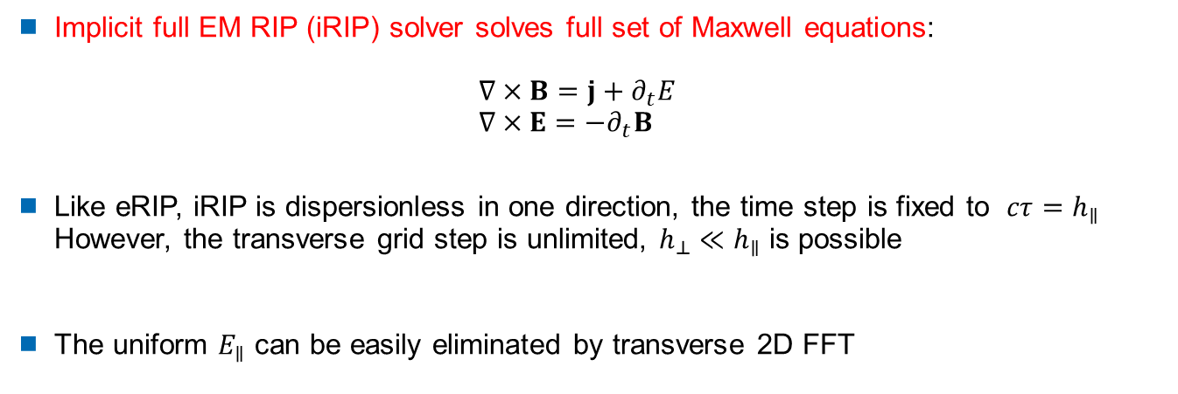
Beam-Beam IP Simulations
Implicit full EM RIP (iRIP) solver solves full set of Maxwell equations:
$∇×B=j+∂_{t}E$
$∇×E=−∂_{t}B$
Like eRIP, iRIP is dispersionless in one direction, the time step is fixed to $cτ=h_{∥}$
However, the transverse grid step is unlimited, $h_{⊥}≪h_{∥}$ is possible
The uniform $E_{∥}$ can be easily eliminated by transverse 2D FFT

Slide 18
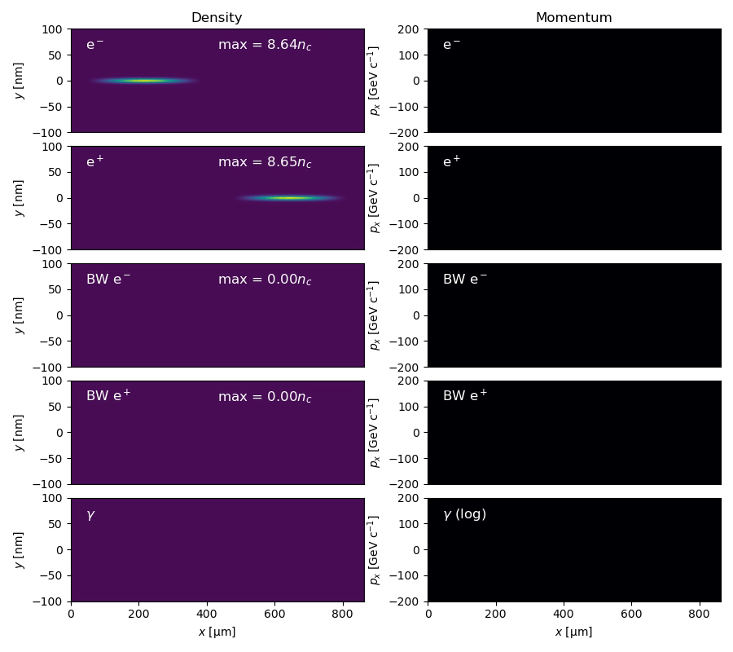
CLIC-like parameters
  x-size σ_{x} = 2.9 nm
  y-size σ_{y} = 144 nm
  Longitudinal size σ_{z} = 70 μm
  Population 4.4x10⁹ (0.7 nC)
  x-emittance ε_{x} = 30 nm
  y-emittance ε_{y} = 950 nm
  Energy 190 GeV (γ ~ 370000)
The same problem was simulated
by GuineaPig++ and static VLPL

Slide 19
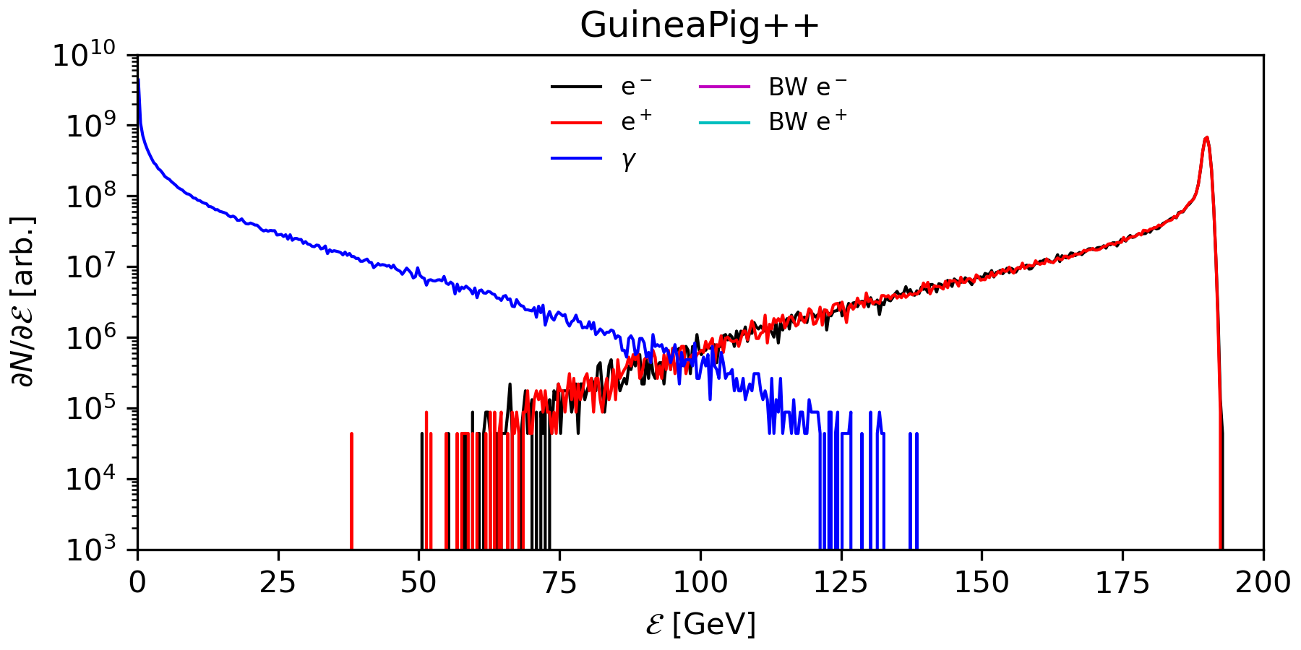
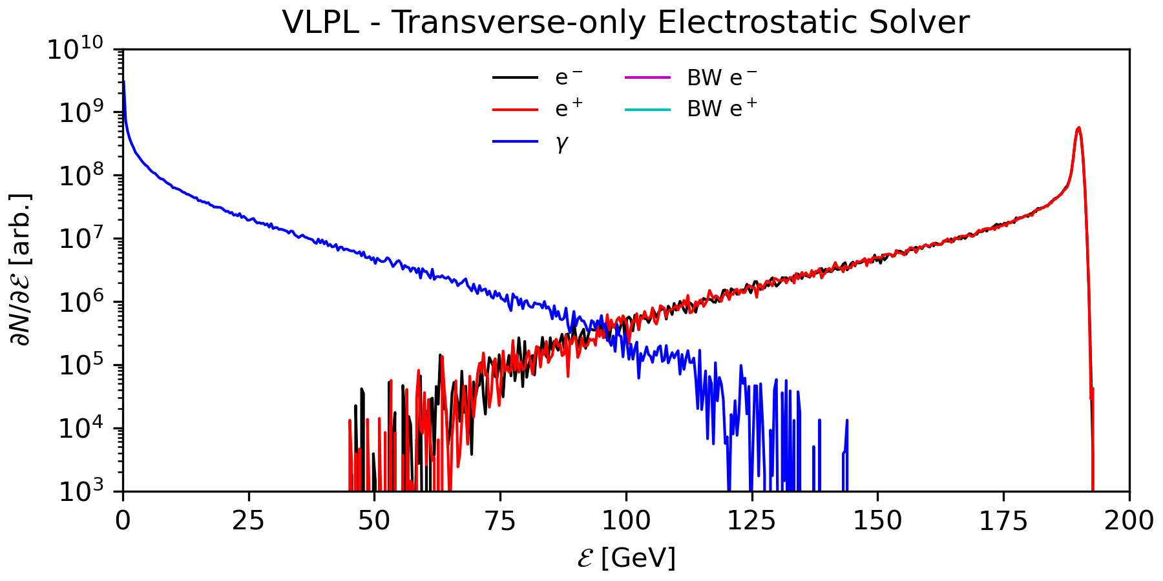
CLIC-like parameters
  x-size σ_{x} = 2.9 nm
  y-size σ_{y} = 144 nm
  Longitudinal size σ_{z} = 70 μm
  Population 4.4x10⁹ (0.7 nC)
  x-emittance ε_{x} = 30 nm
  y-emittance ε_{y} = 950 nm
  Energy 190 GeV (γ ~ 370000)
The same problem was simulated
by GuineaPig++ and static VLPL

Slide 20
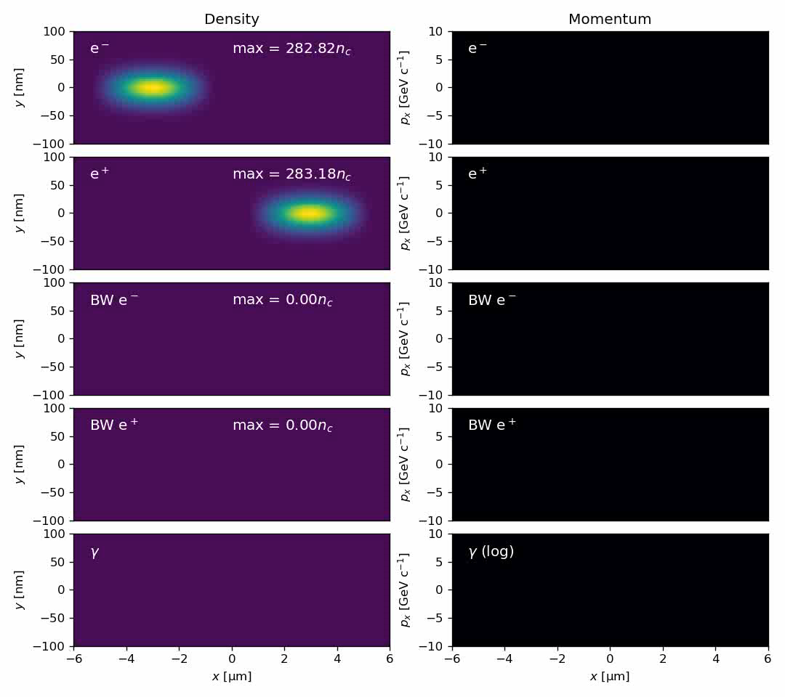
Test case with a short bunch
  x-size σ_{x} = 20 nm
  y-size σ_{y} = 20 nm
  Longitudinal size σ_{z} = 1 μm
  Population 2x10⁹ (0.3 nC)
  x-emittance ε_{x} = 100 nm
  y-emittance ε_{y} = 100 nm
  Energy 8 GeV (γ ~ 15000)
The same problem was simulated
by GuineaPig++ and VLPL
using two different Maxwell solvers

Slide 21
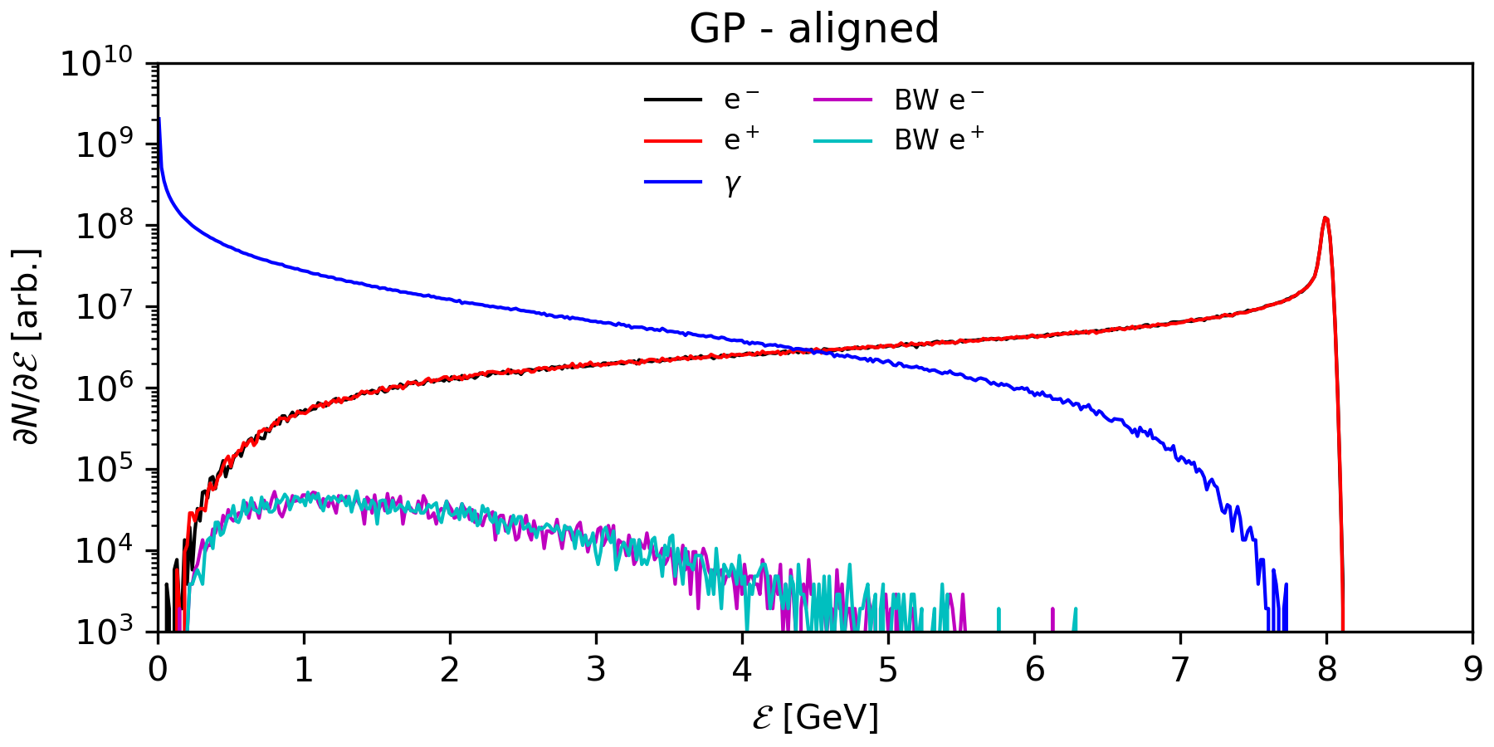
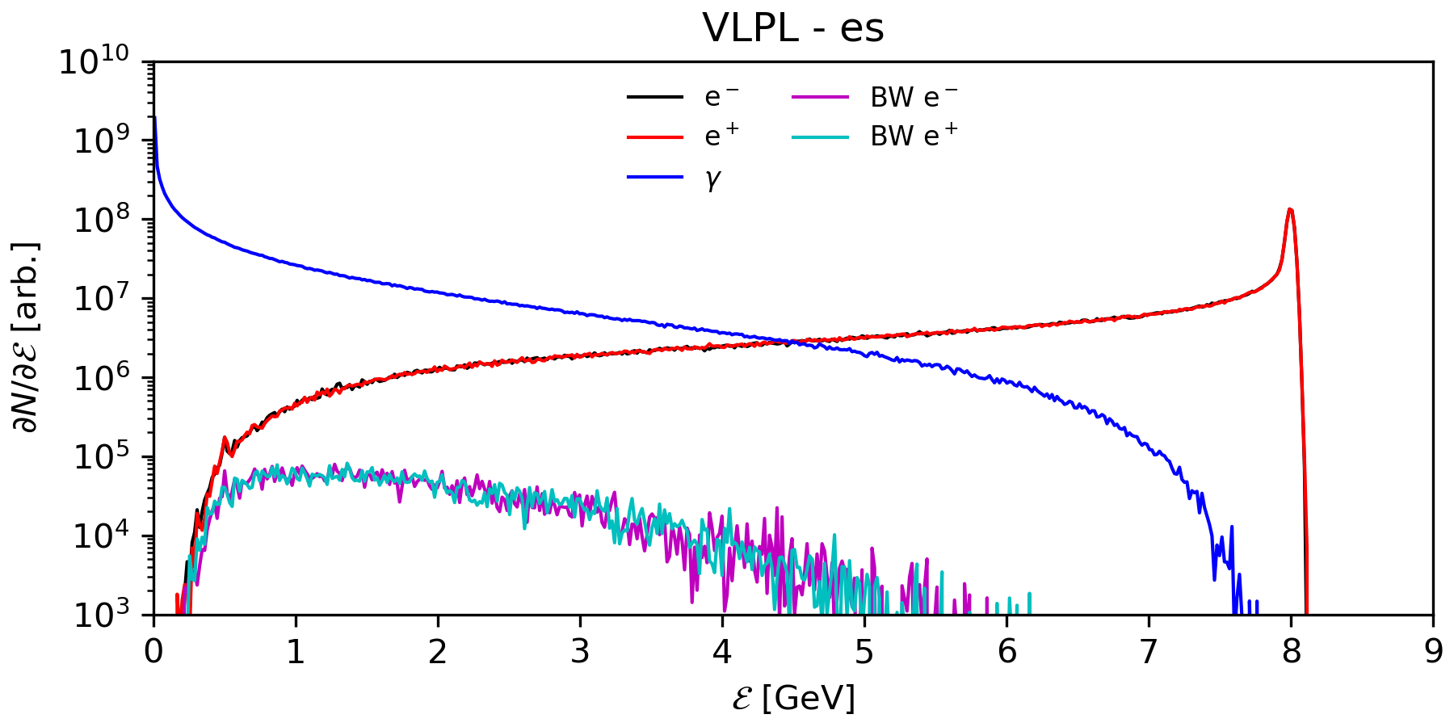
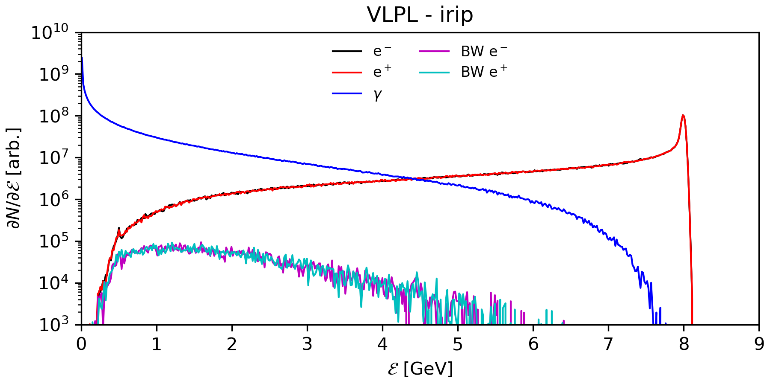
Test case with a short bunch
All 3 results compare very well
Question:
when do we need
full electromagnetic simulations?

Slide 22
Full EM vs Static Simulations
Assume sharp transverse
bunch displacement
Static code:
instantaneous field response
Full EM code:
retarded self-fields
Bunch self-fields
Bunch self-fields

Slide 23
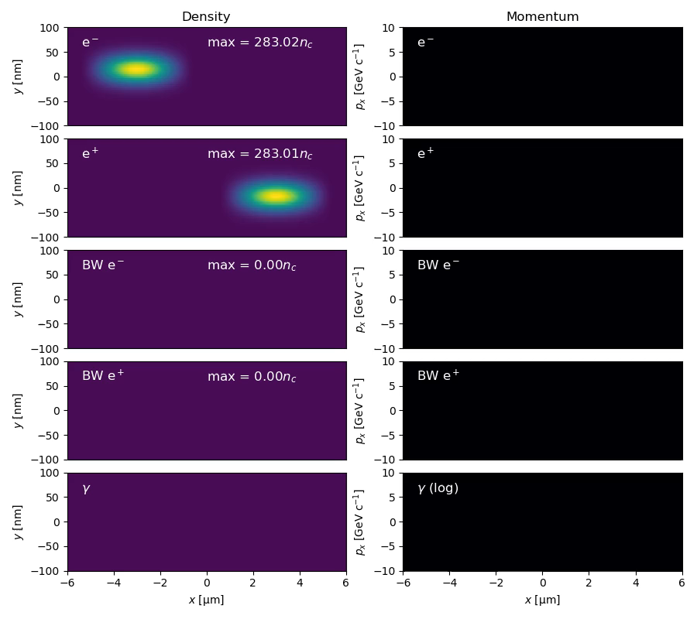
Offset short bunches
  x-size σ_{x} = 20 nm
  y-size σ_{y} = 20 nm
  Longitudinal size σ_{z} = 1 μm
  Population 2x10⁹ (0.3 nC)
  x-emittance ε_{x} = 100 nm
  y-emittance ε_{y} = 100 nm
  Energy 8 GeV (γ ~ 15000)
  Offset Δx = 2.5 σ_{x}
The same problem was simulated
by GuineaPig++ and VLPL
using two different Maxwell solvers

Slide 24
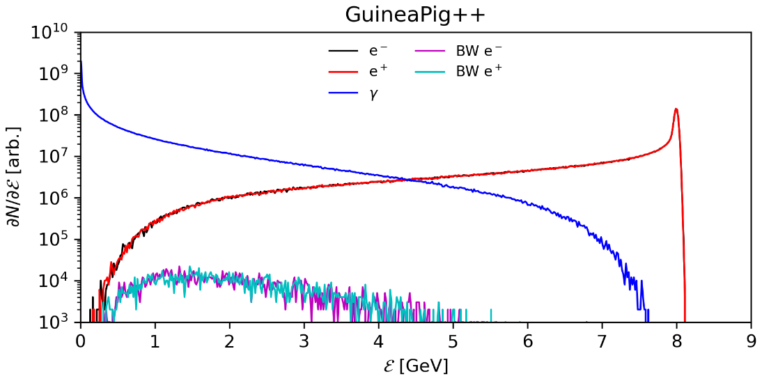
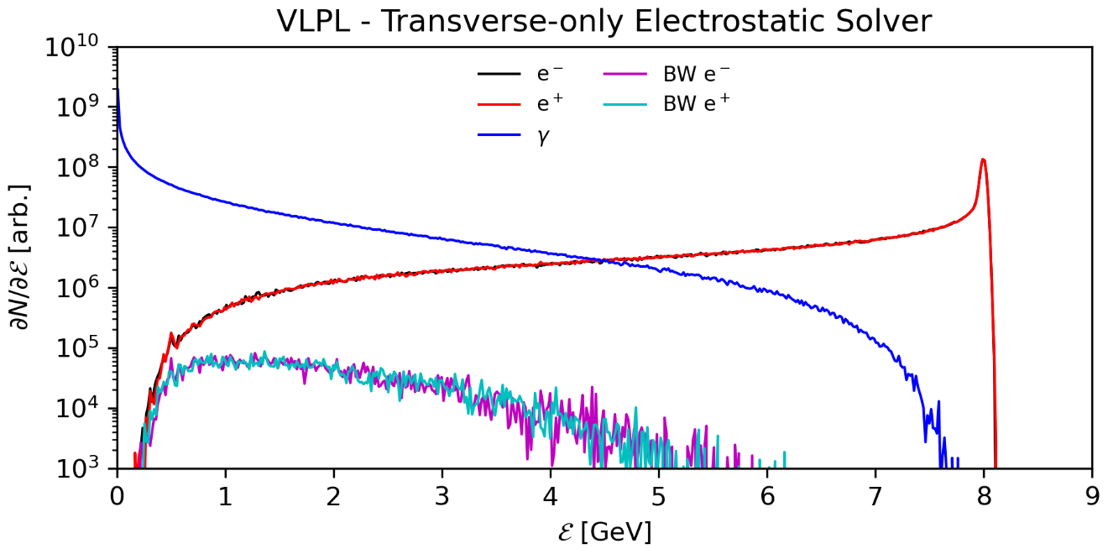
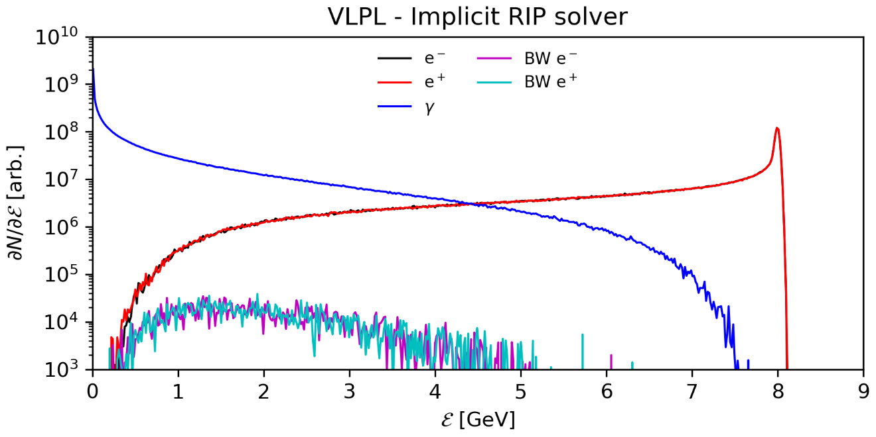
Offset short bunches
All 3 results compare well.
Small differences can be seen
between them, especially
in the Breit-Wheeler pair spectra
Coherent pair-production seems
especially sensitive
to proper representation of the fields
at the IP and the initial
space-charge field distribution

Slide 25
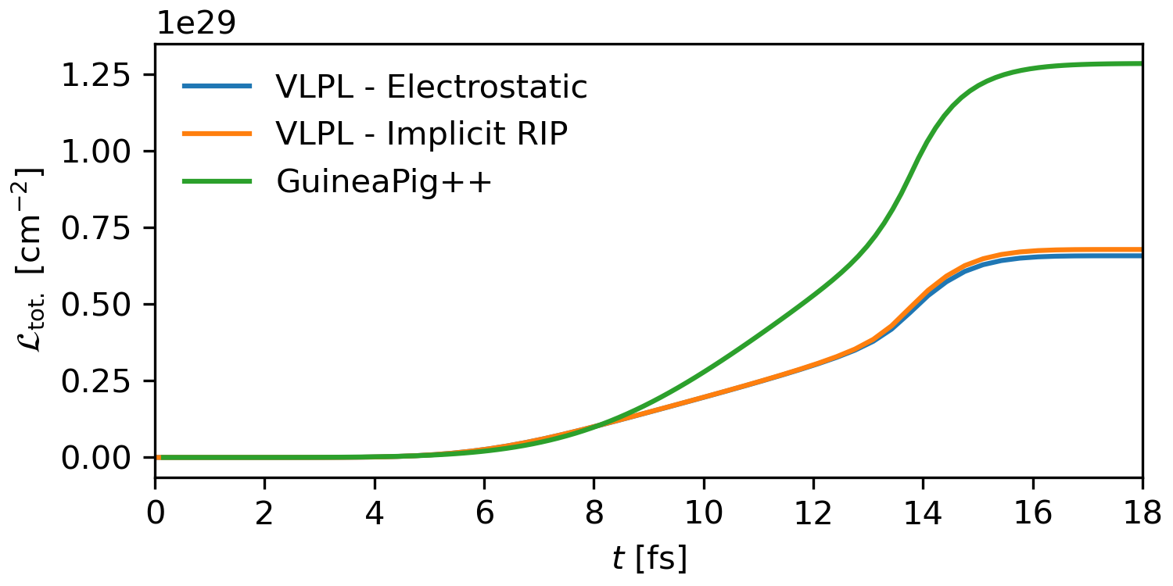
Luminosity test case
We have difference
roughly factor 2
between GuineaPIG++
and VLPL
Looking for the cause

Slide 26
Conclusion
GuineaPIG++ and VLPL were compared and a good agreement achieved
In most relevant cases static approximation works good
VLPL has a new implicit RIP Maxwell solver
It allows to simulate beam-beam IP in full electromagnetic approximation
Samsonov & Pukhov arXiv:2409.09131 (2024)

