Slide 1
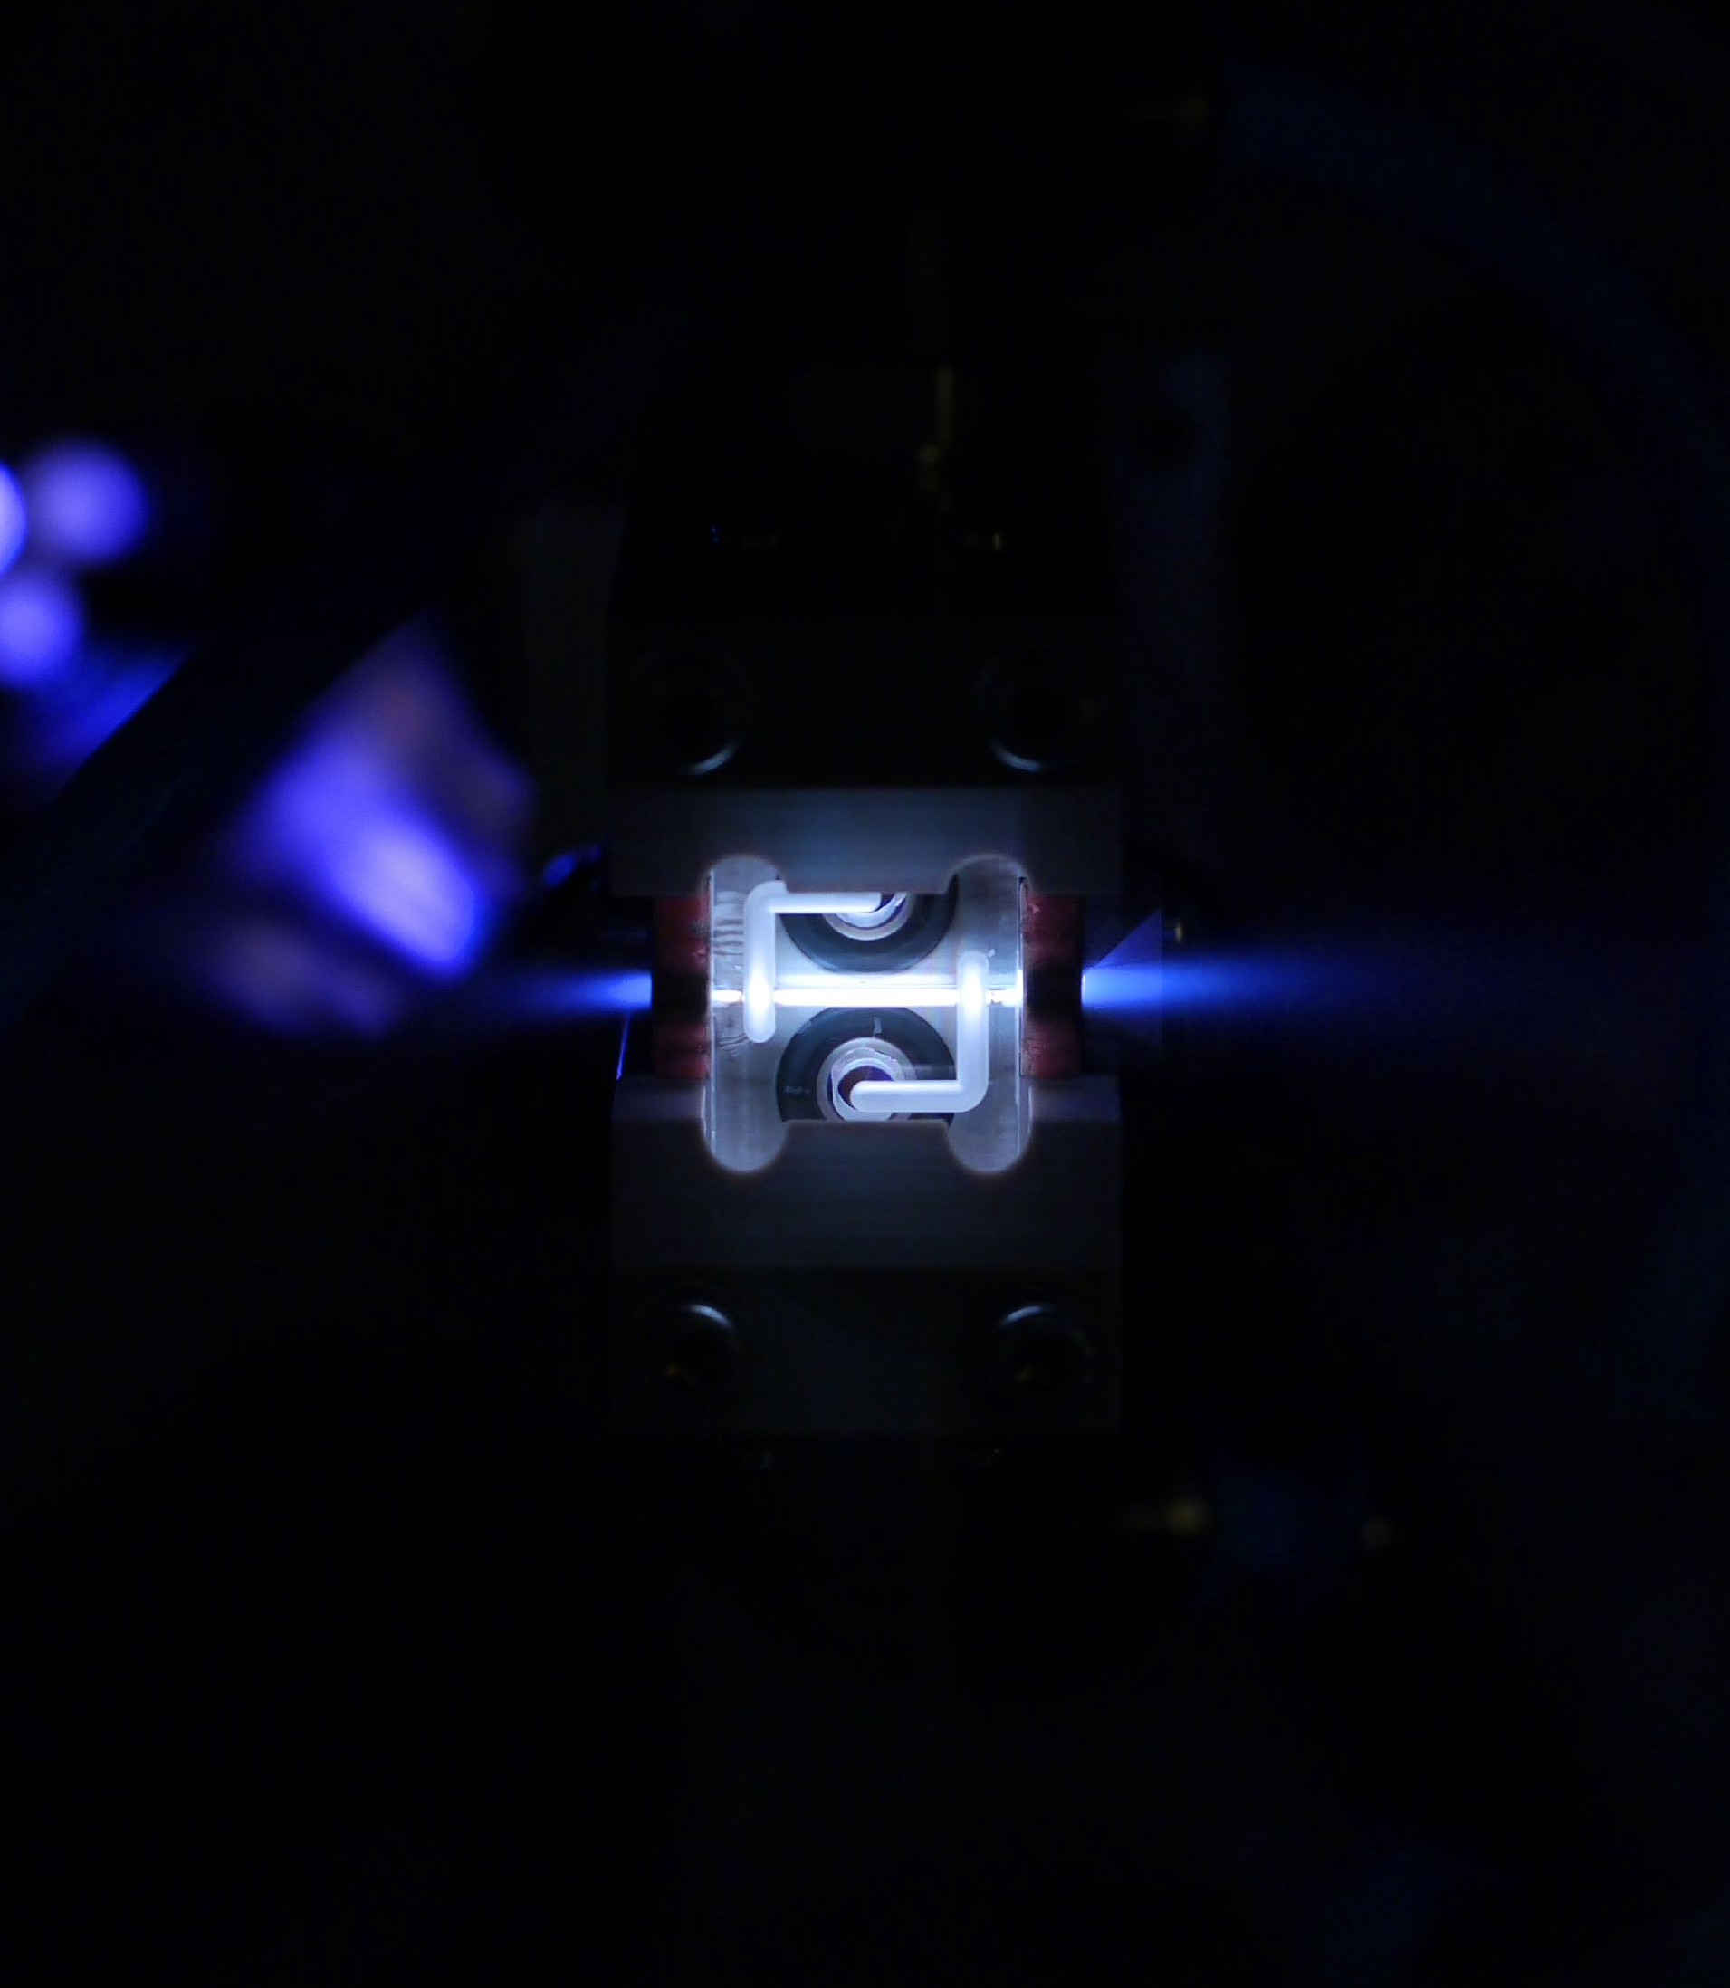



Betatron Radiation and Self-Corrected Energy Spread in Plasma-Wakefield Accelerators
Student lunch meeting
Daniel Kalvik
Department of Physics, University of Oslo
07.05.2025

Slide 2
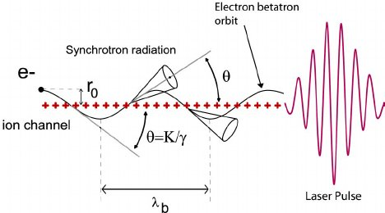
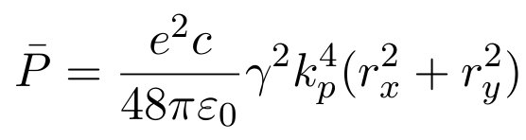
The radiation reaction
background
As the charged particles oscillates in the plasma wake, it emits radiaiton.
The radiated power (averaged over 1 period) is
Since the particles have different amplitudes, they will radiate differently, causing energy-spread in the beam.
Both energy-loss and energy-spread is very important to handle in high-energy cases.
Ta, Phuoc & Burgy, frédéric & Rousseau, Jean-Philippe & Malka, Victor & Rousse, Antoine & Shah, Rahul & Umstadter, Donald & Pukhov, A. & Kiselev, Sergei. (2005). Laser based synchrotron radiation. Physics of Plasmas. 12. 10.1063/1.1842755.
07.05.2025 | Daniel Kalvik | student lunch meeting
Page

Slide 3
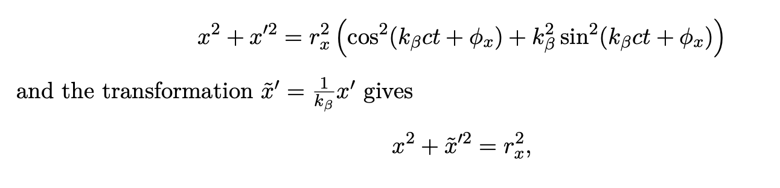
Finding the radiated power
The analytical approach
Since the radiated power is dependant on amplitude, we need to know what this amplitude is
This is useful if we have the distribution in x and x´
07.05.2025 | Daniel Kalvik | student lunch meeting
Page

Slide 4
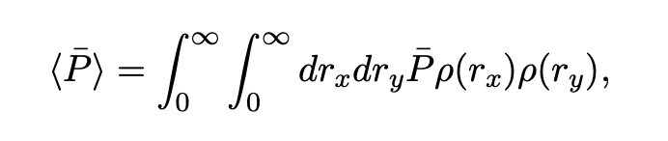
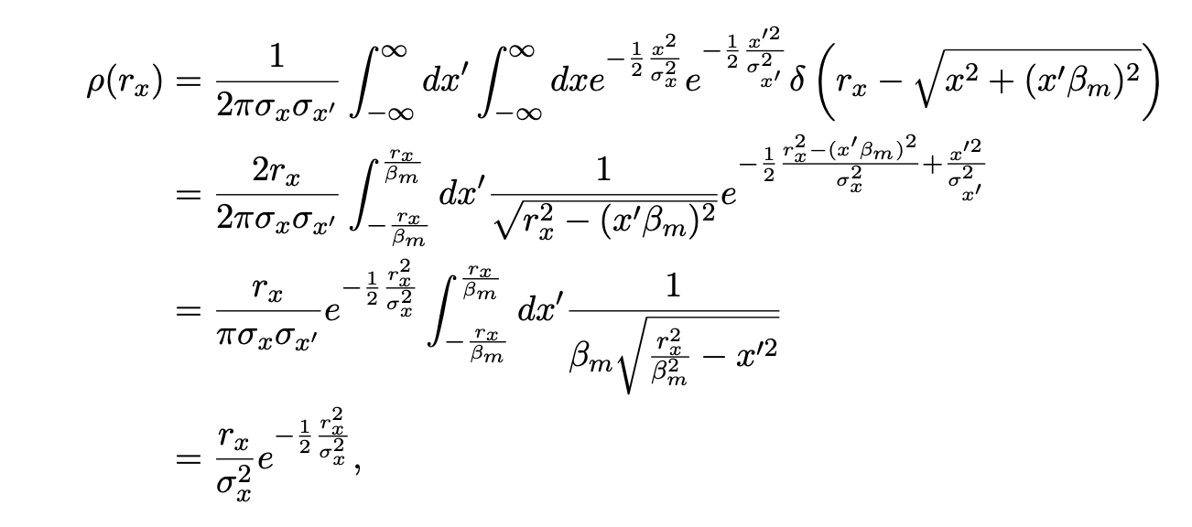
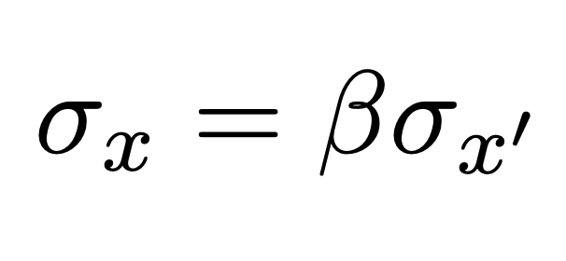
Finding the radiated power
The analytical approach
Simply have to integrate over the distribution of amplitudes in x and y
To find the distributions, we assume to know the distributions in x/x´ and y/y´, (matched beam)
Then the method of finding the distribution is simply to integrate with the correct delta-function.
07.05.2025 | Daniel Kalvik | student lunch meeting
Page

Slide 5
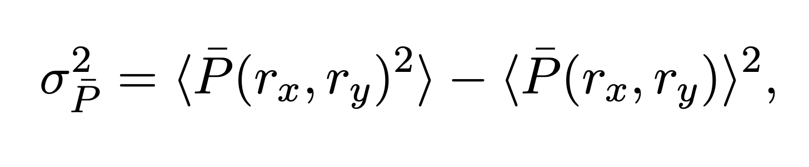
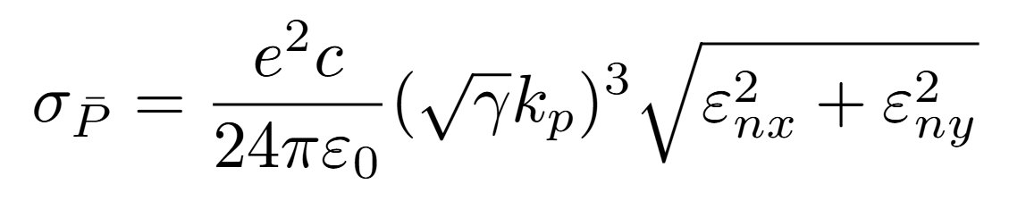
What is the energy spread?
Same approach
Since we are also interested in finding the energy spread, we do the same, but to the second moment of the radiated energy
This gives the expression for the spread in radiated energy
07.05.2025 | Daniel Kalvik | student lunch meeting
Page

Slide 6
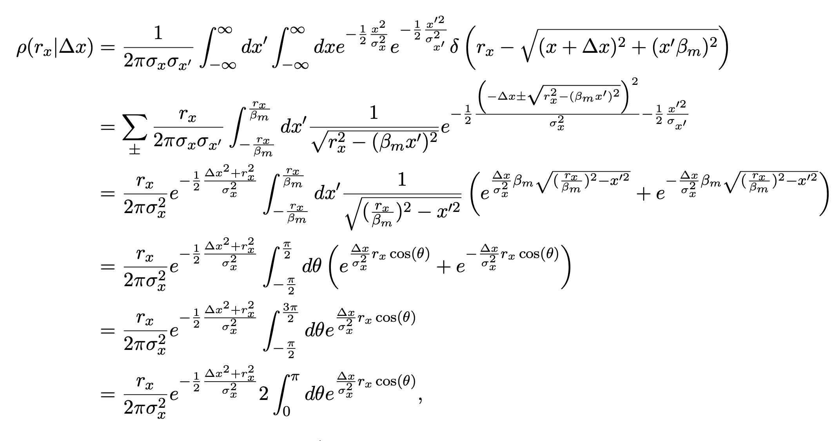
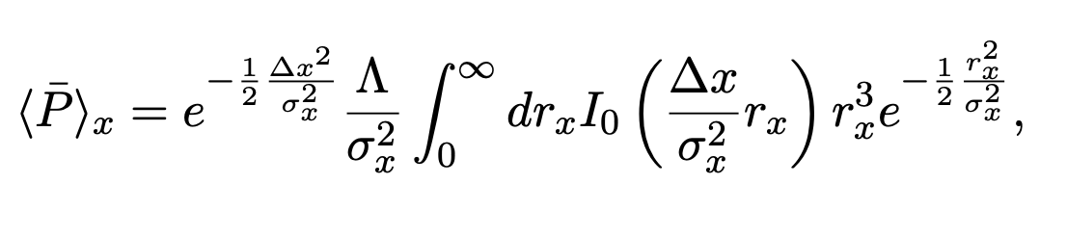
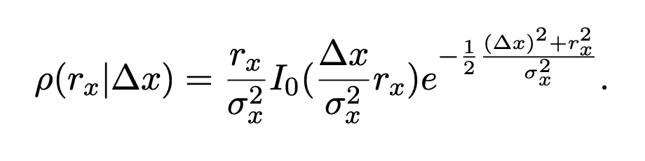
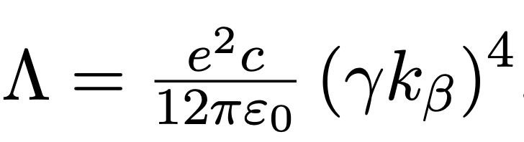
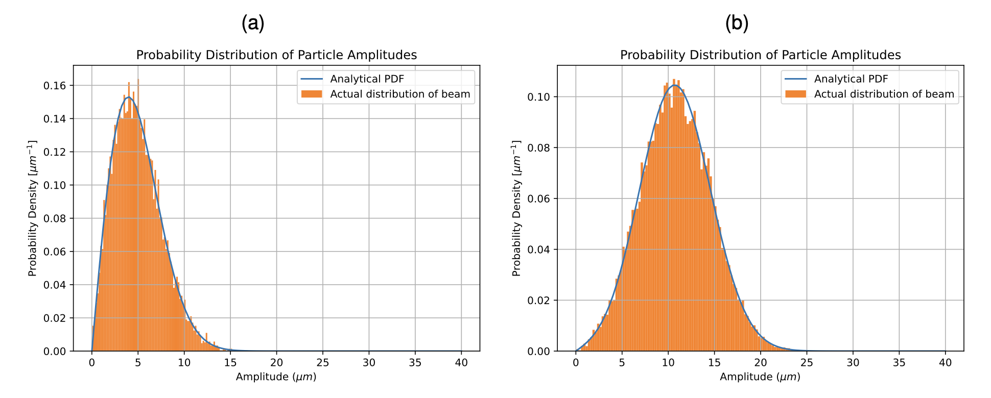
How about offsets?
Exactly the same method as previously
Using this expression for the distribution of particle amplitudes, given an offset. We can calculate the energy loss.
07.05.2025 | Daniel Kalvik | student lunch meeting
Page

Slide 7
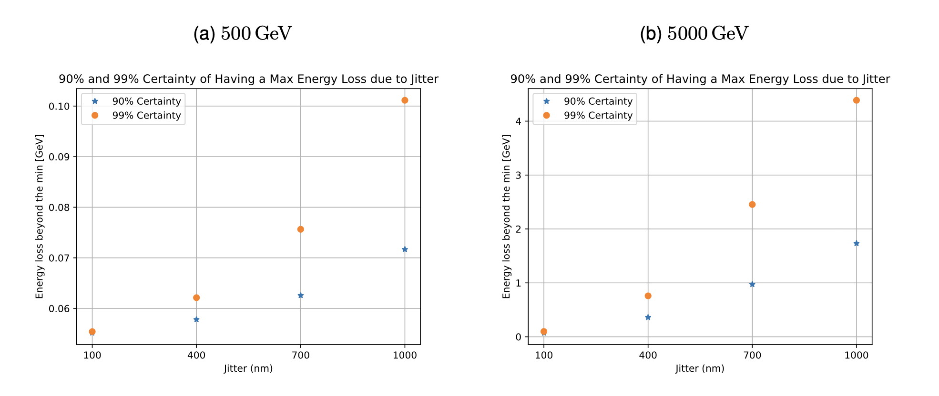
The effects of the offsets
Accounting for transverse jitter
You will have a varying amount of energy between each shot
Since the final focusing in a collider is tuned to a specific energy, this will affect the luminosity.
The width of the jitter distribution around 0
The maximum energy loss (beyond what you get with no offset) with a 90/99% certainty
07.05.2025 | Daniel Kalvik | student lunch meeting
Page

Slide 8
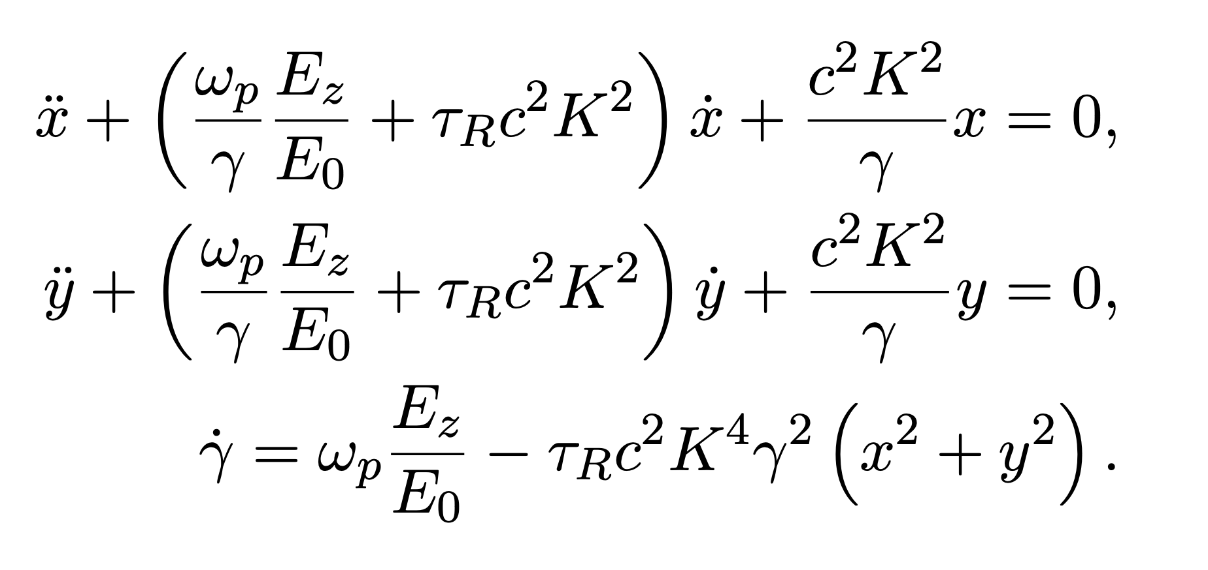
Numerical methods
Subheading
To model the dynamics of the beam, we need to solve the set of equations given in Deng et. al.
These are derived treating the radiaiton reaction as a perturbation.
The energy evolution is a bit stiff
07.05.2025 | Daniel Kalvik | student lunch meeting
Page

Slide 9
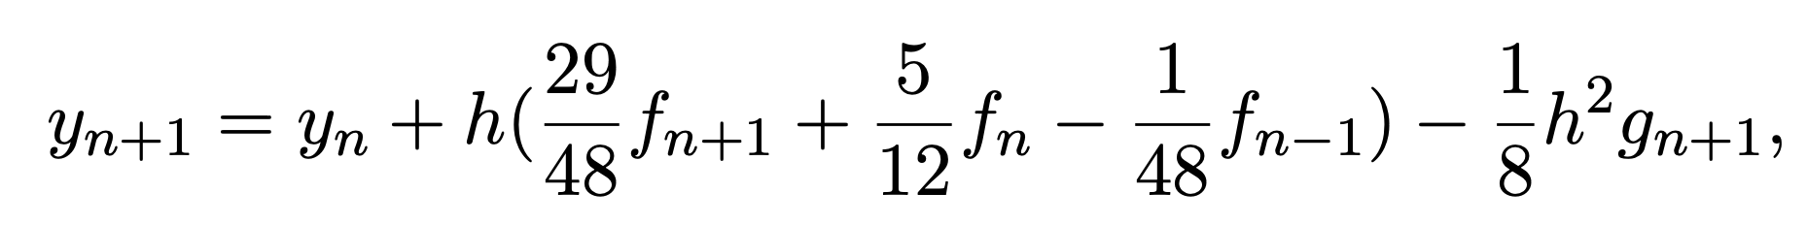
Accounting for the stiffness
Using a multistep method with a nonlinear correction
This uses an off-centered difference scheme for the first derivative, but also includes the second derivative when pushing the particles positions and velocities.
g is found by taking the derivative of the diff. eqs.
07.05.2025 | Daniel Kalvik | student lunch meeting
Page

Slide 10
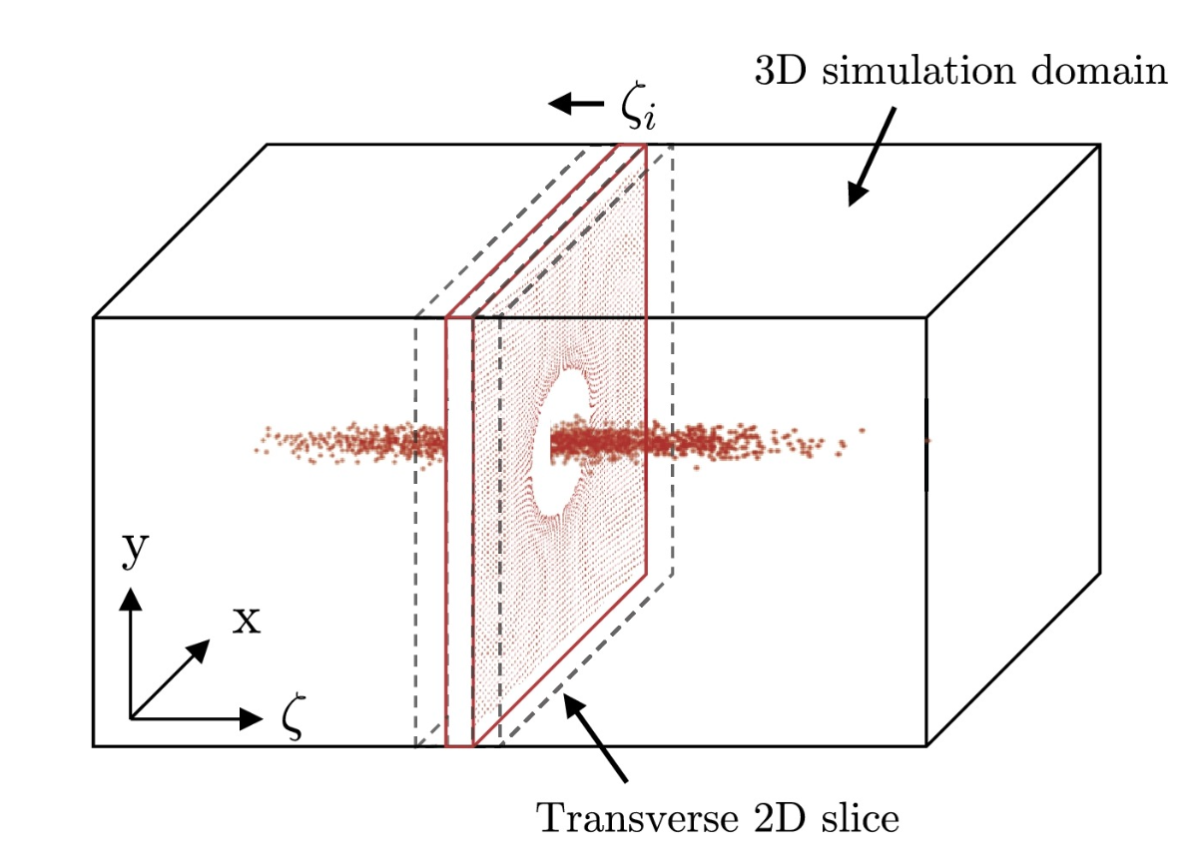
Benchmarking
Using HiPACE++
HiPACE++ is quasi-static code that includes the radiation reaction.
It runs on Nvidia and AMD GPUs
HiPACE++ keeps the beam stationary, while pushing the plasma particles backwards.
07.05.2025 | Daniel Kalvik | student lunch meeting
Page

Slide 11
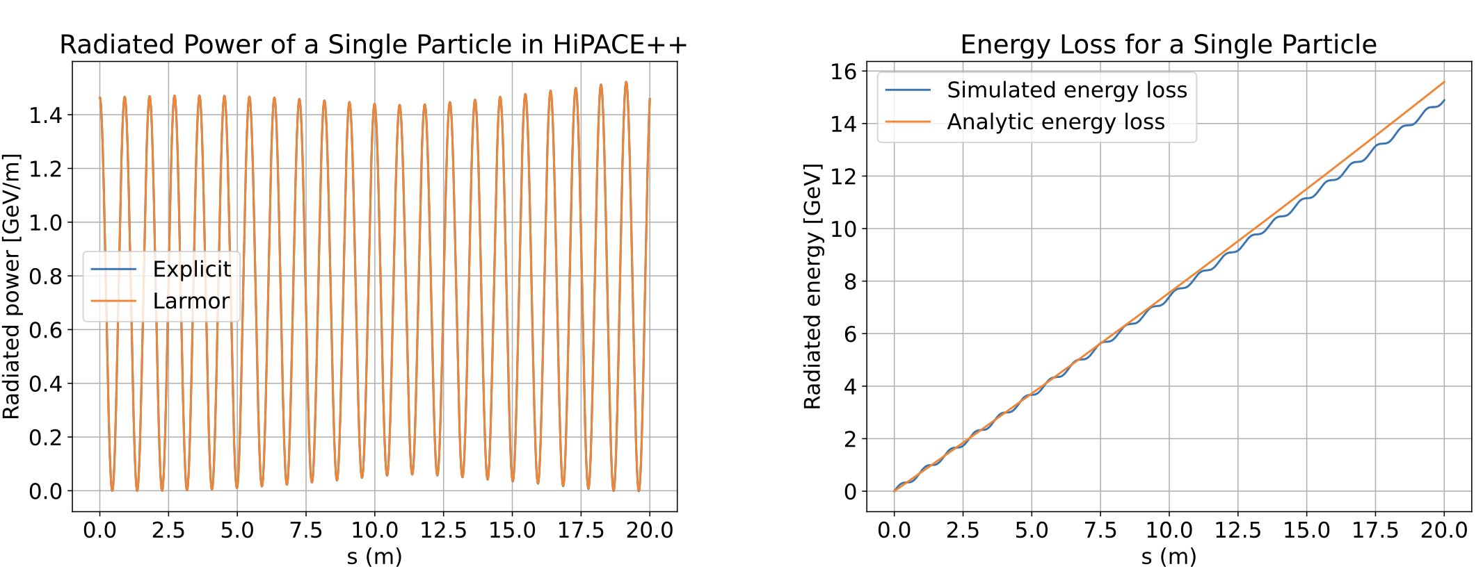
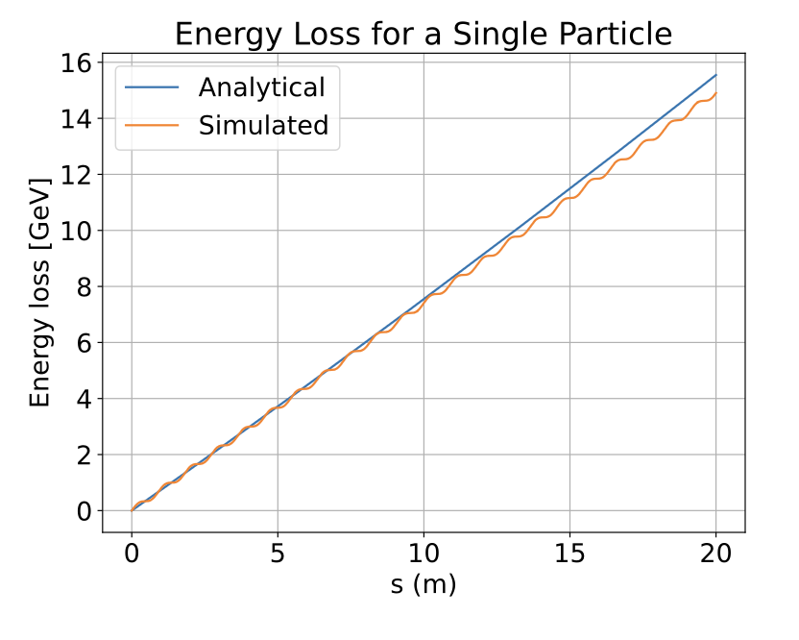
HiPACE++
Benchmarking
Using HiPACE++
The simulations in HiPACE++ were a bit unstable, as plasma often is.
I checked the radiation in HiPACE, and checked that I got (more or less) the same results.
Going back, I would extract the numbers and plot the actual difference.
My solver
Top Plots are from HiPACE++, bottom is from my solver (Yes, the legends should have been consistent☺)
07.05.2025 | Daniel Kalvik | student lunch meeting
Page

Slide 12
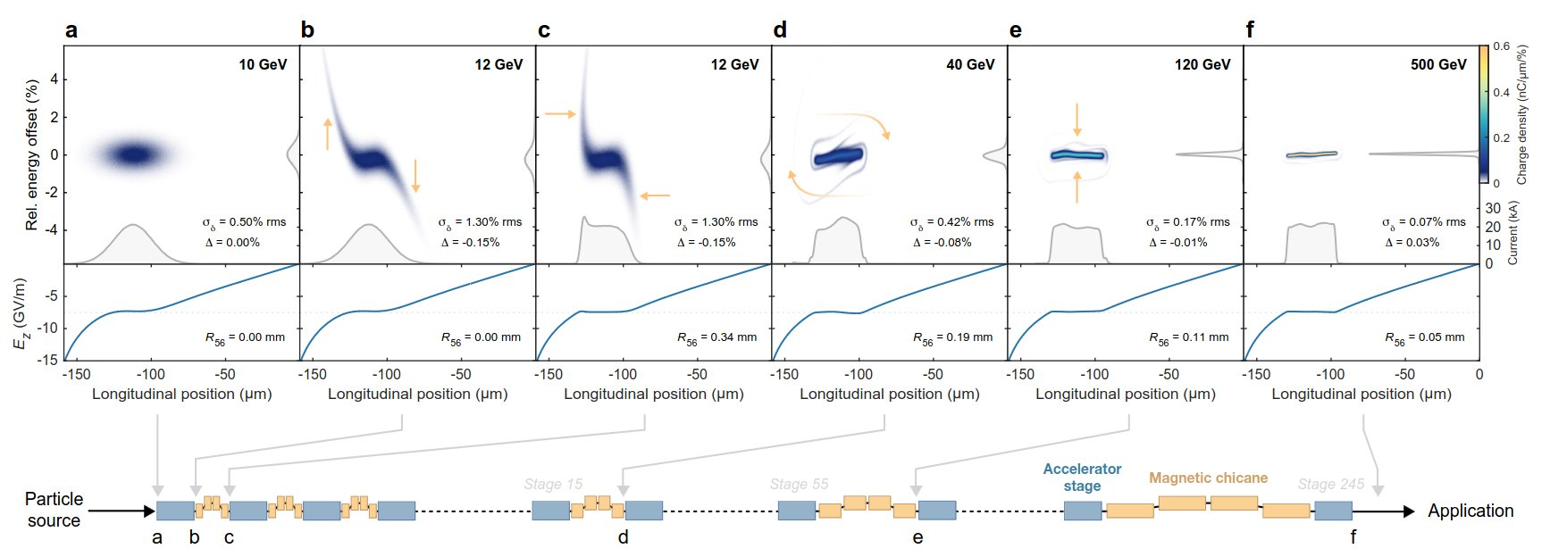
Getting the results
The energy-correcting chicane
What I want to model, is the self-correcting chicanes that fixes the large energy-spread.
07.05.2025 | Daniel Kalvik | student lunch meeting
Page

Slide 13
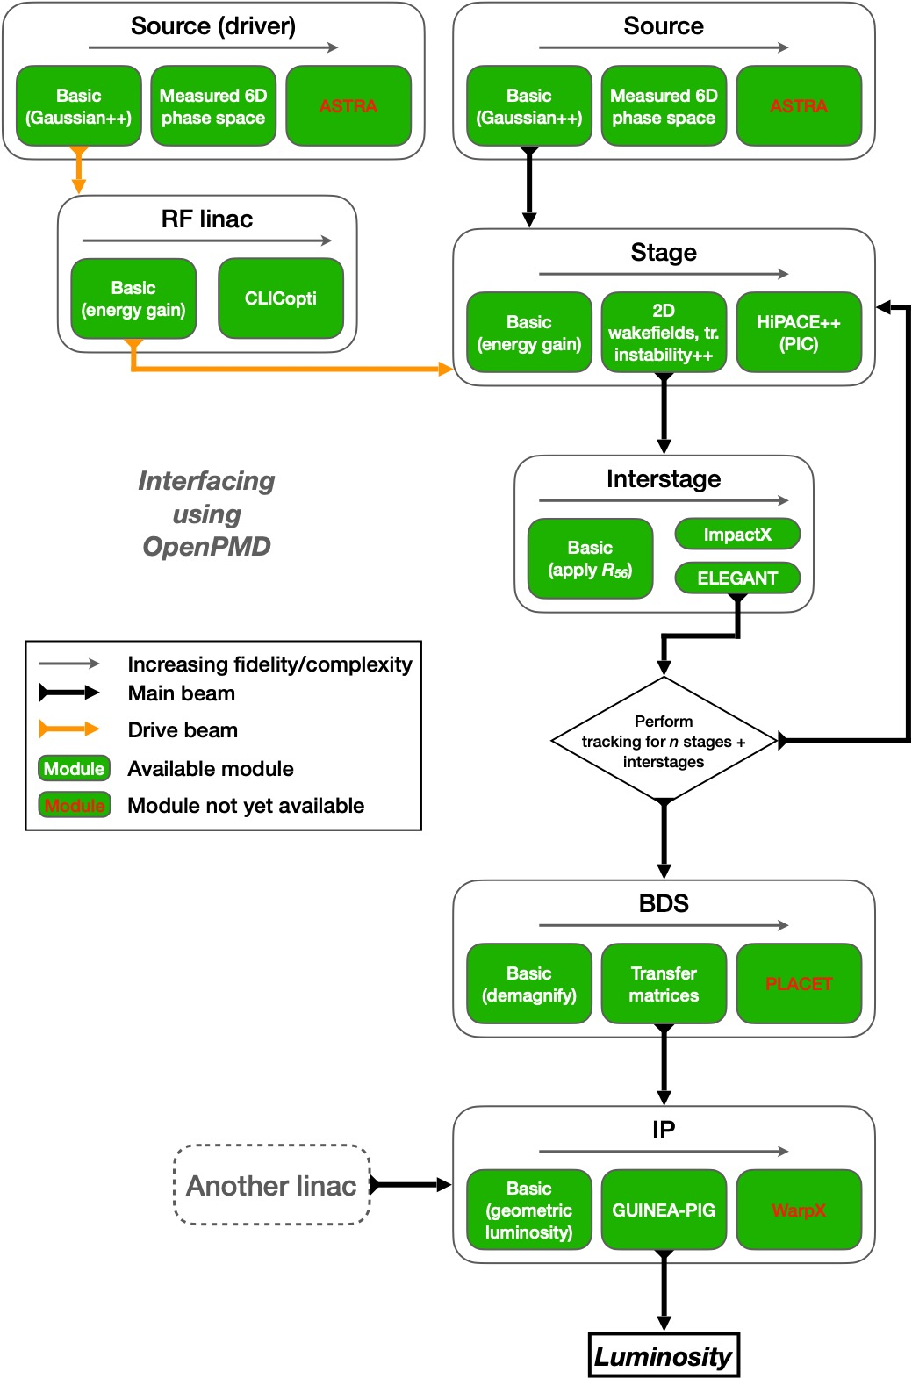
Getting the results
ABEL
I added the radiation reaction solver in the start-to-end framework, ABEL.
ABEL uses multiple codes/frameworks to let the user choose fidelity/performance.
You can model an entire facility, or simulate a single stage.
07.05.2025 | Daniel Kalvik | student lunch meeting
Page
Figure by Jian Bin Ben Chen, UiO

Slide 14
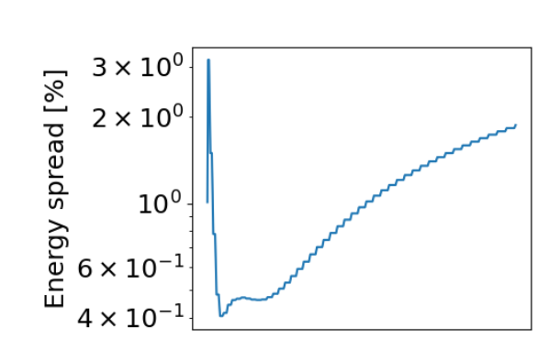
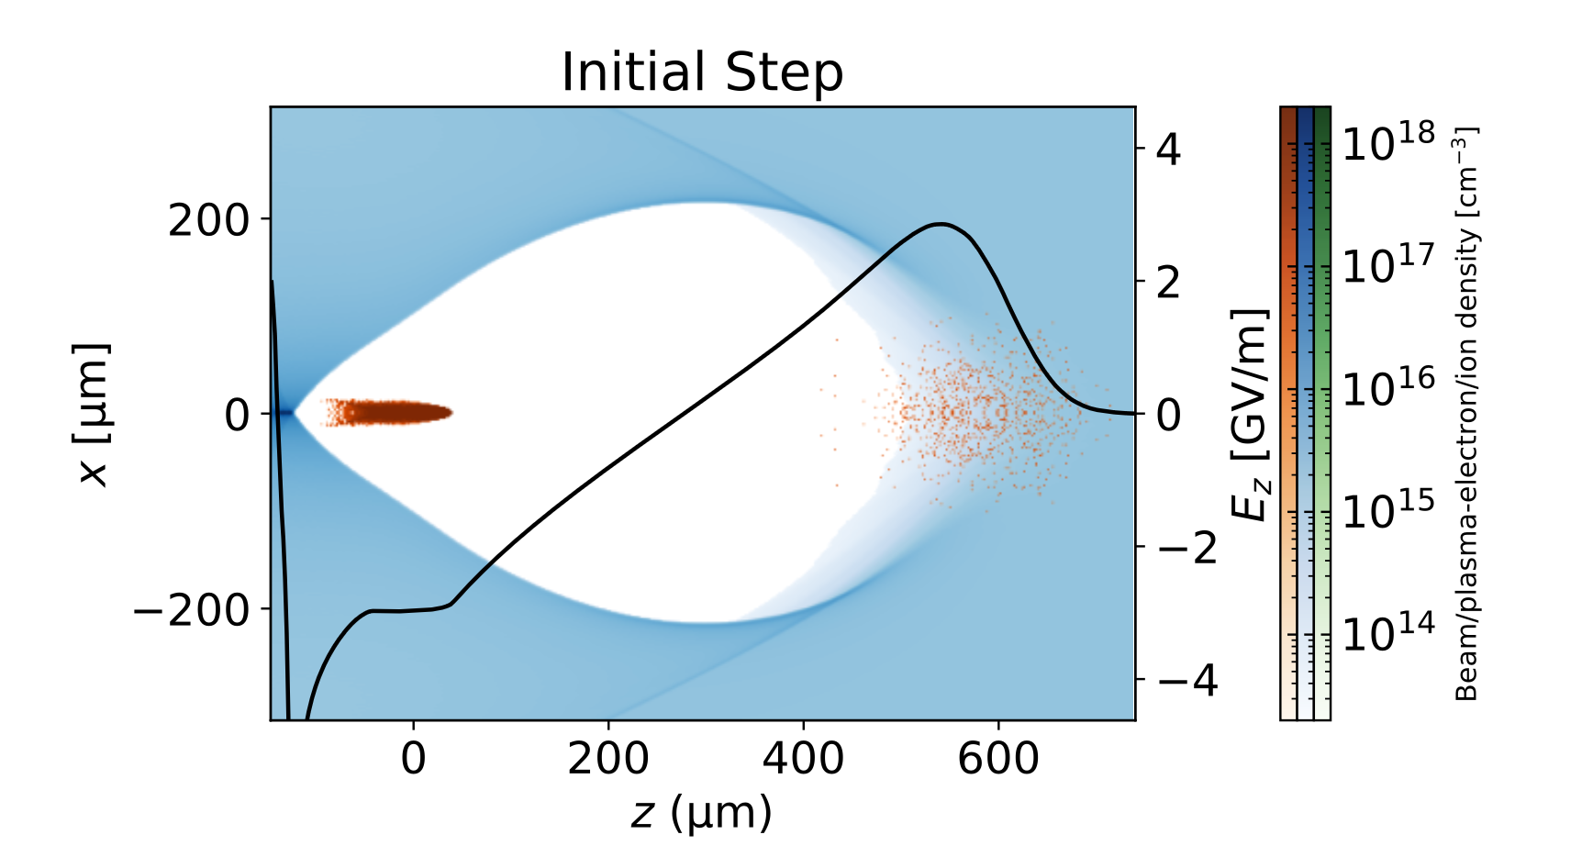
The results
Large energy-spread at higher energies
The self-correction can’t compensate for all the energy-loss.
The beam is shaped into a rocket, because high-amplitude particles are moved backwards in the beam. But not all are moved enough.
The flat field-profile is now an enemy of the process.
Energy-spread evolution and the longitudinal crossection of the beam
07.05.2025 | Daniel Kalvik | student lunch meeting
Page

Slide 15
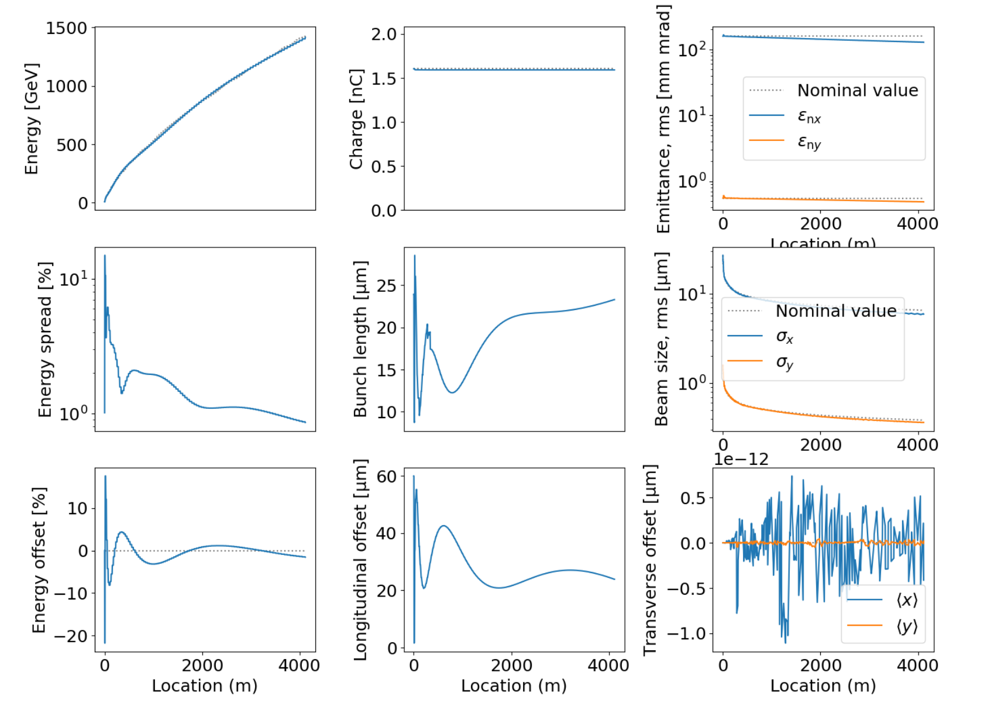
The results
Can it be corrected?
By adjusting the parameters, the self-correction can handle the energy-spread, at the cost of much lower efficiency.
The trick seems to be to shape the beam relatively early
Beam parameters during 1.5 TeV acceleration
07.05.2025 | Daniel Kalvik | student lunch meeting
Page

Slide 16
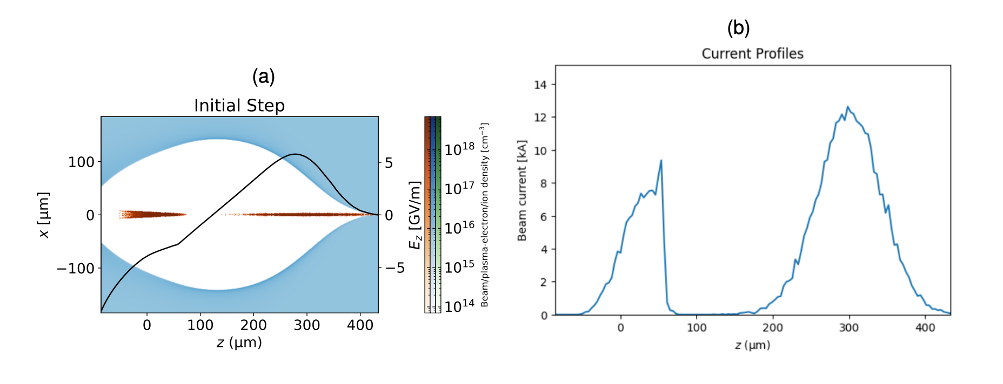
Shaping the beam
Subheading
The self-correction sorts out the beam-particles, loading the wake in a way that perfectly accounts for the energy-loss. I.e a SELF-correction.
If this sorting can happen at a lower energy, the energy-spread can be mitigated more easily.
07.05.2025 | Daniel Kalvik | student lunch meeting
Page

Slide 17
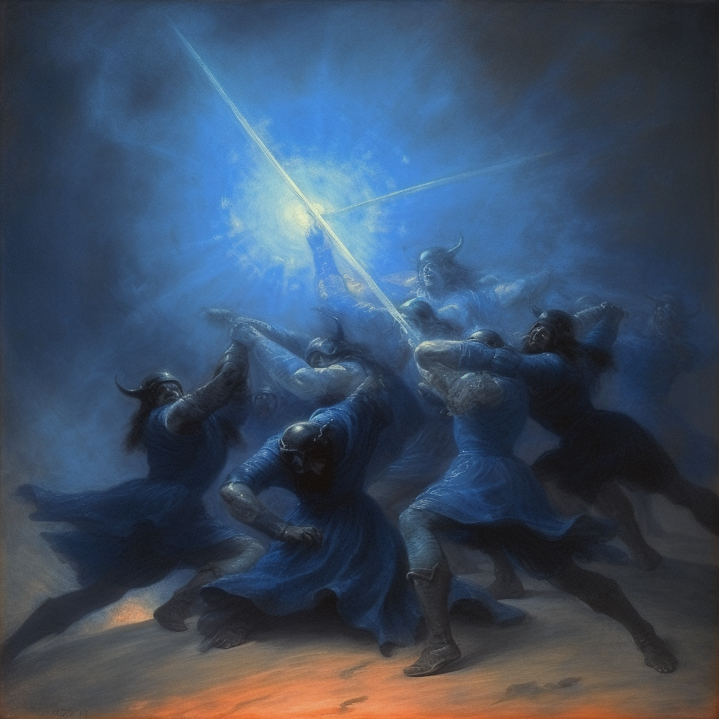

Acknowledgements
Oslo accelerator group:
Erik Adli, Kyrre N. Sjøbæk, J. B. Ben Chen,
Ole Gunnar Finnerud, Jiawei Cao, Daniel Kalvik,
Carl A. Lindstrøm, Pierre Drobniak
Funding:
European Research Council (ERC)
The Research Council of Norway

