Slide 1
Overview
Quad Q0D
Spectrometer
GAMMA2
Electron beam
Electron optic
Foil

Slide 2
Overview
IPOTR1
Quad Q0D
Spectrometer
GAMMA2
Electron beam
Bremsstrahlung
Electron optic
Foil

Slide 3
Overview
IPOTR1
Quad Q0D
WDSOTR
Spectrometer
GAMMA2
Electron beam
Bremsstrahlung
Electron optic
Foil

Slide 4
Overview
IPOTR1
Quad Q0D
WDSOTR
Spectrometer
GAMMA2
Electron beam
Bremsstrahlung
Electron optic
Foil

Slide 5
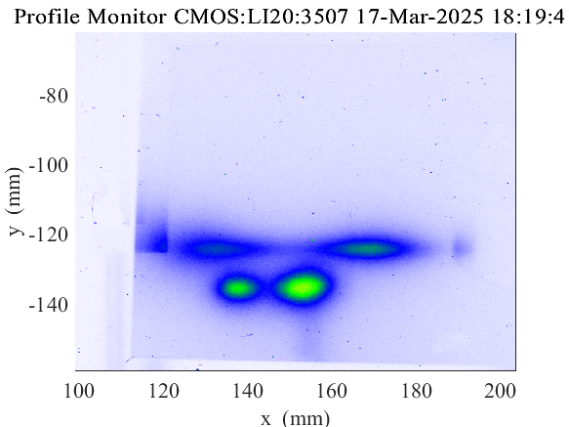
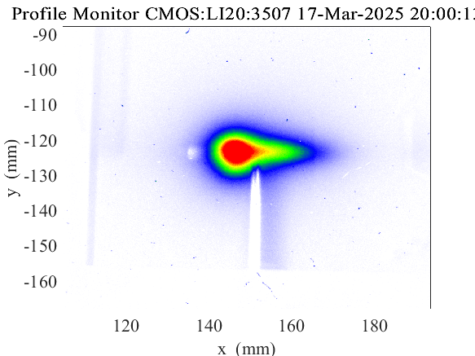
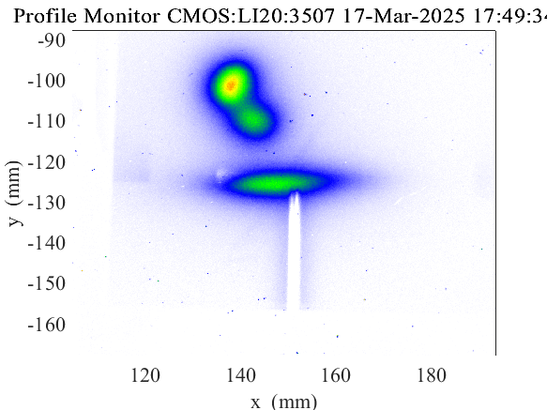
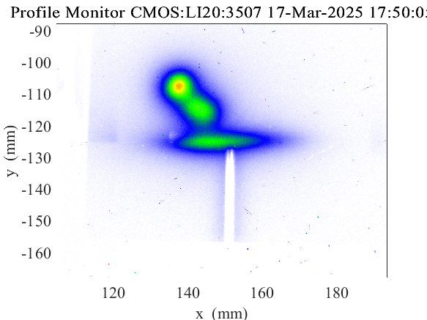
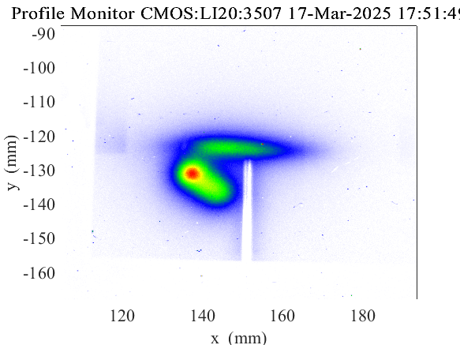
Example images
Intentional misalignment; all four spots visible →
←Spots overlapped and blob size minimized
Independent steering of different spots ↓

Slide 6
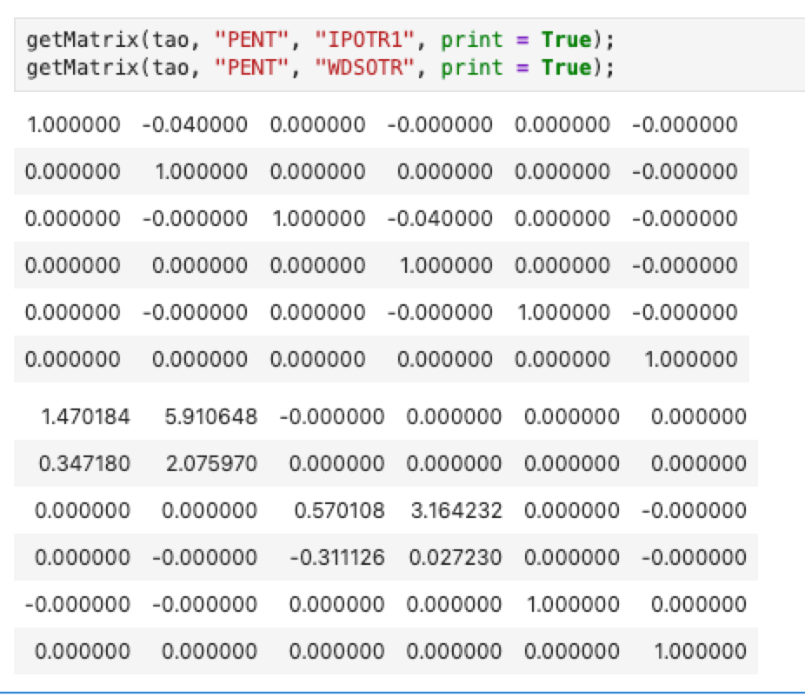
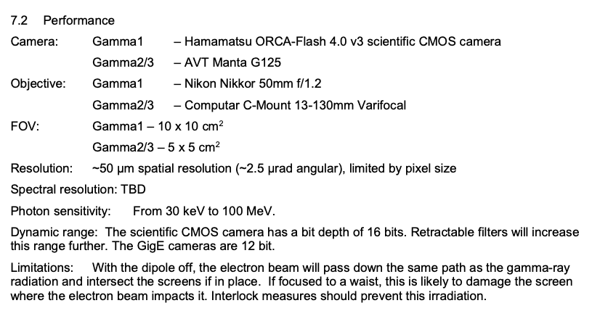
Details
Centroid coordinate on GAMMA2 as a function of electron coordinates at PENT
  IPOTR1 spot
    X = x_{PENT} + 21.39 x’_{PENT}
    Y = y_{PENT} + 21.39 y’_{PENT}
  WDSOTR spot
    X = 7.34 x_{PENT} + 41.02 x’_{PENT}
    Y = -4.69 y_{PENT} + 3.62 y’_{PENT}
Taking GAMMA2’s 125 um resolution as a best case scenario, could resolve ~100 um offsets at PENT in perfect world
  We do not live in a perfect world. Unpredictable point spread function (from bremsstrahlung divergence, secondaries, etc.) is >> mm
Superseded
New value = 125 um
[D. Storey]
[FACET-II Dump Table Diagnostics Summary - Rev3.pdf]
Notes:
IPOTR1 s = 994.733
WDSOTR s = 999.253
DTOTR s = 1016.163
Photon transport is drift
IPOTR1 to DTOTR = 21.43
WDSOTR to DTOTR = 16.91
Approximating GAMMA2 s position = DTOTR

Slide 7
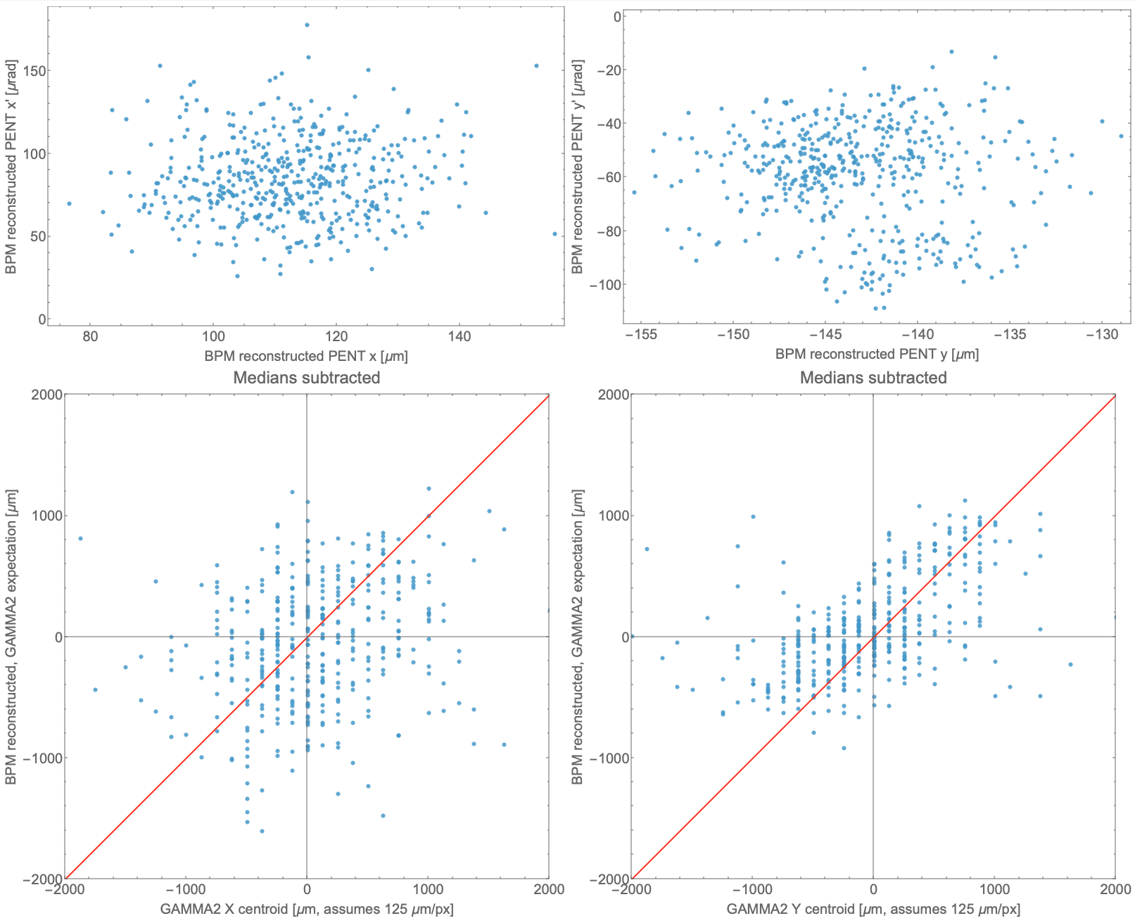
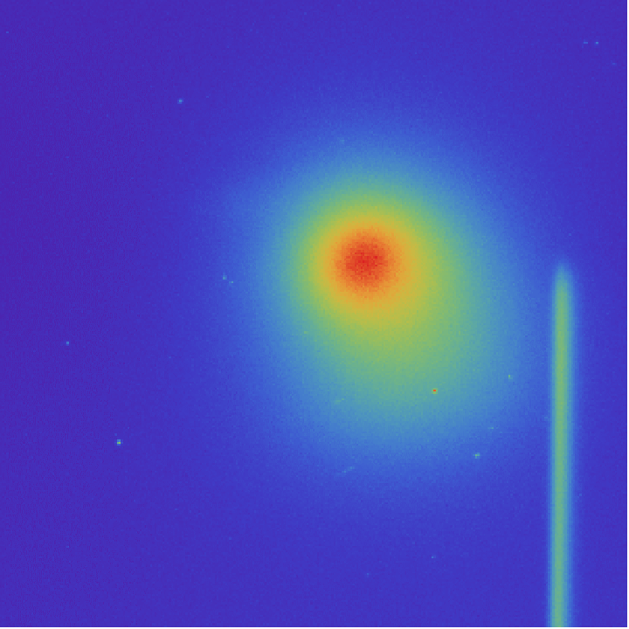
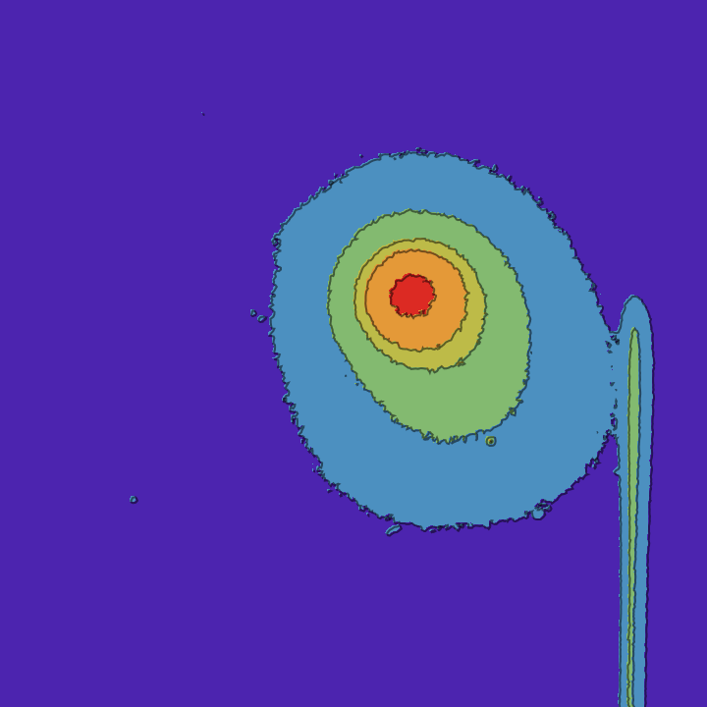
Characterization: Single bunch, single foil
“Easy” starting point where it’s not necessary to deconvolve multiple spots. Just drive beam and IPOTR1 foil; dummy DAQ, using jitter to vary
Using BSA BPMs to reconstruct IP vector and implied GAMMA2 spot position
Washed out by noise; unable to resolve beams at resolution of interest (~10 um)
  Also, angle terms dominate: electron beam is near waist, exacerbated by long photon drift
37.5 mm

Slide 8
Supplemental slides

Slide 9
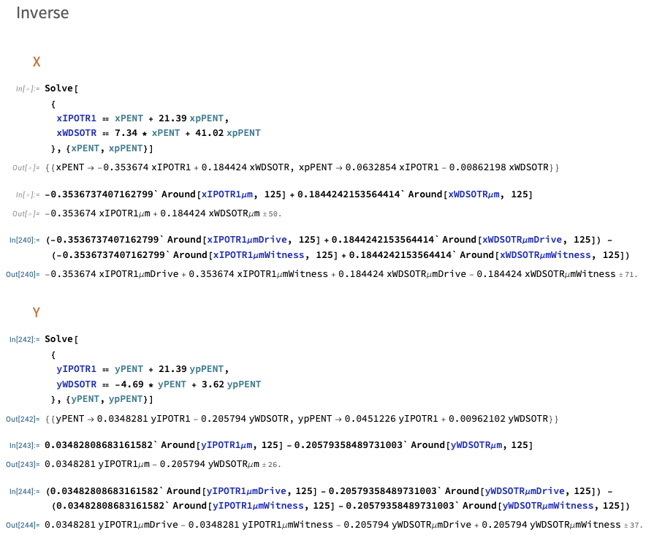
Fundamental limit
Assuming all four GAMMA2 spots could be perfectly resolved (up to the 125 um resolution limit), the smallest offset at PENT between drive and witness that can be resolved in x is 71 um.
Resolution in Y is approximately twice as good with a fundamental limit of 37 um

Slide 10
