Slide 1
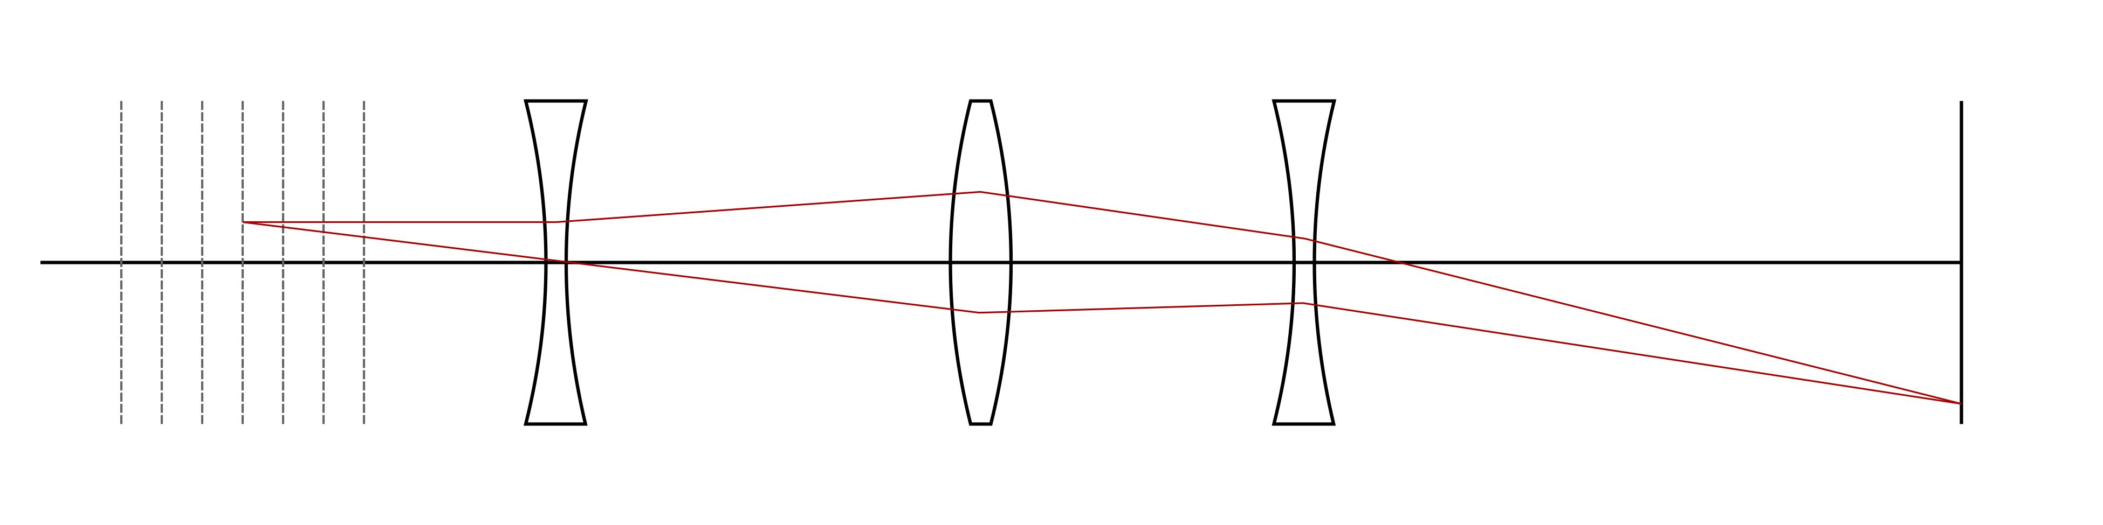

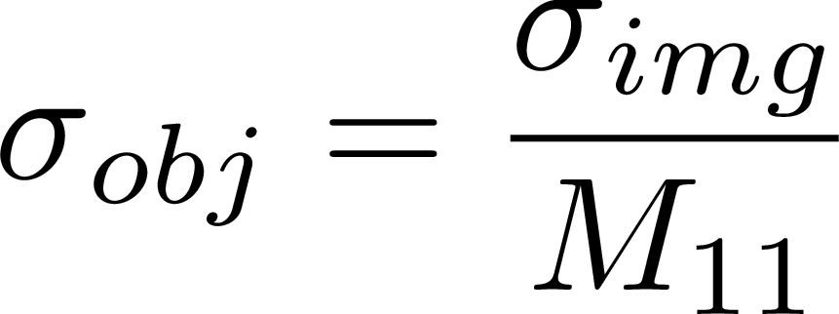
Quad Scan Analysis
Scan object plane by changing quad strengths

Slide 2
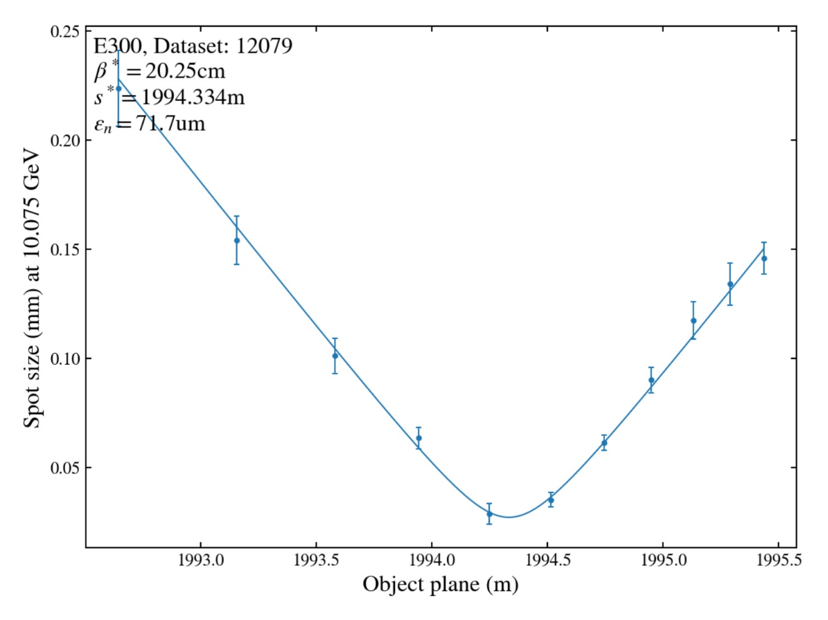
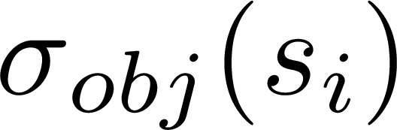
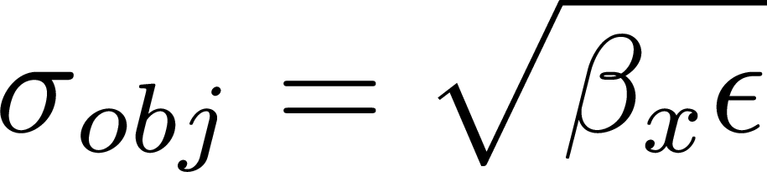
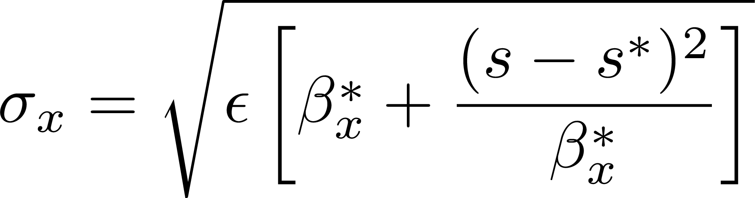
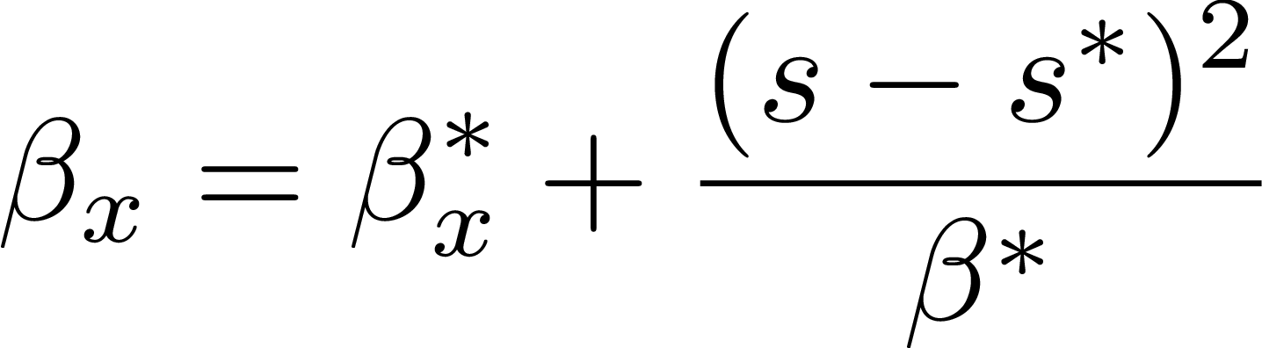
Quad Scan Analysis: CS parameters for each energy slice
Scan object plane by changing quad strengths

Slide 3
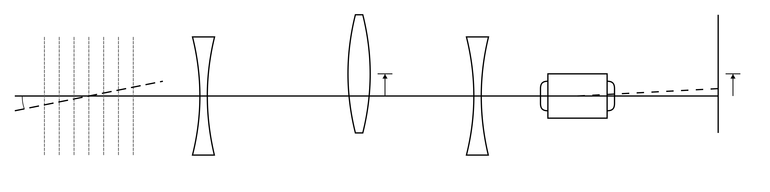



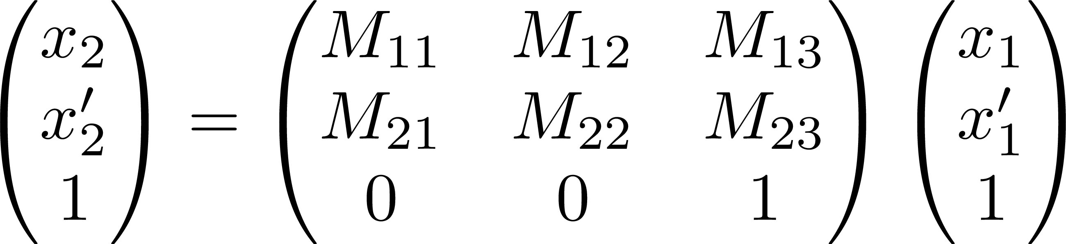
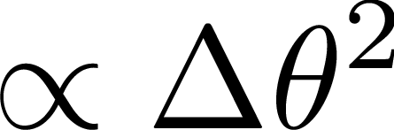
Spectrometer imperfections
Reference axis defined by Q0D and Q2D
Offset adds dipole term:
Dipole term doesn’t change sigma:
Easy to show M11 and M12 are unchanged by offset
Technically, small error in CS fit due to plane spacing being off:

Slide 4
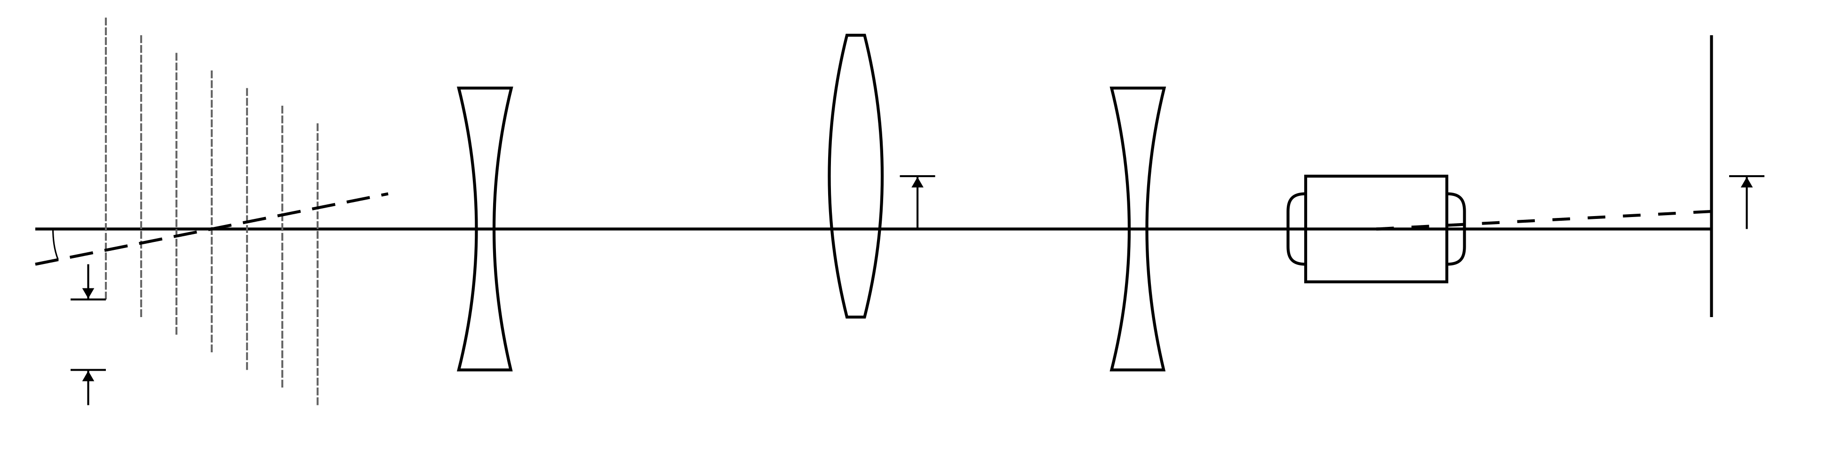
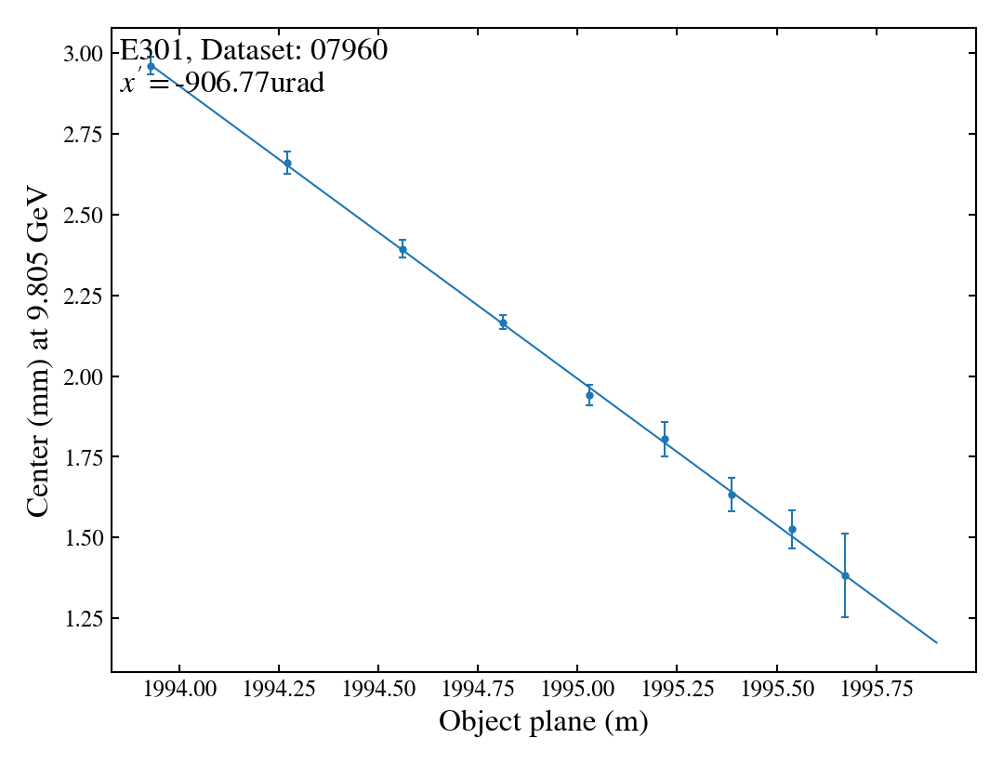

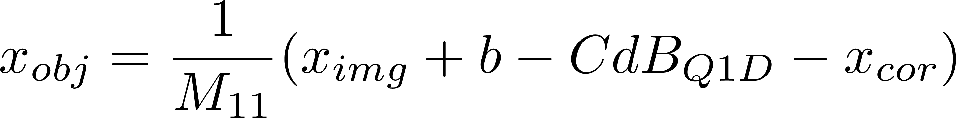
Quad Scan Analysis: dispersion and dispersion’
Offset effects image plane center
Offset varies with energy

Slide 5
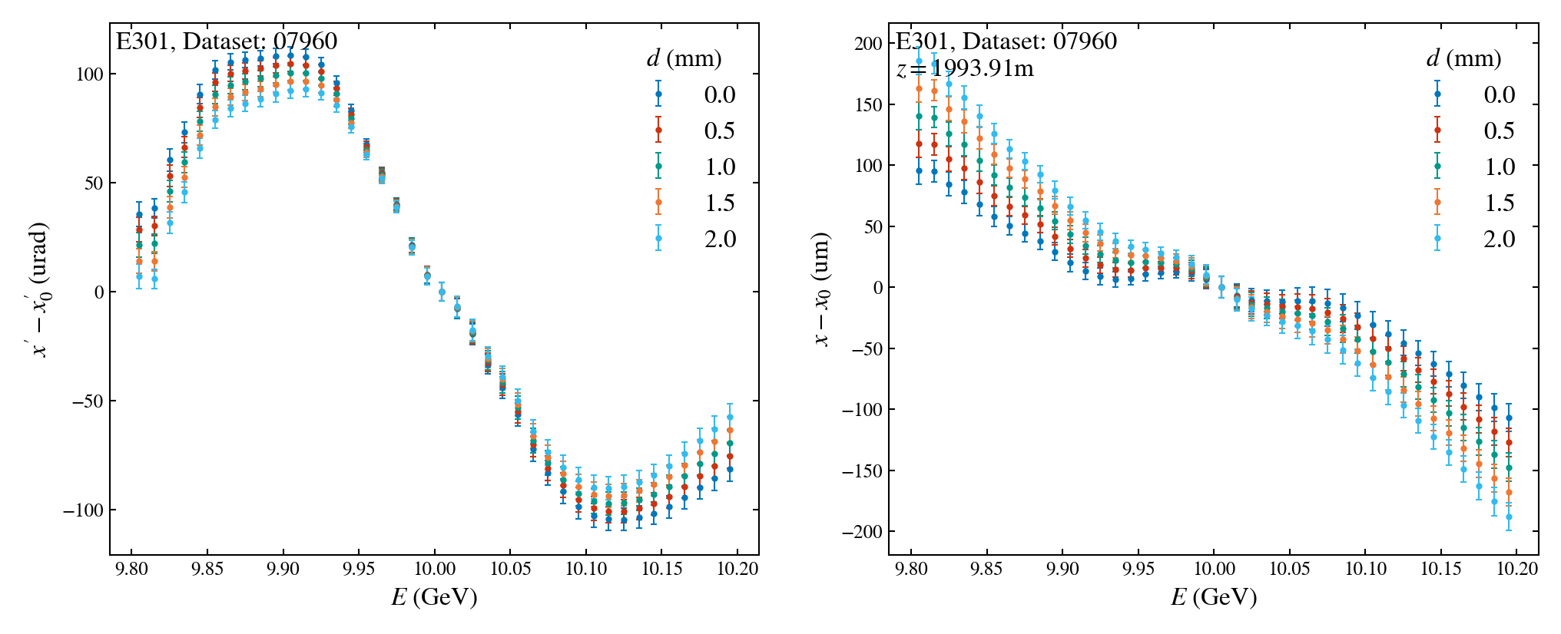
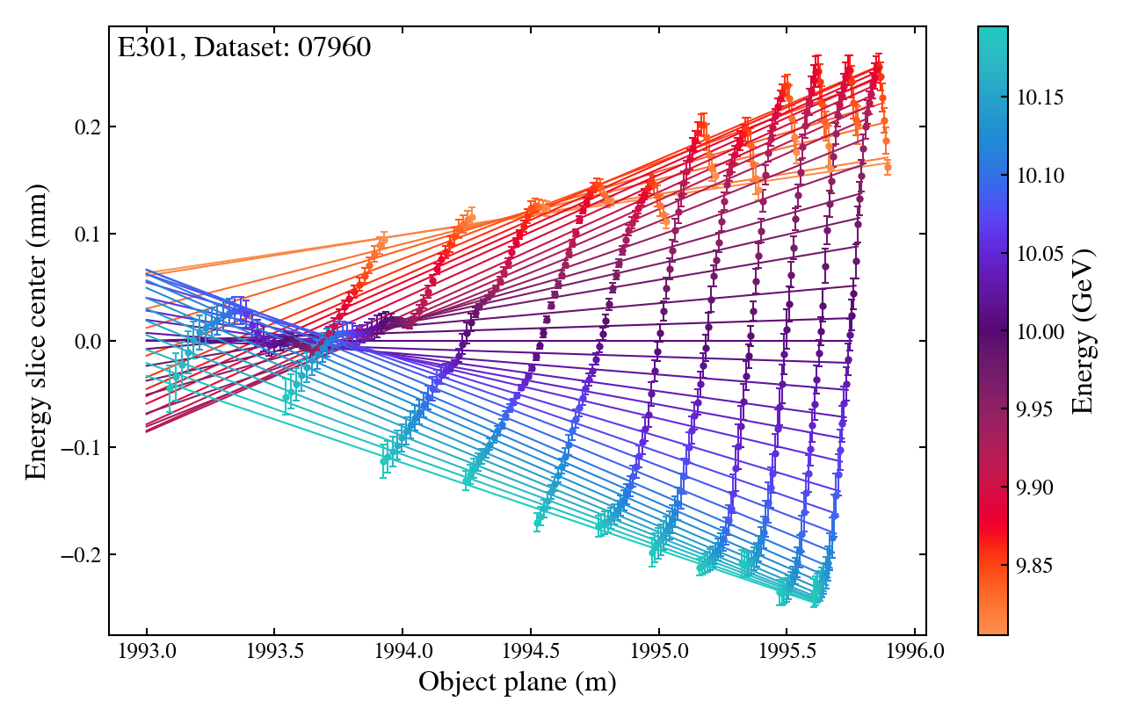
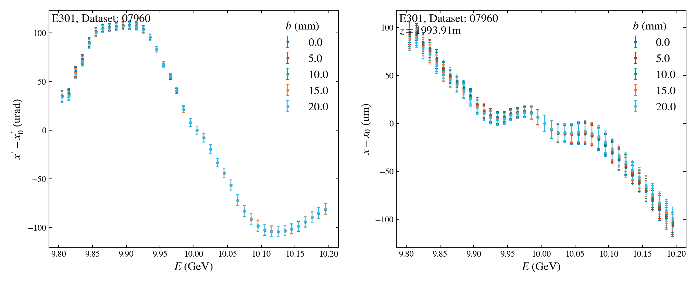
Quad Scan Analysis: errors due to Q1D offset
Q1D offset: 14urad/mm and 45um/mm
Screen offset: 0.1urad/mm and 0.4um/mm

Slide 6
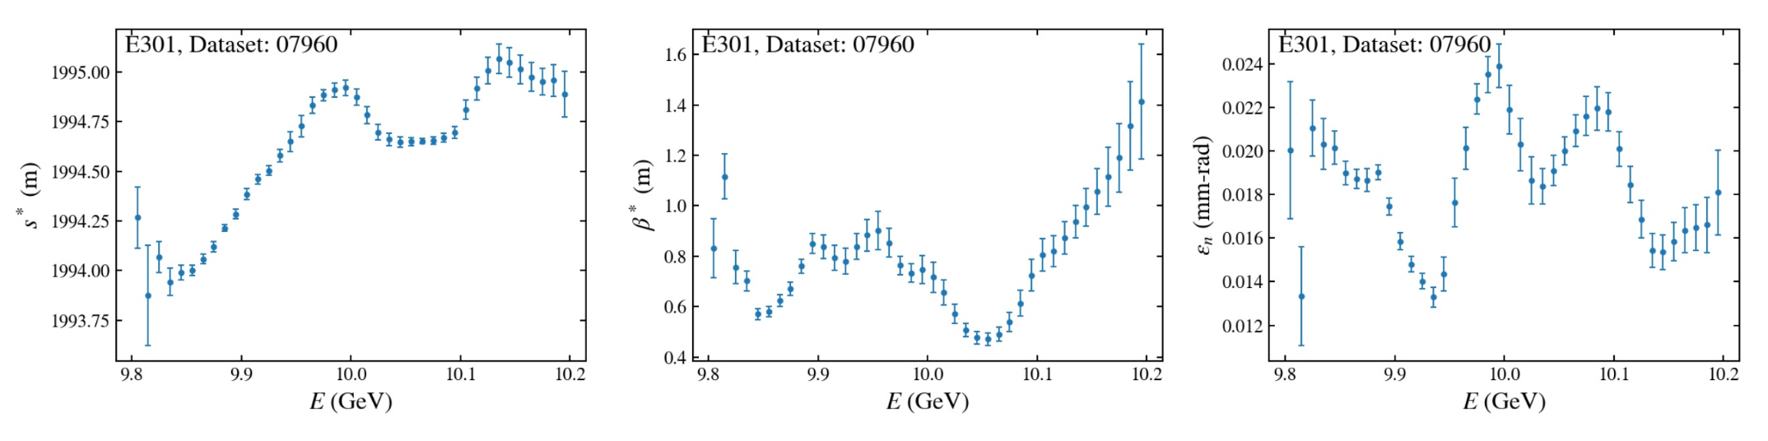
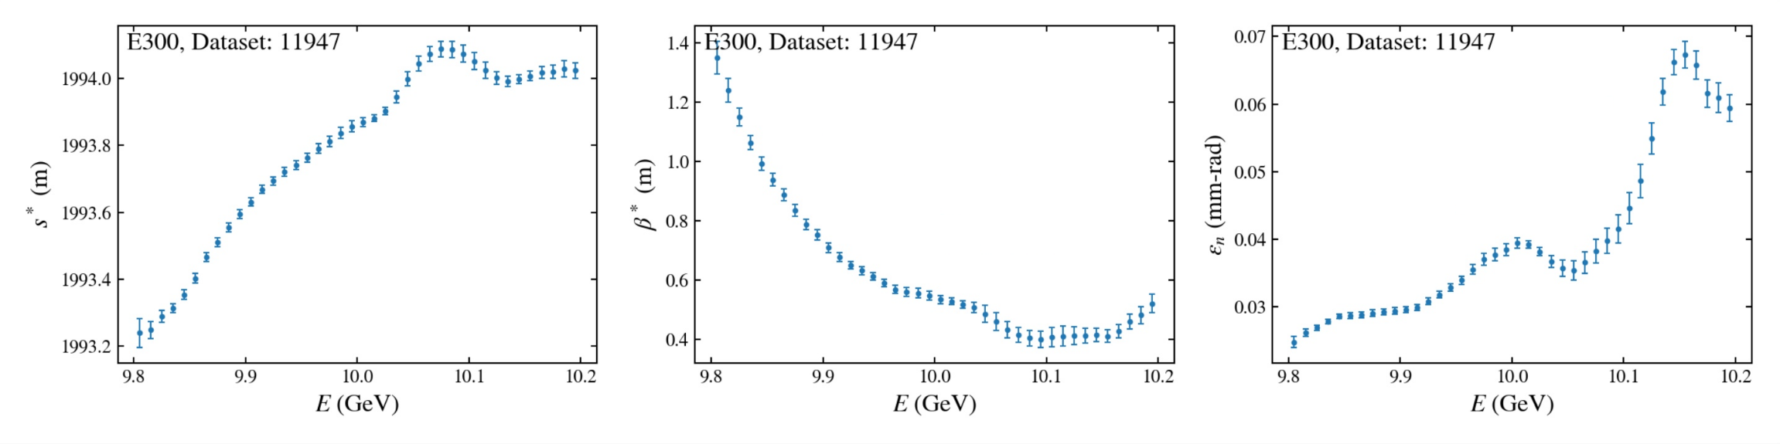
Some example data
Decent day of E301
Slice emittance <25um
Random E300 shift this year
Slice emittance 20-65um

Slide 7
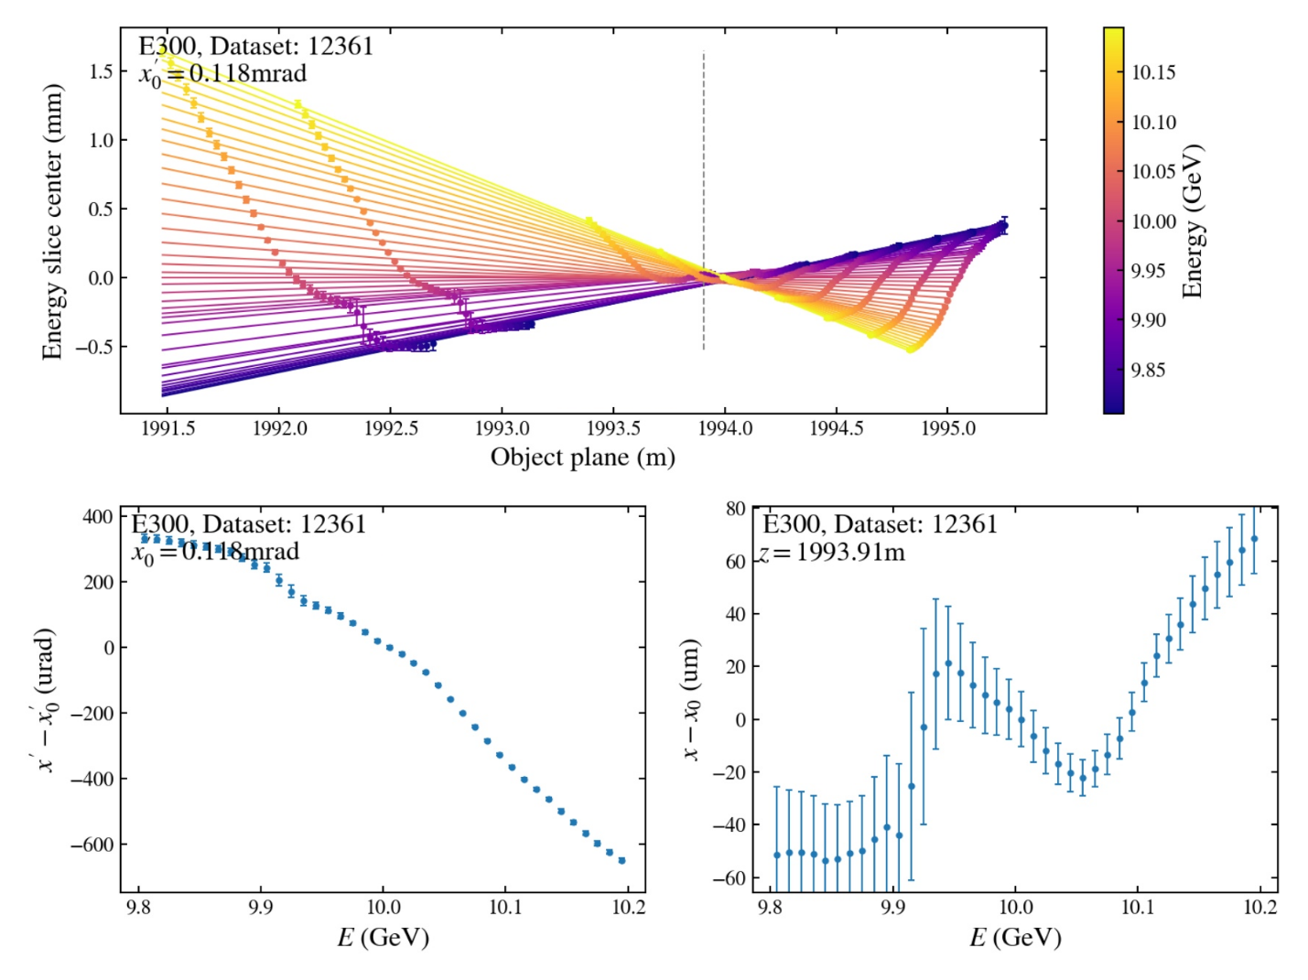
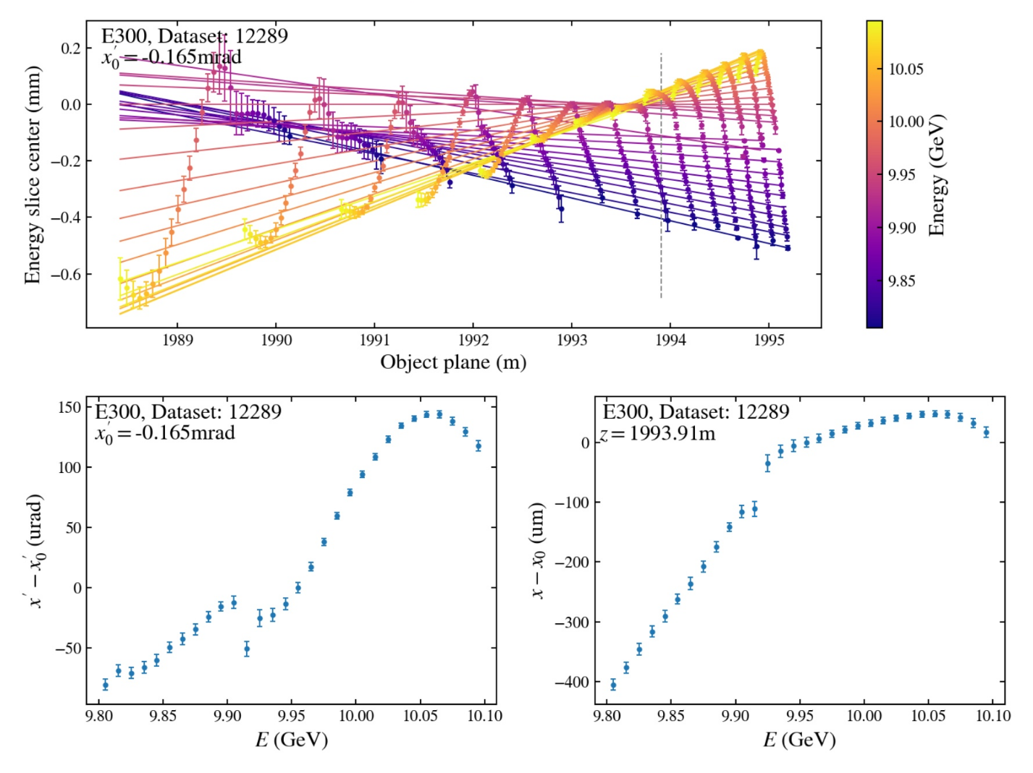
Some example data
Two bunch with large dispersion’

Slide 8
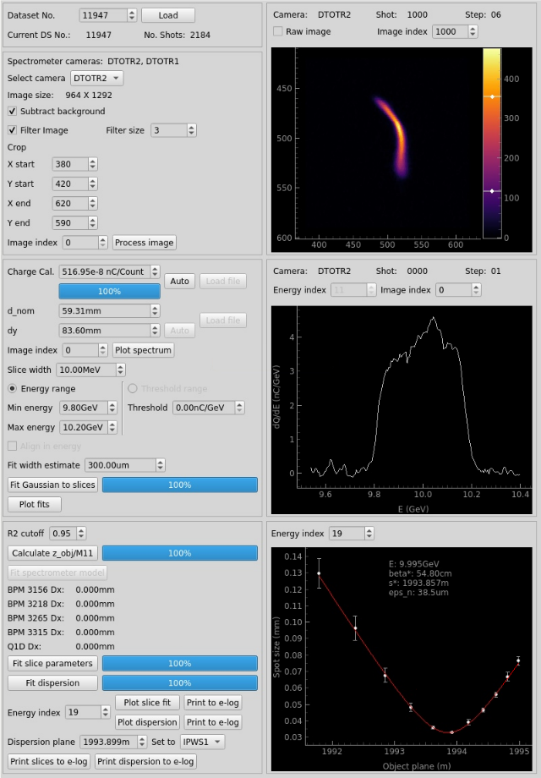
GUI for on-shift analysis/tuning
Data acquired with DAQ
Image processing options
  ROI
  Filtering
Energy slice and fitting settings
  Automatic charge calibration
  Slice size and range
  Plot any fit
CS parameters and dispersion fits
  Set Q1D, spectrometer screen offsets
  Look at fits of individual slices

Slide 9
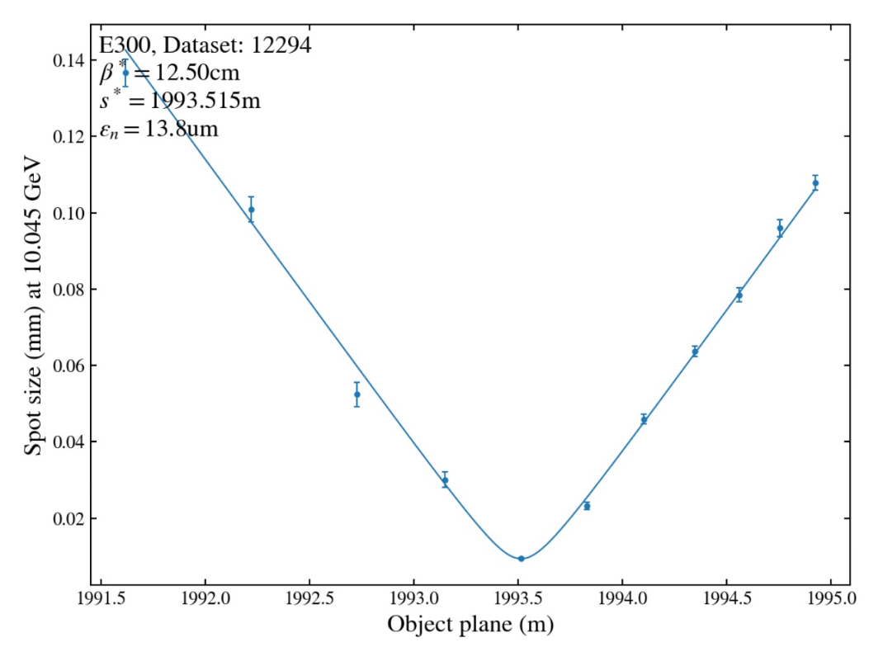
Uses and next steps
More careful comparison with collimator scan+BPM technique
Determine how much Q1D/DTOTR offset remains after recent alignment
  Spectrometer doesn’t necessarily need to be straight if offset is known
Original motivation was to try and close the gap between simulation and experiment
  Waist scans in experiment are much less sensitive than expected
  Emittance growth in the decelerated drive beam much larger than expected
Finish the loop: inform experiment from simulation
  How much variation in beta* and s* is acceptable for E300 goals?
  How much dispersion is acceptable?
Tuning tool and repeatability
  Systematically explore influence of tuning knobs
  More detailed tuning target besides just wire size
  Why do experiments work one day but not another?

