Slide 1
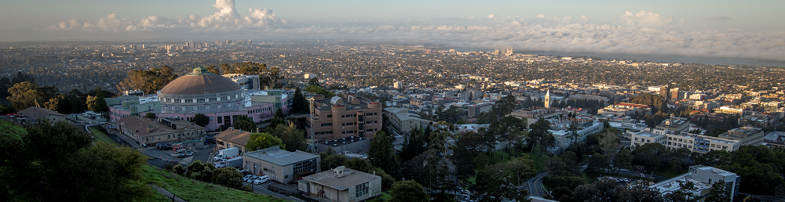
Introduction to Analog-to-Digital Converters
HEPIC Summer School
Katerina Papadopoulou 6/24/2025
Lawrence Berkeley National Laboratory

Slide 2
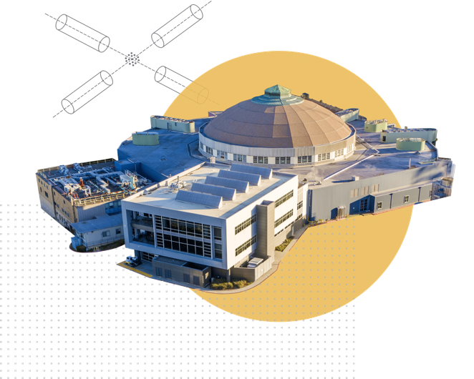

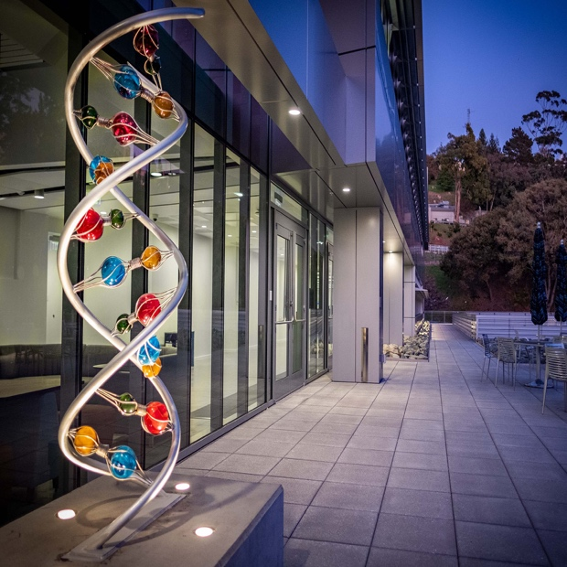
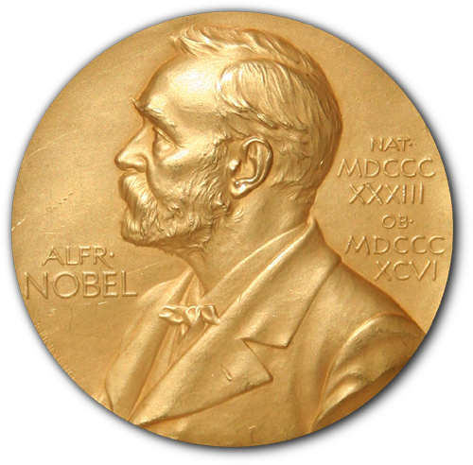

Lawrence Berkeley National Laboratory
MOST DIVERSE
US NATIONAL LABORATORY
Key Strengths
Physical Sciences, Computing, Biosciences, Earth and Energy Sciences, Materials, and Nanotechnology
EXCELLENCE
& DIVERSITY
3500 employees
1000 students
1750 visiting researchers
NATIONAL
USER FACILITIES
Advanced Light Source
National Energy Research Scientific Computing Center
Energy Sciences Network
Joint Genome Institute
Molecular Foundry (including National Center for Electron Microscopy)
16
NOBEL PRIZES
Most recent: 2022 Nobel Prize in Chemistry (Carolyn Bertozzi) and Physics (John Clauser)

Slide 3
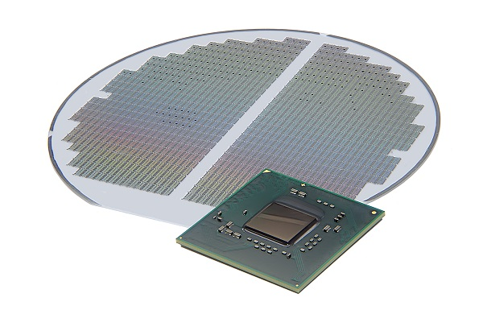
Agenda
ADC Overview
ADC Performance metrics
ADC Architectures
ADC requirements for High-Energy Physics
Extra: Design Study - Oversampling ADC

Slide 4
ADC Overview

Slide 5
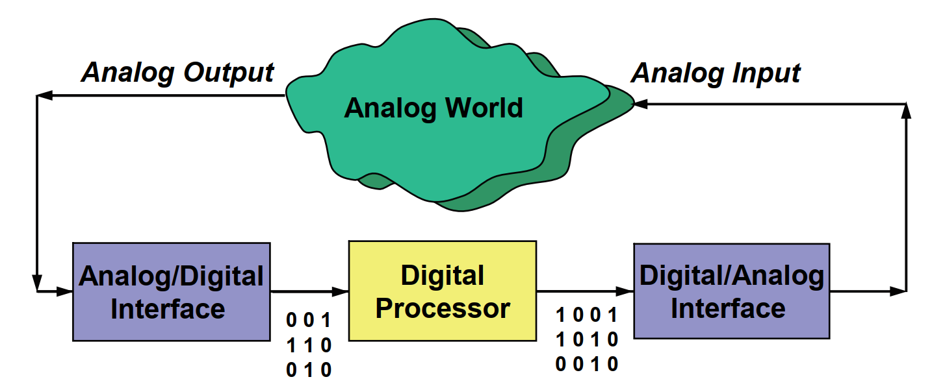
What are ADCs?
Analog-to-Digital Converters (ADCs) provide the link between the analog world and digital processing
In HEP, detector outputs are usually analog (e.g. charge pulses) and ADCs pace experimental improvements

Slide 6
ADC Applications
CT, CA: Continuous time, continuous amplitude
DT, DA: Discrete time, discrete amplitude
Paul Gray (UCB)

Slide 7
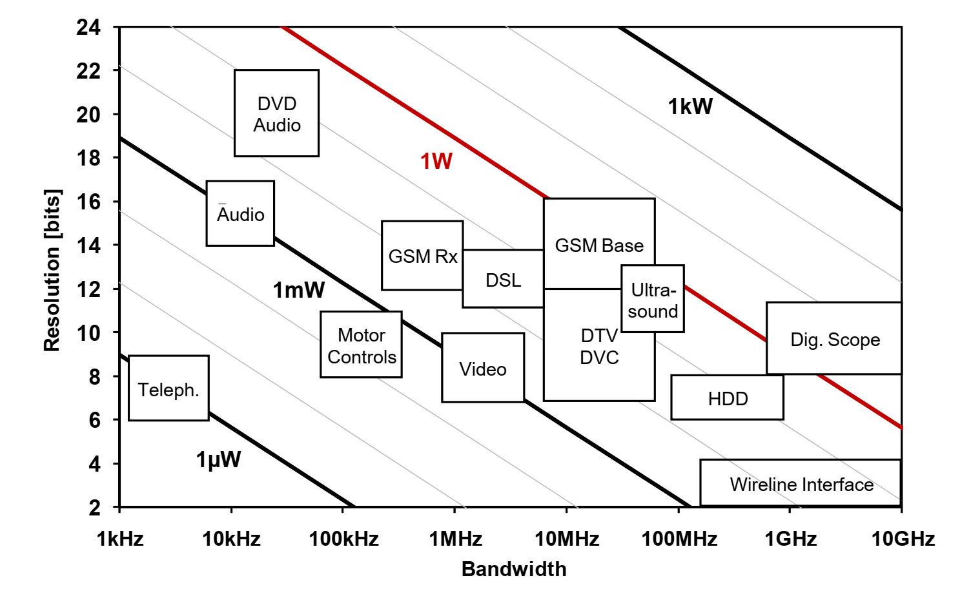
ADC Applications
Resolution:
log₂ of quantization levels
Sampling Rate: number of conversions/sec
Bandwidth: Sampling Rate / 2 (stay tuned!)
B. Murmann (Stanford)
Huge application space → many complementary ADC techniques

Slide 8
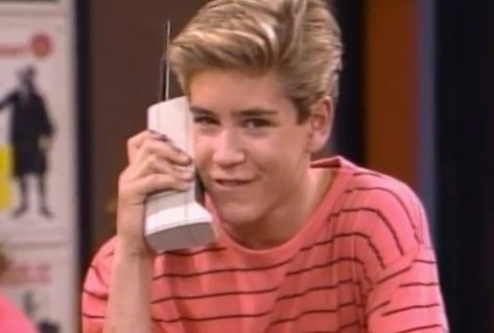
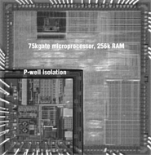
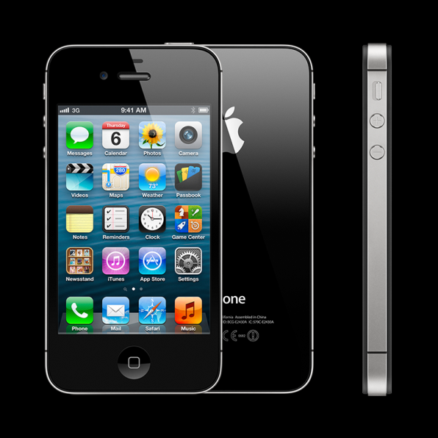
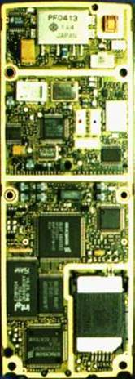
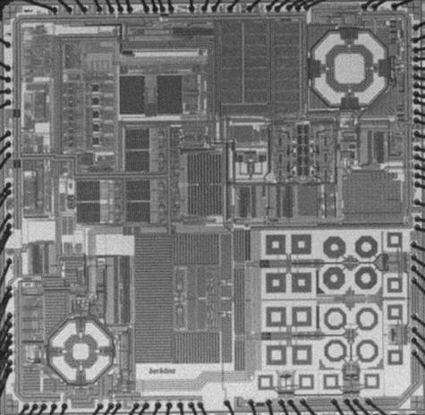
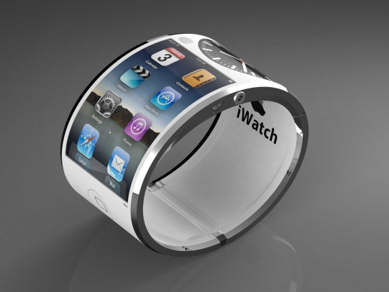
ADC Applications (cellular phone example)
Future
A
D
Ericsson Bluetooth
(CMOS, 2001)
CMOS? or
something else?
Ericsson CH388
(Hybrid, 1995)
Berkäna GSM/GPRS
(CMOS, 2005)
Past
Present
Y. Chui (UTD)

Slide 9
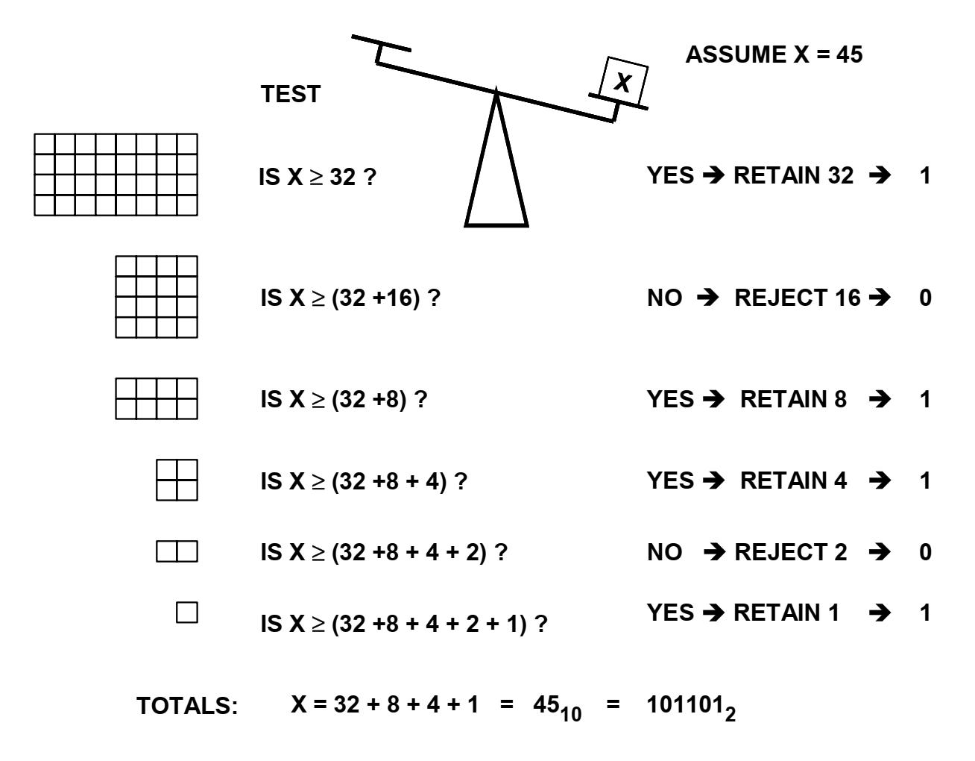
What exactly is Analog-to-Digital Conversion?
Analog-to-Digital conversion is essentially a ruler that can be used to measure an unknown quantity to some level of accuracy
This is an ancient algorithm to determine weights (for example in a metal assay). Today this algorithm is called Successive Approximation (and the leading ADC technique uses this algorithm still).
Analog Devices

Slide 10
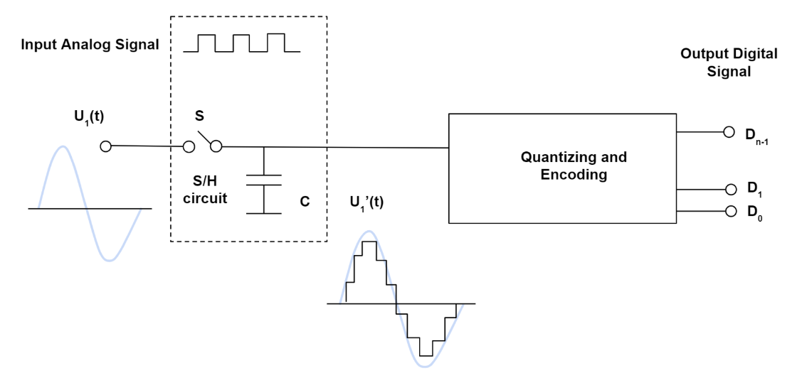
Steps of Analog-to-Digital Conversion
“continuous-time analog”
“digital”
Sampling
“discrete-time analog”
Monolithic Power Inc.

Slide 11
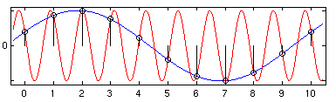
Sampling & Aliasing
How fast do you need to sample?
Aliasing
The frequencies fx and nfs ± fx, n integer, are indistinguishable in the discrete time domain
If aliasing occurs, no signal processing operation downstream of the sampling process can recover the original continuous time signal!
No aliasing if f_{sample} > 2 f_{max} where f_{max} is the maximum frequency in your input signal.
Did you sample the red curve? Or the blue curve?
If a system uniformly samples an analog signal at a rate that exceeds the signal’s highest frequency by at least a factor of two, the original analog signal can be perfectly recovered from the discrete values produced by sampling.
Shannon-Nyquist Theorem:

Slide 12
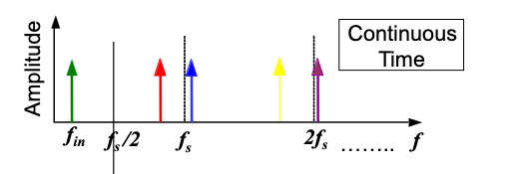
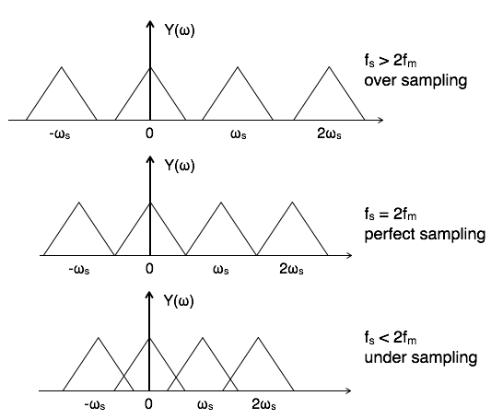
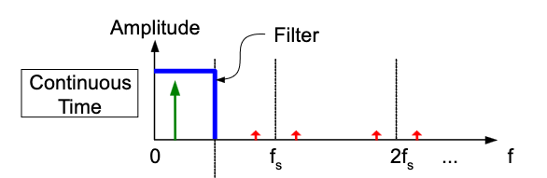
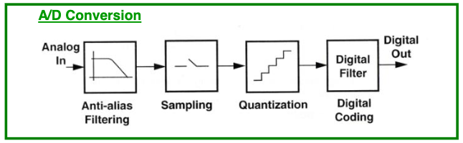

Sampling & Aliasing in the frequency domain
What can you do?
$$Y\left(ω\right)= \frac{1}{T_{S}}\sum_{−∞}^{∞}{X(ω−nω_{s})}$$
Important! Use anti-aliasing filter!
H. Khorramabadi (UCB)

Slide 13





Quantization and Encoding
Y. Chui (UTD)
$$N: number of bits$$
$$VFS: full−scale output$$
$$D_{out}=2^{N}\frac{V_{in}}{V_{FS}}$$
$$Δ: minimum resolvable input →1LSB$$
$$Δ=\frac{V_{FS}}{2^{N}} or N=log2\frac{V_{FS}}{Δ}$$
Important! Every ADC has three inputs. The analog input, the reference, and the power supply.

Slide 14
ADC Performance metrics

Slide 15
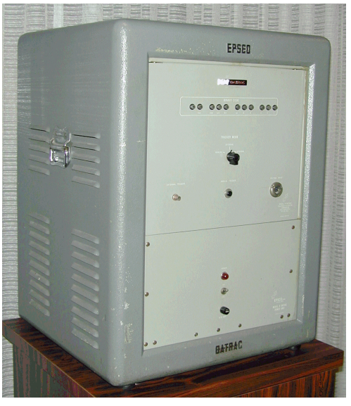
Key ADC Specifications (there are many others…)
Performance Parameters:
Sampling Rate
Resolution
Analog Bandwidth: Different from sampling rate! Can be more or less (e.g. subsampling applications)
Power Dissipation
Die Area
Static:
Linearity
Noise
Offset (Typically don’t care, sometimes you do…)
Gain Error (Typically don’t care)
Dynamic:
Signal-to-Noise-Plus Distortion (SNDR)
Spurious-Free Dynamic Range (SFDR)
Total Harmonic Distortion (THD)
Effective Number of Bits (ENOB)
First commercial ADC. 11b, 50 kS/s
$8500 in 1954 ($96,000 today!)

Slide 16
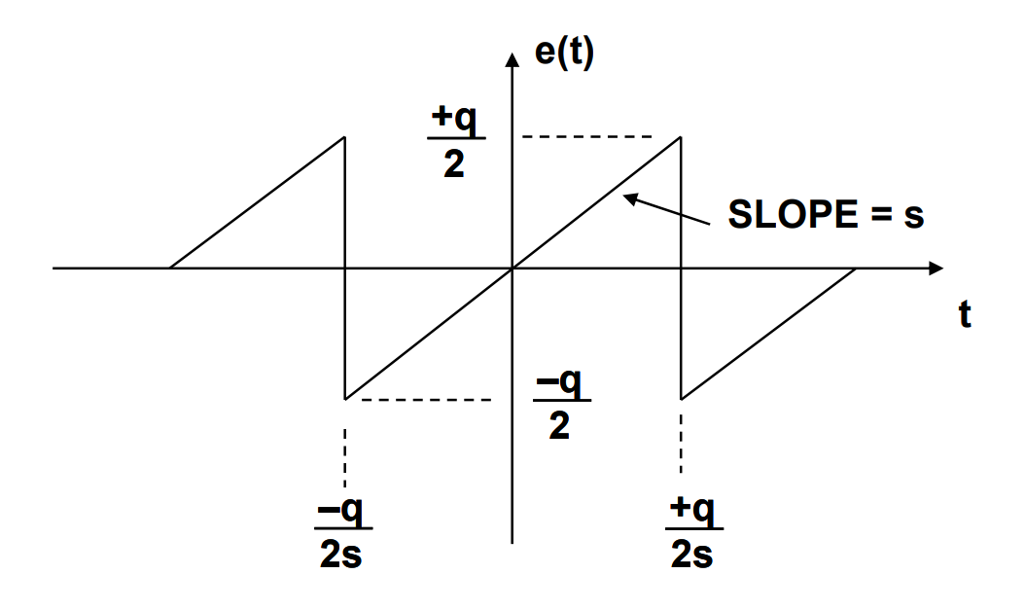
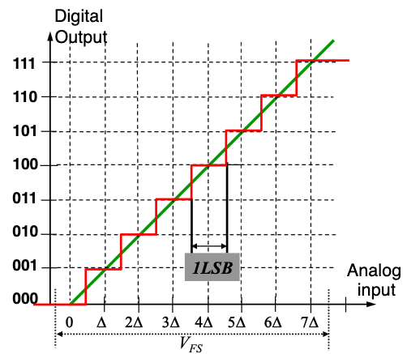

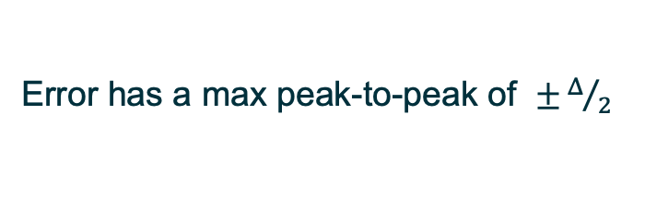
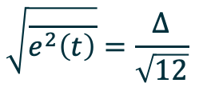



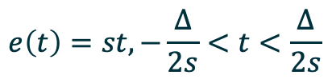

ADC Noise - Quantization
Quantization noise or quantization error or residue:
Difference between ideal output and real digital output
Error has a max peak-to-peak of $±Δ/2$
+$\frac{Δ}{2}$
Ideal converter (infinite number of bits)
-$\frac{Δ}{2}$
Real converter (finite number of bits)
-$\frac{Δ}{2s}$
+$\frac{Δ}{2s}$
$$e\left(t\right)=st, −\frac{Δ}{2s}<t<\frac{Δ}{2s}$$
$$\overline{e^{2}\left(t\right)}=\frac{s}{q}\int_{−Δ/2s}^{Δ/2s}{{\left(st\right)}^{2}}dt= \frac{Δ^{2}}{12}$$
H. Khorramabadi (UCB)
rms quantization noise =
$$\sqrt{\overline{e^{2}\left(t\right)}}=\frac{Δ}{\sqrt{12}}$$

Slide 17
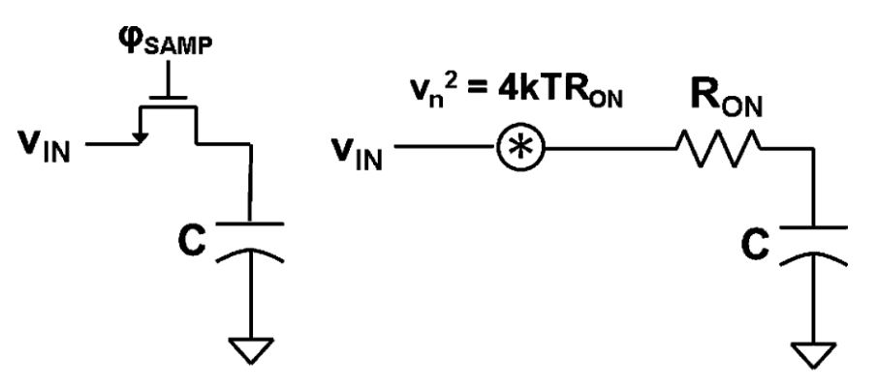
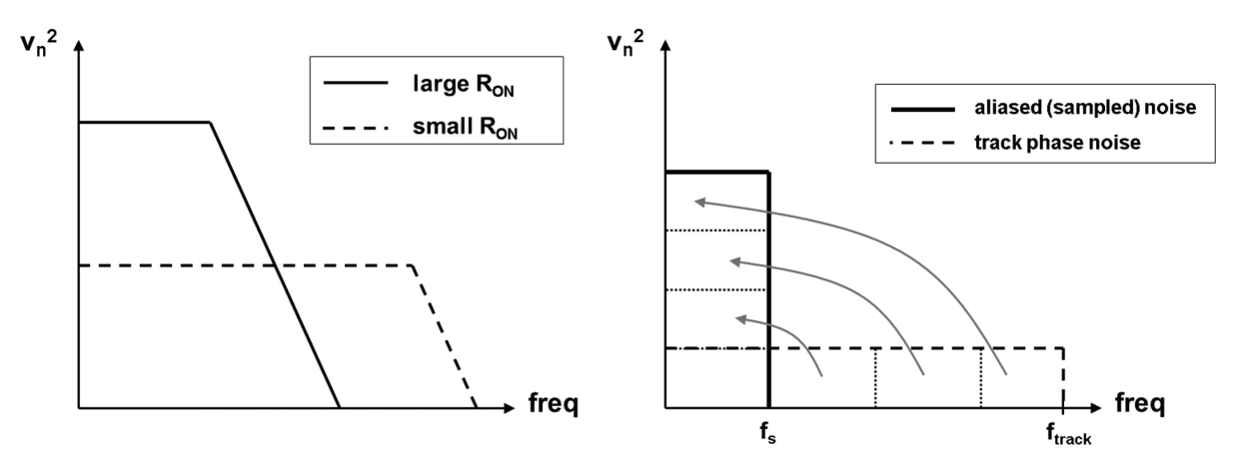
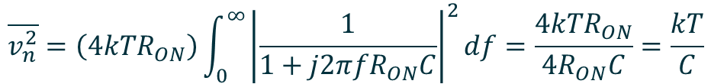
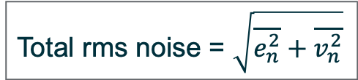
ADC Noise - Thermal
Thermal noise generated by resistances in the circuit (rms level determined by capacitors when sampled)
$$\overline{v_{n}^{2}}=\left(4kTR_{ON}\right)\int_{0}^{∞}{{\left|\frac{1}{1+j2π{fR}_{ON}C}\right|}^{2}df=\frac{{4kTR}_{ON}}{{4R}_{ON}C}=\frac{kT}{C}}$$
Thermal noise depends on sampling capacitance. Fundamental tradeoff between noise, speed, and power
Total rms noise = $\sqrt{\overline{e_{n}^{2}}+\overline{v_{n}^{2}}}$

Slide 18
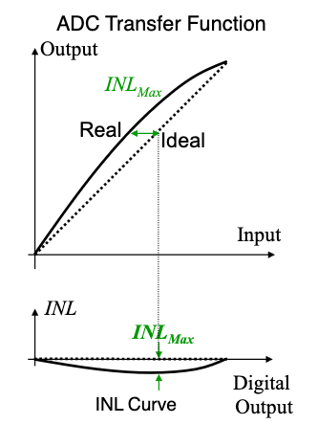
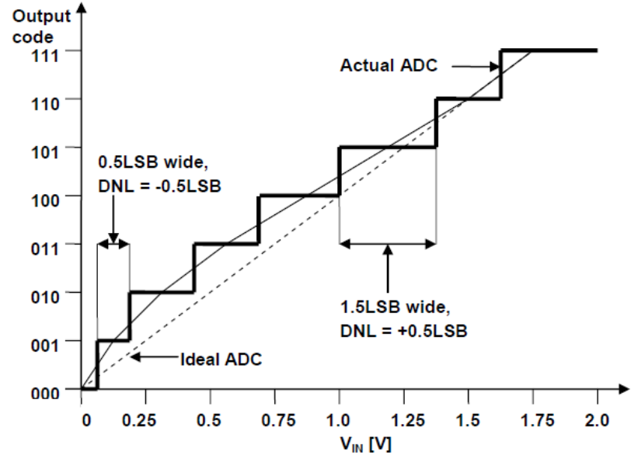
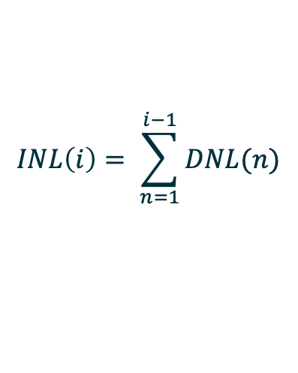
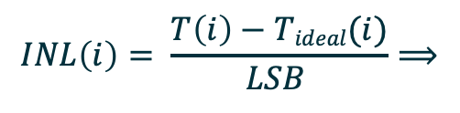
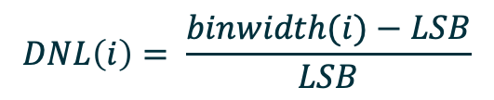
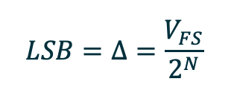
ADC Static Linearity
Often a key specification, and defines the accuracy of the ADC (as opposed to raw resolution)
Two main static linearity measurements: Differential Nonlinearity and Integral Nonlinearity
Simpler in practice than they seem.
$$LSB=Δ=\frac{V_{FS}}{2^{N}}$$
DNL: deviation of code width from Δ
ΙNL: deviation of code transition from its ideal location
$$DNL\left(i\right)= \frac{binwidth(i)−LSB}{LSB}$$
$$INL\left(i\right)= \frac{T\left(i\right)−Tideal(i)}{LSB }⟹$$
$$INL\left(i\right)= \sum_{n=1}^{i−1}{DNL(n)}$$

Slide 19
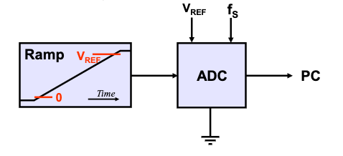
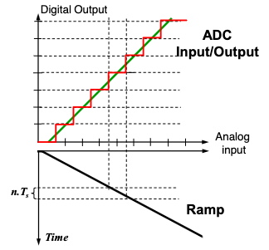
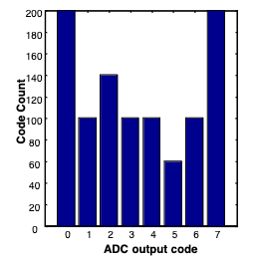
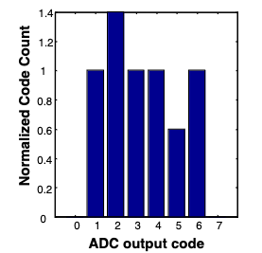
Testing ADC Static Linearity
H. Khorramabadi (UCB)
Knowing how to test an ADC is critical, because it:
1. informs your design choices
2. testing techniques can often be adapted to simulation
General approach:
1. Apply test signal with known probability density function (PDF)
2. Create histogram of measured ADC codes
3. Map measured probability mass function to expected PDF
4. Interpret per-code deviations as DNL and sum DNL to get INL
Example:
Ramp Based Testing: Apply a ramp to ADC input. PDF is uniform (simple!)
DNL for each code is simply count for that code minus average count (simple!)
Don’t need many codes - for 0.01 LSB resolution → 100 samples/code
- for N bit ADC → 2^{N}*100 total samples
Create histogram – remove over-range bins – calculate average count/bin and normalize
Catch: difficult to generate a linear ramp, and typically you want your test signal to be 10X more linear than ADC. Most commercial ramp generators are linear to only 8-10 bits.
Raw
histogram
Normalized
histogram

Slide 20
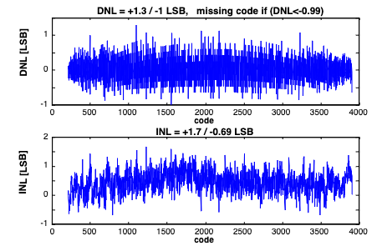
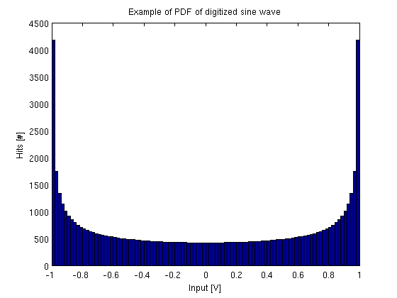
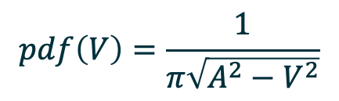
Testing ADC Static Linearity
Solution sine-wave-based testing
It is much easier to generate a linear sine than ramp → can heavily filter
PDF of sine is more complicated than ramp
$$pdf\left(V\right)=\frac{1}{π\sqrt{A^{2}−V^{2}}}$$
“bathtub”
For details:
[1] EE247 Lectures UCB (Matlab code available)
[2] M. V. Bossche, J. Schoukens, and J. Renneboog,
“Dynamic Testing and Diagnostics of A/D Converters,” IEEE
Transactions on Circuits and Systems, vol. CAS-33, no. 8,
Aug. 1986
[3] IEEE Standard 1057

Slide 21
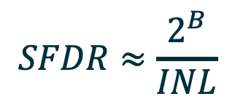

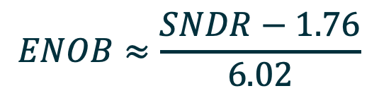
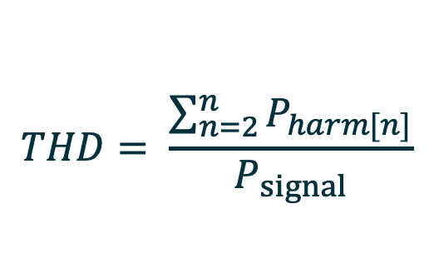
ADC Dynamic Performance
SNDR: Captures both noise and nonlinearity into a single measure.
Assuming a full-scale sine wave input, SNDR is:
$$SNDR=\frac{Psignal}{Pnoise+Pdistortion}$$
SFDR: Difference between input tone and highest harmonic.
Rule of thumb for estimating SFDR:
$$SFDR≈\frac{2^{B}}{INL}$$
THD: Ratio of power of fundamental to sum of powers of all harmonics
$$THD= \frac{\sum_{n=2}^{n}{P_{harm[n]}}}{P_{signal}}$$
ENOB: Number of bits of ideal ADC that gives same SNDR as ADC under test.
When quantization = thermal, ENOB = N-1
$$ENOB≈\frac{SNDR−1.76}{6.02}$$

Slide 22
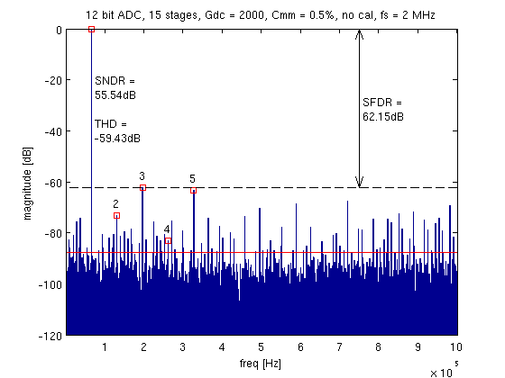
ADC Dynamic Performance – example plot
Here, ENOB = (55.54 – 1.76)/6.02 = 8.9 bits

Slide 23
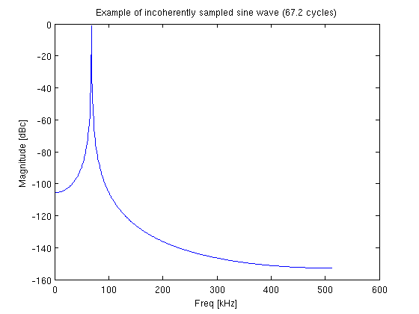
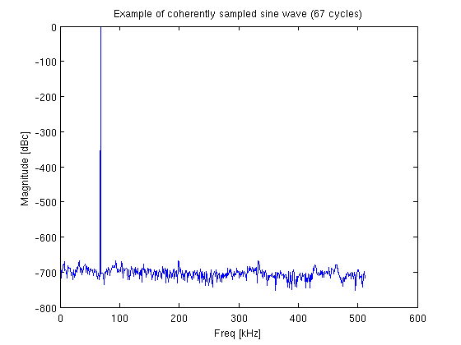

ADC Dynamic Performance – Coherent Sampling
General technique: apply pure sine wave to ADC and take FFT of resulting output codes
$$f_{in}=\frac{N_{cycles}}{N_{samples}}f_{s}$$
Vitally important that all power of input tone is in single FFT bin → Coherent Sampling
Tip: pick prime # of cycles
VERY useful for top-level simulation (and testing!) of ADCs

Slide 24
ADC Testing Takeaways
Make sure your reference & power are significantly more stable than your ADC
Make sure your test signal is significantly more linear than your ADC
Make sure your board and input have extremely low noise during noise tests
Make sure you use coherent sampling for dynamic testing
Make sure you lock both the signal generator and the ADC clock to the same time base

Slide 25


ADC Performance Space
Golden reference for ADC performance space:
B. Murmann, "ADC Performance Survey 1997-2024," [Online]. Available: https://github.com/bmurmann/ADC-survey.
S. Chen, R. Brodersen, “A 6-bit 600-MS/s 5.3-mW Asynchronous ADC in 0.13-μm
CMOS: IEEE J. of Solid-State Circuits, Vol. 41, No. 12, December 2006.

Slide 26




Impact of ADCs (Digital Audio example)
Fairlight CMI
1979: $32000
($132k in 2024)
Genesis, Stevie Wonder,
Duran-Duran
Akai MPC-One
2024: $599
E-mu Emulator II
1984: $8000
($23k in 2024)
Front 242, Depeche Mode,
New Order, Bowie, Vangelis
Akai S-1000
1988: $2500
($6350 in 2024)
Boards of Canada, Cabaret Voltaire,
Portishead, and Everyone!

Slide 27
ADC Architectures

Slide 28
ADC Architectures
HEP Relevant ADC architectures from slowest to fastest. Note: Everything was invented by 1970.
Integrating (“Wilkinson”)
Sigma-Delta
Successive Approximation
Pipelined
Flash

Slide 29




Integrating ADC (and single-slope)
Single-slope ADC:
- T1 proportional to Vin
- Counter output proportional to T1-n*Tclk
Dual-Slope ADC:
- Vin integrated for a fixed amount of time
- Then de-integrated with Vref until Vo=0
- Remove R (direct charge readout) to make a Wilkinson

Slide 30

Oversampling
When fs>>2fm, filtering is easier!
Spread constant noise power over a larger bandwidth and then digitally filter → reduced quantization noise
Extend this by shaping the noise (pushing more of it to higher frequencies where it can be filtered)

Slide 31




Sigma-Delta ADC
Loop order is defined as number of poles in H(z)
Idea: Don’t just oversample, modulate the input to put more of the quantization noise power at higher frequencies
Key Idea: signal sees low-pass filter,
quantization noise sees high-pass filter.
- Oversampling ratio M = f_{s}/2_{fsignal}
- Average of Y approximates X (digital filtering!)=
- 2X increase in M -> 9db (1.5bit) increase in dynamic range
For more details:
S. Pavan, R. Schreier, G. C. Temes, and R. Schreier, Understanding delta-sigma data converters, IEEE Press/Wiley, 2017.
$$SNQR≈−3.4dB+30∗logM$$

Slide 32


Successive Approximation (SAR) ADC
Simple 6-bit example
- Directly implements binary search algorithm in hardware
- High accuracy possible (>16bits)
- Requires N clock cycles for N-bit conversion -> moderate speeds
- Most common type: charge redistribution SAR ADC

Slide 33



Pipelined ADC
H. Khorramabadi (UCB)
Combining the bits
- Cascade several low resolution stages to obtain high overall resolution
- Each stage processes the (amplified) quantization error of previous stage
- Stages can operate concurrently! -> higher speeds
- Latency function of number of stages
- Example: Three 2-bit stages
- The gains between stages are 2^{Bieff}
- Then to combine bits:
$$D_{out}=D_{1}+\frac{1}{2^{B_{1eff}}}D_{2}+{\frac{1}{2^{B_{1eff}}∙2^{B_{2eff}}}D}_{3}$$

Slide 34

Flash ADC
- Very fast.
- Very power Hungry.
- Limited to about 8 bits.
-Used as sub-ADCs in multi-stage ADCs
Sources of error:
- DC offset
- Non-linear input capacitance
- Signal feedthrough
- Signal kickback

Slide 35



Flash ADC
TRW TDC1007 8-bit, 20 MS/s Flash ADC enabled new field of “digital video”
Won technical Emmy for analog/digital video conversion technology in 1989!
ADC designers are creative.

Slide 36
ADC requirements for
High-Energy Physics

Slide 37






In the dark ages*…
IC Development at UC Berkeley
Hodges Flip-Flop (1963)
Ion Implanter
David Hodges
William Black
Mask Camera
Paul Gray
Paul McCreary
*1960s – 1970s
First all-MOS ADC (1975)!
Stephen Lewis – First CMOS Pipelined ADC (1986)

Slide 38






The rise of the Custom ASIC
1960s : Only a few Universities made chips
Late 70s : Technology for Multi-Project Wafers (Mead and Conway)
1981 : Founding of MOSIS with DARPA support
1987 : MOSIS commercialized (first large-scale eCommerce application on the Internet)
Also 1987 : TSMC founded (and Fabless Semi industry was born!)
Trivia alert! The same DARPA program led to the development of the first hardware description language, VHDL.

Slide 39




First Physics ASICs
Microplex – first custom ASIC for Physics Research
SVX – First CMOS ASIC for Physics Research
6.3 mm
11,000 transistors
CDF experiment used 240 SVX chips → 30720 channels
Already at discrete limit
6.3 mm
NMOS process (no P-channel devices) - SLAC - 1984
CMOS process (with P-channel devices) - LBNL - 1987
128 channels
3 mW / channel
Walker, Parker, Hyams, Shapiro, “Development of High Density Readout for Silicon Strip Detectors,” NIM 226 (1984)
128 channels
1.25 mW / channel
Kleinfelder, et al.; “A Flexible 128-Channel Silicon Strip Detector Instrumentation Integrated Circuit with Sparse Data Readout”, TNS 35 (1988)
Technology soon advanced to make on-chip ADCs practical

Slide 40



Unique Challenges for HEP ADCs
Physics experiments often create extreme environments for their readout ASICs
High Radiation
Cold Temperature
Liquid Argon
ATLAS Detector
ProtoDUNE LAr TPC

Slide 41


Unique Challenges for HEP Custom ADCs - Radiation
Two main types of radiation damage to integrated circuits that concern us:
Single Event Upsets: transient effects that could modify data or lead to incorrect data
- affect memory and logic circuits
Total Ionizing Dose: structural damage to silicon structure that leads to failures:
- threshold shifts, leakage currents, oxide degradation etc

Slide 42


Radiation -- Total Ionizing Dose (TID)
Requirements for TID radiation tolerance for physics far exceed any commercial application
F. Faccio

Slide 43


Radiation -- Total Ionizing Dose (TID)
Key mitigations:
use scaled technologies -> reduced charge collection volume (Microplex and SVX only radiation tolerant to 10s of krad)
“Hardness-By-Design” techniques (enclosed layout / guard rings / shielding)
F. Faccio

Slide 44




Radiation – Single Event Upsets (SEUs)
Key mitigations: Triple Modular Redundancy (TMR), Hamming encoding, continuous reconfiguration
Triple Modular Redundancy (TMR)
Continuous Reconfiguration
Hamming encoding
K. Berg

Slide 45



Cryogenic Operation
Reliability and biasing drift
Functionality, Threshold Shifts
Negative resistance and hysteresis. Carrier freeze out also an issue.
180 nm
“Hot” carriers cause early device aging

Slide 46


What’s Next?
Architectures that harness the unique capabilities of scaled CMOS to improve efficiency
Examples
Pipelined SAR
Asynchronous SAR

Slide 47

Thank You
This work was supported in part by the U.S. Department of Energy under Contract No. DE-AC02-05CH11231

Slide 48
Extra: Design Example

Slide 49


Design Example – Sigma-Delta ADC
Goal: 12b – 100 kHz ADC for power monitoring
Synthesize ADC transfer function in MATLAB or Python
Doubling OSR improves
SQNR by (6L+3) dB
or L + 0.5 bits
Choose 2nd order modulator

Slide 50

Design Example – Sigma-Delta ADC
Synthesized modulator close to ideal

Slide 51
Design Example – Sigma-Delta ADC
Implement transfer function coefficients as capacitor ratios
Modulator Schematic

Slide 52

Design Example – Sigma-Delta ADC
1st int
2nd int
Vinput
Filter out

Slide 53



Design Example – Sigma-Delta Digital Filter
Structure called Cascaded Integrator Comb (CIC) filter
$$H\left(z\right)={\left(\frac{1−z^{−OSR}}{1−z^{−1}}\right)}^{3}$$
For sinc³ filter:
Filter implemented with Verilog HDL

Slide 54


Design Example – Sigma-Delta ADC

Slide 55

Design Example – Sigma-Delta ADC filter layout

