Slide 1
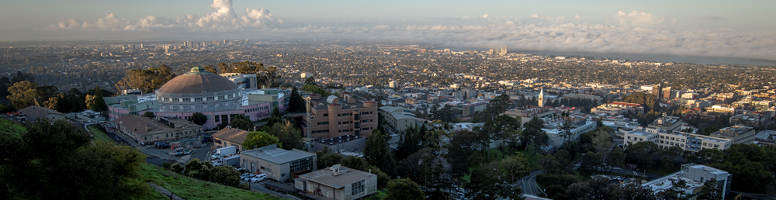
Custom ICs for Physics Research
HEPIC Summer School @ SLAC Seminar
Carl Grace 6/23/2025
Lawrence Berkeley National Laboratory

Slide 2
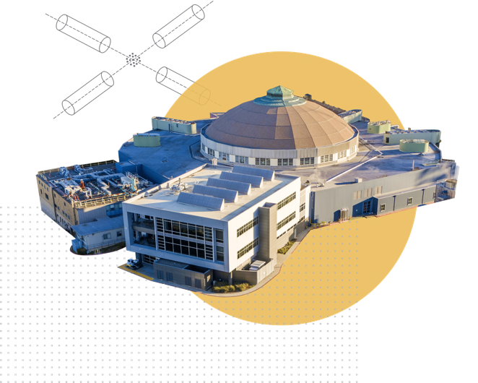

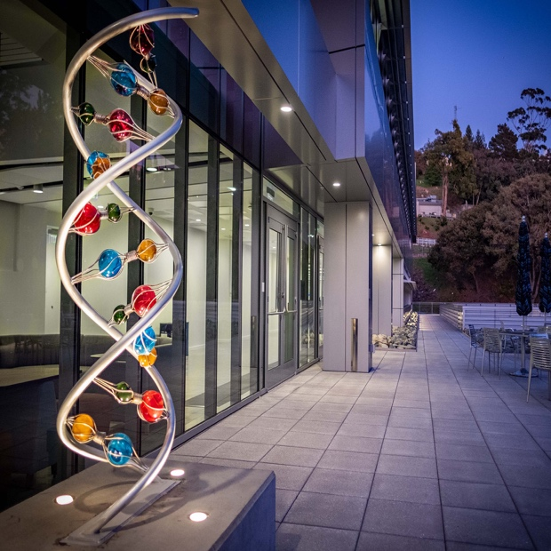
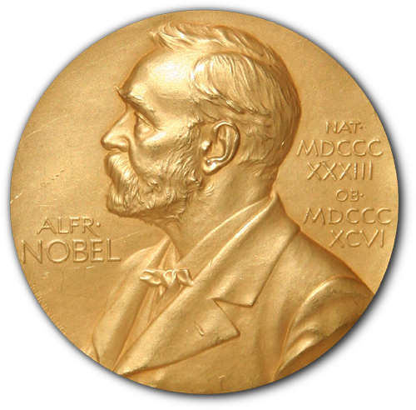

Lawrence Berkeley National Laboratory
MOST DIVERSE
US NATIONAL LABORATORY
Key Strengths
Physical Sciences, Computing, Biosciences, Earth and Energy Sciences, Materials, and Nanotechnology
EXCELLENCE IN SCIENCE
3800 employees
1000 students
16,350 users and visiting researchers
3018 publications in CY24
NATIONAL
USER FACILITIES
Advanced Light Source
National Energy Research Scientific Computing Center
Energy Sciences Network
Joint Genome Institute
Molecular Foundry (including National Center for Electron Microscopy)
16
NOBEL PRIZES
Most recent: 2020 Nobel Prize in Chemistry for co-discovery of CRISPR gene editing (Prof. Jennifer Doudna)

Slide 3
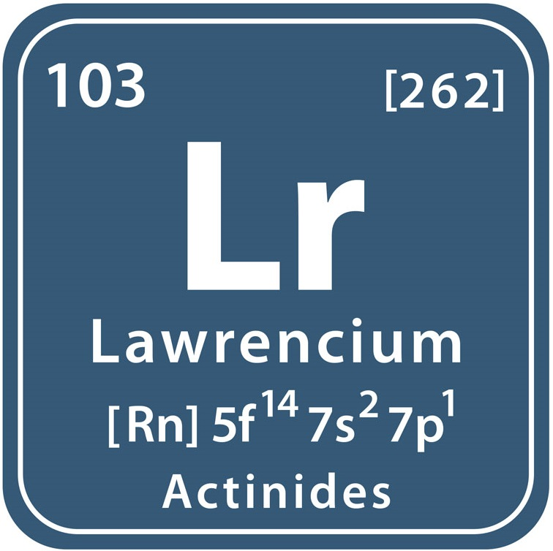
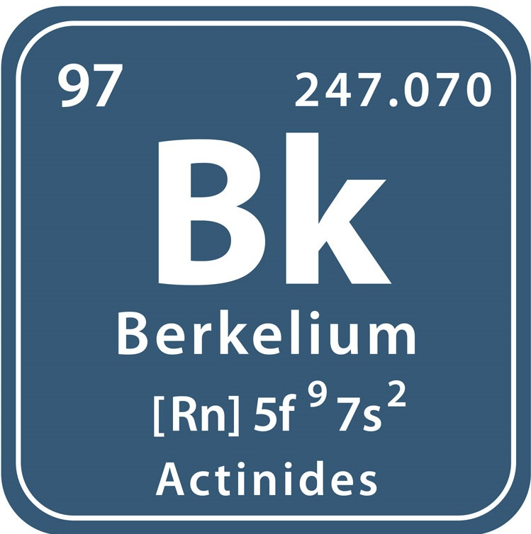
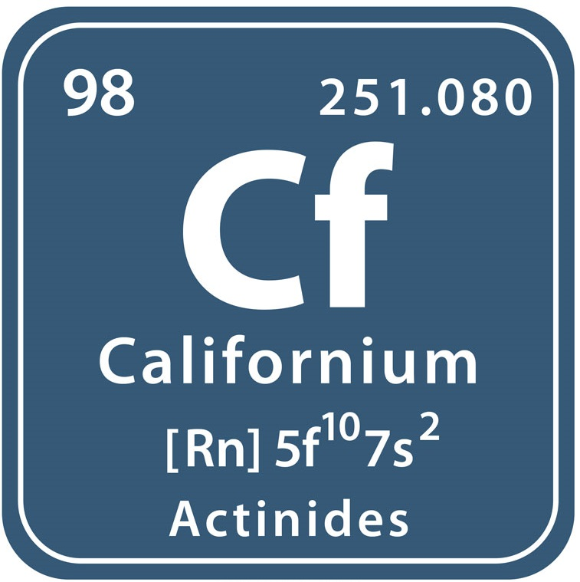
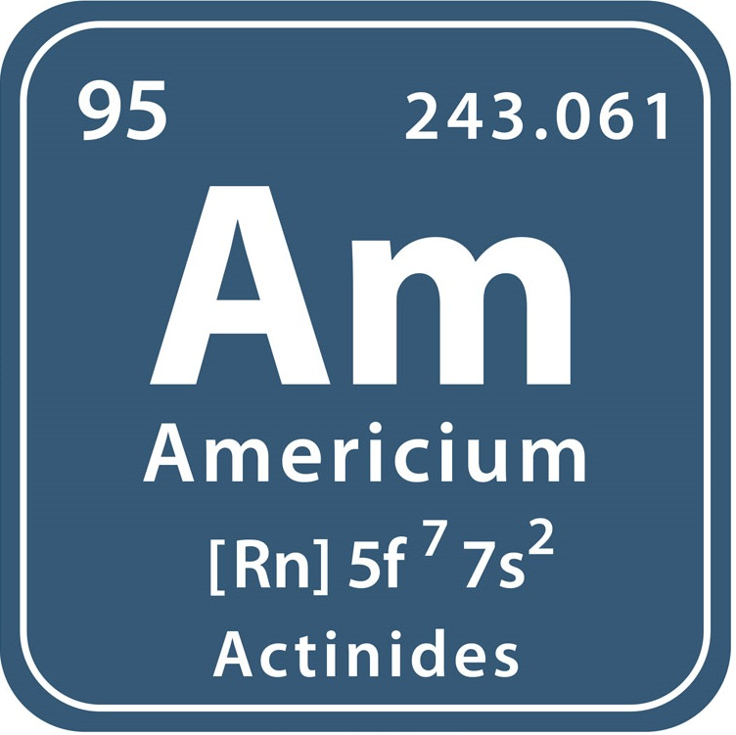
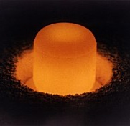
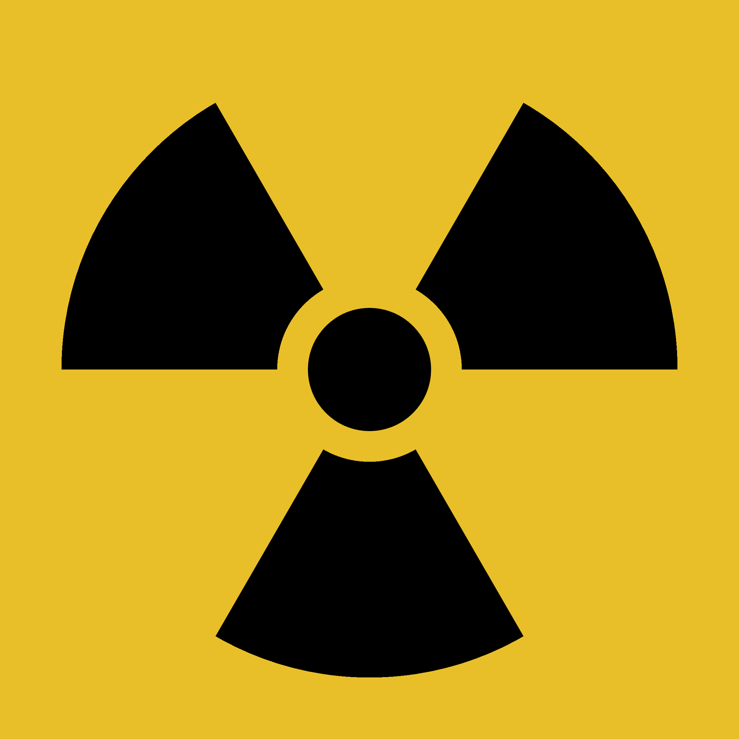
Fun Fact
At LBNL you can write your address in elements!
All discovered by LBNL along with 12 other elements!
Plutonium discovered in 1940 at LBNL
Radiation hazard trefoil invented in 1946 at LBNL

Slide 4

Introduction
Custom Integrated Circuits – also called Application-Specific Integrated Circuits (ASICs) - are an increasingly important technology for experimental physics
ASICs are an enabling technology. Without ASICs, many modern detector systems would not be feasible
The goal of an ASIC in HEP is to generate data that physicists can turn into papers

Slide 5
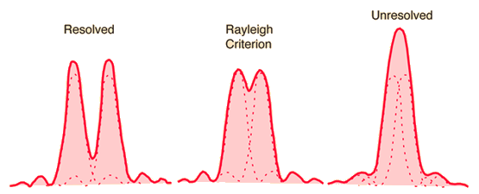
How do we study the Universe?
Probably the best way, is to look at it!
Basic fact in science: Rayleigh Criterion. To see features of something, the probe (light in many cases) must be smaller than the features you wish to see

Slide 6
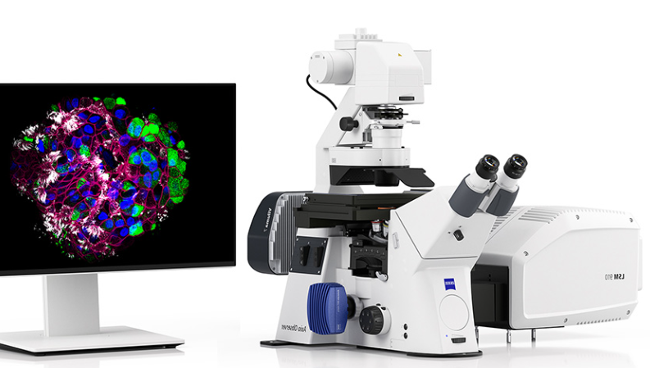
Biology – 10⁻⁶ m (eV). Probe = visible light

Slide 7
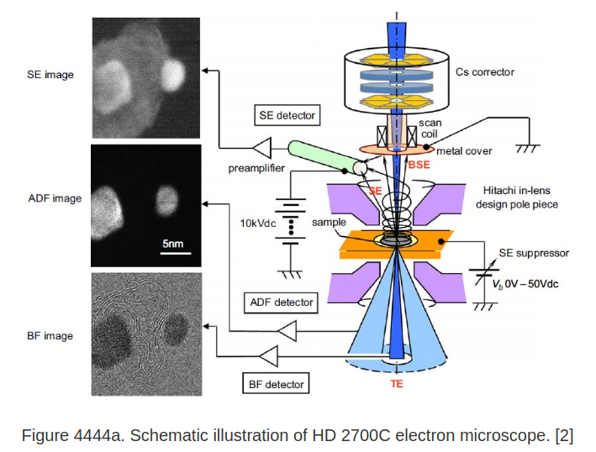
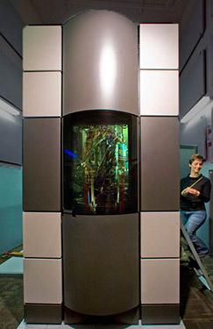
Chemistry / Mat. Sci. – 10⁻⁹ m (keV) Probe: electrons

Slide 8
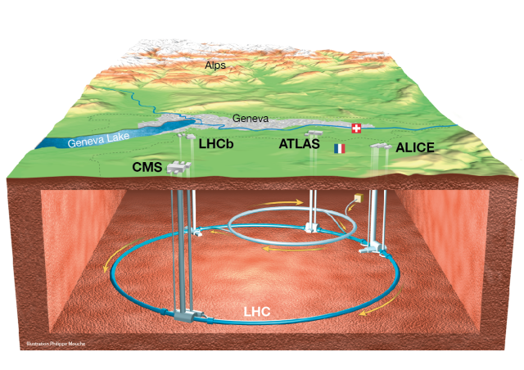
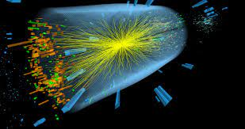
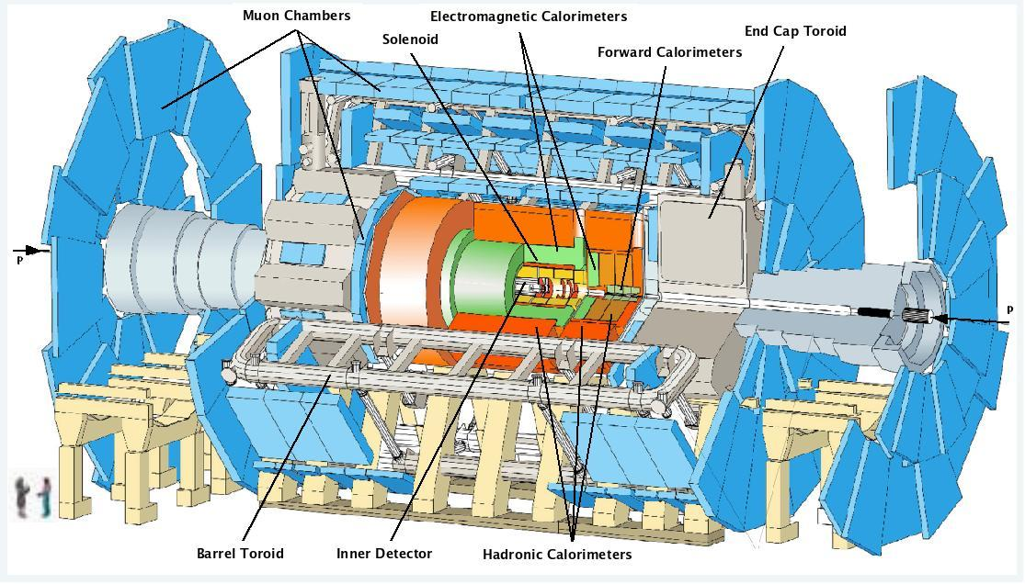
Particle Physics – 10⁻¹⁸ m (TeV) Probe: hadrons

Slide 9
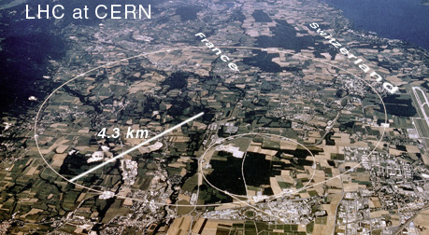
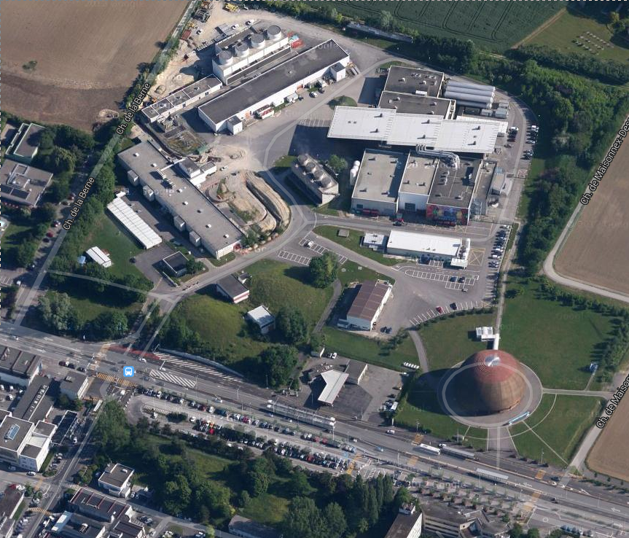
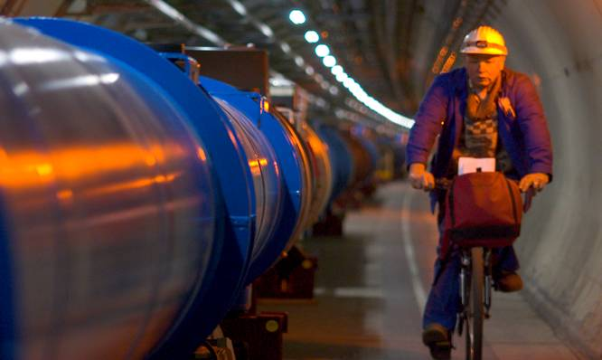
LHC+ATLAS is a microscope
Typical microscope = light source + camera
Best microscope = brightest light source + highest res. camera
Our kind of Microscope = collider + detector
Best Microscope there is = LHC + ATLAS
Detector is 300ft under here
White circle is 300ft underground

Slide 10
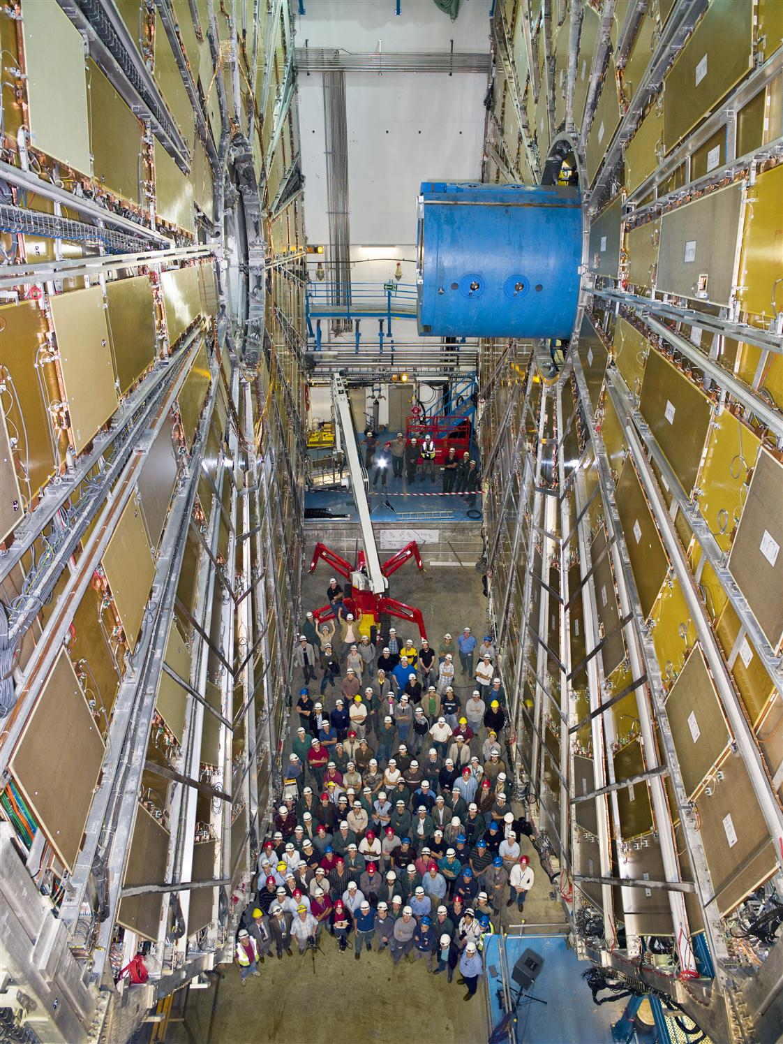
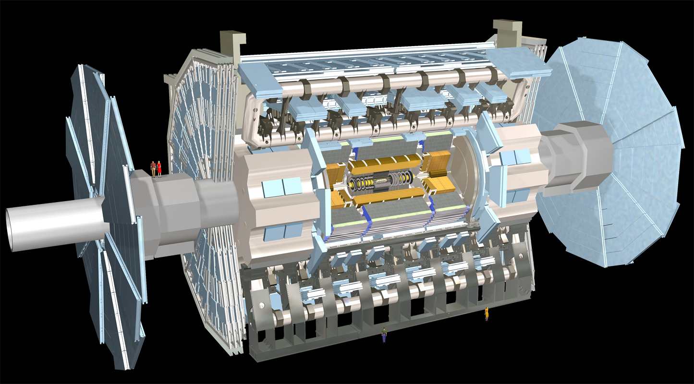
What does it do?

Slide 11
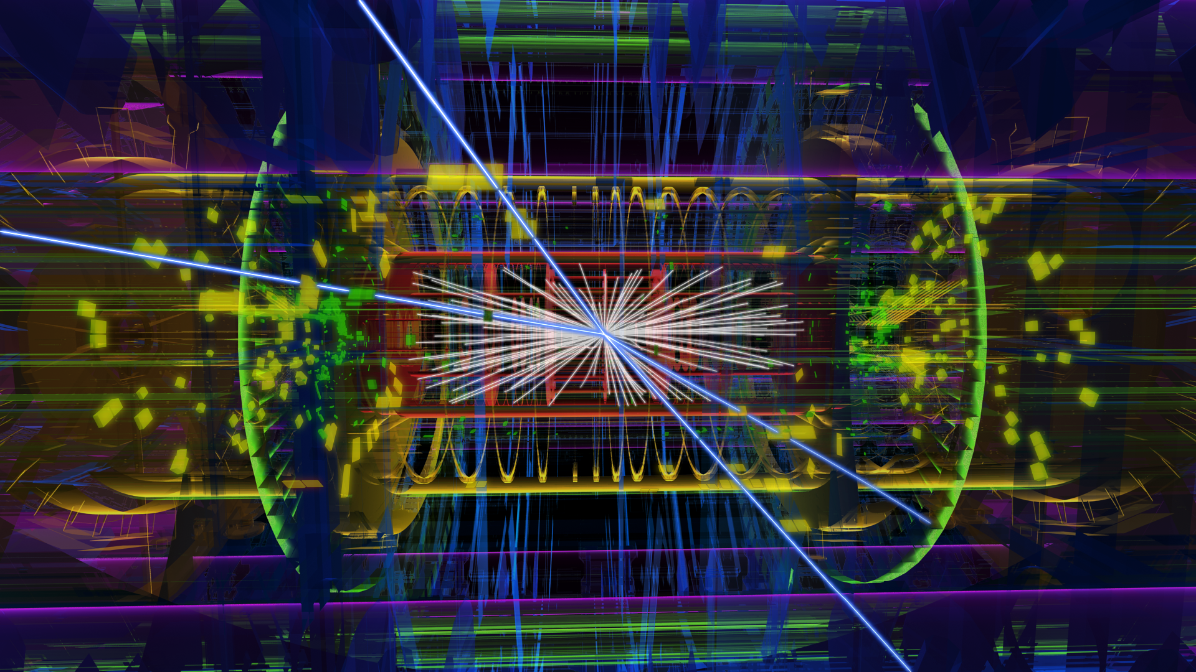
Takes multi-media snapshots of collision events

Slide 12
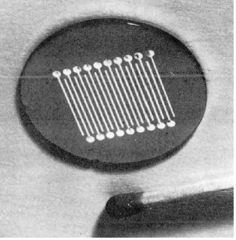
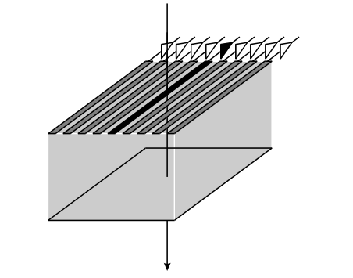
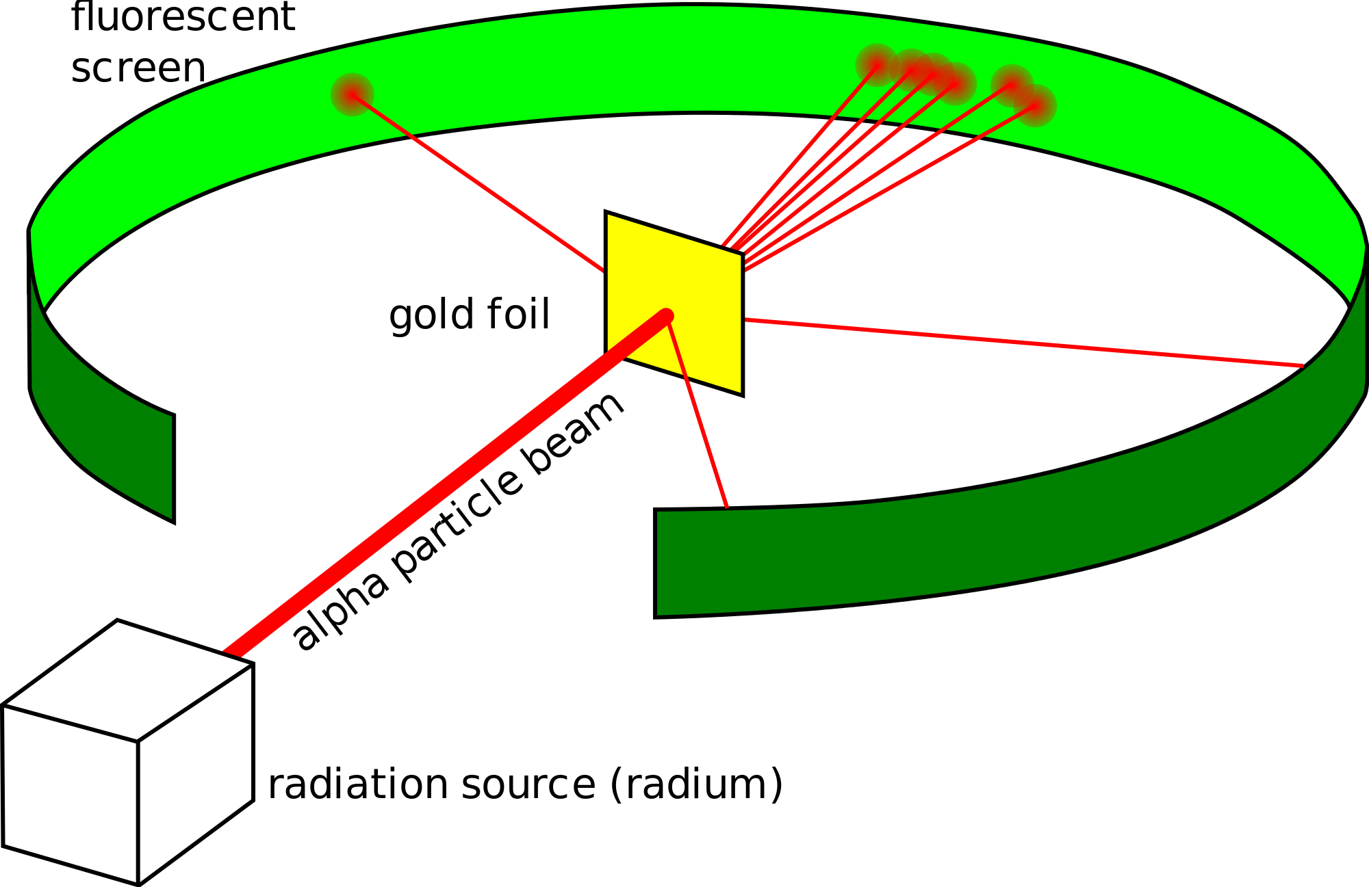
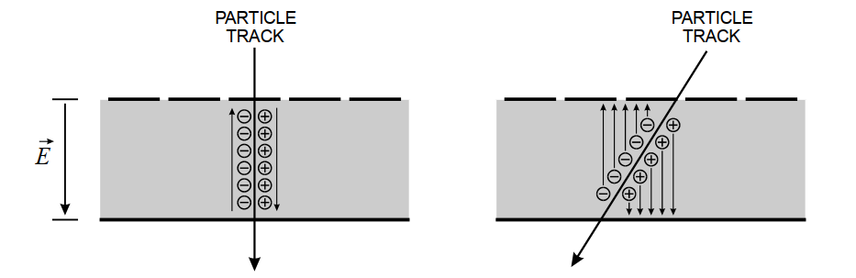
Detector Readout
Rutherford’s discovery of the atomic nucleus (1909)
Detector: Fluorescent Screen
Readout Technology: Eyeball
Worked great! But not exactly scalable…
H. SPIELER
Detector: Silicon Strip (1970s)
Readout Technology: Electronics
Major advance in particle tracking. Is it scalable?

Slide 13
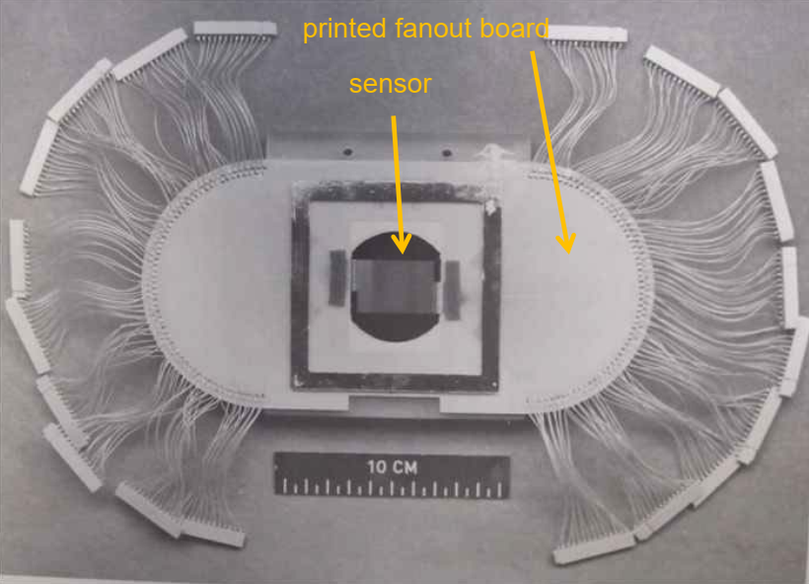
Silicon Strip Readout
State of the art ~ 1980
256 channel strip detector
Readout is implemented using rack of discrete amplifiers and line drivers.
Clearly this is not scalable.
C. HABER

Slide 14
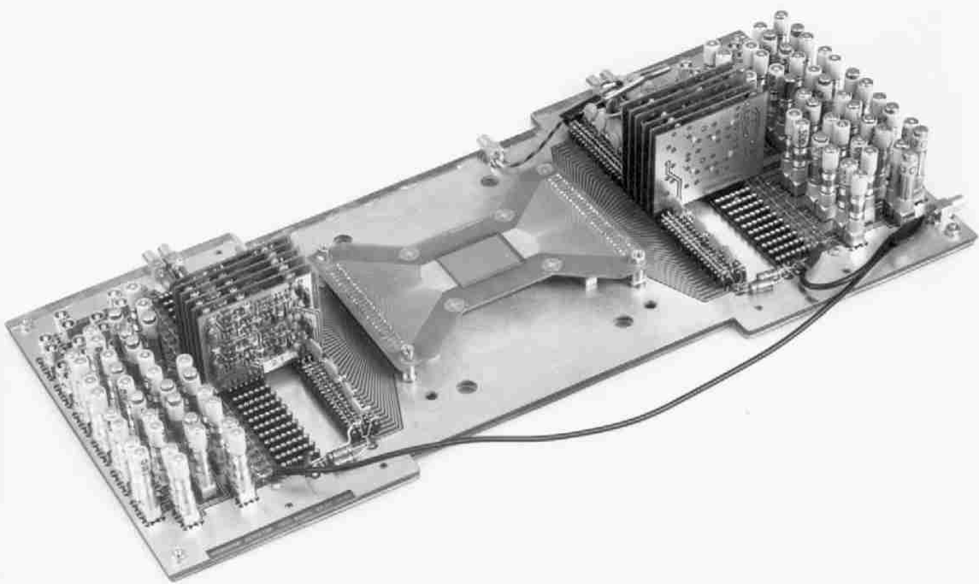
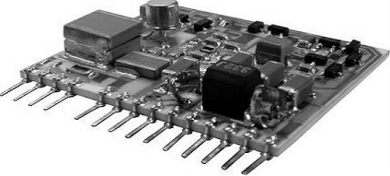
Silicon Strip Readout
NA11 experiment at CERN (1984) measured charm lifetimes.
NA11 deployed community’s first silicon vertex detector using a 128-channel strip detector module.
Strip detector had 20 µm pitch, but state of the art for discrete readout channels (on PCBs now) was 60 µm.
Strips read out using 32 individual 4-channel boards requiring a LIMO connector per channel.
Better, but this is still not scalable. Great for 1000s of channels. Not so great for millions. End of the road?
128 channel Si Strip
4-channel readout cards
Individual readout card
~ 15 mW/channel
C. HABER

Slide 15
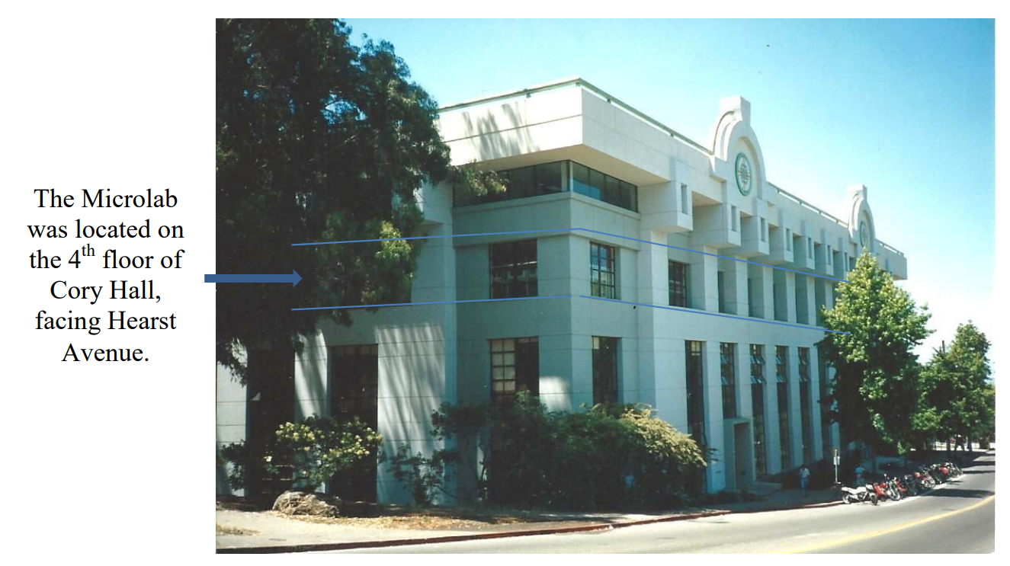
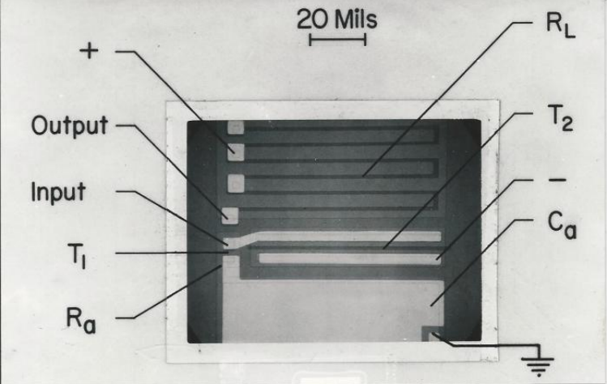
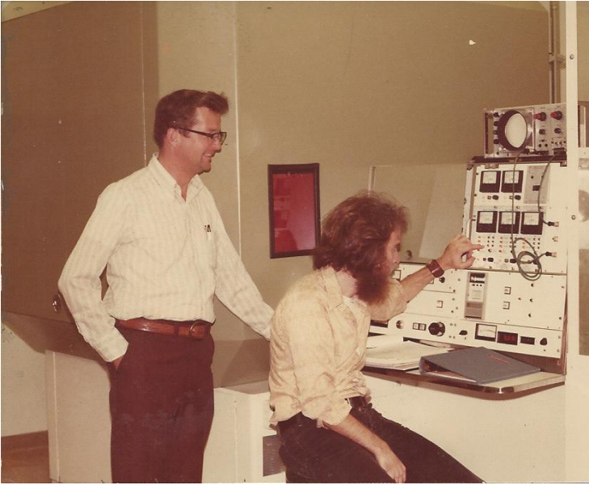
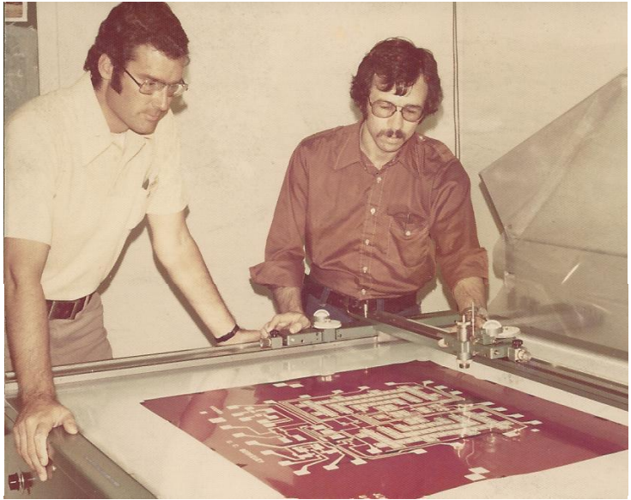
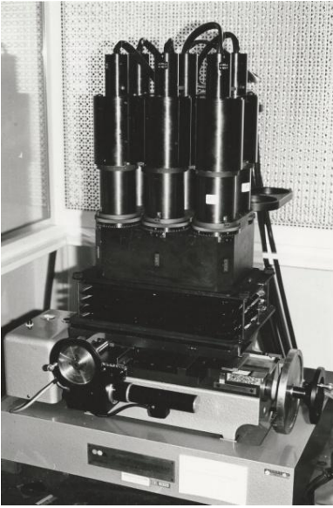
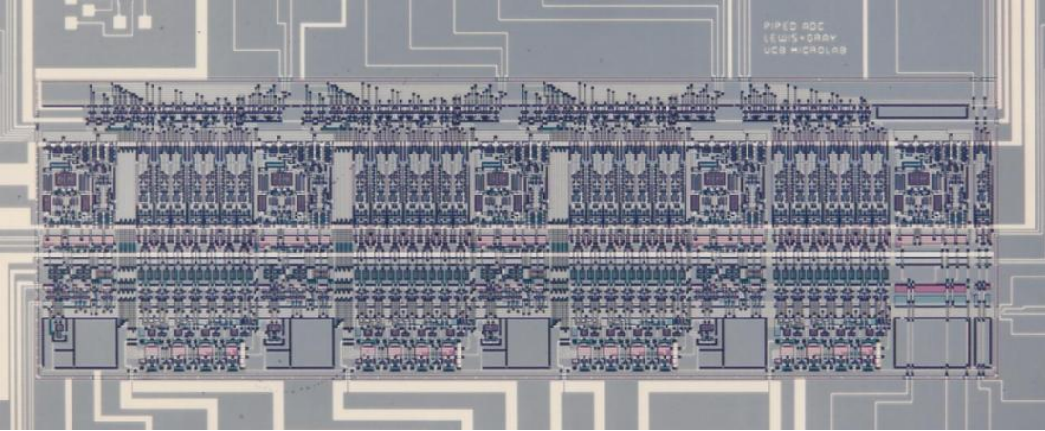
In the dark ages*…
IC Development at UC Berkeley
Hodges Flip-Flop (1963)
Ion Implanter
David Hodges
William Black
Mask Camera
Paul Gray
Paul McCreary
*1960s – 1970s
First all-MOS ADC (1975)!
Stephen Lewis – First Pipelined ADC (1986)

Slide 16


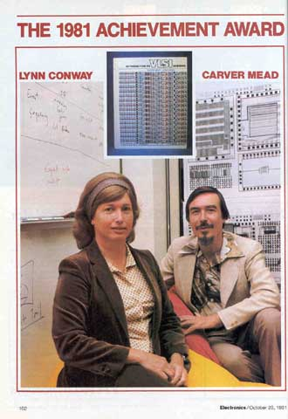

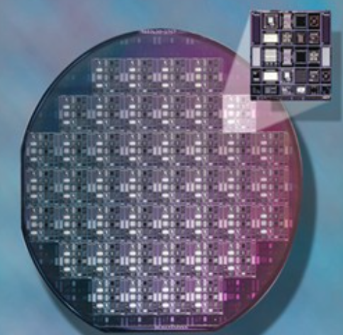

The rise of the Custom ASIC
1960s : Only a few Universities made chips
Late 70s : Technology for Multi-Project Wafers (Mead and Conway)
1981 : Founding of MOSIS with DARPA support
1987 : MOSIS commercialized (first large-scale eCommerce application on the Internet)
Also 1987 : TSMC founded (and Fabless Semi industry was born!)
Trivia alert! The same DARPA program led to the development of the first hardware description language, VHDL.

Slide 17
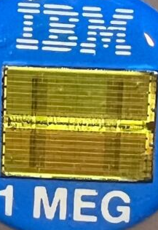
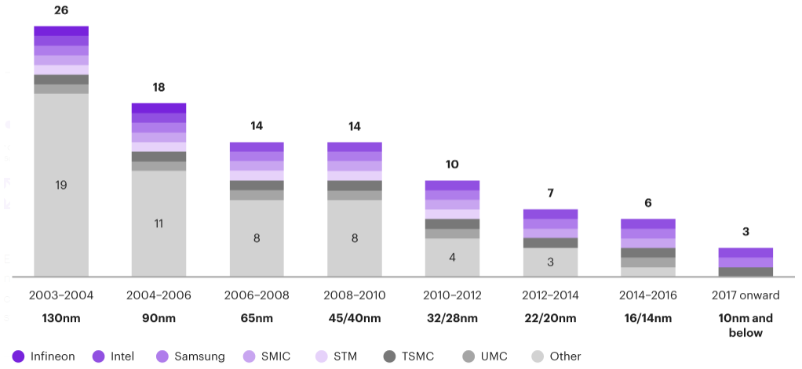
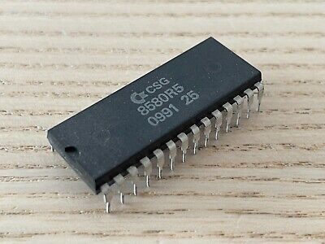
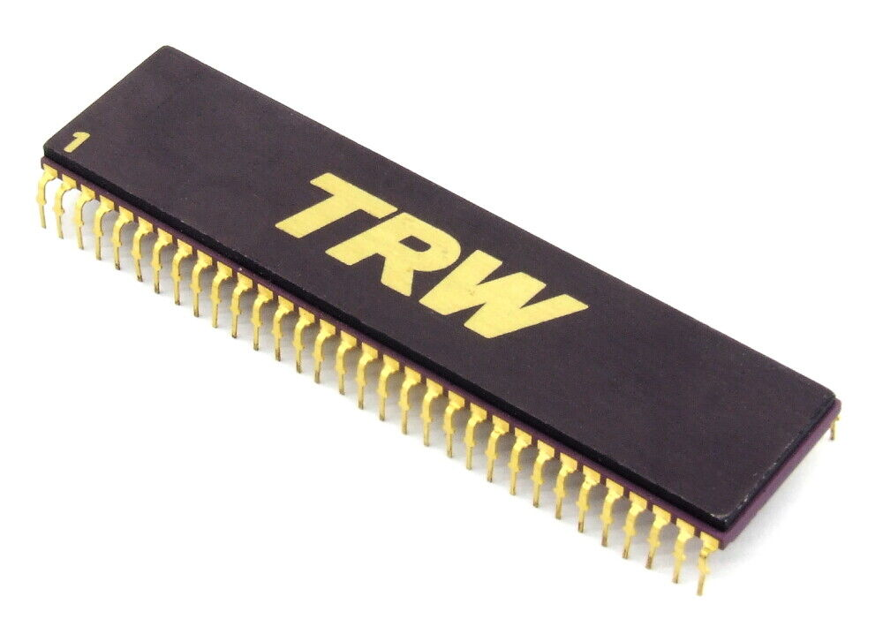
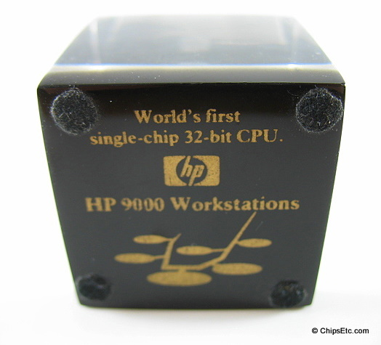
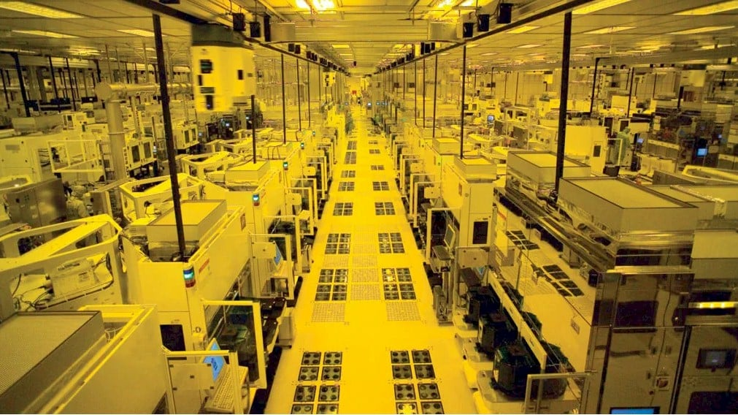
The decline of the “internal fab”
BEFORE
AFTER

Slide 18
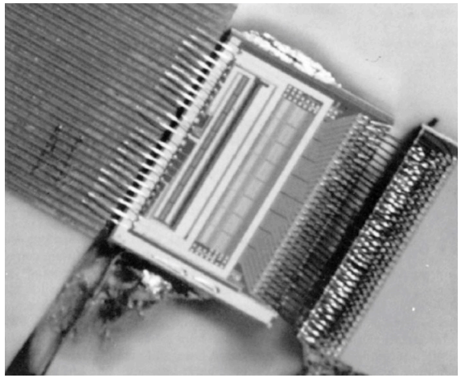
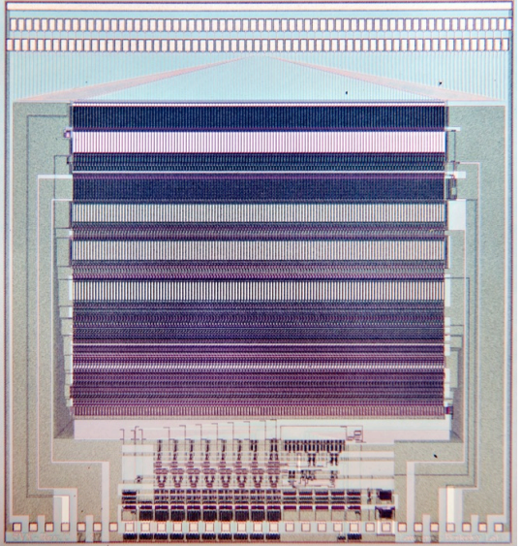


First Physics ASICs
Microplex – first custom ASIC for Physics Research
SVX – First CMOS ASIC for Physics Research
6.3 mm
11,000 transistors
CDF experiment used 240 SVX chips → 30720 channels
Already at discrete limit
6.3 mm
NMOS process (no P-channel devices) - SLAC - 1984
CMOS process (with P-channel devices) - LBNL - 1987
128 channels
3 mW / channel
Walker, Parker, Hyams, Shapiro, “Development of High Density Readout for Silicon Strip Detectors,” NIM 226 (1984)
128 channels
1.25 mW / channel
Kleinfelder, et al.; “A Flexible 128-Channel Silicon Strip Detector Instrumentation Integrated Circuit with Sparse Data Readout”, TNS 35 (1988)

Slide 19
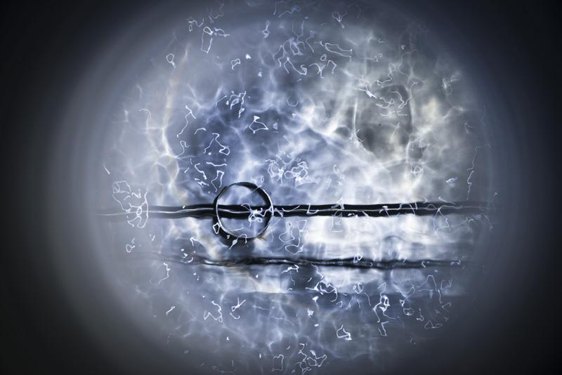
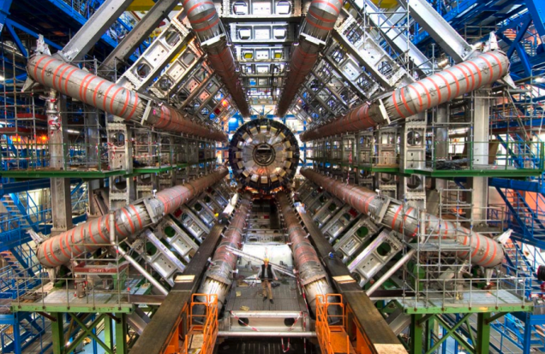
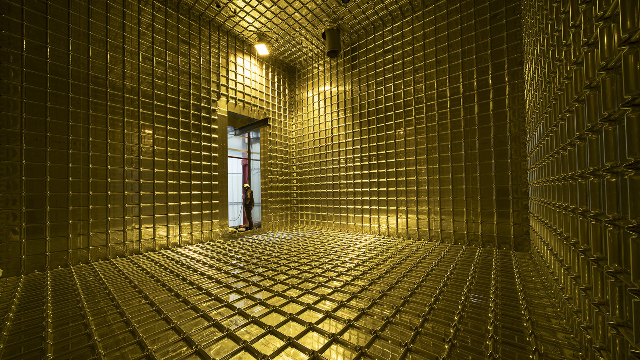
Challenges for Custom ASICs
Physics experiments often create extreme environments for their readout ASICs
High Radiation
Cold Temperature
Liquid Argon
ATLAS Detector
ProtoDUNE LAr TPC

Slide 20
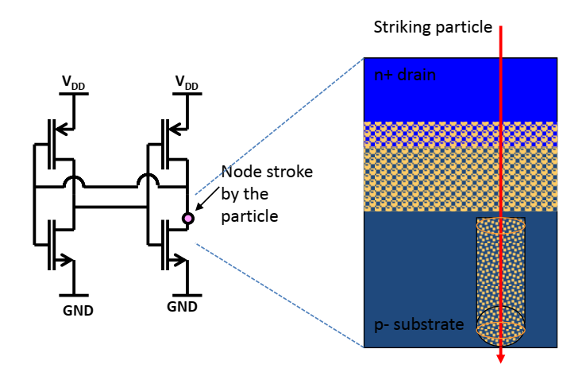

Challenges for Custom ASICs - Radiation
Two main types of radiation damage to integrated circuits that concern us (Single Event Latchup and Single Event Transients of less importance in HEP experiments)
Single Event Upset – transient effects that could modify data or lead to incorrect data
Total Integrated Dose – structural damage to silicon structure that leads to failures

Slide 21


Radiation -- Total Integrated Dose (TID)
Requirements for TID radiation tolerance for physics far exceed any commercial application
F. Faccio

Slide 22


Radiation – Single Event Effects (SEE)
Scaling devices makes ASICs more resilient to TID, but less resilient to SEE
C. Zamantzas
R. Gaillard

Slide 23




Radiation – Single Event Effects (SEE)
Key mitigations: Triple Modular Redundancy (TMR), Hamming encoding, continuous reconfiguration
Triple Modular Redundancy (TMR)
- Device level? Circuit? Module?
Continuous Reconfiguration
Hamming encoding
K. Berg

Slide 24



Cryogenic Operation
Reliability and biasing drift
Functionality, Threshold Shifts
Negative resistance and hysteresis. Carrier freeze out also an issue.
180 nm
“Hot” carriers cause early device aging

Slide 25


Typical ASICs for HEP
Typical large physics experiments use capacitive detectors:
For example, reverse-biased diodes for charged particles, microchannel plates, wires (e.g. in drift chambers), pixels or silicon photomultipliers (SiPMs) for photons (also can be used with scintillators)
Trend is towards lower noise, improved time and energy resolution, operation in extreme environments, reduced power, and increased number of channels
Importance of ASICs in physics research is increasing
Typical multi-channel physics ASIC
Typical timing ASIC
Rivetti “CMOS Front End Electronics for Radiation Detectors”

Slide 26




ASIC for Physics Example: ATLAS Inner Tracker (ITk)
ATLAS Detector
Large Hadron Collider – Switzerland and France
ATLAS Inner Tracking Detector (ITk)

Slide 27



ASIC for Physics Example: ATLAS Inner Tracker (ITk)

Slide 28

ASIC for Physics Example: ATLAS Inner Tracker (ITk)
RD53A – test chip prior to ITk chip
ITk will have 13 m² active area or 1.4 Billion pixels!
Analog island in a sea of synthesized digital logic.
More of a “commercial” design methodology than previous HEP chips.

Slide 29


On 8 October 2013 the Nobel prize in physics was awarded jointly to François Englert and Peter Higgs "for the theoretical discovery of a mechanism that contributes to our understanding of the origin of mass of subatomic particles, and which recently was confirmed …
by the ATLAS and CMS experiments at CERN's Large Hadron Collider."
Actual Event showing the creation of a Higgs Boson, 10/19/2017 @ 11:30 PM, Geneva time

Slide 30
Silicon Tracker Summary
Name | Microplex | SVX | D-OMEGA | LHC1 | FE-I3 | FE-14 | RD53A | ITkPixv1
Year | 1984 | 1987 | 1991 | 1996 | 2005 | 2011 | 2017 | 2021
Node [µm] | 5 | 3 | 3 | 1 | 0.25 | 0.13 | 0.065 | 0.065
Chip Size [mm] | 4.4 x 6.4 | 6.3x6.3 | 8.3x6.6 | 6.6x3.5 | 10.8x7.6 | 10.2x19 | 20x10 | 20x20
Pixel Size [µm] | 47.5 (pitch) | 50 (pitch) | 70x500 | 50x500 | 50x400 | 50x250 | 50x50 | 50x50
Number of Pixels | 128 (strips) | 128 (strips) | 1008 | 2032 | 20k | 26.9k | 79.2k | 158.4k
Transistor Count | ? | 11000 | ? | 800k | 3.5M | 80M | 311M | 600M

Slide 31


ASIC for Physics Example: The DUNE Experiment
The Deep Underground Neutrino Experiment (DUNE) is an international science collaboration focused on neutrinos
Key Purpose:
Enable the search for CP Violation
Help us understand the matter/antimatter
imbalance of the universe.
LBNL is leading the development of the Near Detector (ND) and has an important role in the cold electronics for both the ND and Far Detector (FD).
Neutrinos have a mean-free-path of 60 light years in water so extremely intense beam and dense detector material (Liquid Argon) needed
Illustration courtesy LBNF

Slide 32


What is the ND key technical challenge?
The DUNE ND will experience ~10M neutrino events per year. Below is a simulation of neutrino pileup in the ND from a single beam pulse (each color indicates a separate neutrino interaction) not including neutrino background.
Approximately 50 neutrino interactions per beam spill

Slide 33

What is the ND key technical challenge?
The much larger Far Detector (FD) uses a conventional wire-based liquid Argon (LAr) Time Projection Chamber. Electrons generated by neutrino collisions are drifted in an electric field to wire planes in the cold volume.
3 GeV electron neutrino charge-current interaction in LAr.
Ambiguity could be a showstopper!
Solution: True 3D readout with a pixelated detector immersed in LAr for the DUNE Near Detector.

Slide 34

LArPix – Liquid Argon Pixel ASIC
Approach: Integrating Amplifier with Self-triggered Digitization and Readout
Digital Control
Front-end amplifier
64 channels per ASIC
Charge Sensitive Amplifier
Discriminator (self trigger)
ADC (per channel)
Digital Control logic
Global control logic
2k FIFO
On chip references and bias currents
Only decoupling capacitors needed
Immersed in Liquid Argon (-184° C)
Standard SAR Digitizer
Self-triggering Discriminator
Achieve low power: avoid digitization and readout of mostly quiescent data.

Slide 35






Demonstration of cosmic ray detection at increasing scales
Feb 2018:
128-pixel system @ LBNL
10 cm drift, 200 V/cm
Apr 2018:
512-pixel system @ Bern
60 cm drift, 1 kV/cm
May 2018:
832-pixel system @ LBNL
JINST 13 (2018) P10007

Slide 36


Quick Design Iteration → Continuous Improvement
5.28 mm
5.0 mm
6.25 mm
5.0 mm
LArPix-v1
LArPix-v2
32 channels, 33 mm²
64 channels, 25 mm²

Slide 37



LArPix Pixel Tile
Need O(10 Million) pixels for ND
Closeup of tile
Front of tile with sensor array
Prototype tiles have 100 LArPix ASICs
(30 cm by 30 cm)
ND Tiles will scale to 160 ASICs/tile
Tile with 100 LArPix-v2 ASICs (6400 channels)

Slide 38




Demonstrate system scalability in large LArTPC: ArgonCube 2x2 Demonstrator
4 modular LArTPCs
Total active mass: ~3 ton
Readout area: 6.4 m²
400k pixels, 6.3k ASICs
System successfully operated.
Demonstrator for DUNE Near Detector

Slide 39

Demonstrate system scalability in large LArTPC: ArgonCube 2x2 Demonstrator
Raw data (no filtering) of cosmics in ArgonCube module0 demonstrator.
Detector delivers unprecedented track fidelity and would be impossible to implement without custom ASICs
The final DUNE Near Detector will require approximately 350k ASICs to instrument a 100m² pixel plane (22.4 Mpix)

Slide 40

First Neutrino Events (DUNE ND 2X2 Demonstrator)
First-ever neutrino events measured using pixelated LArTPC at FNAL (July 7, 2024)!

Slide 41

Final Thought (Courtesy M. Garcia-Sciveres)
(EEs)
1980s
1990s
2000s
2010s – 2020s
2030s?
M Garcia-Sciveres

Slide 42

Thank You
This work was supported in part by the U.S. Department of Energy under Contract No. DE-AC02-05CH11231

