Slide 1
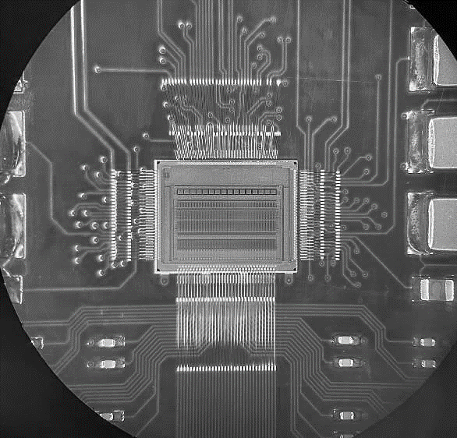
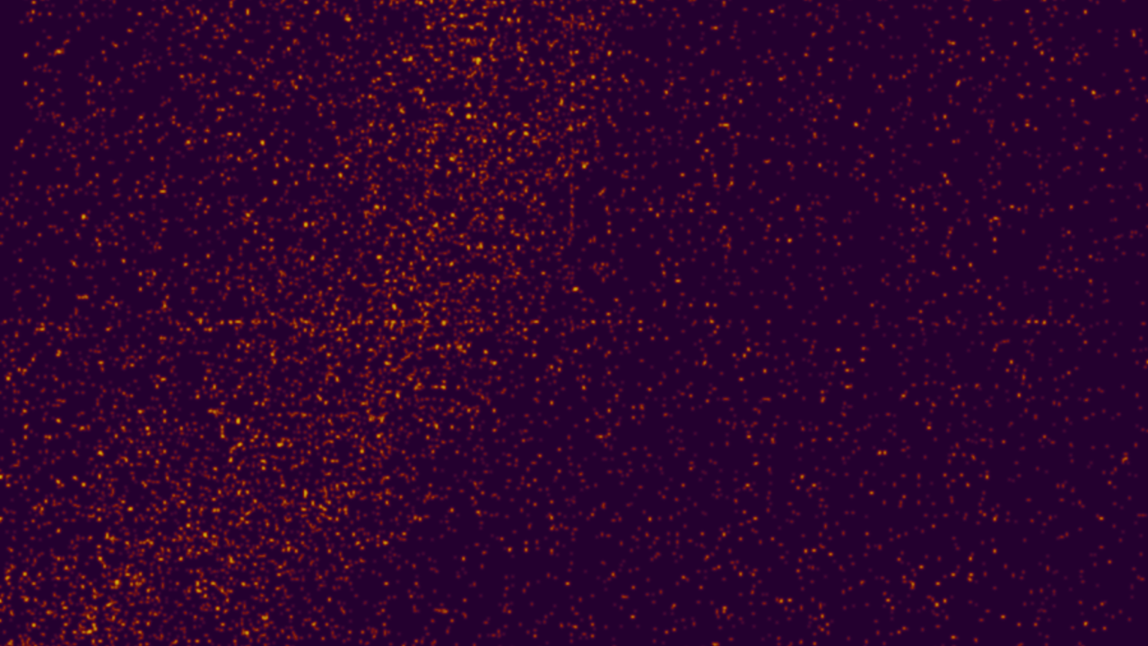
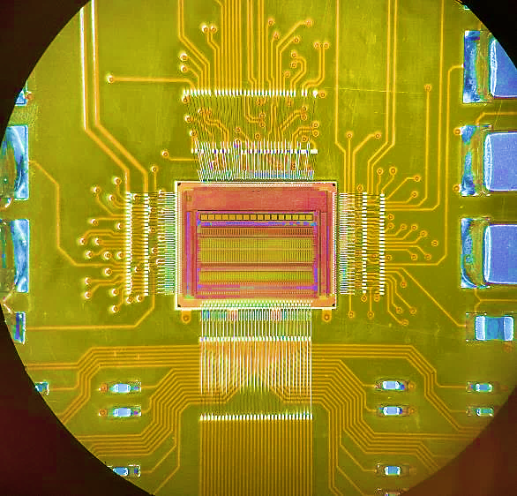


Analog Front-end for HEP
HEPIC Summer Week
Angelo Dragone
23 June 2025

Slide 2
Outline
From Particle to Detected Charge
Sensors
Signal Formation and characteristics
Source model
From Charge to Amplified Analog Signal
Typical Front-End Channel
Charge Sensitive Amplifier
Shaper
Noise and Design Optimization
Thermal, Shot, Flicker
Series vs. Parallel noise
Noise calculation and optimization

Slide 3
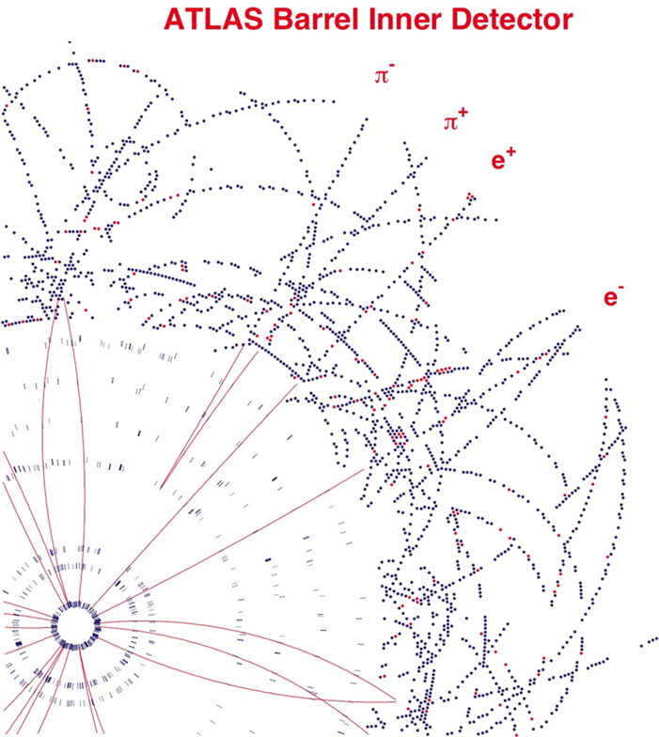
The aims of particle detectors
Discover the identity of the particles that pass through the detector after an event (collision or decay)
To achieve this goal, we need to reconstruct the momenta of the particles, thus tracking their trajectory and measuring their energy.
A detector needs to have:
Enough layers - to recognize trajectories easily and reconstruct them reliably
Large numbers of sensor channels to easily distinguish tracks and achieve the required spatial resolution
Best spatial precision near the interaction point
Material - enough to generate signals but minimize scattering, secondary interactions, and conversions…
Magnetic field to bend trajectories

Slide 4
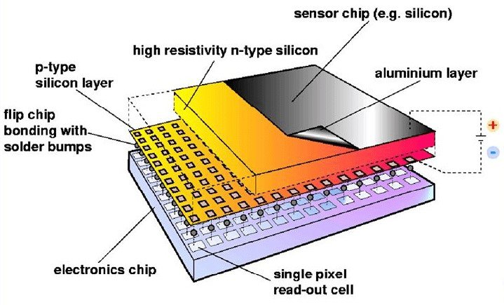
Sensors
Particles passing through a detector lose energy by ionization (charged particles) or by absorption (photons)
Many kind particle detectors exist, built with several kind of sensors. Details are beyond the scope of this lecture, but typically detectors are:
Gaseous detectors
TPC, large volume drift chambers
planar wire chambers, MSGC, GEM,…
straw tubes
Silicon detectors
Pixels, MAPS and CCDs
Silicon strips
Silicon drift detectors
Sensor parameters are not identical but often similar
Signal size ~ 25,000 electrons (~2000 - 100,000e)
Collection time ~few x10ns, but may have slow components
Electrical parameters: capacitance, resistance, leakage currents
Hybrid Detector

Slide 5
Operation principle
The basic principle is the one used in Ionization Chambers
Particles deposit energy in the sensor
Ionize a gas molecule
Charges drift due to the electric field
Current pulse can be measured
We always want signals to be large and collected fast
Most semiconductor sensors work in a similar way
e⁻
e⁻
X-ray
+
+
Gas
+
-
A
HV

Slide 6


Signal size
The basic principle of all tracking devices is to detect the free charges resulting from the interaction of a medium with a passing charged particle.
The Bethe-Bloch formula is used to estimate the average energy loss of a charged particle in a medium:
Where:
z is the charge of the incident particle,
Tmax is the maximum kinetic energy that can be imparted to a free electron in a single collision,
I is the mean excitation energy,
Z is the atomic number
A is the atomic mass of the considered material,
NA Avogadro’s number,
m_{e} is the electron mass,
c is the speed of light,
r_{e} is the classical electron radius,
β is the relative particle velocity ν/c,
γ is the relativistic factor 1/sqrt(1- β²)
βγ=p/Mc where p is the relativistic momentum, and M is the particle mass
δ is the density effect correction

Slide 7
Signal size
The most important region of the Bethe-Bloch plot is the minimum present at βγ~3, which expresses the minimum energy deposited in the medium.
Particles providing such energy loss are called Minimum Ionizing Particles (MIPs)
Each detector system must have an intrinsic noise lower enough to detect these "worst-case" particles.
In silicon, a MIP loses an average energy of about 288eV/um

Slide 8
Signal generation depends on the band gap
Klein’s empirical formula relates energy, E, to create electron-hole pair to the band gap: E = 2.67 E_{Gap} +0.87
 | E_{gap} [eV] | E [eV] | n_{i} [300K, cm³] | Z
Si | 1.12 | 3.6 | 1.45x10¹⁰ | 14
Ge | 0.67 | 2.9 | 2.4x10¹³ | 32
GaAs | 1.42 | 4.3 | 1.8x10⁶ | 31-33
CdTe / CZT | 1.4 | 4.6 | 2.6x10⁵ | 48-52
Diamond | 5.45 | 13.2 | <10³ | 6
E for semiconductors is relatively low compared to other media (Gas ~30eV, Scintillators ~20eV) → Large signals
In Si a MIP produces ~80 e/h pairs per um. For a 300μm thick sensor, the signal is thus ~24000 e/h pairs or 4fC/MIP
Issue: at room temperature, intrinsic semiconductors have too many free electrons

Slide 9
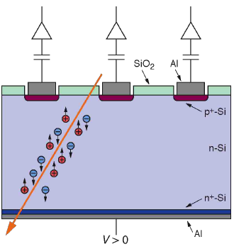

Fully depleted diodes
Solution: create a reverse biased p-n junction to fully deplete the sensor made on a high resistivity substrate
Fast collection time
For Si 350um thick fully depleted with 100V μ = 1350 cm2/Vs:
The electron’s collection time is
~10ns
Segmentation in pixels enables position resolution

Slide 10

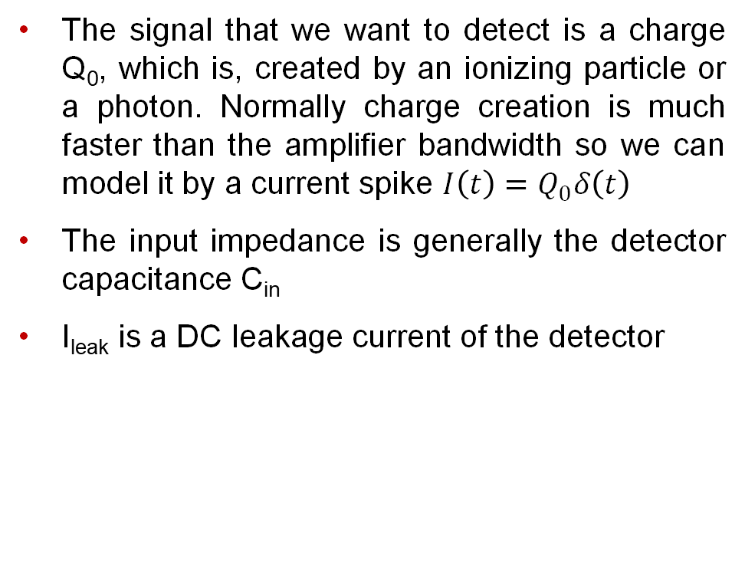
Source model
The signal that we want to detect is a charge Q₀, which is, created by an ionizing particle or a photon. Normally charge creation is much faster than the amplifier bandwidth so we can model it by a current spike $I\left(t\right)=Q_{0}δ\left(t\right)$
The input impedance is generally the detector capacitance C_{in}
I_{leak} is a DC leakage current of the detector
0
$I\left(t\right)$=$Q_{0}δ\left(t\right)$+ Ileak
Detector
=
C_{in}
V+

Slide 11
Outline
From Particle to Detected Charge
Sensors
Signal Formation and characteristics
Source model
From Charge to Amplified Analog Signal
Typical Front-End Channel
Charge Sensitive Amplifier
Shaper
Noise and Design Optimization
Thermal, Shot, Flicker
Series vs. Parallel noise
Noise calculation and optimization

Slide 12
Typical Front-End Channel
Reset
C_{f}
V_{th}
Comp
TDC
I_{in}
CSA
Shaper
Detector
C_{S}
S/H
ADC
Charge Sensitive Amplifier
Integrates the incoming charge on a feedback capacitor. The output is a voltage step. Has a large signal gain
such that the noise of the subsequent stage (shaper) is negligible.
Shaper
Shapes (Filters) the signal to give a predefined
output signal shape, and rejection of noise frequency components that are outside of the signal frequency range and provides an optimal Signal to Noise Ratio
Comparator to detect an event above a certain threshold (event detection)
and/or a TDC to detect the time of arrival/time over threshold (timing detection)
and/or a Sample and Hold circuit for an ADC further in the channel (energy detection)

Slide 13
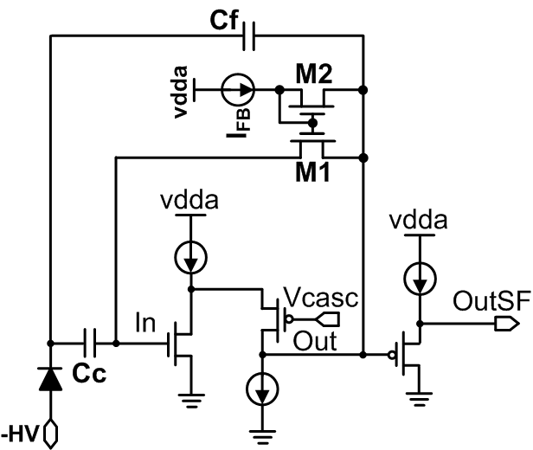
Charge Sensitive Amplifier (CSA)
LF Monopix chip
Cascode Architecutre
Folded-Cascode Architecutre
AC coupling, current feedback, Source Follower stage

Slide 14
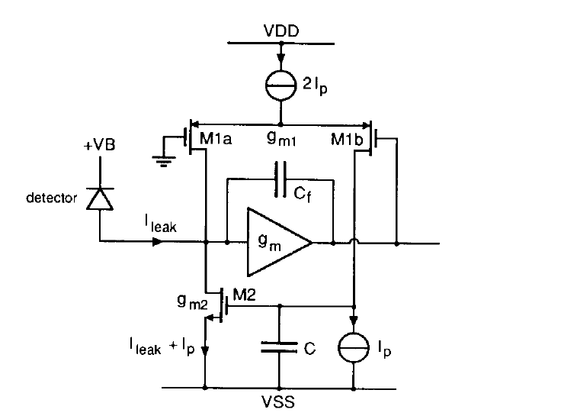
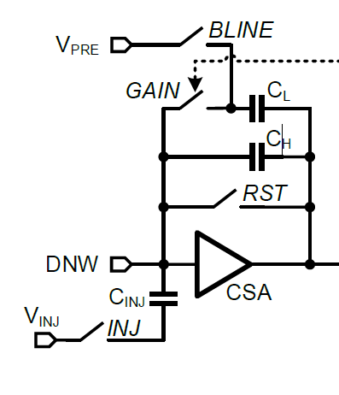
Charge Sensitive Amplifier (CSA)
ePixM for LCLSII
Krummenacher Architecture
Synchronous reset, 2 gain modes
Leakage current compensation
There are many other architectures: differential, inverter based, …. with different reset mechanisms and leakage current compensation

Slide 15
During this week we will examine 3 CSA configurations
VDD
VDD
VDD
VDD
In
Vld
In
In
Out
Vcc
Vcc
Vcc₁
Out
Vcs
Vld1
Vgb
Vcc₂
Vld2
Out
Vld

Slide 16
How to model a simple CSA?
R_{f}
How to calculate the transfer function?
How to derive frequency behavior?
How to derive temporal behavior?
How to choose design parameters?
How to minimize noise?
How to gain design intuition?
I_{f}
C_{f}
I_{in}
-gm
V_{out}
I₁
C_{in}
C_{L}
R_{L}

Slide 17
Understanding CSAs from the Ground Up
…
Intrinsic gain stage
(open loop)
Adding capacitive feedback
Adding a cascode (for higher gain)
Begin by analyzing the basic atomic units of an CSA
Use the gained insights to understand more complex realizations

Slide 18
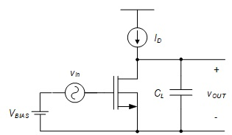
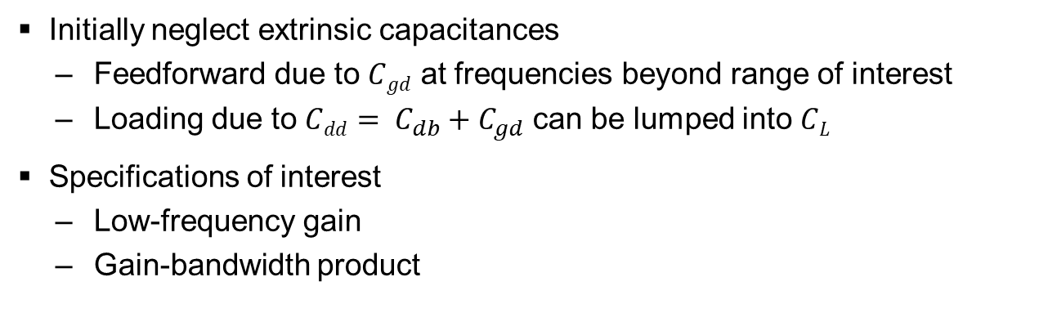
Intrinsic Gain Stage (IGS)
Small-signal model
Initially neglect extrinsic capacitances
Feedforward due to $Cgd$ at frequencies beyond range of interest
Loading due to $Cdd= C_{db}+C_{gd}$ can be lumped into $CL$
Specifications of interest
Low-frequency gain
Gain-bandwidth product

Slide 19








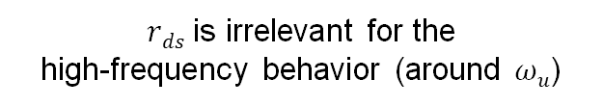

IGS Frequency Response
$$|A_{v}(jω)|$$
$$r_{ds}→ ∞$$
$${|A}_{v0}|=g_{m}r_{ds}$$
$rds$ is irrelevant for the high-frequency behavior (around $ωu$)
$$1$$
$$ω$$
$$\frac{1}{r_{ds}C_{L}}$$
$$ω_{u}$$
$$1=\frac{g_{m}r_{ds}}{|1+jω_{u}{r_{ds}C}_{L}|}≈\frac{g_{m}r_{ds}}{ω_{u}{r_{ds}C}_{L}}$$
$$ω_{u}≈\frac{g_{m}}{C_{L}}$$
Gain-bandwidth product (GBW) of intrinsic gain stage

Slide 20
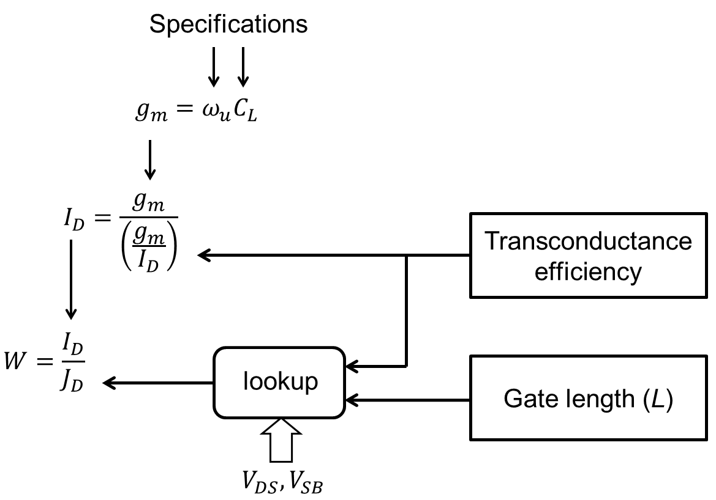
Basic gm/Id Design Flow
Design choices

Slide 21
Closing the Feedback Loop
I_{in}
Questions
What is the phase margin?
How fast does this circuit settle (in response to the input step)?
What is the total integrated output noise?

Slide 22
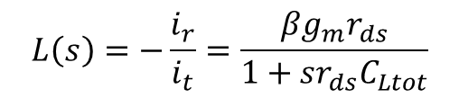


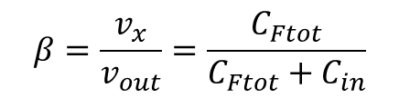



Feedback Loop Analysis
$$C_{Ftot}=C_{F}+C_{gd}$$
$$C_{in}=C_{S}+C_{gs}$$
$$β=\frac{v_{x}}{v_{out}}=\frac{C_{Ftot}}{C_{Ftot}+C_{in}}$$
Feedback factor
$$L\left(s\right)=−\frac{i_{r}}{i_{t}}=\frac{βg_{m}r_{ds}}{1+sr_{ds}C_{Ltot}}$$
$$C_{Ltot}={C_{db}+C}_{L}+\left(1−β\right)C_{Ftot}$$
Loop gain $≡$ Return Ratio
Total load capacitance
$$g_{m}r_{ds}=A_{0}=intrinsic open loop gain$$

Slide 23

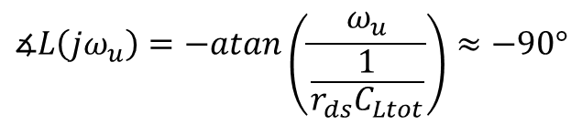


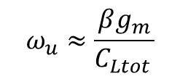




Loop Unity Gain Frequency and Phase Margin
$$|L(jω)|$$
$$L_{0}=βg_{m}r_{ds}$$
$$ω_{u}≈\frac{βg_{m}}{C_{Ltot }}$$
$$ω$$
$$\frac{1}{r_{ds}C_{Ltot}}$$
$$ω_{u}$$
$$∡L\left(jω_{u}\right)=−atan\left(\frac{ω_{u}}{\frac{1}{r_{ds}C_{Ltot}}}\right)≈−90°$$
$$∡L(jω)$$
$$ω$$
$$PM=180°+∡L\left(jω_{u}\right)≈90°$$

Slide 24



Impulse Response of the Closed-Loop Circuit
$$A_{CL}\left(s\right)=\frac{v_{out}\left(s\right)}{i_{in}\left(s\right)}$$
Closed-loop transfer function
Time domain response follows from inverse Laplace transform
$$v_{out}\left(t\right)=ℒ^{−1}\left\{A_{CL}\left(s\right)⋅i_{in}(s)\right\}$$
$$v_{out}\left(t\right)=ℒ^{−1}\left\{A_{CL}\left(s\right)⋅Q0\right\}$$
Impulse response
Need A_{Cl}(s) to make further progress
We could perform a nodal analysis on the closed loop circuit, but it is more insightful to work with a loop gain-based approach

Slide 25
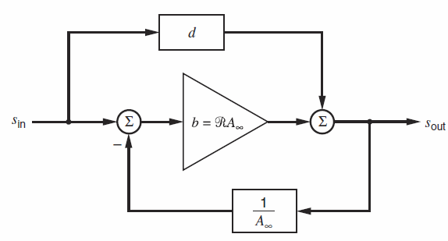
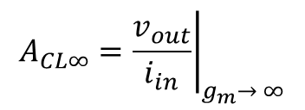
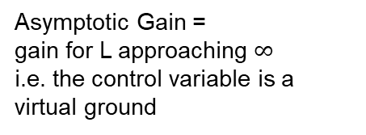


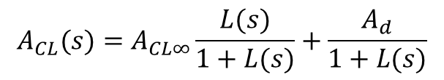
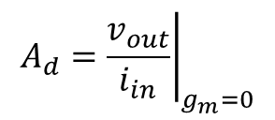
Finding A(s) using Return Ratio Framework
[Gray & Meyer, Chapter 8]
$$ℛ≡L \text{(}\text{our} \text{notation}\text{)}$$
$$d≡A_{d} \text{(}\text{our} \text{notation}\text{)}$$
$$A_{CL∞}={\left.\frac{v_{out}}{i_{in}}\right|}_{g_{m}→ ∞}$$
Asymptotic Gain =
gain for L approaching $∞$
i.e. the control variable is a virtual ground
$$A_{CL}(s)=A_{CL∞}\frac{L(s)}{1+L(s)}+\frac{A_{d}}{1+L(s)}$$
$$A_{d}={\left.\frac{v_{out}}{i_{in}}\right|}_{g_{m}=0}$$
Dead Net Gain =
gain the passive net
i.e. gain of the net with the controlled source generator removed
Models feedforward effects (due to C_{F} in our example)

Slide 26
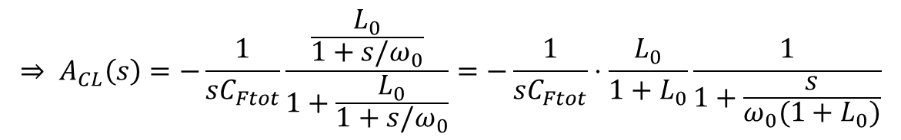
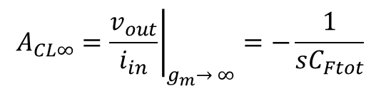
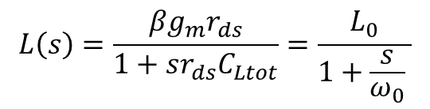
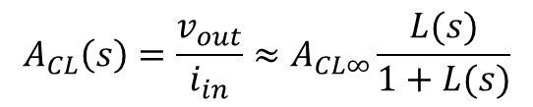
First-Order Analysis (Neglecting Feedforward)
I_{in}
$$A_{CL}\left(s\right)=\frac{v_{out}}{i_{in}}≈A_{CL∞}\frac{L(s)}{1+L(s)}$$
$$L\left(s\right)=\frac{{βg}_{m}r_{ds}}{1+sr_{ds}C_{Ltot}}=\frac{L_{0}}{1+\frac{s}{ω_{0}} }$$
$$A_{CL∞}={\left.\frac{v_{out}}{i_{in}}\right|}_{g_{m}→ ∞}=−\frac{1}{{sC}_{Ftot}}$$
Ideal closed-loop gain
$$⇒ A_{CL}\left(s\right)=−\frac{1}{{sC}_{Ftot}}\frac{\frac{L_{0}}{1+s/ω_{0}}}{1+\frac{L_{0}}{1+s{/ω}_{0}}}=−\frac{1}{{sC}_{Ftot}}⋅\frac{L_{0}}{1+L_{0}}\frac{1}{1+\frac{s}{ω_{0}(1+L_{0})}}$$

Slide 27

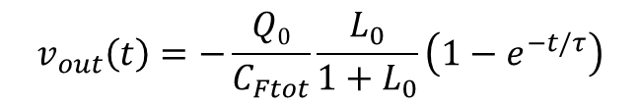
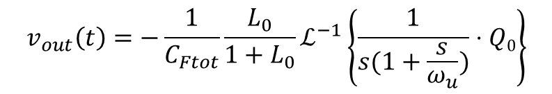
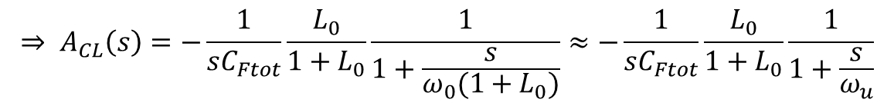
$$⇒ A_{CL}\left(s\right)=−\frac{1}{{sC}_{Ftot}}\frac{L_{0}}{1+L_{0}}\frac{1}{1+\frac{s}{ω_{0}(1+L_{0})}}≈−\frac{1}{{sC}_{Ftot}}\frac{L_{0}}{1+L_{0}}\frac{1}{1+\frac{s}{ω_{u}}}$$
$$v_{out}\left(t\right)=−{\frac{1}{C_{Ftot}}\frac{L_{0}}{1+L_{0}}ℒ}^{−1}\left\{\frac{1}{s(1+\frac{s}{ω_{u}})}⋅Q0\right\}$$
$$v_{out}\left(t\right)=−\frac{Q0}{C_{Ftot}}\frac{L_{0}}{1+L_{0}}\left(1−e^{−t/τ}\right)$$
$$τ≈\frac{1}{ω_{u}}$$
Ideal
Static Error
Dynamic Error

Slide 28

Graphical Illustration
Dynamic Error
Static Error
$$\frac{v_{out}(t)}{v_{out,ideal}(t)}$$

Slide 29
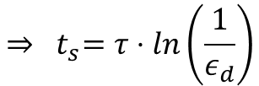

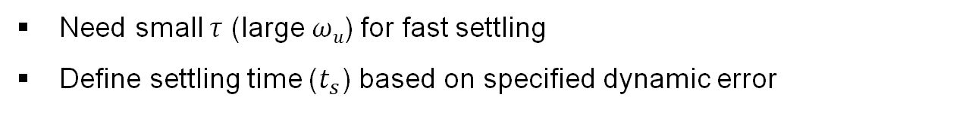
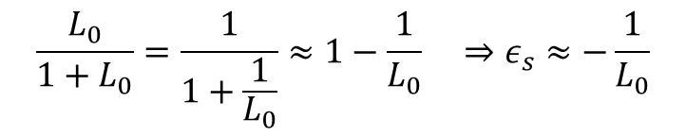
Design Considerations
Need large low-frequency loop gain ($L0$) for small static error ($ε_{s}$)
$$\frac{L_{0}}{1+L_{0}}=\frac{1}{1+\frac{1}{L_{0}}}≈1−\frac{1}{L_{0}} ⇒ε_{s}≈−\frac{1}{L_{0}}$$
Need small $τ$ (large $ωu$) for fast settling
Define settling time ($t_{s}$) based on specified dynamic error
$${⇒ t}_{s}=τ⋅ln\left(\frac{1}{ε_{d}}\right)$$
$$ε_{d}=e^{−t_{s}/τ}$$

Slide 30
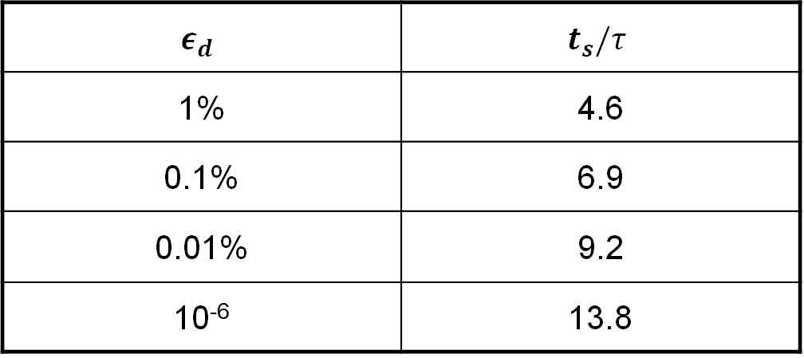
Required Number of Time Constants
$$ε_{d}$$ | $$t_{s}/τ$$
1% | 4.6
0.1% | 6.9
0.01% | 9.2
10⁻⁶ | 13.8
Going from 1% dynamic settling error to 10⁻⁶ requires only a ~3x increase in settling time

Slide 31
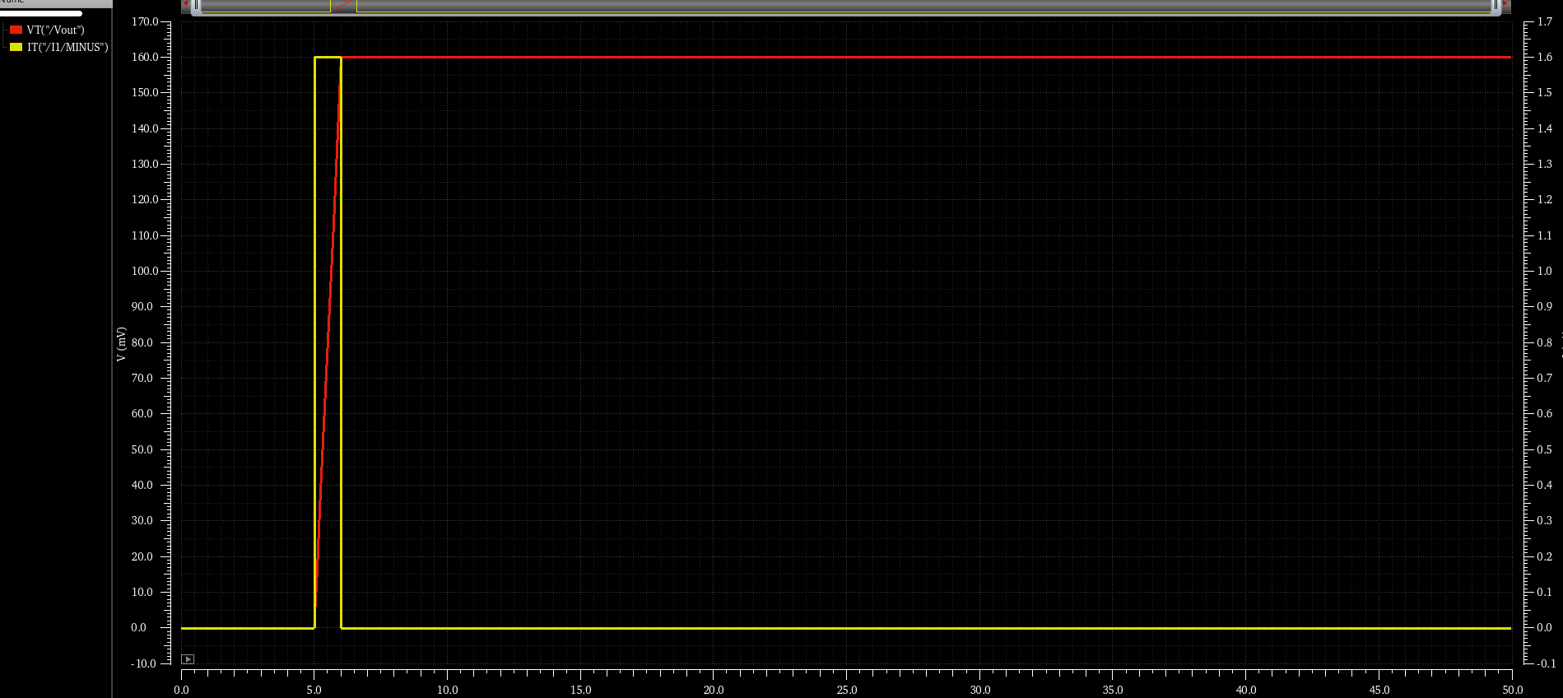
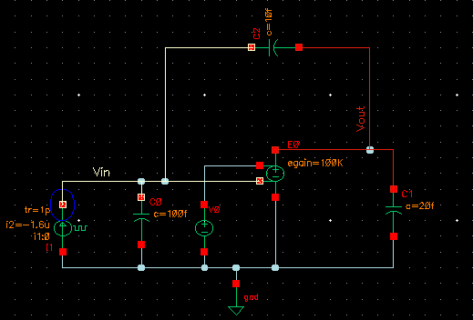

CSA: example ideal case
Vout = Q/C_{f} = 160 mV
Qin = 10 000 e-
C_{in} = 100fF C_{f}= 10fF C_{L} = 20fF
$A_{0}$ = 100k Q = 10 000 e- over 1 ns

Slide 32
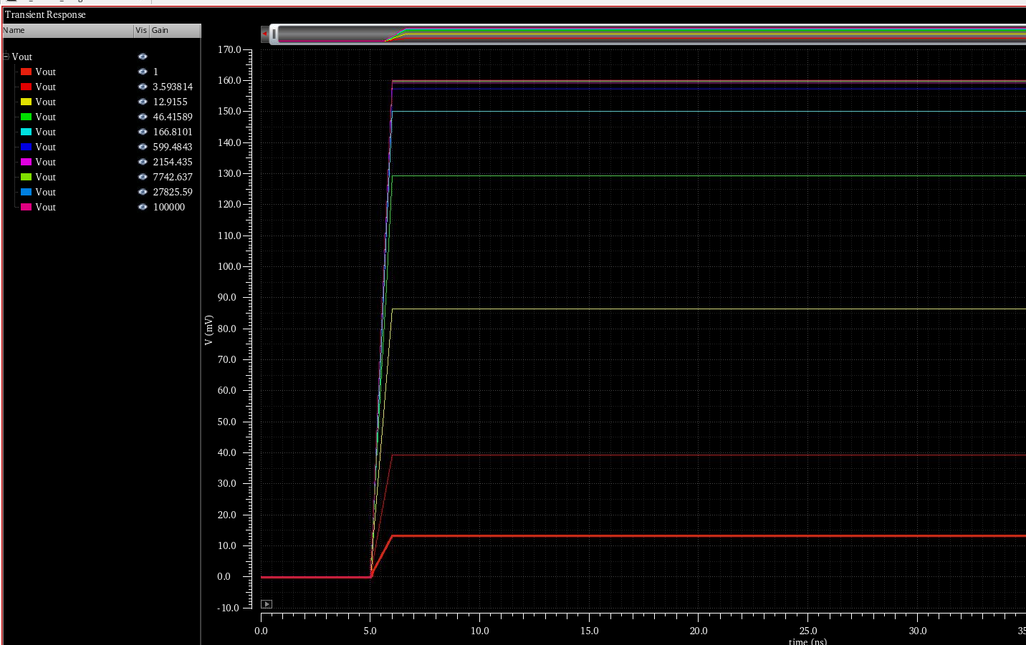
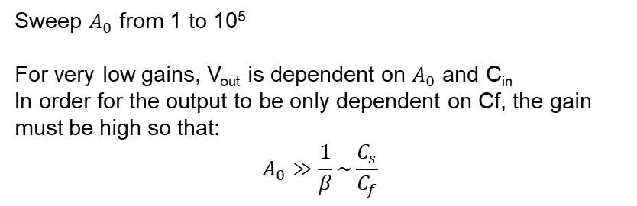

What’s a high open loop gain?
C_{f}
Sweep $A_{0}$ from 1 to 10⁵
For very low gains, V_{out} is dependent on $A_{0}$ and C_{in}
In order for the output to be only dependent on Cf, the gain must be high so that:
$$A_{0}≫\frac{1}{β}\sim \frac{C_{s}}{C_{f}}$$
I_{in}
-gm
V_{out}
I₁
C_{s}
Z_{L}
We could intuitively understand this using Miller
(This approach assumes an ideal amplifier)
I_{in}
C_{s}
$C_{f}(1+A_{0}$)

Slide 33
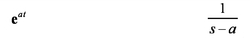
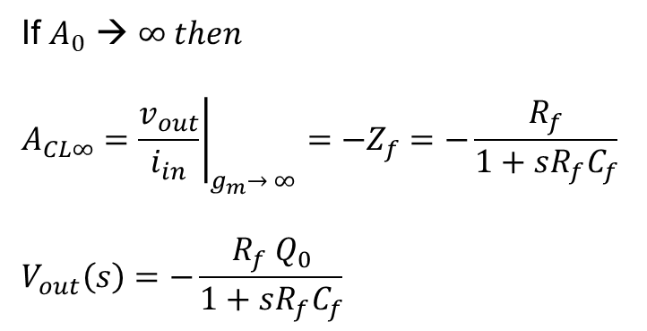
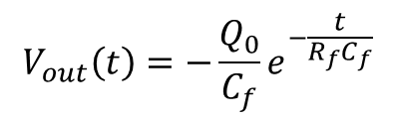
CSA: Returning to baseline – Continuous Reset (ideal amp)
If $A_{0}$ → $∞ then$
$$A_{CL∞}={\left.\frac{v_{out}}{i_{in}}\right|}_{g_{m}→ ∞}=−Z_{f}=−\frac{R_{f}}{1+sR_{f}C_{f}}$$
$$V_{out}\left(s\right)=−\frac{R_{f} Q_{0}}{1+sR_{f}C_{f}}$$
R_{f}
C_{f}
I_{in}
-gm
V_{out}
T domain
S domain
I₁
Z_{in}
Z_{L}
$$V_{out}\left(t\right)=−\frac{Q_{0}}{C_{f}}e^{−\frac{t}{R_{f}C_{f}}}$$
Instantaneous rise time (ideal amp), and discharge with a time constant R_{f}C_{f}

Slide 34
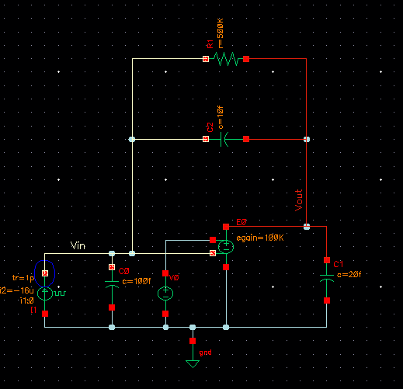
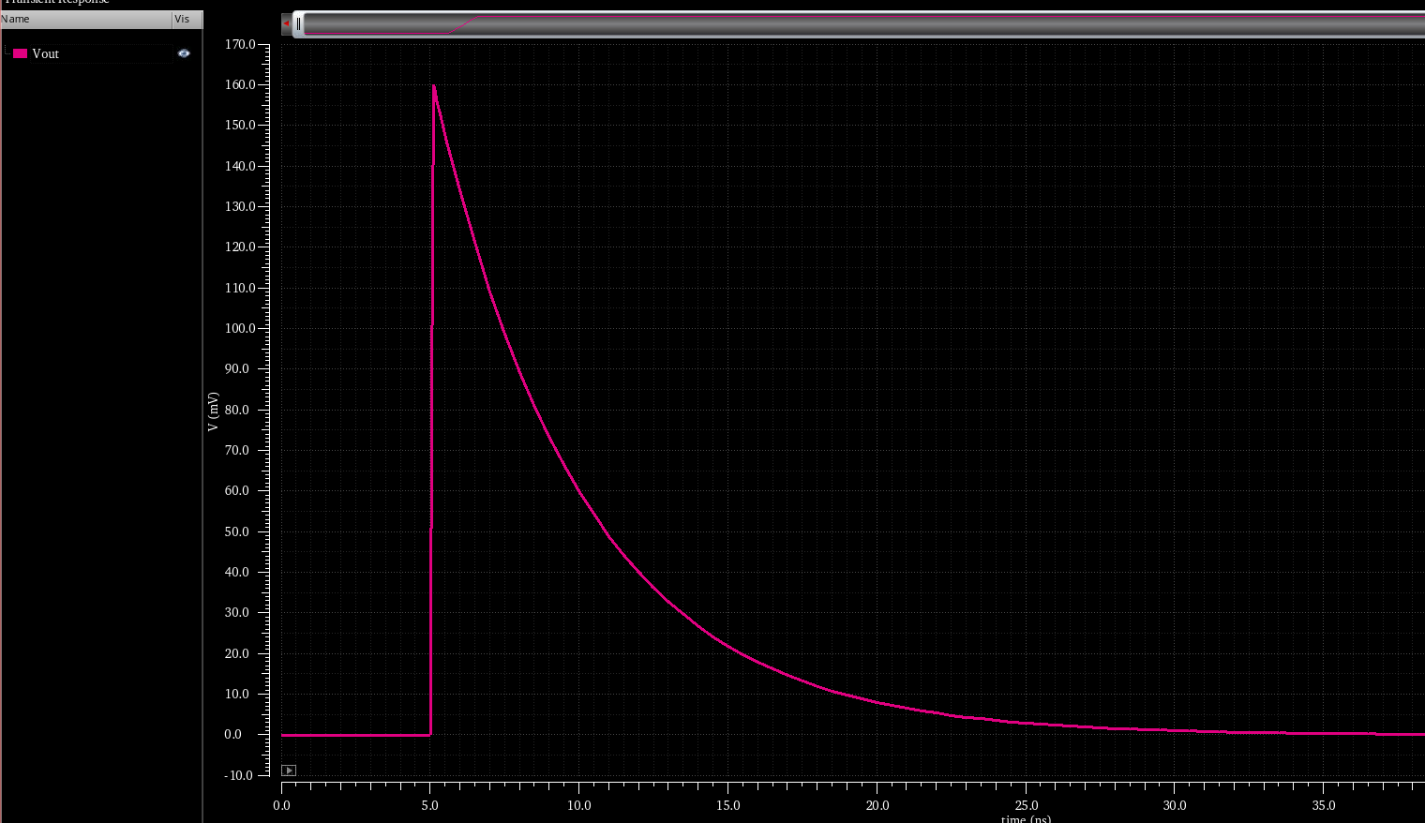
CSA: Returning to baseline – Continuous Reset (ideal amp)
Rf = 500k
RxC = 5 ns
Pole = 1/(2*pi*RC) = 31.8 MHz

Slide 35
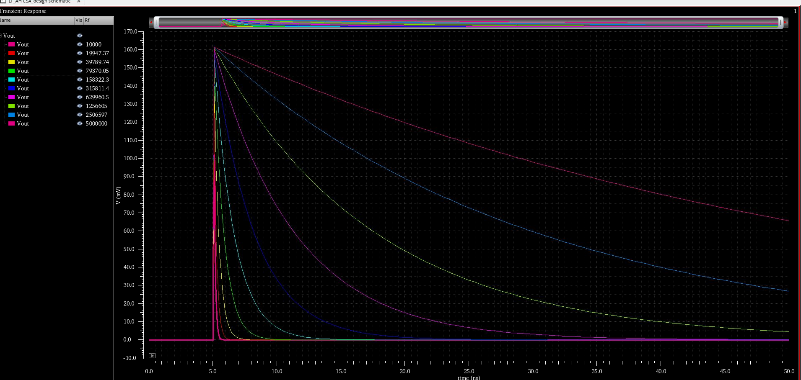
The effect of R_{f} : sweep 10 kΩ - 5 MΩ

Slide 36

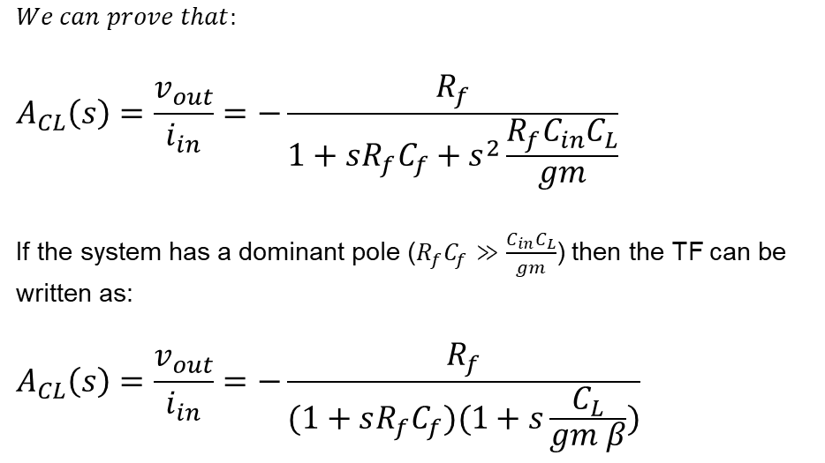
CSA: Returning to baseline – Continuous Reset (real amp)
$$We can prove that:$$
$$A_{CL}\left(s\right)=\frac{v_{out}}{i_{in}}=−\frac{R_{f}}{1+sR_{f}C_{f}+s^{2}\frac{R_{f}C_{in}C_{L}}{gm}}$$
If the system has a dominant pole ($R_{f}C_{f}≫\frac{C_{in}C_{L}}{gm}$) then the TF can be written as:
$$A_{CL}\left(s\right)=\frac{v_{out}}{i_{in}}=−\frac{R_{f}}{(1+sR_{f}C_{f})(1+s\frac{C_{L}}{gm β})}$$
R_{f}
I_{f}
C_{f}
I_{in}
-gm
V_{out}
I₁
Z_{in}
C_{L}
R_{L}
Feedback pole
Output pole
$$A_{CL}\left(s\right)=\frac{v_{out}}{i_{in}}=−\frac{R_{f}}{(1+sτ_{f})(1+sτ_{r})}$$
Falling time constant
Rising time constant

Slide 37
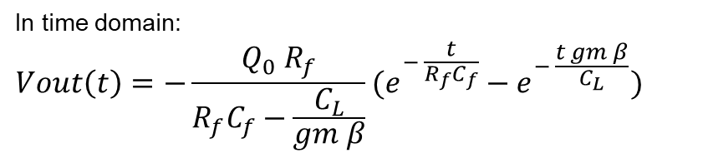
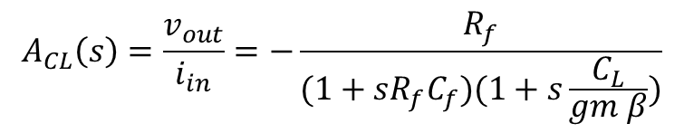
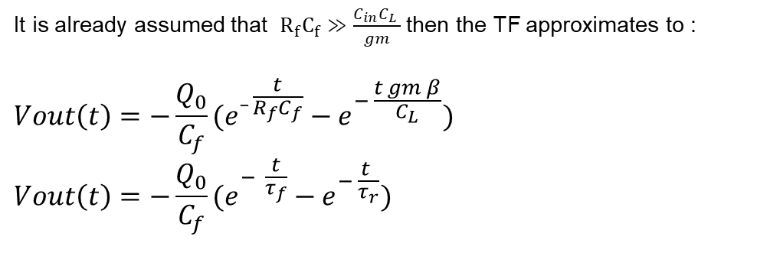
CSA: Returning to baseline – Continuous Reset (real amp)
$$A_{CL}\left(s\right)=\frac{v_{out}}{i_{in}}=−\frac{R_{f}}{(1+sR_{f}C_{f})(1+s\frac{C_{L}}{gm β})}$$
R_{f}
In time domain:
$$Vout\left(t\right)=−\frac{Q_{0} R_{f}}{R_{f}C_{f}−\frac{C_{L}}{gm β}}(e^{− \frac{t}{R_{f}C_{f}}}−e^{− \frac{t gm β}{C_{L}}})$$
C_{f}
I_{in}
-gm
V_{out}
I₁
It is already assumed that $R_{f}C_{f}≫\frac{C_{in}C_{L} }{gm}$ then the TF approximates to :
$$Vout\left(t\right)=−\frac{Q_{0}}{C_{f}}(e^{_ \frac{t}{R_{f}C_{f}}}−e^{− \frac{t gm β}{C_{L}}})$$
$$Vout\left(t\right)=−\frac{Q_{0}}{C_{f}}(e^{− \frac{t}{τ_{f}}}−e^{− \frac{t }{τ_{r}}})$$
C_{in}
C_{L}
R_{L}

Slide 38


CSA: Returning to baseline – Continuous Reset (real amp)
NB: The signal reaches max amplitude only if $R_{f}C_{f}≫\frac{C_{in}C_{L} }{gm}$

Slide 39


Case of complex conjugate poles
P1 = -82 + j 97 MHz
P2 = -82 – j97 MHz
Damped oscillation

Slide 40

Stability Study by Simulation
Simulate open loop response, and check for phase margin. Good practice PM ~ 7$6° never below 65°$

Slide 41












What have learned so far?
We get:
We know:
$$Q_{0}$$
$I\left(t\right)$=$Q_{0}δ\left(t\right)$+ Ileak
$$Q_{max}$$
$$A_{CL}\left(s\right)=\frac{v_{out}}{i_{in}}≈A_{CL∞}\frac{L\left(s\right)}{1+L\left(s\right)}≈−\frac{1}{{sC}_{Ftot}}⋅\frac{L_{0}}{1+L_{0}}\frac{1}{1+\frac{s}{ω_{u}}}$$
Ileak
C_{s}
$$β=\frac{C_{Ftot}}{C_{Ftot}+C_{S}+C_{gs}}$$
$$ω_{u}≈\frac{βg_{m}}{C_{Ltot }}$$
$$C_{Ltot}={C_{db}+C}_{L}+\left(1−β\right)C_{Ftot}$$
$$A_{0}≫\frac{1}{β}\sim \frac{C_{s}}{C_{f}}$$
$$L_{0}={βg}_{m}r_{ds}={β A}_{0}$$
$$PM=180°−atan\left(\frac{ω_{u}}{ω_{p}}\right)>65° ideally 75°$$
$$v_{out}\left(t\right)=−\frac{Q0}{C_{Ftot}}\frac{L_{0}}{1+L_{0}}\left(1−e^{−t/τ_{r}}\right)$$
$$τ_{r}≈\frac{1}{ω_{u}}$$
$${ t}_{s}=τ_{r}⋅ln\left(\frac{1}{ε_{d}}\right)$$
$$Vout with reset\left(t\right)=−\frac{Q_{0}}{C_{f}}(e^{− \frac{t}{τ_{f}}}−e^{− \frac{t }{τ_{r}}})$$
w$here τ_{f}≈\frac{1}{{ R}_{f}C_{f}}$
i$f R_{f}C_{f}≫\frac{C_{in}C_{L} }{gm}$

Slide 42
Outline
From Particle to Detected Charge
Sensors
Signal Formation and characteristics
Source model
From Charge to Amplified Analog Signal
Typical Front-End Channel
Charge Sensitive Amplifier
Shaper
Noise and Design Optimization
Thermal, Shot, Flicker
Series Vs Parallel noise
Noise calculation and optimization

Slide 43
Typical Front-End Channel: 2- Shaper
C_{f}
V_{th}
Comp
Counter
I_{in}
CSA
Shaper
Detector
C_{in}
S/H
ADC
Chare Sensitive Amplifier
Integrates the incoming charge on a feedback capacitor
Shaper
Shapes (Filters) the signal for an optimal Signal to Noise Ratio
Comparator to detect an event above a certain threshold
And/Or
a Sample and Hold circuit for an ADC further in the channel

Slide 44




Shaper: CR-RC filter
Differentiator
= High pass filter
Integrator
= Low pass filter
$τ_{z}=R_{1}C_{1}$
$τ_{p}=R_{2}C_{2}$
Shaper = Band pass filter

Slide 45








Qualitative Approach
CSA output
(assuming $R_{f}=∞)$
Effect of $τ_{p}$ while $τ_{z}$= constante
Effect of $τ_{z}$while $τ_{p}$ = constante
$$V_{out}(t)∝\frac{Q_{in}}{C_{f}}\left(e^{−\frac{1}{τ_{z}}}−e^{−\frac{1}{τ_{p}}}\right)$$
Normally the choice $τ_{z}$ = $τ_{p}$ is the best compromise for signal amplitude within a fixed duration, and for filtering of high and low noise frequencies
$${Where τ}_{z}≠τ_{p}$$

Slide 46




CR-RC Shaper Modeling
It can be demonstrated that for $τ=τ_{z}=τ_{p}$ :
Taking inverse Laplace Transform yields:
The peaking time is T_{peak} = $τ$
And the maximum amplitude is:
NB: The ratio of resistors and capacitors can introduce gain in addition to filtering

Slide 47



CR-RC^{N} shaper
Introducing ‘N’ number of integrator stages yields a higher the order of the shaper
Higher order filters give faster return to baseline, useful for high-rate applications, at the expense of power and circuit surface

Slide 48

Optimum Filter for Amplitude Measurement

Slide 49




Complex Conjugate Shapers
The Gaussian shape approaches the optimal filter’s response.
This response can better be approximated using complex conjugate poles in the transfer function.
The math can be complex, so there are tables that give the poles positions as a function of the shaper order. (Poles are normalized to $σ$ ➔ $p=σs$)
Theoretical Gaussian pulse shape

Slide 50
Outline
From Particle to Detected Charge
Sensors
Signal Formation and characteristics
Source model
From Charge to Amplified Analog Signal
Typical Front-End Chain
Charge Sensitive Amplifier
Shaper
Noise and Design Optimization
Thermal, shot, Flicker
Series Vs Parallel noise
Noise calculation and optimization

Slide 51


Noise
Practically, the signal fluctuates around a mean value for baseline and amplitude due to noise. This limits the capability of the CSA to detect small charges, which must be distinguishable from the noise.
In order to optimize our circuit, we need to understand the origin of noise sources.
Noise ca be represented by a voltage source whose power spectral density is noted $S_{v}\left(f\right)$ measured in $\left[\frac{V2}{Hz}\right]$. The average output power obtained after integration over the BW is then noted $<v^{2}>.$
Noise can also be represented as current sources.

Slide 52









Types of Electronic Noise
Thermal noise
Associated with the thermal agitation of charge carriers in conductors (Brownian motion)
Occurs in resistive components regardless of DC current
Relevant for resistors, MOSFETs in moderate and strong inversion
Power spectral density is proportional to temperature
Resistor: In a resistor of value R, the thermal noise:
$\frac{\overline{v_{n}^{2}}}{df}=4k_{B}TR$ or $\frac{\overline{i_{n}^{2}}}{df}=\frac{4k_{B}T}{R}$
MOS transistor: In a transistor, thermal noise is given by
$\frac{\overline{v_{n}^{2}}}{df}=\frac{4γk_{B}T}{gm}$ or$\frac{\overline{i_{n}^{2}}}{df}=4γk_{B}Tgm$
$γ=\frac{2}{3}$ for strong inversion and $\frac{1}{2}$ for weak inversion
$$R$$
noiseless
$$v_{n}^{2}$$
$$i_{n}^{2}$$
$$R$$
noiseless
$$v_{n}^{2}$$
$$i_{n}^{2}$$

Slide 53





Types of Electronic Noise
Shot noise
Associated with the flow of DC current across a barrier (PN junction, impurities, defects)
It stops when the current stops
Power spectral density $2qI$is not directly dependent on temperature ($but the current may be$)
If the leakage current through a diode is 𝐼_𝑙𝑒𝑎𝑘 then the shot noise is:
$$\frac{\overline{i_{n}^{2}}}{df}=2qI_{leak}$$
$$v_{n}^{2}$$
Both thermal noise and shot noise are considered White Noise, that is, their power spectral density is constant for all frequencies
$$f$$

Slide 54






Types of Electronic Noise
Flicker (1/f) noise
Non-fundamental, technology related
Attributed to material defects and "roughness“ (dangling bonds) creating traps near interfaces
The traps randomly capture and release carriers, leading to fluctuations in the number of carriers and their mobility
$$\frac{\overline{v_{g}^{2}}}{df}=\frac{Kf}{WLC_{ox}f^{α}}$$
$$\frac{\overline{i_{d}^{2}}}{df}=\frac{Kf}{WLC_{ox}f^{α}}g_{m}^{2}$$
$$with 1.3>α>0.8$$
$$\frac{\overline{v_{g}^{2}}}{df}$$
$$\frac{\overline{i_{d}^{2}}}{df}$$
Equivalent

Slide 55



Noise calculation
Considering a noise spectral density of $\frac{\overline{v_{n}^{2}}}{df}$ at circuit input, whose unit is $\left[\frac{V2}{Hz}\right]$
$H(f)$is the system’s transfer function
The average output noise is:
$<v_{out}^{2}> =\int_{0}^{∞}{\frac{\overline{v_{n}^{2}}}{df}.{\left|H(f)\right|}^{2}df}$ [V²]
$$v_{n}^{2}$$
H(f)
$$<v_{out}^{2}>$$
V_{out}
V_{in}

Slide 56

Series Vs Parallel noise
We see that, when referred to the input, the noise can be represented either by voltage sources connected in series with the input or by current sources connected in parallel as they are different in nature.
Voltage sources e.g. input MOS thermal noise, 1/f noise. They are directly applied to input of amplifier and are generally reduced as you reduce the amplifier bandwidth (i.e. increase peaking time).
Current sources e.g. : leakage current, feedback circuitry noise current. These currents are integrated on C_{in} (like input charge) and increase as the integration window increases (increase with slow peaking time).
Noise optimization consists in reducing the overall noise of the system
Normally the resolution of the front-end is limited by the noise from the input MOSFET
HEPIC 2025 – Analog Signal Processing for Radiation Detectors

Slide 57


Series vs Parallel noise: calculation
C_{s}
Since the transfer function $H\left(jω\right)$ is already calculated for an input current, we can directly use it to calculate the output noise due to current noise sources.
The voltage noise sources can be treated as current using the Norton equivalent
By assuming a total series and parallel unilateral noise spectral densities of S_{vn} and S_{in,} respectfully, then the total output noise N is:
$$N^{2}=\frac{1}{2π}\int_{0}^{∞}{\left[S_{in}{\left|H\left(jω\right)\right|}^{2}+{\left(C_{s}+C_{g}+C_{f}\right)}^{2}s^{2}S_{vn}{\left|H\left(jω\right)\right|}^{2}\right]}dω$$
HEPIC 2025 – Analog Signal Processing for Radiation Detectors

Slide 58





Equivalent Noise Charge
The Equivalent Noise Charge is the input charge that generates a S/N ratio at the output equal to 1
Assuming that the front-end implements a time invariant filter with overall impulse response h(t). If the input charge is $Q_{0} δ\left(t\right).$ Then the output response is V_{out} (t) = $Q_{0}δ\left(t\right)∗h\left(t\right)=Q_{0}h\left(t\right)$ which admits a maximum at t=t₀
$$Max Signal=Vout\left(t0\right)= Q{\left.h\left(t\right)\right|}_{max}^{ }=Vout_max$$
We have calculated that the output noise is:
$$N^{2}=\frac{1}{2π}\int_{0}^{∞}{\left[S_{in}{\left|H\left(\left(jω\right)\right)\right|}^{2}+{\left(C_{s}+C_{g}+C_{f}\right)}^{2}s^{2}S_{vn}{\left|H\left(\left(jω\right)\right)\right|}^{2}\right]}d\left(ω\right)$$
${\left(\frac{S}{N}\right)}^{2}=\frac{Q^{2}{\left.h(t)\right|}_{max}^{2}}{\frac{1}{2π}\int_{0}^{∞}{\left[S_{in}{\left|H(jω)\right|}^{2}+{\left(C_{s}+C_{g}+C_{f}\right)}^{2}ω^{2}S_{vn}{\left|H(jω)\right|}^{2}\right]}dω}=1$
Thus, the SNR is:
The charge that would make SNR = 1 is:
$Q^{2}=ENC^{2}=\frac{\frac{1}{2π}\int_{0}^{∞}{\left[S_{in}{\left|H(jω)\right|}^{2}+{\left(C_{s}+C_{g}+C_{f}\right)}^{2}ω^{2}S_{vn}{\left|H(jω)\right|}^{2}\right]}dω}{{\left.h(t)\right|}_{max}^{2}}$
(in Coulombs)
HEPIC 2025 – Analog Signal Processing for Radiation Detectors

Slide 59


Equivalent Noise Charge – with Shapers
Using a classical model (only approximation in deep technologies )
$C_{g}=C_{ox}WL, S_{w}=\frac{4γkT}{g_{m}}, A_{ƒ}=\frac{K_{ƒ}}{C_{ox}WL}$ $, S_{p}=\frac{4kT}{Rf}+2qIleak$
$ENC^{2}={\left(C_{in}+C_{ox}WL+C_{f}\right)}^{2}\left[\frac{1}{τ}\frac{4γkT}{g_{m}}a_{w}+2π\frac{K_{ƒ}}{C_{ox}WL}a_{f}\right]$ $+\left(\frac{4kT}{Rf}+2qIleak\right)τa_{p}$
In this case, one could note that:
Series and parallel noise are weighted inversely WRT $τ$
MOS thermal noise is reduced by increasing gm
Parallel noise is reduced by increasing R_{f}
Flicker is reduced by increasing the transistor area WL
Overall noise is reduced by decreasing C_{in} , C_{f}
While optimizing for noise, one must keep an eye on other specifications, like gain, speed, count rate, maximum area, power, etc
HEPIC 2025 – Analog Signal Processing for Radiation Detectors

Slide 60

Series Vs Parallel noise: Example
By calculations or simulations, we can optimize the peaking time in order to have a minimum ENC for the system
Considering an amplifier whose ENC changes with peaking time as in the above figure
Peaking time = 1.8 us
ENC = 67 e-rms
Peaking time = 50 ns
ENC =275 e-rms
Non-optimized design
Optimized design
HEPIC 2025 – Analog Signal Processing for Radiation Detectors

Slide 61
References
Angelo Rivetti «CMOS Front-end Electronics for Radiation Sensors .» CRC Press. 2015
Boris Murmann / Angelo Dragone – Stanford EE214B 2024
Francis Aghinolfi - Analog Signal Processing of Particle Detector Signals, CERN 2005
Veljko Radeka - Detector Signal Processing, NSS 2009
Gianluigi De Geronimo - MOSFET Optimization in Deep Submicron Technology for Charge Amplifiers, TNS 2004
Acknowledgment: Alexandre Habib

Slide 62
Conclusion

Slide 63
Pole zero cancellation
Rf
Rf
Rz

Slide 64




Equivalent Noise Charge – Shaperless case
We’ve already seen that the transfer function of a CSA with RC feedback can be modeled as:
$$H(s)=−\frac{R_{f}}{(1+sτ_{f})(1+sτ_{r})}$$
By integrating the different noise sources’ spectral densities over all frequencies, we can demonstrate that:
$$ENC^{2}={\left(C_{s}+C_{g}+C_{f}\right)}^{2}\left[\frac{S_{w}}{4τ_{r}}+A_{ƒ}\ln\left(\frac{τ_{f}}{τ_{r}}\right)\right]+{\frac{Sp}{4}}_{ }τ_{f}$$
Using a classical model (only approximation in deep technologies)
$C_{g}=C_{ox}WL, S_{w}=\frac{4kTγ}{g_{m}}, A_{ƒ}=\frac{K_{ƒ}}{C_{ox}WL}$ $, S_{p}=\frac{4kT}{Rf}+2qIleak$
And knowing that
$${τ_{r}}_{ }=\frac{\left(C_{in}+C_{g}+C_{f}\right)C_{L}}{{gmC}_{f}}$$
${τ_{f}}_{ }=R_{f}$ $C_{f}$
HEPIC 2025 – Analog Signal Processing for Radiation Detectors

Slide 65
Equivalent Noise Charge – Shaperless case
The ENC is thus expressed as:
$$ENC^{2}={\left(C_{s}+C_{g}+C_{f}\right)}^{2}\left[\frac{γkTC_{f}}{\left(C_{s}+C_{g}+C_{f}\right)C_{L}}+\frac{K_{ƒ}}{C_{ox}WL}\ln\left(\frac{R_{f} {C_{f}}^{2}{gm}_{ }}{\left(C_{s}+C_{g}+C_{f}\right)C_{L}}\right)\right]+{\frac{\left(\frac{4kT}{Rf}+2qIleak\right)}{4}}_{ }R_{f} C_{f}$$
Thermal noise
Flicker noise
Parallel noise
In this case, one could note that:
MOS thermal noise is not reduced by increasing gm
Parallel noise is not reduced by increasing Rf
Flicker is reduced by increasing the transistor area WL
Overall noise is reduced by decreasing C_{in} , C_{f}
HEPIC 2025 – Analog Signal Processing for Radiation Detectors

Slide 66


ENC dependencies
HEPIC 2025 – Analog Signal Processing for Radiation Detectors

Slide 67










Stability of a closed loop system
$$jω$$
The transfer function can be written under this form:
$$A_{CL}\left(s\right)=\frac{A_{CL0}}{1+\frac{s}{ω_{0}Q}+\frac{s^{2}}{ω_{0}^{2}}}$$
$ω_{0}$ is called the natural frequency, and $Q$ the quality factor. The denominator admits the following roots:
$$P_{1,2}=−\frac{ω_{0}}{2Q}(1±\sqrt{{1−4Q}^{2}})$$
If $Q<0.5$then the poles are real, and the system is over-damped (stable)
If $Q$=0.5 then the poles are real and coincident, and the system is critically-damped (stable)
If $Q>0.5$ then the poles are complex conjugate, and the system exhibits damped oscillations
X
X
$$σ$$
$$−\frac{ω_{0}}{2Q}$$
$$jω$$
X
$$σ$$
X
$$−ω_{0}$$
$$jω$$
X
$$σ$$
X
$$−\frac{ω_{0}}{2Q}$$

