Slide 1
Laser Drivers WG Kick-off slides
WG co-conveners:
L. Kiani, A. Galvanauskas, Mariastefania De Vido

Slide 2
Laser Drivers WG Kick-off
Outline:
  Plans for the working group
  What are the key anticipated laser driver performance parameters?
  What are the main challenges?
  What technologies and techniques should be considered?
  Survey ongoing work and existing literature on this topic. Highlight current state-of-the-art results and projected future developments

Slide 3
Plans for the Laser Drivers Working Group
Understand the laser needs for the machine parameters identified in ultra-high energy linear colliders studies, discuss the challenges and R&D paths to meet the needs. Ref:https://iopscience.iop.org/article/10.1088/1748-0221/18/09/P09022/pdf
Regular Working Group meetings (monthly with option to meet more often if needed)
  Meetings will be posted to Indico: https://indico.slac.stanford.edu/category/138/
Collaborative work via Google docs and Overleaf
  Input to the European Strategy on Particle Physics Update (https://www.overleaf.com/4445631349fhbgxpdsqkcf#51bb89)
  Reports, presentations, etc.
Regular coordination with other working groups and organizers
  Co-conveners will attend bi-weekly co-convener meetings
  Working Group members will collaborate on documentation
Our aim is to publish a design report by 2028 and we will need to develop intermediate reports ahead of that date.

Slide 4
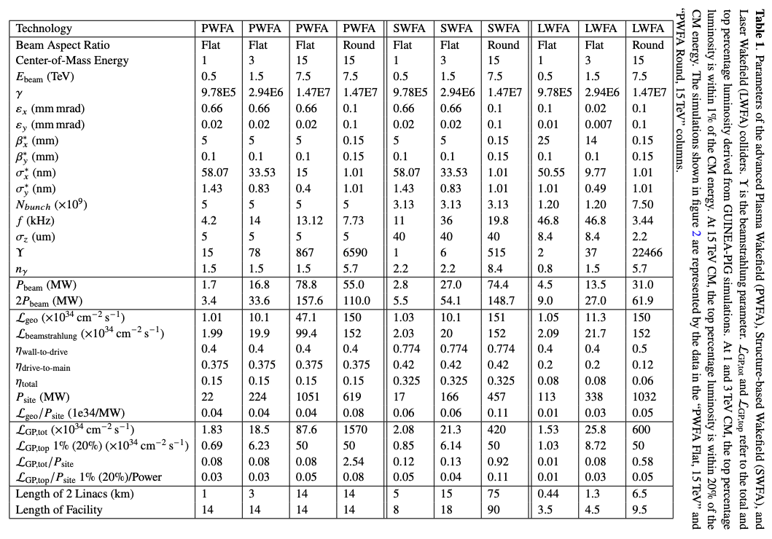
Machine Parameters
https://iopscience.iop.org/article/10.1088/1748-0221/18/09/P09022/pdf

Slide 5
What are the key anticipated laser driver performance parameters?
Pulse peak power: ~ 100 - 300 TW
Wavelength: ~ 0.5-10 µm (1-2 µm)
Pulse Energy: ~ 10 J
Pulse Duration: ~ 30 - 100 fs *
Repetition Rate: ~ 10 - 100 kHz
Average Power: ~ 100 - 1000 kW
Wall Plug Efficiency: >10 %
Pre-pulse Contrast: > 10⁵ for ns-ps window
Beam Quality: Strehl > 0.95
Energy Stability: < 1%
Beam Pointing Stability: < 0.1 µrad
From: “Report of the basic research needs workshop on laser technology,” https://science.osti.gov/- /media/ardap/pdf/2024/ Laser-Technology-Workshop-Report_20240105_final.pdf
* For 1-2µm, scalable with wavelength

Slide 6
What are the main challenges and potential solutions?
Average power scaling to 100s kW at 100s TW peak powers
Wall-plug efficiency
Beam quality and stability
Pre-pulse contrast
Pulse duration
What technologies and techniques should be considered?
Coherently combined fiber lasers
Tm:YLF
Yb:YAG
Other?

Slide 7
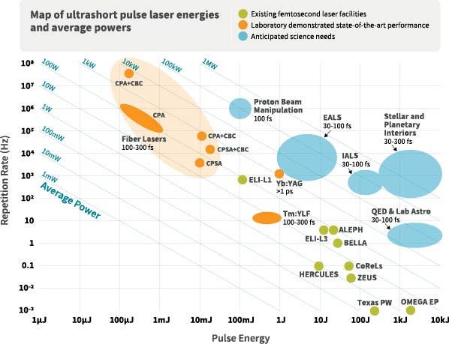
Current State-of-the-art
- Initial estimate for TeV class collider
“Report of the basic research needs workshop on laser technology,” https://science.osti.gov/- /media/ardap/pdf/2024/ Laser-Technology-Workshop-Report_20240105_final.pdf

Slide 8
Survey of Current Technological Landscape
Current state-of-the-art in key technologies:
Ti:sapphire pumped by DPSSL
Direct CPA
Coherent combination of fibers
OPCPA schemes
Thin disks

Slide 9
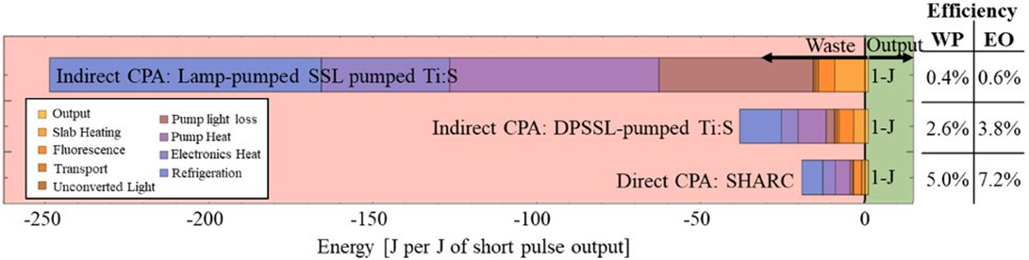

Ti:Sapphire pumped by DPSSL
Broad gain bandwidth [1] → fs-pulses & tuneable outputs ☺
High thermal conductivity (46 W/mK @ 300 K) ☺
∼34% quantum defect → high thermal load ☹
Short lifetime (τ ∼ 3.2 µs) → needs to be pumped by a laser → use DPSSL for high rep rate ☹
Notable systems:
HAPLS (ELI-beamlines/LLNL): 30 J/ 30 fs/ 10 Hz, 16 J / 28 fs / 3.33 Hz demonstrated [1] pumped by frequency-doubled Nd:glass DPSSL
EPAC (CLF): 30 J/ 30 fs/ 10 Hz, pumped by frequency-doubled DiPOLE Yb:YAG DPSSL [2]
KALDERA (DESY): 3 J / 30 fs / 1 kHz [4]
kBELLA (LBNL): 3 J / 30 fs / 1 kHz [5]
Commercial: Amplitude, Thales
1.https://www.llnl.gov/news/llnl-meets-key-milestone-delivery-world%E2%80%99s-highest-average-power-petawatt-laser-system (2017).
2.https://www.clf.stfc.ac.uk/Pages/EPAC.aspx
3.W. Leemans, et al. “BELLA laser and operations,” Proceedings of PAC2013.
4.http://mls.desy.de/kaldera
5.https://bella.lbl.gov/kbella/
6.E. Sistrunk, et al., Proc. SPIE 11034, Short-pulse High-energy Lasers and Ultrafast Optical Technologies, 1103407 (2019)

Slide 10
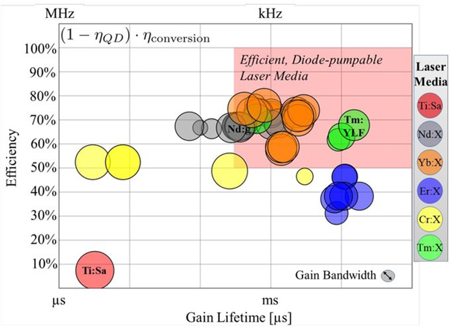
Direct CPA
Higher efficiency from direct diode pumping☺
Simpler laser architecture ☺
Gain materials can have limited apertures ☹
Gas cooling can be complicated ☹
Notable systems:
POLARIS (HI-Jena): Yb:glass/Yb:CaF2, 26.6 J / 98 fs / 0.02 Hz demonstrated [1];
PENELOPE (HZDR): Yb:CaF2, 12.6 J / broadband ns / 3.3·10-3 Hz demonstrated [2]
SHARC (LLNL): 150 J / 150 fs / 10 Hz, Nd:glass [3]
BAT (LLNL): >100 J / 100 fs / 1 kHz, Tm:YLF, prototyping [4]
M. Hornung, et al., Opt. Lett. 41(22), 5413-6 (2016).
D. Albach, et al., High Power Laser Science and Engineering 7, 1-9 (2019).
E. Sistrunk, et al., Proc. SPIE 11034, Short-pulse High-energy Lasers and Ultrafast Optical Technologies, 1103407 (2019).
I. Tamer, et al., Opt. Express 30, 46336-46343 (2022).

Slide 11
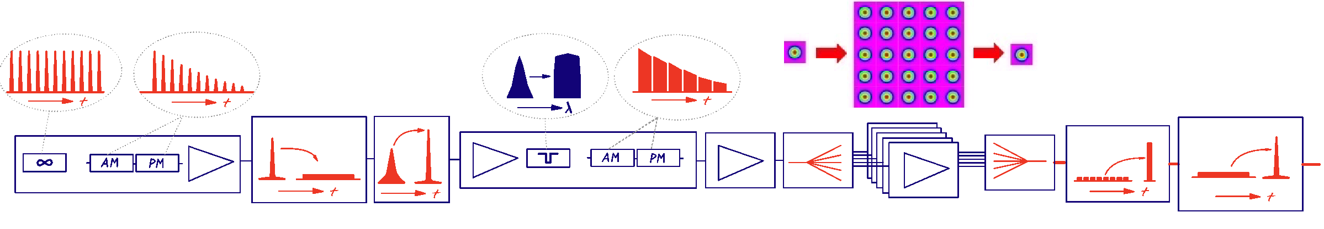
Coherently Combined Fiber Lasers
High efficiency with direct diode pumping ☺
  Up to ~50% WPE with commercial ~100kW cw systems
Distributed heat dissipation enables efficient cooling at multi-kW average powers ☺
Diffraction-limited output beams at high powers ☺
Compact and robust/integrated laser architecture ☺
Gain bandwidth limited to ~50-100fs ☹
Active phasing for coherent combining ☹

Slide 12
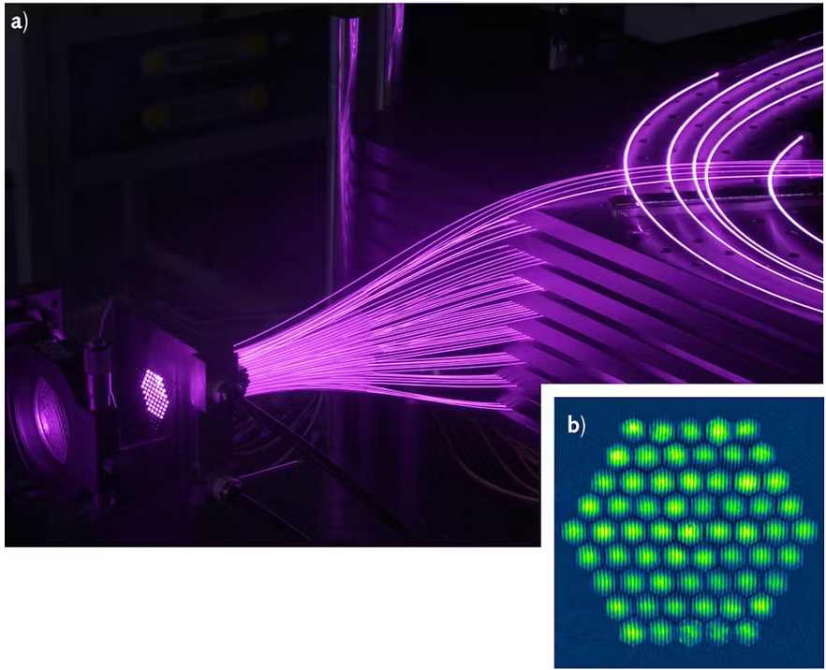
State-of-the-Art in Ultrashort Pulse Coherently Combined Fiber Laser Arrays
Coherent beam combining (CBC) of 61 parallel fiber CPA channels using ~40µm core PCFs produced after combiner^{[1]}
  ~500µJ (8.2µJ/channel) at 2 MHz and <300fs pulses
  Would need >12 000 channels for ~10J of combined energy
CBC of 16 parallel fiber 3ns CPA + 8-pulse divided pulse amplification (DPA) using ~81µm PCF-rods produced in a combined beam^{[2]}
  ~48mJ (~3mJ/channel) at 20kHz and 158fs pulses (~1kW average power)
  Would need ~3300 channels for ~10J of combined energy
CBC of 4 parallel fiber channels + 81-pulse CPSA using ~85µm 3C fibers produced in a combined beam ^{[3]}
  ~27mJ (~7mJ/channel) at 2kHz and ~300fs pulses
  With demonstrated^{[4]} ~10mJ/channel would need ~1000 channels for ~10J of combined energy
From [1]
[1] Ihsan Fsaifes at al. Opt. Express 28, 20152-20161 (2020)
[2] Henning Stark et al. Opt. Lett. 48, 3007-3010 (2023)
[3] A. Rainville et al. in CLEO 2023, (Optica Publishing Group, 2023), paper SF3H.6.
[4] A. Rainville et al. Optica 11, 1540 (2024)

Slide 13
OPCPA Technology
High single pass parametric gain → compact geometries J☺
Large gain bandwidth → few-fs pulses, tuneable ☺
High intensity contrast ☺
High rep rate if DPSSL pump
Lower thermal effects, but likely to require cooling for high energy, high P_{av} systems due to residual absorption
Efficiency ☹
Crystal aperture ☹
Requires high quality pump beam ☹
Notable systems:
L1 ALLEGRA (ELI-Beamlines): 30 mJ / 15 fs / 1 kHz [1], upgrade to 100 mJ planned
L2 DUHA (ELI-Beamlines): under commissioning, targeting 2 J / 20 fs / 50 Hz [2]
Petawatt Field Synthesiser (LMU, MPQ): 5 J / 5 fs / 10 Hz
GEKKO-EXA (Osaka, Japan): under development 10 J / 10 fs / 100 Hz [3]
P. Bakule, et al., "Readiness of L1 ALLEGRA Laser System for User Operation at ELI Beamlines," in OSA High-brightness Sources and Light-driven Interactions Congress 2020, paper HF1B.7.
L. Indra, et al., "Development of L2-DUHA laser front-end for near-IR and mid-IR generation at ELI-Beamlines," Proc. SPIE 12577, High-power, High-energy Lasers and Ultrafast Optical Technologies, 125770B (2023).
J. Kawanaka, et al., “Conceptual design of sub-exa-watt system by using optical parametric chirped pulse amplification,” J. Phys.: Conf. Ser. 688 012044 (2016).

Slide 14
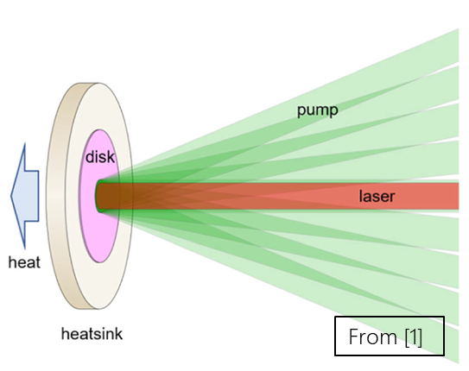
Thin Disk Approaches
Face-cooling configuration minimizes transversal temperature gradients → beam quality ☺
Can sustain absorbed volume pump power densities up to 1 mW/cm³ ☺
Low gain medium volume → limited pump storage capability ☹
Limitation on power scaling ☹
Could combine the output of multiple thin disk amplifiers
Notable systems:
TRUMPF thin-disk based regen: 550 mJ / 602 fs (fraction) / 1 kHz [1]
TRUMPF & DLR: 2.44 mJ / pre-compressed to 10 ps / 800 kHz [2]
CSU: 1 J / <5 ps / 0.5 kHz (“thick disk”) [3]
Laser Lightning rod project: target few-J / 1 ps / 1 kHz [4]
HiLASE: PERLA Lasers
C. Saraceno, et al, “The amazing progress of high-power ultrafast thin-disk lasers,” Journal of the European Optical Society-Rapid Publications 15:15 (2019).
Y. Pfaff, et al., "Thin-Disk based Regenerative Chirped Pulse Amplifier with 550 mJ Pulse Energy at 1 kHz Repetition Rate," in Laser Congress 2021 (ASSL,LAC), paper AM2A.5.
J. Dominik, et al., "Multi-kilowatt Ultrafast Laser with Thin-disk Technology," in Laser Congress 2021.
C. Baumgarten, et al., "1 J, 0.5 kHz Repetition Rate Picosecond Laser,” Optics Letters, Vol. 41, 3339-3342, (2016).
T. Produit, et al. “The Laser Lightning Rod Project,” Eur. Phys. J. Appl. Phys. 93, 10504 (2021).

Slide 15
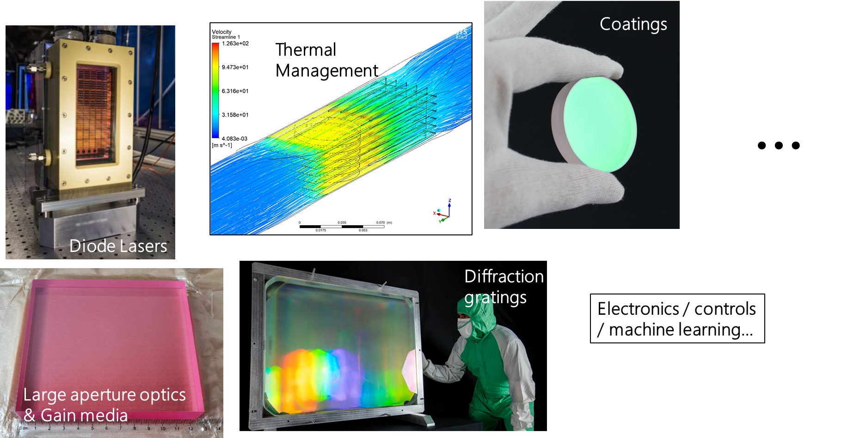
Enabling Technologies

