Slide 1


Status of the CYBORG beamline at UCLA:
Cryo-RF Photoinjectors for High Brightness Electron Beams
F. Bosco, J. Rosenzweig et al.
fbosco@physics.ucla.edu

Slide 2
Collaborators
UCLA
A. Fukasawa
J. Imenez Zepeda
G. Lawler (now at TibaRay)
C. Pennington
R. Robles (now at SLAC)
Y. Sakay (now at BNL)
A. Smith
O. Williams
M. Yadav
LANL
E. Simakov
H. Xu
A. Alexander
P. Anisimov
Cornell
J. Maxson
ASU
S. Tantawi
INFN
B. Spataro
A. Mostacci
L. Palumbo
M. Carillo

Slide 3
Outline
Motivation for cryo-RF photo-injectors
  The UCXFEL case and its driving cryo-RF gun
  Flat beams from magnetized cryo-rf guns
CYBORG beamline: gaining experience with cryo-RF gun
  Description of the beamline
  Temperature dependent dark current studies
  Towards the emission of photo-electrons from Cu cathodes
  Plans to test alternative cathodes

Slide 4
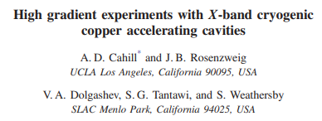
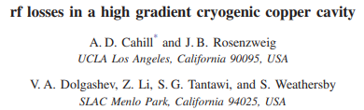
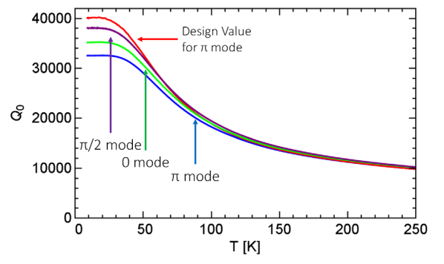
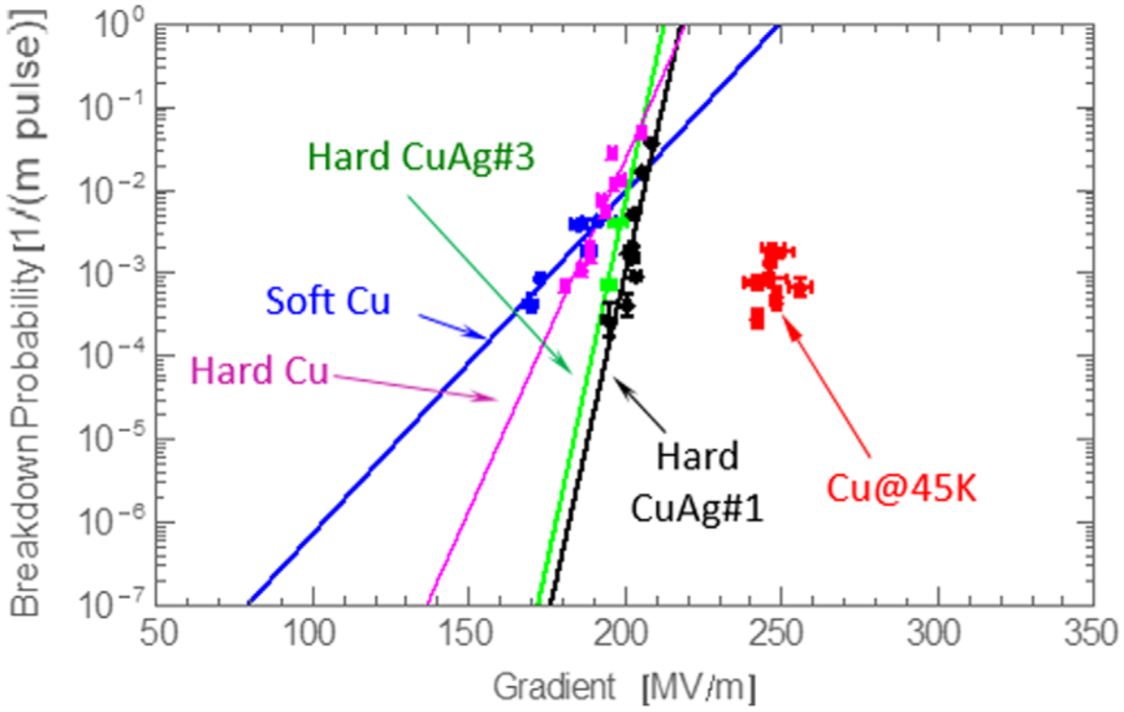
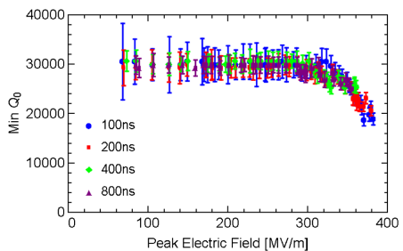
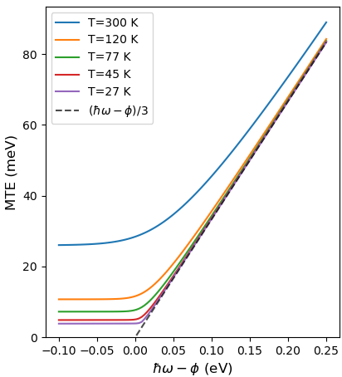
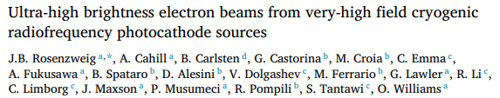
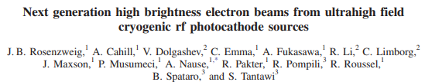
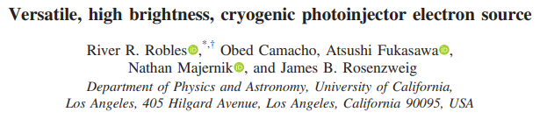
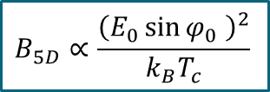

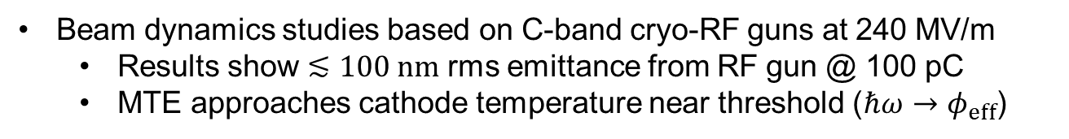
Advantages of Cryo-RF Guns
Copper at cryogenic temperature
  Increased conductivity (Q-factor) and hardness
  Reduced breakdown rate and CTE
  Tolerable dark current below 300 MV/m
Cahill et al., PRAB, 2018
Cahill et al., PRAB, 2018
Beam dynamics studies based on C-band cryo-RF guns at 240 MV/m
  Results show $≲100 nm$ rms emittance from RF gun @ 100 pC
  MTE approaches cathode temperature near threshold ($ℏω→φ_{eff}$)
$$∝T_{c}∝ε_{i}^{2}$$
$$B_{5D}∝\frac{{\left(E_{0}\sin{φ_{0}} \right)}^{2}}{k_{B}T_{c}}$$
J. Rosenzweig et al., NIM, 2018
J. Rosenzweig et al., PRAB, 2019
R. Robles et al., PRAB, 2021

Slide 5
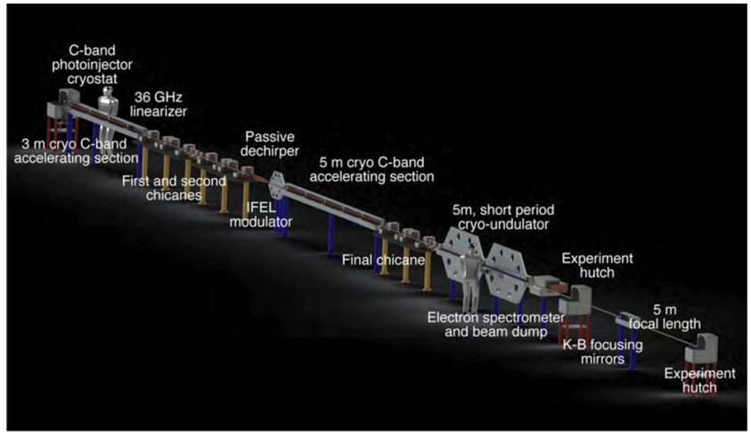
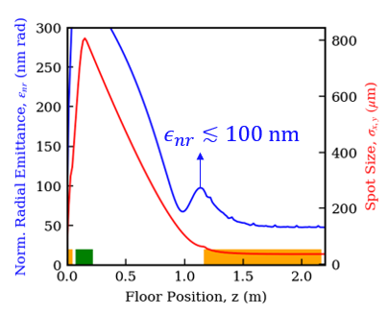
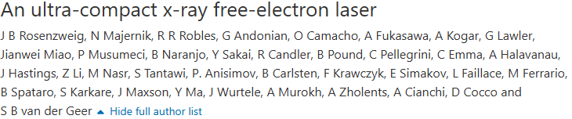
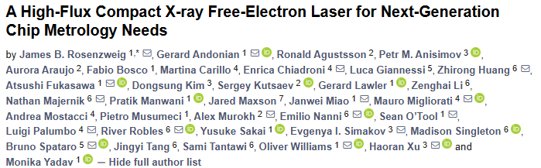
Cryo-RF Gun for UCXFEL
Proposal for a university-scale hard X-ray FEL
Ultra-bright electron beam source: cryogenic RF gun
  C-band (5.712 GHz) and Cryogenic (77 K)
  High field (240 MV/m at cathode)
  Expected to deliver sub-100 nm rms emittance @ 100 pC
  Compensation in a matched linac leads to ~50 nm
J. Rosenzweig et al., New Journal of Physics, 2020
J. Rosenzweig et al., Instruments, 2024

Slide 6
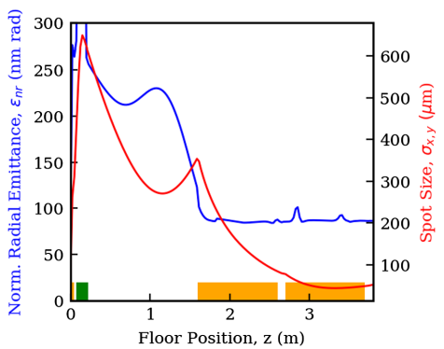
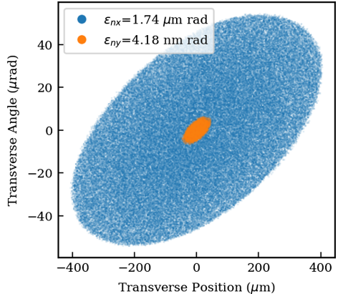
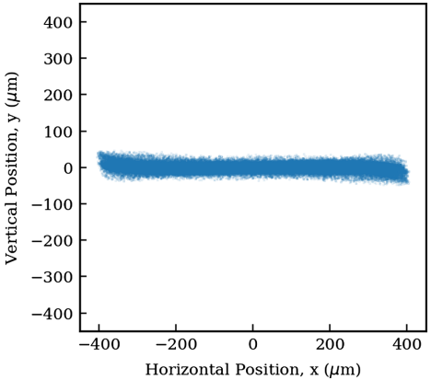
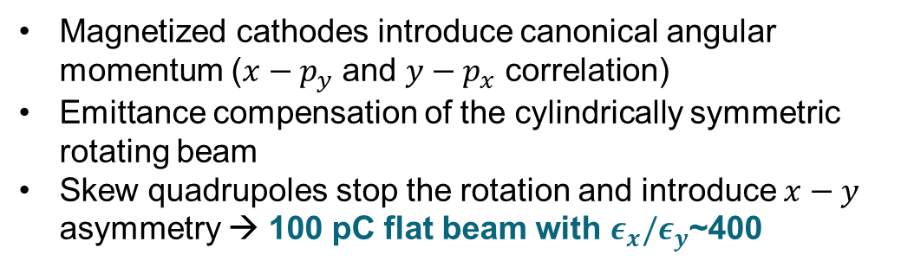
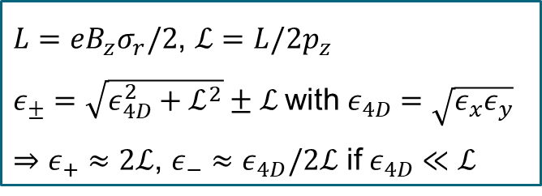
Magnetized Cryo-RF Gun for Flat Beams
Magnetized cathodes introduce canonical angular momentum ($x−p_{y}$ and $y−p_{x}$ correlation)
Emittance compensation of the cylindrically symmetric rotating beam
Skew quadrupoles stop the rotation and introduce $x−y$ asymmetry → 100 pC flat beam with $ε_{x}/ε_{y}$~400
$L=eB_{z}σ_{r}/2$, $ℒ=L/2p_{z}$
$ε_{±}=\sqrt{ε_{4D}^{2}+ℒ^{2}}±ℒ$ with $ε_{4D}=\sqrt{ε_{x}ε_{y}}$
$⇒ε_{+}≈2ℒ$, $ε_{−}≈ε_{4D}/2ℒ$ if $ε_{4D}≪ℒ$
R. Robles et al., PRAB, 2021
Emittance compensation before skew quads
Transverse phase space after skew quads
Beam cross section space after skew quads
Round rotating beam
Flat non-rotating beam

Slide 7
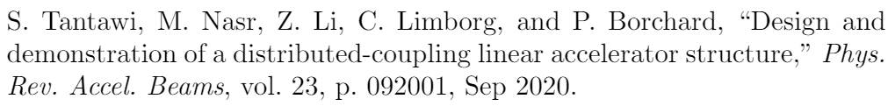
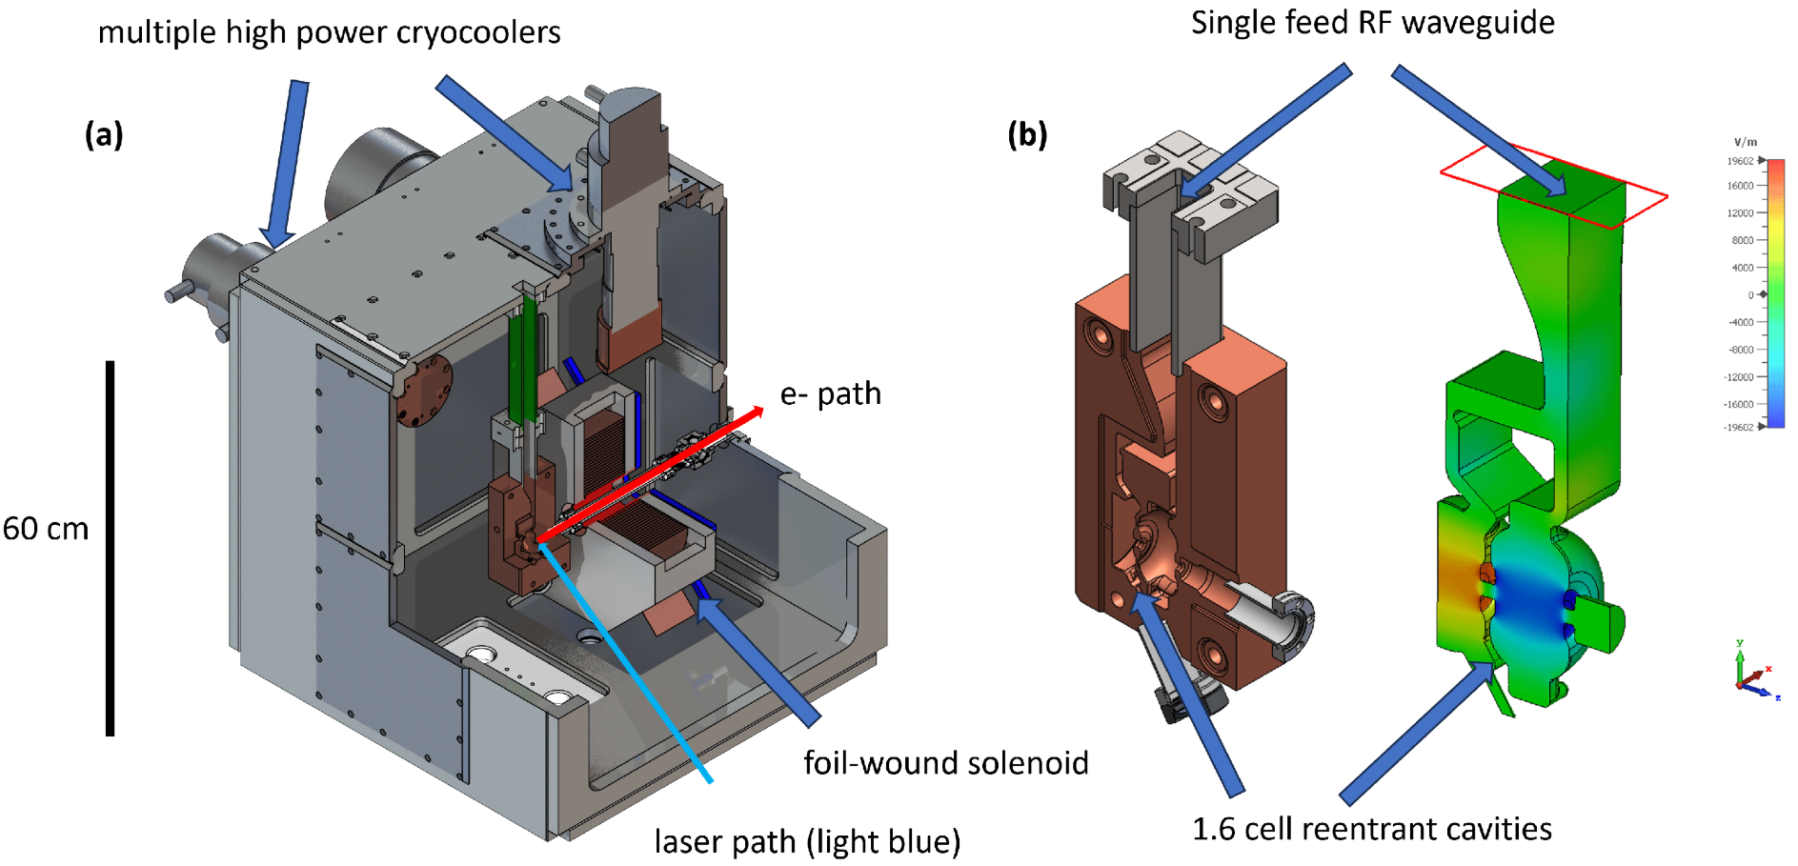
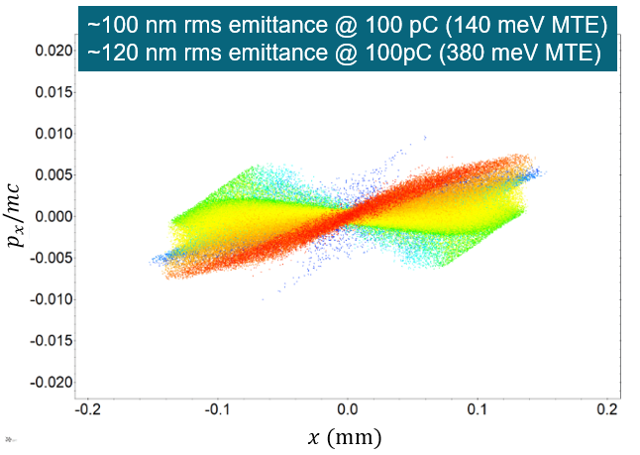

1.6 Cell Cryo-RF Gun for the UCXFEL
1.6 cell cryogenic, distributed coupling(*) RF gun at C-band (5.712 GHz) with 240 MV/m peak field and insertable cathodes
Expected challenges
  Manufacturing (distributed coupling, tuning..)
  Sustaining high electromagnetic field (breakdown, dark current, cathode lifetime..)
  Integrating RF, cryogenics and UHV Loadlock system
(*)
Intermediate steps:
UCLA: Simplified geometry (0.5 cell), lower target field (120 MV/m) but cryogenic system with insertable cathodes
LANL: Room temperature version with and without the insertable cathodes at ~200 MV/m

Slide 8
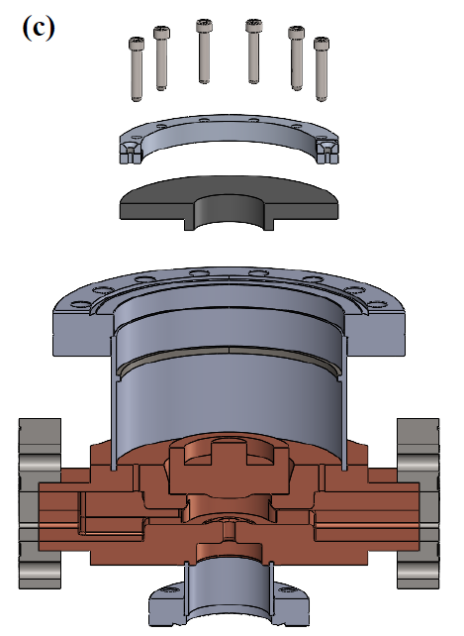
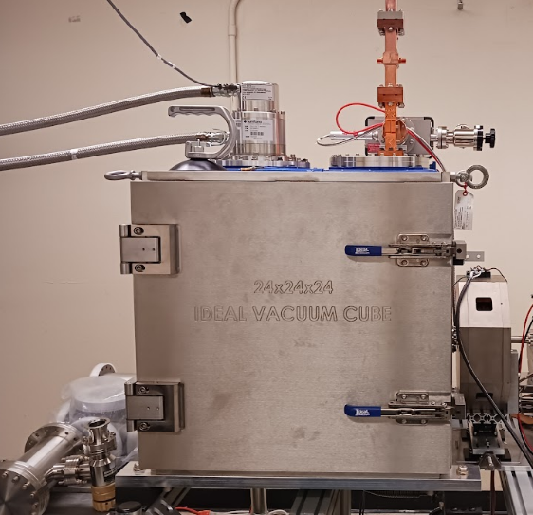
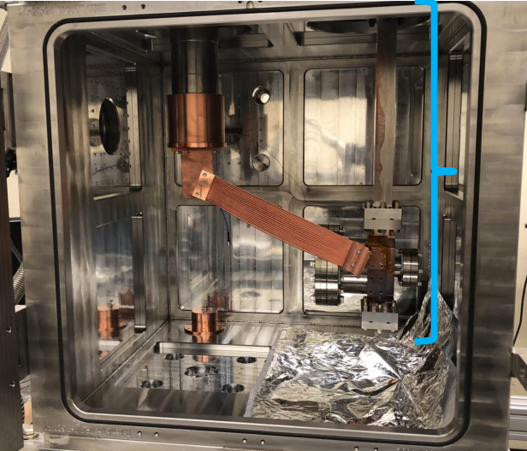
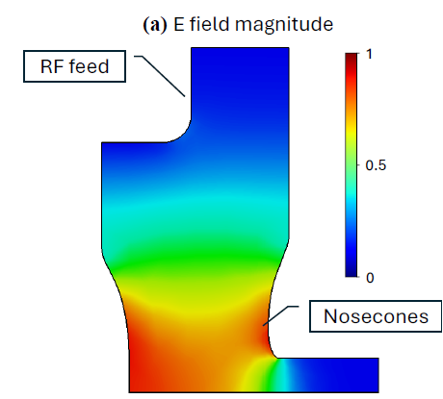
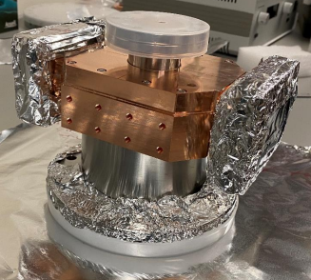
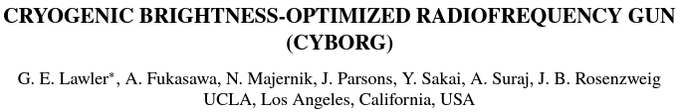

CYBORG Beamline
CYBORG (CrYogenic Brightness-Optimized Rf Gun) beamline at MOTHRA Lab (UCLA)
  C-band (5.712 GHz) re-entrant half cavity with demountable back plane
  120 MV/m at ~80 K achievable with ~0.8 MW power
  Helium compressor cryo-coolers
CYBORG
Gun cavity
Lawler et al., IPAC 22, 2022
Lawler et al., Instruments, 2024

Slide 9
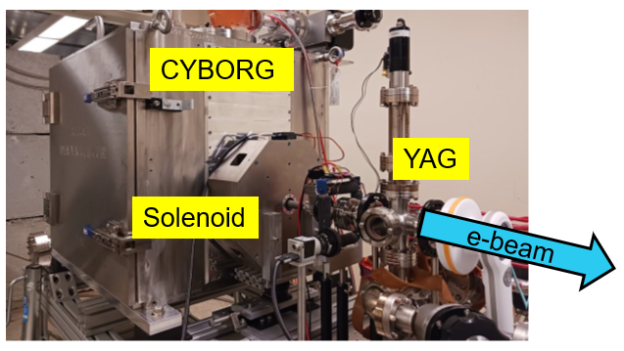
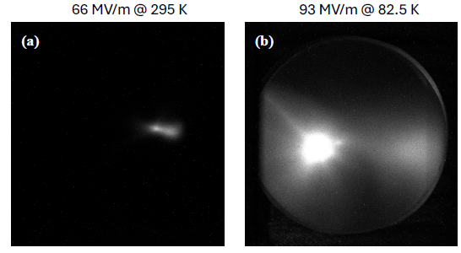
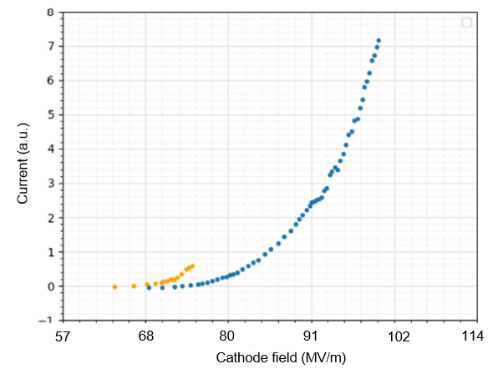
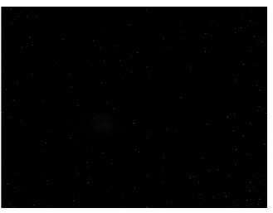


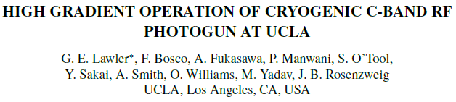
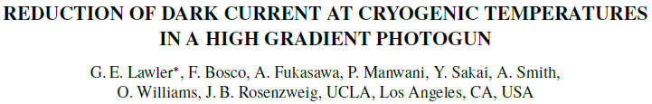
Dark Current in CYBORG
Dark current is produced in absence of photons: thermal and (mostly) field emission mechanisms
Maximum input power ~0.5 MW* (~75 MV/m at room temp, ~95 MV/m at 83 K)
Reduction of dark current at cold temperature
(*) Before klystron optimization
cold
warm
cold
Same field
Same power
Room temp 295 K
Cryo temp 83 K
G. Lawler et al., IPAC 24, 2024
G. Lawler et al., IPAC 24, 2024
Notes:
Here I am showing a small summary on the measurement of dark current, visible in this snapshots .
DC refers to electrons produced in absence of a laser beam on the photocathode with a hybrid emission process attributed to thermal and field emission effects. The emimeasurements

Slide 10
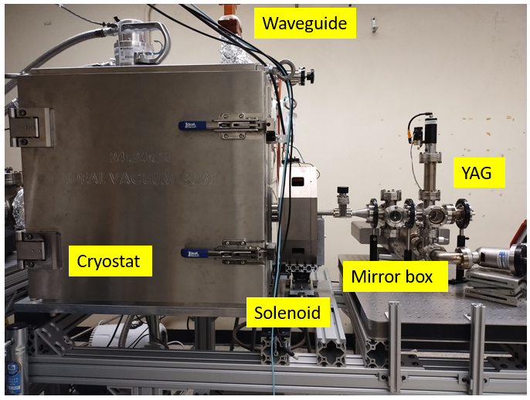
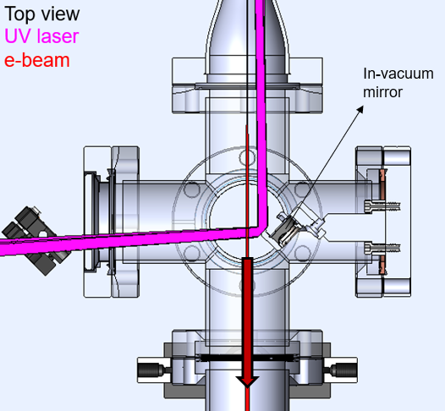
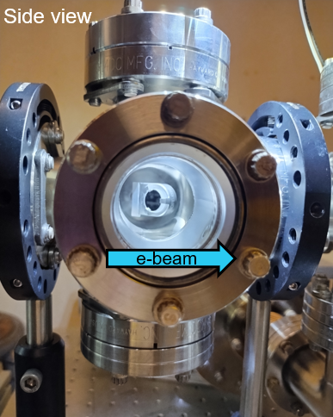
Photo-electrons from Cu Cathodes
Current status of the beamline: mirror box for UV injection
Finalizing laser transport and RF synchronization
First beams expected in March
Finalizing diagnostics (TEM grid and spectrometer) for full characterization ~Summer 2025
e-beam

Slide 11
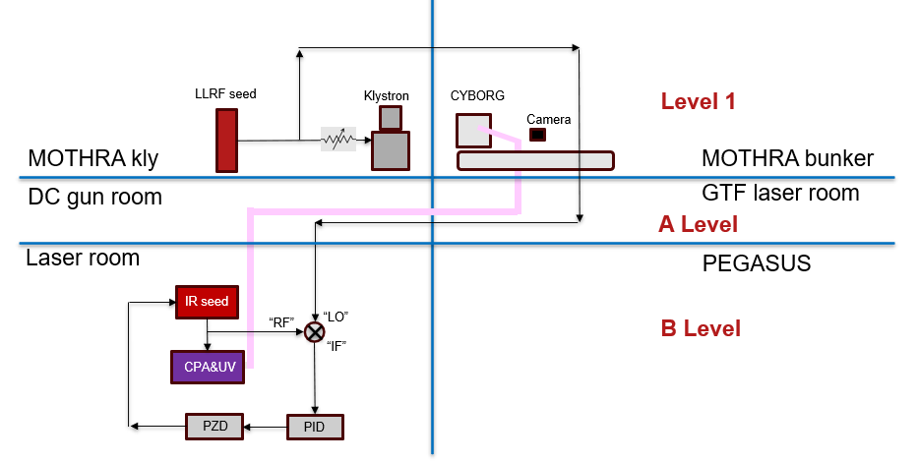
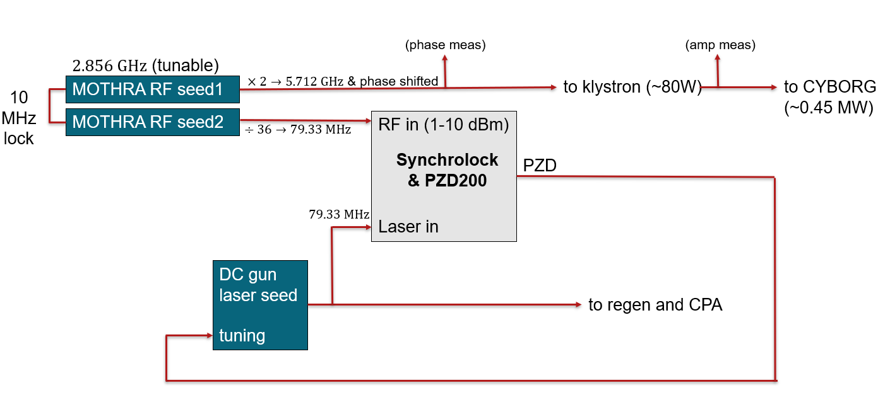
Photo-electrons from Cu Cathodes
Current status of the beamline: mirror box for UV injection
Finalizing laser transport and RF synchronization
First beams expected in March
Finalizing diagnostics (TEM grid and spectrometer) for full characterization ~Summer 2025
Laser transport
e-beam
Synchronization architecture

Slide 12
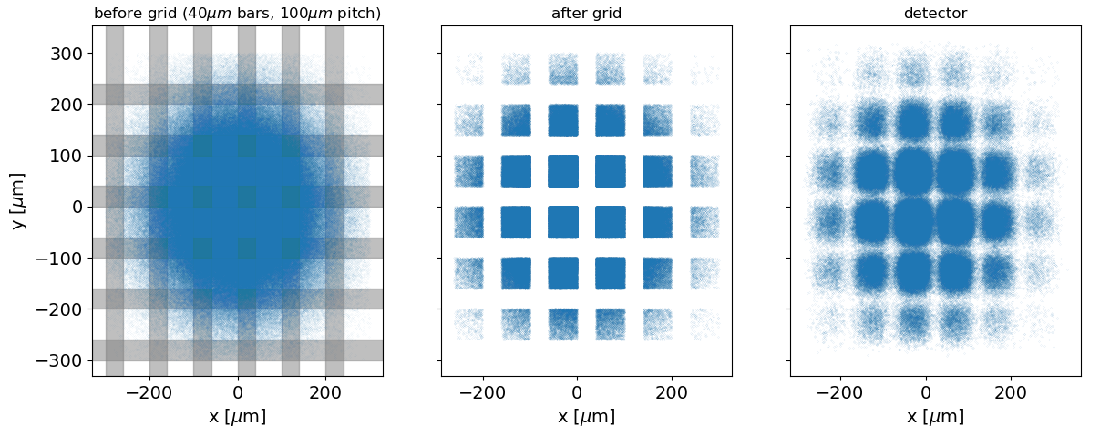
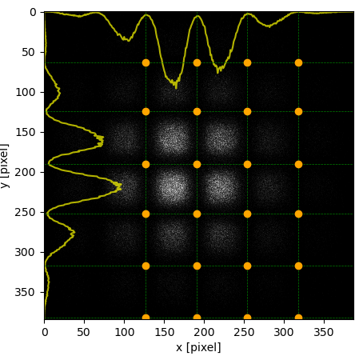
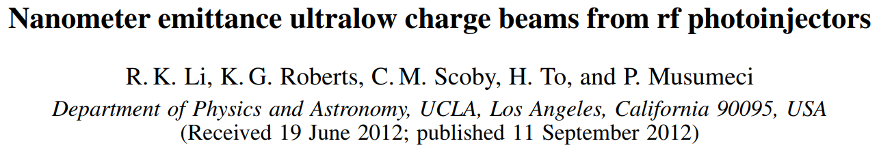
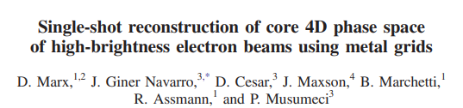
Photo-electrons from Cu Cathodes
Current status of the beamline: mirror box for UV injection
Finalizing laser transport and RF synchronization
First beams expected in March
Finalizing diagnostics (TEM grid and spectrometer) for full characterization ~Summer 2025
e-beam
Numerical studies for the design of a TEM grid for emittance measurement
R. Li et al., PRAB, 2012
D. Marx et al., PRAB, 2018

Slide 13
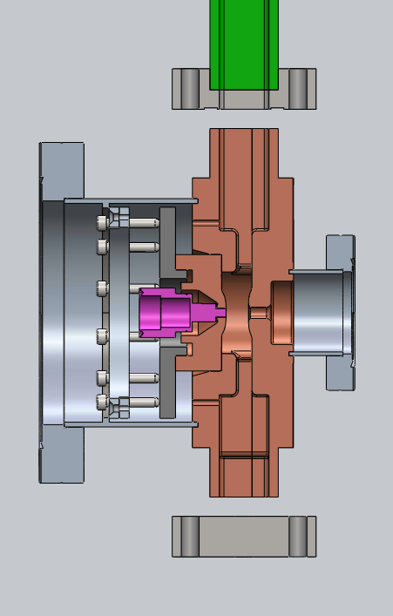
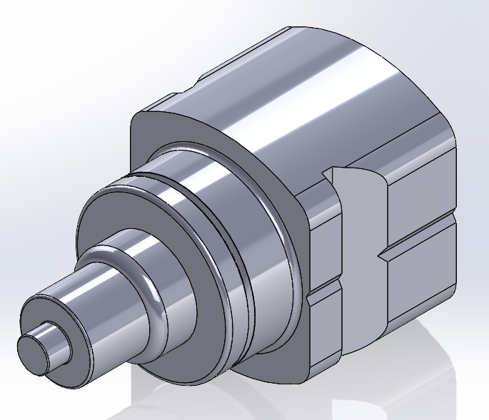
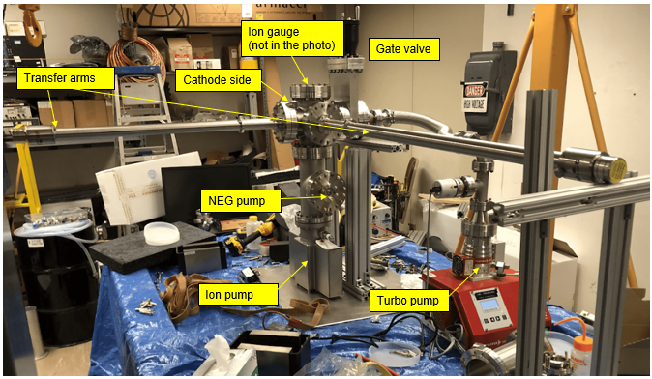
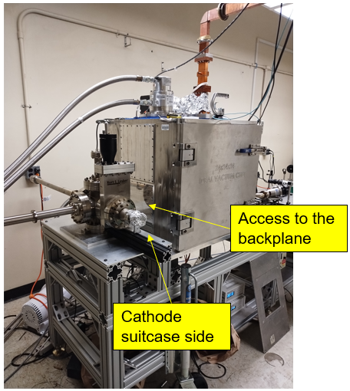
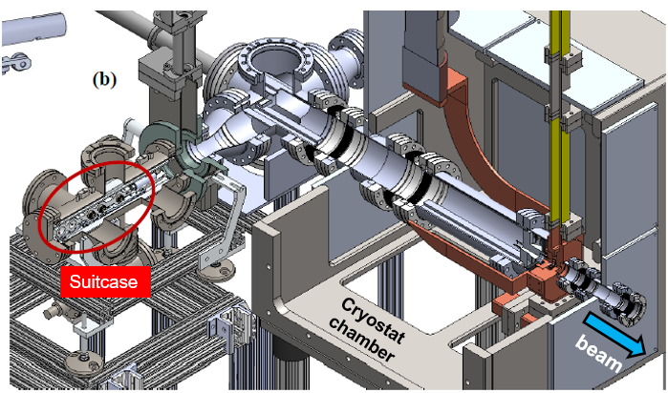
Insertable Cathodes
Loadlock for cathode exchange: photo-electrons from alternative cathodes (e.g. Cs2Te)
New cathode backplane and INFN-mini plugs
First assembly and vacuum tests
Integration with the cryo-RF gun expected by the end of the year 2025
Studies of low-MTE cryogenic cathodes from ~Jan 2026

Slide 14
Summary
Cryogenic RF guns can operate at very high launch fields (~240 MV/m) increasing the beam brightness
  Candidate applications in ultra compact X rays FELs and production of flat beams for plasma or dielectric wakefield accelerators and linear colliders
CYBORG beamline at UCLA: a stepping stone facility to gain expertise on cryo-RF photoinjectors and testing low-MTE cryogenic cathodes
  Phase I and dark current studies
  Excitement for Phase II: photo-electrons from Cu cathodes
  Near future plans: integration with the load lock for cathode exchanges
Acknowledgements
G. Lawler, C. Pennington, J. Imenez Zepda, A. Fukasawa, Y. Sakai, O. Williams, G. Andonian, B. Naranjo, P. Manwani, M. Yadav, W. Lynn, J. Mann, A. Smith, I. Da Silva and J. Rosenzweig
Thank you for your attention
(Questions are welcome)
fbosco@physics.ucla.edu
This work was supported by the U.S. National Science Foundation under Award PHY-1549132, the Center for Bright Beams

Slide 15
SPARE SLIDES

Slide 16
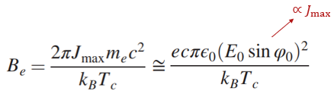


Advantages of Cryo-RF Guns
Copper at cryogenic temperature
  Increased conductivity (Q-factor) and hardness
  Reduced breakdown rate and CTE
  Tolerable dark current below 300 MV/m
Cahill et al., PRAB, 2018
Cahill et al., PRAB, 2018
Beam dynamics studies based on C-band cryo-RF guns at 240 MV/m
  Results show $≲100 nm$ rms emittance from RF gun @ 100 pC
  Smaller MTE near threshold ($ℏω→φ_{eff}$)
$$∝ε_{i}^{2}∝MTE$$
J. Rosenzweig et al., NIM, 2018
J. Rosenzweig et al., PRAB, 2019
R. Robles et al., PRAB, 2021

Slide 17

MTE and QE vs Temperature
Copper material: $E_{F}=7.05 eV$, $φ=4.6 eV$

Slide 18






MTE & QE Equations
MTE = Mean transverse energy
$MTE=\frac{\left\langle p_{⊥}^{2}\right\rangle }{2m}=k_{B}T=\frac{\left\langle p_{x}^{2}\right\rangle }{2m}+\frac{\left\langle p_{y}^{2}\right\rangle }{2m}≡\frac{\left\langle p_{x}^{2}\right\rangle }{m}$(assuming x-y symmetry in the lattice)
Intrinsic emittance
$$ε_{i}=\frac{σ_{x}σ_{px}}{mc}=σ_{x}\sqrt{\frac{MTE}{mc^{2}}}$$
Dowell and Schmerge, PRAB, 2009
J. Feng et al., APL, 2015
Three steps model (absorption, migration, escape):
$$MTE=\left\langle p_{x}^{2}\right\rangle /m=\frac{\int_{E_{F}+φ−ℏω}^{+∞}{dEf_{FD}\left(E\right)DOS\left(E\right)\left(E+ℏω\right)\left(\frac{2}{3} −\sqrt{\frac{E_{F}+φ}{E+ℏω}}+\frac{1}{3}{\left(\frac{E_{F}+φ}{E+ℏω}\right)}^{3/2}\right)}}{\int_{E_{F}+φ−ℏω}^{+∞}{dEf_{FD}\left(E\right)DOS\left(E\right)\left(1−\sqrt{\frac{E_{F}+φ}{E+ℏω}}\right)}}$$
$$QE=\frac{\left(1−R\left(ω\right)\right)}{2}F_{e−e}\left(ω\right)\frac{\int_{E_{F}+φ−ℏω}^{+∞}{dE\left(1 −\sqrt{\frac{E_{F}+φ}{E+ℏω}}\right)\left(1−f_{FD}(E+ℏω)\right)f_{FD}(E)}}{\int_{E_{F}−ℏω}^{+∞}{dE\left(1−f_{FD}(E+ℏω)\right)f_{FD}(E)}}$$
$ℏω−φ≫k_{B}T$ limit provides $MTE=(ℏω−φ)/3$
$ℏω−φ≫k_{B}T$ limit provides $QE∝{\left(ℏω−φ\right)}^{2}$

Slide 19







RF Infrastructure
Klystron
C-band Thomson (TH2067) tube and XK5 tank inherited from SLAC
Nominally 5 MW peak power in 5 $μs$ pulses at 20 Hz (0.5 kW avg)
Current output: ~0.8 MW, 2 $μs$ pulses at 1 Hz
Cband klystron tube (Thales)
Original solenoid
XK5 tank (meant for Sband)
Modulator
Homemade pulse forming network (PFN)
Array of 7 capacitor-inductors discharged by a thyratron produce ~120 kV, ~30 A, 5 us DC pulse

Slide 20



RF Infrastructure (2)
C-band WR-187 waveguide filled with Nitrogen (~25 psi)
Directional couplers probe KLY-FWD and GUN-REFL power
RF window allows EM waves propagation isolating vacuum volumes
5 MW isolator protects klystron from reflection
Concrete bricks separate the bunker from the control room
Ion pump
Concrete bricks
Directional coupler
RF window
Directional coupler
Circulator

Slide 21



Conditioning
RF power in the gun
Vacuum fluctuations in the gun due to extraction of material
Slow process: progressively increasing pulse length and amplitude
Breakdown events
  Charge spike allover the YAG screen
  Distortion in the reflected waveform
Breakdown event
Regular pulse
Notes:
Once the beamline and the RF waveguide connecting the klystron to the gun were assembled we were able to inject rf power into the cavity and start the conditioning process
There are a few indicators that show this process is happening: vacuum fluctuations in the gun as material is extracted by the field on the copper surfaces (progressively reduces via RF cleaning)
Breakdown events visible either as charge spikes covering the full surface of the CCD camera or anomalous shape of the reflected power waveform indicating that the power is dissipated in the sparc

Slide 22





RF Power
Most promising working point: 115 VAC filament, 22 kV charging voltage, 160 A solenoid → 0.8 MW$±$6%
  Enough for 120 MV/m at 80 K
  UED case at 180 MV/m would require 1.8 MW (very challenging)
800 kW$±$6%
180 MV/m
120 MV/m
UED case: scaling predicts
1.8 MW
$$E_{0}∝\sqrt{P_{rf}}$$
120 MV/m at 0.8 MW & 80 K
From GL
80 K

Slide 23






Laser/RF Timing
Laser pulses: ~79 MHz (from the IR laser cavity) → Then reduced to 10s of Hz when amplifying and frequency tripling to UV
RF pulses: ~1 Hz, 1.5 $μs$ long, C-band (5.712 GHz)
~10 Hz, UV, sub-ps
79.33 MHz, IR
~1 Hz, C-band RF, 1.5 $μs$
RF field
time
UV pulse
Notes:
The timing is a fundamental aspect for a photo-injector: the laser extracts the electrons and the RF field accelerates them. These two actions need to be properly timed and the synchronization must be locked to compensate natural drifts induced by environmental causes (temperature, phase noise in the electronics)
To make sure that the uv pulses are consistently synchronized with the accelerating field over time we need to make sure that the phases of the two signals are matched
----
The IR seed produces IR pulses where the 80 MHz is dictated by the round trip in the laser cavity
After the amplification and conversion to UV this frequency is closer to 10 Hz
On the other hand the rf pulses in the gun have a rep rate of 1 Hz

Slide 24

Phase Lock Loop (PLL)
Match the phase of a secondary signal (laser cavity output) to the phase of a high quality reference tone (RF seed) → Phase “locking”
Use a piezodriver motor to adjust the laser cavity length
Multipliers can be introduced to lock in phase a sub-harmonic of the reference
Synchronization requires phase matching
1st harmonic of the IR pulse train signal
RF field
1:36 frequency ratio
RF seed (scaled)
error
control
out
HQ ref (+)
Voltage controlled oscillator (VCO)
Phase detector (PD)
Loop filter (PID)
Meas (-)
Laser cavity
“Feedback is how machines think”, A. Moravia
Notes:
A phase locked loop is a feed back circuit that makes sure this matching condition is maintained
What it does is to adjust the laser cavity length and therefore the pulse frequency with a piezodriver motor
The corrections are based on an error signal that compares the phase of the laser cavity signal to the higher quality oscillator that drives the RF system
The loop makes sure the error goes to zero such that the laser cavity matches the frequency of the primary oscillator

Slide 25




Synchronization architecture
(phase meas)
(amp meas)
$2.856 GHz$ (tunable)
MOTHRA RF seed1
$×2→5.712 GHz$ & phase shifted
to klystron (~80W)
to CYBORG
(~0.45 MW)
10 MHz lock
MOTHRA RF seed2
$$÷36→79.33 MHz$$
RF in (1-10 dBm)
Laser in
Synchrolock
& PZD200
PZD
$$79.33 MHz$$
DC gun laser seed
tuning
to regen and CPA
Notes:
This procedure happens in the synchrolock which represents the core of our synchronization architecture
This system receives the input from the reference RF seed and from the laser pulse signal and generates a driver signal that adjust the laser cavity tuning the pulse rep rate
All parts available, just need to be connected and tested
Next thing I want to discuss is the phase shift

Slide 26
UV Laser
Current plan is to share the laser used for the DC gun beamline (Musumeci’s group)
Transport of the UV laser to the cathode
Laser-RF synchronization
Notes:
The current plan is to use a laser system that belongs to the group of professor Musumeci: IR Seed, Amplified and frequency tripled to UV
I’m showing here a simplified schematic of the arrangement of the rooms involved
The laser is already in use for running experiments in the two adjacent rooms
We started by transporting the laser to the bunker room
At the same time with need synchronization and triggering signal for the correct time alignment of the laser and the rf signal driving the klystron which I’ll cover later

Slide 27


Beamline upgrade plan
Phase 1: Cryo-rf Gun and YAG screen (no laser) → Dark current studies
Phase 1.5: Phase 1 + Mirror box → First photoelectrons from Cu cathode
Phase 2: Phase 1.5 + Diagnostics → Full characterization of Cu photoelectrons
Phase 3: Loadlock + Phase 2 → Alternative cathodes (e.g. CsTe)
Phase 1
Phase 3
Phase 1.5
.. Phase 2 ..

Slide 28


Photo-electrons from Cu Cathodes
Current status of the beamline: mirror box for UV injection
Finalizing laser transport and RF synchronization
First beams expected in March
Finalizing diagnostics (TEM grid and spectrometer) for full characterization ~Summer 2025
Side view
In-vacuum mirror
e-beam
Laser transport
e-beam
Synchronization architecture

