Slide 1
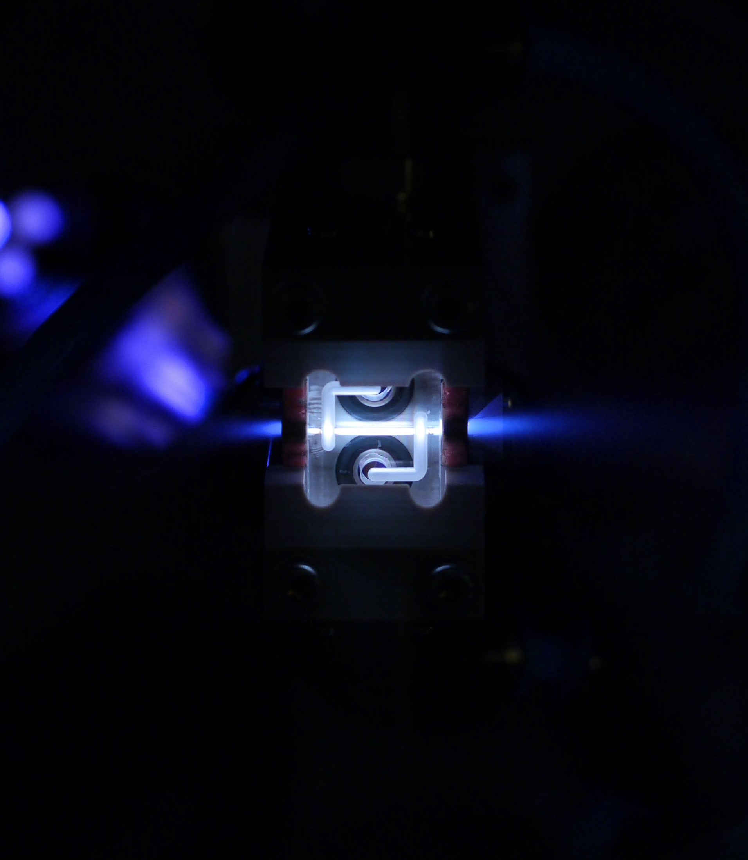

Betatron Radiation and Self-Corrected Energy Spread in Plasma-Wakefield Accelerators
ALEGRO workshop 2025
Daniel Kalvik
12.06.24

Slide 2
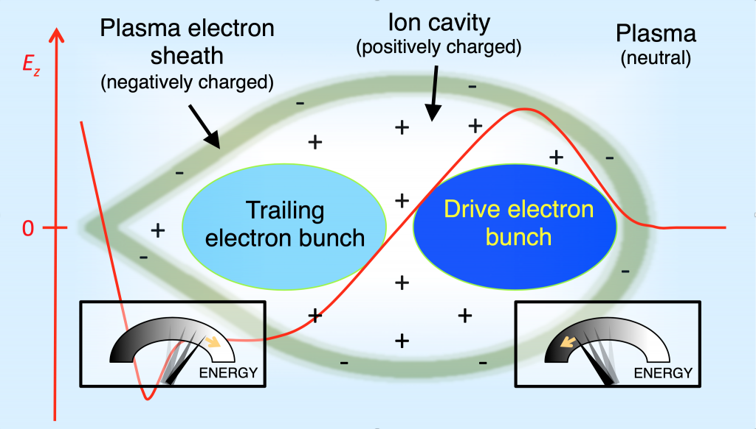
Induced energy spread
The longitudinal electric field generates a large energy spread.
Laboratoire d’Optique Appliquée (LOA), 2024, https://loa.ensta-paris.fr/research/upx-research-group/particle-beam-driven-plasma-wakefield-acceleration/
05.03.25 | Daniel Kalvik | ALEGRO

Slide 3
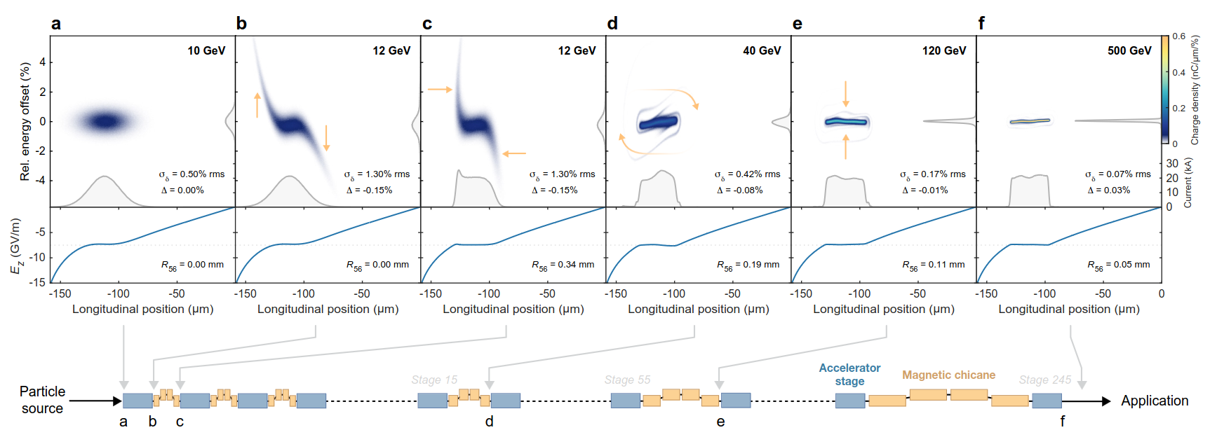
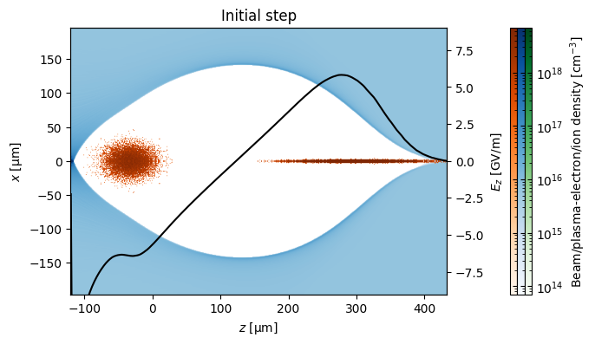
Self-correction mechanism
How to reduce the energy spread
Stronger electric field
Weaker electric field
The longitudinal dynamics in bending magnets can reduce the energy spread.
High energy particles are bent less (they take a longer path), low energy particles are bent more, they take a longer path.
05.03.25 | Daniel Kalvik | ALEGRO

Slide 4
Self-correction mechanism
How to reduce the energy spread
High energy-gain
Low energy-gain
The strength of the correction is tuned to a specific location in the wake.
I.e. the energy gain (decided by location of the beam) is predetermined.
05.03.25 | Daniel Kalvik | ALEGRO

Slide 5
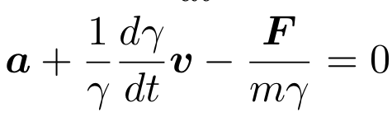
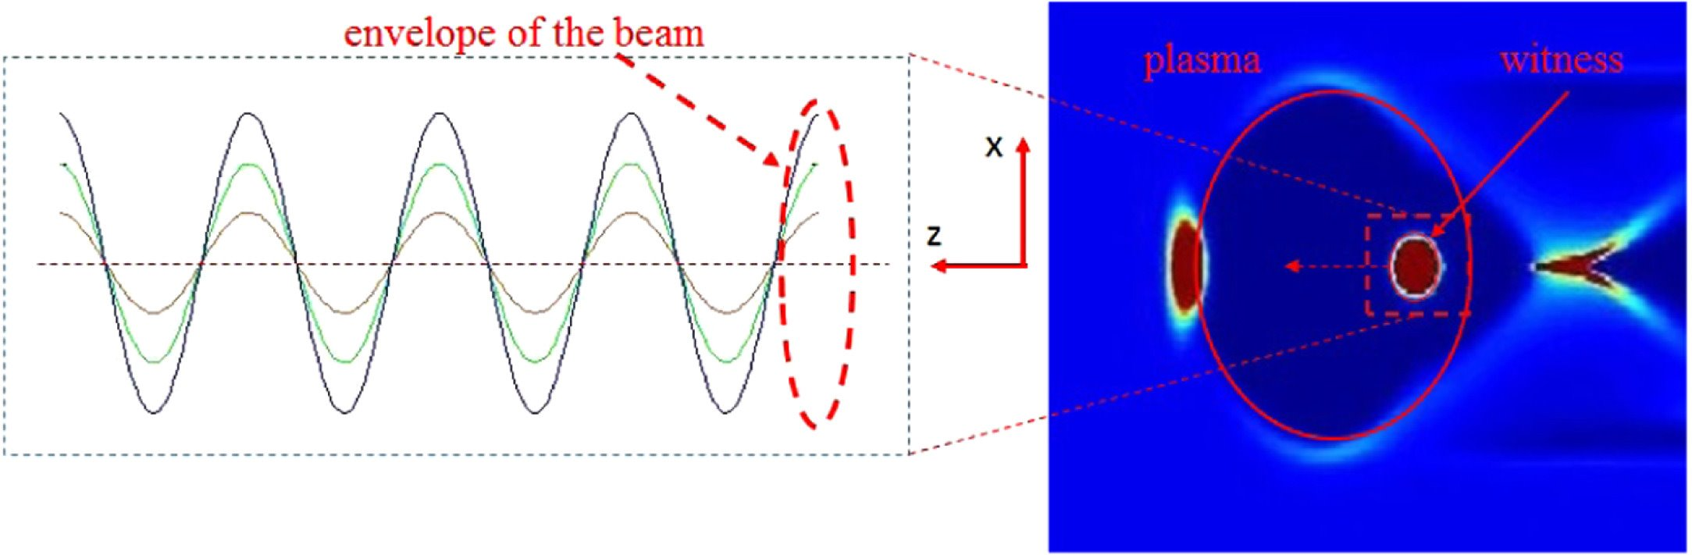
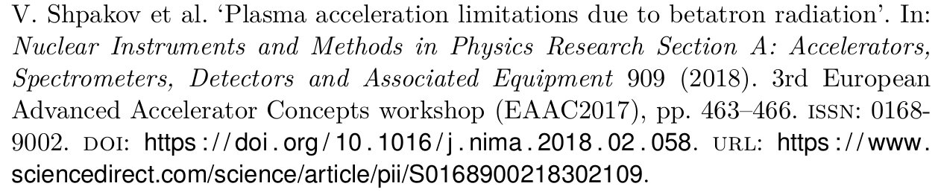
Particle dynamics
Motion in an ion cavity
Newton's second law gives the equations of motion
If the Lorentz factor is increasing, the oscillations are damped. This is known as adiabatic damping.
In an ion cavity, the equation of motion becomes a harmonic oscillator
05.03.25 | Daniel Kalvik | ALEGRO

Slide 6
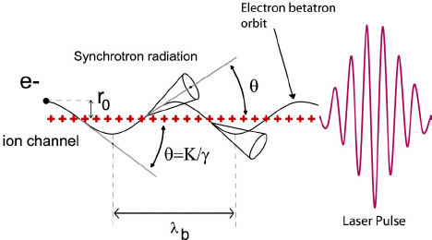
The radiation reaction
Interaciton between a charged particle and its own electromagnetic field
As charged particles oscillate, a force is exerted on the particle by its own electromagnetic field; hence it is a self-force.
This self-force is called the radiation reaction force, and its effect, the radiation reaction.
Particles of different amplitudes radiate differently and contributes therefore to energy spread.
Ta, Phuoc & Burgy, frédéric & Rousseau, Jean-Philippe & Malka, Victor & Rousse, Antoine & Shah, Rahul & Umstadter, Donald & Pukhov, A. & Kiselev, Sergei. (2005). Laser based synchrotron radiation. Physics of Plasmas. 12. 10.1063/1.1842755.
05.03.25 | Daniel Kalvik | ALEGRO

Slide 7
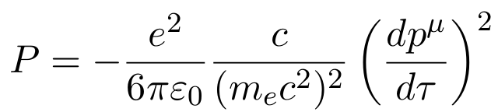
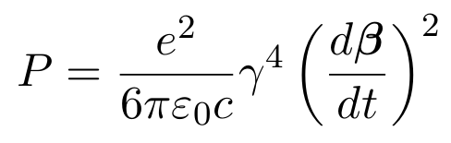
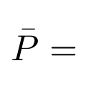

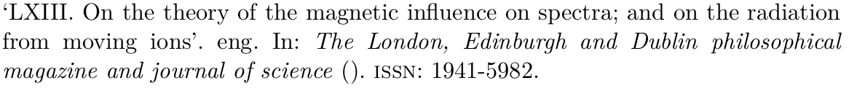
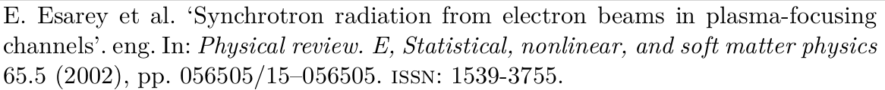
Particle dynamics and the Larmor formula
Radiation for an oscillating charged particle
The Larmor formula, *, tells us how much energy is radiated by accelerating charges.
Simplifies to , which gives **, which is the radiated power, averaged over one betatron period.
The radiation emitted as the particles oscillate, is betatron radiation.
* **
Amplitude of oscillations
05.03.25 | Daniel Kalvik | ALEGRO

Slide 8
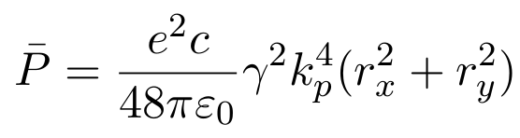
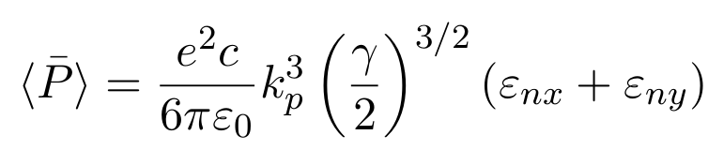
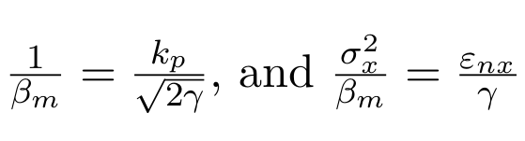
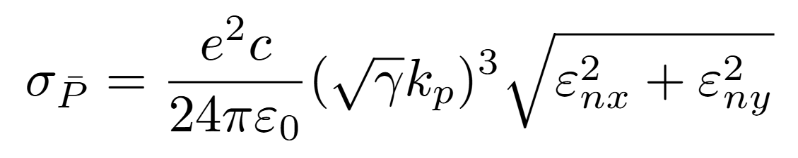
Radiation in both transverse dimensions
Radiation for oscillating charged particles
Expanding to 2D oscillations the new mean radiated power is
. The equation is no longer dependent on the betatron
amplitude. The amplitude in x/y give independent contributions.
By averaging over all the betatron amplitudes for a bunch of particles, the total radiated power is
And the spread in the radiation is (for no energy spread).
05.03.25 | Daniel Kalvik | ALEGRO

Slide 9
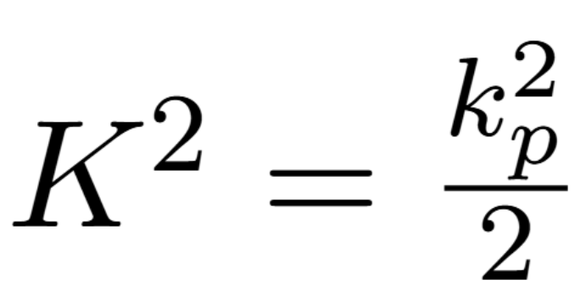
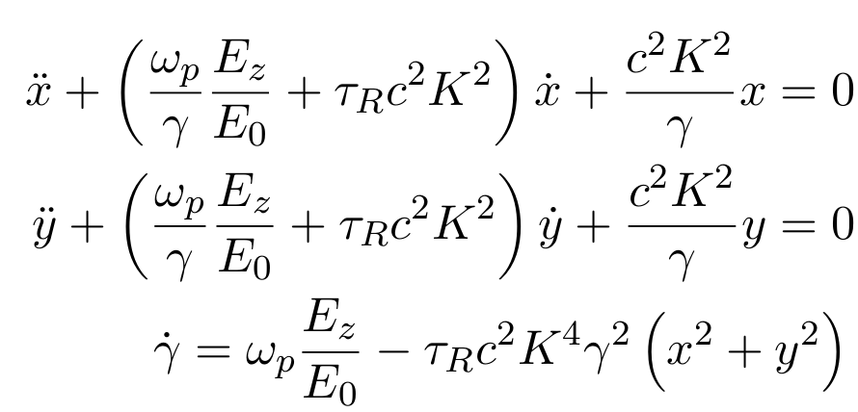
Self-consistent motion for accurate simulations
Including the radiation reaction and adiabatic damping
The equations of motion for each individual particle are (Deng et al.)
05.03.25 | Daniel Kalvik | ALEGRO

Slide 10
Self-consistent motion for accurate simulations
Including the radiation reaction and adiabatic damping
The equations of motion for each individual particle are (Deng et al.)
My results are obtained by solving this set of equations, using a multistep method.
Damping from radiation reaction force
Adiabatic damping
05.03.25 | Daniel Kalvik | ALEGRO

Slide 11
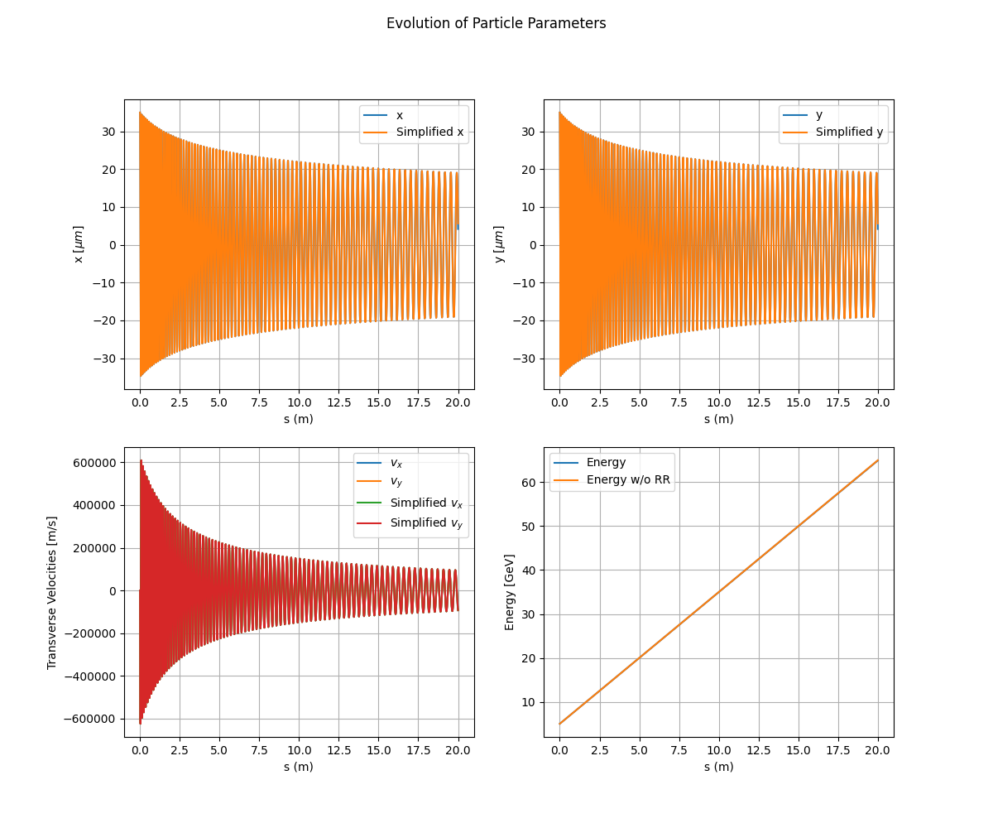
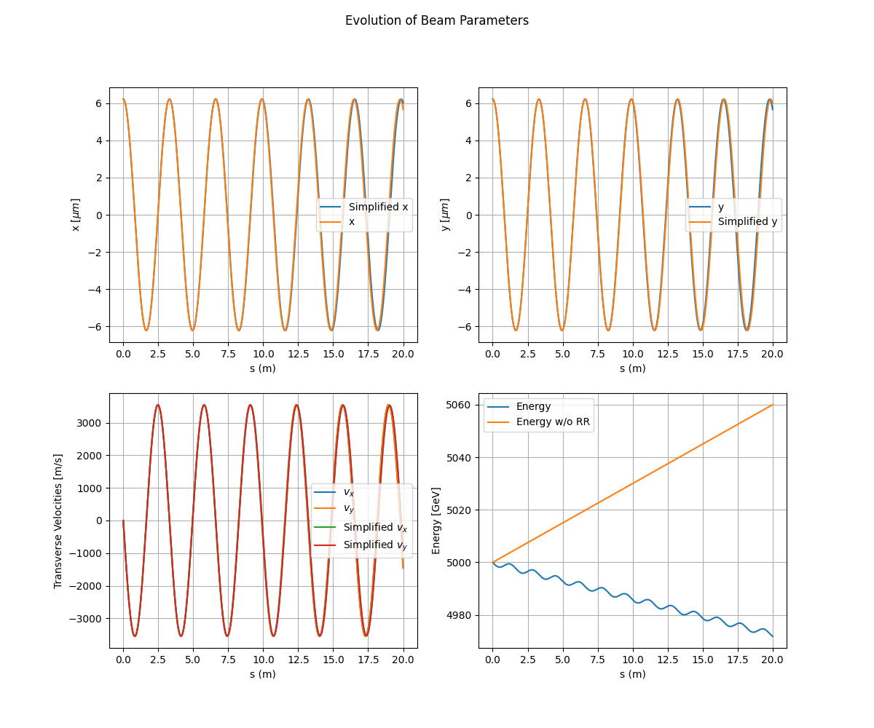
Single-particle motion
Energy loss due to radiation reaction
A diagonal oscillation with and without radiation damping
Adiabatic damping due to increase in energy
Caption
5 TeV
5 GeV
05.03.25 | Daniel Kalvik | ALEGRO

Slide 12
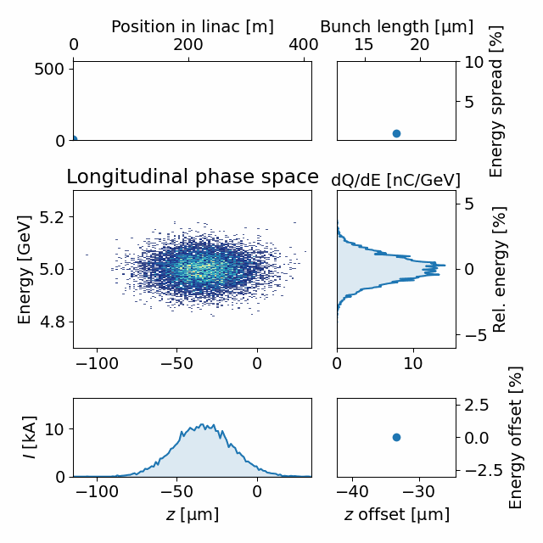
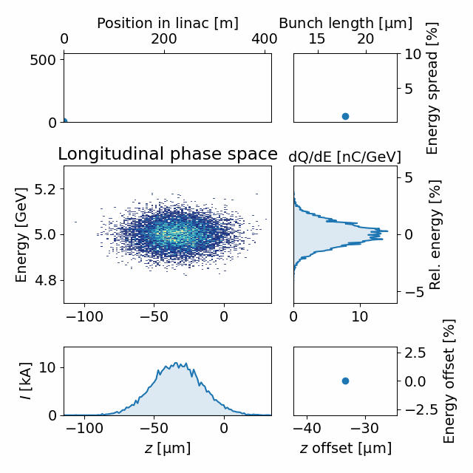
Beam energy loss
What does the effects of radiation reaction look like in the longitudinal phase space?
The particles with large betatron amplitudes lose more energy.
This causes a "Bleed" in energy, and an increase in energy spread.
05.03.25 | Daniel Kalvik | ALEGRO

Slide 13
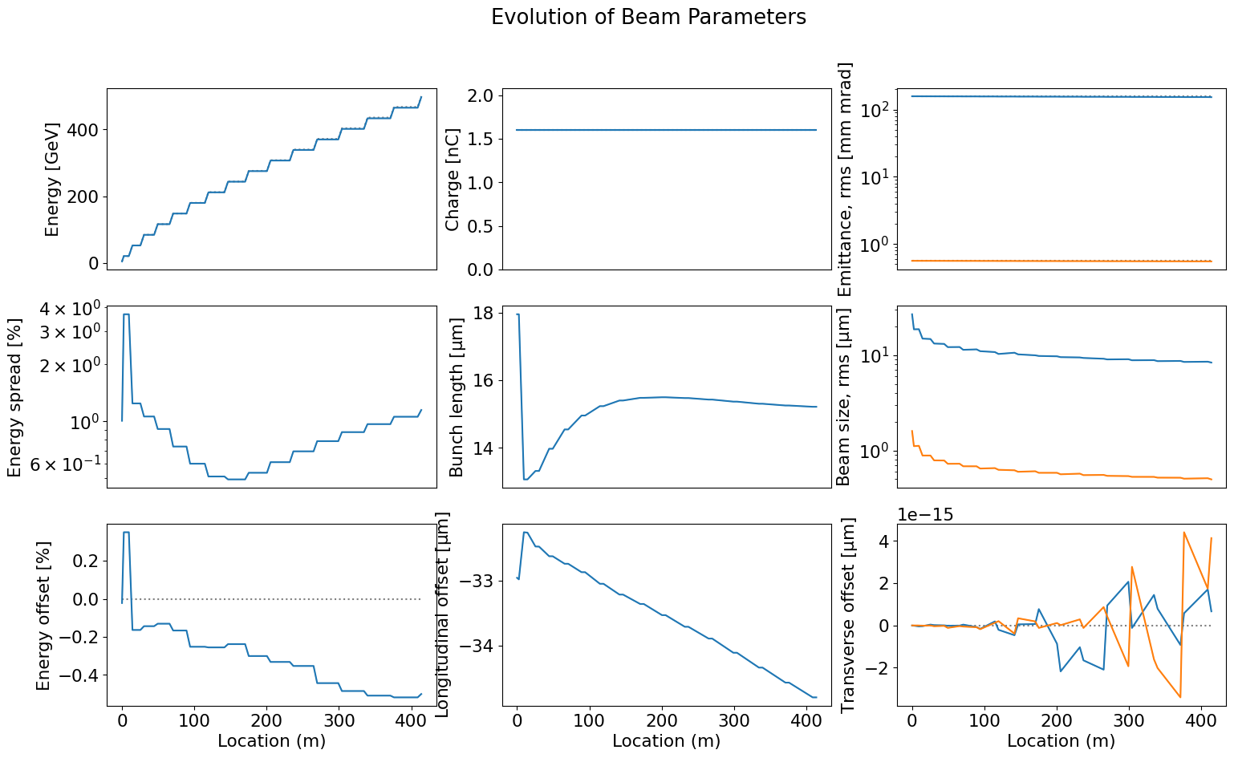
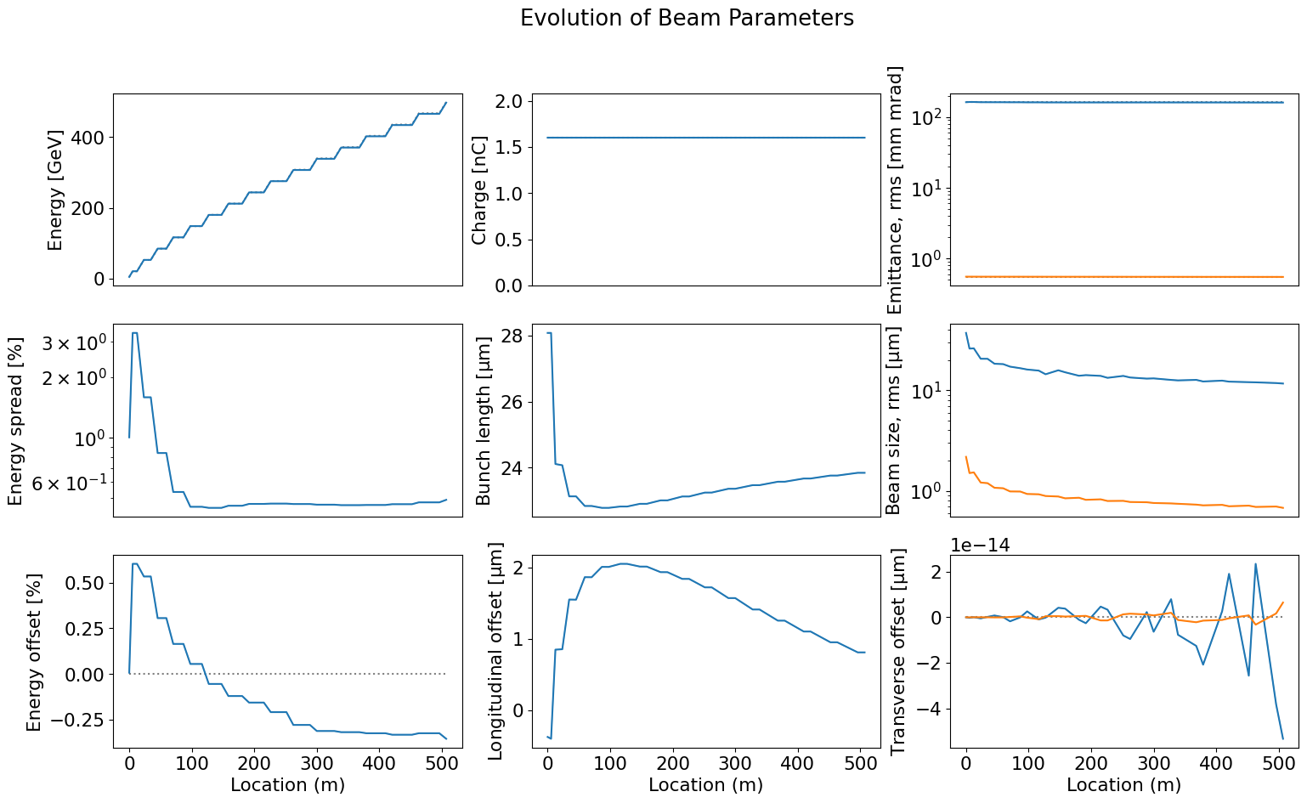
HALHF simulations
Tracking a beam through 16 stages
Already at 500 GeV, we have had to lower the density
n₀ = 7e21 m⁻³
n₀ = 2e21 m⁻³
Goes as n₀^{3/2}
05.03.25 | Daniel Kalvik | ALEGRO

Slide 14
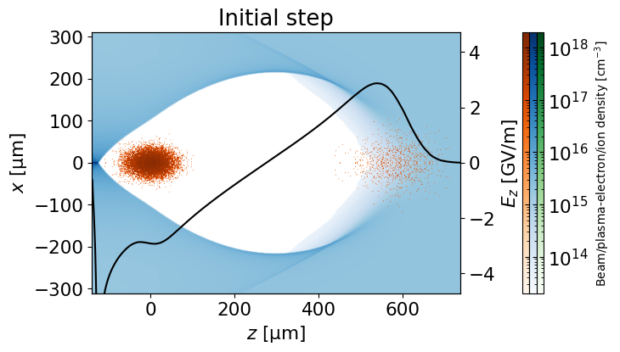
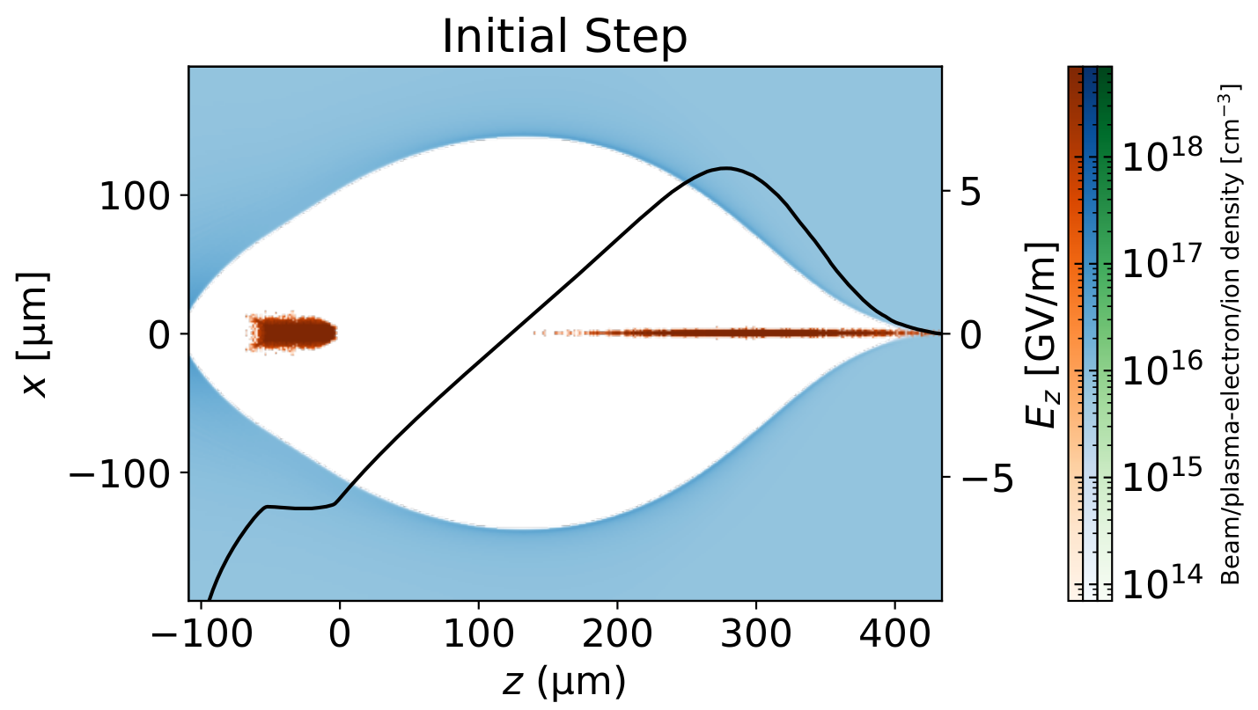
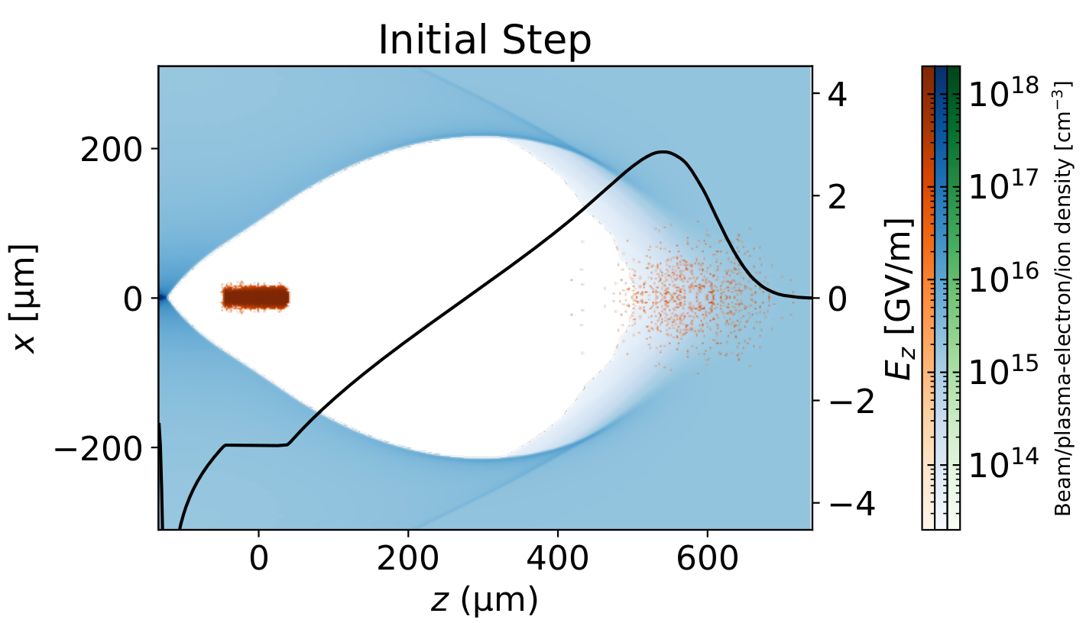
Plasma wakes
The effects of the radiation reaction + self-correction mechanism
Along with the self-correction mechanism, the beam shapes into a bullet.
1st stage
16th stage
16th stage
n₀ = 2e21 m⁻³
n₀ = 7e21 m⁻³
n₀ = 2e21 m⁻³
Goes as n₀^{3/2}
05.03.25 | Daniel Kalvik | ALEGRO

Slide 15
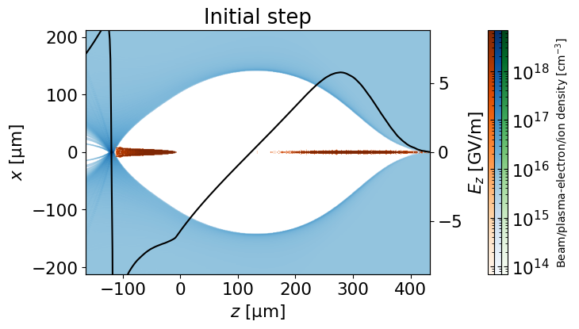
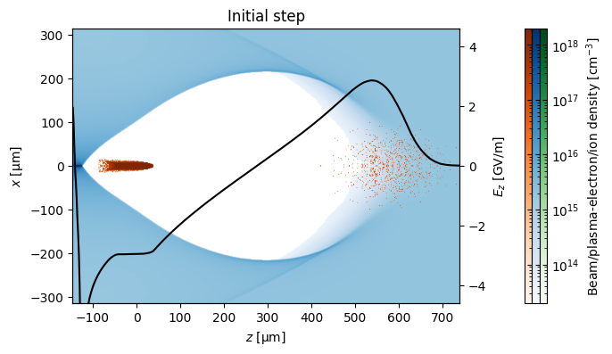
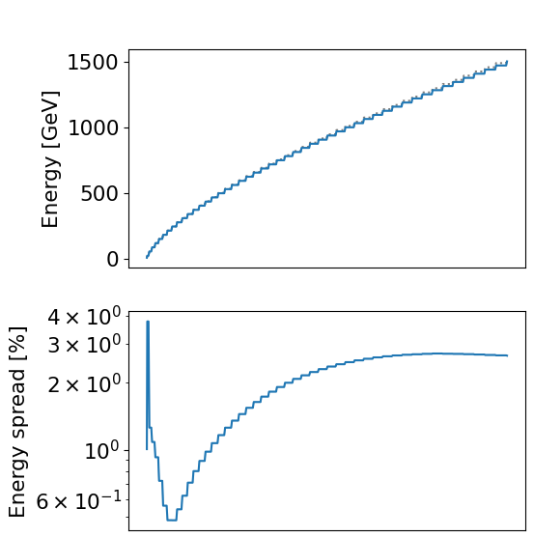
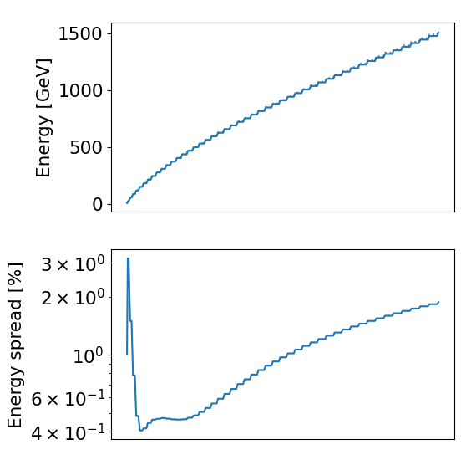
Reaching TeV energies
Can we take the self-correction further?
The energy spread becomes too large.
The beam reaches the end of the wake.
n₀ = 7e21 m⁻³
n₀ = 2e21 m⁻³
05.03.25 | Daniel Kalvik | ALEGRO

Slide 16
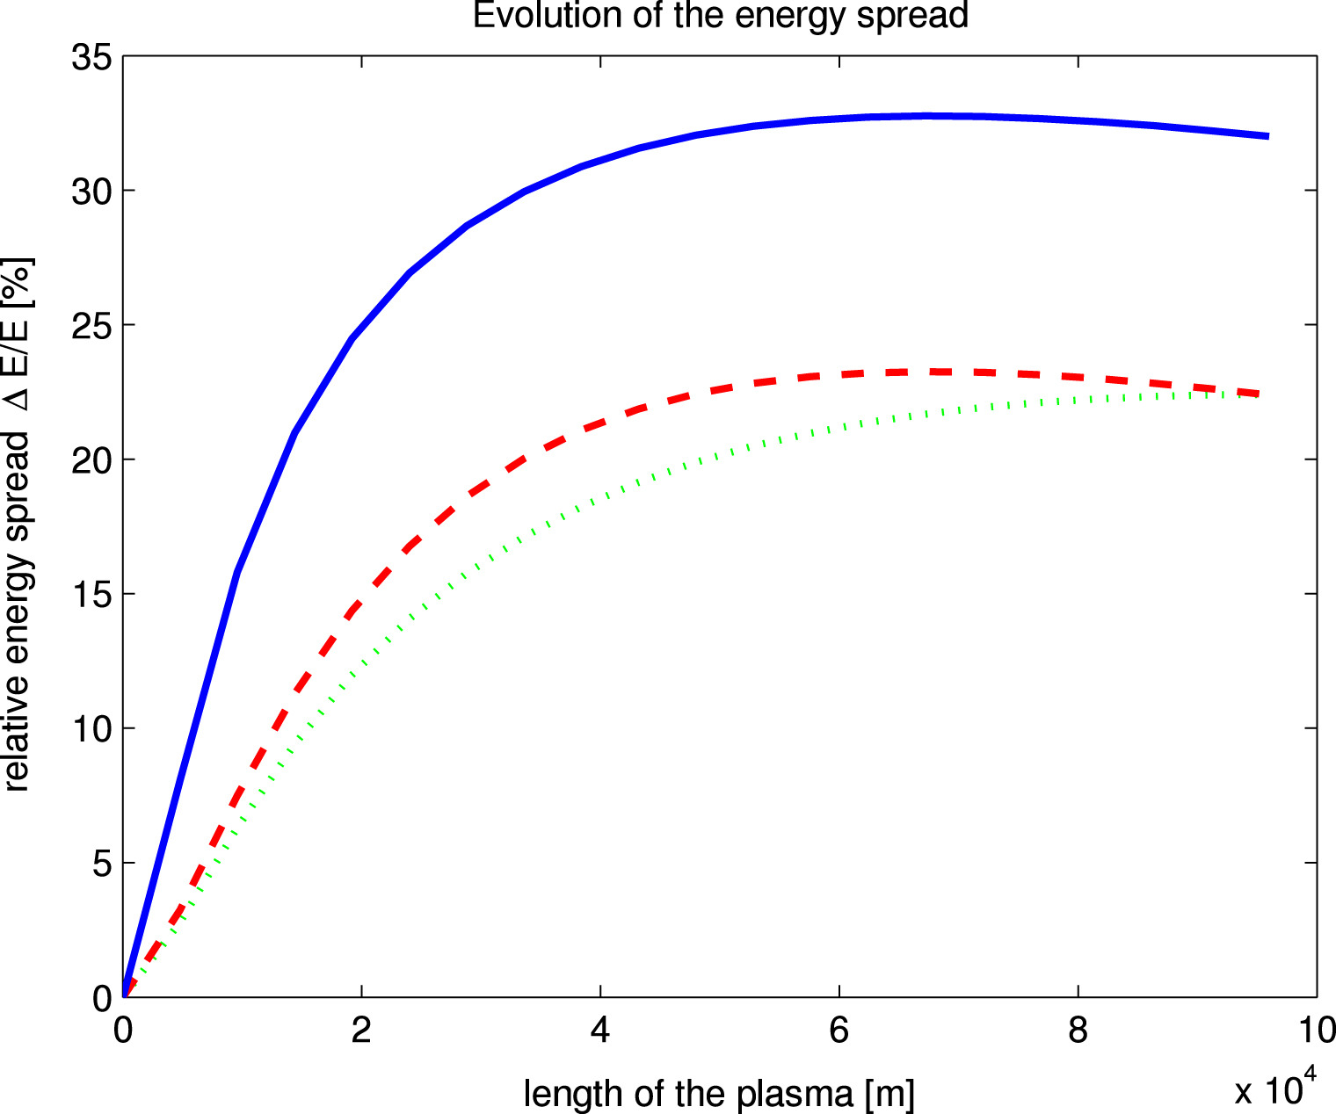
Maximum energy-spread
Shpakov et al. Nuclear Instruments and Methods in Physics Research Section A: Accelerators,
Spectrometers, Detectors and Associated Equipment 909 (2018)
1 mm mrad
0.5 mm mrad
n₀ = 7e21 m⁻³
n₀ = 1e22 m⁻³ (blue/red), n₀ = 5e21 m⁻³ (green). no self-correction
05.03.25 | Daniel Kalvik | ALEGRO

Slide 17
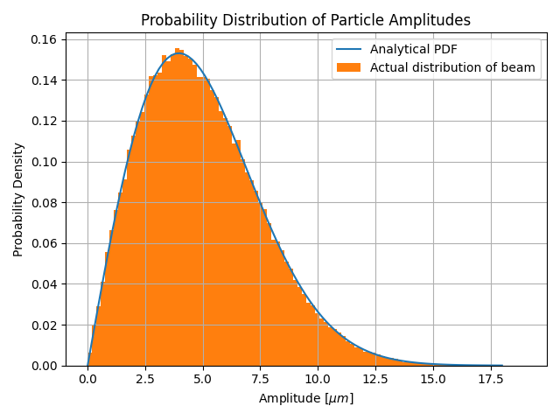
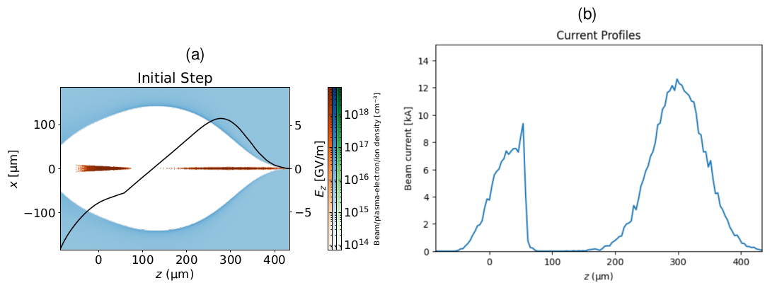
Reaching TeV energies
There is now a strong correlation between longitudinal position and betatron amplitude!
n₀ = 7e21 m⁻³
05.03.25 | Daniel Kalvik | ALEGRO

Slide 18
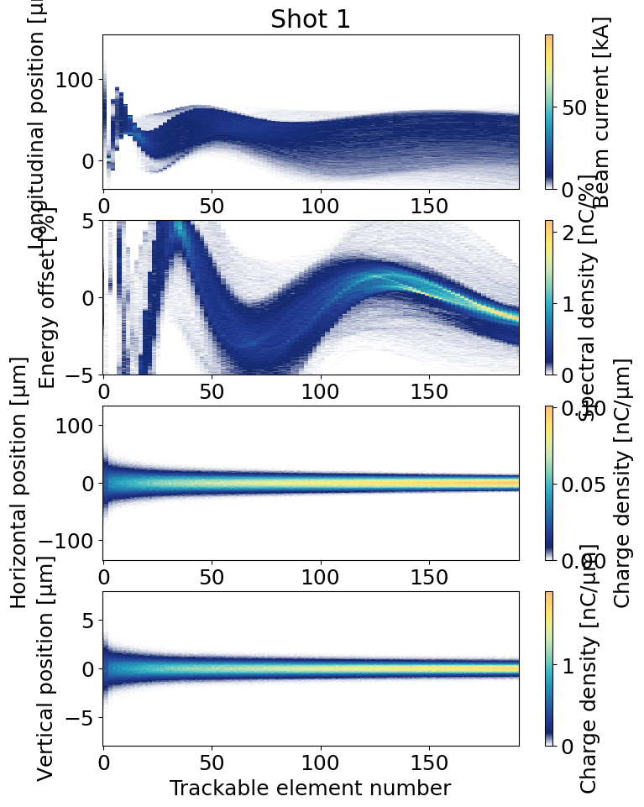
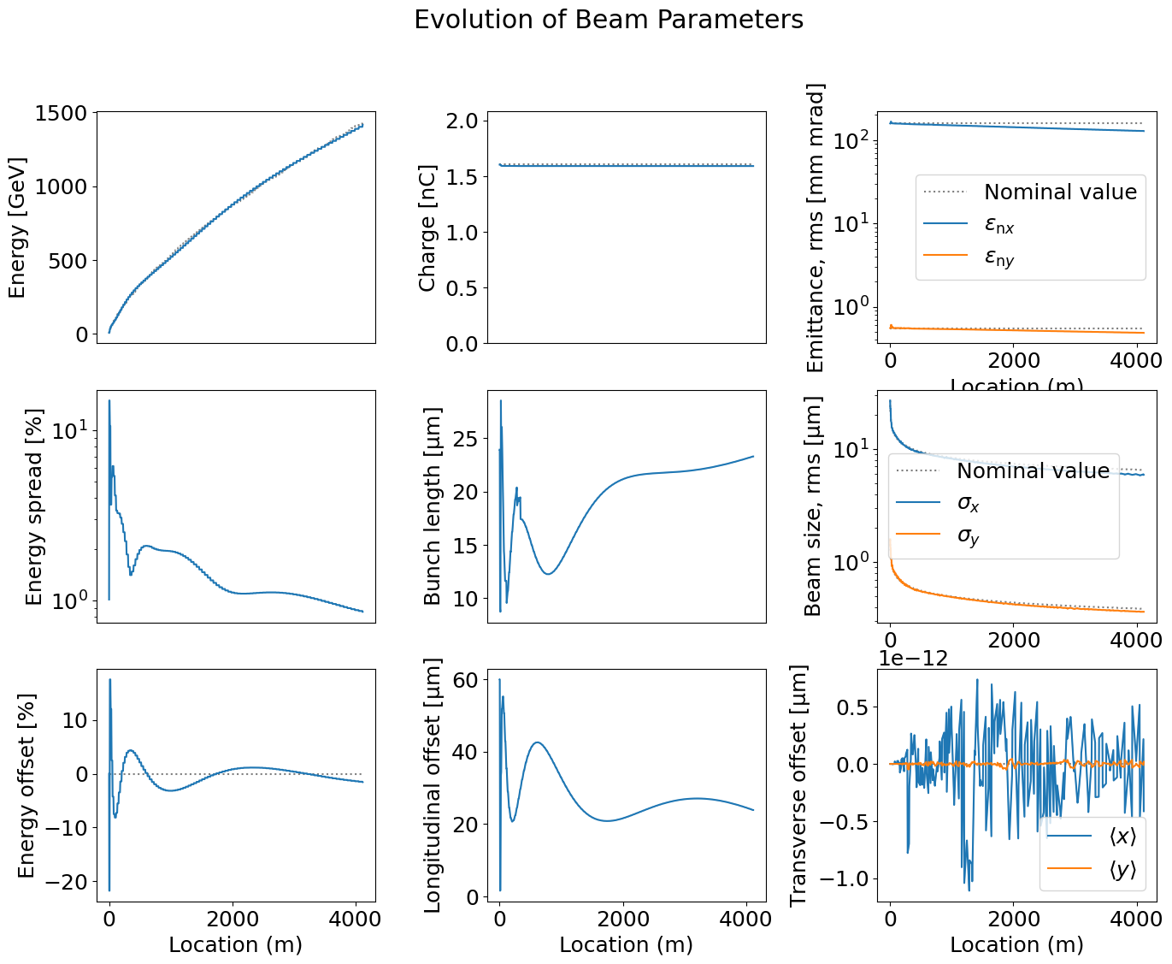
Reaching TeV energies
Adjusting the parameters
n₀ = 7e21 m⁻³
05.03.25 | Daniel Kalvik | ALEGRO

Slide 19
Reaching TeV energies
The self-correction can't be applied forever. The beam size will increase in the magnetic chicanes.
05.03.25 | Daniel Kalvik | ALEGRO

Slide 20
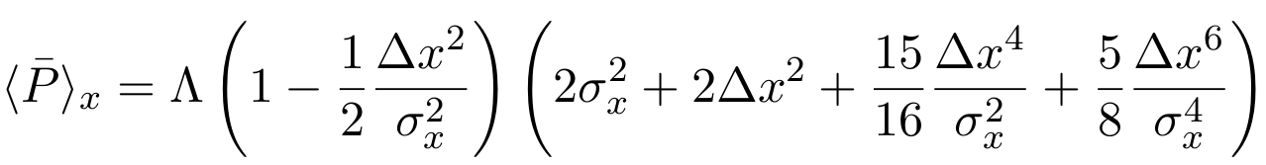
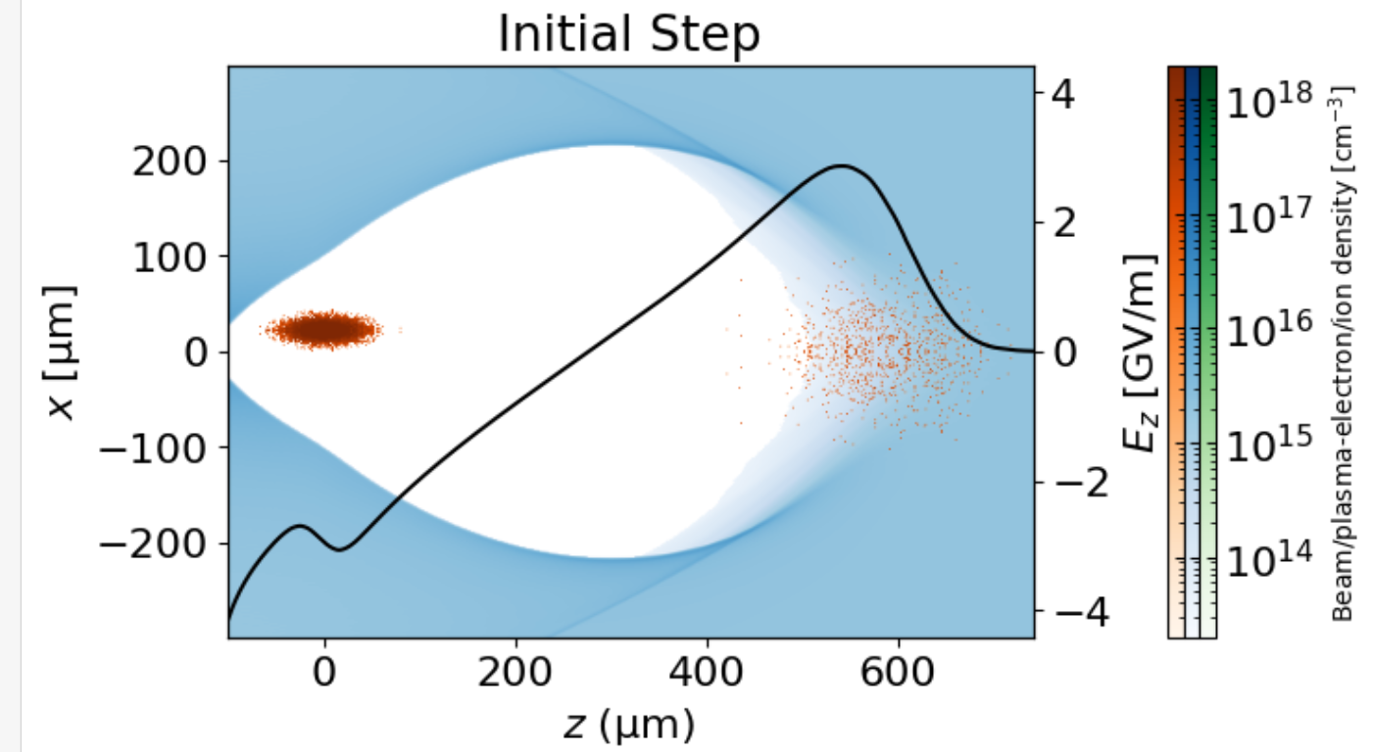
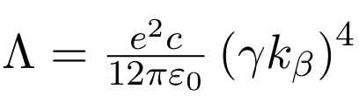
What About Jitter?
Radiation due to small offsets in staging
When the beam enters the plasma, it will have a small random offset (jitter). In x, this means the new energy loss will be
X'
05.03.25 | Daniel Kalvik | ALEGRO

Slide 21
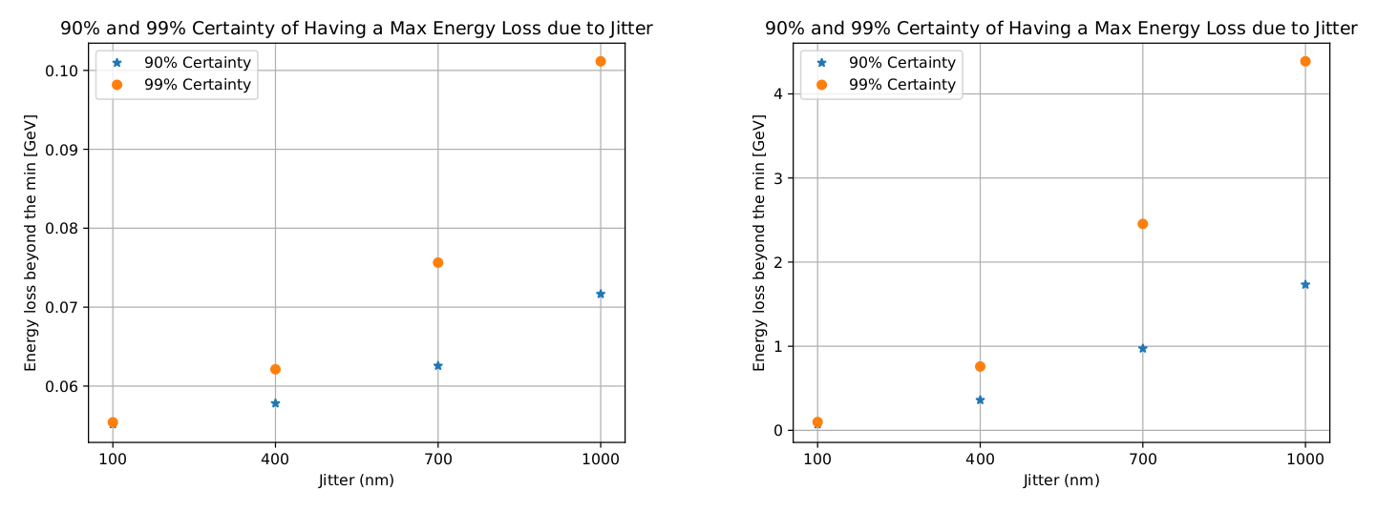
What about jitter?
Extra energy loss (beyond what the beam would lose anyway) due to jitter
500 GeV
5 TeV
Maximum energy loss with 90/99 % certainty.
05.03.25 | Daniel Kalvik | ALEGRO

Slide 22
What About Jitter?
Extra energy loss (beyond what the beam would lose anyway) due to jitter
500 GeV
5 TeV
If we accept 0.1% uncertainty in final energy -> no problem for HALHF at 2e21 m⁻³. Will be worse for higher densities.
Need to consider jitter in the 3 other dimensions (x', y, y'). If equal jitter in just y, restricts the jitter to less than 700nm at 5 TeV.
05.03.25 | Daniel Kalvik | ALEGRO

Slide 23
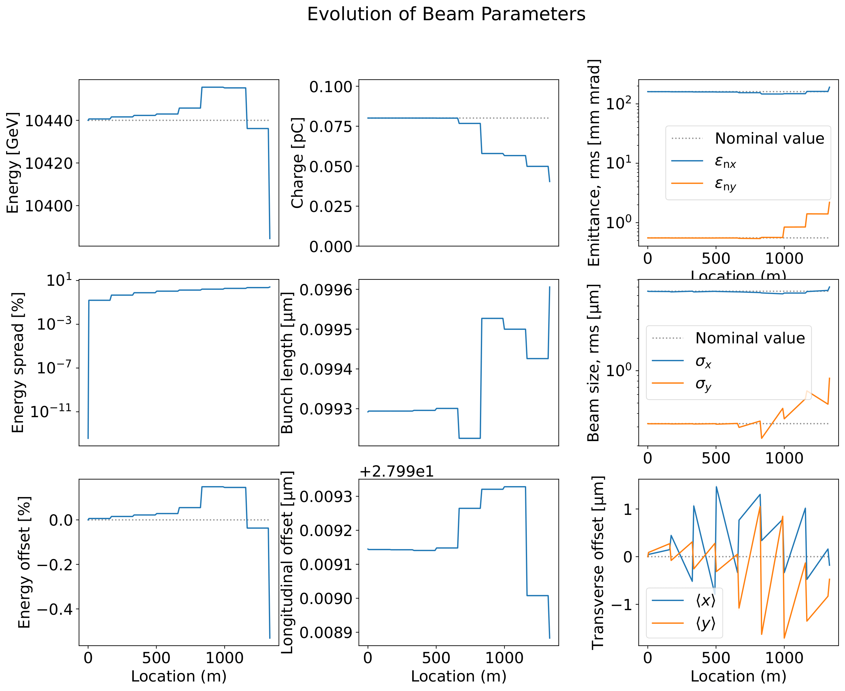
What about jitter?
Maximum achievable energy
With staging, there is a maximum achievable energy.
This maximum is probabilistic, and depends on the offset.
Jitter = 250 nm in x and y.
05.03.25 | Daniel Kalvik | ALEGRO

Slide 24
Summary
The radiation reaction causes energy loss and energy spread. The self-correction mechanism helps correct for the energy spread, but will it work in practice at 5 TeV?
These simulations show that TeV acceleration is possible with regards to energy spread. Still need to examine the radiation reaction in the correcting chicanes.
Jitter contributes to energy loss, and random energy offsets. Seems not to be a problem for HALHF but seems to impose restrictions at 5 TeV.
05.03.25 | Daniel Kalvik | ALEGRO

Slide 25
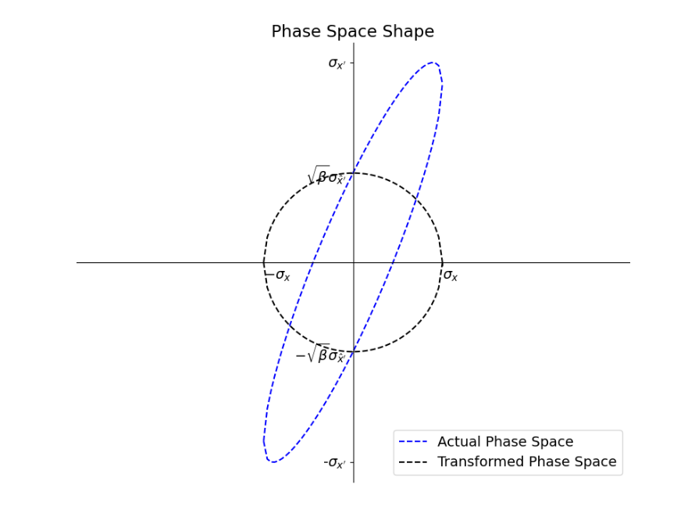

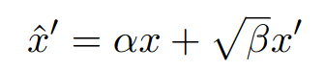
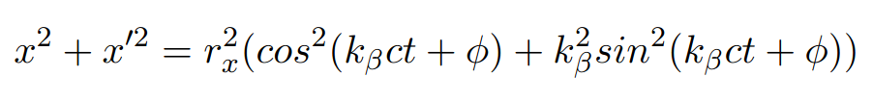


Extra
Matching and Betatron Amplitude
Normalized phase space (from ellipse eq.)
where
We also have
Which means where
Caption
12.06.24 | Daniel Kalvik | UiO

Slide 26

Extra
Matching and Betatron Amplitude
For a matched beam; α=0, and the single particle trajectories must follow the shape of the phase space.
I.e must match the shape of , or the energy spread will cause emittance increase.
We therefore know that
Caption
12.06.24 | Daniel Kalvik | UiO

Slide 27
Extra
Betatron Motion at 5 TeV
Even at 5 TeV, the motion
w/wo radiation reaction is
almost the same
Caption
12.06.24 | Daniel Kalvik | UiO

Slide 28
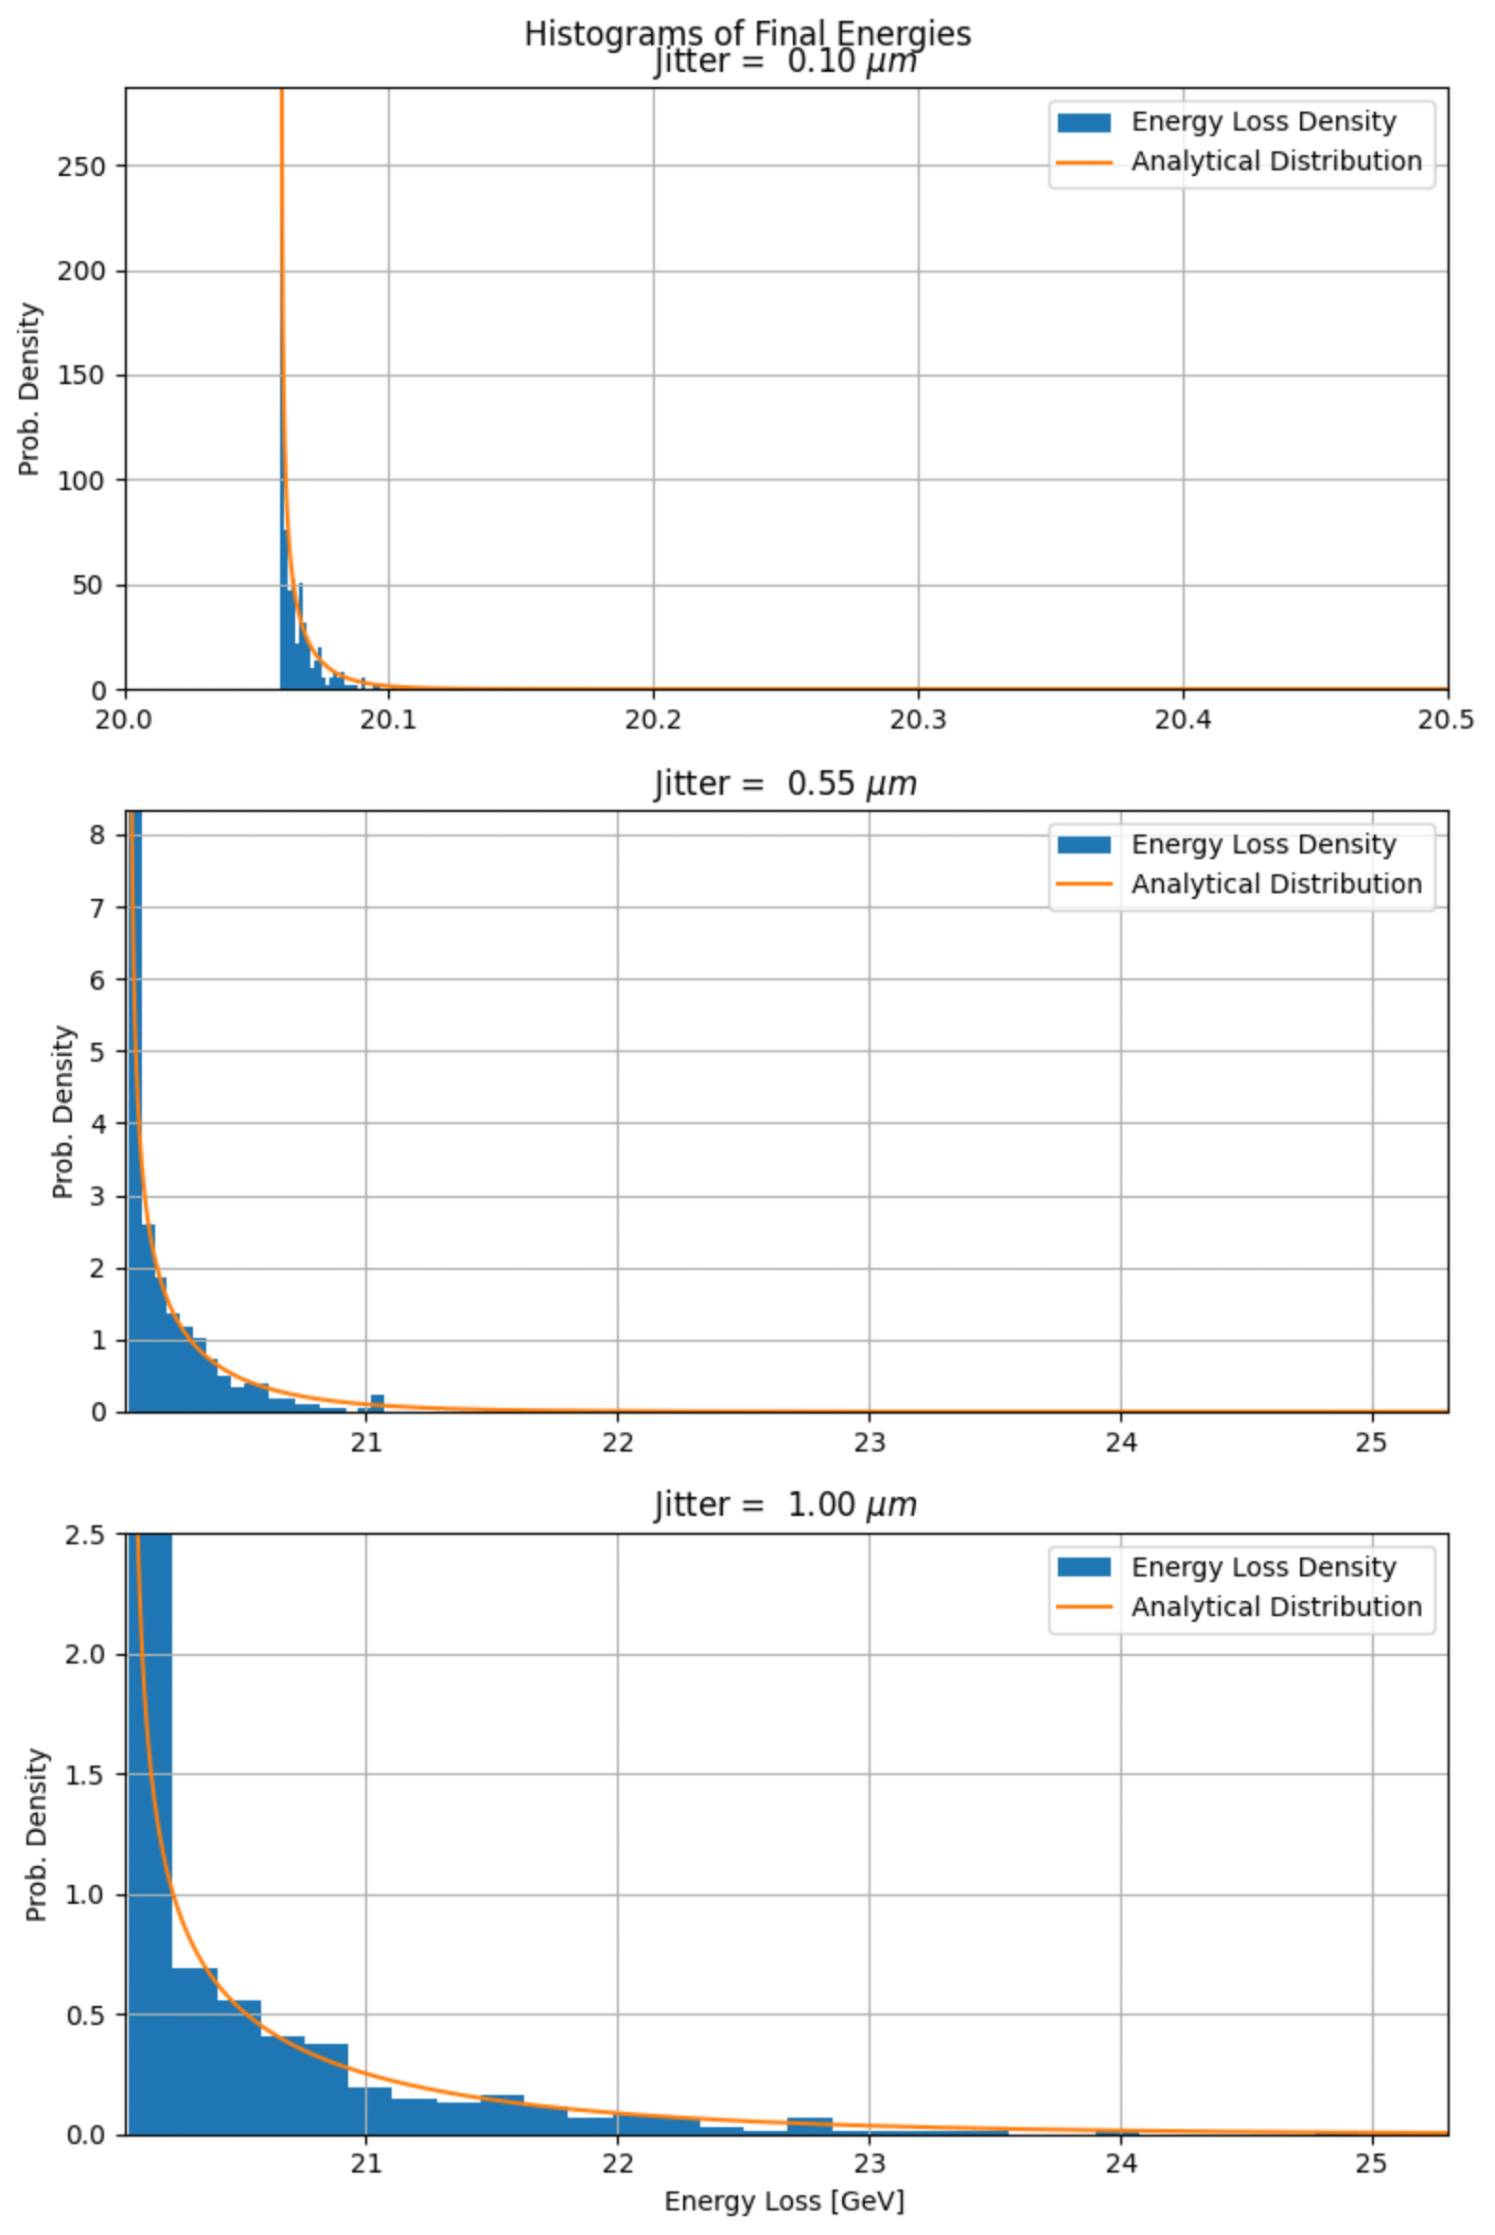
Extra
Jitter energy loss at 7.5 TeV
The plot that led me to believe my initial expression for the jitter energy loss was correct
12.06.24 | Daniel Kalvik | UiO

