Slide 1
γγ Colliders
ALEGRO 2025 Workshop
Tim Barklow
March 05, 2025
Outline
Introduction to γγ Colliders
γγ Collider Higgs Factories
Multi-TeV γγ Colliders
Future Work

Slide 2
XCC layout of 1 keV XFEL , 63 GeV e⁻ Beams near Interaction Point
All of this is simulated by CAIN MC
>
>
Primary IP
2 mrad? 20 mrad?
Compton IP’s
>
>
1 KeV XFEL γ
62.6 GeV e⁻
62.5 GeV γ + spectrum of e⁻ , e⁺ , γ

Slide 3


Slide 4
C3 + XFEL a.k.a XFEL Compton Collider or XCC

Slide 5
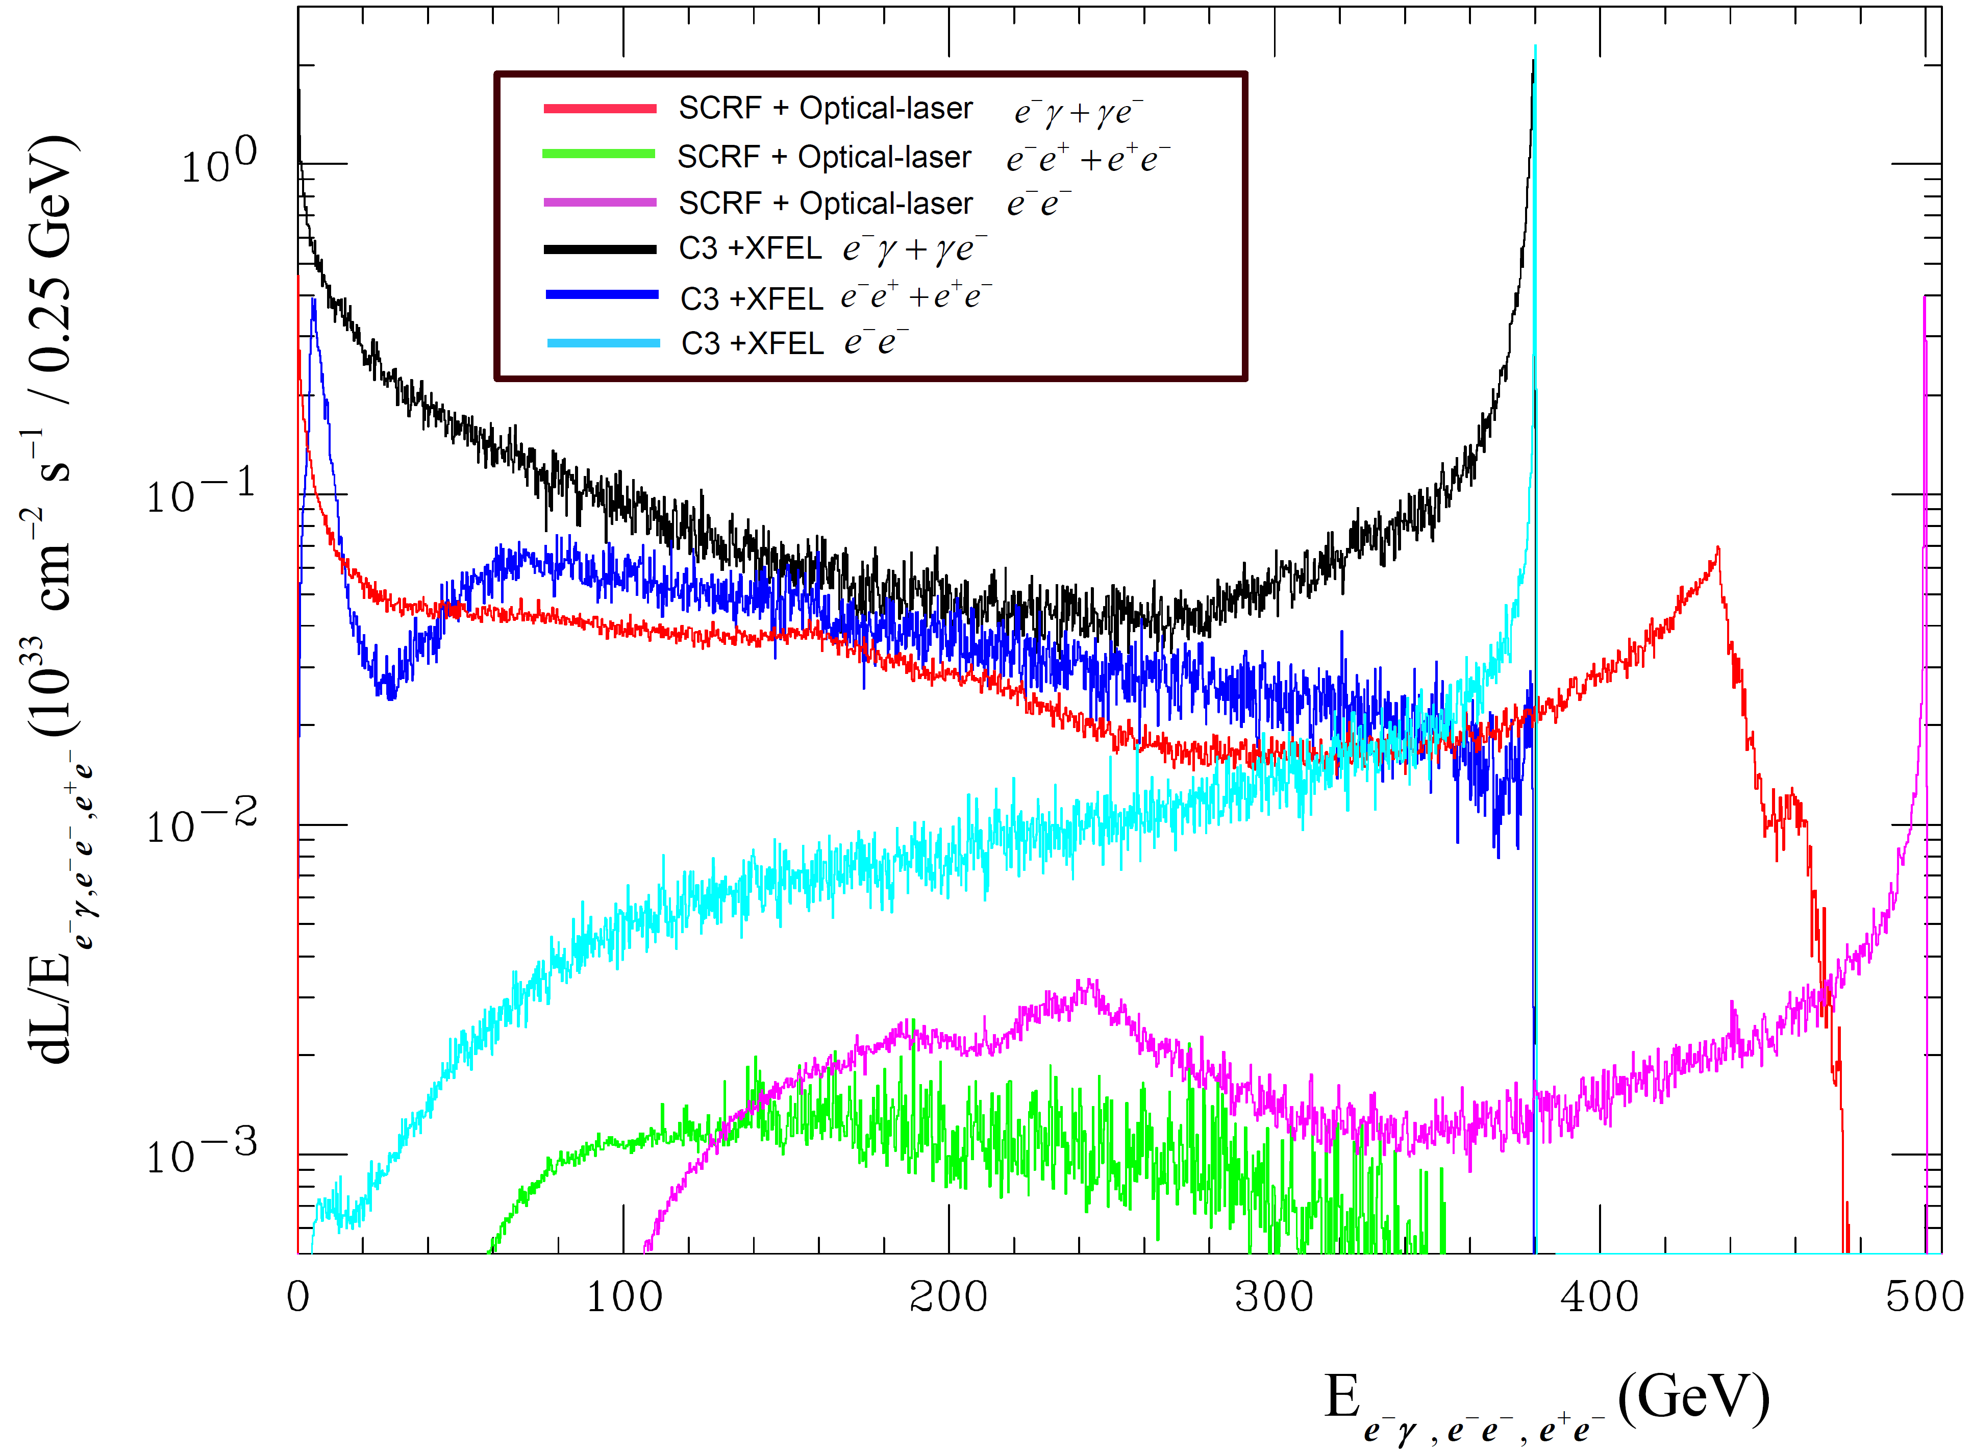

Slide 6
Simulation of 15 TeV γγ Collider

Slide 7
Replace 62.5 GeV C³ e- beam w/ 7500 GeV PWFA e- beam and simulate γγ Collisions using CAIN MC
γγ PWFA
Round
15
7.5
1.4E+07
0.12
0.12
0.30E-04
0.30E-04
0.48
0.48
5.00E+09
7725
5
6.58E+36

Slide 8
x=4.8 adjust parameters to get ~ 100 % conversion w/ linear QED
Start with x=4.8 because this was considered the typical γγ collider x value before this study was performed

Slide 9
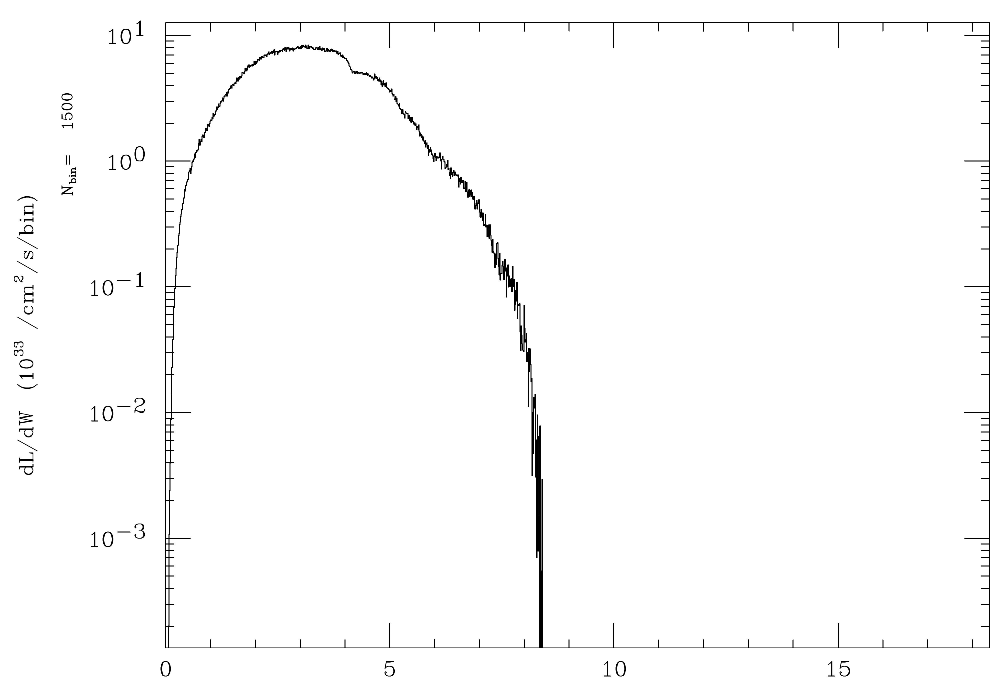
x=4.8 , parameters with ~ 100 % conversion w/ linear QED
E_{γγ} (TeV)
E_{γγ} (TeV)

Slide 10
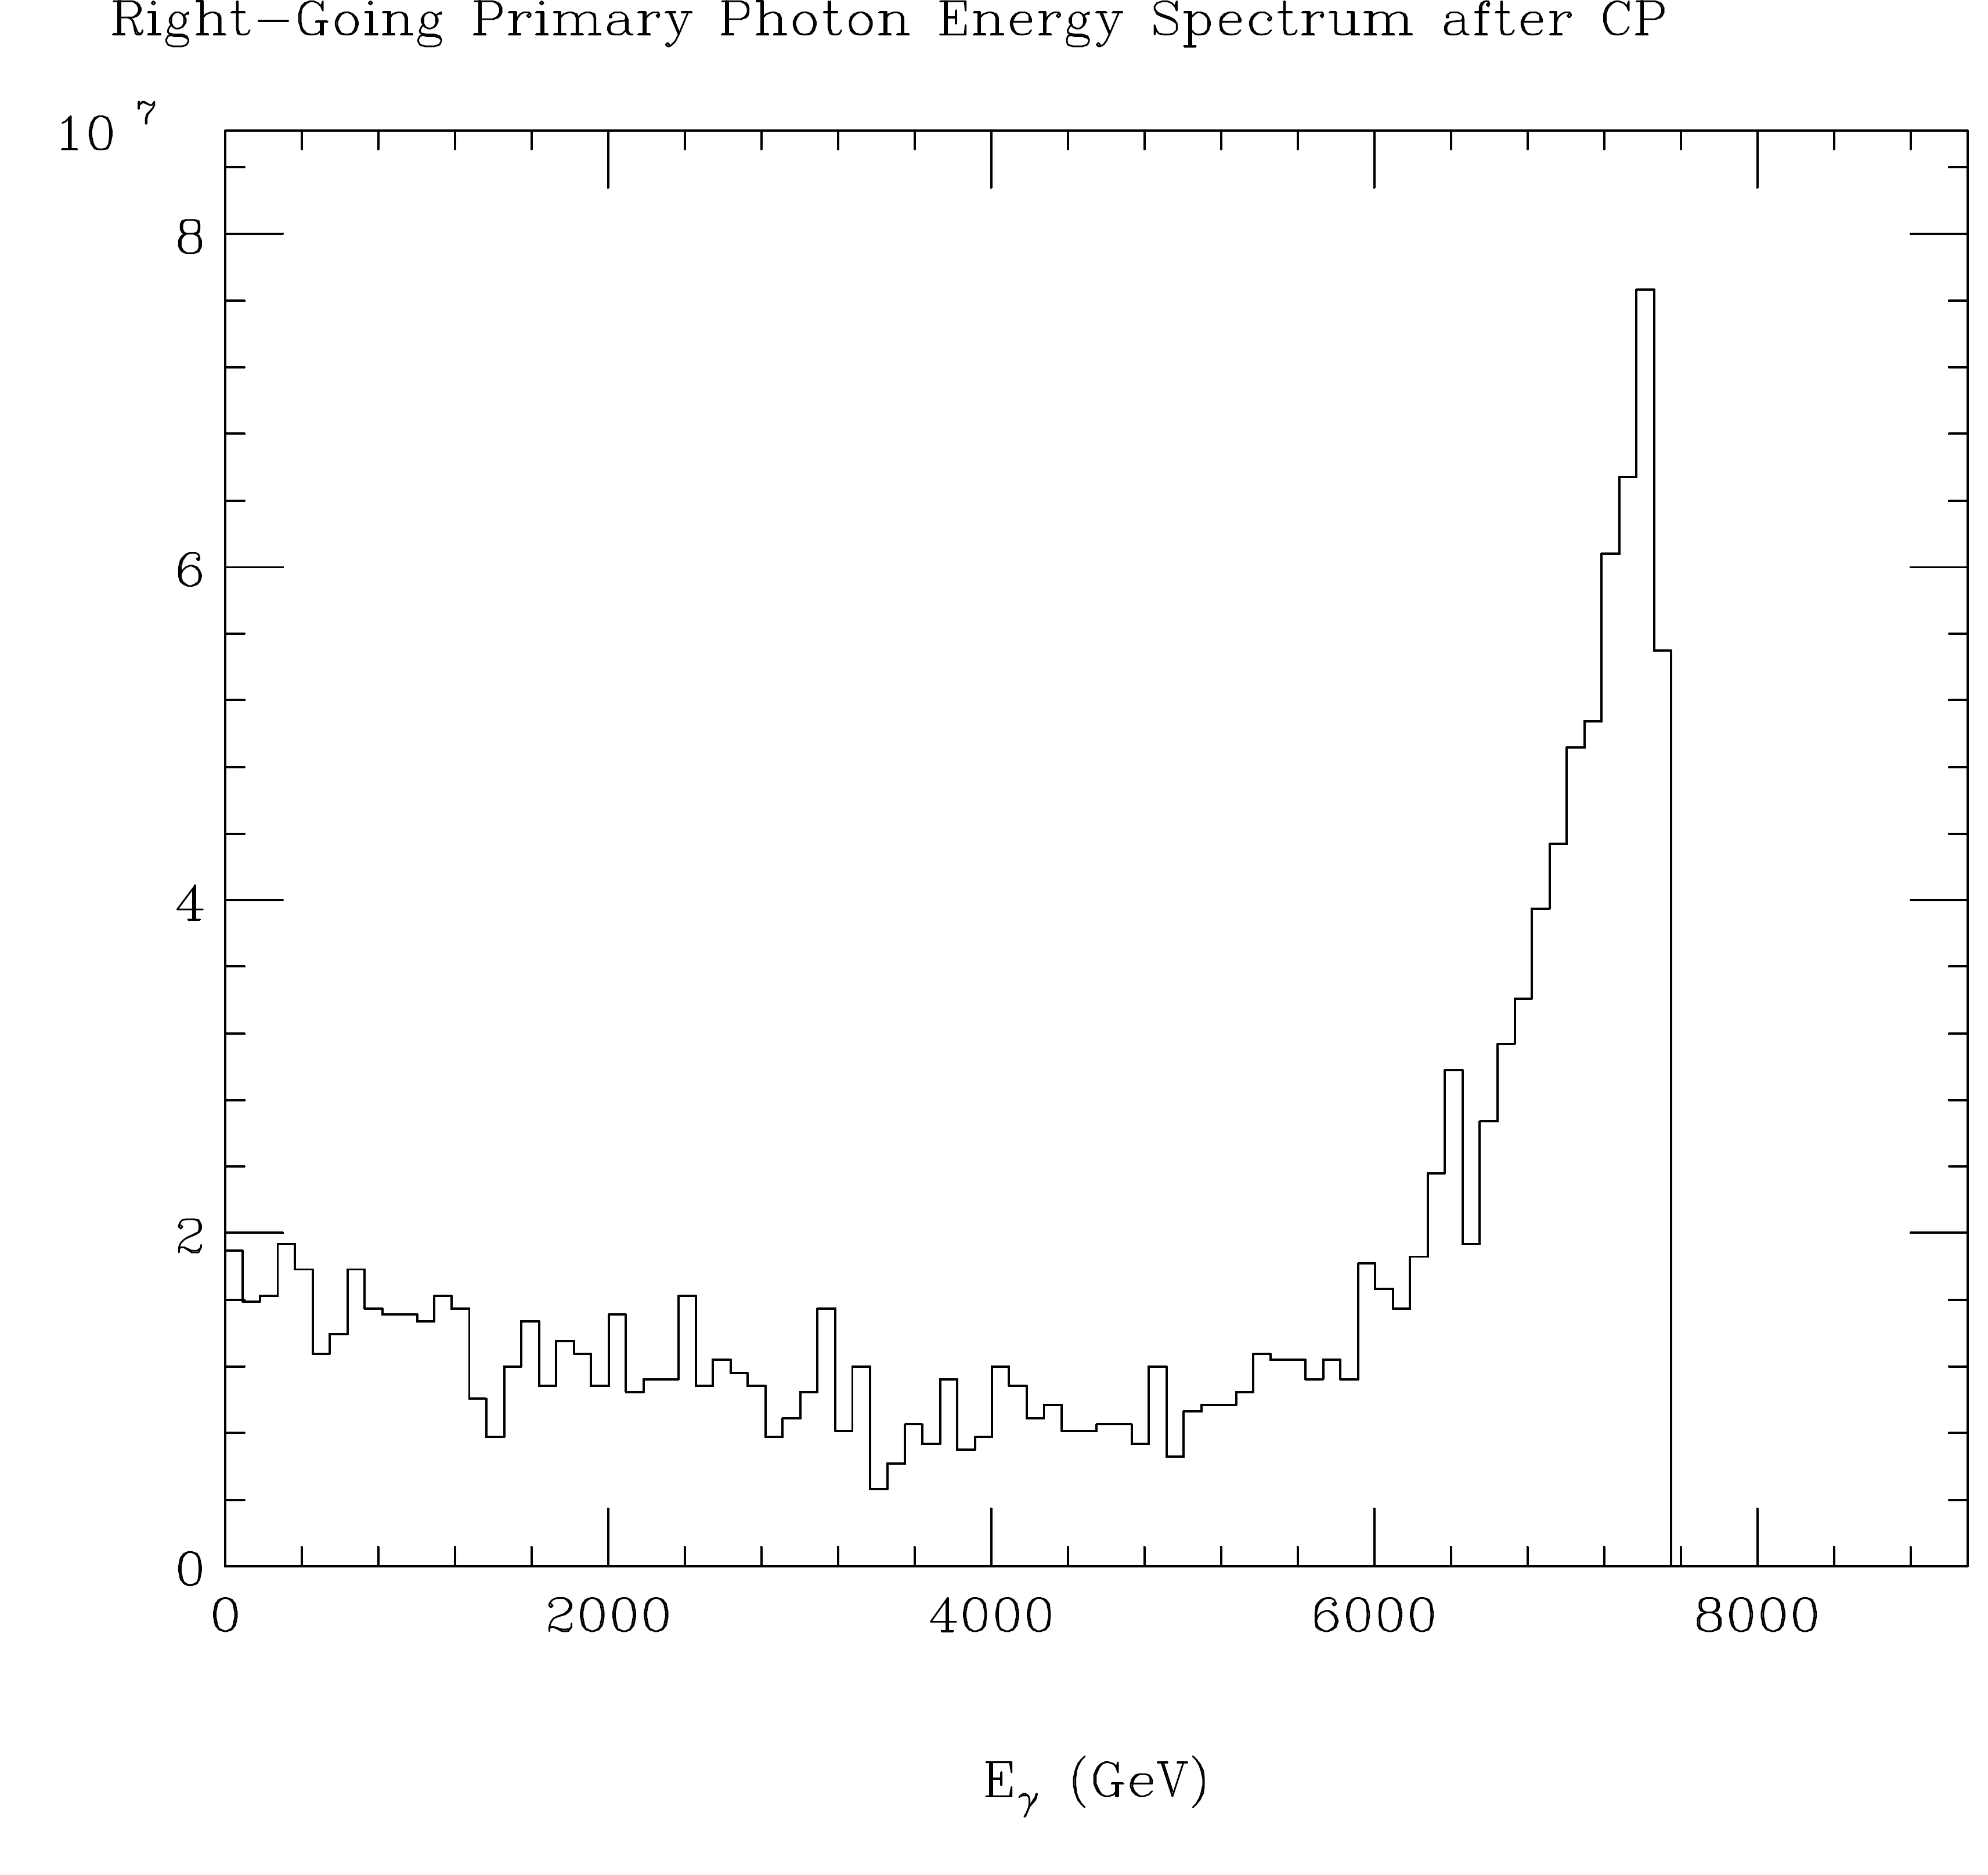
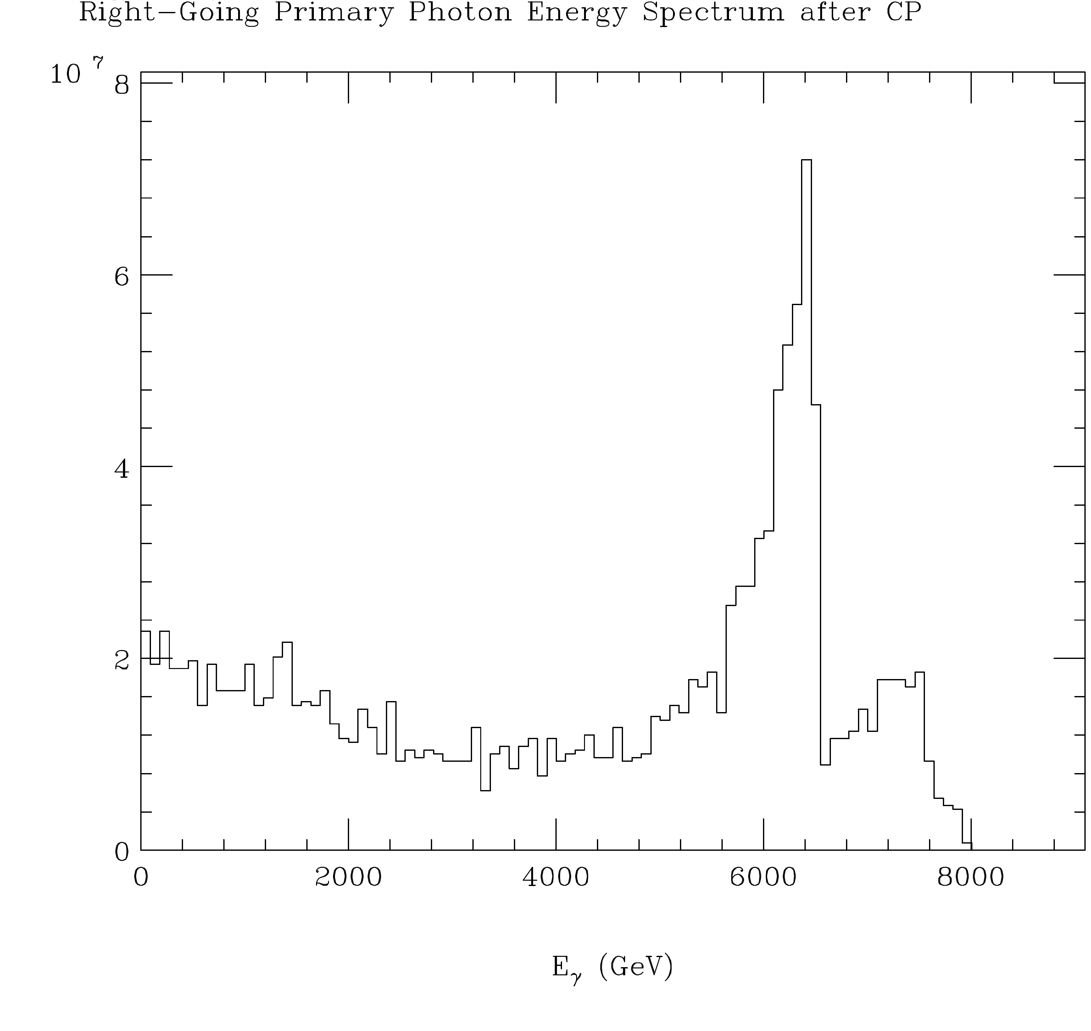
x=4.8 dial back E_{pulse} to get ξ² < 1

Slide 11
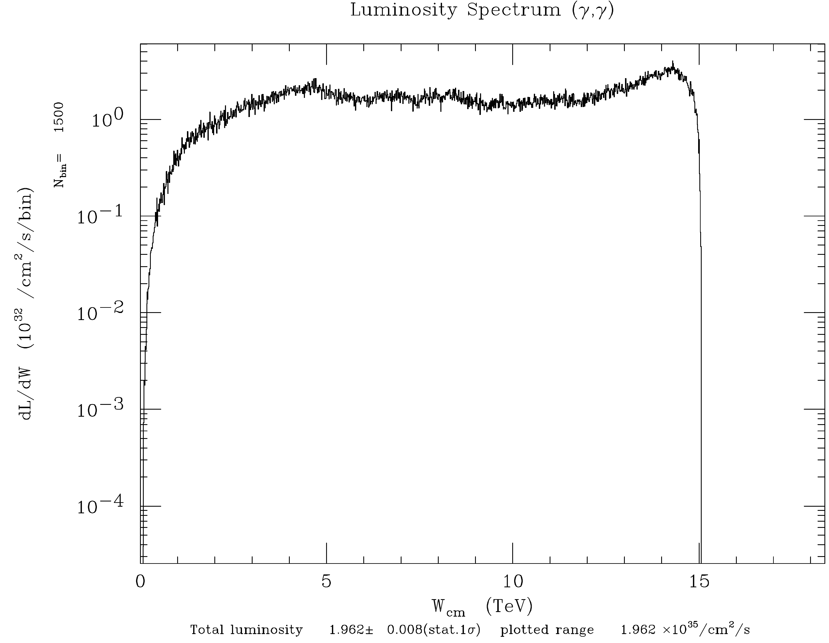
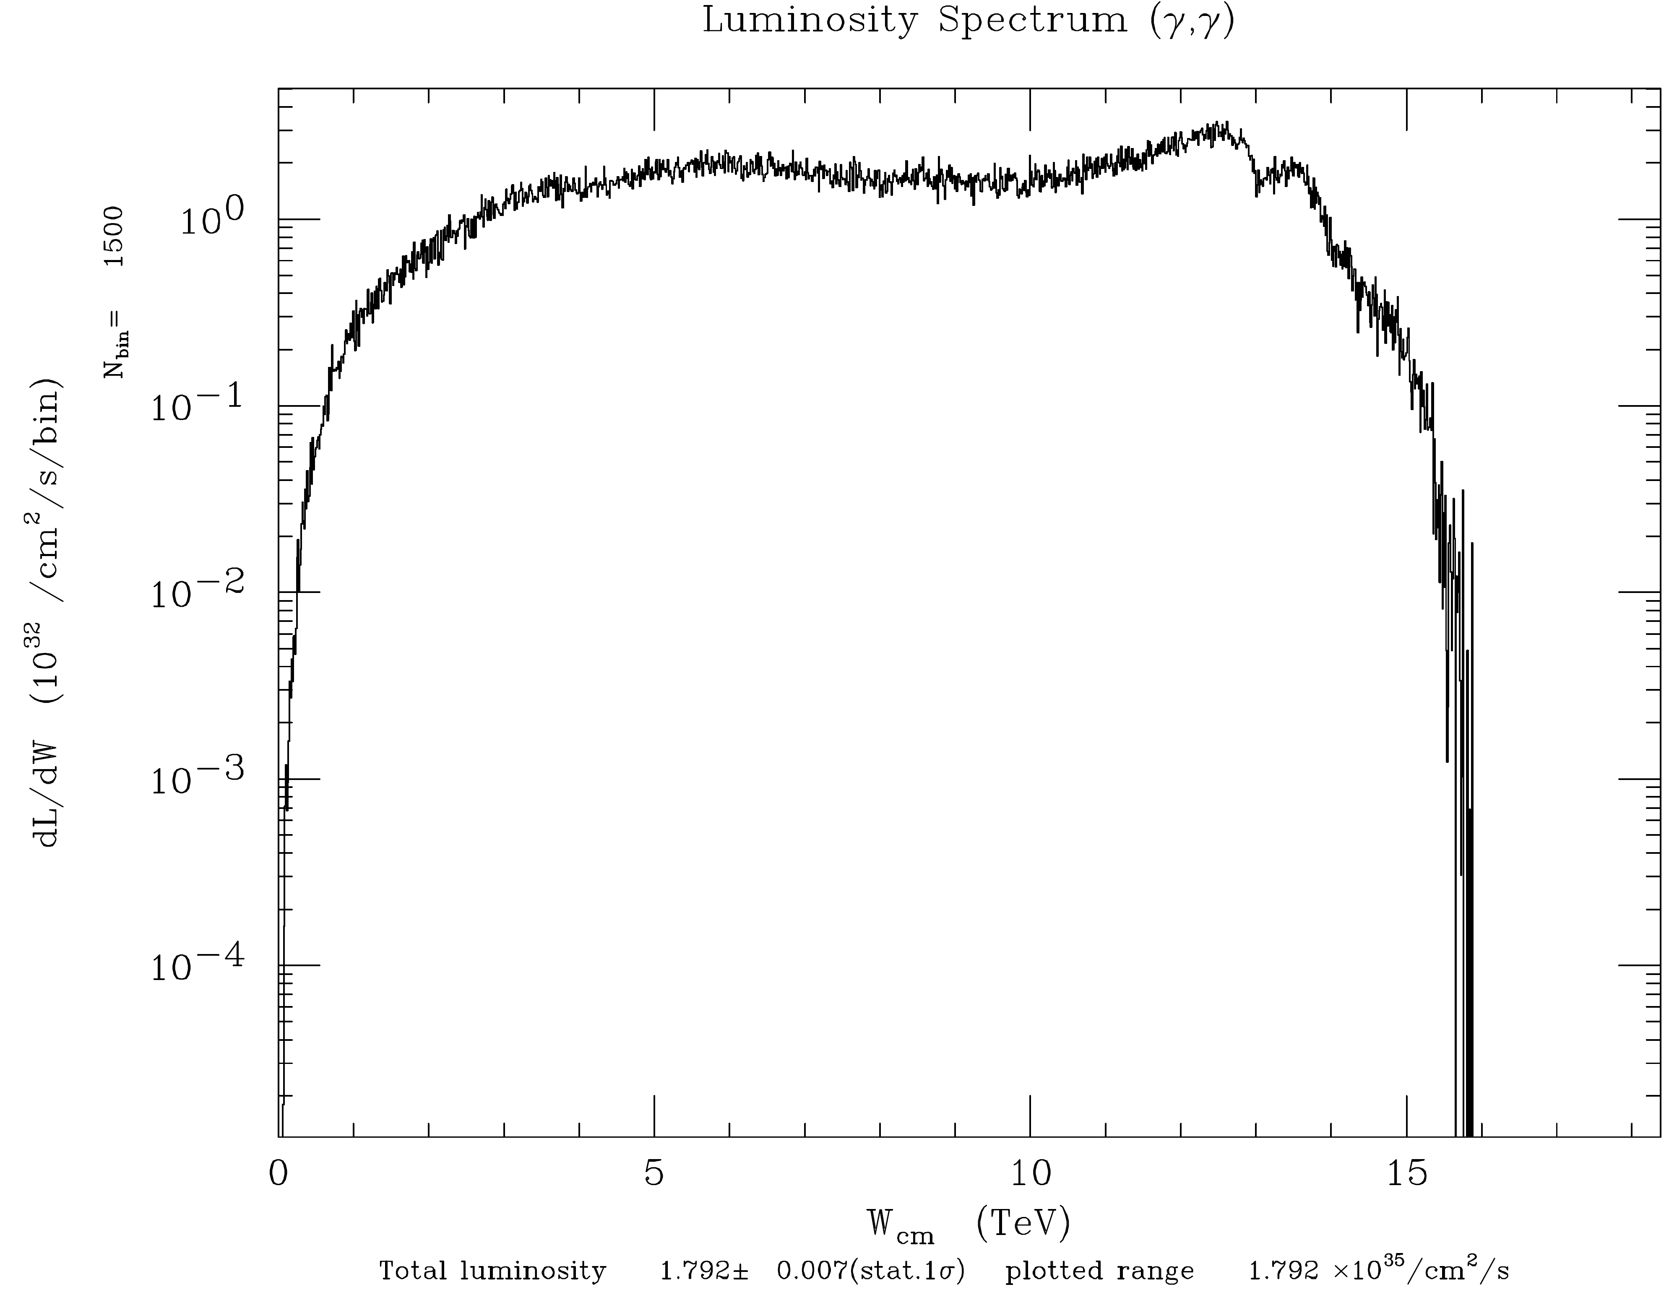
x=4.8 dial back E_{pulse} to get ξ² < 1
E_{γγ} (TeV)
E_{γγ} (TeV)

Slide 12
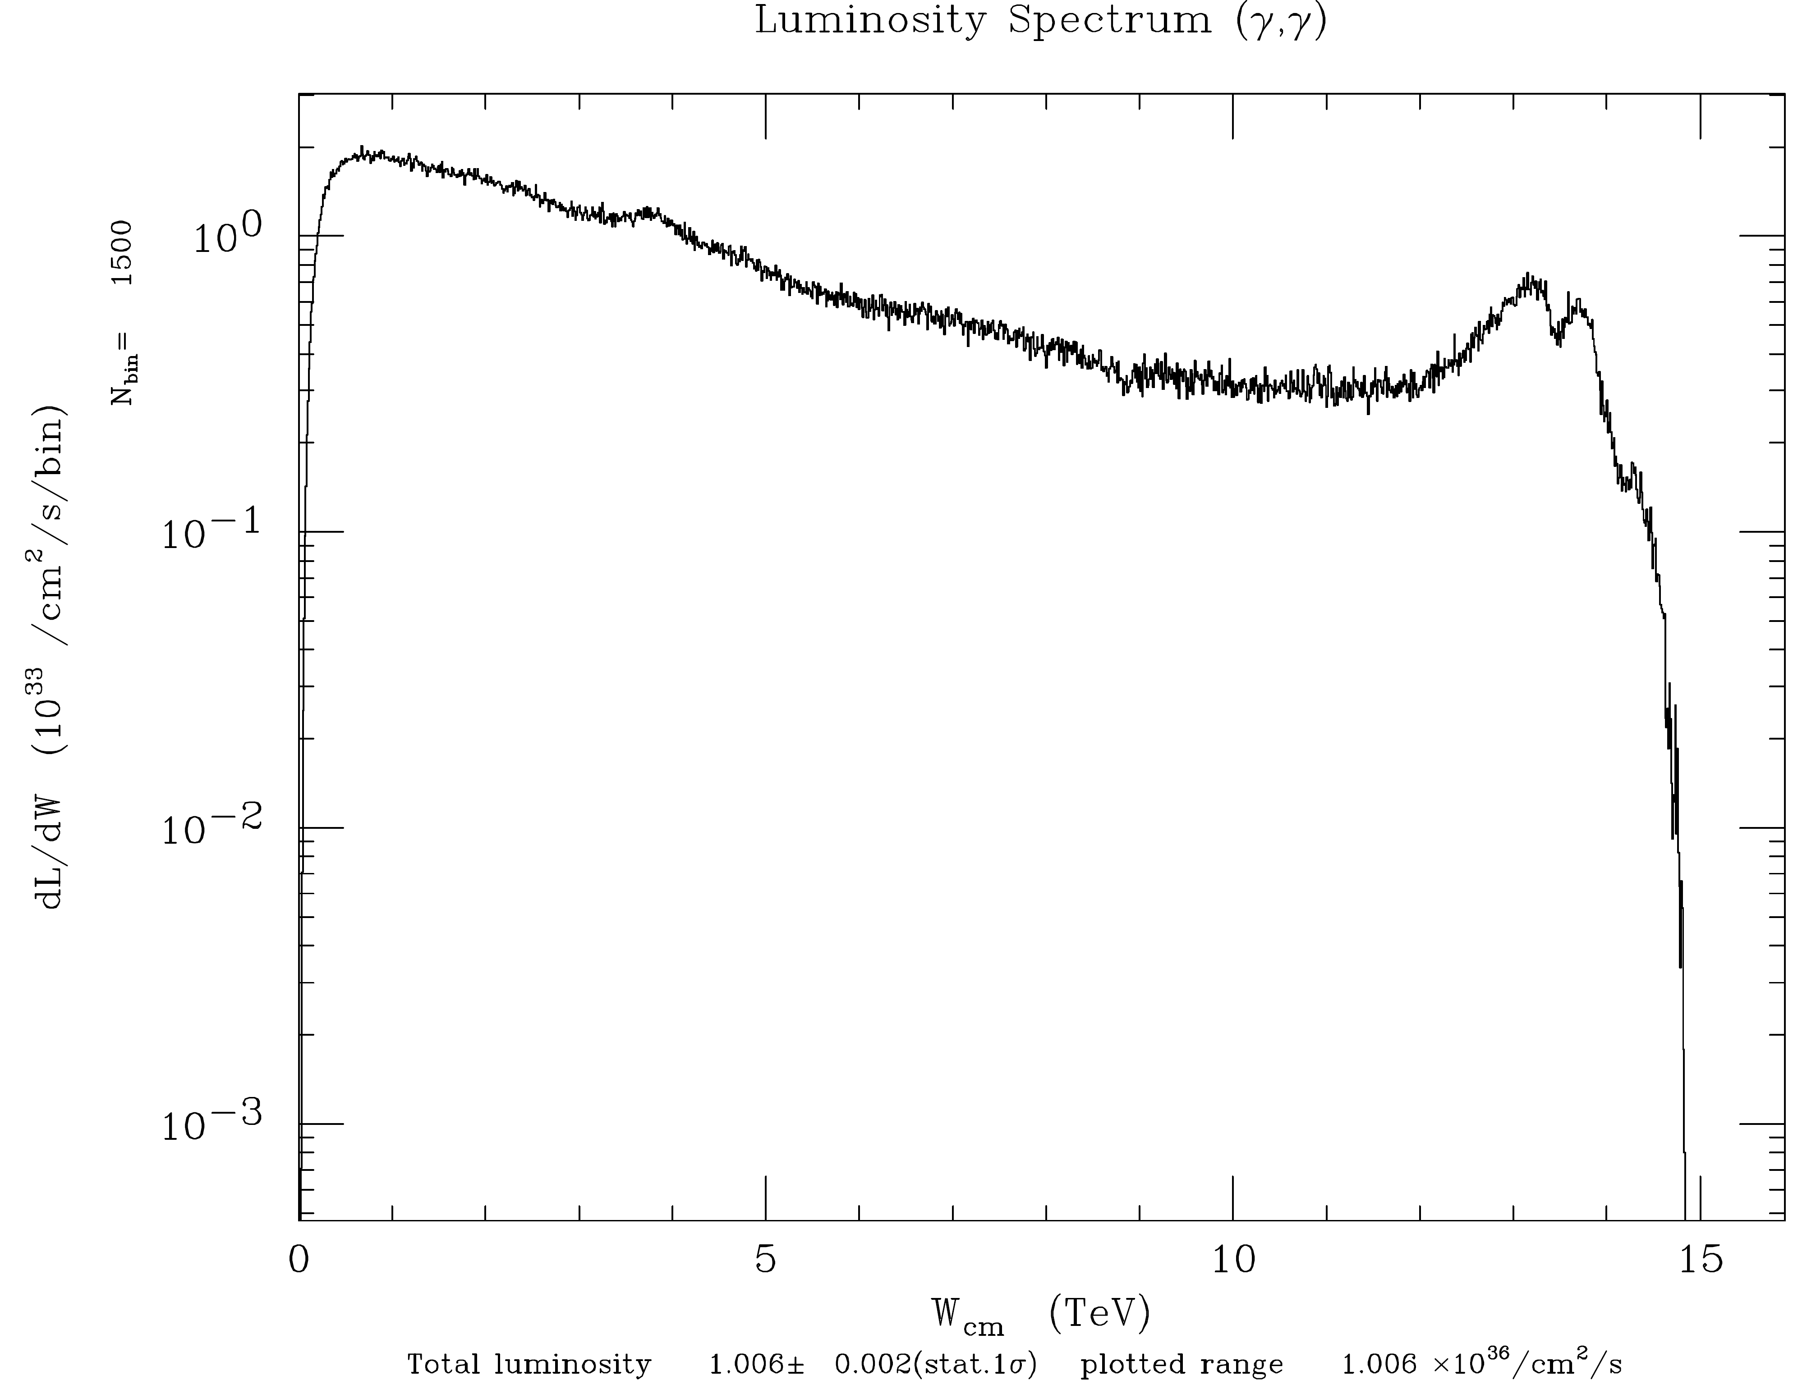
Try x=40 to get more of a peak in the spectrum
v05617
E_{γγ} (TeV)
E_{γγ} (TeV)

Slide 13
15 TeV and x=40 Turn on coherent processes
Halfway through the collision CAIN complains:
(SUBR.COHPAR) Algorithm of coherent pair generation wrong.
Call the programmer prob,pmaxco= 8.309E-01 8.000E-01
Solution:
number of macro particles produced per coherent beamstrahlung photon = 1 → 0.01
number of pairs of macro particles produced per coherent e+e- pair = 1 → 0.0001
number of macro particles produced per incoherent particle = 1 → 0.01

Slide 14
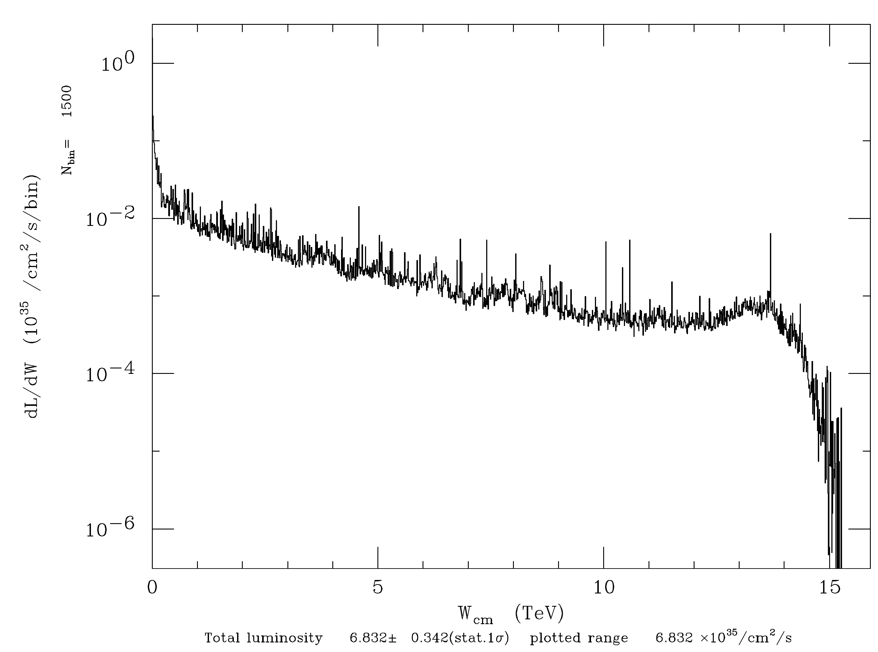
15 TeV and x=40 Turn on coherent processes
v05617
v05706
E_{γγ} (TeV)
E_{γγ} (TeV)
Coherent pair production eats up the 7.5 TeV photons and produces many e+ that pinch the e- beam leading to higher fields and even more coherent pair production.

Slide 15
e⁻ γ collisions at E_{eγ}=140 GeV I.P. geometric e⁻ σ_{x},σ_{y}=5.1 nm
N_{e-} in 3.3 μm slice
N_{e-} in 3.3 μm slice
N_{e+} in 3.3 μm slice
N_{e+} in 3.3 μm slice

Slide 16
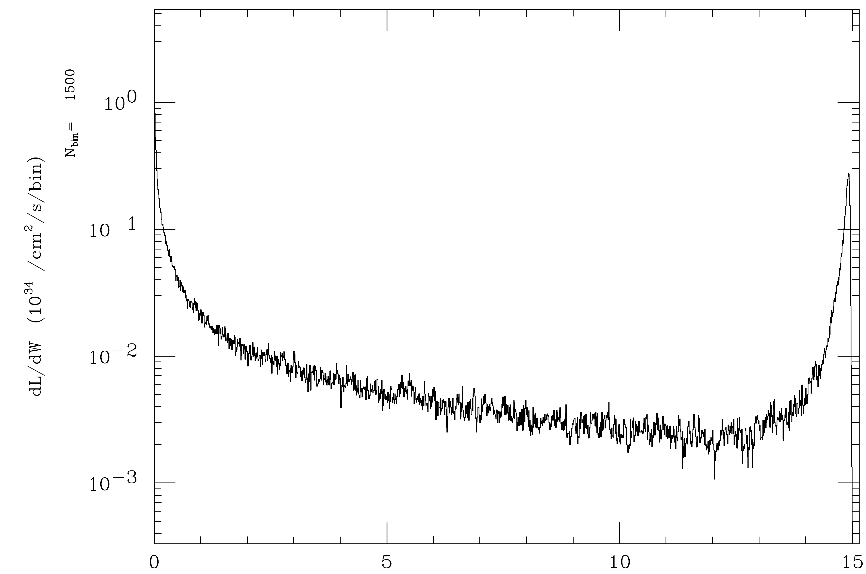
x=1.2x10⁵ (1 keV γ) not affected as much by coherent processes
v06311
v05706
E_{γγ} (TeV)
E_{γγ} (TeV)

Slide 17
v06311
E_{γγ} (TeV)

Slide 18
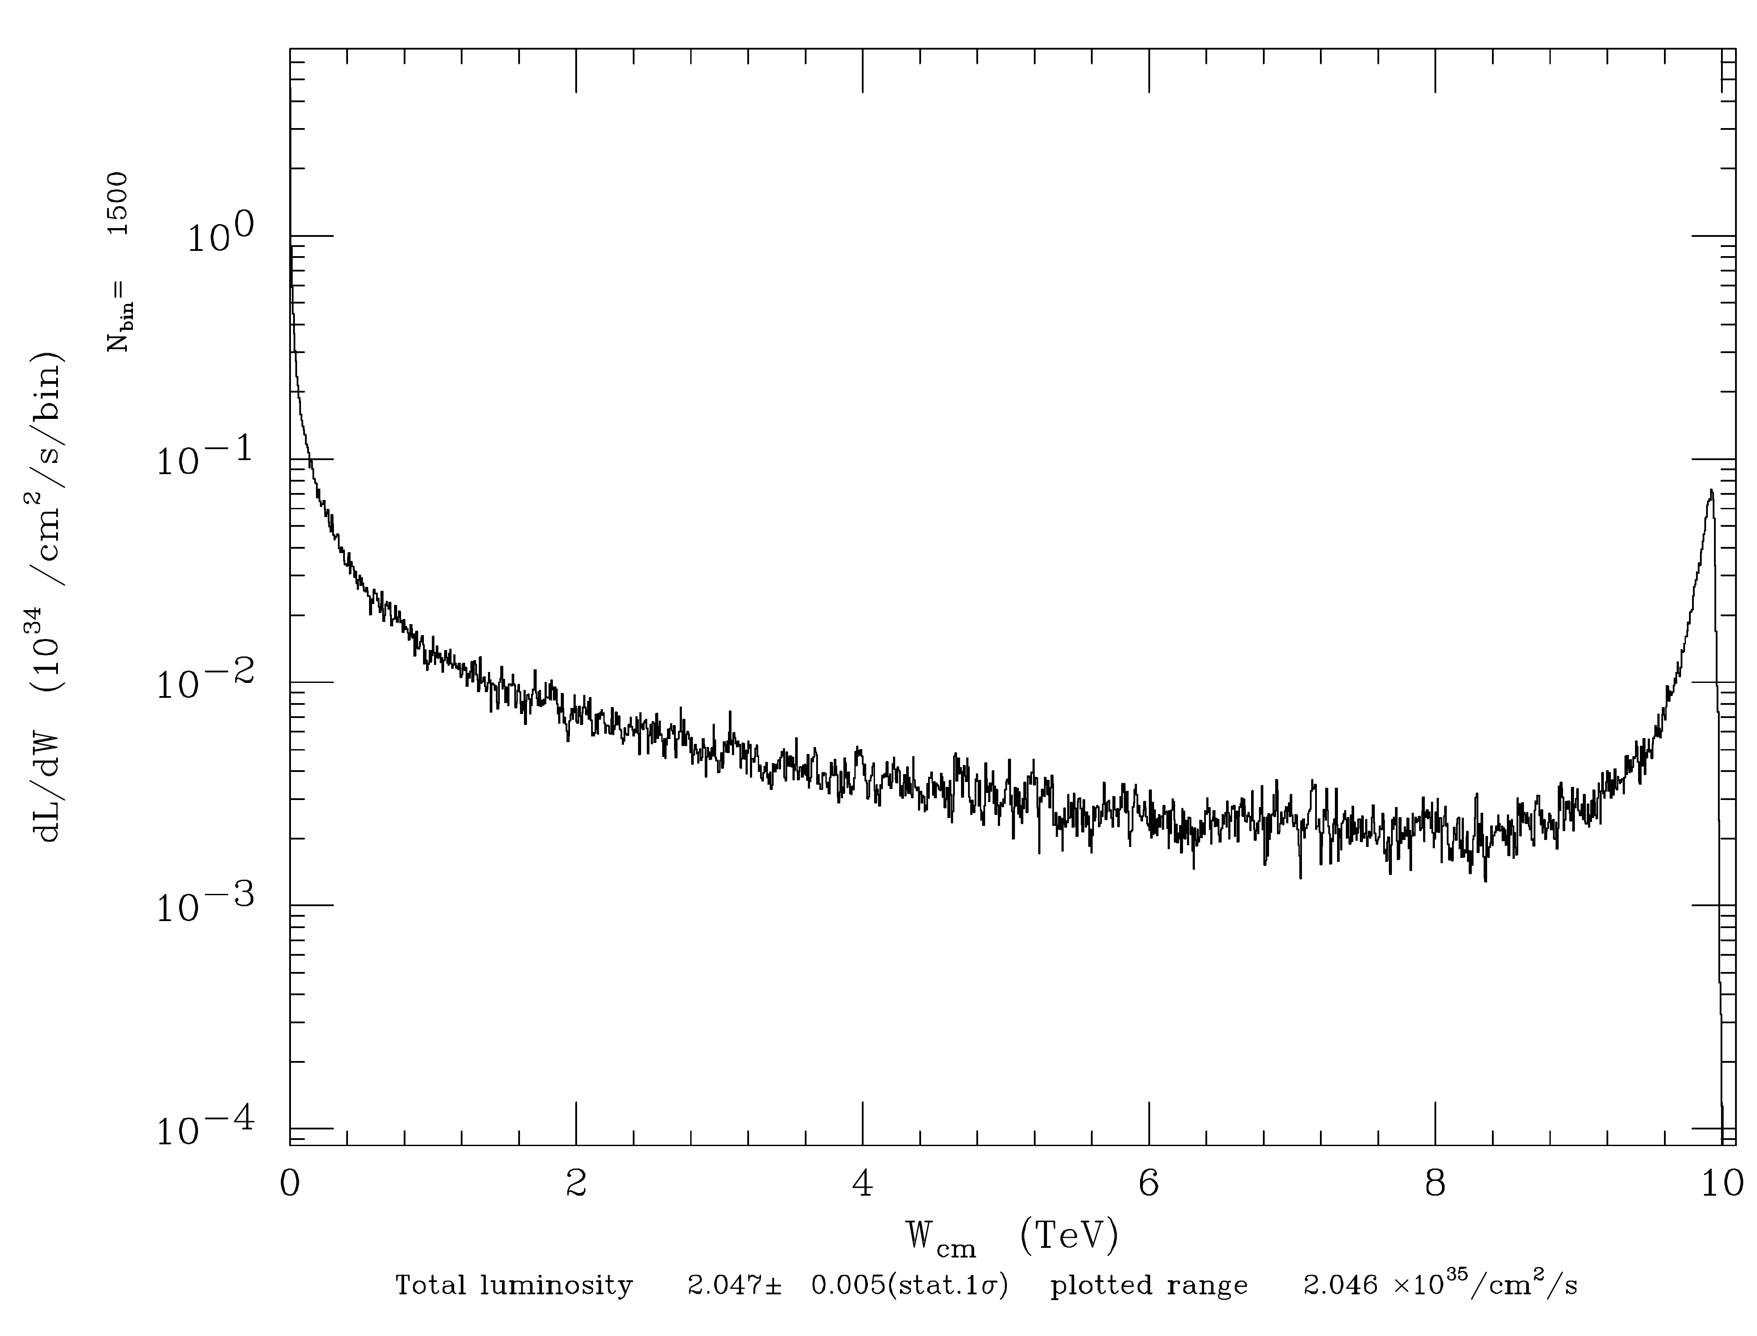
Compare 15 and 10 TeV
v06311
E_{γγ} (TeV)
E_{γγ} (TeV)

Slide 19
10 TeV γγ Luminosity: Compton vs e⁻e⁻ Collider
v06400
v06403
E_{γγ} (TeV)
E_{γγ} (TeV)

Slide 20
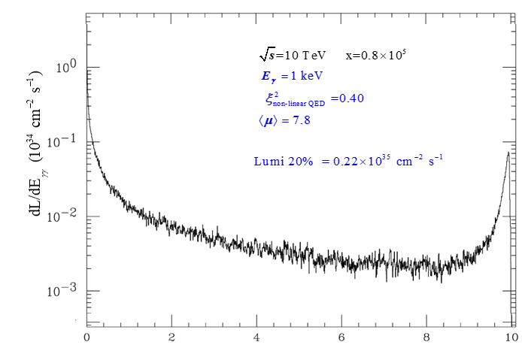
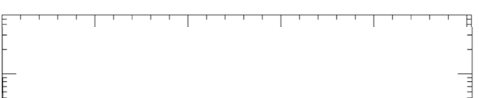
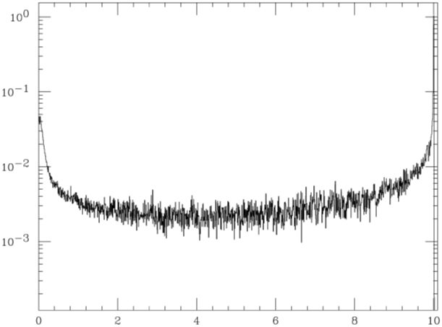
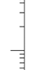
v06400
E_{γγ} (TeV)
E_{γγ} (TeV)
E_{γγ} (TeV)

Slide 21
v06403
E_{γγ} (TeV)
E_{γγ} (TeV)

Slide 22
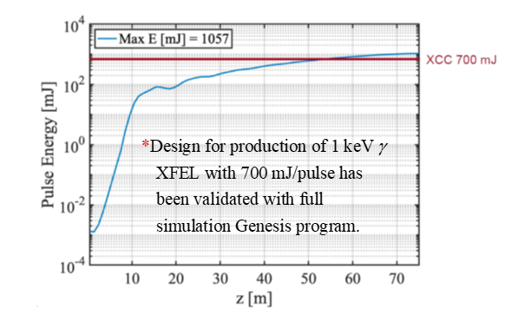
XCC Collider Accelerator Challenges
undulator
Table of XCC KB mirror parameters

Slide 23
Mirror Damage Limit (single pulse)
Boron carbide is the highest damage threshold coating and is used for this calculation
Assumes the incident fwhm beam size is ½ the substrate length
No safety factor is included in these calculations – 5-10x below this value should be planned for
Calculation is weakly dependent on incident angle below the mirror cutoff (0.3 deg AOI used)
A large mirror (> 1 m) is needed to survive ~ 1 J pulse energies

Slide 24
Mirror Reflectivity

Slide 25
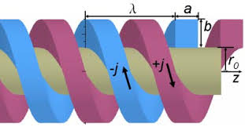
XCC Schematic with 1.4 km line between XFEL and KB mirrors
KB mirrors
1.4 km
Final triplet
e- Final Focus
Detector
10 m

Slide 27
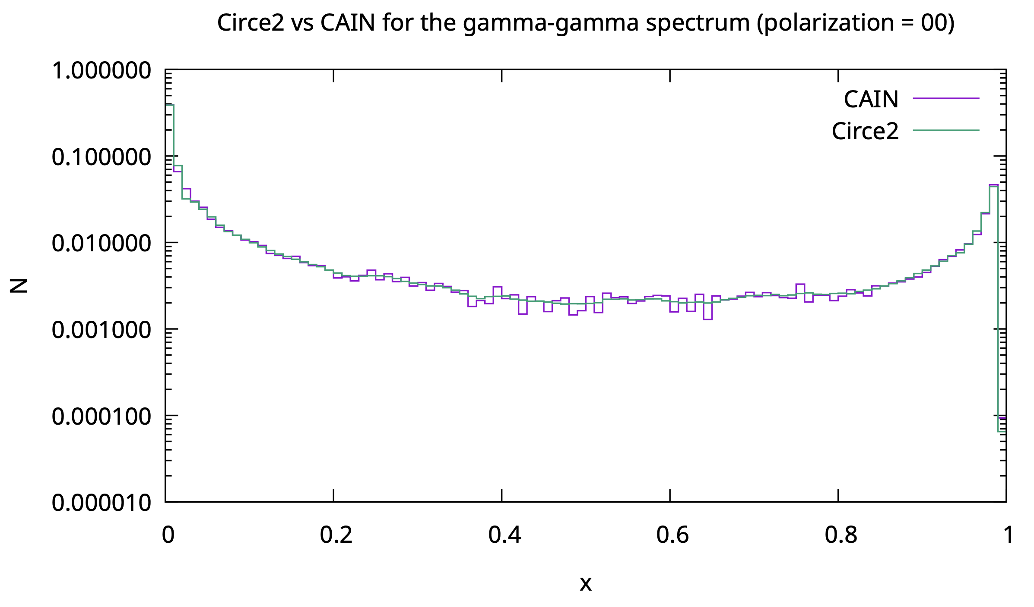
Event Simulation

Slide 28
Future Work

Slide 29
Backup Slides

Slide 30
TESLA TDR, Part VI, Chapter 1: The Photon Collider at TESLA

Slide 31
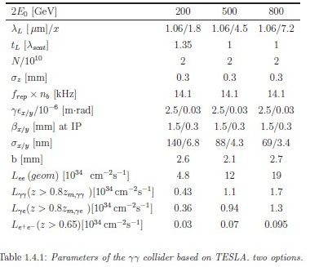
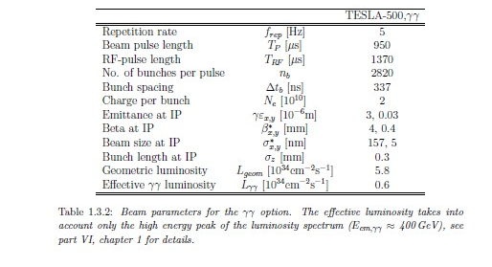
Let’s check this with CAIN. Calculate energy incident on 6 cm dia. cryostat at L*=3m.
Assume 6 cm dia cryostat

Slide 32
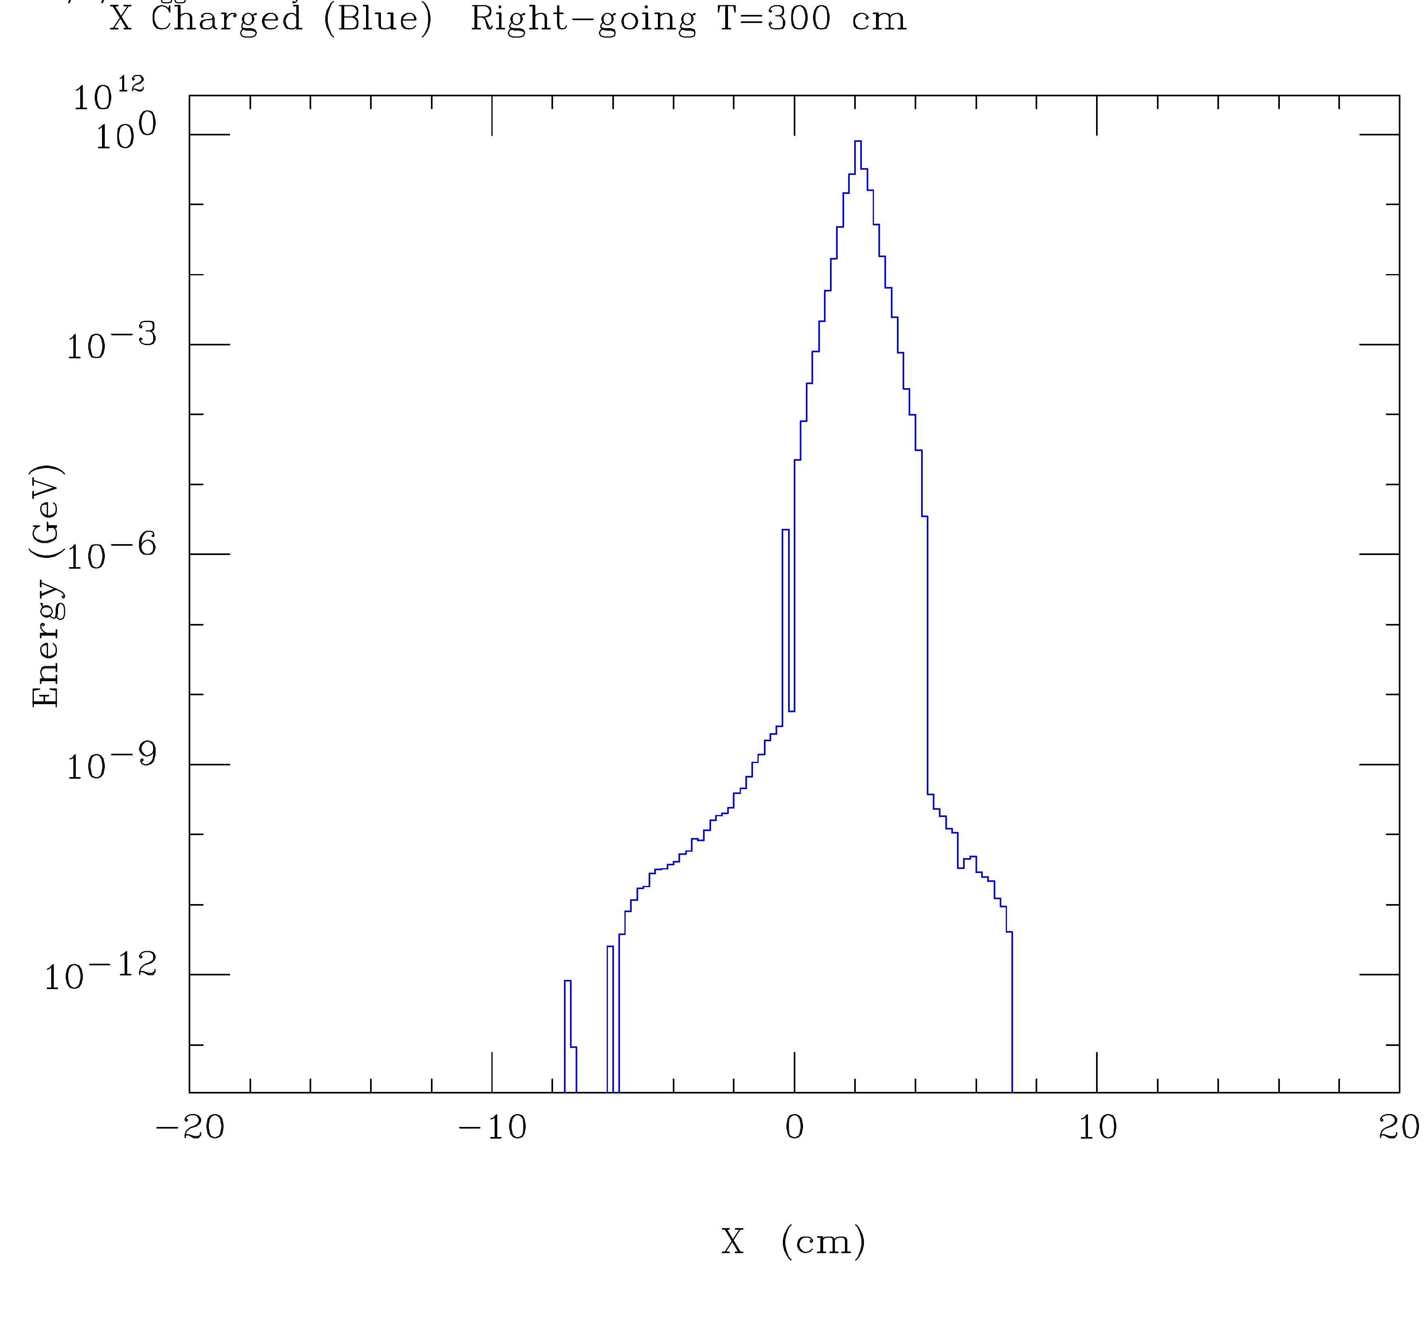
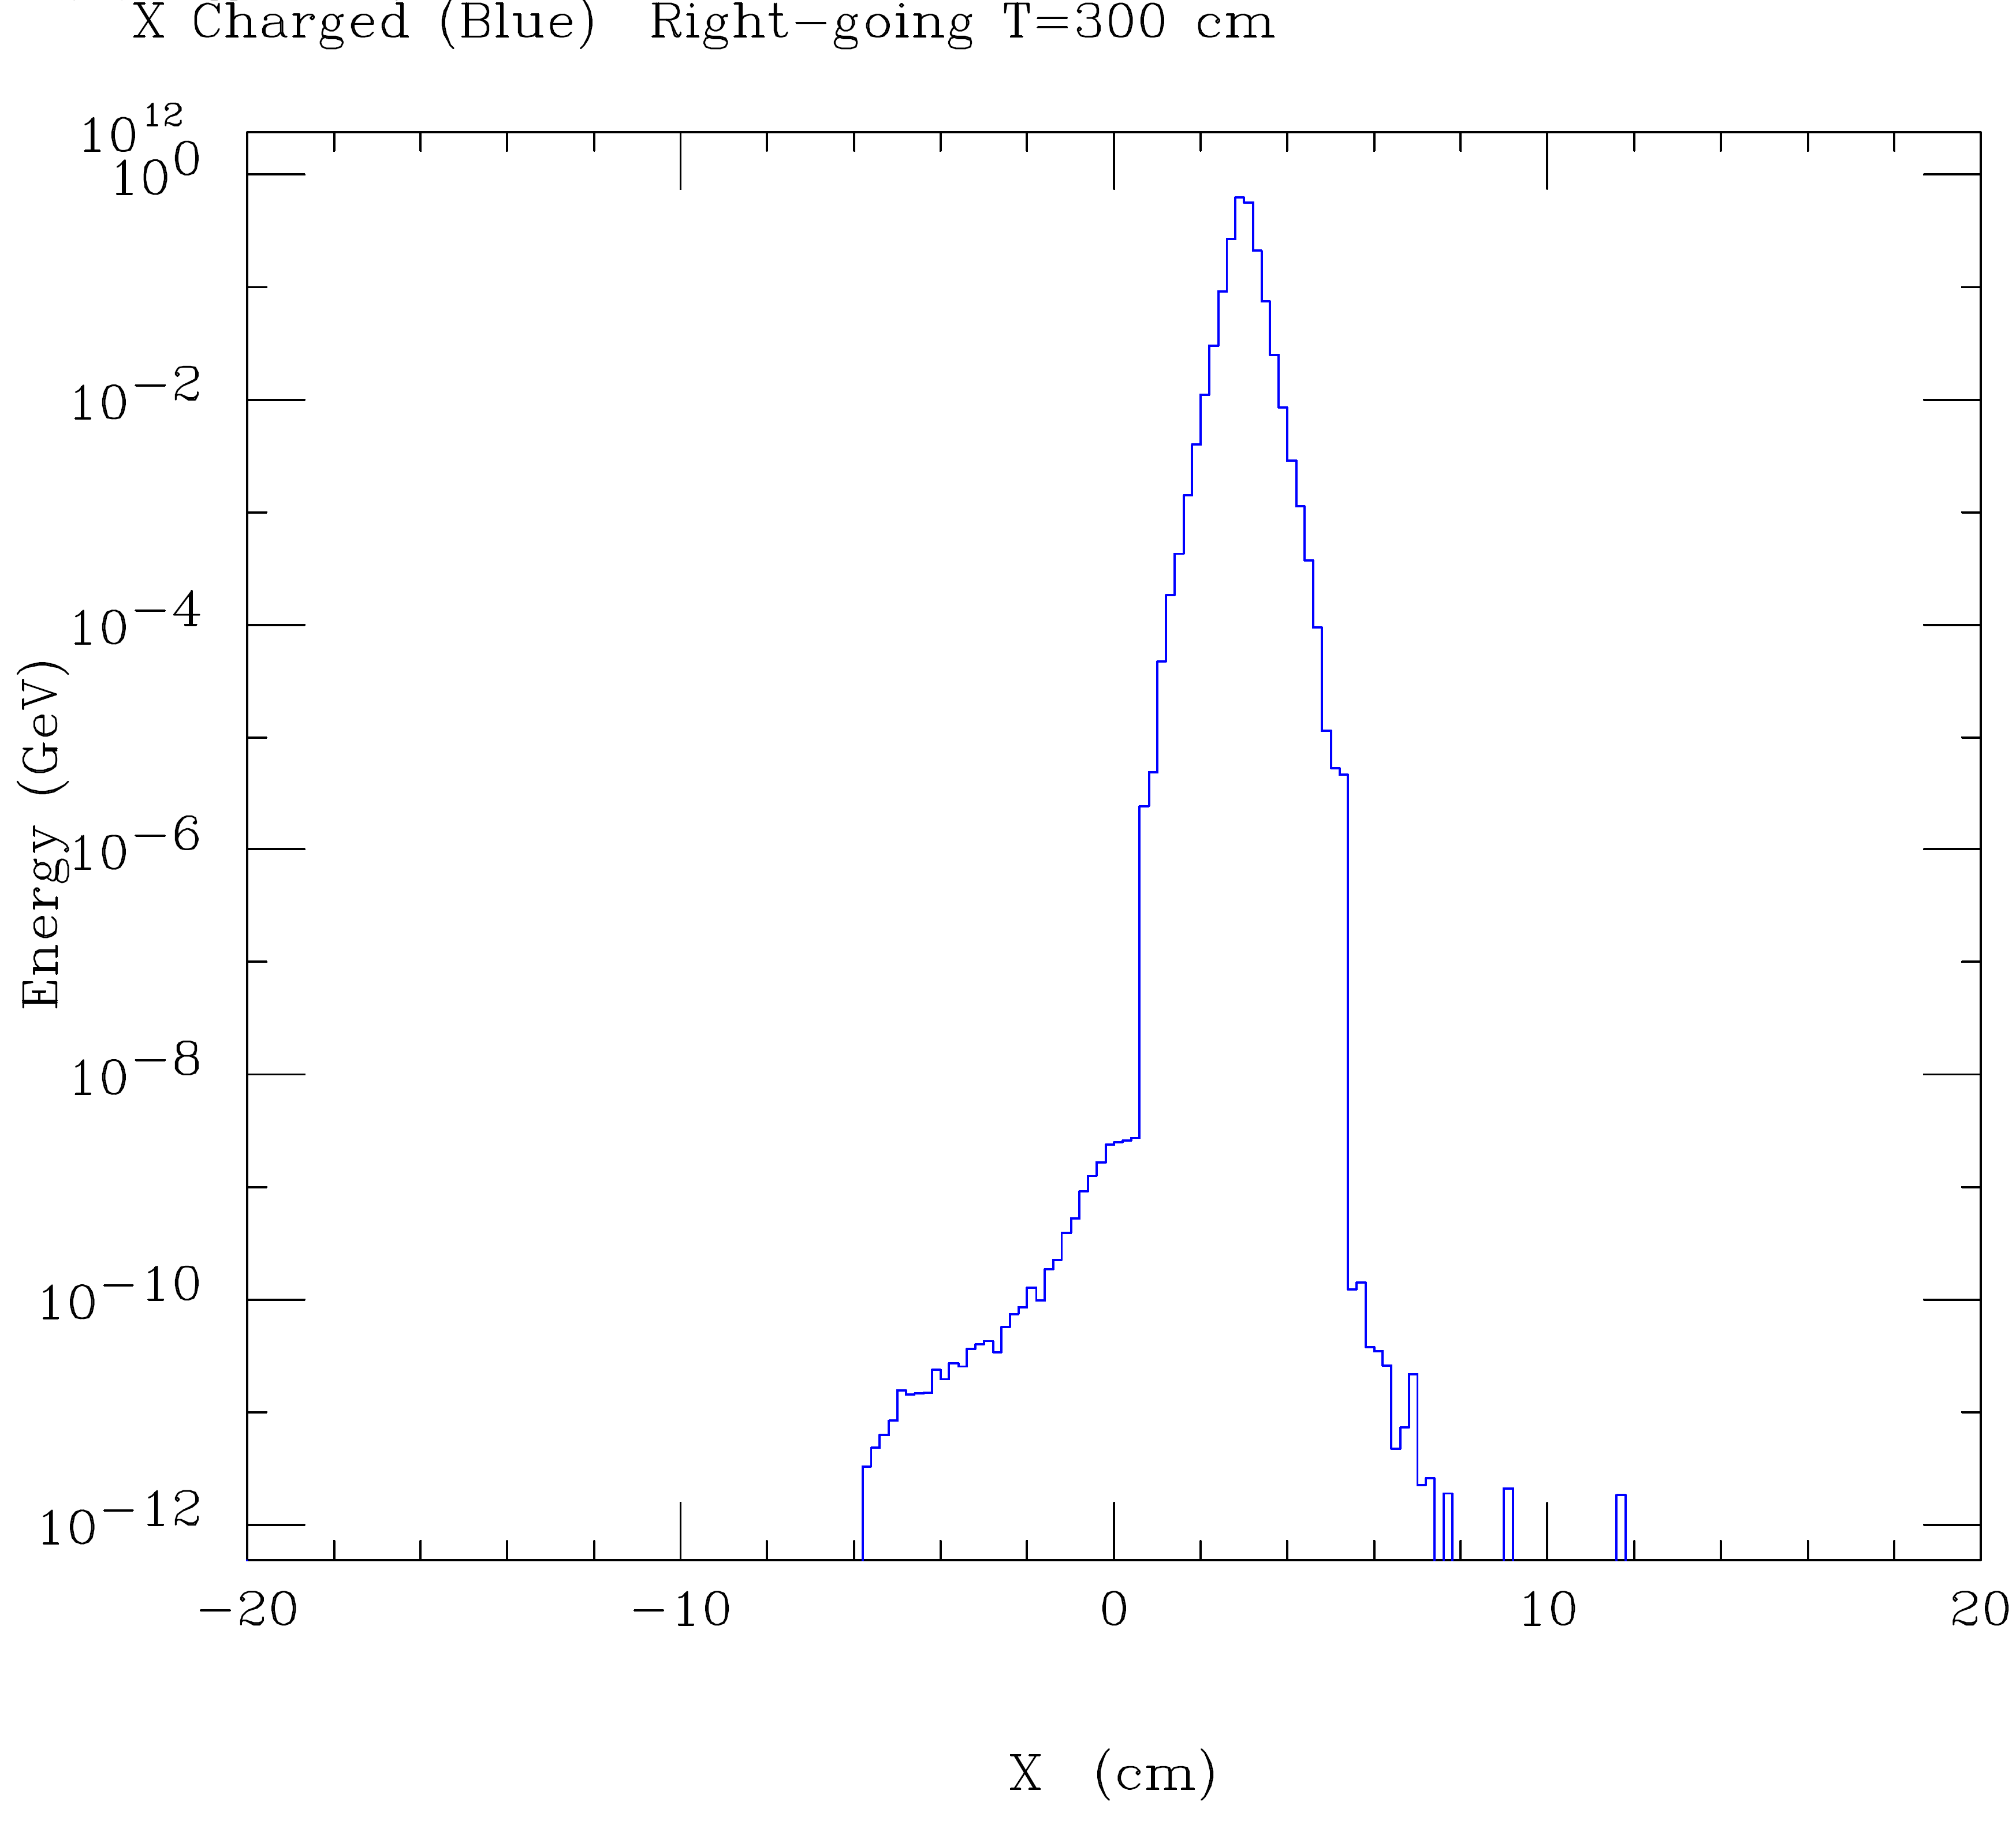
v06801
v06804
Assuming only few Watts on QD0 is tolerable, we conclude that 14 mrad is insufficient and 20 mrad is the minimum crossing angle.

Slide 33
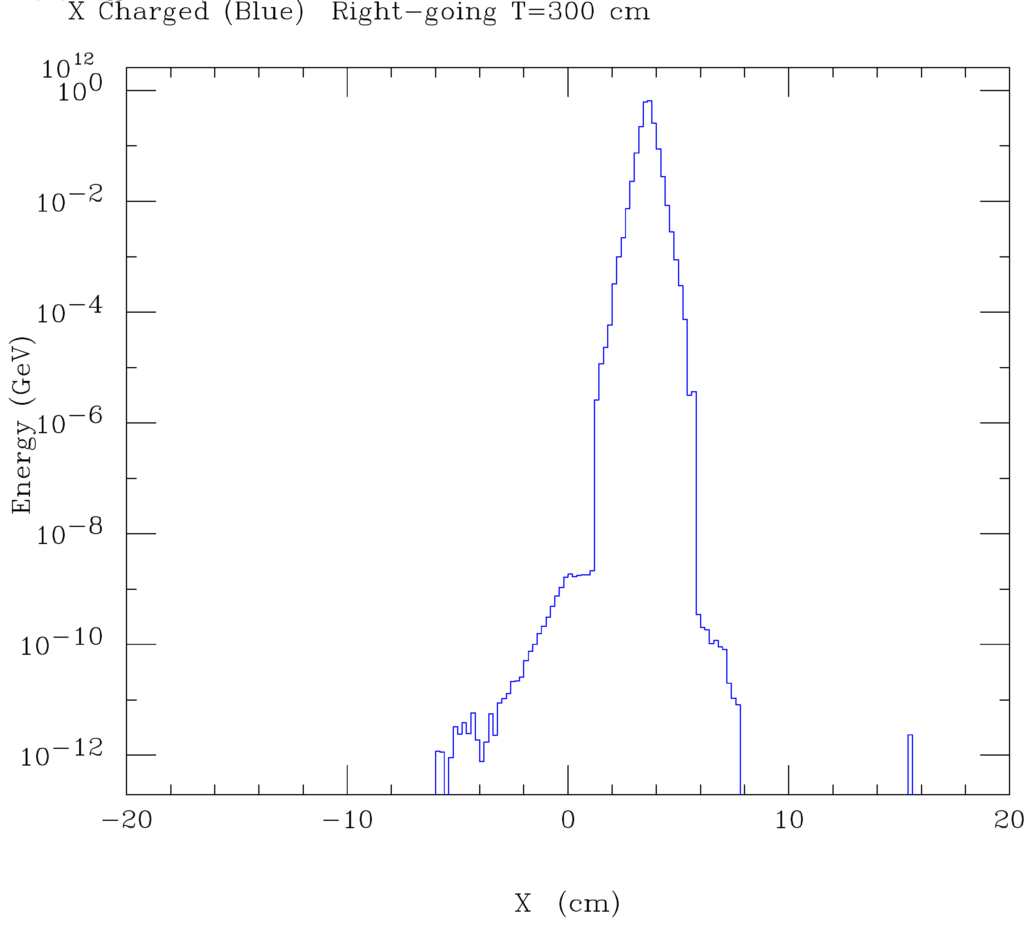
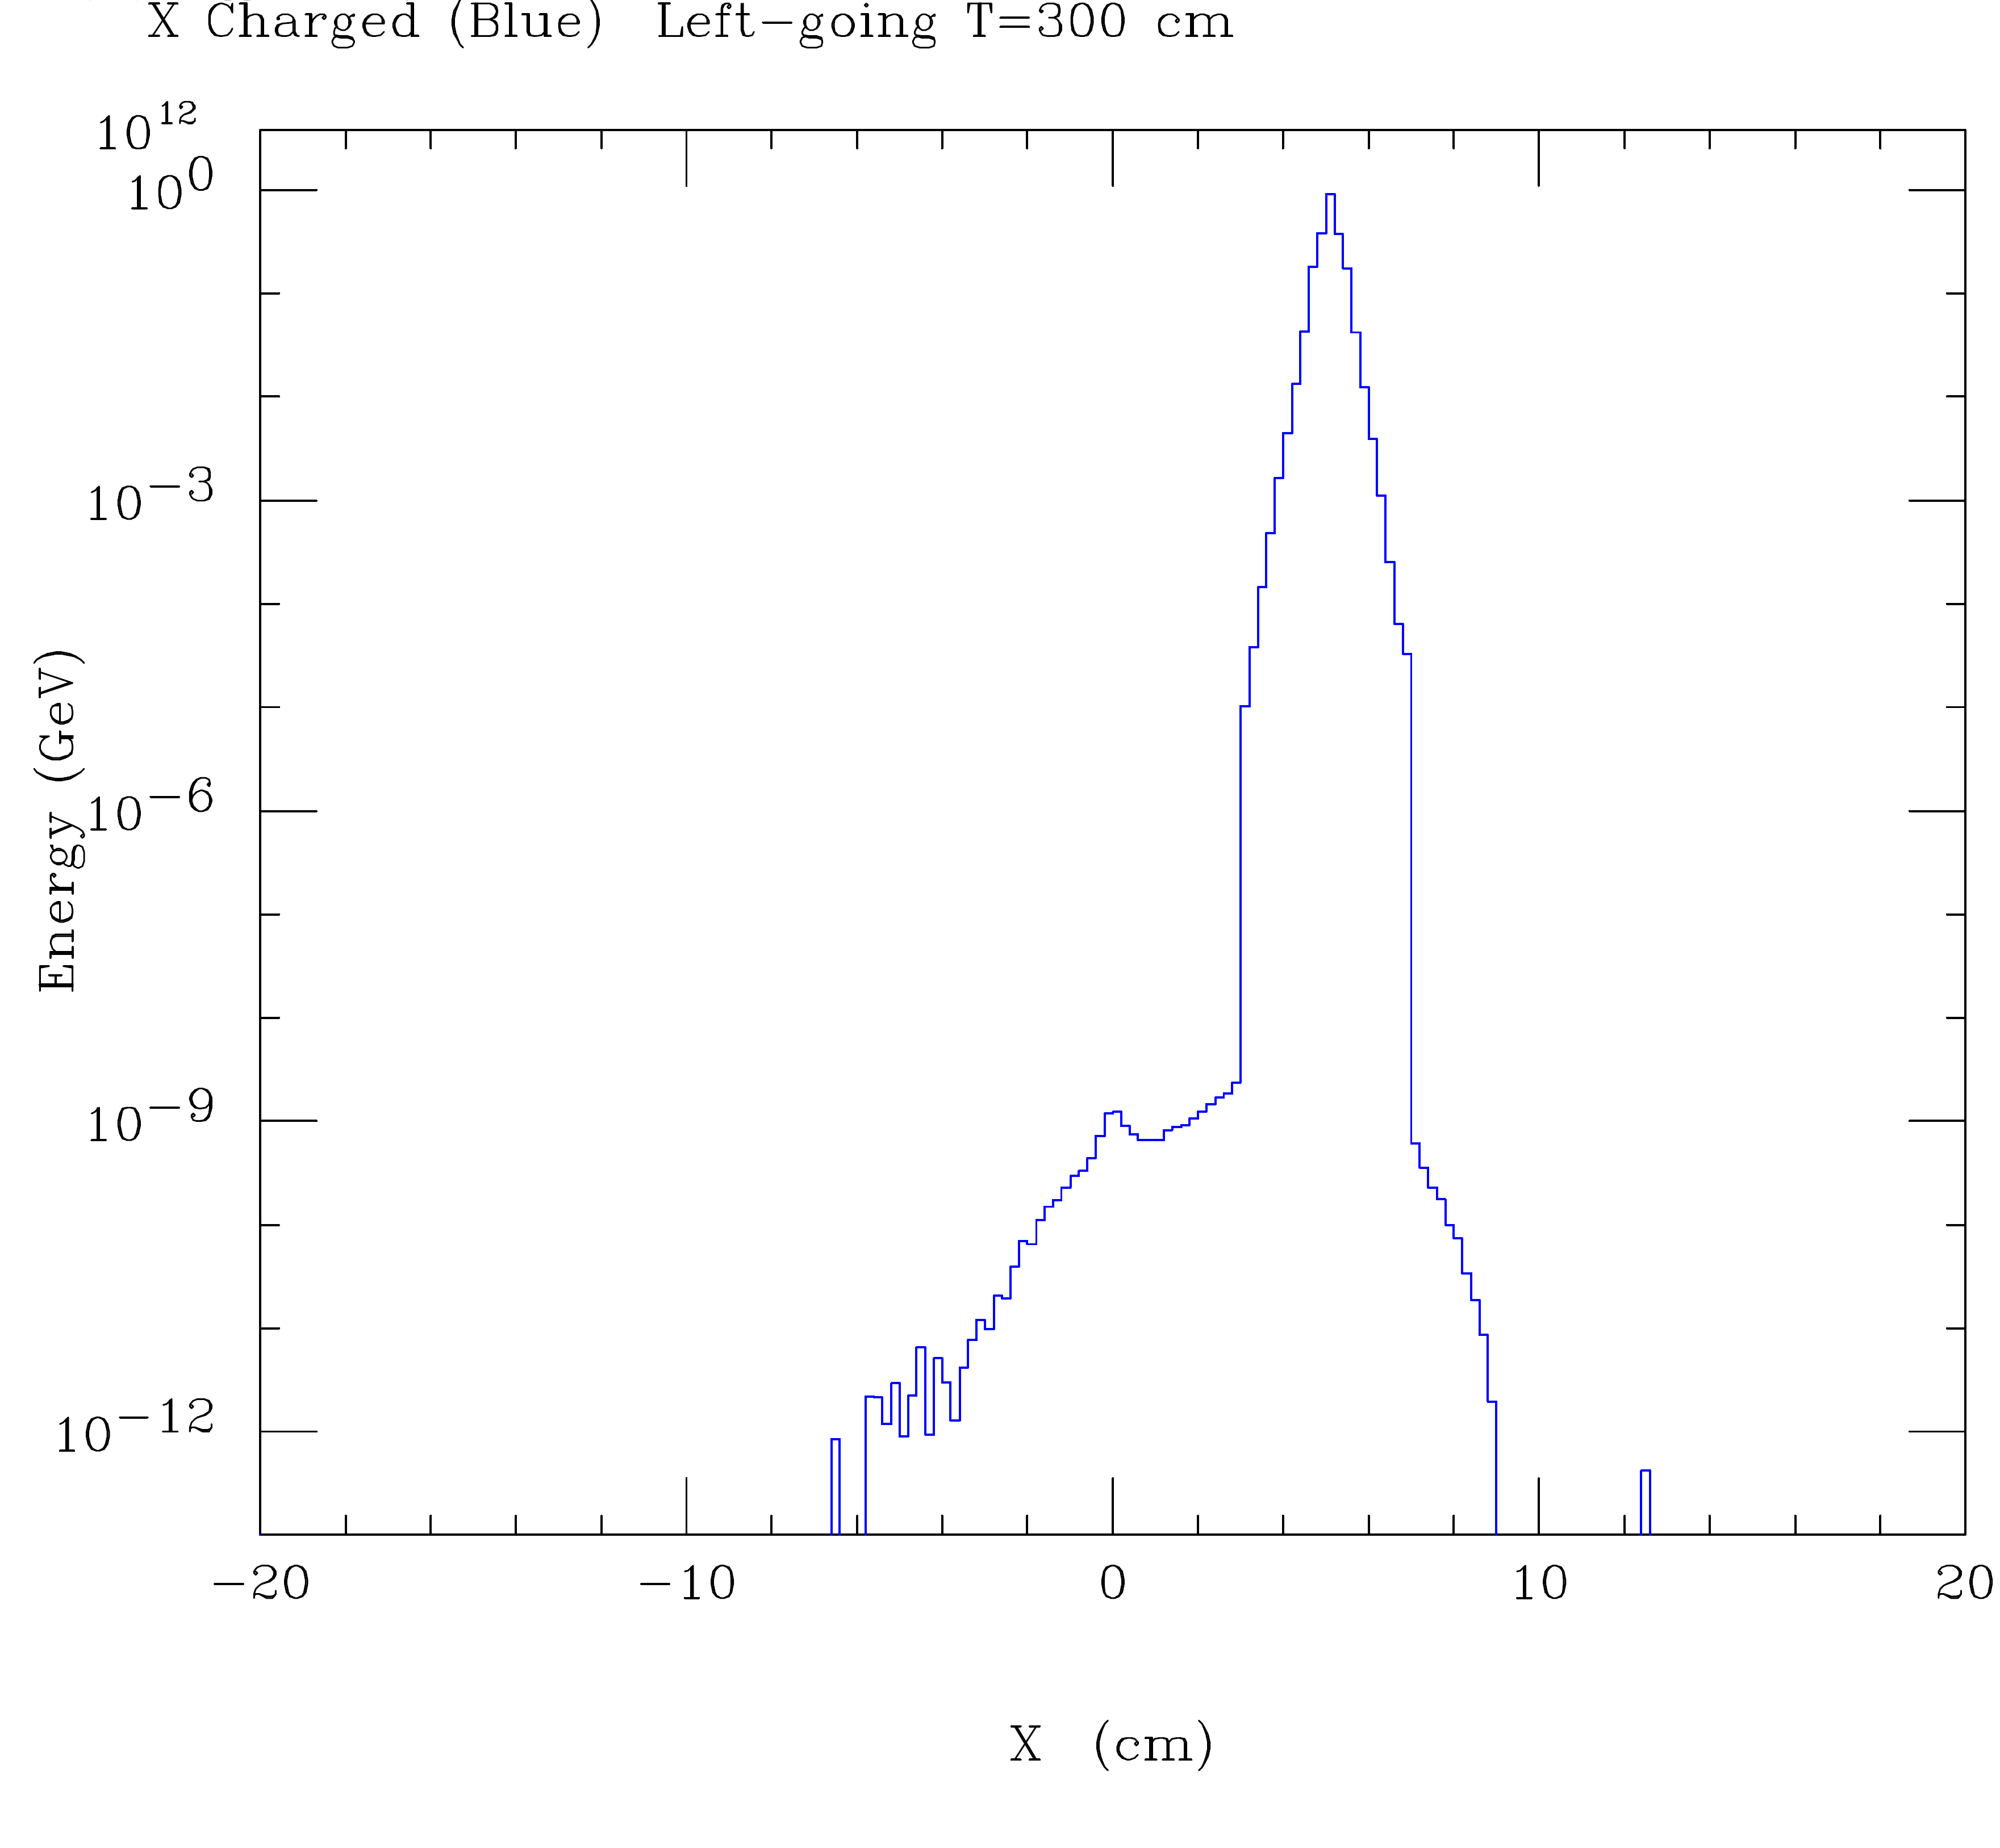
v06802
v06803
Conclude from CAIN that 24 mrad is more comfortable than 20 mrad and 34 mrad is overkill

Slide 34
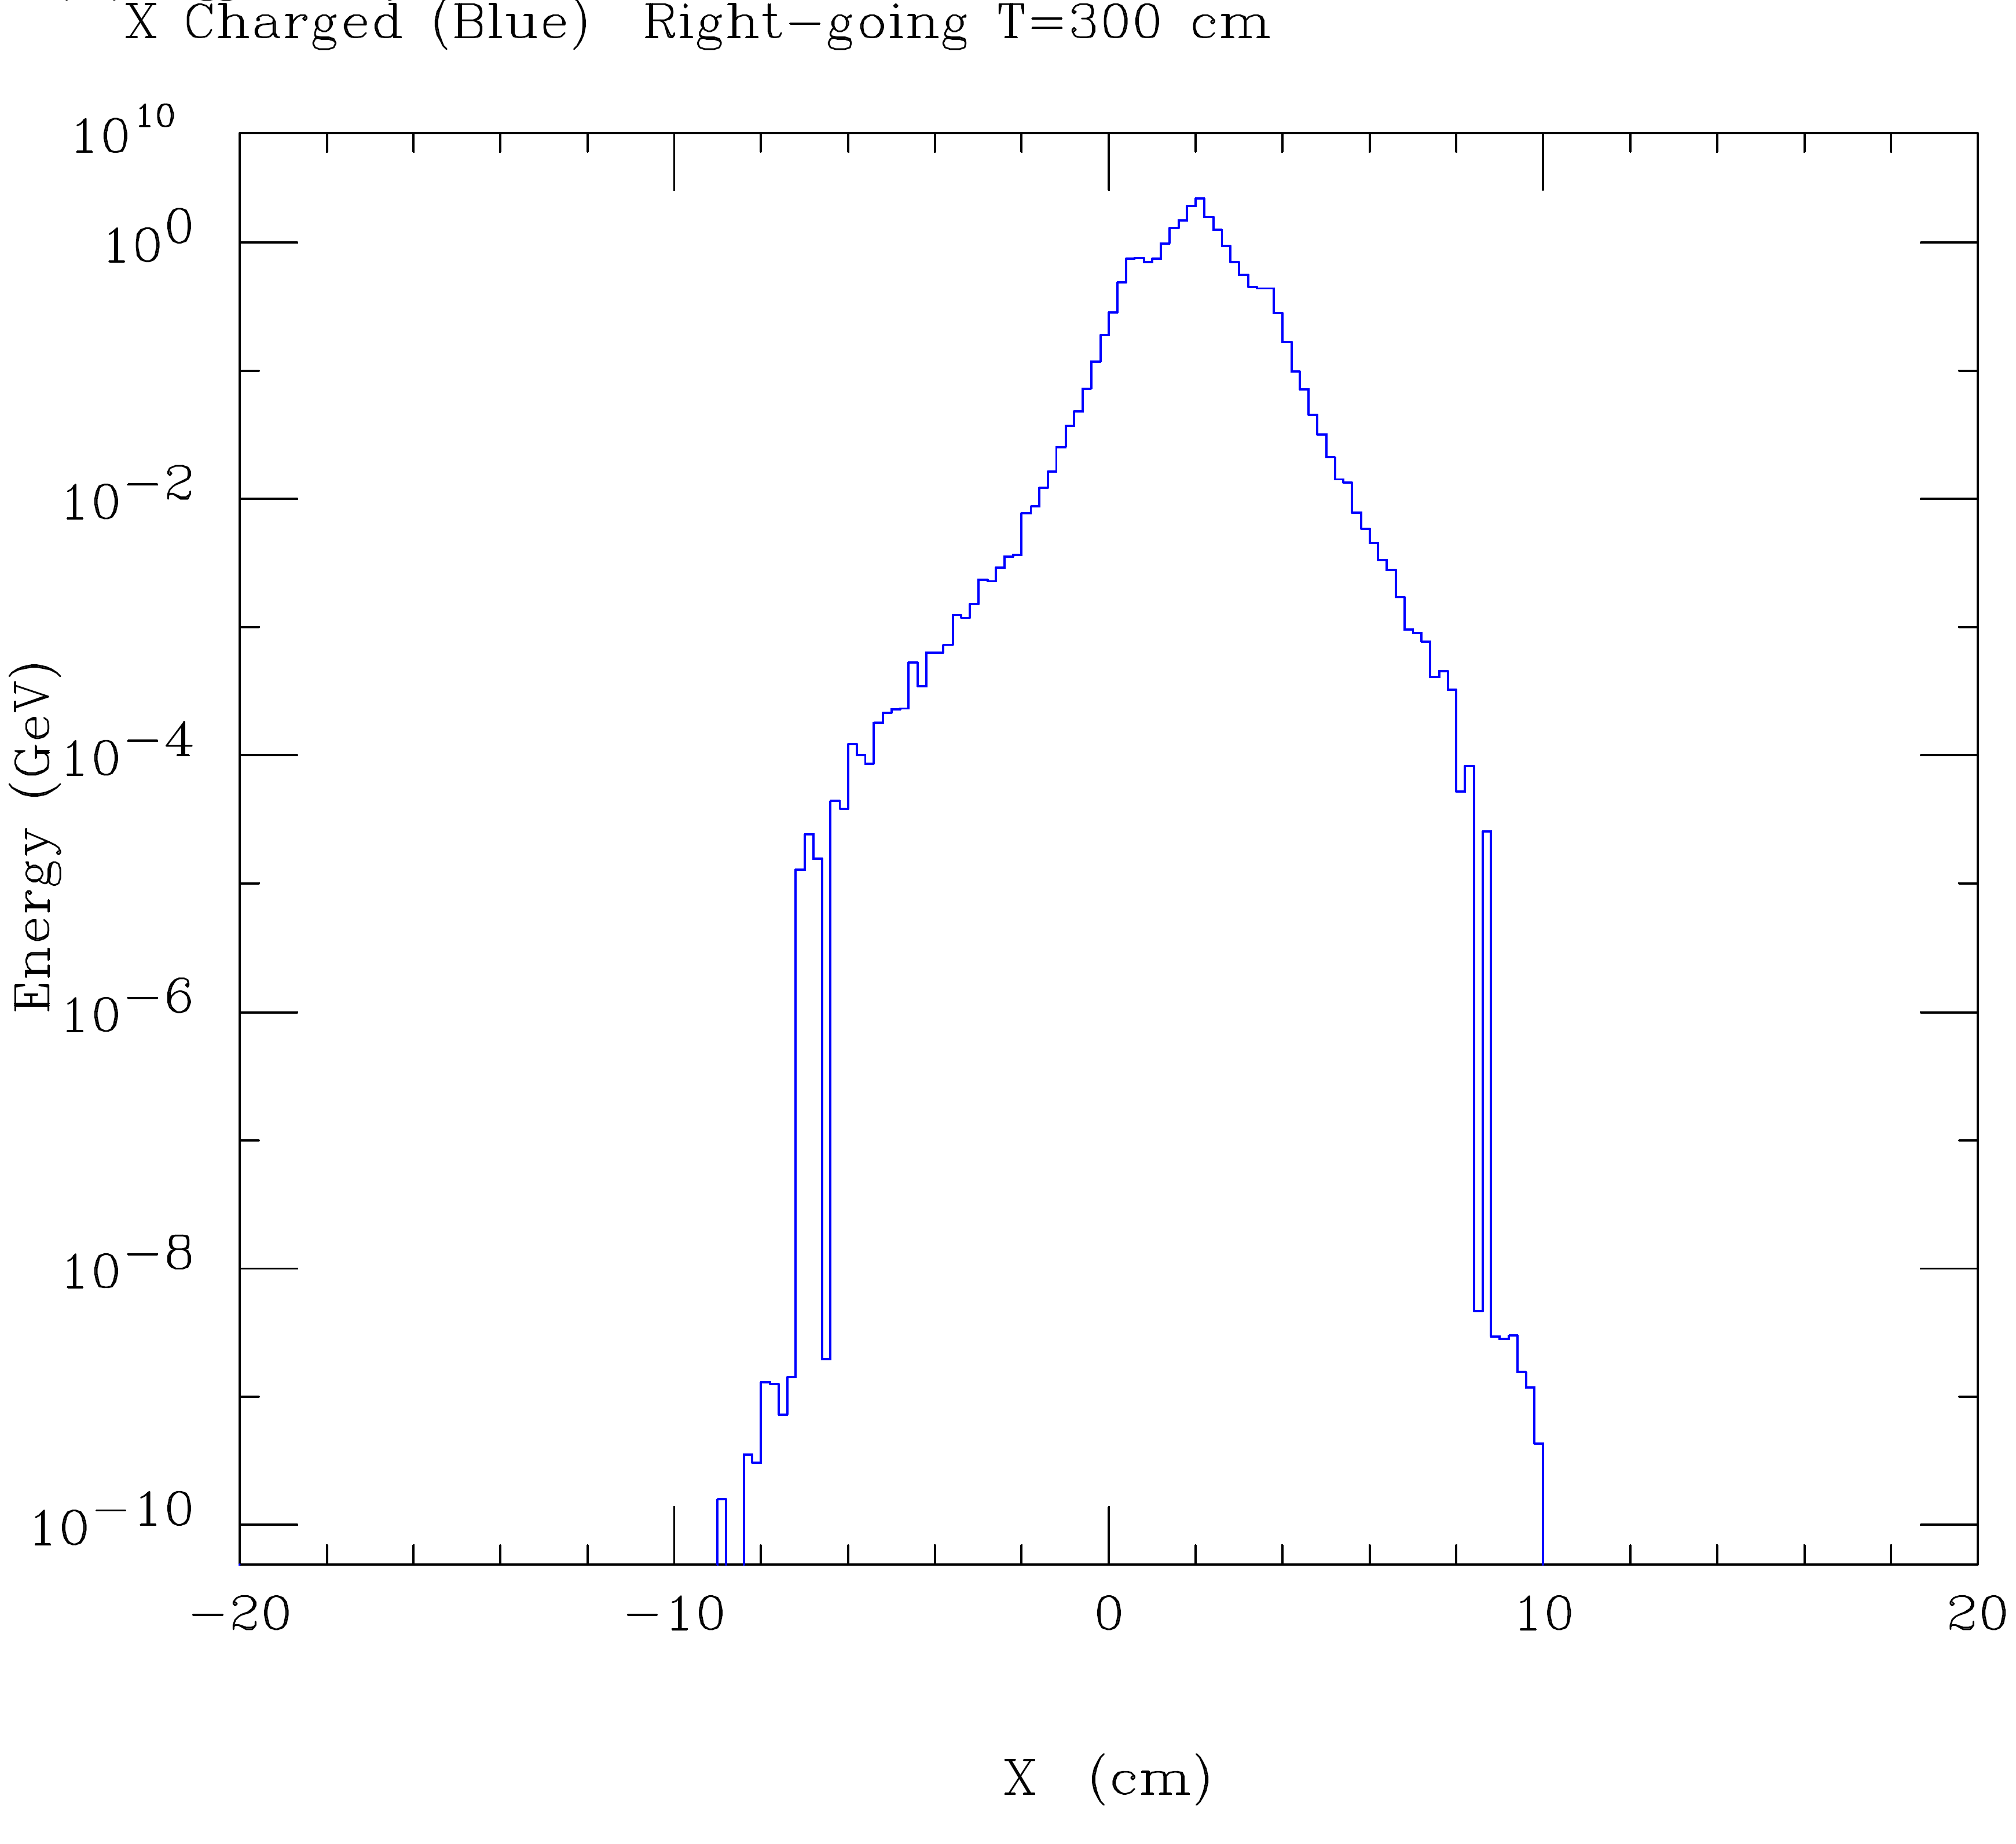
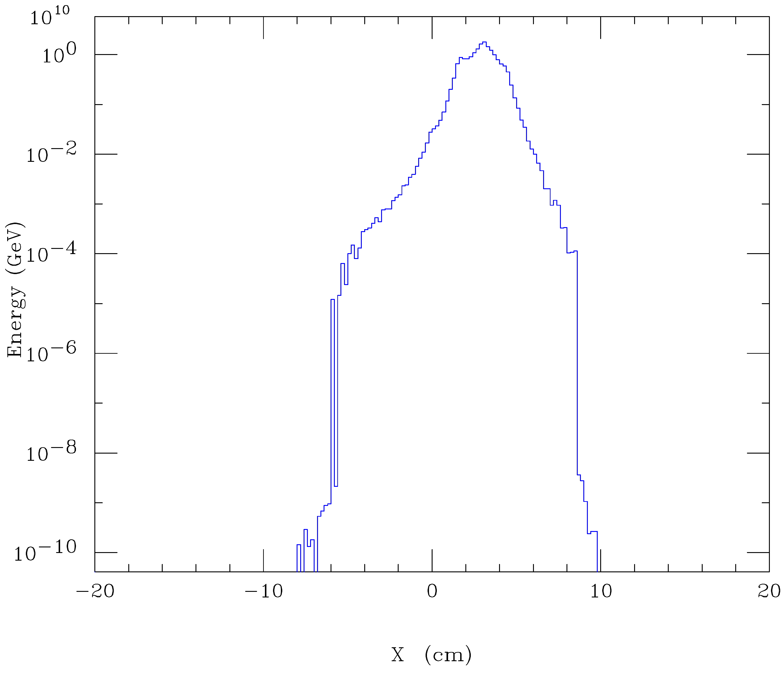
v06781
v06792
20 mrad will work if collimators are installed to protect QD0; must study size of collimator backscatter into detector

Slide 35
Solution requires large aperture HL-LHC-like final triplet. Significant departure from usual e+e- collider design

