Slide 1
Beam Quality in a Plasma Collider
Tor Raubenheimer
March 4, 2025

Slide 2
Introduction
Beam quality challenges:
Efficiency
Transverse emittance dilution
Energy spectrum, Energy jitter and Transverse jitter
Thoughts on required demonstrations
Subsystems: staging, beam dumps, sources, BDS and collimation
T. Raubenheimer, March 4, 2025 ALEGRO 2025 Workshop

Slide 3
Why me?
I’m a skeptic.
Started working on SLC / NLC / CLIC in 1980’s
Interested in exploring TeV-energy scale with e+/e-
Switched to ILC in 2004 to develop RDR and $ estimate
ILC cost was “2x too high” → Congress zeroed funding
Plasma solution! Coordinated FACET proposal
Developed PWFA-LC to focus on challenges
T. Raubenheimer, March 4, 2025 ALEGRO 2025 Workshop

Slide 4
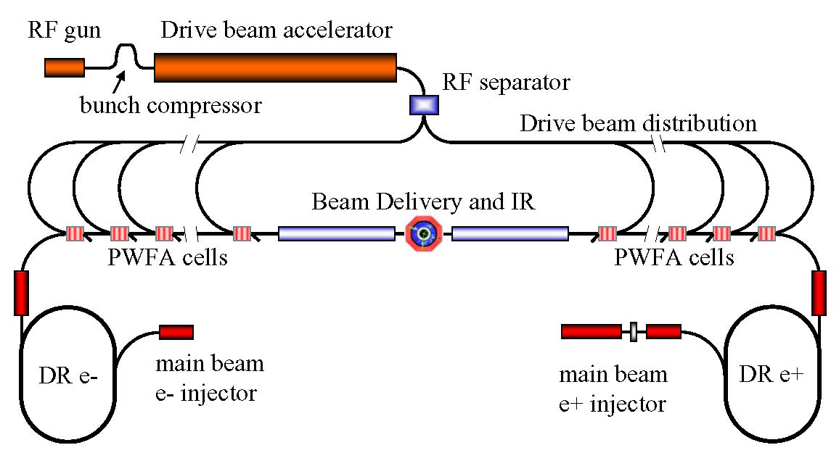
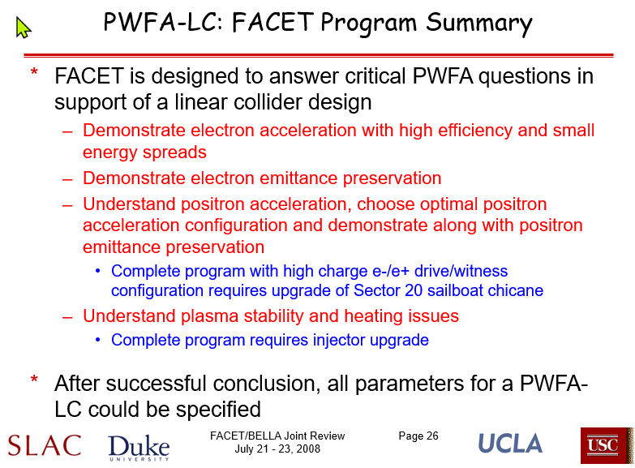
FACET and PWFA-LC
Combined PWFA with existing LC concepts (ILC, NLC, CLIC) to clarify challenges to be addressed at FACET
T. Raubenheimer, March 4, 2025 ALEGRO 2025 Workshop

Slide 5
Caveats
My studies focused on linear colliders from 1980’s through late 2000’s and I have tried to extrapolate that understanding to plasma accelerators
I have not followed recent R&D (the last I looked was in 2022 for the CERN R&D Roadmap and then Snowmass)
I led the effort to get FACET funded. There were wonderful science results but I wish there had been more focus on critical demonstrations
The physics is understood. I think there should be a major 3D simulation effort which I think can be much more efficient that experimentation
T. Raubenheimer, March 4, 2025 ALEGRO 2025 Workshop

Slide 6
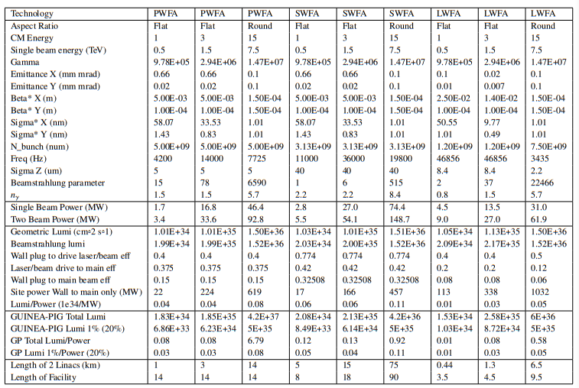
10 TeV Plasma Collider Parameters

Slide 7
Linear Collider Luminosity
Convert luminosity expression using beam power
P_{beam} = E_{cms} * eN * n_{b} * f_{rep}
Required to have large beam powers
Further constrained by IP effects
Beamstrahlung – synchrotron radiation due to strong beam fields
Disruption – beam distortion due to strong beam fields at the IP
Hourglass – β ≥ σ_{z}
For flat beams (σ_{x} >> σ_{y}) where δ ~ N²/σ_{x}²σ_{z}

Slide 8
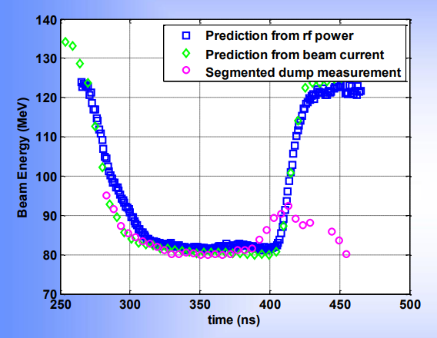
Efficiency
Linear colliders aim a net linac efficiency of >20% AC → Beam
What does this imply?
In a beam driven system, the drive beam can be generated with ~70% efficiency → need ~30% of drive beam energy into witness beam
In a laser driven system, similar scaling is thought to hold
CLIC aimed for 90% extraction of RF from drive beam with ~ 30% beam loading of the RF (CTF3 demonstrated ~50%)
CTF3 results with ~50% extraction
T. Raubenheimer, March 4, 2025 ALEGRO 2025 Workshop

Slide 9
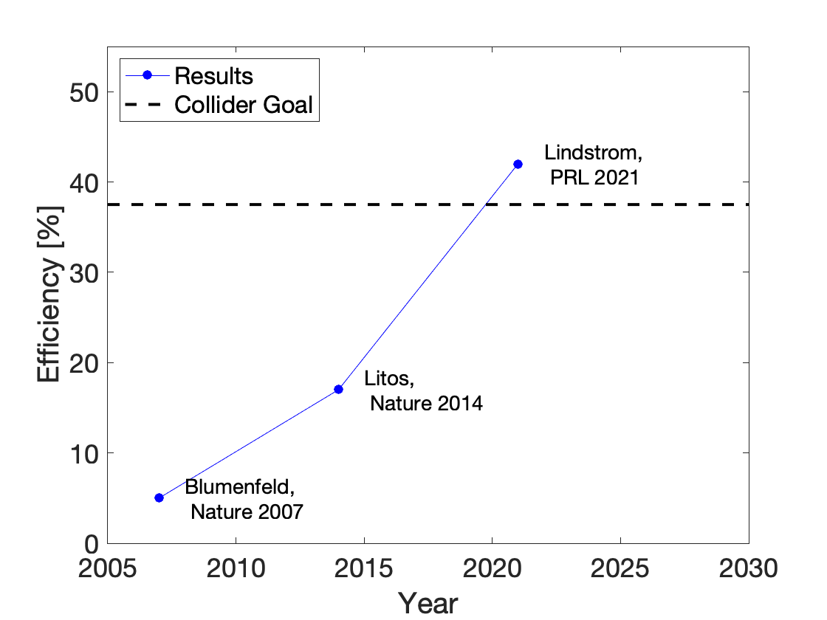
Efficiency Demonstrations
Presentation by AAC community to P5, SLAC Town Hall, May 2023
Beam-Driven Plasma
T. Raubenheimer, March 4, 2025 ALEGRO 2025 Workshop

Slide 10
Some Efficiency Demonstrations (as of 2022)
Litos, 2014, https://www.nature.com/articles/nature13882
30% local energy transfer with 74 pC accelerated by 1.6 GeV BUT the drive was 20 GeV 1nC beam → 0.6% efficiency
C. A. Lindstrøm et al., 2021, https://doi.org/10.1103/PhysRevLett.126.014801
42% local energy transfer with 100 pC accelerated by 50 MeV BUT the drive was 1 GeV with 490 pC → 1% efficiency
A. J. Gonsalves et al., 2019, https://doi.org/10.1103/PhysRevLett.122.084801.
62 pC at 6 GeV driven by 31 J laser → 1% efficiency
Real question, what limits them? Seems hard to extend systems.
T. Raubenheimer, March 4, 2025 ALEGRO 2025 Workshop

Slide 11

Instantaneous Efficiency
Ford Bronco gets 50 Miles per Gallon of gasoline
True, going down a 10% grade, but not very relevant to the bill at the gas station
Please at least qualify that this is local
Beam-Driven Plasma
T. Raubenheimer, March 4, 2025 ALEGRO 2025 Workshop

Slide 12
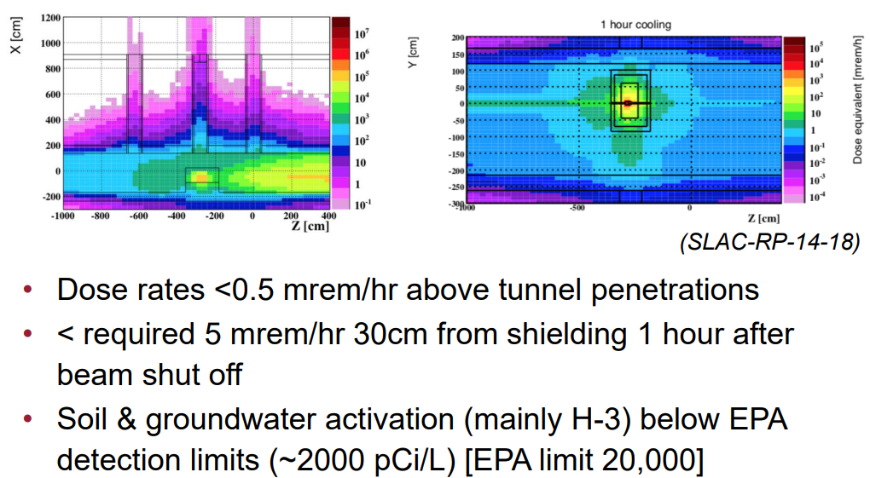
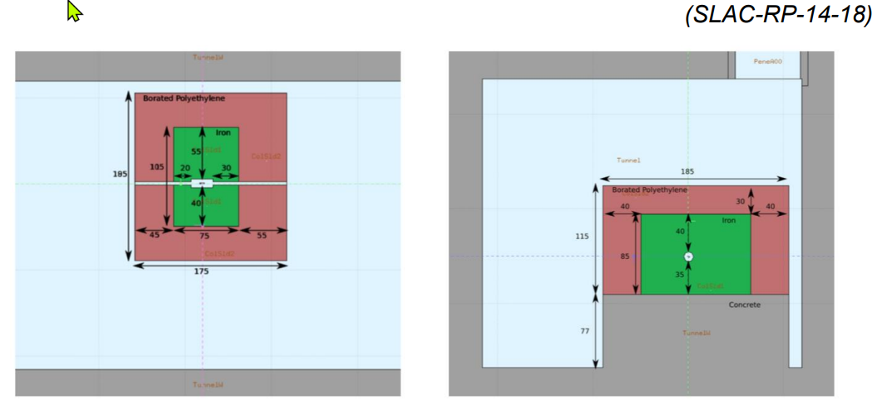
Aside: Mundane Stuff - Beam-Driven Dump Transport
Sets a limit on the energy extraction of the drive beam
Shielding of uncontrolled losses is expensive and limits design
Might consider CLIC Drive Beam dump concept to deal with spectrum
LCLS-II CEDOG Collimator with 1 kW

Slide 13
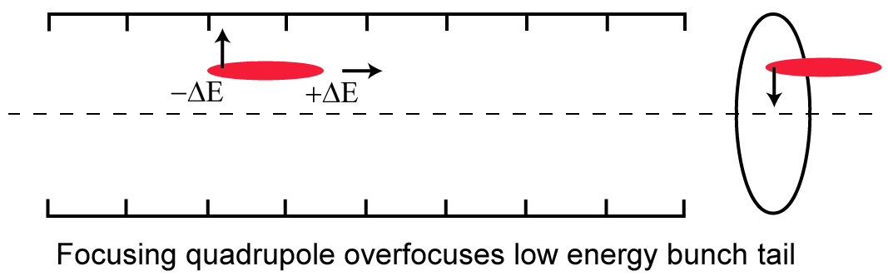
Emittance Preservation
Plasma in blowout regime has “linear” fields
Primary issues are matching into and out of plasma, errors in transition sections, and hosing (transverse wakefields)
In conventional accelerators wakefields are quantified by δ_{BNS}
δ_{BNS} ~ NW┴β² / γ
W┴ ~ σ_{Z} / a⁴
T. Raubenheimer, March 4, 2025 ALEGRO 2025 Workshop

Slide 14
Transverse Wakefields Already demonstrated NLC wakefield control at FFTB
Transverse wakefields in TESLA are 1000x smaller
True but incomplete statement
Effect of wakefields depends on charge, bunch length, and focusing
Real comparison is effect of wakefields on the beam
Best quantified with the “BNS autophasing” energy spread
X-band LC wakefield control already demonstrated at FFTB
 | δ_{Auto}
SLC Design | 9.9%
SLC Operation | 5.8%
FFTB | 1.1%
X-band LC Design | 1.1%
TESLA Design | 0.11%
SLC Design parameters too difficult → Operation with lower charge
FFTB operation with still lower charge → very stable beam – easy operation
Plasma accelerators have δ_{BNS} >> 10%

Slide 15
Emittance Preservation
Cannot compare plasma effects to conventional LC. In plasma cancellation must come from other focusing variation…ions motion seems to be in vogue
1992 VLEPP design with 16 nC bunches: “Wakefields are good!”
Vladimir Balakin, deputy director of BINP
Maybe true but requires very delicate cancellation of focusing and wakefields. Certainly for VLEPP and probably true for plasma
T. Raubenheimer, March 4, 2025 ALEGRO 2025 Workshop

Slide 16
Beam Matching and variation along linac
Need to match the beam to the plasma beta function
Plasma beta function scales as γ^{1/2}
Typically ranges from few cm to 10’s cm but, for same plasma density, different at every acceleration stage
Might try scaling plasma density but hard to match the bunch length
Plasma cells are highly chromatic → any mismatch will filament and the next mismatch will add
Strong focusing into plasma cells is also highly chromatic (or sensitive to alignment errors) further complicating the match
No successful demonstration of reasonable matching
T. Raubenheimer, March 4, 2025 ALEGRO 2025 Workshop

Slide 17
Additive RMS versus Linear and Multiplicative Sources
Most sources of dilution are random
→ if phases are random, add as RMS (linear in ε)
BUT plasma stages are highly chromatic and effects will filament within a single stage
→ filamentation reduces amplitude but adds linearly
AND after filamentation mismatches add multiplicatively
T. Raubenheimer, March 4, 2025 ALEGRO 2025 Workshop

Slide 18
Emittance Preservation Demonstrations
V. Shpakov et al., 2021, https://doi.org/10.1103/PhysRevAccelBeams.24.051301
2.8 um → 3.8 um (30% growth due to mismatch) BUT 3 MeV gain (3%) with 0.3% efficiency
C. A. Lindstrøm et al., 2023, https://arxiv.org/pdf/2403.17855
2.85 um → 2.80 um (no measurable growth) BUT 40 MeV gain (4%) with 0.4% efficiency
PWFA and LWFA FEL demonstrations also indicate ~2 um emittances
How do we do better? How do we extend the interaction?
T. Raubenheimer, March 4, 2025 ALEGRO 2025 Workshop

Slide 19
Energy Jitter
Typical RF accelerators require phase stability at ~0.1% of the RF wavelength (LCLS aims for 100 fs)
Strong longitudinal focusing may reduce tolerances but it introduces synchrotron radiation limiting applicability
Develop real lattice with corrections and track with errors
Calculate the required specs … guessing it is <0.1 fs over km
Thermal effects, ground motion, electronics are all >>
Describe mitigation strategies and required diagnostics
T. Raubenheimer, March 4, 2025 ALEGRO 2025 Workshop

Slide 20
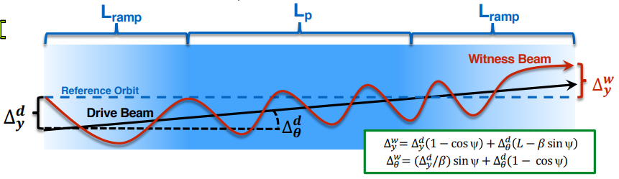
Transverse Jitter
Two main sources:
Drive beam / laser versus relative to the witness See G. White et al., 2019 Requires stabilizing drive beams to << 0.01% drive beam size – how to measure this?
Strong focusing elements between plasma stages The system focusing the witness beam to 100 nm sizes will have tighter tolerances, e.g. >>10 nm
T. Raubenheimer, March 4, 2025 ALEGRO 2025 Workshop

Slide 21
Jitter Issues
Need to estimate tolerances through simulation and analytic estimates. Hard to study experimentally because typical sources are too large.
NLC & CLIC invested in studying ground motion and feedback approaches. Estimated ~10 nm floor for f>10 Hz
Plasma colliders will have 10 kHz repetition rates allowing much more aggressive feedback
Need beam diagnostics with high resolution and high rep rate

Slide 22
Further Challenges for 10 TeV
Beams in linacs in a 10 TeV collider have beam sizes that range from 150 nm (20 GeV) → 40 nm (5 TeV) (2e16)
Correction developed at one location will not clearly work at another unless one scales other parameters
Peak beam fields scale from few 100 V/A → 1000 V/A
Ion motion will be significant as will tunneling ionization
Choose plasma to balance ionization versus motion…is this possible?
T. Raubenheimer, March 4, 2025 ALEGRO 2025 Workshop

Slide 23
Simulations for 10 TeV
No experiments will be able to model 10 TeV beams or beam-plasma interaction → must rely on simulation
Physics is known, simulation tools exist, and simulations seem to be well benchmarked against experiments
Full Start-2-End may be challenging
Effects tend to scale as 1/γ or 1/ γ^{1/2} → calculate logarithmic sections: 10 GeV acceleration at 50 GeV, 100 GeV acceleration at 500 GeV and 1 TeV section at 5 TeV
…OK, maybe not but scale rationally with energy
T. Raubenheimer, March 4, 2025 ALEGRO 2025 Workshop

Slide 24
Subsystems for Plasma Collider
The plasma cell is probably the least expensive part
Need to develop designs not sketches for the subsystems
Beam Delivery has gotten a lot of attention but is there a real optics?
What about particle sources? With or without polarization?
How about staging optics and the drive beam transport?
In PWFA-LC we needed 100m between plasma cells (250 MV/m) and the turn-arounds were ~2B$ and 100 MW

Slide 25
PWFA-LC Experimental Program

Slide 26
PWFA-LC Simulation/Design Program
Extensive simulation and theoretical development program in parallel with FACET experimental program
Also directed design and engineering program for PWFA-LC

Slide 27
Summary
There has been lots of innovation, but plasma acceleration needs to be shown to be realistic and cost-effective
Simulation will be the only tool for multi-TeV studies
Many of us old guys who looked at this got disenchanted
This is your opportunity to prove us wrong … but the challenges need to taken seriously to demonstrate a viable linear collider
I greatly look forward to the output of this study!

Slide 28
