Slide 1
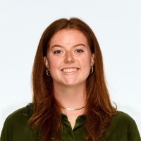
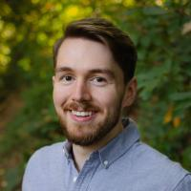
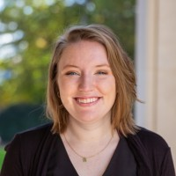
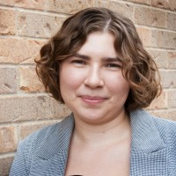
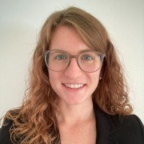
US LUA 2024 LR Winners
Andrew Dowling (Syracuse University)
Brendon Bullard (SLAC)
Elliott Kauffman (Princeton University)
Emily Thompson (LBNL)
Gabriella Pesticci (Kenyon College)
Kate Richardson (Massachusetts Institute of Technology)
Lauren Larson (University of Texas at Austin)
Miles Cochran-Branson (University of Washington)
Notes:
1

