Slide 1
Automating ATLAS control room anomaly detection with machine learning
Avery Hanna
CERN Summer Student
Supervisors: Mario Campanelli, Antoine Marzin
December 17, 2024

Slide 2
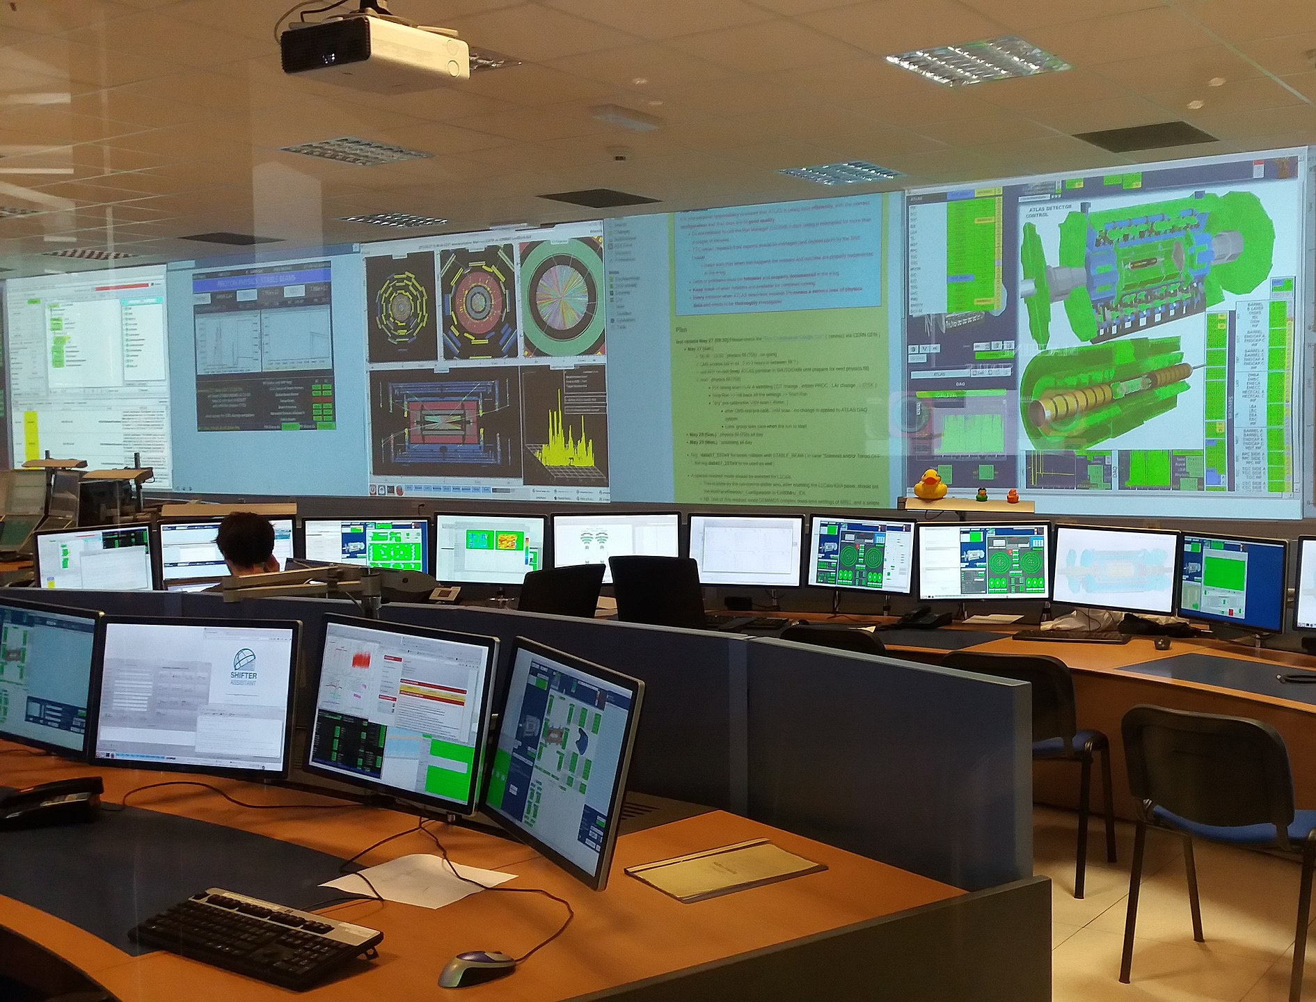
Motivations
High-quality data acquisition via effective anomaly detection in ATLAS operation
Currently, shifters manually monitor data in control room
Problems in consistency, accuracy
Shifters monitor many plots over 8-hour period
High personnel demand
Approach:
Online machine learning model to watch incoming time-series data and alert staff to anomalies

Slide 3
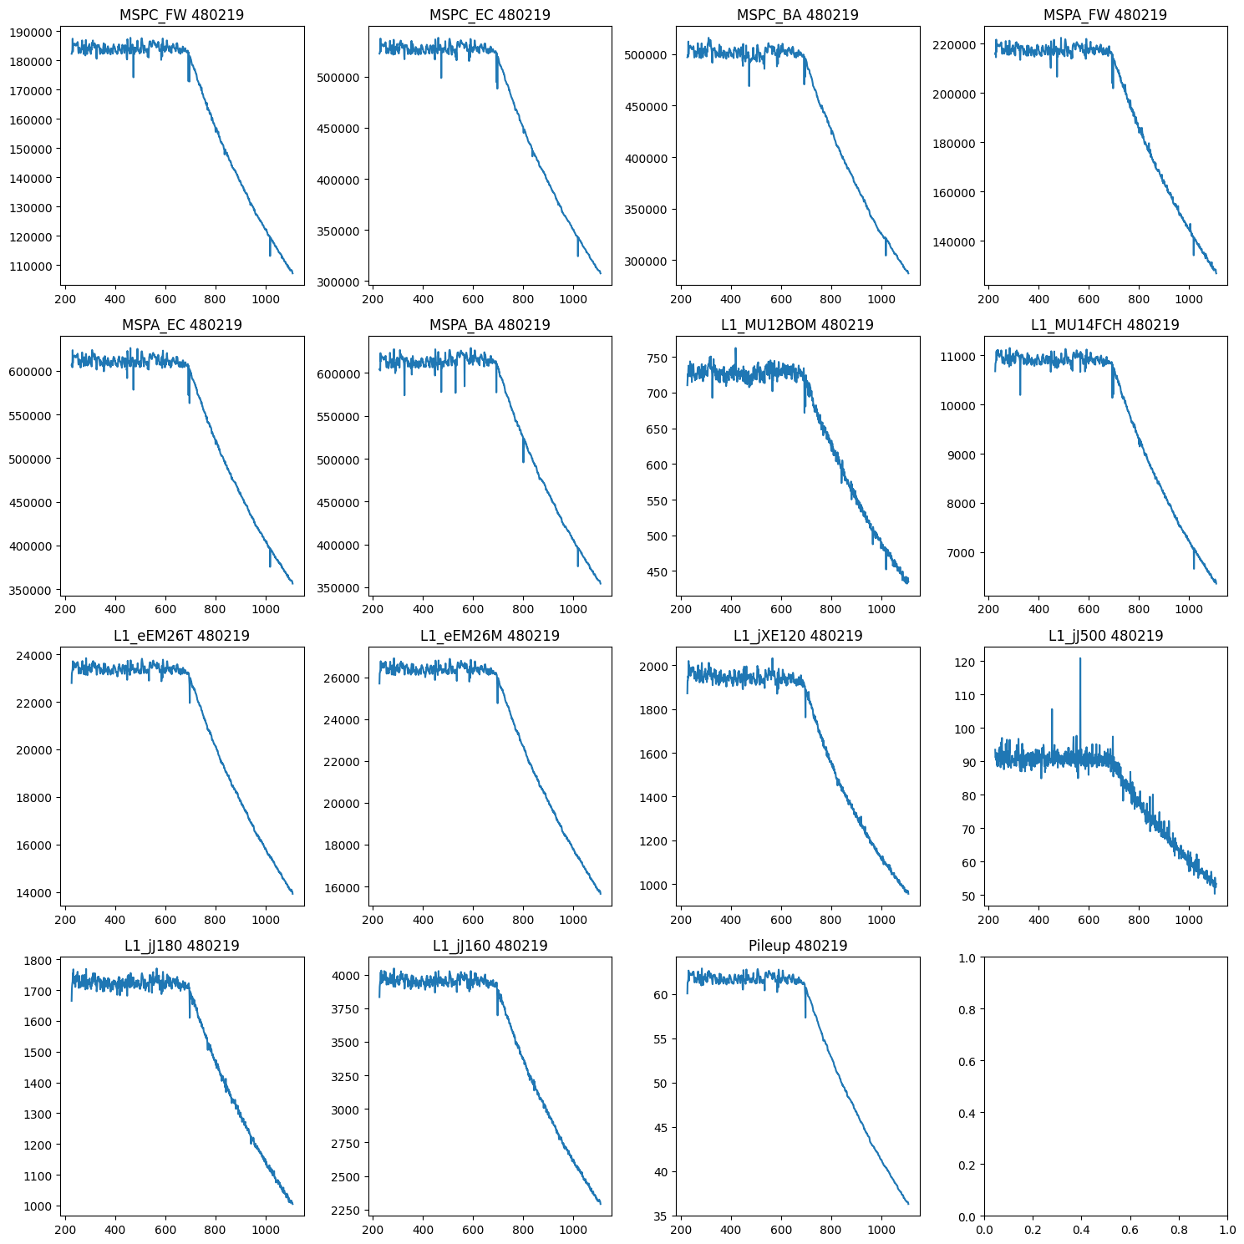
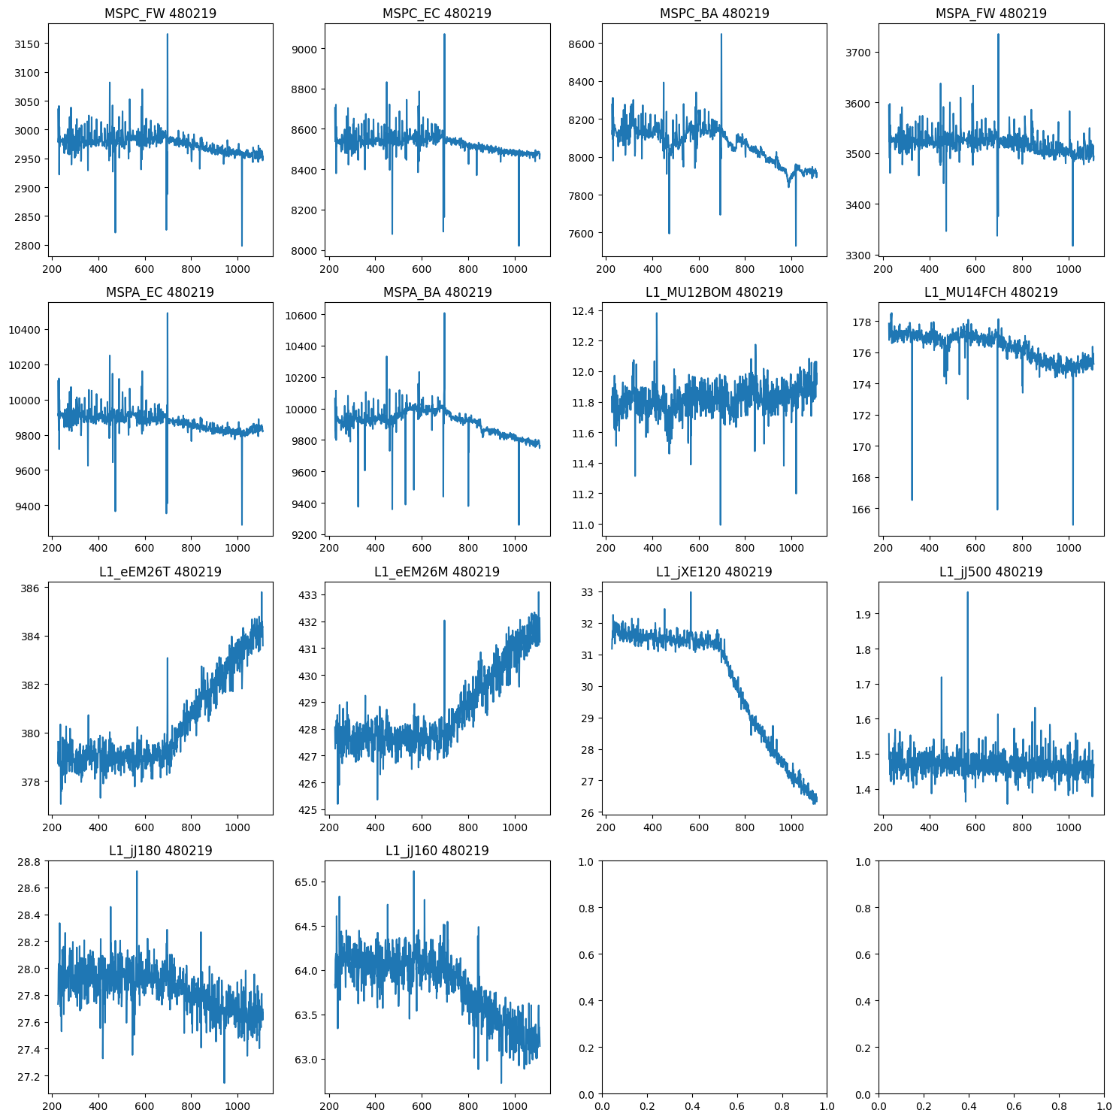
Data
Features (normalized by pileup):
L1 trigger rates: frequency with which detect electrons, muons, missing transverse energy, jets
Multiple L1 rates for each corresponding to different energy levels
L1 muon sector logic inputs: muon rate by section of detector
Pileup: average number of interactions per bunch crossing. Constant for ~1/2 run, then decays
Normalizing by pileup
Input
Time series data of 5 samples
Each sample includes values for each of 14 features
Robust scaling
Output
Prediction of 14 features for next sample (one luminosity block/one minute in future)

Slide 4
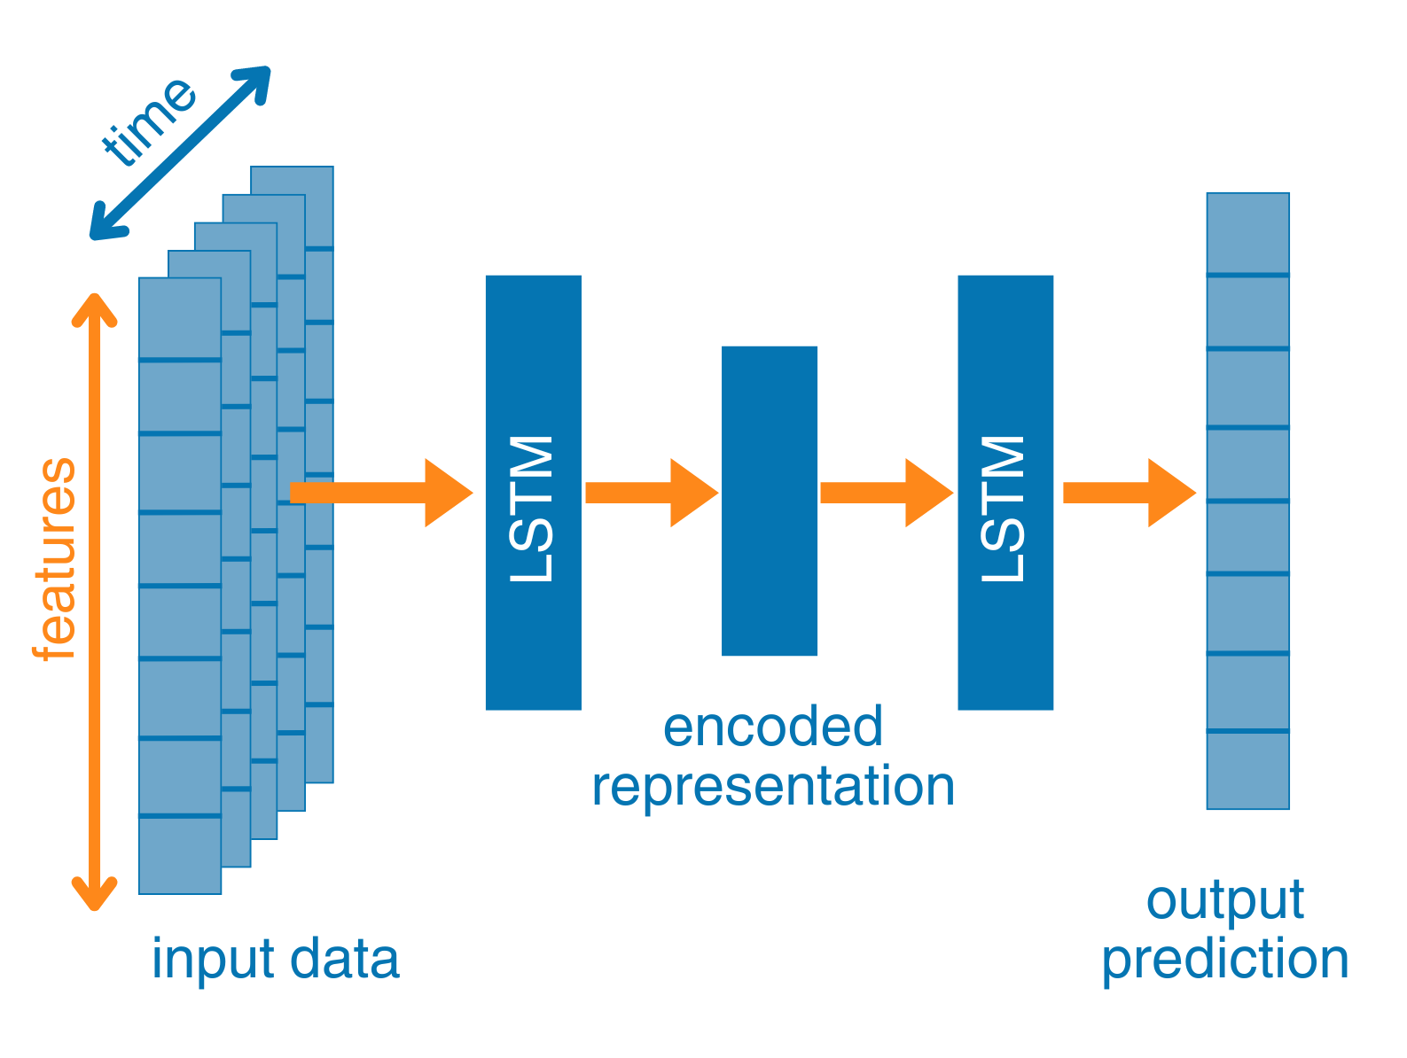
Model architecture
Model trained on clean data so low mean squared error (MSE) with clean values, high MSE with anomalies
Set threshold MSE between clean and anomalous classifications
Long short-term memory (LSTM) layers incorporate time-series element of data
Autoencoder shape forces model to learn lower dimensional representation of data
Will be especially important as step up number of features
Small network with only four layers

Slide 5
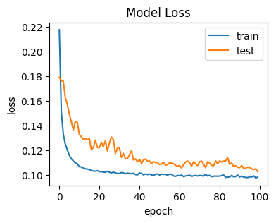
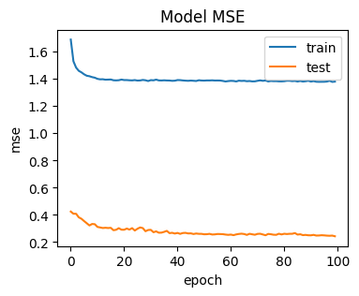
Model performance – loss, MSE
Training data: 10 full runs (around 8000 datapoints)
Test data: single full run (around 900 datapoints)
Huber loss
Quadratic for small errors, linear for larger
Chosen because don’t want outliers in data to influence training as occurs with MSE
Mean squared error
A few outliers cause large separation in train and test

Slide 6
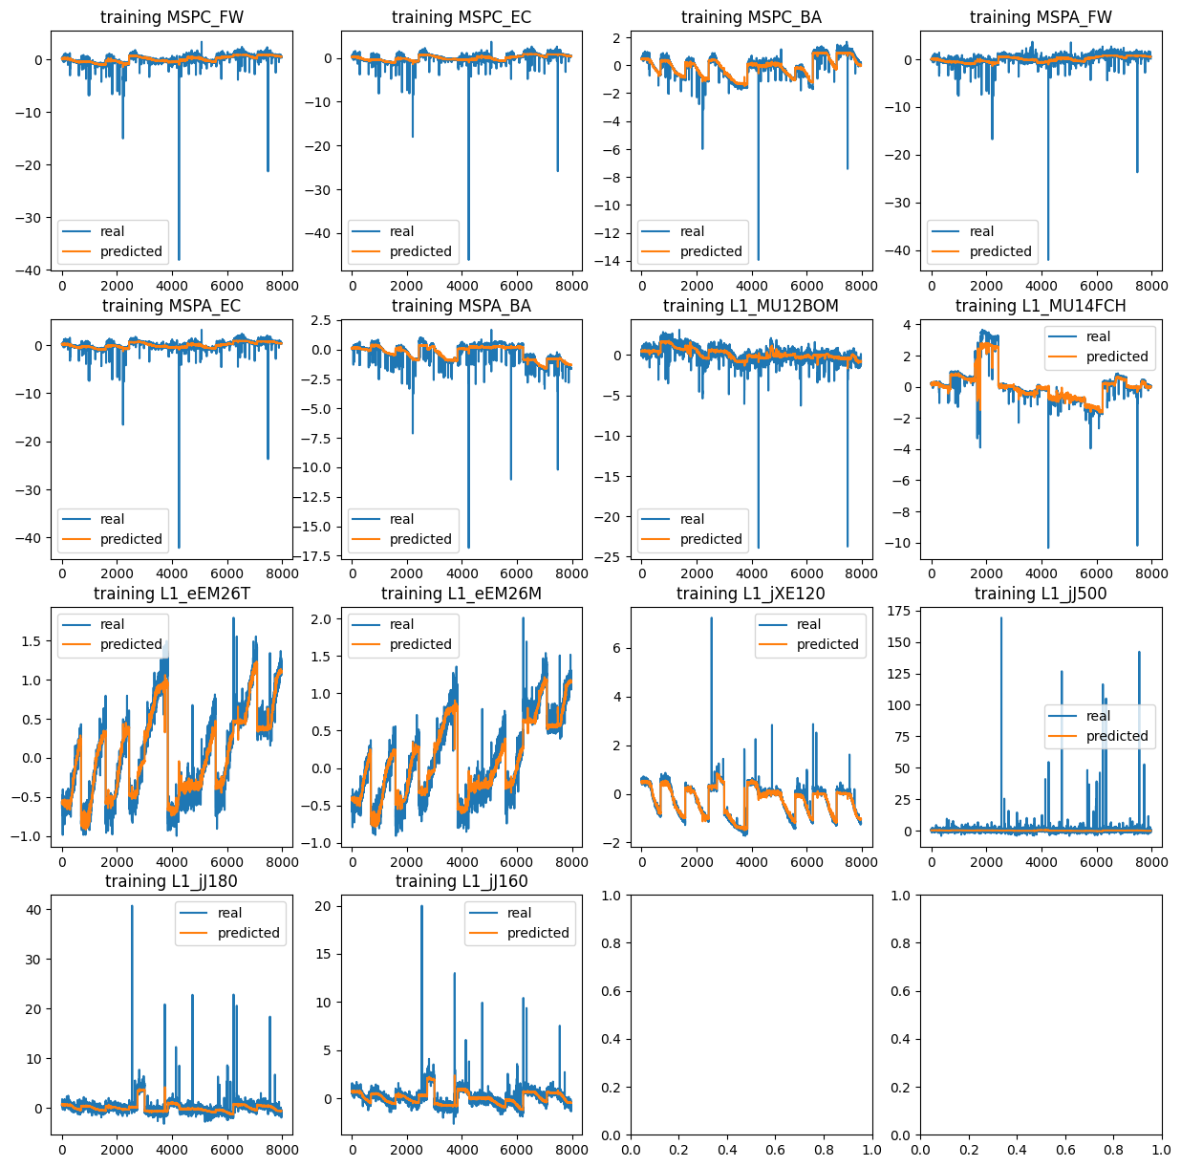
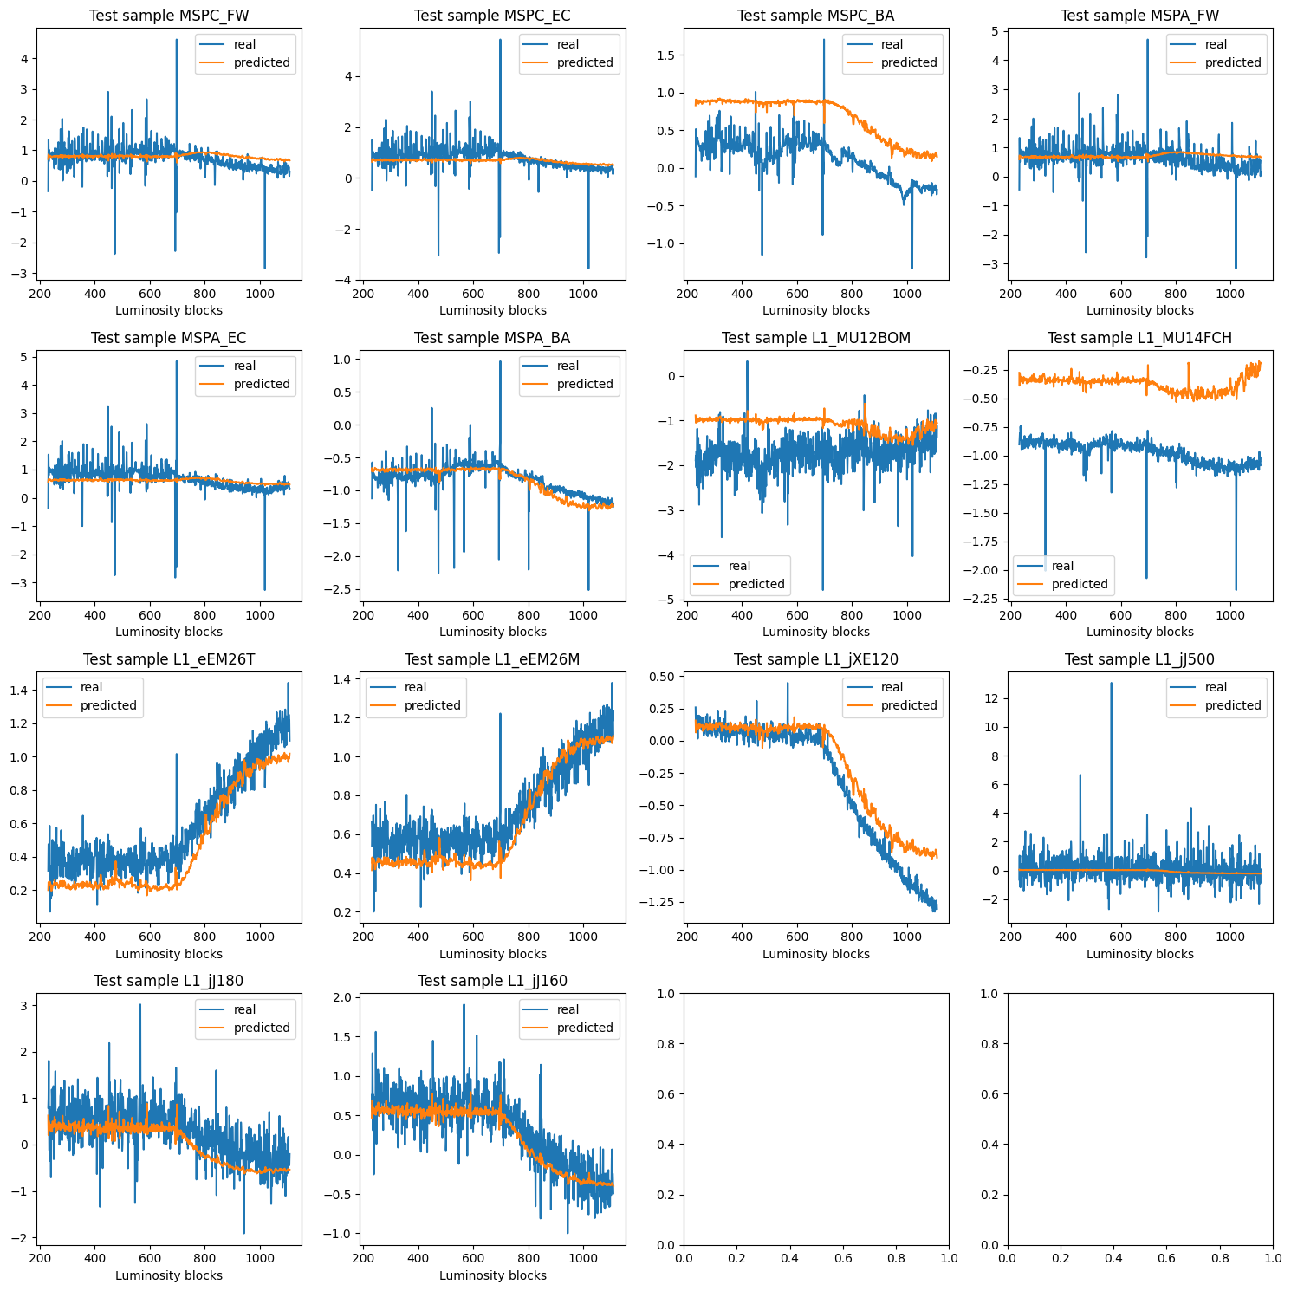
Model performance – training and test predictions
Predictions align well with training data, smooth out variations
Observe offset between prediction and real in certain features, worse performance in tail of run

Slide 7
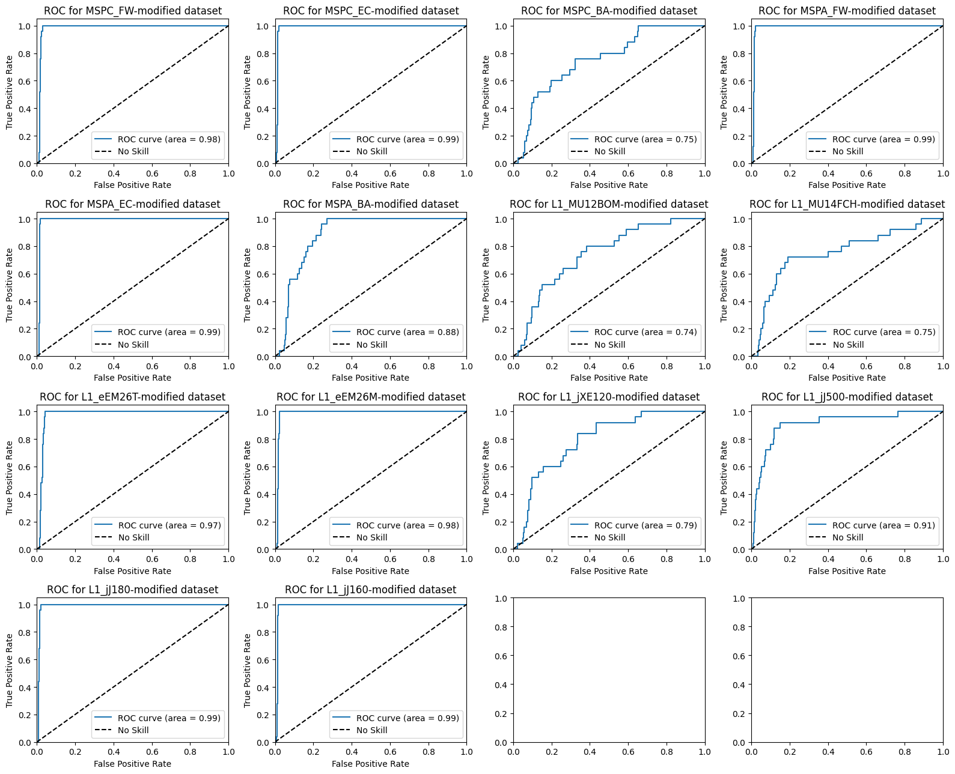
Model performance – artificial 5% anomaly
For single feature in test data set, first 30 LBs increased by 5%
On right, ROC curves show how performance differs based on which feature was modified
AUC varies from 0.74 for L1_MU12BOM-modified dataset to 0.99 for five datasets

Slide 8
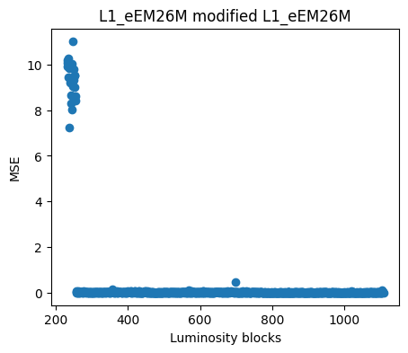
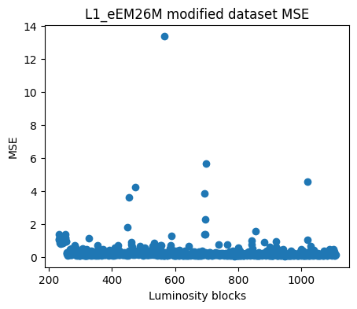
Model performance – artificial 5% anomaly
Looking at MSE for the specific feature that was modified, see clear spike
After averaging over all features still see bump, but not as clearly distinguished

Slide 9
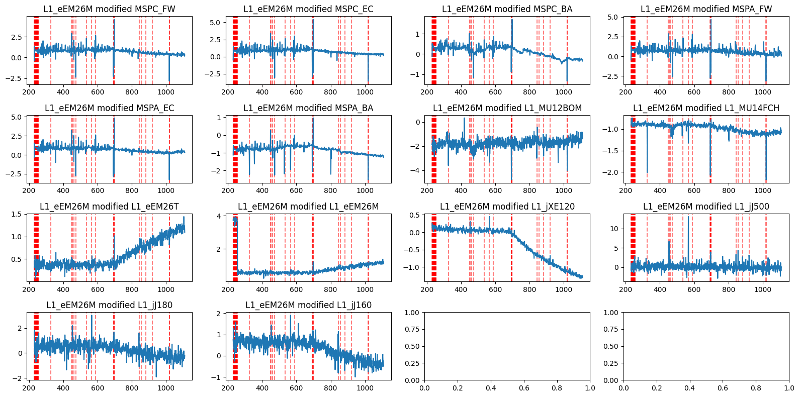
Model performance – artificial 5% anomaly
24/25 = 96% modified LBs correctly detected as anomalies
19/859 = 2.2% clean LBs falsely classified as anomalies
Several of these correspond to real spikes in the dataset

Slide 10
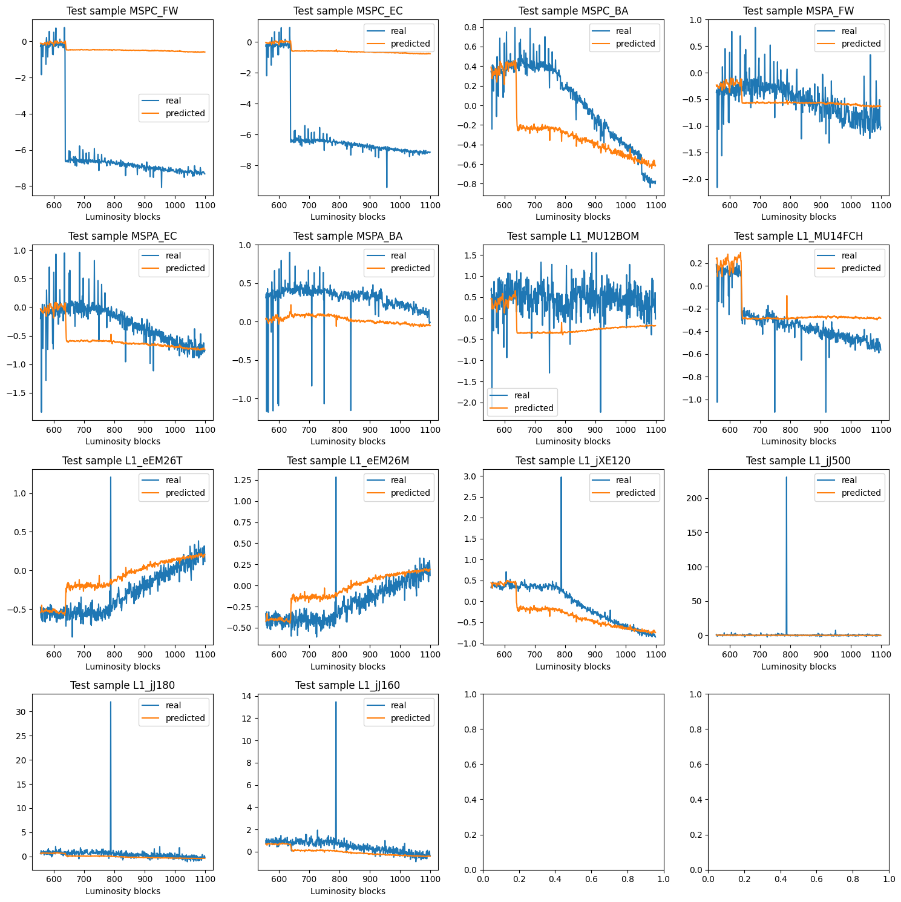
Model performance – muon end cap shutdown
In early June, a sector of the muon end cap was disabled (1/8 of one side of detector). We used this test data to see how our model responded. Clear spike in MSE when disabled corresponding to the large variation between real and predicted values.

Slide 11
Next Steps
Recently implemented
Threshold on number of features detected as anomalous to flag overall anomaly
Upcoming
Separate models for constant pileup and decaying pileup or separate models for different classes of features
Optimizing for better performance in low pileup region
Scaling up for more extensive feature set
Continuous learning
Structure for online usage
Acknowledgements:
Thank you to my supervisors Mario Campanelli and Antoine Marzin for their guidance over the summer. I’d also like to acknowledge the University of Michigan REU program for their support.

Slide 12
BACKUP SLIDES

Slide 13
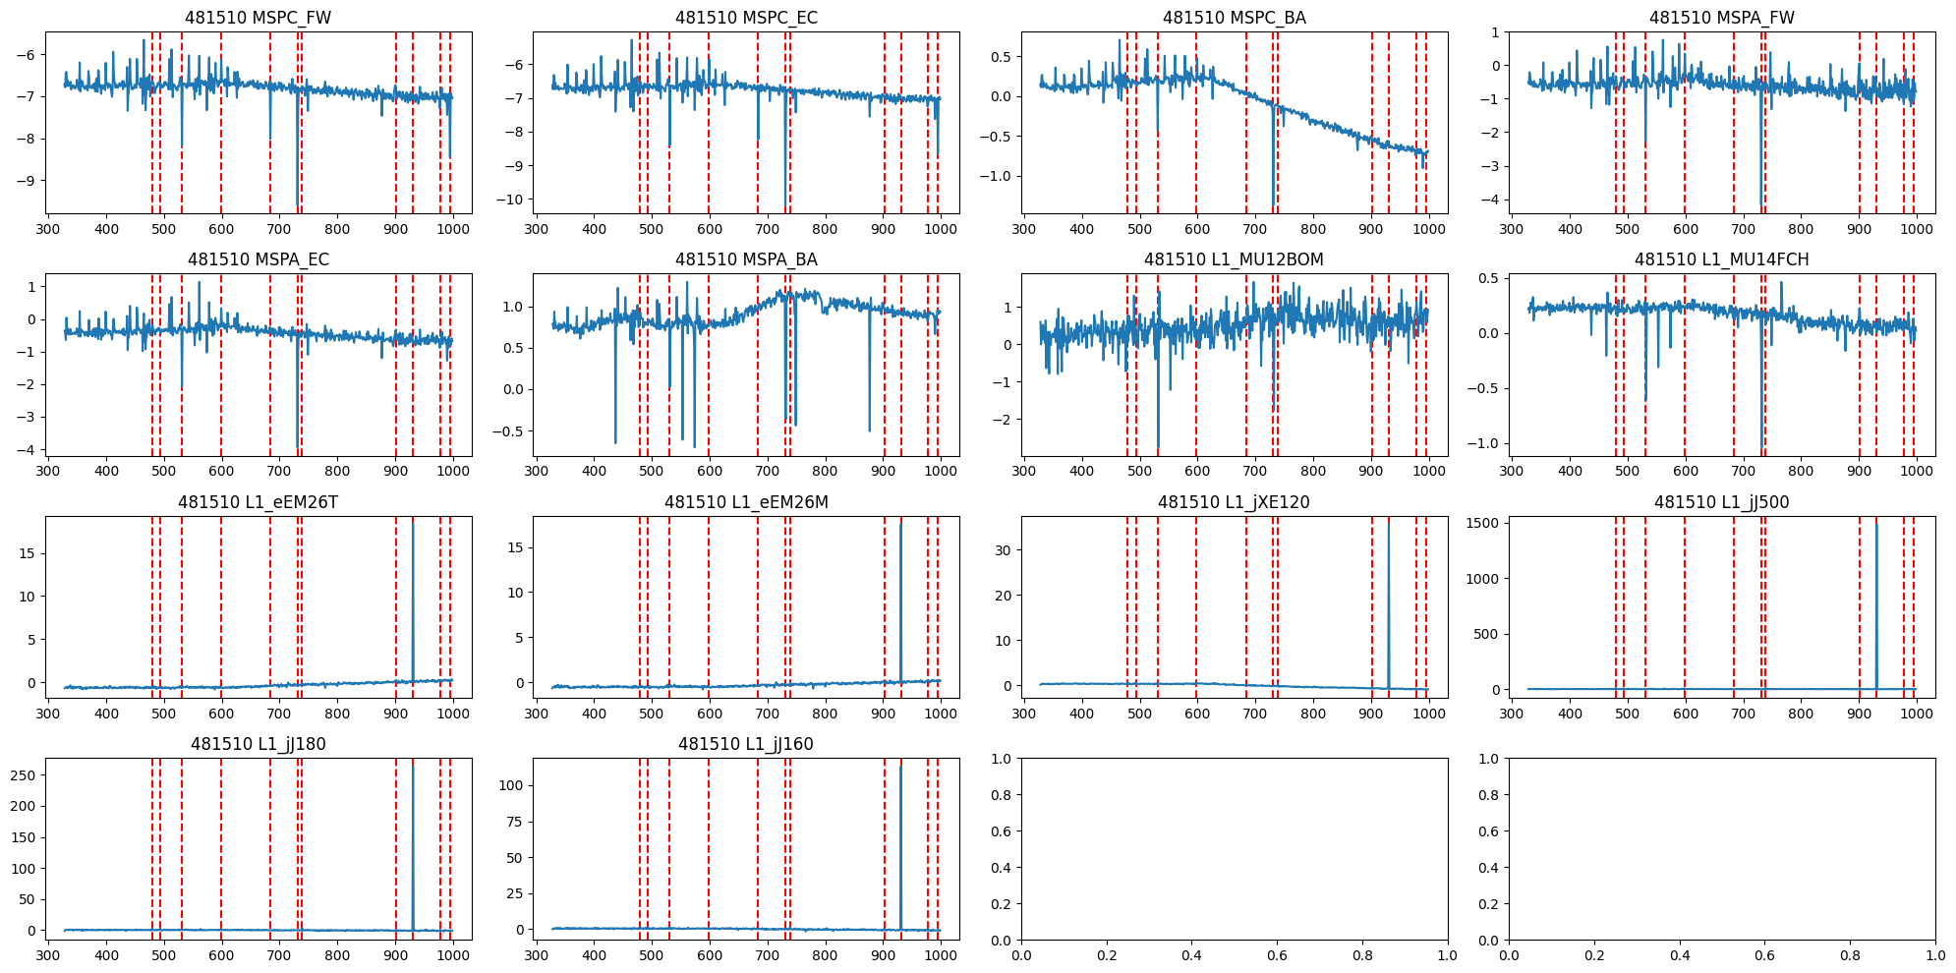
Model performance – anomalies in unmodified runs
Using a run from the end of the summer as test data, we check what our model identifies as anomalies
With threshold = 8, model flags 11 anomalies in run 481510

