Slide 1
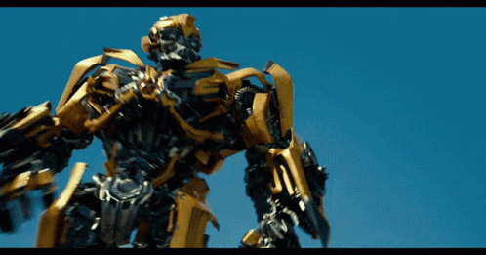

Bumblebee: Foundation Model for Particle Physics Discovery
AJ Wildridge, Jack Rodgers, Ethan Colbert,
Yao Yao, Mia Liu, Andy Jung
2024 US LUA Annual meeting
arXiv:2412.07867v1

Slide 2



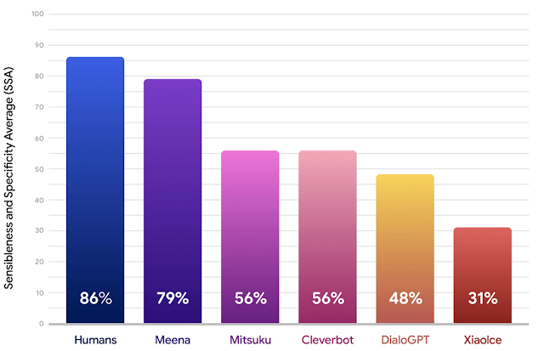
What are Foundational Models?
Foundational models learn representations of their inputs that can be used in many downstream tasks
Popularized in natural language processing (NLP)
Enables state of the art performance where supervised techniques struggle
arXiv:2001.09977

Slide 3
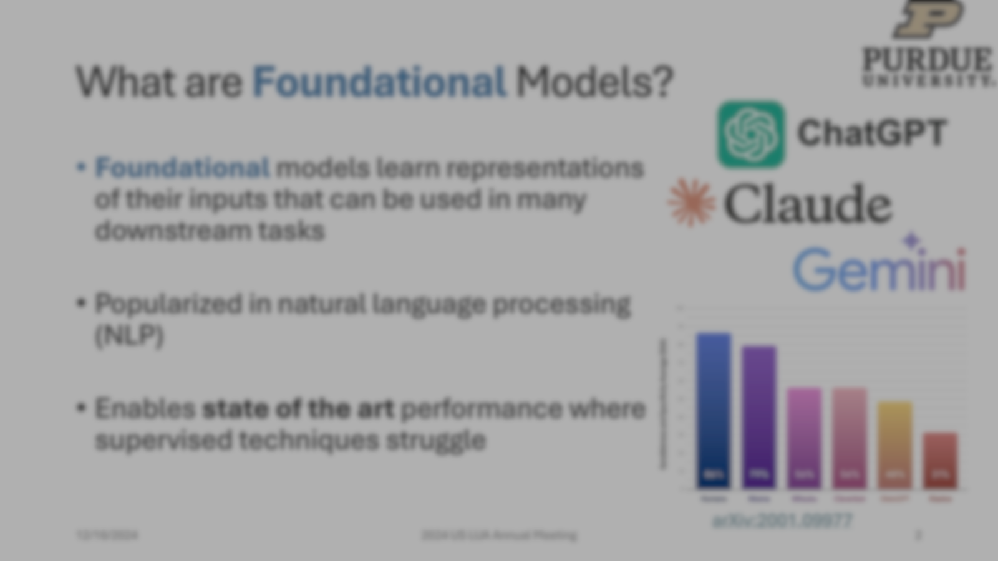
Can we create a foundation model to discover new phyiscs?

Slide 4
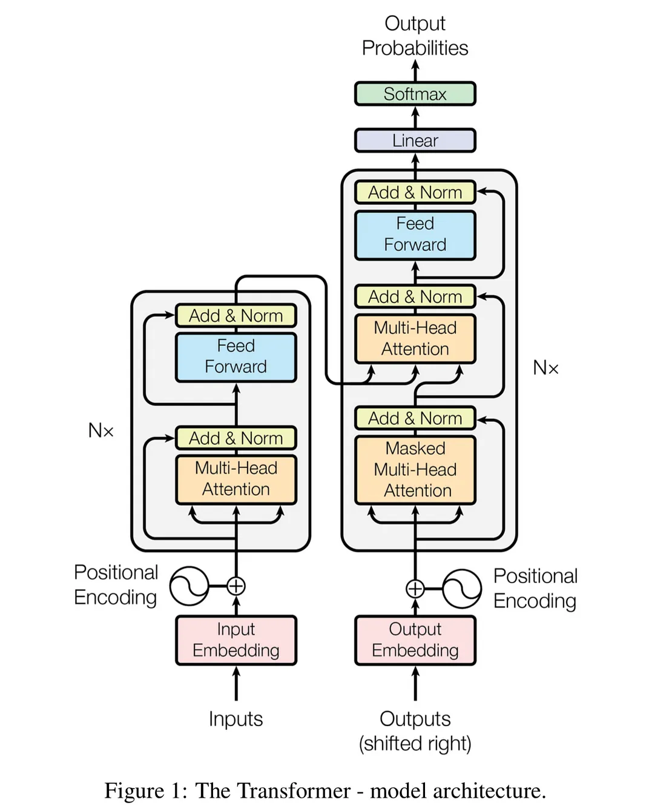
Bumblebee
arXiv:1810.04805
Same spirit as BERT
Particle physics is permutation invariant →remove positional encodings
Particle vector learned input embeddings in Bumblebee
8 encoder layers, 768-dimensional hidden state, 16 self-attention heads
→ 57M parameters

Slide 5
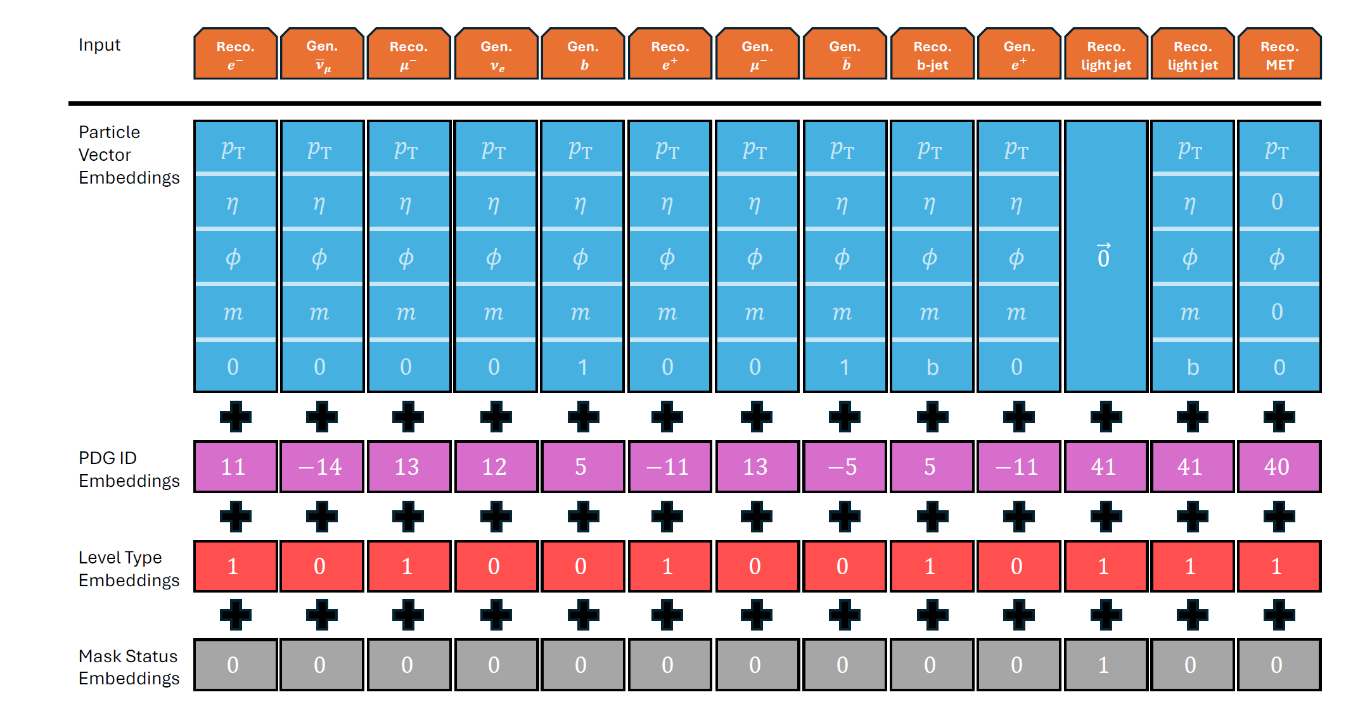
Bumblebee – Pre-training
Input Embedding
Masked pre-training task
  50% of the time randomly mask a particle
  25% (25%) of the time mask all reco (gen) particles
Backpropagate on MSE loss on masked particles

Slide 6
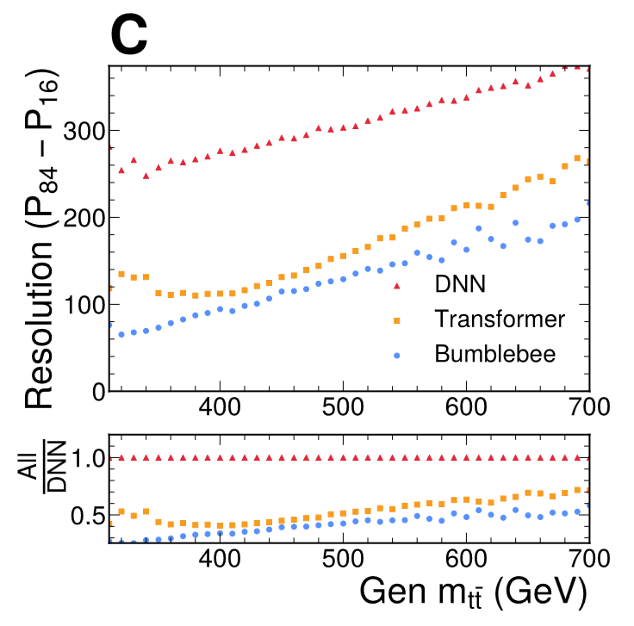
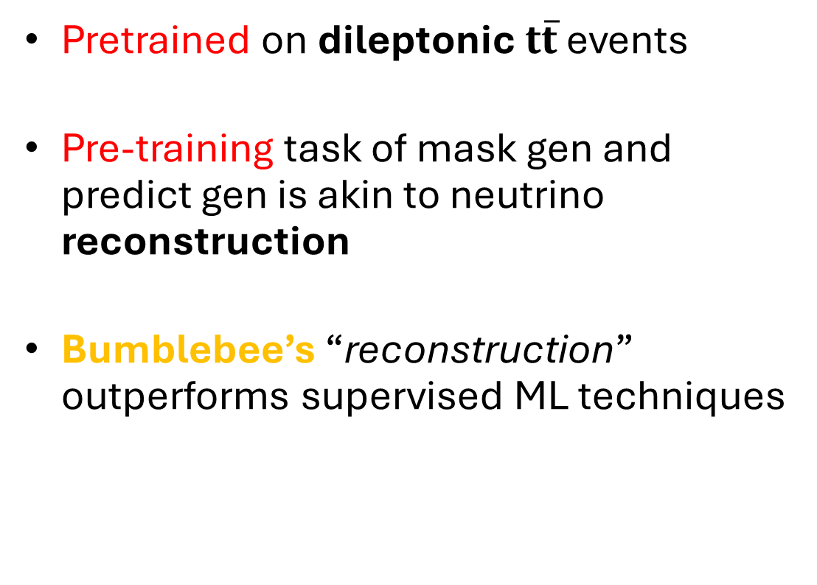
Bumblebee – Pre-training Results
Pretrained on dileptonic $t\overline{t}$ events
Pre-training task of mask gen and
predict gen is akin to neutrino
reconstruction
Bumblebee’s “reconstruction”
outperforms supervised ML techniques

Slide 7
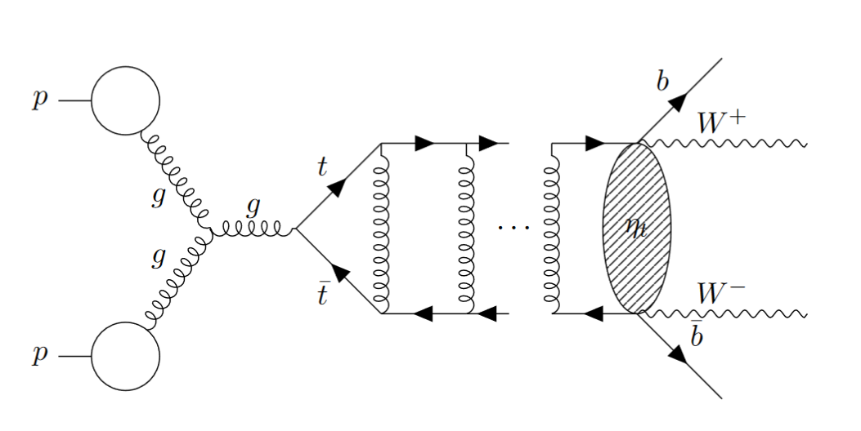
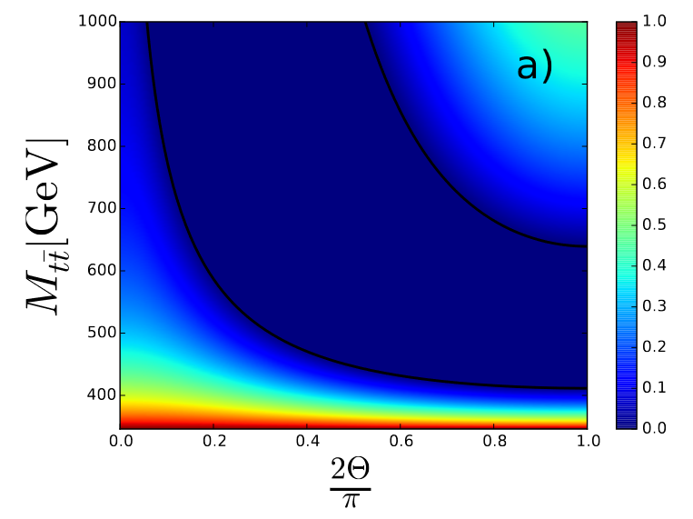
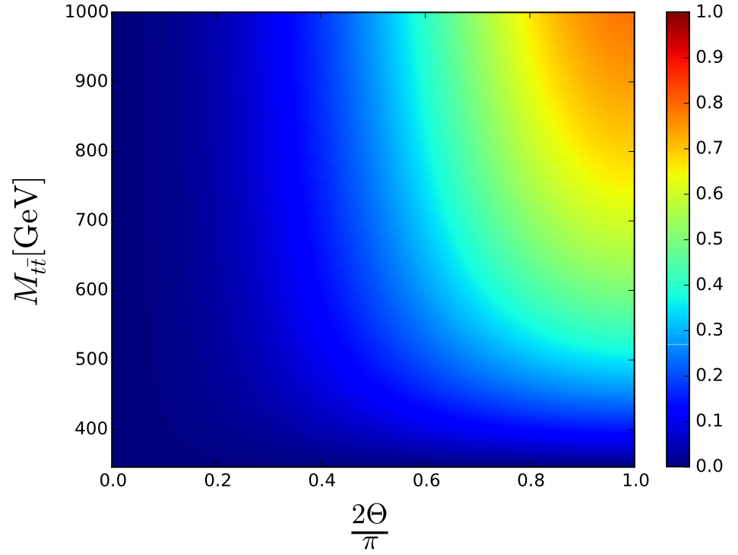



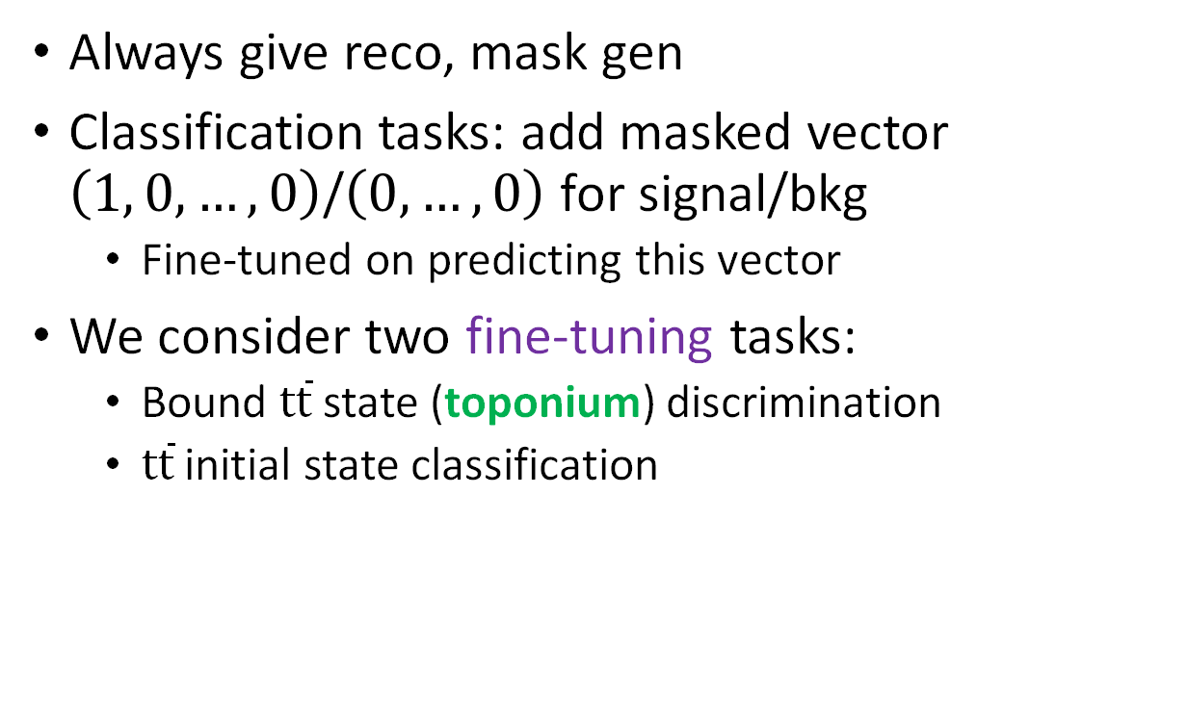
Bumblebee – Fine-tuning
Always give reco, mask gen
Classification tasks: add masked vector $\left(1, 0, …, 0\right)$/$\left(0, …,0\right)$ for signal/bkg
  Fine-tuned on predicting this vector
We consider two fine-tuning tasks:
  Bound $t\overline{t}$ state (toponium) discrimination
  $t\overline{t}$ initial state classification
Toponium
[Eur. Phys. J. Plus 136, 907]
$$gg$$
$$q\overline{q}$$
$$q\overline{q}$$

Slide 8
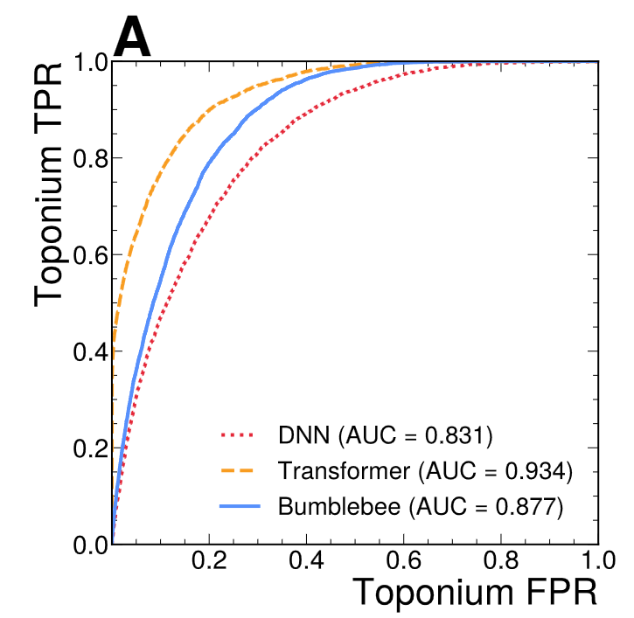
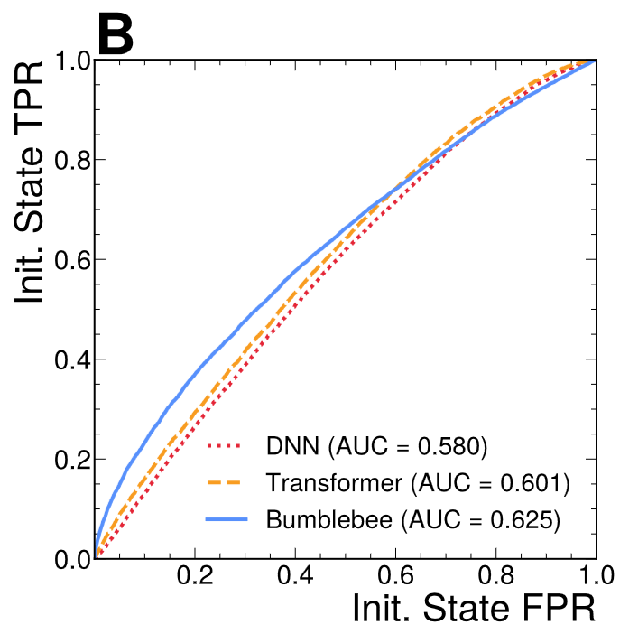

Bumblebee – Downstream task performance
Bumblebee improves state-of-the-art on a difficult task
Use toy model of ground state of toponium, $η_{t}$
MLP 0.831 vs Bumblebee 0.877 AUC

Slide 9
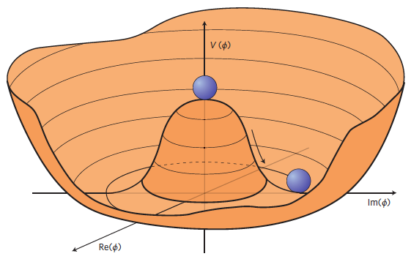
Summary
Bumblebee is a foundational model and when
fine-tuned on 2 downstream tasks competitive w/
supervised methods
Plenty of exciting use cases for Bumblebee
  Easily extend to other event topologies
Pre-training objective alone very useful

Slide 10

Thanks!
awildrid@purdue.edu

Slide 11
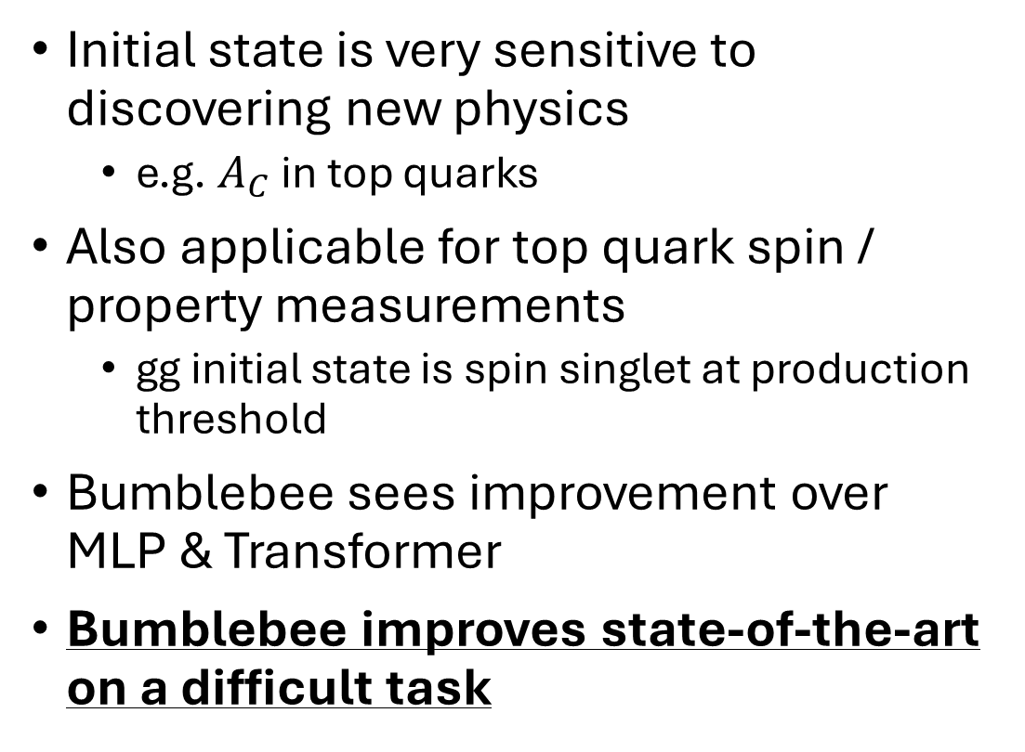

Bumblebee – $t\overline{t}$ Initial State Classification
Initial state is very sensitive to discovering new physics
  e.g. $A_{C}$ in top quarks
Also applicable for top quark spin / property measurements
  gg initial state is spin singlet at production threshold
Bumblebee sees improvement over MLP & Transformer
Bumblebee improves state-of-the-art on a difficult task
Phys. Lett. B 707, 92 (2012)
[Eur. Phys. J. Plus 136, 907]

Slide 12
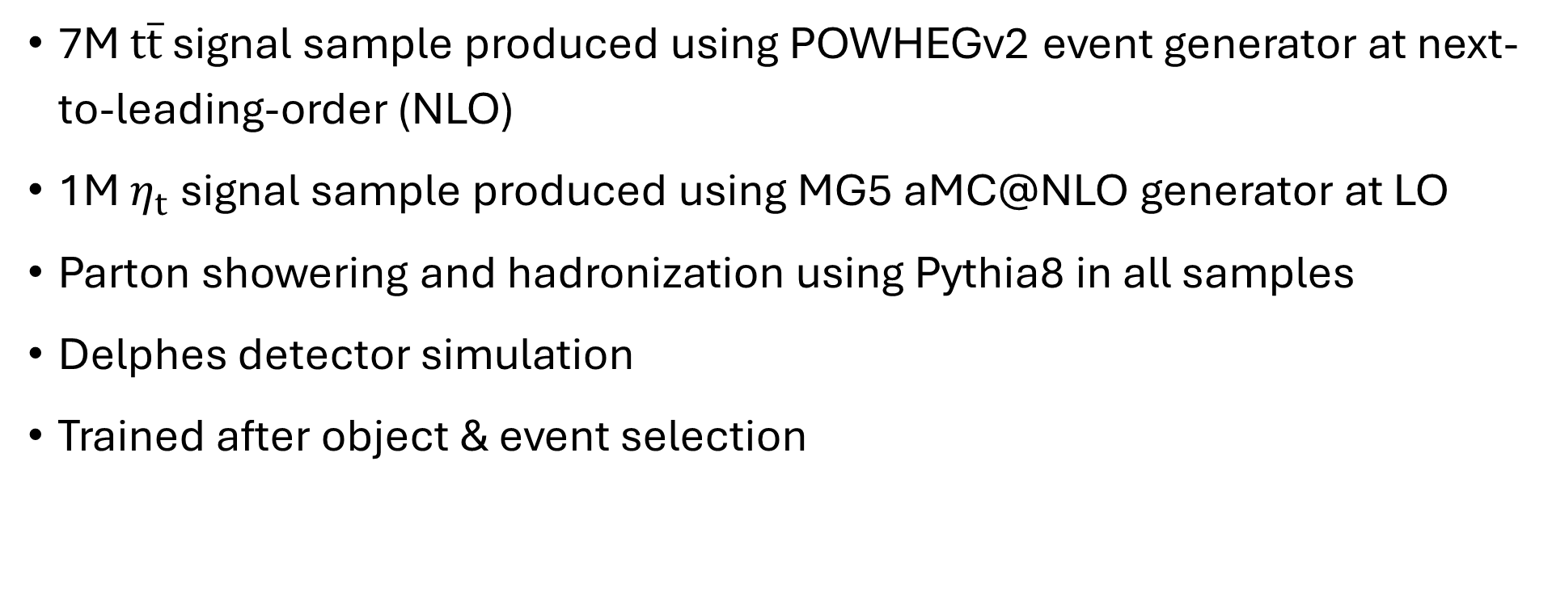
Bumblebee - Datasets
7M $t\overline{t}$ signal sample produced using POWHEGv2 event generator at next-to-leading-order (NLO)
1M $η_{t}$ signal sample produced using MG5 aMC@NLO generator at LO
Parton showering and hadronization using Pythia8 in all samples
Delphes detector simulation
Trained after object & event selection

Slide 13
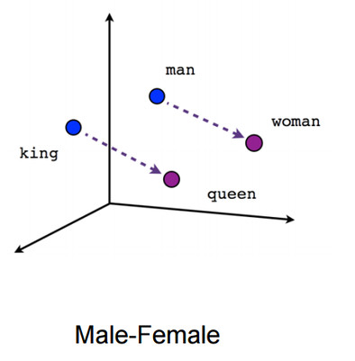
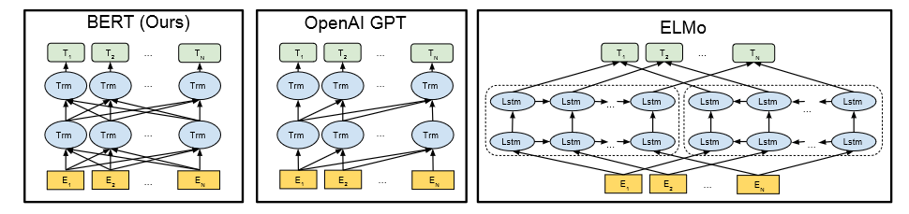
Foundational Models
word2vec & GloVe created “thought vectors”
  e.g. (king - man) + woman = queen
  Powerful learned embeddings for other tasks
BERT, GPT and ELMo moved to DNNs / Transformers for this task

Slide 14
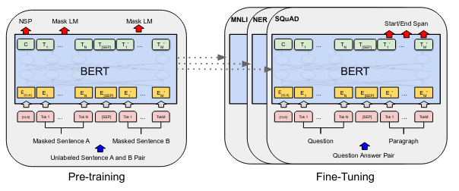
Bidirectional Encoder Representations from Transformers (BERT)
arXiv:1810.04805
Used only the encoder portion of transformer
Two tasks: pre-training and fine-tuning
Pre-trained model learns a vector embedded representation that can be
used for downstream tasks

