Slide 1
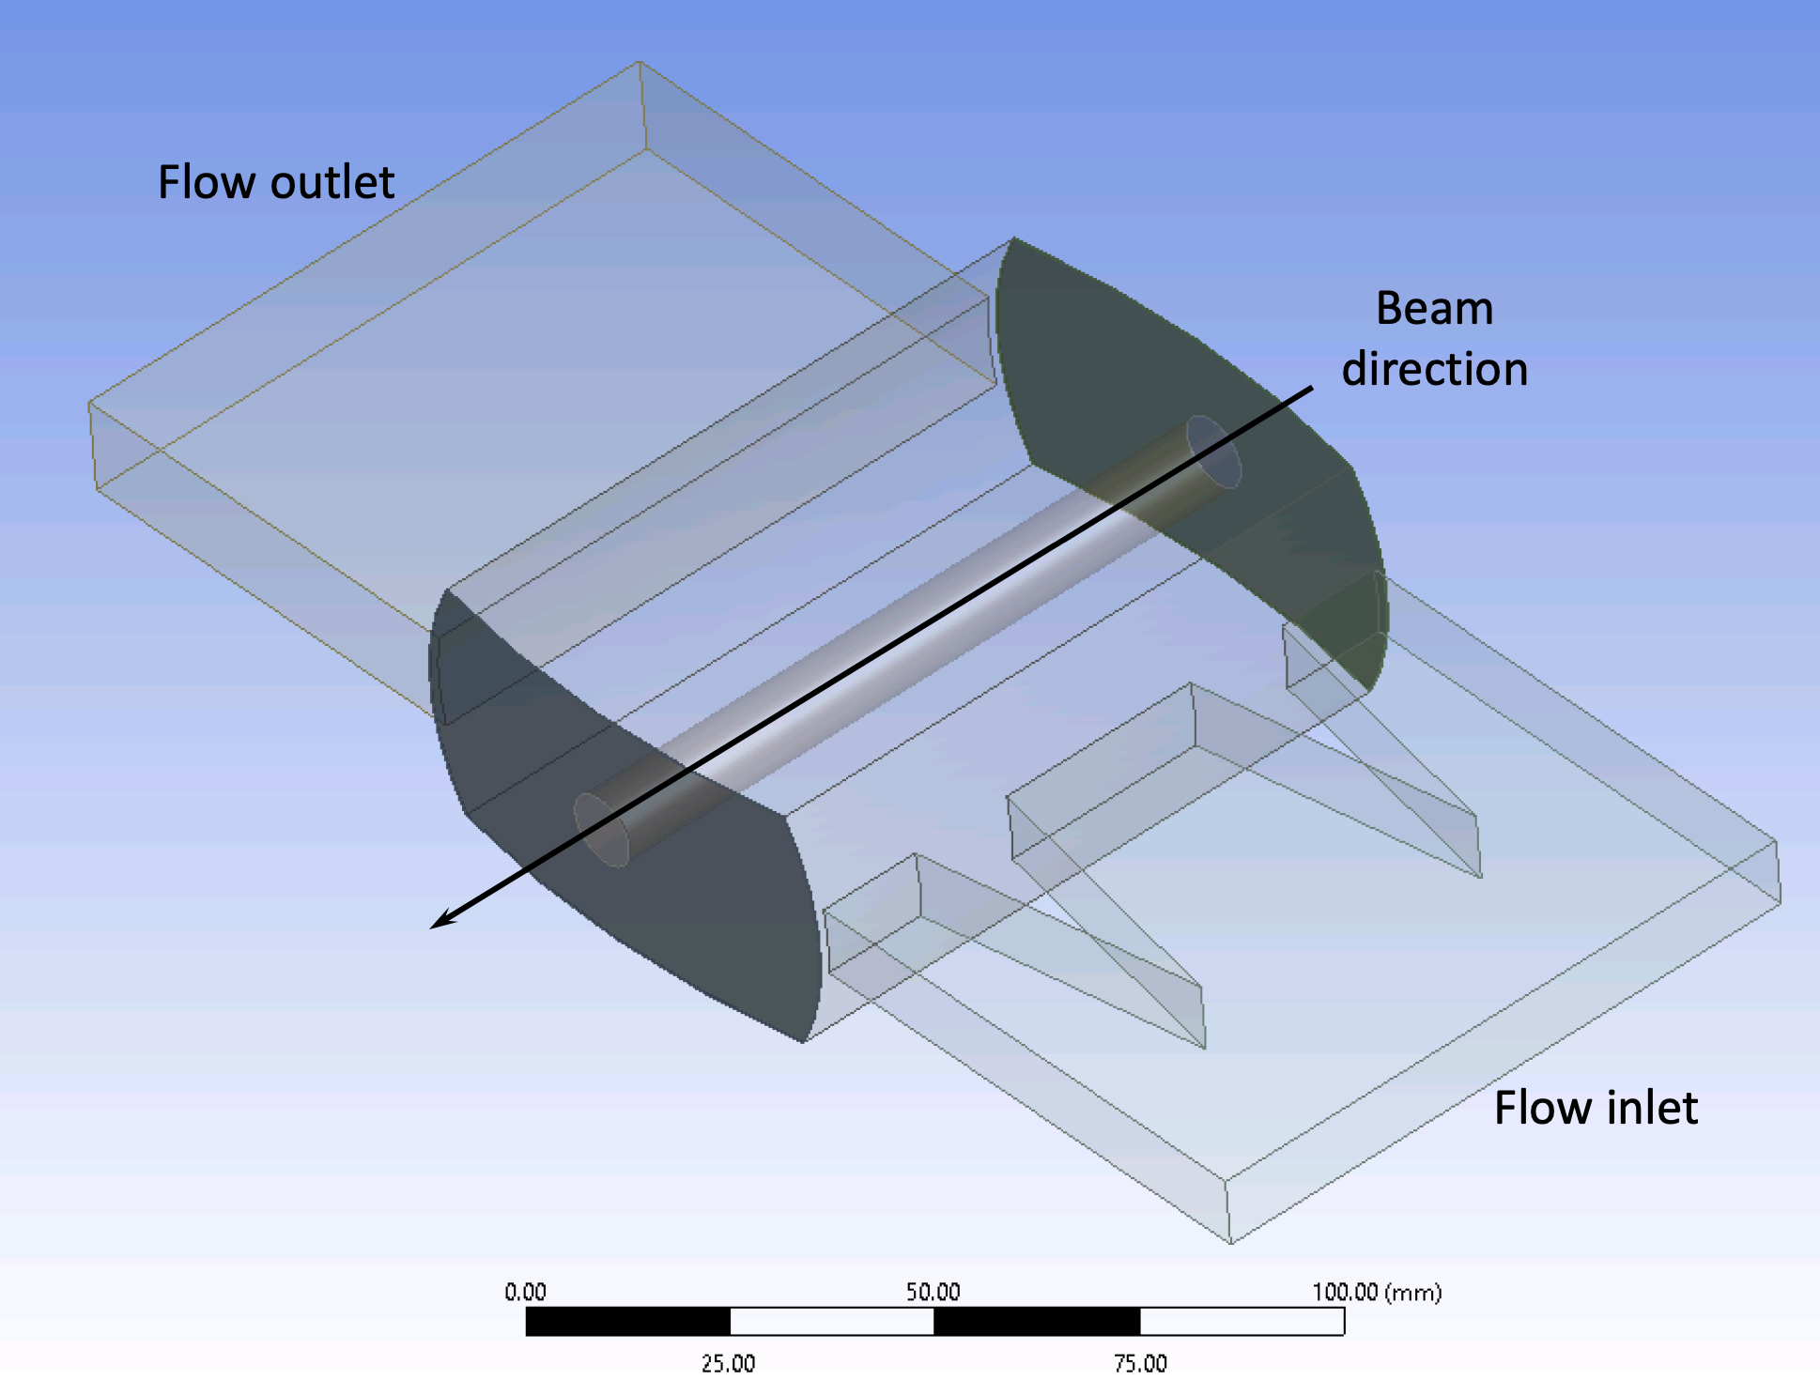
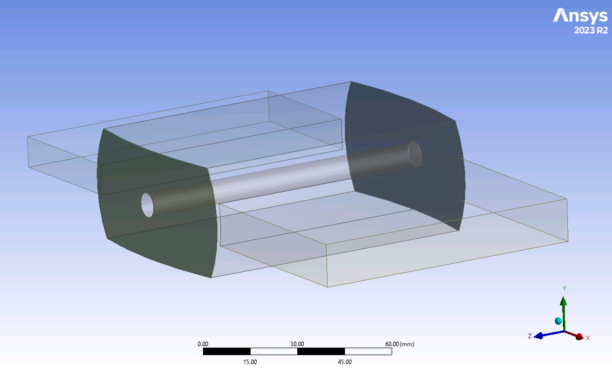
LXe Target Concept
Cell 3
SLAC-RIKEN group: LXe positron target concept for future Linear Colliders
  10 cm long for 3, 6 and 10 GeV e- beams
Over the past year with the DOE-HEP grant:
  developed a cell geometry at and simulated it with CFD
  After 3 geometry iterations found a model that might satisfy the ILC requirements
CFD simulation parameters:
  2-phase flow considered, LXe at cell inlet at 170 K, 35 psia, 2.5 m/s (saturates at 181.8 K and freezes at 160.4 K), properties corrected for T-dependence
  Time-dependent simulations: beam is ON for 1 ms then OFF for 199 ms, and so on, beam frequency 5 Hz
Over the next two years the cell model could be refined to increase the power into LXe, mitigate boiling at the windows, try the ILC beam time structure, mitigate potential shock waves between beam pulses
Cell 1
Flow inlet
Beam direction
Flow outlet

Slide 2
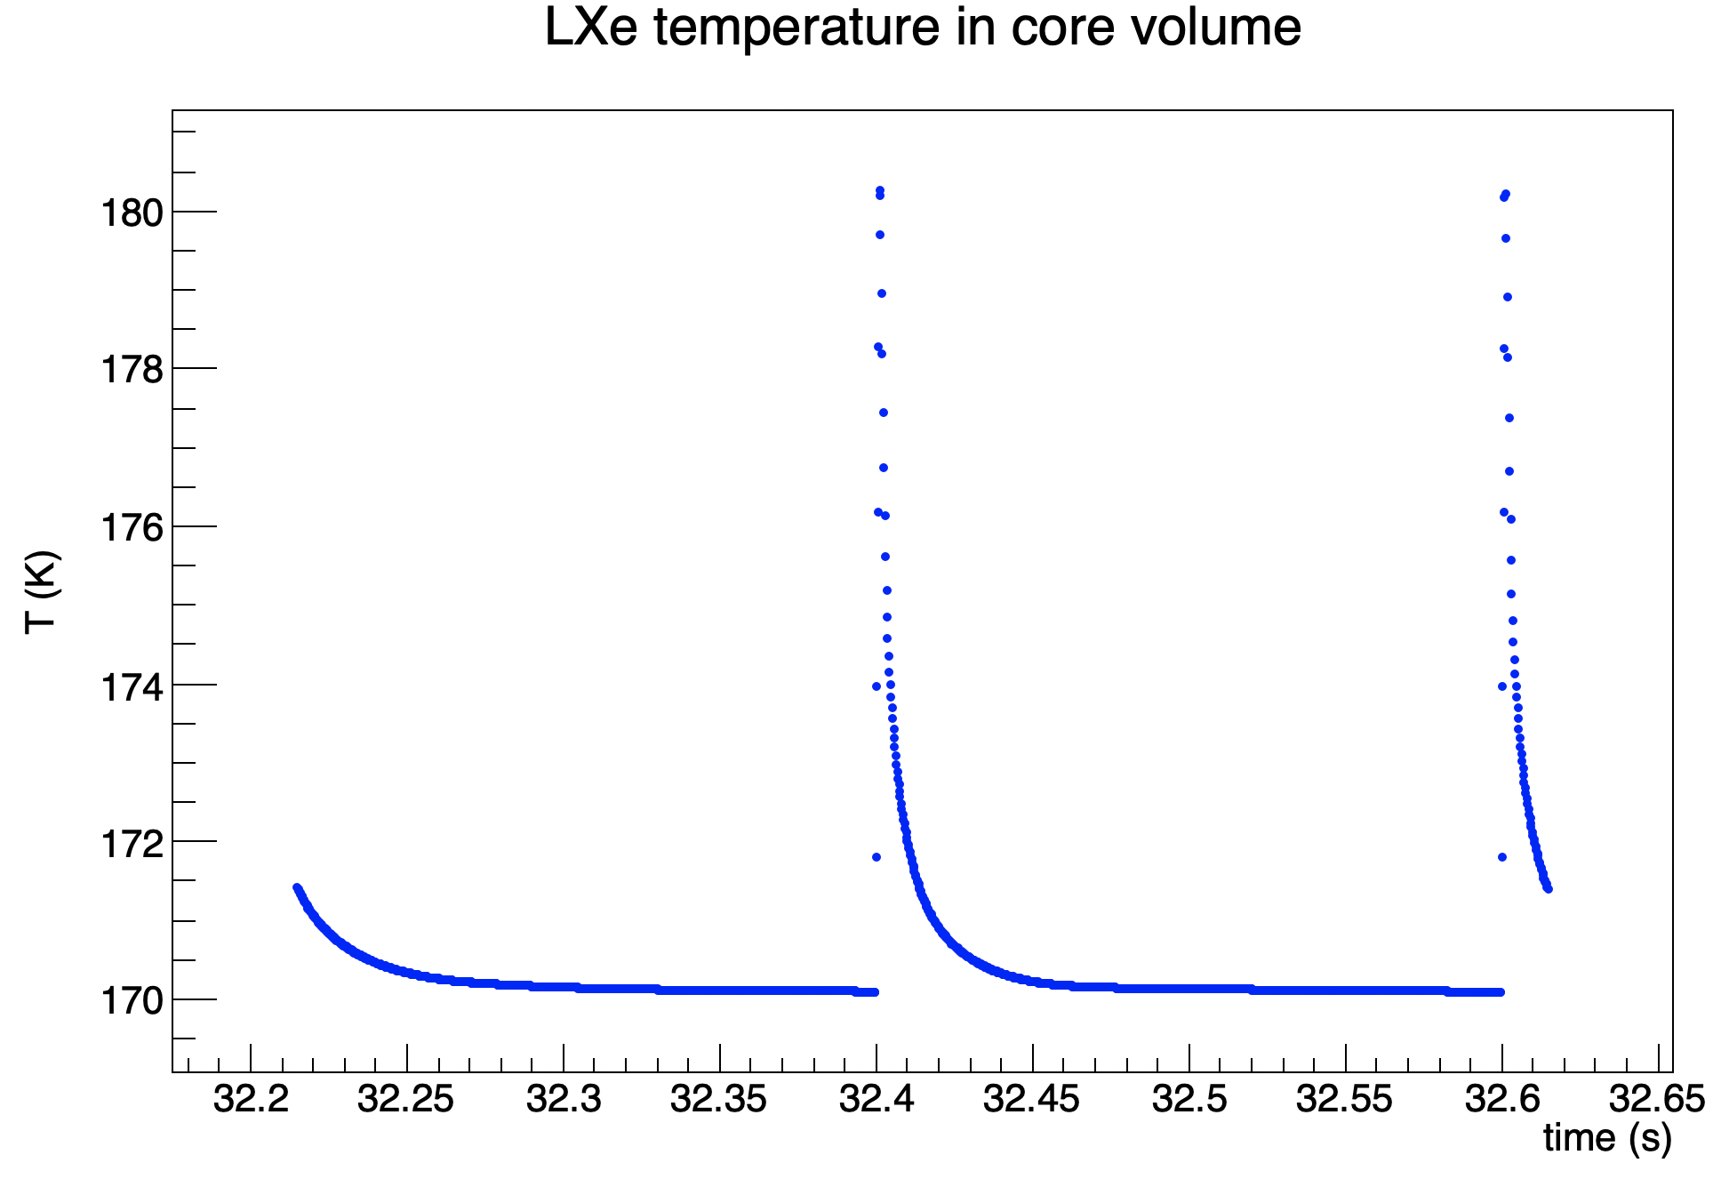
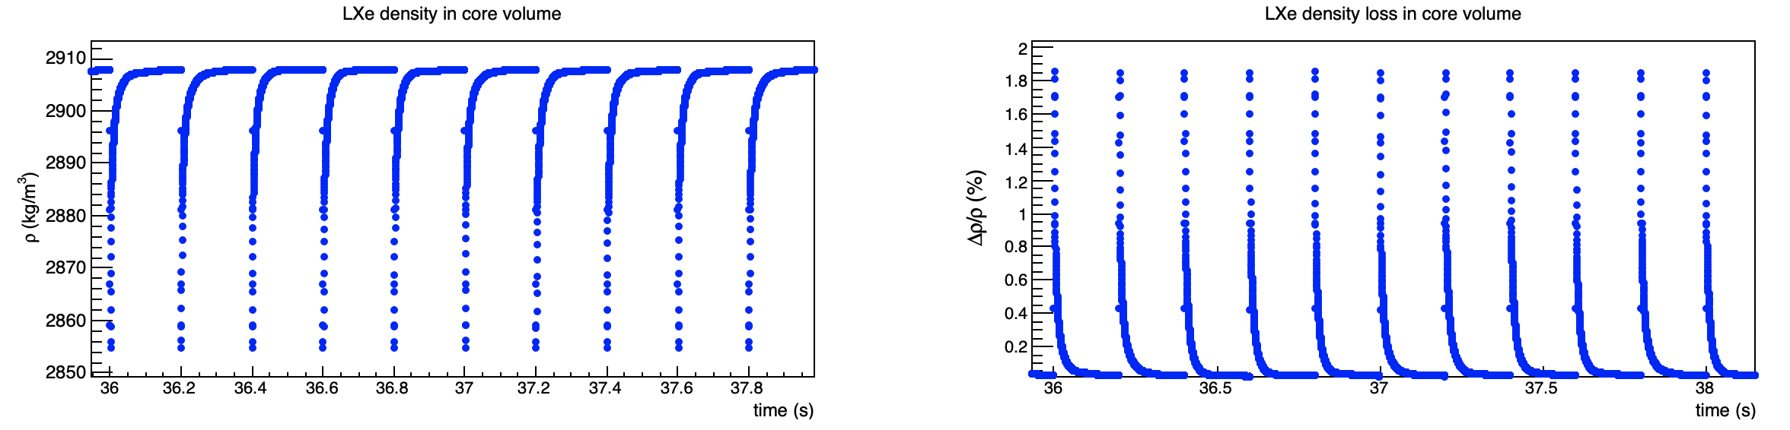
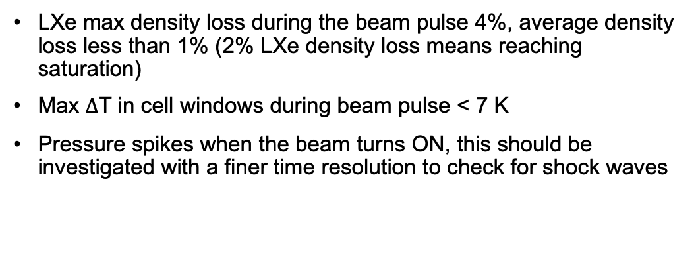
LXe Target CFD Results
LXe max density loss during the beam pulse 4%, average density loss less than 1% (2% LXe density loss means reaching saturation)
Max $∆$T in cell windows during beam pulse < 7 K
Pressure spikes when the beam turns ON, this should be investigated with a finer time resolution to check for shock waves

Slide 3
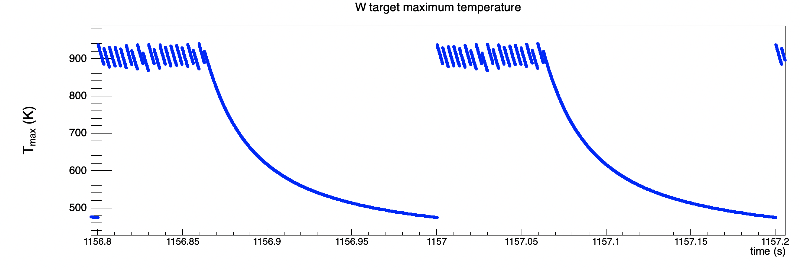
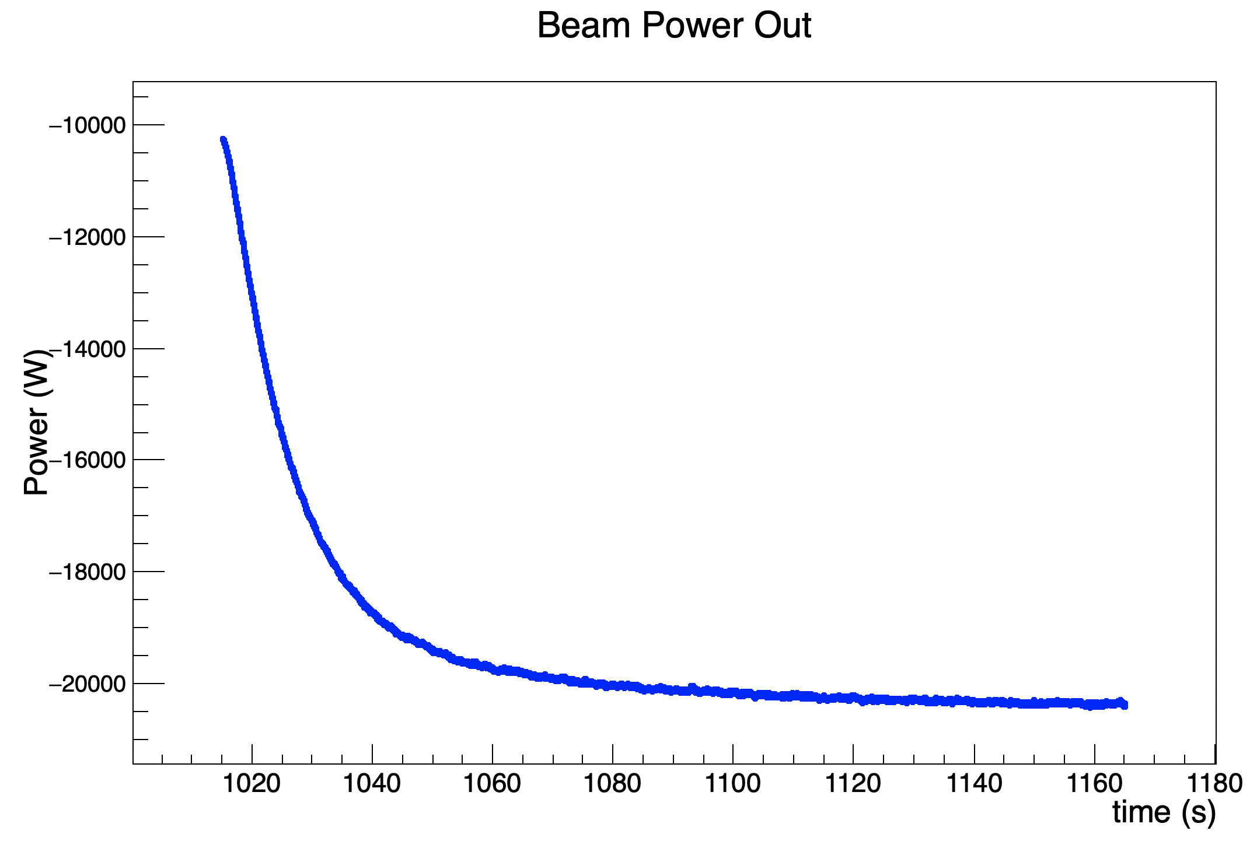
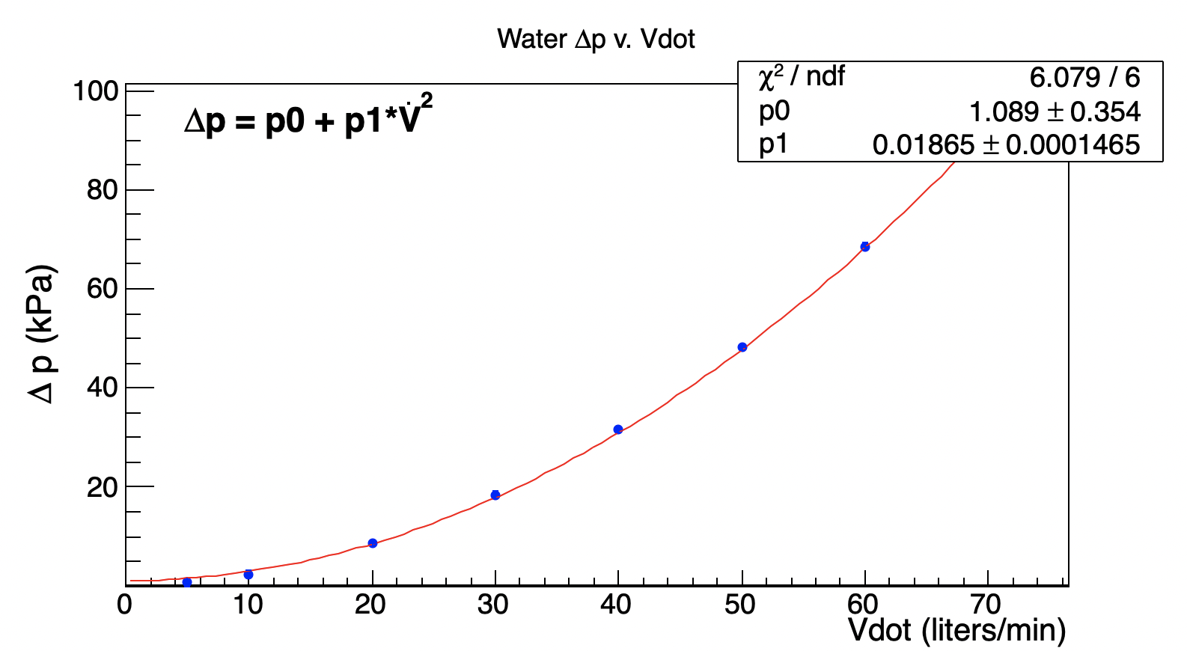
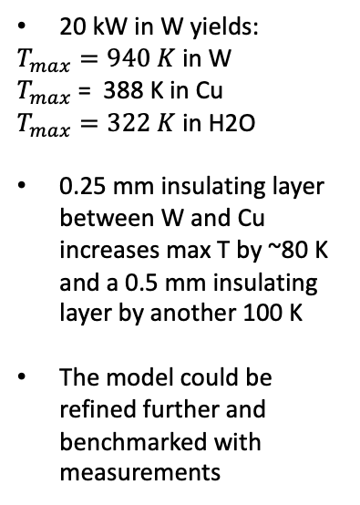
SKEKB Target CFD Predictions with ILC Beam
Maximum temperature evolution with ILC beam structure
Cooling water circuit pressure loss between inlet and outlet v. volume rate
20 kW in W yields:
$T_{max}=940 K$ in W
$T_{max}$ = 388 K in Cu
$T_{max}=322 K$ in H2O
0.25 mm insulating layer between W and Cu increases max T by ~80 K and a 0.5 mm insulating layer by another 100 K
The model could be refined further and benchmarked with measurements
Power out in the water circuit

