Slide 1
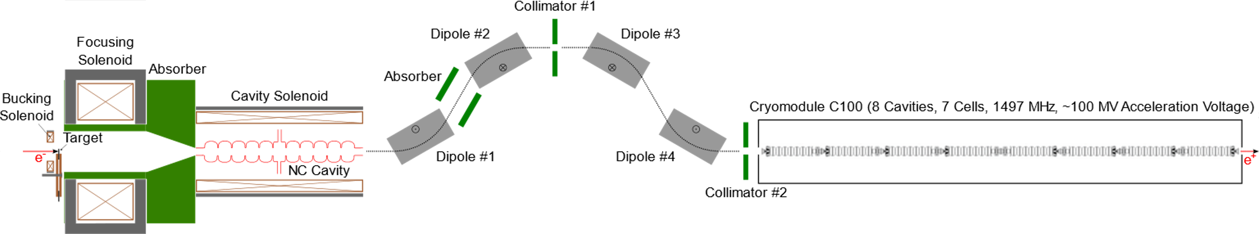
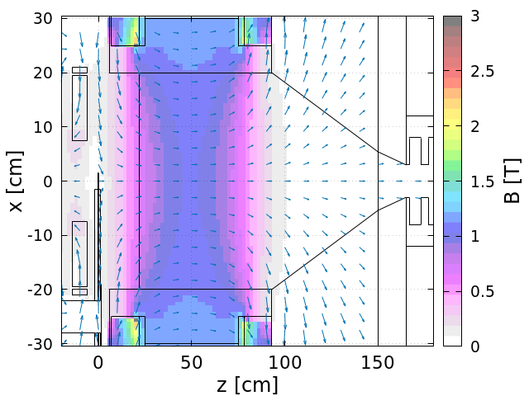
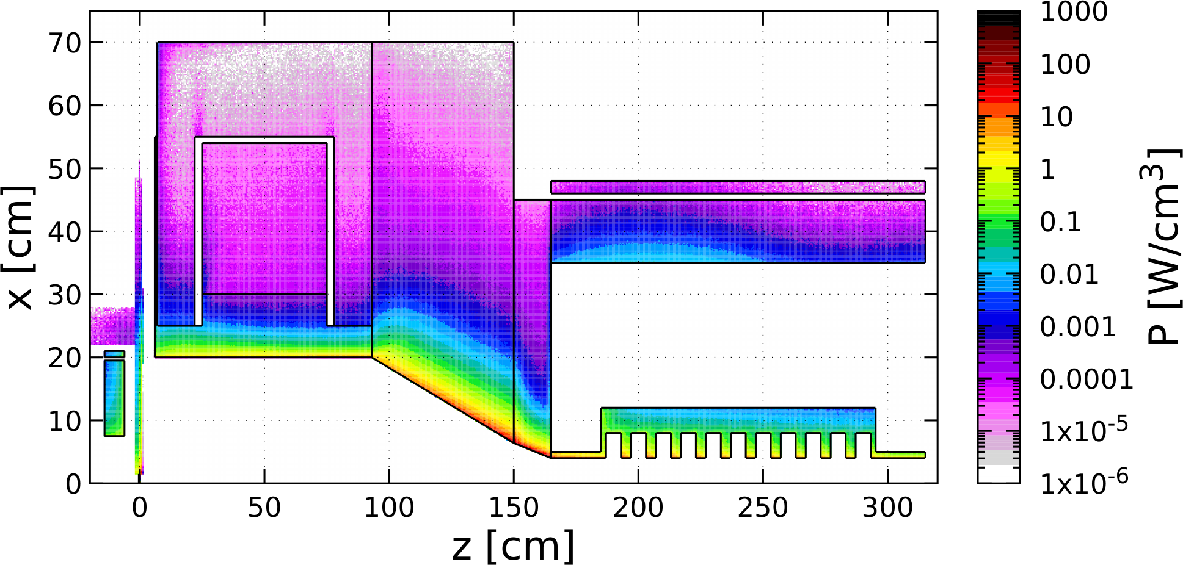
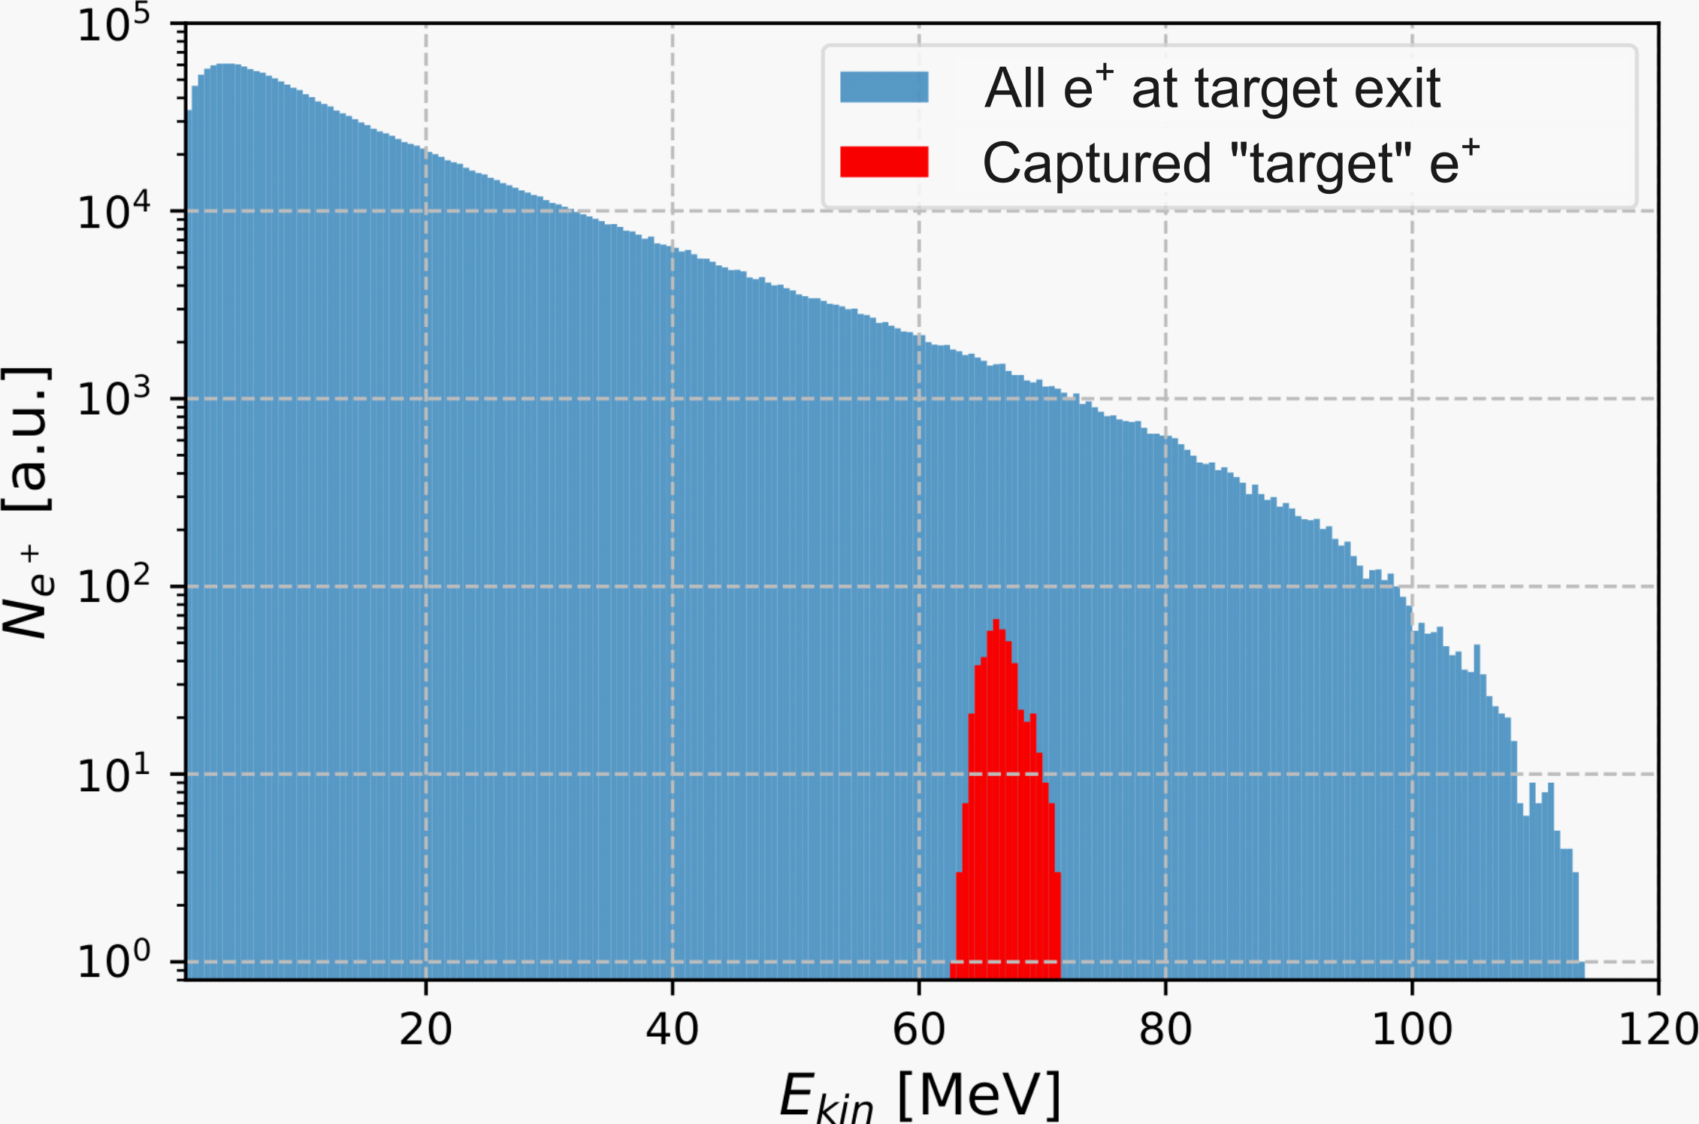
Ce⁺BAF: Simulations of CW Positron Beam Generation, Capture and Acceleration
Simplified Scheme of Positron Generation, Capture, Selection of e⁺ Energy Band and Acceleration to 123 MeV
1 mA
120 MeV
Target and Capture Magnets
Power Deposited by 1 mA e‒ Beam @ 120 MeV
e⁺ Energy Spectrum at Target Exit and Captured e⁺
Bucking
Solenoid
Main Solenoid
Absorbers
Steel
Target
TZM
Cu Coil
Cu Coil
W10Cu
W10Cu
Cavity
Cu Cavity*
Compensation
Solenoid
Target

Slide 2
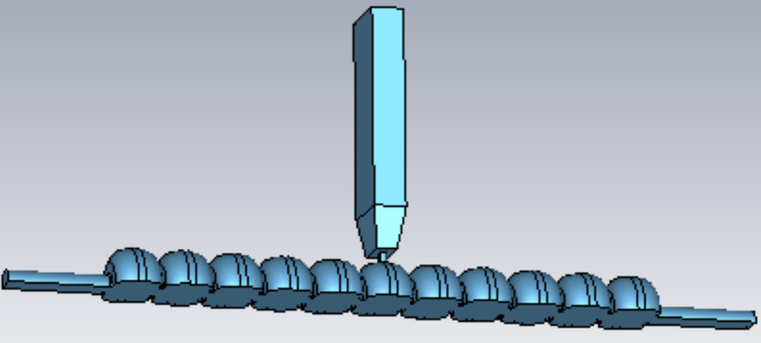
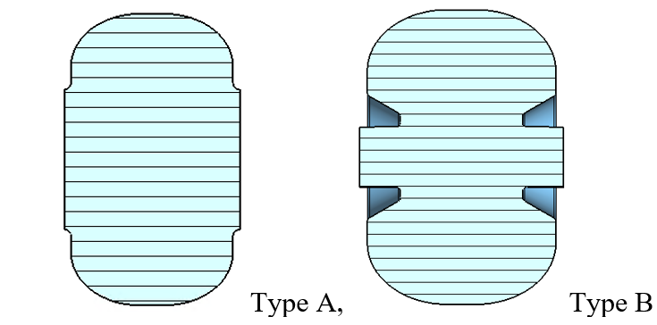
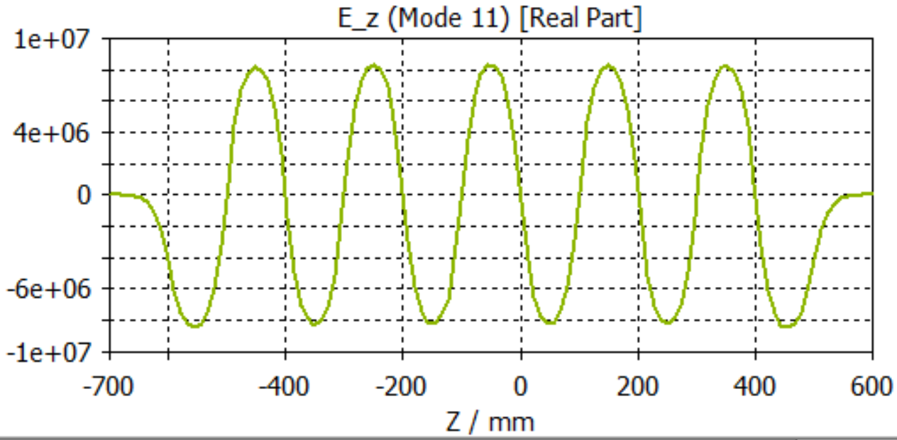
Conceptual Development and Design of CW NC Capture Cavity
Conceptual Development
Improve design of e⁺ injector
Develop pCDR
Capture Cavity Design Strategy
Capture cavity set for CW Ce⁺BAF was obtained for further capture section design
Studied influence of solenoid magnetic field to the e⁺ transportation before entering cavity
Performed initial studies of the action of cavity field on 20, 60 MeV positrons
At the early design stage, the goal is not to produce a single design but to provide a range of options
Address Critical Risk Areas
mA polarized e⁻ source
High power target
CW capture cavity
Balance and Tradeoff
Large cavity iris radius is expected, >15mm, to accommodate more e⁺ transversely → lowers the shunt impedance
As high as possible E field gradient is desired to manipulate the incoming e⁺ beam longitudinally → requires high shunt impedance
Year 1: Define solenoid and cavity specifications, generate preliminary cavity fields, integrate with target geometry, perform radiation simulations, thermal analysis, preliminary e⁺ and e⁻ beam tracking
Year 2: Iterate and optimize magnet and cavity design, explore beam loading and magnetization effects, find optimal parameters of capture system with an adjustable energy selection band
Type A: simpler structure, larger cell-to-cell coupling
Type B: typically higher shunt impedance

