Slide 1
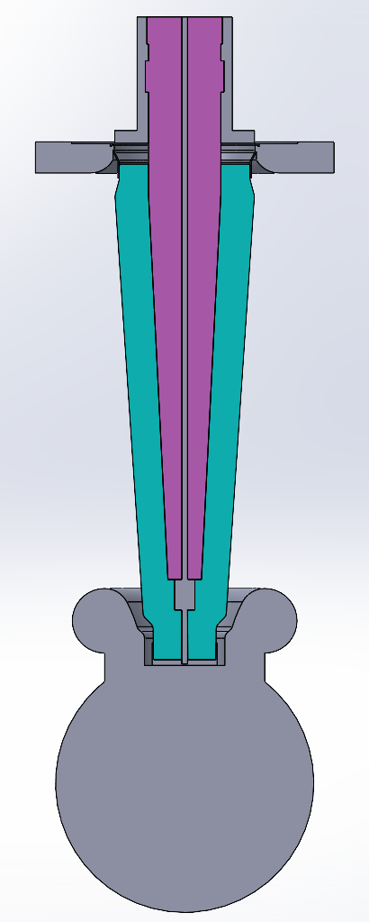
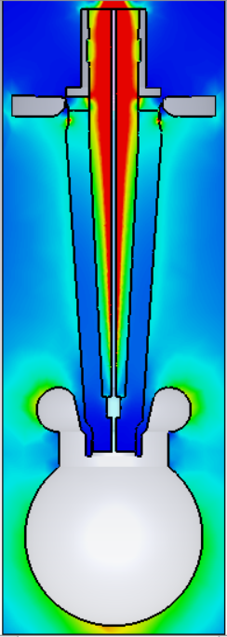
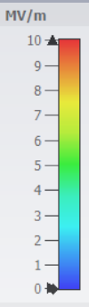
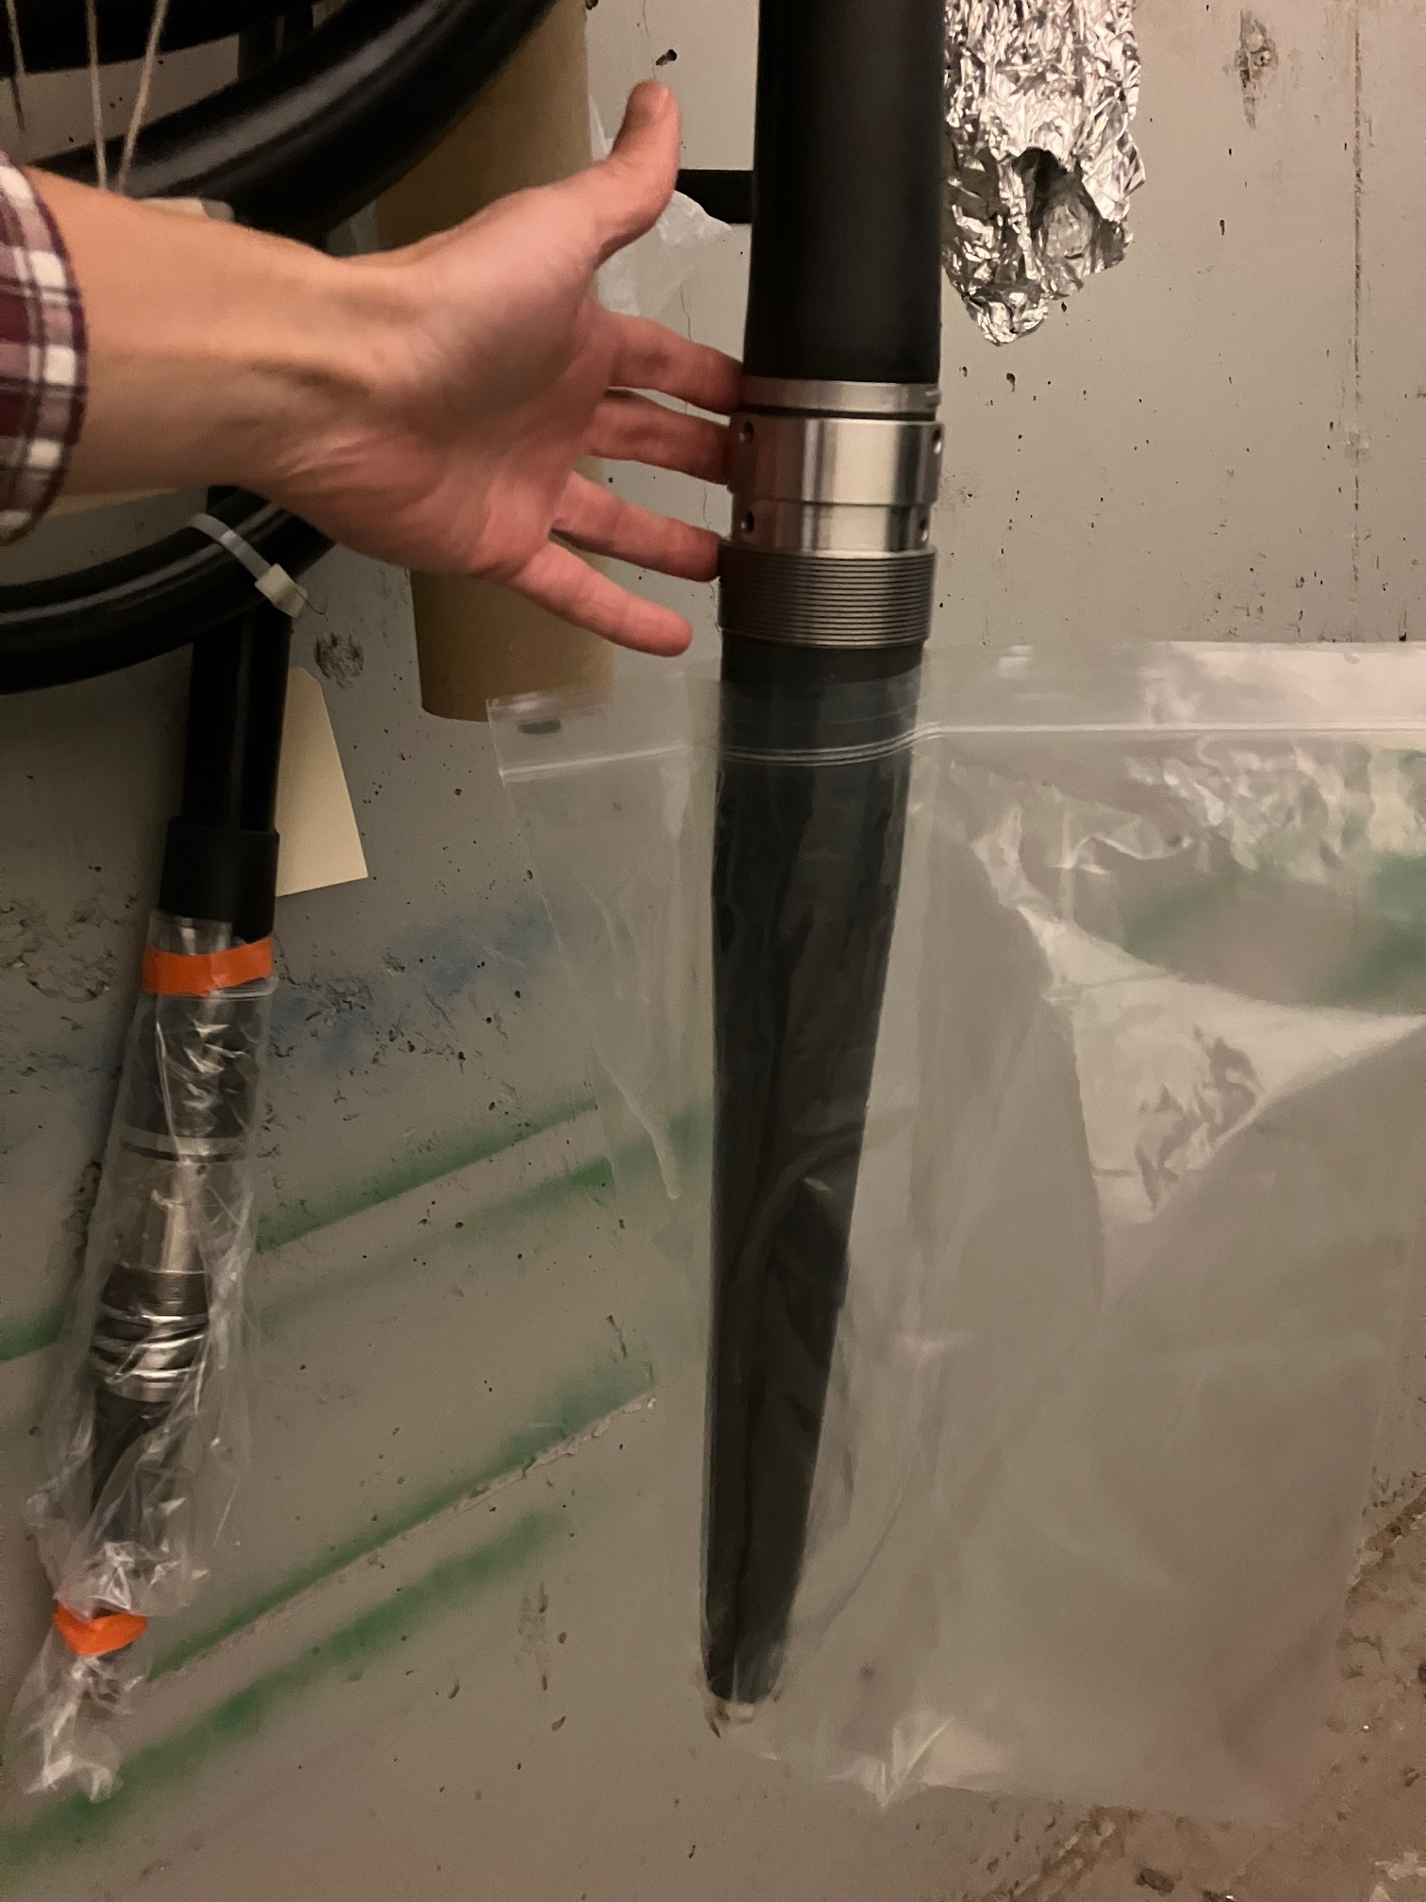
Kyocera high voltage insulator development
Kyocera has manufactured a 200 kV insulator (R28) sample and is in the process of manufacturing two prototypes: one from pure alumina, and one from their novel modified alumina with lower secondary electron yield
KEK has shipped flanges, metallic rings and insulator tip to Kyocera for metallization and brazing.
Estimated shipping date from Kyocera to JLab is August 22, 2024.
JLab will high voltage test the R28 insulator prototype
122 mm
JLab has completed the electrostatic design for a 500 kV insulator prototype to fit commercial high voltage cables.
The shielding electrode has been designed to linearize the potential along the insulator and minimize the electric field at the triple point junction (insulator-metal-vacuum).
JLab demonstrated (Aug. 2023) 500 kV in a prototype insulator immersed in SF₆, but that prototype does not fit commercial cables. This insulator has been tested in vacuum up to 250 kV, but field emission prevents applying higher voltage.
410 mm

