Slide 1
E300 Long-term planning
AARD Planning Meeting
Doug Storey | AARD
8/22/2024

Slide 2
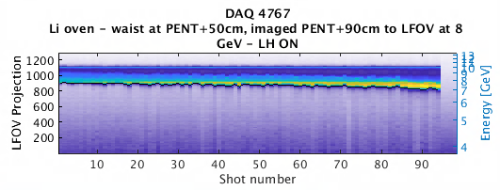
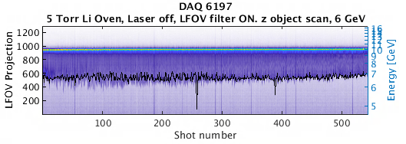
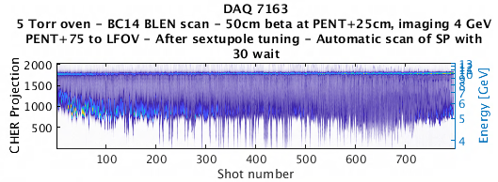
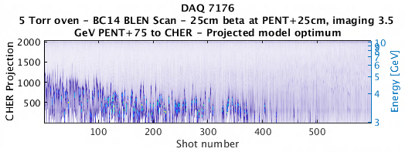
Summary of single-bunch results
November run
  σ ~35x35x ~30 µm
  ~3 GeV energy loss, ~10% energy transfer
March E300
  σ ~ 50x50x ~20 µm
  ~4 GeV energy loss, ~14% energy transfer
Mid-April:
  σ ~ 35x30x ~20 µm
  Before sextupole tuning:
    5-6 GeV energy loss, ~25% energy transfer
  After ML tuning:
    >7 GeV energy loss, ~40% energy transfer
Oven dead

Slide 3
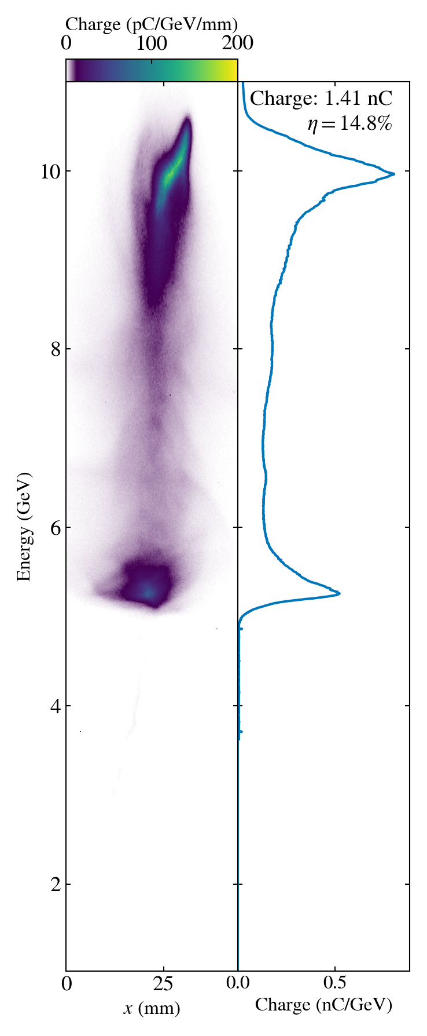
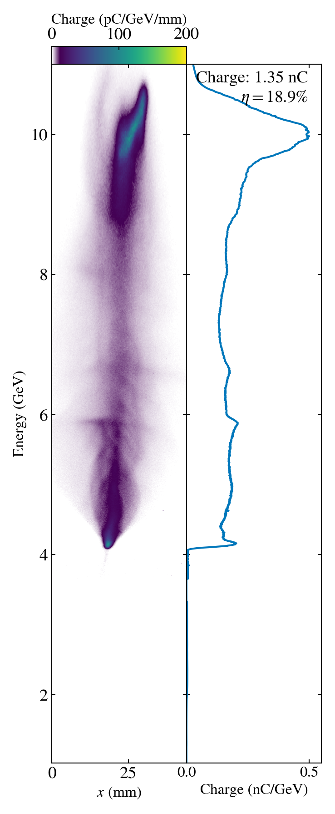
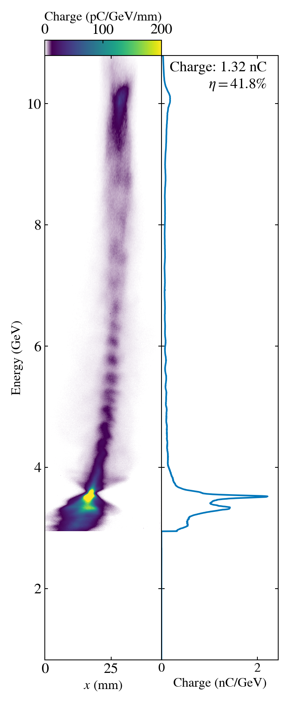
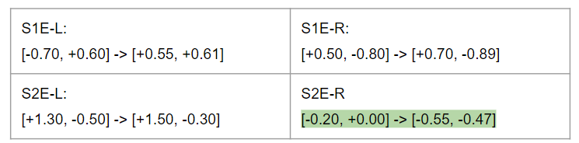
Sextupole optimization – single bunch
-Waist location
-Bunch compression
-Orbit
-Sextupole tuning
ML sextupole tuning:
Bayesian optimization

Slide 4
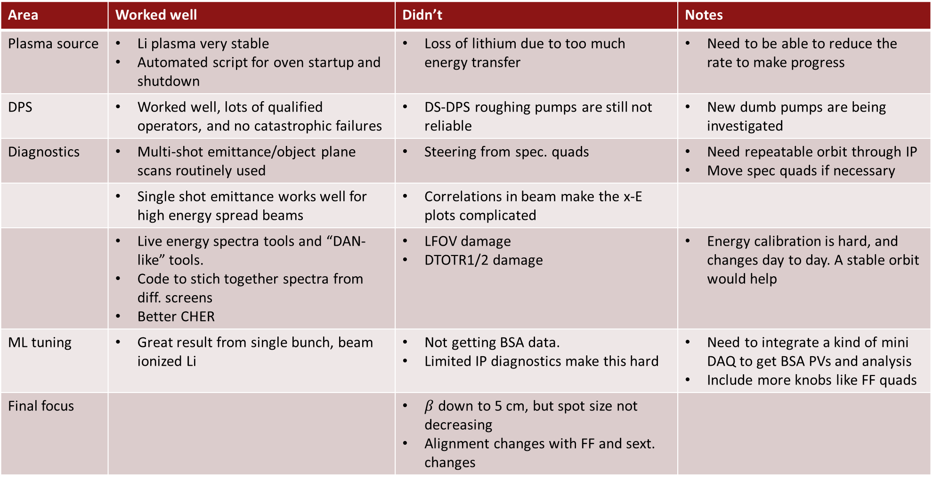
What worked well, what didn’t
Area | Worked well | Didn’t | Notes
Plasma source | Li plasma very stable Automated script for oven startup and shutdown | Loss of lithium due to too much energy transfer | Need to be able to reduce the rate to make progress
DPS | Worked well, lots of qualified operators, and no catastrophic failures | DS-DPS roughing pumps are still not reliable | New dumb pumps are being investigated
Diagnostics | Multi-shot emittance/object plane scans routinely used | Steering from spec. quads | Need repeatable orbit through IP Move spec quads if necessary
 | Single shot emittance works well for high energy spread beams | Correlations in beam make the x-E plots complicated
 | Live energy spectra tools and “DAN-like” tools. Code to stich together spectra from diff. screens Better CHER | LFOV damage DTOTR1/2 damage | Energy calibration is hard, and changes day to day. A stable orbit would help
ML tuning | Great result from single bunch, beam ionized Li | Not getting BSA data. Limited IP diagnostics make this hard | Need to integrate a kind of mini DAQ to get BSA PVs and analysis Include more knobs like FF quads
Final focus |  | $β$ down to 5 cm, but spot size not decreasing Alignment changes with FF and sext. changes

Slide 5
What worked well, what didn’t (2)
Area | Worked well | Didn’t | Notes
S20/14 BLEN | S14 BLEN was the most useful tool correlating with single-bunch PWFA | Would S20 BLEN give more information?
Stability |  | Difficult to perform parameter scans with large jumps in beam parameters
Dispersion/ Sextupole tuning | Massive improvement to drive-to-wake energy transfer by tuning these | Hand tuning based on DTOTR profiles was not necessarily the best way to do this | Critical for both single and 2 bunch progress Need dedicated time to analyze and develop tools
Laser Heater | Mostly worked to suppress buffer ionization (at large beta) | We did see some signs of ionization in some cases (injection, hard to diagnose the beam with no plasma) | Not the highest priority, but we will need to address, especially as we tune the spot size down
S15 TCAV |  | Doesn’t exist yet

Slide 6
Possible publications (1)
Beam dynamics in non-optimal matching conditions (needs a better title…)
Self matching of the drive beam to emittance growth in PWFA
  Analysis of transverse dynamics of the beam when the waist position is scanned around the plasma entrance
    Measure the change in the emittance of the decelerated charge
    Change in betatron radiation emitted as you get closer to a matched condition
    Simulations to match
  What do we need to publish:
    Probably need to get cleaner data
    Simulations
    We have some Gamma1 data, but Gamma2 was always dead
    Running the beam at 10 Hz through the oven could lead to problems again → SCAV line?

Slide 7
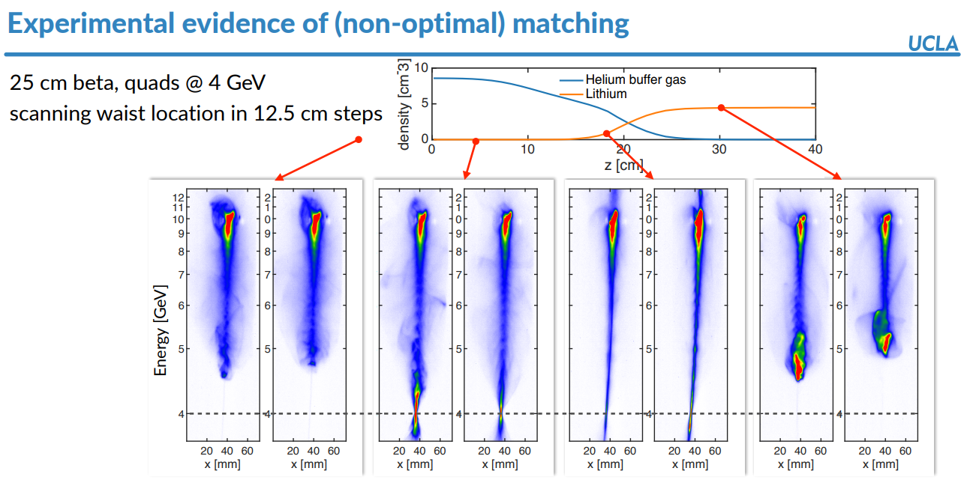
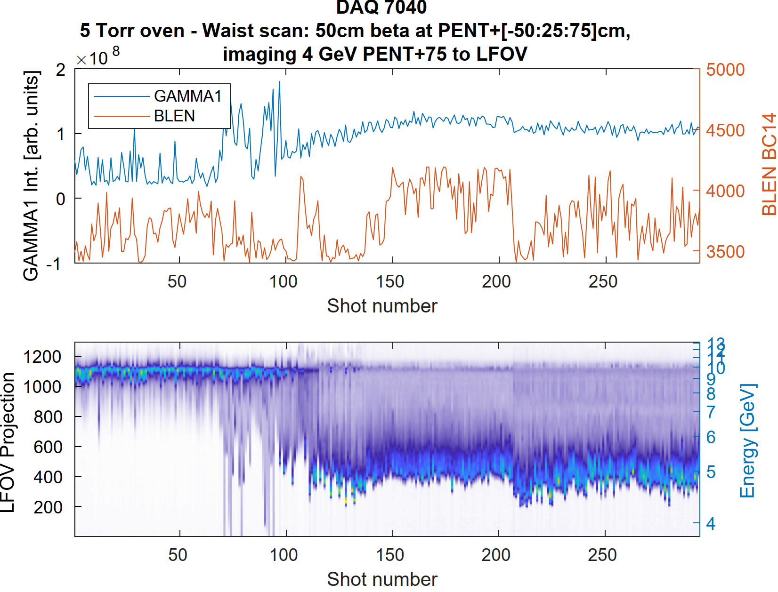
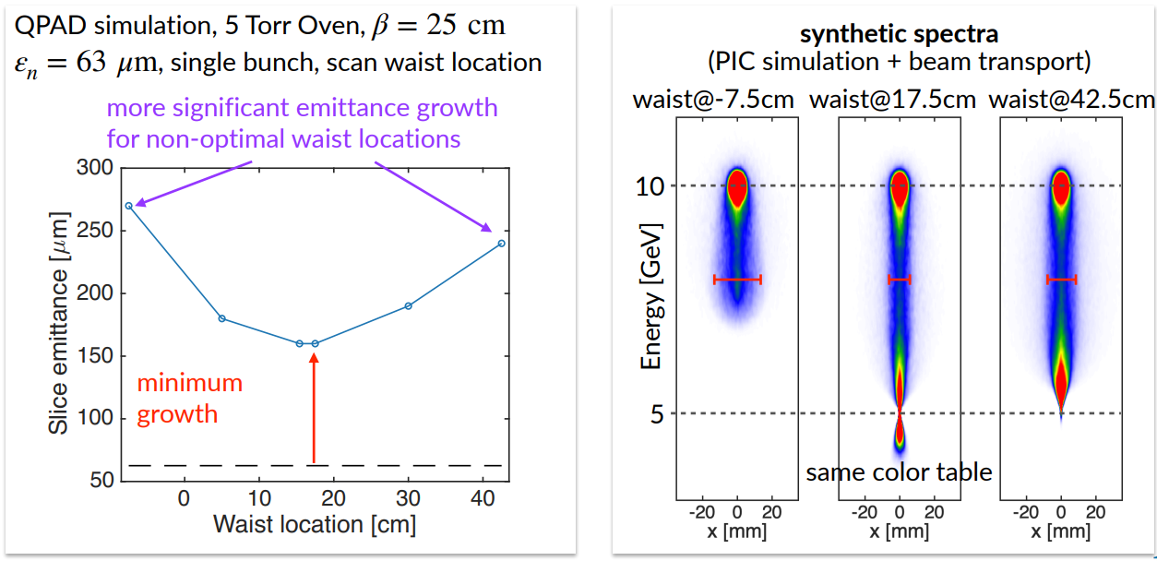
Non-optimal matching(??)
-50cm
-25cm
PENT
+50cm
+75cm
+25cm
From Chaojie

Slide 8
Possible publications (2)
Single bunch drive-to-wake transfer eff. up to ~40% with ML tuning
  Saw vast improvement using ML tuning (use of TuRBO makes this novel)
  We did not have chance to characterize post-ML beam due to DPS failure
  How do we make this into a publication?
    Combine with 4-D phase space reconstruction that shows the improvement in the LPS
  What do we need in order to publish:
    Redo this optimization with before and after characterization
      Need lower rate or short bursts with the oven
      Could work much better if we have BSA inputs to the ML algorithm
      Invite Sebastiens kids to be users
    Develop 4D phase space reconstruction
      Improved TCAV kick
      Time for development with Ryan R.

Slide 9
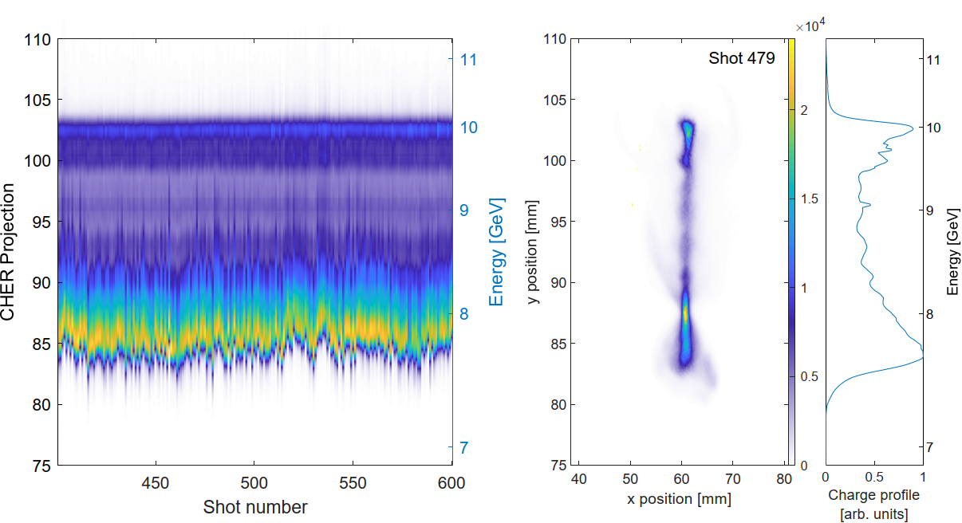
Drive to wake energy transfer with two bunches
In previous single bunch runs we demonstrated ~40% energy transfer to the wake in the Li oven
  However – the Li oven was damaged in these runs, leading to loss of Li
  In the two-bunch studies we were working with an unknown plasma density profile
Drive only energy transfer
Witness collimated at the end of linac
Max energy loss of ~2.5 GeV
>85% of charge participating
Total energy transfer = 1.4 ± 0.1 J (~13%)
Relatively small energy loss, but high participating
charge → oven in poor state

Slide 10
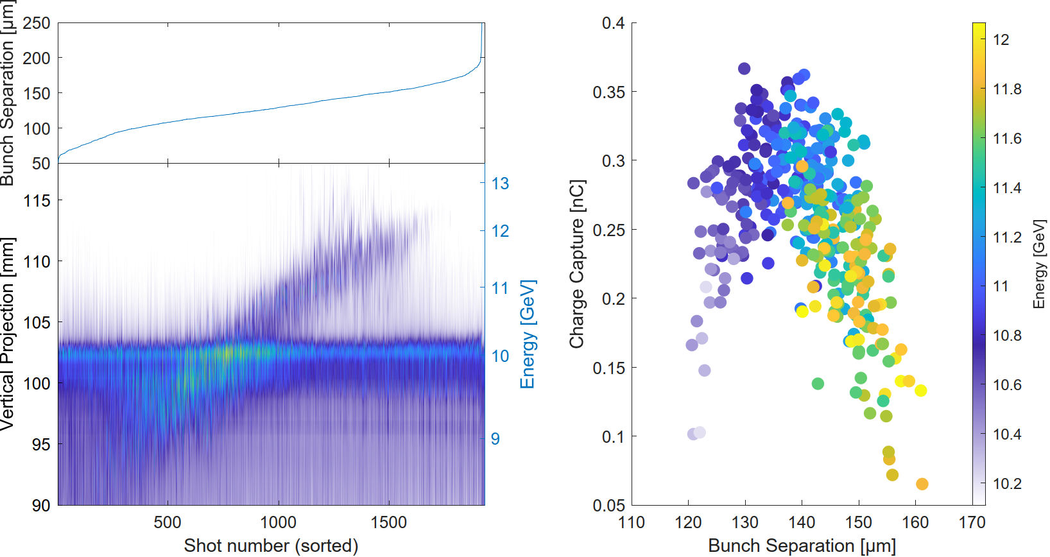
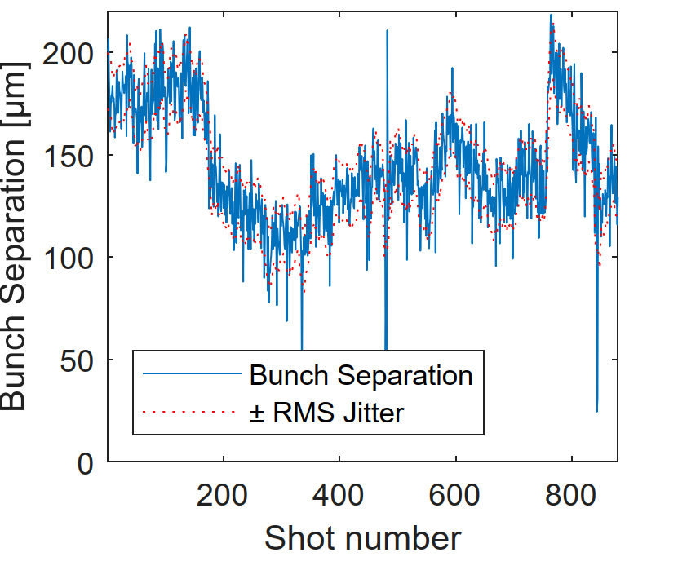
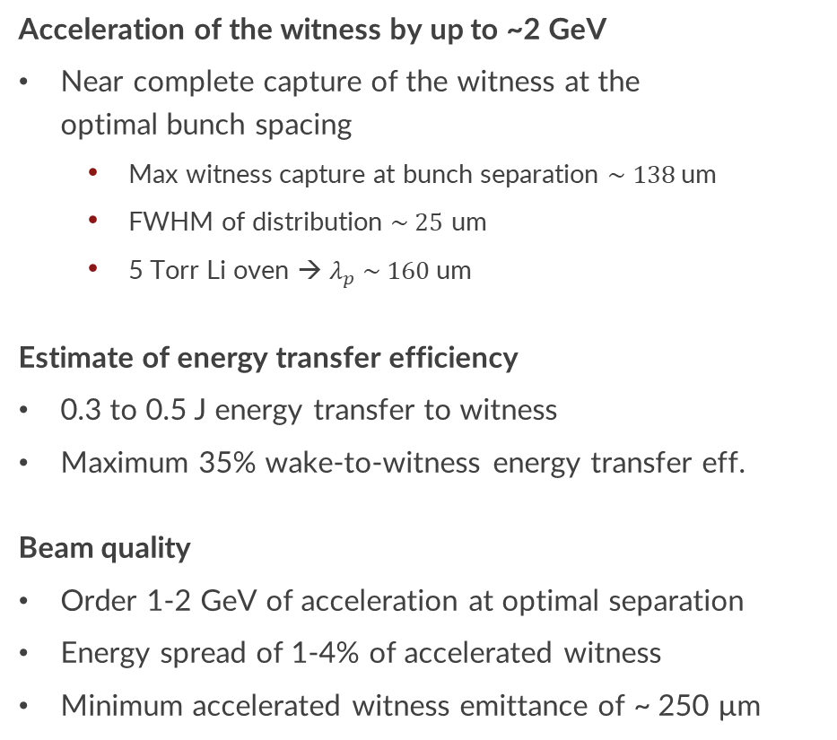
Witness acceleration
Acceleration of the witness by up to ~2 GeV
Near complete capture of the witness at the
optimal bunch spacing
  Max witness capture at bunch separation $\sim 138$um
  FWHM of distribution $\sim 25$ um
  5 Torr Li oven → $λ_{p} \sim 160$um
Estimate of energy transfer efficiency
0.3 to 0.5 J energy transfer to witness
Maximum 35% wake-to-witness energy transfer eff.
Beam quality
Order 1-2 GeV of acceleration at optimal separation
Energy spread of 1-4% of accelerated witness
Minimum accelerated witness emittance of ~ 250 µm

Slide 11
What worked well, what didn’t (3)
Area | Worked well | Didn’t | Notes
EOS | Online BL measurements critical for progress | Damage to crystals from TCAV/forgetting to remove A bit finicky
Diagnostics | Dump screens worked well to optimize plasma interaction | Damage to screens Relatively blind after injector | “optimal” solution with plasma looks terrible with no plasma
Oven | It didn’t because we broke it 2 bunches were much easier in Li oven than in beam ionized H2 | High losses from 2 bunch sometimes made DPS unreliable
Tuning | After massive effort of tuning by feeling, we made it work | Again – we were mostly doing this blind Relied on finding a hard to find signal and then tuning a massive parameter space to try optimize | BL, sextupoles, and dispersion tuning were most important But also weird things like seemlingly random orbit tuning
Feedback |  |  | Exercised the knobs, but needs work to find a practical and effective solution
Live analysis tools | Incredibly useful | Not BSA | Making sure this is working right is critical for progress

Slide 12
Goals and to-do list for this run
Facility/HW:
  Replace Li oven – this fall
  Replace DS-DPS roughing pumps – TBD
    2 spares being sent off-site for repairs
  S20 BLEN
  SLED and other XTCAV upgrades
  Ability to run at 1 Hz to IP
Single bunch:
  Aim for >60% energy transfer in single bunch
    Reduce beta/spot size
  ML tuning with 4D phase space reconstruction
  More betatron rad. measurements
Two bunch:
  Stable two bunch delivery
    All the stuff Nathan talked about
    Feedbacks
    Increase to ~1.6nC drive?
  BSA live analysis for ML tuning

