Slide 1
ALS-U Alignment Status
Presenter: Hongyan Zhu
Survey and Alignment Group
Federico Carrara
Dan Ellis
Chris Hernikl
Katherine Ray
Wylie Rosenthal
Magnet Group
Chuck Swenson
Erik Wallen
2024-Oct

Slide 2
Outline
ALS-U Project Introduction
Accumulator Ring
  Magnet to magnet Alignment tolerance breakdown
  Stretch Wire magnetic measurement
  Prestaging
  AR Prestaging and Installation progress

Slide 3
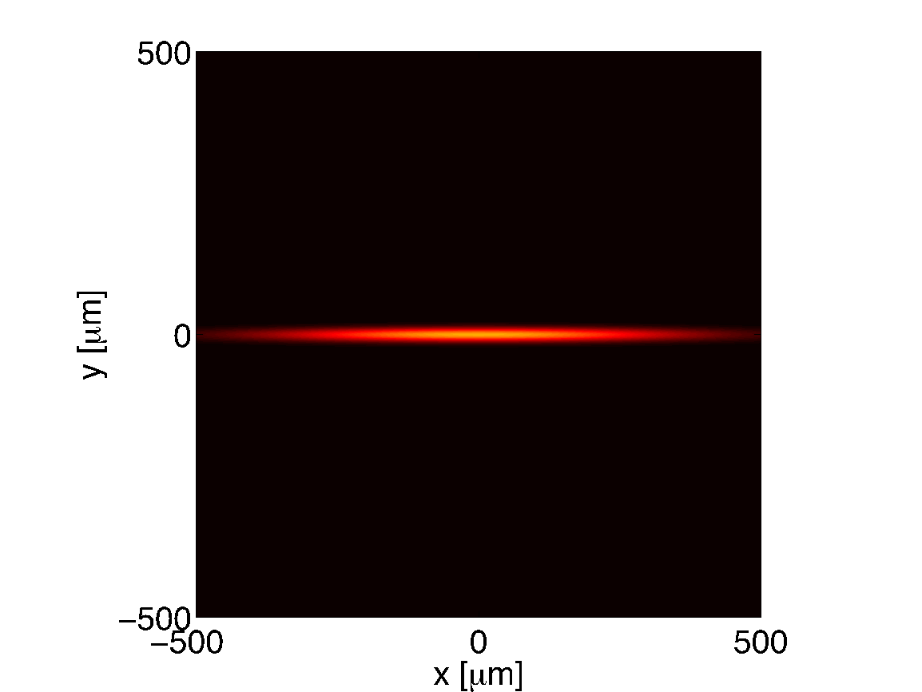
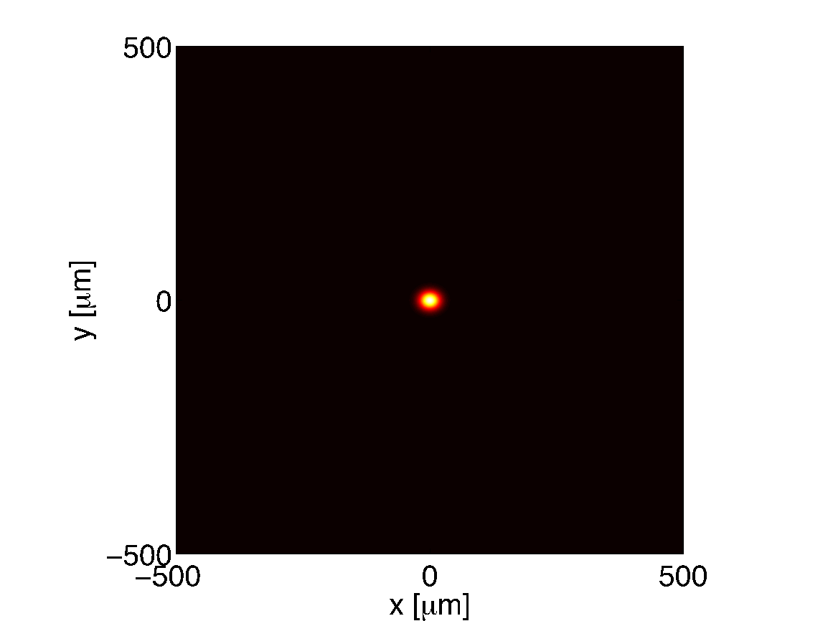
ALS-U Project
Electron Beam Profiles
  High-level goals:
  Achieve an increase in brightness and coherent flux of soft x-rays (@1 keV) of at least 2 orders of magnitude beyond today’s ALS capabilities
  Develop a set of world-class experimental capabilities that will push the frontiers in soft x-ray science and maintain ALS leadership in this area
  Provide infrared and hard x-ray capabilities comparable to present-day ALS
Today’s ALS
Future ALS
Slide credit: David Robin

Slide 4
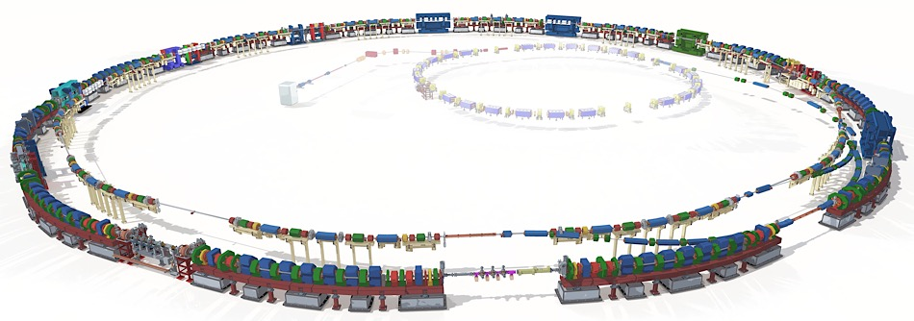
ALS-U Accelerators
Three Transfer Lines:
Booster to AR (BTA)
AR to SR (ATS)
SR to AR (STA)
  Accumulator Ring(AR)
  3rd Generation light source
  Circumference:182.130m
  LINAC, Booster
  Existing, no Change
Booster
(existing)
Linac
(existing)
  Storage Ring (SR)
  4th Generation light source
  Circumference:196.5097m
  9-bend achromat lattice
All accelerators will be installed on a level plane.
All magnets will be installed to nominal position without considering the existing beamlines position.

Slide 5
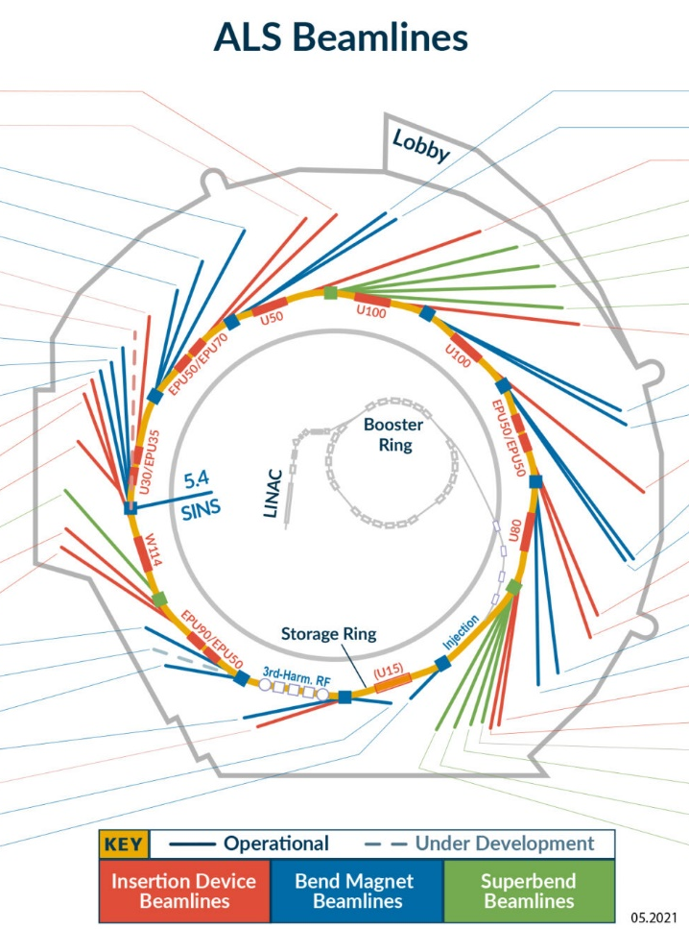
ALS-U Beamlines
  Insertion Device BLs Upgrade:
    7.0.1 (COSMIC)
    7.0.2 (MAESTRO)
    8.0.1 (TENDER)
    10.0.1 (FLEXON)
  No position change for the rest of IDBLs (Red BLs in the image)
  All Bend Magnet and Superbend BLs need to be moved to match the new Source centric: 25+ BLs. (All the dark blue and green BLs.)

Slide 6
ALS-U Installation Plan
  Install AR and BTA during ALS summer and winter shutdowns, 3+ years.
  Start commissioning BTA and AR to minimize risk and duration of the main dark time.
  Dark Time
    Remove ALS BTS and SR.
    Install ALS-U SR.
    Install ATS and STA.
    The Beamline relocation
    happens in parallel with
    Accelerator installation.
We are here

Slide 7
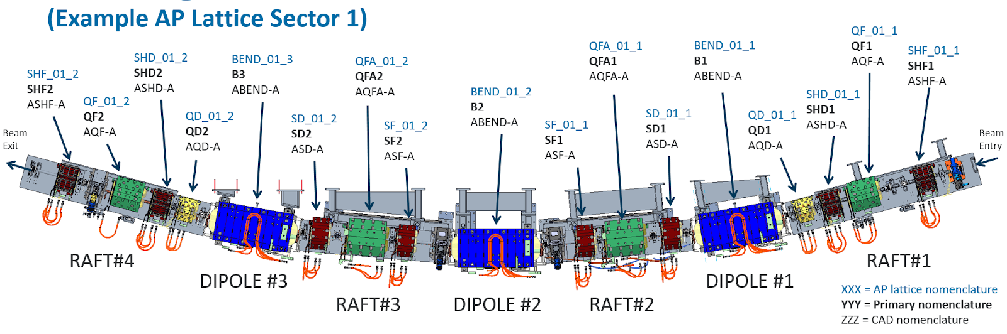
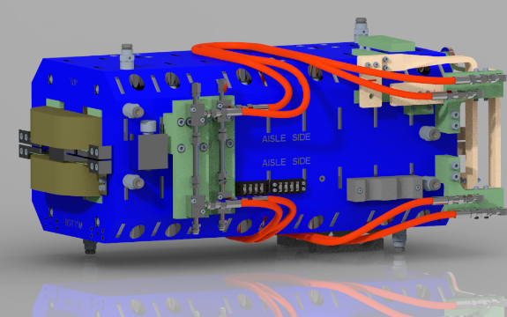
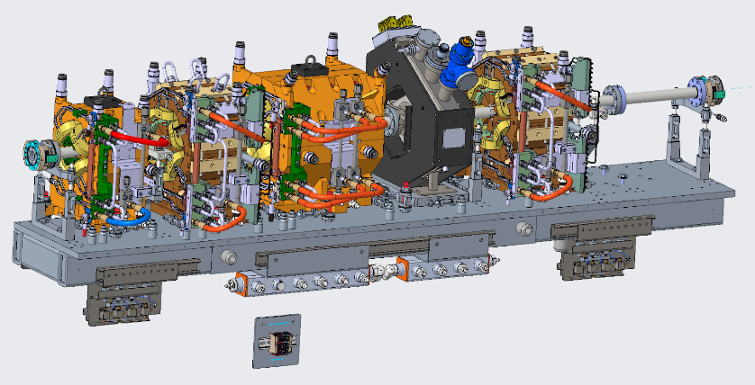
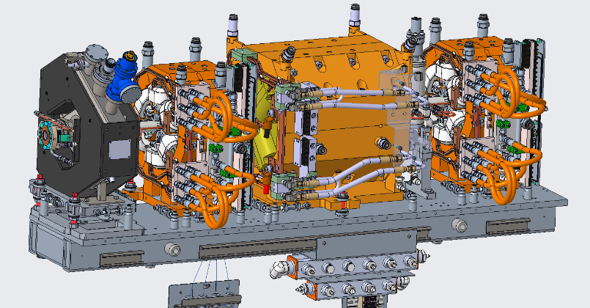
Accumulator Ring
12 Arc Sectors
3 Dipoles and 4 Rafts
  The lattice of Raft#1 and Raft#4 is symmetrical.
  The lattice of Raft#2 and Raft#3 is symmetrical.
  Dipoles and Rafts are separately supported.
Raft#1
Raft#2

Slide 8
ALS-U Accelerator Alignment tolerance
 |  | X(µm) | Y(µm) | Z(µm) | Rx(µrad) | Ry(µrad) | Rz(µrad)
AR & BTA | Magnet to Magnet | ± 100 | ± 100 | ± 400 | ± 1000 | ± 1000 | ± 1000
 | Raft to Raft | ± 100 | ± 100 | ± 1000 | ± 200 | ± 200 | ± 200
 | Sector to Sector | ± 200 | ± 200 | NA | NA | NA | NA
SR & ATS & STA | Magnet to Magnet | ± 60 | ± 60 | ± 200 | ± 400 | ± 400 | ± 400
 | Raft to Raft | ± 60 | ± 60 | ± 200 | ± 35 | ± 35 | ± 200
 | Sector to Sector | ± 200 | ± 200 | NA | NA | NA | NA
  The Magnet-to-Magnet(M2M) alignment tolerance for each magnet relates to its relative positioning with respect to its nearest neighboring (adjacent) magnets. A minimum of 4 fiducials per magnet should be used. For magnets at the edge of a raft, this needs to only be evaluated relative to the one neighbor on the same raft.
  The specified error interval corresponds to a 95%(≈2σ)confidence based on a Gaussian error distribution.

Slide 9
ALS-U Accelerator Alignment tolerance
 |  | X(µm) | Y(µm) | Z(µm) | Rx(µrad) | Ry(µrad) | Rz(µrad)
AR & BTA | Magnet to Magnet | ± 100 | ± 100 | ± 400 | ± 1000 | ± 1000 | ± 1000
 | Raft to Raft | ± 100 | ± 100 | ± 1000 | ± 200 | ± 200 | ± 200
 | Sector to Sector | ± 200 | ± 200 | NA | NA | NA | NA
SR & ATS & STA | Magnet to Magnet | ± 60 | ± 60 | ± 200 | ± 400 | ± 400 | ± 400
 | Raft to Raft | ± 60 | ± 60 | ± 200 | ± 35 | ± 35 | ± 200
 | Sector to Sector | ± 200 | ± 200 | NA | NA | NA | NA
  The raft-to-raft(R2R) alignment tolerance for each raft relates to its relative positioning with respect to its nearest neighboring (adjacent) rafts. This is determined by least square fit of all magnets on either raft. A minimum of 3 fiducials per magnet should be used.
  The specified error interval corresponds to a 95% (≈2σ) confidence based on a Gaussian error distribution.

Slide 10
ALS-U Accelerator Alignment tolerance
 |  | X(µm) | Y(µm) | Z(µm) | Rx(µrad) | Ry(µrad) | Rz(µrad)
AR & BTA | Magnet to Magnet | ± 100 | ± 100 | ± 400 | ± 1000 | ± 1000 | ± 1000
 | Raft to Raft | ± 100 | ± 100 | ± 1000 | ± 200 | ± 200 | ± 200
 | Sector to Sector | ± 200 | ± 200 | NA | NA | NA | NA
SR & ATS & STA | Magnet to Magnet | ± 60 | ± 60 | ± 200 | ± 400 | ± 400 | ± 400
 | Raft to Raft | ± 60 | ± 60 | ± 200 | ± 35 | ± 35 | ± 200
 | Sector to Sector | ± 200 | ± 200 | NA | NA | NA | NA
  The sector-to-sector alignment tolerance for each sector (i.e. set of rafts) relates to its relative positioning with respect to its nearest neighboring (adjacent) sectors. This is determined by least square fit of all magnets in either sector.
  The specified error interval corresponds to a 95%(≈2σ) confidence based on a Gaussian error distribution.

Slide 11
ALS-U Accelerator Alignment tolerance
  AR Magnet to magnet Alignment tolerance breakdown
Survey Alignment contributes to three attributes in the list, two will be covered in the following slides.
The cumulative position error can meet the 95%(≈2σ) confidence level.
The AR R2R and SR M2M,R2R Tolerance breakdown are in progress.
Credit: Chuck Swenson

Slide 12
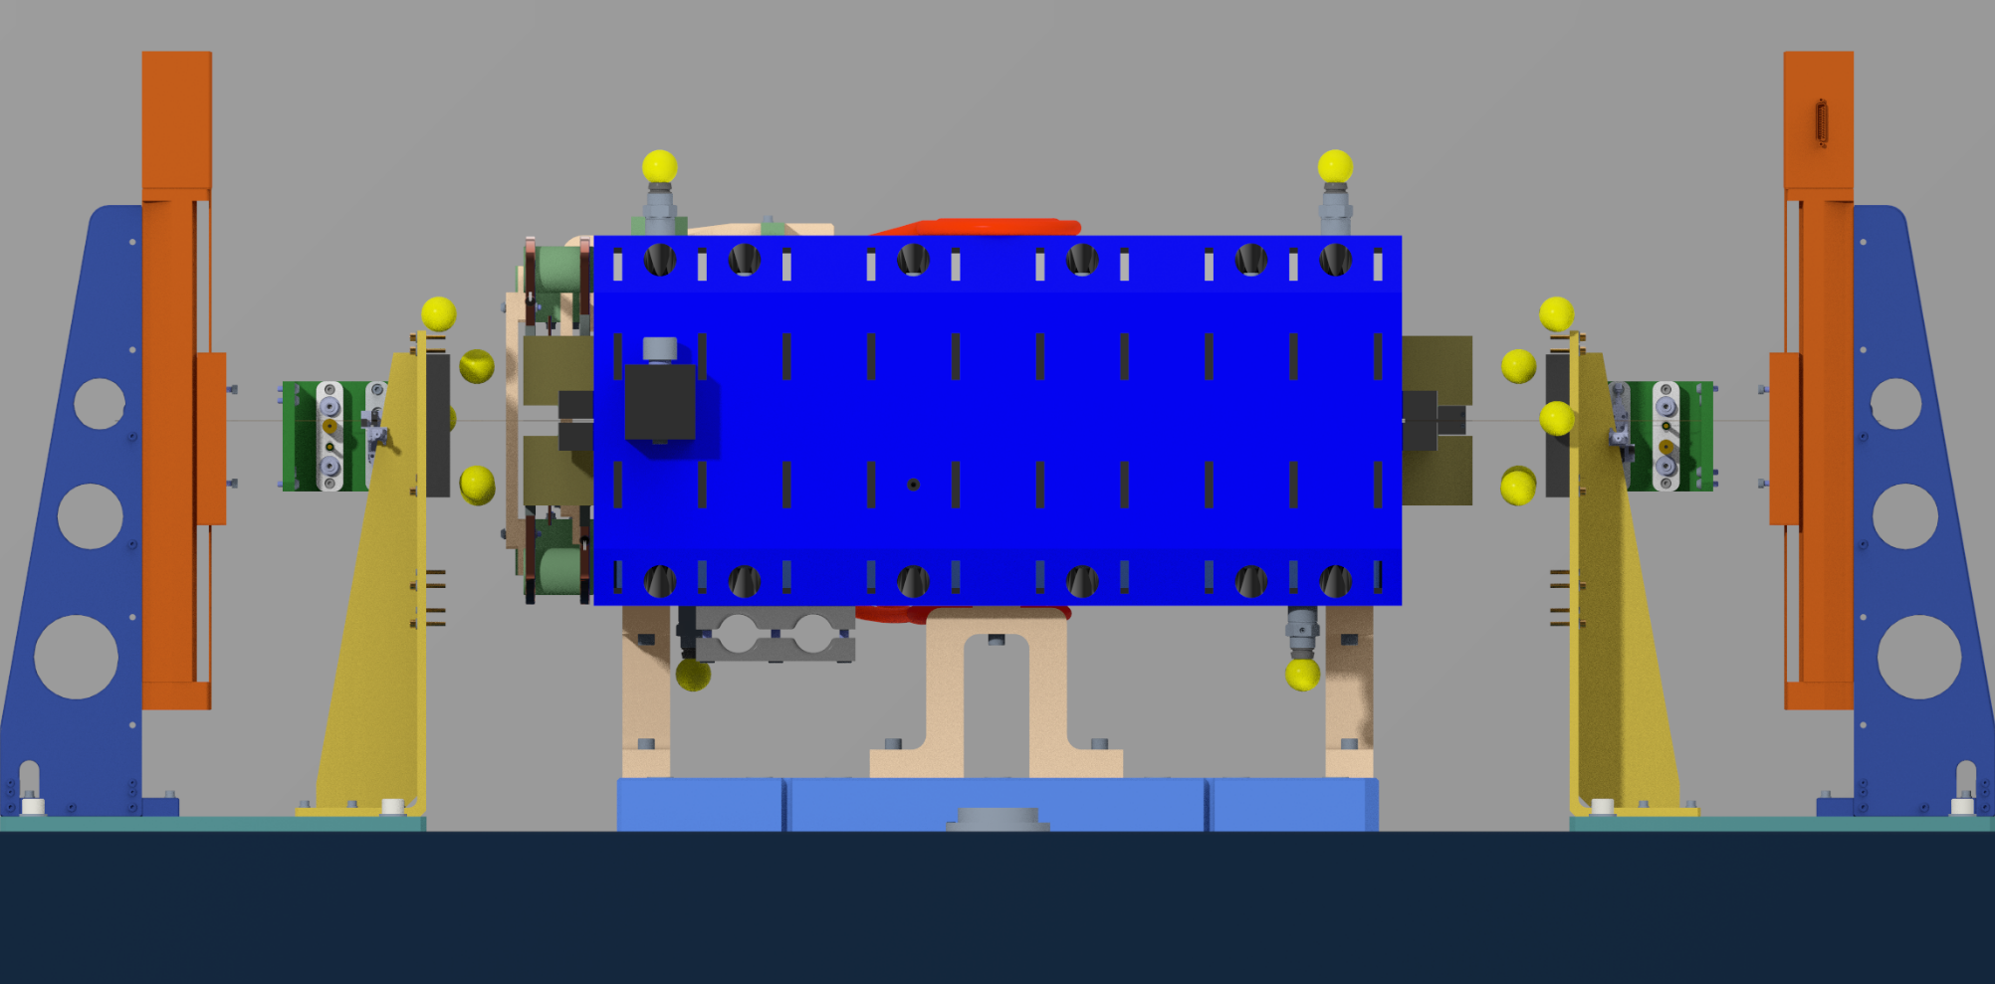
Stretch Wire Magnetic Measurement
Z
X
Y
ABEND Fiducials
SW System:
The Perpendicularity of Upstream(US) and Downstream(DS) XY 2-axes stages are better than 100µrad.
The Parallelism between US and DS stages are better than 100µrad
Two Laser Micrometers:
  Repeatability: 3
  Non-Linearity: < 10µm
  Fiducialized with CMM, Mapped with Laser tracker: 225 mapping points.
US Laser Micrometer
DS Laser Micrometer
DS Laser-XY
Wire Sensor
Fiducials
US Laser-XY
Wire Sensor
Fiducials
ABEND Fiducials
XY 2-axes Linear Stages

Slide 13
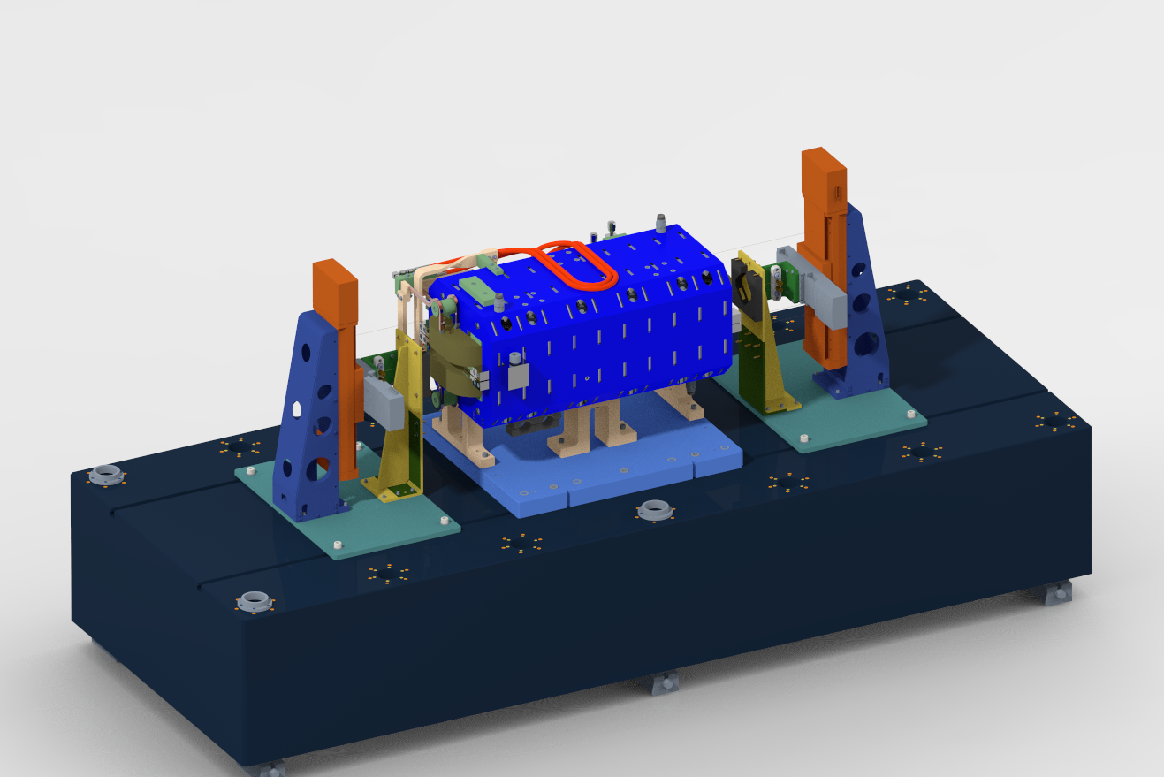

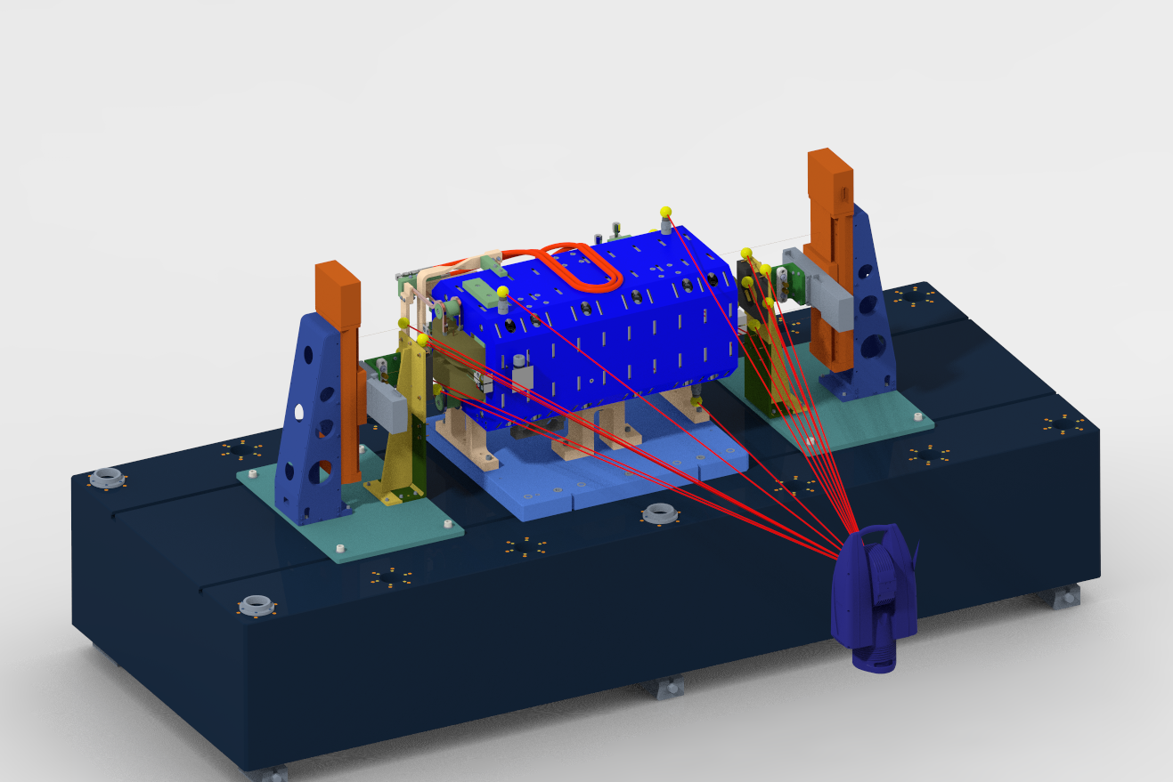
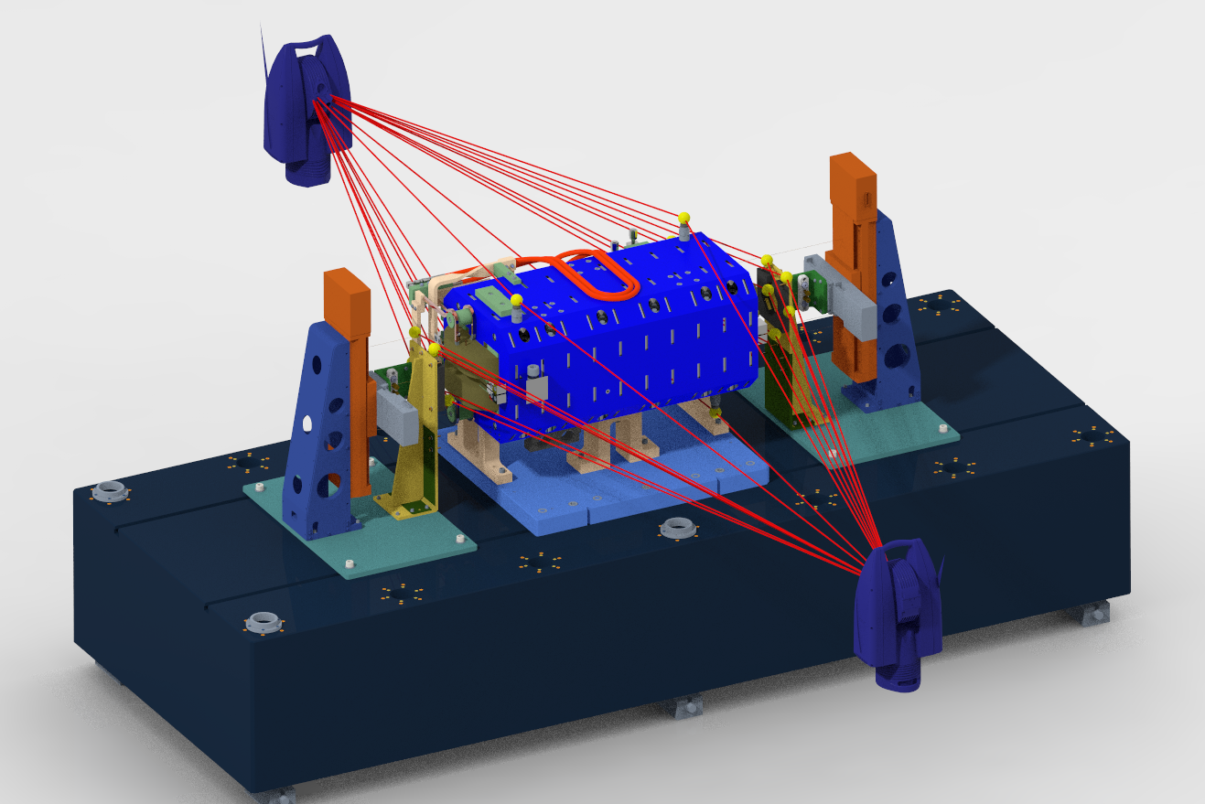
Stretch Wire Magnetic Measurement
Procedures:
Bisect the US and DS stage coordinate system(CS) to get the SW CS.
Align the CMM fiducialized magnets to the SW CS within +/-5mm @X&Y and +/-3mrad @Rx,Ry &Rz.
Use Two Laser tracker stations to measure all the Magnet’s fiducials and Laser Micrometers’ fiducials.
Calculate the intersections between the Magnet’s mechanical axis and the Laser Micrometers’ laser curtain.
Stages drive the wire to the intersections to start magnetic measurement.
The offset between mechanical and magnetic center in X and Y direction can be measured and applied to the magnet fiducialization data.
Data processing is integrated in one Spatial Analyzer measurement plan, increase efficiency.

Slide 14
Stretch Wire Magnetic Measurement
Uncertainty attribute: Sensitivity of SW magnetic apparatus.
  Utilizing the standard deviation of the differential errors determined by comparing the magnetic field fiducialization’s positional estimate to the mechanical fiducialization estimate made with a CMM. And Including the Laser micrometer fiducialization error and mapping error.
  The fiducialization uncertainties reported by magnetic measurements implicitly have underlying uncertainties introduced by the LT utilized to position the magnet, and apparatus on the bench. The reported magnetic measurement uncertainties may therefore be a bit optimistic.
 | X(µm) | Y(µm) | Z(µm) | Rx(µrad) | Ry(µrad) | Rz(µrad)
Uncertainty(1σ) | ± 15 | ± 15 | NA | ± 60 | ± 60 | ± 60
Estimated

Slide 15
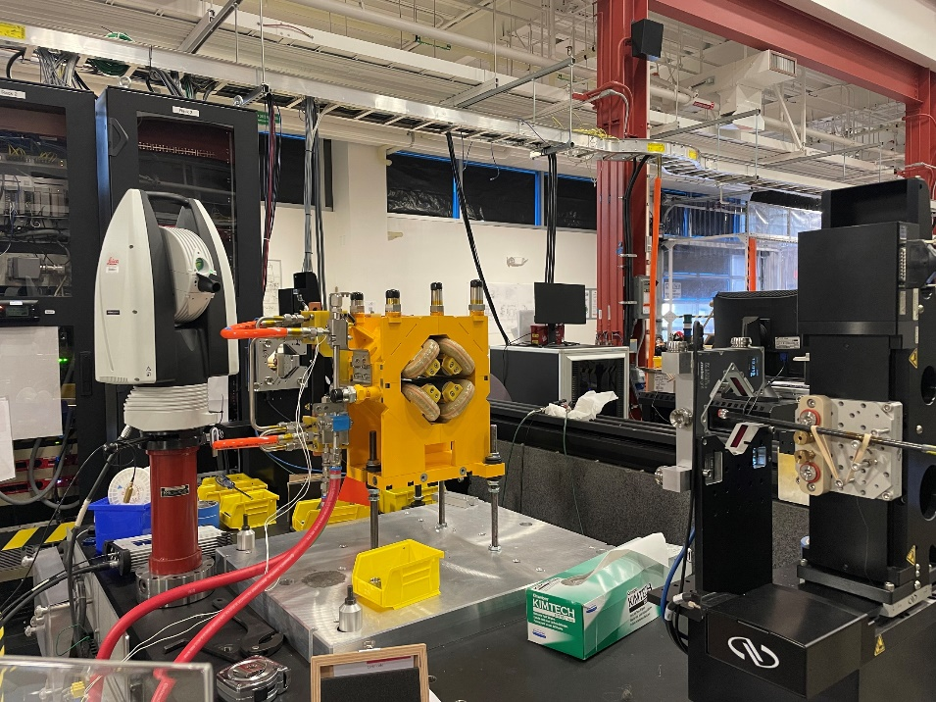
Stretch Wire Magnetic Measurement
AR 100% Dipole and 25% Non-Dipole are measured by SW.
The magnetic and mechanical center offset are applied for all Dipoles, not for Non-dipole magnets.
Completed all AR magnets SW measurements.

Slide 16
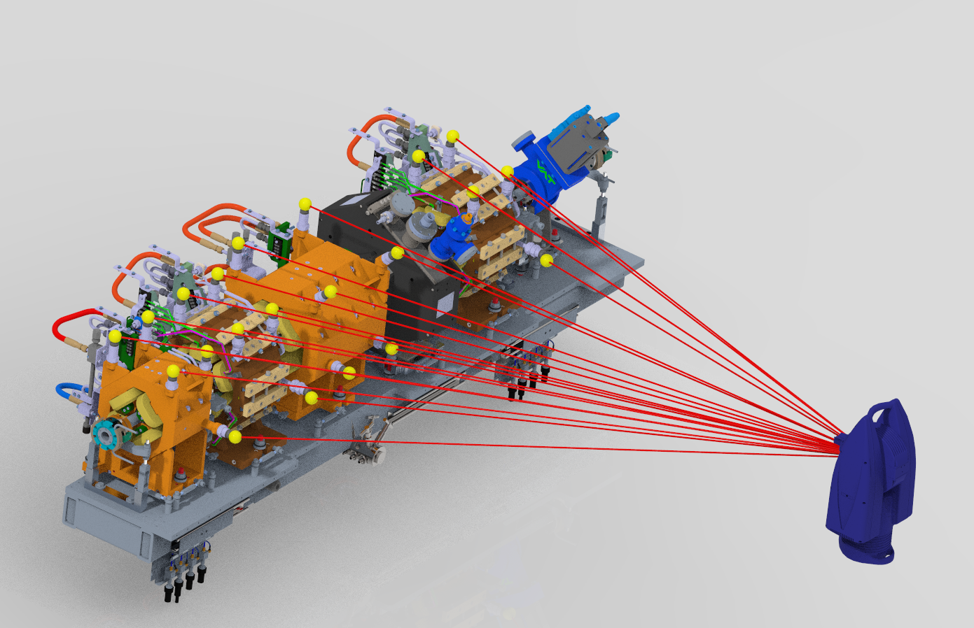
Prestaging
Raft#1
Procedures:
Measure Raft weldment X,Y,Z datum to align laser tracker to the Model.
Align the middle Quad relative to the Raft weldment.
Align the two adjacent Sextupoles relative to the Quad.
Align the end Quad to the adjacent Sextupole.
Align the BPMs, vacuum pumps and chambers.
Multiple laser tracker stations to record the magnet fiducials, BPM fiducials and critical features of Vacuum system.
Data processing, report generating and alignment requirements checking are integrated in one measurement plan.
Laser tracker monitoring during alignment
Raft#2

Slide 17
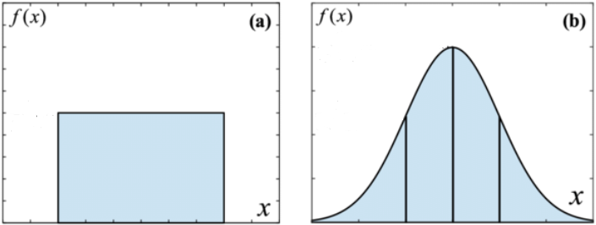
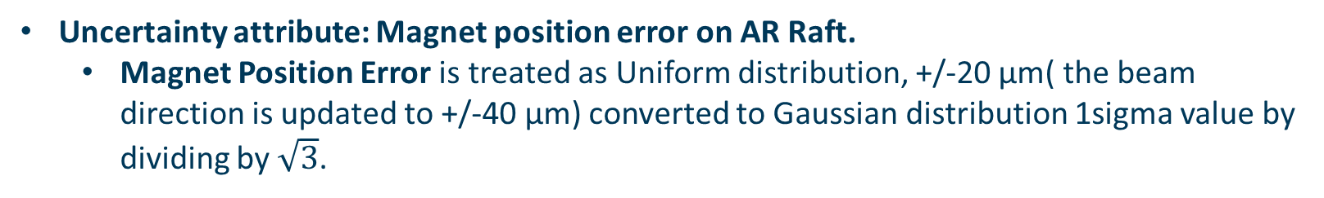
Prestaging
Uncertainty attribute: Magnet position error on AR Raft.
  Magnet Position Error is treated as Uniform distribution, +/-20 µm( the beam direction is updated to +/-40 µm) converted to Gaussian distribution 1sigma value by dividing by $\sqrt{3}$.
 | X(µm) | Y(µm) | Z(µm)
Magnet position error on AR Raft(1σ) | ± 11.5 | ± 11.5 | ± 23
Uniform distribution
Gaussian distribution
-σ
σ
-20
0
20
-11.5
0
11.5

Slide 18
Prestaging
Raft#1
Uncertainty tribute: Magnet position error on AR Raft.
  Statistics of the finished 30 Rafts, there are 88 magnets pairs, the magnet to magnet position error distributions on three axes are different.
  X and Z are slightly better than Uniform distribution. Y direction is close to Gaussian distribution.
  Treating three directions position error as Uniform distribution is reasonable when allocating error budget in the designing phase.
Raft#2

Slide 19
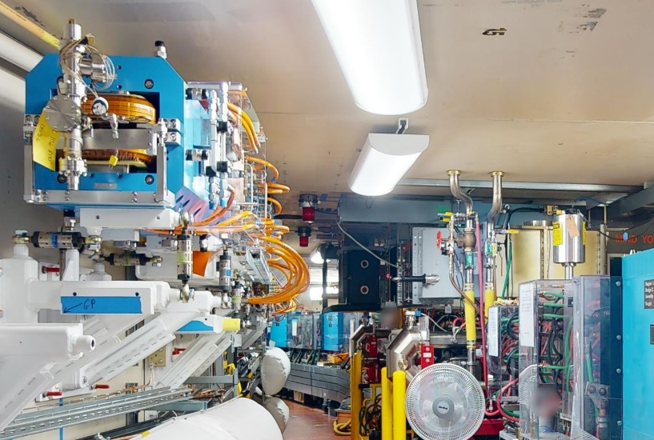
AR Prestaging and Installation progress
75% Rafts prestaging.
56% Rafts initial tunnel alignment.
52% Dipoles initial tunnel alignment.
In initial tunnel alignment phase, all Rafts and Dipoles are aligned to nominal position, then vacuum connection can be made. After the completion of initial tunnel alignment and vacuum connection, there will be fine alignment for the whole AR.

Slide 20
What has been presented is very much a Group Effort…
Survey and Alignment Group:
Federico Carrara
Dan Ellis
Chris Hernikl
Katherine Ray
Wylie Rosenthal
Magnet Group:
Chuck Swenson
Erik Wallen
Thanks for your attention!

