Slide 1
Efficient RF Sources
Emilio Nanni
C³ Workshop @ NIKHEF
10/8/2024
Notes:
A lepton-collider Higgs factory, to precisely measure the couplings of the Higgs boson to other particles, followed by a higher energy run to measure the Higgs self-coupling, is widely recognized as a primary focus of modern particle physics. In this talk, we will present the study of a new concept for a high gradient, high power accelerator with beam characteristics suitable to study the Higgs boson, the Cool Copper Collider (C3), with the goal of minimizing the capital and operating costs. C3 is based on the latest advances in rf accelerator technology and utilizes optimized cavity geometries, novel rf distribution, and operation at cryogenic temperatures to allow the linear accelerator to achieve high accelerating gradients while maintaining the overall system efficiency. We will present the latest demonstrated performance of prototype accelerators and highlight the future development path for C3.

Slide 2

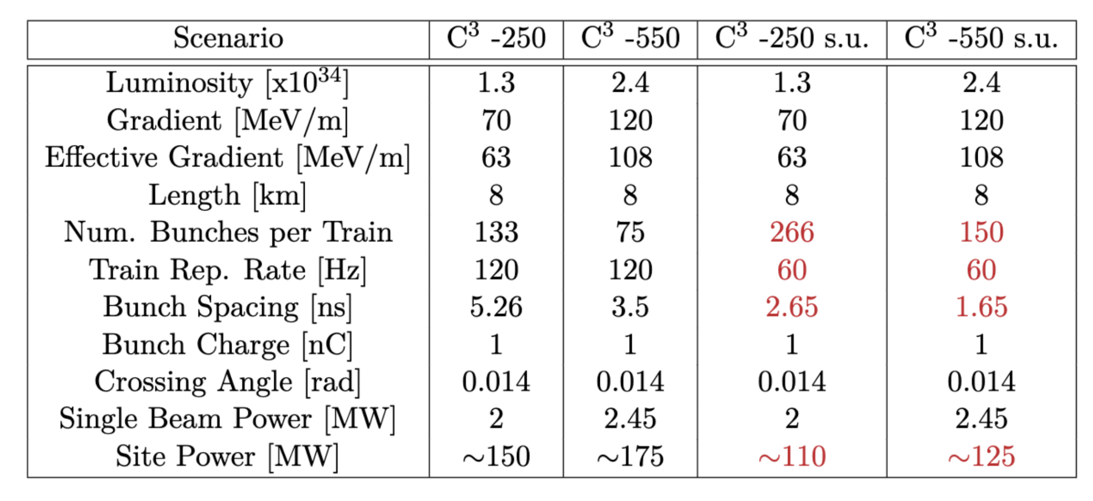
Table of Parameters
Updated parameters from LCWS 2024
C3 @ NIKHEF

Slide 3
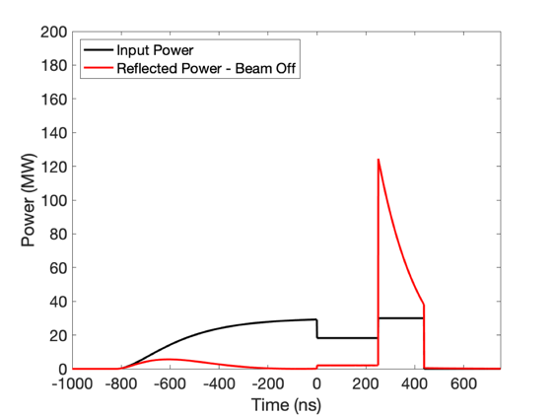
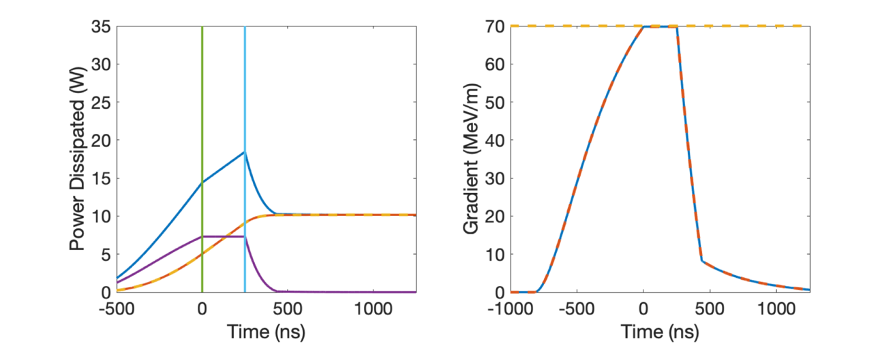
RF Power Requirements
70 MeV/m 250 ns Flattop (extendible to 1400 ns)
~2 microsecond rf pulse, ~30 MW/m
Conservative 2.3X enhancement from cryo
No pulse compression
Ramp power to reduce reflected power
Flip phase at output to reduce thermals
RF Power
One 65 MW klystron every two meters -> Matches CLIC-k rf module power
Increases to 80 MW/m for C3-550 and 120 MeV/m
Gradient
Thermals
C3 @ NIKHEF

Slide 4
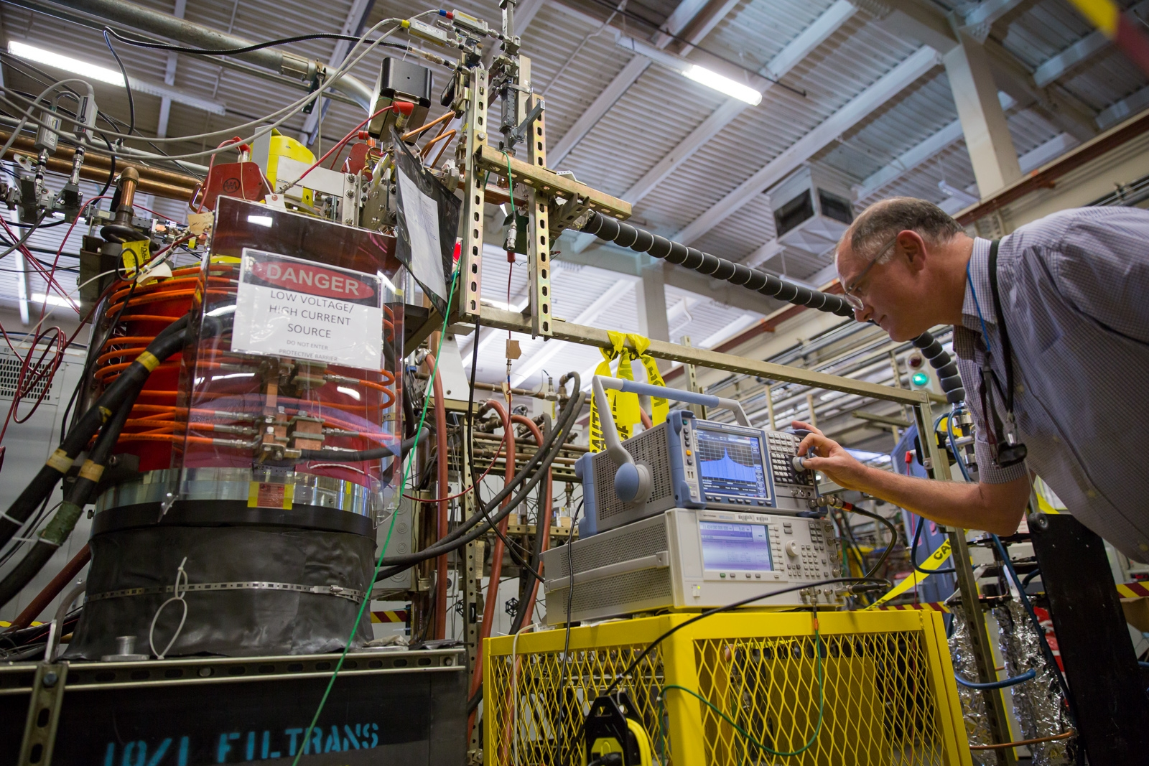
RF Sources Requirements for C³
50% [65%] RF Source Efficiency, 65 [80] MW peak power, 2 [1] $μ$s, 250 [550] GeV CoM, 60 Hz
Imposes requirement that circuit efficiency be pushed to ~70% or greater
Significant ongoing work (see next slides and this whole workshop)
Solenoidal electromagnet consumes too much power
XL4 solenoid consumes >20 kW average power
Needs to go to near zero
Periodic permanent magnets (PPM)as an appealing option
Focus of Next Linear Collider (NLC) program
C3 @ NIKHEF

Slide 5
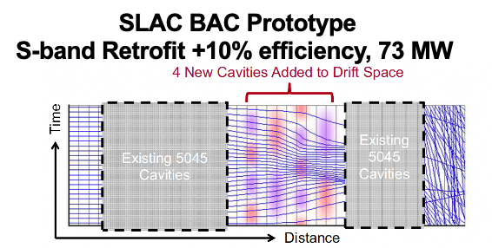
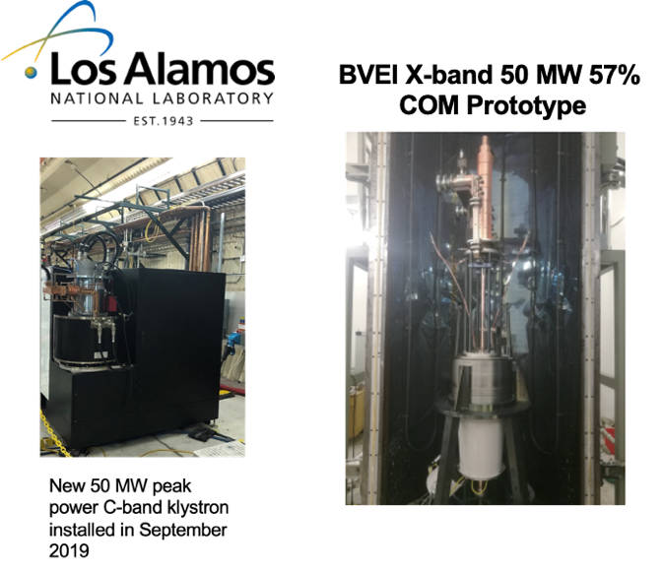
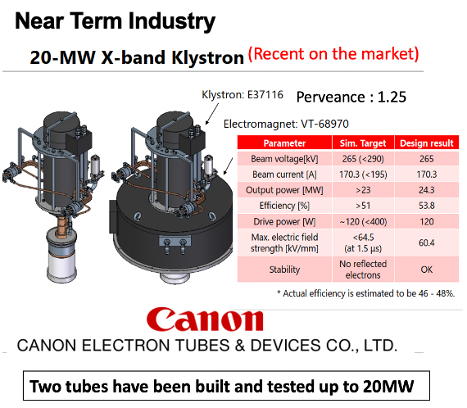
RF Sources Available vs. Near Term Industrial Efforts
RF sources and modulators capable of powering CCC-250 commercially available
Plan to leverage significant developments in performance (HEIKA) of high power rf sources – requires industrialization
C3 @ NIKHEF

Slide 6
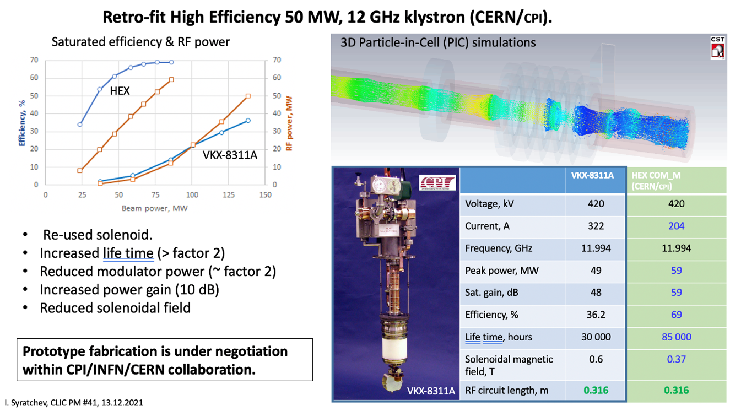
High Efficiency Klystrons
Please See I. Syratchev’s Talk for Many Great Examples from Designs to Prototypes
https://indico.cern.ch/event/1101548/contributions/4635964/attachments/2363439/4034986/CLIC_PM_13_12_2021.pdf
iFast is leading rf source development in this space
Most recent results presented at Efficient RF Source Workshop 2024
https://indico.cern.ch/event/1407353/timetable/?view=standard_numbered
C3 @ NIKHEF

Slide 7
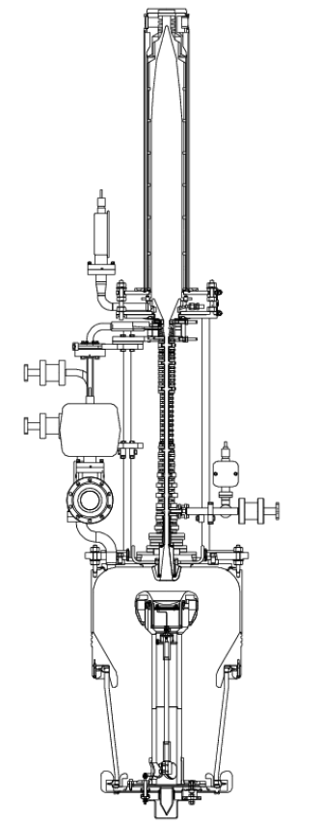
75XP Series Klystrons as RF sources for C³
The SLAC 75XP is a PPM-focused, X-band klystron designed for 75 MW peak power
Motivated/funded by the Next Linear Collider (NLC) program
Years of engineering effort → attractive candidate for a potential C³ demonstrator
Specification | Target
Beam Voltage | 490 kV
Beam Current | 257 A
RF Output Power | 75 MW
Frequency | 11.424 GHz
RF Pulses | 1.5 µs @ 60 Hz
Saturated Gain | 55 dB
Bandwidth | 75 MHz
Efficiency | 55%
Design Features:
Large “DESY” HV gun insulator
7-cavity gain circuit
5-cell extended-interaction output
Isolated collector

Slide 8
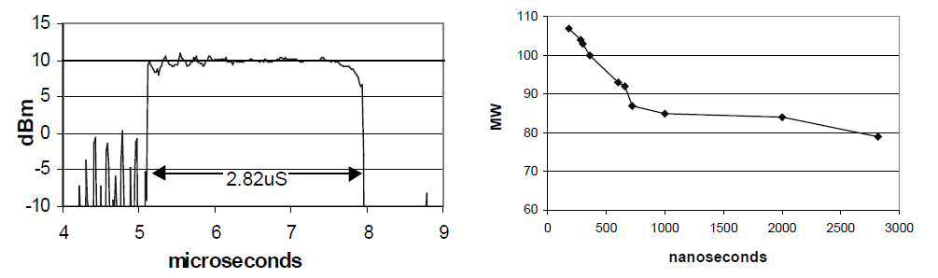
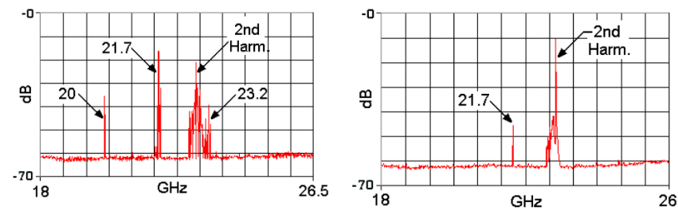
75XP1 Test Results
The original 75XP-1 was built, and eventually reached 79 MW at 2.8 μs in test
Power levels exceeding 100 MW were measured at shorter pulse widths
RF Pulse Envelope at 75 MW
Peak RF Power vs Pulse Width
Gun and output oscillations were observed, but corrected after rework

Slide 9
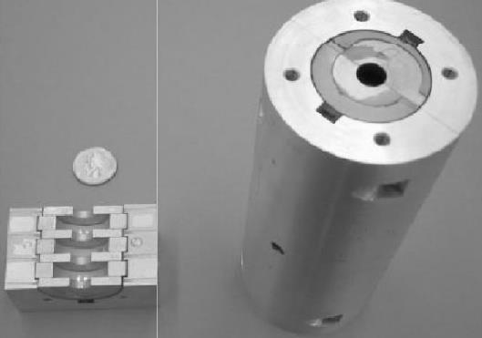
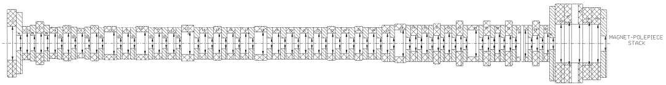
Lessons learned from the 75XP Series
75XP series met specifications, and in some cases exceeded them (over 100 MW at < 500 ns)
Gun & output oscillations were a recurring but solvable challenge.
Key issues identified:
75XP1, XP Diode, and 75XP3-2 were susceptible to gun oscillations
Magnetic circuit is quite complicated (i.e., expensive & hard to build)
At high duty, runaway condition with NdFeB magnets overheating
Body current vs. gun coil current settings were a “bit touchy”

Slide 10
The 75XP4 Redesign
The next design iteration, 75XP4, was partially complete when NLC was cancelled
The goal was to make the 75XP4 more robust against 75XP3 failure modes:
Potential for gun and output oscillations
Complexity of PPM stack
Runaway conditions of overheating magnets near output
Design sensitivity of gun coils
High gradient RF breakdown in output
For the C³ demonstrator source, we simulated the design that was already completed, and made further changes to address past issues.

Slide 11
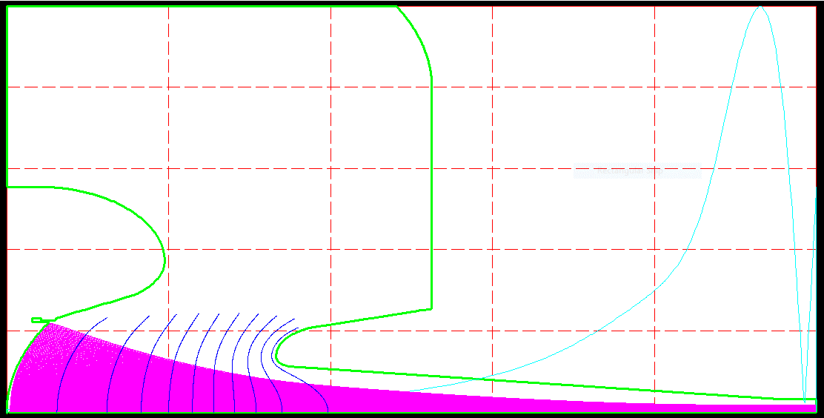
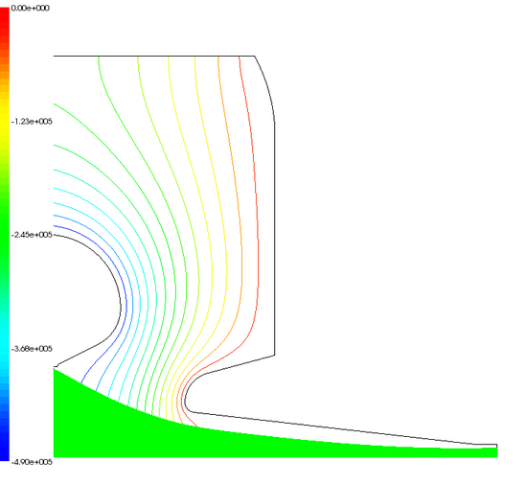
75XP4 Electron Gun
Gun re-modeled with & without magnets for beam trajectory and gradients
Simulations in both EGUN and MICHELLE, for use in TESLA & MAGIC sims
Correct perveance & beam size, gradients < 20 MV/m
Gun can was reshaped to de-tune previous oscillation modes
EGUN and MICHELLE models of gun in good agreement. ~260A @ 490 kV / 60% fill factor

Slide 12
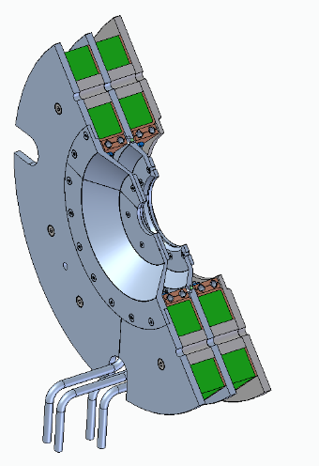
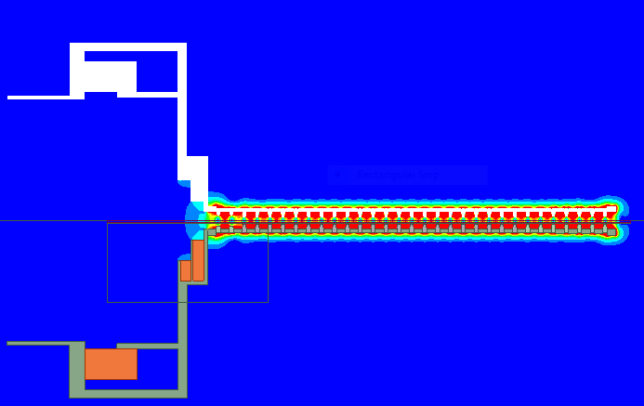
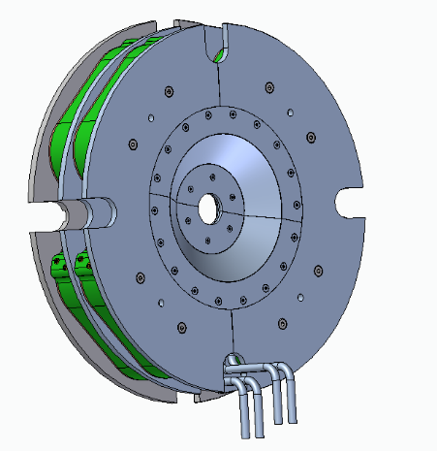
75XP4 Magnet Modifications
75XP4 magnet stack is much simpler than the previous 75XP tubes
All NdFeB magnets replaced with SmCo – higher grades available today
Only 3 magnet variants – reduced from ~40 unique magnets
Nominal design will use wound-on solenoid gun coils
New design of slide-in off-axis pot coils is being simulated now
Simplified magnet stack model in Ansys Maxwell
Off-axis coils for easier assembly

Slide 13
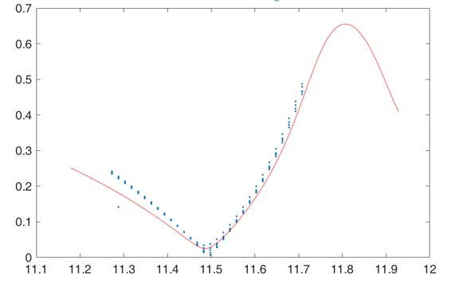
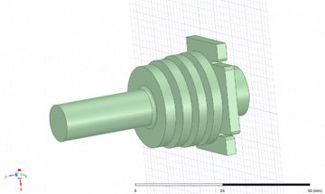
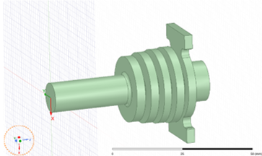
75XP4 Cavities & OP redesign
Original output cavity design (coupler cell) at risk of RF breakdown
Output coupler cell was reoptimized to meet more modern RF breakdown criteria
Original design: Sharp edges and small radius nose led to high surface currents
New design: “Racetrack” coupler layout to minimize gradients and surface currents
RF pulse heating reduced by ~3x; cell impedance unchanged from original design
Output Pulse Heating Reduced from 152 K → 50 K
Old vs. New S₁₁ vs Freq.
Original (square) output cell
New (racetrack) output cell

Slide 14
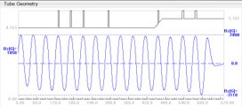

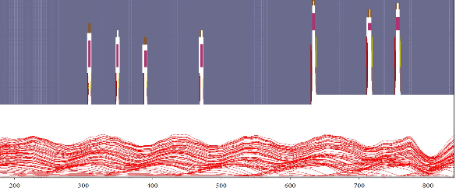
75XP4 DC Beam Transmission
B-field Profile in TESLA
DC beam simulated in both TESLA and MAGIC 2D to check for beam transmission
Coil adjusted for cathode field that minimizes DC beam scalloping
No beam intercept observed in either simulation
Spent beam was exported for collector thermal modeling; no modifications needed
TESLA DC Beam
MAGIC DC Beam

Slide 15
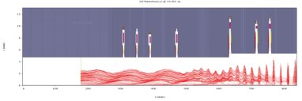
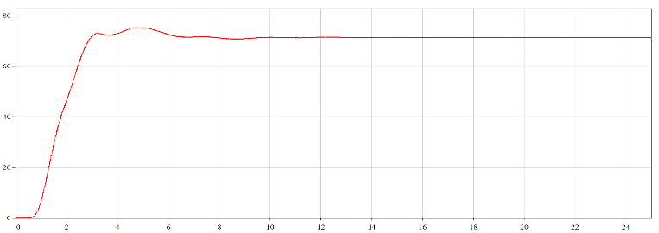
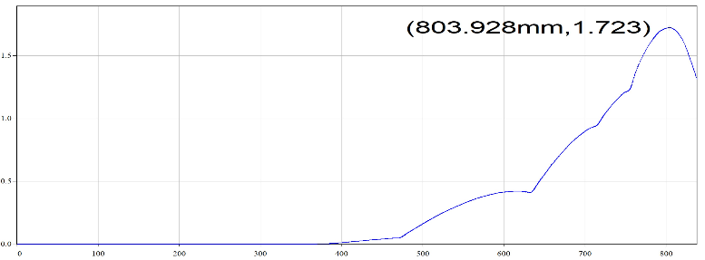

MAGIC2D PIC Simulations
RF performance simulated in MAGIC 2D
72 MW achieved with 40 W drive; Gun coil & beam voltage may be adjusted in test
Will confirm models in CST Microwave Studio, TESLA-Z, and MAGIC 3D while build proceeds
Bunching section @ 50 ns: RF beam
Direction of Beam Travel
Convergence of output power vs time
Output structure: 72 MW power extraction, no intercept
RF Current / DC Current vs. z [mm]. Max 1.72

Slide 16
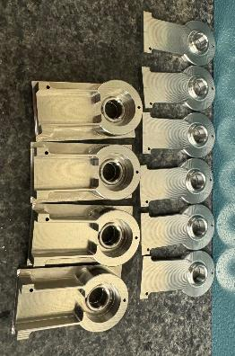
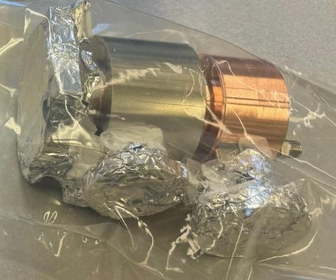
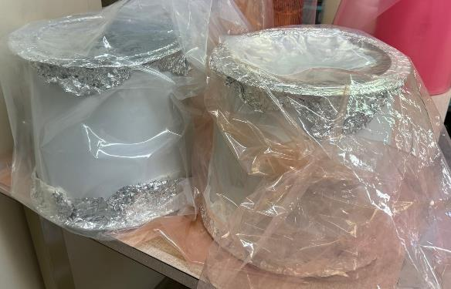
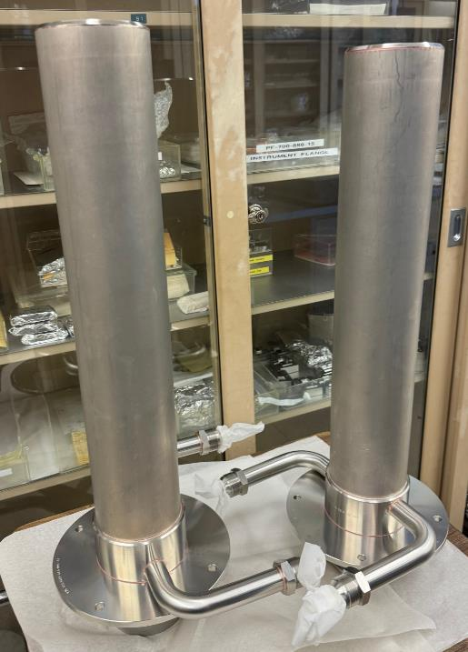
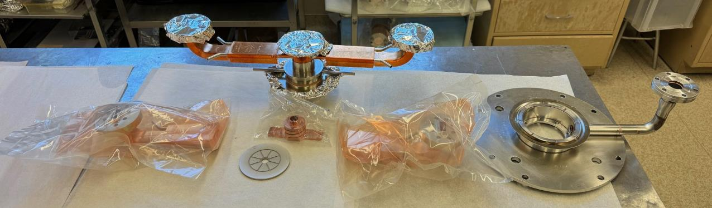
First prototype 75XP4 is under construction now

Slide 17
Thank you! This work would not be possible without building on decades of past efforts from the former SLAC Klystron Department. RF Source slide material from B. Weatherford talks at IVEC 2024 and LCWS 2024. Some material in this presentation was borrowed heavily from published SLAC-PUB articles and presentations by Daryl Sprehn, Arnie Vlieks, and Erik Jongewaard. Erik continues to be a fountain of knowledge for our department today.

Slide 18
Questions?

Slide 19
Backup

Slide 20
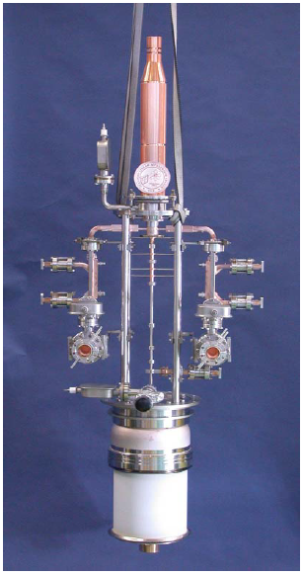
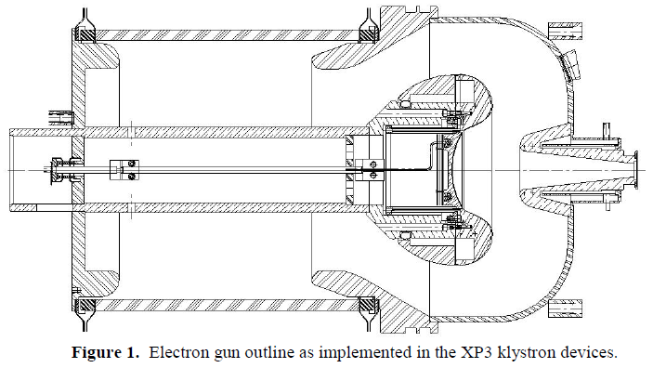
75XP3 Specifications
All specs identical to the 75XP1 except:
Pulse width target increased to 3.2 microseconds (for a while…)
Compact Gun Redesign for 75XP3

Slide 21
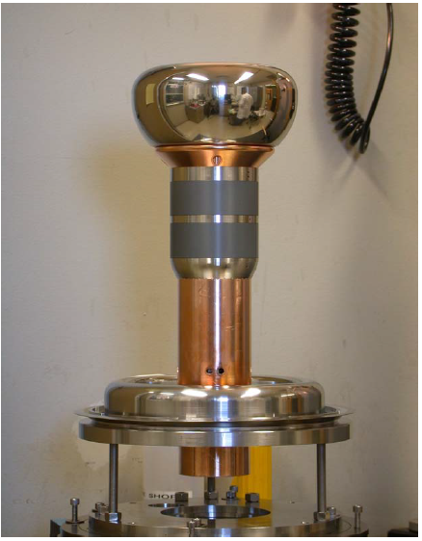
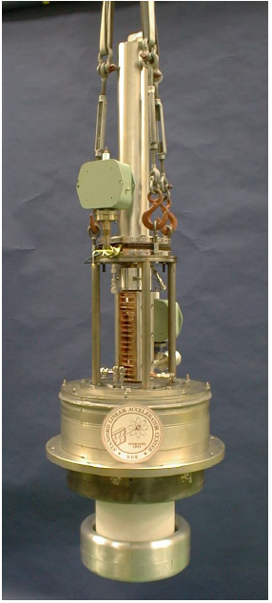
75XP3 Diode
Gun/PPM/Collector Diode was built to validate new components for the 75XP3:
New beam tunnel size and focusing magnets
New compact gun and collector designs
Addition of gun coil assembly
Gun oscillation at 3.17 GHz corrected w/ loss collar
After loss collar added, 99.9% transmission, ran to full beam spec at 490kV / 3 µs / 120 Hz

Slide 22
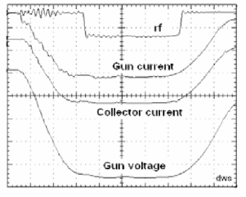
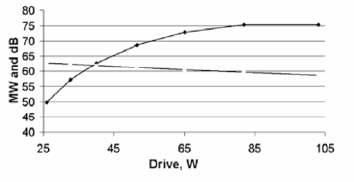
Summary of 75XP3 Serial Numbers
RF, current, and voltage waveforms for 75XP3-4
75XP3-1 (first serial number):
First tube with clamped-on magnets
Result: OP Oscillation @ 11.7 GHz
Arose due to a fabrication error. It is suppressed when output chain is assembled correctly
75XP3-2:
Also used clamped-on magnets
Result: Died from gun arc at 3.2 microsecond pulse width
Smaller gun size had reduced safety factor; also, 3.2 µs was 2x original design target
Also observed a gun oscillation
75XP3-3: Added gun loss ceramic
Result: Met specification
75 MW @ 120 Hz / 1.6 µs
NLC spec at this point was reduced back to 1.6 µs
Some beam intercept
No temperature monitoring due to clamp-on magnet stack
75XP3-4: Integral Pole Pieces
Result: Met specification again
75 MW @ 120 Hz / 1.6 µs
Beam loss was 1.3%
Needed slight voltage increase to meet power
Power & gain vs. drive
22

Slide 23
Design Modifications for the 75XP3
The 75XP3 series was a full-tube design iteration of the 75XP1
Goal was to make a “design for manufacturing” in support of NLC:
Introduced clamp-on “clam-shell” magnet assemblies to allow pre-test
Removed the adjustable gun design / tightening of gun tolerances
Modified cavity spacings
Modified beam tunnel sizes / tailpipe and cooling
Gun coil assembly added for adjusting beam match into PPM stack during test
Implementation of dual-window output

