Slide 1

Update on the FCC-ee injector
S. Bettoni¹, A. Latina², A. Grudiev², P. Craievich¹, S. Doebert², A. Kurtulus², J.-Y. Raguin¹, R. Zennaro¹
(WP1 FCCee Injector Study Group)
¹ Paul Scherrer Institut, Villigen (Switzerland)
² CERN, Meyrin (Switzerland)

Slide 2
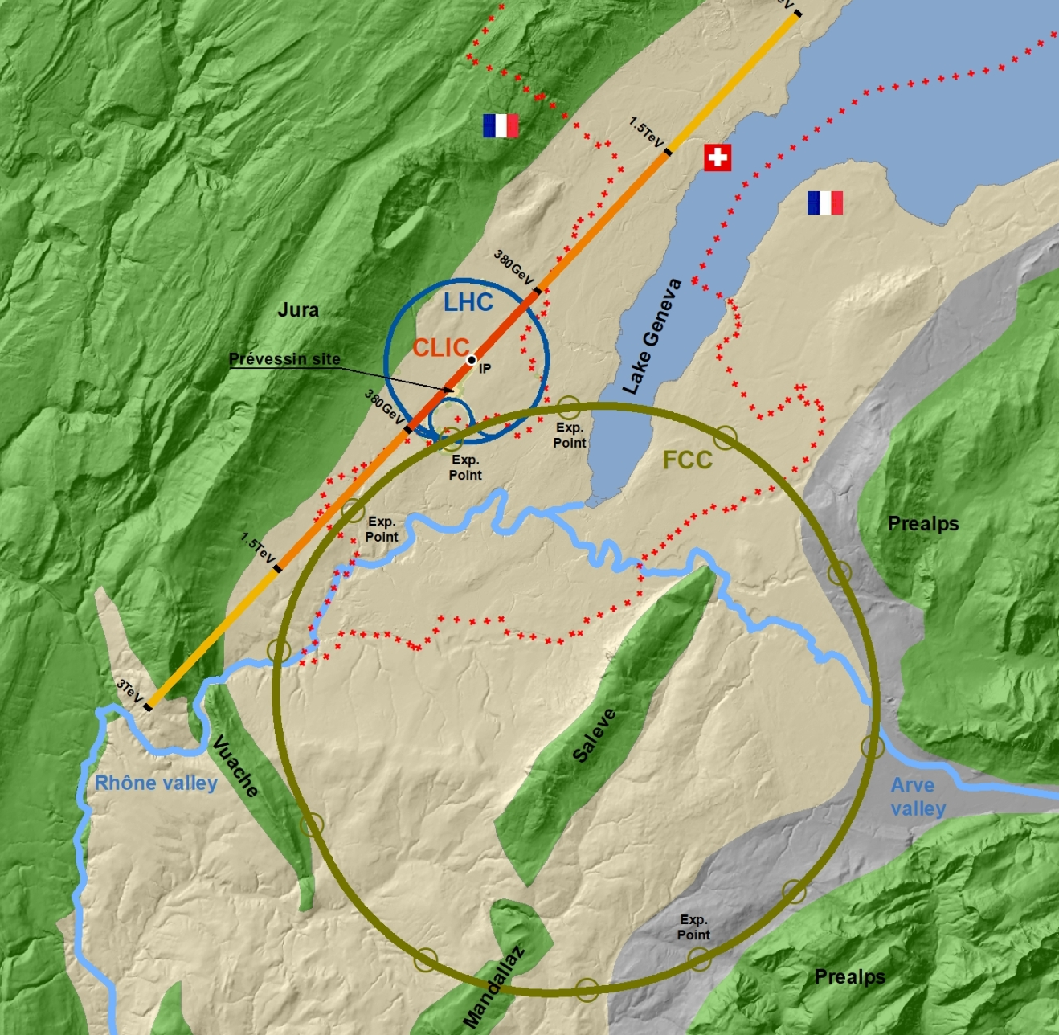
Outlook
FCC, FCCee, and the FCCee injector complex
Static effects:
  Transverse dynamics: emittance preservation in presence of elements misalignments and mitigation strategies
  Longitudinal phase space manipulation: match the target energy spread and bunch length
Dynamic effects:
  Single bunch jitter and jitter amplification
  Multi-bunch jitter and jitter amplification
Conclusions

Slide 3
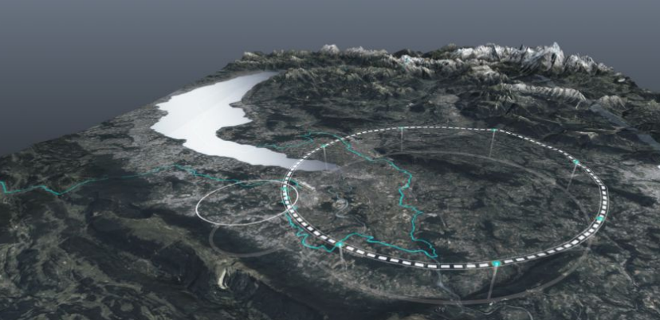


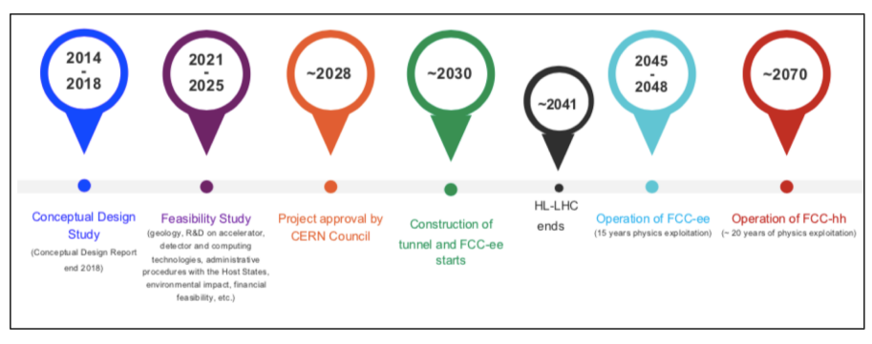
Future Circular Collider e+/e-: FCCee
Circumference ~ 91 km
Energy range (CM): ~ 90-360 GeV
Leman lake
 | Z | WW | ZH | ttbar | Unit
Beam energy | 45 | 80 | 120 | 182.5 | GeV
Number bunches/ring | 11200 | 880 | 248 | 36
Luminosity per IP (x10³⁴) | 182 | 19.4 | 7.3 | 1.33 | cm⁻²s⁻¹
Luminosity/year 4 IPs | 8 | 18 | 6 | 10 | ab⁻¹/year
Geneva
1st stage FCCee:
electron-positron collisions: electroweak and Higgs factory, indirect exploration of the next energy frontier (x10 from LHC)
2nd stage FCChh:
proton-proton collisions at ~ 100 TeV: direct exploration of the next energy frontier (x10 LHC): Higghs coupling, heavy ions collisions, …
Sources: F. Gianotti at the 2024 FCC Week (link here), and mid-term review (Oct 2023)

Slide 4
Project structure
Collaboration between PSI and CERN with external partners, CNRS-IJCLab (Orsay), INFN-LNF (Frascati)
Other collaborators and/or observers:
  KEKB
  INFN-Ferrara
Project officially started in summer 2021
WP1 and WP2 merged in a WP (WP1) responsible for the e+/e- linacs up to 20 GeV
Present phase FCC-ee Injector study: CDR+ with cost estimate
  Baseline and cost estimate provided at the mid-term review (MTR) in October 2023
  New optmization based on the reccomendations and new baseline for the feseability study report to be delivered by March 2025

Slide 5
Evolution of the injector complex layout
400 Hz
Use the SPS as pre-booster to bring the beam energy from 6 GeV up to 20 GeV (linac up to 6 GeV)
200 Hz
200 Hz
Layout 3A
Inject directly the 20 GeV
beam to the booster ring (linac
up to 20 GeV)
400 Hz
200 Hz
200 Hz
200 Hz
Option 3 (present)
Layout 3B
Positrons generated at a lower electron beam energy (possible because of the large yield)
No common linac with 2x repetition rate, no long return line and large arc
Both species with flat emittances from DR
Higher energy DR (2.86 GeV) for positrons and DR for electron beam
More stable and better-quality electron bunches at the injection to the HE linac
100 Hz
100 Hz
100 Hz

Slide 6


Layout 3B compared to layout 3A
From the October 2023 mid-term review to present:
Overall linacs power consumption reduced by more than factor 3, by means of:
  New accelerating structure design with higher shunt impedance
  Lower gradient (from ~30 MV/m ~24 MV/m to 22.5 and 20.5 MV/m)
  Lower repetition rate
Operation reliability is improved:
  Lower gradient
  Lower repetition rate (100 Hz instead of 200 Hz and 400 Hz)
  Lower average and peak power
😐4 bunches per pulse poses some challenges:
  Electron and positron sources (WP1 and WP3)
  Long range wakefield suppression and beam loading compensation (WP1)
Total length of the linacs is higher: injector siting on the CERN site under study
  ☺ It has a small impact on the total cost
  This potentially facilitates an upgrade to higher energy by adding more RF power sources, in case required in the future
Courtesy of A. Grudiev,
P. Craievich

Slide 7
Target parameters
200 MeV
1.54 GeV
6 GeV
20 GeV
Layout 3A
σ_{z} = 1 mm
(ε_{x}. ε_{y}) = (3.2,3.2) mm.mrad
σ_{z} = 1 mm → 4 mm
(ε_{x}. ε_{y}) < (10,10) mm.mrad
200 MeV
2.86 GeV
2.86 GeV
20 GeV
Layout 3B
e- linac
DR
HE linac
BOOSTER
σ_{z} = 1 mm
(ε_{x}. ε_{y}) = (3.2,3.2) mm.mrad
σ_{z} = 1 mm
(ε_{x}, ε_{y}) = (10,1) mm.mrad
σ_{z} = 1 mm → 4 mm
(ε_{x}, ε_{y}) < (20,2) mm.mrad
Parameter | Value | Unit
Norm. emittance (x, y) (rms) | <(2,20) | mm.mrad
Bunch length (rms) | ~4 | mm
Energy spread (rms) | 0.1-0.15 | %
Transverse jitter | 1 | sigma
Number of bunches | 4
Bunch spacing | 25 | ns
Charge variation | 100 | %
7

Slide 8
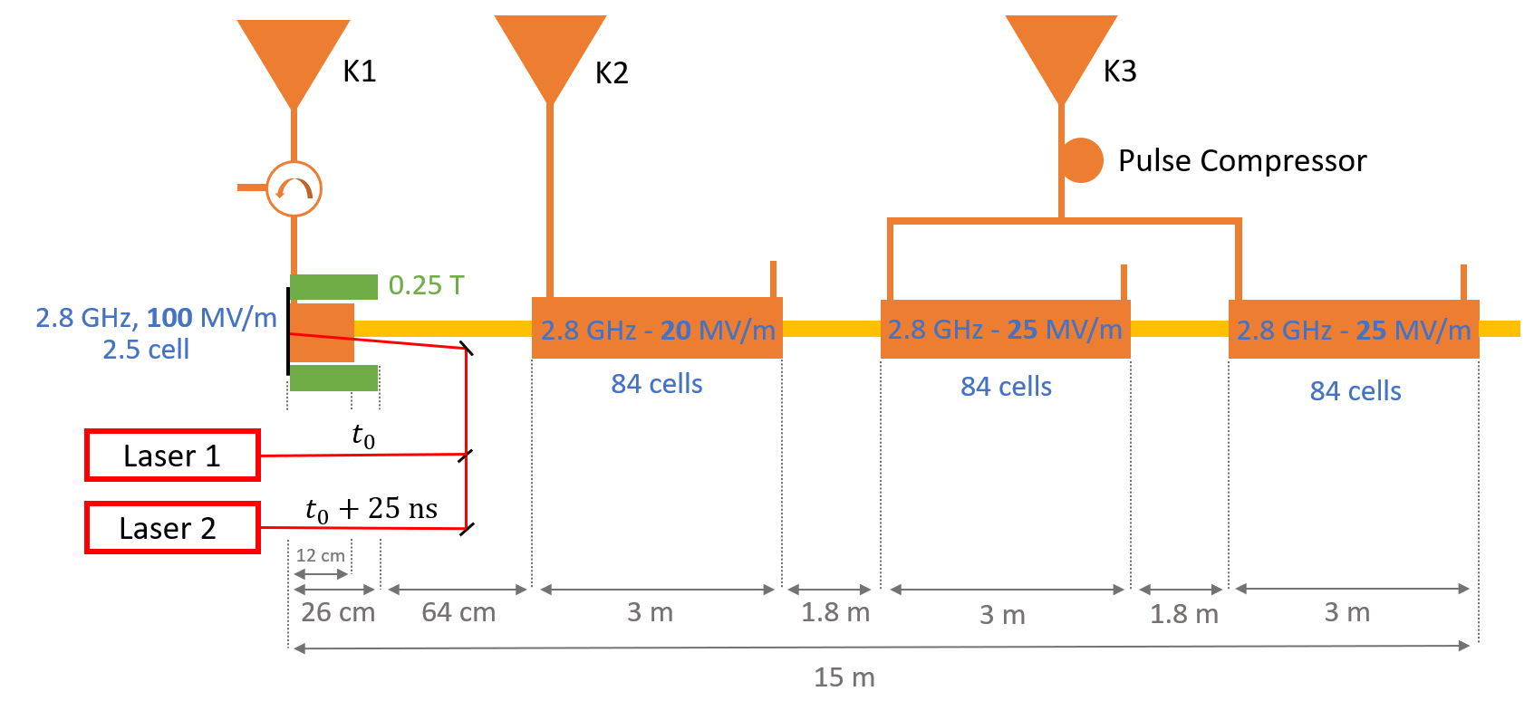
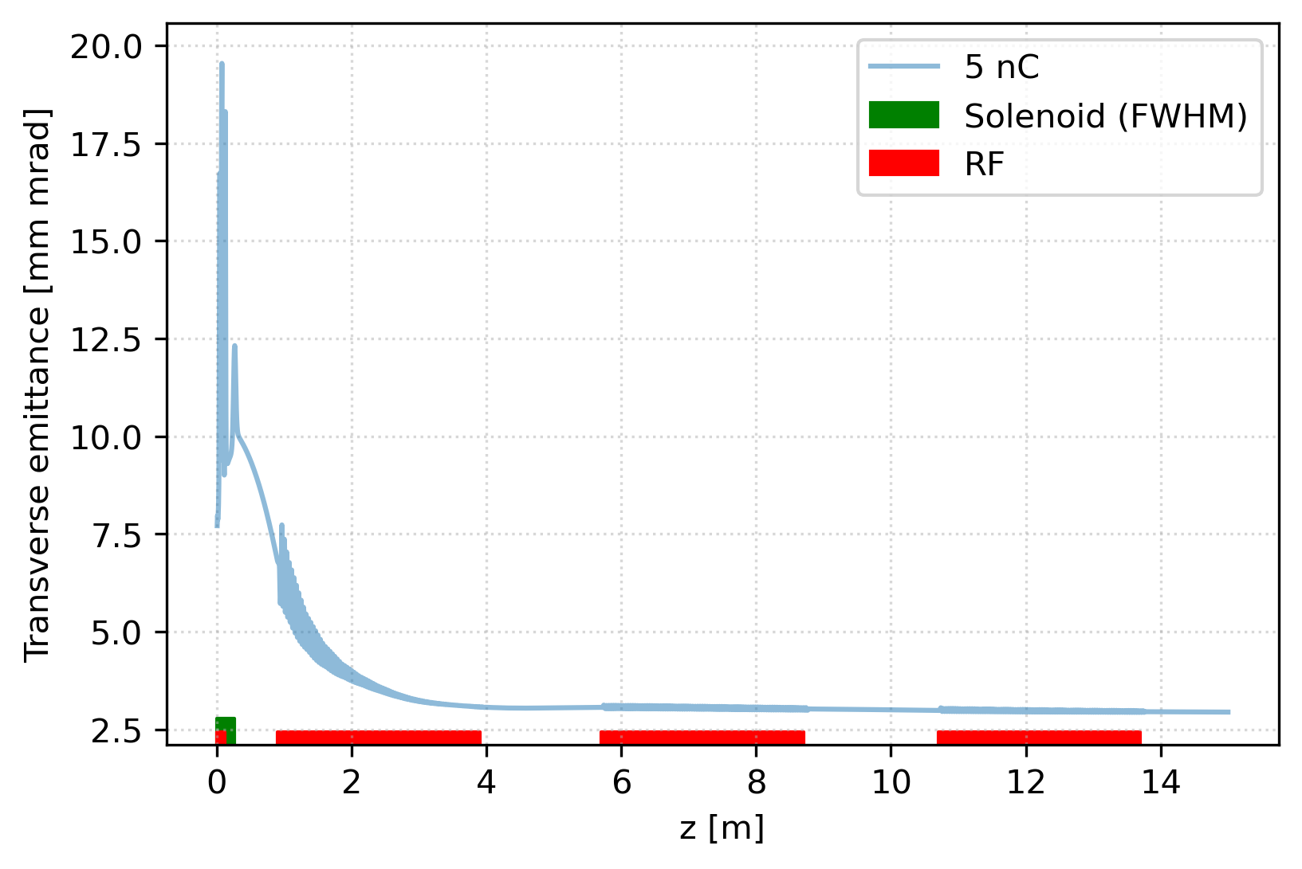
Electron source
SwissFEL S-band gun
Top-up mode studied: solution to preserve the shot-by-shot emittance for different bunch charges (Digital Micromirror Device)
Design documented and published in
https://doi.org/10.1016/j.nima.2024.169261
Next steps: prototyping of hardware and testing of top up mode charge variation
Bunch parameter | Simulation | Target
Transverse emittance | 3.14 mm.mrad (rms) Assumed 3.2 mm.mrad (rms) | < 4 mm.mrad
Bunch length | 0.96 mm (rms) | 1 mm
Final energy | 190 MeV | 200 MeV
Energy spread | 0.2% (390 keV ) | < 0.5 %
Bunch charge | 5 nC | 5 nC
Courtesy of S. Doebert and Z. Vostřel

Slide 9
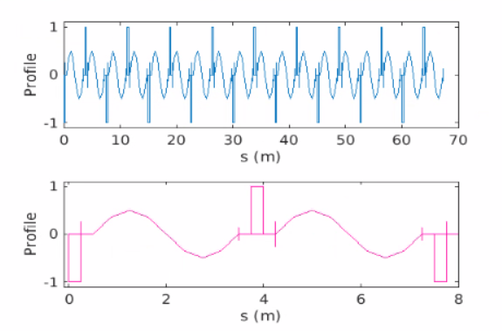
Linacs’ modeling and simulation codes
Lattice modeling:
    FODO lattice with 90 degs phase advance/cell
    One quadrupole/RF structure: distance among the quadrupoles≿3 m
    RF structures’ wakefield: Bane model (a in the following is the iris radius)
    90 degrees of the RF cavity corresponds to on-crest operation
    a/λ corresponds to the mean a/λ
Very important for the bunch jitter amplification
Simulation codes:
    MAD-X: optics matching
    Elegant: single bunch tracking simulations longitudinal plane
    RF-Track (A. Latina): single and multi-bunch tracking simulations transverse plane
RF structure
RF-Track→ https://zenodo.org/records/4580369
Quadrupole

Slide 10
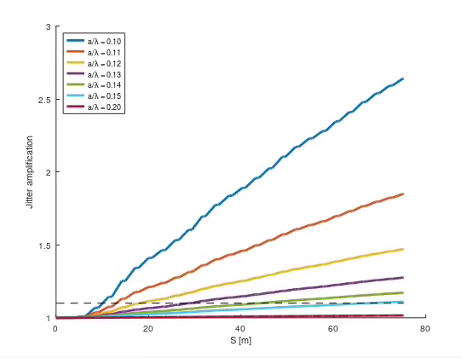
Transverse dynamics
SINGLE BUNCH
MULTI-BUNCH
Static misalignments
Bunch jitter amplification
Bunch-to-bunch jitter amplification
Jitter amplification
s (m)
Source: misalignments of the lattice elements
Effect: emittance growth
Cures: trajectory correction schemes
Source: off-axis incoming orbit and short-range wakefield
Effect: bunch jitter amplification
Cures: lattice and RF aperture
Source: preceding bunch and long range wakefield
Effect: bunch-to-bunch jitter amplification
Cures: lattice and RF high order mode mitigation

Slide 11
Transverse Dynamics: single bunch: static

Slide 12
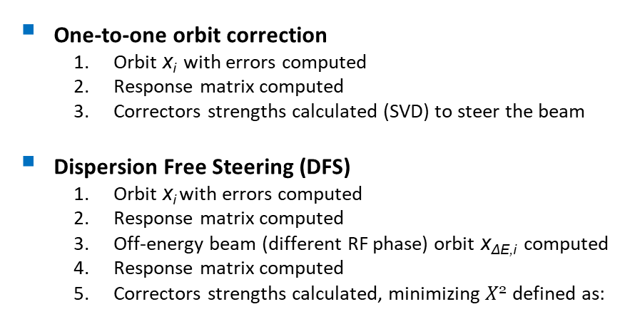
Errors, orbit steering, and impact to the machine
Quadrupoles
Offset x, y = 50 μm rms
Gaussian distribution
RF cavities
Offset x, y = 100 μm rms
Gaussian distribution
BPM
Offset x, y = 30 μm rms
Resolution x, y = 10 μm
Gaussian distributions
Elements
misalignments
  Taken more than 98% of the “good seeds”
  (very pessimistic assumption)
Steering algorithms
No orbit correction
One-to-one correction
One-to-one correction + DFS in cascade
One-to-one orbit correction
  Orbit x_{i} with errors computed
  Response matrix computed
  Correctors strengths calculated (SVD) to steer the beam
Dispersion Free Steering (DFS)
  Orbit x_{i} with errors computed
  Response matrix computed
  Off-energy beam (different RF phase) orbit x_{ΔE,i} computed
  Response matrix computed
  Correctors strengths calculated, minimizing $X$² defined as:

Slide 13
Static single bunch layout 3A: results
Layout 3A
a/λ | a (mm) | e- Linac | Common Linac (82 deg) | Common Linac (90 deg)
0.10 | 10.7 | 5.0 | / | 5.1
0.12 | 12.9 | 0.8 | 1.6 | 0.6
0.13 | 13.9 | / | / | /
0.14 | 15.0 | 0.3 | 0.8 | 0.2
0.15 | 16.1 | 0.2 | 0.5 | 0.1
Low energy (0.2-1.56 GeV)
Outcomes:
Largest emittance growth/length at the low energy section→ important reduction in case of the e- damping ring option
Emittance growth strongly depends on the RF operating phase
a/λ | a (mm) | e- linac | Common linac (90 deg) | HE linac, Nbins = 10
0.10 | 10.7 | 5.0 | 5.1 | 0.3
0.11 | 11.8 | 2.4 | 1.7 | 0.3
0.12 | 12.9 | 0.8 | 0.6 | 0.3
0.13 | 13.9 | 0.7 | 0.3 | 0.2
0.14 | 15.0 | 0.3 | 0.2 | 0.1
0.15 | 16.1 | 0.2 | 0.1 | 0.1
HE linac
(6-20 GeV)
Outcomes:
Relatively small emittance growth even for smaller RF apertures
Essential to separate the orbit steering/DFS in several sections (what we call bins)

Slide 14
Static single bunch layout 3B: results
Layout 3B
2.86 GeV
e- Linac (0.2-2.86 GeV)
N_bins | Δε (mm.mrad) | ε (mm.mrad)
3 | 0.5 | 3.7
4 | 0.4 | 3.6
5 | 0.3 | 3.5
7 | 0.3 | 3.5
10 | 0.3 | 3.5
0.2 GeV
20 GeV
a/λ = 0.15 (layout 3A)
HE linac (2.86-20 GeV)
N_bins | Δε (mm.mrad) | ε (mm.mrad)
8 | 0.6 | 1.6
9 | 0.6 | 1.6
10 | 0.6 | 1.6
12 | 0.6 | 1.6
a/λ = 0.12
N_bins | Δε (mm.mrad) | ε (mm.mrad)
3 | 1.8 | 5.0
4 | 1.5 | 4.7
5 | 1.2 | 4.4
7 | 1.2 | 4.4
10 | 1.2 | 4.4
a/λ = 0.12
(HE linac layout 3A)
Outcome:
Larger emittance growth than in layout 3A (longer linac)
Final emittance in the specifications in the most critical plane (<2 mm.mrad in y)
Under evaluation aperture restriction in e- linac (with WP3, WP4)
Outcomes:
Essential to separate the orbit steering/DFS in several bins
We are considering smaller RF apertures compared to layout 3A (ongoing verification of the obtained parameters by positrons-done-and DR groups)

Slide 15
Longitudinal Dynamics: single bunch: static

Slide 16
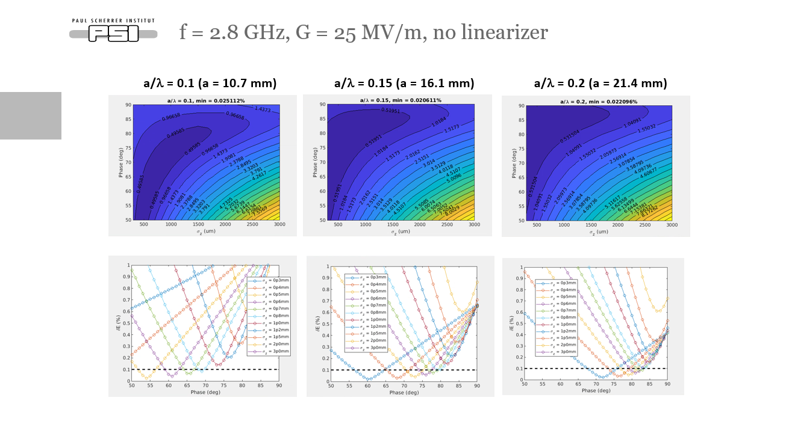
Beam and RF parameters optimization
Goals: projected energy spread ~0.1-0.15% and bunch length up to ~4 mm at the booster injection
Procedure: scan of the RF frequency, gradient, and geometry (a/λ-being a the iris radius).
For each configuration, the maximum bunch length and the corresponding phase giving the target energy spread are selected
f (GHz) | G (MV/m) | a/λ | a (mm) | Maximum σ_{z} (mm) |  | Maximum phase (deg)
 |  |  |  | δ_{E} = 0.1 % | δ_{E} = 0.15 % | δ_{E} = 0.1 % | δ_{E} = 0.15 %
2.8** | 25 | 0.1 | 10.7 | 0.8 | 1.2 | 69 | 89
2.8** | 25 | 0.15 | 16.1 | 0.8 | 1 | 79 | 82
2.8** | 25 | 0.2 | 21.4 | 0.7 | 0.8 | 82 | 82
2.8** | 40 | 0.1 | 10.7 | 0.8 | 0.8 | 77 | 85
2.8** | 40 | 0.15 | 16.1 | 0.7 | 1 | 82 | 79
2.8** | 40 | 0.2 | 21.4 | 0.7 | 0.8 | 85 | 84
5.6** | 25 | 0.15 | 8.0 | 0.5 | 0.6 | 61 | 66
5.6** | 25 | 0.2 | 10.7 | 0.5 | 0.6 | 74 | 66
5.6** | 40 | 0.1 | 5.4 | 0.4 | 0.5 | 81 | 73
5.6** | 40 | 0.15 | 8.0 | 0.5 | 0.5 | 71 | 72
5.6** | 40 | 0.2 | 10.7 | 0.4 | 0.5 | 67 | 72
2.0* | 25 | 0.1 | 15 | 1 | 1.2 | 78 | 81
2.0* | 25 | 0.15 | 22.5 | 1 | 1.2 | 85 | 85
2.0* | 25 | 0.2 | 30 | 1 | 1.2 | 84 | 86
2.0* | 40 | 0.1 | 15 | 1 | 1.2 | 87 | 88
2.0* | 40 | 0.15 | 22.5 | 1 | 1.2 | 86 | 84
2.0* | 40 | 0.2 | 30 | 1 | 1.2 | 88 | 87
Typical scans
** Electron linac at 2.8 GHz * Electron linac at 2 GHz

Slide 17
Most promising layouts (full chain)
Layout 3A
Kept for layout 3B for now
f (GHz) | G (MV/m) | a/λ | a (mm) | Maximum σ_{z} (mm) |  | Maximum phase (deg)
 |  |  |  | δ_{E} = 0.1 % | δ_{E} = 0.15 % | δ_{E} = 0.1 % | δ_{E} = 0.15 %
2.8 | 25 | 0.15 | 16.1 | 0.8 | 1 | 79 | 82
5.6 | 25 | 0.2 | 10.7 | 0.5 | 0.6 | 74 | 66
5.6 | 40 | 0.2 | 10.7 | 0.4 | 0.5 | 67 | 72
2.0 | 25 | 0.1 | 15 | 1 | 1.2 | 78 | 81
With all these configurations we reach
energy spread ~ 0.1-0.15%, BUT we need to operate off-crest the linac (impact on the emittance), and decompress the beam at the end to match the booster requirements
We operate on-crest, and we tune configuration the parameters in the high energy section using the energy compressor
σ_{z0} >~ 1 mm, φ~80 deg
Larger aperture
Lower gradient and klystron availability
e- linac
Common linac
HE linac
σ_{z0}
f1 = 2.0 GHz
f1 = 2.0 GHz
f1 = 2.0 GHz
σ_{z0} ~ 1 mm, φ~80 deg
Selected
e- linac
Common linac
HE linac
σ_{z0}
f1 = 2.8 GHz
f1 = 2.8 GHz
f1 = 2.8 GHz
More off-crest operation
Low energy gain and larger Δε
σ_{z0} ~ 0.5 mm, φ~70 deg
e- linac
Common linac
HE linac
σ_{z0}
f1 = 5.6 GHz
f1 = 5.6 GHz
Shorter bunch length
Larger initial emittance and more energy loss
f1 = 5.6 GHz
More reported at previous FCC Weeks

Slide 18
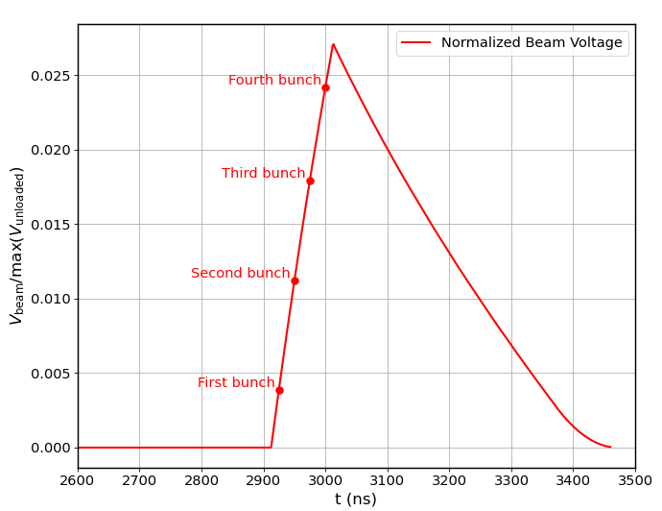
The energy compressor (EC): how we plan to use it
A special thanks to R. Zennaro
Goal: manipulate the bunch longitudinal phase space
Similar system in SuperKEK-B to maximize the number of positrons to DR
f1
f2
DR
HE linac
R₅₆
RF EC
To booster
ΔEnergy
(intra/inter-bunch)
ΔTime
Target energy difference along the bunch (single bunch) and/or in between the bunches (multi-bunch)
RF Δphase
Single bunch
Multi-bunch and single bunch
4 bunches separated by 25 ns each
(variation DE/E from the 1st to the 4th bunch ~ 2%)
Courtesy of
A. Kurtulus, A. Grudiev
R₅₆ and incoming chirp→bunch length
RF voltage and R₅₆ →single bunch energy spread
More similar single bunch energy spread for low charge bunch compared to the case without the EC
Compensate also for the bunch-to-bunch energy variation
Extra knob necessary: chirp from the upstream compressor, bunch length, moderate off-crest operating phase, …

Slide 19
The energy compressor: single and multi-bunch results
R₅₆ = 0.6 m
f2 = 2.8 GHz
V = 663 MV
f1 = 2.8 GHz
HE linac
RF EC
σ_{z0} = 0.8 mm
σ_{z0} = 0.8 mm
ΔE/E = 0.56%
ΔE_{cen} /E = 0.43%
σ_{z0} = 3.9 mm
ΔE/E = 0.56%
ΔE_{cen} /E = 0.43%
Q = 5 nC, σ_{z0} = 3.9 mm, ΔE/E = 0.13%
ΔE_{cen} /E = 0.01%
f2 = 5.6 GHz
V = 331.5 MV
Several combination layouts studied:
  Normal conducting or superconductive dipoles, S-band and C-band RF cavities
  Total length: 50-100 m according to the selected case including matching sections upstream and downstream of EC
Using EC:
  Tuned the single bunch length and energy spread with a factor between 3 and 4 margin on the booster requirements
  Minimized the bunch-to-bunch energy separation without using possibly complicated LLRF schemes
  Minimized the emittance growth and maximized the energy efficiency operating HE linac on-crest
  Tunability of the beam to the booster without modifying the linacs
At the exit of the EC (Q = 5 nC)
 | Bunch 1 | Bunch 2 | Bunch 3 | Bunch 4
Single bunch DE/E (%) | 0.16 | 0.15 | 0.13 | 0.10
Rms bunch length (mm) | 3.94 | 3.90 | 3.86 | 3.83
DE/E centroid from bunch 1 (%) | 0 | -0.018 | -0.019 | -0.042
Outcomes:
  Bunch length~4 mm
  Single bunch ΔE/E~0.10-0.15% (~4 times smaller possible)
  Bunch-to-bunch ΔE/E centroids compensated at the 10⁻⁴ level
  For low charge mode less impact than without the EC

Slide 20
Transverse Dynamics: dynamic

Slide 21
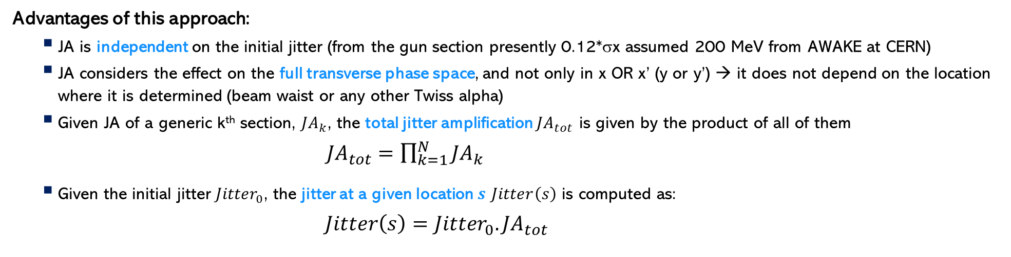
“Painting” of the transverse phase space and jitter
Bunch
x’
Approach proposed by A. Latina, and already applied to the CLIC design
Jitter amplification computation:
  Single bunches distributed on a circle (in 10 degrees step size) injected to the line with different (x,x’) or (y,y’)
  Computed the area in the initial beam transverse phase space → A₀
  Computed the area in the final beam transverse phase space → A_{F}
  Jitter amplification, JA, is defined as the ratio of the areas → A_{F} /A₀
x
Advantages of this approach:
    JA is independent on the initial jitter (from the gun section presently 0.12*σx assumed 200 MeV from AWAKE at CERN)
    JA considers the effect on the full transverse phase space, and not only in x OR x’ (y or y’) → it does not depend on the location where it is determined (beam waist or any other Twiss alpha)
    Given JA of a generic k^{th} section, ${JA}_{k}$, the total jitter amplification ${JA}_{tot}$ is given by the product of all of them
    ${JA}_{tot}=\prod_{k=1}^{N}{{JA}_{k}}$
    Given the initial jitter ${Jitter}_{0}$, the jitter at a given location $s$ $Jitter\left(s\right)$ is computed as:
    $Jitter\left(s\right)={Jitter}_{0}.{JA}_{tot}$

Slide 22
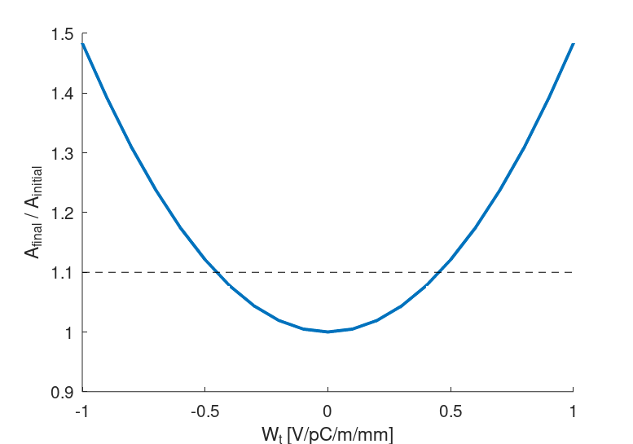
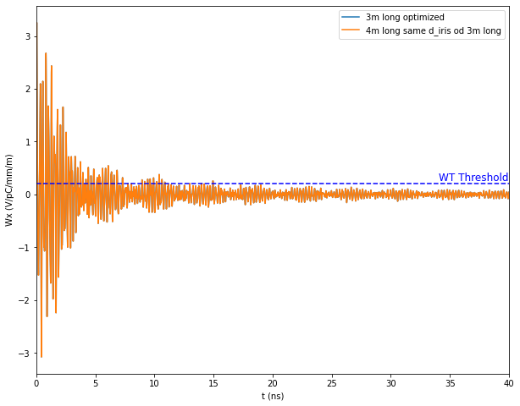
Multi-bunch jitter amplification: procedure
Simulations’ strategy: provide specifications for the RF design
    Imposed a kick to the second bunch to simulate the long-range wakefield generated by the first bunch to the following one: independent on the bunch time separation
    Determined the tolerable kick to maintain the JA below the defined threshold
    RF design aims to produce transverse wakefield below this value
    This method is independent on the minimum bunch separation
Jitter amplification
JA limit
Bunch 1
Bunch 2
Courtesy of A. Kurtulus,
A. Grudiev
Kick limit

Slide 23
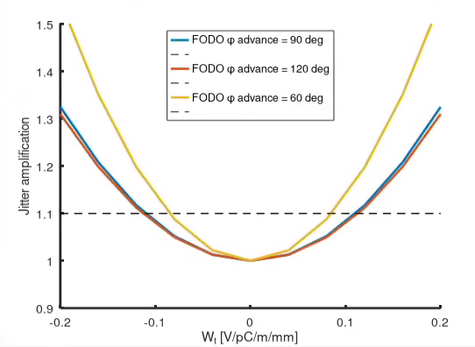
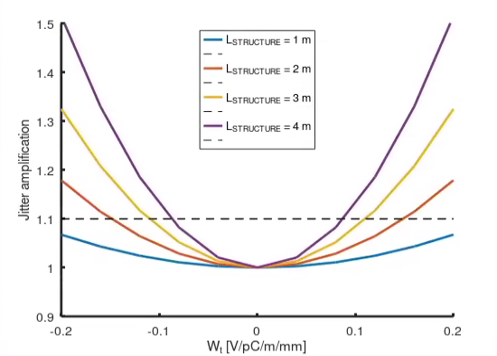
Multi-bunch jitter amplification: dependences
Layout 3A
  Simulations → full linac chain from 200 MeV (gun section exit) to 20 GeV
FODO phase advance
RF structure length ←→ distance quad-to-quad
Outcomes:
  Strong dependence of the jitter amplification on the FODO optics phase advance solely far away from the 90 degrees phase advance lattice
  Strong dependence of the jitter amplification on the (RF structure length) distance among the quadrupoles

Slide 24
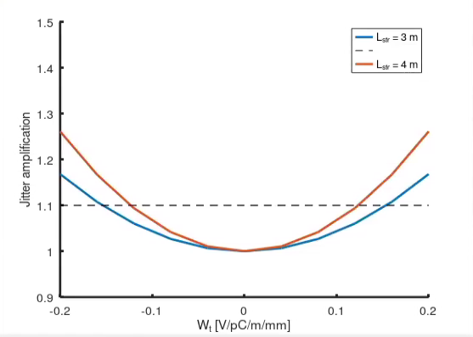
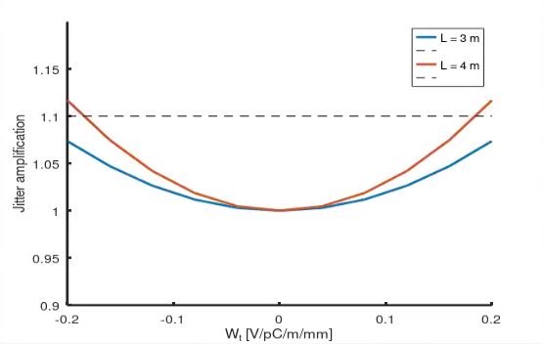
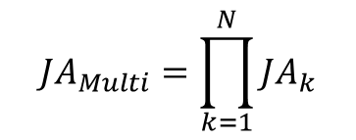
Multi-bunch, jitter amplification: results
Layout 3B
$${JA}_{Multi}=\prod_{k=1}^{N}{{JA}_{k}}$$
$${JA}_{Multi}={JA}_{eLin}.{JA}_{Kicker inj}.{JA}_{DR}.{JA}_{Kicker extr}.{JA}_{HELin}$$
WP3
Injection/extraction experts
e- linac
HE linac
Maximum kick<0.11 V/pC/m/mm → ${JA}_{e−linac}$~1.08$,{JA}_{HE}$~1.03

Slide 25
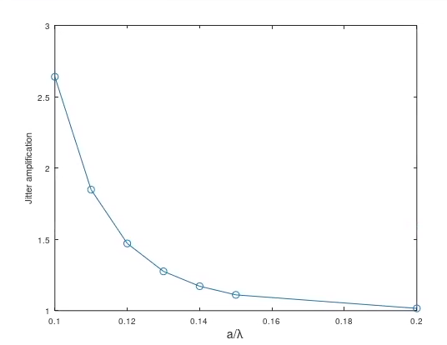
Single bunch jitter amplification: procedure
Simulation setup:
  Compute the JA along the considered linac
  Determine the JA at the end of the considered linac
  Given the maximum acceptable jitter, determine the specifications for the RF design
JA limit
RF aperture limit

Slide 26
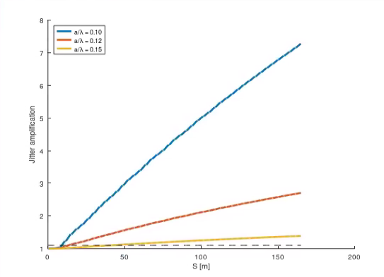
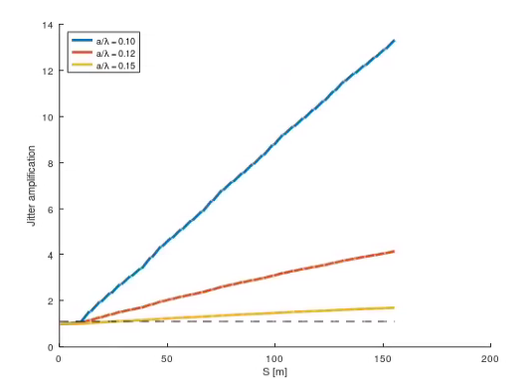
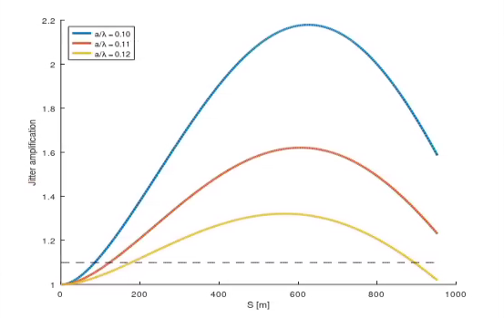
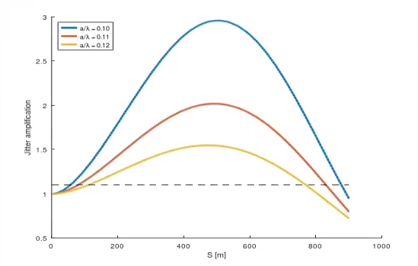
Single bunch jitter amplification: results
Layout 3B
L RF structure ←→ quadrupoles distance ≡ d_{q}
 | d_{q} = 3 m | d_{q} = 4 m
a/λ = 0.10 | 7.25 | 13.40
a/λ = 0.12 | 2.73 | 4.15
a/λ = 0.15 | 1.40 | 1.75
e- linac
d_{q} = 3 m
d_{q} = 4 m
 | d_{q} = 3 m | d_{q} = 4 m
a/λ = 0.10 | 1.59 | 0.72
a/λ = 0.11 | 1.23 | 0.80
a/λ = 0.12 | 1.02 | 0.94
HE linac
d_{q} = 3 m
d_{q} = 4 m
Outcomes:
  Electron and high energy linac (single and multi-bunch together) use ~20% of the jitter budget with the present RF and line design
  This conclusion relies on a strong reduction of the jitter amplification. What is the mechanism?

Slide 27
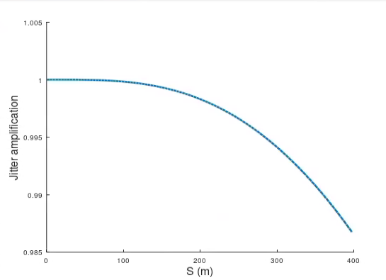
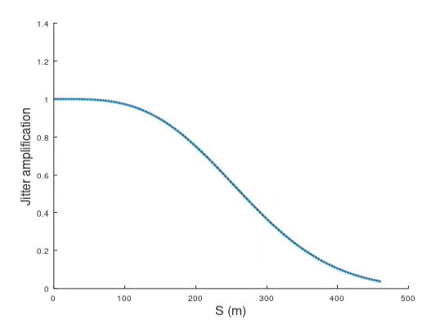
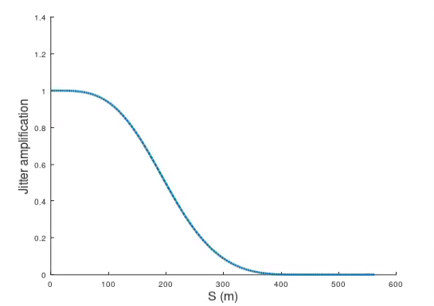
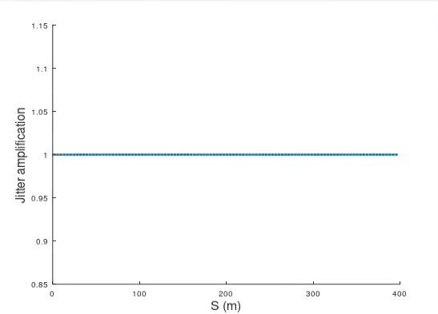
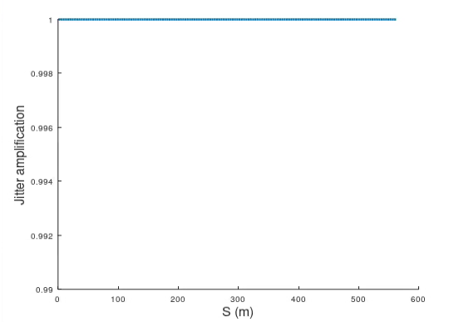
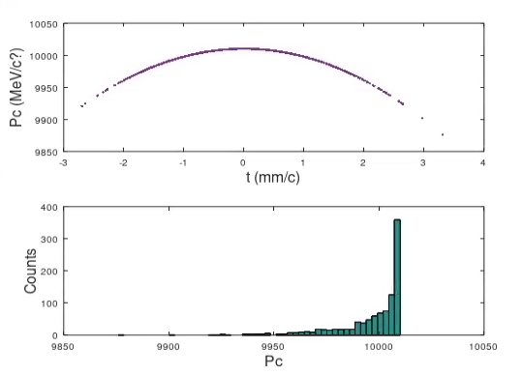
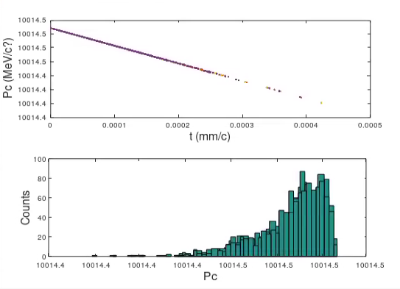
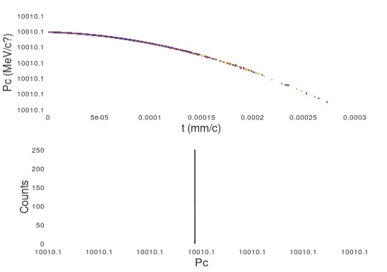
Single bunch jitter amplification: observations
φ = 0 deg , σ_{z} = 1 mm
φ = 30 deg , σ_{z} = 1 mm
φ = 45 deg , σ_{z} = 1 mm
More off-crest the operating RF phase is, larger the effect is
More off-crest the operating RF phase is, larger the energy spread along the bunch is
φ = 0 deg, σ_{z} = 1 mm
φ = 0 deg, σ_{z} = “0 mm”
φ = 45 deg, σ_{z} = “0 mm”
No transverse wakefield included: effect independent on the bunch charge
Larger the bunch length is, larger the effect is
Longer the bunch is, larger the energy spread along the bunch is

Slide 28
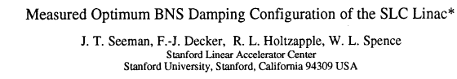
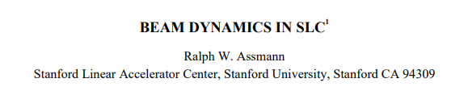
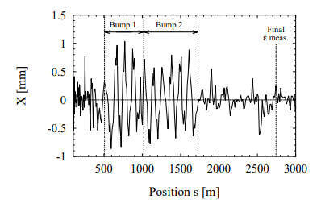
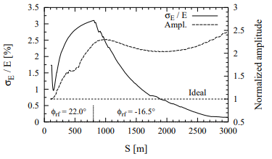
Single bunch jitter amplification: possible explanation
A technique to reduce the resonant blowup of the tail by the head is called BNS damping, where the energy of the longitudinal tail of the bunch is reduced from that of the head by offsetting the initial RF phases. With this technique, the net “defocusing” transverse wakefield forces on the tail are to a large extent canceled by the increased focusing of the quadrupole lattice for the tail
Using the slope of the accelerating RF, an energy difference is between head and tail is induced (“correlated energy spread”). With a proper choice of RF phases, the defocusing wakefield effects for the tail can then be cancelled by chromatic effects from the quadrupoles. Ideally, the normalized amplitude of a betatron oscillation is one along the whole linac (same trajectories of head and tail).
Possible mechanism in our case
Energy variation along the bunch
Different frequency of betatron oscillation (difference in phase advance)
Centroid oscillation amplitude reduced
Relatively long bunch
RF curvature
Different focusing along the bunch
Head-tail max. relative momentum difference ~ 0.5%
Kind of BNS damping via bunch elongation:
  On-crest operation → more energy efficient
  On-crest operation → optimal for beam quality
  Longer bunch length → better for initial emittance

Slide 29
Conclusions
During 2024 the injector complex has been optimized in term of cost and power
Power consumption reduced by more than a factor 3 and machine reliability improved
    New RF structure design
    Lower gradient, repetition rate, average and peak power
Transverse dynamics (static): emittance growth
    Achieved 40% margin on the target emittances for the booster
    Investigation of the possible use of the same RF structures along all the linacs (change those of the e- linac)
Transverse dynamics (dynamic): jitter
    The full linac chain (single and multi-bunch) use 20% of the jitter budget
    for the injection to the booster
    Observed a kind of “BNS damping” which strongly reduces the jitter
Longitudinal dynamics(static): energy spread and bunch length
    With the energy compressor: target parameters achieved; multi-bunch compensated at the 10⁻⁴ level without relying on LLRF
    Without the energy compressor: larger emittance growth expected, less energy efficient, bunch decompression system needed in any case, multi-bunch energy compensation relies on LLRF
The present design fulfills the booster target requirements with some margin
Experimental tests to verify some of the outcomes from the simulations are essential

Slide 30


Credits
Credits
PSI | B. Auchmann, I. M. Besana, S. Bettoni, P. Craievich, M. Duda, R. Fortunati, H. Garcia-Rodrigues, D. Hauenstein, R. Ischebeck, P. Juranic, J. Kosse, F. Marcellini, U. Michlmayr, G. L. Orlandi, M. Pedrozzi, J.-Y. Raguin, S. Reiche, R. Rotundo, S. Sanfilippo, M. Schär, N. Strohmaier, N. Vallis, M. Zykova, R. Zennaro, H.H. Braun, M. Seidel all the technical groups involved in the P3 experiment
IJCLab | F. Alharthi, R. Chehab, I. Chaikovska, V. Mytrochenko, Y. Wang
CERN | W. Bartmann, H. Bartosik, M. Calviani, S. Doebert, Y. Duthell, J. L. Grenard, A. Grudiev, B. Humann, A. Kurtulus, A. Latina, A. Lechner, R. Mena Andrade, A. Perillo Marcone, K. Oide, Y. Zhao, F. Zimmermann, Z. Vostrel, M. Benedikt
INFN-LNF | C. Milardi, A. De Santis, O. Etisken, S. Spampinati
SLAC | T. Raubenheimer
KEK | Y. Enomoto, K. Furukawa
and L. Bandiera, M. Soldani, A. Sytov (INFN/Ferrara), A. Bacci, M. Rossetti Conti (INFN/Milano)
This work was done under the auspices of CHART (Swiss Accelerator Research and Technology) Collaboration, https://chart.ch - CHART Scientific Report: https://chart.ch/reports/
FCCIS: 'This project has received funding from the European Union's Horizon 2020 research and innovation programme under the European Union's Horizon 2020 research and innovation programme under grant agreement No 951754.'
A special thanks to P. Craievich (PSI) for providing some material for this presentation

Slide 31
Conclusions
During 2024 the injector complex has been optimized in term of cost and power
Power consumption reduced by more than a factor 3 and machine reliability improved
    New RF structure design
    Lower gradient, repetition rate, average and peak power
Transverse dynamics (static): emittance growth
    Achieved 40% margin on the target emittances for the booster
    Investigation of the possible use of the same RF structures along all the linacs (change those of the e- linac)
Transverse dynamics (dynamic): jitter
    The full linac chain (single and multi-bunch) use 20% of the jitter budget
    for the injection to the booster
    Observed a kind of “BNS damping” which strongly reduces the jitter
Longitudinal dynamics(static): energy spread and bunch length
    With the energy compressor: target parameters achieved; multi-bunch compensated at the 10⁻⁴ level without relying on LLRF
    Without the energy compressor: larger emittance growth expected, less energy efficient, bunch decompression system needed in any case, multi-bunch energy compensation relies on LLRF
The present design fulfills the booster target requirements with some margin
Experimental tests to verify some of the outcomes from the simulations are essential

Slide 32
Target, design, and next goals
Parameter | Target | Design | Unit
Normalized emittance (x, y) (rms) | <(2,20) | (1.6,~11) | mm.mrad
Bunch length (rms) | ~4 | ~4 | mm
Energy spread (rms) | ~0.1-0.15 | ~0.13, minimum~0.05 (with EC) | %
Transverse jitter (rms) | <1 | 0.2 (single and multi-bunch linacs) | sigma
Number of bunches | 4 | 4
Bunch spacing | 25 | 25 | ns
Charge variation | 100 | 100 | %
Open points to finalize/ further improvements of the injector design:
  Low energy part (up to 2.86 GeV) RF structures: margin to reduce the aperture to have the same as in the HE linac?
    Damping ring group: tolerable incoming jitter → ongoing analysis by WP4
    Positron source group: jitter and emittance corresponding to the case a/λ = 0.12 → tolerable (WP3)
  Energy compressor:
    Booster group: evaluation of the acceptable parameters for the low charge mode → to be requested/investigated
    Booster group: accepted time delay among the bunches → to be requested/investigated
    High energy transfer line group: energy spread increase during the beam transport (TL WP) → ongoing
  Definition of the jitter parameters for the DR:
    Injection group: determination of the kicker jitter → to be requested/investigated
  Experimental verification of the jitter amplification model:
    Open for discussion

