Slide 1
Preliminary Damping Ring Design for the Cool Copper Collider
Matthew Andorf

Slide 2
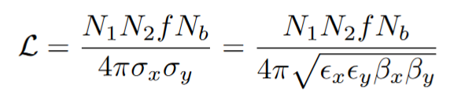
Motivation for Damping Rings
Spin Polarized Electron Production:
GaAs photocathode operated in a DC electron gun
Round beam, ~2-3 μm normalized emittance
Positron production:
Tungsten target
2-3 orders of magnitude larger beam emittance than electron beam
Damping Rings optimize beam luminosity!
Can produce ~100 nm horizontal emittances
Produce flat beams, ~1 nm emittance
Beamstrahlung:
Use of a flat beam reduces beam collision induced radiative losses

Slide 3

Ring Layout
Most damping designs use a race-track layout:
Arcs consist of periodic cells designed for low emittance
Straight sections provide room for damping wigglers, RF cavities and injection/extraction lines
Damping wigglers, RF
Periodic arc-cells
Periodic arc-cells
injection/extraction lines/wigglers
From Booster Linac
(or pre-damping ring)
To Main Linac

Slide 4
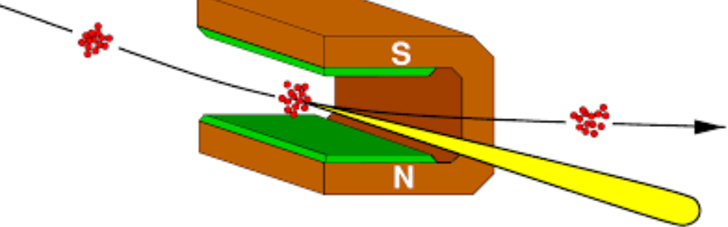
Synchrotron Radiation Damping
Synchrotron radiation damps particle motion in all three planes (horizontal, vertical and longitudinal)
Longitudinal damping is straightforward
Particles with more energy radiate more, particles with less energy radiate less
RF cavities restore energy loss
Results in reduction of particle beam energy spread

Slide 5
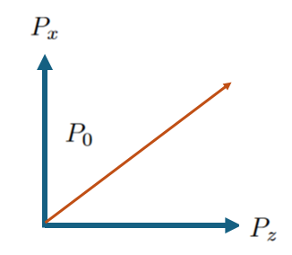
Synchrotron Radiation Damping
Synchrotron radiation damps particle motion in all three planes (horizontal, vertical and longitudinal)
Longitudinal damping is straightforward:
Particles with more energy radiate more, particles with less energy radiate less
Results in reduction of particle beam energy spread
Damping in the transverse planes is more complicated:

Slide 6
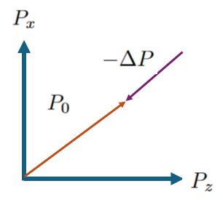
Synchrotron Radiation damping
Synchrotron radiation damps particle motion in all three planes (horizontal, vertical and longitudinal)
Longitudinal damping is straightforward:
Particles with more energy radiate more, particles with less energy radiate less
Results in reduction of particle beam energy spread
Damping in the transverse planes is more complicated:
A photon is emitted tangential to particle path

Slide 7
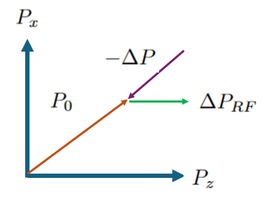
Synchrotron Radiation damping
Synchrotron radiation damps particle motion in all three planes (horizontal, vertical and longitudinal)
Longitudinal damping is straightforward:
Particles with more energy radiate more, particles with less energy radiate less
Results in reduction of particle beam energy spread
Damping in the transverse planes is more complicated:
A photon is emitted tangential to particle path, resulting in a change in momentum in both P_{x} and P_{z}
RF cavities restore energy in the longitudinal plane only

Slide 8
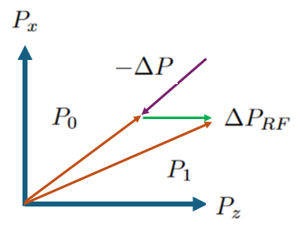
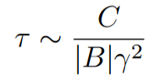
Synchrotron Radiation damping
Synchrotron radiation damps particle motion in all three planes (horizontal, vertical and longitudinal)
Longitudinal damping is straightforward:
Particles with more energy radiate more, particles with less energy radiate less
Results in reduction of particle beam energy spread
Damping in the transverse planes is more complicated:
A photon is emitted tangential to particle path, resulting in a change in momentum in both P_{x} and P_{z}
RF cavities restore energy in the longitudinal plane only
Total cycle results in a reduction of P_{x} only, and consequently beam emittance

Slide 9
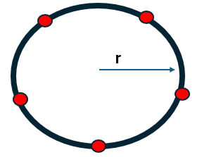

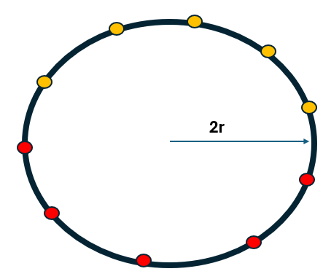
Damping Ring Basic Considerations
Givens:
Collider repetition rate
Bunch structure (e.g. bunch spacing, number of bunches per train)
Injected beam emittance
Choices:
Number of stored bunch trains (N_{train})—determines min. circumference
Stored number of damping times(Nτ )—constrains value of damping time
Lattice design, wiggler parameters
Consequences of those choices:
Beam energy
Extracted beam emittance
Train 1
Train 2

Slide 10
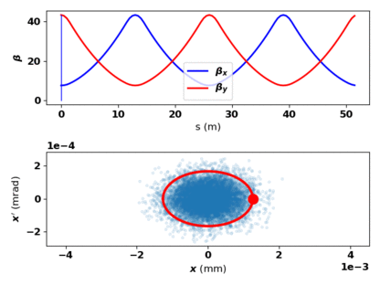



Periodic Focusing and Lattice Function
Circular accelerators are necessarily periodic
For any periodic lattice, the Twiss parameters (α, β, γ) can be found
Together (α, β, γ) can describe the particles “action”, which is an invariant of motion in the lattice
The emittance can be defined by an ellipse which encloses the beam.

Slide 11
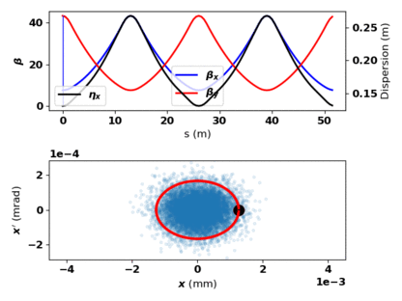



Periodic Focusing and Lattice Function
A particle with an energy deviation from the machine design will be displaced horizontally in a bending magnet
The dispersion function and its derivative describe the displacement:
Dispersion is generated from bend magnets and controlled with quadrupoles
Outside of dipoles, a dispersion invariant (“Curly H”) exists.

Slide 12
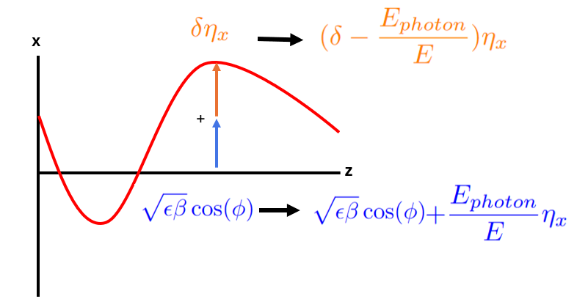
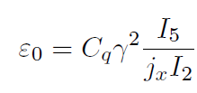



Natural Equilibrium Emittance
SR damping is countered by quantum excitation leading to a ‘natural’ or zero-charge beam emittance
The emission of a photon in a dispersive region results in an increase in betatron motion.
Optimized by layout of quads/bend magnets
In vertical plane, ultimate emittance set by opening angle of radiation emission
fixed by ring geometry
Magnet misalignments and IBS will additionally grow emittance.

Slide 13

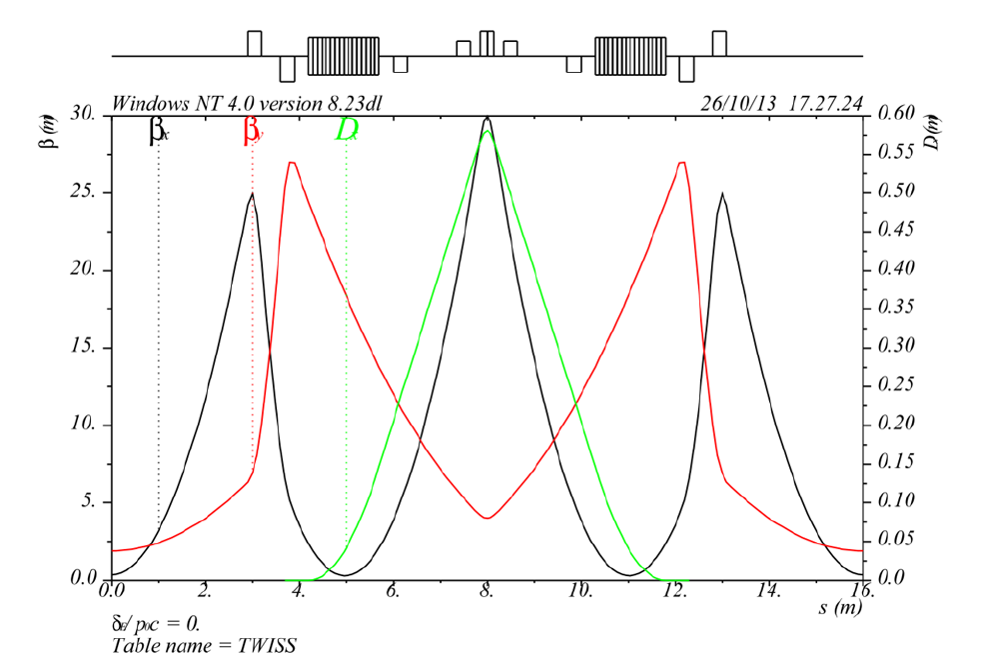
Arc Cell design
Bending magnets
DBA
Double Bend and Multibend Achromats (DBA, MBA)
Produce low emittance while also providing dispersion free straight sections outside dipole pairs
All diffraction limited light sources use MBA’s

Slide 14
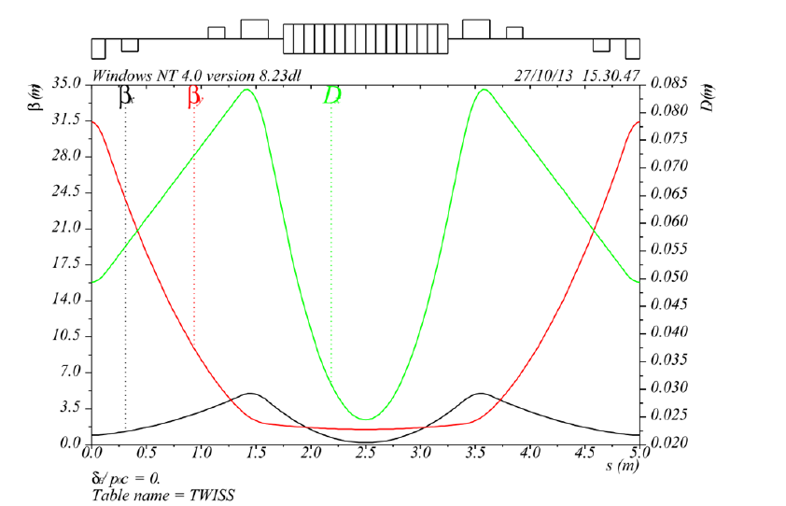

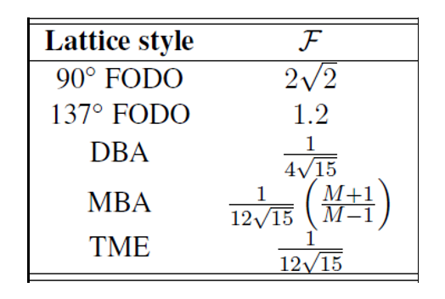


Arc cell design
Bend magnet
Theoretical Minimum Emittance (TME) cells:
Produce lowest achievable emittance
Twiss parameters chosen to minimize I₅ integral while accounting propagation through dipole
Does not produce dispersion free section…not a problem for damping rings!
Optimal values at dipole center

Slide 15
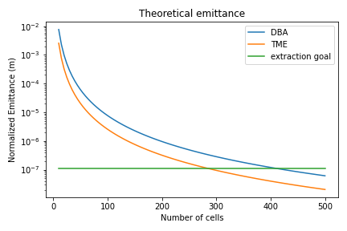
Arc Lattice design
Emittance scales as θ³. Therefore, more cells results in a lower emittance
Some limitations to consider:
The minimum cell length needs to be achievable from magnet/vacuum design considerations
TME cells require strong focusing resulting in high chromaticity. Operating at optimum emittance may not be achievable.
Higher number of cells will result in a tighter alignment requirement (vertical emittance)
The cost and complexity of building the ring goes up with number of cells

Slide 16
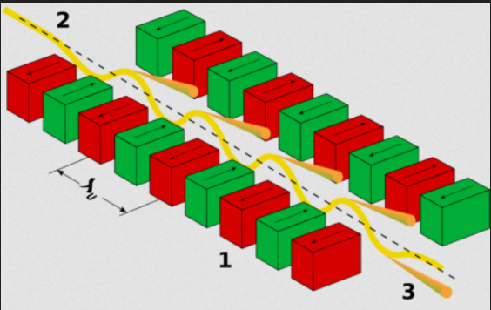
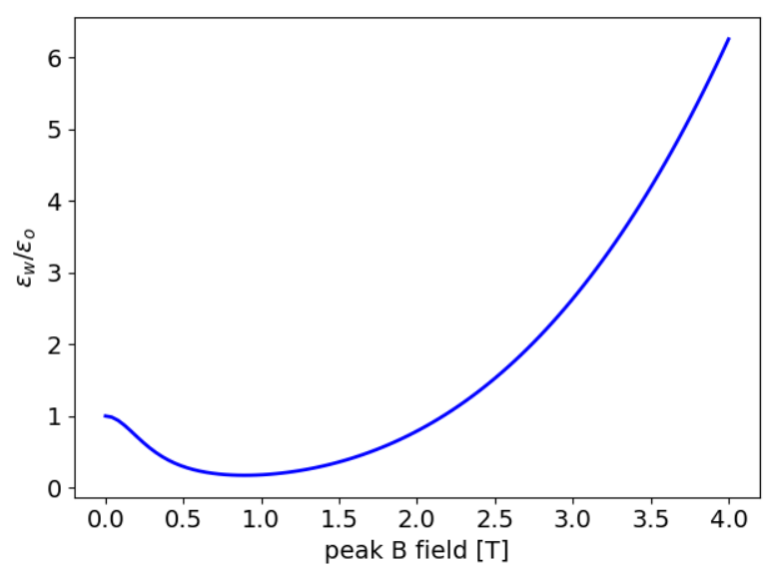
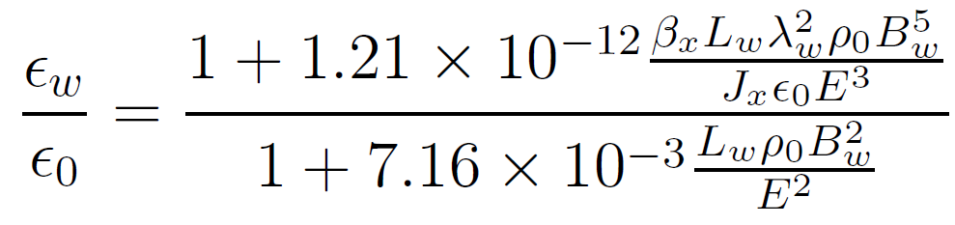

Damping Wigglers
Damping Wigglers can be used to both lower the equilibrium emittance
Damping rate is proportional to radiative losses around the ring
I₂ is increased due to extra bending (independent of ring circumference) directly lowering eq. emittance
Faster damping allows reduction in design energy, indirectly lowering eq. emittance
Wigglers are installed in dispersion free region
Wiggler ‘self-dispersion’ modifies I_{5.} Wiggler B-field can not be increases arbitrarily.

Slide 17
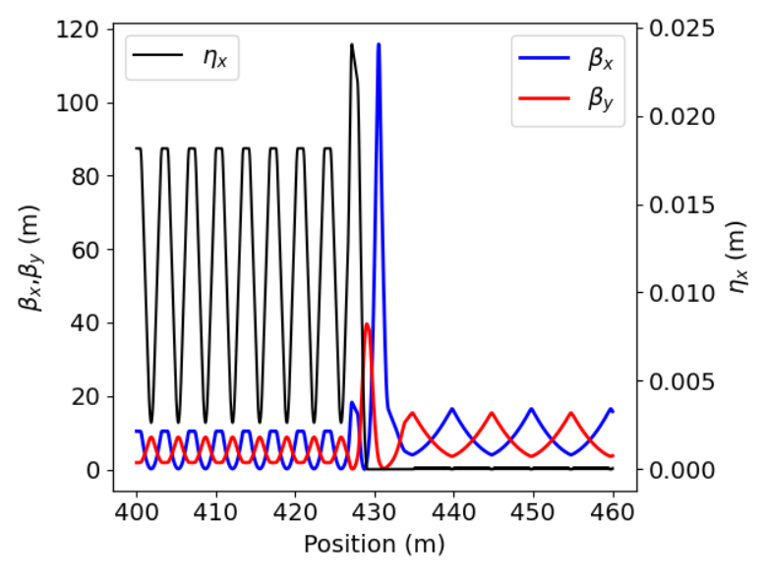
C³ design parameters
Parameter | Value
Energy (GeV) | 4.6
Rep-rate (Hz) | 60
Stored bunch trains | 2
Bunches per train | 266
Bunch train length (m) | 423
Circumference (m) | 1190
# TME cells | 248
#FODO cells | 30
Horizontal tune | 120.44
Vertical tune | 52.28
Damping time (ms) | 4.2
N_{t} | 7.9
Hor. Normalized natural emittance (nm) | 170
TME section
FODO section

Slide 18
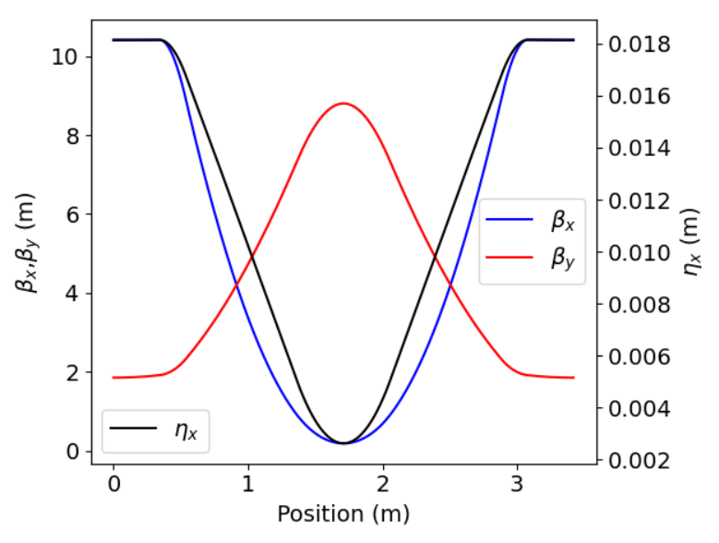

TME cell
Parameter | Value
Bend angle (degree) | 1.43
Bend B field (T) | 0.55
Bend Length (m) | 0.7
Bend gradient | +22.9
QF1 gradient (T/m) | -60
QF1 length (m) | 0.20
QF2 gradient (T/m) | -17.6
QF2 length (m) | 0.20
ξ_{x}/Q_{x} (Normalized natural chromaticity) | -2.79
ξ_{x}/Q_{x} (Normalized natural chromaticity) | -2.56
ε/ε_{opt} | 2.6

Slide 19
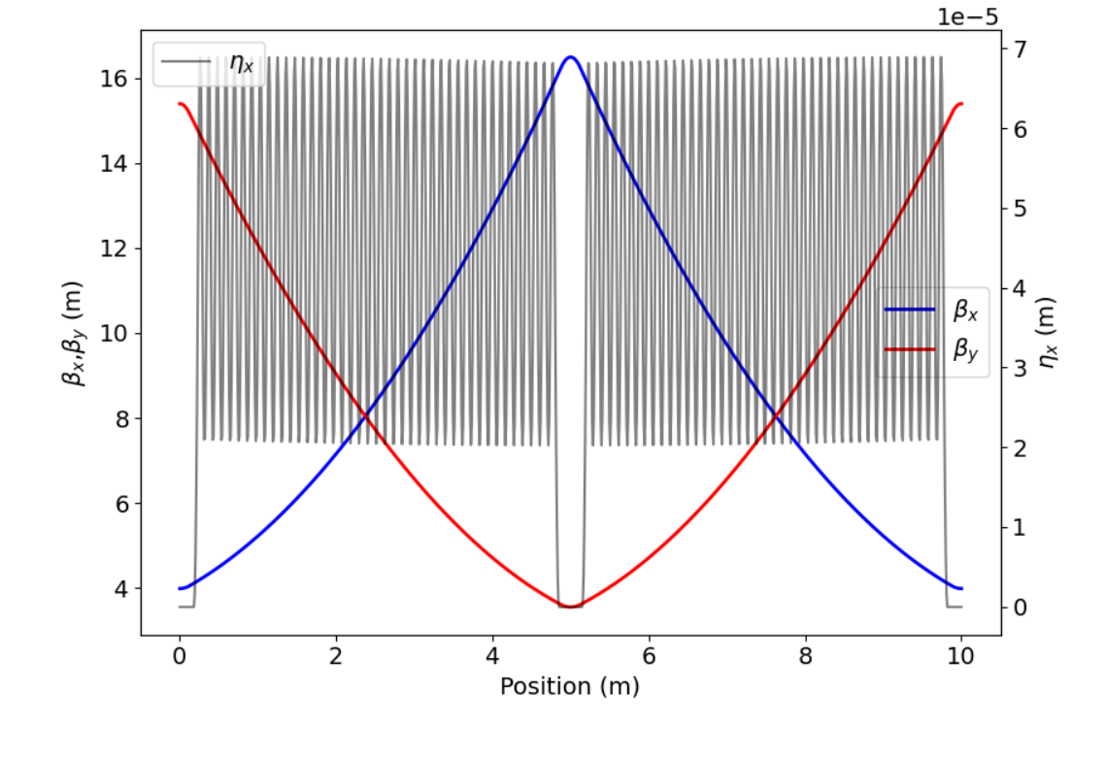
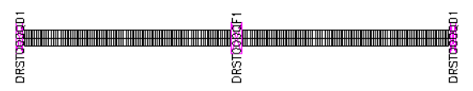
FODO/Wiggler section
Parameter | Value
QF1 gradient (T/m) | -15.4
QF1 length (m) | 0.25
QF2 gradient (T/m) | 15.2
QF1 length (m) | 0.25
Wiggler peak field (T) | 1.0
Wiggler period (m) | 0.11
Filling factor (%) | 90

Slide 20
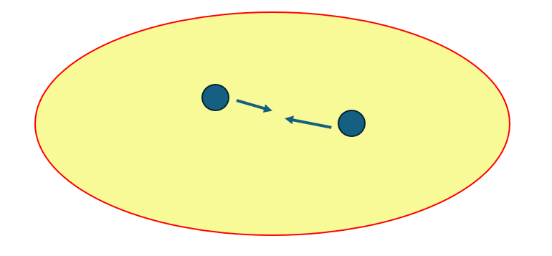
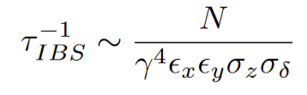
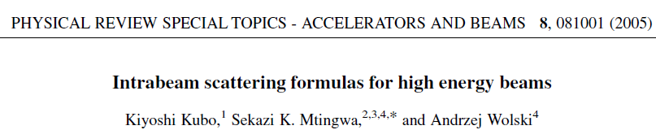
Intrabeam Scattering
As particles undergo betatron/synchrotron oscillations, collisions occur
Large angle scattering results in particle loss
Touschek lifetime
Needs to be reasonably long for machine tuning but not relevant during collider runs
Multiple small angle scattering results in emittance growth in all three planes
IBS
Theory simplifies at high energy (“CIMP”), allowing fast computation of IBS effect
Rates are a function of lattice and beam parameters
IBS program available in BMAD

Slide 21

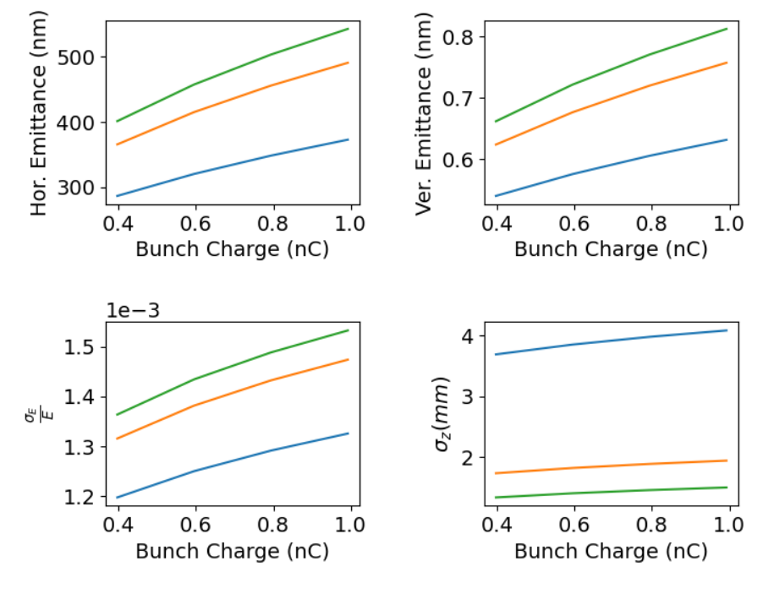
IBS in C³ Damping Rings
Zero-charge bunch length can be varied by RF voltage
IBS rates depend strongly on bunch length
Long bunch reduces IBS effect
Shorter bunch simplifies bunch compression after extraction
Trade-off to be analyzed in future work
IBS looks very manageable for C³!

Slide 22
Summary
Damping rings are critical for achieving high luminosity in electron-positron linear colliders
Reduce by several orders of magnitude the source emittances of both electrons and positrons
Naturally produces a flat-beam which minimizes beamstrahlung effect
Theoretical Minimum Emittance (TME) cells used in arc’s produce lowest achievable emittances
Damping wigglers improve performance by:
Decreasing damping time, allowing operation at lower energy
Decreasing horizontal beam emittance with correct B-field choice
C³ damping ring design in progress!
Ultimately focused on achieving highest possible beam luminosity

