Slide 1
Positron Source
Yoshinori Enomoto (KEK)

Slide 2
contents
Recent progress of positron source for ILC
Electron driven positron source LINAC (EDPL)
Layout
Parameters
Possibility of a C3 application

Slide 3
contents
Recent progress of positron source for ILC
Electron driven positron source LINAC (EDPL)
Layout
Parameters
Possibility of a C3 application

Slide 4
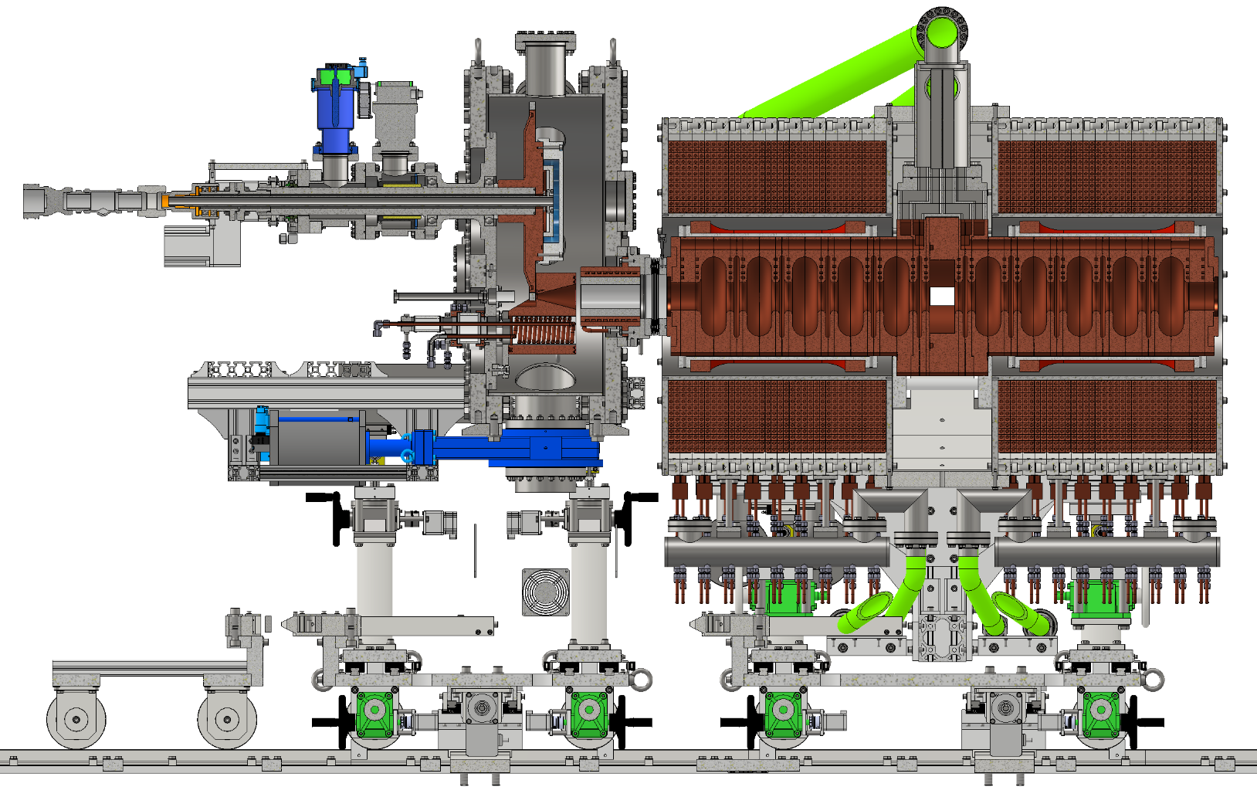
Prototype to be built by JFY2027
target
Acc. structure
solenoid
Flux concentrator

Slide 5
What we did in JFY2023
Target
rotation mechanism
Vacuum system
Solenoid
Design and procurement of material
ACC structure
RF design, 3D model
FC
Design and manufacture parts

Slide 6
What we plan to do in JFY2024
Target disk
Collimator with pillow seal
solenoid
ACC structure
Manufacturing test
FC
assemble

Slide 7
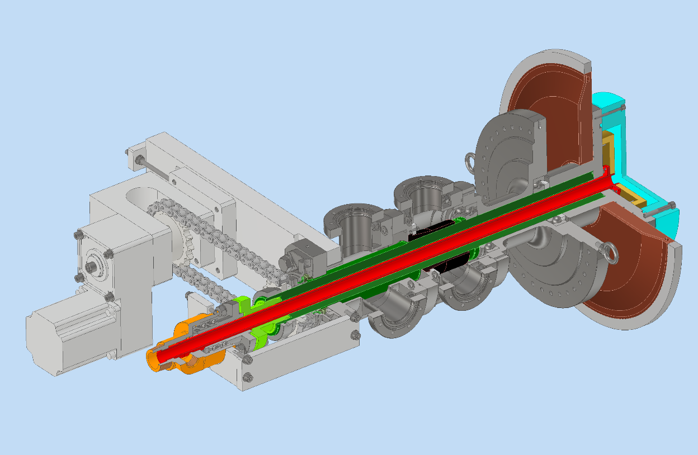
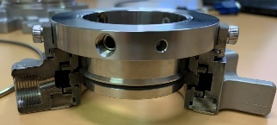
Target
 | Technical design | Engineering design | 3D model | Drawings | Manufacturing | Evaluation
Rotation mechanism | Done | Done | Done | Done | Done | Done
Target disk | Done | Done | Done | Done | Done | In progress
Design and manufacturing of rotation mechanism done in FY2023
Design and manufacturing of target disk finished
Assembled into the chamber
Vacuum test OK
Rotation test OK
run-out evaluation by laser displacement sensor is in progress
Thermal contact evaluation between W and Cu is planned
Narrow gap1 for differential pumping 30um
<10⁻⁵ Pa
Mechanical face seal
~10⁻² Pa
~10¹ Pa
Narrow gap2 for differential pumping 100um

Slide 8
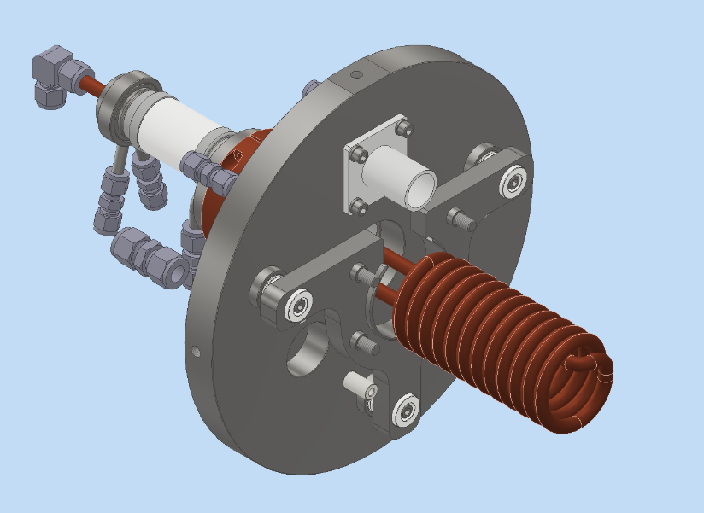
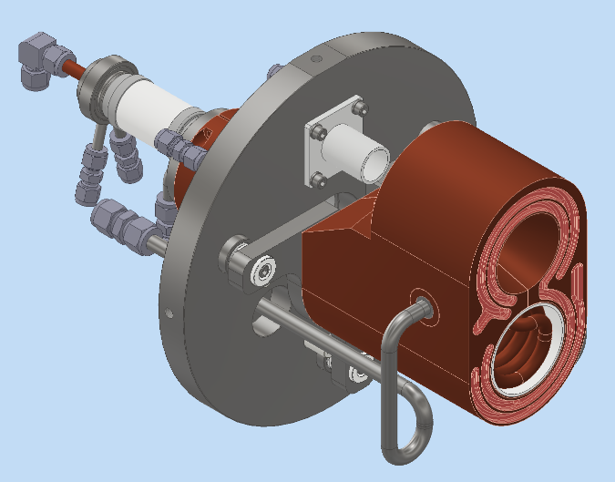
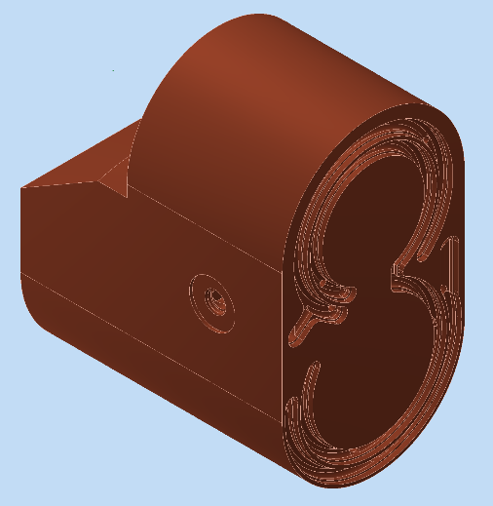
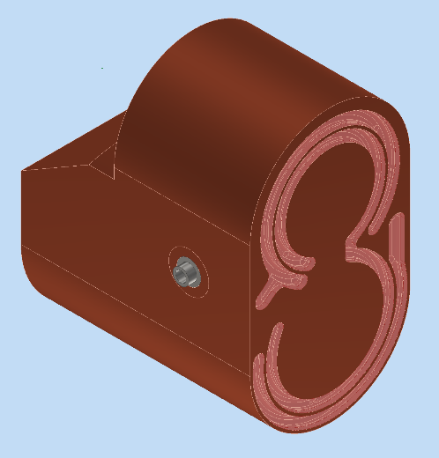
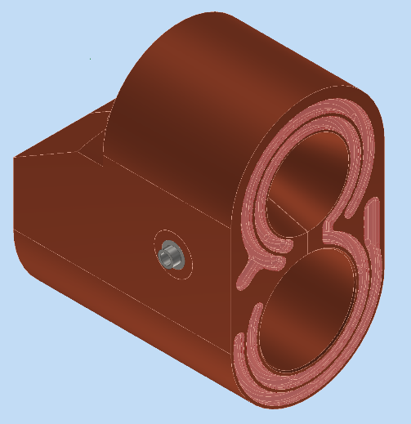
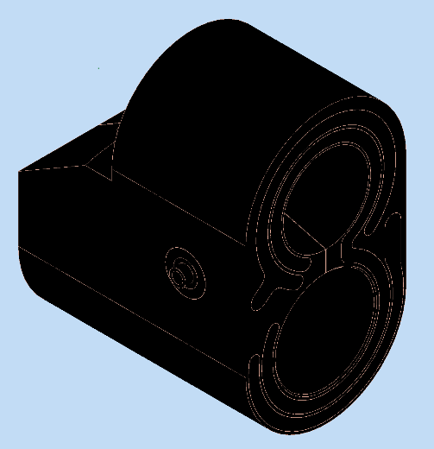
FC
FY2023
FY2024
Welding & assembly
Parts(delivered)
feedthrough
flange, support
piping
electrode
bolt, pin, bush
coil
Machining
done
EBW
done
Secondary working
Milling & EDM
done
Black plating
done

Slide 9
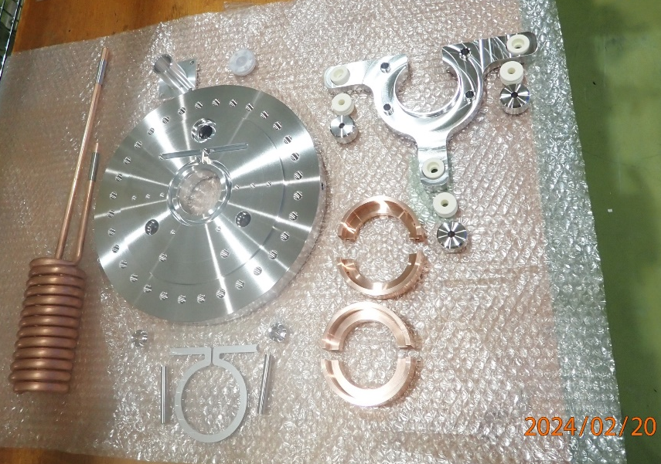
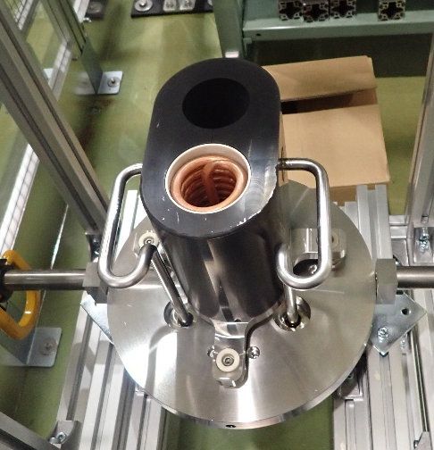
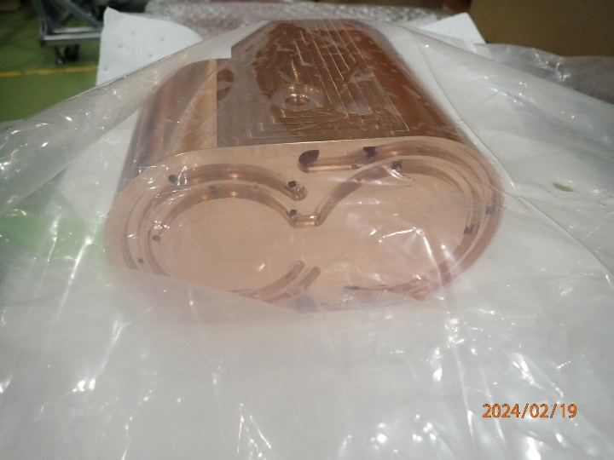
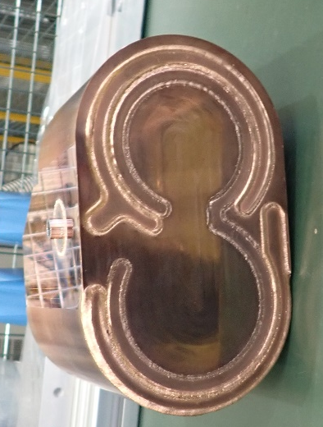
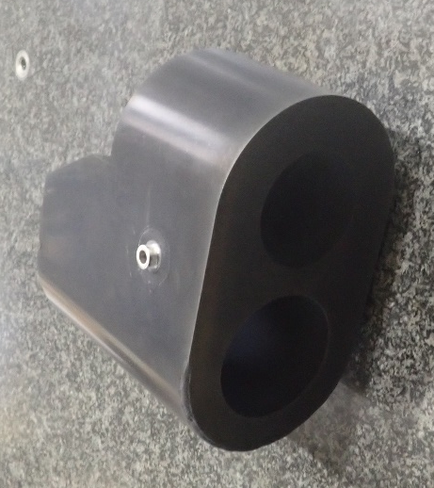
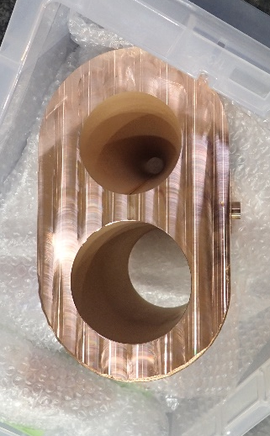
FC
FY2023
FY2024
Welding & assembly
Done
Parts(delivered)
feedthrough
flange, support
piping
electrode
bolt, pin, bush
coil
Machining
done
EBW
done
Secondary working
Milling & EDM
done
Black plating
done

Slide 10
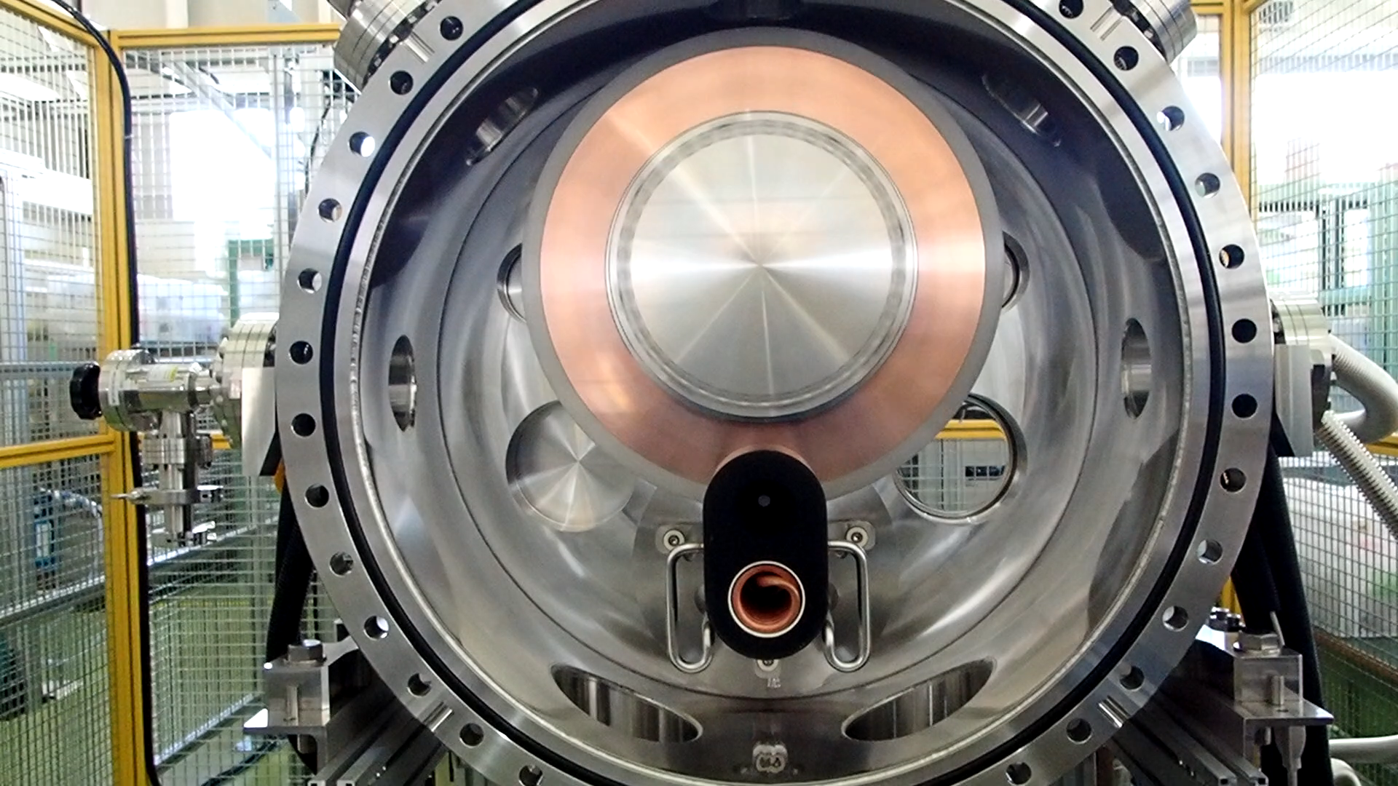

Slide 11
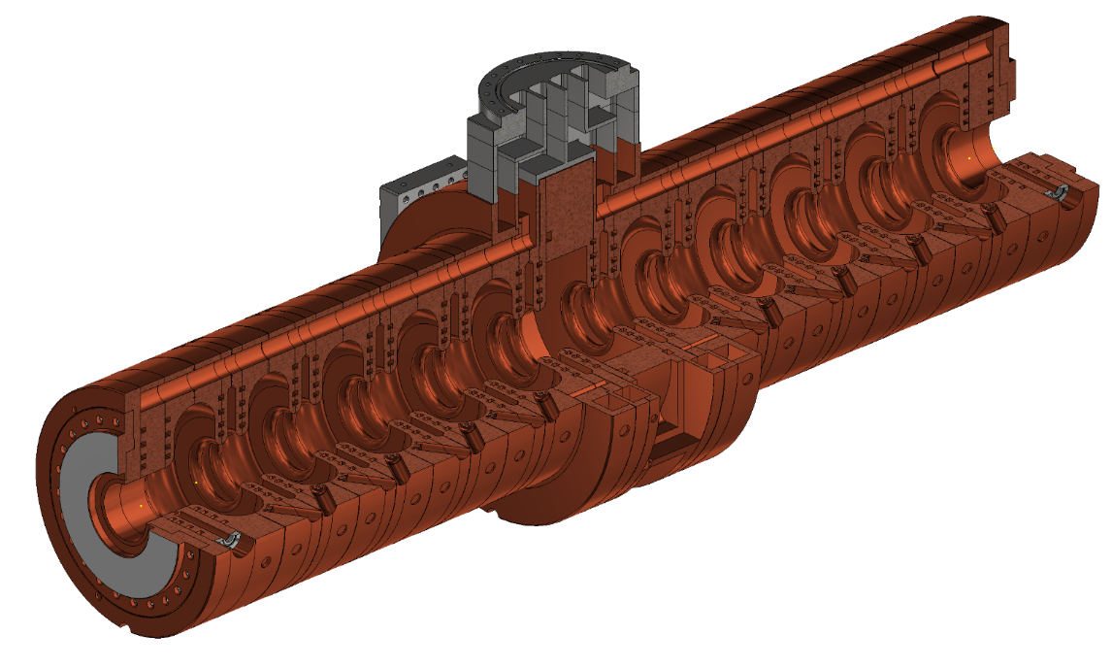
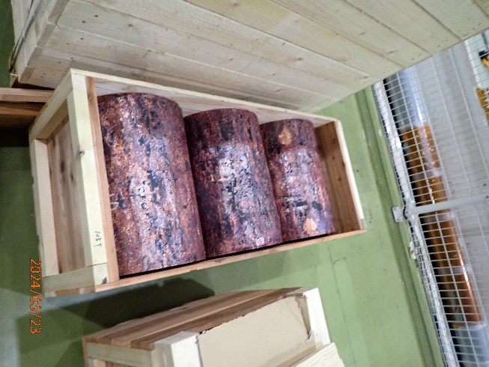
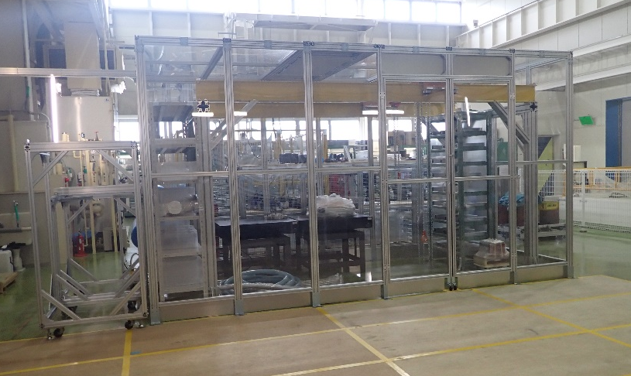
Acc. structure
 | Technical design | Mechanical design | 3D model | Drawings | Material | Manufacturing
Acc. Structure | Done（RF） | Done | Done | Ongoing | Delivered 2024/3 + additional 2025/3 | FY2024-FY2025
Test cell | Done（RF） | Done | Done | Done | Delivered 2024/3 | In progress
Machining and bonding of test cell is in progress
Drawing preparation is almost finished
Clean hut for RF test and assemble work was built
Precise cost estimation for all the prototype manufacturing process completed

Slide 12
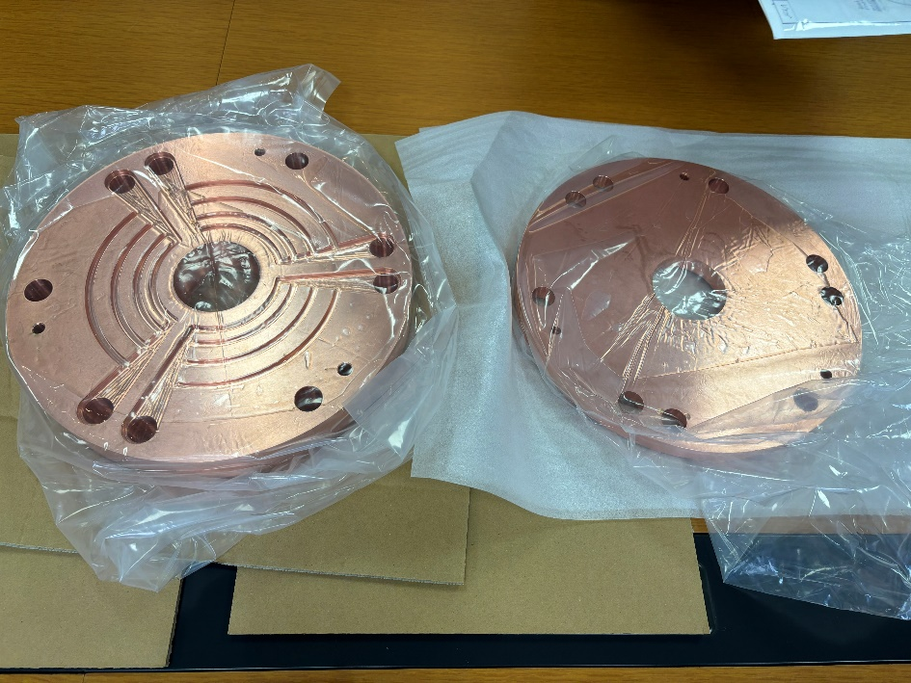
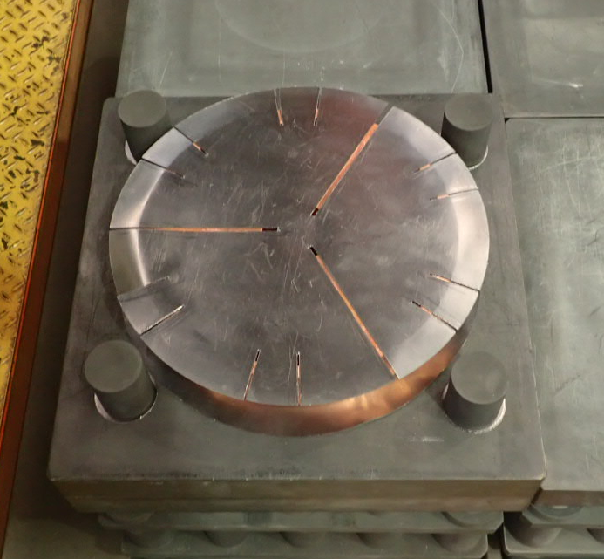
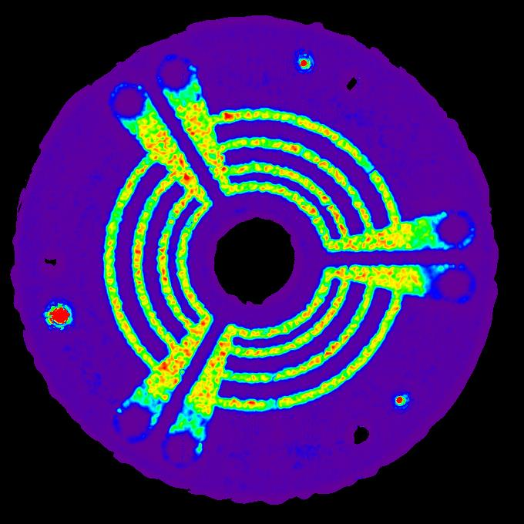

Hot pressing cells
C plate
□445×40t
294 kN@900℃
coupling-cell rp
C sheet 0.5t
accelerating-cell rp
C plate
□445×40t

Slide 13
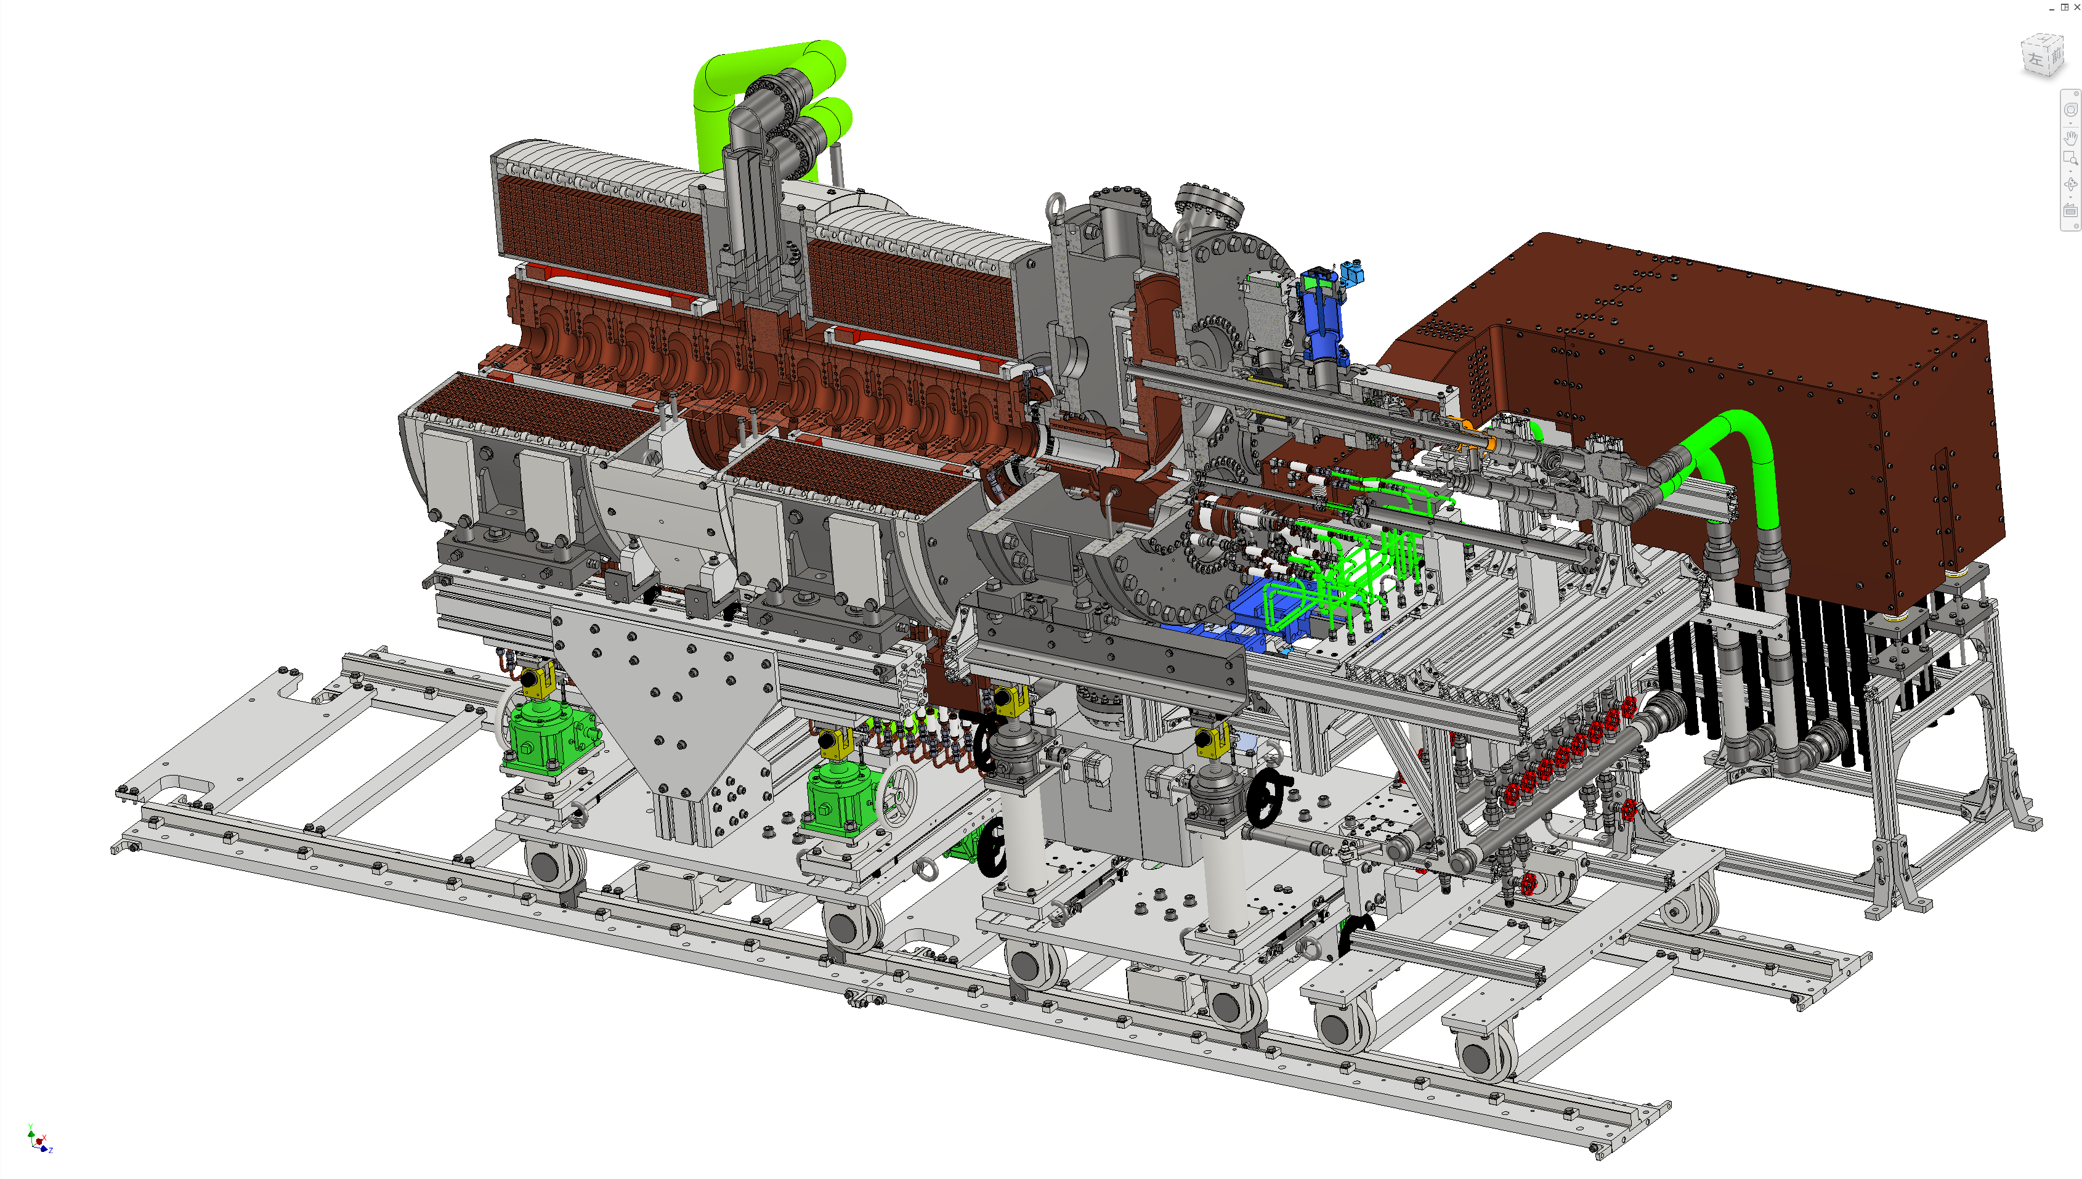
3D model
Updated largely including many peripheral devices,
such as piping and cable connections
These peripheral devices will be manufactured and integrated by the end of FY2024

Slide 14
contents
Recent progress of positron source for ILC
Electron driven positron source LINAC (EDPL)
Layout
Parameters
Possibility of a C3 application

Slide 15
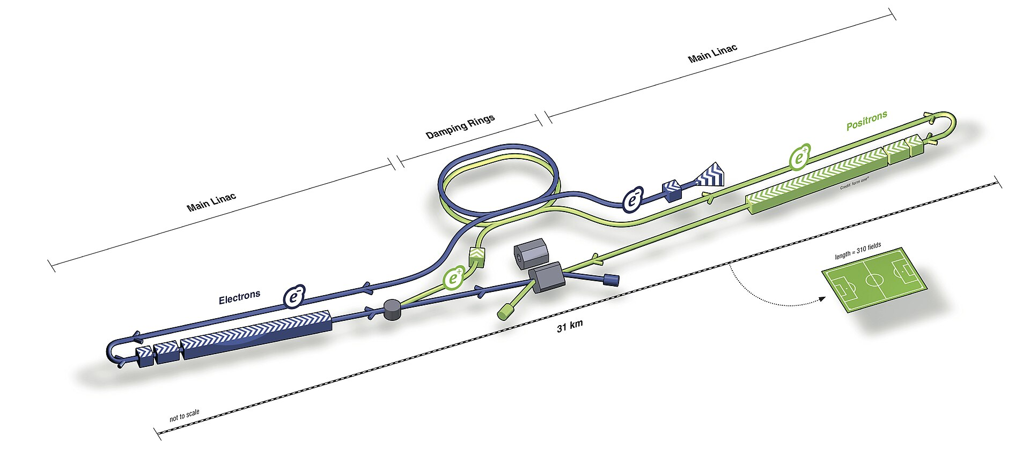
Layout of ILC
Additional linac for electron driven positron source

Slide 16
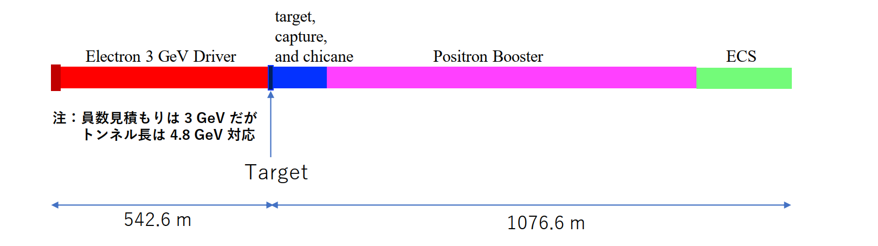
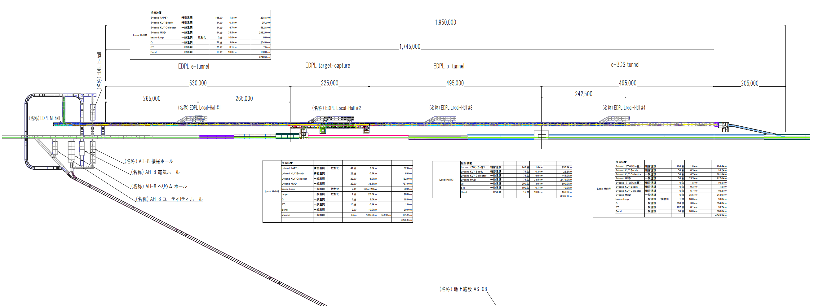
Present layout of EDPL

Slide 17
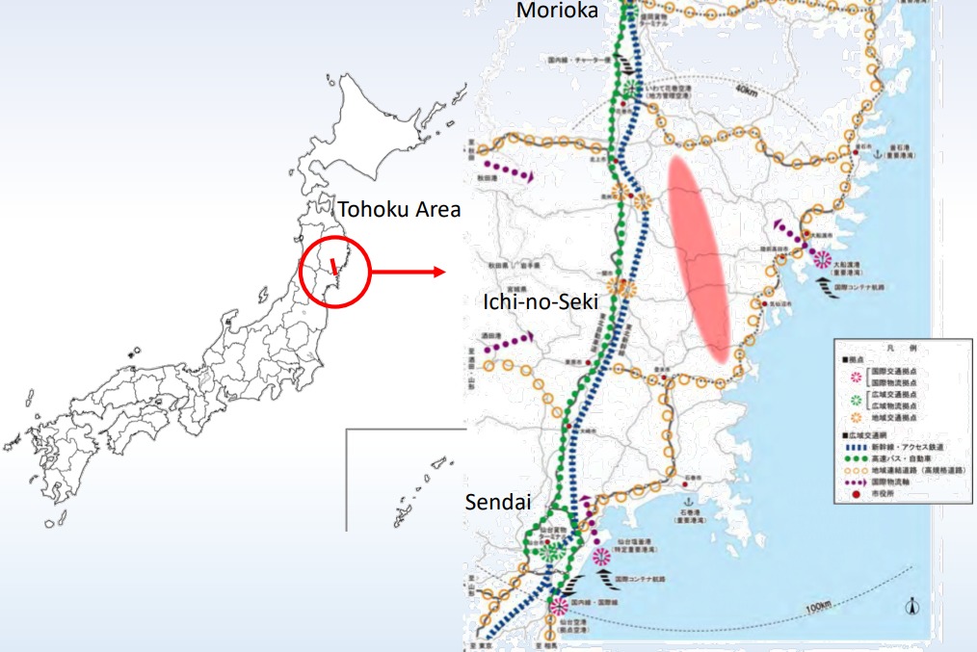
Candidate site
H. Hayano

Slide 18
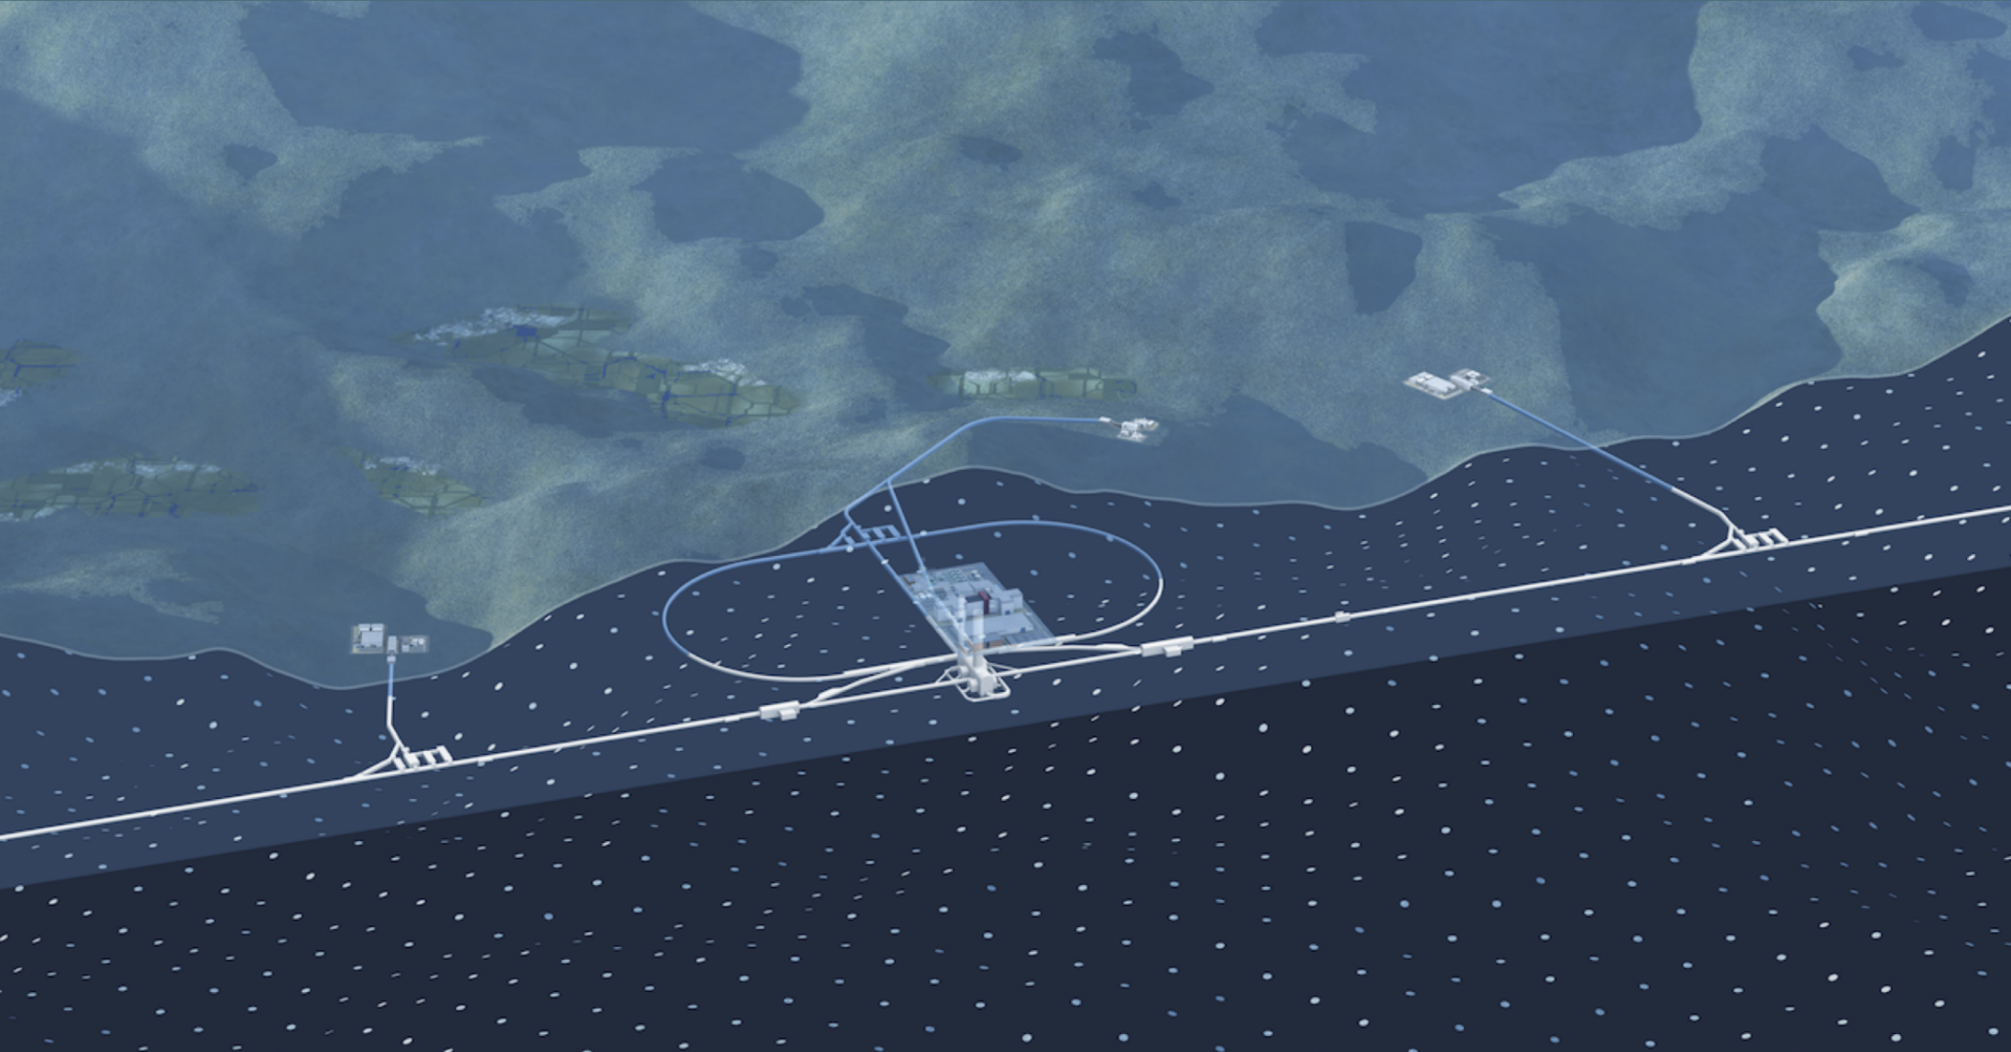
Candidate site
H. Hayano

Slide 19
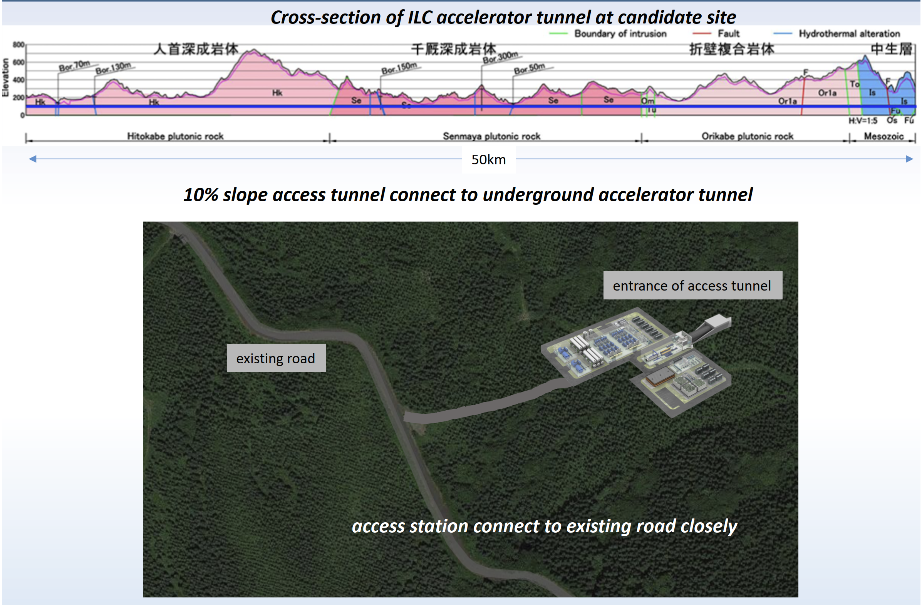
H. Hayano

Slide 20
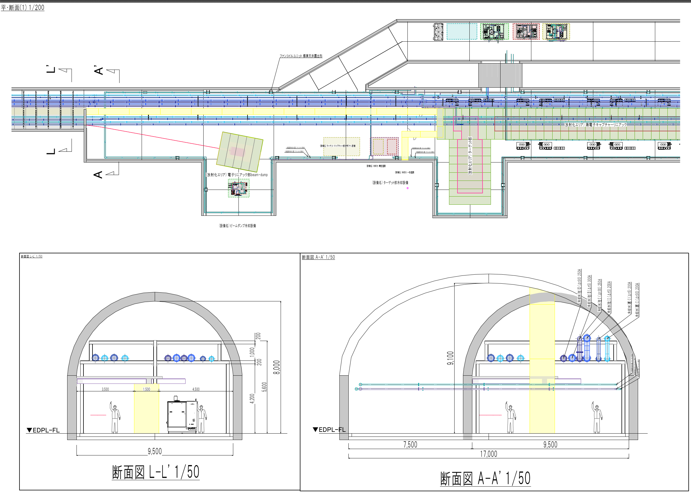

Slide 21
Conditions
The candidate site is mountainous
It’s difficult to prepare long flat area to build Linac on surface
Dumping Ring and Main Linac are both deep under ground
EDPL (2 km) will be also in the same level
Long and wide tunnel for EDPL deep under ground is not cost effective
Compact (< 300 m) high gradient Linac on surface might be a promising alternative

Slide 22
Parameters
Primary electron energy | 3 GeV
Primary electron bunch charge | ～4 nC
No. of bunches / pulse | 66
repetition | 300 Hz / 100 pps
Positron energy | 5 GeV
Positron bunch charge | 4.2 nC

Slide 23
Possible layout
< 300 m
Large aperture capture linac
(0 → 1 GeV)
target
Electron 3 GeV Driver
(high gradient)
Electron gun
Pre-dumping ring
To DR
Positron booster
(high gradient 1 → 5 GeV)
ECS
Use a pre-dumping ring to reduce emittance of positron beam.
Small aperture high shunt impedance Acc. Structure is applicable for positron booster section

Slide 24
Summary
Prototyping of a positron source for the ILC is ongoing
Target disk and FC delivered and assembled
EDPL design and cost estimation is in progress
High gradient compact linac will be a promising option

Slide 26
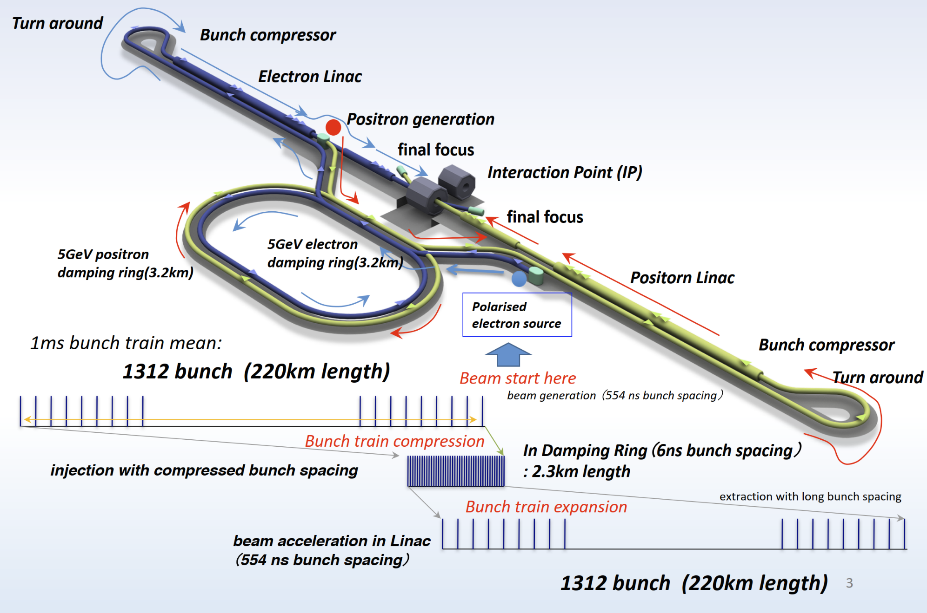
Bunch structure
H. Hayano

Slide 27
Bunch structure
M. Kuriki, OHO seminar 2021
Create positron for 66 ms
Store them in the DR for 199.3 ms
Extract them to main linac for 0.7 ms
20 pulse / train
66 bunch / pulse
1312 bunch / train (8 bunch subtracted)
Repetition 5 Hz
EDPL operated 100 pps / 300 Hz
66
…….
train
3.3 ms✕20 = 66 ms
pulse

