Slide 1
C-Band Reduced Phase Advance Distributed Coupling Structure
Zenghai Li, Emilio Nani, Muhammad Shumail, WeiHou Tan (SLAC)
C3 Workshop 2024 Oct 7-8
Nikhef, Netherland

Slide 2
Outline
Distributed coupling linac structure
High efficiency, larger aperture reduced phase advance accelerator cell
Distributed coupling schemes for the 135 deg/cell structure
HOM detuning
HOM damping
Outlook

Slide 3
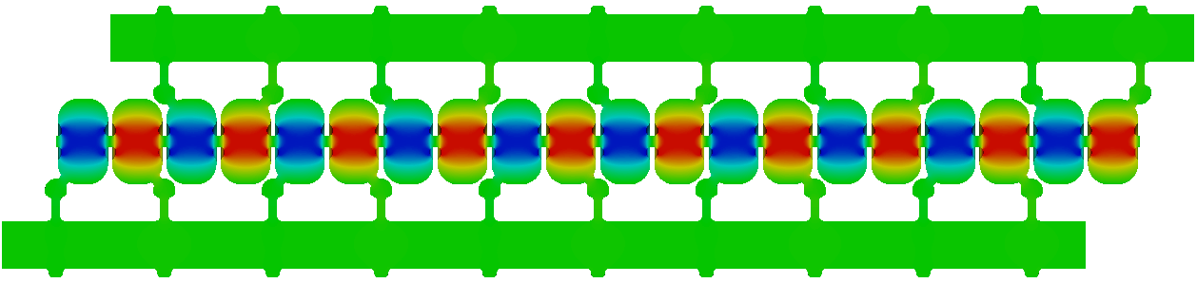

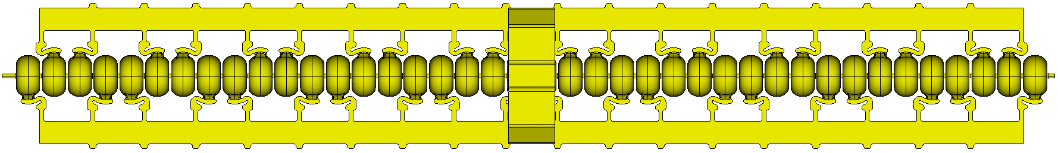
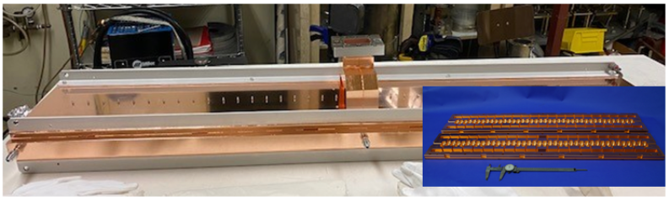
Distributed Coupling Structure
Each distributed coupling waveguide feeds a group of cells of PI phase difference
Advantages
Iris radius not dictated by cell-to-cell RF coupling
Cell shape can be optimized to achieve higher efficiency
Structure can be machine in two halves or quadrants
Structure tuning straight forward
Current 40-cell C3 structure design
Pi-mode
Requires two parallel feed waveguides

Slide 4
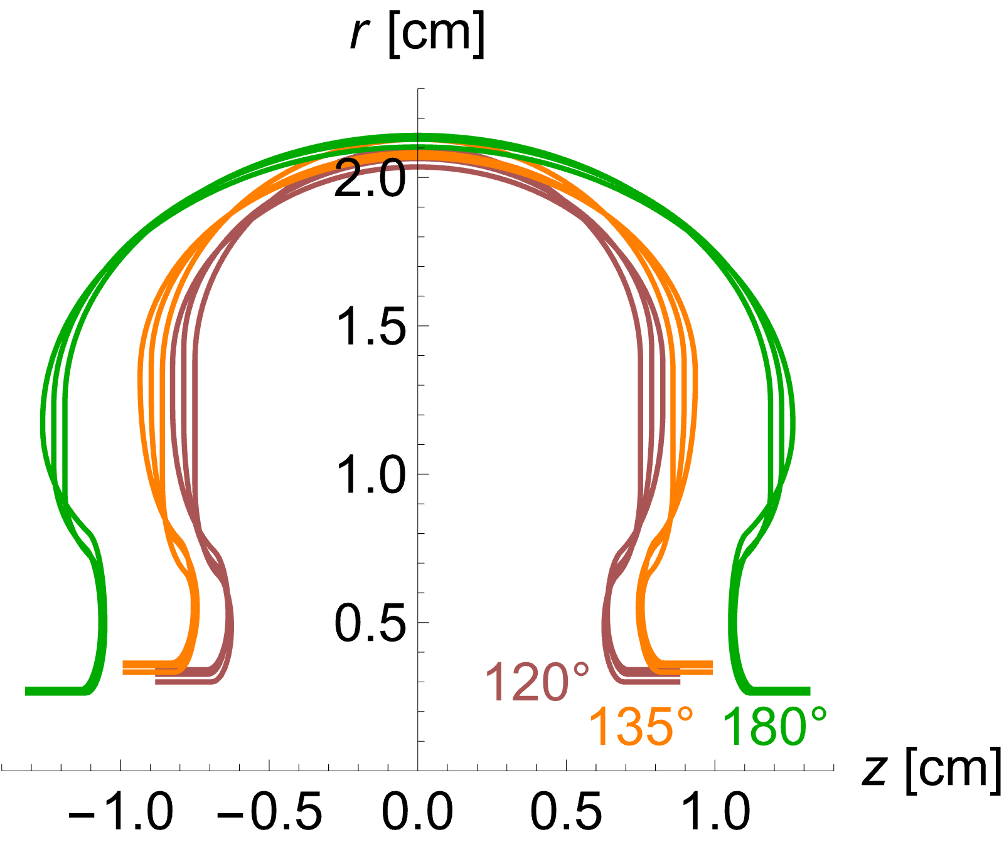
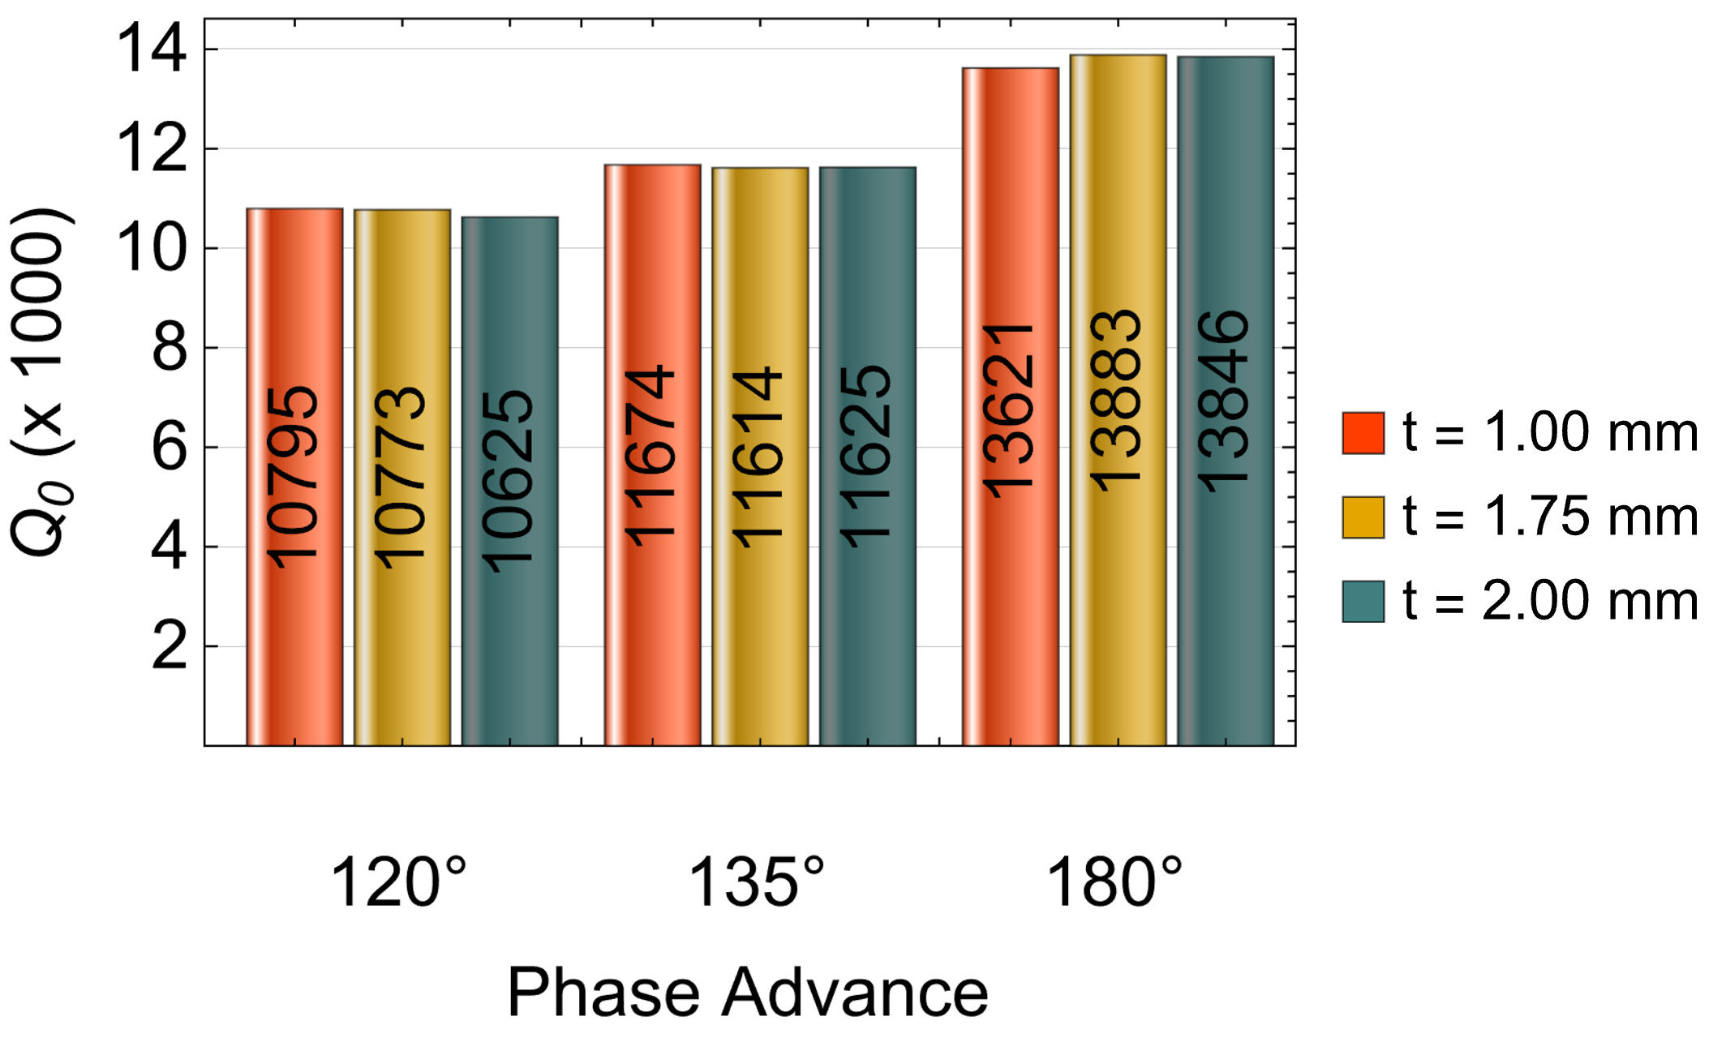
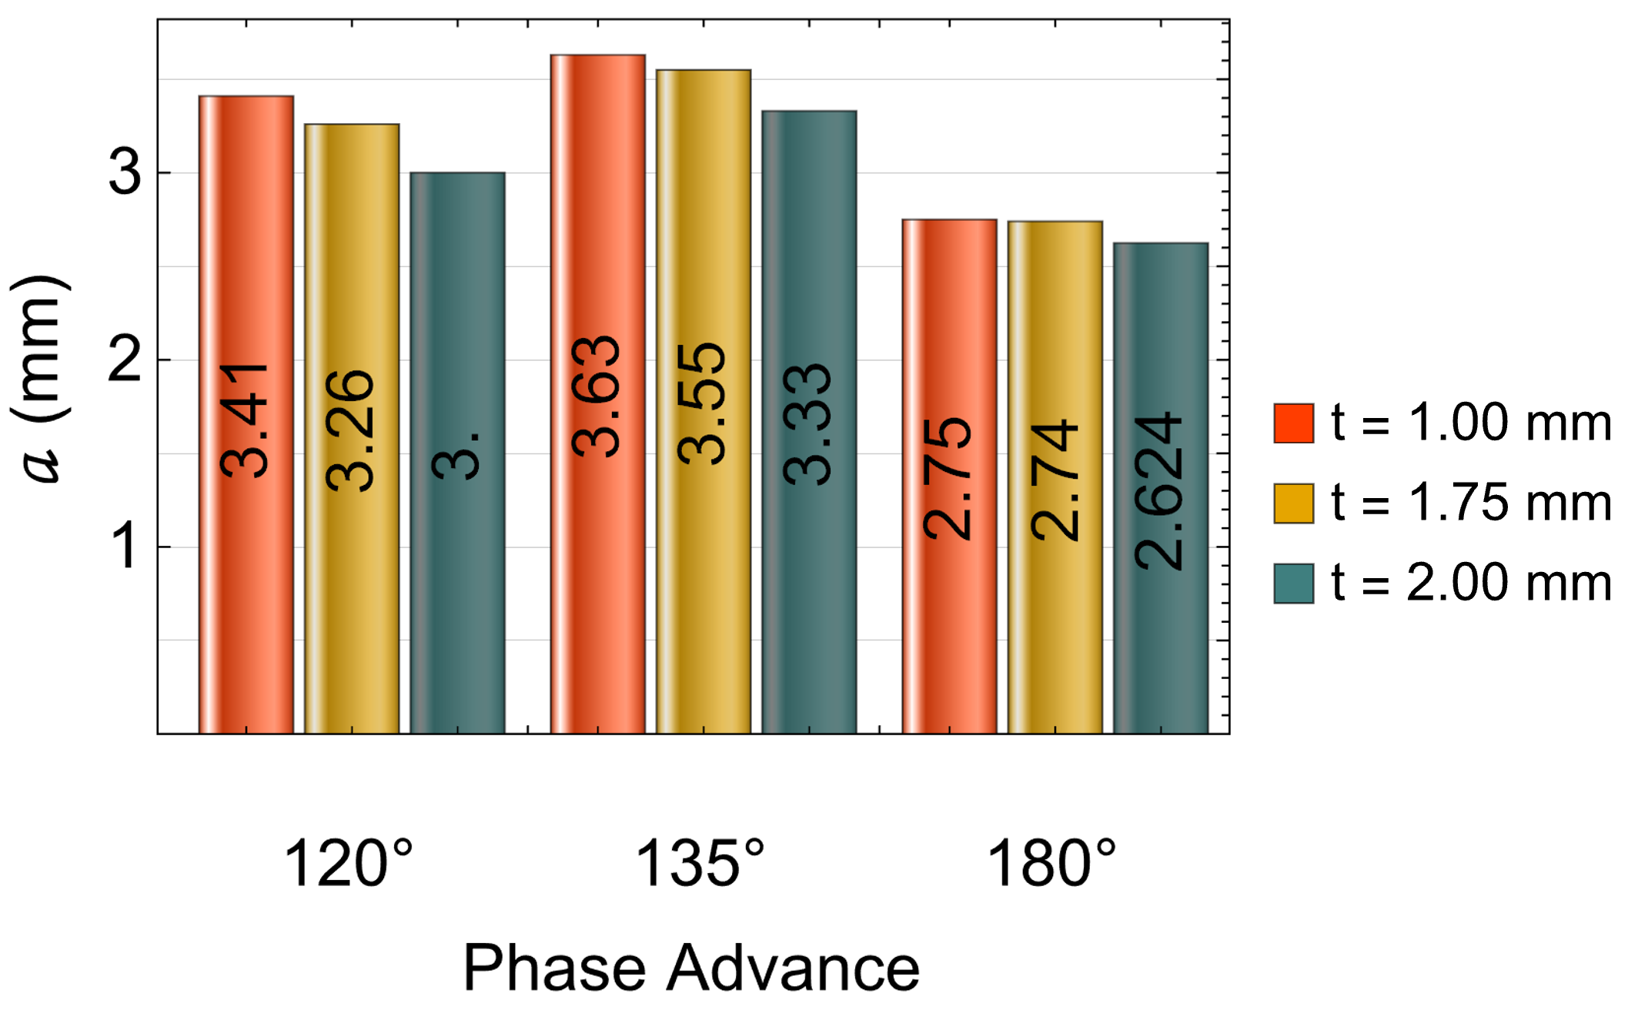
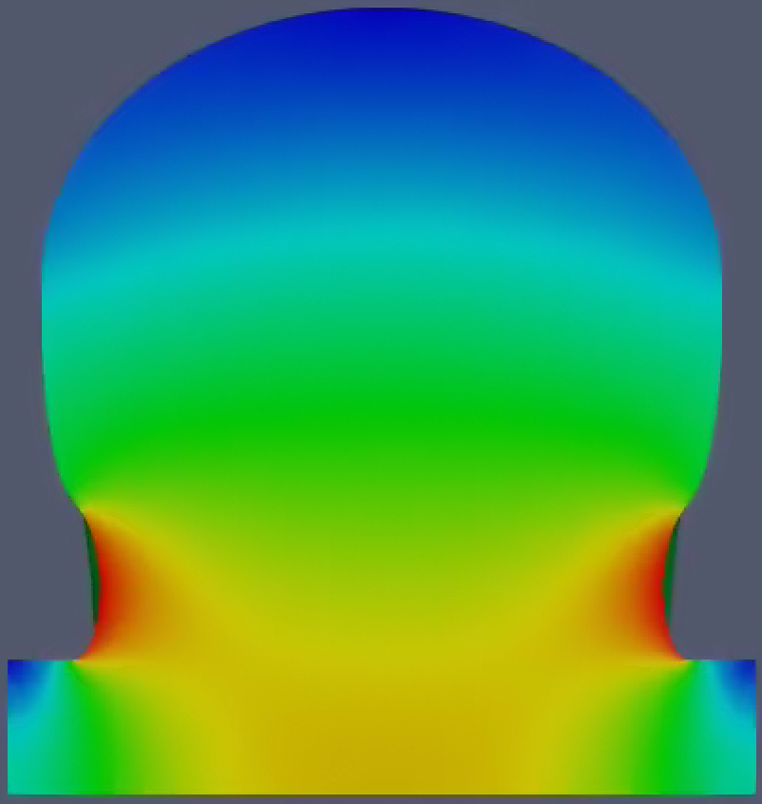
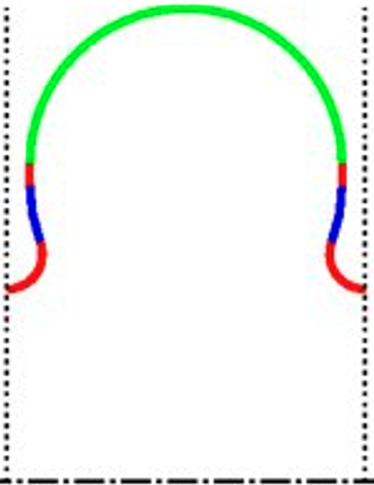
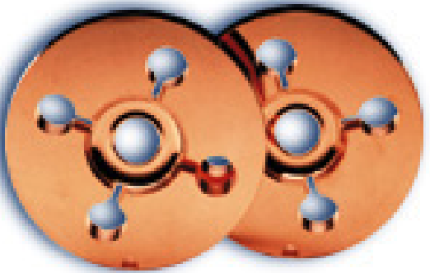
Max Shunt Impedance with 135 deg Phase Advance Achieve Same Efficiency with a Larger Aperture (compared with 180 deg cell) (Muhammad Shumail)
Quality factor, aperture size, and gap distance for $R_{s}=114 MΩ/m$ and $Es/Ea=2$
NLC X-Band structures for comparison:
shunt impedance (300K) : 98 MΩ/m
iris radius: 4.75 mm
135 deg/cell, field profile

Slide 5
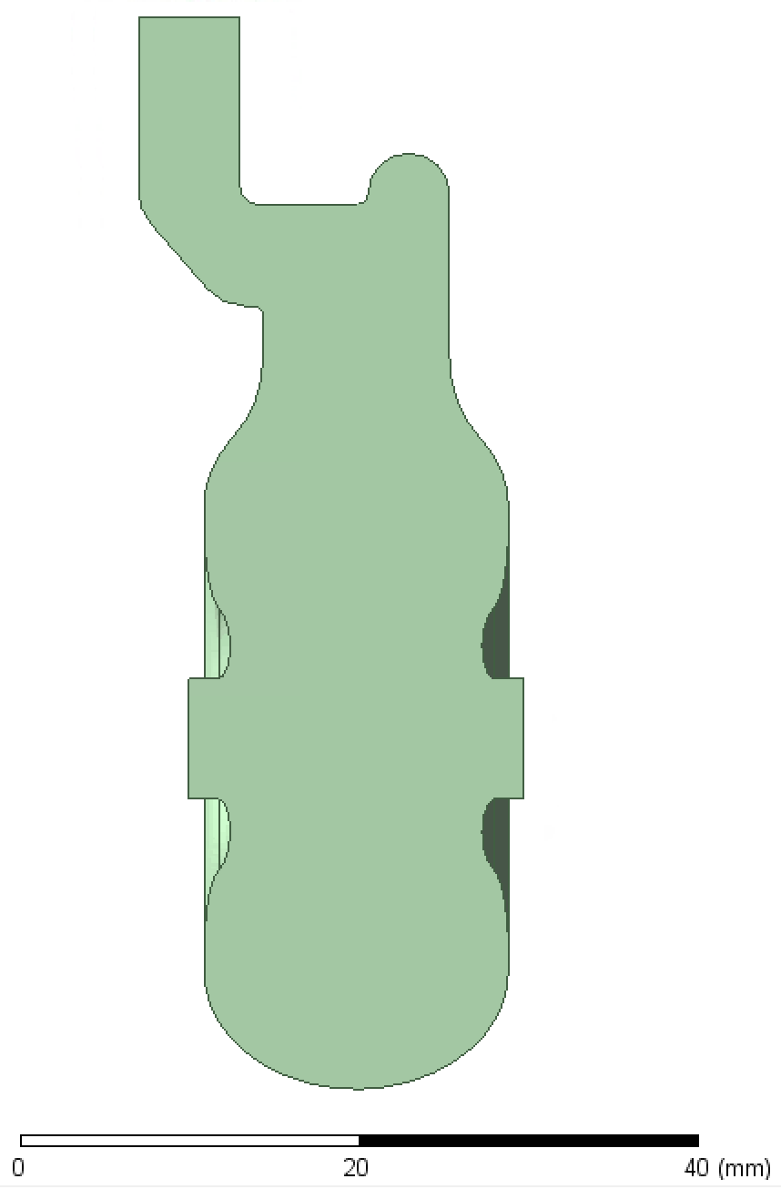
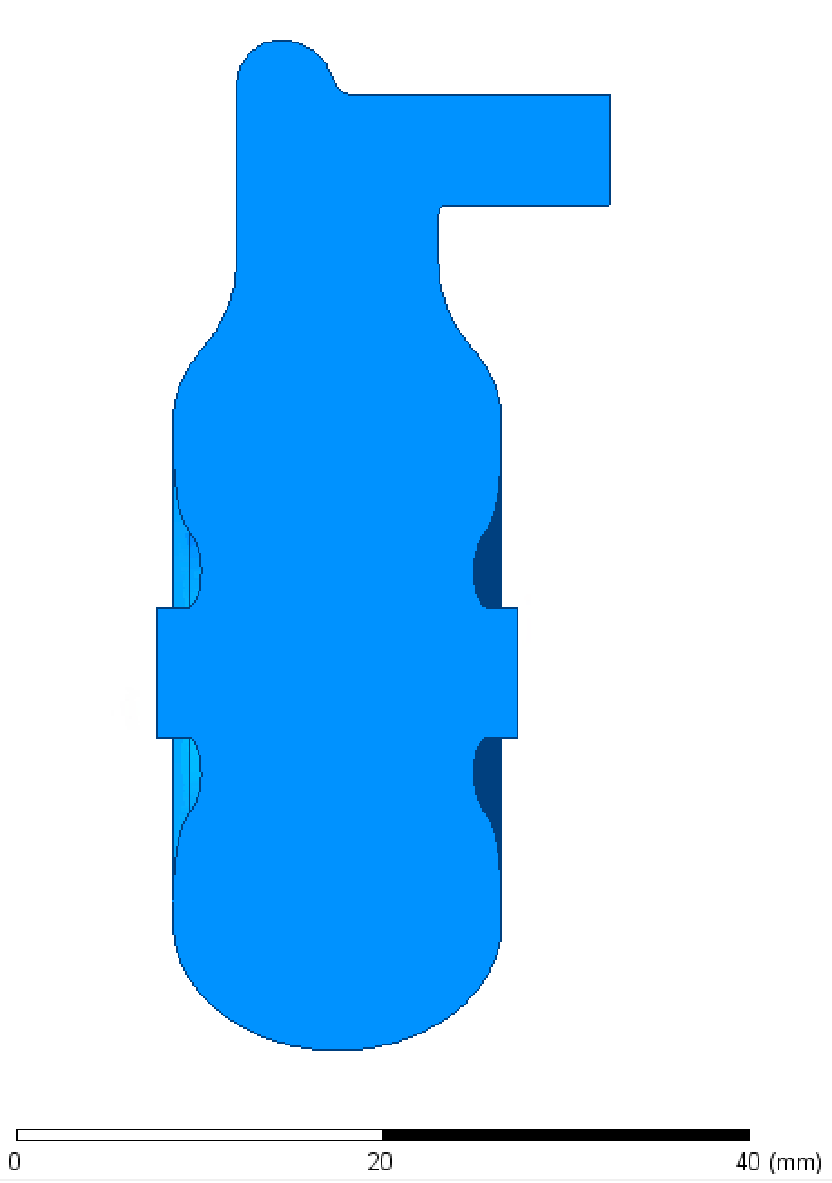

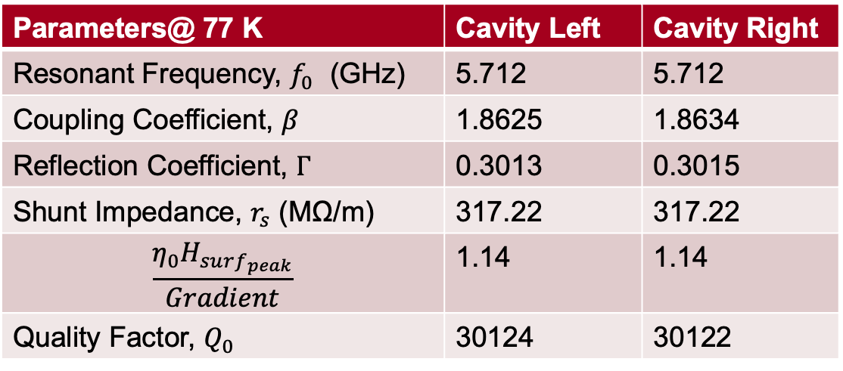
Cavity (with two different coupler implementations) Parameters
Parameters@ 77 K | Cavity Left | Cavity Right
Resonant Frequency, $f_{0}$ (GHz) | 5.712 | 5.712
Coupling Coefficient, $β$ | 1.8625 | 1.8634
Reflection Coefficient, $Γ$ | 0.3013 | 0.3015
Shunt Impedance, $r_{s}$ (MΩ/m) | 317.22 | 317.22
$$\frac{η_{0}H_{surf_{peak}}}{Gradient}$$ | 1.14 | 1.14
Quality Factor, $Q_{0}$ | 30124 | 30122
$φ$ 7.1 mm
(Muhammad Shumail)
135/deg vs 180/deg Design
3π/4 phase Design
Aperture radius of 3.55 mm, same shunt impedance (300 MΩ/m (77K) and the peak E field
With 35% larger aperture, rf structure is much more resilient to both short-range and long-range wakefield effects.
PI phase design
Aperture radius of 2.624 mm, shunt impedance 300 MΩ/m (77K)

Slide 6
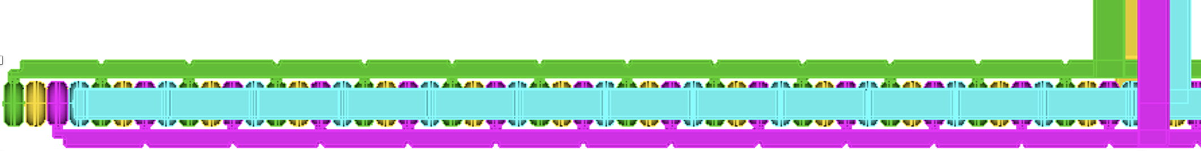
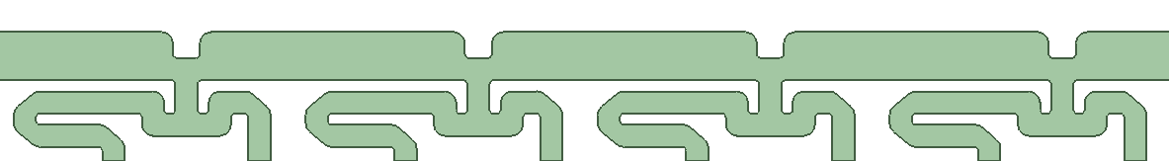


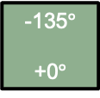
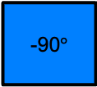

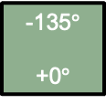



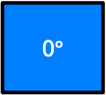
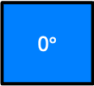
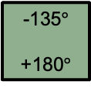


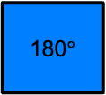

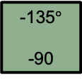
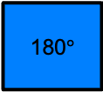
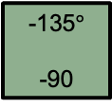

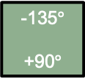
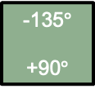


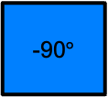



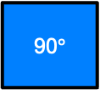
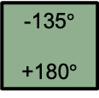
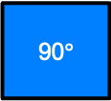

Distributed Coupling Schemes for 135$°$ Phase Advance Design
0$°$
-135$°$
-270$°$
-405$°$
-540$°$
-675$°$
-810$°$
-945$°$
-1080$°$
-1215$°$
-1350$°$
-1485$°$
-1620$°$
-1755$°$
-1890$°$
-2025$°$
Version-1: four waveguide scheme
135 deg design naturally requires 4 parallel-feed waveguides
New developed two waveguide scheme
each tap-off to feed two cells - requires a power splitter
0° 180$°$ 0° 180$°$
0$°$
-135$°$
+0$°$
90$°$
-135$°$
+90$°$
180$°$
-135$°$
+180$°$
-90$°$
-135$°$
-90
0$°$
-135$°$
+0$°$
90$°$
-135$°$
+90$°$
180$°$
-135$°$
+180$°$
-90$°$
-135$°$
-90
0° 180$°$ 0° 180$°$

Slide 7
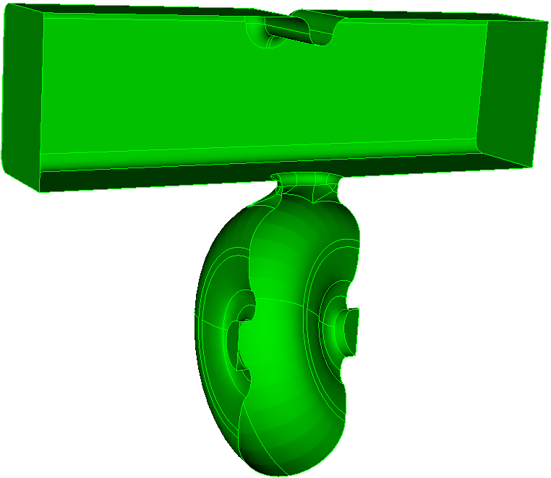
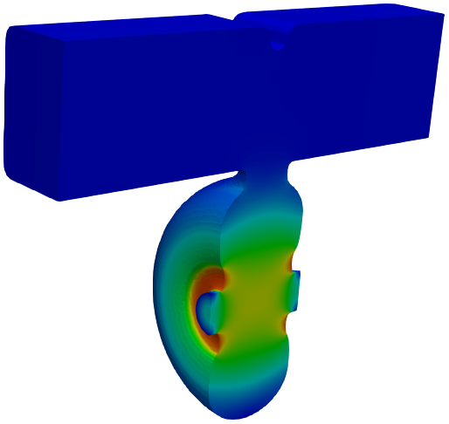
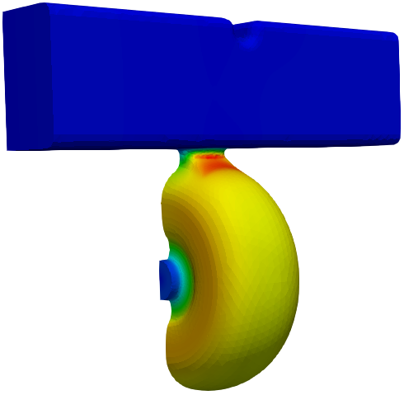
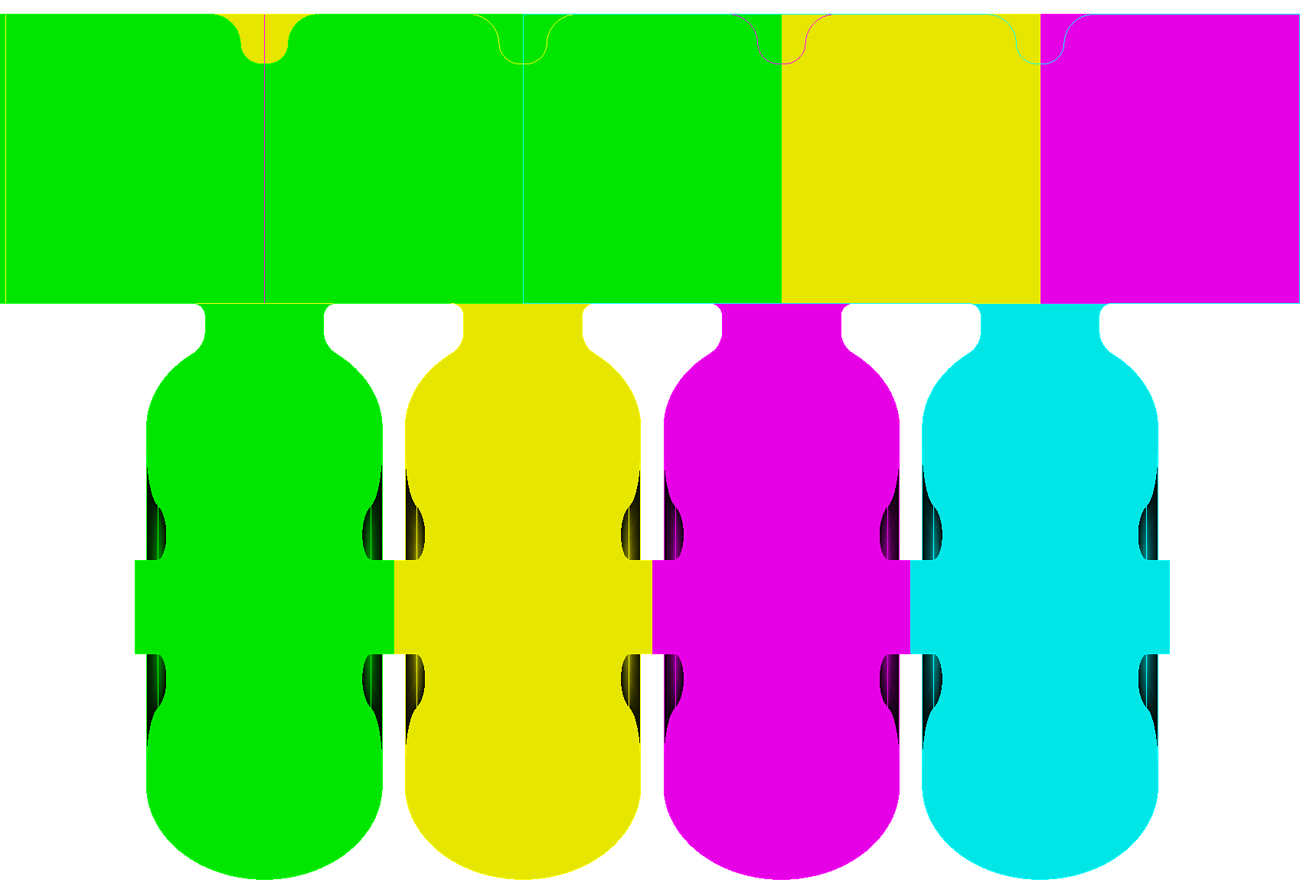
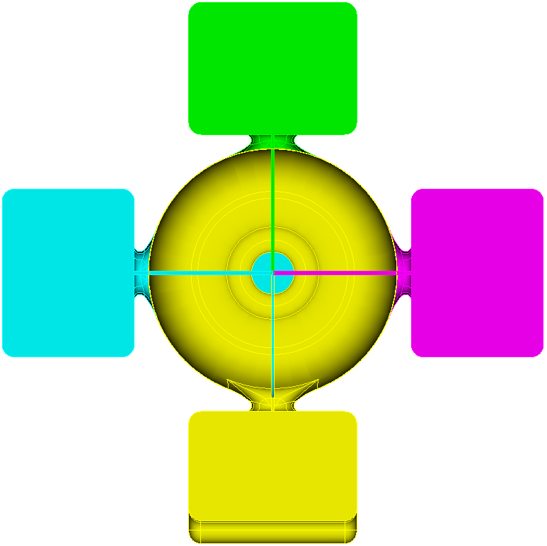
C-Band 135 deg/cell Structure – (power-feed V1)
Cell length: 19.682 mm
Total number of cells: 104
Parallel feed waveguides: 4, feed at middle of structure
E B
T-junction: single cell with parallel feed waveguide
A period = 4 cells
4 135-deg cells form a 360+180 deg section
each cell fed by a respective waveguide
Cross section
2m 104 cell Structure

Slide 8
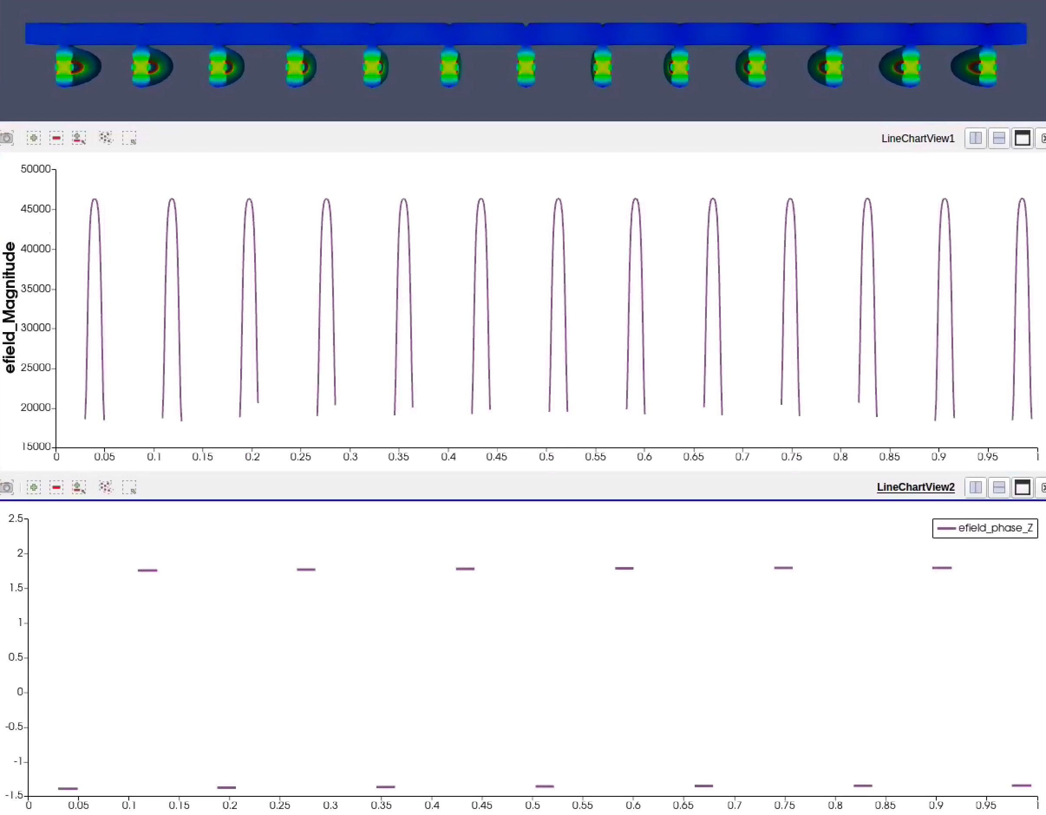
135 deg/cell Parallel Feed System Simulation
Phase advance of one feed waveguide is 180 degrees
2-m structure (112 cell)
RF power fed at the middle of the structure
Parallel waveguide feed 13 cells on either side of upstream and down stream
amplitude
RF phase: 180 deg between the cells

Slide 9
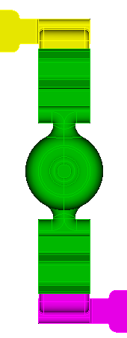
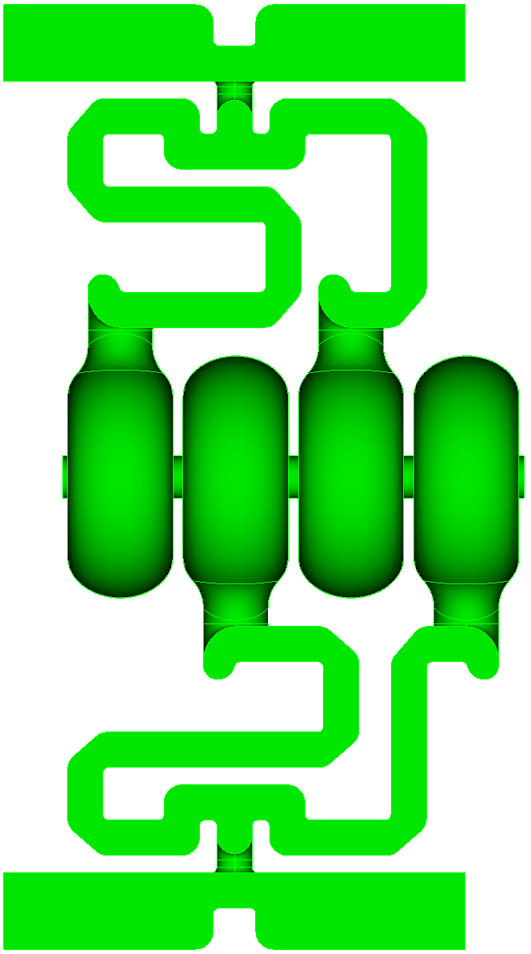
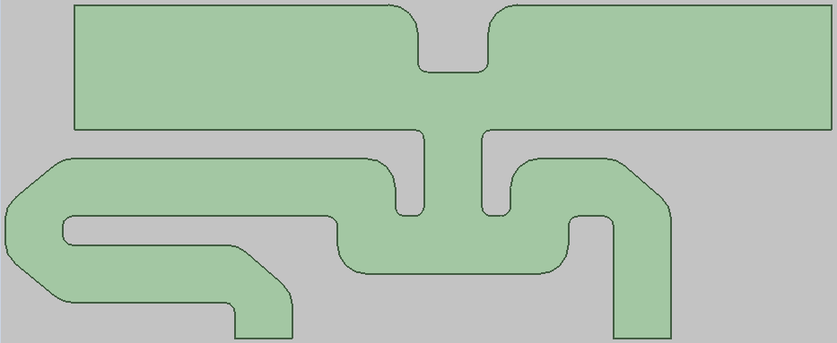

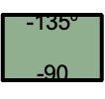
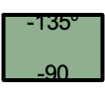

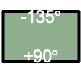


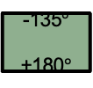

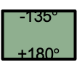
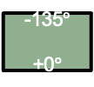
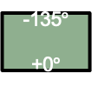


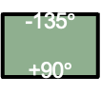

Distributed coupling for 135 deg Design - v2 (Muhammad Shumail)
Equivalent phases and Feeding Scheme:
Beam Direction
0° 180$°$ 0° 180$°$
0$°$
-135$°$
+0$°$
90$°$
-135$°$
+90$°$
180$°$
-135$°$
+180$°$
-90$°$
-135$°$
-90
0$°$
-135$°$
+0$°$
90$°$
-135$°$
+90$°$
180$°$
-135$°$
+180$°$
-90$°$
-135$°$
-90
0° 180$°$ 0° 180$°$
There has to be a phase difference of 135$°$ between the upper and lower rf feeding manifold.
T-junction
with power splitter
1-period of 135 deg distributed coupling structure

Slide 10
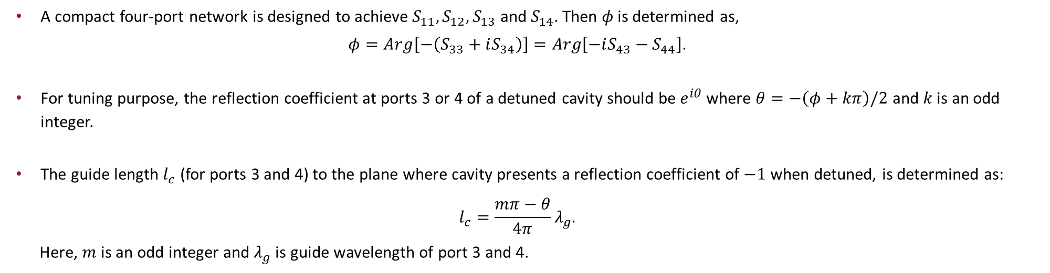
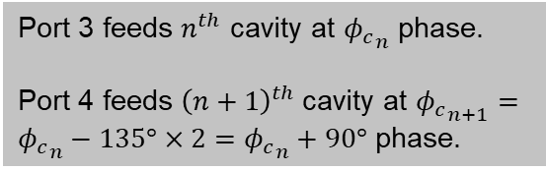
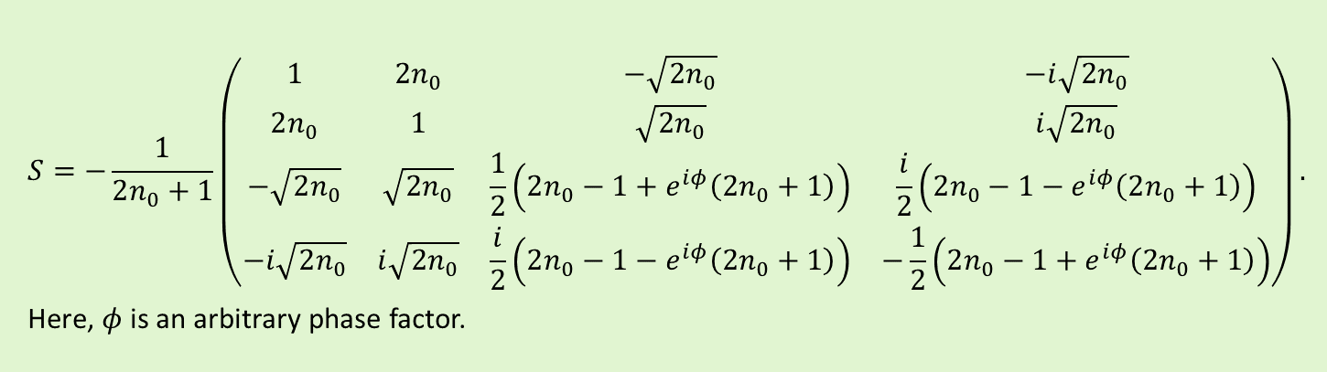
The General S-Parameter for Four-Port Network That Makes a Unit of This Distributed Feed ($n_{0}$: Number of Networks to be Cascaded in Each Manifold)
Port 1
Port 2
$$S=−\frac{1}{2n_{0}+1}\left(\text{⁠}\begin{matrix}1 & 2n_{0} & −\sqrt{2n_{0}} & −ⅈ\sqrt{2n_{0}} \\ 2n_{0} & 1 & \sqrt{2n_{0}} & ⅈ\sqrt{2n_{0}} \\ −\sqrt{2n_{0}} & \sqrt{2n_{0}} & \frac{1}{2}\left(2n_{0}−1+ⅇ^{ⅈφ}\left(2n_{0}+1\right)\right) & \frac{i}{2}\left(2n_{0}−1−ⅇ^{ⅈφ}\left(2n_{0}+1\right)\right) \\ −ⅈ\sqrt{2n_{0}} & ⅈ\sqrt{2n_{0}} & \frac{i}{2}\left(2n_{0}−1−ⅇ^{ⅈφ}\left(2n_{0}+1\right)\right) & −\frac{1}{2}\left(2n_{0}−1+ⅇ^{ⅈφ}\left(2n_{0}+1\right)\right)\end{matrix}\right).$$
Here, $φ$is an arbitrary phase factor.
Port 3
Port 4
Port 3 feeds $n^{th}$ cavity at ${φ_{c}}_{n}$ phase.
Port 4 feeds ${\left(n+1\right)}^{th}$cavity at ${φ_{c}}_{n+1}={φ_{c}}_{n}−135°×2={φ_{c}}_{n}+90°$ phase.
[Shumail]
A compact four-port network is designed to achieve $S_{11},S_{12},S_{13}$ and $S_{14}.$ Then $φ$ is determined as,
$$φ=Arg\left[−\left(S_{33}+iS_{34}\right)\right]=Arg\left[−iS_{43}−S_{44}\right].$$
For tuning purpose, the reflection coefficient at ports 3 or 4 of a detuned cavity should be $e^{iθ }$where $θ=−\left(φ+kπ\right)/2$ and $k$ is an odd integer.
The guide length $l_{c}$ (for ports 3 and 4) to the plane where cavity presents a reflection coefficient of $−1$ when detuned, is determined as:
$$l_{c}=\frac{mπ−θ}{4π}λ_{g}.$$
Here, $m$ is an odd integer and $λ_{g}$ is guide wavelength of port 3 and 4.

Slide 11

Response of Cavities Through the Manifold (for Tuning Purpose)
Port 1
Port 2
When all cavities in the manifold are detuned except, possibly, those connected to port 3 and/or 4 of one of the four-port unit networks then the reflection coefficient at Port 2 of that network is 1.
The graphs below show the response of the cavities as seen through Port 1 when one or none of them are detuned for various values of $φ$.
Port 3
Port 4
-- Blue: Response of cavity at port 3 when cavity at port 4 is detuned
-- Orange: Response of cavity at port 4 when cavity at port 3 is detuned
-- Green: Response of both cavities at port 3 and port 4

Slide 12


Right Going 7x2 Manifold
-41 dB
0
1 2 3 4 5 6 7 8 9 10 11 12 13 14

Slide 13


135 deg Standing Wave Structure with 2 Feed Waveguide – 56 cell, 1 meter
Two waveguides need to be 135 deg difference in phase
Hybrid power splitter to isolate the two feed waveguides

Slide 14


HOM Detuning and Damping
Effect of detuning
Effect of damping

Slide 15




Past Work on RDDS Structure Wakefield Damping
Round Damped Detuned Structure (RDDS)
RDDS structure
HOM couples to manifold via slots cut into disk
Manifold matched to external HOM load
Wakefield profile for Detuned Structure and Damped Detuned Structure

Slide 16



NLC X-Band Traveling Wave Structure Detuning
NLC RDDS structure
206 cells
Gaussian detuning vis aperture (1st band) and disk thickness (6th band)
Dipole mode spectrum (1st band)
Cell dimension for HOM detuning

Slide 17





C-Band 135/deg Dipole detuning via Iris Radius “a” – Not effective
Cell-to-cell phase advance: 135 deg
Cell length: 19.682 mm
Detuning using iris “a”
a=2.55mm
R=129 Mohm/m
a=3.00mm
R=122 Mohm/m
a=3.55mm
R=114 Mohm/m
(vg/c=0.056%)

Slide 18




C-Band 135/deg Dipole detuning
Cell length: 19.682 mm
Detuning using iris “thickness”
Gap1
R=113.67 Mohm/m
Gap1-0.5mm
R=114.32 Mohm/m
Gap1-1mm
R=114.38 Mohm/m
Detuning effective
Need to explore effect of profile details on different HOM bands

Slide 19
Gaussian Detuned Spectrum
TE11 beam pipe cutoff
A=3.55 mm
Fc=24.74 GHz

Slide 20
56-Cell Structure Tapered HOM Mode
Band 1 (9.3 GHz)
Band 2 (10.0 GHz)
Band 3 (13.6 GHz)

Slide 21



56-Cell Structure Tapered HOM Mode
Band 1 (9.3 GHz)
Band 2 (10.0 GHz)
Band 3 (13.6 GHz)

Slide 22




HOM Mode via Lossy Slots
0.5mm slot
Conductivity on slot surface: 1e6
Mod synchronize with beam interact stronger with beam

Slide 23








Using Tapered Slot Could Further Improve Damping
180 deg/cell Structure HOM Damping with Tapered Lossy Slot – Dongsung Kim
Slot surface conductivity (Ni-Cr) 1.0E+6 S/m
Tapered slot
Linear taper: slot height: from 300 micron to 100 micron
Non-linear taper
Need understand more detail
Lossy materials at cold temperature (77K)
Coating or thin layers brazing on to structure

Slide 24


135/cell Structure – Possible Damping Scheme (power feed V1)
Parallel feed waveguide acting as damping manifold
similar to NLC DDS structure
Narrow slot cutting through the iris couples the cells to waveguide
HOM calculation in progress
NLC RDDS
(illustration of damping)
HOM power extraction

Slide 25
Next Steps
Detuning
Optimize detuning spectrum
Explore interleaved detuning as needed
Iterate with beam dynamics
Damping
Include waveguide system
Optimize slot dimension
Study tolerance of conductivity of lossy surface

Slide 27

C³ Parameters

