Slide 1
Accelerator Structure Design and Optimization for the FCC-ee Pre-injector Complex
A. Kurtulus, A. Grudiev, A. Latina :: CERN
S. Bettoni, P. Craievich, J.-Y. Raguin :: PSI
Acknowledgment: P. Wang

Slide 2
Introduction

Slide 3
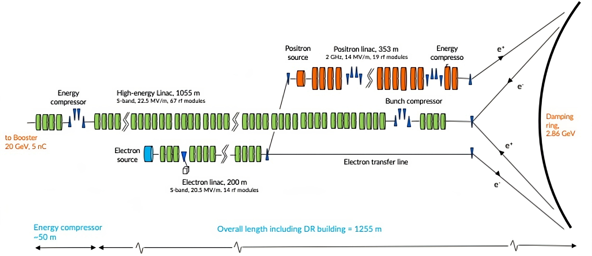
FCCee injector linacs layout (new baseline)

Slide 4
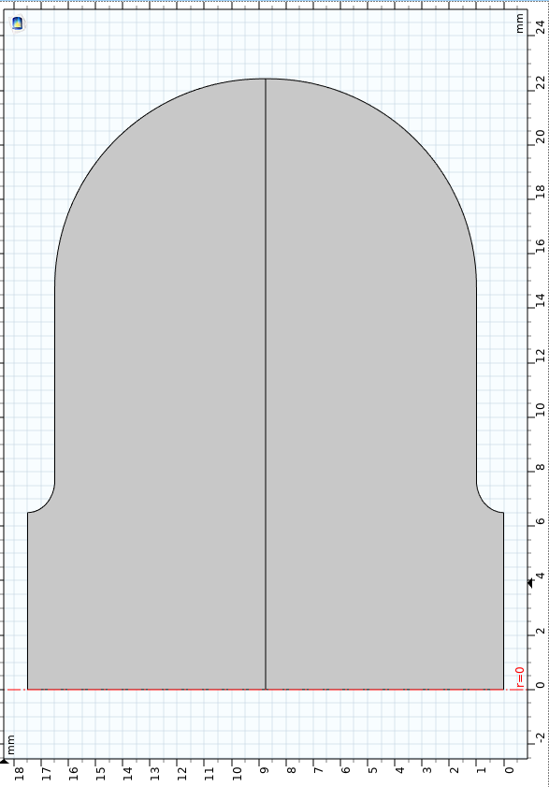
Methodology
Initially, lookup tables were created as functions of aperture and iris thickness of convex cell geometry for the first 20 HOMs to be used to calculate RF parameters of the structure.
This method allows us to compute many structures rapidly.
Motivation of the study:
  Increase the effective shunt impedance of the structure compared to the previous S-band structure.
  As a result of a good compromise between beam dynamics and RF constraints, we studied accelerator structure with an average aperture of 0.12λ.
Structure parameters and requirements:
  f = 2.8 GHz, Length = 3m, Phase advance = 2π/3.
  <a> = 0.12λ, tapered aperture, tapered iris thickness.
  |Wx| from 17.5 to 30 ns < 0.1 V/pC/mm/m
  Emax < 100 MV/m and Sc < 2300 mW/μm²
e_iris = (radial size)/d_iris
Rc
d_iris
a
L = βλψ/(2π)

Slide 5
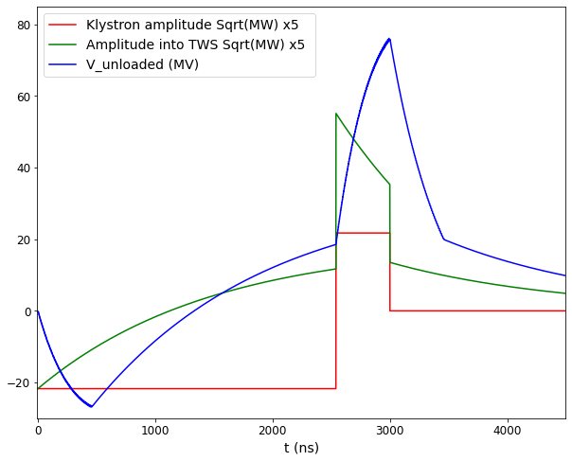
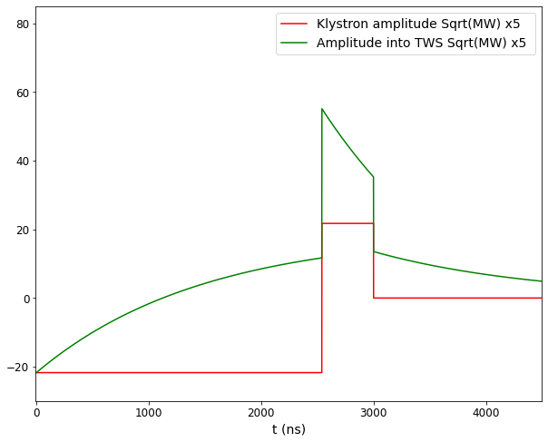

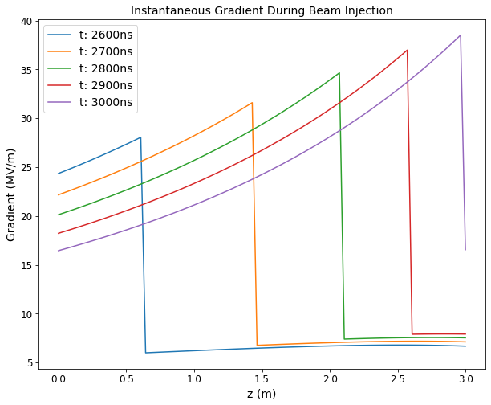
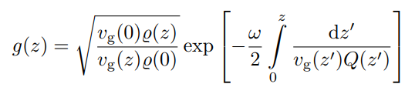

RF Pulse Compression and Accelerating Structure
The SLED-type RF pulse compressor has been analytically designed and realized.
Pulse compressor increases peak pulse amplitude and reduces pulse length by charging storage cavity.
The electric field strength within the accelerator cavities depends on the peak power of the RF signal.
For rectangular klystron pulse, gradient at injection can also be derived analytically:
where
$$V_{}=\int_{0}^{L_{s}}{dz′G(z,T_{k}})$$
We define an effective shunt impedance: R_{eff} = V_{max}²/P_{klystron}/L_{structure} [MΩ/m]

Slide 6






Parameter Sweeps
Damping long-range wakes by HOM detuning.
Aperture and Iris thickness sweeps to get highest effective shunt impedance which satisfies the wake condition.
Constant aperture structure
$a_{first}$ = a
$a_{last}$ = a
a = <a> = 0.12λ= 12.8483 mm
delta
Down tapering structure
delta
$a_{first}$ = a+delta
Delta values = 0.2 to 4mm by step of 0.2mm
$a_{last}$ = a-delta
a = <a> = 0.12λ= 12.8483 mm
Up tapering structure
delta
delta
$a_{last}$ = a-delta
Delta values = -4 mm to -0.2 by step of 0.2mm
$a_{first}$ = a+delta
a = <a> = 0.12λ= 12.8483 mm

Slide 7
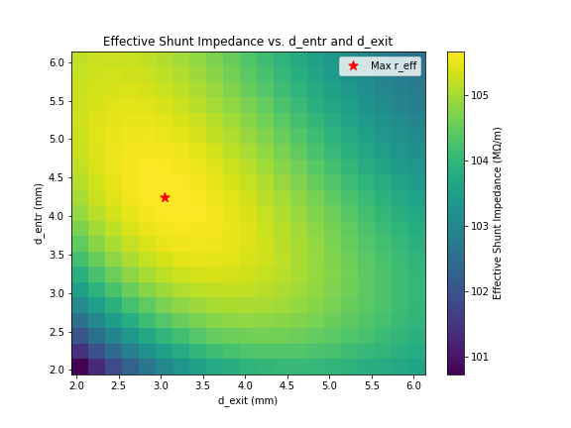
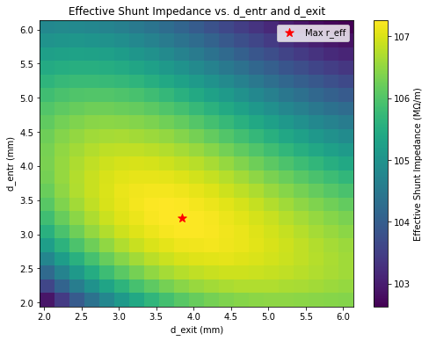
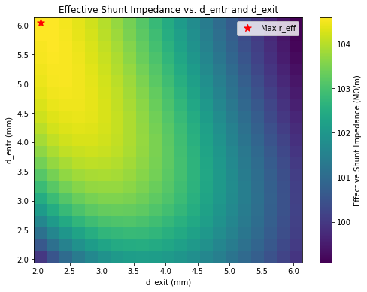
Parameter Sweeps
For each delta we find entrance (firstl cell) and exit (last cell) iris thicknesses for the highest effective shunt impedance.
Scanning iris thickness from 2.04 mm to 6.2 mm by step of 0.2mm (These numbers are the limits of Lookup table).
Q_{0,SLED} = 2e5, T_{klystron} = 3 us.
Up tapering
Constant aperture
Down tapering
(Delta from -4mm to -0.2 mm)
(Delta from 0.2 mm to 4mm)
Highest shunt imp.
Highest shunt imp.
Highest shunt imp.
delta= -2 mm
delta= 0 mm
delta= 2 mm

Slide 8
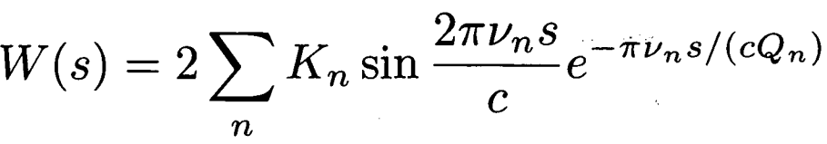
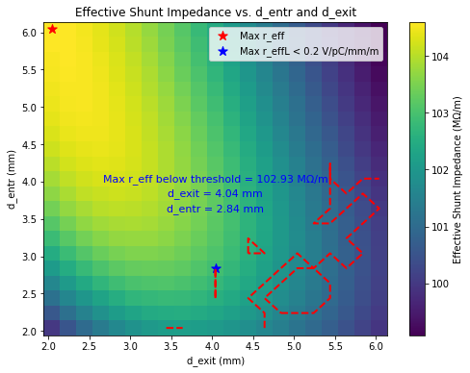

Parameter Sweeps
Checking for Transverse wake condition: |Wx| from 17.5 to 30 ns < 0.1 V/pC/mm/m
Long-range wake from frequency-domain parameters: R/Q, Q and ω.
Where
delta= 2 mm
Highlighting the areas that satisfy the wake requirment for every delta.
Updating maximum effective shunt impedance for < 0.1 V/pC/mm/m.
Calculating structure parameters with the corresponding aperture and
iris thickness.

Slide 9
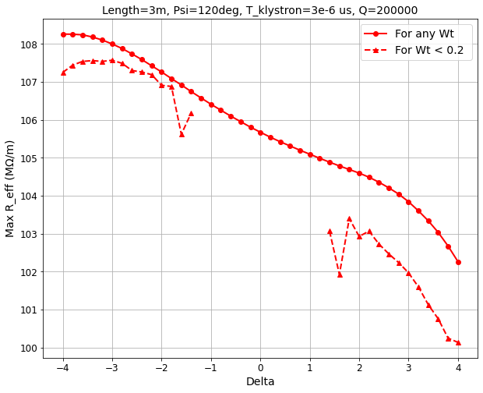
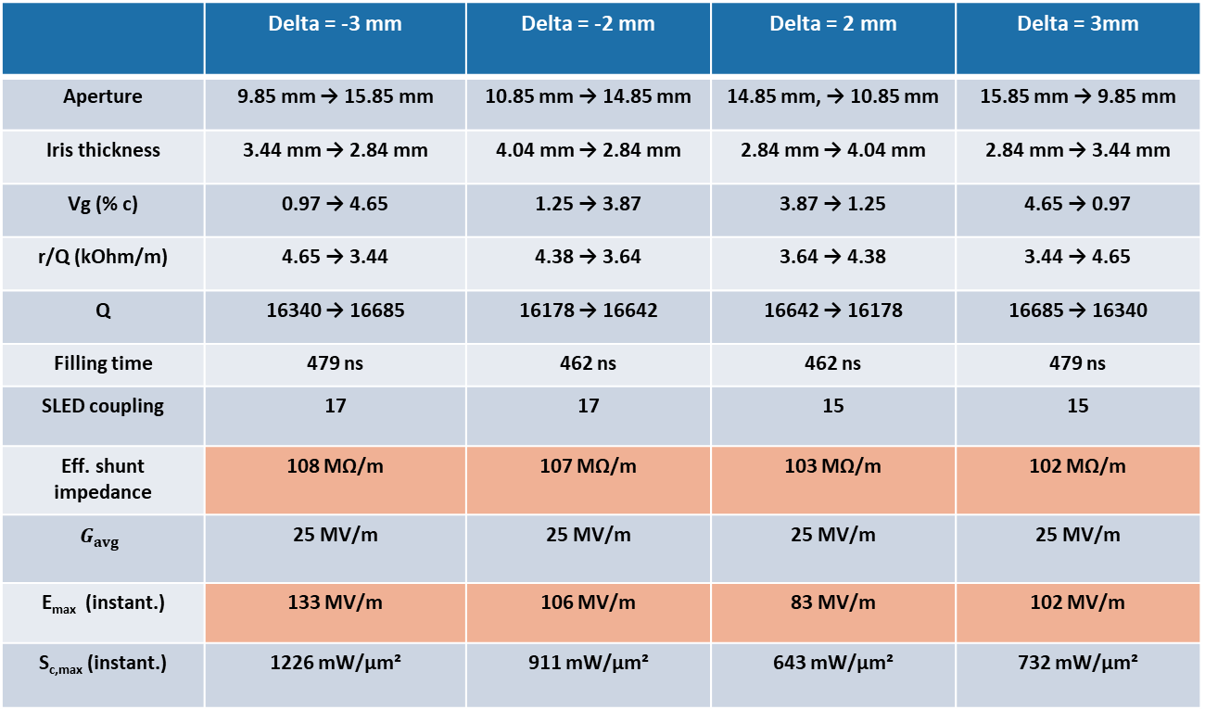
Parameters Sweep Results
 | Delta = -3 mm | Delta = -2 mm | Delta = 2 mm | Delta = 3mm
Aperture | 9.85 mm → 15.85 mm | 10.85 mm → 14.85 mm | 14.85 mm, → 10.85 mm | 15.85 mm → 9.85 mm
Iris thickness | 3.44 mm → 2.84 mm | 4.04 mm → 2.84 mm | 2.84 mm → 4.04 mm | 2.84 mm → 3.44 mm
Vg (% c) | 0.97 → 4.65 | 1.25 → 3.87 | 3.87 → 1.25 | 4.65 → 0.97
r/Q (kOhm/m) | 4.65 → 3.44 | 4.38 → 3.64 | 3.64 → 4.38 | 3.44 → 4.65
Q | 16340 → 16685 | 16178 → 16642 | 16642 → 16178 | 16685 → 16340
Filling time | 479 ns | 462 ns | 462 ns | 479 ns
SLED coupling | 17 | 17 | 15 | 15
Eff. shunt impedance | 108 MΩ/m | 107 MΩ/m | 103 MΩ/m | 102 MΩ/m
$$G_{avg}$$ | 25 MV/m | 25 MV/m | 25 MV/m | 25 MV/m
E_{max} (instant.) | 133 MV/m | 106 MV/m | 83 MV/m | 102 MV/m
S_{c,max} (instant.) | 1226 mW/μm² | 911 mW/μm² | 643 mW/μm² | 732 mW/μm²
  Emax < 100 MV/m and Sc < 2300 mW/μm²
  Based on requirements delta=2mm is the best candidate.

Slide 10
Wakefield Studies

Slide 11
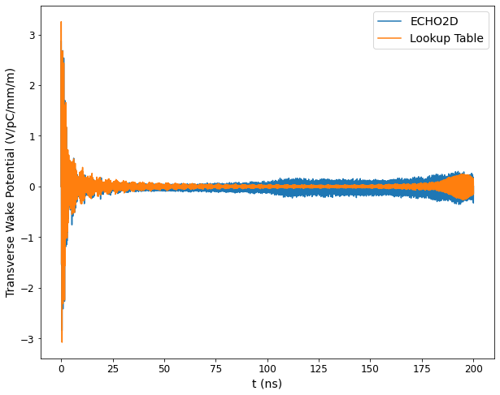
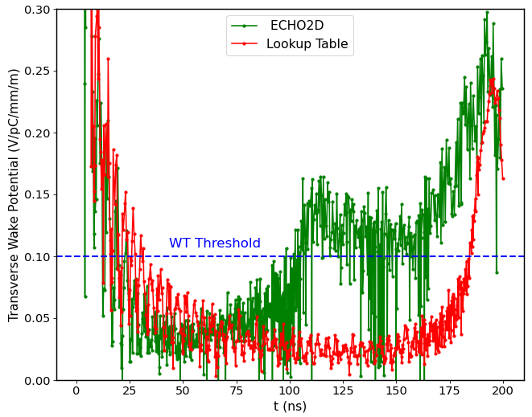
Wakefield Studies
Wakefields are calculated both with lookup table and ECHO2D time-domain wakefield solver by I. Zagorodnov.
Long-range wake damping by dipole mode detuning is effective by tapering both aperture and iris thickness.
25 ns of bunch spacing with 4 bunches.

Slide 12
CST benchmarking

Slide 13
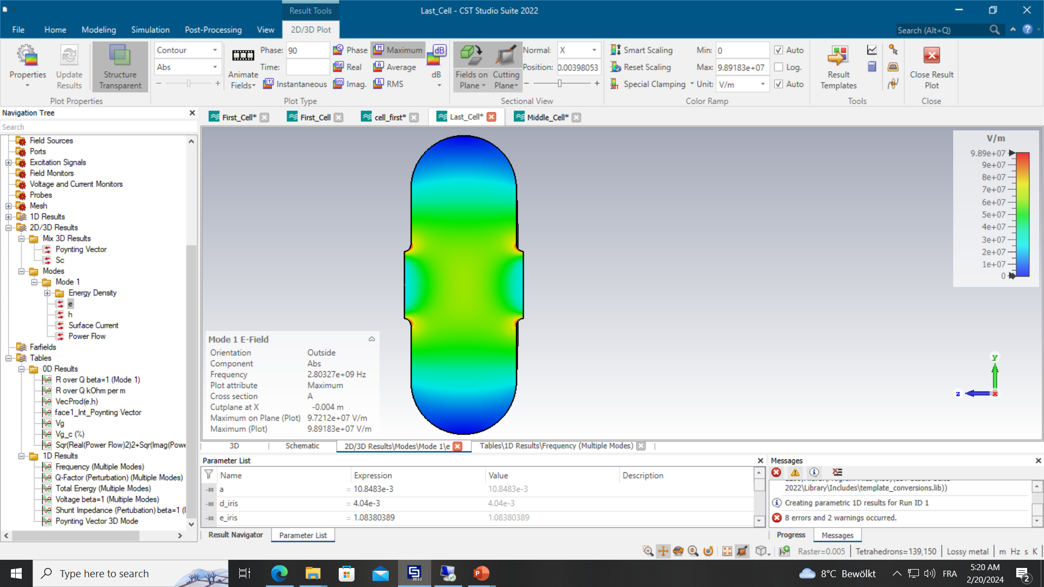
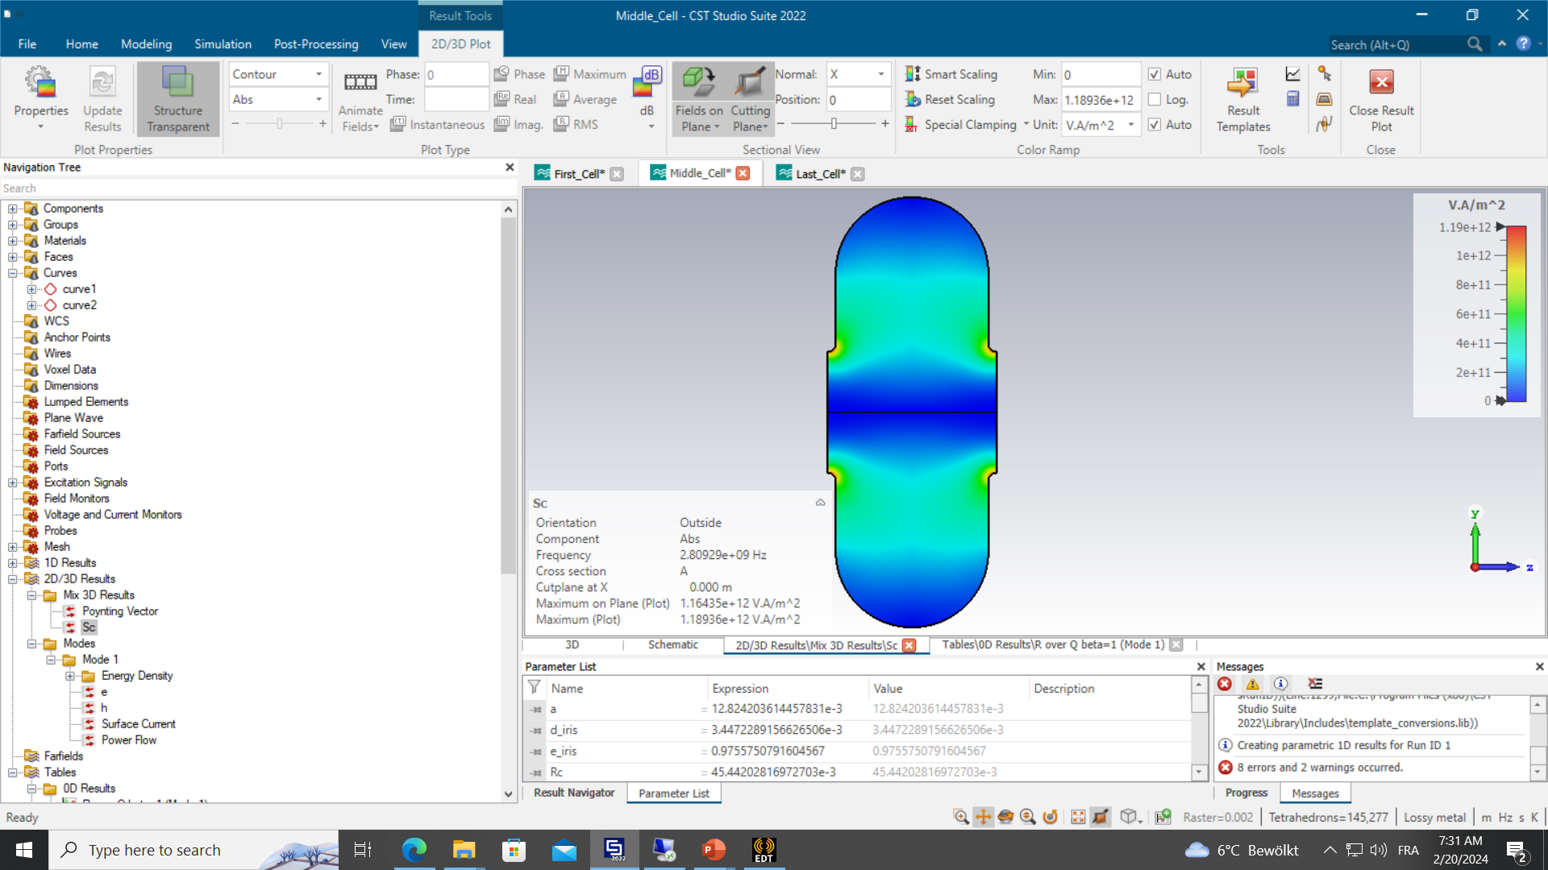
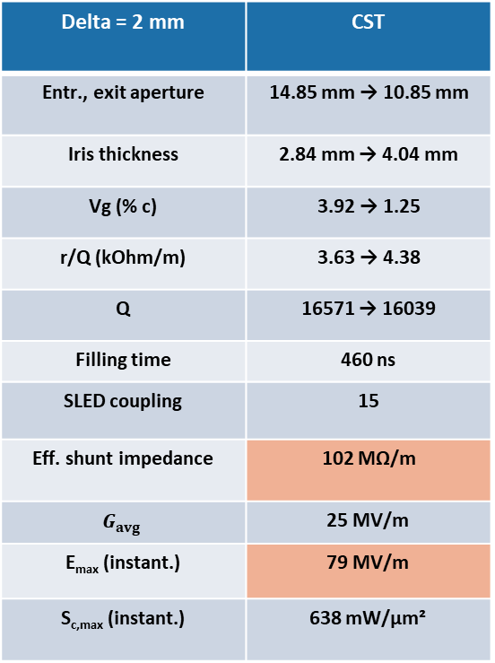
Benchmarking with CST Model
After we decided aperture and iris thickness parameters, we benchmarked our lookup table results with the 3D model in CST for the first, middle and last cells.
Less surface fields observed with the 3D model in CST.
Delta = 2 mm | CST
Entr., exit aperture | 14.85 mm → 10.85 mm
Iris thickness | 2.84 mm → 4.04 mm
Vg (% c) | 3.92 → 1.25
r/Q (kOhm/m) | 3.63 → 4.38
Q | 16571 → 16039
Filling time | 460 ns
SLED coupling | 15
Eff. shunt impedance | 102 MΩ/m
$$G_{avg}$$ | 25 MV/m
E_{max} (instant.) | 79 MV/m
S_{c,max} (instant.) | 638 mW/μm²
 | f (GHz) | Q | Rz/Q (kOhm/m) | Vg/c (%)
First Cell | 2.8 | 16571 | 3.63 | 3.92
Middle Cell | 2.8 | 16293 | 4.02 | 2.34
Last Cell | 2.8 | 16039 | 4.38 | 1.25
E-fields
 | Esmax/G | Sc/G^2
First Cell | 2.8669 | 9.105e-4
Middle Cell | 2.4254 | 5.876e-4
Last Cell | 2.0923 | 3.614e-4
Sc-fields

Slide 14
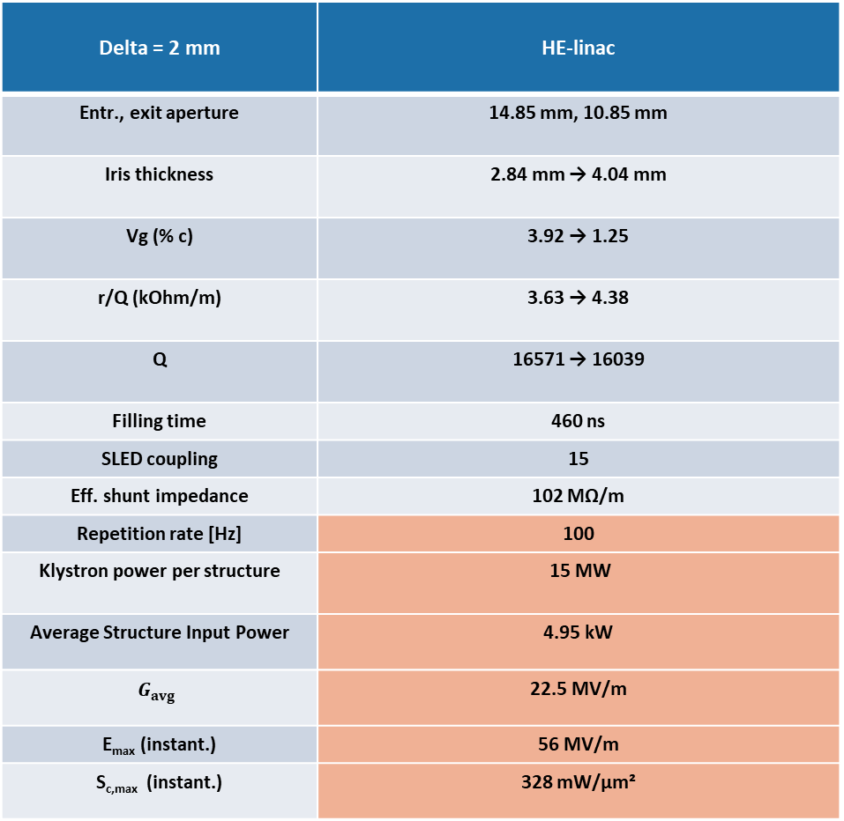
High Energy Linac
Delta = 2 mm | HE-linac
Entr., exit aperture | 14.85 mm, 10.85 mm
Iris thickness | 2.84 mm → 4.04 mm
Vg (% c) | 3.92 → 1.25
r/Q (kOhm/m) | 3.63 → 4.38
Q | 16571 → 16039
Filling time | 460 ns
SLED coupling | 15
Eff. shunt impedance | 102 MΩ/m
Repetition rate [Hz] | 100
Klystron power per structure | 15 MW
Average Structure Input Power | 4.95 kW
$$G_{avg}$$ | 22.5 MV/m
E_{max} (instant.) | 56 MV/m
S_{c,max} (instant.) | 328 mW/μm²

Slide 15
Thermomechanical Studies

Slide 16
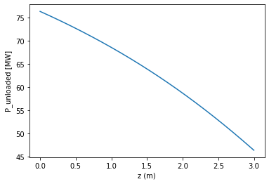
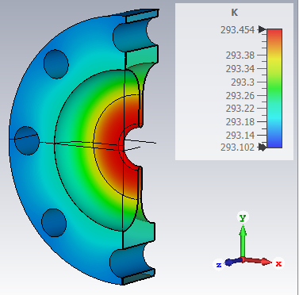
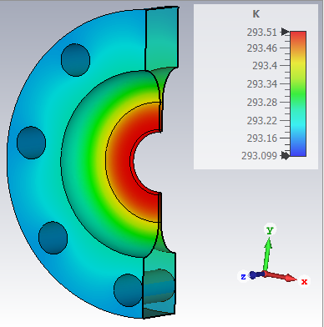
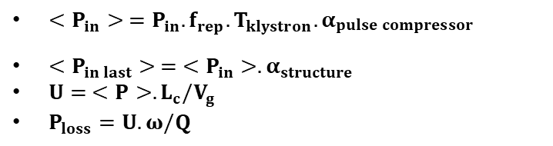
Thermal Studies
Pin
…….
Common Linac structure
…….
Pout=0.607xPin
3m long structure (84 cells)
Thermal load parameters of first cell
f_{rep ,} T_{klystron} | 100 Hz, 3 µs
α_{pulse_compressor} | 0.872
Pin (Klystron power per structure) | 18.9 MW
<Pin> (Avg. structure input power) | 4.95 kW
U_{first_cell} | 1.5e-5 J
P_{loss} (Avg. wall losses first cell) | 16.11 W
Thermal load parameters of last cell
α_{struture} | 0.607
<Pin_last> (Avg. Last cell input power) | 3 kW
U_{last_cell} | 1.4e-5 J
P_{loss} (Avg. wall losses first cell) | 15.36 W
$<P_{in}> =P_{in}.f_{rep}.T_{klystron}.α_{\begin{aligned}pulse compressor \\ \end{aligned}}$
$<P_{in last}> = <P_{in}>.α_{structure}$
$U= <P>.L_{c}/V_{g}$
$P_{loss}=U.ω/Q$
ΔT = 0.41 ͦC increase
Cooling channel diameter | 16 mm
Convection to water channel | 4 kW/m²/K
ΔT = 0.35 ͦC increase

Slide 17
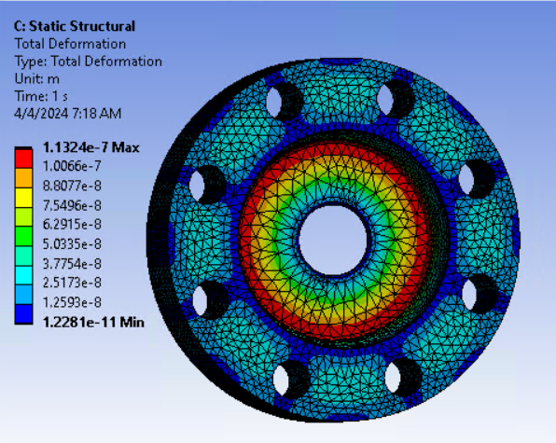
Mechanical Studies
Based on thermal studies we simulated total deformation on the first cell with mechanical solver of ANSYS.
Max deformation ≈ 0.1 μm which is negligible

Slide 18
Beam-loading effect

Slide 19
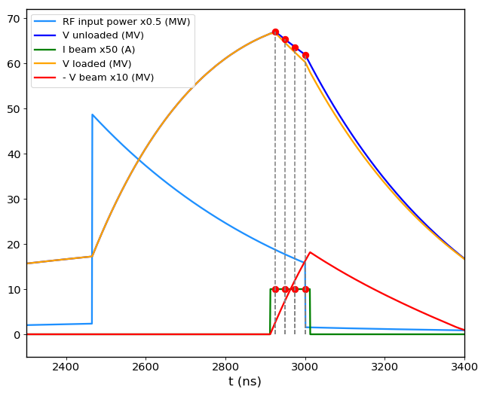
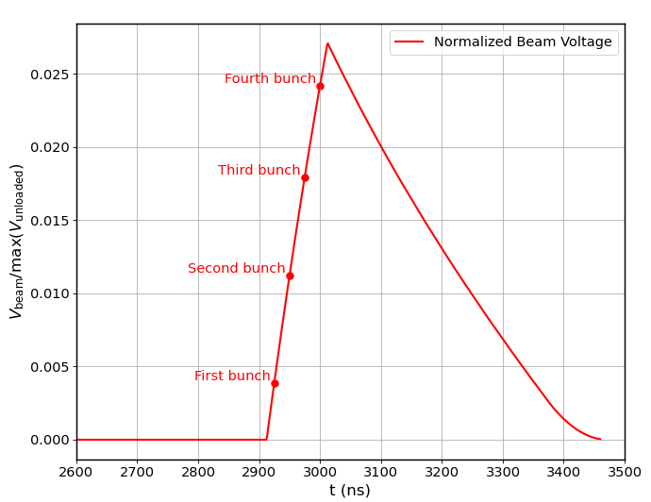
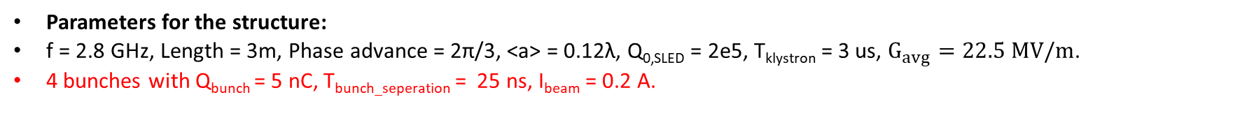
Beam-loading effect
Parameters for the structure:
f = 2.8 GHz, Length = 3m, Phase advance = 2π/3, <a> = 0.12λ, Q_{0,SLED} = 2e5, T_{klystron} = 3 us, $G_{avg}=22.5 MV/m$.
4 bunches with Q_{bunch} = 5 nC, T_{bunch_seperation} = 25 ns, I_{beam} = 0.2 A.
Max energy spread is 2.45%

Slide 20
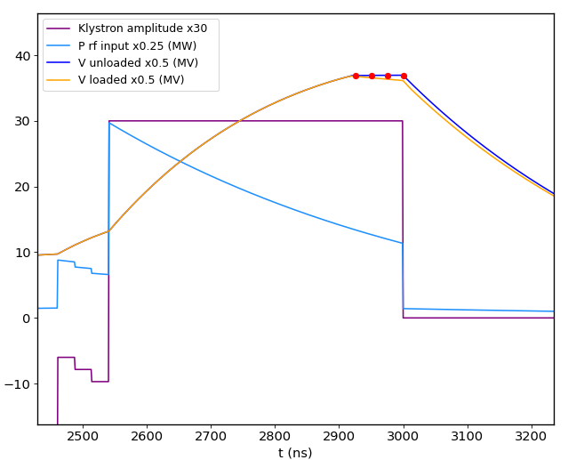
Minimization of bunch-to-bunch energy variation
By modulating the input pulse shape of the klystron, we can optimize the energy variation between the bunches.
After modifying the input pulse shape of the klystron, we successfully achieved a flattening of the unloaded (also loaded) voltage, with the total bunch-to-bunch energy variation observed to be less than 0.1%.

Slide 21
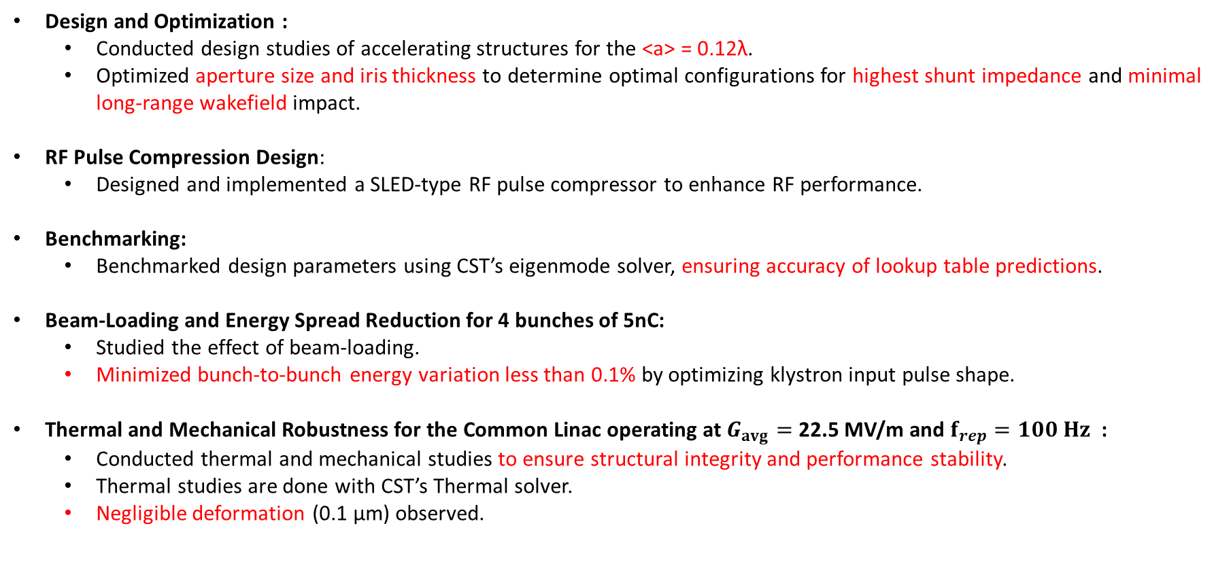
Conclusion
Design and Optimization :
  Conducted design studies of accelerating structures for the <a> = 0.12λ.
  Optimized aperture size and iris thickness to determine optimal configurations for highest shunt impedance and minimal long-range wakefield impact.
RF Pulse Compression Design:
  Designed and implemented a SLED-type RF pulse compressor to enhance RF performance.
Benchmarking:
  Benchmarked design parameters using CST’s eigenmode solver, ensuring accuracy of lookup table predictions.
Beam-Loading and Energy Spread Reduction for 4 bunches of 5nC:
  Studied the effect of beam-loading.
  Minimized bunch-to-bunch energy variation less than 0.1% by optimizing klystron input pulse shape.
Thermal and Mechanical Robustness for the Common Linac operating at $G_{avg}=$ 22.5 MV/m and $f_{rep}=100 Hz$ :
  Conducted thermal and mechanical studies to ensure structural integrity and performance stability.
  Thermal studies are done with CST’s Thermal solver.
  Negligible deformation (0.1 μm) observed.

Slide 22
Thanks for your attention!

Slide 23
Spare Slides

Slide 24
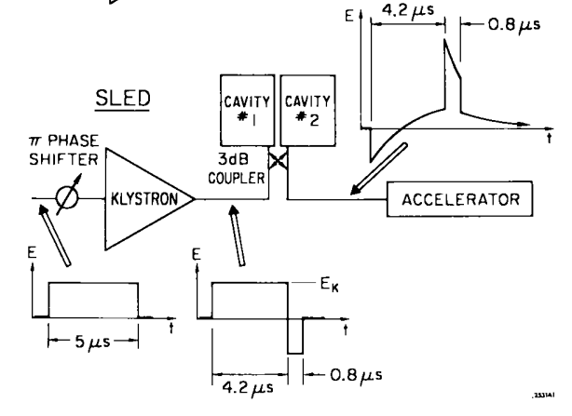
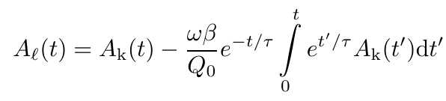
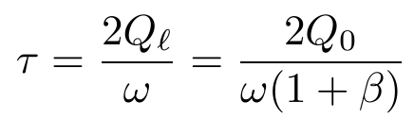
SLED-type RF pulse compressor
Farkas et al., A method of doubling SLAC‘s energy, Proc. HEACC 1974
Increase peak pulse amplitude and reduce pulse length by charging storage cavity
Output pulse A_{L} given by
where A_{K}: klystron pulse, β, Q₀, τ: coupling, Q-factor, filling time of storage cavity.

Slide 25
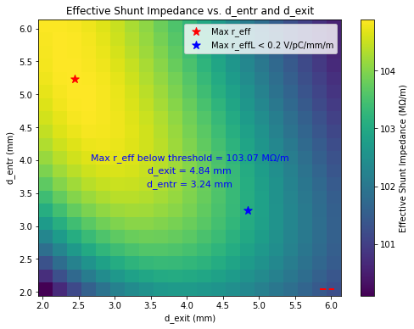
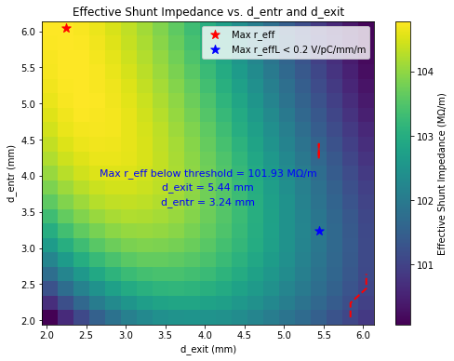
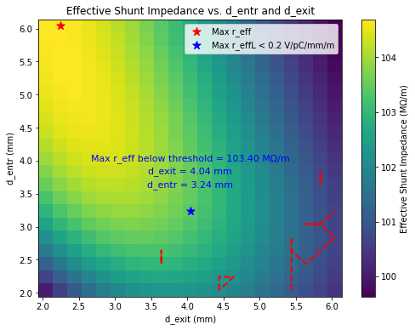
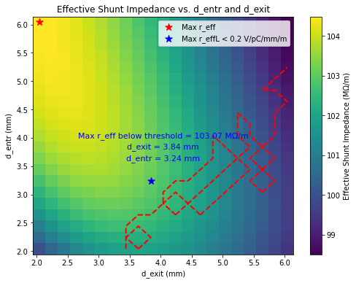
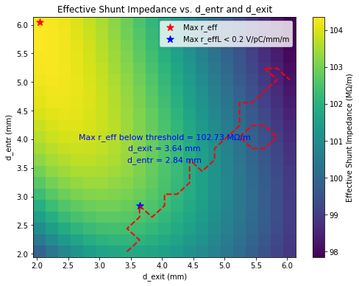

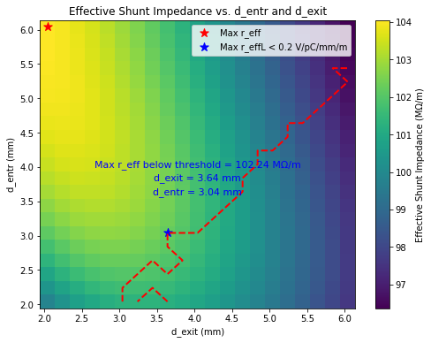
DOWN TAPERING
@2.8 GHz, 0.12λ = 12.8483 mm
a_entr = 12.8483 + delta, a_exit = 12.8483 – delta, where delta = -4 to 4 mm by step of 0.2mm
delta=1.4 mm
delta=1.6mm
delta=1.8mm
delta=2mm
a_entr = 14.2483, a_ext=11.4483
a_entr = 14.4483, a_ext=11.2483
a_entr = 14.6483, a_ext=11.0483
a_entr = 14.8483, a_ext=10.8483
delta=2.2 mm
delta=2.4 mm
delta=2.6 mm
delta=2.8 mm
a_entr = 15.0483, a_ext=10.6483
a_entr = 15.2483, a_ext=10.4483
a_entr = 15.4483, a_ext=10.2483
a_entr = 15.6483, a_ext=10.0483

Slide 26

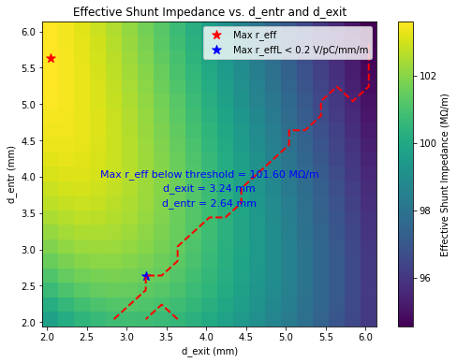
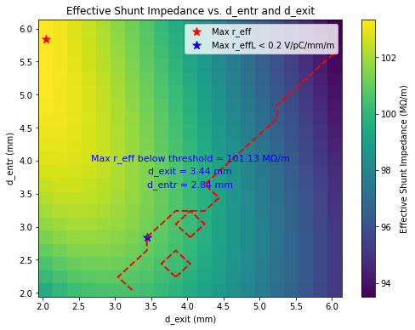
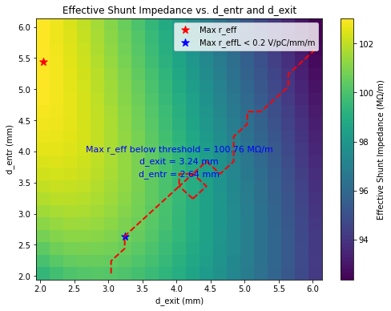
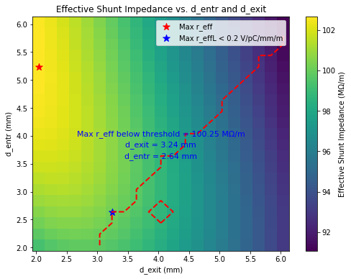
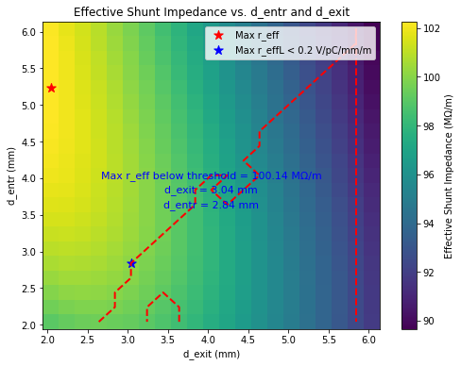
DOWN TAPERING
@2.8 GHz, 0.12λ = 12.8483 mm
a_entr = 12.8483 + delta, a_exit = 12.8483 – delta, where delta = -4 to 4 mm by step of 0.2mm
delta=3 mm
delta=3.2 mm
delta=3.4 mm
delta=3.6 mm
a_entr = 15.8483, a_ext=9.8483
a_entr = 16.0483, a_ext=9.6483
a_entr = 16.2483, a_ext=9.4483
a_entr = 16.4483, a_ext=9.2483
delta=3.8 mm
delta=4 mm
a_entr = 16.6483, a_ext=9.0483
a_entr = 16.8483, a_ext=8.8483

Slide 27
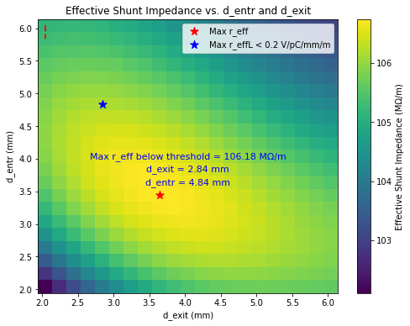
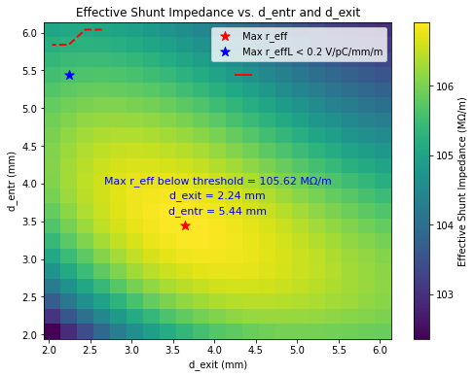
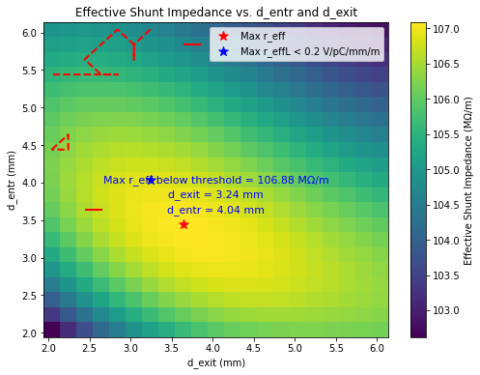
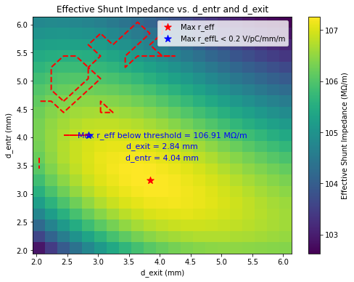
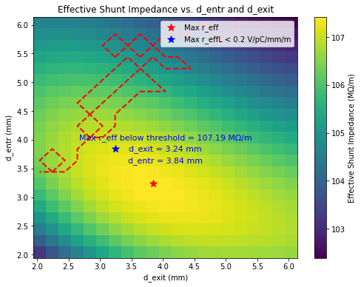
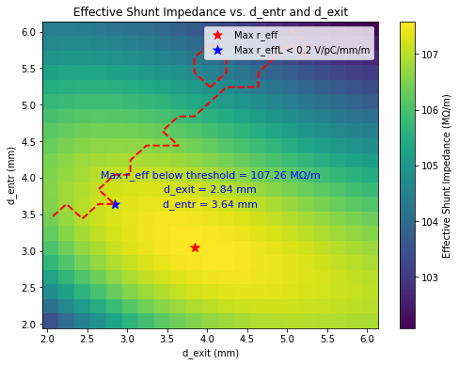


UP TAPERING
@2.8 GHz, 0.12λ = 12.8483 mm
a_entr = 12.8483 + delta, a_exit = 12.8483 – delta, where delta = -4 to 4 mm by step of 0.2mm
delta= -1.4 mm
delta= -1.6 mm
delta= -1.8mm
delta= -2mm
a_entr = 11.4483, a_ext= 14.2483
a_entr = 11.2483, a_ext= 14.4483
a_entr = 11.0483, a_ext= 14.6483
a_entr = 10.8483, a_ext= 14.8483
delta= -2.2 mm
delta= -2.4 mm
delta= -2.6 mm
delta= -2.8 mm
a_entr = 10.6483, a_ext= 15.0483
a_entr = 10.4483, a_ext= 15.2483
a_entr = 10.2483, a_ext= 15.4483
a_entr = 10.0483, a_ext= 15.6483

Slide 28






UP TAPERING
@2.8 GHz, 0.12λ = 12.8483 mm
a_entr = 12.8483 + delta, a_exit = 12.8483 – delta, where delta = -4 to 4 mm by step of 0.2mm
delta= -3 mm
delta= -3.2 mm
delta= -3.4 mm
delta= -3.6 mm
a_entr = 9.8483, a_ext= 15.8483
a_entr = 9.6483, a_ext= 16.0483
a_entr = 9.4483, a_ext= 16.2483
a_entr = 9.2483, a_ext= 16.4483
delta= -3.8 mm
delta= -4 mm
a_entr = 9.0483, a_ext= 16.6483
a_entr = 8.8483, a_ext= 16.8483

Slide 29


Other parameter scans
Different Q_{0,SLED}, T_{klystron} , Length of the structure, Phase advance scanned .
Q_{0,SLED} from 2e5 to 2.5e5.
≈ 1% of increase

Slide 30

Other parameter scans
Different Q_{0,SLED}, T_{klystron} , Length of the structure, Phase advance scanned .
T_{klystron} from 3 us to 4 us.
≈ 14% of increase

Slide 31

Other parameter scans
Different Q_{0,SLED}, T_{klystron} , Length of the structure, Phase advance scanned .
Length of the structure from 3 m to 4 m.

Slide 32

Other parameter scans
Different Q_{0,SLED}, T_{klystron} , Length of the structure, Phase advance scanned .
Phase advance from 2π/3 to 5π/6.

