Slide 1
1K Plate Design
Tori Ankel
8/5/2024

Slide 2
What is fixed?
66 cm
1K shield
1K plate
20mK plate
1K standoffs
4K ring
Inverted top hat

Slide 3
What are the open questions?
Materials
Interfaces
Snorkel
SC connection
Flexible 1K cold finger
connection
Attocubes!

Slide 4
Materials
Needs to be cooled through the 1K flexible connection (with acceptable thermal gradients)
Inside of the shield and plate need to be superconducting
Needs to be mechanically stable
First ideas?
Notes:
(insides of 1k shield, plate and tophat? – maybe flat parts are more important bc of inductor)
Some ideas? What is first step + copper ring maybe

Slide 5
Calculations Required
For a given design/ set of materials
Do we have sufficient cooling power?
Will it support the weight we need?
How can we get it made?
Given the temperature at the end of the cold finger connection and using known heat loads on the 1K plate what are the thermal gradients across the 1K plate and shield?
What is the temperature at the end of the flexible 1K cold finger connection?
What is the total heat load on the 1K plate?

Slide 6
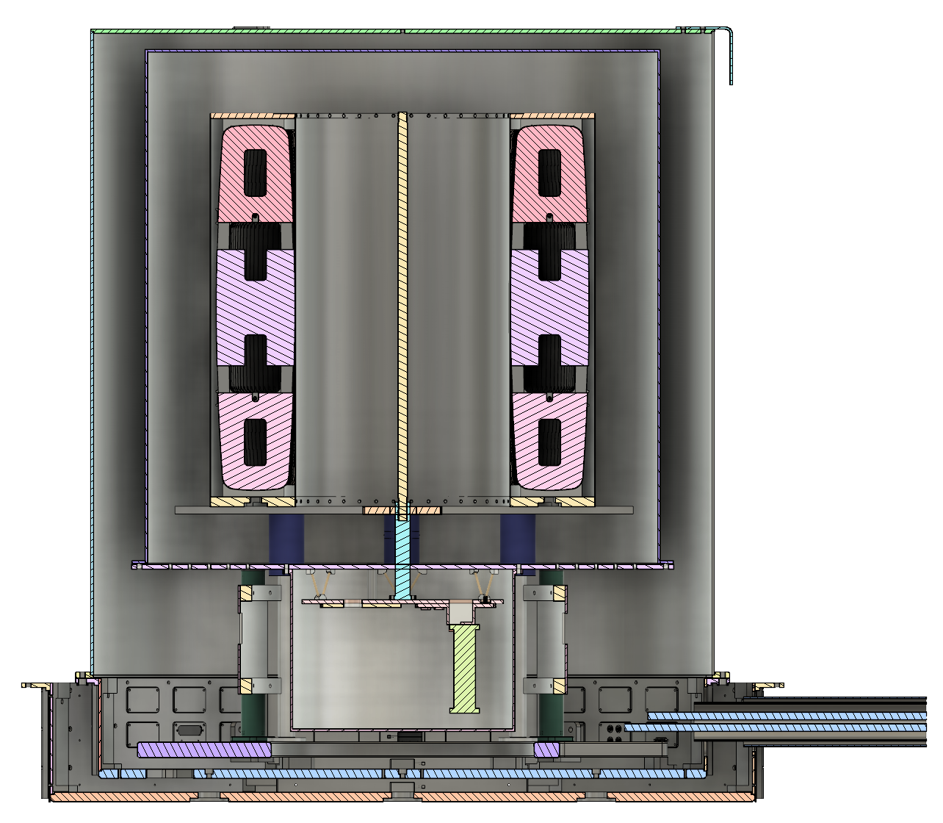
Heat Load on the 1K Plate
4K → 1K
Radiation
Sheath
Magnet structural legs & skirts
4K shield
4K ring
1K ring standoffs
4K thermal shield onto 1K cold finger
Conduction
1K standoffs
DC Phosphor Bronze wiring from 4 K intercept
DC Copper (low resistance) wiring from 4K intercept
RF wiring from 4 K intercept (NbTi)

Slide 7
Heat Load on the 1K Plate
4K → 1K
Radiation
Sheath
Magnet structural legs & skirts
4K shield
4K ring
1K ring standoffs
4K thermal shield onto 1K cold finger
Conduction
1K standoffs
DC Phosphor Bronze wiring from 4 K intercept
DC Copper (low resistance) wiring from 4K intercept
RF wiring from 4 K intercept (NbTi)

Slide 8
Radiation
→ Set emissivity to 0.3 for all undesigned parts
→ Use Stefan-Boltzmann law to estimate an upper bound
Sheath walls + sheath top lid
Magnet structural legs & skirts
4K shield walls + shield top lid
4K ring
1K standoffs
4K thermal shield onto 1K cold finger
Total = 8.5 μW
https://arxiv.org/pdf/1501.07153

Slide 9
G10 is for the standoff
Conduction
1K standoffs
400 μW; from four-nine
DC Phosphor Bronze wiring from 4 K intercept
DC Copper (low resistance) wiring from 4K intercept
RF wiring from 4 K intercept (NbTi)
Total = 405.4 μW
From Joe’s wire conductivity spreadsheet + Nicholas’s heat load calculations

Slide 10
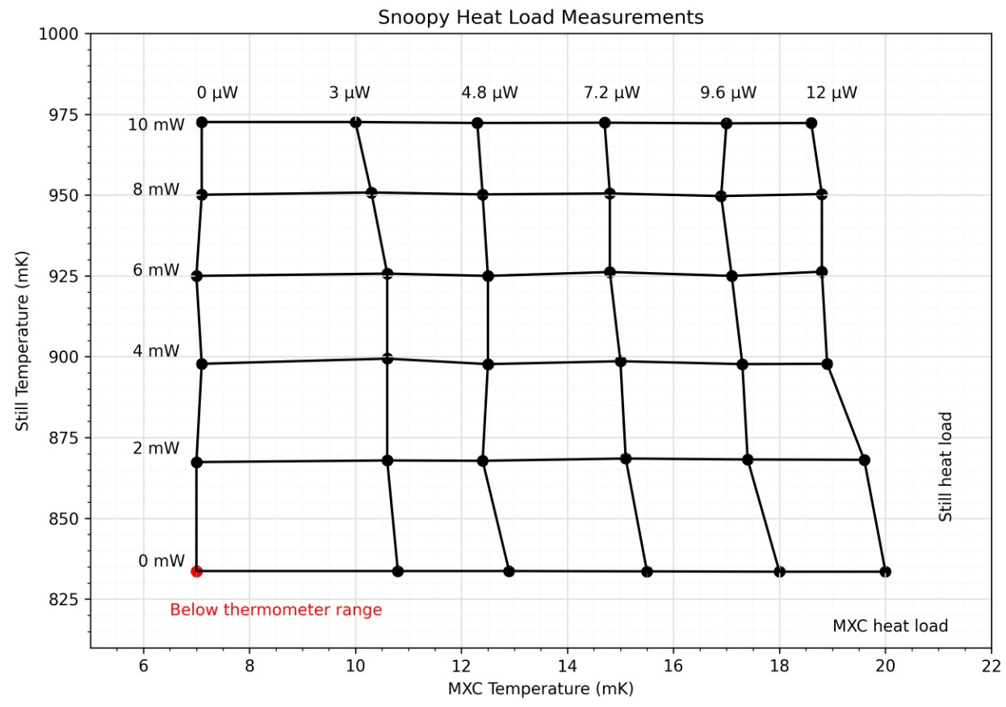
Effect on the Still Temperature
Total Heat Load ~ 413.9 μW
This corresponds to a still temperature of
~841 mK!
841
.413 mW

Slide 11
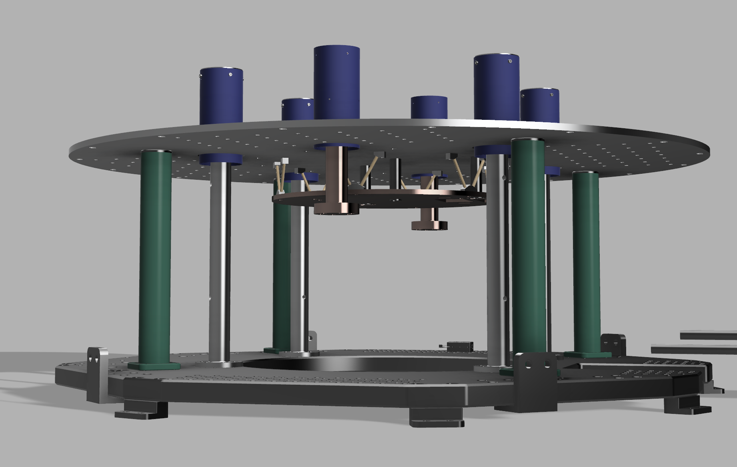
1K Plate Interfaces
Skirts + SC wire connection on thermal legs
Wiring
Design of the stand-offs?
20 mK struts
Attocubes
Flexible connection to 1K cold finger
Inverted top hat
Thermal and structural legs

Slide 12
1K Shield Interfaces
Snorkel
4K to 1K connection
May interface with both the 1K plate and the 1K shield
Connection between 1K shield and 1K plate
Requires an analysis of screening currents
Permanent thermometer on the top of the shield

Slide 13
Timeline
Aug. 20
Finalize 1K interfaces to structural legs and standoffs, make decisions about adding a SC wire to thermal legs
Aug. 14
Model temperature gradients for a pure Al plate and shield as a baseline
Aug. 27
Discuss and determine how the 1K shield will be attached to the 1K plate
Sep. 3
Decide on materials for plate and shield
Sep. 10
Determine the cold finger 1K connection
Sep. 17
Finalize attocube positioning on the 1K plate
Sep.17
Finish snorkel interface
Sep. 20
Finalize interfaces to the 20mK plate, including wiring
Sep. 26
Finalize all interfaces from the 1K plate and shield
Oct
1K plate and shield ordered
Nov
1K plate delivered

