Slide 1





REBCO High-Temperature Superconductor Coatings for RF Applications
Sergio Calatroni, on behalf of the Collaboration.

Slide 2
Setting the scene: future accelerators

Slide 3
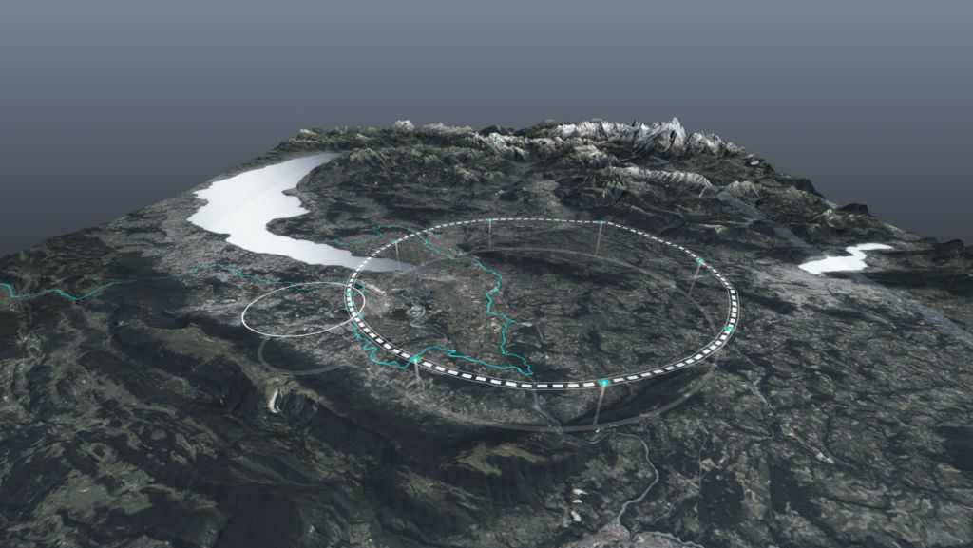










Future Circular Collider
http://cern.ch/fcc
Work supported by the European Commission under the HORIZON 2020 projects EuroCirCol, grant agreement 654305; EASITrain, grant agreement no. 764879; iFAST, grant agreement 101004730, FCCIS, grant agreement 951754; E-JADE, contract no. 645479; EAJADE, contract number 101086276; and by the Swiss CHART program

Slide 4

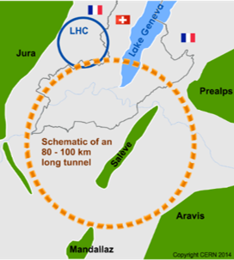
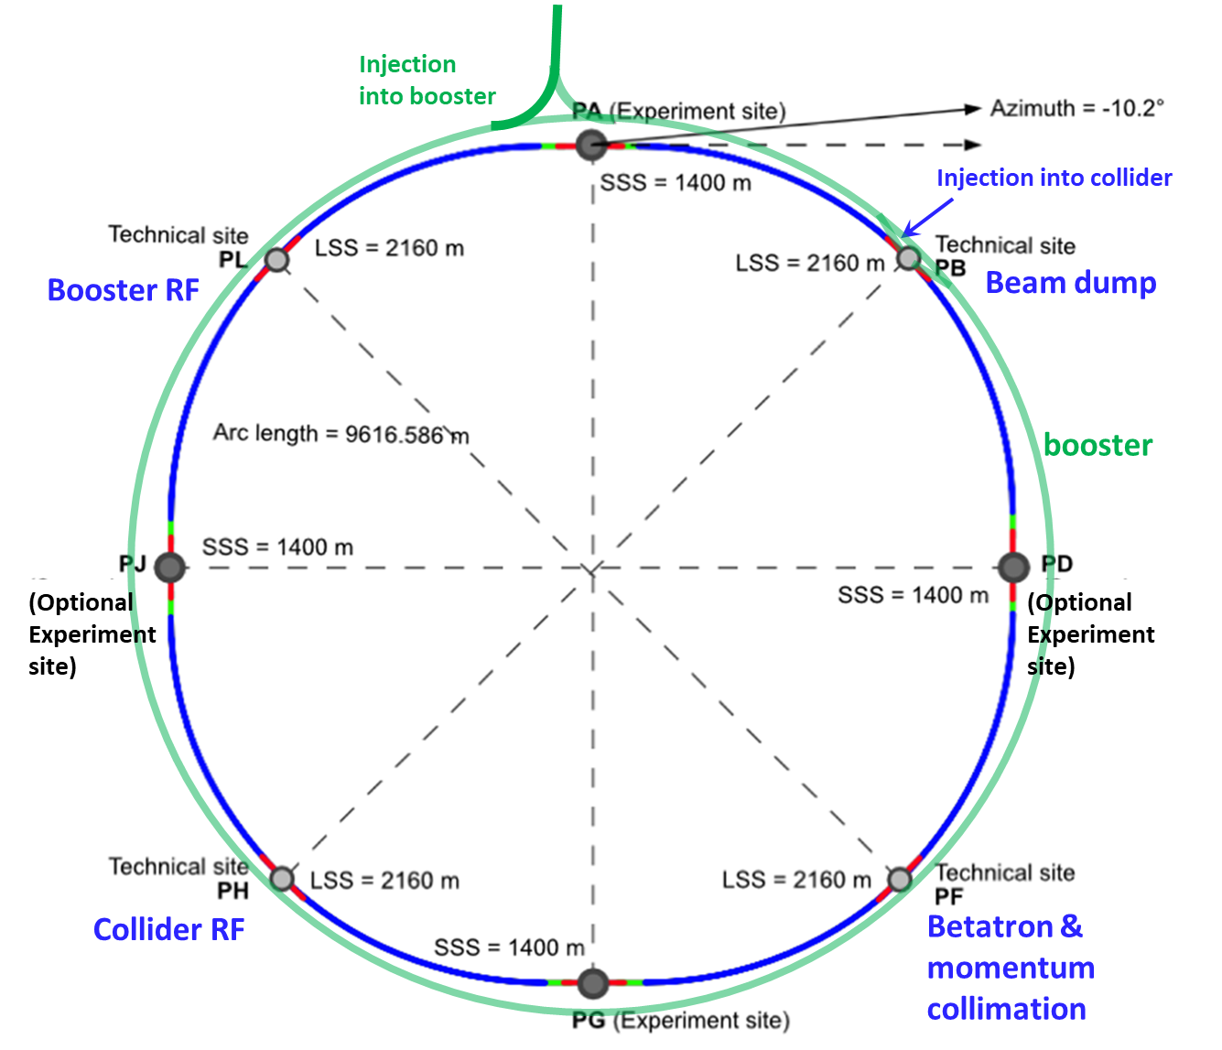
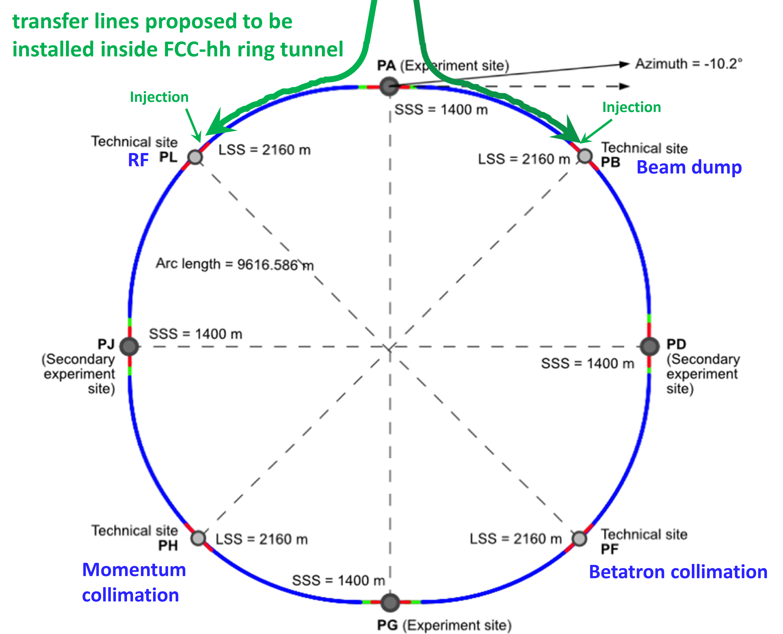
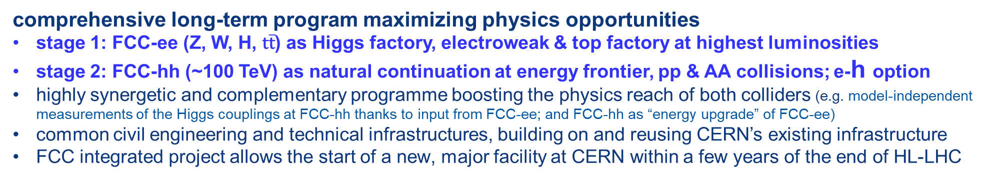
FCC integrated program
Link to the FCC week 2024
comprehensive long-term program maximizing physics opportunities
stage 1: FCC-ee (Z, W, H, $\text{t}\overline{\text{t}}$) as Higgs factory, electroweak & top factory at highest luminosities
stage 2: FCC-hh (~100 TeV) as natural continuation at energy frontier, pp & AA collisions; e-h option
highly synergetic and complementary programme boosting the physics reach of both colliders (e.g. model-independent measurements of the Higgs couplings at FCC-hh thanks to input from FCC-ee; and FCC-hh as “energy upgrade” of FCC-ee)
common civil engineering and technical infrastructures, building on and reusing CERN’s existing infrastructure
FCC integrated project allows the start of a new, major facility at CERN within a few years of the end of HL-LHC
FCC-ee
FCC-hh
2020 - 2040
2045 - 2063
2070 - 2095
From M. Benedikt, FCC Study leader

Slide 5
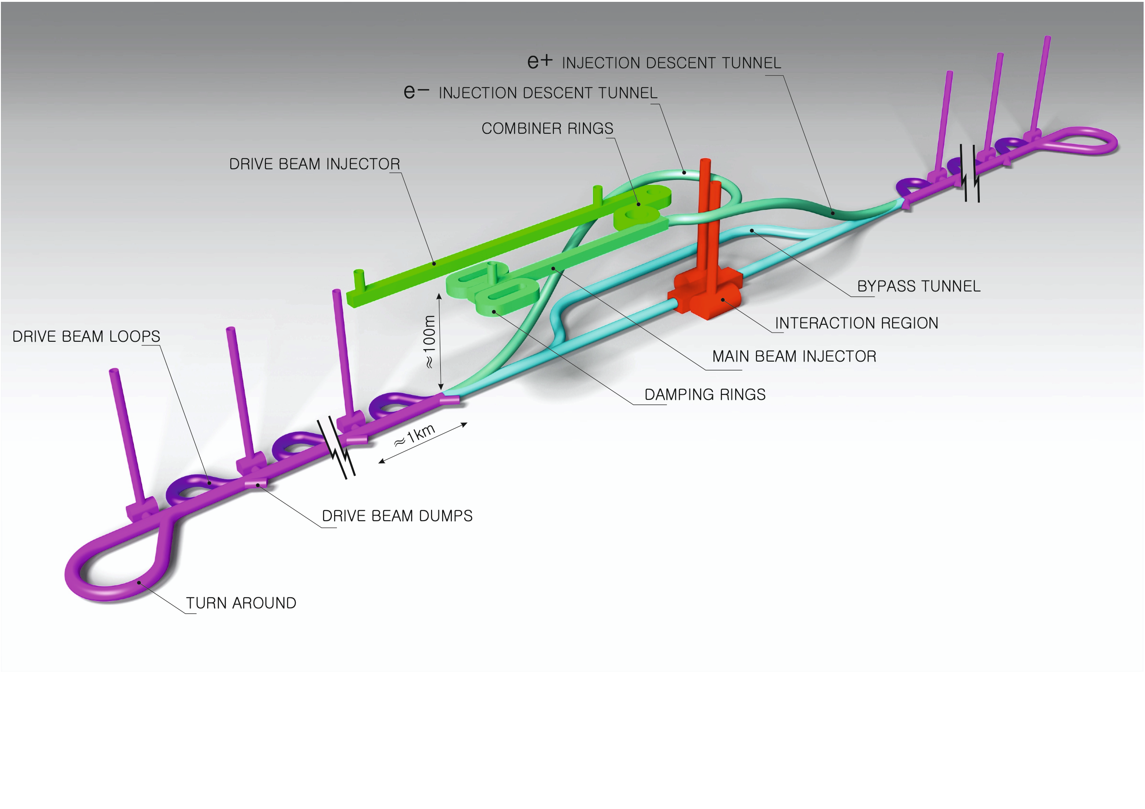
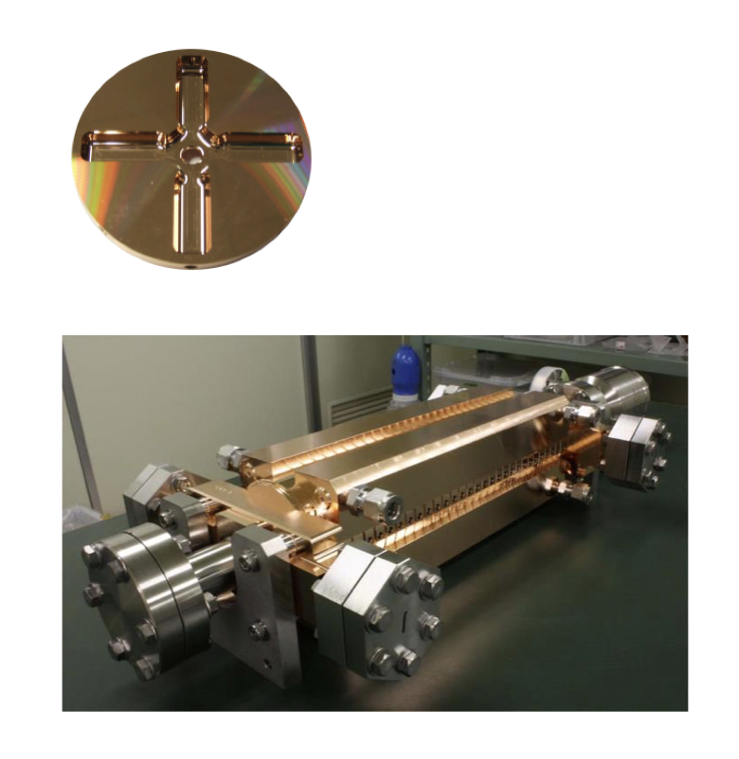
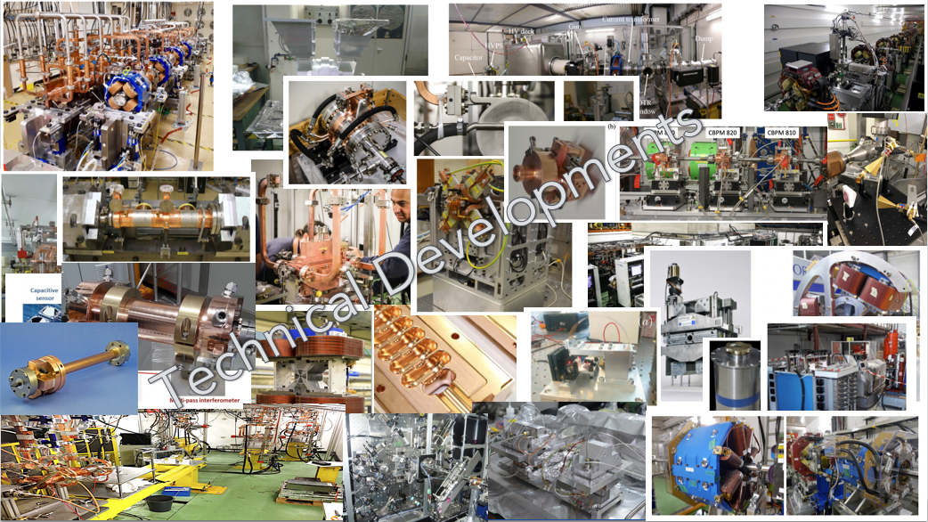
The Compact Linear Collider (CLIC)
  Recent talks: eeFACT-I1 and eeFACTI2
  Timeline: Electron-positron linear collider at CERN for the era beyond HL-LHC
  Compact: Novel and unique two-beam accelerating technique with high-gradient room temperature RF cavities (~20’500 structures at 380 GeV), ~11km in its initial phase
  Expandable: Staged programme with collision energies from 380 GeV (Higgs/top) up to 3 TeV (Energy Frontier)
  CDR in 2012 with focus on 3 TeV. Updated project overview documents in 2018 (Project Implementation Plan) with focus 380 GeV for Higgs and top.
Accelerating structure prototype for CLIC: 12 GHz (L~25 cm)
The CLIC accelerator studies are mature:
Optimised design for cost and power
Many tests in CTF3, FELs, light-sources and test-stands
Technical developments of “all” key elements
From: Steinar Stapnes

Slide 6
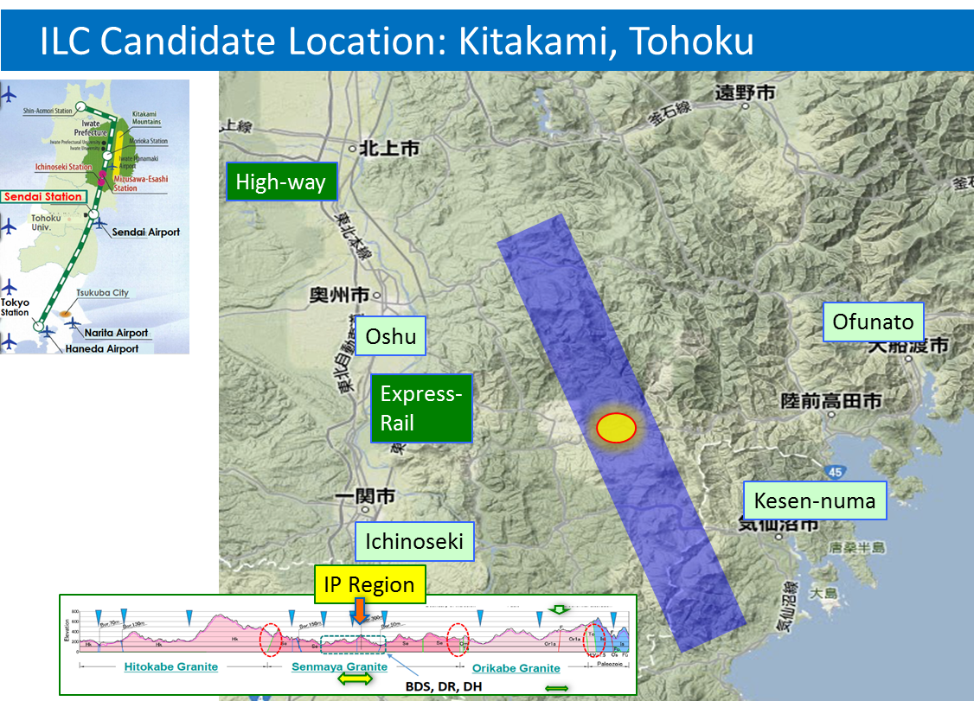
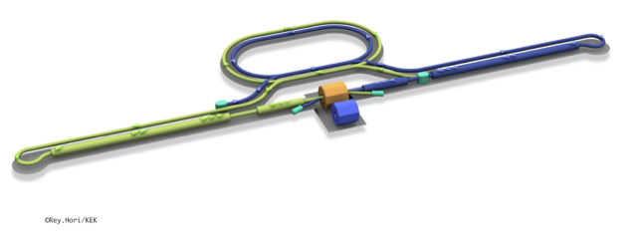
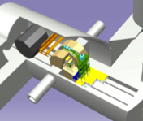
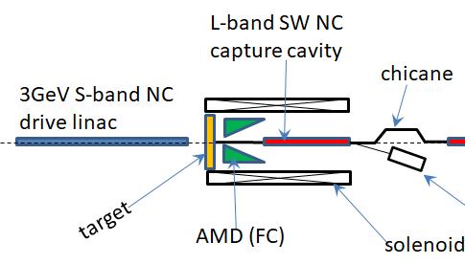
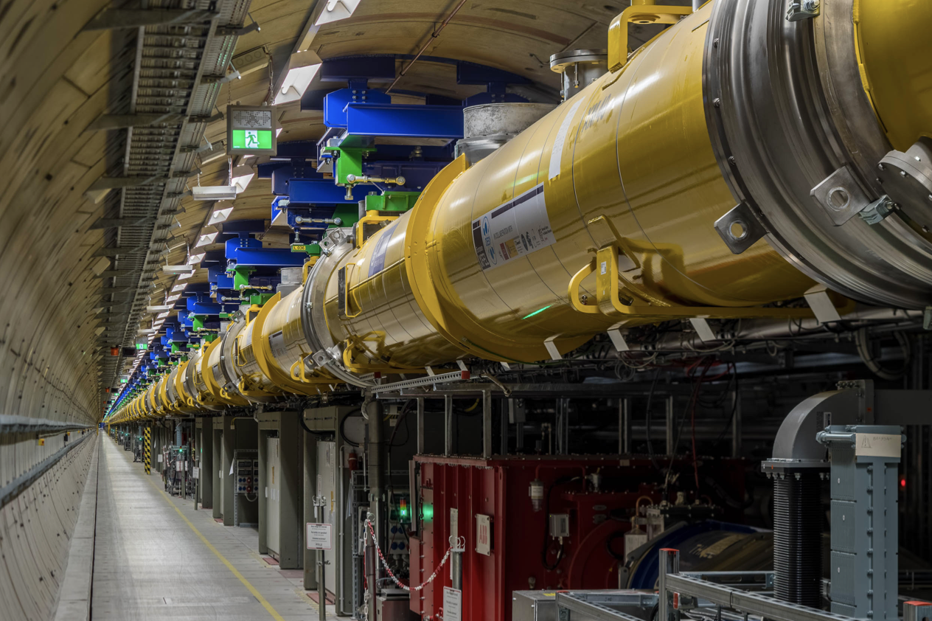
The ILC250 accelerator facility
  Recent talks: eeFACT-I1 and eeFACTI2
Interaction point
Damping Ring
e+ Source
e- Source
e- Main Linac
Beam dump
Physics Detectors
e+ Main Liinac
Bunches of ~10¹⁰ e+/e-
Undulator positron source
Creating particles Sources
  polarized elections/positrons
High quality beam Damping ring
  low emittance beams
Acceleration Main linac
  superconducting radio frequency (SRF)
Collide them Final focus
  nano-meter beams
Go to Beam dumps
Electron driven positron source
From: Steinar Stapnes

Slide 7
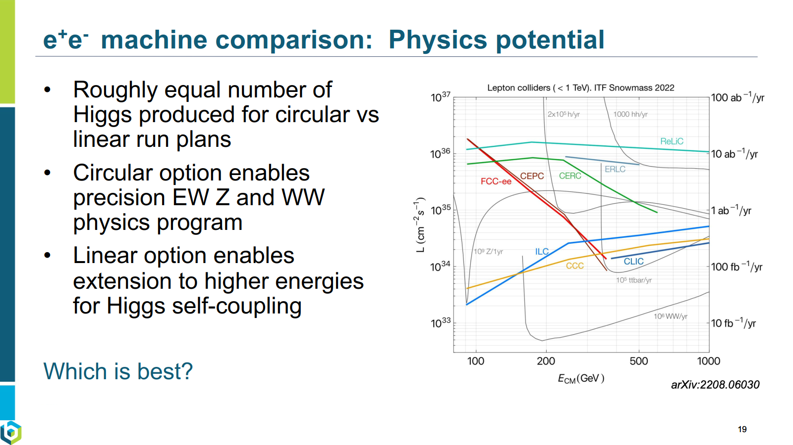
From JoAnne Hewett, FCC week 2024

Slide 8
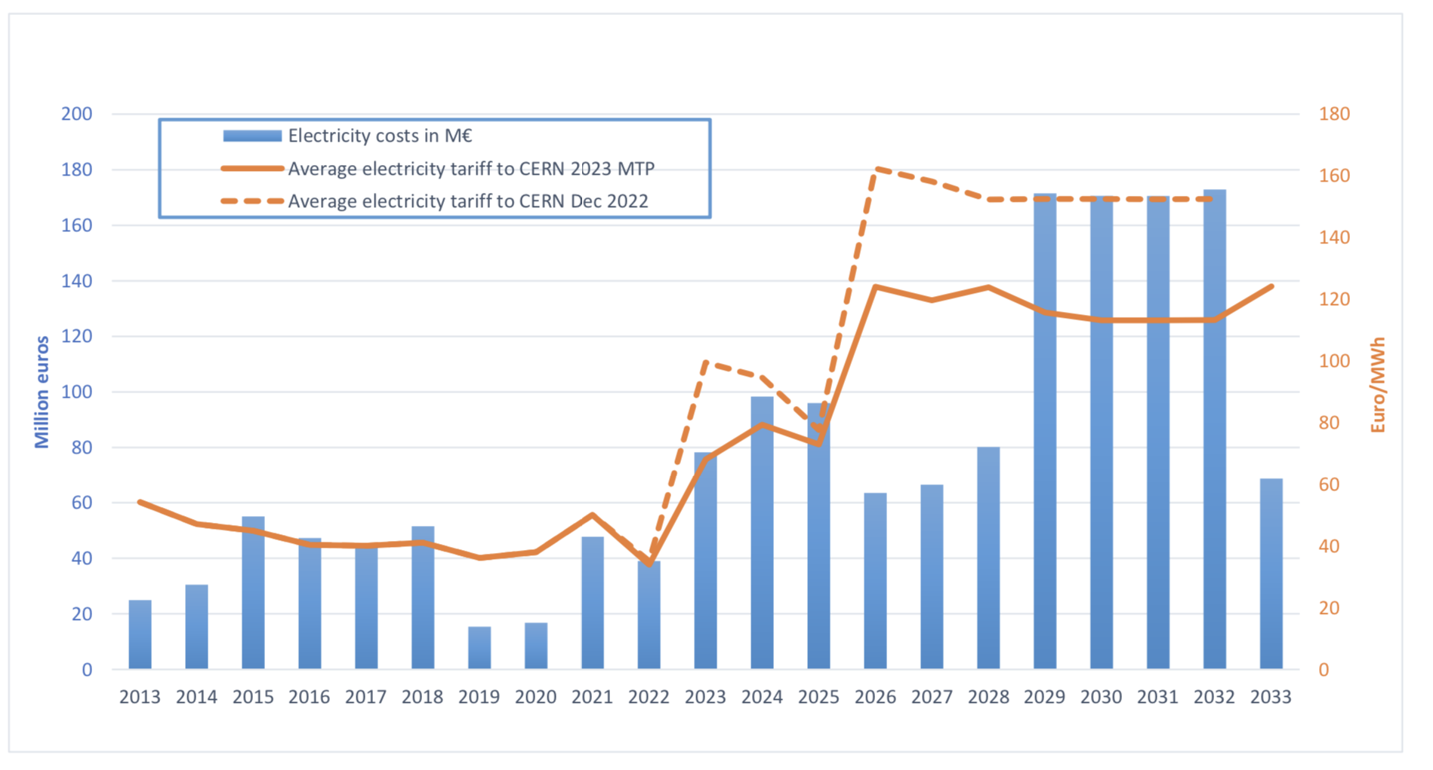
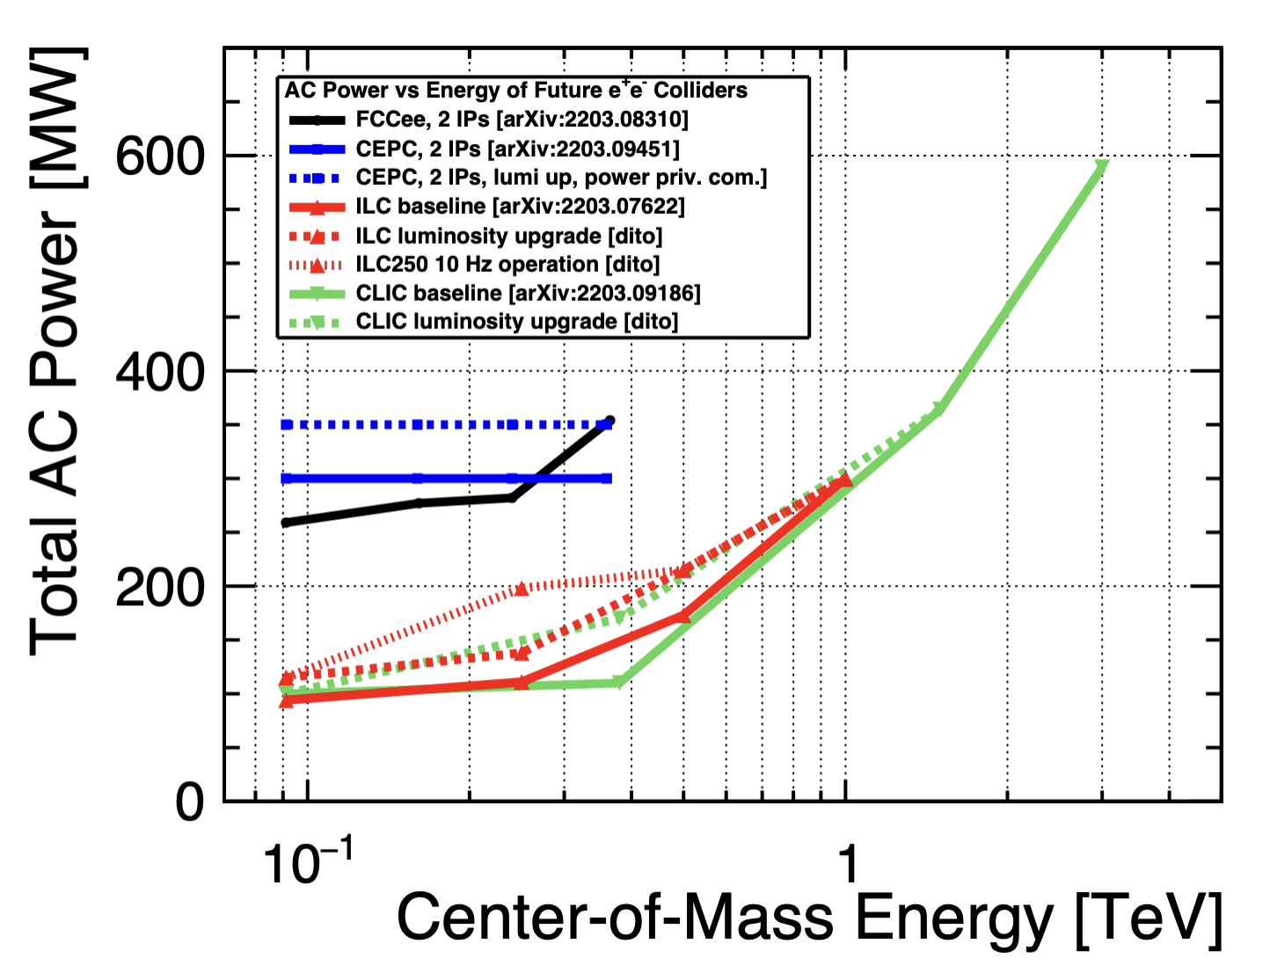
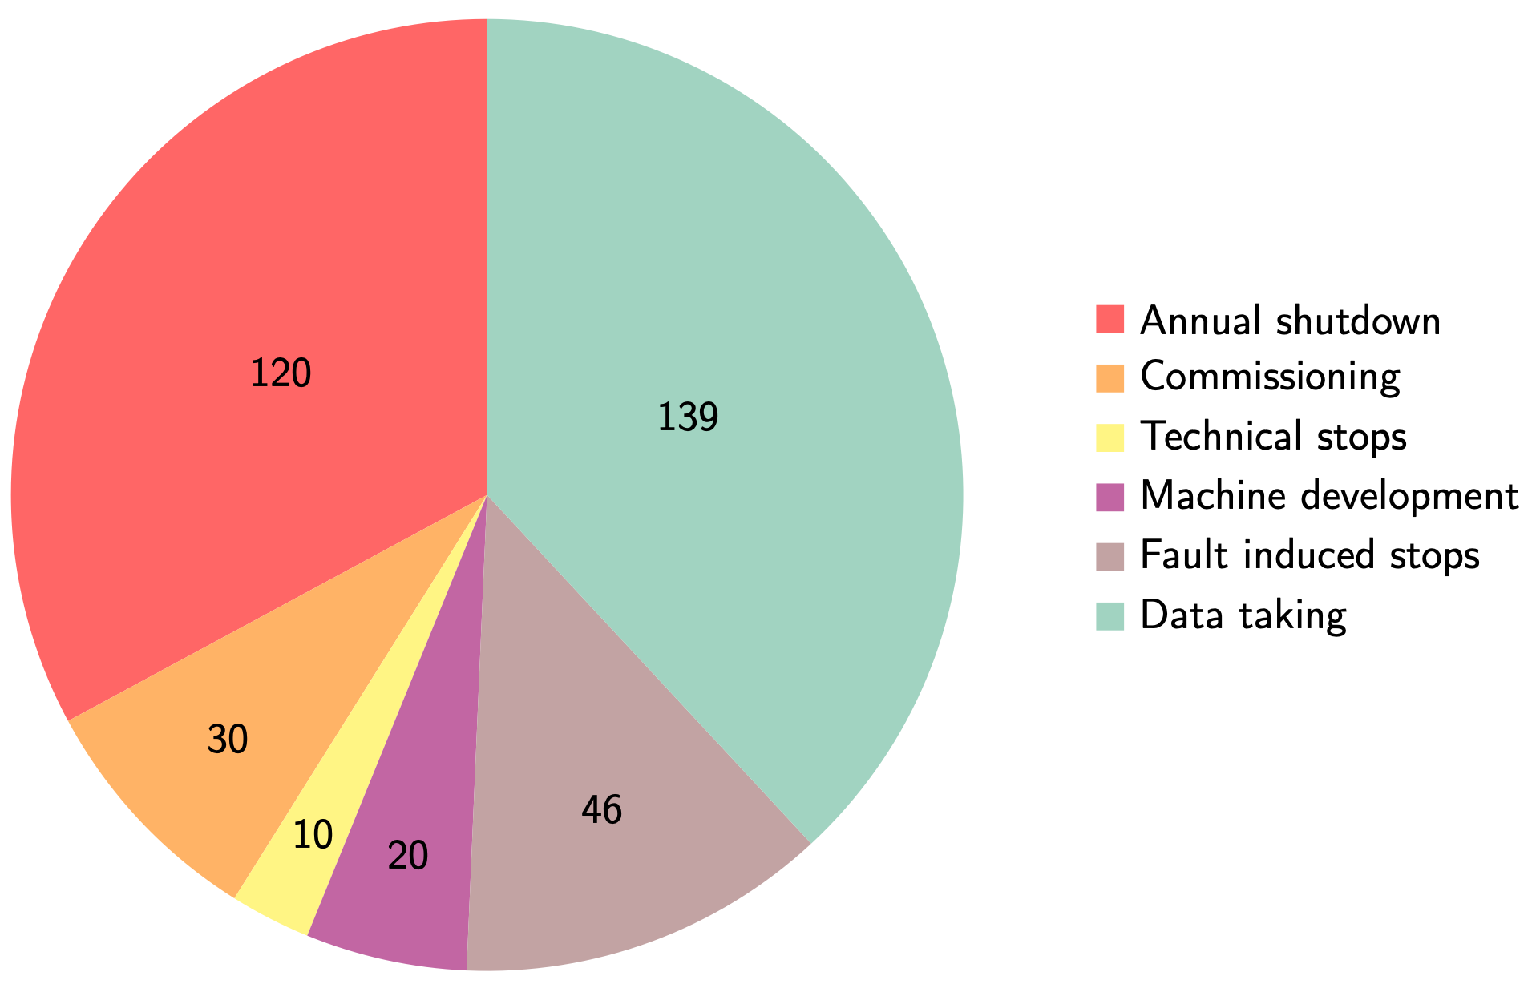
Power and energy: LHC and future machines
Obsolete
Very uncertain but MTP assumes 120 MCHF/TWh beyond 2026.
With “standard” running scenario (on the right) every 100 MW corresponds to ~0.6 TWh annually, corresponding to ~75 MCHF annually.
Linear collider studies predict roughly similar power consumption for equivalent machines (ILC vs CLIC)
From: Steinar Stapnes

Slide 9
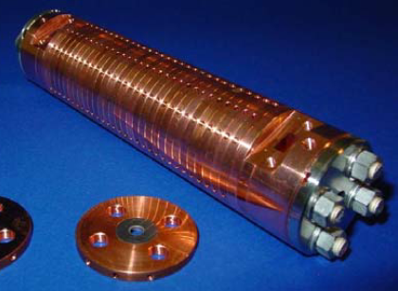
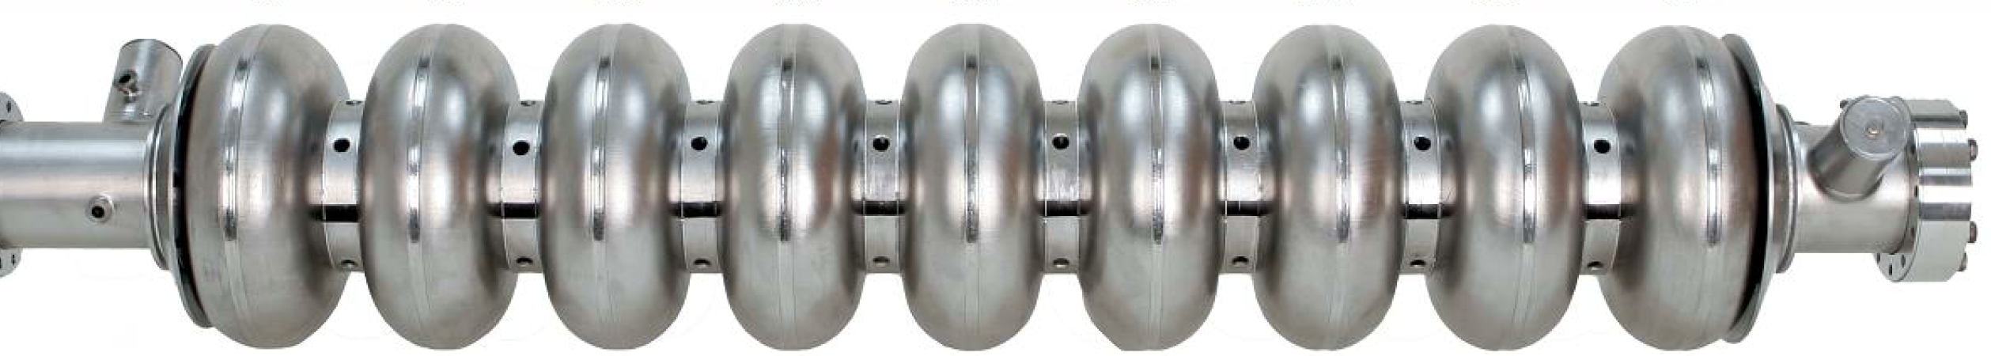

How can SC and NC have the same power consumption?
Linear collider RF systems fall in two categories
Despite the ~10⁶ difference in quality factor, (~10³ considering cryo efficiency), pulsing at low duty factor allows reducing the average consumption for NC accelerating structures down to the SC level – which cannot be effectively be pulsed
In our study, we want ultimately to verify whether HTS in pulsed RF mode allows a further power gain compared to both Nb and Cu
SC niobium, Q₀≈10¹⁰, 35 MV/m, CW
$R_{s}∝{1/Q}_{0}$ $P=\frac{1}{2}R_{s}H^{2}$
NC copper, Q₀≈10⁴, 100 MV/m, pulsed

Slide 10
C3, a new kid on the block?
More info on C³ here
Even a factor 10 improvement in Q factor compared to copper
could pave the way for energy savings
From: Emilio Nanni

Slide 11
High-temperature Superconductors

Slide 12
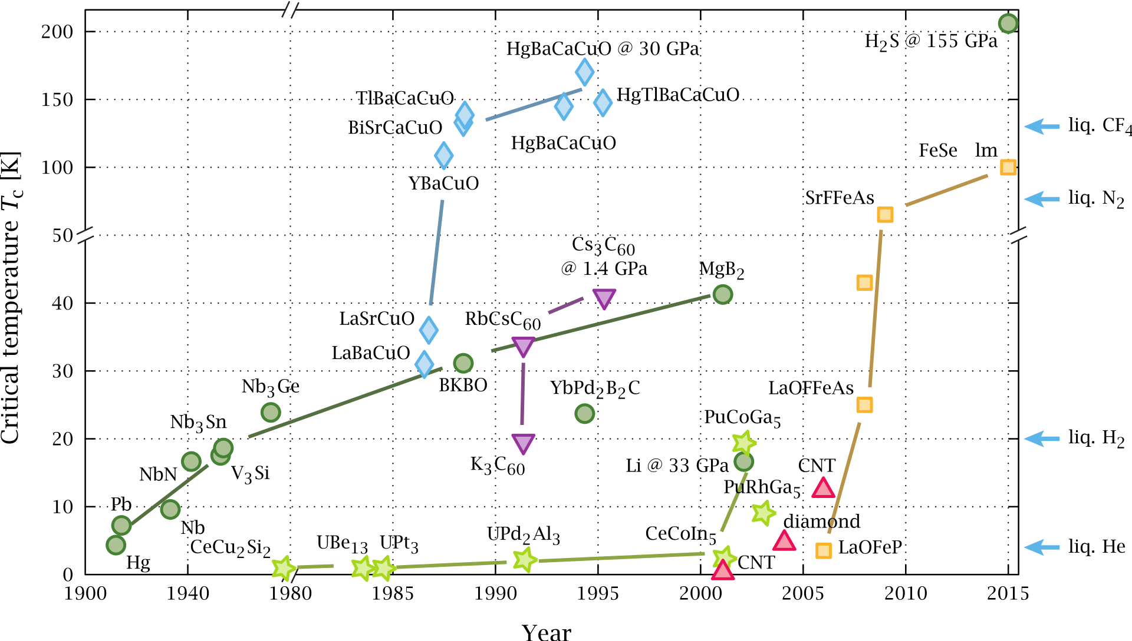
Superconductors zoo
By PJRay - Own work, CC BY-SA 4.0, https://commons.wikimedia.org/w/index.php?curid=46193149

Slide 13
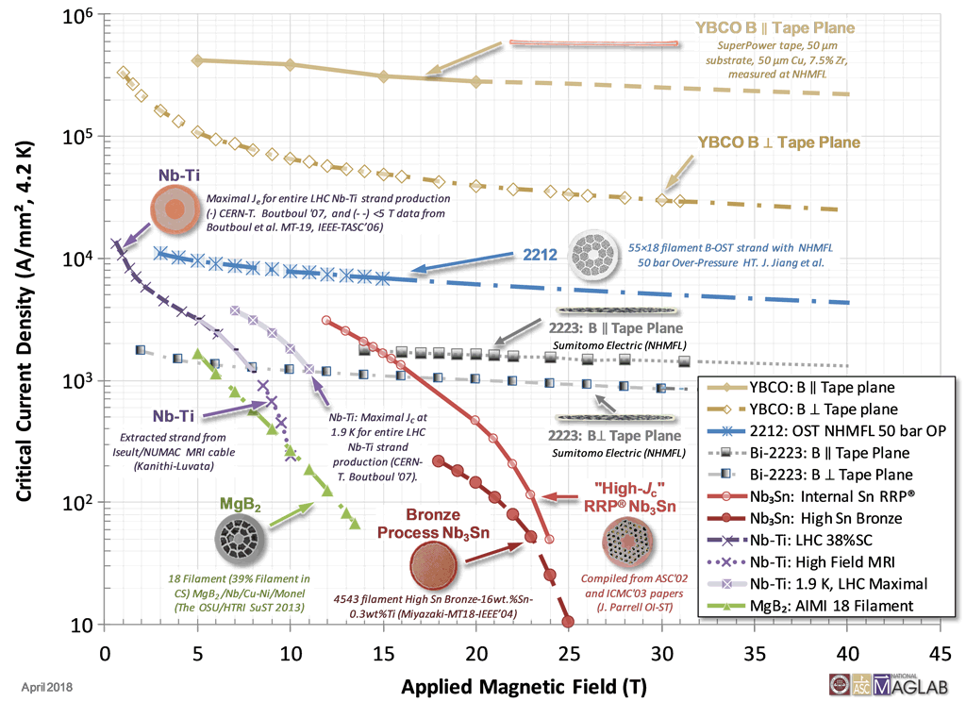
Zoo of superconductors
J_{c} may vary of orders of magnitude.
H_{c2} has much smaller variation.
YBCO most promising candidate
NbTi – NbTiN possible candidates at B < 10T
Nb₃Sn for B < 15 T
https://nationalmaglab.org/magnet-development/applied-superconductivity-center/plots

Slide 14
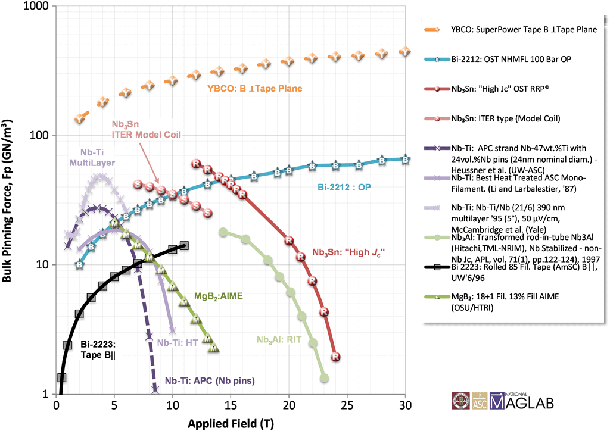
Zoo of superconductors
Pinning force
https://nationalmaglab.org/magnet-development/applied-superconductivity-center/plots

Slide 15
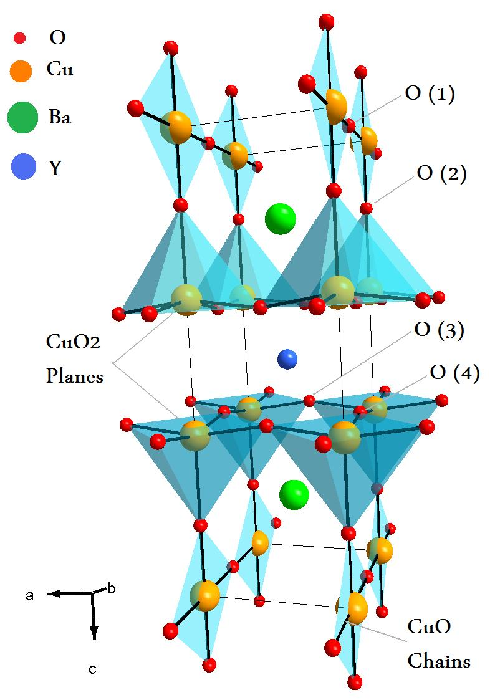
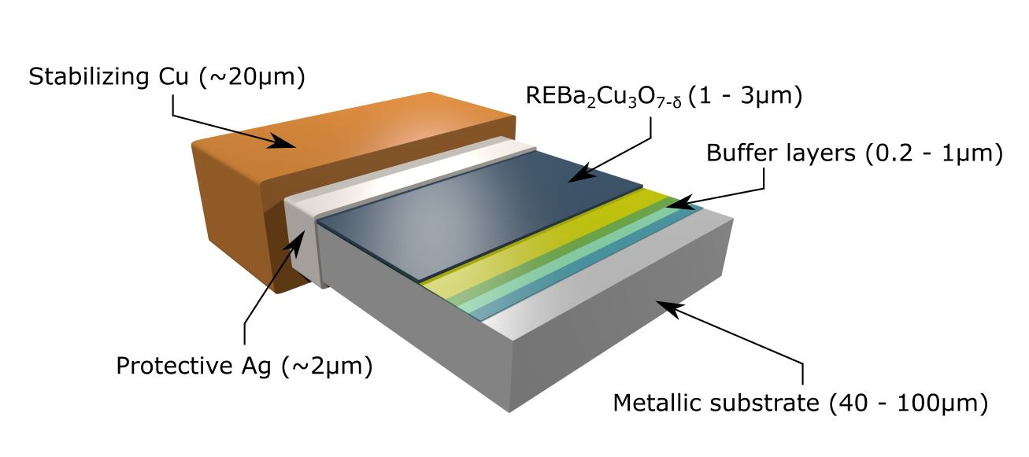
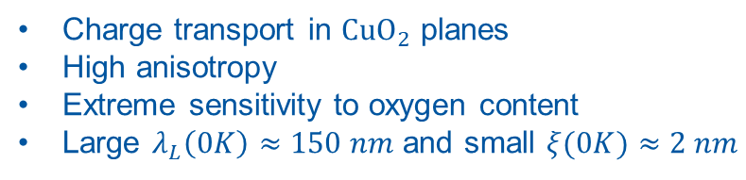
REBCO coated conductors
REBCO crystal structure
Scheme of Coated Conductor (CC)
Electronic features:
Buffer layers allow biaxial epitaxial REBCO growth
Metallic substrate makes tape ductile
Charge transport in $CuO_{2}$ planes
High anisotropy
Extreme sensitivity to oxygen content
Large $λ_{L}\left(0K\right)≈150 nm$ and small $ξ(0K)≈2 nm$
Artur Romanov, PhD dissertation, UA Barcelona 2022

Slide 16
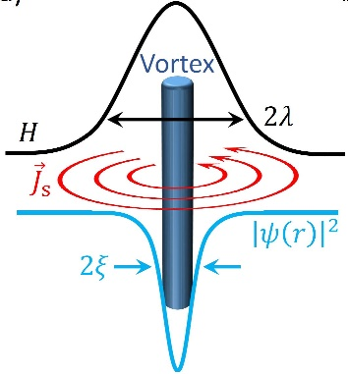
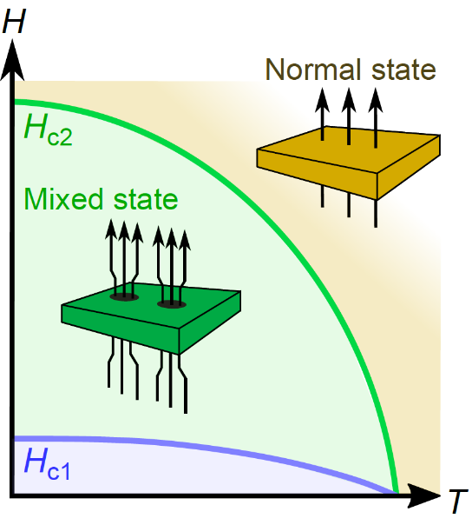
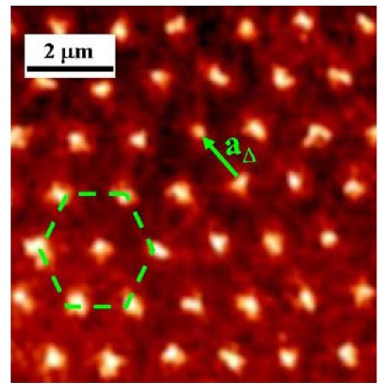
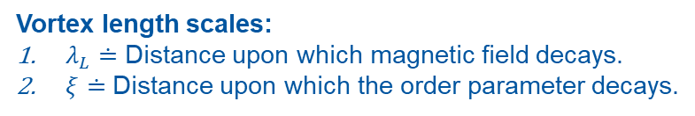
Type II superconductors
Vortex in type II SC
Magnetic phase diagram
for type II SC
Abrikosov lattice
Vortex length scales:
$λ_{L}≐$ Distance upon which magnetic field decays.
$ξ≐$ Distance upon which the order parameter decays.
Characterized by mixed phase
with vortex penetration.
Distribution into hexagonal lattice in homogenous material.
Artur Romanov, PhD dissertation, UA Barcelona 2022

Slide 17
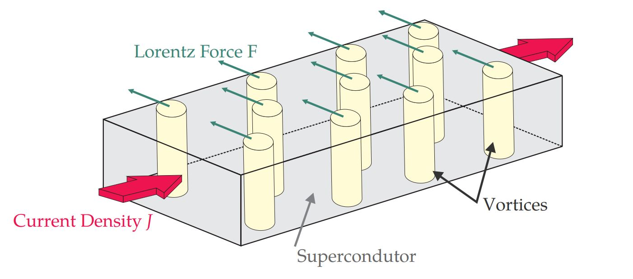
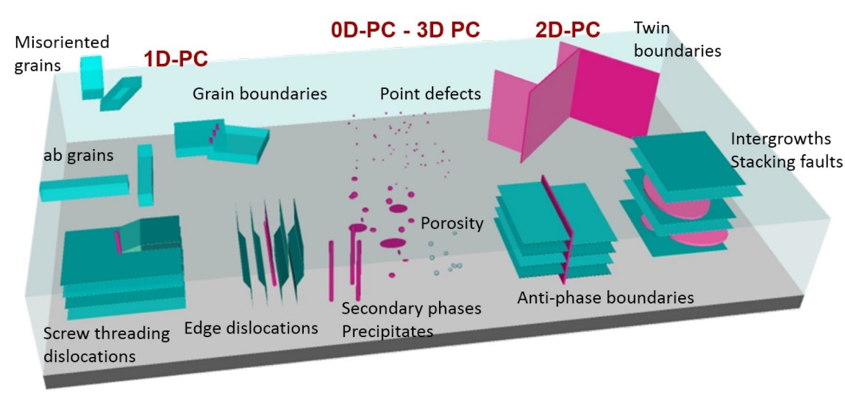





Vortex pinning
Lorentz-like force provokes vortex movement
Defects: Strategy to pin vortices
Scales with current density and magnetic field$:$
$${\overset{⃑}{F}}_{L}=\overset{⃑}{J}×\overset{⃑}{B}$$
Critical current density ${\overset{⃑}{J}}_{c}:$
Defect landscape:
0D: Impurity atoms, interchanged atoms
1D: Dislocations, columnar defects
2D: Twin boundaries, grain boundaries
3D: Nanoparticles, associated strained regions
$${\overset{⃑}{F}}_{P}={\overset{⃑}{J}}_{c}×\overset{⃑}{B}$$
The maximum value of $J$ without moving the lattice, without presenting resistance.
Artur Romanov, PhD dissertation, UA Barcelona 2022

Slide 18
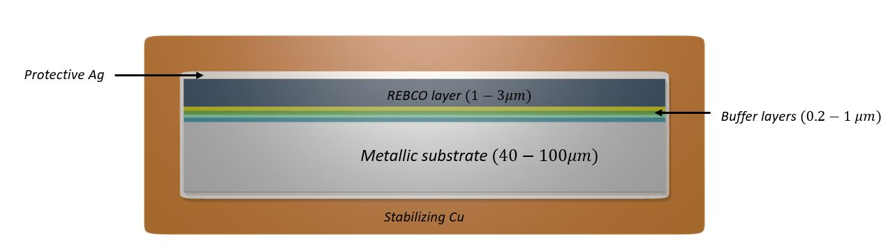










Various producers of CCs
Bruker
Fujikura APC
SuNAM
SuperOx 2
YBCO (1.6 $μm$) + BZO nanorods
EuBCO (2.5 $μm$) + BHO nanorods
GdBCO (1.5 $μm$)
YBCO (3 $μm$) + Y₂O₃ nanodots
CCs differ in architecture and REBCO microstructure.
Artur Romanov, PhD dissertation, UA Barcelona 2022

Slide 19
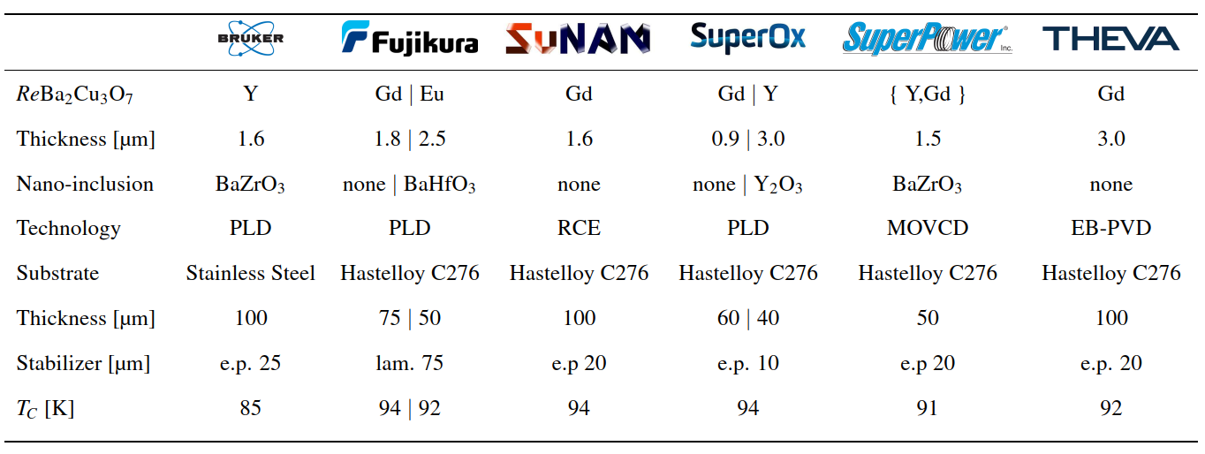
HTS coating technologies
Patrick Krkotic, PhD dissertation, UPC Barcelona 2022

Slide 20
Outline
The past (?): HTS at low RF gradient, in a strong magnetic field
  FCC beam screens and RADES axion detectors
The present: HTS at high-gradient RF
  The I.FAST collaboration CERN – KIT – ICMAB, with the support of SLAC
The future (???): HTS in both high-gradient RF and strong magnetic field
  The muon collider

Slide 21
Outline
The past (?): HTS at low RF gradient, in a strong magnetic field
  FCC beam screens and RADES axion detectors
The present: HTS at high-gradient RF
  The I.FAST collaboration CERN – KIT – ICMAB, with the support of SLAC
The future (???): HTS in both high-gradient RF and strong magnetic field
  The muon collider

Slide 22
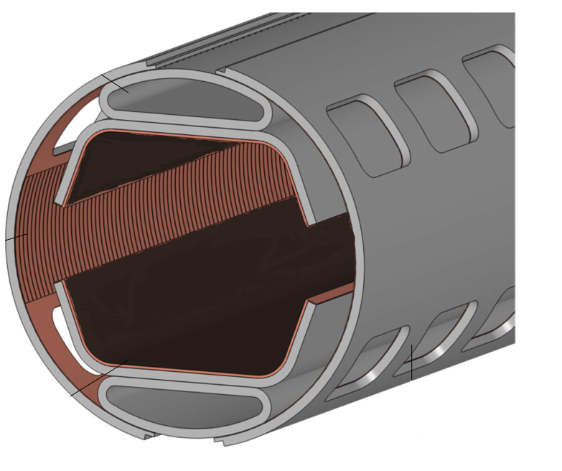
HTS for the FCC-hh beam screen
FCC-hh, a proposed 100 TeV p-p collider at CERN, with 16 T dipoles operated at 1.9 K
A beam screen held at 50 K, to protect the dipoles from synchrotron radiation ~30 W/m/beam (LHC < 0.2 W/m)
HTS materials instead of copper in the FCC-hh beam screen,
to improve beam stability (-> impedance) at 50 K
Bunched particle beams produces RF fields, up to ~1 GHz
Extremely challenging requirements:
  HTS must operate at 50 K and 16 T
  Critical fields Hc₂ , H_{irr} >> 16T
  J_{c} > 25 kA/cm² (2.5x10⁸ A/m²)
  Surface resistance R_{s} better than for copper
Compatible with accelerator environment
  Minimize dipole field distortion due to persistent currents
  UHV compatible, low SEY, lifecycle assessment, etc..
16 Tesla !
Calatroni, IEEE TAS 26, 3500204 (2016)
Calatroni et al, SuST 30, 075002 (2017)

Slide 23
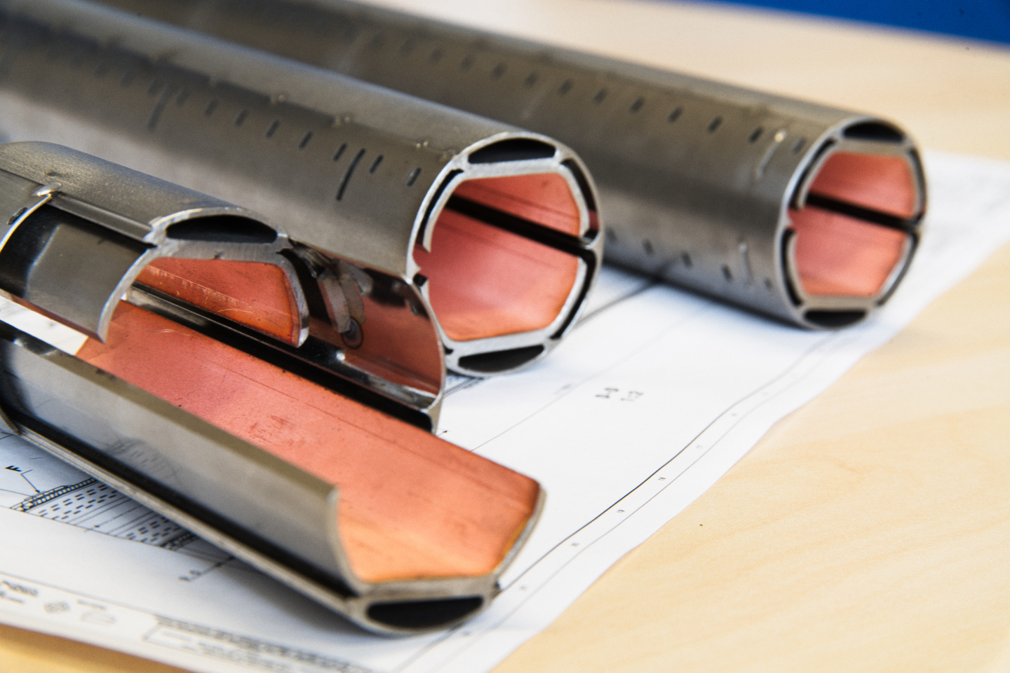









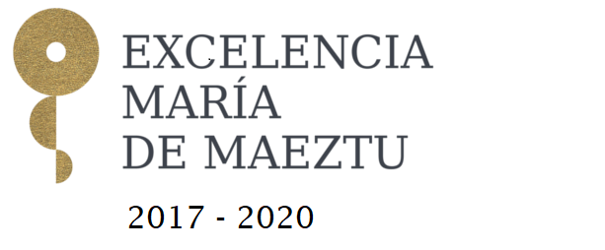


Two material choices
Manufacture the screen using REBCO tapes soldered to the screen
Coat the inside of the screen
with Tl-1223 films

Slide 24
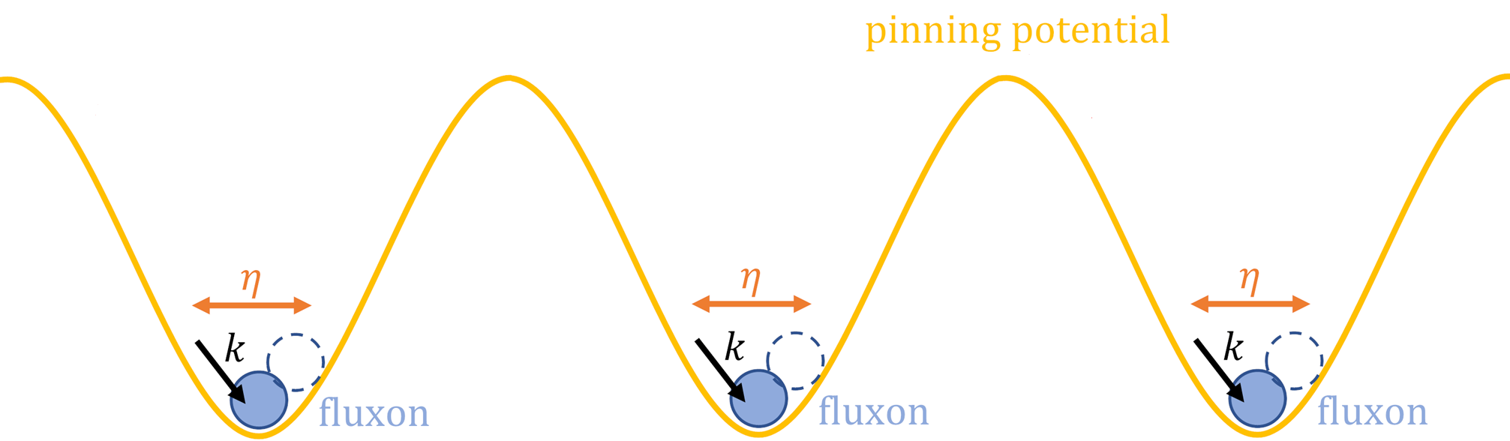
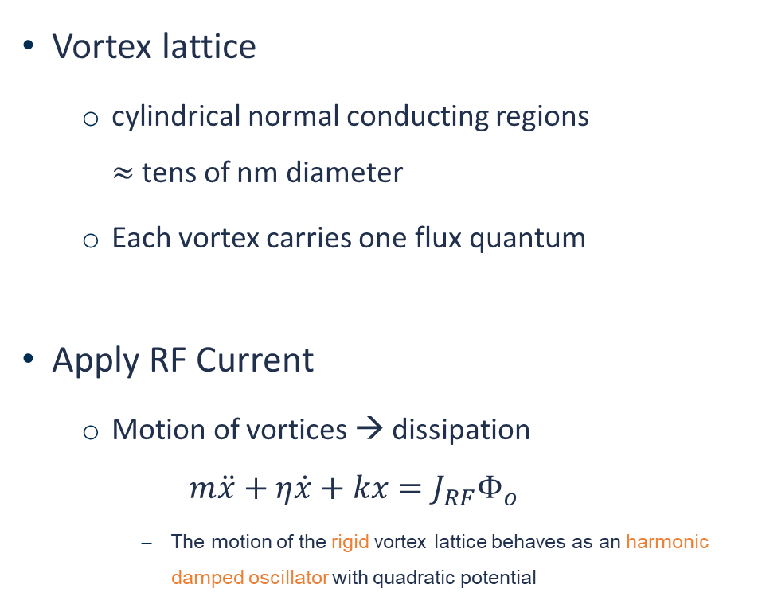



RF when an external magnetic field is present
Vortex lattice
  cylindrical normal conducting regions
  $≈$tens of nm diameter
  Each vortex carries one flux quantum
Apply RF Current
  Motion of vortices → dissipation
  $$m\ddot{x}+η\dot{x}+kx=J_{RF}Φ_{o}$$
    The motion of the rigid vortex lattice behaves as an harmonic damped oscillator with quadratic potential
Gittleman and Rosenblum: Phys Rev. Lett. 16, 734 (1966)
Calatroni and Vaglio, IEEE Trans. Appl. Supercond. 27 (2017) 3500506
Coffey, Clem PRL 67, 386 (1991)
Brandt PRL 67 2219 (1991)
Silva et al, PRB 78, 094503 (2008)
$$B_{DC}$$
$$J_{RF}$$
Vortex pinning
  Artificial pinning centres
$$HTS$$
Simplified model valid for estimates and scaling
Patrick Krkotic, PhD dissertation, UPC Barcelona 2022

Slide 25
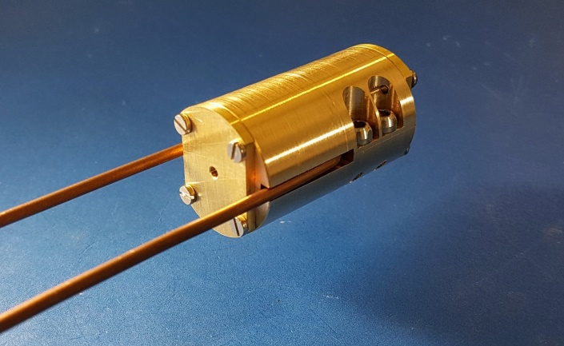
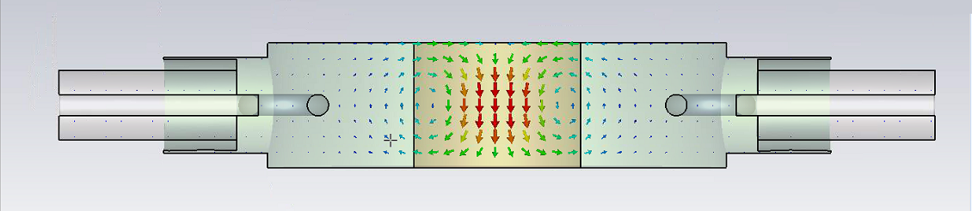
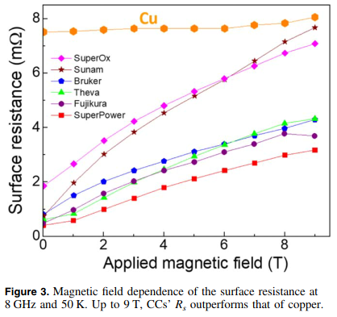
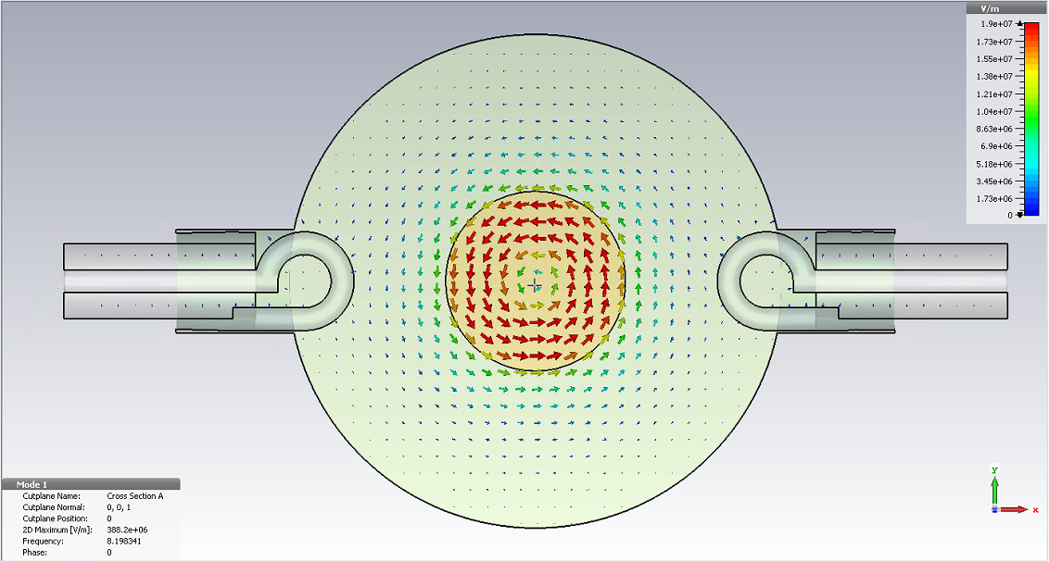

Validation of RF performance (UPC - ICMAB)
In house developed 8.05 GHz cavity resonator compatible with 25mm bore 9 T magnet at ICMAB
REBCO CCs outperform Cu at 50K and up to 9T
R_{S} is microstructure dependent
Surface currents equivalent to 0.1 MV/m of a typical accelerating cavity
Puig et al, SuST 32, 094006 (2019)

Slide 26




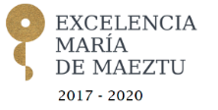
Coating process I
1) Pre-tinning
2) Edge removal
Solder
Solder
Ag
Ag
REBCO
REBCO
Buffer layers
Buffer layers
Substrate
Substrate
Ag
Ag
Cu
Cu
Developed in the context of FCC-hh impedance reduction by coating the beam screen with HTS tapes

Slide 27
Coating process II
3) Soldering
4) Substrate extraction
Solder
Ag
Cu
REBCO
Cu
Buffer layers
Ag
Substrate
Substrate
Cu
Ag
Substrate
Buffer layers
Ag
Cu
REBCO
Buffer layers
Ag
REBCO
Cu
Ag
Solder
Cu
Cu
Surface to coat
Solder
Cu
Surface to coat
N. Lamas et al., to be published

Slide 28
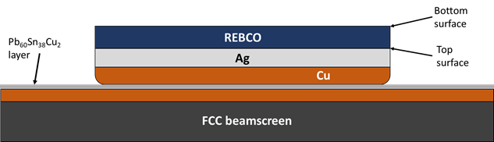
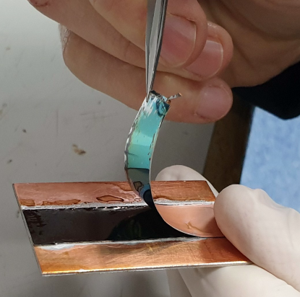
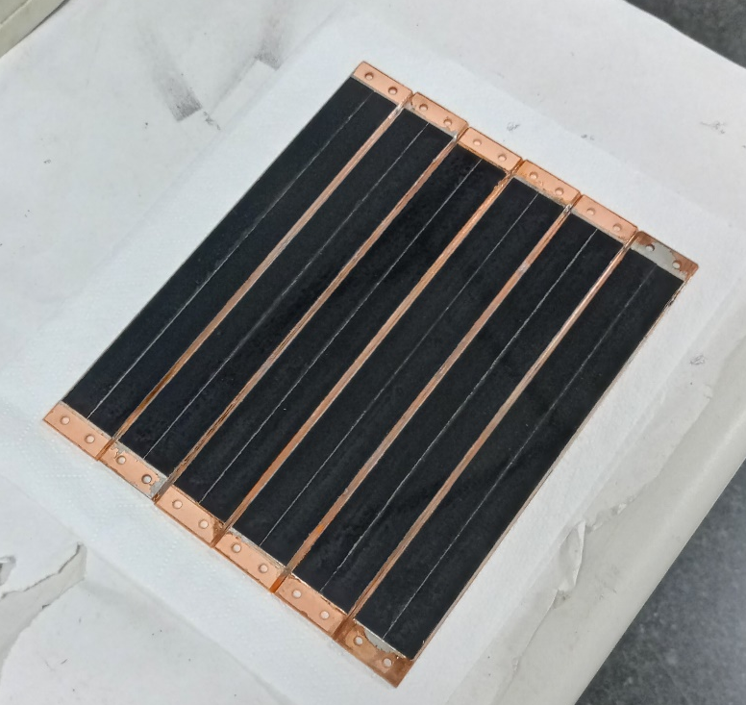
Development of soldering technology
Solder
HTS tapes
Solders based on
Sn / Pb / Cu / Bi & In
temperatures < 220ºC
CC
Beamscreen
2x80 km of beam screens to be coated with HTS

Slide 29

HTS for axion searches
Motivation:
Axion haloscope
$$ℱ \sim { g}_{Aγ}^{4}{ Q T}_{sys}^{−2}{V^{2}G}^{4}m_{A}^{2} B^{4}$$
Increase Q
copper coating → superconducting coating
Requirement: High quality factor in a high magnetic field

Slide 30
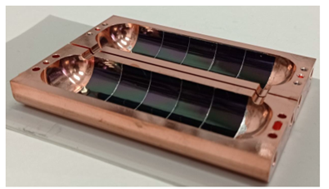
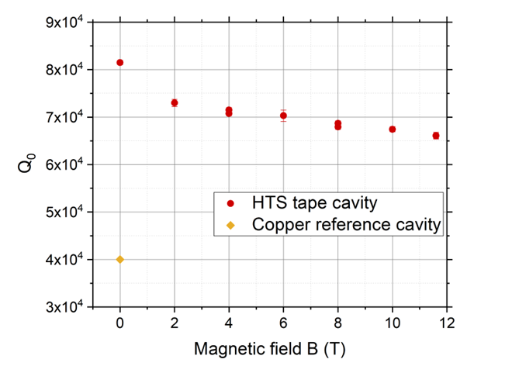
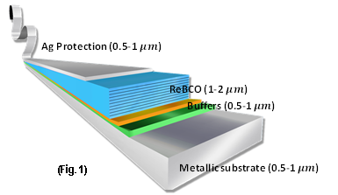
First real cavity, f≈9 GHz
We have developed a technology for applying 2D HTS tapes to 3D RF “RADES” cavities demonstrating the potential of HTS for RF applications J. Golm et al., IEEE TAS, Vol. 32, No. 4, (2022) 1500605
2x improvement of RF quality factor compared to copper
(newer prototype 5x improvement)
12 mm-wide HTS tapes
RADES cavity for axion searches

Slide 31
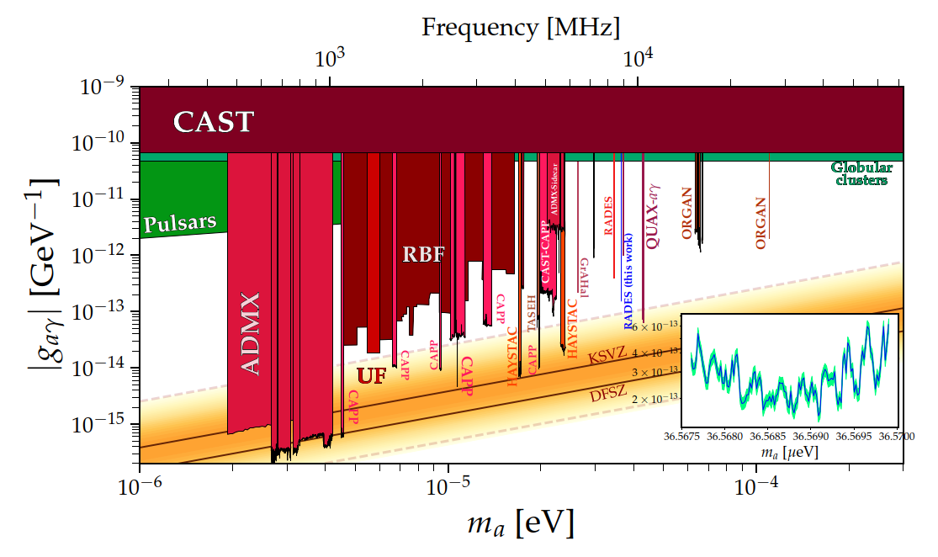

First published physics results with an HTS coated cavity
arXiv:2403.07790

Slide 32

Other results from CAPP
3.5x10⁻⁵ Ω
2.2x10⁻⁵ Ω
From: D. Ahn, CAPP. More info at Patras Workshop

Slide 33
Outline
The past (?): HTS at low RF gradient, in a strong magnetic field
  FCC beam screens and RADES axion detectors
The present: HTS at high-gradient RF
  The I.FAST collaboration CERN – KIT – ICMAB, with the support of SLAC
The future (???): HTS in both high-gradient RF and strong magnetic field
  The muon collider

Slide 34
First: a caveat
HiPIMS +DC Bias
J_{C} decrease is guiding the development of Nb/Cu films
Rationale:
Results from HIE-ISOLDE and bulk Nb
Modelling of losses as hysteretic losses from RF fluxons penetration
Existing HTS Coated Conductors might not be the best choice at high-gradient RF, being optimized for flux pinning
Nb/Cu samples
HIE-ISOLDE
Bulk Nb
4K, 250mT
From: Carlota Pereira Carlos

Slide 35


Low-power RF measurements
An improvement larger than x10 compared to copper (Rs=8mΩ) has been measured on samples of tapes (8 GHz) at low RF power
Cu
Adapted from Romanov et al, Sci. Rep. (2020) 10:12325

Slide 36



Testing at higher RF power
THEVA inclined deposition
0 T external field
HTS coated conductors at 8 GHz (dielectric resonator) and 50 K
Patrick Krkotic, PhD dissertation, UPC Barcelona 2022

Slide 37

Literature review
There are very few measurements on HTS at high RF currents (mostly microstrip resonators). But physics is proven.
~10¹¹ A/m² RF current (microstrip resonator, 200 µm, 350 nm thick, 8 GHz)
Powell et al. Journal of Applied Physics 86, 2137 (1999)
For 1 µm thickness this is equivalent to 10⁵ A/m (≅ 0.1 T ≅ 25 MV/m)
Entering the “high-gradient” range

Slide 38



High-gradient testing at SLAC – supported by I.FAST IIF
“Mushroom” cavity. Can achieve H_{peak} of about 360 mT – 2.9x10⁵ A/m (equivalent to ~80 MV/m in a standard accelerating cavity) using 50 MW XL-4 Klystron at 11.4 GHz.
Zero E-field on the sample
Maximum H-field on the sample
Sample accounts for ⅓ of total cavity loss
Goal: demonstrate high-gradient pulsed operation of HTS, at cryo-temperatures

Slide 39




First results at SLAC, at low gradient
Two HTS measurements, after calibration measurements with Cu and Nb
Soldered REBCO-CCs on copper (Fujikura by CSIC-ICMAB)
Directly grown REBCO on MgO and on copper+MgO (CERACO)
R_{s} Cu ≅ 17 mΩ
R_{s} REBCO tapes ≅ 1.7 mΩ
R_{s} REBCO PVD ≅ 1.0 mΩ

Slide 40
Preliminary SLAC results at high-gradient I
From: Mitch Schneider

Slide 41
Preliminary SLAC results at high-gradient II
Shaded area: change from 100 W to 1.6 kW of forward power
From: Ankur Dhar

Slide 42




First device validation – supported by I.FAST Innovation Fund
Next goals: develop large-size tapes (50 mm wide) in collaboration with KCT, to be first tested on discs at SLAC. Two-years plan funded by IIF
(Ideally: REBCO coating directly on 3D objects)
Device validation: X-band pulse compressor (SLAC) as first “real” RF device
Coating will be performed by CSIC-ICMAB
Courtesy Greg LeSage, SLAC
Pulse compressor

Slide 43







Axion cavity as earlier demonstrator
Approach being validated also for axion detection cavities in RADES collaboration having a similar geometry
Copper body manufactured at Mainz University, adapted to 12 mm wide coated conductors, coated by CSIC-ICMAB
    f= 9.3 GHz
Q₀ = 356 070
    Surface currents
Axion cavity
    E-field
Q₀ = 268 520 (75%)

Slide 44



Summary of milestones and deliverables: WP1 CERN
M1 - Samples and substrates procurement (due 12/2023). Achieved but we have some alignment difficulties of the segments still to be solved
D1 - RF low power characterization of segmented cavities (small tapes) (due 6/2024). On track with some potential small delays pending the solution of the above difficulties. However, this is mitigated by:
Extra – Segmented cavity from SLAC already produced (was foreseen after completion of HIGHEST) and commissioned ready to be coated with small tapes
SLAC confidential
Do not disclose
CERN
Segmented cavity
Segmented cavity

Slide 45


Summary of milestones and deliverables: WP2 KCT
M1 - Design and fabrication of sample holder system (due 3/2024). Achieved well in advance
D1 - HTS coating of large samples (due 3/2025). On track and well under way, first 40 mm wide tape already coated (final goal is 50 mm, but 40 mm is enough for our final goal)
KCT confidential
Do not disclose
Roll to roll coater
for HTS tapes
40 mm wide
HTS tape

Slide 46



Summary of milestones and deliverables: WP3 CSIC
D1 - Coating on discs and segmented cavities for benchmarking (small tapes) (due 3/2024). Achieved for discs, already high-power tested at SLAC (presented at EUCAS 2023 / IPAC 2024) waiting for readiness of segmented cavity
D2 - Measurement of superconducting properties of large size tapes (due 3/2025). On track and well under way, first 40 mm wide tape already characterized
First tests of 40 mm tape
Copper disc coated with 12 mm tapes
CSIC confidential
Preliminary results
Do not disclose

