Slide 1
TMS at DUNE Near Detector
SLAC Neutrino Group Summer Retreat
Tom Markiewicz /SLAC
15 July 2024

Slide 2
Outline
Description of scope of activities (and its context within the overall DUNE ND) along with SLAC roles/responsibilities.
Issues, challenges in design, prototyping, and physics studies
Upcoming major activities, milestones, decision points
Needs/opportunities of more SLAC (or other) engagement

Slide 3
NDLAr and TMS
TMS measures muon momentum via range and muon charge by bending in a 1-Tesla field
40 planes 15mm
60 planes 40mm
100 40mm slots for detectors
Detectors are 35mm x 3m x 17mm scintillator arranged in 6 32bar panels per plane
Readout is via WSF, SiPM and CAEN 5202 system

Slide 4
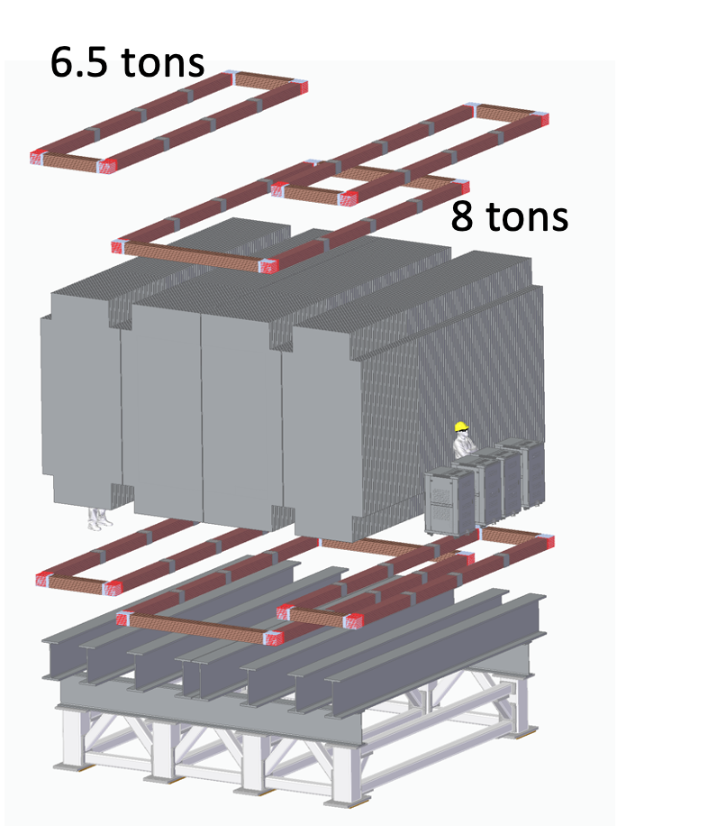
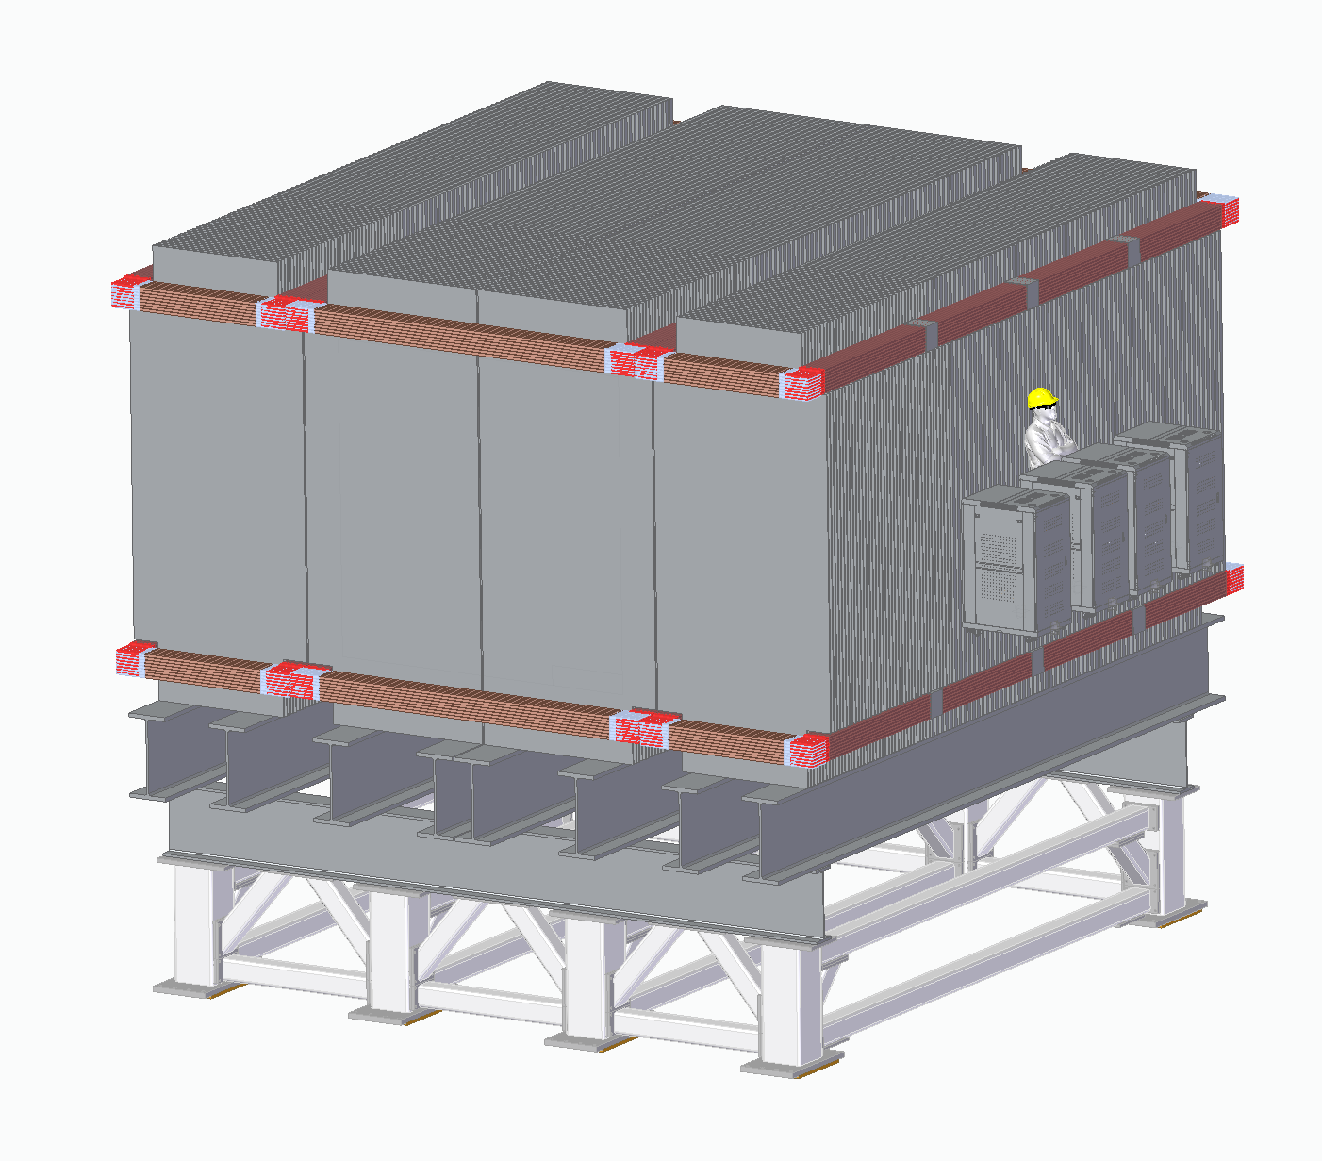
TMS Magnet Based on Pre-Assembled Coils

Slide 5
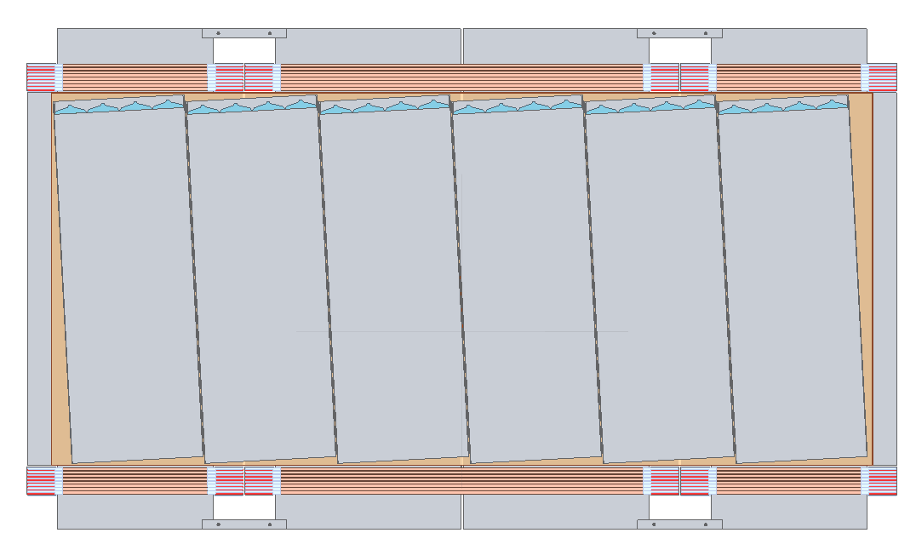
Detector Planes
Steel height 5066mm->4200mm
Height above/below coil = 300mm
Feature of the Flux Return Insert
Middle plate split for transport
Detector “cassettes” of 6 panels (was 4)
±3° stereo 32 x 35mm 3m long bars
90° 32 x 35mm 3.5m long bars
Number horizontal panels TBD
Cassettes installed after magnet assembled and tested
Removable for servicing
Details of scintillator-fiber-SiPM-Connector interface, location of Front-End Readout and cable plant not final
Cassette Mechanics and required space between coils not final

Slide 6
Scope of activities and SLAC roles/responsibilities
TMS Consortium
Design, document, defend, prototype, procure, build, install, run, analyze TMS
SLAC
Management: L2 (Tom), Lead Engineer (Marco Oriunno)
Engineering design and procurement of support structure, steel plates and coil
Marco, Wes Craddock, Scott Newbry
University of Minnesota
Individual Detector Panels and packaging into “cassettes” of 6 panels
LSU and U. Pittsburg
SiPMs, cabling, front end electronics, power, digital data concentration
Analysis: Various: U. Mississippi lead, Wichita State University, Rochester
Installation and Integration: TBD but U. Rochester included

Slide 7
Issues, challenges in design, prototyping, and physics studies
Issues
Cost constraints
Old technology may not attract new collaborators
Design Challenges
Design iteration difficult
FEA for fields & forces has many elements and requires long run times
No physics analysis to support design choices
Prototyping
Coil corner & copper bar samples to test weld
Mini-scintillator panels (1/2 width, 1/3 length), full size first example
Tests of commercial CAEN SiPM readout
Physics Studies
Team led and populated with junior members
Simple reconstruction and basic performance plots not available

Slide 8
Upcoming major activities, milestones, decision points
Major activities
Convert CDR Design to PDR and document
All sub-elements of TMS have changed
Milestones
January 2025 PDR presentations supported by PDR document and updated BOE
June 2025 CD2 of Full Near Detector
Decision Points
Final width & thickness of scintillator bars and Final size of panels
Independent evaluation of changes to magnet and coil design

Slide 9
Needs/opportunities of more SLAC (or other) engagement
Analysis support from the ML group
Track reconstruction would seem to me to be an easy project

Slide 10
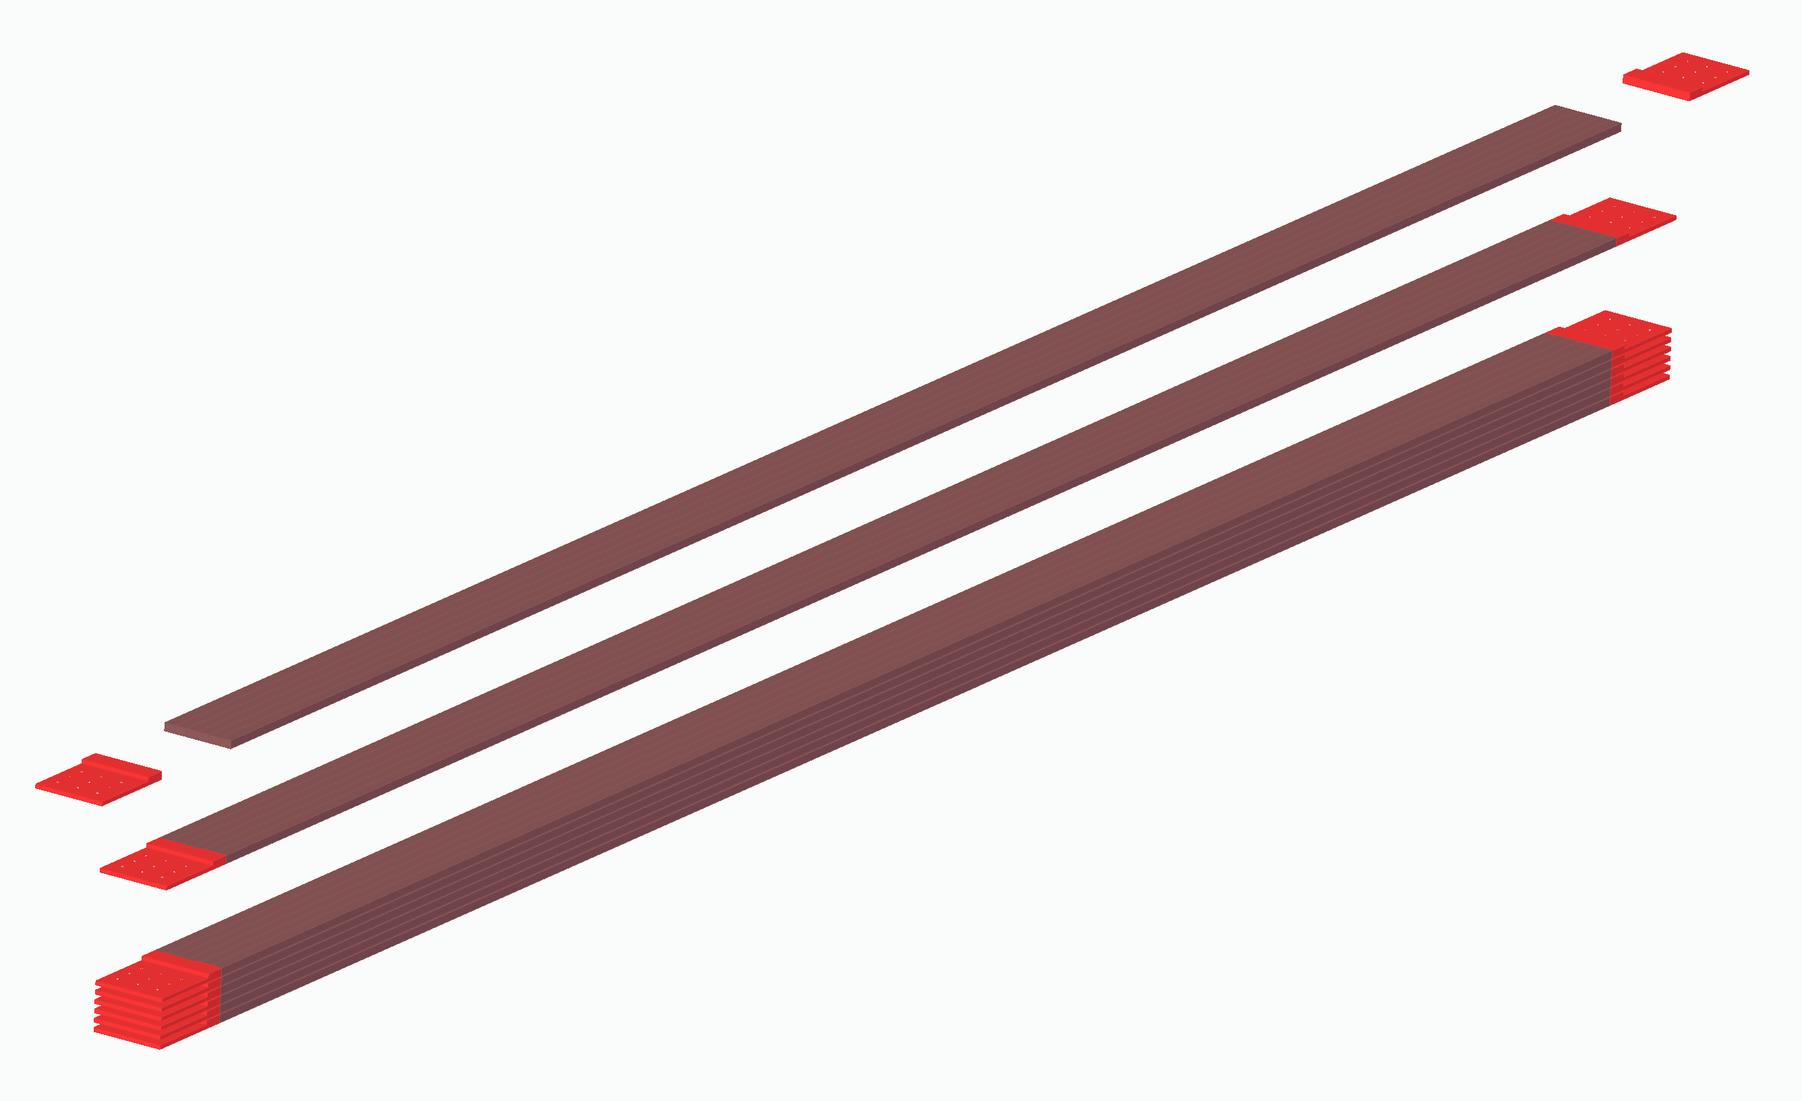
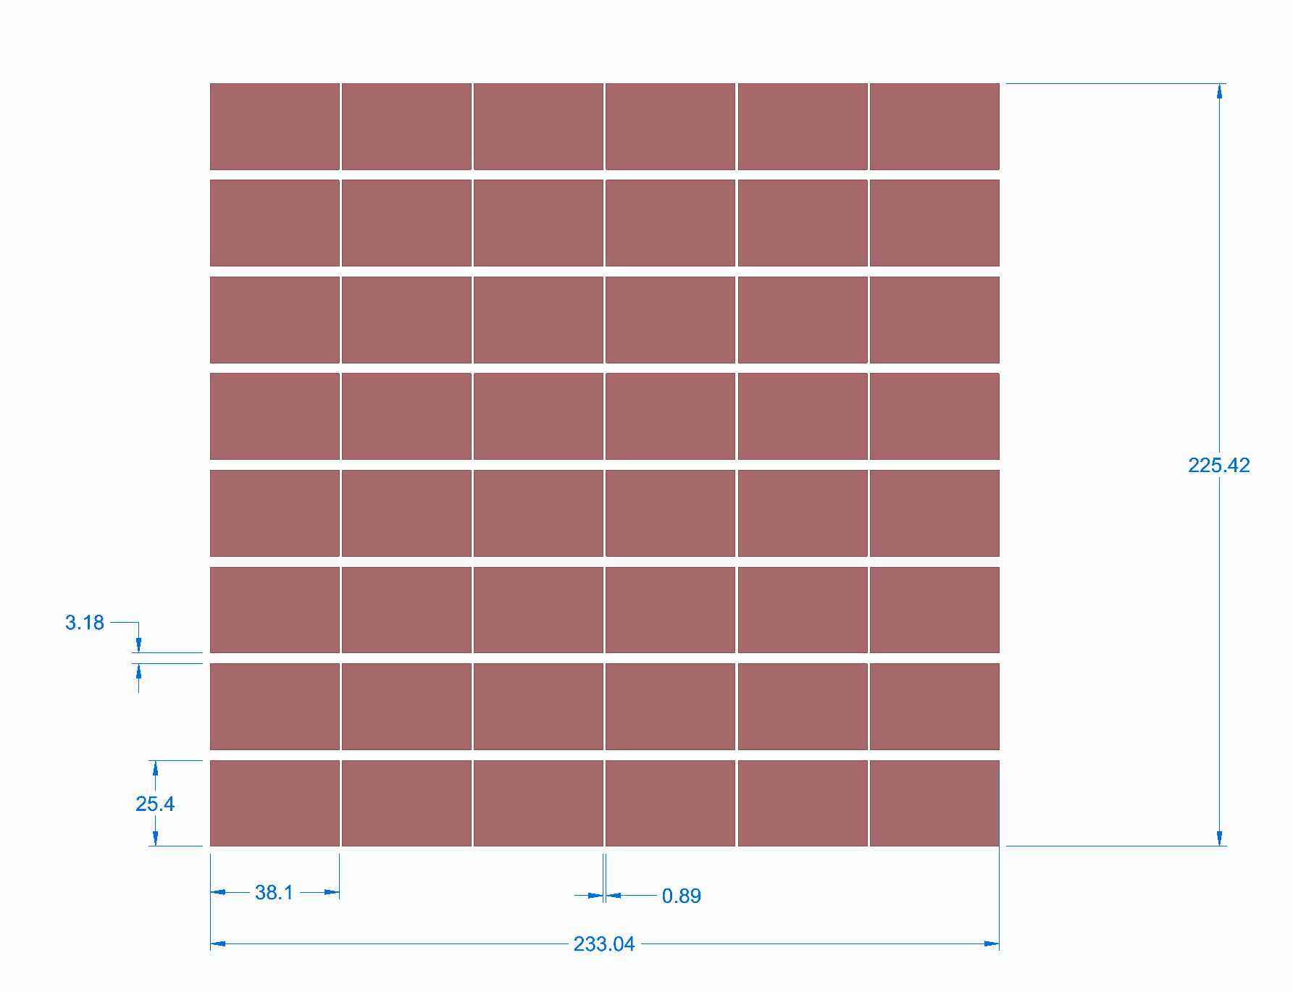
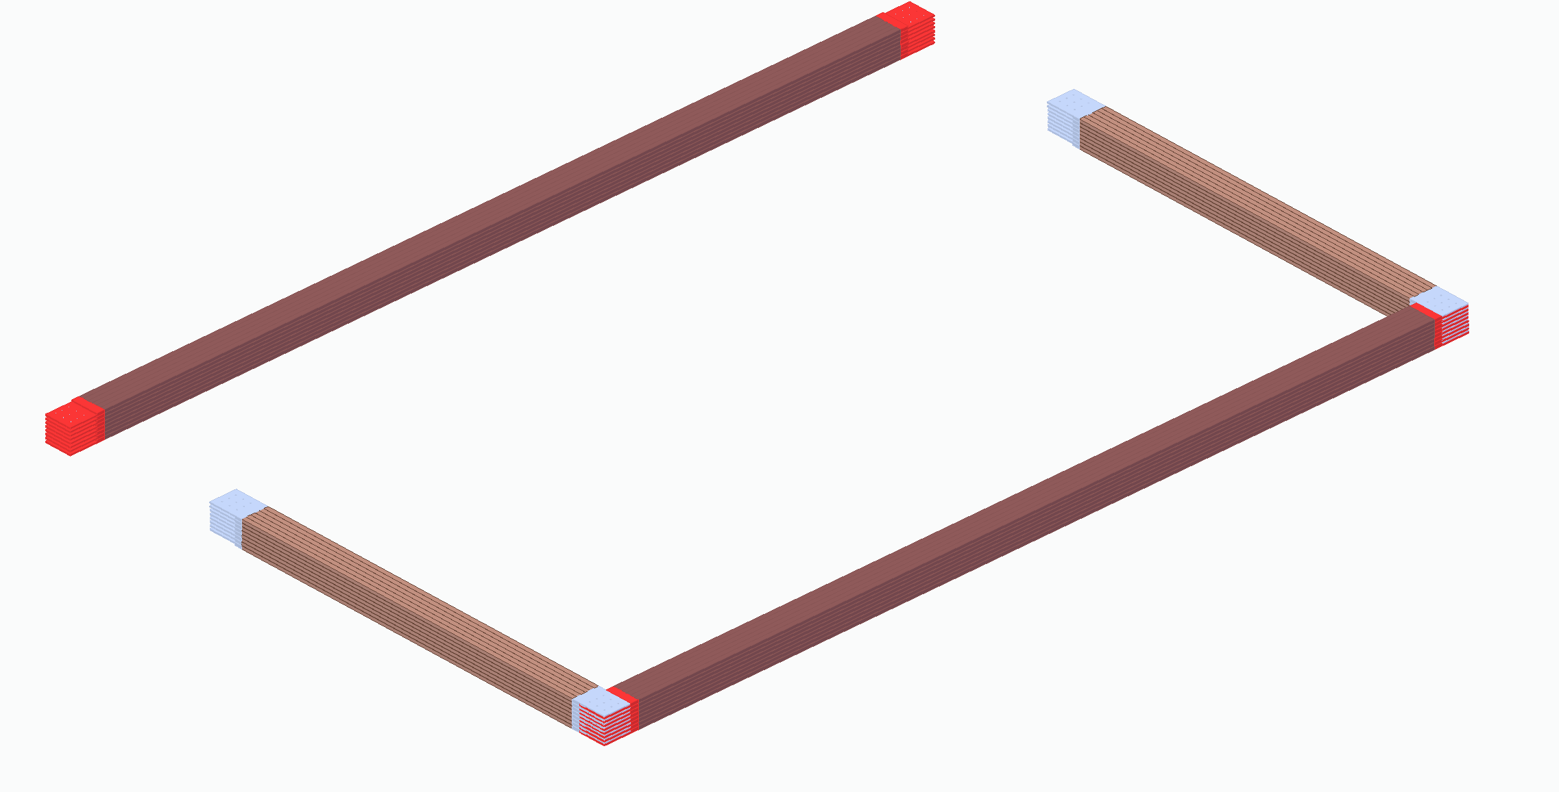
TMS Coils Based on MINOS Plank Design Vendor fabricated and pre-tested
For long legs, 1.5” x 1.0” Copper Bars, 8 planks high

Slide 11
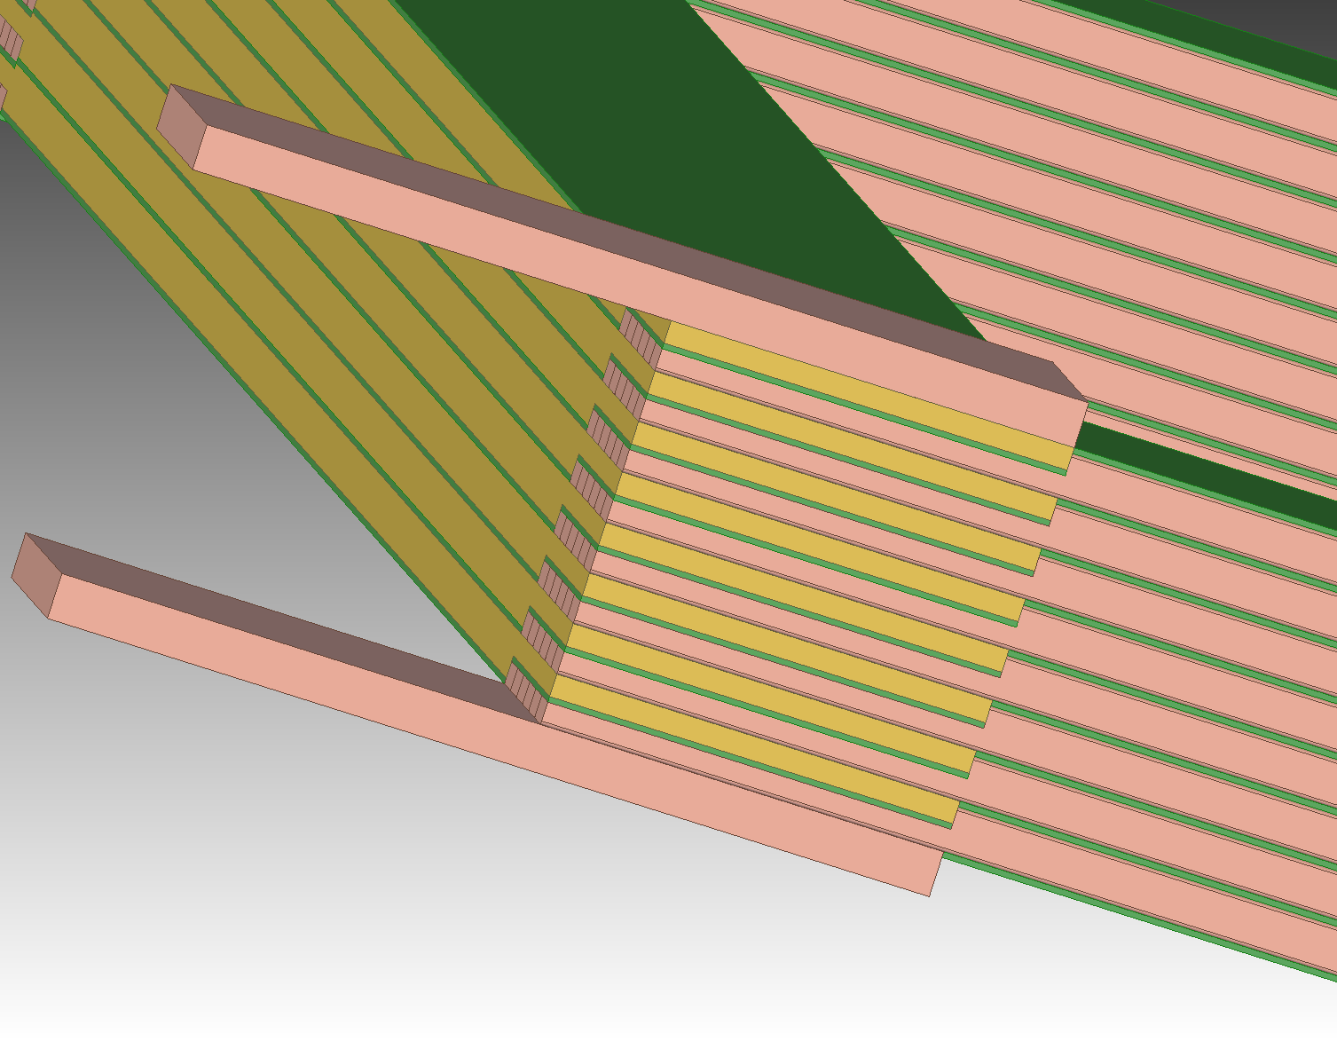
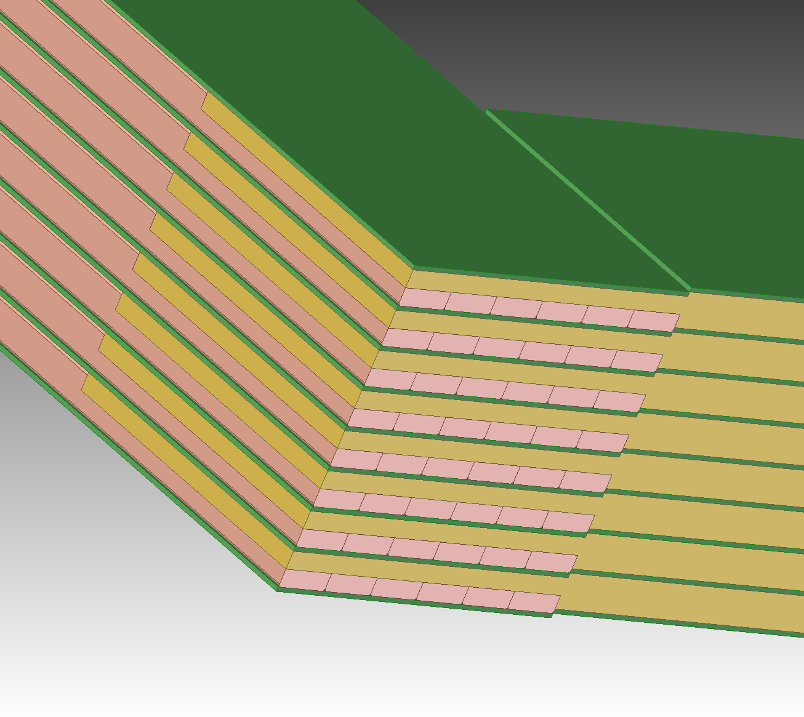
Coil Corner Details
Current Corner Detail
(opposite from Current In/Out)
Notice double sided machining on plank end and G-10 step mismatch
Current Input/Output Corner Detail

Slide 12
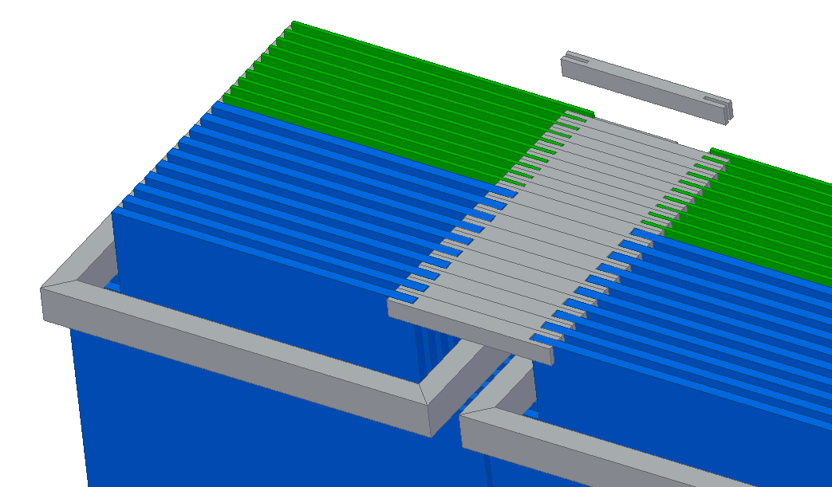
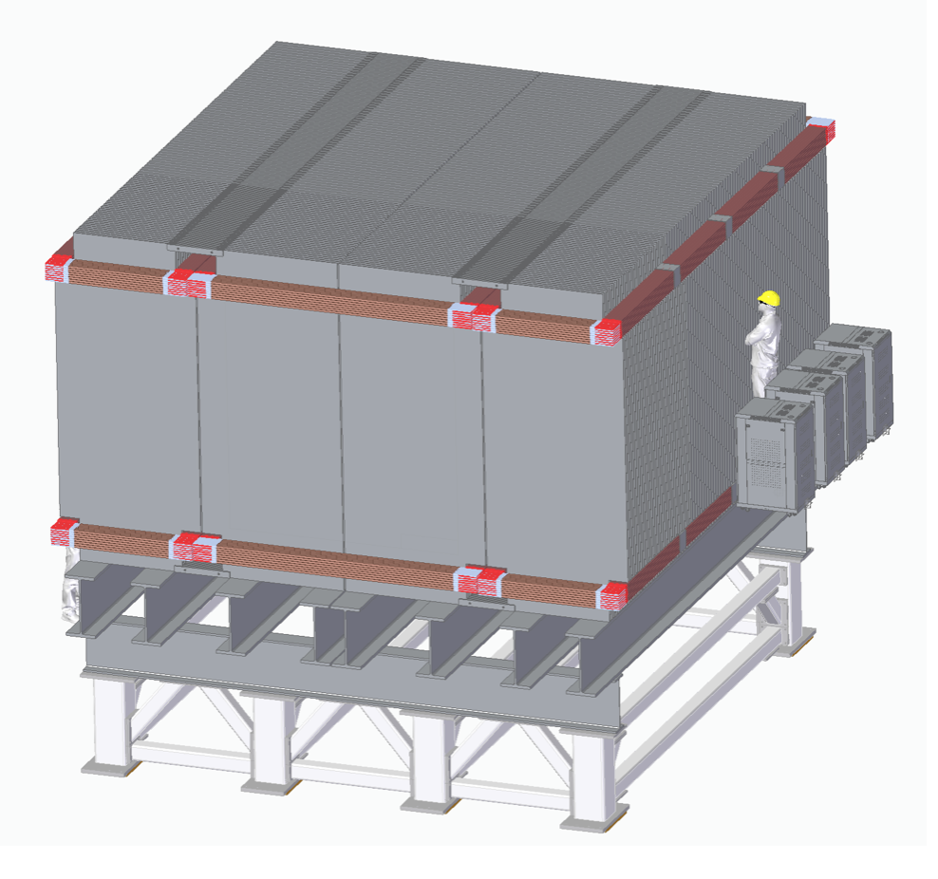
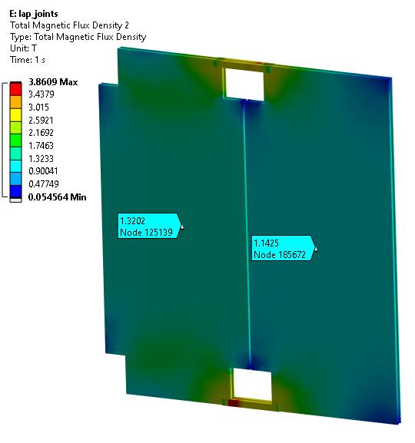
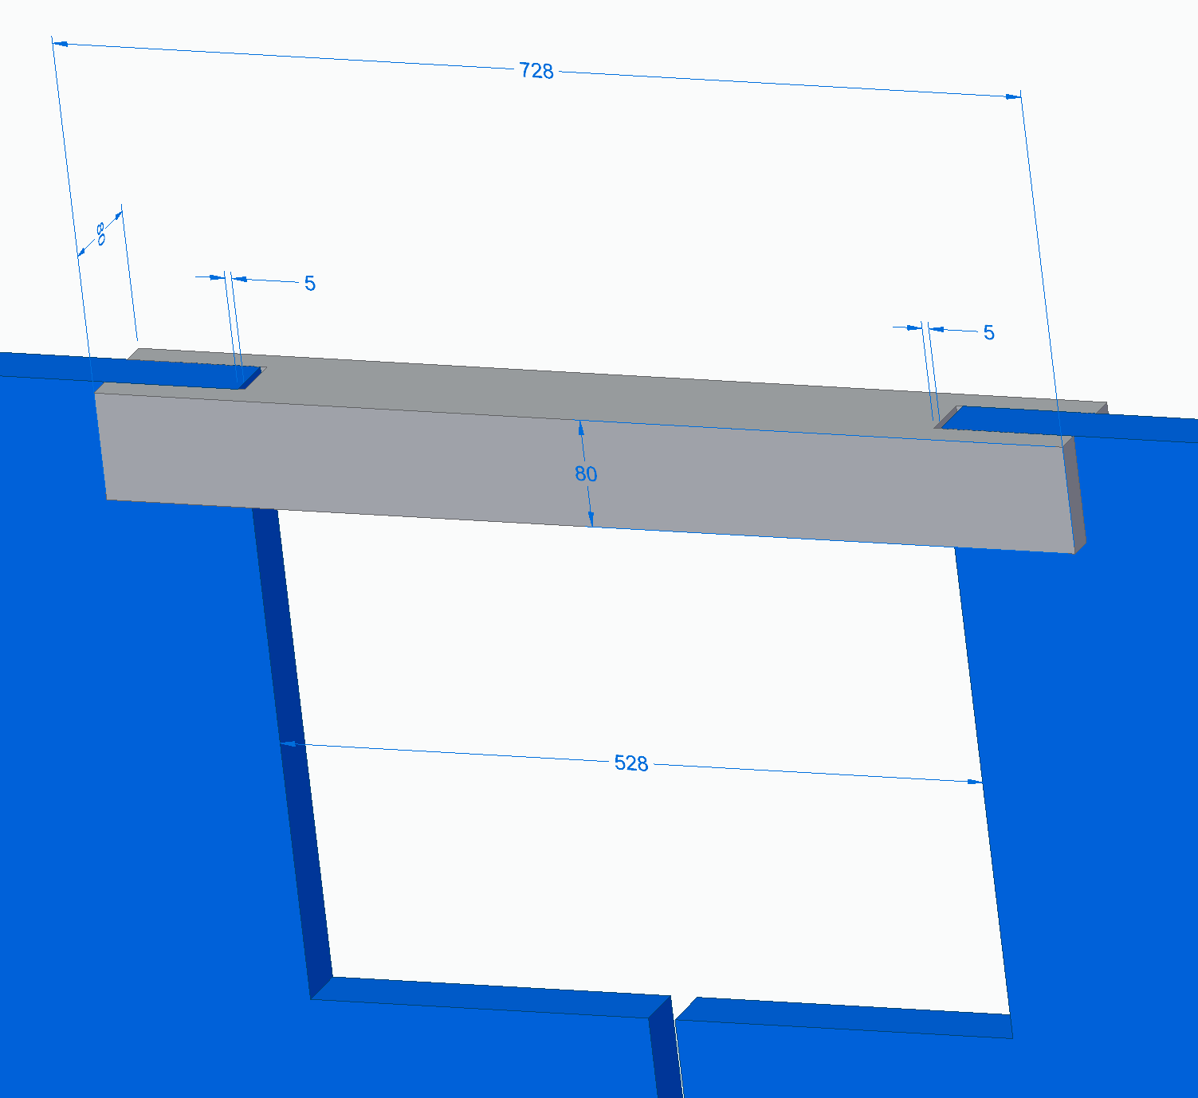
Flux Return Bridged by “Lap Joints”
Will also act as plate stiffeners

Slide 13
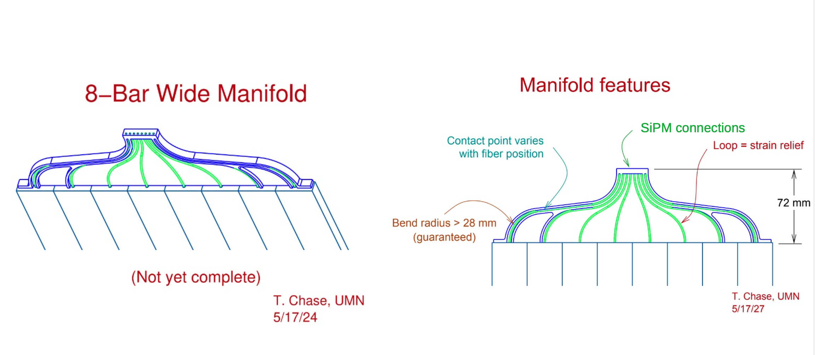
Fiber to Fiber-Plug Design

Slide 14
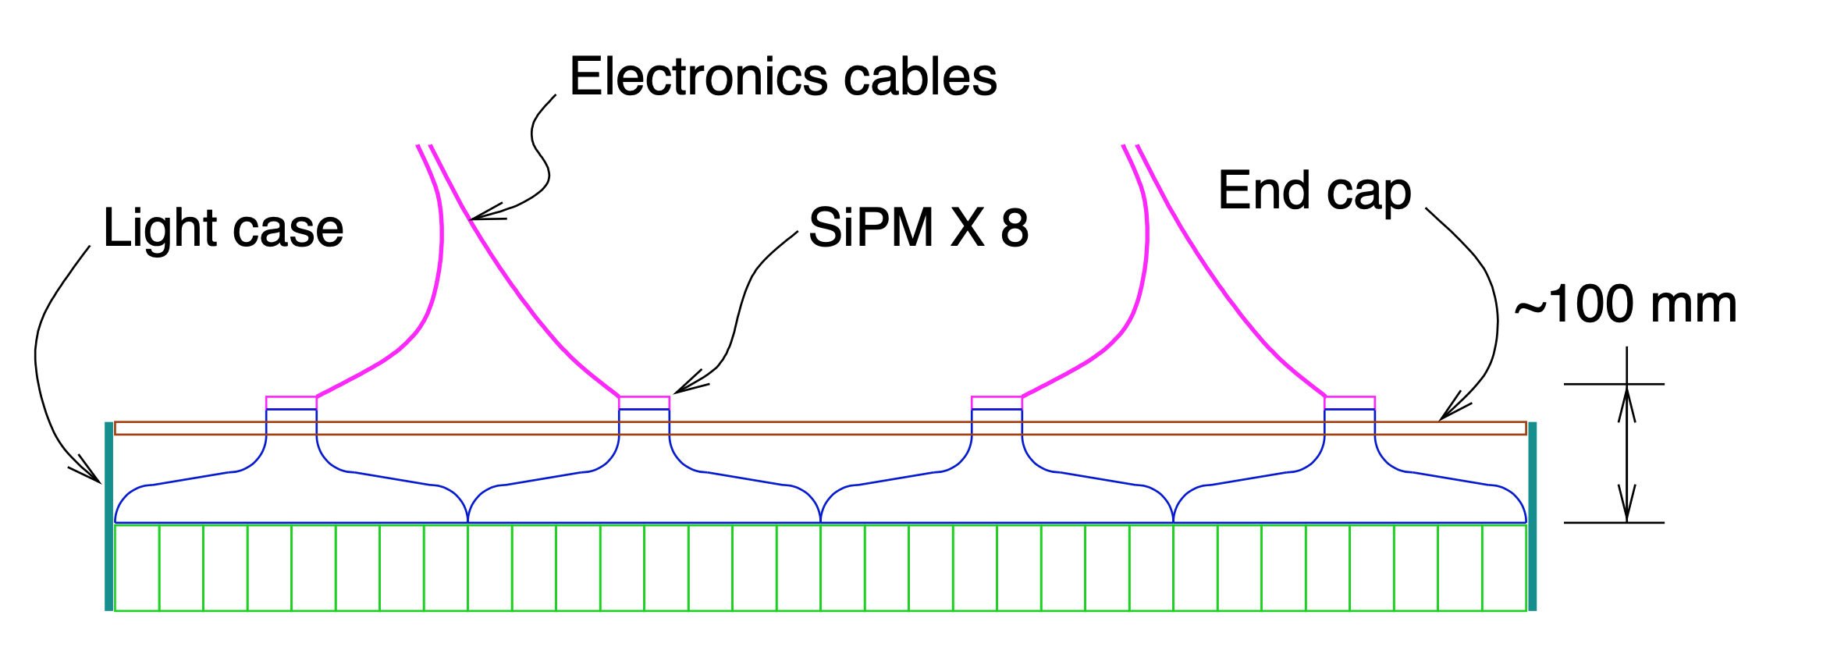
Module End Concept: Tom Chase UMN 5/30/24

Slide 15
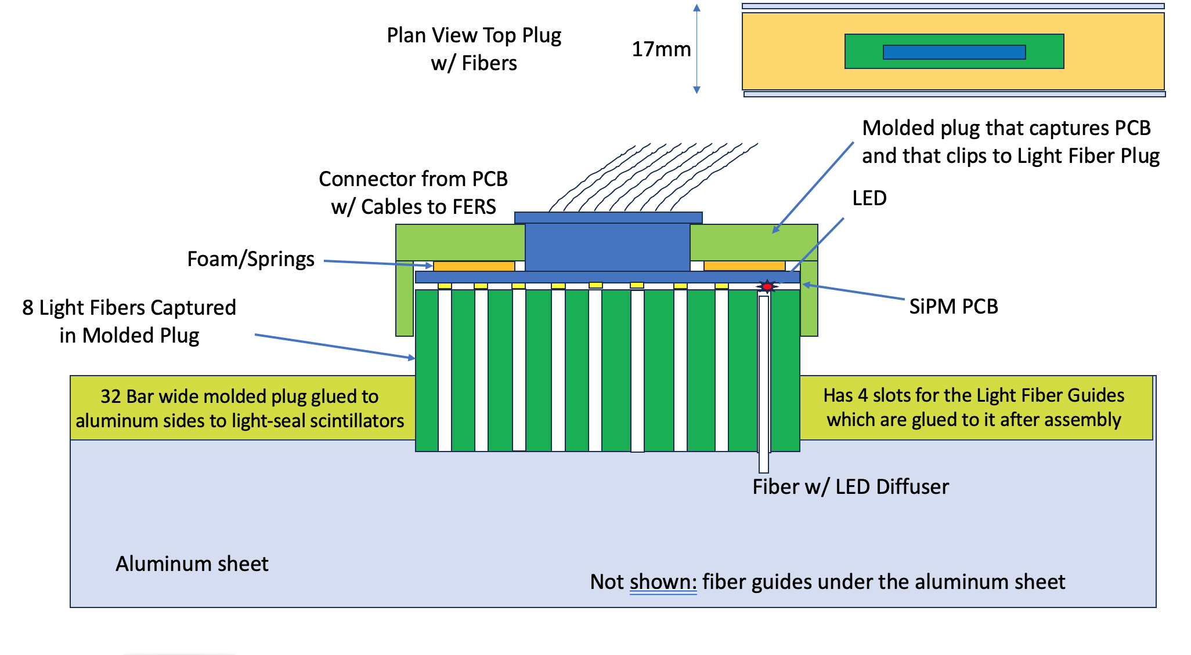
PPT Detail View of Fiber-SiPM Interface

Slide 16
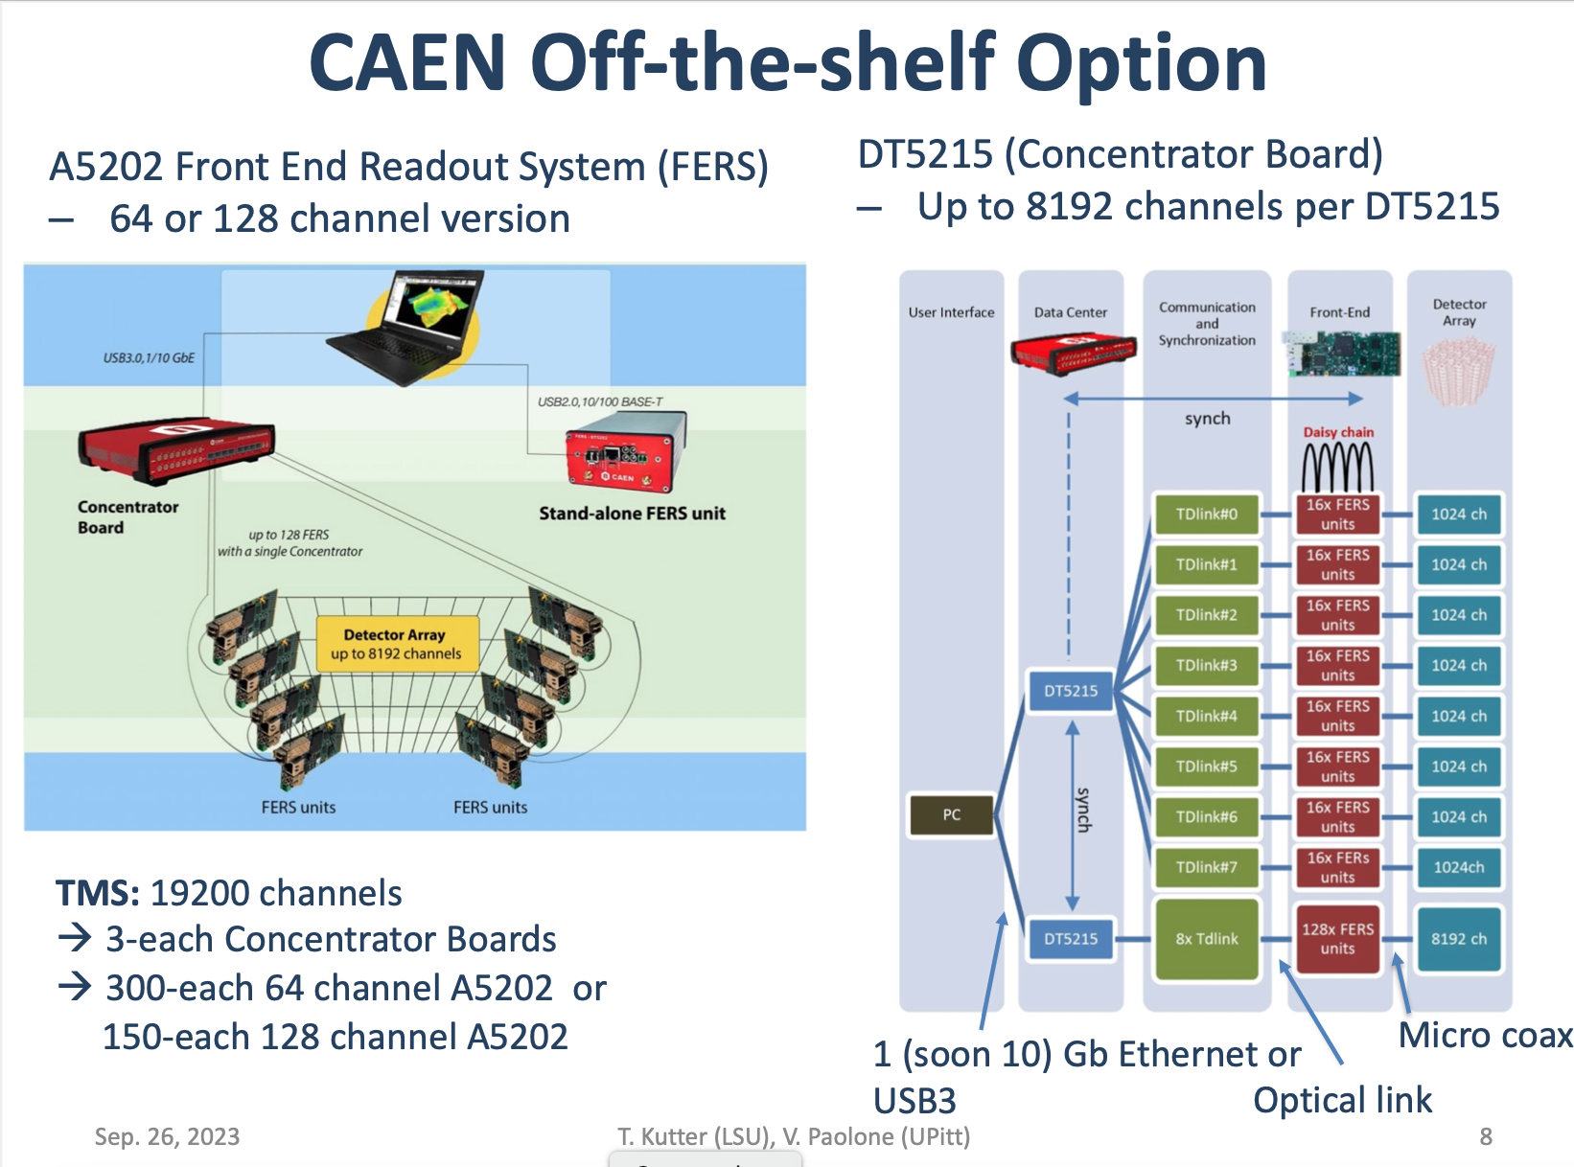
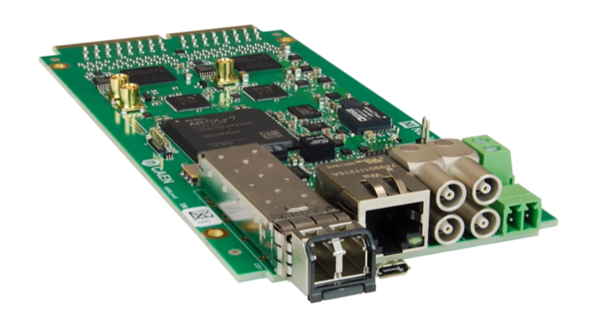
Front End Readout: Commercial
3 A5202 64-channel boards per layer
3 DT5215 Concentrator Boards Total

Slide 17
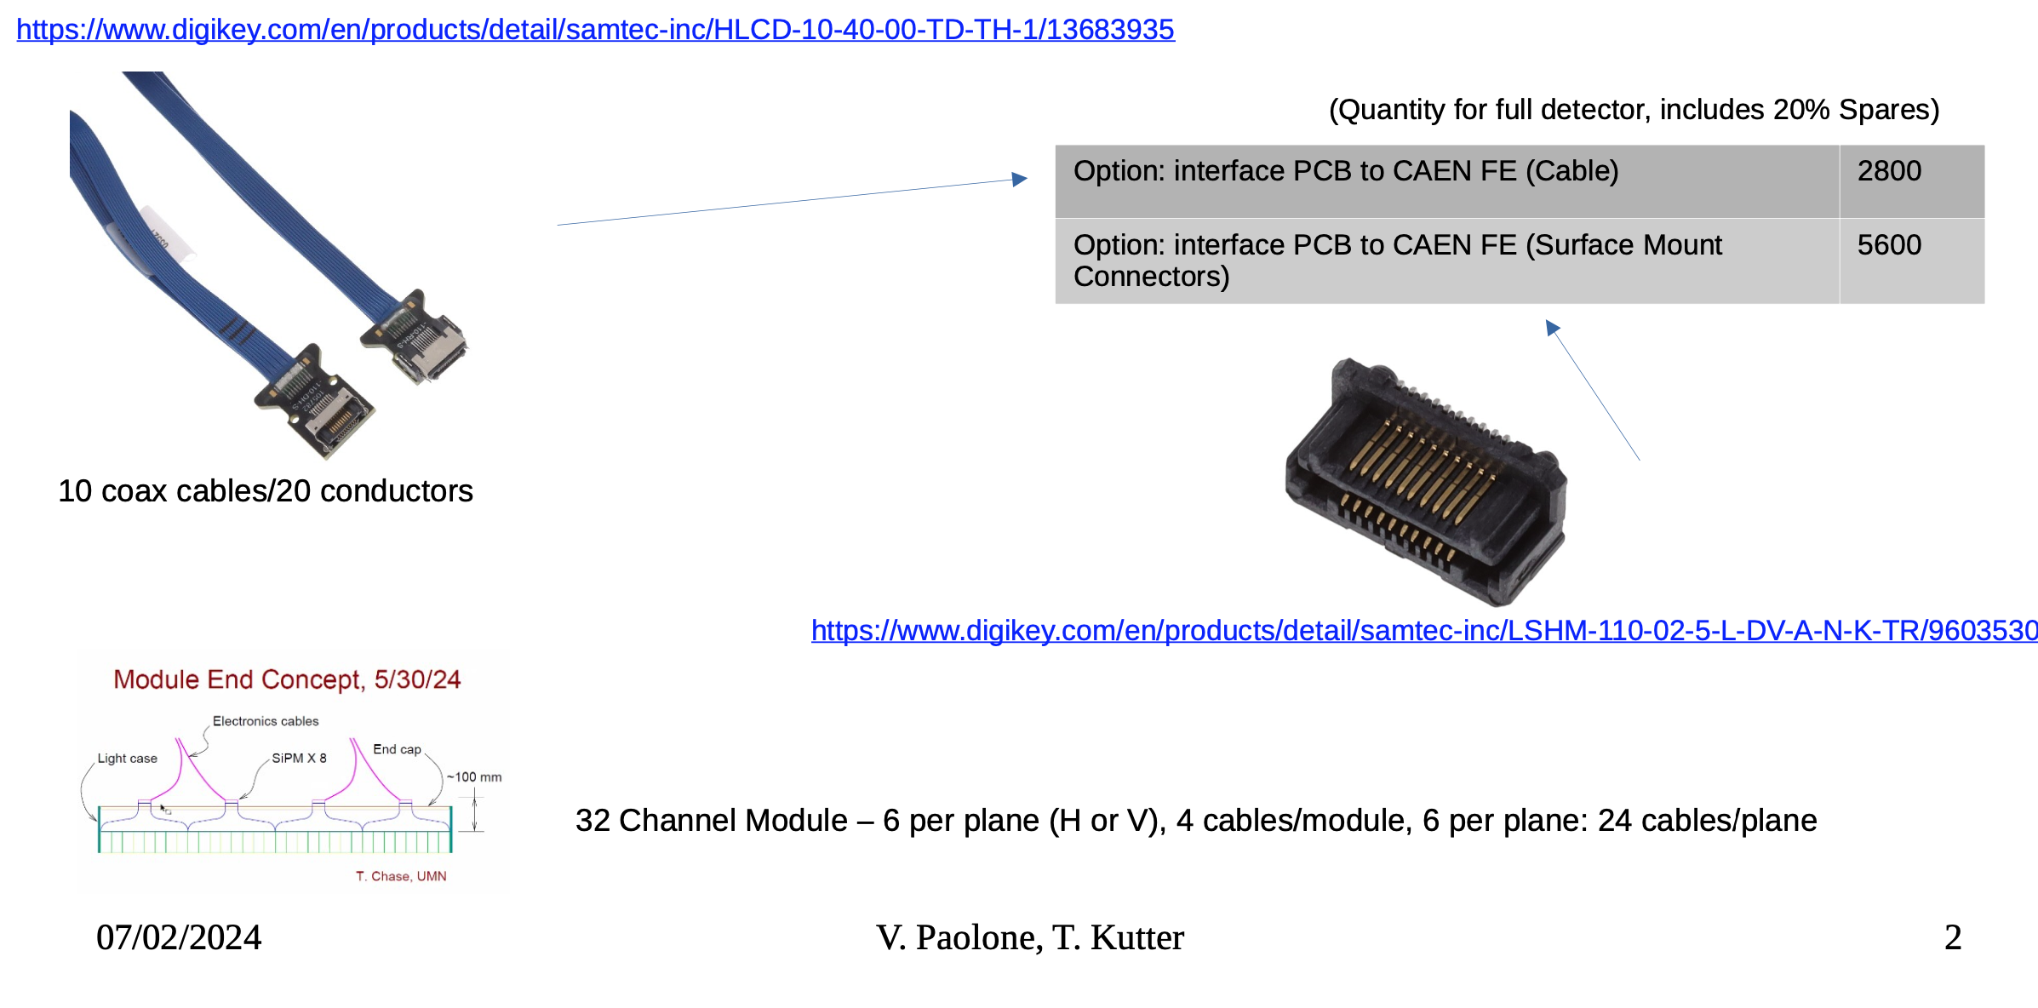
Examples of Cables and Connectors

