Slide 1
SLAC Neutrino Group: How did it get started?

Slide 2
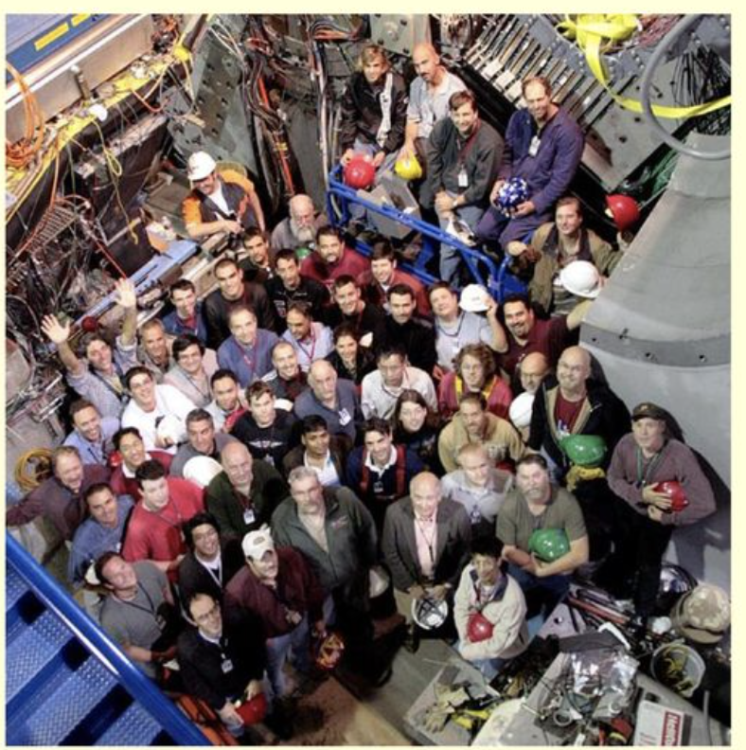
Pre-History
Wait, we just finished installing 600 muon chambers!
BaBar ends data-taking in 2008
  Higher luminosity PEP-II upgrade?
    Nope, SLAC will do LCLS. HEP->BES
  2012: Italian Super-B?
    Nope, Berlusconi says no (I think)
  Join Belle-II?
    Nope, Italy or nothing for SLAC
What will SLAC do in the (recently defined) Intensity Frontier?
  September 2011, retreat held to identify options:
    Super-B, Belle-II, rare K Decays, Mu2E, LBNE, EXO, HPS, etc.
    LBNE selected: ”Go to it, Mark!”

Slide 3
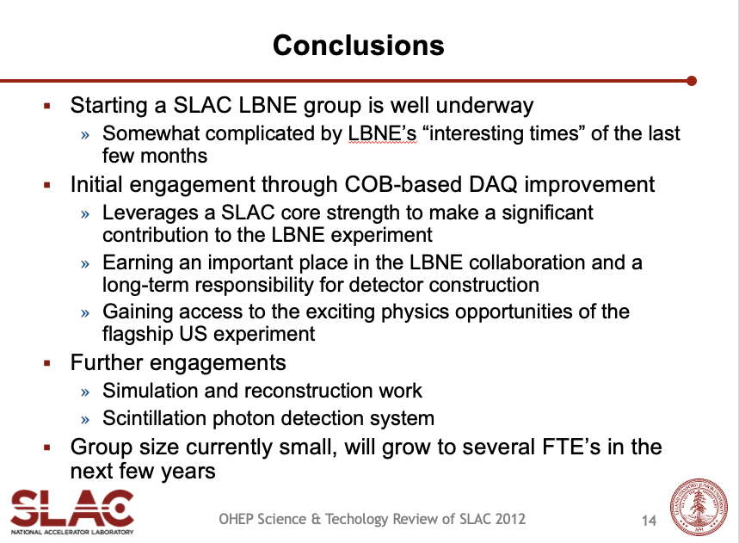
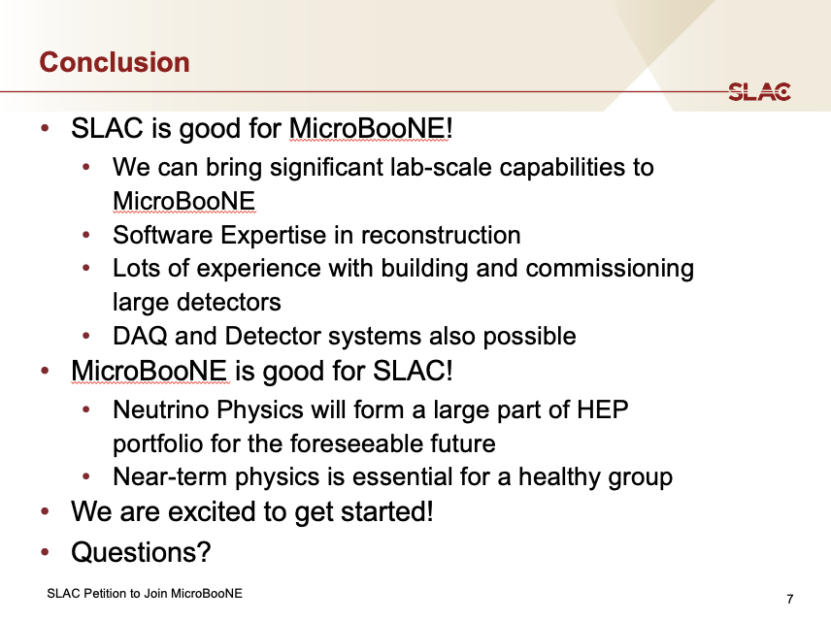
Early Developments
December 2011, Matt Graham, Charlie Young and I attended our first LBNE meeting at Argonne
  The committee to select the FD technology announces its decision
    H20 Cherenkov!!
  We’re not LBNE members yet, but called in for a meeting a few weeks later
    After 30 minutes we start asking each other why everyone’s talking about LArTPC?
    Unbeknownst to us, the FD decision had been changed to LArTPC!
  Spring 2012, We’re admitted to LBNE
    Initial involvement in DAQ and 35-ton LArTPC Prototype
Summer 2012: OMG, LBNE won’t have data until 2024, we need a near-term physics plan!
  Another retreat: considered NOvA, MicroBooNE, and MINERvA
  Decision to join MicroBooNE -> I go to FNAL in May 2013 to present our petition
  But, what do we bring? Tracy!! After some negotiations, we’re accepted into collaboration
Subsequent major steps:
  LBNE->DUNE (2015)
  New people joining, new efforts started:
    DUNE ND, ML Reco 3D, LArTPC R&D, ICARUS, …
June 2012
May 2013

