Slide 1
The (re)discovery of the “charmed φ” in Frascati
Marcello Piccolo
Laboratori Nazionali di Frascati dell’I.N.F.N.
SLAC 11/8/2024

Slide 2
Today’s menu
    Few words concerning the birth of the Frascati Laboratory and the Physics program in the early ‘70.
    The storage ring operation at that time.
    Second generation experiments running at Adone.
    The night of the (re) discovery.
    The PRL paper.

Slide 3
The Frascati National Laboratory
Born in 1954 by the effort of (few) Enrico Fermi’s co-workers: Edoardo Amaldi, Gilberto Bernardini et. al.
First operational director G. Salvini.
First accelerator to be built: electron synchrotron of 1100 MeV.
The first accelerator started its Physics program in 1959.
In February 1960 Bruno Toushek proposed on the basis of discussions with Rolf Wideroe (some fifteen years back) the colliding electron-positron ring.
Such technique, for protons and electrons, was also proposed around the same date by Gerald O’ Neil and Burton Richter. Parallel efforts were also carried out in Russia by Gersh Budker and collaborators.

Slide 4
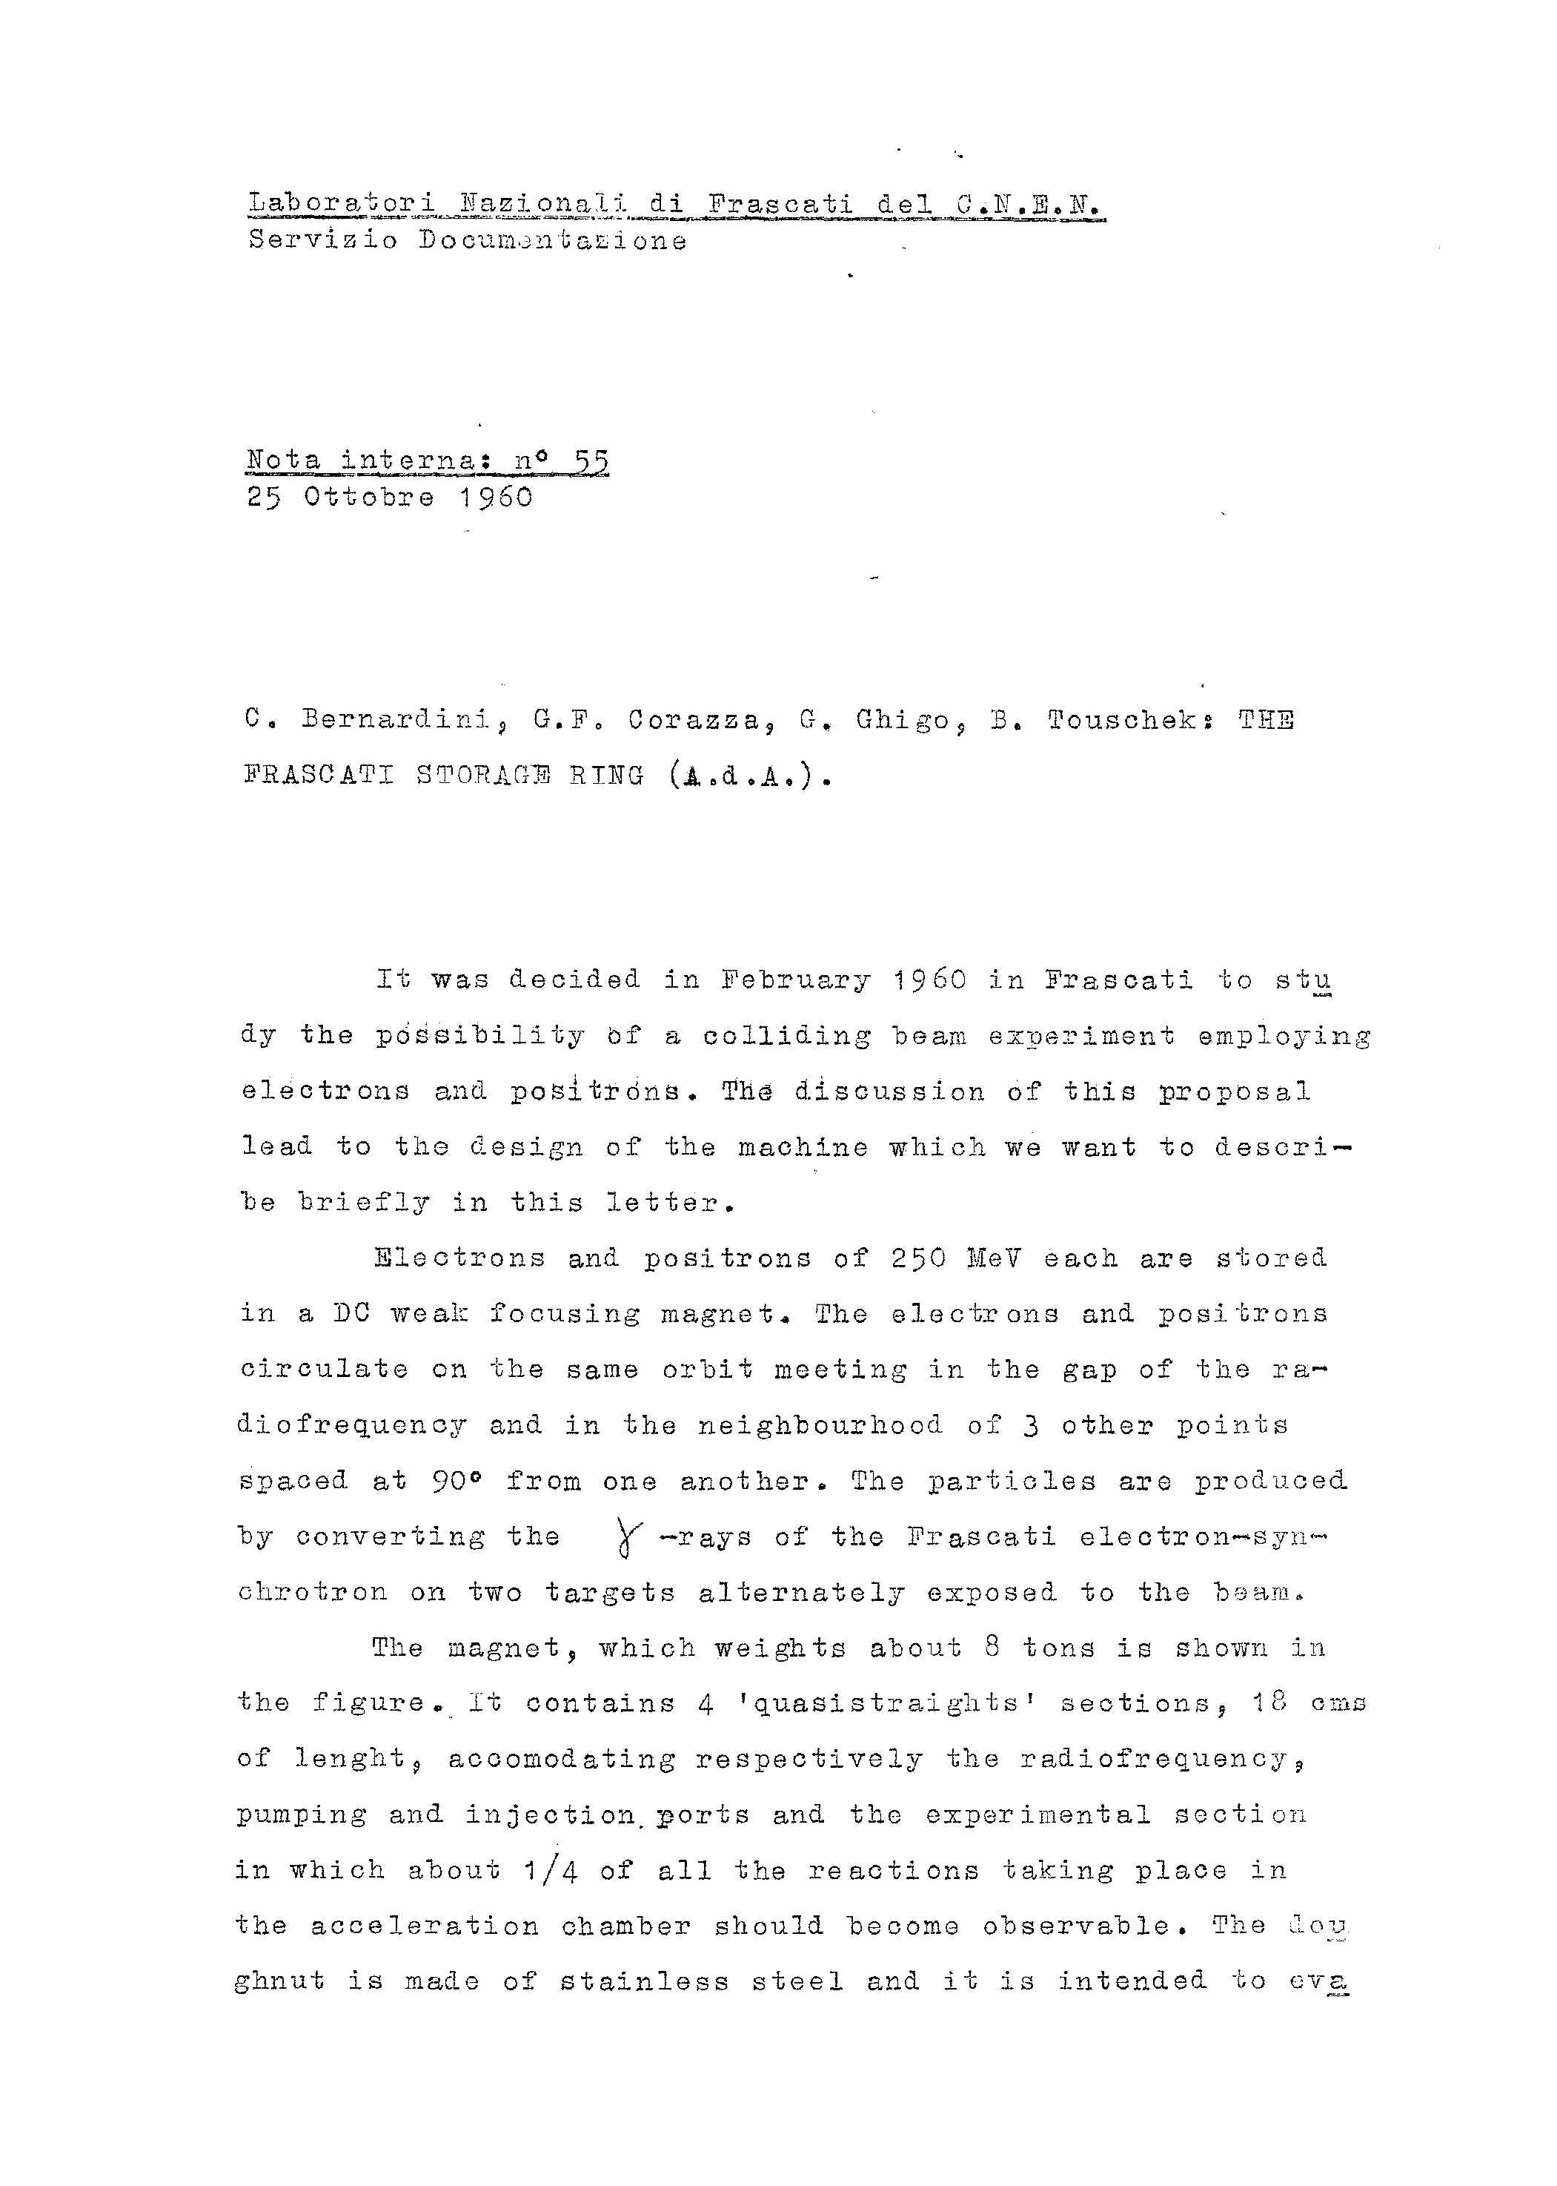
The original proposal to build an e⁺e⁻ storage ring
The name ADA was always thought being the Italian acronym of storage ring ( Anello Di Accumulazione), but, if you asked Bruno Toushek, he would tell you the machine was named after his aunt Ada, living in Rome as a dealer of a German company selling submersible pumps.

Slide 5
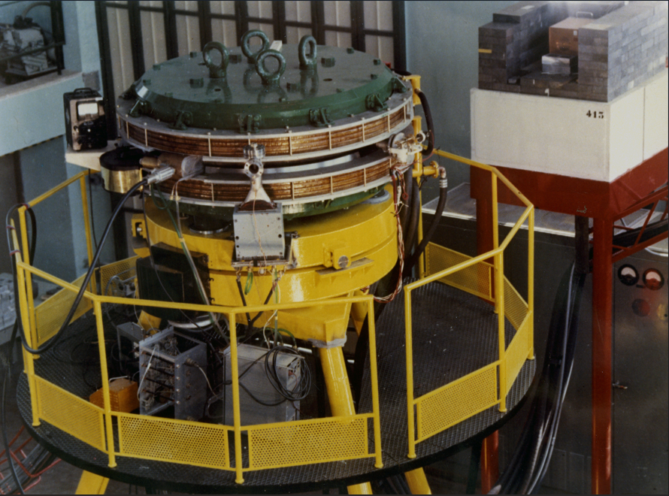
Here is ADA in one of her first runs
The written version of the presentation at the “International Conference on High Energy Physics Accelerators “(Brookhaven 1961)

Slide 6
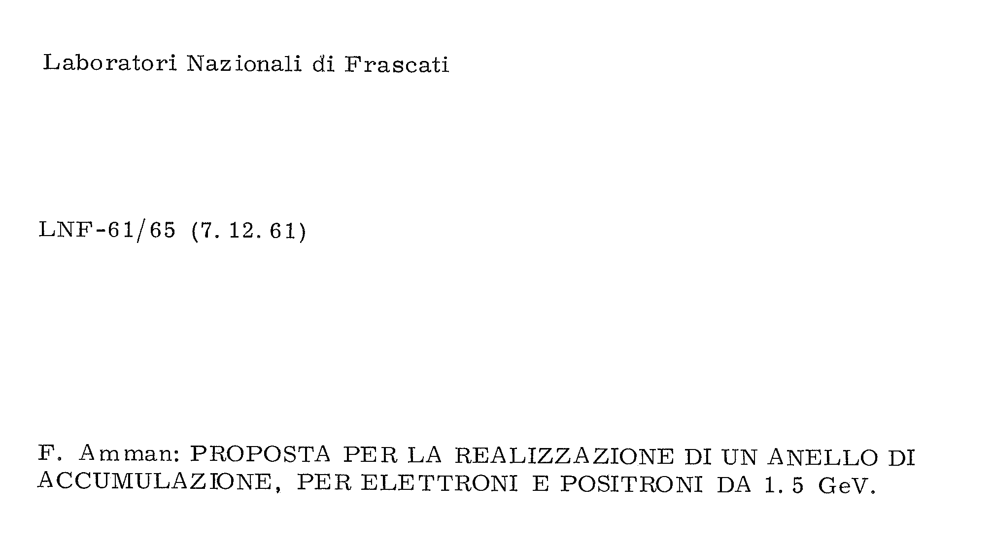
And after ADA there was big ADA -> ADONE
In Italian when you want to ‘enlarge’ you add the suffix “one” to the word…. so a big ADA would be ADONE.
The word (in Italian) is also the name of the mythological lover of Aphrodite and Persephone (ADONIS); and has been always believed to be the standard for male beauty.
The legend says that the Aphrodite’s tears mixed with his blood, when he was mangled by a wild boar, became the anemone flower.

Slide 7
The ADONE physics running
ADONE started physics runs in 1969, the startup was difficult. The machine was designed with an angle crossing, but a head–tail instability on the electrodes (so interpreted by Claudio Pellegrini) prevented such type of running.
As a result, the beam spot was a bit less than a meter long reducing substantially the detectors’ acceptances.
Nevertheless, the multi-hadronic production was discovered; the R-ratio measured by three of the four first generation experiments was around 2, substantially higher than expected at that time.
About at the same time, the second generation experiments were designed and built , three different experiments were installed in the straight sections of the machine :
  Baryon-antibaryon: as the name says devoted to heavy particles production.
  Gamma-gamma2 : calorimetric device with good neutral detection.
  MEA : a magnetic detector with B-field running perpendicular to the beams’ directions.

Slide 8
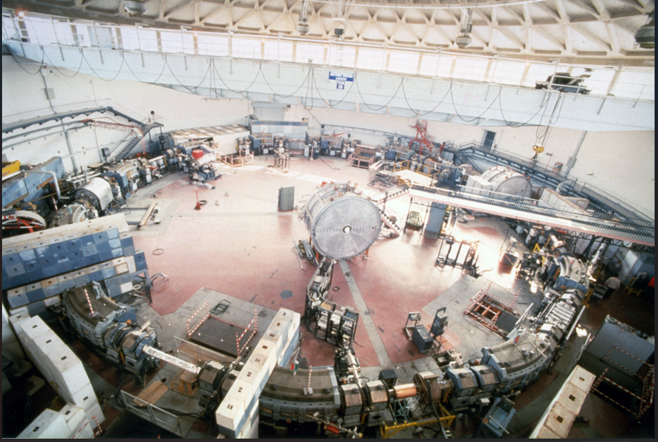
Adone parameters (end 1974)
Total length 104. m
Energy (total) 2.2 – 3.1 GeV
Luminosity (@ 3.1 GeV) ~3* 10²⁹cm⁻² sec⁻¹
Lum. Region long. (FWHM) 40* E^{3/2}_{beam} cm
Lum. Region (transv.) 1. x 0.1 cm²
Lum. Lifetime few hours
Injection and ramping times ½ hour
Energy width (σ) 0.3*E²_{CM} (in GeV)MeV
Energy calibration ( abs.) 2 MeV
Energy (re) setting 0.3 MeV
# of bunches/beam 3
Typical integrated luminosity 1 nb⁻¹/day

Slide 9
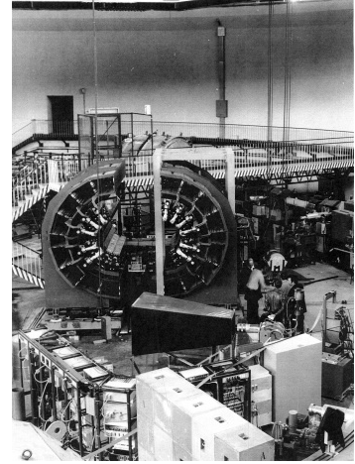
Second generation experiments at ADONE
Baryon-antibaryon
High quality calorimetric apparatus,
Completely digital .
Optimized to detect heavy particles.
Symmetry axis parallel to beam direction.
Solid angle coverage (point source) 70%*4π
Liquid scintillator for heavy particle energy measurement.
Minimum energy to trigger for a π ~ 60 MeV.
Trigger at least 2 “π”

Slide 10
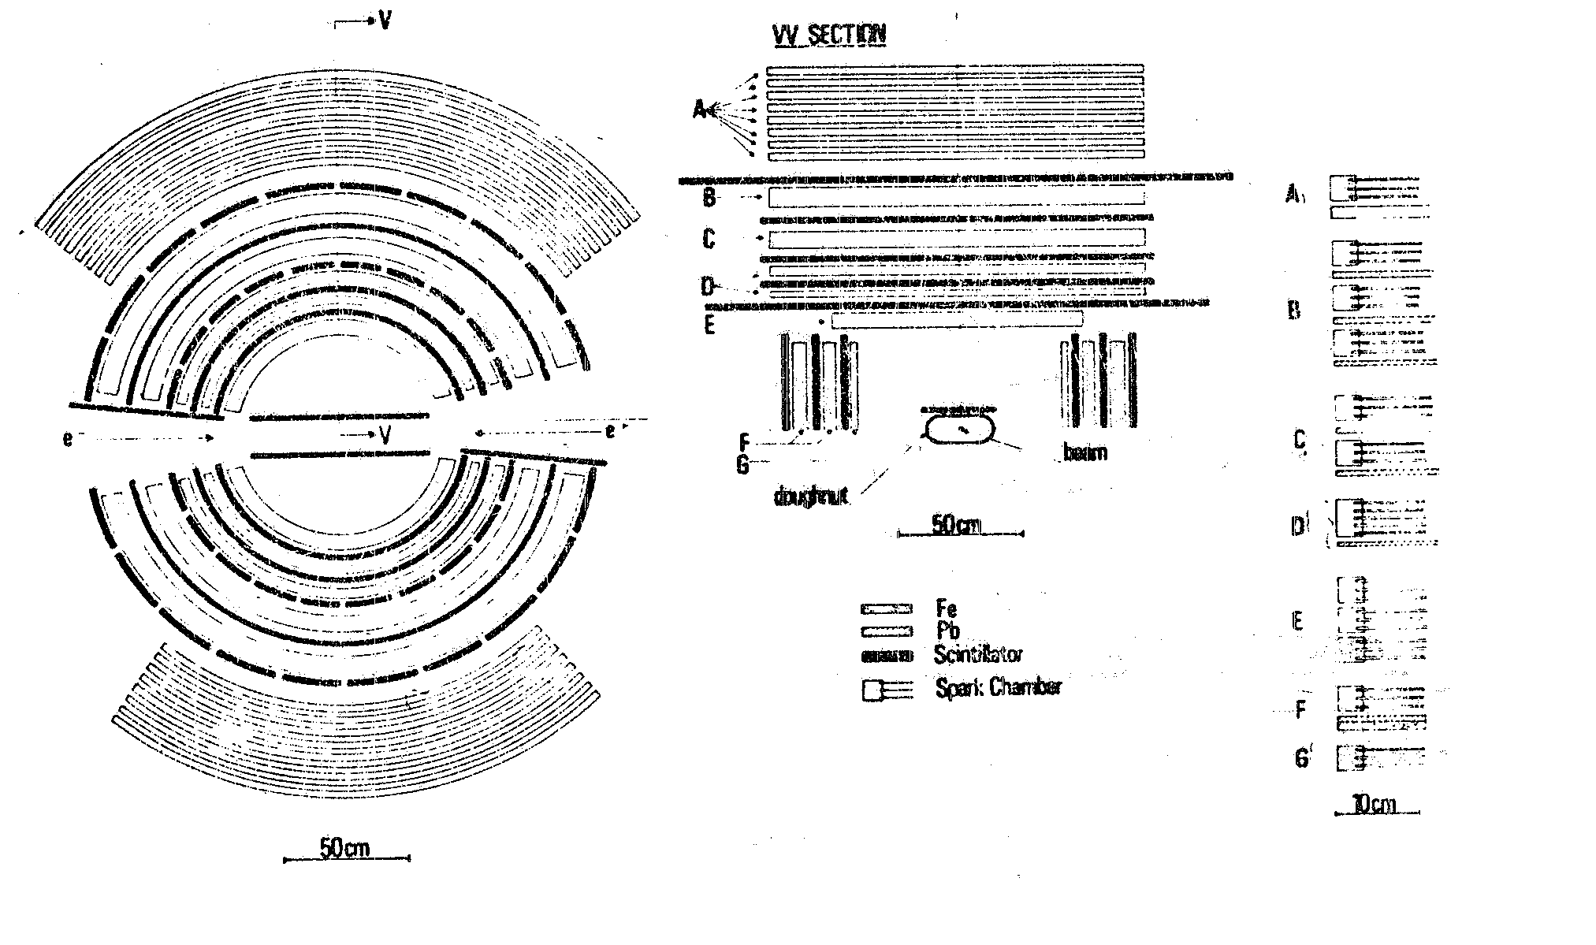
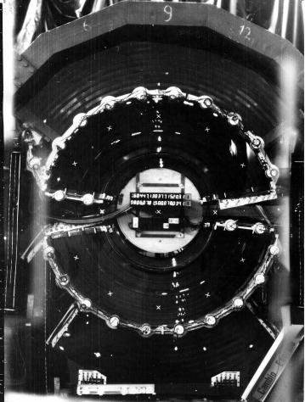
Second generation experiments at ADONE gamma gamma 2
Calorimetric apparatus optimized to detect neutrals.
Symmetry axis perpendicular to beam direction. Such choice dictated by the use of optical spark chambers .
Solid angle coverage (point source) 66%*4π.
Minimum energy to trigger for a π 120 MeV.
Minimum energy to trigger for a γ 40 MeV.
Trigger 1 “π” (120 MeV) or photon(s) with a low energy “p” (40 MeV).

Slide 11
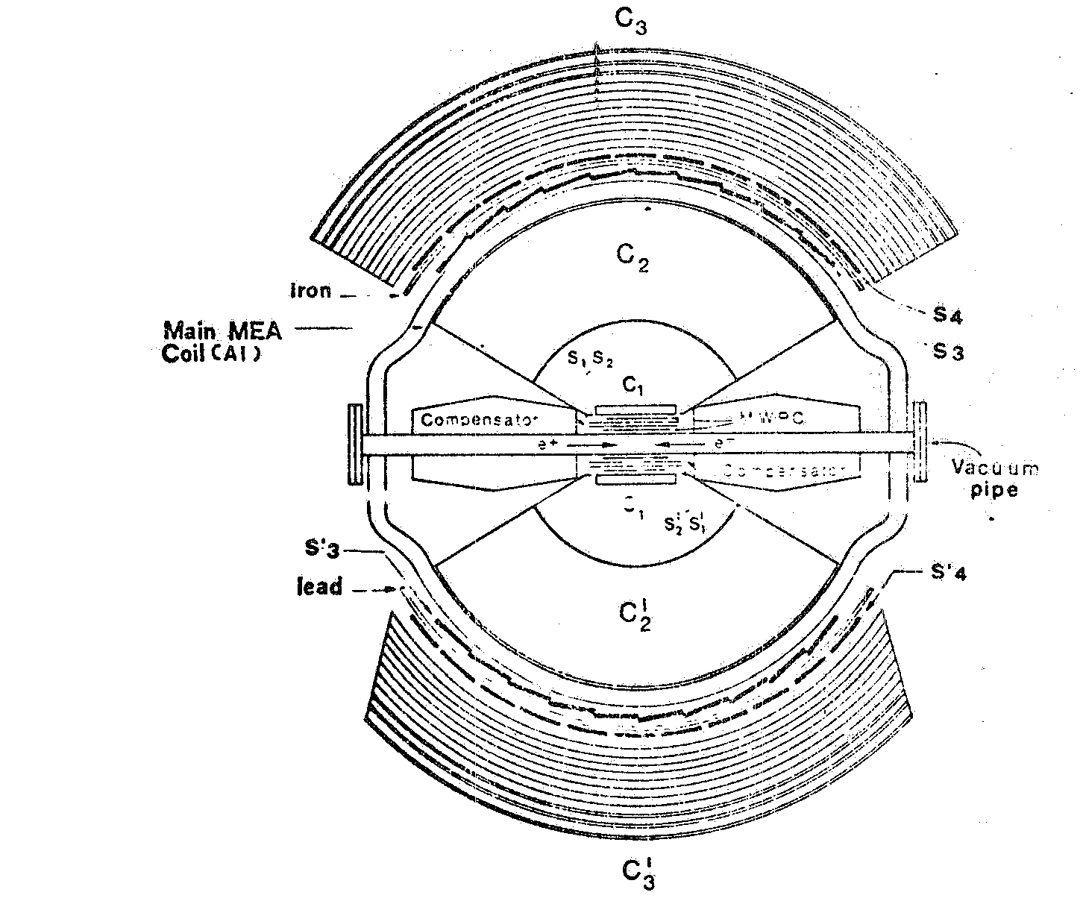
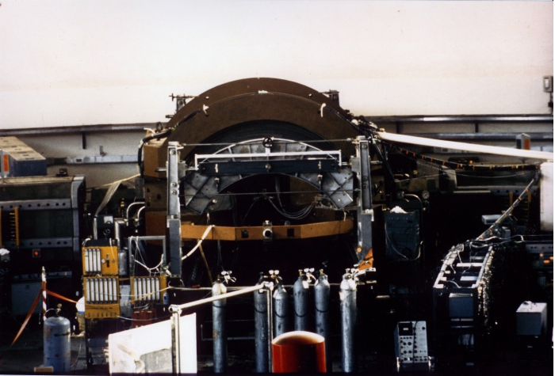
Second generation experiments at ADONE M.(agnete)E.(sperienze)A.(DONE)
Magnetic apparatus: operational B-field 2.5 KG
Symmetry axis perpendicular to beam direction. Such choice dictated by the use of optical spark chambers .
Solid angle coverage (point source) 40%*4π.
(momentum measurement)
Minimum energy to trigger for a π 130 MeV.
Beams interaction with detector B-field somehow critical. Compensation needed to few parts 10⁻⁴.
Trigger 2 “π” 130 MeV each.

Slide 12
The news of the “charmed φ “
On Nov. 11th 1974, in Frascati we were told that a new particle had been found by the S.C.C. Ting group in Brookhaven and by the SLAC-LBL collaboration, Mark I at SPEAR.
The mass of this new resonance was higher than the nominal max. energy for ADONE (3 GeV), but we set up to look for it pushing the Adone magnet some 100 MeV above the limit.
It took us three days to find it, as we were having some B-field saturation, but in the night of Nov. 14th we found it.

Slide 13
There it was
Around 11 P.M. I was running the n-th energy scan with my experiment (MEA) when the trigger beeper went berserk….
We had a typical trigger counting rate of about 1 every couple of minutes: all of a sudden we had 1 trigger every few tens seconds.
We were almost on top of the resonance.
Prof. Giorgio Salvini, running his shift on the gamma gamma2 experiment, had the machine operators open the machine access door (the access door for Adone was few meters above the vacuum pipe) and started looking at the spark chambers of his experiment: they looked like a Christmas tree with a counting rate for multi-particles events never seen before.
We kept logging events all night and, comes the morning, most of the high energy physicists in the Rome area appeared in the ADONE counting rooms.

Slide 14
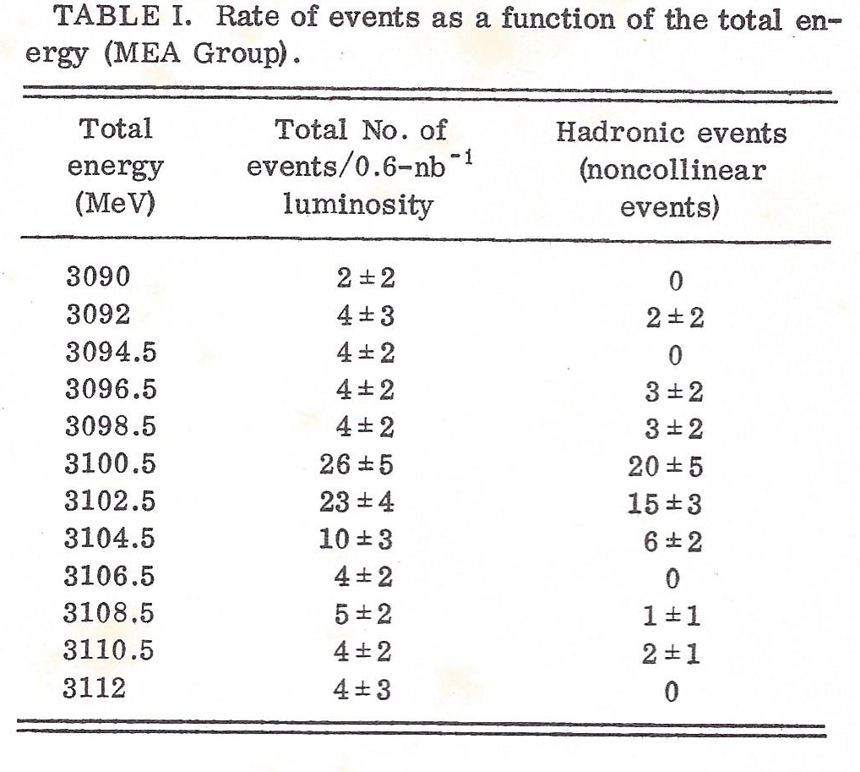
The results
In few days we recorded and analyzed/scanned few hundred events; on Nov. 18th a joint paper from ADONE experiments was published on PRL.

Slide 15
Few odds and ends
The PRL paper was dictated over the phone by Giorgio Bellettini (then director of the Laboratory).
It took quite a while, as the words had to be spelled one by one by Giorgio.
The result was quite a disaster regarding the spelling of the Authors’ names…..
The original paper was dated Nov. 18th ….but a new version with the right authors’ names was released on Dec. 2nd

Slide 16
The original (and amended) author list from PRL
C. Bacci, R. Balbini Celio, M. Berna-Rodini, G. Caton, R. Del Fabbro, M. Grilli, E. Iarocci, M. Locci, C. Mencuccini, G. P. Murtas, G. Penso, G. S. M. Spinetti, M. Spano, B. Stella, and V. Valente
B. Bartoli, D. Bisello, B. Esposito, F. Felicetti, P. Monacelli, M. Nigro, L. Paolufi, I. Peruzzi, G. Piano Mortemi, M. Piccolo, F. Ronga, F. Sebastiani, L. Trasatti, and F. Vanoli
G. Barbarino, G. Barbiellini, C. Bemporad, R. Biancastelli, F. Cevenini, M. Celvetti, F. Costantini, P. Lariccia, P. Parascandalo, E. Sassi, C. Spencer, L. Tortora, U. Troya, and S. Vitale
C. Bacci, R. Baldini Celio, M. Bernardini, G. Capon, R. Del Fabbro, M. Grilli, E. Iarocci, L. Jones, M. Locci, C. Mencuccini, G. P. Murtas, G. Penso, G. Salvini, M. Spano, M. Spinetti, B. Stella, V. Valente,
B. Bartoli, D. Bisello, B. Esposito, F. Felicetti, P. Monacelli, M. Nigro, L. Paoluzi, I. Peruzzi, G. Piano Mortari, M. Piccolo, F. Ronga, F. Sebastiani, L. Trasatti, F. Vanoli,
G. Barbarino, G. Barbiellini, C. Bemporad, R. Biancastelli, M. Calvetti, M. Castellano, F. Cevenini, F. Costantini, P. Lariccia, S. Patricelli, P. Parascandalo, E. Sassi, C. Spencer, L. Tortora, U. Troya, and S. Vitale
Usually: S as in sierra
Giorgio spelling: S as in Salvini

Slide 17
Interpretation(s)
The end of 1974 was a hectic period for the theoreticians, who were trying to assess the nature of “3.1” particle.
  A colored state
  A new quantum number ground state
  A vector boson ( …. careful not the Z₀)
We tested the last hypotesis looking at the charge asymmetry in the μ⁺μ⁻ channel.
Is the 3104-MeV Vector Meson the ϕ_{c} or the W₀ ?
G. Altarelli, N. Cabibbo R. Petronzio (Rome Un.),L. Maiani (ISS), G. Parisi (LNF)
Lett.Nuovo Cim. 11 (1974) 14, 609-612

Slide 18
At the end of the year…..
Here is what we found :
Aver. asymmetry = (49-53)/(49+53) = -.04 ± .1
Unfortunately, we decide to split the measurement vs. energy and we ended up with an unexplainable result:
In the 2 MeV before the peak we found:
Asymmetry = (32-16)/(32+16) = .33 ± .14
In the 2 MeV after the peak we found:
Asymmetry = (12-28)/(12+28) = -.40± .14

Slide 19
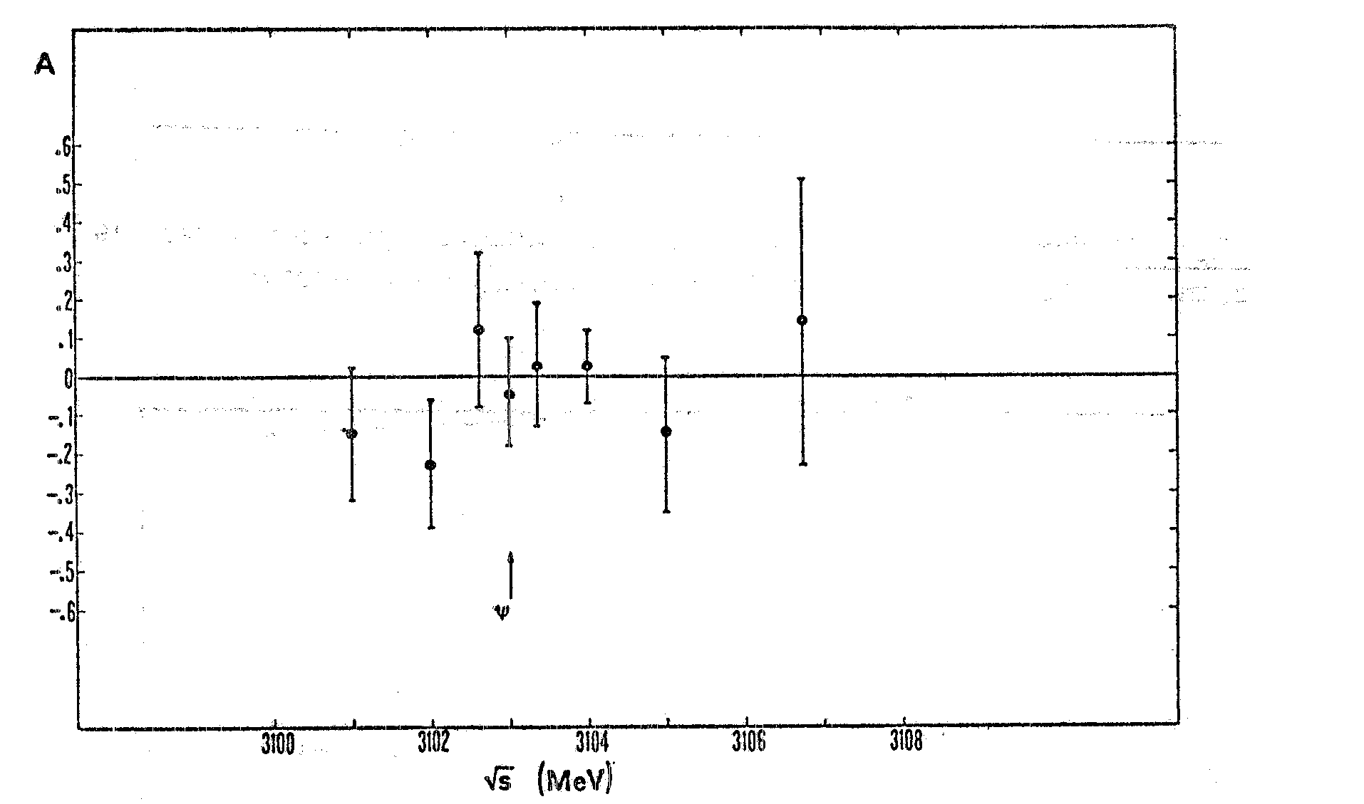
Sometimes statistics hit you hard
And this was the case :
It took one year of data taking to smooth out the fluctuation…
End 1974
Beginning 1976

Slide 20
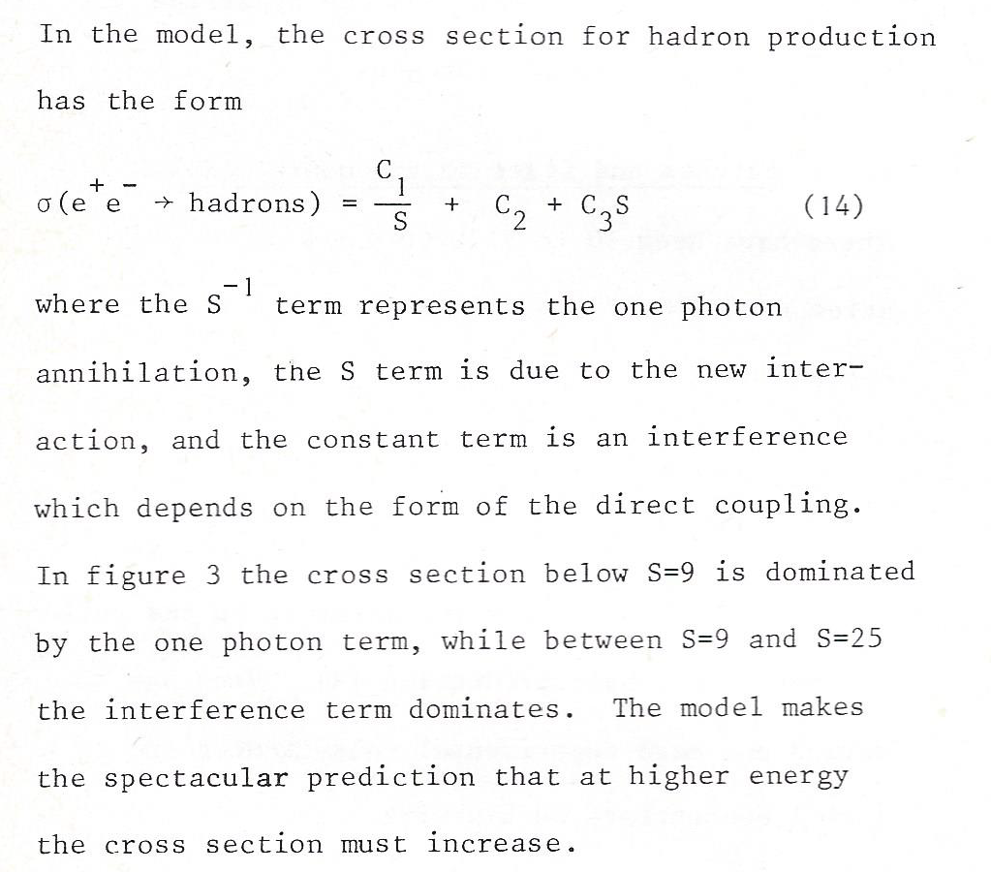
It was really a revolution
At the 1974 ICHEP conference in London, Burt Richter gave a rapporteur talk on e⁺e⁻ physics. It was difficult to understand the R-ratio behaviour: ( here is an excerpt )
The example here describes a model with a linearly increasing (vs. E²) e⁺e⁻ multi-hadronic cross section…Now we know that thresholds were opening around 4 GeV and the first hint was really the “charmed φ “.(confirmation came soon after with the ψ’) .

Slide 21
Conclusions
The generation of physicists that was professionally active at the time of the charm discovery lived through a very exciting time….
I was one of the lucky bunch.
I remember my first presentation at an international conference in February1975 (rencontres de Moriond), where I met people with whom I worked for most of my scientific carrier.
Sadly, several of them are not with us anymore.

