Slide 1
Wide Band Gap Materials for 4D Tracking
Carl Haber
Lawrence Berkeley National Laboratory

Slide 2
Introduction
LBNL/North Carolina State Univ/BNL have a collaboration aimed at developing 4H-SiC LGADs
Other collaborations in : China, Japan, Austria, Slovenia, Czech Republic, and growing
Motivation
  Able to run at high temperature to lower the mass of cooling and support
  Possibility of enhanced radiation resistance
  Theoretically 2x faster than Si-LGAD (but electronics may be the limiting factor)
Status
  Have developed models and simulations which give us design insight
  Have fabricated devices which demonstrate charge gain and good time resolution
  Considerable testing and characterization infrastructure now in place
  Have fabricated AC coupled multi-segment devices which show charge sharing
  Main issue is breakdown voltage too low to fully deplete – we have reached ~50% depletion

Slide 3
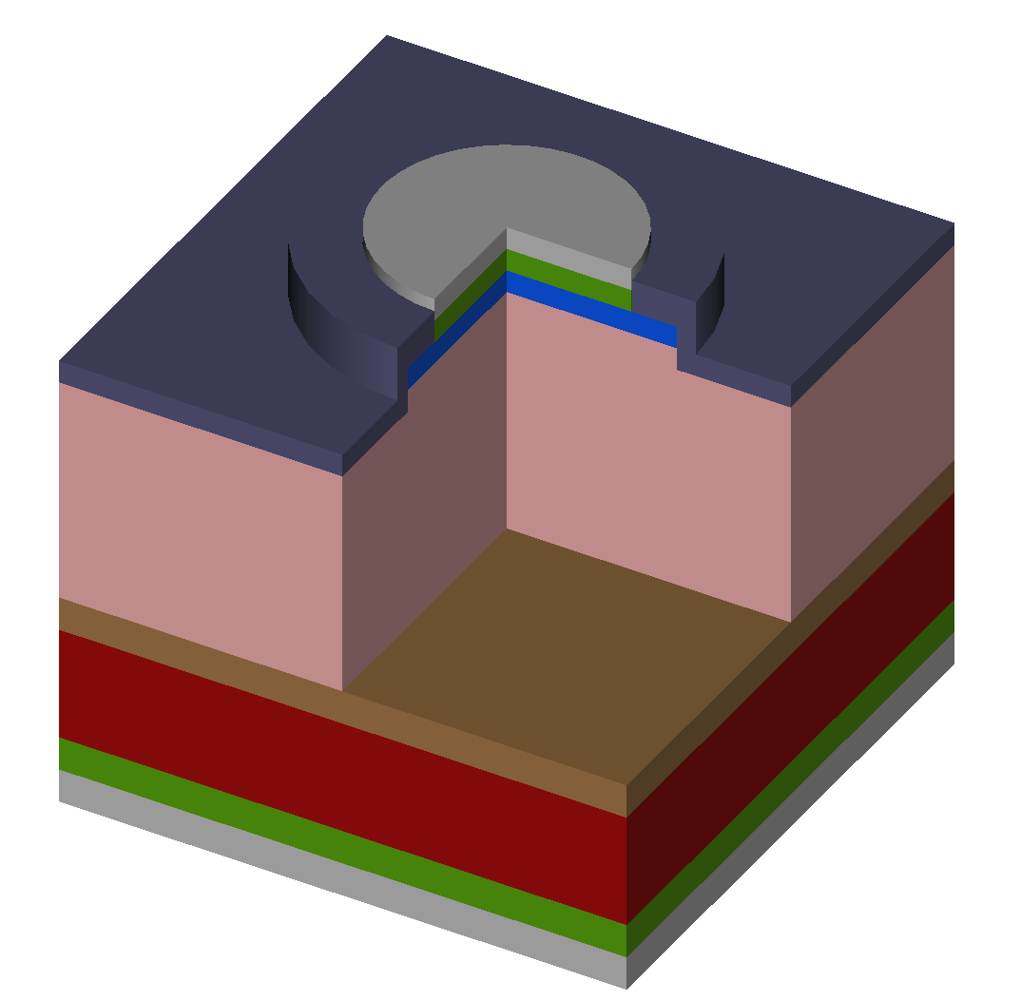
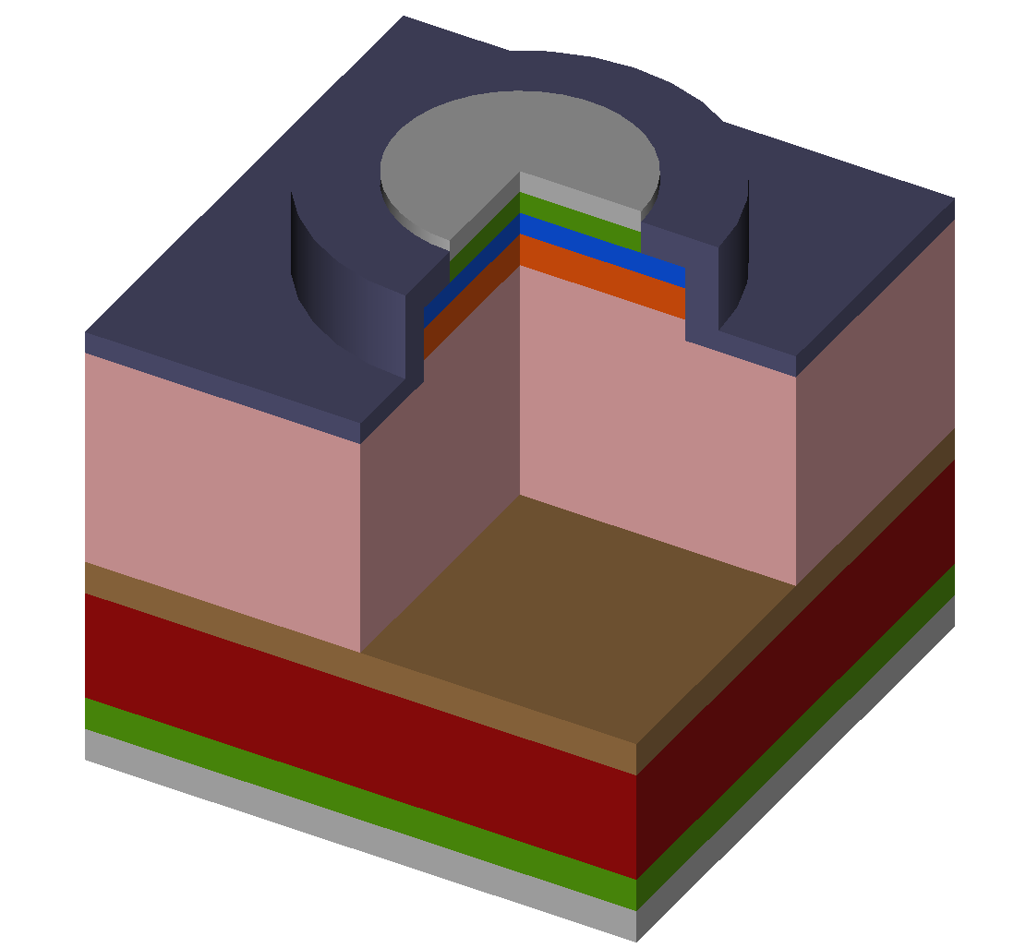
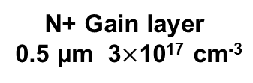
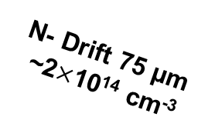
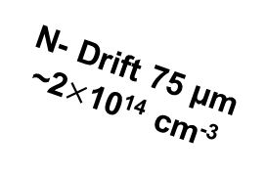
Method: Compare LGAD to PIN
P++
0.3 µm ~10²⁰ cm⁻³
N+ Gain layer
0.5 µm 3$×$10¹⁷ cm⁻³
P++
0.3 µm ~10²⁰ cm⁻³
Al
Al
Ti/Al
Ti/Al
Electric Field
SiO₂
Electric Field
SiO₂
N- Drift 75 µm
~2$×$10¹⁴ cm⁻³
N- Drift 75 µm
~2$×$10¹⁴ cm⁻³
N+ Buffer ~10¹⁸ cm⁻³
N+ Buffer ~10¹⁸ cm⁻³
N++ Substrate
N++ Substrate
Ti/Ni
Ti/Ni
Ti/Ni/Au
Ti/Ni/Au

Slide 4
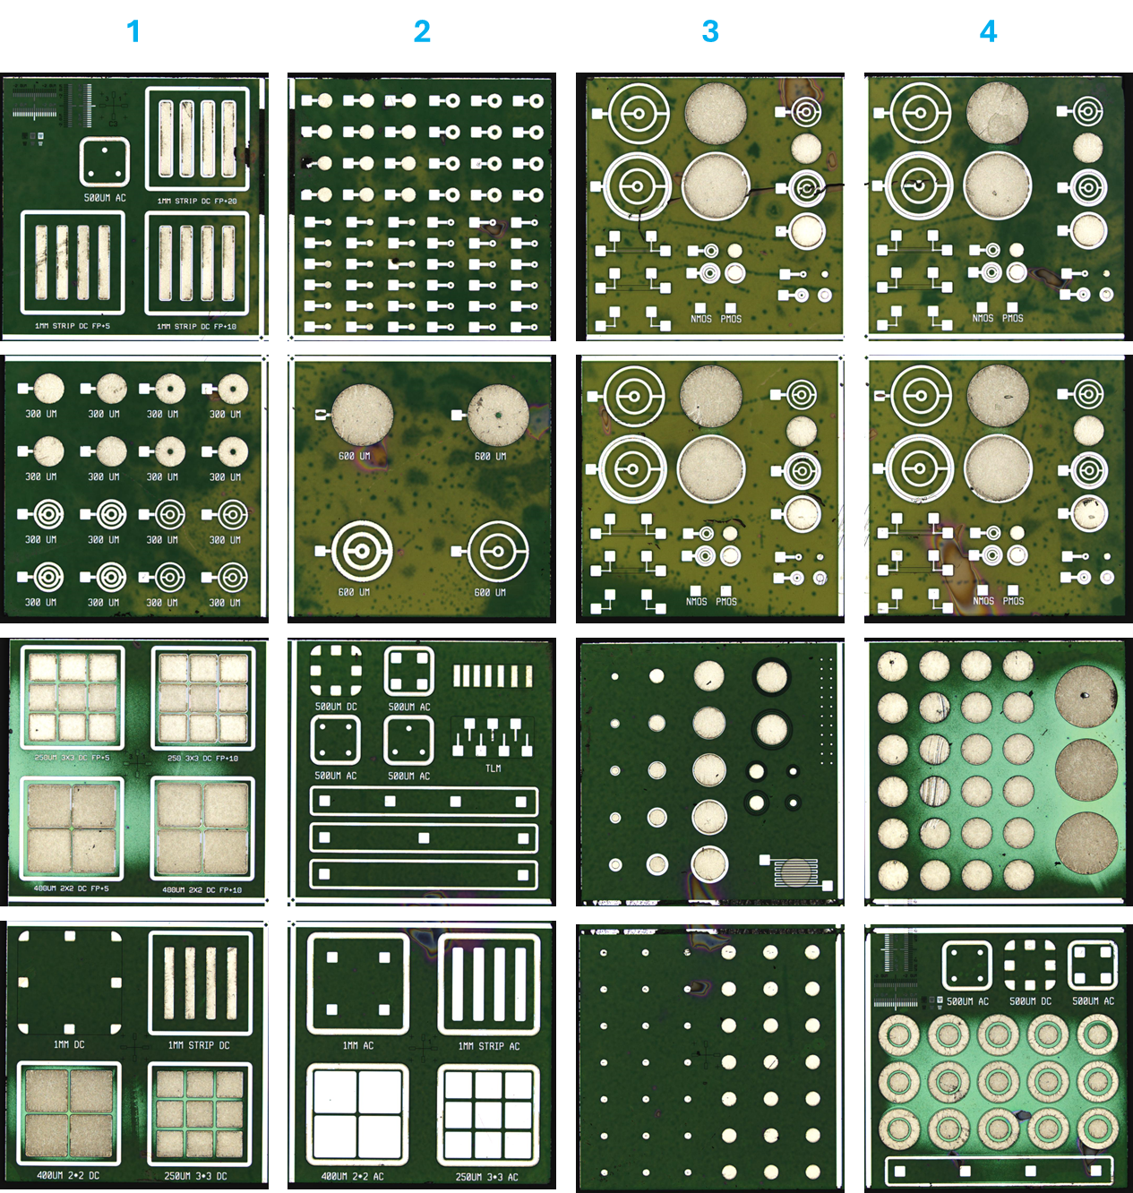
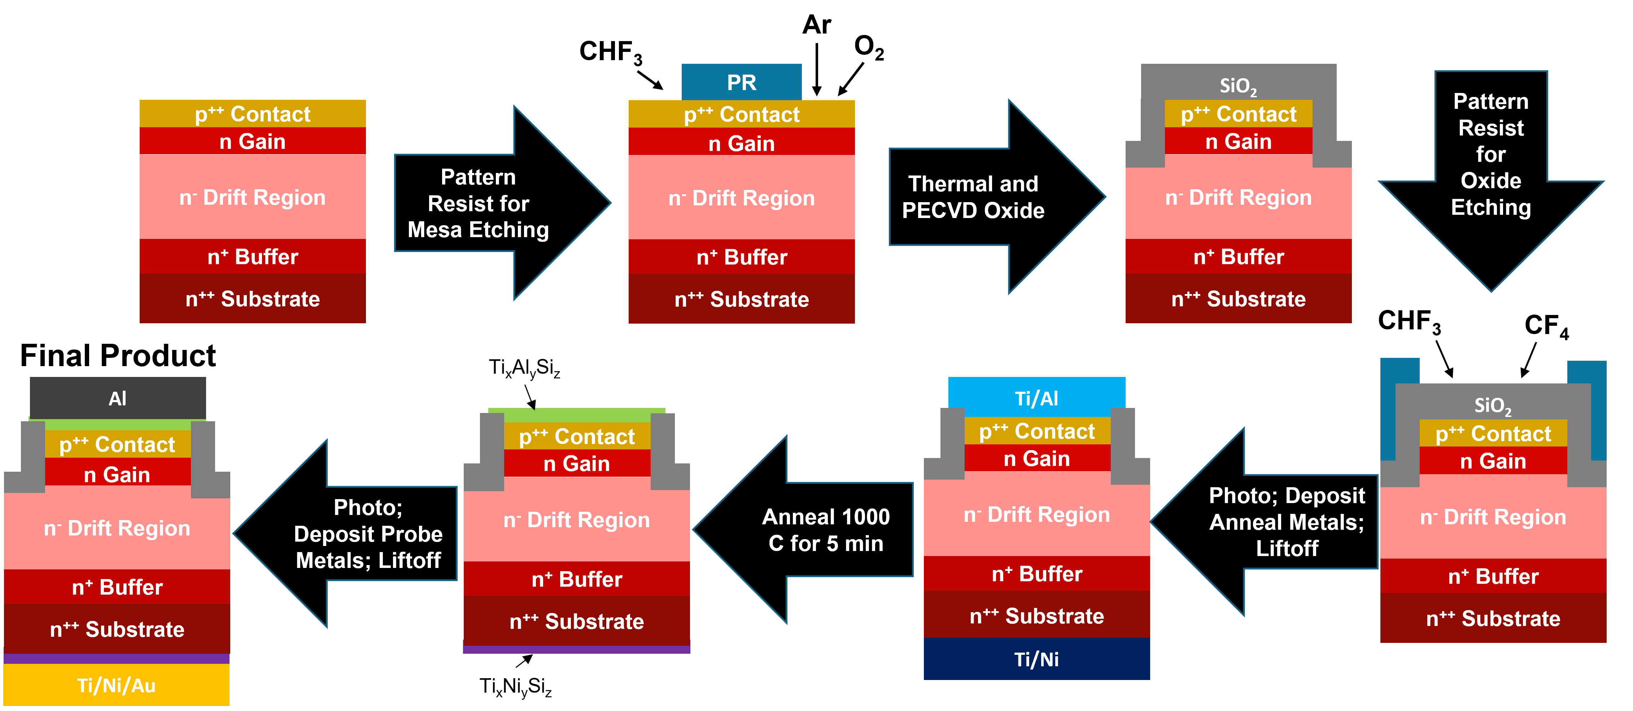
Processing
We designed a broad set of devices and test structures
Size, shape, segmentation, metallization, field control, process monitor
Process developed and performed in NCSC Nano Fab center on campus
This is a second iteration of the fabrication process
Later iterations are under design to include ion implantation – off site

Slide 5
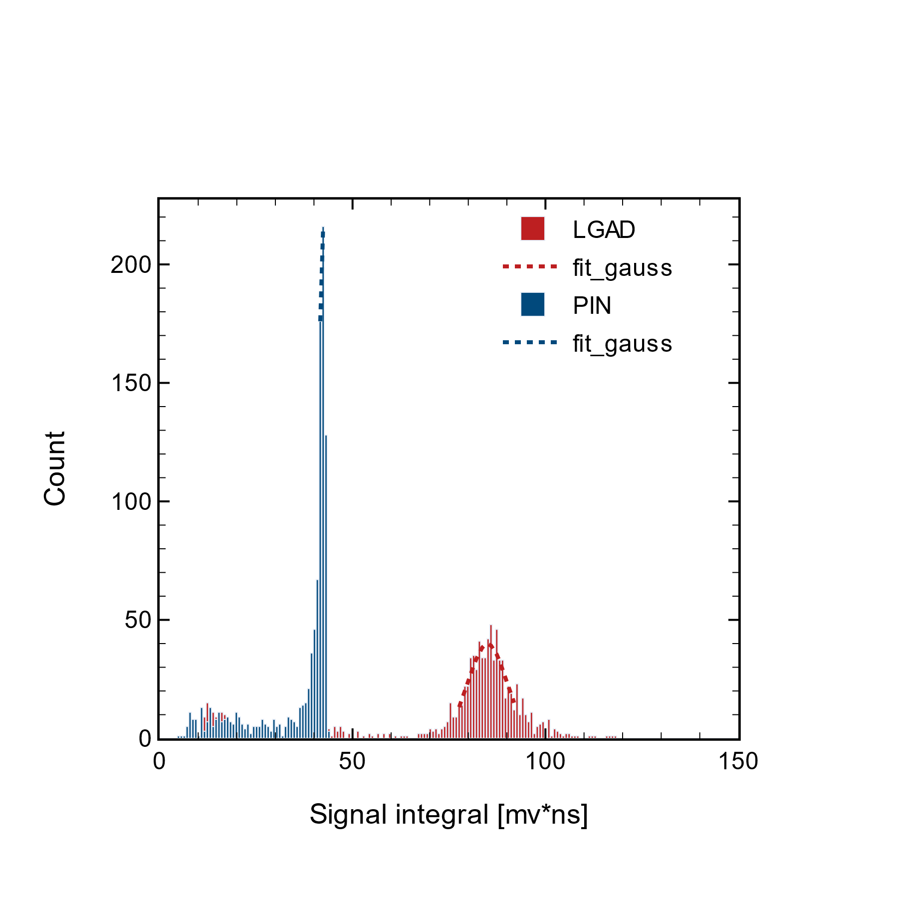
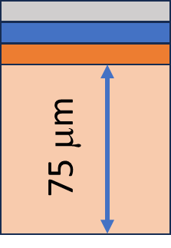
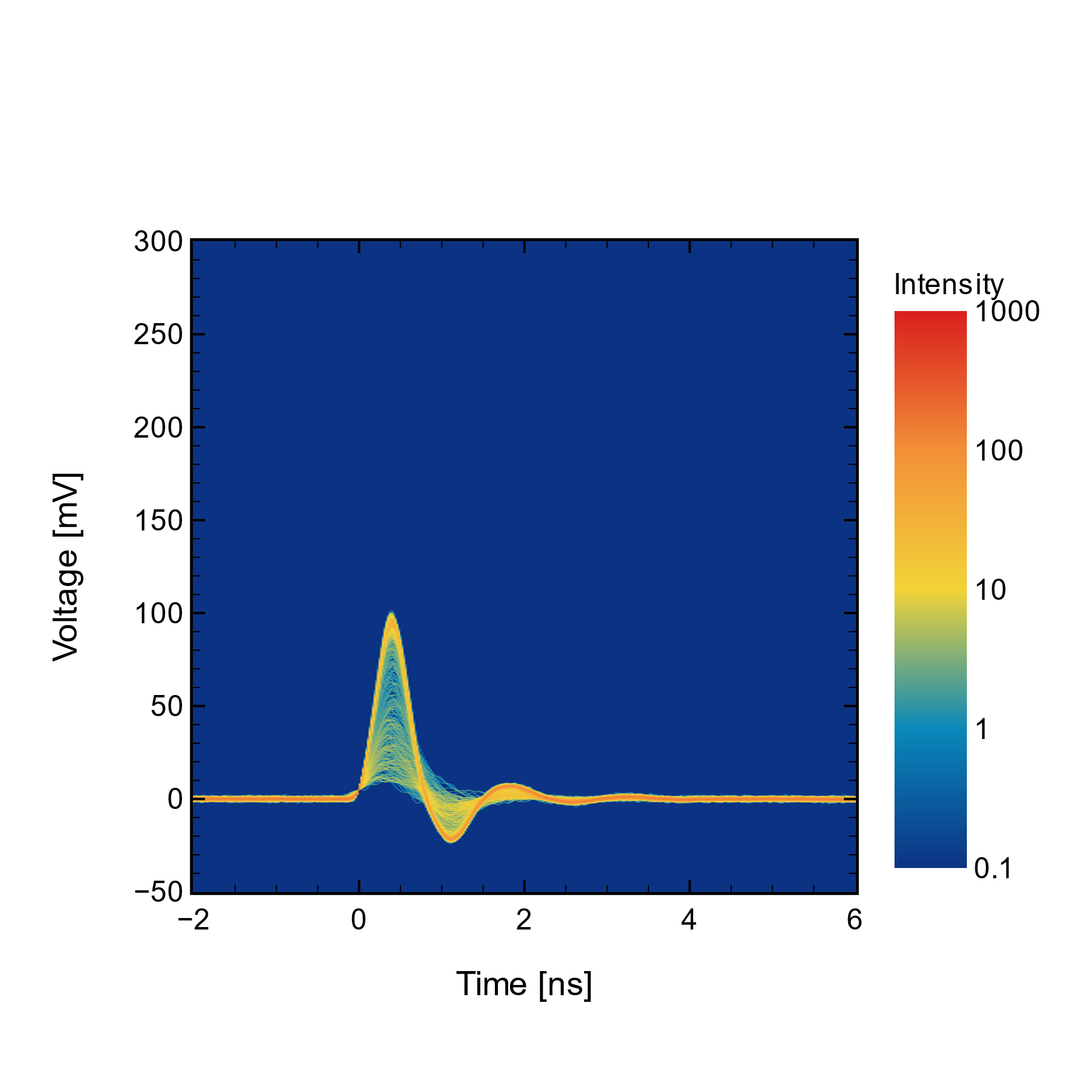
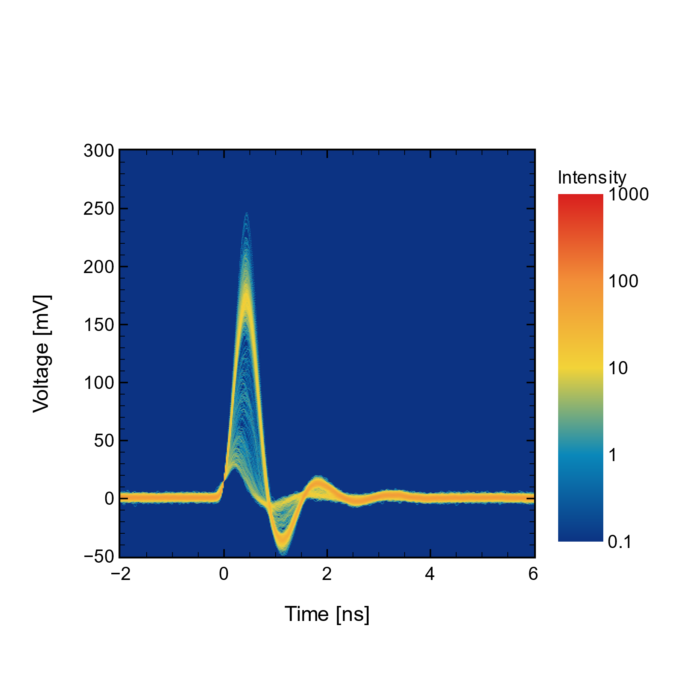
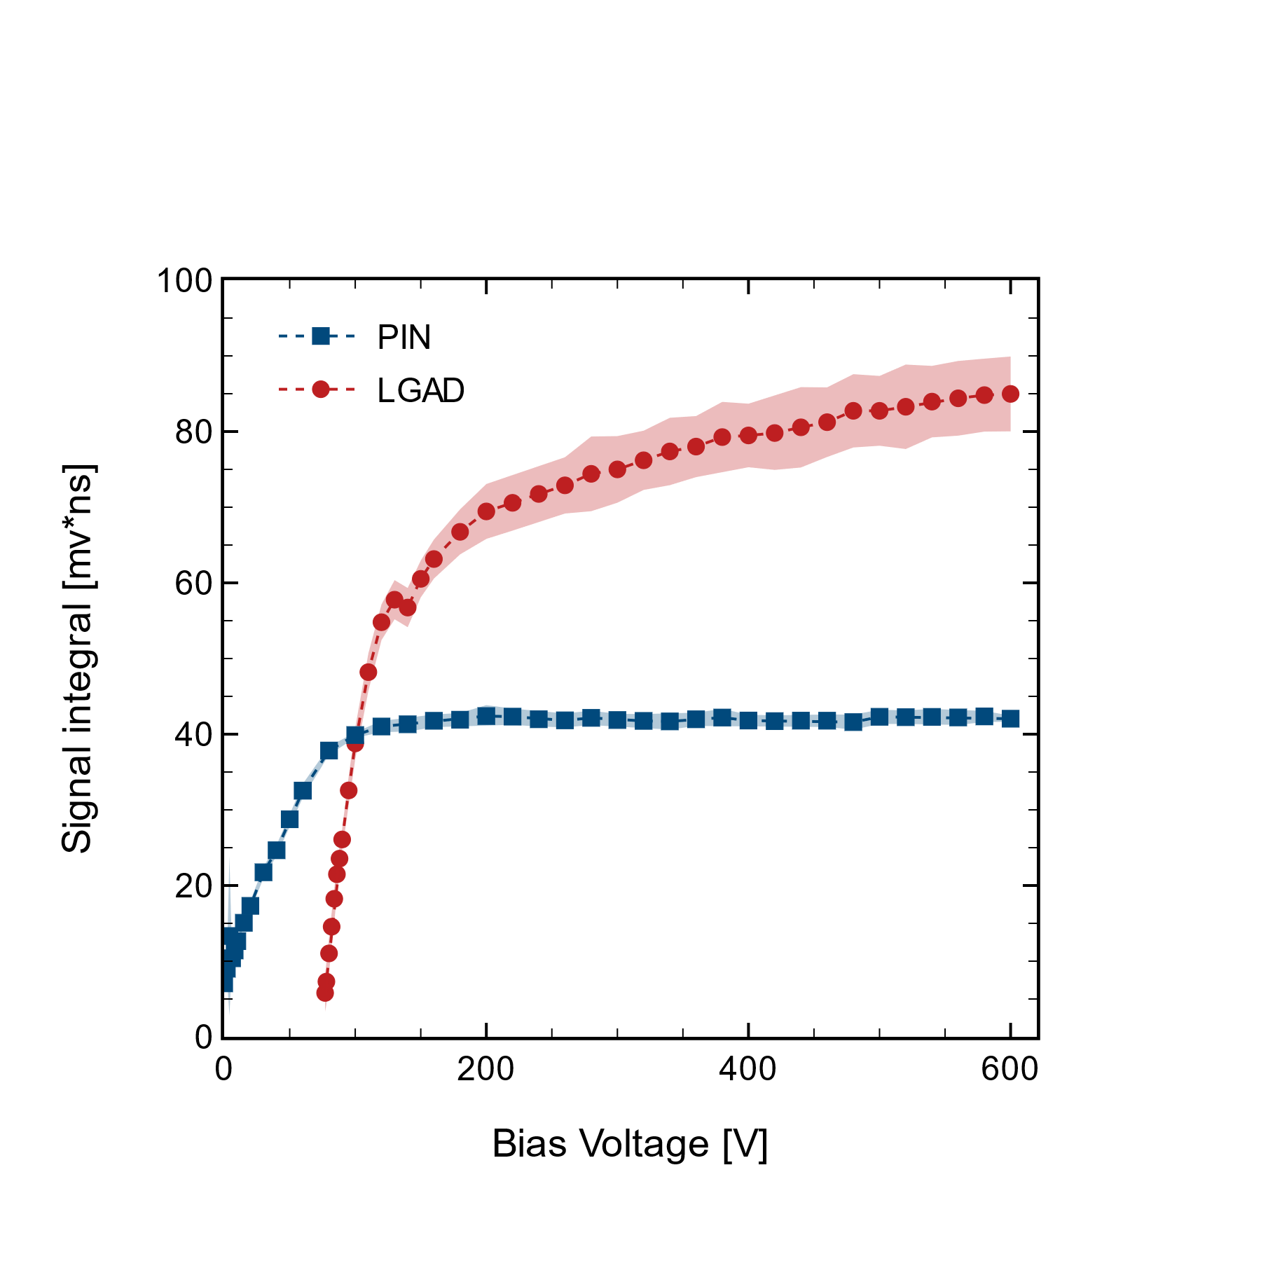
Bench Tests
Full depletion around 1200 V, now at 600 V
At present we cannot fully deplete the drift layer, so cannot fully measure MIP signal
Need to reach full depletion before breakdown
Now use alpha particles which lose all energy in ~15 microns to test gain performance
Use UV laser to study timing
PiN@600V
LGAD @600V
PiN @600V
LGAD @600V

Slide 6
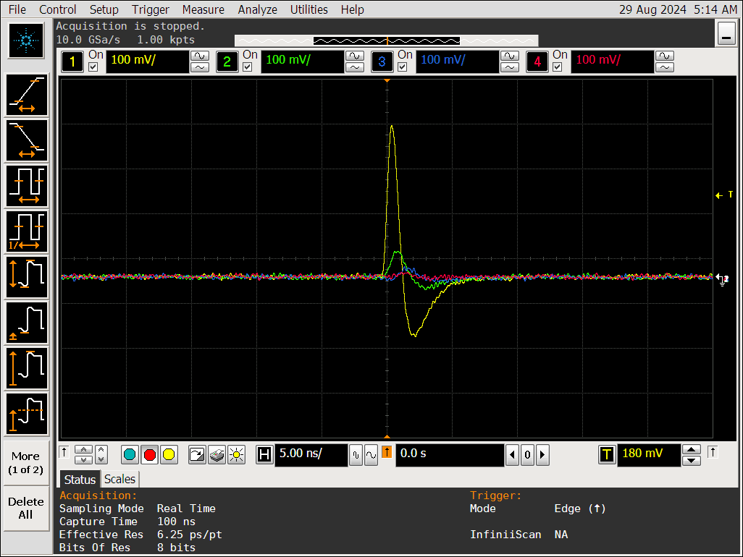
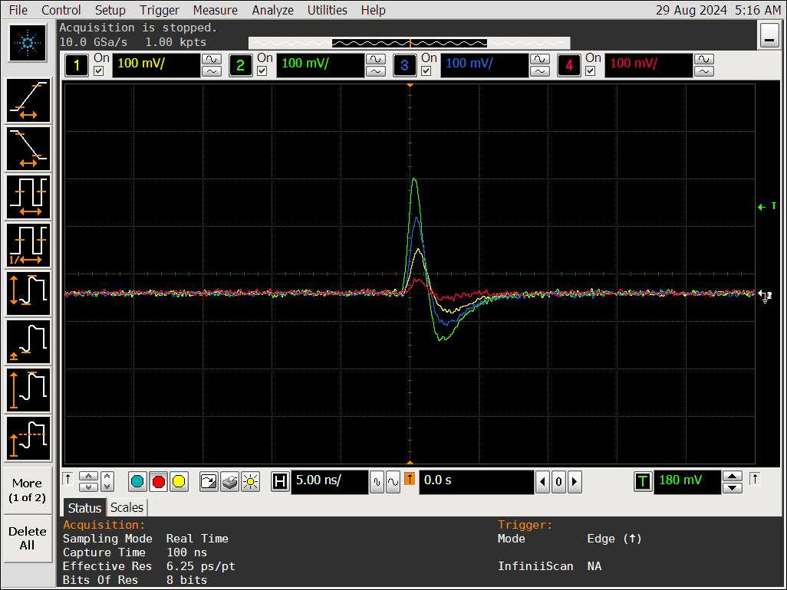
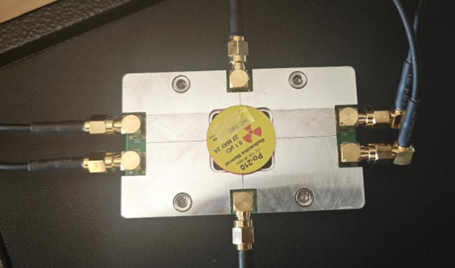
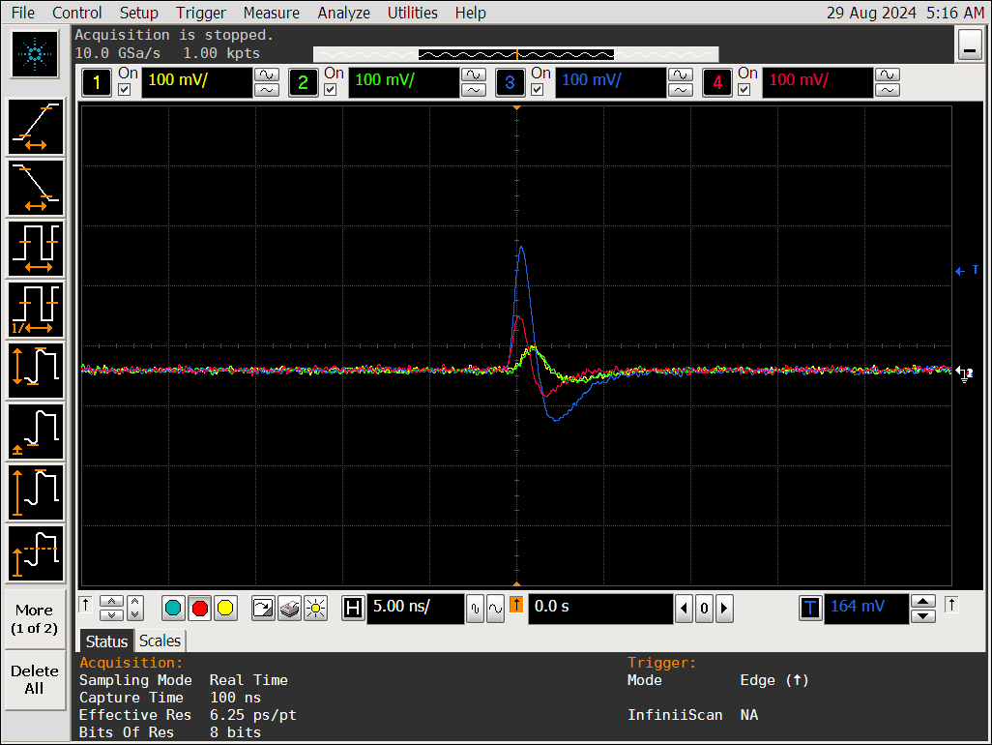
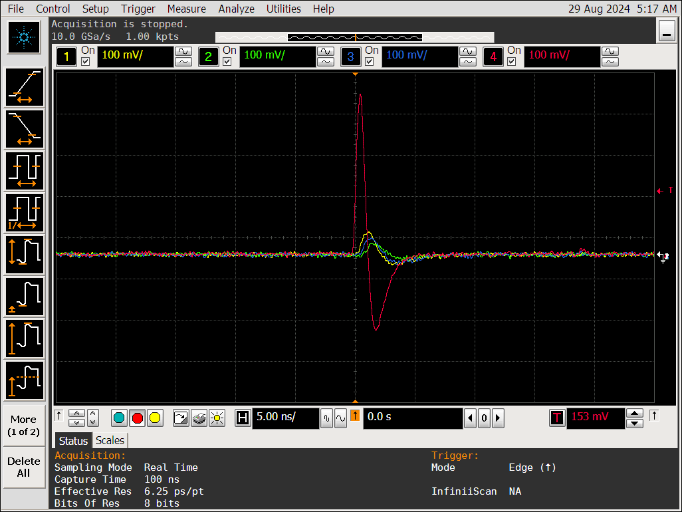
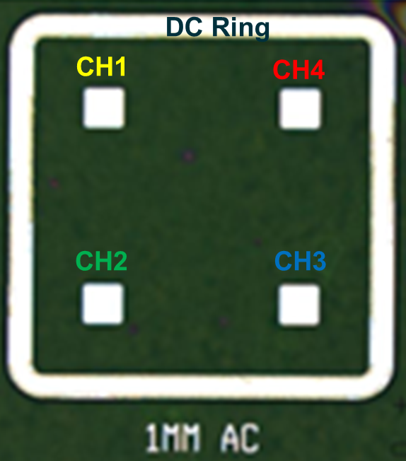
Segmentation
We included some AC coupled devices on wafer
Can already see charge sharing with 4 AC coupled pads with alphas
4-channels TIA board
Charge sharing in ac-coupling pads with different hits
1mm*1mm 4H-SiC AC-LGAD

Slide 7
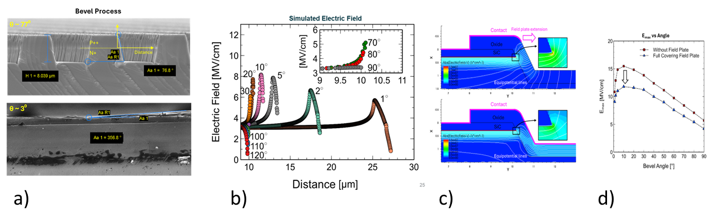
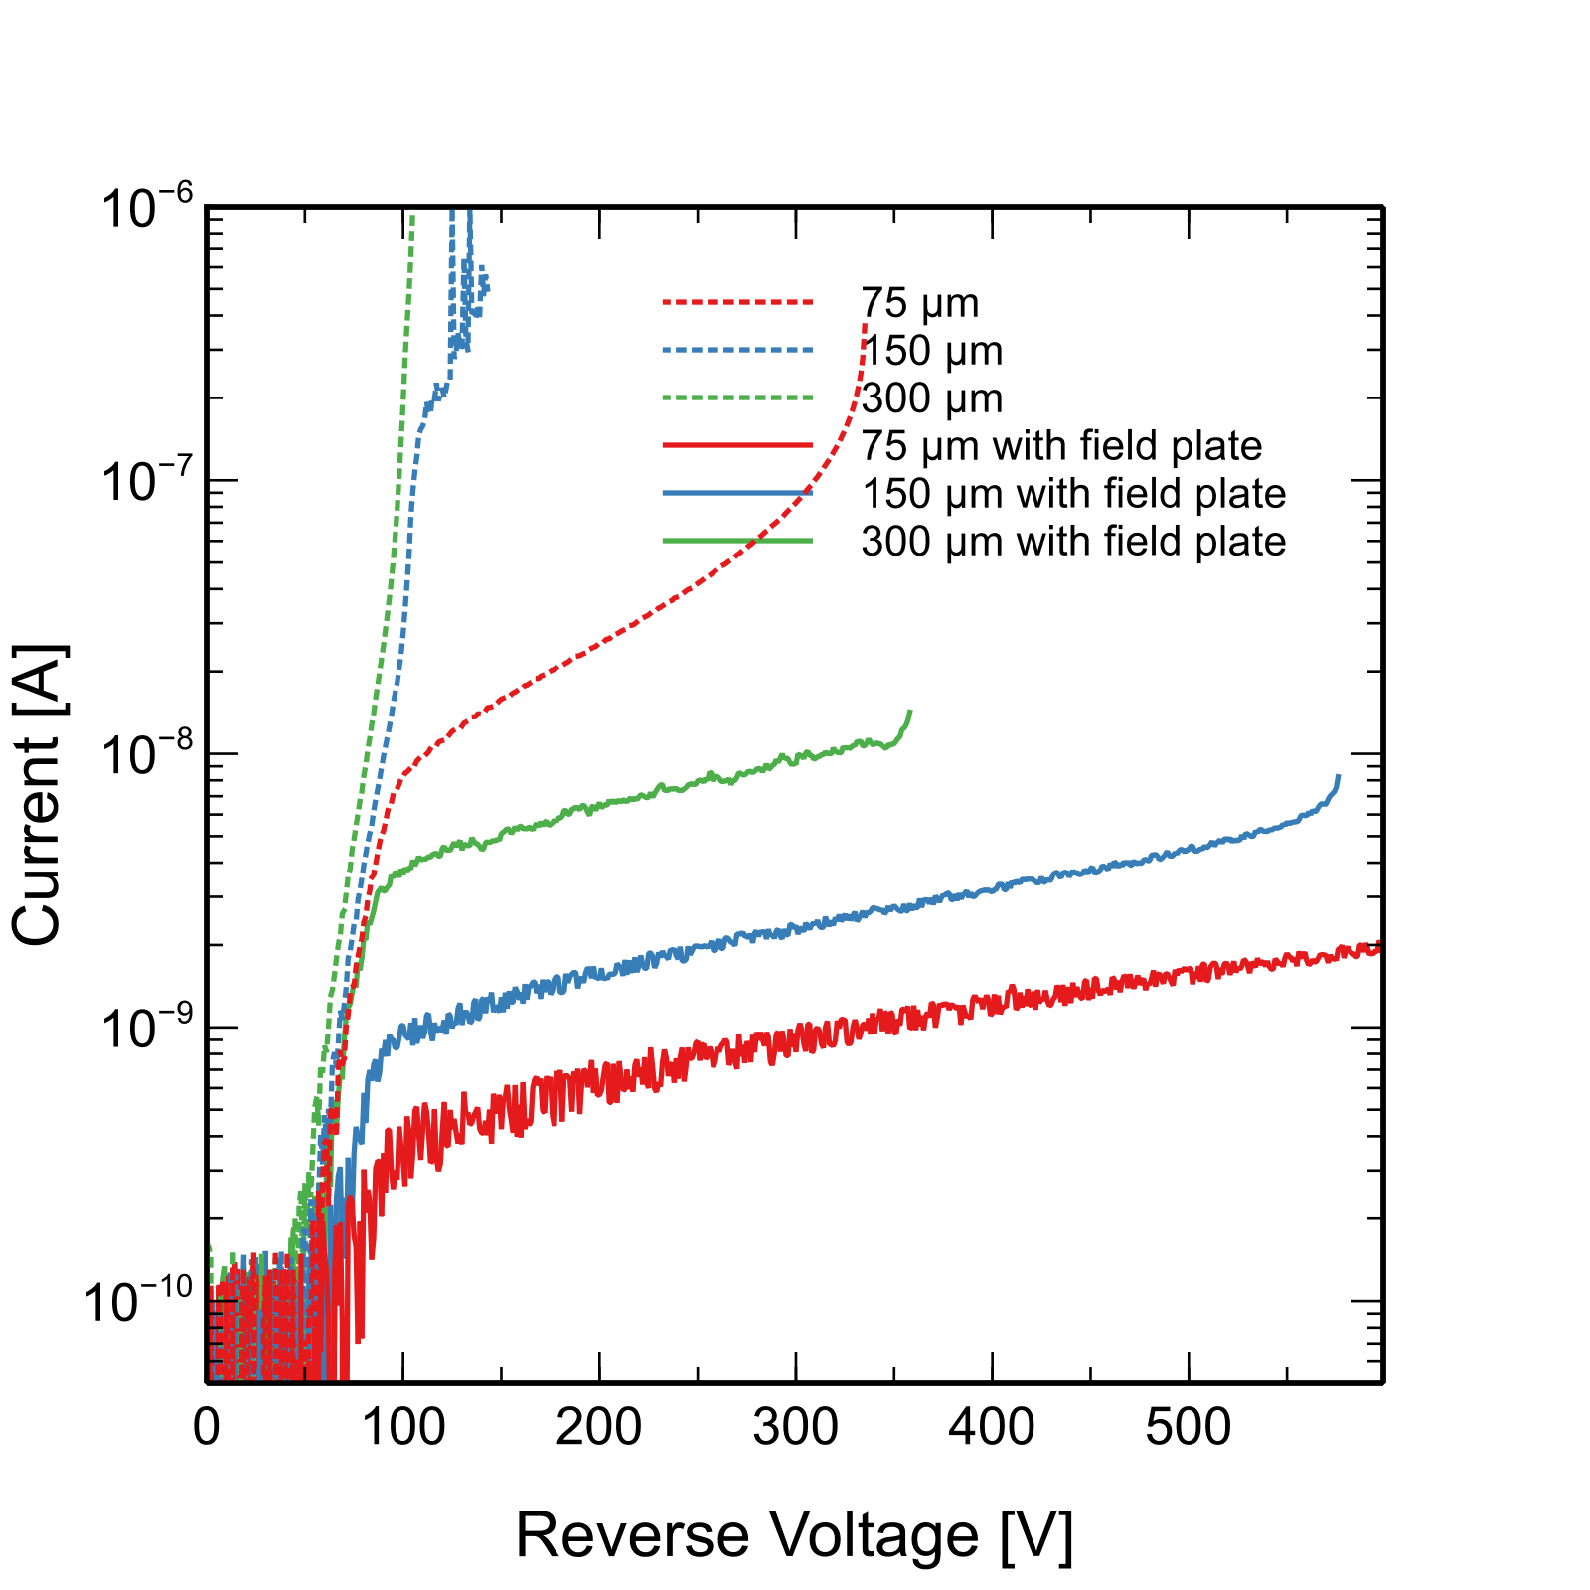
Field Control
Angle of mesa has strong effect on edge fields and therefore breakdown voltage
Best are small or obtuse angles (not practical) or ~90º (a,b)
But still may be insufficient
Metal coverage adds additional control (c,d)
Further study required to see if we can reach full depletion using field control, otherwise will purse ion implanted JTE structures

Slide 8
Outlook Relative to the 4D Project
Our present mesa design will likely evolve to use implanted junction termination structure and achieve high breakdown
AC coupling results are very encouraging and may offer a route to fine segmentation
1st irradiation campaign at BNL but no test results yet – cooldown
A major additional development – outside our present scope – would be to develop front end readout electronics in a SiC high temperature process
Emerging processes do not have the bandwidth we require but can evolve as Si did – note SiC is intrinsically fast
See this as a major opportunity of our colleagues in microelectronics and ASIC design!!!

Slide 9
Emerging SiC IC Processes Aimed at High Temperature Operation
NASA Glenn Research Center – high temperature JFET IC process
https://www1.grc.nasa.gov/research-and-engineering/silicon-carbide-electronics-and-sensors/
Significant documentation and design resources are posted
KTH Sweden
https://www.mdpi.com/2079-9292/8/5/496
PDK and process flow available
Ozark Integrated Circuits
https://www.ozarkic.com/our-services/high-temperature/
Fraunhofer IISB Germany
https://europractice-ic.com/technologies/compound-semiconductors/fraunhofer-iisb/

Slide 10
LBNL/NCSU/BNL Collaboration
Tao Yang, Carl Haber. Steve Holland
Ben Sekely, Yashas Satapathy, Greg Allion, Philip Barletta, John F. Muth, Spyridon Pavlidis,
Stefania Stucci, Abe Tishleman-Charny

Slide 11
Back up

Slide 12
Si-PIN
Si-LGAD
WBG-LGAD
n++/p
n++/p+/p
p++/n+/n
50 μm
75 μm
300 μm
~2-5 x 10¹⁴
Few x 10¹²
Establish HV operation, full depletion
Junction termination
Radiation studies
Fine segmentation
75 μm

