Slide 1
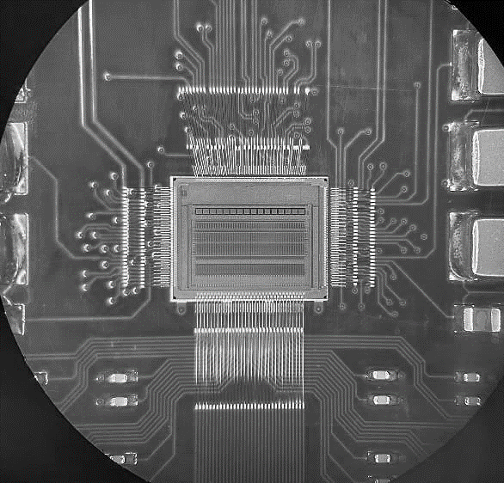
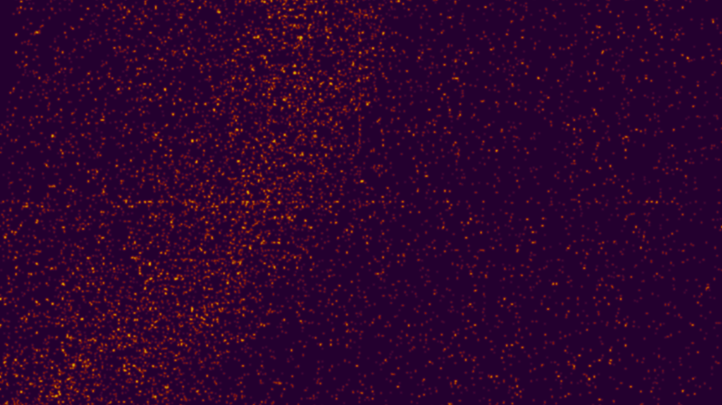
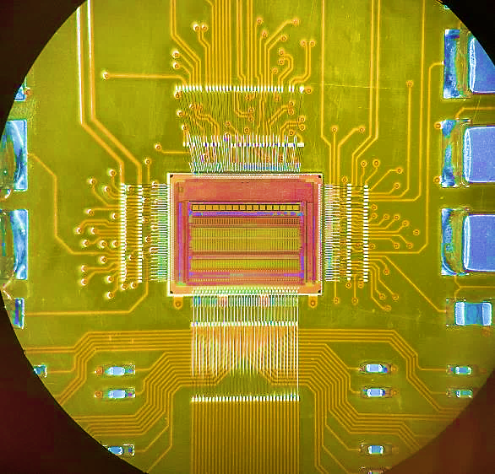


Analog Front-end for HEP
HEPIC Summer Week – Design Challenge
24 June 2024

Slide 2
Approach and Goal
The goal of this challenge is to gain some insights on the design and optimization of front-end preamplifiers for radiation detectors
Four teams: Team SLD, Team Mark-II, Team BaBar, Team ATLAS.
  Teams will work together over the next 3 days on the design of a preamplifier and present their results on Friday morning.
With a basic set of specifications and constraints.
We will use a generic 180nm technology PDK
The design is open-ended
  As you progress with your work, you may discover new aspects that you want to address
It is a challenge but not a competition the goal on Friday is to learn from each other

Slide 3
Design Tasks
Let’s assume we want to design a front-end charge sensitive amplifier for a pixel readout.
Let’s assume that to optimize the noise in our chain we will used a 2nd order real pole shaper
The pixel input capacitance is 300fF
The sensor has a leakage current of -50pA per pixel
We want to accommodate a maximum signal of 25 fC
We can use a maximum of 12uA of current in the input transistor of the preamplifier
We can use a maximum processing time for the filter of 7us
We can tolerate a maximum ENC of 150e-

Slide 4
Question 1
Let’s chose a preamplifier architecture among the following three options:
VDD
VDD
VDD
VDD
In
Vld
In
In
Out
Vcc
Vcc
Vcc₁
Out
Vcs
Vld1
Vgb
Vcc₂
Vld2
Out
Vld

Slide 5
Question 1
Let’s start building the simple straight cascode architecture:
Size the transistors to meet requirements (assume L for the input transistor slightly larger than minimum - 0.2um)
  Maximize the open loop gain (how do the 3 architectures compare?). Let’s see if we can get as high as 60dB
Close the amplifier in a feedback loop to form a Charge Sensitive Amplifier
Provide a full characterization of your CSA (transient, AC, noise)

Slide 6
Question 2 (if there is time)
Let’s try to understand how changes in the detector capacitance and the shaper time constants affect your design
Provide a full characterization of your CSA + Shaper (transient, AC, noise)
  Set the shaper gain to 1
  Use ideal amplifiers for the shaper or a transfer function in your simulations
We will need to produce some relevant plots

Slide 7
Let’s start
Remember this is meant to be a learning process!
  All questions are acceptable
  As we discover things:
    We can adjust our design strategies
    We can depart from the suggested solutions
    We can decide to ask ourself different questions
  Let’s have fun and see what we have on Friday

