Slide 1
SLAC + Penn AD Trigger Weekly
2/9/2024 - RA Progress Update
Paul Gontard, Stanford

Slide 2
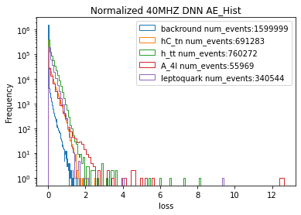
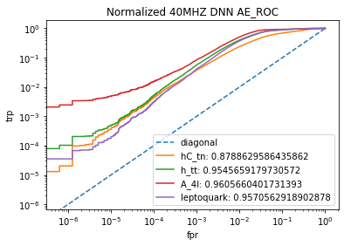
Code Verification & Plot Reproduction
Reproduced plots
Trained new model and successfully reproduced histograms and ROC plots in main branch of repository
Transferability issues
File configuration error with Version 1 of 40MHz data files, need to use “filtered” V2 files
Unable to use pretrained model from repo (unknown error), but was successful with new model trained using 40MHz trainer defaults

